Slide 1
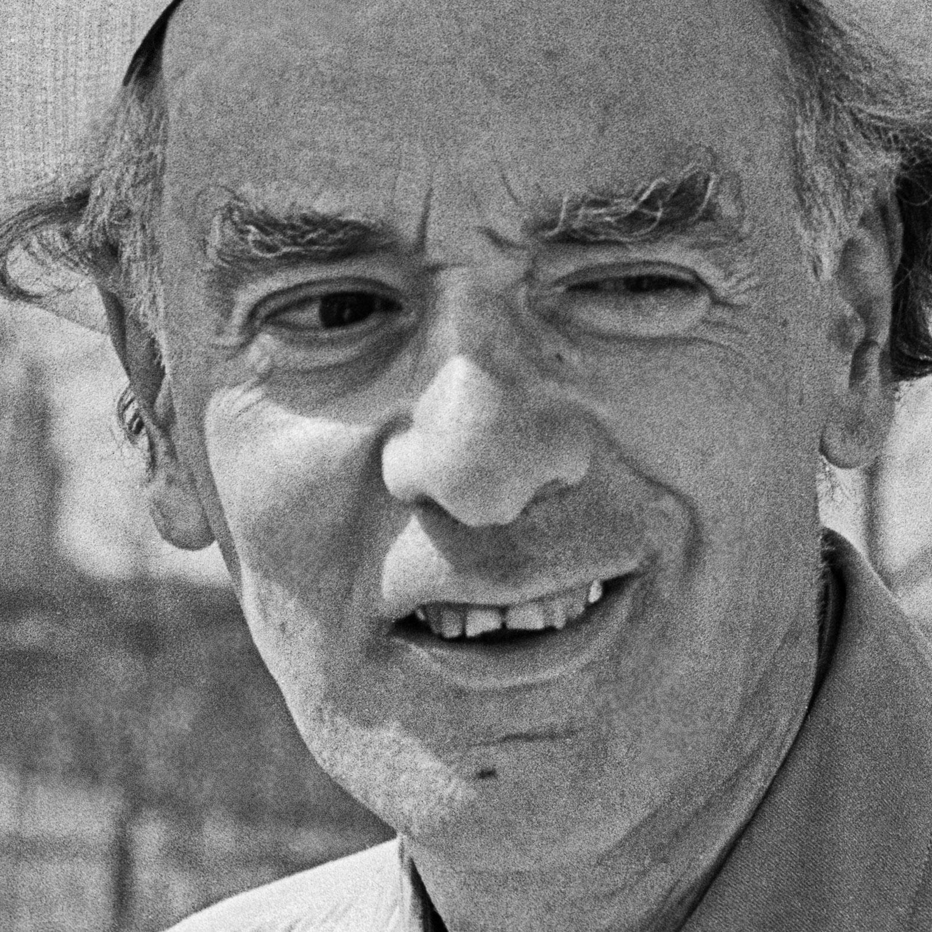
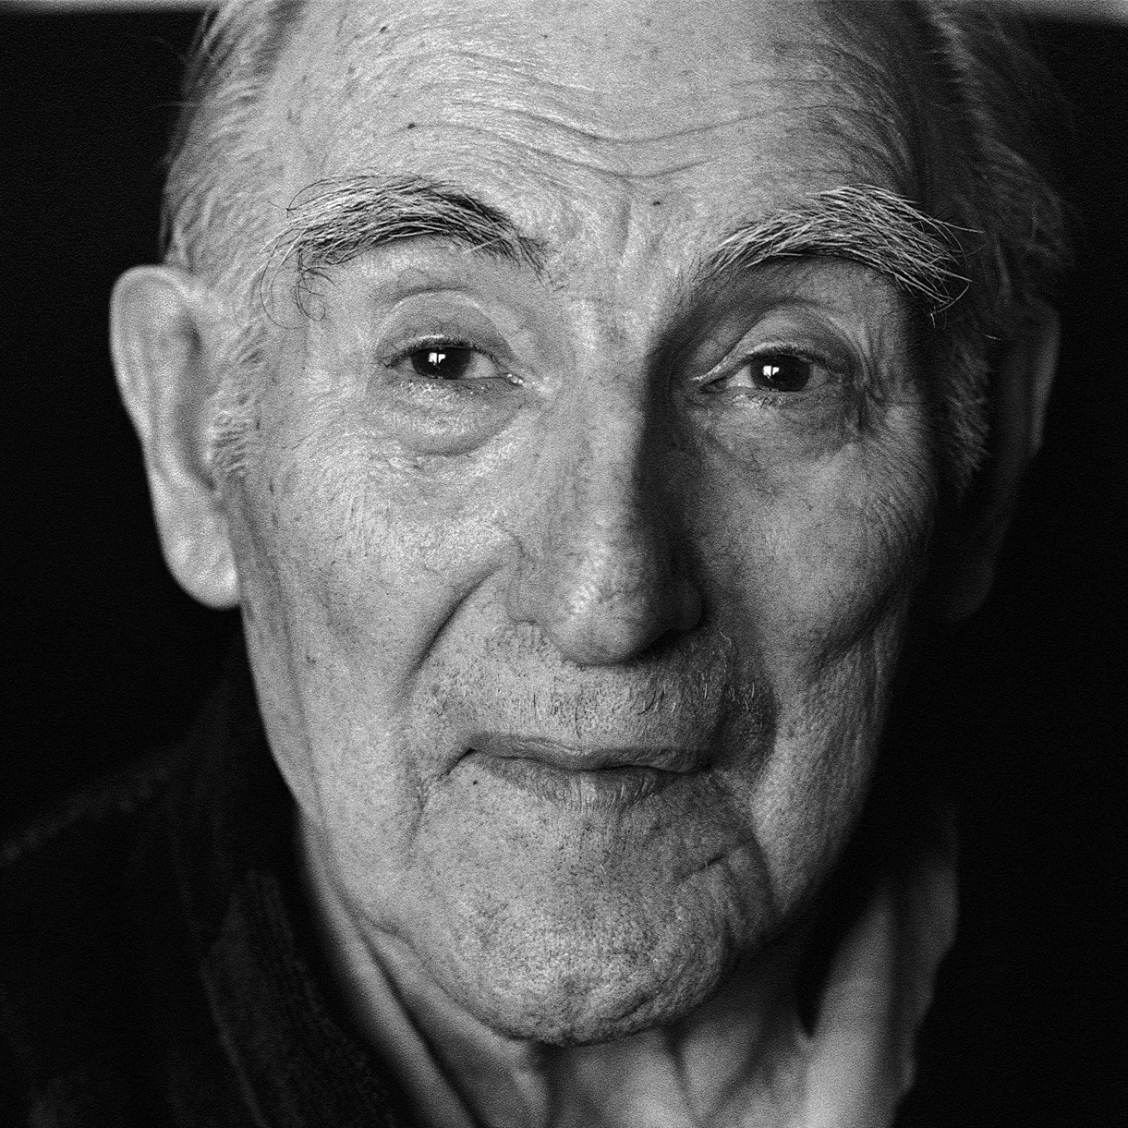
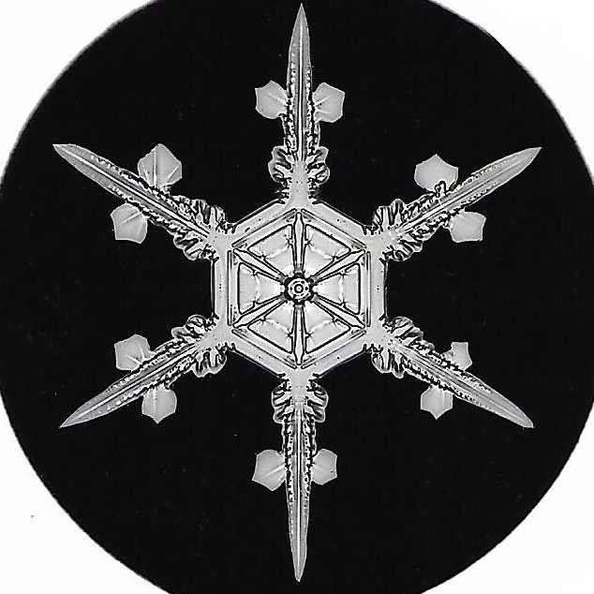
M R E
IS
DIFFERENTLY
DIFFERENT
The multiphaseted nature
of condensed matter
Jacopo Fiore
PhD seminars – S06E01
February 8th 2023

Slide 2
Outline
Introduction: how differently?
Multiphaseted materials and superconductivity
Probing phases and their signatures
Example: phase coexistence in NbSe₂
Conclusion: same phase… different faces

Slide 3
(I did not come up with this title…)
Kanoda, 2022
Paschen&Si, 2021

Slide 4
Explaining the –ly
The constructionist hypothesis breaks down when confronted with the twin dificulties of scale and complexity. The behavior of large and complex aggregates of elementary particles, it turns out, is not to be understood in terms of a simple extrapolation of the properties of a few particles. Instead, at each level of complexity entirely new properties appear, and the understanding of the new behaviors requires research […] inspiration and creativity to just as great a degree as in the previous one.
Anderson, 1972

Slide 5
Explaining the –ly… Fifty years later
Strongly correlated electron systems host a tremendous variety of fascinating macroscopic phenomena […] the essential physics of many of these systems is still not understood, and we do not have a overall perspective on strong electron correlations. Moreover, our predictive power for such systems is lacking. […] Is a unified perspective even possible? Or is the “Anna Karenina Principle” in effect – all non-interacting systems are alike; each strongly correlated system is strongly correlated in its own way?
Alexandradinata&al., 2020

Slide 6
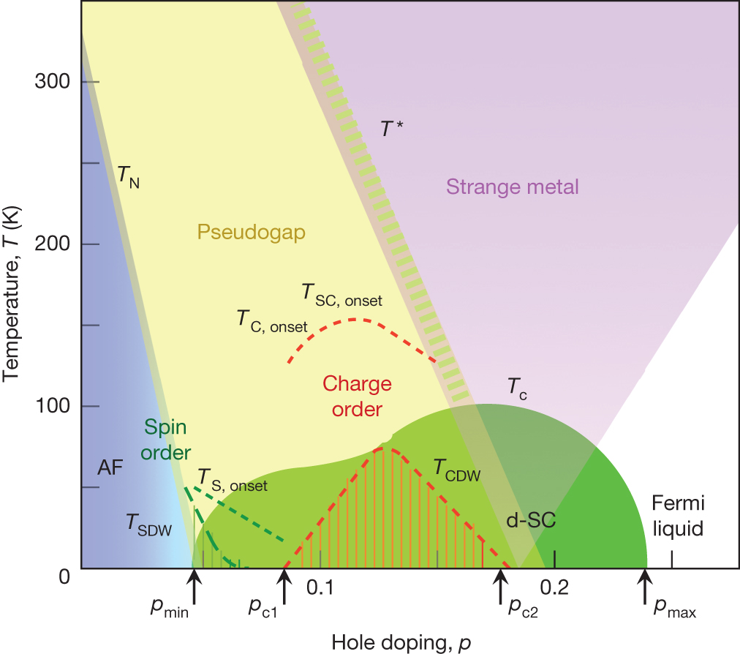
Multiphaseted materials
Topology
Topological
superconductors
(p-wave, Majorana)
Magnetic Weyl semimetals,
axion insultators
Cuprates, iron
based
Unconventional
superconductivity
Magnetism
Twisted bilayer
graphene
Itinerant
magnetism
Strange metals
Cuprates, heavy
fermions, organics
Alexandradinata&al., 2020
Keimer&al., 2015

Slide 7
The superconducting phase
$$T<T_{c}$$
$$T>T_{c}$$
Breakdown of resistivity
Meissner effect
Discontinuity of specific heat
$$ρ$$
$$\vec{B}$$
$$c_{V}$$
$$T_{c}$$
$$T$$
$$T_{c}$$
$$T$$

Slide 8
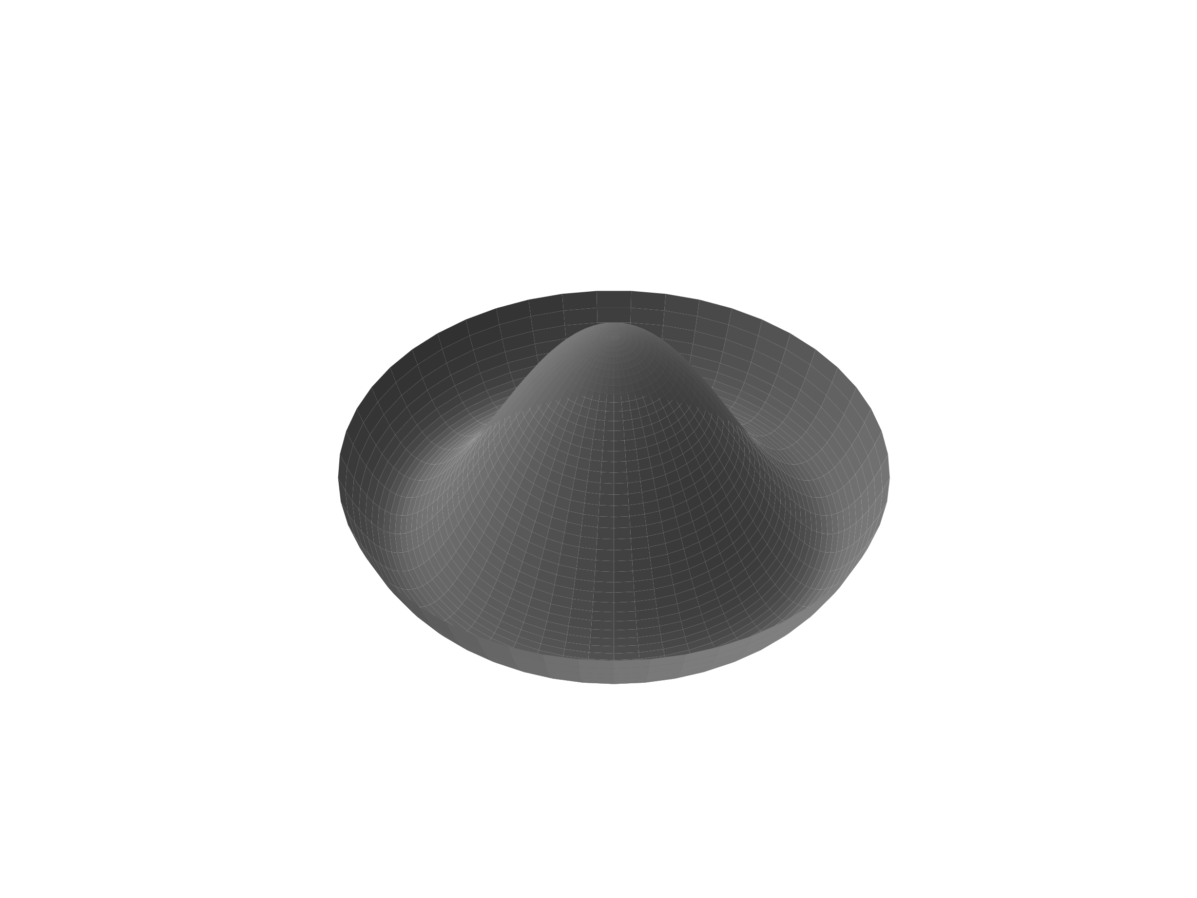
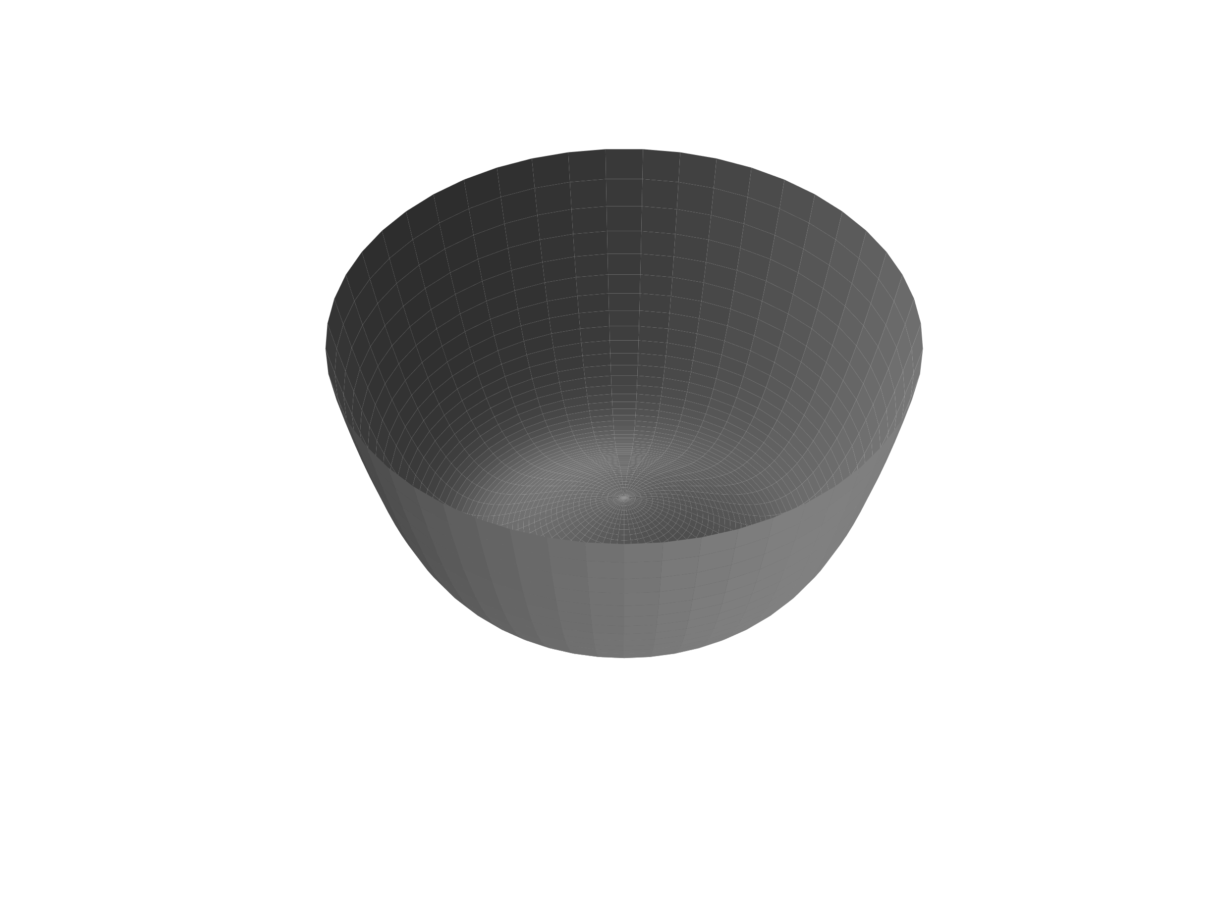
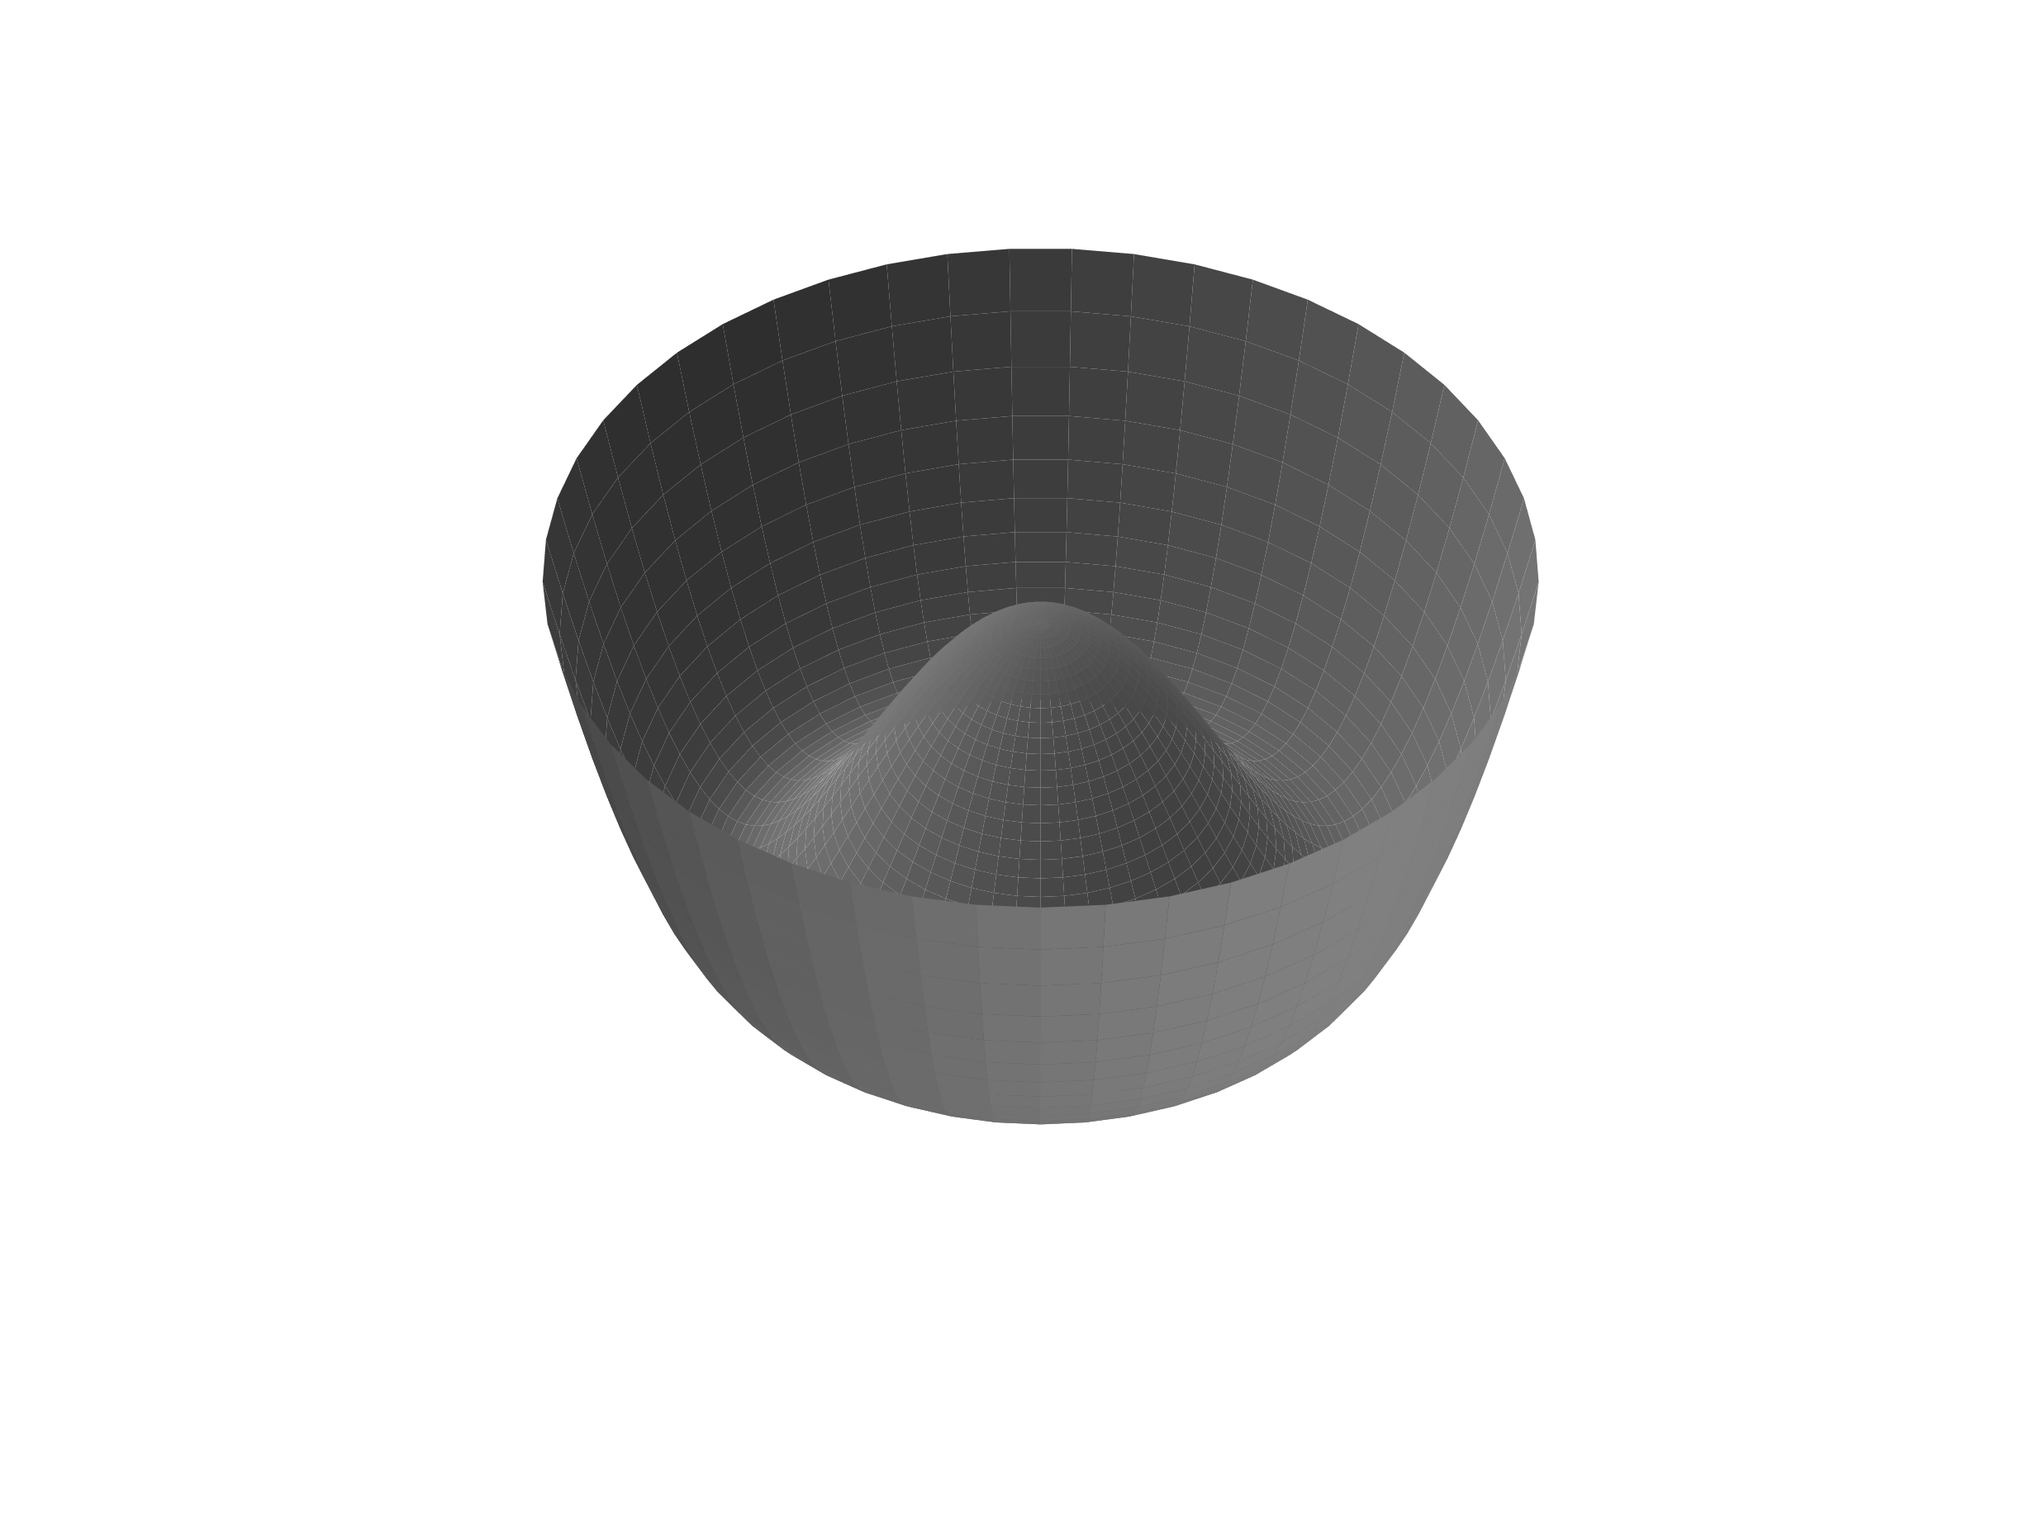
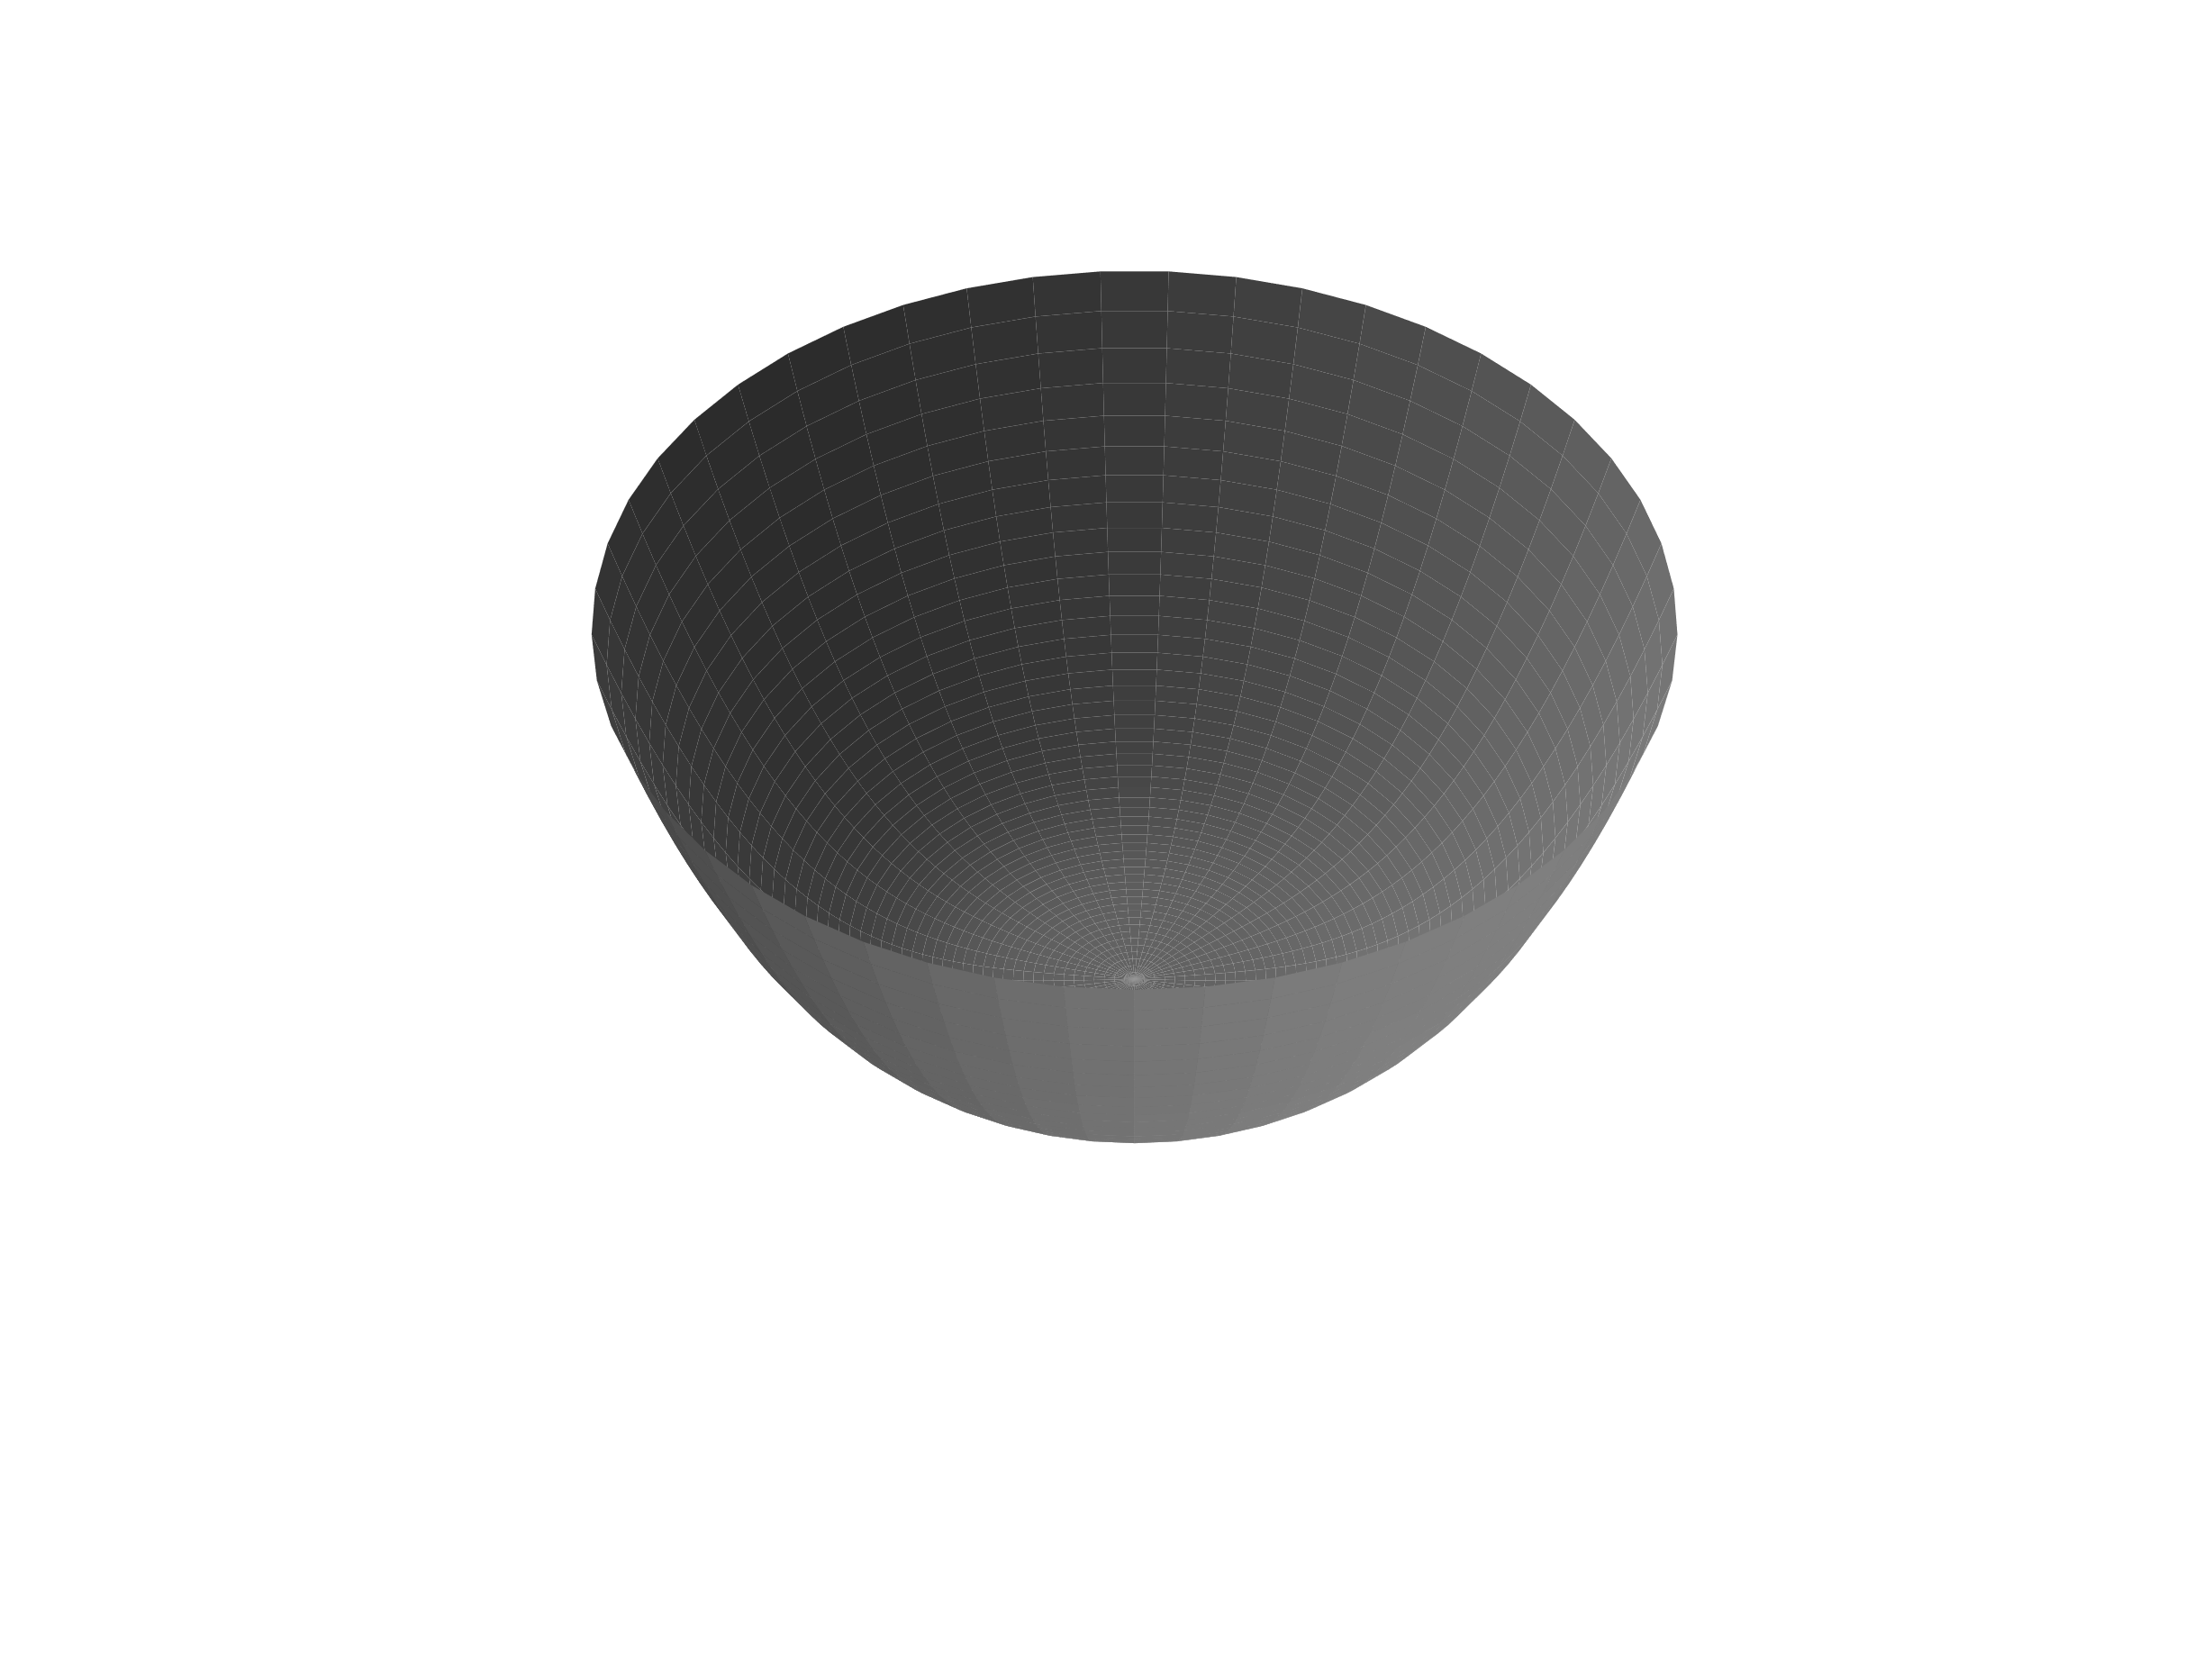
The superconducting phase
Bardeen, Cooper&Schrieffer, 1957
Ginzburg&Landau, 1950
$$H=\sum_{kσ}{ξ_{k}{c_{kσ}^{†}c}_{kσ}}−\sum_{kk^{′}}{V_{kk^{′}}c_{k↑}^{†}c_{−k↓}^{†}c_{−k^{′}↓}c_{k^{′}↑}}$$
$$ℱ\left[ψ\right]=ℱ_{n}+α\left(T−T_{c}\right){\left|ψ\right|}^{2}+\frac{β}{2}{\left|ψ\right|}^{4}$$
$$E_{k}$$
$$∆$$
$$2∆$$
$$k$$
$$ℱ\left[ψ\right]$$
$$T_{c}$$
$$T$$
$$\operatorname{Re}{ψ}$$
$$\operatorname{Im}{ψ}$$

Slide 9
Collective modes of superconductors
Fluctuations of the complex order parameter
$$ψ→\left|ψ_{0}+δψ\right|e^{i\left(θ_{0}+δθ\right)}$$
$δψ$ amplitude or Higgs fluctuations have mass $2∆$
$δθ$ phase or Goldstone fluctuations are massless
Do not miss the quasiparticle continuum!
$$ω$$
$$2∆$$
$$q$$

Slide 10
Probing collective modes…

Slide 11
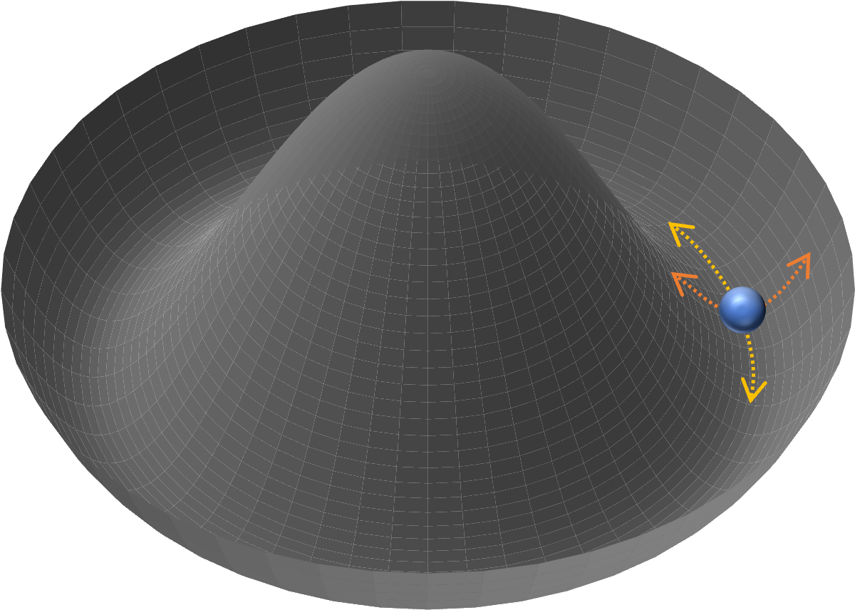
Probing collective modes…
Transmission
(thin films)
Reflection
(bulk)
NIR-Vis
IR
THz
Third
Harmonic
Generation
$$E$$
$$DOS$$
Pump
Probe
Electronic
excitations
Phonons
SC modes
Nicoletti&Cavalleri, 2016
Udina&al., 2019/ Udina&al., 2022

Slide 12
An example: NbSe₂
$$T (K)$$
$$ℱ\left[ψ,φ\right]=\overset{SC}{\overbrace{−α{\left|ψ\right|}^{2}+\frac{β}{2}{\left|ψ\right|}^{4}}}\overset{CDW}{\overbrace{−a{\left|φ\right|}^{2}+\frac{b}{2}{\left|φ\right|}^{4}}}$$
$\underset{coupling}{\underbrace{+λ{\left|ψ\right|}^{2} {\left|φ\right|}^{2}}}+\underset{driving}{\underbrace{εA^{2}\left|φ\right|}}$
$$34$$
$$φ$$
$$ψ$$
$$\left\{\begin{aligned}\left(ω^{2}−ω_{ψ}^{2}\right)\left|ψ\right|+λ\left|φ\right|=0 \\ \left(ω^{2}−ω_{φ}^{2}\right)\left|φ\right|+λ\left|ψ\right|=εA^{2}\end{aligned}\right.$$
CDW
$$T_{SC}$$
$$T_{CDW}$$
$$T$$
$$7$$
SC+CDW
SC
$$4$$
$$P (GPa)$$
Grasset&al., 2018/ Cea&Benfatto, 2014

Slide 13
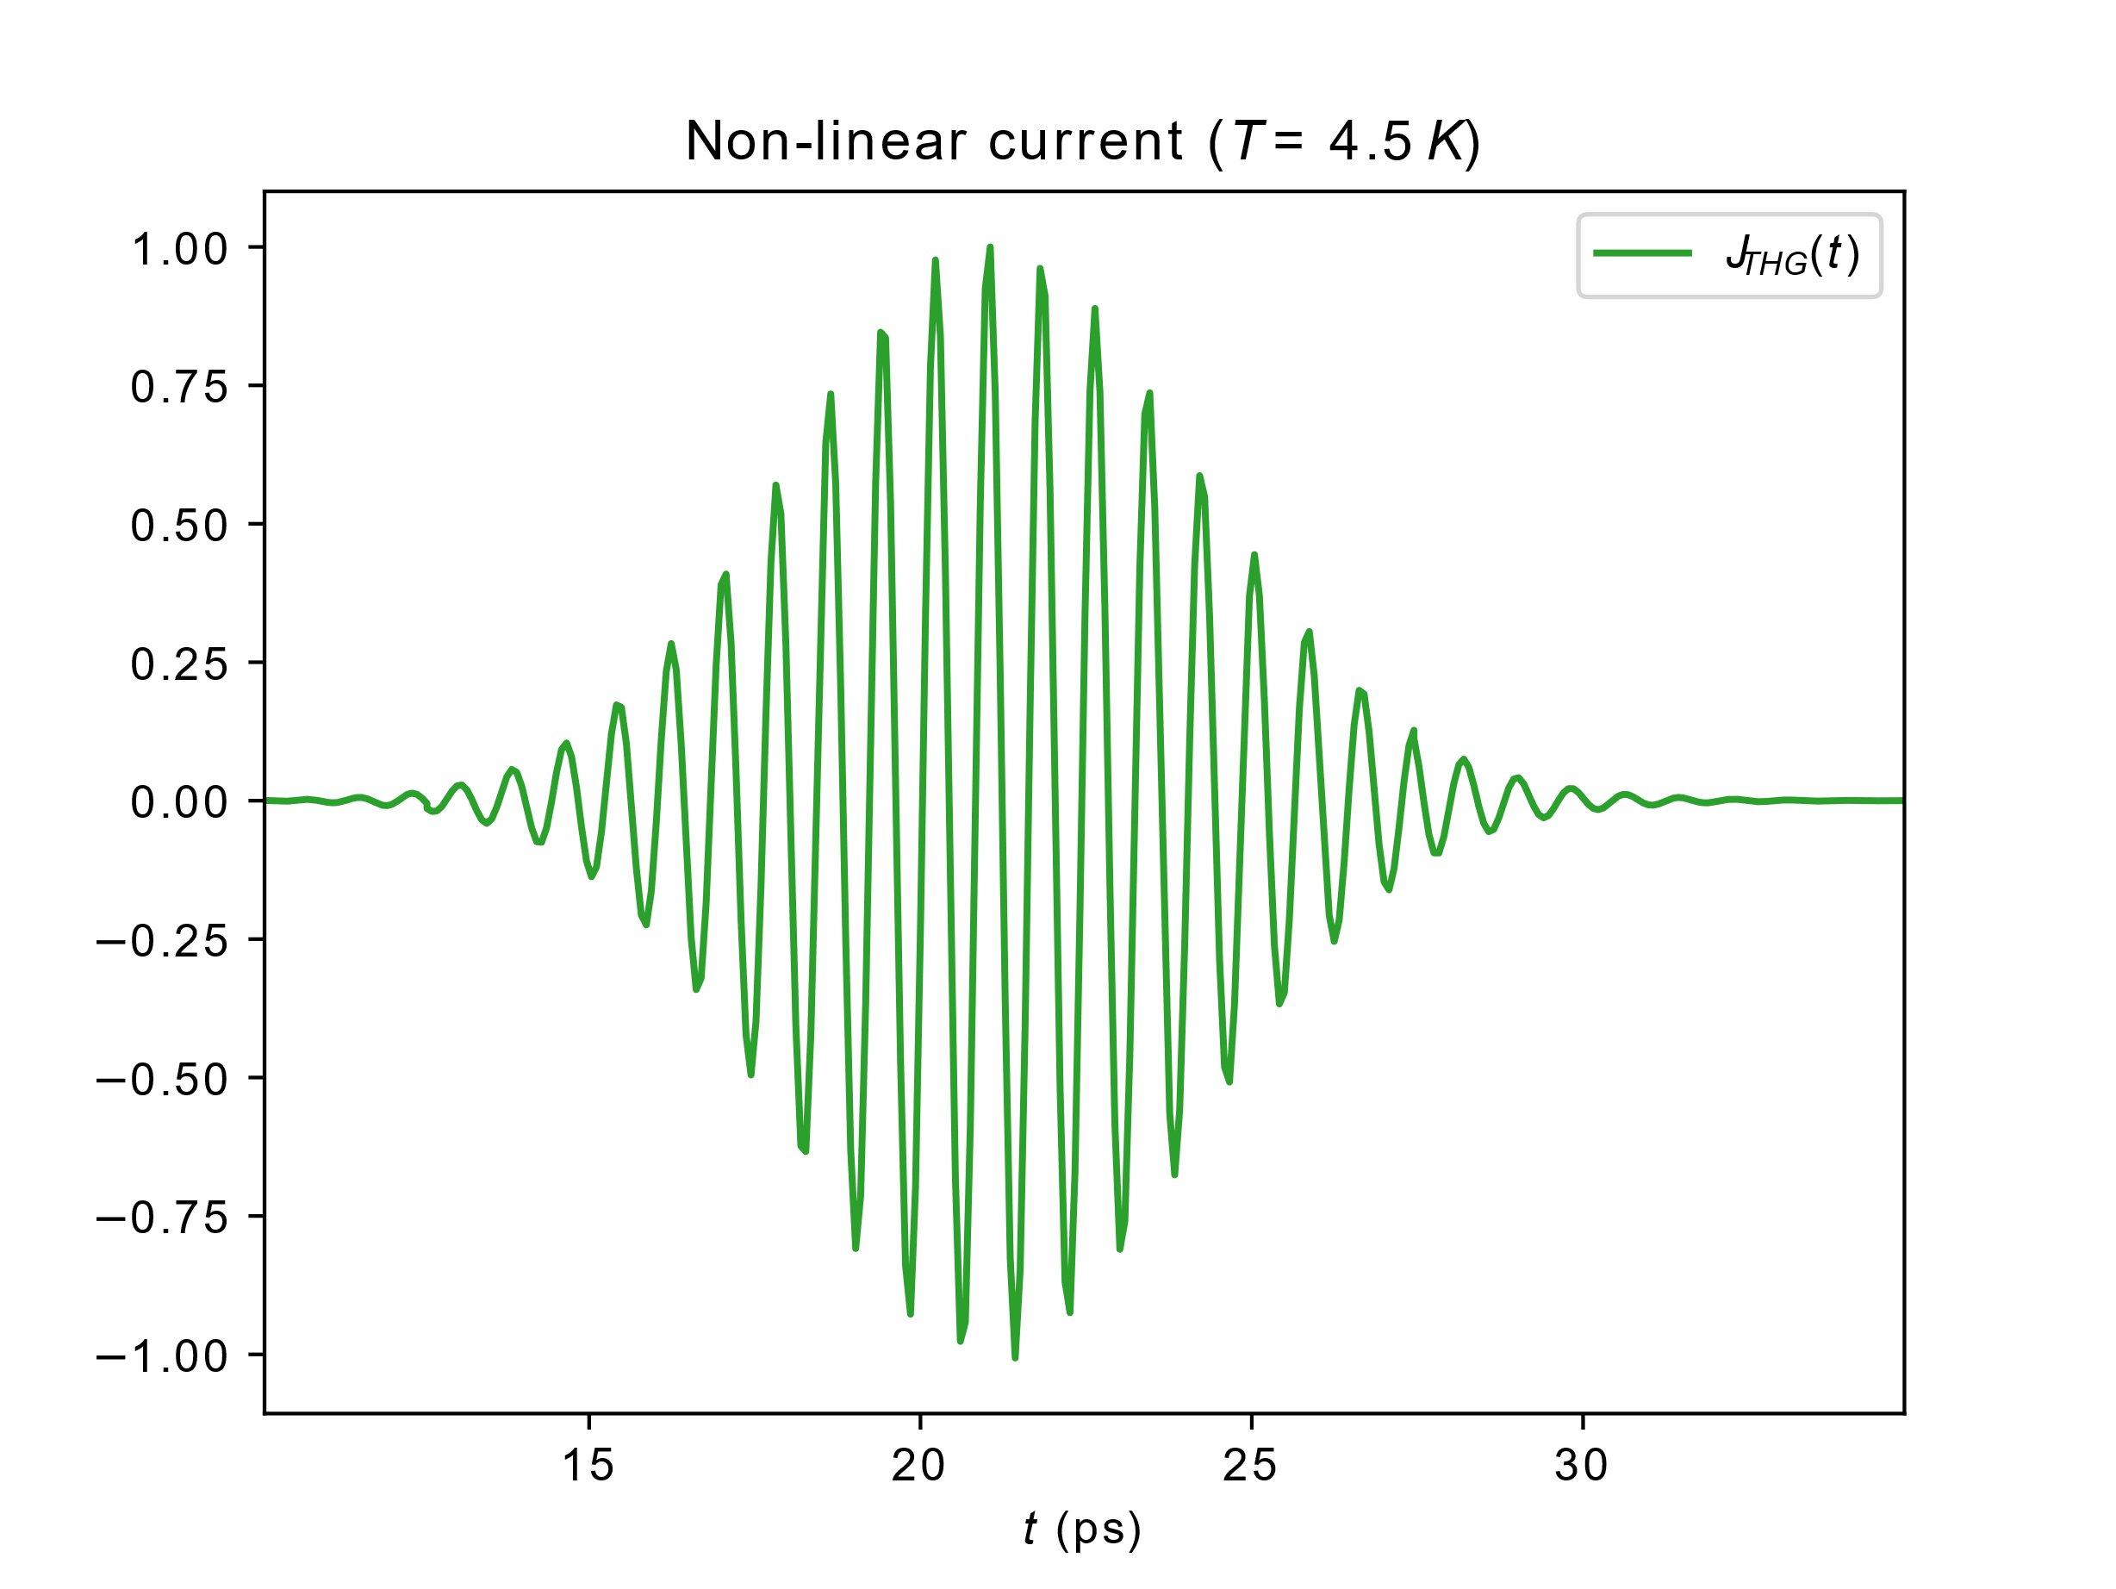
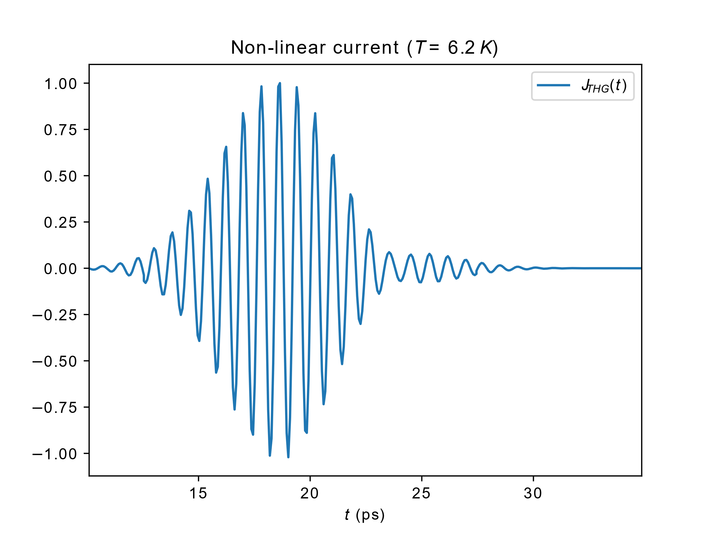
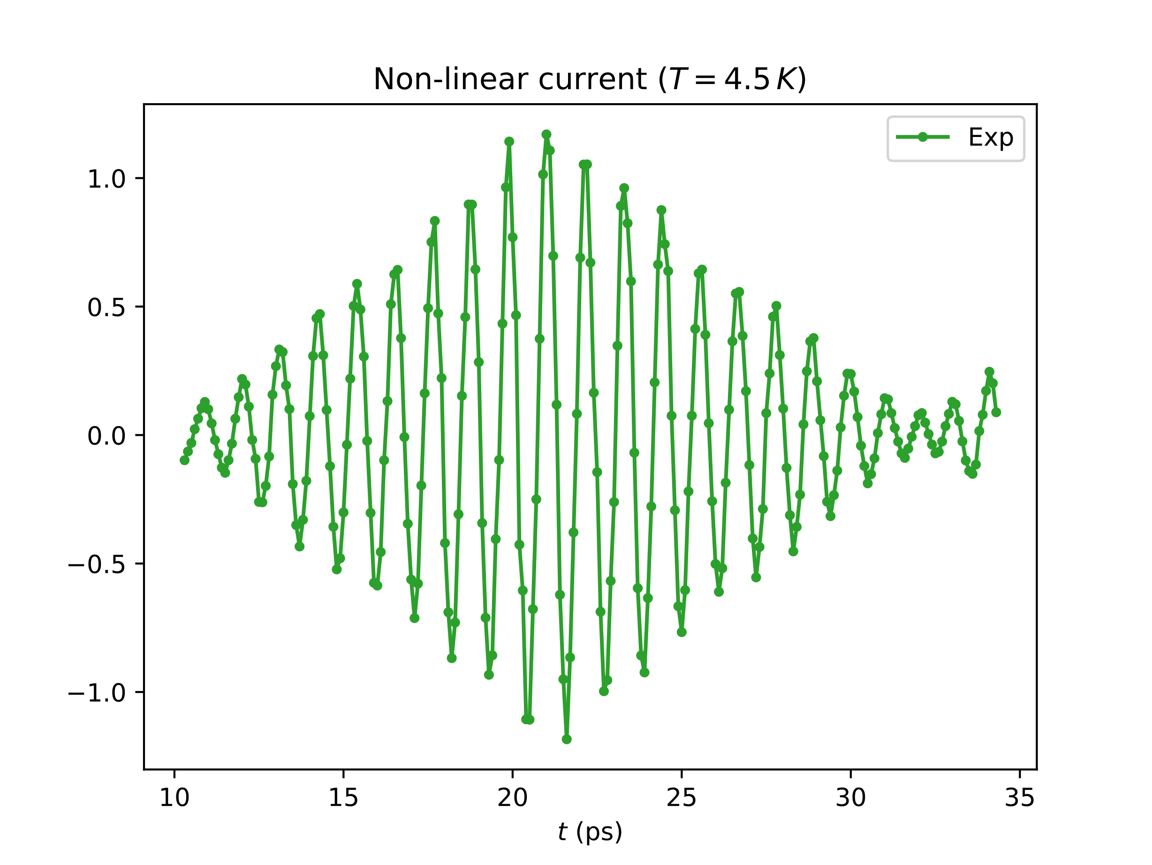
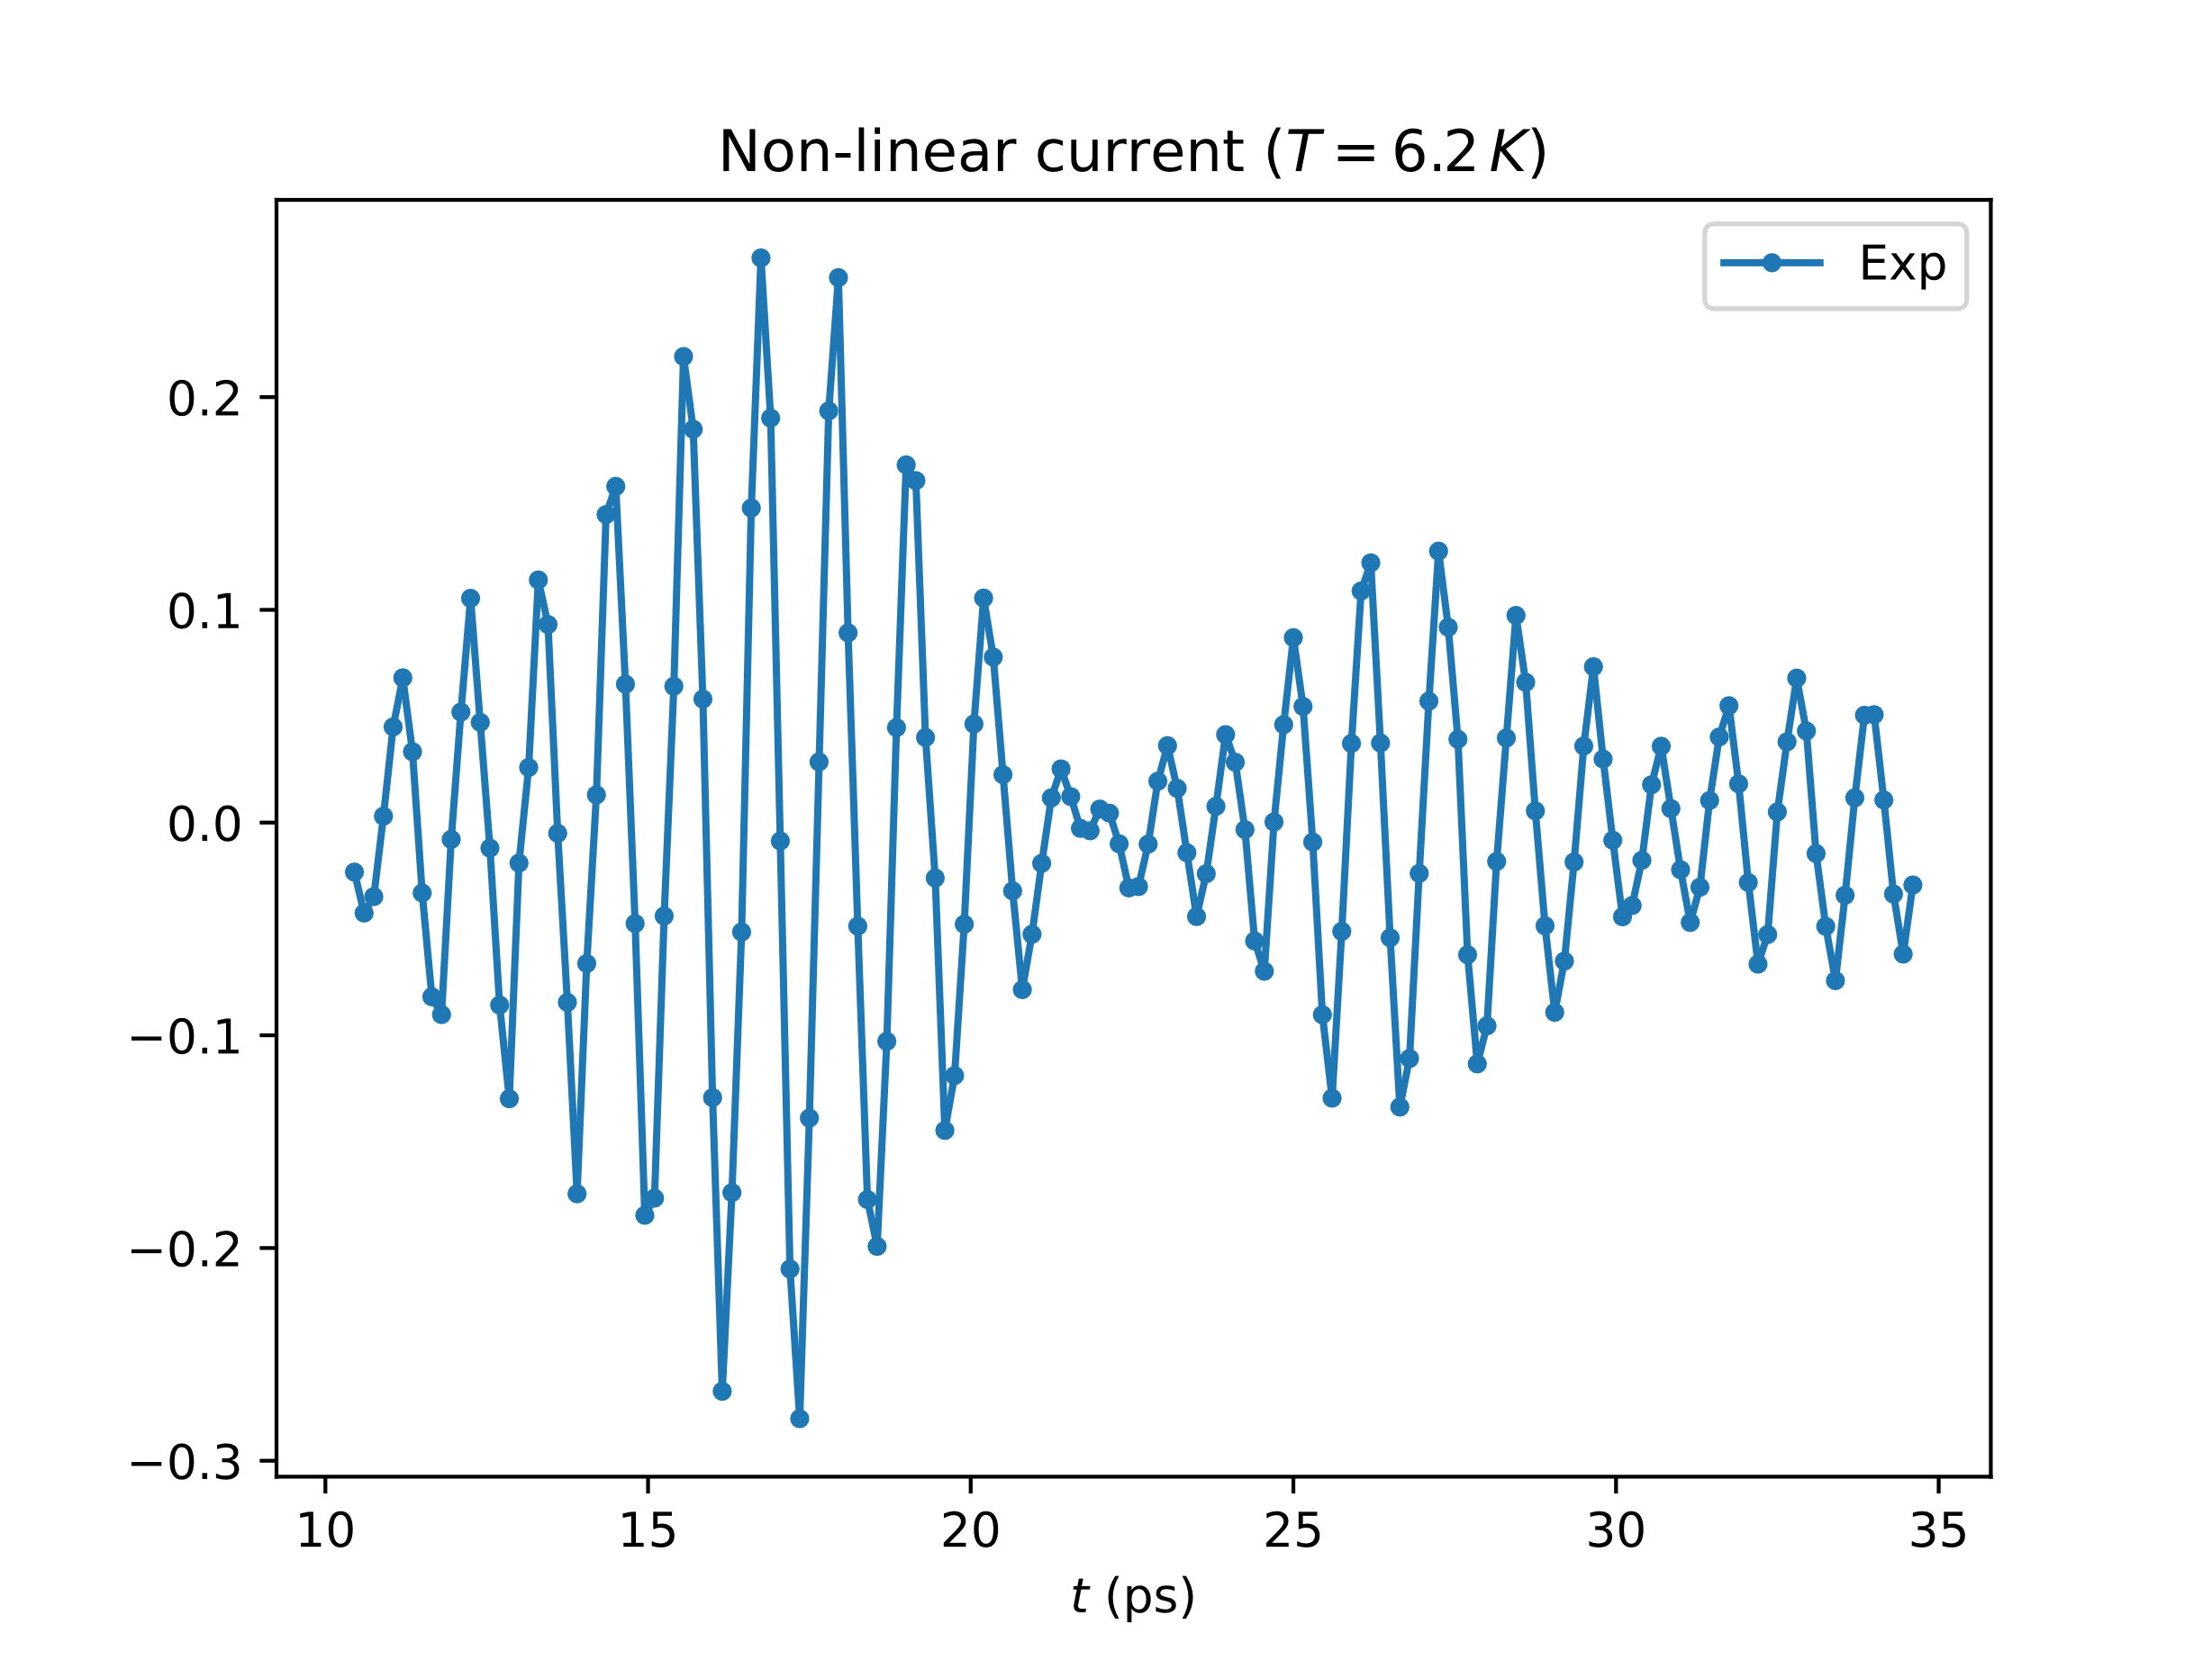
An example: NbSe₂
$$δA_{pp}∝\frac{∂ℱ}{∂ε}=\underset{K_{NL}}{\underbrace{\frac{\left(ω^{2}−ω_{ψ}^{2}\right)}{\left(ω^{2}−ω_{1}^{2}\right)\left(ω^{2}−ω_{2}^{2}\right)}}}A^{2}$$
$K_{NL}∝$ $\frac{1}{ω^{2}−ω_{1}^{2}}$
$$K_{NL}∝ω^{2}−ω_{ψ}^{2}$$
IN PREPARATION!
IN PREPARATION!
Feng&al.,2022

Slide 14
Perspective: LSCO
?
Feng&al.,2022

Slide 15
Conclusion: same phase… different faces
Libbrecht, 2005
Bentley, 1902

