Slide 1


Recent Progress on CAPP’s
Main Axion eXperiment
(CAPP-MAX) for
18th Patras Workshop on Axions, WIMPs and WISPs
Woohyun Chung
Center for Axion and Precision Physics Research (CAPP)
Institute for Basic Science (IBS)
Notes:
My name is Woohyun Chung.
I am overseeing the Axion Search Program, called “CULTASK”.
Even though we are one of those latecomers in axion business,
We made a rapid, but steady progress, to become the biggest axion search facility in the world.

Slide 2
CAPP’s Axion Search: CULTASK
CAPP-MAX reached DFSZ sensitivity
R&Ds will move us forward further
I would like to present….
  CAPP’s axion search facility
  Recent progress (prototype projects)
  Recent progress (CAPP-MAX)
  Near future

Slide 3
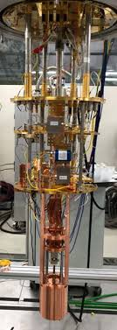
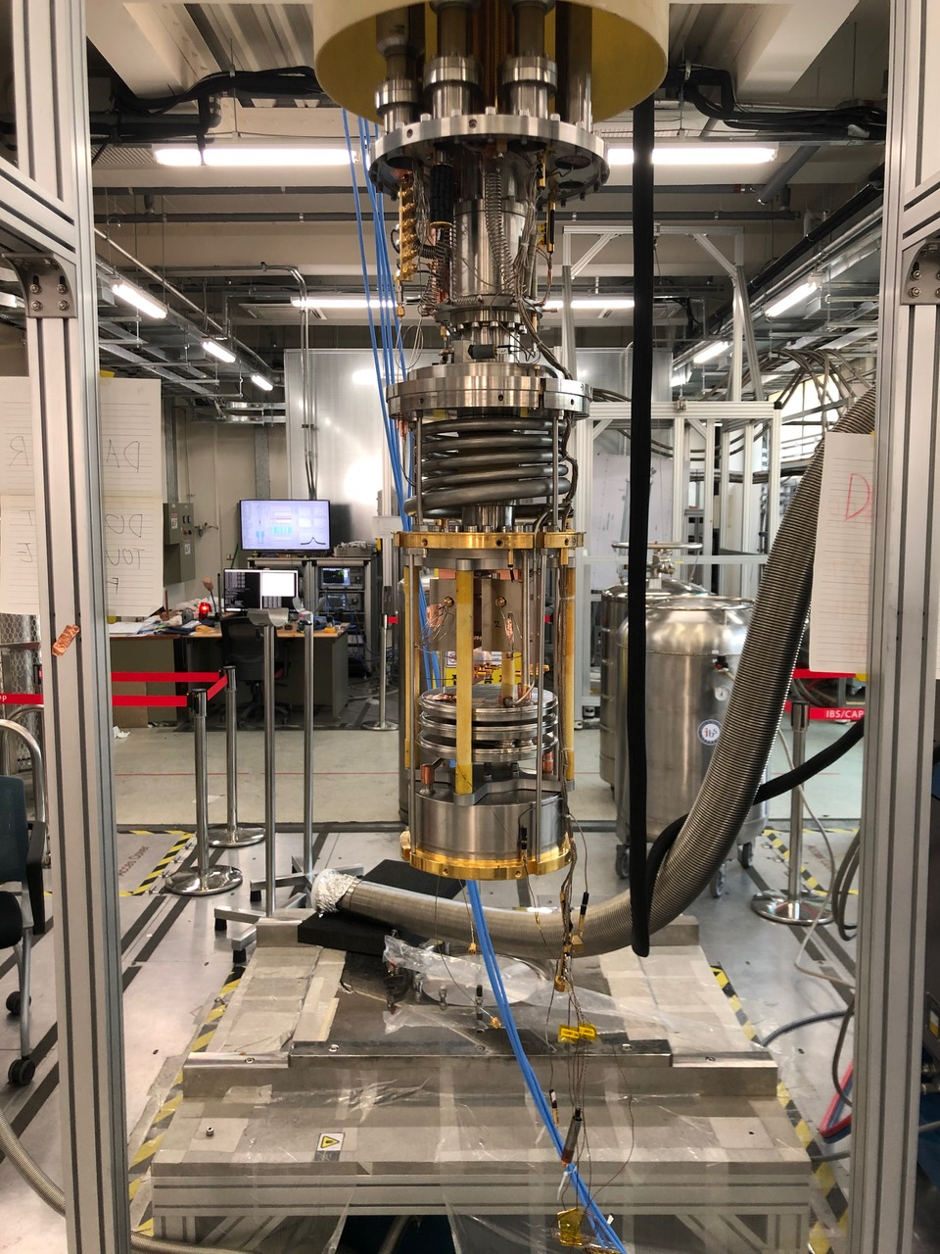
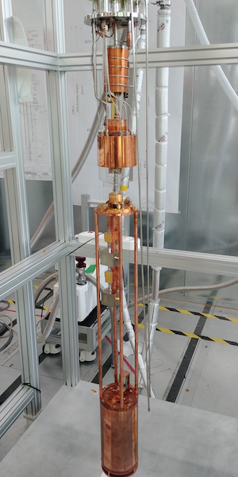
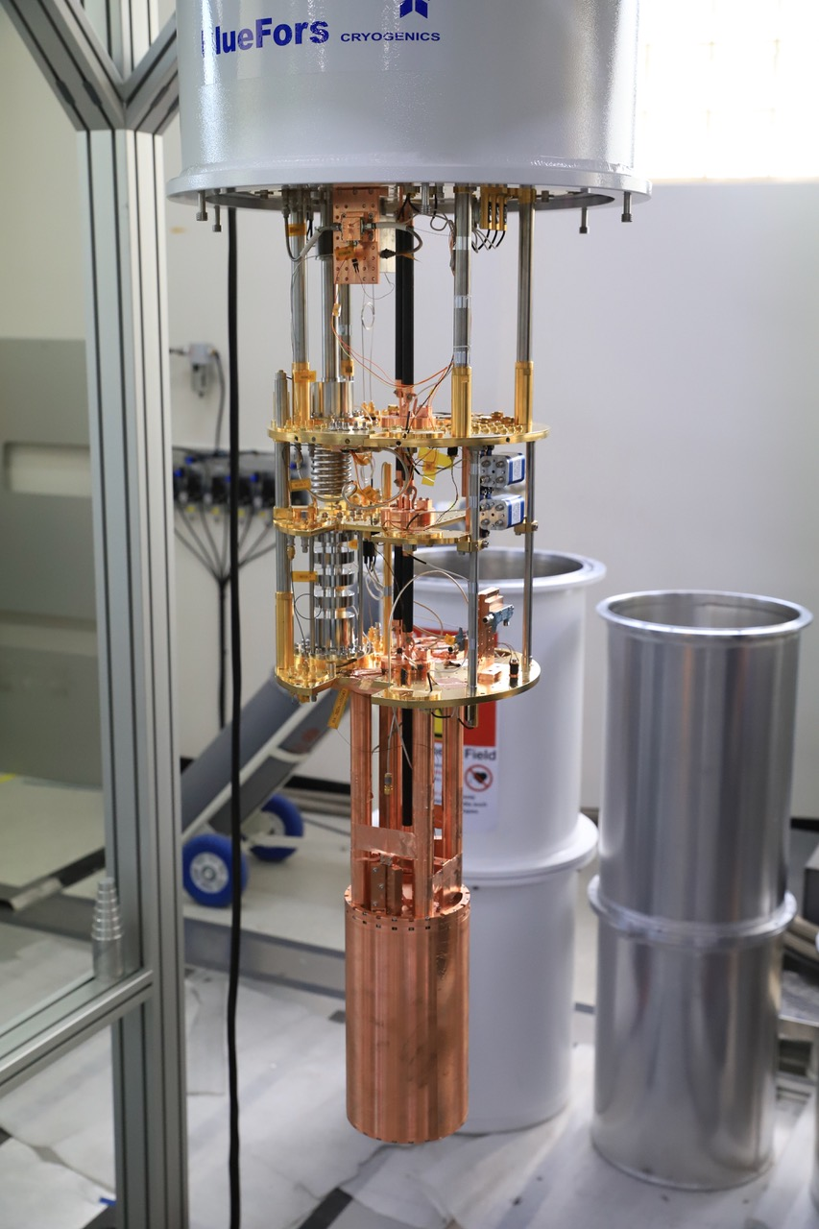
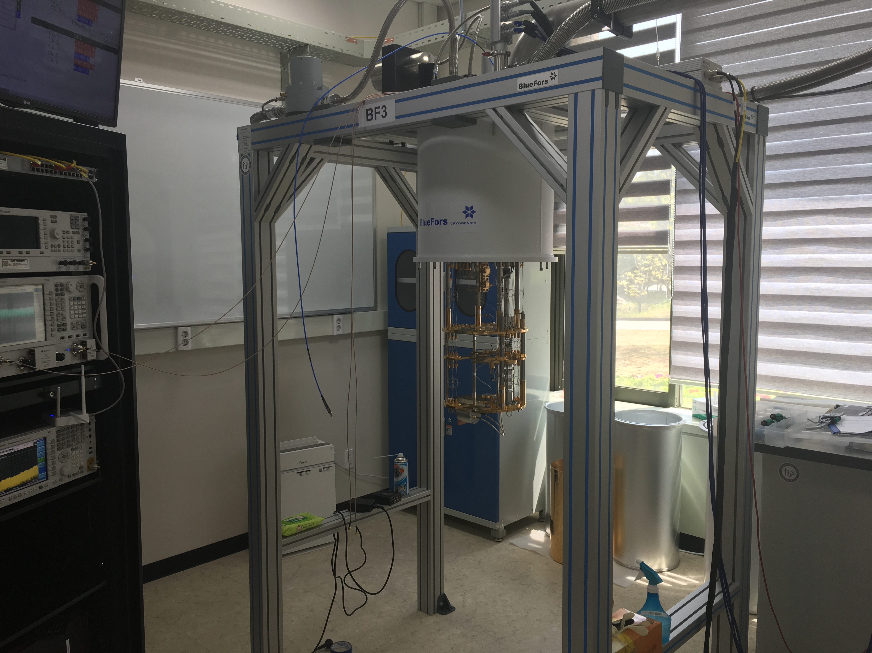
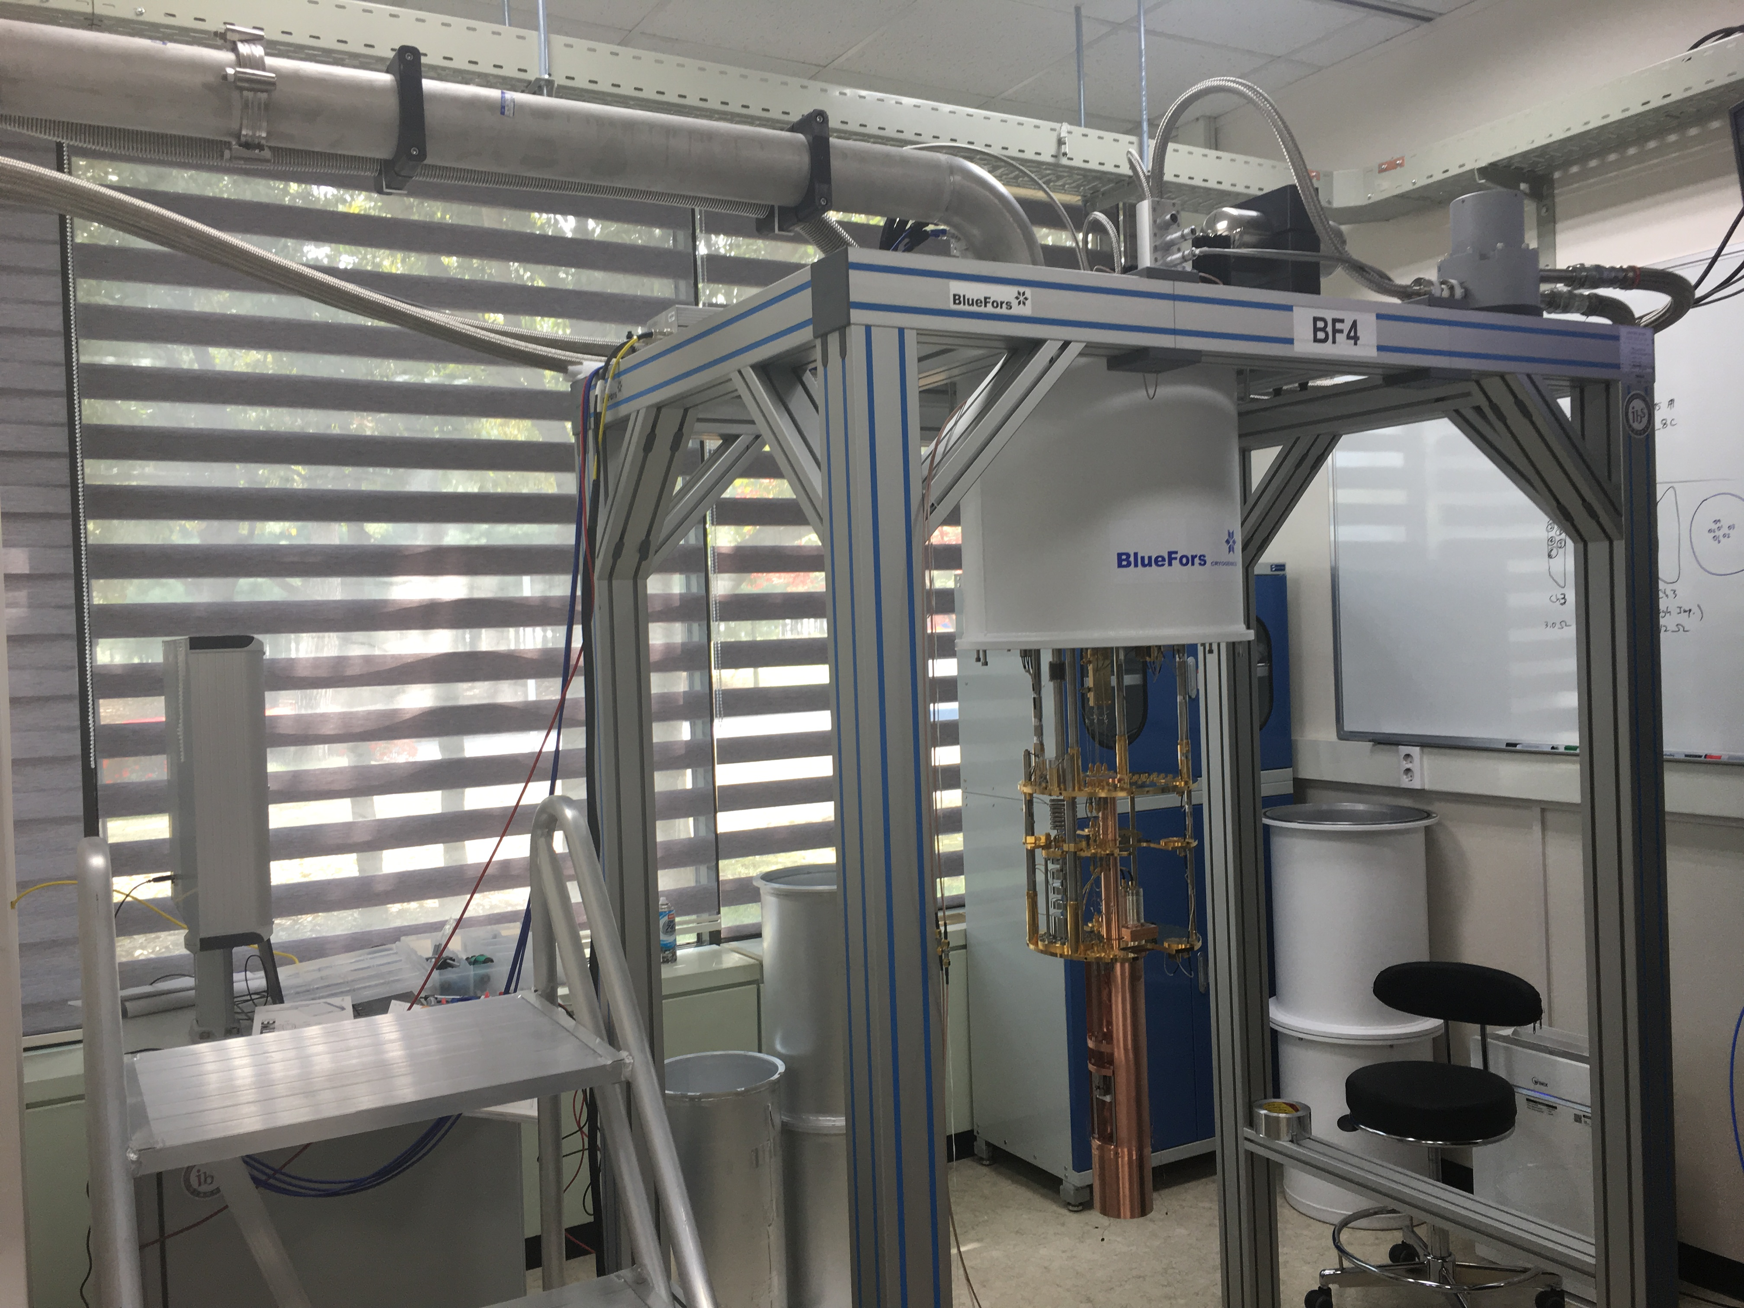
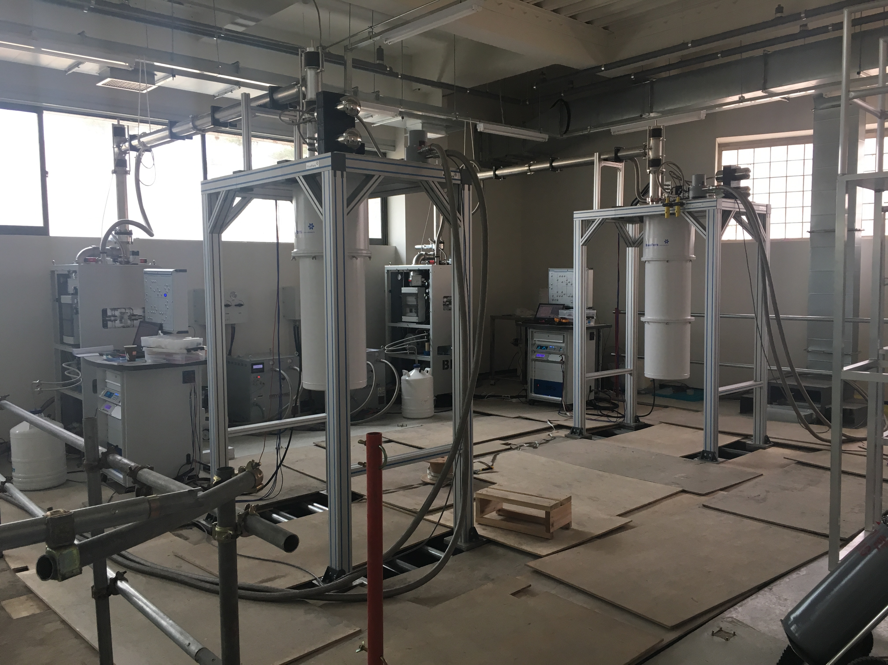
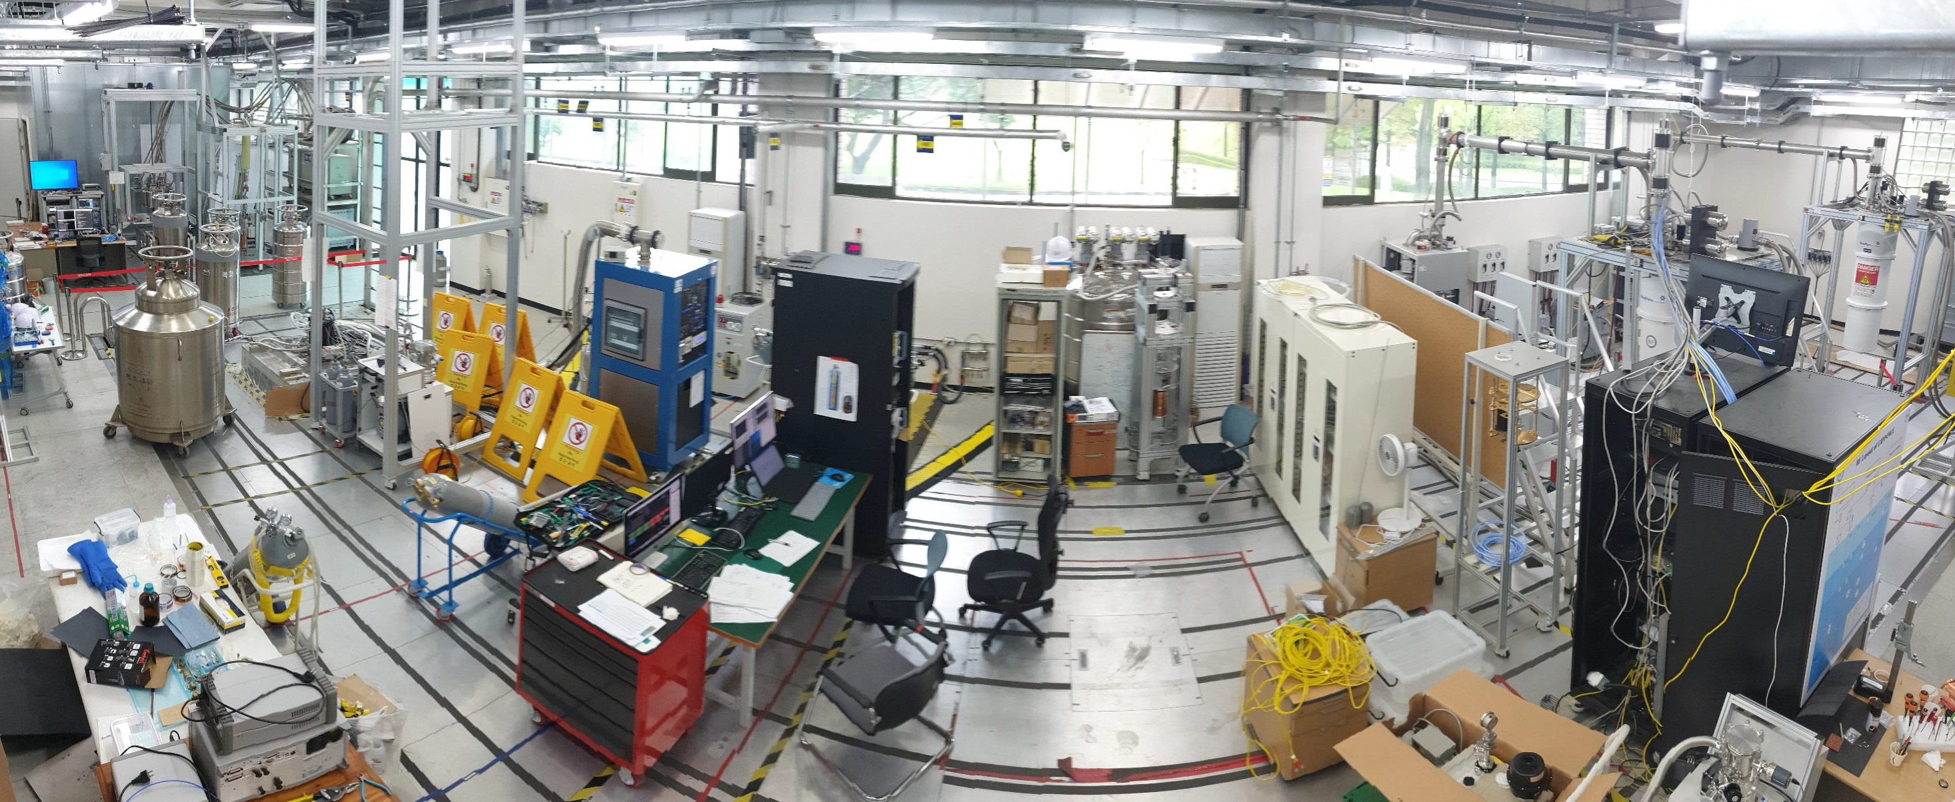
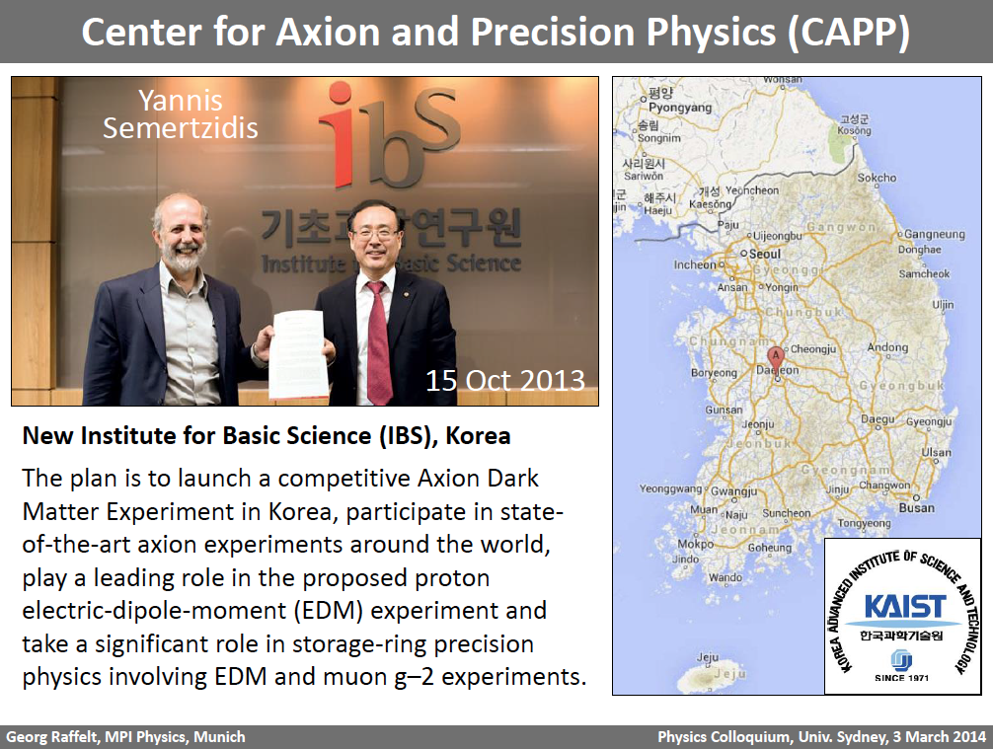
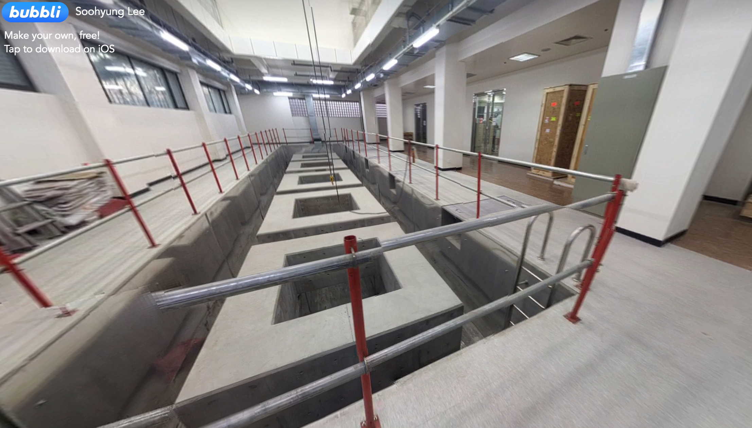
CAPP’s First 9 years…
Founded in 2013 (Oct16th.)
2013 | 2014 | 2015 | 2016 | 2017 | 2018 | 2019 | 2020 | 2021 | 2022 | 2023
Procuring equipment, testing cavities, cryo-RF @KAIST
Constructing 7 LVPs @KAIST Munji campus
BF3 & BF4 installed
BF5 & BF6 installed
Janis (He³) installed
12T Oxford Magnet & Leiden installed
CAPP-PACE-HEMT
CAPP-PACE-JPA
CAPP-PACE-JPA-6cell
CAPP-PACE-JPA-SC
CAPP-PACE-SHeT-SC
CAPP-8TB-HEMT
Collecting Axion DM Physics Data
CAPP-8TB-JPA-8cell
CAPP-8TB-AQN-SC
CAPP-HF-2cell
CAPP-12TB-JPA
CAPP-12TB-commissioning
CAPP-12T-HF-JPA-3cell
Notes:
We are now collecting axion dark matter data in three different experiments, including our flagship experiment CAPP-12TB.
I would like to emphasize that most of this exciting progresses started to bear fruits just after our center’s 5th year review,

Slide 4
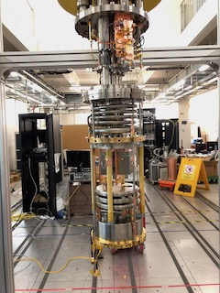
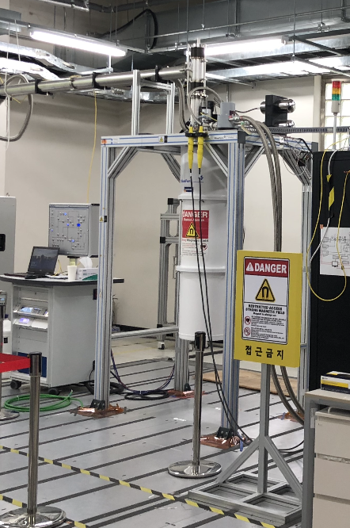
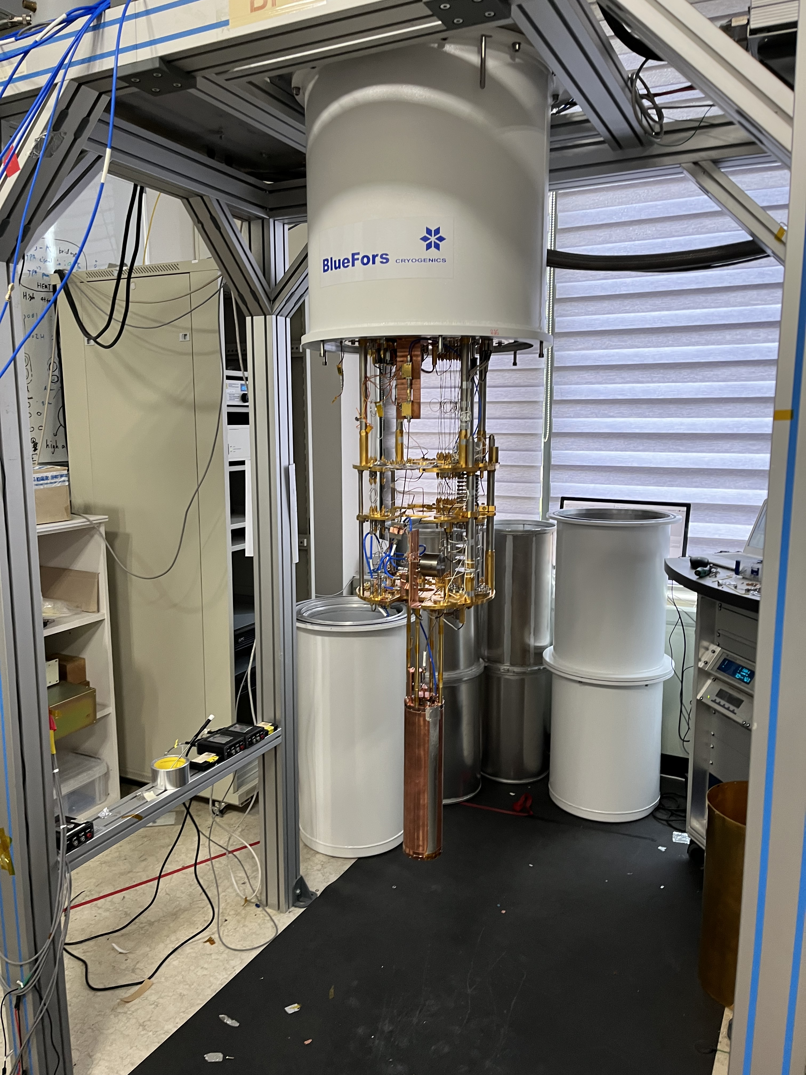
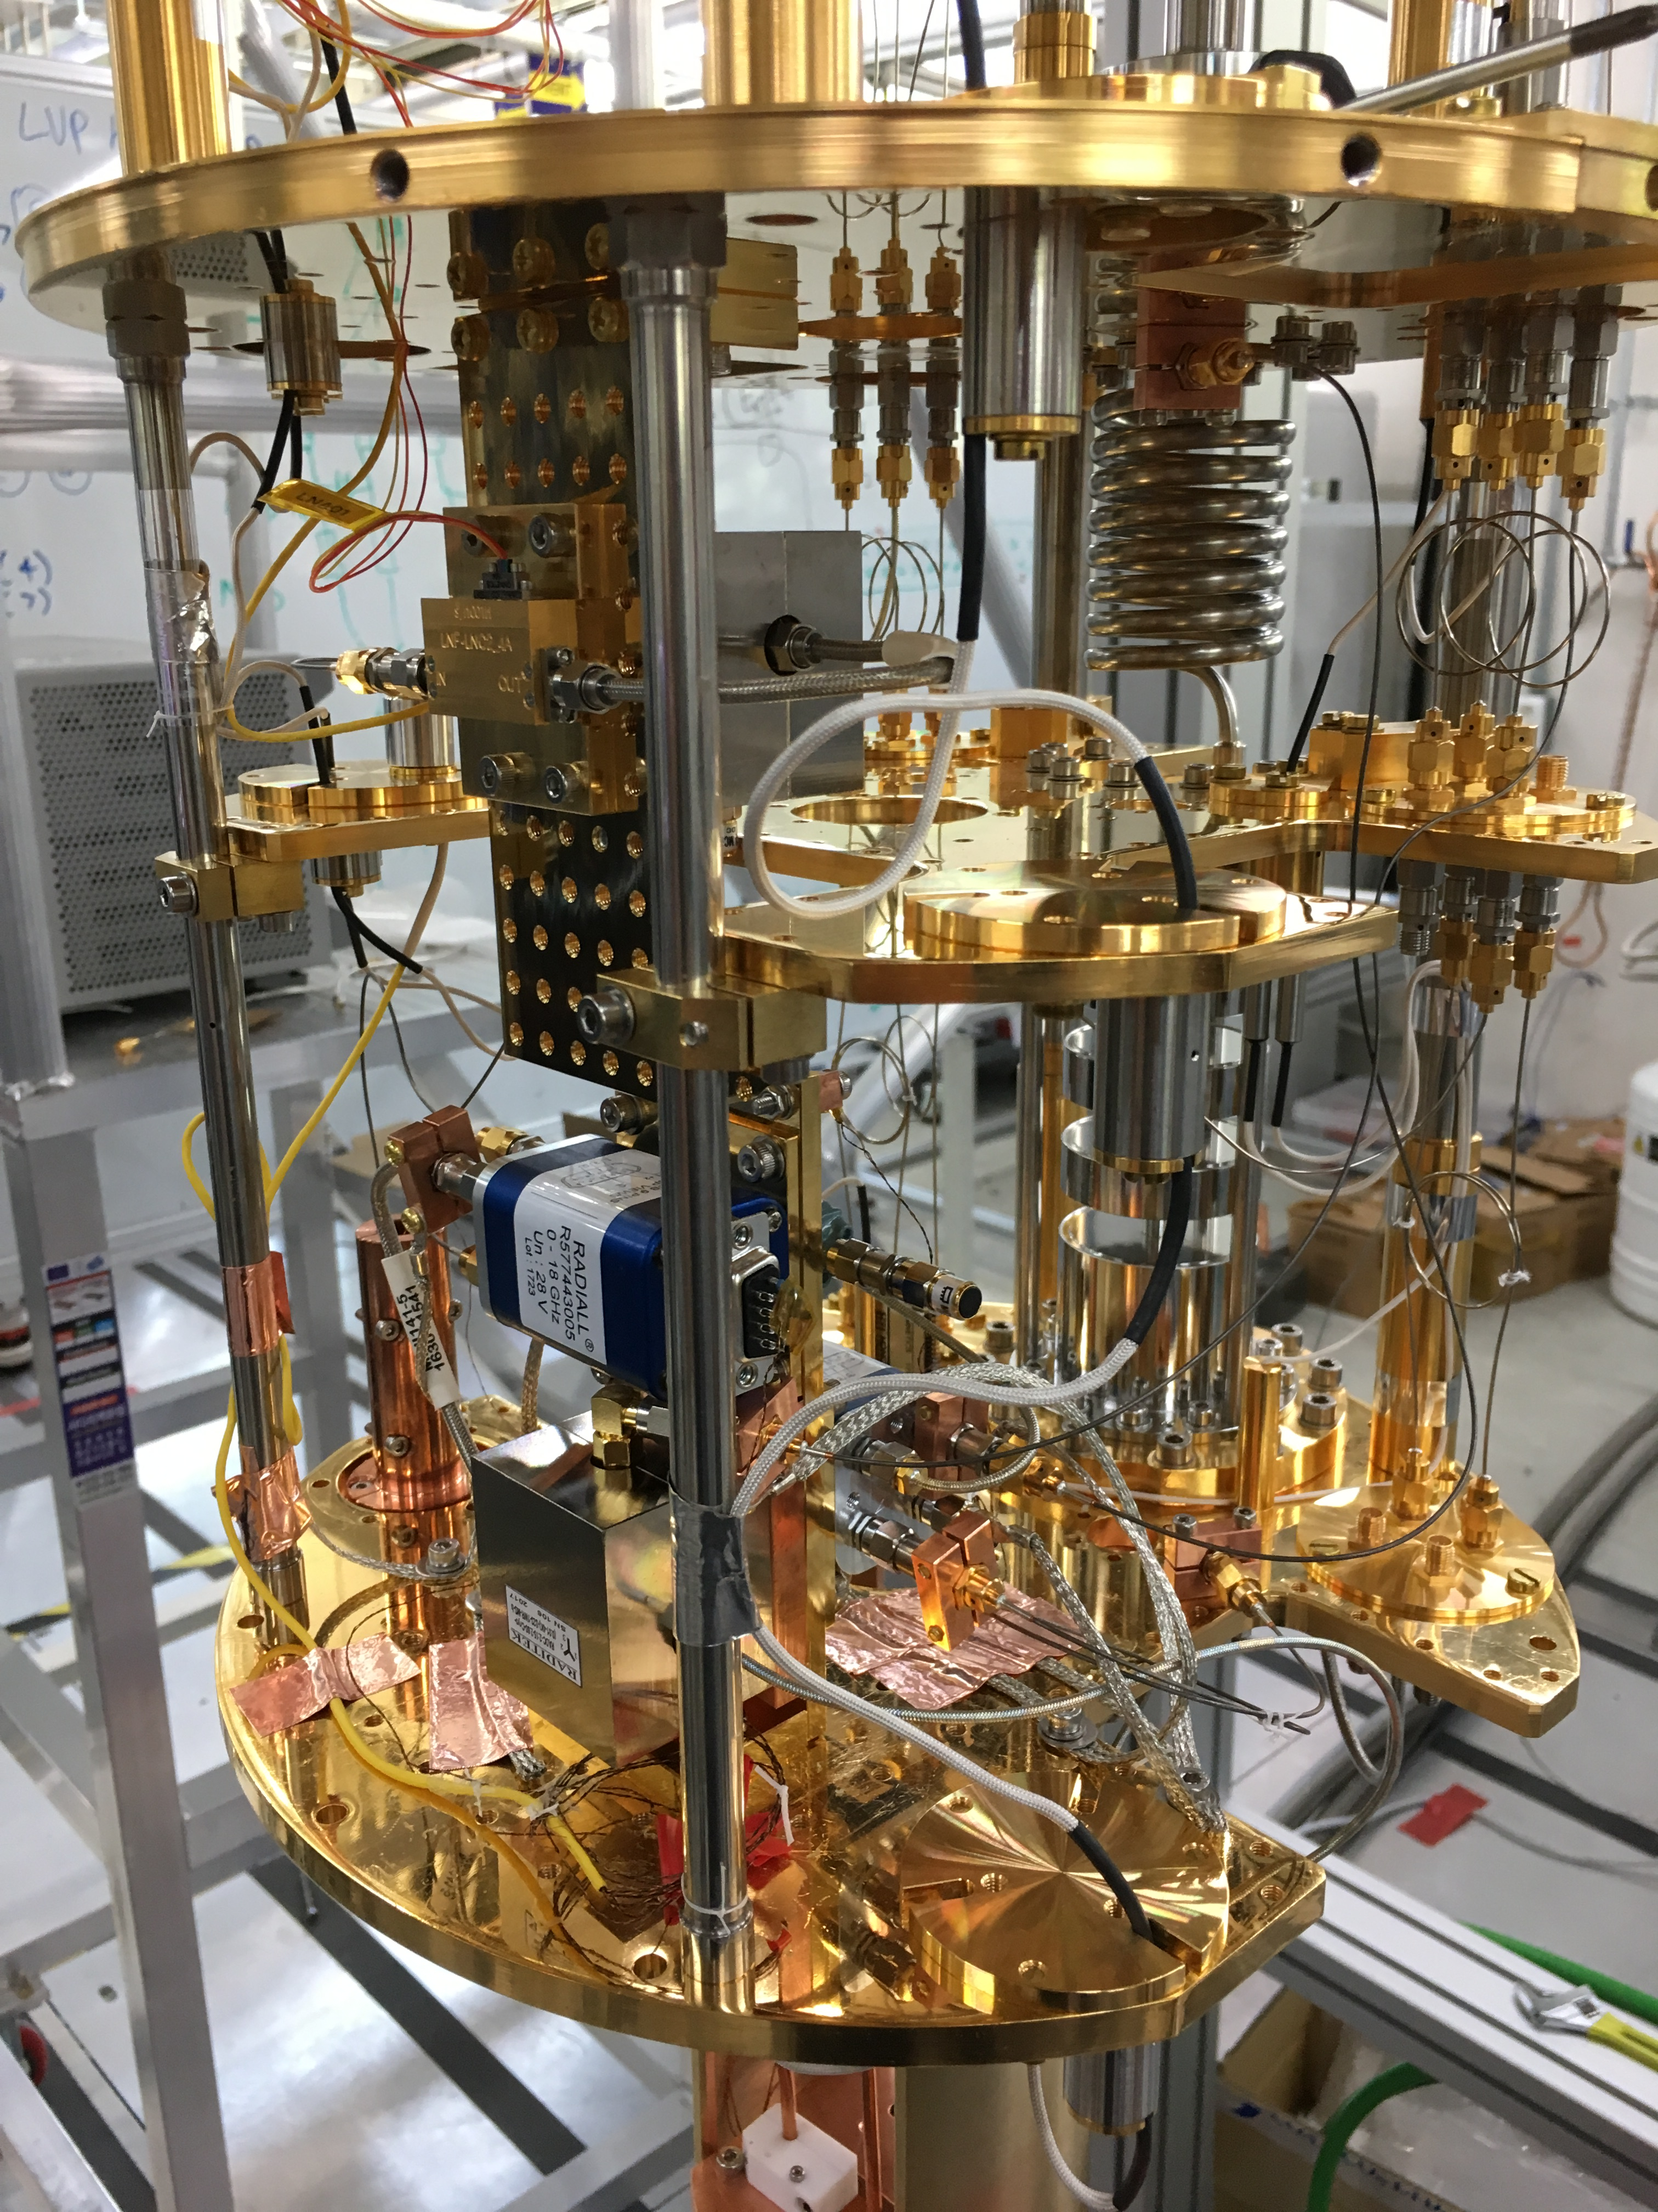
CAPP Experimental Hall (LVP)
CAPP-12TB
CAPP-HF
CAPP-MAX
CAPP-HeSC
CAPP-AQN
Notes:
this picture shows the axion lab of our center.
each of three running experiments is sitting in its own LVP.
running experiments capp-mc, capp-pace and capp-8tb are shown.
capp-12tb is our flagship experiment with 12 T 32cm bore oxford magnet
and the size of the resonant cavity is 30 liters.
The commissioning is scheduled in the summer of this year.

Slide 5
Status of CULTASK at CAPP
Refrigerators |  |  |  |  |  | SC Magnets |  |  |  |  | Experiments
Vendor | Model | BaseT | Power | Type | Install | B field | Bore | Mat. | Vendor | Install | Exp. | Status | Freq (GHz)
Leiden | DRS1000 | 10 mK | 1.3mW@120mK | wet | 2020 | 12T | 32cm | Nb₃Sn | Oxford | 2020 | CAPP-MAX | Running | 1.0~1.5
BlueFors (BF3) | LD400 | 10 mK | 580uW@100mK | dry | 2016 | 12T | 10cm | Nb₃Sn | AMI | 2021 | CAPP-HF | Running | 4.0~10.0
BlueFors (BF4) | LD400 | 10 mK | 580uW@100mK | dry | 2016 |  |  |  |  |  | CAPP-QNA | Testing | JPA test
BlueFors (BF5) | LD400 | 10 mK | 580uW@100mK | dry | 2017 | 8T | 12cm | NbTi | AMI | 2016 | CAPP-PACE | Running | 2.0~3.0 (5.6-5.9)
BlueFors (BF6) | LD400 | 10 mK | 580uW@100mK | dry | 2017 | 8T | 16.5cm | NbTi | AMI | 2017 | CAPP-8TB | Running | 1.5~2.0 (5.8-6.0)
Janis | He3 | 300 mK | 25uW@300mK | wet | 2017 | 9T | 12cm | NbTi | Cryo-Magnetics | 2017 | CAPP-HF | Installing | 3.5~4.5 (~10.0)
Oxford | Kelvinox | 30 mK | 400uW@120mK | wet | 2017 | 18T | 7cm | GdBCO | SuNAM | 2017 | CAPP-18T | upgrading | 4.5~6.0
Notes:
THis is the table summary of our refrigerators and superconducting magnets.
we have four bluefors dry dilution frigs and two wet dilution firgs. and one Janis He3 refrigerator.

Slide 6
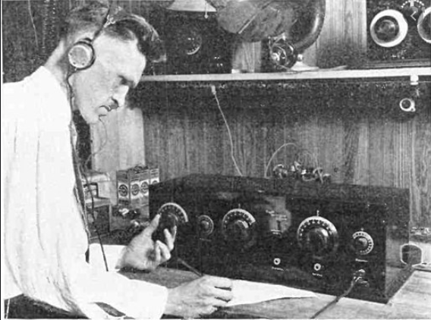
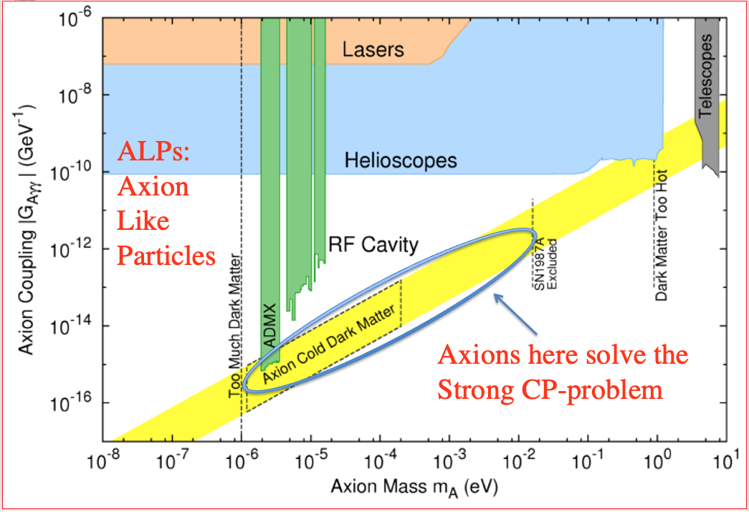
Axion Detection (experimentalist’s view)
Haloscope: the most sensitive method known today, but
Still very wide range of mass to scan…
Needs innovations/breakthroughs to speed up the search!
Taking advantage of the advancement of Superconductor technology (quantum noise-limited amp + superconducting tapes)
Notes:
Discovering the axion is like dialing through zillions of frequencies in a radio.
Even though the haloscope is the most sensitive method,
To search it with a enough sensitivity for a wide range of masses, or frequencies, it might take our whole life.
That’s why we need innovations or breakthroughs to speed up the search.
We happened to live in a era where things are very fast in the field of superconductor technology.
We woudl like to take advantage of those in quantum computing and high temperature superconductor applications.

Slide 7
Axion Detection Scheme (Haloscope)
Signal from Conversion power (a→γγ)
Noise from k_{B}T_{syst}
F.O.M. = Scan (detection) rate
- theoretical parameters
- experimental parameters
Coupling constant
Effective volume
Cavity Q factor
Axion Q factor
Cavity Q_{L},V,C
Axion number density
Magnetic field
γ
g_{aγγ},ρ_{a},m_{a},Q_{a}
Integration time
Axion bandwidth (~10⁻⁶ f)
Strong B₀
System noise temperature
Notes:
There are two things we have to consider in axion haloscope detection.
We have to maximize the axion signal and reduce the noise as much as possible.
In order to boost the signal, we have to have a powerful magnet with huge bore and prepare a very high q-factor resonant cavity.
Also we have to align electric and magnetic field to maximize the form factor.
And we have to minimize the noise by lowing the system noise temperature, both physical and amplifier noise.
The end of the day, what we care is the scan rate.
For example, if we lower the system noise by an order of magnitude, 100 years axion search could be done in a year.
That’s where the ultra low noise amplifier comes in and play a great contribution, just like quantum amplifiers.
It wasn’t even possible 10 years ago if I remember correctly, but now it is possible to have a quantum amplifier showing the noise limited only by quantum theory.

Slide 8
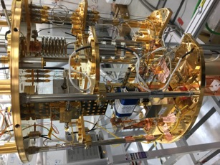
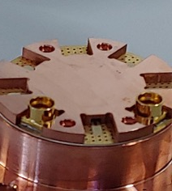
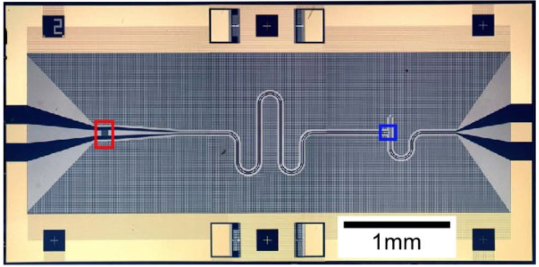

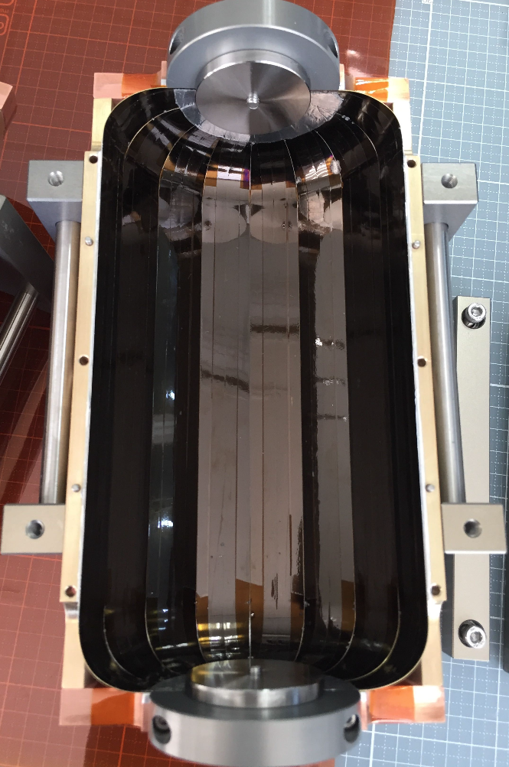
Axion Detection Scheme (CULTASK)
P. Sikivie’s Haloscope:
Cryogenics (<40mK)
Dilution Refrigerators
Quantum Amplifier
SQUID and/or JPA (T_{N} ~ SQL)
To RF Receiver
High Q Tunable Cavity
Superconducting tapes
High Field & Big bore Magnet
12T LTS Big Bore SC Magnet
photon
axion
Virtual photon
Notes:
This is the cartoon that shows the CAPP’s axion detection scheme in a nutshell.
in order to minimize the system noise we have to use the dilution refrigerator and lower the cavity temperature below 40 mK
and utilize the JPA which shows the noise near the quantum limit.
To boost the axion signal, we use the high field big bore superconducting magnet
and develop a high q-factor superconducting cavity which maintains q-factor in a high magnetic field.

Slide 9
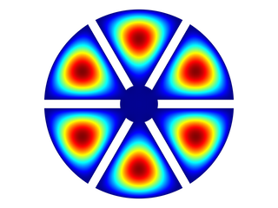
CAPP’s R&D
What we achieved
  7 refrigerators (6 magnets) operational at CAPP
  4 (better than KSVZ sensitivity) experiments running…
R&Ds needed to search 1~10 GHz in 5 years
  Optimizing cryo-RF receiver with quantum amplifiers (JPA) at or near SQL
    Ultra-low physical temperature (< 25 mK)
    Reduce the total noise ~ 120 mK @ 1 GHz
    >5 MHz /day scanning speed
  Developing Superconducting Cavity under High Magnetic Field
    HTS cavity could enhance the scan speed > 10 times
  Developing High-Frequency Cavities
    Avoid sacrificing volume of the cavity
    Multi-cavity, dielectric cavity and photonic gap crystal
    Superfluid He tuning
Notes:
So there are things we could do.
with very rough calculations, comparing with the small cavity we used with HEMT amplifiers.
If we utilize these improvements, we should be able to speed up our axion search at least 1000 times.
And to cover the wide range of masses, especially high masses
We are also developing a method to scan higher frequency ranges without shrinking volume of cavity.

Slide 10
How to improve?
Maximize Signal (B²VQ)
  12T 32cm bore LTS magnet by Oxford
  Improve Q-factor of cavity – SC cavity
Minimize Noise (T_{system} = T_{physical} + T_{amp})
  Quantum noise-limited amplifier – JPA
  Optimize cryo-RF receiver chain (SQL)
  Single photon detector in the future
Higher frequencies without sacrificing volume
  Pizza Cavity
  Dielectric rings (TM₀₃₀ and TM₀₅₀)
  Photonic cell cavity
  Meta material + Superfluid LHe tuning
  > x100 faster scan (than 8T-10cm)
> x 20 faster scan than Cu
~ x50 faster scan compared to HEMTs
Notes:
So there are things we could do.
with very rough calculations, comparing with the small cavity we used with HEMT amplifiers.
If we utilize these improvements, we should be able to speed up our axion search at least 1000 times.
And to cover the wide range of masses, especially high masses
We are also developing a method to scan higher frequency ranges without shrinking volume of cavity.

Slide 11
Axion Experiments at CAPP
 | CAPP-PACE | CAPP-8TB | CAPP-HF | CAPP-PACE -JPA | CAPP-PACE -JPA-6cell | CAPP-8TB -JPA-8cell | CAPP-PACE -JPA-SC | CAPP-MAX | CAPP-AQN-SC | CAPP-HeT-SC | CAPP-12T-HF-3cell
Year | 2018 | 2019 | 2019 | 2020 | 2021 | 2021 | 2021 | 2021 | 2023 | 2023 | 2023
Magnet [T] | 8 | 8 | 9 | 8 | 8 | 8 | 8 | 12 | 8 | 8 | 12
m_{a} [GHz] | ~2.5 | ~1.6 | ~4.0 | ~2.3 | ~5.6 | ~5.8 | ~2.3 | 1.0 ~ 2.0 | ~2.3 | ~5.4 | ~5.3
Δm_{a} [MHz] | 250 | 200 | 250 | 30 | 80 | >100 | 30 | 20 ~ 300 | - | > 50 | ~30
Sensitivity | 10*KSVZ +KSVZ | 4*KSVZ | 10*KSVZ | 2*KSVZ | 3*KSVZ | KSVZ | KSVZ | DFSZ | DFSZ | KSVZ | KSVZ
T_{phy} [K] | < 0.05 | < 0.05 | ~2 | ~0.05 | ~0.05 | ~0.03 | ~0.04 | ~30 mK | 60 mK | 30 mK | 30 mK
T_{sys} [K, mK] | ~1 K (HEMT) | ~1 K (HEMT) | ~2 K (HEMT) | ~200 mK | <300 mK | <300 mK | <200 mK | <300 mK | ~200 mK | ~400 mK | ~400 mK
Comments | R&D machine: First physics run (coldest axion data) | First result published by CAPP | First multi-cell cavity result | First run with JPA | First run with JPA+6-cell | First run with JPA+8-cell | First run with JPA+SC | CAPP’s main axion detector with JPA | Axion Quark Nugget + SC cavity (Q~1.6M) | First run with He tuning + SC cavity (Q~10M) | 3-cell with 12T mag + JPA SC cavity (future)
Publication | Published in PRL | Published in PRL | Published in PRL | Published in PRL | -- | Will publish | Will publish | Published in PRL
Notes:
these are the summary of physics runs we already performed and capp-12tb will be commissioned very soon this year.
i will show the mass ranges they covered in the following pages.
capp-8tb result is our first published one and
capp-mc is our first multi-cell cavity experiment.
capp-pace is the designated r&d machine to try new improvements.
last year, we had successful data run with Nakamura group's JPA and
we will try to add superconducting cavities this year.
other r&ds we will try this year is liquid hellium tuning with dielectric cavities and meta material cavities.

Slide 12
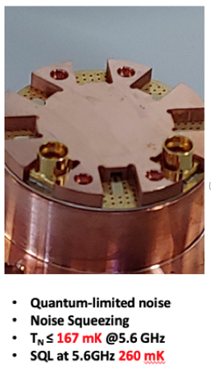
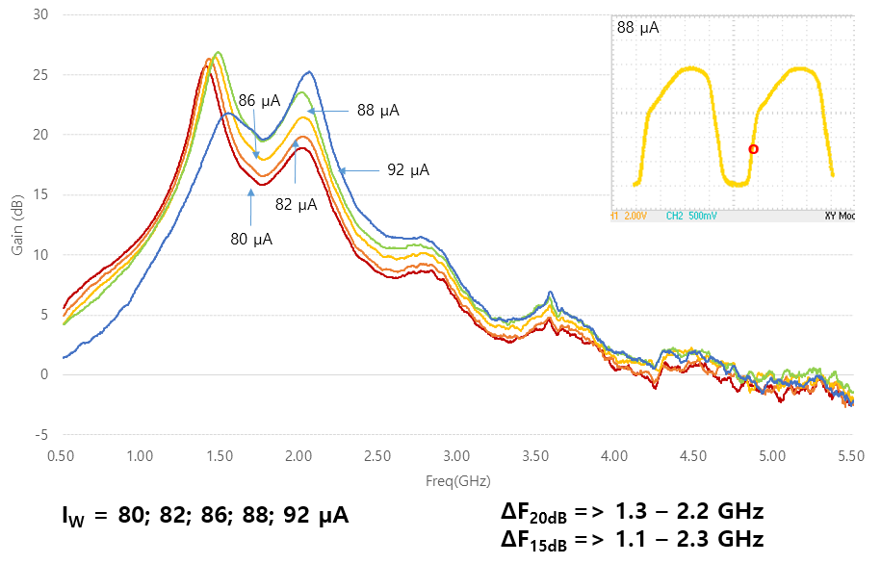
Quantum Noise-Limited Amp (JPA)
Collaboration with Nakamura’s group (U. of Tokyo, RIKEN)
  > 200 JPA chips delivered (1.0 – 6.0) GHz (4 batches) + Packaged at CAPP
  1.0 GHz
    DAQ running ~ 1.0 GHz data in CAPP-MAX (DFSZ)
  2.3 GHz
    Excellent Noise Temperature (close to SQL) ~120 mK
    Completed taking axion dark matter physics data around 2.3 GHz
    Excluded ~30 MHz range (CAPP-PACE)
    Improves scanning speed ~ 50 times
  6.0 GHz
    Wider bandwidth: ~ MHz covers ~ 300 MHz of frequencies
    Taken 5.5-6.0 GHz physics data using 6 & 8 cell Pizza Cavity (two DRs)
    Shows excellent NT: ~ 250 mK
Wideband (1~15 GHz) TJWPA (INFN) and TWJPA (Lancaster)
Single photon detector for higher frequency
Notes:
Now i have to talk about our r&d efforts.
first, quantum amplifier.
we have a collaboration with prof. nakamura's group in U. of tokyo and riken
who provided about 200 jpa chips in the range of 1 to 6 GHz.
they were all packaged and characterized at CAPP by Sergey Uchaikin and Andrei Matlashov.
all of them showed excellent noise temperature close to standard quantum limit.
I mentioned that we completed taking axion dark matter data run around 2.3 GHz for about 30 MHz range.
we are presently planning for 6 GHz data run with 6 and 8 cell cavities this year in two dilution ref.
Also preparing to take around 1 GHz data in capp-12tb main experiment (summer of this year).
Very wideband travelling wave jpa test is in line, waiting for samples from INFN, Italy and Lancaster U. of UK.
Ultimately we would like to go beyond 10 GHz with single photon detector.

Slide 13
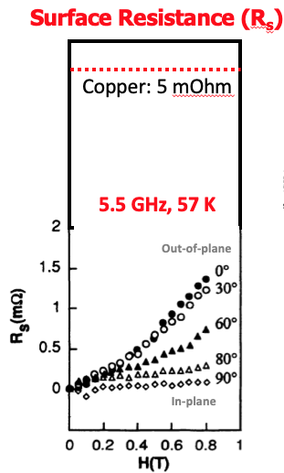
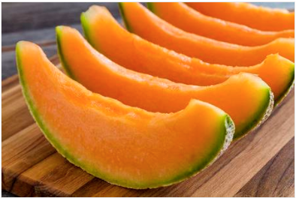
HTS Superconducting Cavity
SC Resonant Cavity in Axion Haloscope Exp.
  Could improve axion to photon conversion power: enhancing scanning speed (> x10)
  Requirement: should sustain high enough Q-factor in high magnetic field (up to 25 T?)
Choice of SC at CAPP: well-known ReBCO
  Reasonably low surface resistance
  Very high Hc2 (~100 T) and high depinning frequency (~100 GHz)
  “biaxially textured”
    Technically challenging to grow on 3D surface
    But, many “grain aligned" high quality tapes are commercially available.
How can we attach those tapes on the inner surface of resonant cavity?
  3D surface with planar objects: polygon cavity based on TM010 mode (called ”melon cut”)
Excellent results (Q>500,000) even up to 8 T (further improvement in progress)
Physics data run is complete: will publish soon
Much higher Q-factor (>10,000,000) achieved (Dr. D. Ahn’s talk)
Notes:
Now i have to change gears again, and talk about the superconducting cavity r&d.
when I started this r&d, i couldn't find any significant result about superconducting cavity in high magnetic field last 15 years.
Nobody probably cares.....
Until recently there was a huge interest by FCC, future collider people in designing their beam screen part.
However, in axion experiment, it could be a major improvement.
Not only for increasing the scan rate, but also useful to look at the structure of the axion shape.
first we have to carefully choose the right material and think about how to implement it to the inner surface of the cavity.
Our choice of the material is a ReBCO family.
Using commercially available high quality SC tapes and adopting polygon style design,
we have successfully fabricated working superconducting cavity that maintains most of it Q-factor even under the high magnetic field.
and we are sure that we could even improve it further in the near future.

Slide 14
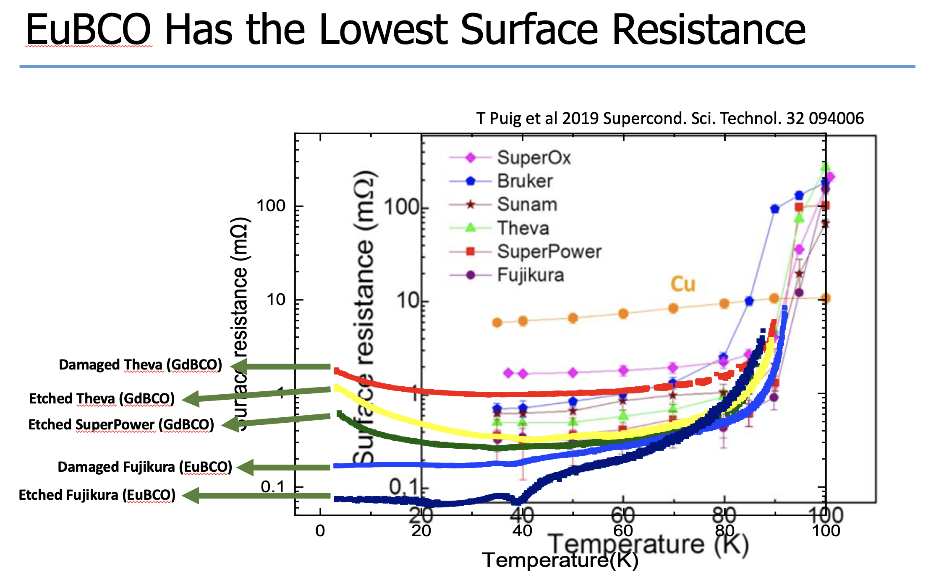
HTS Superconducting Cavity (D. Ahn)
Notes:
Capp에서는 앞서 말씀드린 컨셉을 이용하여 그동안 세 세대의 캐비티를 제작했습니다. 성능이 더 좋은 테잎을 찾고 제작 과정을 점차 개선하였고, q 인자를 점점 높였습니다.

Slide 15
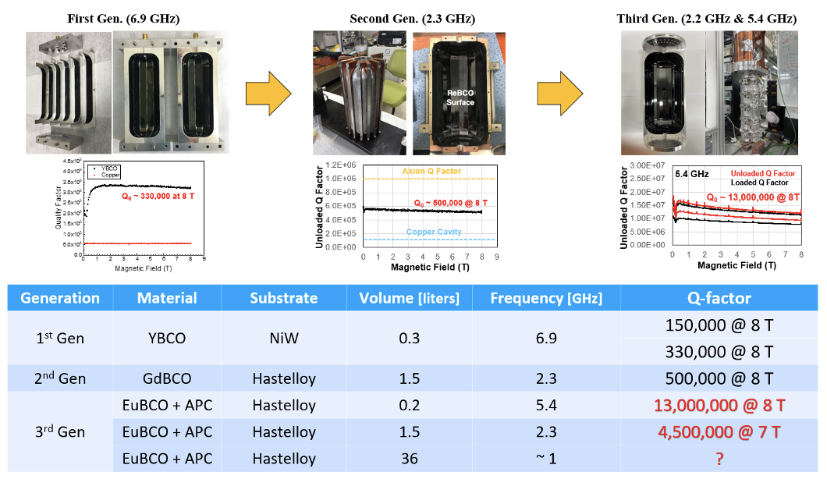
HTS Superconducting Cavity (D. Ahn)
3,700,000 @ 8T
Notes:
Capp에서는 앞서 말씀드린 컨셉을 이용하여 그동안 세 세대의 캐비티를 제작했습니다. 성능이 더 좋은 테잎을 찾고 제작 과정을 점차 개선하였고, q 인자를 점점 높였습니다.

Slide 16
Prototype Projects + CAPP-MAX
SC cavity + JPA (Danho Ahn)
Pizza cavity (6 GHz) (Soohyung Lee)
complete
AQN w/ SC cavity (Jinsu Kim)
Superfluid He tuning + SC cavity (HeeSu Byun)
HF multi-cavity + 12T (Junu Jeong)
CAPP-MAX results (Saebyeok Ahn)
Running

Slide 17
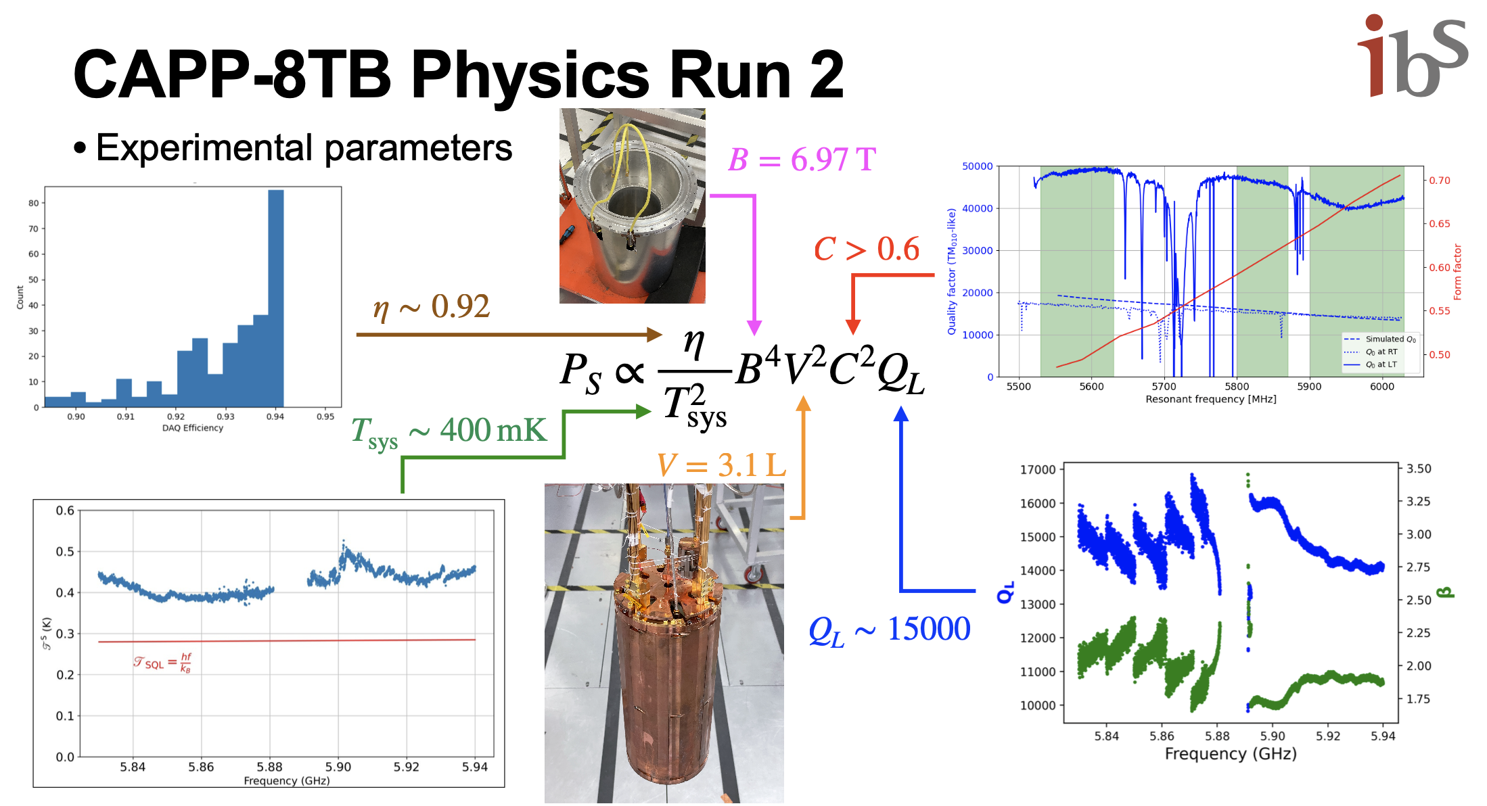
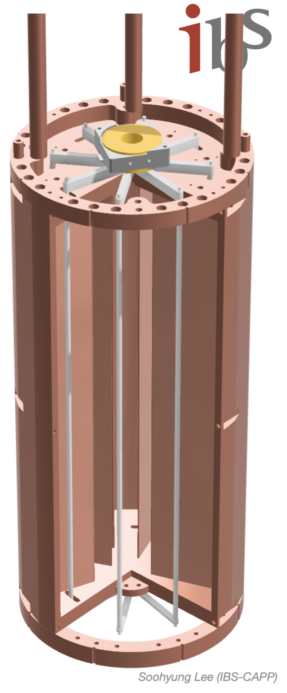
Multi-cell (8) cavity + JPA (6 GHz) (S. Lee)
By S. Lee

Slide 18
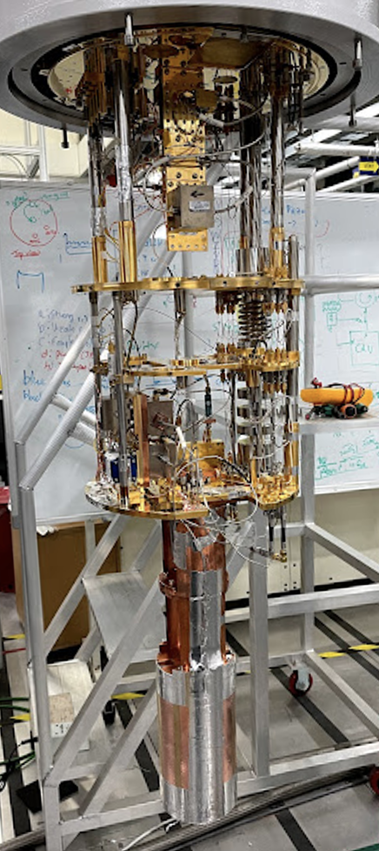
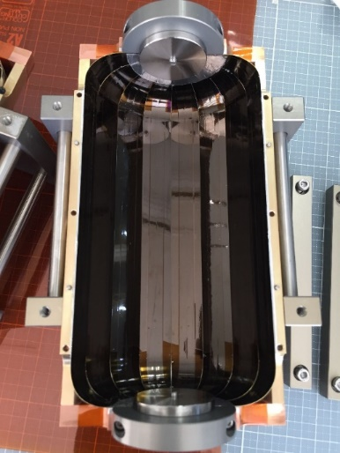
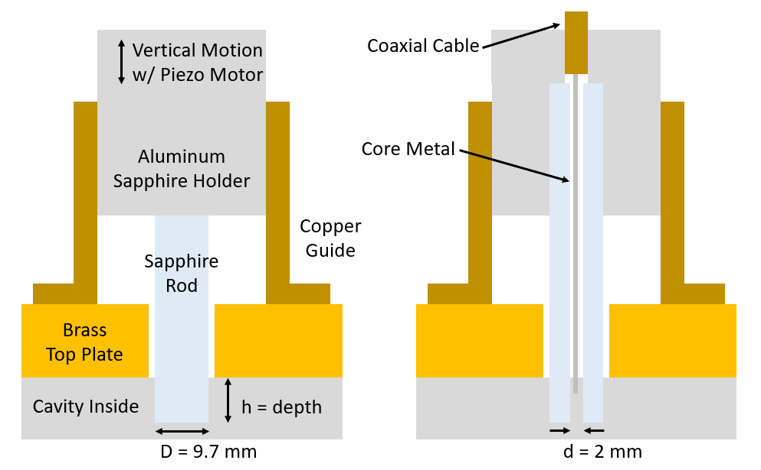
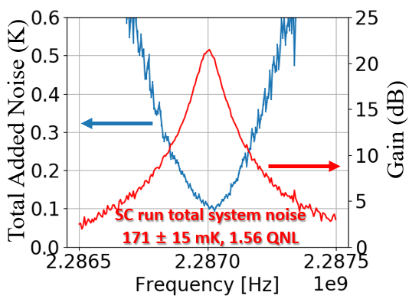
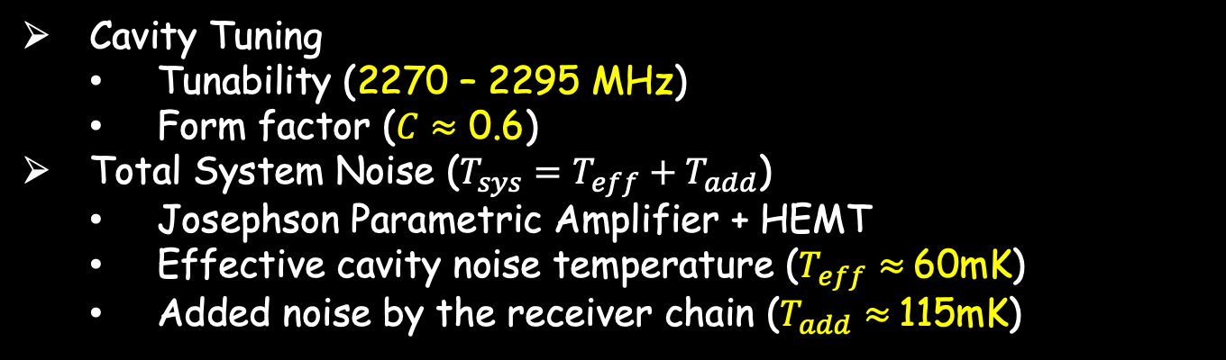
Axion Search w/ SC Cavity (D. Ahn)
First axion exp. w/ HTS taped SC cavity (Q ~ 500k))
Cavity Tuning
  Tunability (2270 – 2295 MHz)
  Form factor ($C≈$ 0.6)
Total System Noise ($T_{sys}=T_{eff}+T_{add}$)
  Josephson Parametric Amplifier + HEMT
  Effective cavity noise temperature ($T_{eff}≈$60mK)
  Added noise by the receiver chain ($T_{add}≈$115mK)
Notes:
캐비

Slide 19
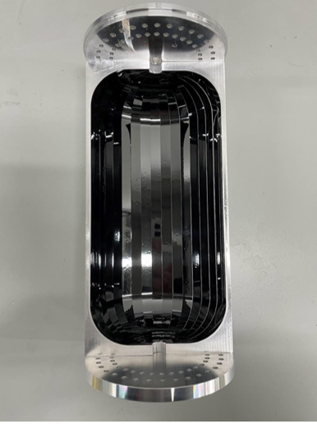
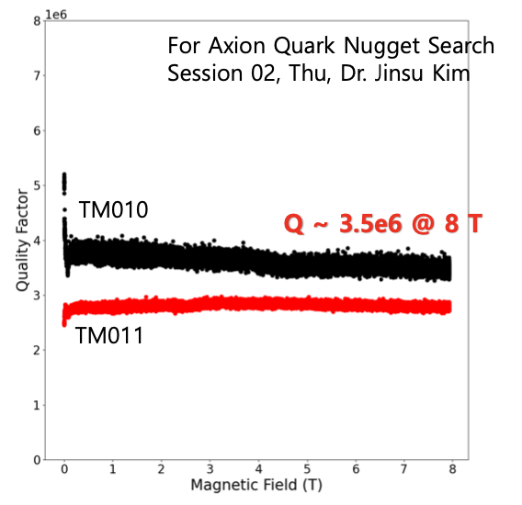
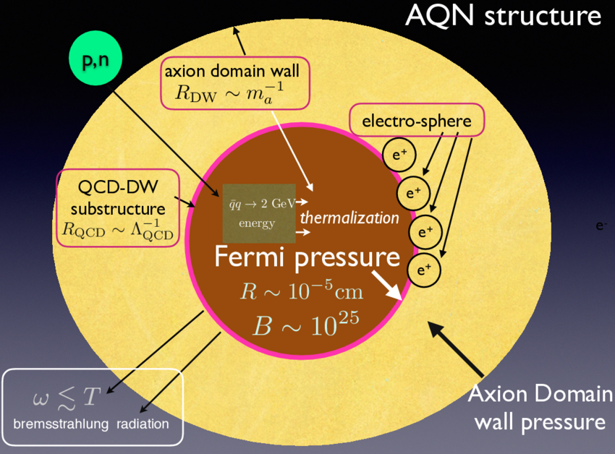
AQN Experiment at CAPP (Jinsu Kim)
CAPP’s first Axion Quark Nugget experiment w/ haloscope
SC taped cavity (Q > 1.6 M) is implemented
Demonstrate the ability of analyzing high-Q data
  Develop AQN analysis (can be done in parallel using haloaxion data)

Slide 20
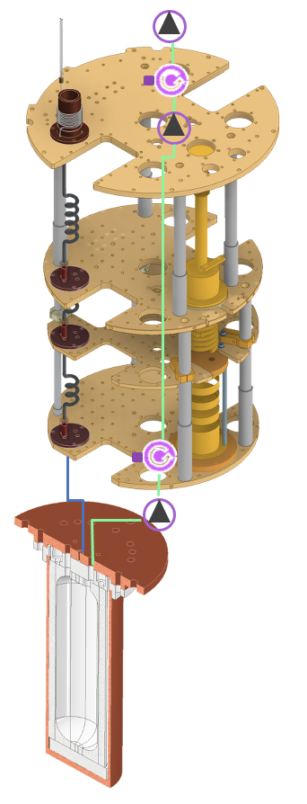
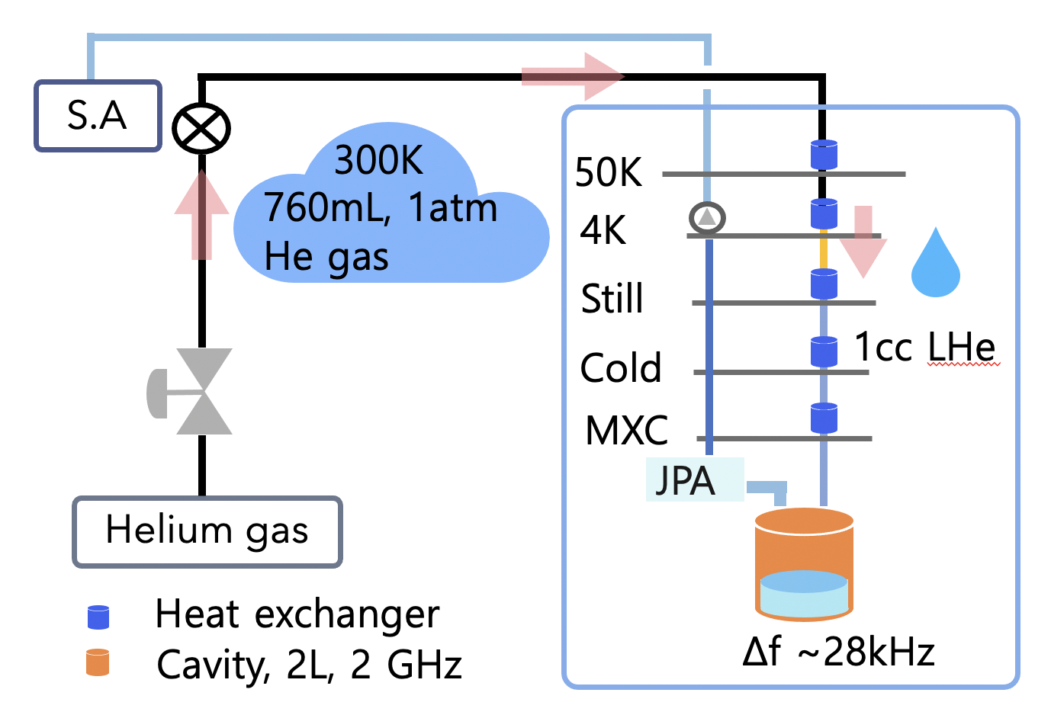
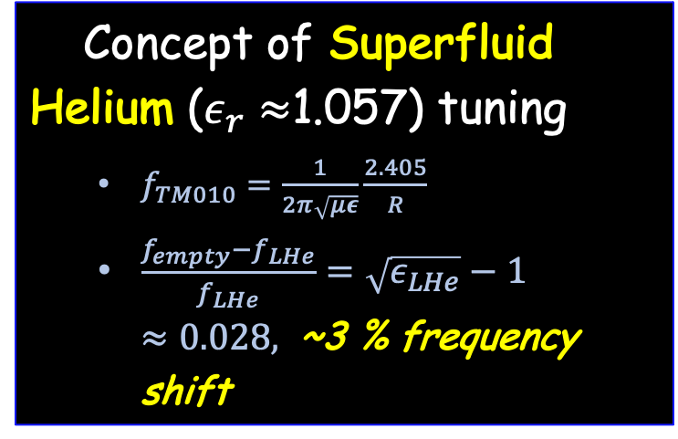
Superfluid Helium Tuning w/ SC cavity (H. Byun)
  Applicable to superconductor cavity and metamaterial cavity
  No significant change in field distribution, form factor and Q-factor
  DAQ run with JPA + SC cavity (Q~13M) + superHe is in progress
Concept of Superfluid Helium ($ε_{r}≈$1.057) tuning
  $f_{TM010}=\frac{1}{2π\sqrt{με}}\frac{2.405}{R}$
  $\frac{f_{empty}−f_{LHe}}{f_{LHe}}=\sqrt{ε_{LHe}}−1≈0.028,$ ~3 % frequency shift

Slide 21
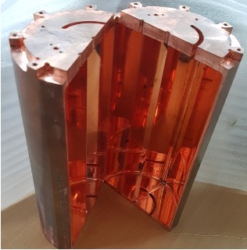
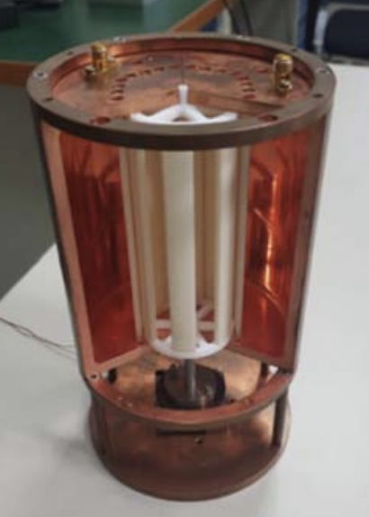
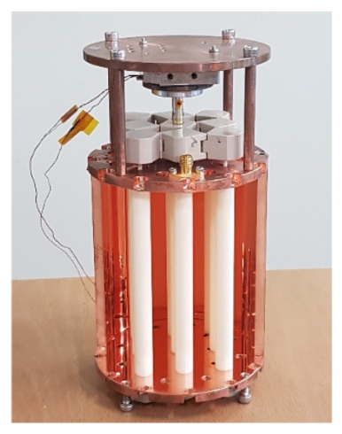
High-Frequency Cavity Designs at IBS-CAPP
High-Frequency Cavity Design (J. Jeong)
Multiple-cell Cavity [J. Jeong et al., Phys. Lett. B 777, 412]
Wheel Tuning Mechanism [J. Kim et al., J. Phys. G: Nucl. Part. Phys. 47, 035203]
Tunable Photonic Crystal [S. Bae et al., Phys. Rev. D 107, 015012]

Slide 22
CAPP-MAX
From ByeongRok Ko
CAPP’s main flagship experiment
Powerful 12 Tesla Nb3Sn superconducting magnet with big 32 cm bore, only two in the world
Collecting axion dark matter physics data with DFSZ sensitiviity around 1 GHz
With JPA, T_{sys} reaches 100 ~ 200 mK, depending on physical temp. of cavity (15~50 mK)
20 MHz, 58 MHz, and 150 MHz scan complete. 1.2~1.5 GHz scan about to start
Aim to scan > 1 GHz next year (with Superconducting cavity?)
Notes:
Now i have to talk about our r&d efforts.
first, quantum amplifier.
we have a collaboration with prof. nakamura's group in U. of tokyo and riken
who provided about 200 jpa chips in the range of 1 to 6 GHz.
they were all packaged and characterized at CAPP by Sergey Uchaikin and Andrei Matlashov.
all of them showed excellent noise temperature close to standard quantum limit.
I mentioned that we completed taking axion dark matter data run around 2.3 GHz for about 30 MHz range.
we are presently planning for 6 GHz data run with 6 and 8 cell cavities this year in two dilution ref.
Also preparing to take around 1 GHz data in capp-12tb main experiment (summer of this year).
Very wideband travelling wave jpa test is in line, waiting for samples from INFN, Italy and Lancaster U. of UK.
Ultimately we would like to go beyond 10 GHz with single photon detector.

Slide 23
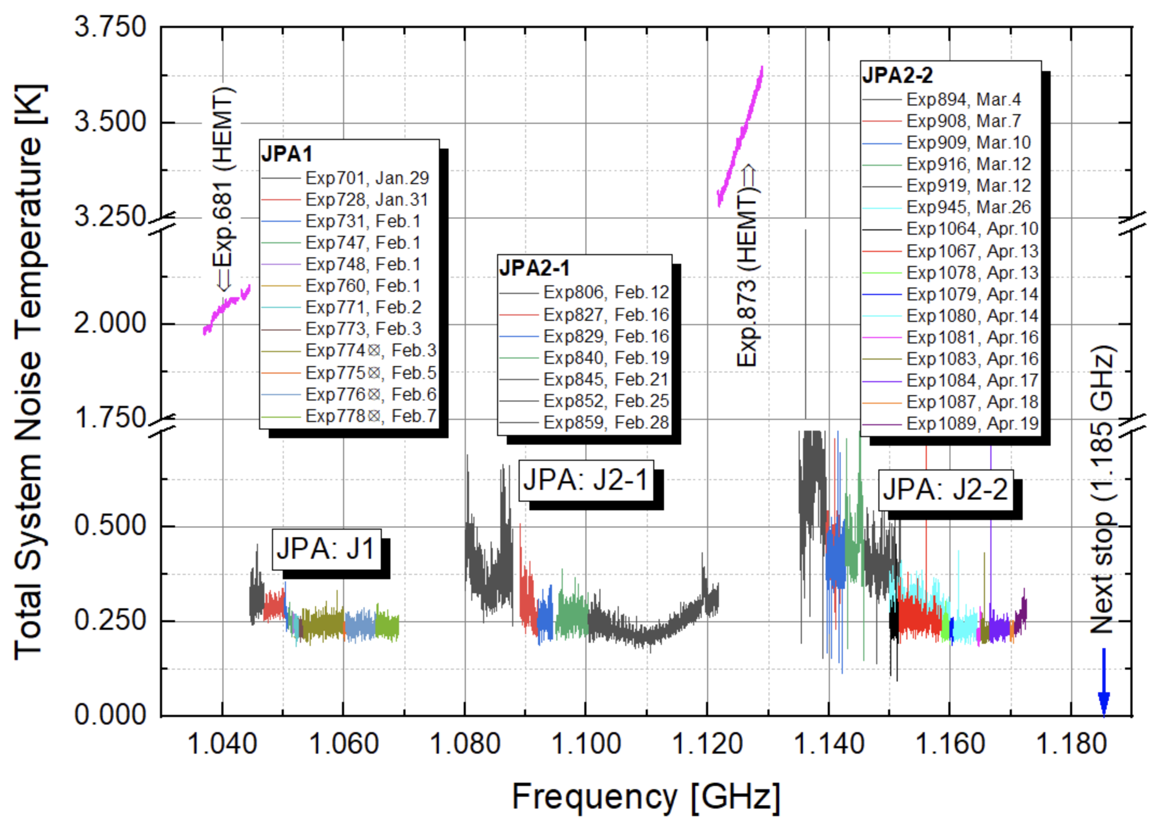
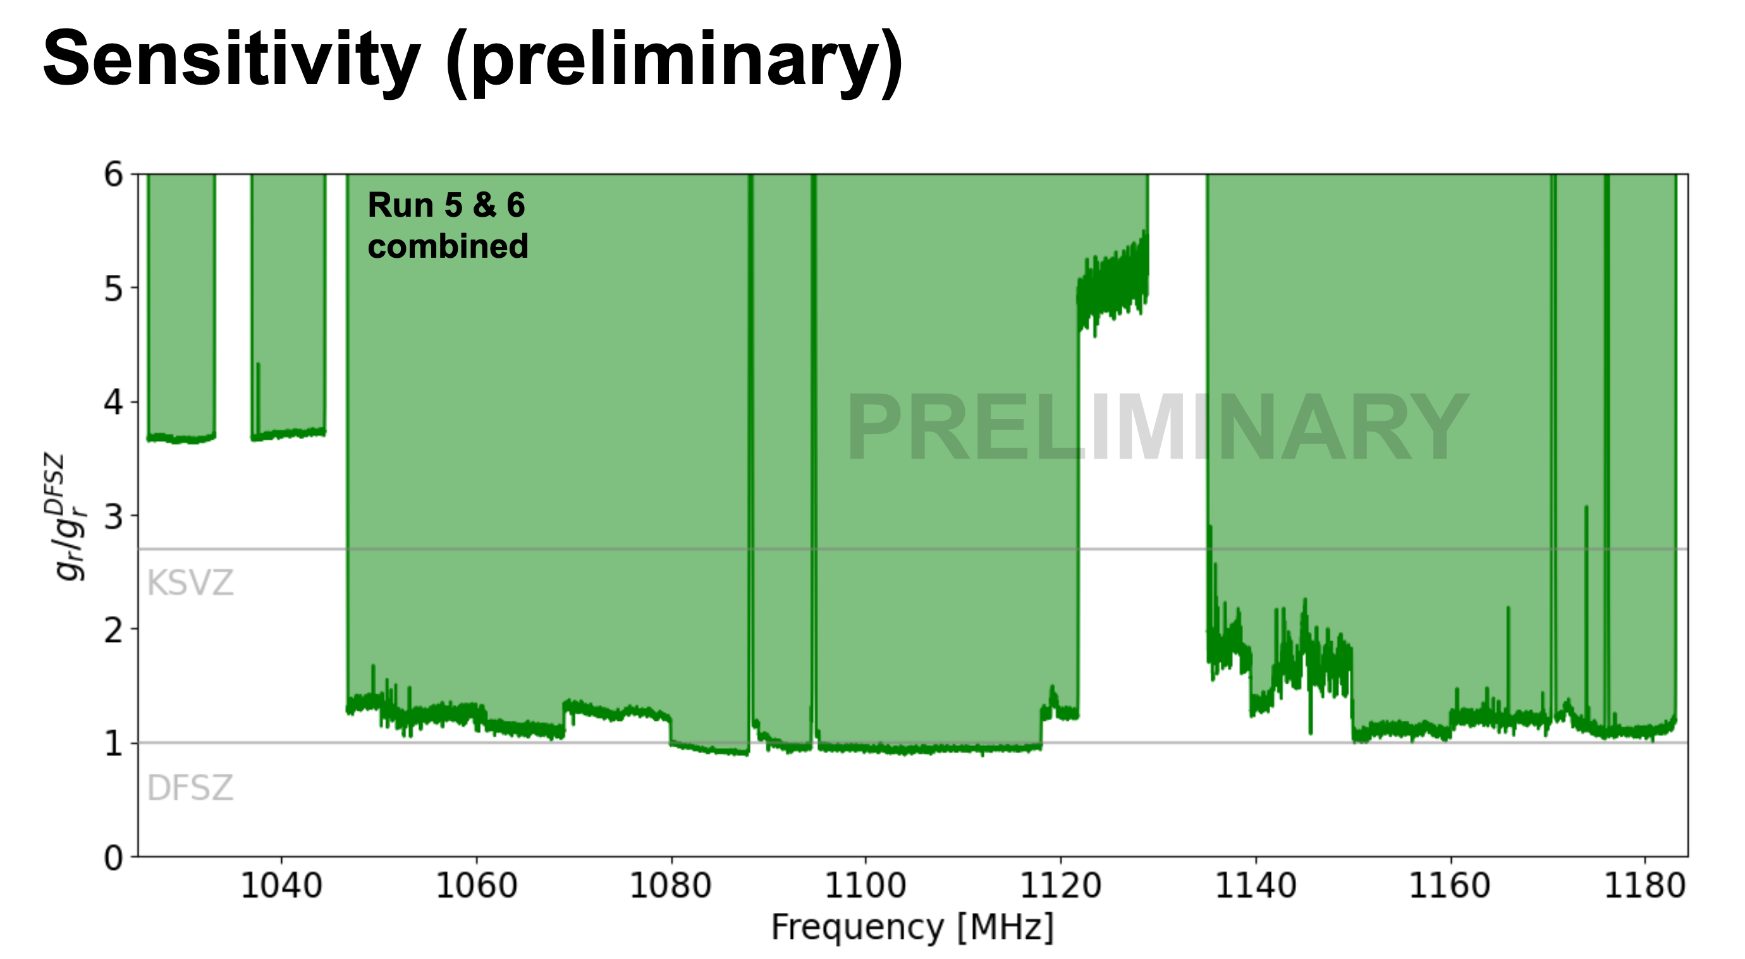
Preliminary sensitivity
CAPP-MAX
First scan: ~20 MHz (4.51~4.59 µeV)
Published in PRL
Second + Third scan: ~58 + 150 MHz scan ~@1 GHz: complete, will publish soon
(Talk by Saebyeok Ahn)
Total system noise temperature
Notes:
Now i have to talk about our r&d efforts.
first, quantum amplifier.
we have a collaboration with prof. nakamura's group in U. of tokyo and riken
who provided about 200 jpa chips in the range of 1 to 6 GHz.
they were all packaged and characterized at CAPP by Sergey Uchaikin and Andrei Matlashov.
all of them showed excellent noise temperature close to standard quantum limit.
I mentioned that we completed taking axion dark matter data run around 2.3 GHz for about 30 MHz range.
we are presently planning for 6 GHz data run with 6 and 8 cell cavities this year in two dilution ref.
Also preparing to take around 1 GHz data in capp-12tb main experiment (summer of this year).
Very wideband travelling wave jpa test is in line, waiting for samples from INFN, Italy and Lancaster U. of UK.
Ultimately we would like to go beyond 10 GHz with single photon detector.

Slide 24
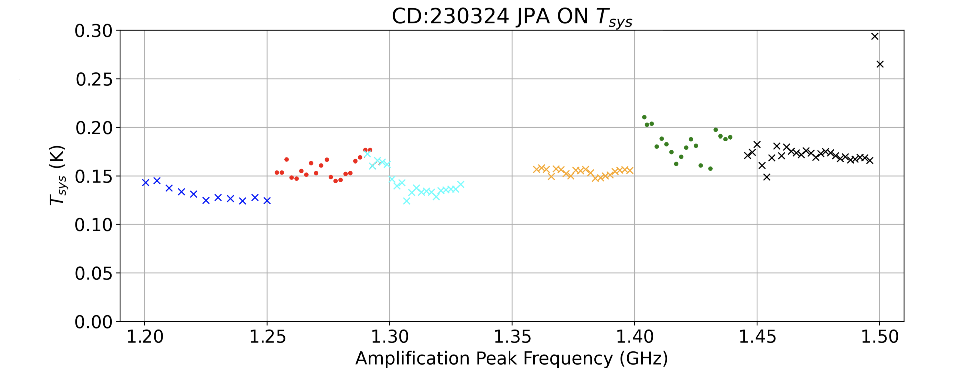
CAPP-MAX
Fourth scan: ~300 MHz (1.200 – 1.500 GHz) about to begin
  Preparing 6 JPAs : T_{sys} < 200 mK → > 3 MHz / day
  Preparing SC cavities: SC tuning rod in now (Q ~ 120k)
  Speed up more: 36 liter 100% SC cavity will be fabricated by Sep.
Notes:
Now i have to talk about our r&d efforts.
first, quantum amplifier.
we have a collaboration with prof. nakamura's group in U. of tokyo and riken
who provided about 200 jpa chips in the range of 1 to 6 GHz.
they were all packaged and characterized at CAPP by Sergey Uchaikin and Andrei Matlashov.
all of them showed excellent noise temperature close to standard quantum limit.
I mentioned that we completed taking axion dark matter data run around 2.3 GHz for about 30 MHz range.
we are presently planning for 6 GHz data run with 6 and 8 cell cavities this year in two dilution ref.
Also preparing to take around 1 GHz data in capp-12tb main experiment (summer of this year).
Very wideband travelling wave jpa test is in line, waiting for samples from INFN, Italy and Lancaster U. of UK.
Ultimately we would like to go beyond 10 GHz with single photon detector.

Slide 25
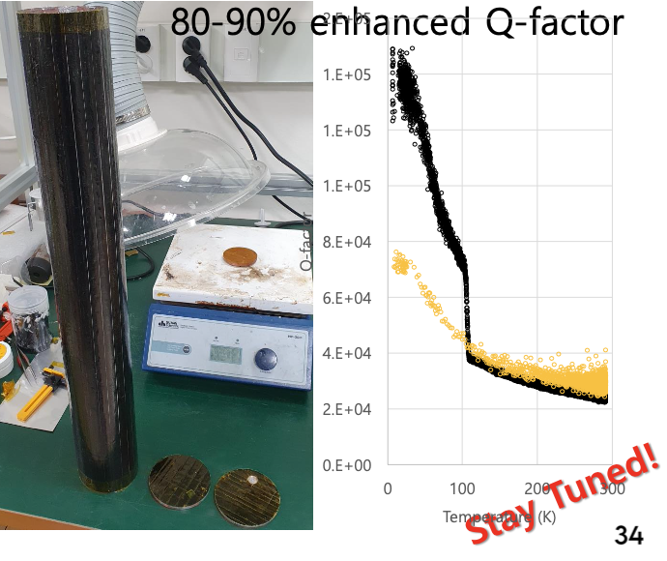
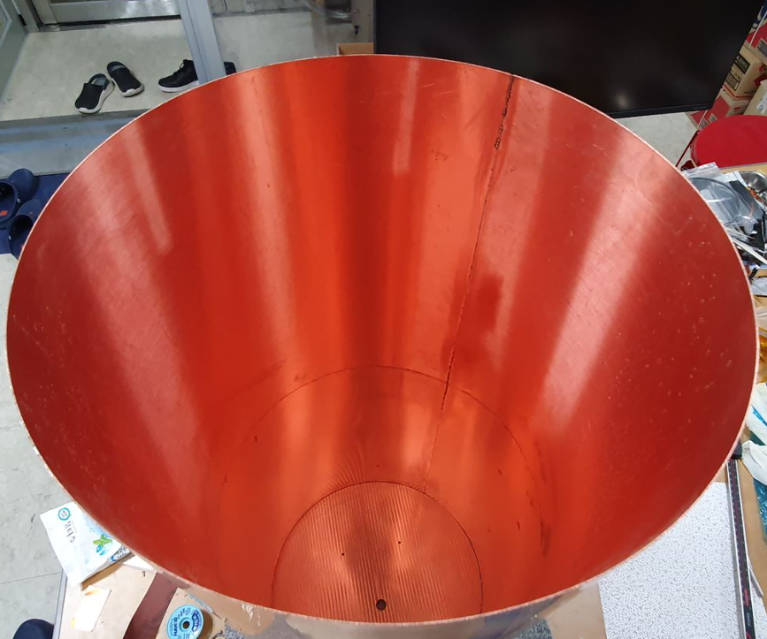
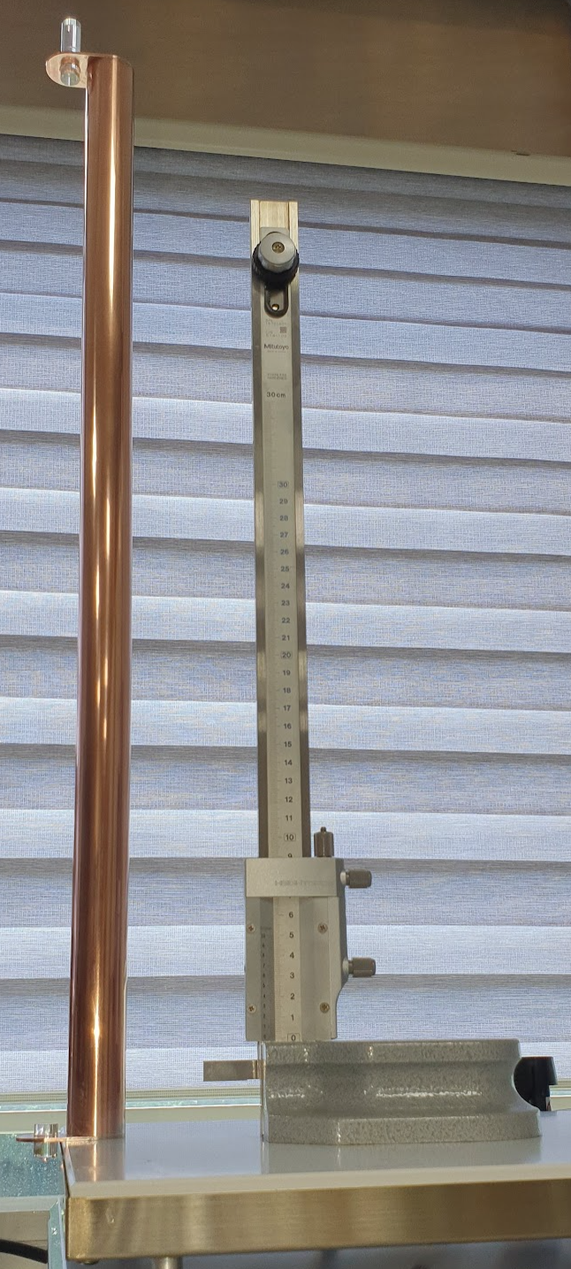
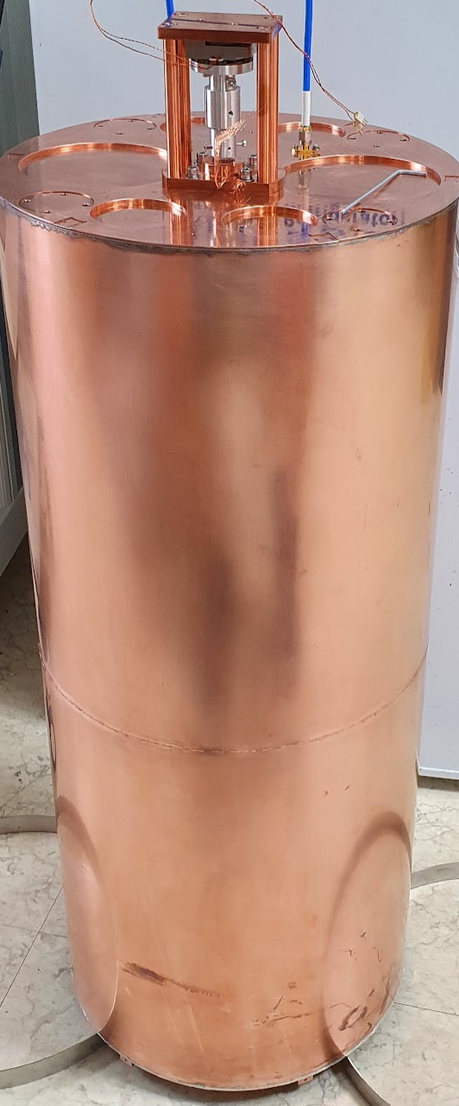

Ultra-Light Cavity (ULC) for CAPP-MAX
Designed for CAPP-MAX
  37 liters with <5 kg weight
  Tuning rod works with a piezo-actuator (no gear box)
  Q₀ : 120k – 85k
  Easy to thermalize and ready for superconducting cavity
0.5mm thickness

Slide 26







CAPP’s setup for physics runs with JPA
Superconducting Cavity (Q ~ 500k) + JPA Physics run
→ > 150 times faster scan (0.5 MHz/day for KSVZ)
By Jinsu Kim
Cavity | JPA | Experiment
Normal Cu cavity | 2.3 GHz JPA | CAPP-PACE + 2.3 GHz JPA ~30 MHz scan with ~2*KSVZ
6-cell cavity | 5.7 GHz JPA | CAPP-PACE + 6.0 GHz JPA + 6-cell Cavity ~80 MHz scan with ~2*KSVZ
8-cell cavity | 5.8 GHz JPA | CAPP-8TB + 6.0 GHz JPA + 8-cell Cavity > 100 MHz scan with KSVZ
SC cavity | 2.2 GHz JPA | CAPP-PACE + 2.3 GHz JPA +SC Cavity ~25 MHz scan with KSVZ (Sapphire tuning)
ULC cavity | 1.1 GHz JPA | CAPP-MAX + 1.1 GHz JPA +ULC >20 MHz scan with DFSZ
Completed
Running

Slide 27



Axion Experiments at CAPP
By 2024
2020
+
+
+
CAPP-MAX + JPA + SC cavity + HF
12T LTS magnet working as expected
Ultra-light Cu (later SC) cavity of 37 liters for now
Physics data (w/ 1 GHz JPA)
$∆$f ~ 1 GHz (w/ JPA) /year for DFSZ sensitivity
Superconducting Cavity: maybe this year
High frequency R&D in progress
Notes:
but real power house in coming to town this summer.
when capp-12tb is equipped with standard quantum noise limited jpa and huge volume cavity,
we should be able to play a major role in global axion research scene.
our first commissioning run will be with 1 GHz jpa and when it reaches the SQL, we should be able to scan about 1 GHz per year.
other critical path is to use this detector for higher frequencies without sacrificing the volume which is one of our r&d focus.

Slide 28

Axion Experiments at CAPP
Future
2020
+
+
+
Notes:
if we combine our r&ds on quantum amplifier, superconducting cavity and multi-cell cavity,
we should be able to scan 1 to 8 GHz range of possible QCD axion band with dfsz sensitivity in coming 5 years.

Slide 29
CAPP’s Winning Strategy
Objective: pinpointing axion mass (discovery) in mass range 1-10 (near future) and 10-100 GHz (requires more R&D)
Scanning Speed is the key to cover the possible axion mass range, asap
Required Technology: cryogenics + big & powerful magnet, quantum noise limited amplifiers and high Q-factor superconducting cavity
CAPP is equipped with everything required now (plus multiple fridges) and ready to race!
CAPP’s advantage:
  Powerful Flagship exp. w/ 12T-32cm SC magnet + 4 dry dilution refrigerators
  Achieved the lowest system noise temperature ( < 200 mK) among existing experiments
  Physics data w/ HTS superconducting cavities (> 10 times boost) (new gen. SC cavity shows >10M Q-factor even under 8T field)
Notes:
in summary
CAPP has successfully established multiple haloscope axion dark matter experiments in Korea.
Within this year we would like to run with the combination of jpa and sc cavity.
Major improvement is expected with our flagship capp-12tb for next 5 years.
Thank you very much!

Slide 30
Summary
CAPP has successfully established multiple haloscope axion dark matter experiments in Korea, the best axion research facility in the world
Through R&Ds we are ready to speed up our axion search and presently, we are collecting data with DFSZ sensiitiivity for axion dark matter search in our flagship experiment, CAPP-MAX
HTS SC cavity in all our Haloscope
Major improvement is expected with CAPP-MAX for next 5 years
QA + SC + HF (1-10 GHz)
Stay tuned!
Notes:
in summary
CAPP has successfully established multiple haloscope axion dark matter experiments in Korea.
Within this year we would like to run with the combination of jpa and sc cavity.
Major improvement is expected with our flagship capp-12tb for next 5 years.
Thank you very much!

Slide 31
Thank You For Your Attention!

Slide 32

CAPP’s Axion Research
Axion Research at CAPP
CULTASK (Haloscope)
CAPP/CAST
ARIADNE & GNOME
CAPP-12TB
CAPP-8TB
CAPP-18T
CAPP-HF
CAPP-PACE
CAPP-MAX

Slide 33

Discovered by WC in Bogota, Colombia (Sep. 14th, 2018)
Notes:
From dimensional analysis

Slide 34

Axion & Dark Matter
Axion is an excellent (and attractive) dark matter candidate
  Pseudo Goldstone Boson
  Extremely Weakly Interacting
  Small Mass (1μeV<m_{a}<10meV)
  Local Halo Density of 0.45 GeV/cm³
Notes:
Axions are extremely weakly interacting goldstone bosons with a small mass and move as slowly as classical particles, thousandth of the speed of light.
Theorist couldn’t pinpoint the mass of the axion, leaving us the huge range of masses we have to scan,
We adopted the detection scheme by Prof. Sikivie (haloscope) which is, to date, the most sensitive one.
In this scheme, we are detecting photons converted from axions in a very strong magnetic field.

Slide 35
Global Trend in Axion Research
Axion solves both strong CP problem and a dark matter puzzle
Two most popular dark matter candidates: Axion and WIMP, but axion is gaining momentum compared to WIMP
Presently, there are >30 axion experiments worldwide with front-runners including
Notes:
Axions are extremely weakly interacting goldstone bosons with a small mass and move as slowly as classical particles, thousandth of the speed of light.
Theorist couldn’t pinpoint the mass of the axion, leaving us the huge range of masses we have to scan,
We adopted the detection scheme by Prof. Sikivie (haloscope) which is, to date, the most sensitive one.
In this scheme, we are detecting photons converted from axions in a very strong magnetic field.

Slide 36


Haloscope
Conventional axion haloscope technique consists of a high-Q microwave cavity inside a homogeneous magnetic field to trigger the conversion of DM axions into photons.
P. Sikivie, \Experimental tests of the invisible axion," Phys. Rev. Lett. 51 (1983) 1415 . 6 , 53 , 61 , 63
Running Axion Experiments (Haloscope)
ADMX
HAYSTAC
CULTASK
QUAX

Slide 37
OUTLINE
Introduction
  Dark Matter Axion and Detection Scheme
Status of Axion Experiments at CAPP
  CULTASK (CAPP’s Ultra Low Temperature Axion Search in Korea)
  Physics data
Improvements/Innovations
  Quantum noise-limited JPA
  HTS superconducting cavity
  Higher frequency w/o losing volume
Summary
Notes:
This is the outline of my talk.
In introduction, I will briefly talk about dark matter axions and how we are going to detect them.
And then, I will show how we established multiple axion detectors at CAPP
and how we’ve started collecting our physics data with our detectors.
We call our axion search program, CULTASK.
In the second part, I will go over our R&D efforts, especially, quantum amplifiers and superconducting cavity development.
And how we are going to speed up our axion search through these R&Ds.

Slide 38









Josephson Parametric Amplifier (JPA)
Kutlu et al SUST (2022)
Total Added Noise (K)
Gain (dB)
SC run total system noise
171 ± 15 mK, 1.56 QNL
SQUID ($L=∂Φ/∂I$)
as Variable Inductor
$10 μ$m
JPA is Josephson junction based quantum-noise-limited amplifier
CAPP Flux-driven JPA was developed in collaboration with Nakamura group at Univ. of Tokyo and RIKEN
Operation range: 2.27 GHz – 2.30 GHz
JPA was protected by two layer superconducting shield (shielding factor: roughly 1,500)
Total system noise temperature
$$T_{JPA,idler}=T_{cav}=\frac{hν}{k_{B}}\left(\frac{1}{e^{hν/k_{B}T_{phy}}−1}+\frac{1}{2}\right)$$
Noise from cavity
JPA irreducible noise in the phase-insensitive operation
$$T_{sys}=T_{cav}+T_{add}, T_{add}=\left(T_{JPA,idler}+T_{JPA,irr}\right)+\frac{T_{postJPA}}{G_{JPA}}$$
Added noise generated
in the post-JPA chain
Total system noise
Chain added noise
JPA added noise from idler photon
JPA Gain
Notes:
0.5 flux quanta shielding factor 만으로도 fluctuation이 많이 줄어든다 실험 환경에서 괜찮았음

Slide 39

HTS Microwave Cavity Design Simulation
Gap
Only an evanescent field
enters into the gap
J_{TM010}
J_{TM010}
Normalized Surface Loss (Ω⁻¹)
Normalized Magnetic Field Square (Ω⁻¹)
Normalized Magnetic Field Square (Ω⁻¹)
Surface current direction is parallel to the in-plane direction of gaps.
Only evanescent field enter into a gap.
Misalignments are considered based on fabrication error.
  Gap geometry: Gap tilting, Step between superconducting main surfaces
  Surface Condition: Metal on the gap sides (R_{side}, Ag), Defects on the main surface (R_{def}, Ni-9W).

Slide 40

N Gaps Do Not Degrade Q_{TM010}
Gap
Only an evanescent field
enters into the gap
J_{TM010}
J_{TM010}
Normalized Surface Loss (Ω⁻¹)
Normalized Magnetic Field Square (Ω⁻¹)
Normalized Magnetic Field Square (Ω⁻¹)
N gaps do not degrade Q factor
less than axion Q factor (10⁶)
Surface defect can degrade Q factor less than 10⁶

Slide 41

2.3 GHz HTS Superconducting Cavity for Axion Haloscope
2.3 GHz HTS Cavity
  Q ~ 500,000 at 8 T (THEVA GdBCO Tape, 1.5 L)
Q₀ ~ 500,000 at 8 T
Notes:
이후 액시온 실험에 사용하기 위해 더 큰 캐비티를 제작하였고 8t에서 50만을 달성하였습니다.

Slide 42


2.3 GHz HTS Superconducting Cavity for Axion Haloscope
2.3 GHz HTS Cavity
  Q ~ 3,700,000 at 8 T (Fujikuira EuBCO Tape, 1.5 L)
Q₀ ~ 500,000 at 8 T
Notes:
이후 액시온 실험에 사용하기 위해 더 큰 캐비티를 제작하였고 8t에서 50만을 달성하였습니다.

Slide 43

13 million Q-factor HTS Cavity
Q ~ 1.3e7 @ 8 T
TM010
TM011
The result shows that HTS cavity can reach 10 times larger than axion quality factor (~ 10⁶)
If we use next generation cavities, the scan rate will be more than 50 times bigger than copper cavities
CAPP is also planning to construct 36 liter HTS cavity for CAPP-MAX

Slide 44

CAPP-MAX
Third scan: ~150 MHz (1.035 – 1.185 GHz) complete
Will publish soon
Notes:
Now i have to talk about our r&d efforts.
first, quantum amplifier.
we have a collaboration with prof. nakamura's group in U. of tokyo and riken
who provided about 200 jpa chips in the range of 1 to 6 GHz.
they were all packaged and characterized at CAPP by Sergey Uchaikin and Andrei Matlashov.
all of them showed excellent noise temperature close to standard quantum limit.
I mentioned that we completed taking axion dark matter data run around 2.3 GHz for about 30 MHz range.
we are presently planning for 6 GHz data run with 6 and 8 cell cavities this year in two dilution ref.
Also preparing to take around 1 GHz data in capp-12tb main experiment (summer of this year).
Very wideband travelling wave jpa test is in line, waiting for samples from INFN, Italy and Lancaster U. of UK.
Ultimately we would like to go beyond 10 GHz with single photon detector.

Slide 45
First, I would like to thank the organizers to have me in this wonderful place.
My name is Woohyun Chung, working for IBS and director Yannis at CAPP,
overseeing CAPP’s axion program CULTASK.
My talk is about the progress of CAPP’s CAPP-MAX experiment that has recently reached DFSZ sensitivity.
Which is such an accomplishment to celebrate, but I still remember what my advisor said when I had my ph.D.
“It’s like getting a black belt in Taekwondo. Now you are ready to explore.”
We got here in such a short time, but with whole lot of effort and dedication to innovate.
Our R&Ds made it possible to accomplish all these milestones, and will make us move forward.
I would like to show you what we have accomplished
And

