Slide 1
The First Dedicated
Axion Quark Nugget Experiment
Using a Haloscope at CAPP
07/06/2023
Introduced by prof. Ariel Zhitnitsky
Jinsu Kim
IBS-CAPP

Slide 2
Table of Contents
Motivation
Axion Quark Nuggets (AQNs)
Properties of AQN
Experiment at CAPP
Summary

Slide 3
Motivation
Many DM axion experiments aim for finding virialized haloaxions
However, there are other axion sources, depending on scenarios
CAST experiment searches helioaxions coming from the Sun
ADMX recently searched for cosmic axion background
Those axions have different density & velocity distribution
Analysis w/ various models = higher chance of finding axion
New CAST limit on the axion–photon interaction. Nature Physics, 2017, 13.6: 584-590.
Nitta, T., et al. "Search for the Cosmic Axion Background with ADMX." arXiv preprint arXiv:2303.06282 (2023).

Slide 4
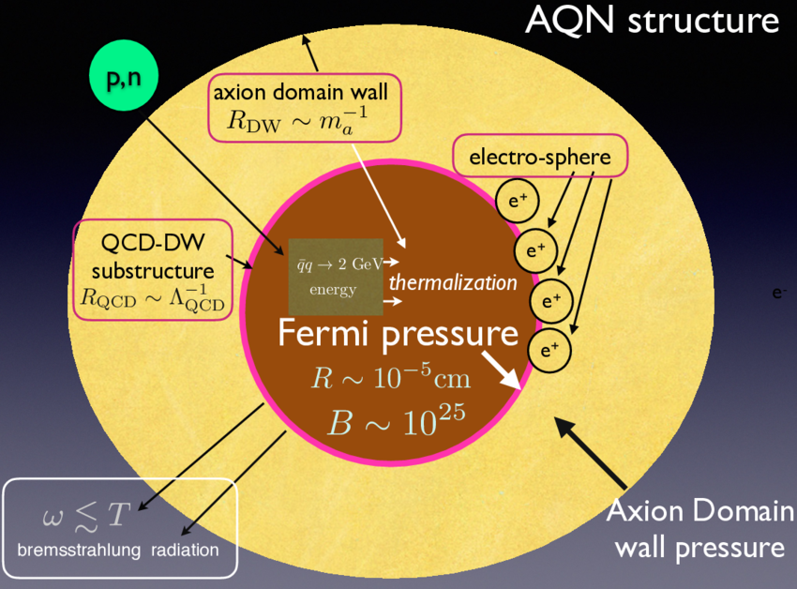
New axionic structure: AQNs
AQNs are dark matter (DM) candidates introduced by prof. Ariel Zhitnitsky
(Anti-)quarks are trapped inside the axion domain wall
AQN is stable enough to be DM
Typical radius of the AQN: R~100 nm
Typical baryon number of the AQN: |B|~$10^{25}$
AQN energy density: same as CDM (Maxwellian)
Axions are expected to be released if the structure collapses
Zhitnitsky, Ariel. "Structure Formation Paradigm and Axion Quark Nugget dark matter model." arXiv preprint arXiv:2302.00010 (2023).
[1] Zhitnitsky, Ariel. "Axion quark nuggets. Dark matter and matter–antimatter asymmetry: Theory, observations and future experiments." Modern Physics Letters A 36.18 (2021): 2130017.

Slide 5
AQN-induced axions
There are several mechanisms for AQNs to be collapsed
The mechanism used at CAPP is based on AQN-Earth pair annihilation^{[1]}
If dark matter AQN passes through Earth, there is a chance of (matter in Earth) - (anti-matter in AQN) annihilation near the laboratory
Axion domain wall disappears, and many axions are released from the wall
AQN-induced axions are now detectable using the haloscopes
[1] Zhitnitsky, Ariel. "Axion quark nuggets. Dark matter and matter–antimatter asymmetry: Theory, observations and future experiments." Modern Physics Letters A 36.18 (2021): 2130017.

Slide 6
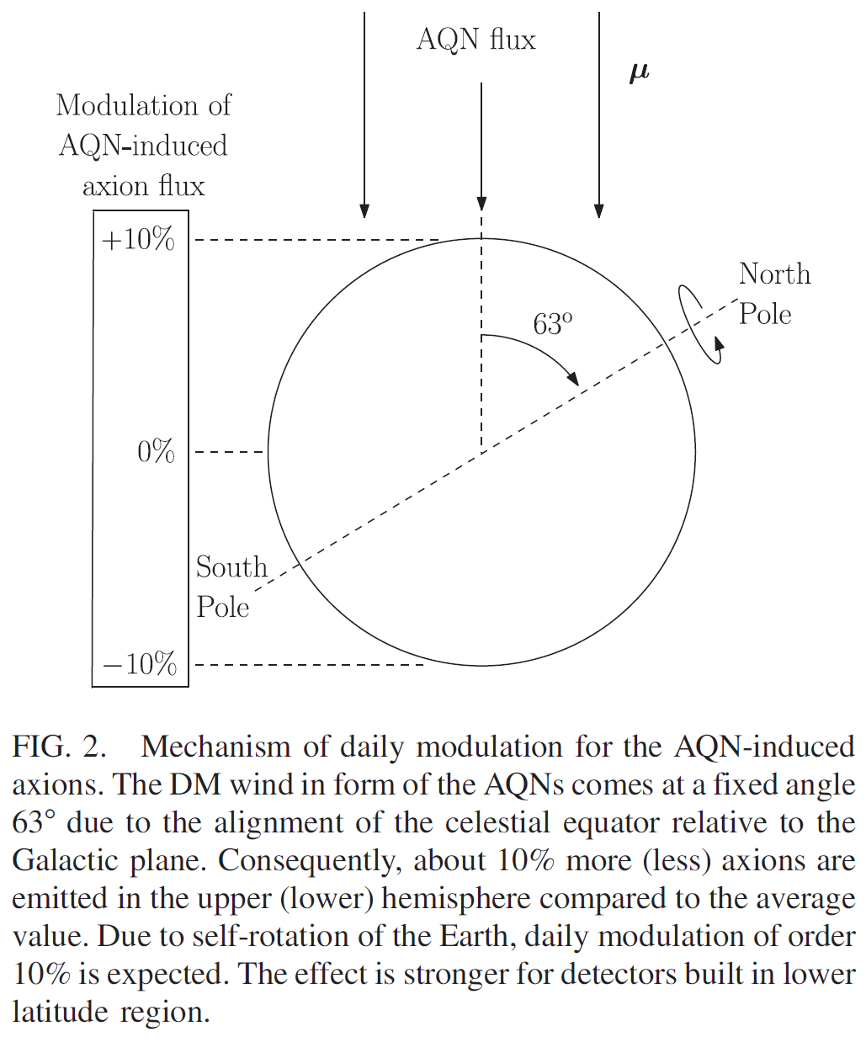
Property 1: daily modulation
DM wind due to the Earth’s rotation
DM wind in oscillation by the Earth spin
Noticeable daily modulation exists (~10%)
South Korea has $δP_{a}≈0.03×P_{a}$
Liang, Xunyu, et al. "Axion quark nugget dark matter: Time modulations and amplifications." Physical Review D 101.4 (2020): 043512.

Slide 7
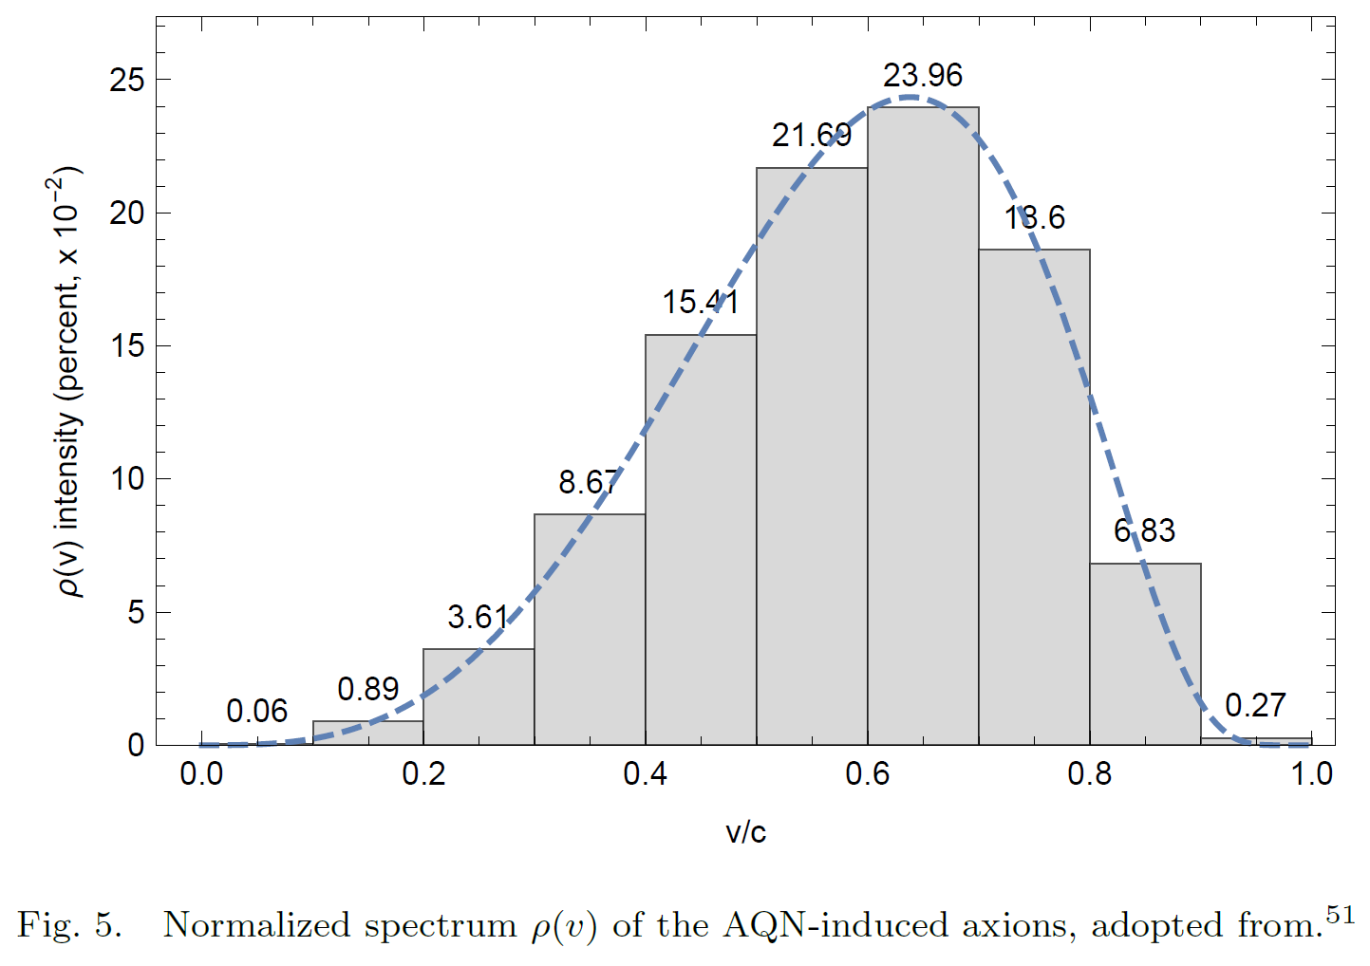
Property 2: broadband axion
If AQNs are dominant dark matter, AQN must be cold according to CDM model
However, AQN-induced axions have different energy distribution, as the potential energy of the AQN can be added to axion kinetic energy
Broadband search is possible (axion is everywhere)
Axions are dispersed broadly ($Q\sim O\left(1\right)$) ^{[1]}
Zhitnitsky, Ariel. "Axion quark nuggets. Dark matter and matter–antimatter asymmetry: Theory, observations and future experiments." Modern Physics Letters A 36.18 (2021): 2130017.

Slide 8
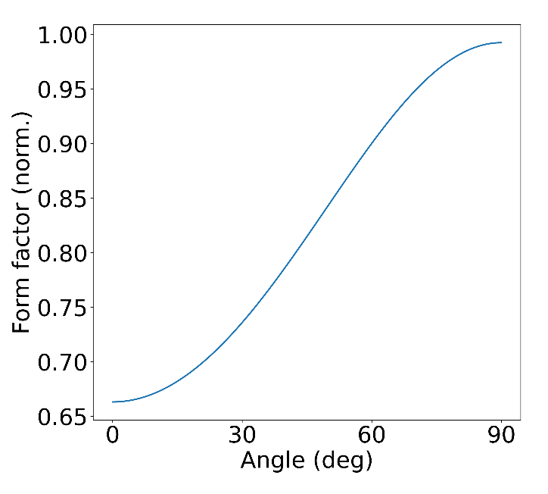
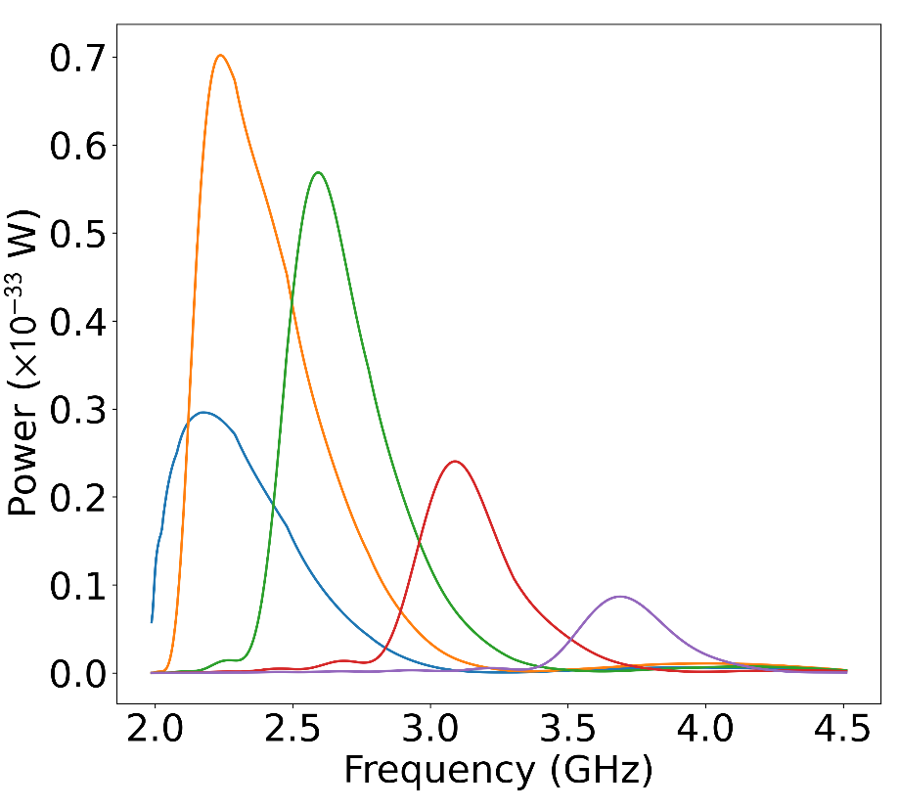
Property 3: new form factor
Most of AQN-induced axions are relativistic
Short wavelength induces spatial dependency
${\vec{E}}_{010}⋅{\vec{B}}_{0}∂_{t}a≠Const.$ → Form factor is dependent on the axion direction
$m_{a}$ = 8.2 ueV
TM010 (2.270 GHz)
TM011 (2.391 GHz)
TM012 (2.720 GHz)
TM013 (3.195 GHz)
TM014 (3.760 GHz)
$$γ$$
$$Θ$$
New Form factor: $C_{010}\left(θ\right)={\left(J_{0}\left(v_{a}ω_{a}ρ_{c}\sin{θ}\right)sinc\left(2v_{a}ω_{a}Lcos θ\right)\right)}^{2}$
$$a$$
$${\vec{E}}_{010}$$

Slide 9
Challenges of AQN experiments
Daily modulation amplitude is about 3% of the conversion power
AQN-induced axions lose CDM Q factor advantage: $O\left({10}^{−6}\right)$
Averaged form factor is smaller than non-relativistic axions: $O\left({10}^{−1}\right)$
Boost of the axion signal is necessary

Slide 10
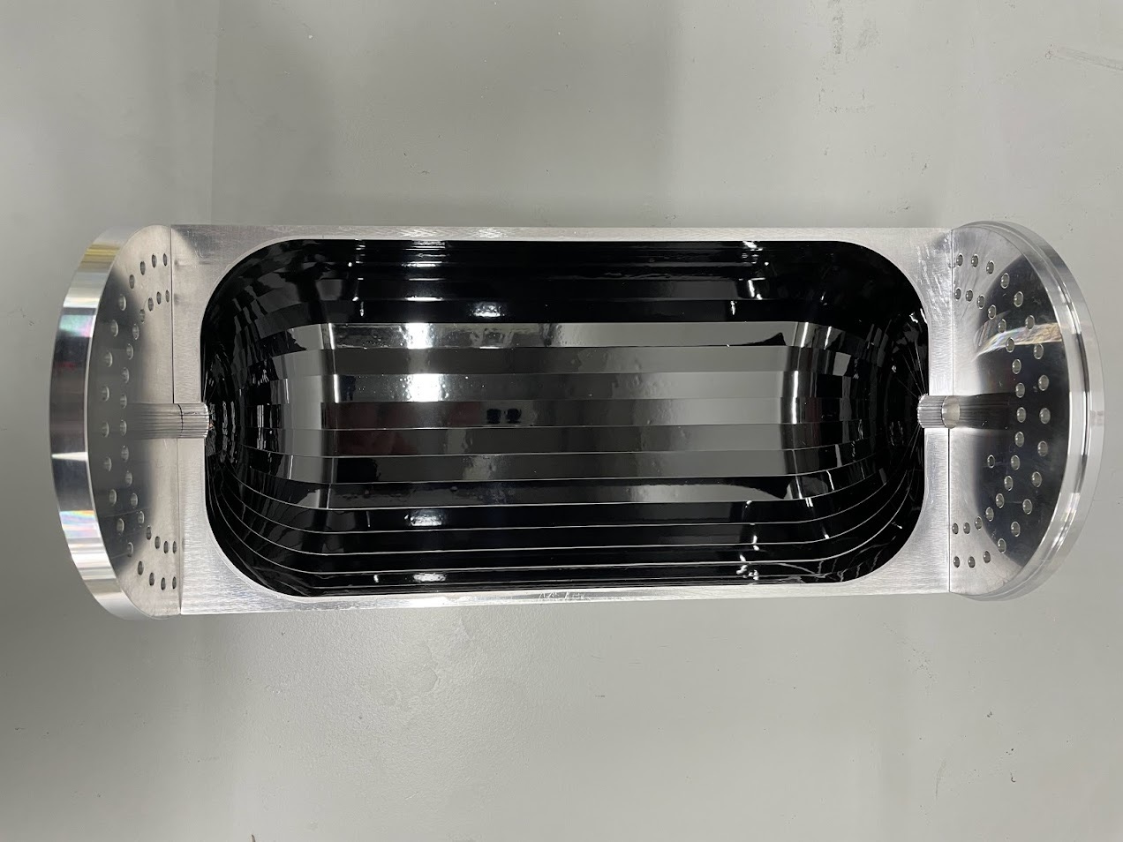
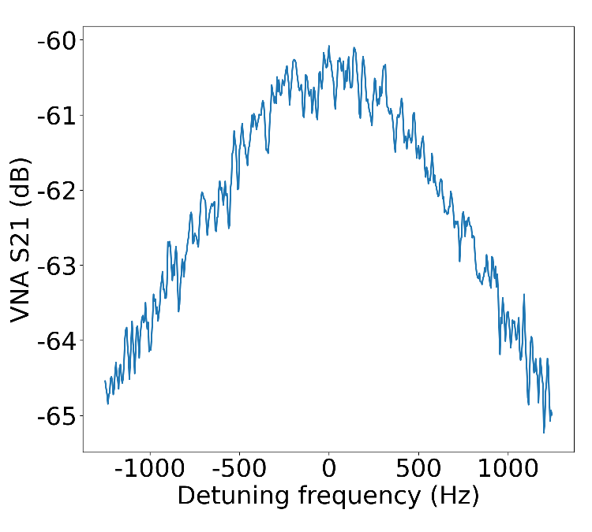
AQN experiments at CAPP
CAPP recently launched an AQN experiment using the haloscope
SC taped cavity, developed by CAPP SC team, is implemented
$$Q_{L}\sim 1.2 M @ 8 T$$
$$β\sim 0.5$$
$$→Q_{0}\sim 1.8 M ‼$$
Dr. Danho Ahn’s talk

Slide 11
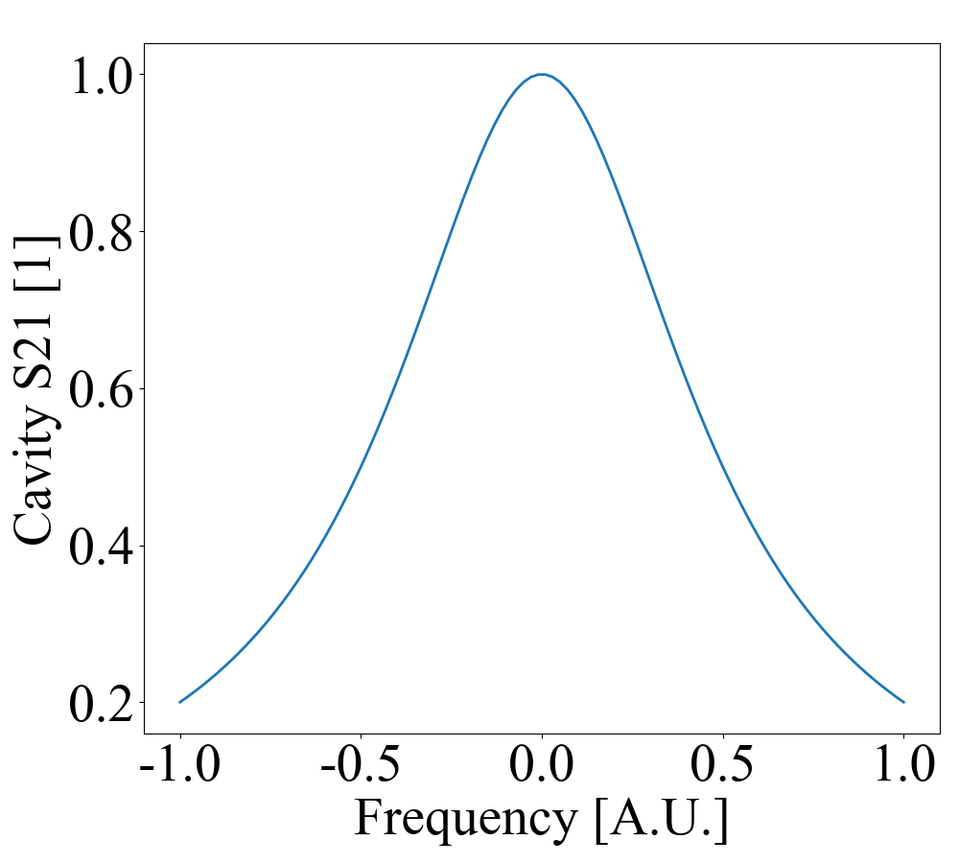
Conversion power of high-Q cavities
Let’s consider a non-tunable cavity with $Q_{c}≥Q_{a}$
Only small portion of the axion energy is converted to photons
However, high-Q means less resistance, increasing steady power
For Lorentzian signal, two effects cancels each other, leaving $P_{a}∝Q_{a}$^{[1]}
Less loss
Cavity bandwidth
Axion bandwidth
Detuning
[1] Kim, Dongok, et al. "Revisiting the detection rate for axion haloscopes." Journal of Cosmology and Astroparticle Physics 2020.03 (2020): 066-066.

Slide 12
Noise & SNR of high-Q cavities
Then why do we have to use SC cavity?
Copper cavity is already $Q_{c}≫Q_{a}\sim O\left(1\right)$
However, the noise power inside the cavity bandwidth is reduced
$δP_{n}=\frac{kTΔf_{c}}{\sqrt{Δf_{c}Δt}}∝1/\sqrt{Q_{c}}$ (Nyquist theorem)
Figure of merit$={\left(\frac{P_{a}}{δP_{n}}\right)}^{2}Δf_{scan}∝Q_{c}Q_{a}^{2}×Δf_{a}∝Q_{c}Q_{a}$
The higher Q factor, the better scanning speed

Slide 13
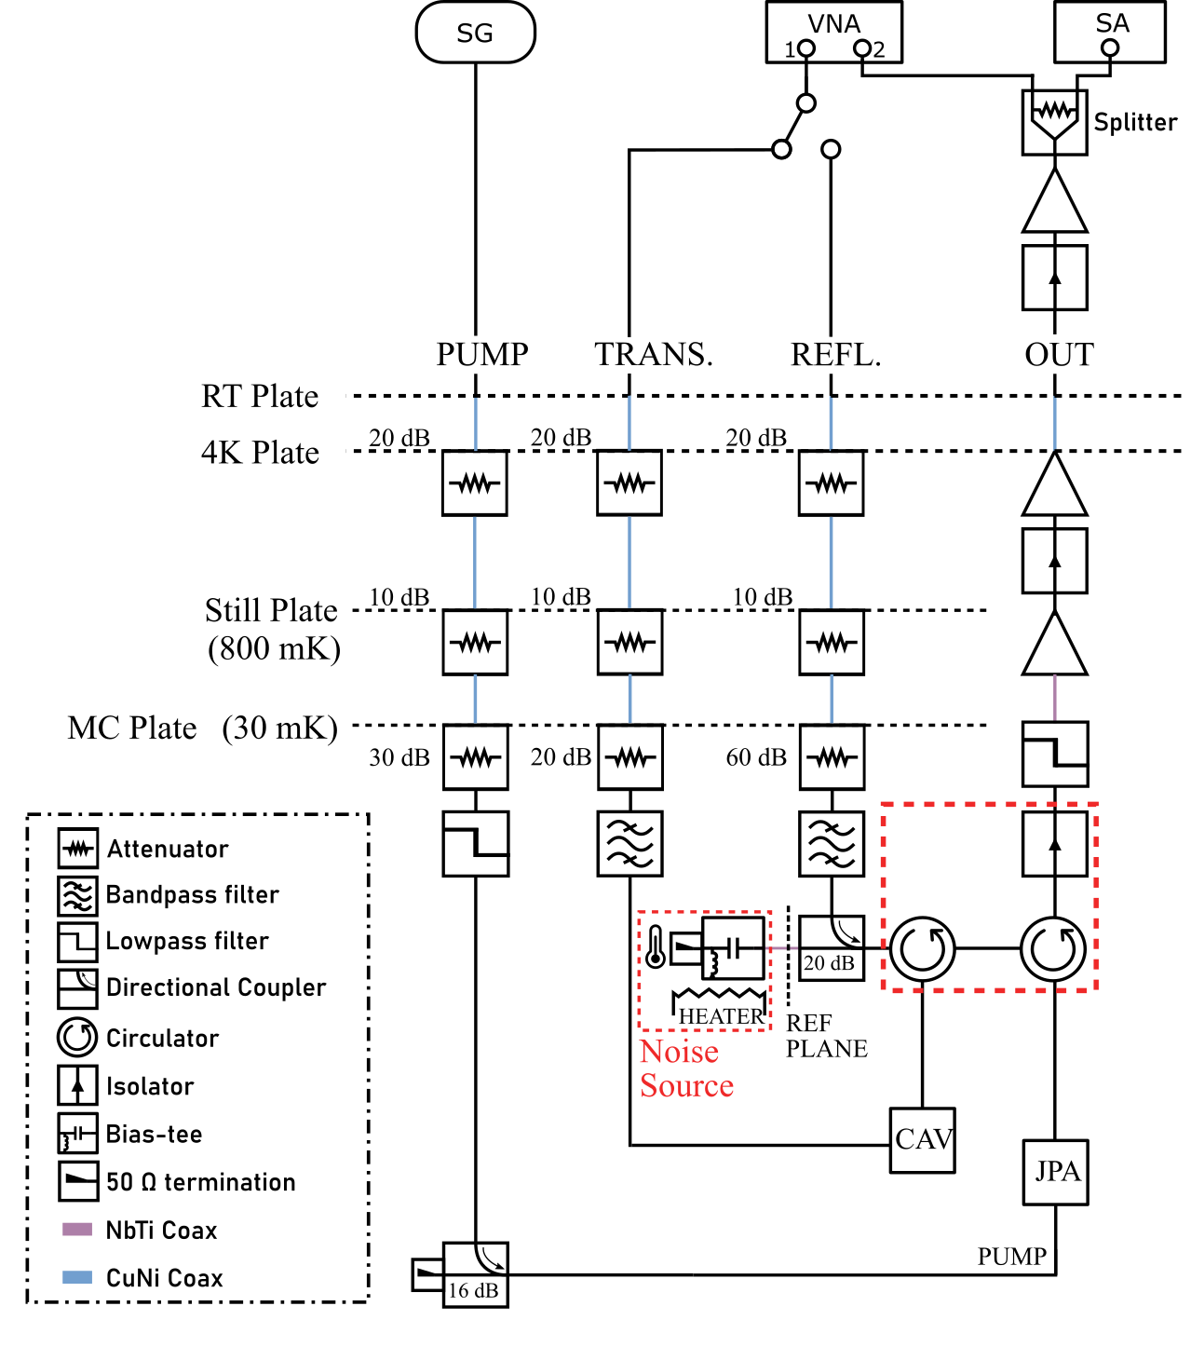
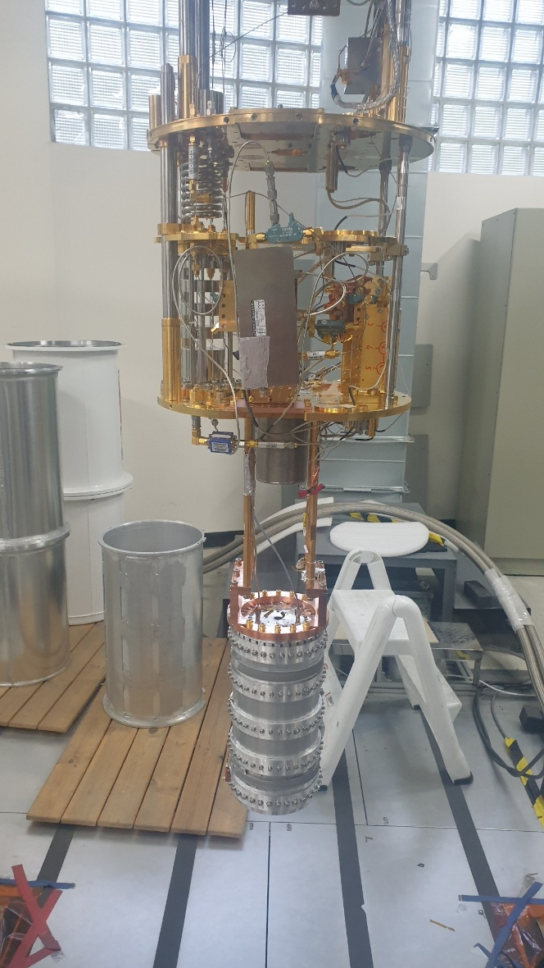
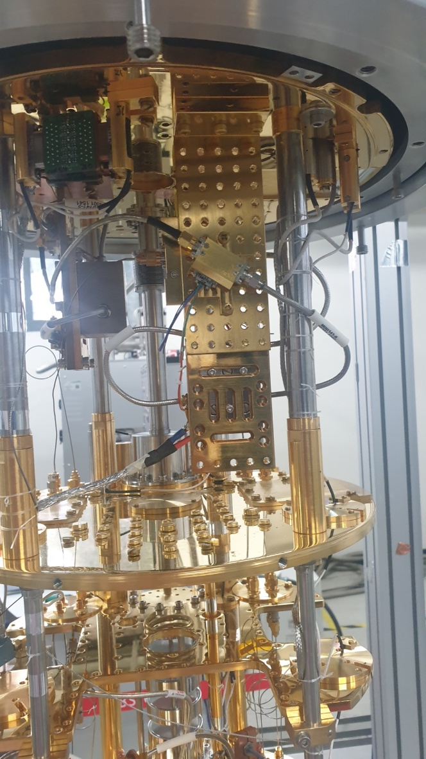
Experimental setup

Slide 14
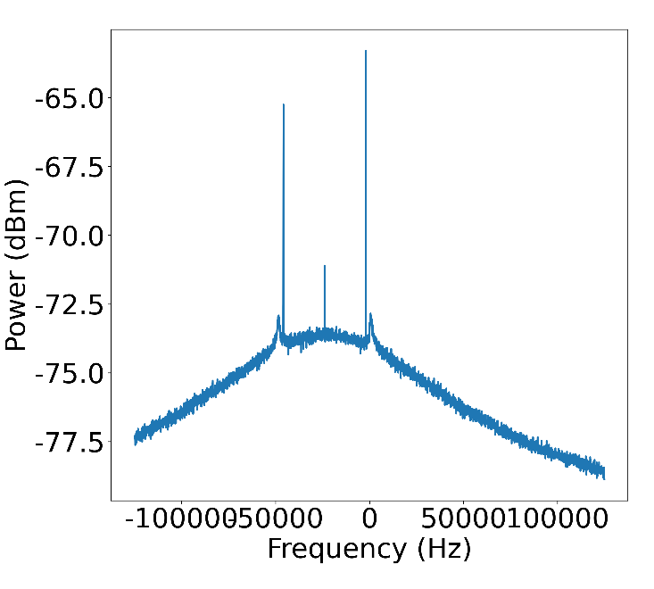
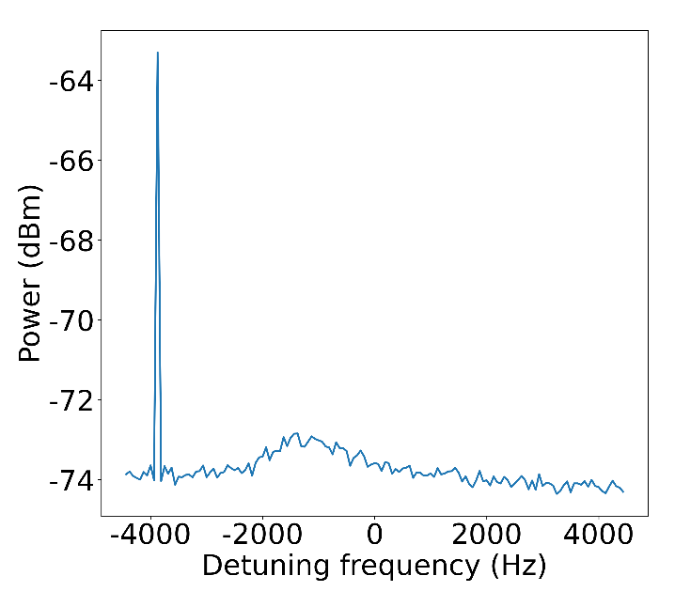
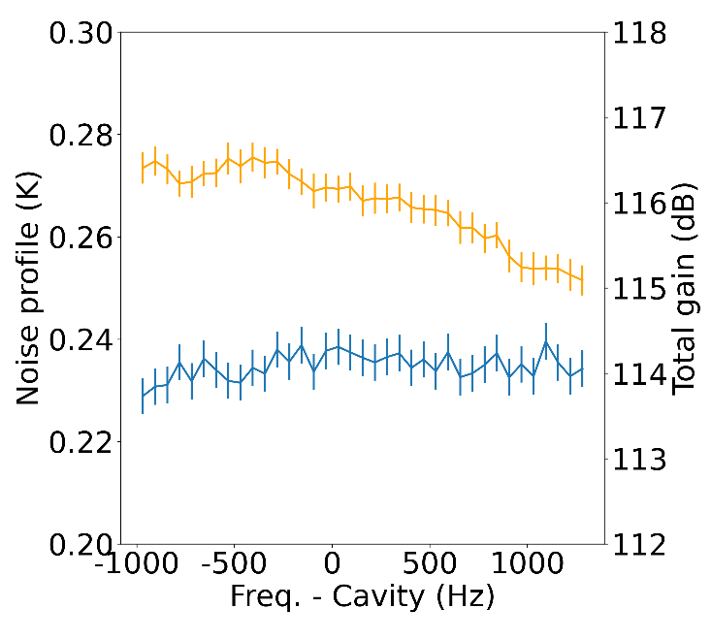
Experimental parameters
Data collected: June 8th ~ (now ongoing)
SC cavity & JPA are implemented to the system
Digitizer w/ 62.5 Hz resolution
Frequency | Loaded Q | Coupling | Volume | B-field | Base | Cavity bottom | JPA gain | Tsys
2,269,455,000 Hz | 1,200,000 | 0.5 | 1.5 L | 8 T | 60 mK | 75 mK | 19.5 dB | 250 mK (2.2 SQL)
Reference
tone
Reference
tone
Idler
Y-factor noise
(absolute meas.)
→ Track using VNA data & reference tone
Artifact

Slide 15
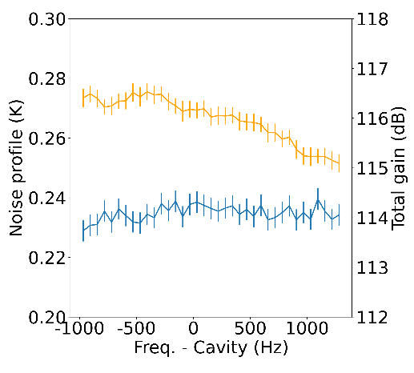
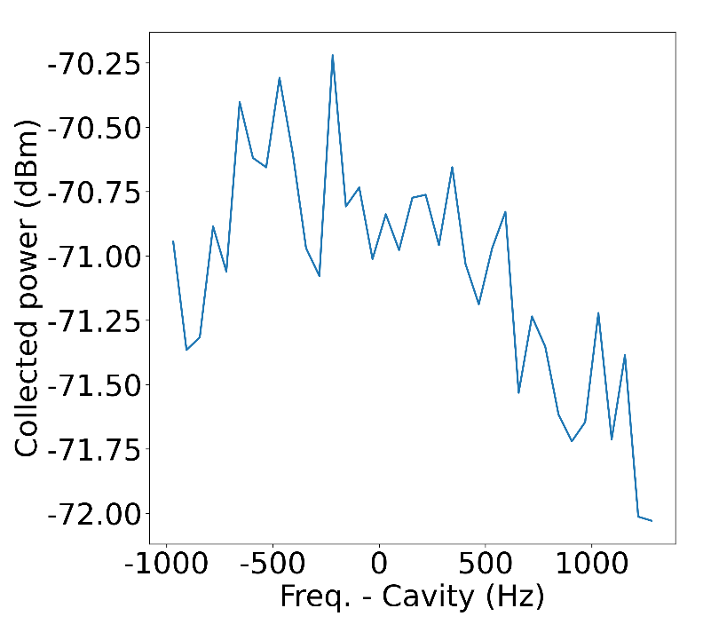
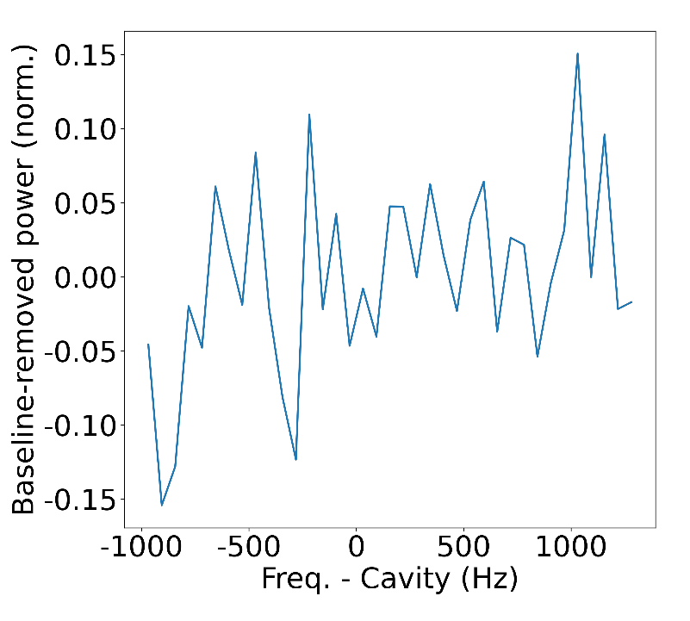
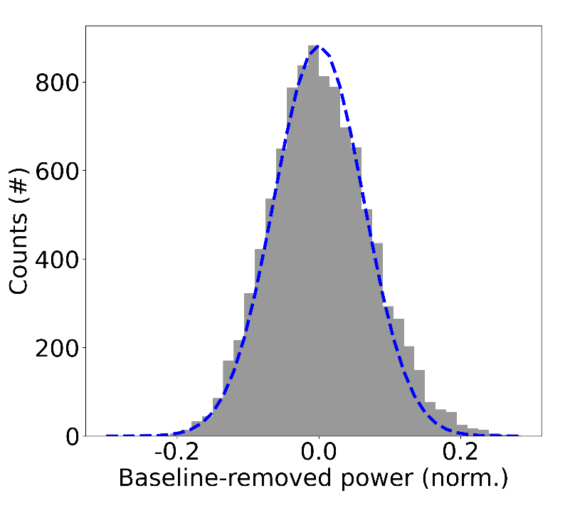
Gain & noise calibration of the spectrum
Histogram of the ‘(left) x 240’
(blue: theoretical statistics by the Nyquist theorem)
Gain & noise calibrated
Raw spectrum
Gain & noise
Reference signal

Slide 16
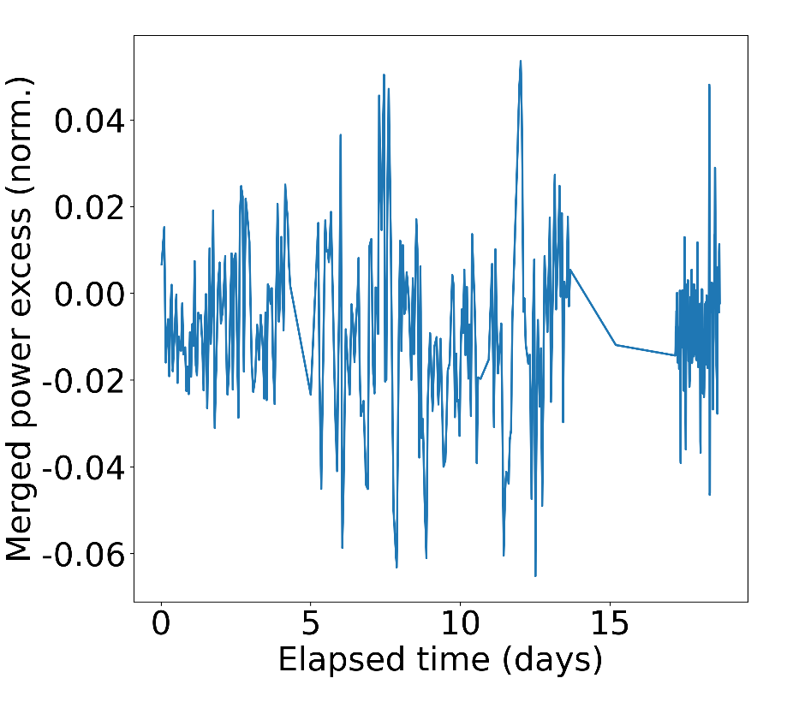
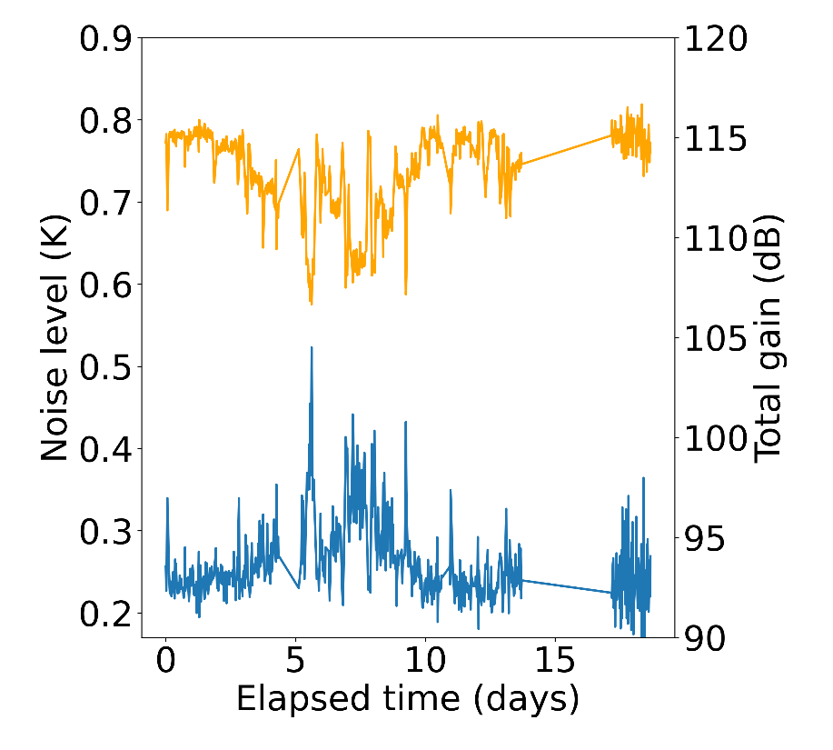
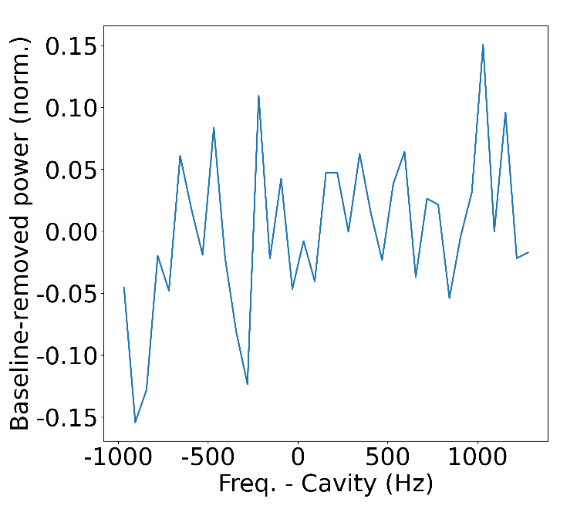
Excess series over time
= JPA adjustment
Merge spectrum
(combination)
Repeat
Single point

Slide 17
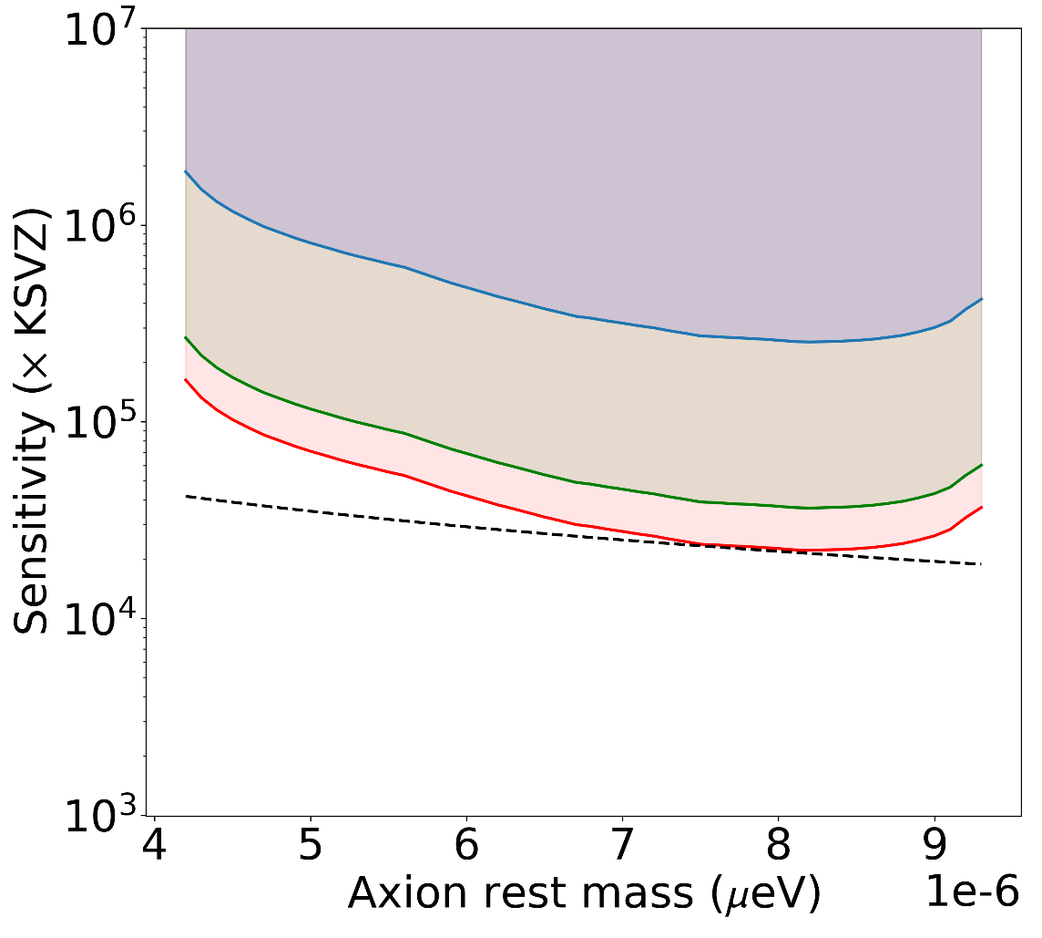
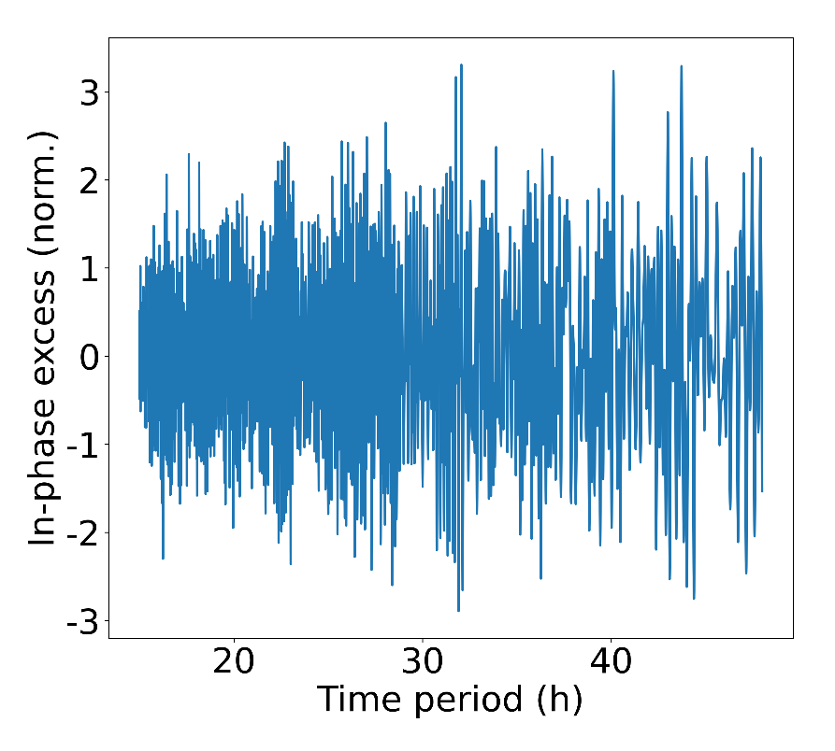
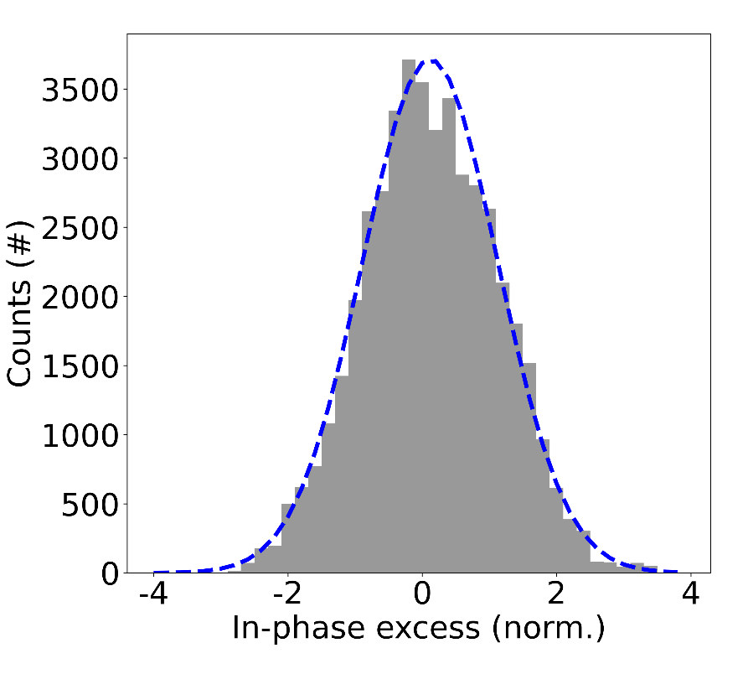
Preliminary results
Until so far (~18 days data), there is no significant 24 hours period signal
The analysis is still ongoing (Bayesian method)
~ 1.3 GHz range!
Preliminary
Blue: fitted
Now (modulation)
DC level + 3% mod.
CAST (2017)
He tuning cav. (Dr. HeeSu Byun)

Slide 18
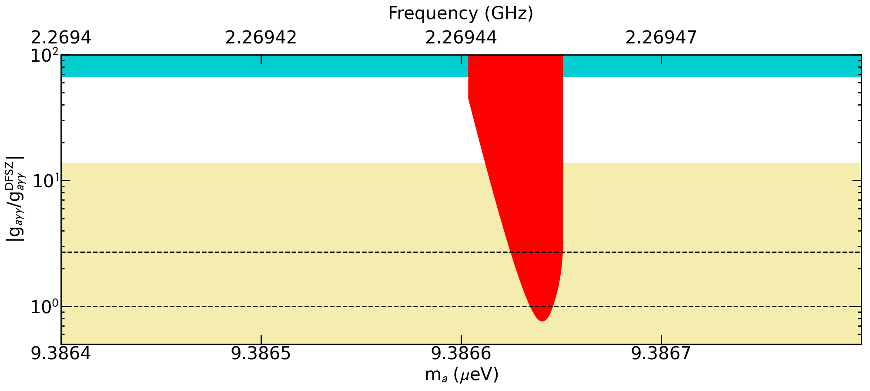
Haloaxion analysis
Haloaxion analysis using the data after 2nd JPA adjustment (~ 16 hours)
< DFSZ sensitivity has been reached
RBF
This work
0.78 x DFSZ
Preliminary
QCD band
KSVZ
x 14,400
DFSZ

Slide 19
Summary
AQN dark matter is the alternative model to the haloaxion dark matter
AQN-induced axions are daily modulating broadband signals
From single haloscope data it is possible to analyze using both models
AQN haloscope experiment is ongoing at CAPP
SC cavity ($Q_{L}\sim 1.2$M) & JPA ($T\sim 250$ mK) are implemented
Analysis is in progress
THANK YOU

