Slide 1
WP4: Access to Research Infrastructures
for Detectors
Marko Mikuž
University of Ljubljana and Jožef Stefan Institute, Ljubljana, Slovenia
WP4 Meeting, Zoom, January 30th 2023

Slide 2
Today’s Meeting
We are end of M5 of the project !
TA start-up
Experience, questions, problems
Round the table reports from all RI’s
Service improvements
A look at the milestones and deliverables
A.O.B.

Slide 3
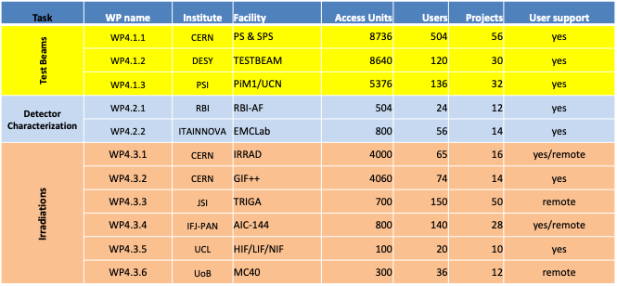
WP4.1-3 Deliverables
Each RI delivers Access Units (~beam hours) to Projects with Users
Two access modalities: physical/remote access
Physical: users at RI (user support)
Remote: users send samples to RI (handling, shipment)

Slide 4
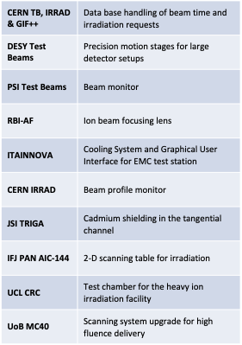
WP4.4 Service Improvements
Aimed at improving access to RI for EURO-LABS
Each RI proposed improvements with maximum impact on user access
Improvements have to be ready in Y2 of the project
EC contributions are matched by RI’s own funding, typically exceeding EC

Slide 5
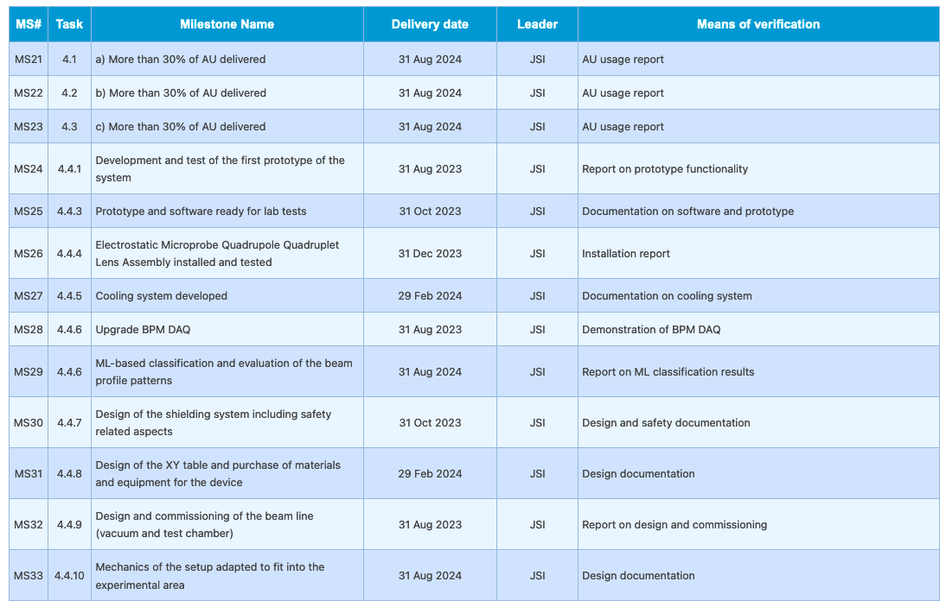
WP4 - Milestones
TA - M24
SI – M12 – M18 – M24
All deliverables (1 TA, 3 SI) in M46

Slide 6
User Selection Panel for TA in WP4
RD50->DRD3 (Solid): Gianluigi Casse (Univ. Liverpool) <gcasse@hep.ph.liv.ac.uk> RD51->DRD1 (Gas): Eraldo Oliveri (CERN) <Eraldo.Oliveri@cern.ch> RD53->DRD7 (Electronics): Mohsine MENOUNI (CPPM Marseille)<menouni@cppm.in2p3.fr> LHC experiments: Anna Macchiolo (Univ. Zurich) Anna.Macchiolo@cern.ch DRD6(Calorimetry): to be nominated (2023, when proto-collaboration formed) WP4.1: Eva Barbara Holzer (CERN) <Barbara.Holzer@cern.ch> WP4.2: Fernando Arteche (Itainnova) <farteche@itainnova.es> WP4.3: Michael Moll (CERN) <Michael.Moll@cern.ch> WP4: Marko Mikuz (Univ. Ljubljana & JSI) <Marko.Mikuz@cern.ch> (Chair)

Slide 7
Acceptance Procedure for TA in WP4
0) There might be the requirement for the Project to be pre-approved by the Facility's managerial structure (e.g. CERN test-beam -> SPSC).
The PI (User Group Leader) of the project fills in the two forms (application form, application data) from the Eurolabs https://web.infn.it/EURO-LABS/how-to-apply-for-transnational-access/ and submits them to the Facility Coordinator (FC).
b) The FC sends the Project Office (PO) a notification of the Project pre-approval (including resources allocated) based on the submitted application forms, the contact with the PI and resources availability.
c) The PO notifies the USP. Any objections should be sent by USP members to the USP mailing list, cc to PO and FC. In case of objections the USP needs to convene remotely and find a solution.
d) With no objections raised by USP within 2 weeks, PO notifies back the FC that the Project can go ahead.

