Slide 1

Large recoil, symmetric photonic colliders, a way towards intrinsically mono-chromatic γ -ray beams, plasma heating and ultra-low emittance positron/muon beams
Luca Serafini – INFN-Milan and LASA
co-authors V. Petrillo, C. Curatolo, I. Drebot, S. Samsam, M. Rossetti, A. Bacci, A. Puppin
Electron-photon interaction in linear QED (in vacuum) is characterized by 2 dimensionless parameters: Recoil X = 4γ² hν /E_{e} and Asymmetry A = βγ²− X/4 = γ² (β−hν/E_{e})
When Recoil is large (X»1) we have “cooling of photons”, i.e. monochro-maticity of incident electron beam is mapped into the scattered photon beam
When the scattering is symmetric (A=0, the divide between Inverse and Direct Compton Scattering) the energy-angular correlation (so-called γ²θ² disease) vanishes and, at low recoil, the electron beam is heated by the photon beam
When X exceeds TPP threshold (X > 8) we have positron beam generation with ultra-low emittance, above MPP threshold (X > 1.8.10⁵) muon beams
All I.C.S. X/γ ray Sources work at X<1 and A » 1
STAR (350 keV) X_{STAR} < 2.6.10⁻³ A_{STAR} > 10⁴
ELI-NP (20 MeV) X_{ELI-NP} < 0.026 A_{ELI-NP} > 2.4.10⁵

Slide 2
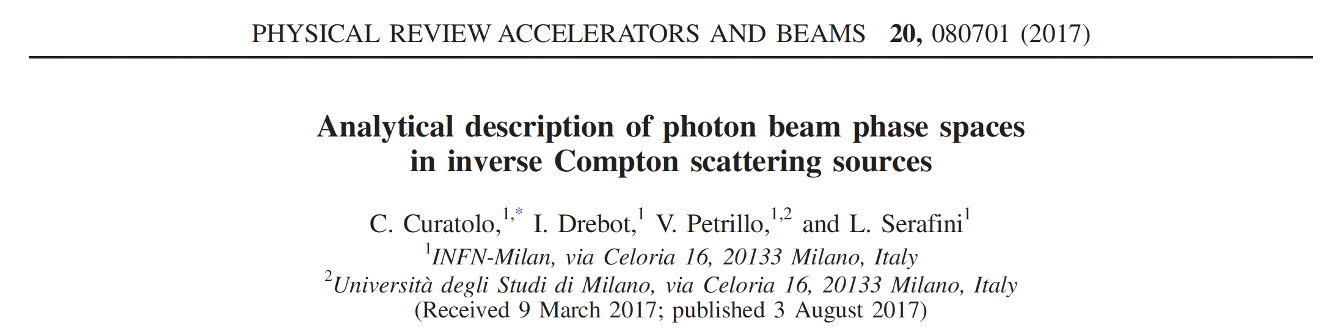
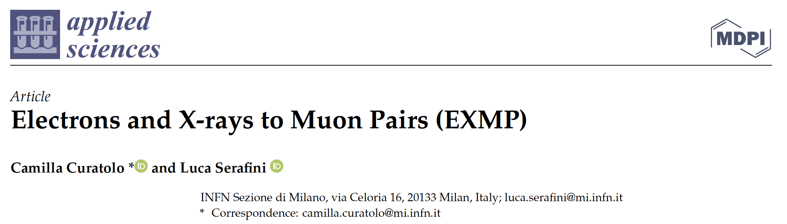
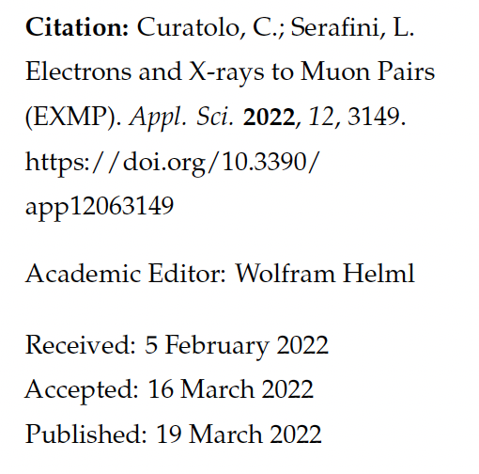
This Study on Symmetric Compton Scattering and positron beam generation is a follow up of 2 papers

Slide 3
Large Recoil in ICS damps the effect of large bandwidth incident photon beams onto the bandwidth of scattered photons
equivalent to FELs Kim-Pellegrini crit. on 3D inhomogeneous effects on photon bandwidth
beam
en. spread
diffraction
collimation
angle
incident
photons
en. spread
beam
emittance
non
linearity

Slide 4
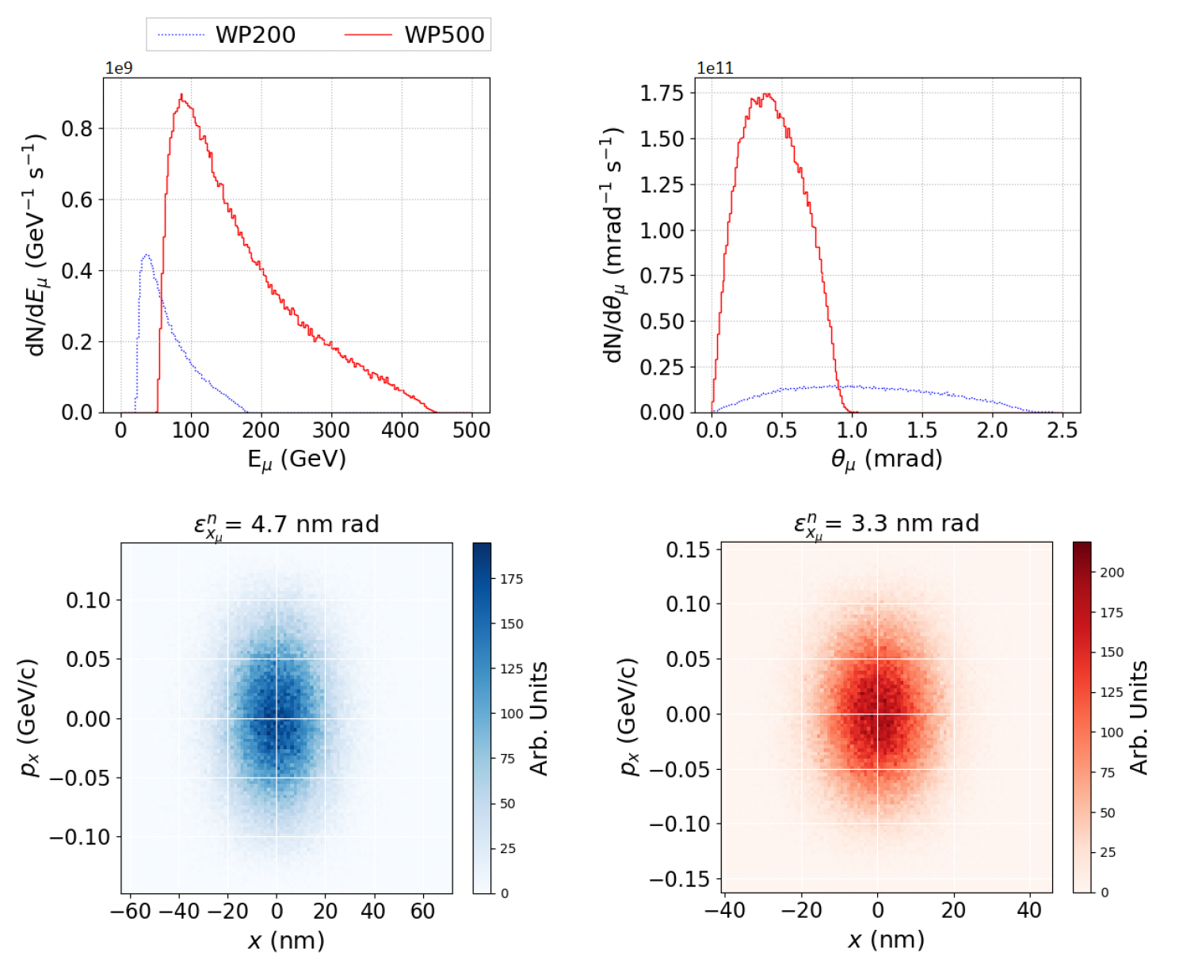
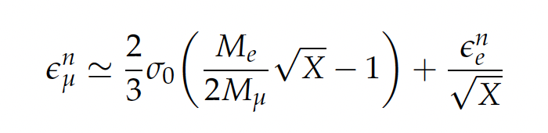
Large Recoil in MPP damps the normalized emittance of the secondary generated muon beam
muon beam norm. emittance
cmp. MAP norm. emitt. 2.5.10⁴ nm.rad
after ionization cooling

Slide 5

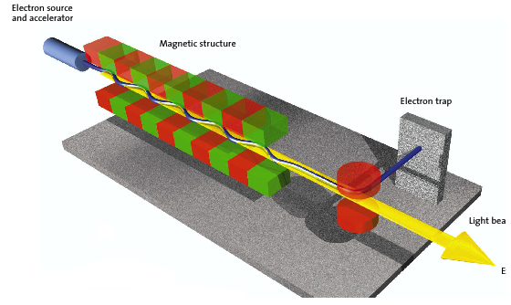
The Classical E.M. view (Maxwell eq.): Thomson Sources as synchrotron radiation sources with electro-magnetic undulator
FEL’s and Thomson/Compton Sources common mechanism:
collision between a relativistic electron and a (pseudo)electromagnetic wave
3 km
cm und. period λ_{u}
1-25 GeV
electrons
100-0.5 Å
photons
20-150 MeV electrons
0.8 μm laser λ
20-500 keV
photons
20 m

Slide 6
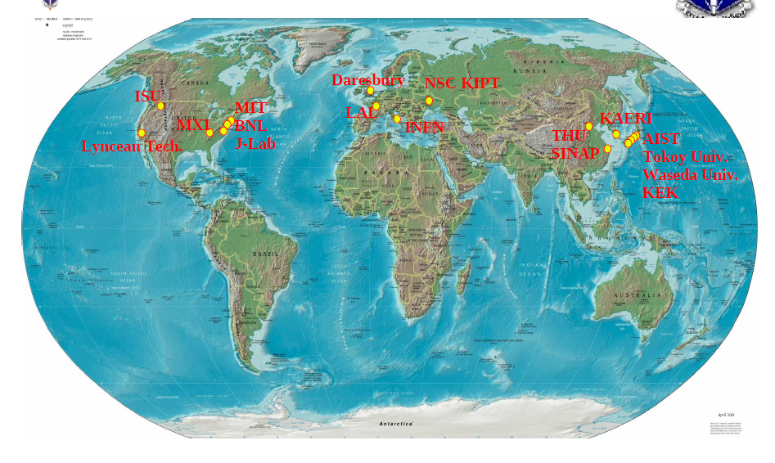
CALA
ELI-NP
HigS
STAR
ICS are the most effective “photon accelerators” (boost twice than FELs)
“4γ² boost effect”
Courtesy A. Variola

Slide 7
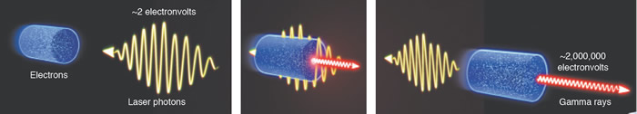
I.C.S. : Inverse Compton Scattering
Inverse Compton Scattering: why Inverse?
(direct) Compton Scattering is performed by an energetic photon (X-rays) interacting with an atomic electron (eV)
Inverse Compton Scattering is performed by an energetic electron (MeV-GeV) onto a visible (eV) photon (“inverse” refers to the reaction kinematics, not the dynamics)

Slide 8
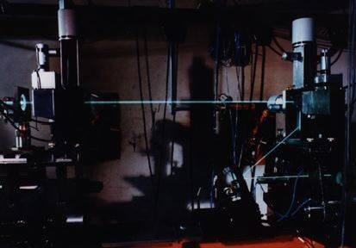
Hadronic Physics was the original motivation for Compton back-scattering experiments (cfr. Ladon at INFN-LNF, Graal at ESRF, etc): single photon per bunch collision at energies > 50 MeV with tagging (quite popular decades ago)
L. Federici, G. Giordano, G. Matone, G. Pasquariello, P. G. Picozza, et al. Backward compton scattering of laser light against high-energy electrons: the ladon photon beam at frascati.
Il Nuovo Cimento B (1971-1996), 59(2):247–256, 1980.

Slide 9
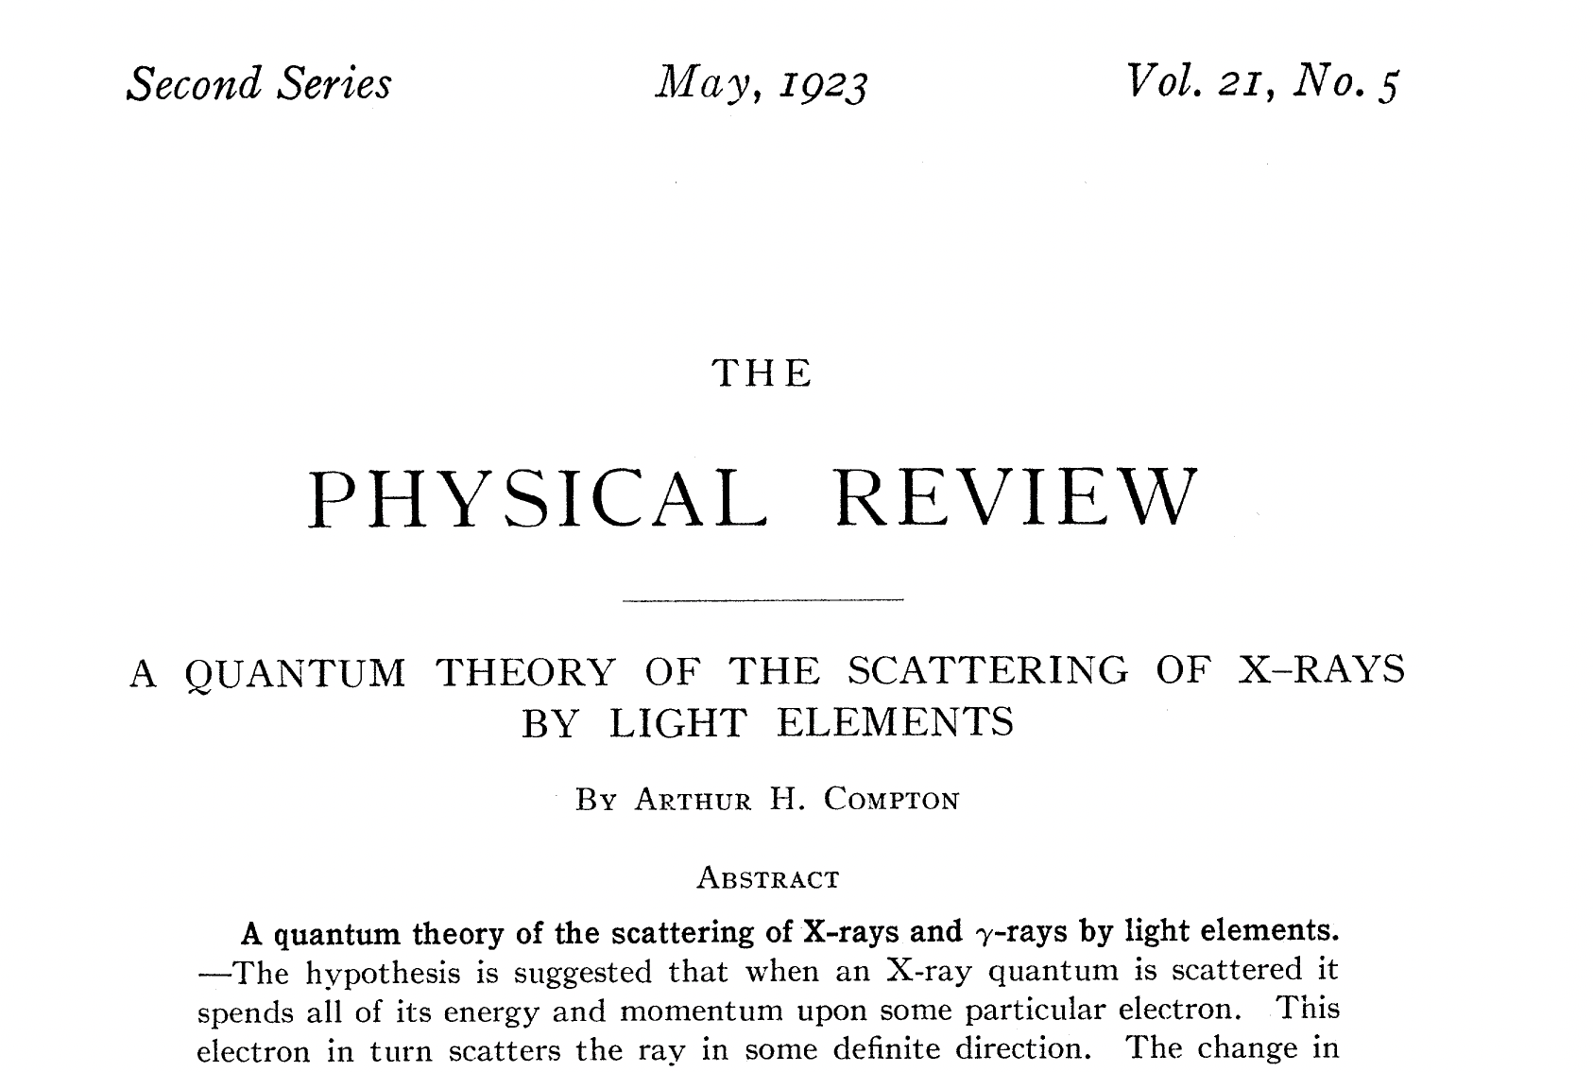
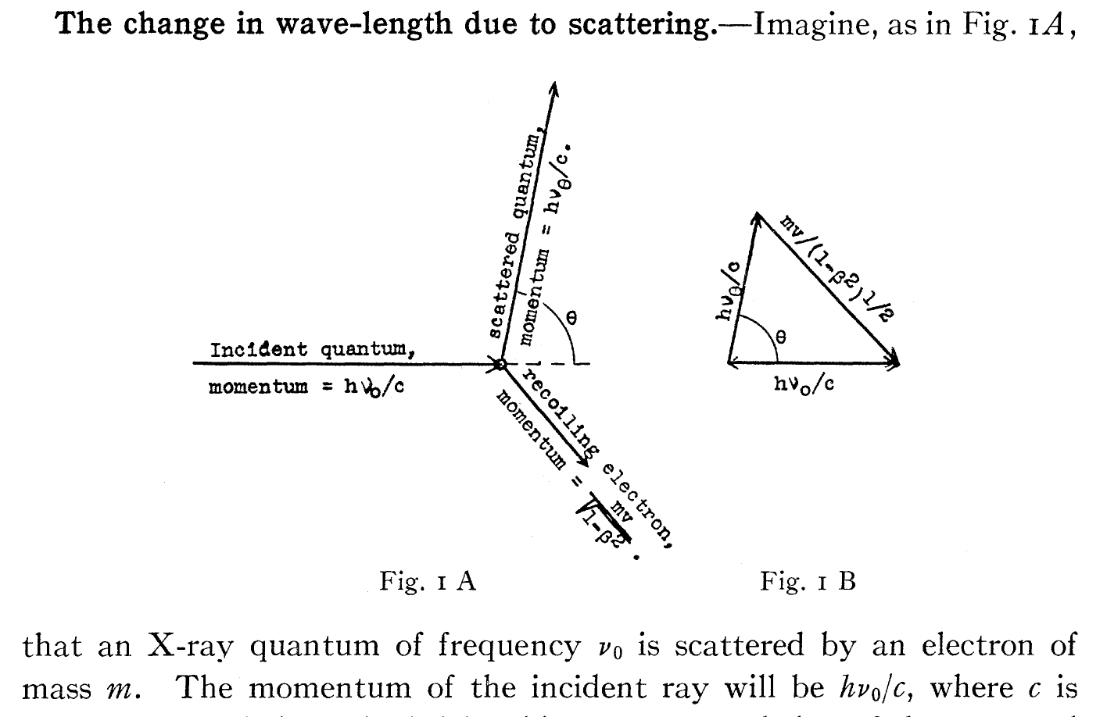

Slide 10
where is the Continental Divide
between
Compton Scattering
and
Inverse Compton Scattering?
when the electron becomes
a projectile (as in ICS)
instead of
a target (as in Compton)?
Does it depend only on electron energy?
No, it depends only on asymmetry in colliding momenta

Slide 11
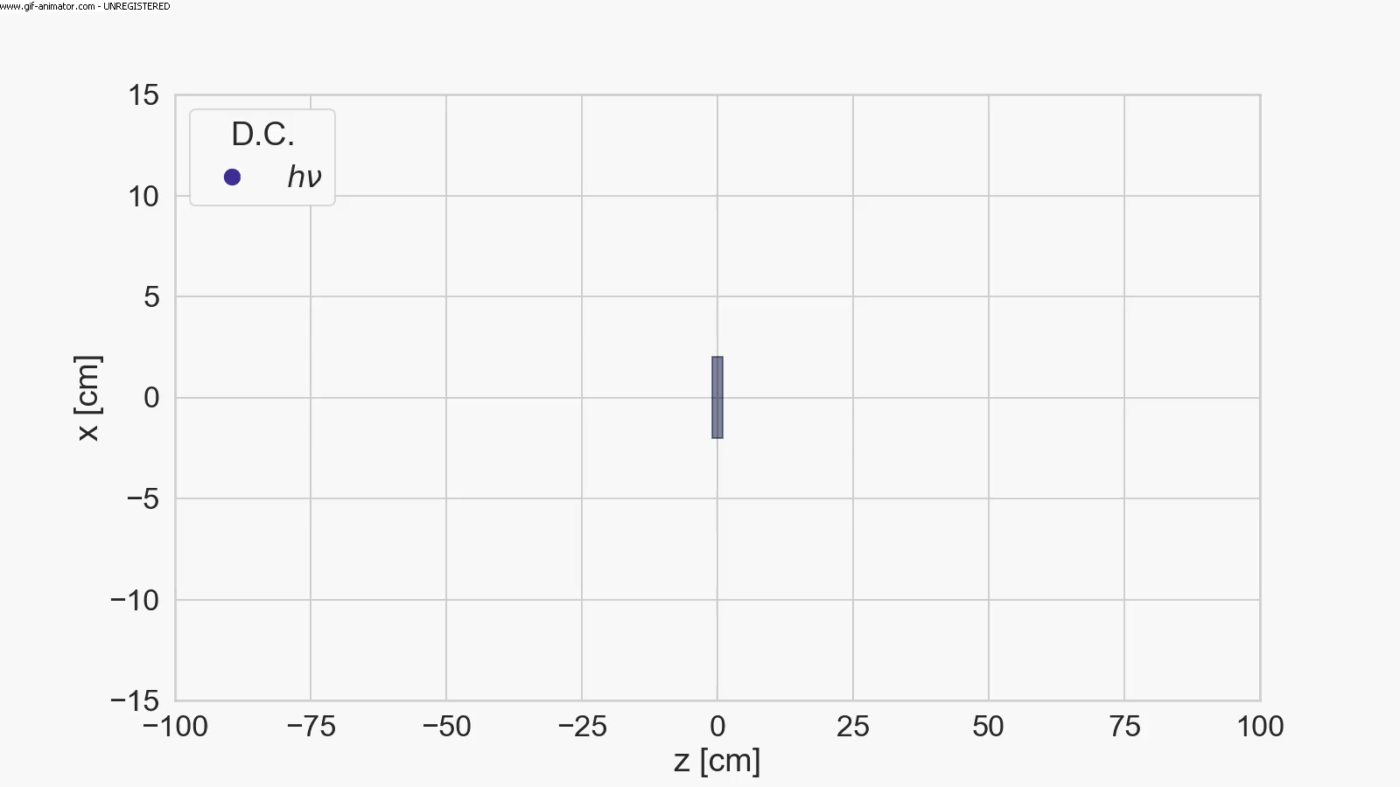
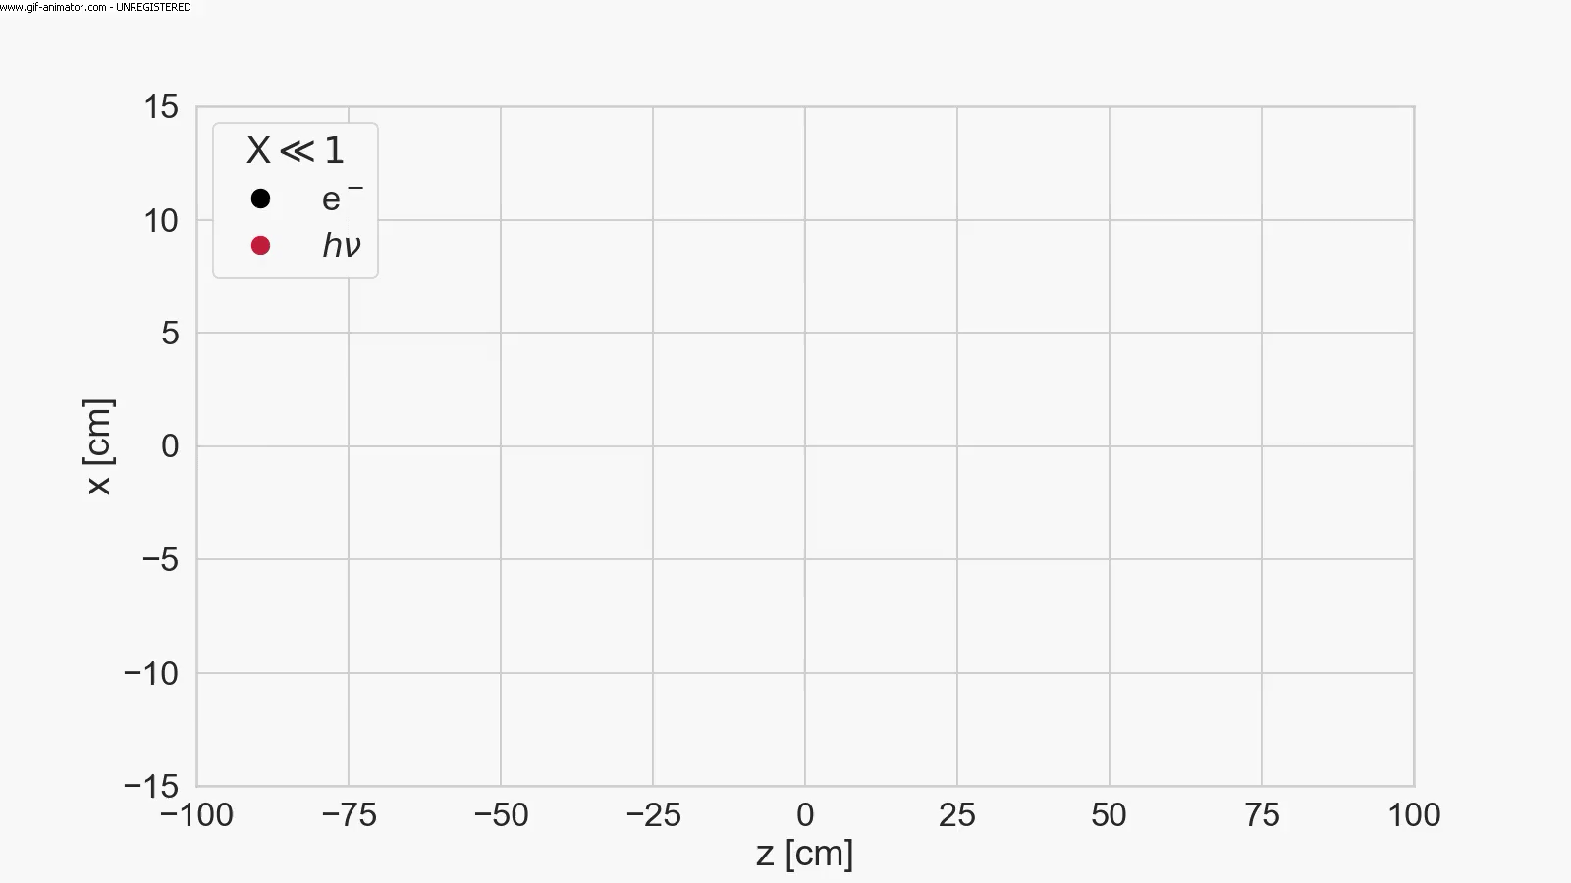

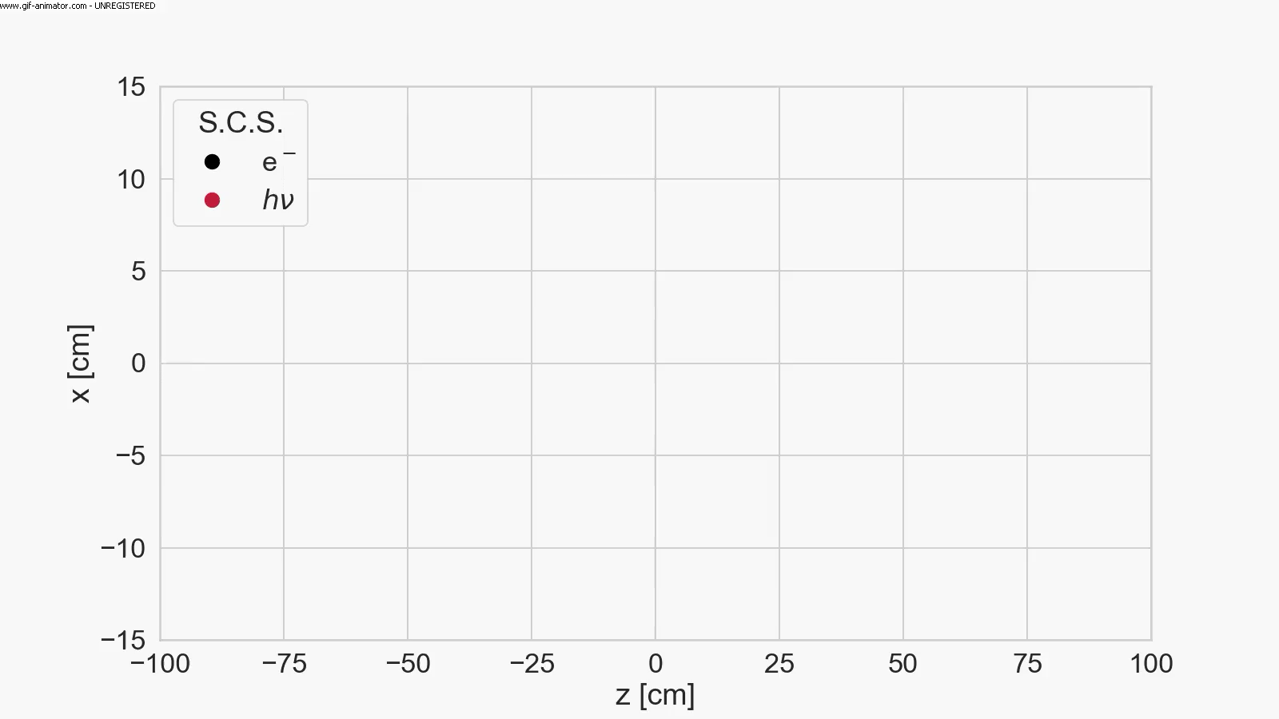



CM rest frame moves with
the photon in Direct Compton
CM rest frame moves with the electron in
Inverse Compton, FEL, Synchrotron light
$$γ_{cm}\sim γ$$
CM rest fr. slows down in Inv. Compton with deep recoil
CM rest frame is steady in Symmetric Compton
$$γ_{cm}=1$$
$$γ_{cm}≪γ$$
M. Rossetti Conti

Slide 12

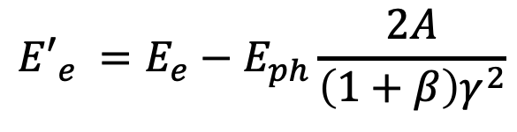
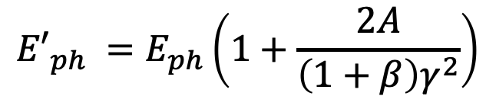

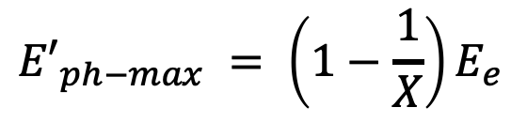



$${E′}_{ph}$$
$$E_{e}$$
$$E_{ph}$$
$${E′}_{e}$$
I.C.S. low recoil X<<1
${E′}_{ph−max} = 4γ2$ $E_{ph}$
$${E′}_{ph−max} = \left(1−\frac{1}{X}\right)E_{e}$$
I.C.S. large recoil X>>1
$${E′}_{ph} =E_{ph}\left(1+\frac{2A}{\left(1+β\right)γ^{2}}\right)$$
S.C.S. (A=0) or
quasi-SCS (A<<1)
$${E′}_{e} ={E_{e}−E}_{ph}\frac{2A}{\left(1+β\right)γ^{2}}$$

Slide 13
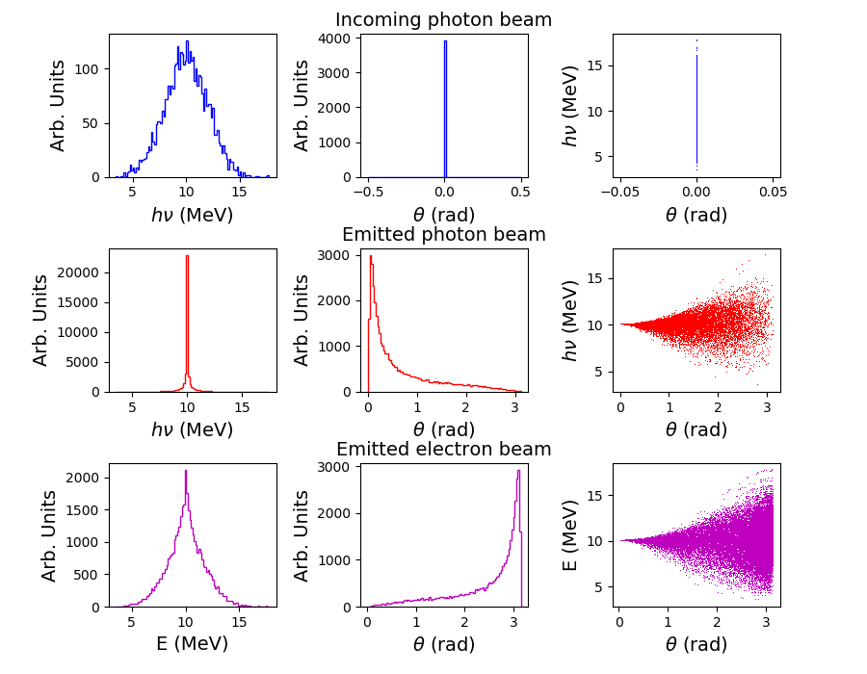
γ -ray in-vacuum mono-chromatization, SCS at large Recoil
20% rms spread
Incoming e- beam 10⁻⁴ rms spread
Electron
Cooling of
photons!!
2.10⁻⁴
rms spread
no energy-
angular
correlation
10⁻¹ spread
e- beam
is heated
C. Curatolo - Whizard

Slide 14
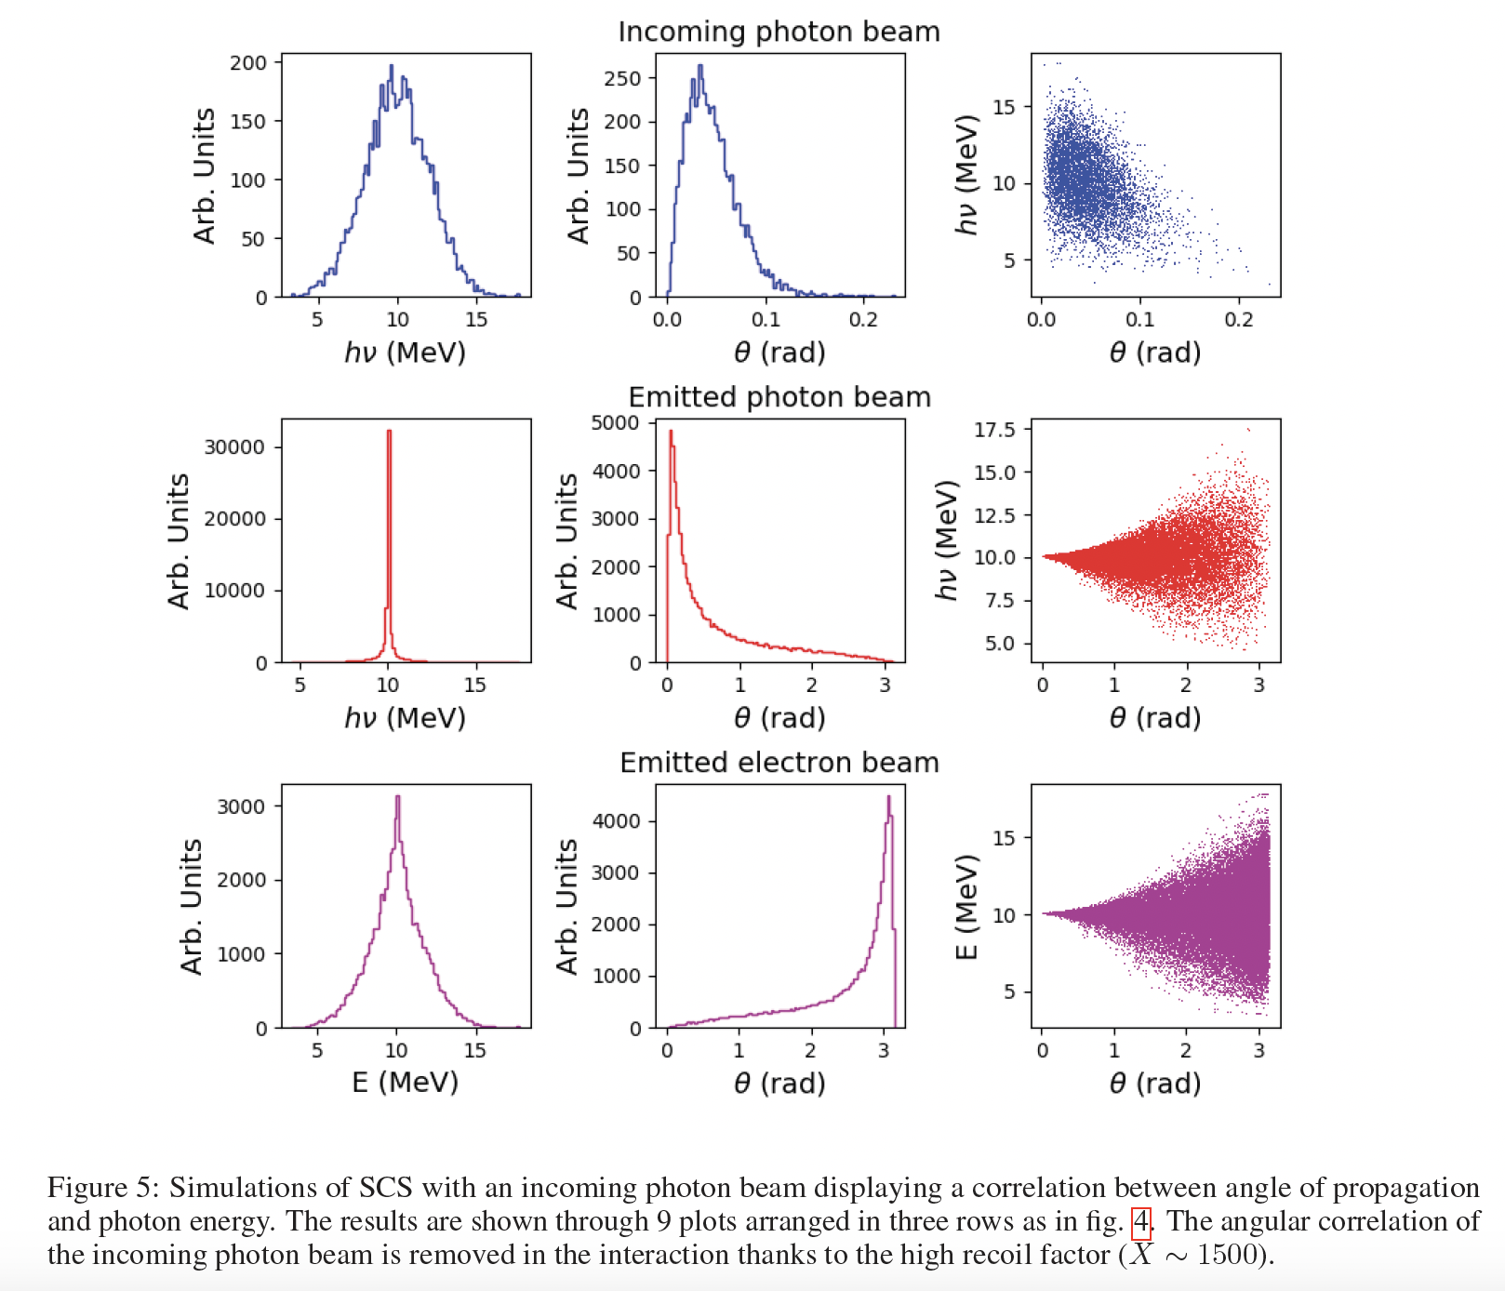
Spread of incidence angle
(resembles emittance)
cooling of
photons still
effective
as well as
heating of
electrons

Slide 15
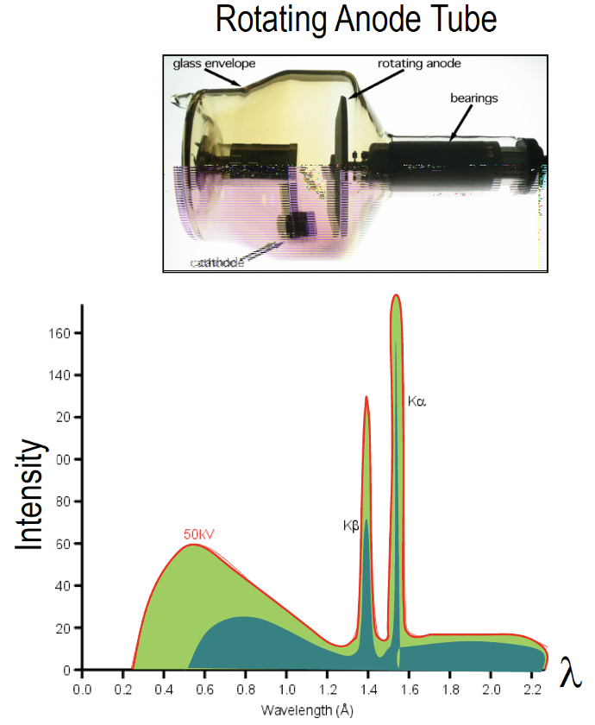
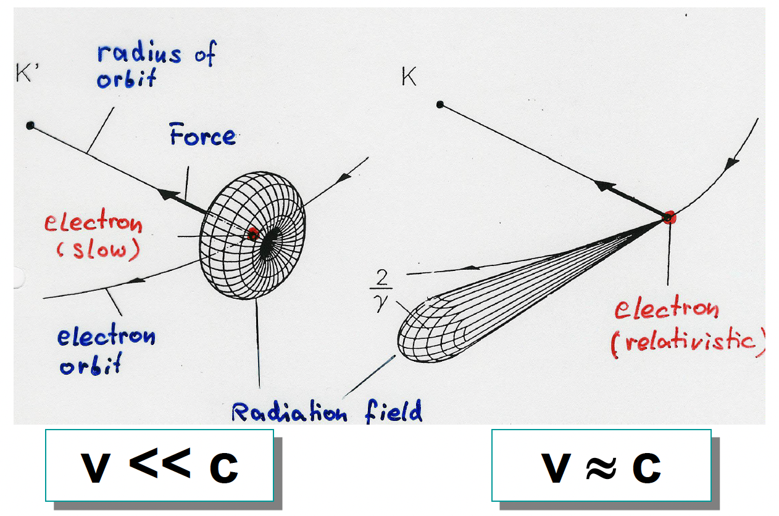
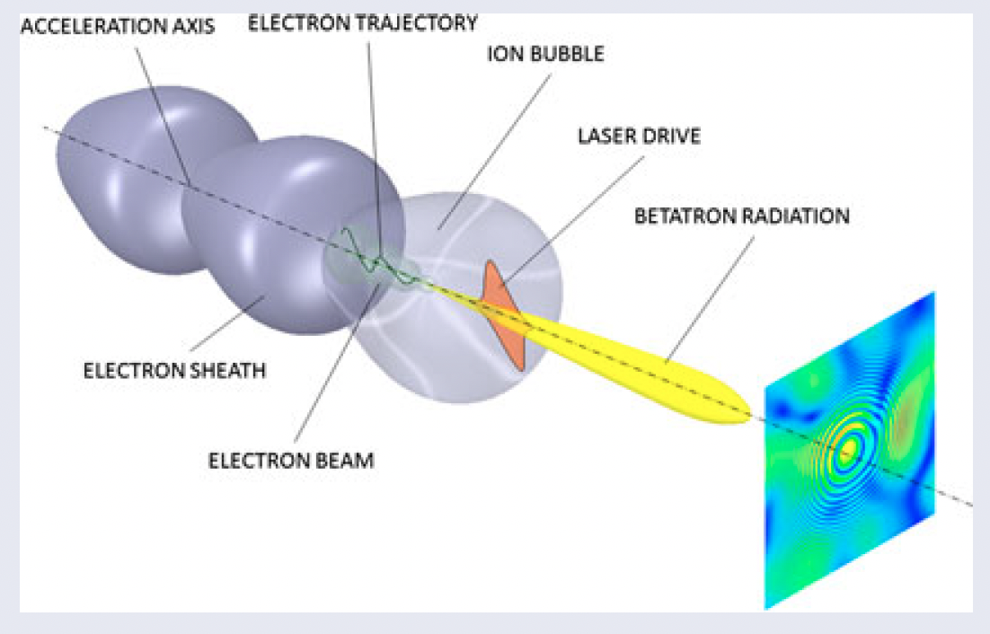
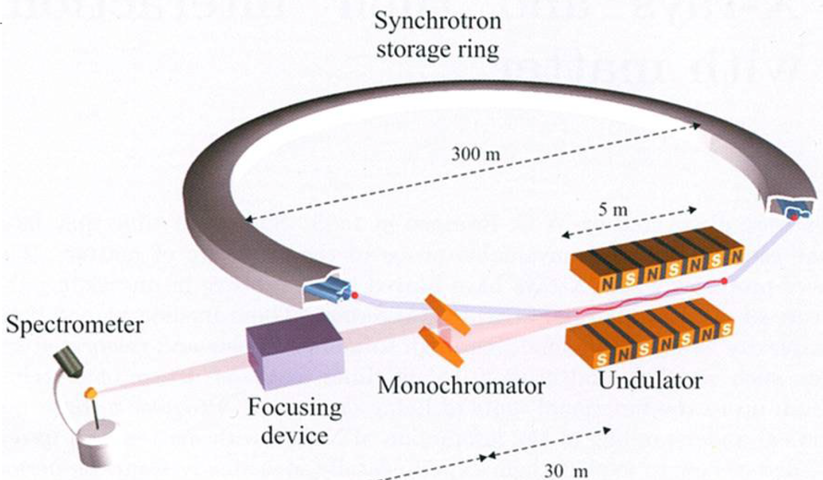
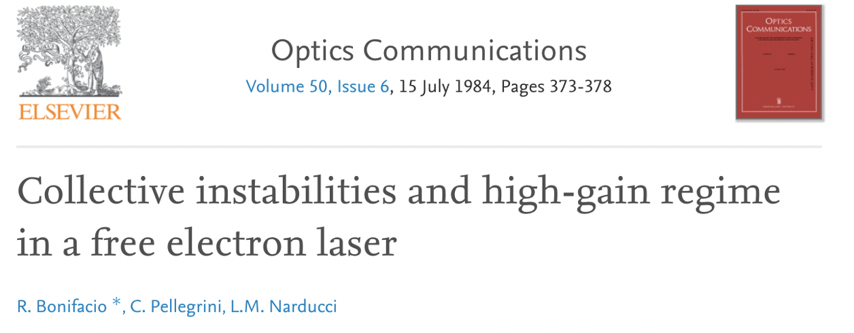


Schematic recap of X/γ Radiation Sources
(keV, MeV, GeV…)
Spontaneous undulatory radiation (synchrotron, wiggler, betatron, channeling, bremsstrahlung)
Resonant/amplified undulatory radiation (undulator, FEL)
$$E_{X}=f\left(γ^{2}θ^{2}\right)$$
courtesy B. Paroli, M. Potenza
courtesy L. Rivkin
$$E_{X}≠f\left(γ^{2}θ^{2}\right)$$

Slide 16
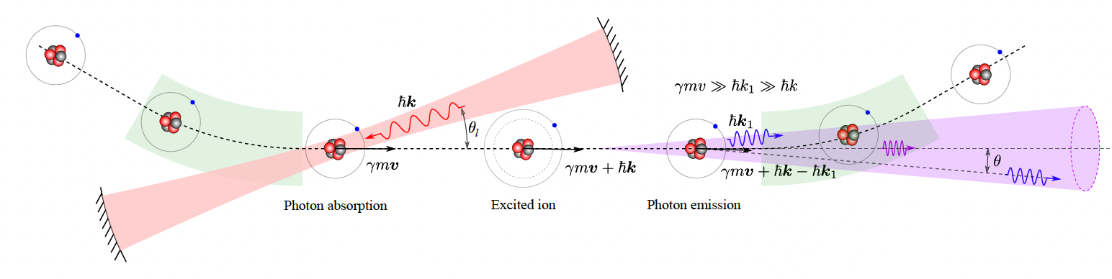
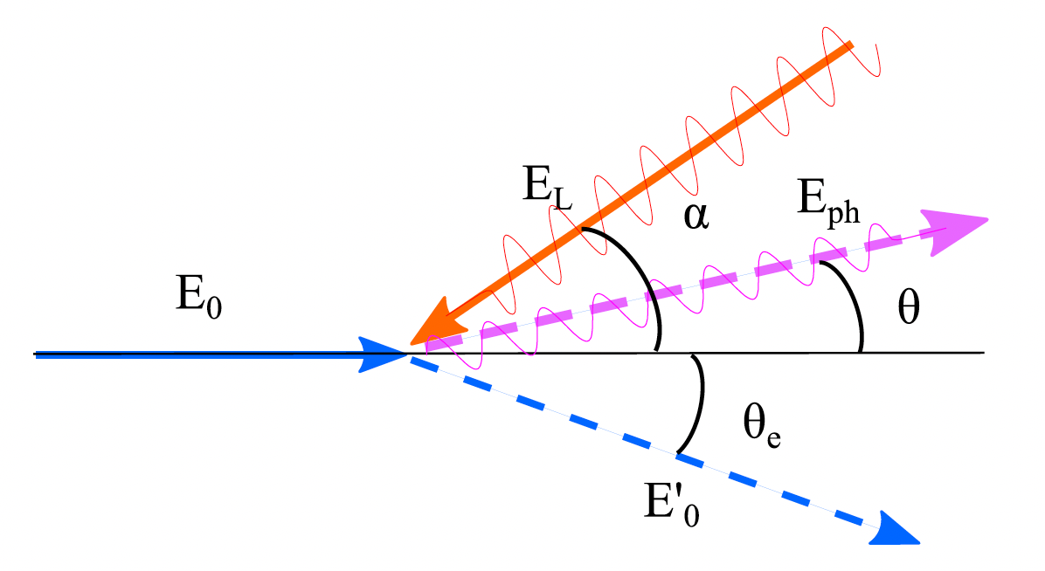
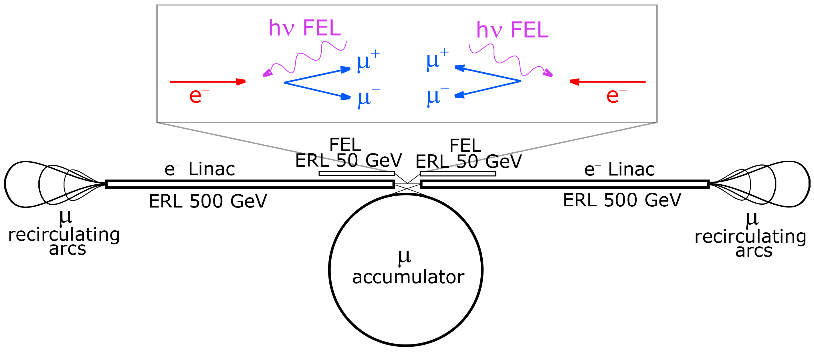
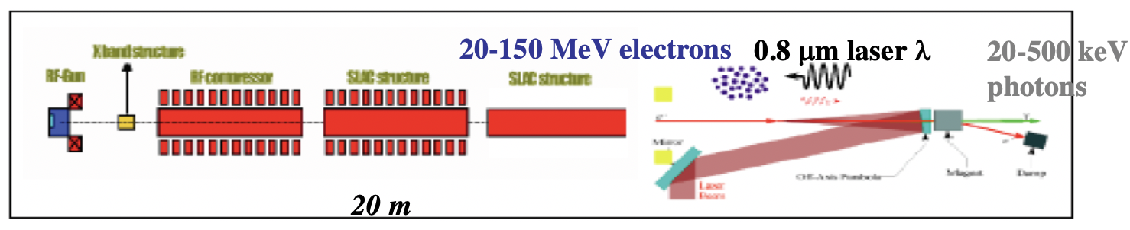
Collisional radiation
(Relativistic Rayleigh Scattering aka Gamma Factory, Inverse Compton Scattering, Large Recoil ICS, Symmetric Compton Scattering)
Gamma Factory
deep recoil I.C.S.
I.C.S.
EXMP
low recoil
I.C.S. - STAR

Slide 17
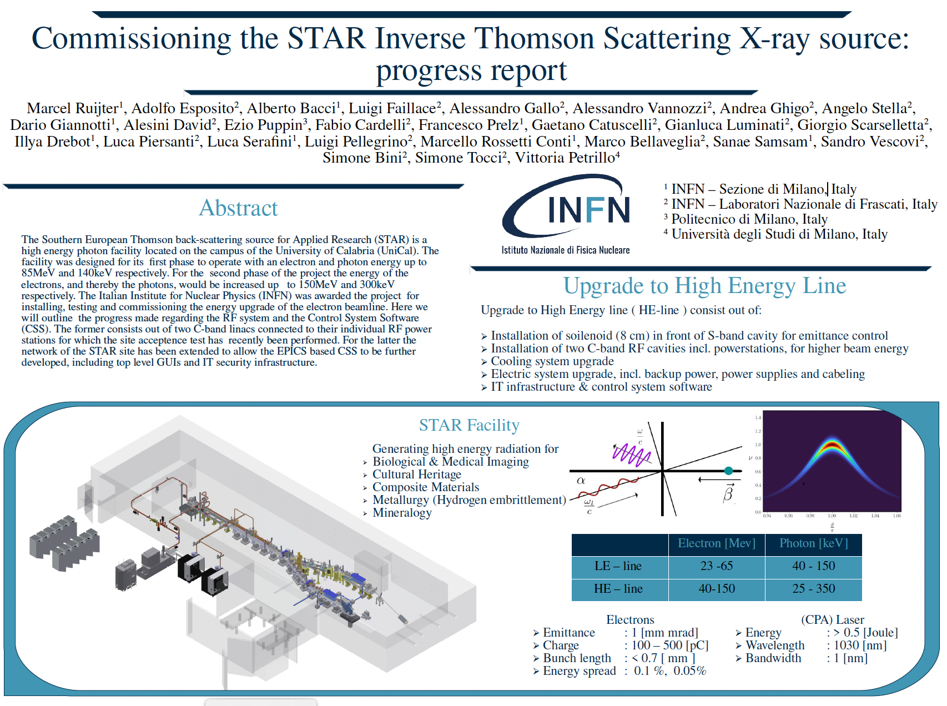

Slide 18
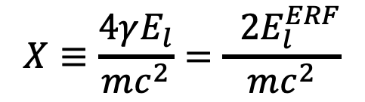

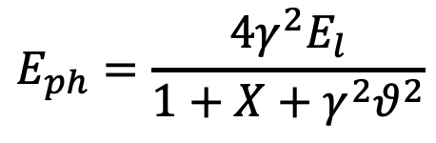
The γ²θ² issue/disease
All radiation originated by a Lorentz Boost associated to relativistic emitting particles (electrons, heavy ions) is intrinsically poli-chromatic because of γθ correlation (energy boost of scattered photons depends on scattering angle, at θ=1/γ photon energy is 50% of max photon energy at θ =0 ) of single electron spectrum (on top of inhomogeneous effects)
True for all kinds of Undulatory and Collisional radiation (bremsstrahlung, wiggler/betatron, synchrotron, RRS, ICS), while resonant or amplified radiation (undulators, FELs), that are diffraction limited thanks to their beam quality, are not (or only partially) affected
$$E_{ph}=\frac{4γ^{2}E_{l}}{1+X+γ^{2}θ^{2}}$$
$$E_{0}=γmc^{2}$$
$$X≡\frac{4γE_{l}}{mc^{2}}=\frac{ 2E_{l}^{ERF}}{mc^{2}}$$

Slide 19
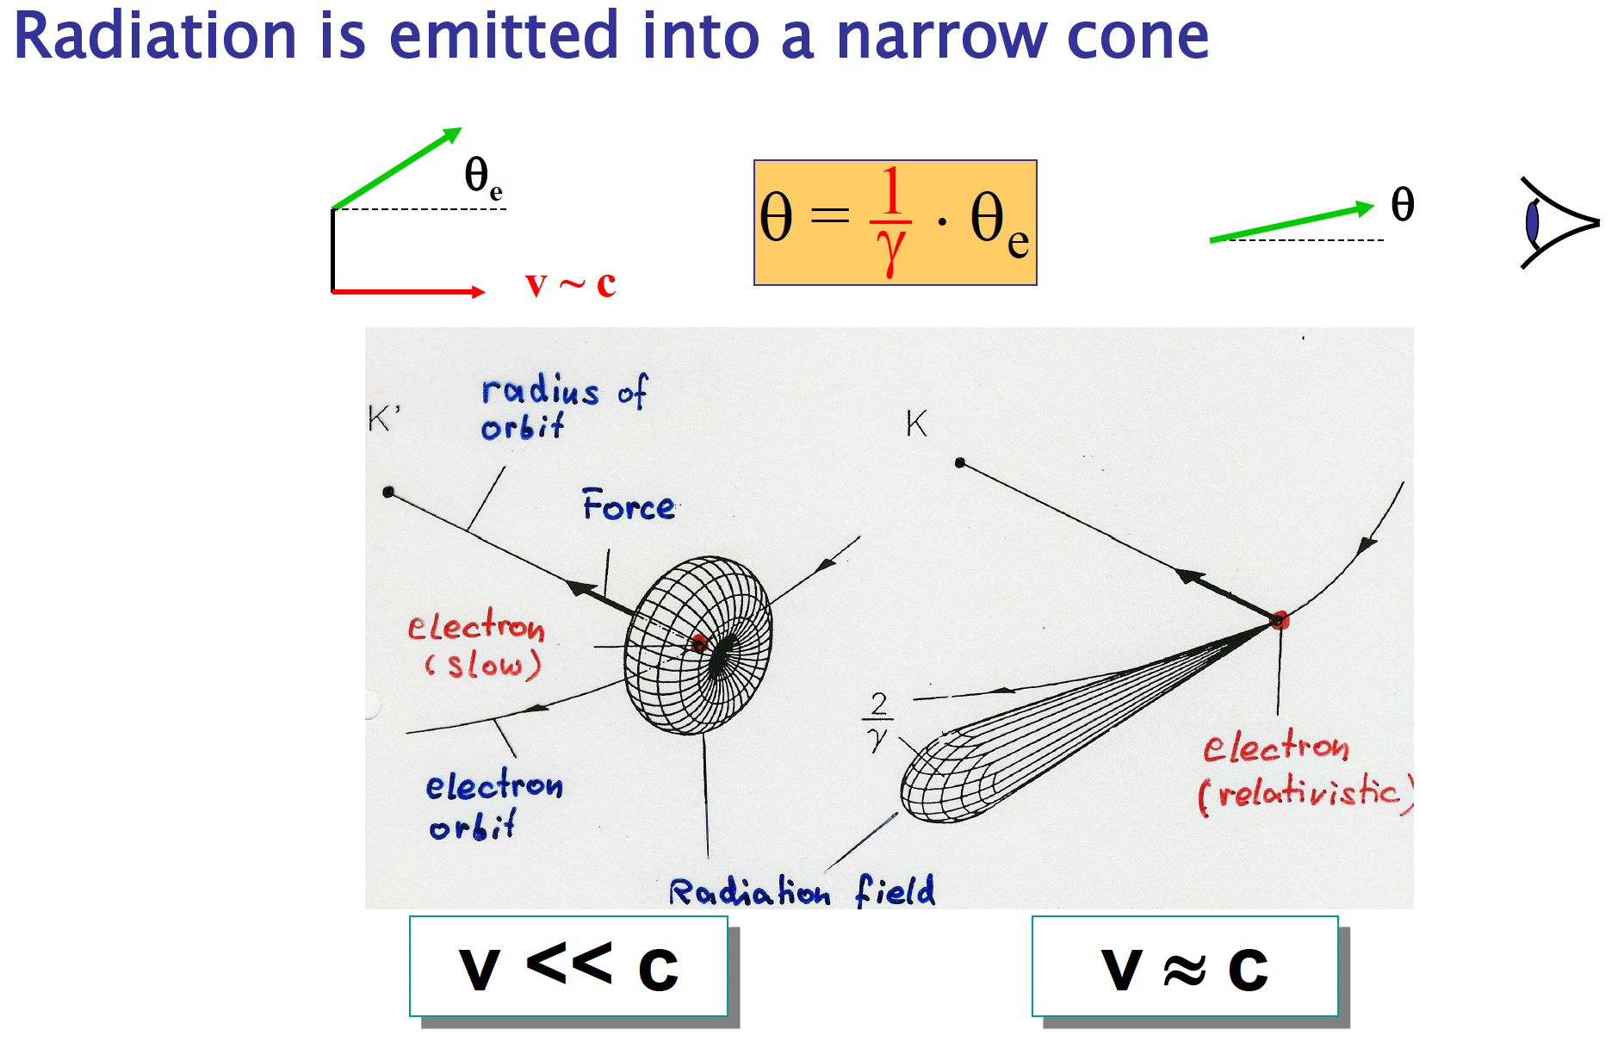
Courtesy L. Rivkin

Slide 20
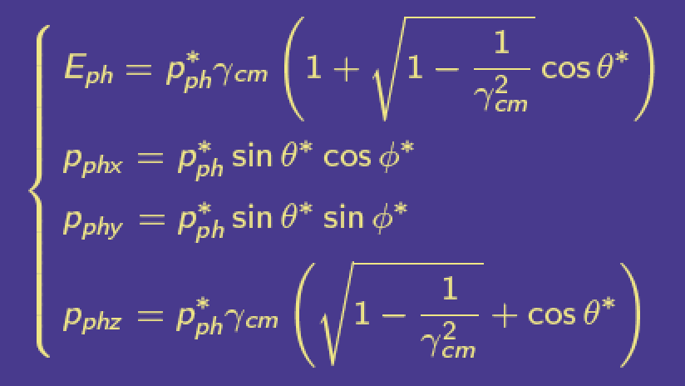
To transform to the Lab ref. system we need to compute
Then apply a Lorentz transformation

Slide 21
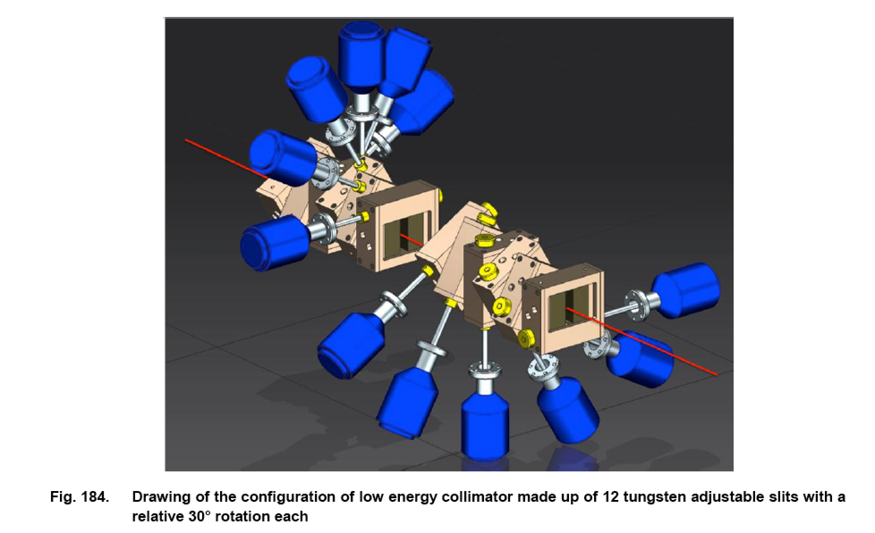
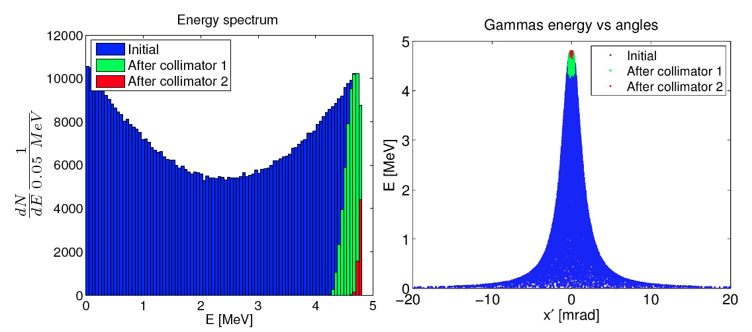
Poli-chromaticity implies using mono-chromators of different kinds (bragg-reflectors, collimators) to select a narrow bandwidth line from a broad-band spectrum
ELI-NP-GBS γ –beam
collimator (2-19 MeV)
X-ray monochromator

Slide 22
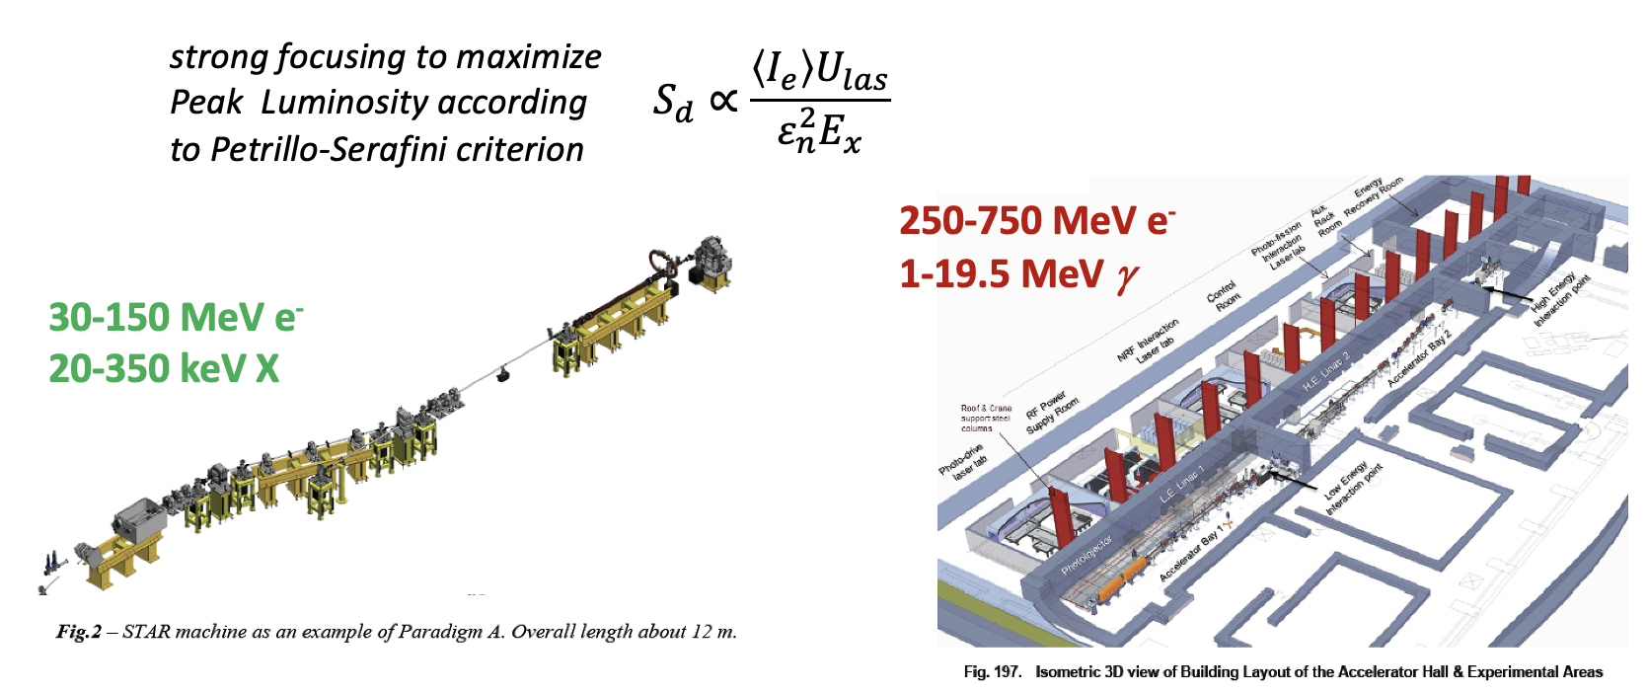
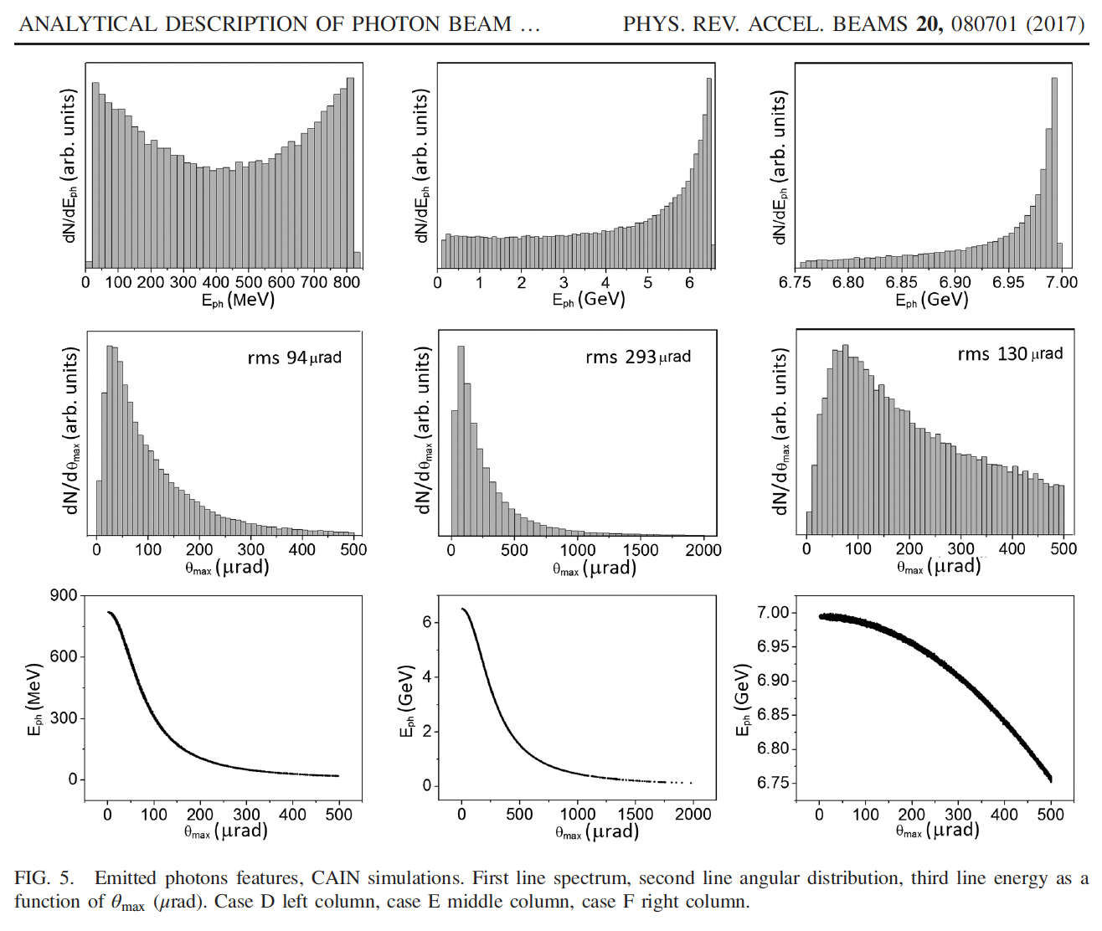
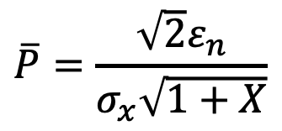
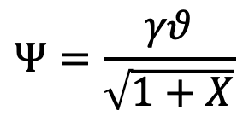
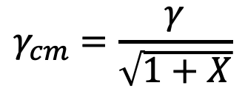
Deep Recoil I.C.S. helps attenuating the γ²θ² problem through slowing down of Lorentz boost γ_{cm}<<γ
7 GeV e⁻ beam
laser
UV FEL
X FEL
$$Ψ=\frac{γθ}{\sqrt{1+X}}$$
$$\overline{P}=\frac{\sqrt{2}ε_{n}}{σ_{x}\sqrt{1+X}}$$
X=0.13
X=13.
X=1300.
$$γ_{cm}=\frac{γ}{\sqrt{1+X}}$$
R. Hajima and M. Fujiwara, Narrow-band GeV photons
generated from an x-ray free-electron laser oscillator, Phys.
Rev. Accel. Beams 19, 020702 (2016). XFELO Project

Slide 23
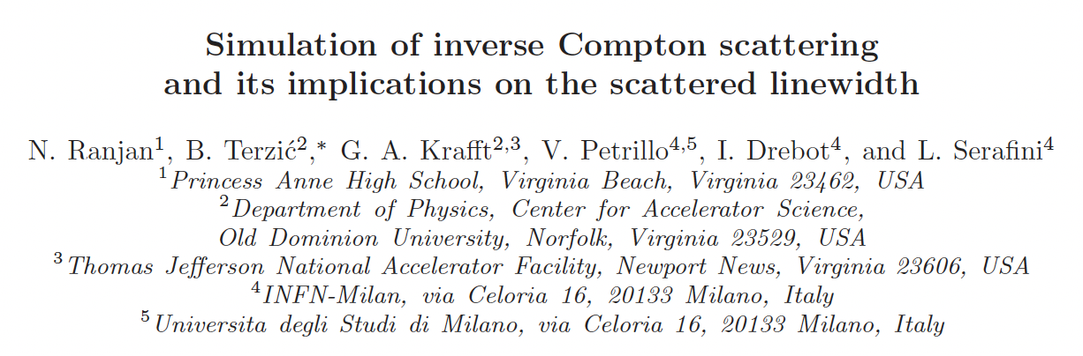
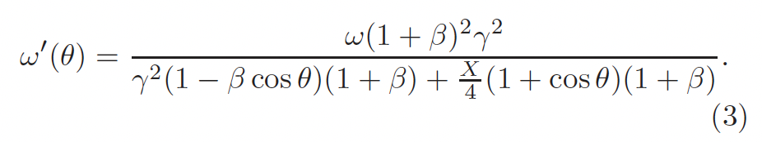
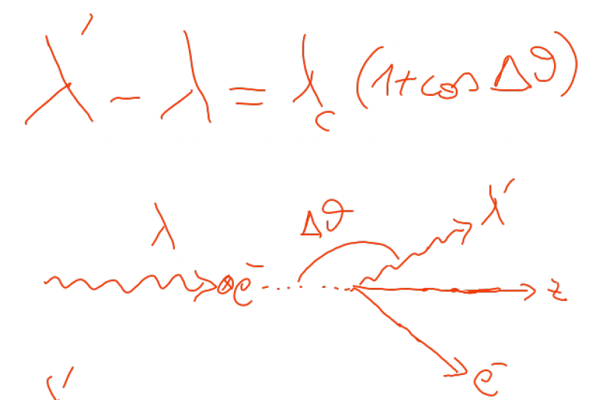


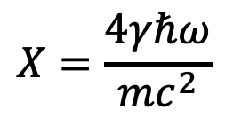


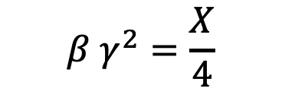
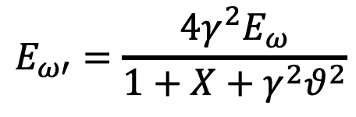
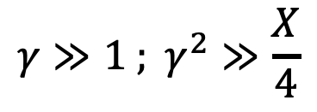

An invariant view at Compton effect - 1
(any inertial ref. frame)
Phys. Rev. AB (2018)
21, 030701
$$X=\frac{4γℏω}{mc^{2}}$$
Arthur Compton,
Nobel Prize 1927
A<0
$$γ≫1 ; γ^{2}≫\frac{X}{4}$$
A<0
A=0
photon looses energy
electron looses energy
$$β=0$$
S.C.S.
I.C.S.
$$β γ^{2}=\frac{X}{4}$$
$$E_{ω′}=\frac{4γ^{2}E_{ω}}{1+X+γ^{2}θ^{2}}$$
$$E_{ω′}={βE}_{e}=βγmc^{2}$$
$$λ′≠∞$$
$$E_{ω′}≠f\left(γ^{2}θ^{2}\right)$$
$$\lim_{X→∞}{E_{ω′}}=E_{e}$$
isolated e⁻ cannot absorb a photon

Slide 24
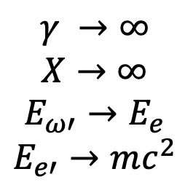

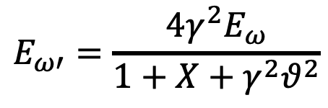
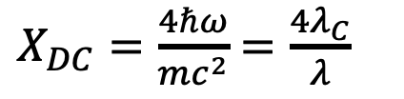








An invariant view at Compton effect - 2
(any inertial ref. frame)
$$X=\frac{4γℏω}{mc^{2}}$$
A<0
A=0
A<0
photon looses energy
electron looses energy
$$\overset{⃑}{p_{e}}=−\overset{⃑}{p_{ω}}$$
Direct Compton
S.C.S.
I.C.S.
$$β=0 ; γ=1$$
$$X=4β γ^{2}$$
$$E_{ω′}=\frac{4γ^{2}E_{ω}}{1+X+γ^{2}θ^{2}}$$
$$ν′=\frac{ν}{1+\frac{X_{DC}}{4}\left(1+\cos{θ}\right)}$$
$$E_{ω}=p_{e}c=βγmc^{2}$$
$E_{ω′}=E_{ω}$ $∀θ$
$$γ →∞$$
$$X→∞$$
$$E_{ω′}→E_{e}$$
$$E_{e′}→mc^{2}$$
$X_{DC}=\frac{4ℏω}{mc^{2}}$ $=\frac{4λ_{C}}{λ}$
$$E_{e′}=E_{e}= γmc^{2} ∀θ$$
$$γ_{cm}=1$$
CM ref. frame = Lab ref. frame

Slide 25


E’_{ph}
(keV)
ICS
1 eV – O(100) MeV

Slide 26


Slide 27



Symmetric Compton
Scaling of photon energy vs. electron kinetic energy
$$E_{ω}=p_{e}c=βγmc^{2} (MeV)$$
$$T_{e}=E_{e}−mc^{2}= \left(γ−1\right)mc^{2} (MeV)$$

Slide 28




Symmetric Compton
Scaling of X, recoil factor, vs. electron kinetic energy
$$E_{ω}=p_{e}c=βγmc^{2}$$
$$X=4β γ^{2}$$
$T_{e}=E_{e}−mc^{2}= \left(γ−1\right)mc^{2}$ (MeV)

Slide 29
Symmetric Compton Scattering suppresses the γ²θ² correlation
Photons are scattered at same energy at any angle
Lorentz Boost is damped
Radiation emission is intrinsically mono-chromatic
Poli-chromaticity of incident photon beam is transferred to the scattered electron beam and viceversa (photon cooling, electron heating)

Slide 30
















A look at 4-vectors (head-on collision)
Inverse Compton
Symmetric Compton
$E_{ω}≪γmc^{2 }; γ≫$1
$$E_{ω}=p_{e}c=βγmc^{2}$$
$$\overline{P_{e}}=\left\{γmc,0,0,βγmc\right\}$$
$$\overline{P_{e}}=\left\{γmc,0,0,βγmc\right\}$$
$$\overline{P_{ω}}=\left\{{E_{ω}}/c,0,0,−{E_{ω}}/c\right\}$$
$$\overline{P_{ω}}=\left\{βγmc,0,0,−βγmc\right\}$$
$$\overline{P_{tot}}≅\left\{γmc+\frac{E_{ω}}{c},0,0,βγmc−\frac{E_{ω}}{c}\right\}$$
$$\overline{P_{tot}}=\left\{\left(1+β\right)γmc,0,0,0\right\}$$
$$E_{cm}≡c\sqrt{\overline{P_{tot}}⊗\overline{P_{tot}}}$$
$$E_{cm}=mc^{2 }\sqrt{1+\frac{\left(1+β\right)X}{2}}≈$$
$$≈mc^{2 }\sqrt{1+{4γE_{ω}}/{mc^{2 }}}$$
collider
fixed target
$$γ_{cm}≡\frac{E_{lab}}{E_{cm}}$$
$$E_{cm}=\left(1+β\right)γmc^{2 }$$
$$γ_{cm}≅γ/{\sqrt{1+X}}$$
$${; γ}_{cm}$$
1
$$γ_{cm}=1$$
$$γ→∞$$

Slide 31
SCS - What Matters?
SCS may allow to design a laser-less γ-ray source for nuclear photonics, aka ELI-NP-GBS, using a compact low energy Linac (20-30 MeV versus 750 MeV)
It can be used to extend the photon energy range of Light Sources and Free Electron Lasers up to MeV’s photon beams (LCLS 12 keV, XFEL 19 keV, ESRF 100 keV ⇒ 1-10 MeV)
Follow-ups in Astrophysics: Synchro-Compton catastrophe (see Malcolm Longair, High Energy Astro-Physics)
Applications to Plasma Physics: additive trapping of electrons (positrons?) in magnetic bottles

Slide 32


S.C.S. Spectra at different Recoils

Slide 33


Symmetric Compton (CSC)
(10 MeV Linac vs. bremsstrahlung/betatron/
channeling/coherent bremsstrahlung beam)
Electron energy=10.013 MeV, Photon energy=10 MeV, ΔE_{phot}/E=20% Deep Recoil X=1533
Q=1.e-9 C N_X=2.*10⁸ σ₀=1 μm rep-rate=200 MHz
HWHM = 10 keV = 0.1%
ΔE_{phot}/E=0.2
ΔE_{e}/E=0.155
FWHM=2.4 MeV
N_el=6.*10⁹ N_X=2.*10⁸ Σ=2.6*10⁻²⁷ =2.6 mbarn N_X’ (s⁻¹)=5*10⁶ S=500 s-¹eV⁻¹
Vittoria Petrillo – Compton montecarlo

Slide 34
Symmetric Compton at moderate recoil
Initial Electron energy=611 keV, Initial Photon energy=335 keV , ΔE_{phot}/E=0.1
Symmetric Compton (p_{e}=-p_{phot}), moderate recoil X=3.13
ΔE_{phot}/E=0.1
ΔE_{phot}/E=0.071
ΔE_{e}/E=0
ΔE_{e}/E=0.023
SCS and large recoil factors are both needed to mono-chromatize broad band incident photon beams

Slide 35
Fixed recoil X=1531
Moving away from Symmetric Compton
incident ΔE_{phot}/E=20%
Initial Electron energy=10.013 MeV,
Initial Photon energy=10.0MeV
Initial Electron energy=11.0 MeV,
Initial Photon energy=9.08MeV
Initial Electron energy=12.0 MeV,
Initial Photon energy=8.33 MeV
No γ²θ² disease
The onset of γ²θ² disease

Slide 36



Fixed recoil X=1531
going from SCS to ICS
Initial Electron energy=20.0 MeV,
Initial Photon energy=5 MeV,
ΔE_{phot}/E=0.2
Initial Electron energy=100.0 MeV,
Initial Photon energy=1 MeV,
ΔE_{phot}/E=0.2
Initial Electron energy=40.0 MeV,
Initial Photon energy=2.5 MeV,
ΔE_{phot}/E=0.2
full γ²θ² disease – the moustache pattern

Slide 37

BriXSinO’s ICS source – Illya Drebot with CAIN –
ICS Moustache
BriXSinO T.D.R. @ www.marix.eu

Slide 38
FEL beam vs. compact Linac
Initial Electron energy=20 MeV, Initial Photon energy=20 keV , ΔE_{phot}/E=0.0001
moderate recoil X=6.12
up to 10⁸ photons/s at 17 MeV with 50 keV bdw: S 2000 s⁻¹eV⁻¹

Slide 39

X-ray beam from Light Source vs. compact Linac
Electron energy=20 MeV, Photon energy=100 keV , ΔE_{phot}/E=0.001 recoil X=30.63
up to 10⁷ photons/s at 17 MeV with 50 keV bdw

Slide 40

Turning a radio-active Cobalt-60 fixed energy
gamma-ray source into a tunable sorce of gamma-rays

Slide 41


2 spectral lines merged into a single tunable line

Slide 42


Slide 43


Trapping electrons (positrons) into a magnetic bottle by SCS
at low recoil ( 72 keV photon beam heats up 5 keV e⁻ beam)

Slide 44

S.C.S. – incident photon energy vs.
incident electron kinetic energy
E_{ph} (keV)
T_{e} (MeV)

Slide 45


Slide 46

60% of scattered electrons are (additively) trapped
into the magnetic bottle (w.o. any external field)

Slide 47
Conclusions
If S.C.S. will be the base of
Next Generation hard-X-Ray and gamma-rays,
we are not yet able to say,
but chances are quite promising.
If S.C.S. will play a role in plasma heating,
soon we’ll be able to say.
Within Astro-physics context more studies
must be pursued to check about
Compton Catastrophe and related topics.

Slide 48


Grazie per l’attenzione – more details in

Slide 50
Follow-ups in Astrophysics: cosmic background an-isotropy due to comptonization, Synchro-Compton catastrophe, non collimated cosmic gamma sources (SCS spreads high energy photons over full solid angle - ICS makes collimated photon beams, see Malcolm Longair, High Energy Astro-Physics)

Slide 51




Slide 52


Slide 53

Ultra-low emittance positron beams from deep recoil
electron-photon collider: 5 GeV ERL vs. 5 keV FEL, X=391
up to 10¹³⁻¹⁴ e⁺/s at 50 MeV within 5% en. spread
Son of
EXMP
E_{cm}=10 MeV
E_{cm}=346 MeV
0.5 MeV/c rms
transv. momentum
0.5-1*10⁻⁷ m.rad rms norm. transv. emittance with round beam (no-cooling)
V. Petrillo, A. Puppin – Whizard

Slide 55

Inverse Compton Sources rivaling/overcoming
Synchrotron Light Sources at photon energies above 80-100 keV
ELI-NP-GBS
STAR
I.C.S.

Slide 56
Inverse Compton Sources, Overview, Theory, Main Technological Challenges – Photonic Colliders
New Generation of X/γ ray beams via electron-photon beam collisions for advanced applications in medicine/biology-material science/cultural heritage/national security and fundamental research in nuclear physics and high energy physics (e-γ, γ-γ colliders, pol. e⁺ beams, hadron. physics, etc)
Inverse Compton Sources (ICS) are e⁻/photon colliders aimed at producing secondary beams of photons
Several Test-Facilities world-wide: after a decade of machine test&development we are entering the era of User Facilities in X-ray imaging and γ-ray Nuclear Physics and Photonics

Slide 57
Challenges of electron-(optical)photon colliders as X/γ beam Sources using Compton back-scattering
Need of high peak brightness/high average current electron beams (cmp. FEL’s drivers) fsec-class synchronized and μm-μrad-scale aligned to high peak/average power laser beams
Main goal for Nuclear Physics and Nuclear Photonics: Spectral Densities > 10⁴ N_{ph}/(s.eV) photon energy range 1-20 MeV, bandwidths 10⁻³ class
Main goal for Medical Applications with X-rays: tunability in the 20-120 keV range, good mono-chromaticity (1-10 %), high flux (10¹¹ min., 10¹² for radio-imaging, 10¹³ for radio-therapy)

Slide 58
Main goal for MeV-class γ − γ and TeV γ - nucleon colliders: Peak Brilliance > 10²¹ N_{ph}/(s.mm^{2.}mrad^{2.}0.1%) 10⁹<N_{ph}<10¹³ Source spot size μm-scale (low diffraction, few μrad) Tunability, Mono-chromaticity, Polarization (H,V,C)
Photon-Photon scattering (+ Breit-Wheeler: pair creation in vacuum) is becoming feasible with this new generation γ-beams: a γ-γ low energy collider

Slide 59


3rd-4th Generation Light Sources
Synchrotron light sources: < 50 keV, > 50 ps (100 m, 300 M$)
X-ray FEL (LCLS): energy ≤25 (50?) keV, 1-100 fs (1 km, 1 G$)
New approach: inverse Compton scattering (ICS) 20-200 keV , sub-ps, (10 m , 10 M$) – sometimes called Laser Synchrotron since a laser pulse substitutes the magnetic undulators

Slide 60



Brilliance of Lasers and X-ray sources
ELI
12.4
1.24
0.124
λ (nm)
BELLA
FLASH
$$B_{peak}=\frac{N_{ph}}{{\sqrt{2π}σ_{t}ε}_{x}^{2}\frac{ΔE_{X}}{E_{X}}}$$
Thomson/Compton Sources
$$B_{av}=\frac{N_{ph}f}{ε_{x}^{2}\frac{ΔE_{X}}{E_{X}}}$$

Slide 61


Rivaling with Synchr. Light Sources for energies above 50 keV
$$B_{av}=\frac{N_{ph}f}{ε_{x}^{2}\frac{ΔE_{X}}{E_{X}}}$$

Slide 62

Photon / Particle Beams: diffraction, envelope, matching, co-propagation.
Example: TEM₀₀ Gaussian Laser mode (circ. pol. M²=1 diffr. limited)

Slide 63
LASER
PARTICLE BEAM

Slide 64

with
electron recoil
without
electron recoil

