Slide 1
Use of parametric acoustic sources to generate neutrino-like signals
Bou-Cabo Manuel
Ardid-Ramírez Miguel
Camarena-Femenía Francisco
Espinosa-ResolloVíctor
Larosa Giuseppina
Martínez-Mora Juan A
(IGIC- Universitat Politècnica de València)

Slide 2
Contents
Introduction
Parametric acoustic sources
Use of the technique for neutrino calibrators
Studies with parametric generation
Studies with parametric generation (results)
Conclussions
Next steps

Slide 3
Introduction
For the acoustic detection of neutrino it is very important to have a good calibrator in order to:
  Check and monitor the sensitivity
  Test the system and its reliability
Due to a properties of neutrino-like signal (short bipolar pulse and directive ‘pancake’) it is not easy to reproduce it.
The simplest approximation to do it could be to build a linear array with many elements (long array, which might be not easy to deploy).
With this job we would like to study the possibility of using acoustic parametric sources to generate neutrino like-signals since they are quite directive.

Slide 4
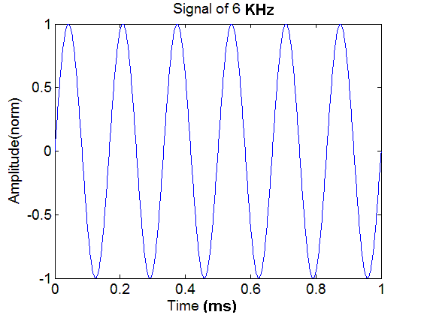
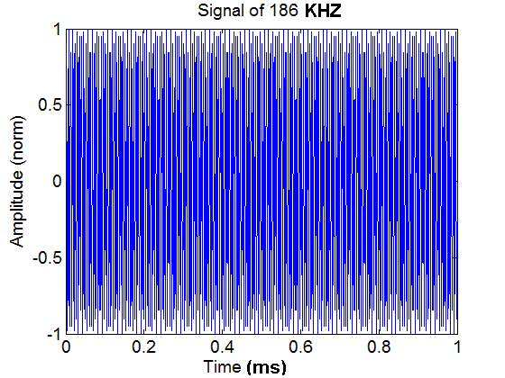
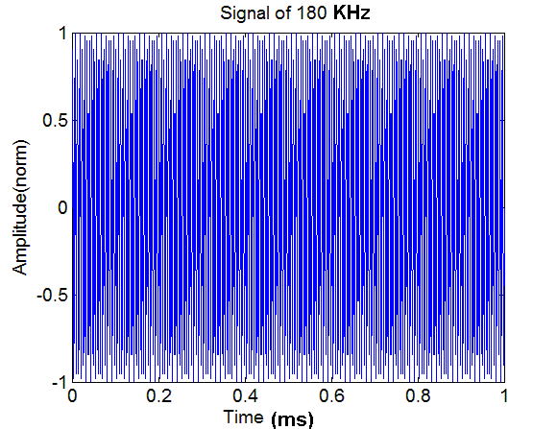
Parametric acoustic sources
When two high frequency signals (with close frequencies) are radiating from primary transducer to water medium they interact with each other in the area of non-linear interaction and thus produce number of signals with sum, difference, double frequencies and harmonics.
The main operating frequency is difference one (F=f1-f2) because it is low enough (due to closeness of high primary frequencies) and has narrow (2-4°) side-lobeless beam pattern in wide band that is easily adjusted by changing electrically the frequency one of primary waves.
It’s possible due to non-linear properties of medium of propagation of sound

Slide 5
Parametric acoustic sources
The parametric acoustic sources has some advantages with respect to traditional linear radiating systems:
- Opportunity of obtaining narrow directional pattern at small overall dimensions of
primary transducer.
- Absence or low level of side-lobes in a directional pattern on a difference frequency.
- Broad band of operating frequencies of radiated signals.
The same effect can be used for transient signals:
  It is possible to generate a transient signal by a “special modulation” at a larger frequency in such a way that it “interacts” with himself in the medium providing the desired signal due to the difference of f2-f1 frequencies from the spectral content of the short modulated signal

Slide 6
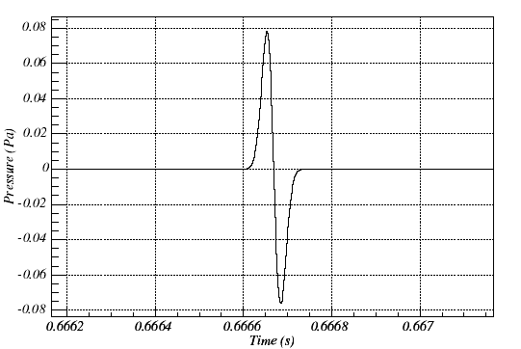
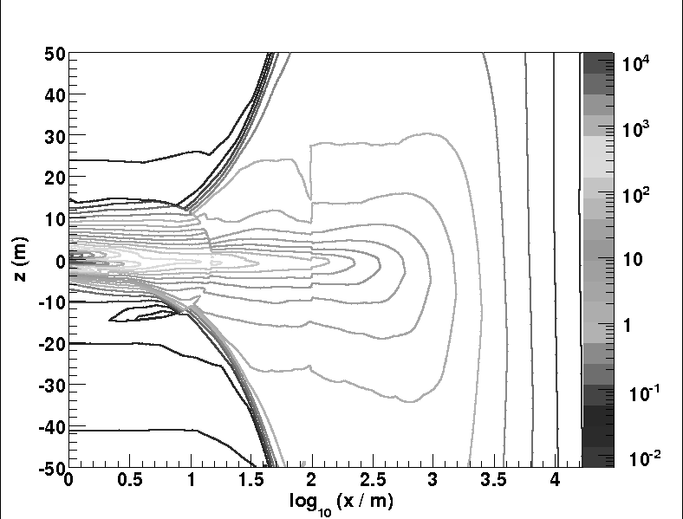
Use of the technique for neutrino calibration
Neutrino acoustic signals are very directive bipolar transient signals
Using parametric acoustic sources, it will be easier to reproduce the ‘pancake’ directivity with fewer sources, and in a more compact design:
  Cheaper and ease of deployment and operation in the sea (for example, instead of using 10 hydrophones in 5 m, use 3 in 0.5 m)
Warnings:
  Clever modulation needed? Yes, but clever people have already made a big part of the job
  Need large intensities? Yes, but since neutrino signals are weak, with reasonable intensities are enough

Slide 7
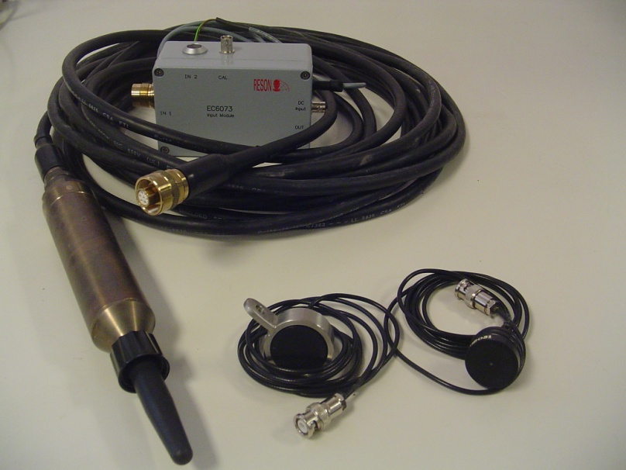
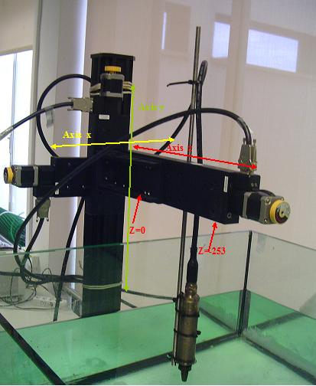
Studies with parametric generation
Experimental setup:
- Hydrophones used. - Reference system.
Reson TC 4014
Reson TC 3027(1MHz)
Reson TC 3021(2MHz)
Emitter hydrophone is fixed.
Receiver hydrophone moves along z axis.
For each position of z scan in x and y direction
Dimension of tank is
Sampling frequency (in reception) 10,20MHz -> 2MHz

Slide 8
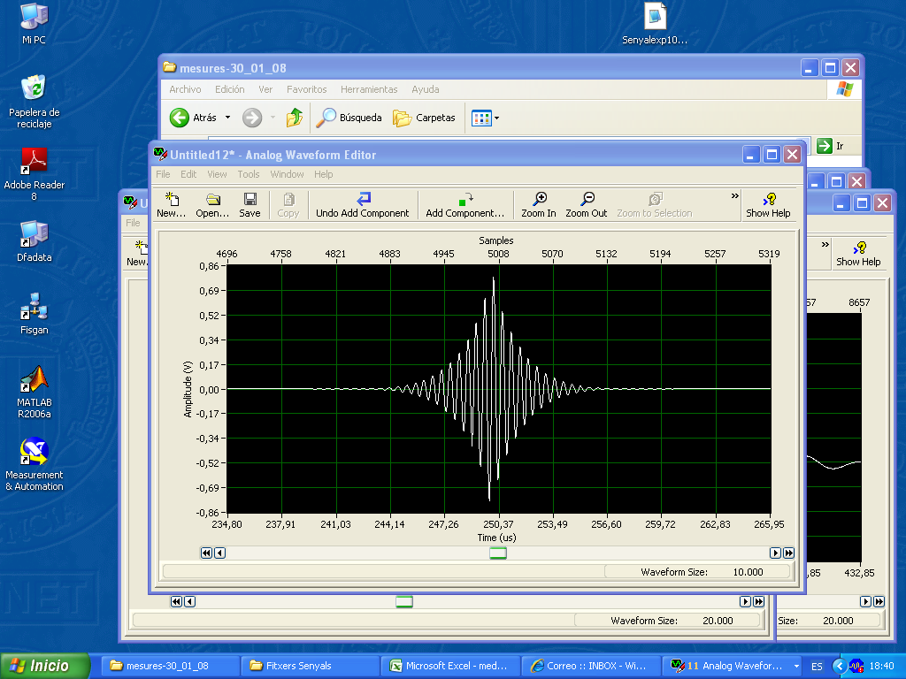

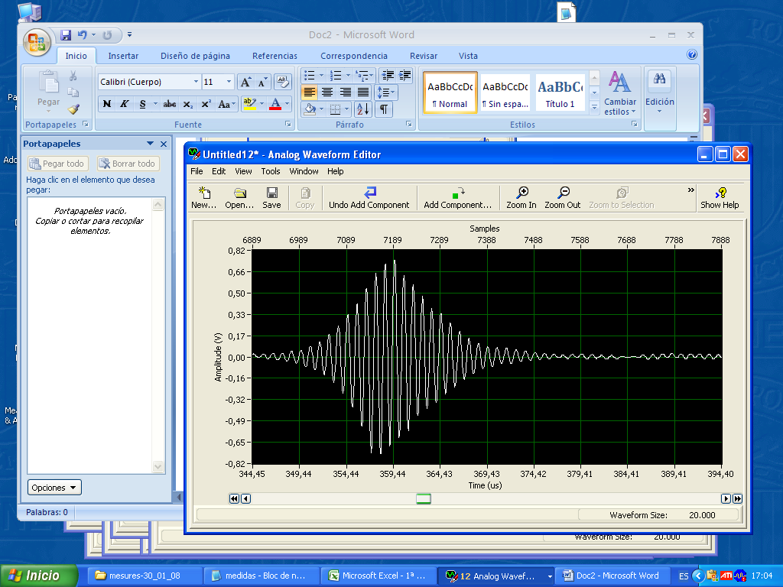
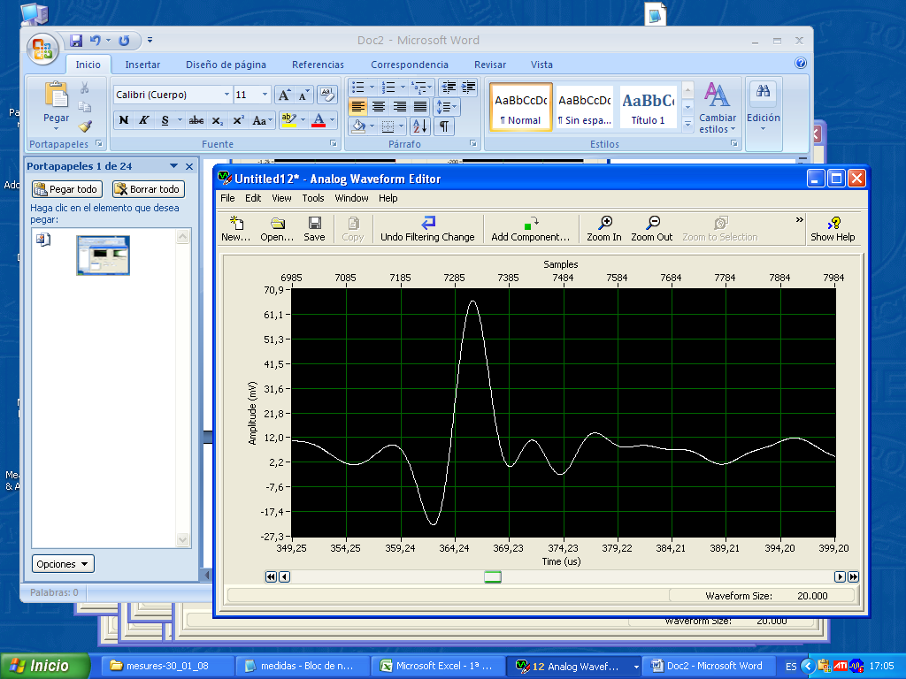
Studies with parametric generation
Modulation calculated from parametric theory:
Emitted signal (before amplification)
The goal of this study is:
  Obtain bipolar pulse after apply high frequency filter on received signal.
  To characterize the directivity of parametric beam (x,y direction).
After High Frequency filter
Received signal

Slide 9
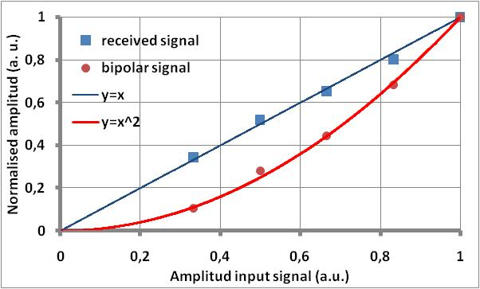
Studies with parametric generation(results)
1MHz Transducer. (Exemple of reproduction of neutrino like signal).

Slide 10
Studies with parametric generation(results)
1MHz Transducer.
Results for x scan , dv means difference of maximum and minimum value of voltage.

Slide 11
Studies with parametric generation(results)
1MHz Transducer.
Results for yscan , dv means difference of maximum and minimum value of voltage.

Slide 12
Studies in IGIC – UPV(Results)
2MHz Transducer.
Results for xscan , dv means difference of maximum and minimum value of voltage.

Slide 13
Studies in IGIC – UPV(Results)
2MHz Transducer.
Results for y scan , dv means difference of maximum and minimum value of voltage.

Slide 14
Studies with parametric generation(results)
Relation of voltages beetwen original signal received and filtered signal is proportional factor 10.
Seems that parametric beam haven’t a good efficiency!!!
According to the fits of original and filtered signal, the attenuation of parametric beam is smaller than 1/r.

Slide 15
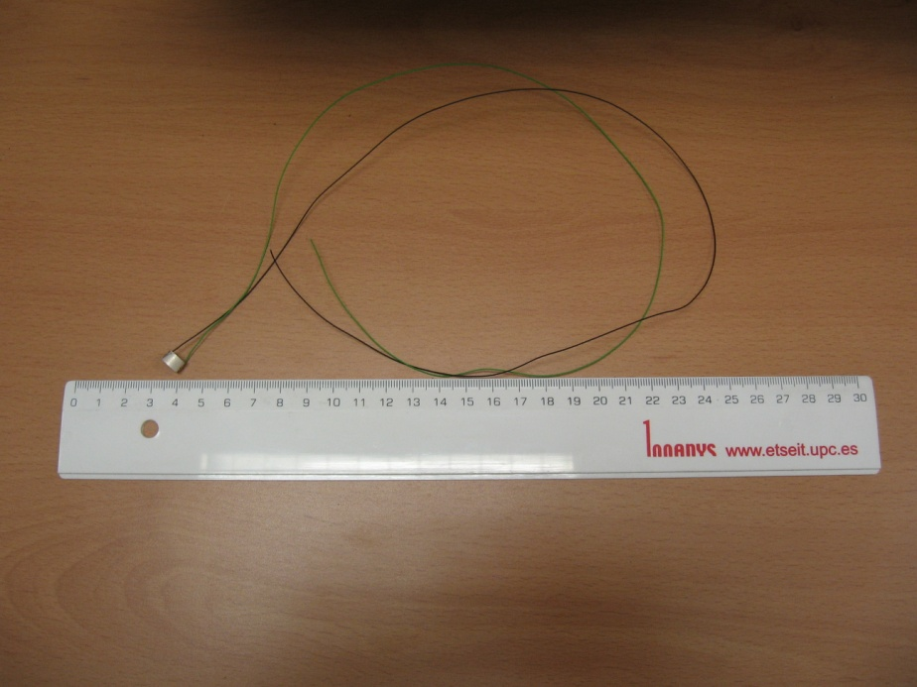
Next Steps
Study this effect over large distances.
We are working now in construction of n array using cylindrical transducers
  First step: to know the behavior of one single piezo-ceramics.
  Design and construction of the array

Slide 16
Conclusions
First results in the study of the parametric technique to generate directive neutrino-like signals seem very promising.
Therefore, we will continue in this direction, aiming to design and build a prototype based on this technique.

