Slide 1
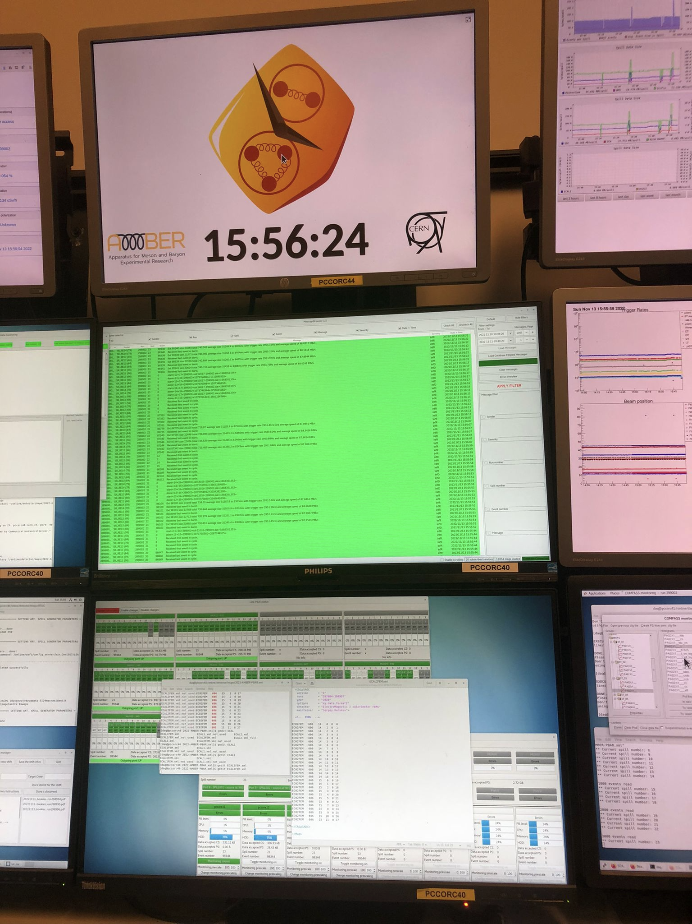
EHN2 working group
23/02/2023
  AMBER – plans for 2023
Outlook
AMBER APX:
  - 2023 preparations
2. PRM
  - 2023 set-up

Slide 2
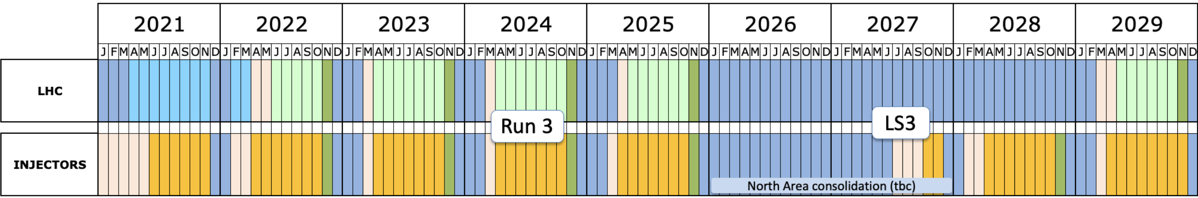
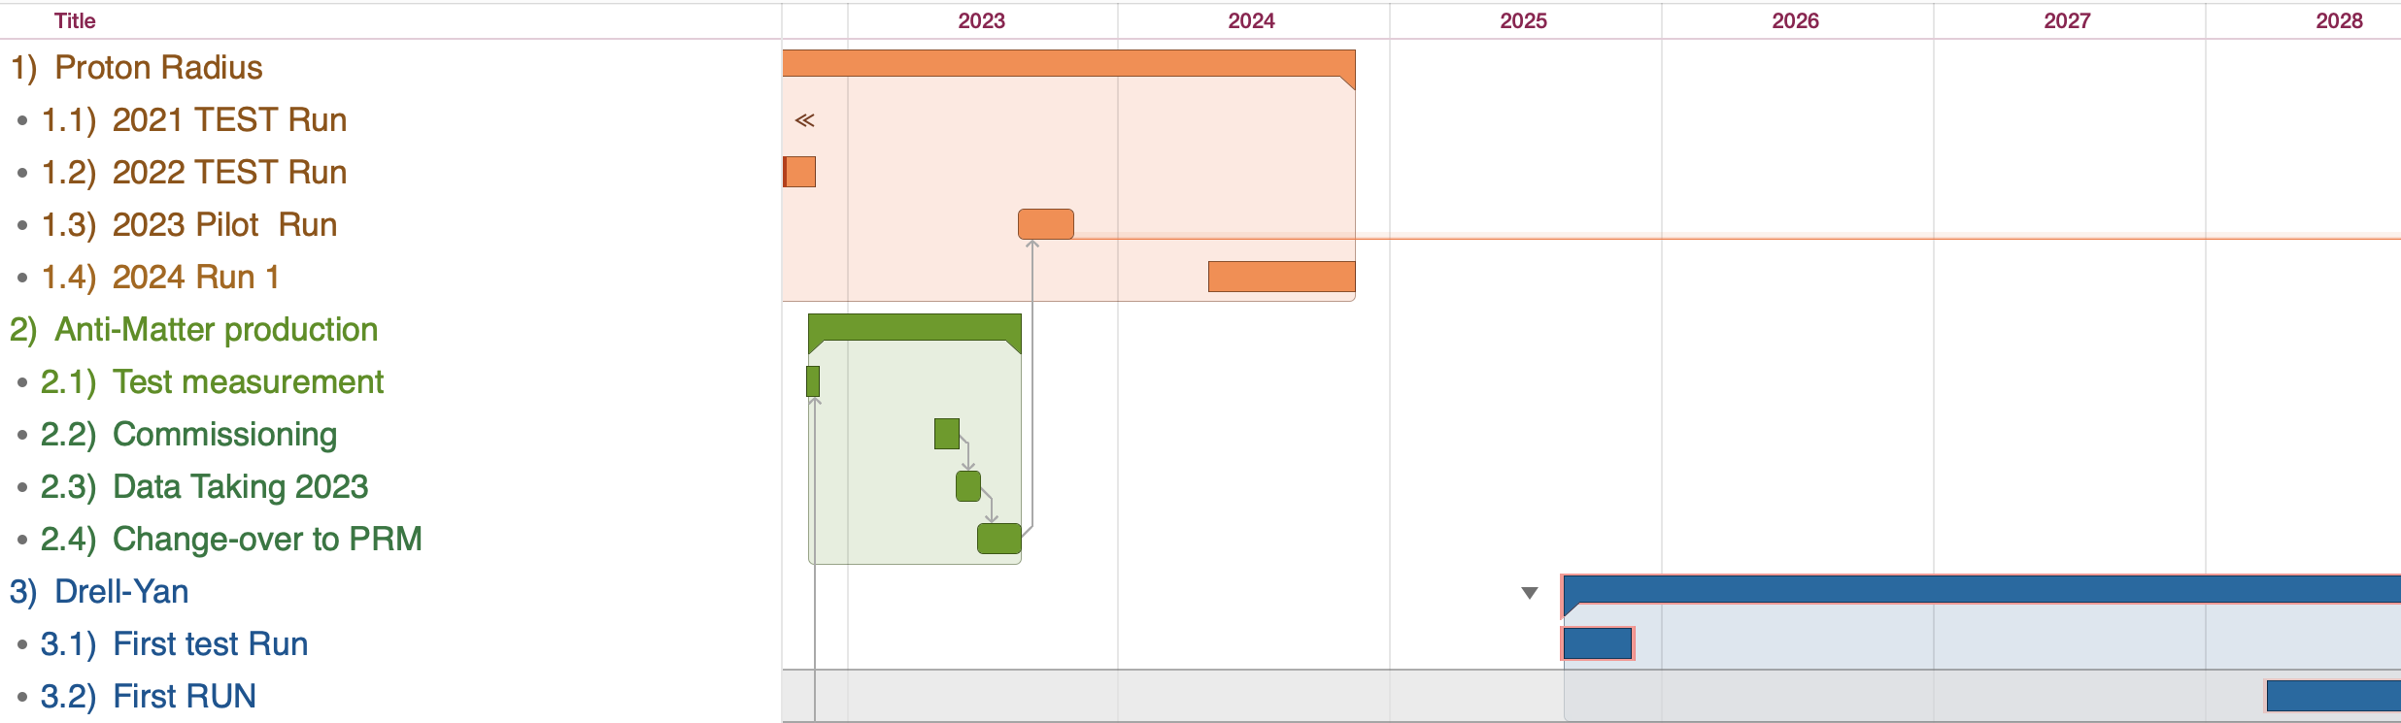
AMBER Phase-1 running plan
Milestones:
May 1st 2023 – Antimatter production Run (Std. DAQ)
Sep. 1st 2023 – PRM pilot (FreeDAQ, very limited setup)
May 1st 2024 – PRM Run (FreeDAQ, limited setup)
Sep. 1st 2025 – DY Pilot (FreeDAQ, all trackers + mu id)
May 1st 2028 – DY Run (Full Spectr. Ex. RICH, Calorimeters)
Approved AMBER Phase-1 Program:
AXS: 2 months
Drell-Yan: 2 years
PRM: 1 + 1 year (conditionally)
Long Shutdown 3

Slide 3
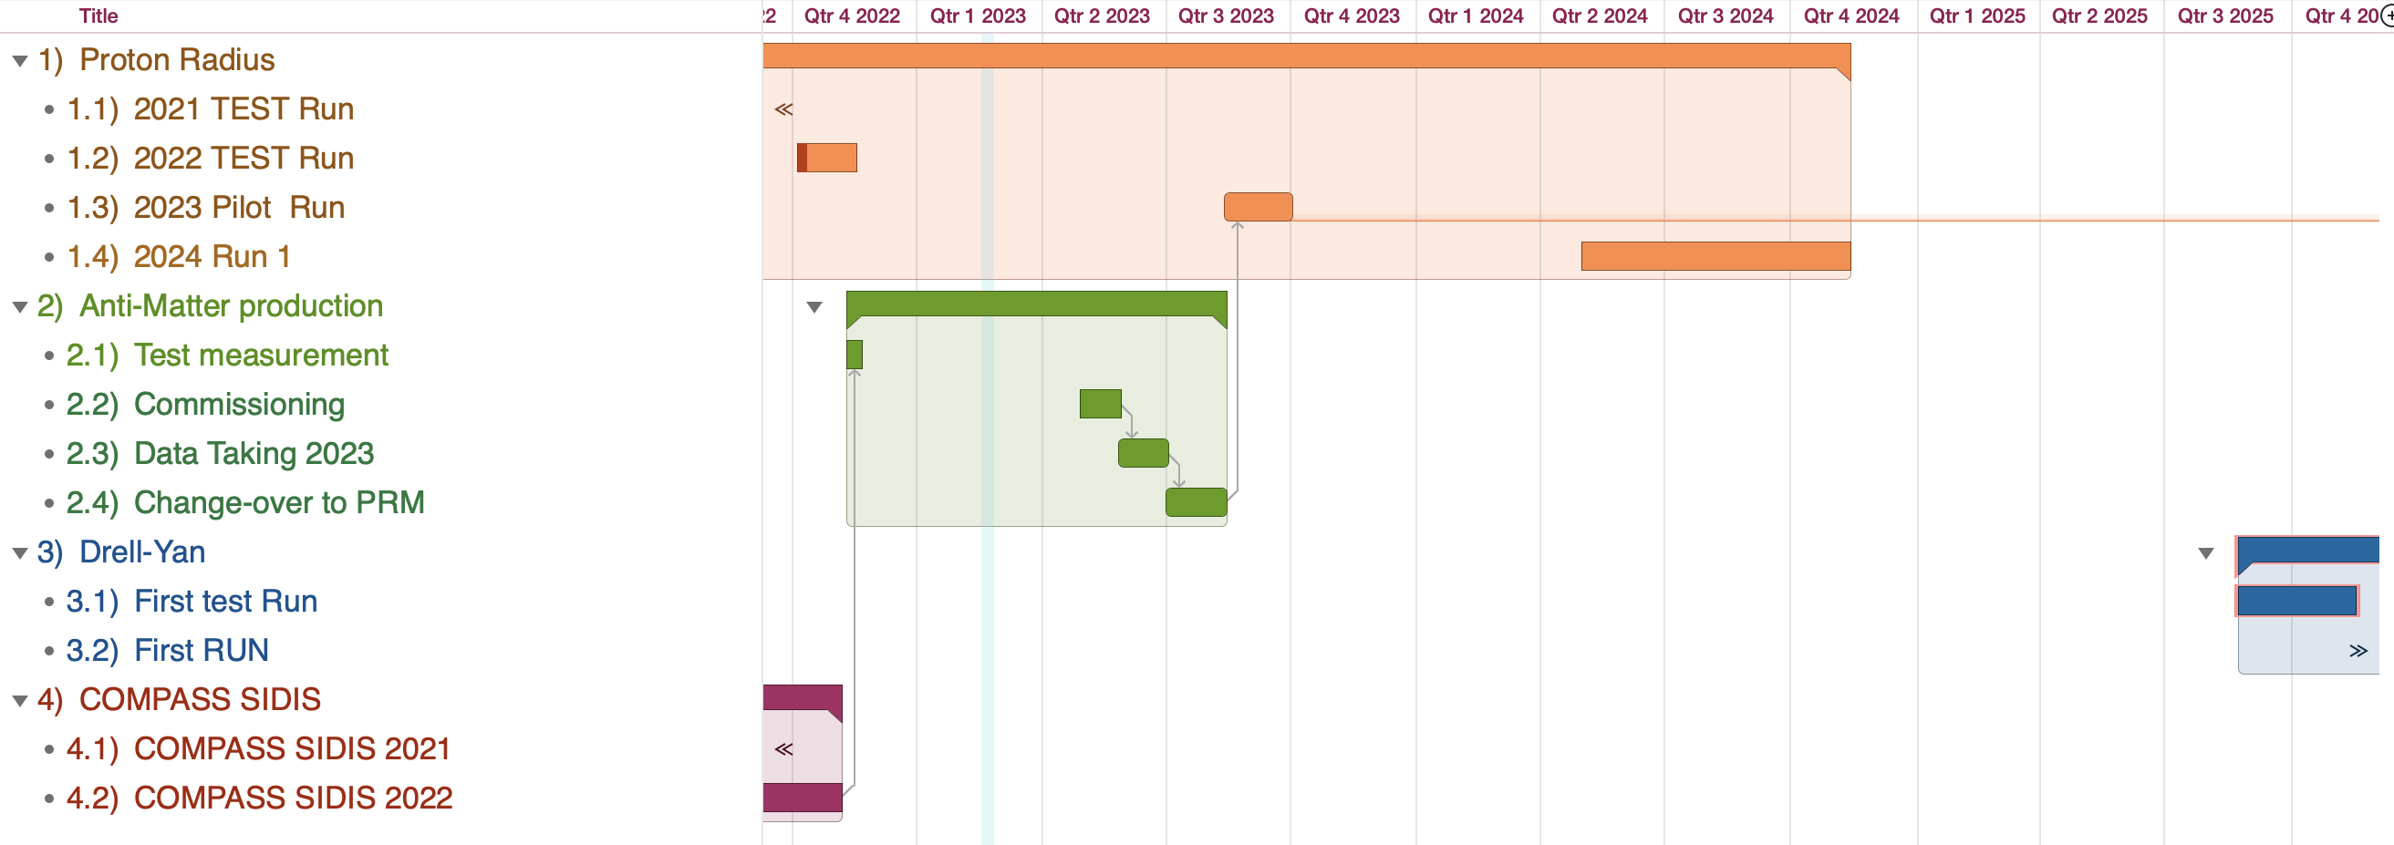
AMBER Running Plan
1. AMBER APX: 1st May – 30th June 2023
2. Changeover APX ➔ PRM : 30th June – 15th/30th August
3. PRT Pilot Run: 15th/30th August – 28th September

Slide 4
Spectrometer composition 2023
BeamLine:
[X] Cedar (CE01,02)
Not available for the test run
Working for installation of: one CEDAR West (
lower momentum coverage) + one CEDAR North for 2023
BeamTelescope:
[X] Cold Silicons (SI01,02,03)
[X] SciFis (Fi01,15,02)
[X] Vetos (VI1,VI2,Vbl,Vout)
Large Angle Spectrometer (LAS):
[X] MicroMegas (PM01,02,03)
[X] GEMs (GM01,02,03,04,05,06)
[X] SciFis (Fi03,04,05, 55)
[X] Small DCs (DC0,1)
[X] Big DCs (DC4,5)
[X] MWPCs (PS01, PA01,02)
[X ] Straw (ST03)
[X ] Rich
[X ] RichWall (RW01)
[] ECAL1
[] HCAL2
[X] MuonWall1 (MW11,12)
[] Hodoscopes (HG01/02)
Small Angle Spectrometer (SAS):
[X] GEMs (GP03,GM07,08,09,10,11)
[X] MWPCs (PA03,04,05,06,11,PB01,02,03,04,05,06)
[] Hodoscopes (HO03/04, HM04/05, HL04/05, HI05)
[X] SciFis (Fi07,08)
[X] W45 (DW01/02/03/04/05/06)
[] ECAL2
[] HCAL2
[X] MuonWall2 (MW21,22,23,24,25,26)

Slide 5
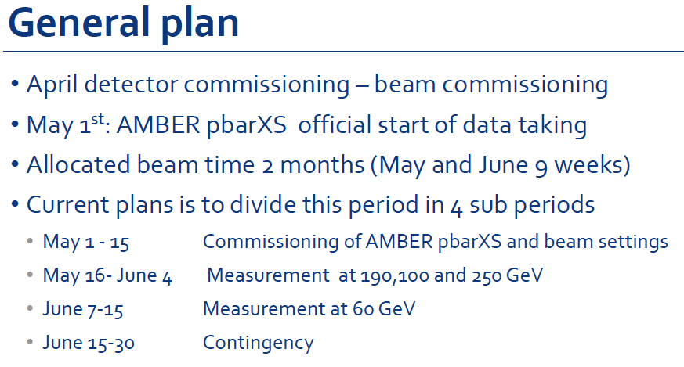
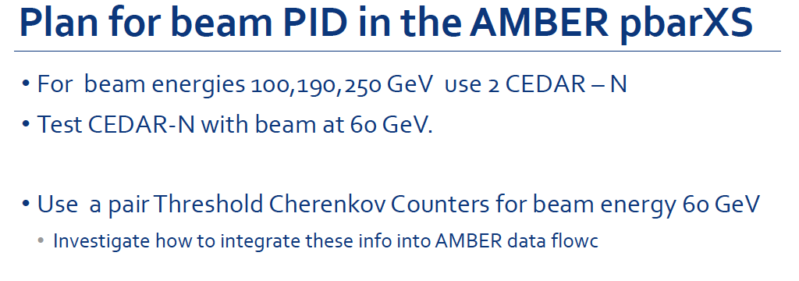
APX running plan

Slide 6
CEDARs studies
Limitation of CEDAR N to tag p at lower momenta
Dipanwita: commissioning of CEDAR N at 60 GeV/c in April
If not successful we will use 2 CEDAR N and add two Cherenkov counters​ for the last part of the run

Slide 7
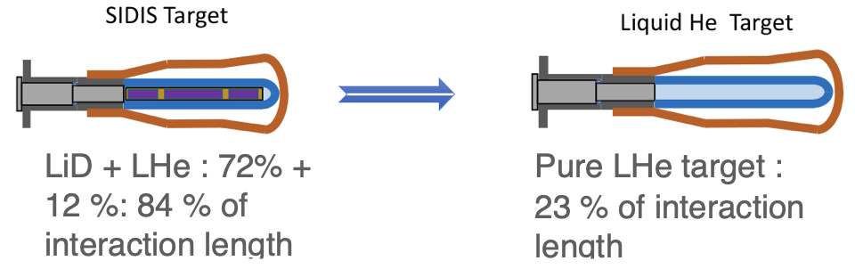
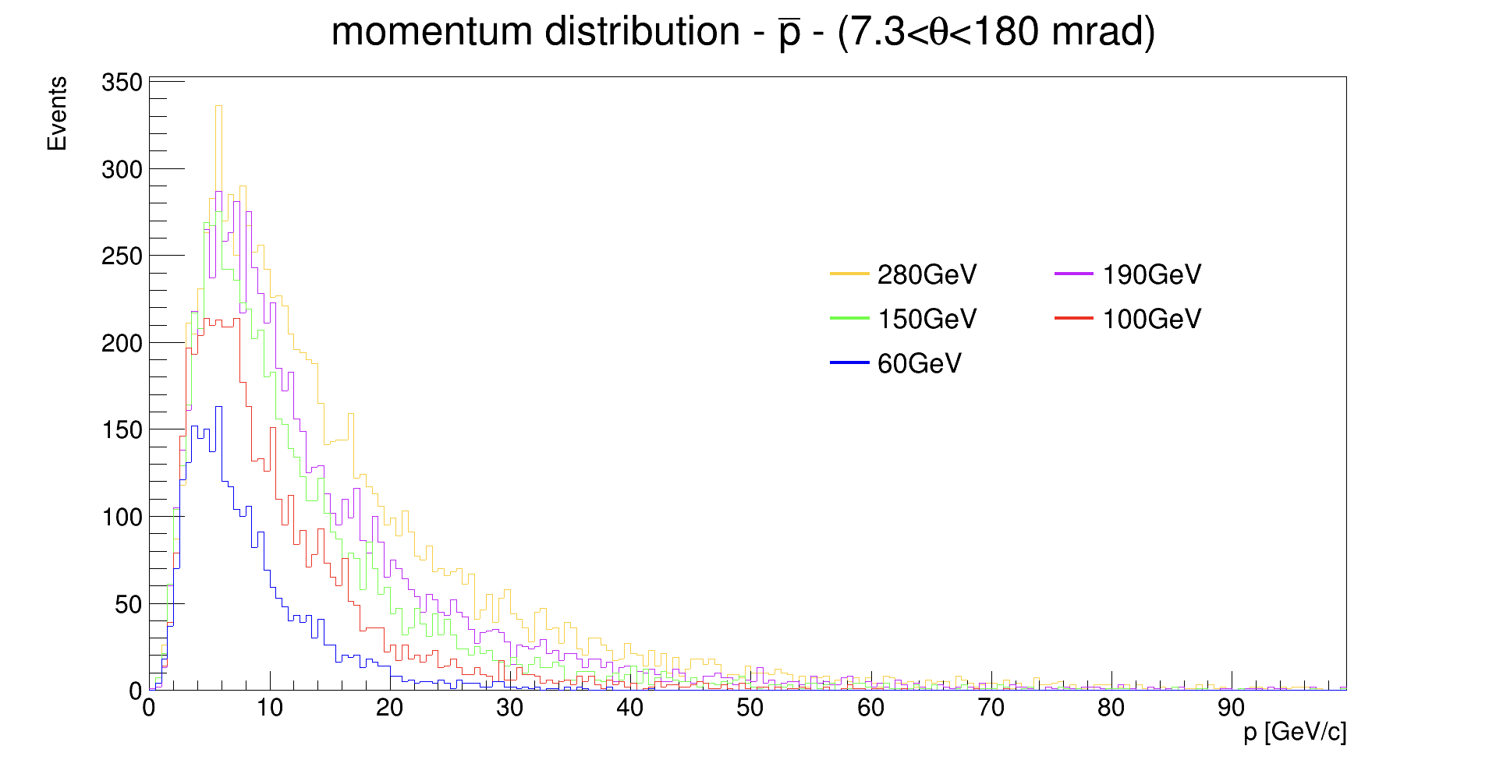
Second test run Nov. 2022
Test performed with the COMPASS SIDIS 2022 LiD Target
the difference in the trigger rate between LiD target and Liquid He Target is ~ factor 3 —> pre-scale the trigger/decrease beam intensity
Data taking at different beam momentum:
250 GeV/c, 190 GeV/c, 100 GeV/c, 60 GeV/c
Minimum bias trigger:
1. beam trigger + hodoscope veto —> ensures that the particle reaches the experiment within the geometrical target acceptance
2. beam killer —> remove non-interacting beam particles

Slide 8
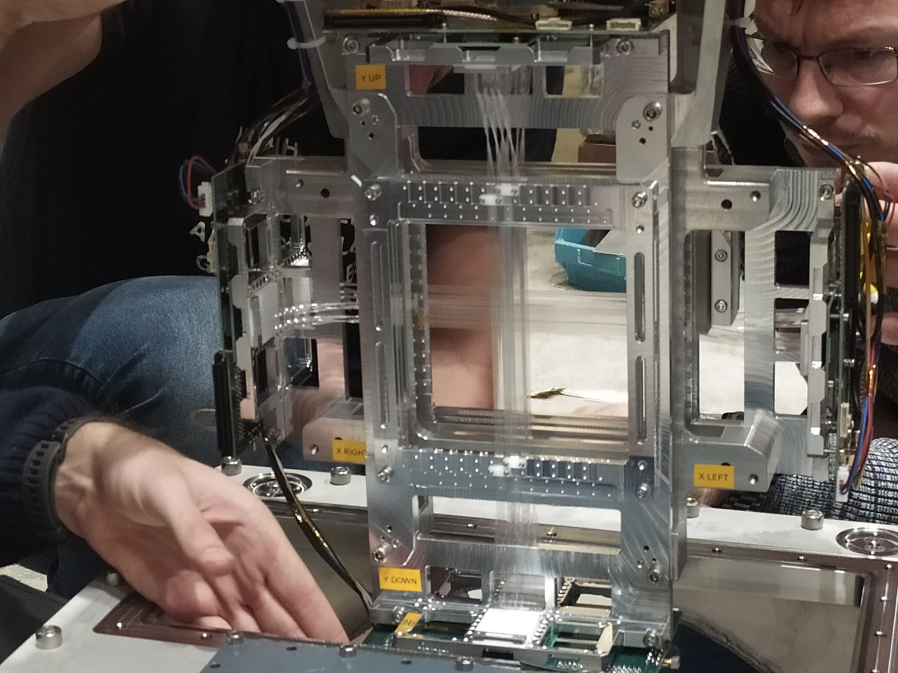
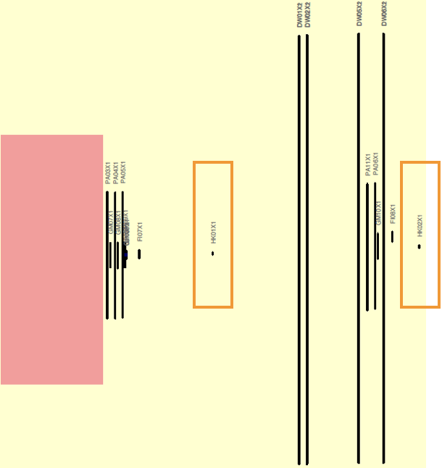
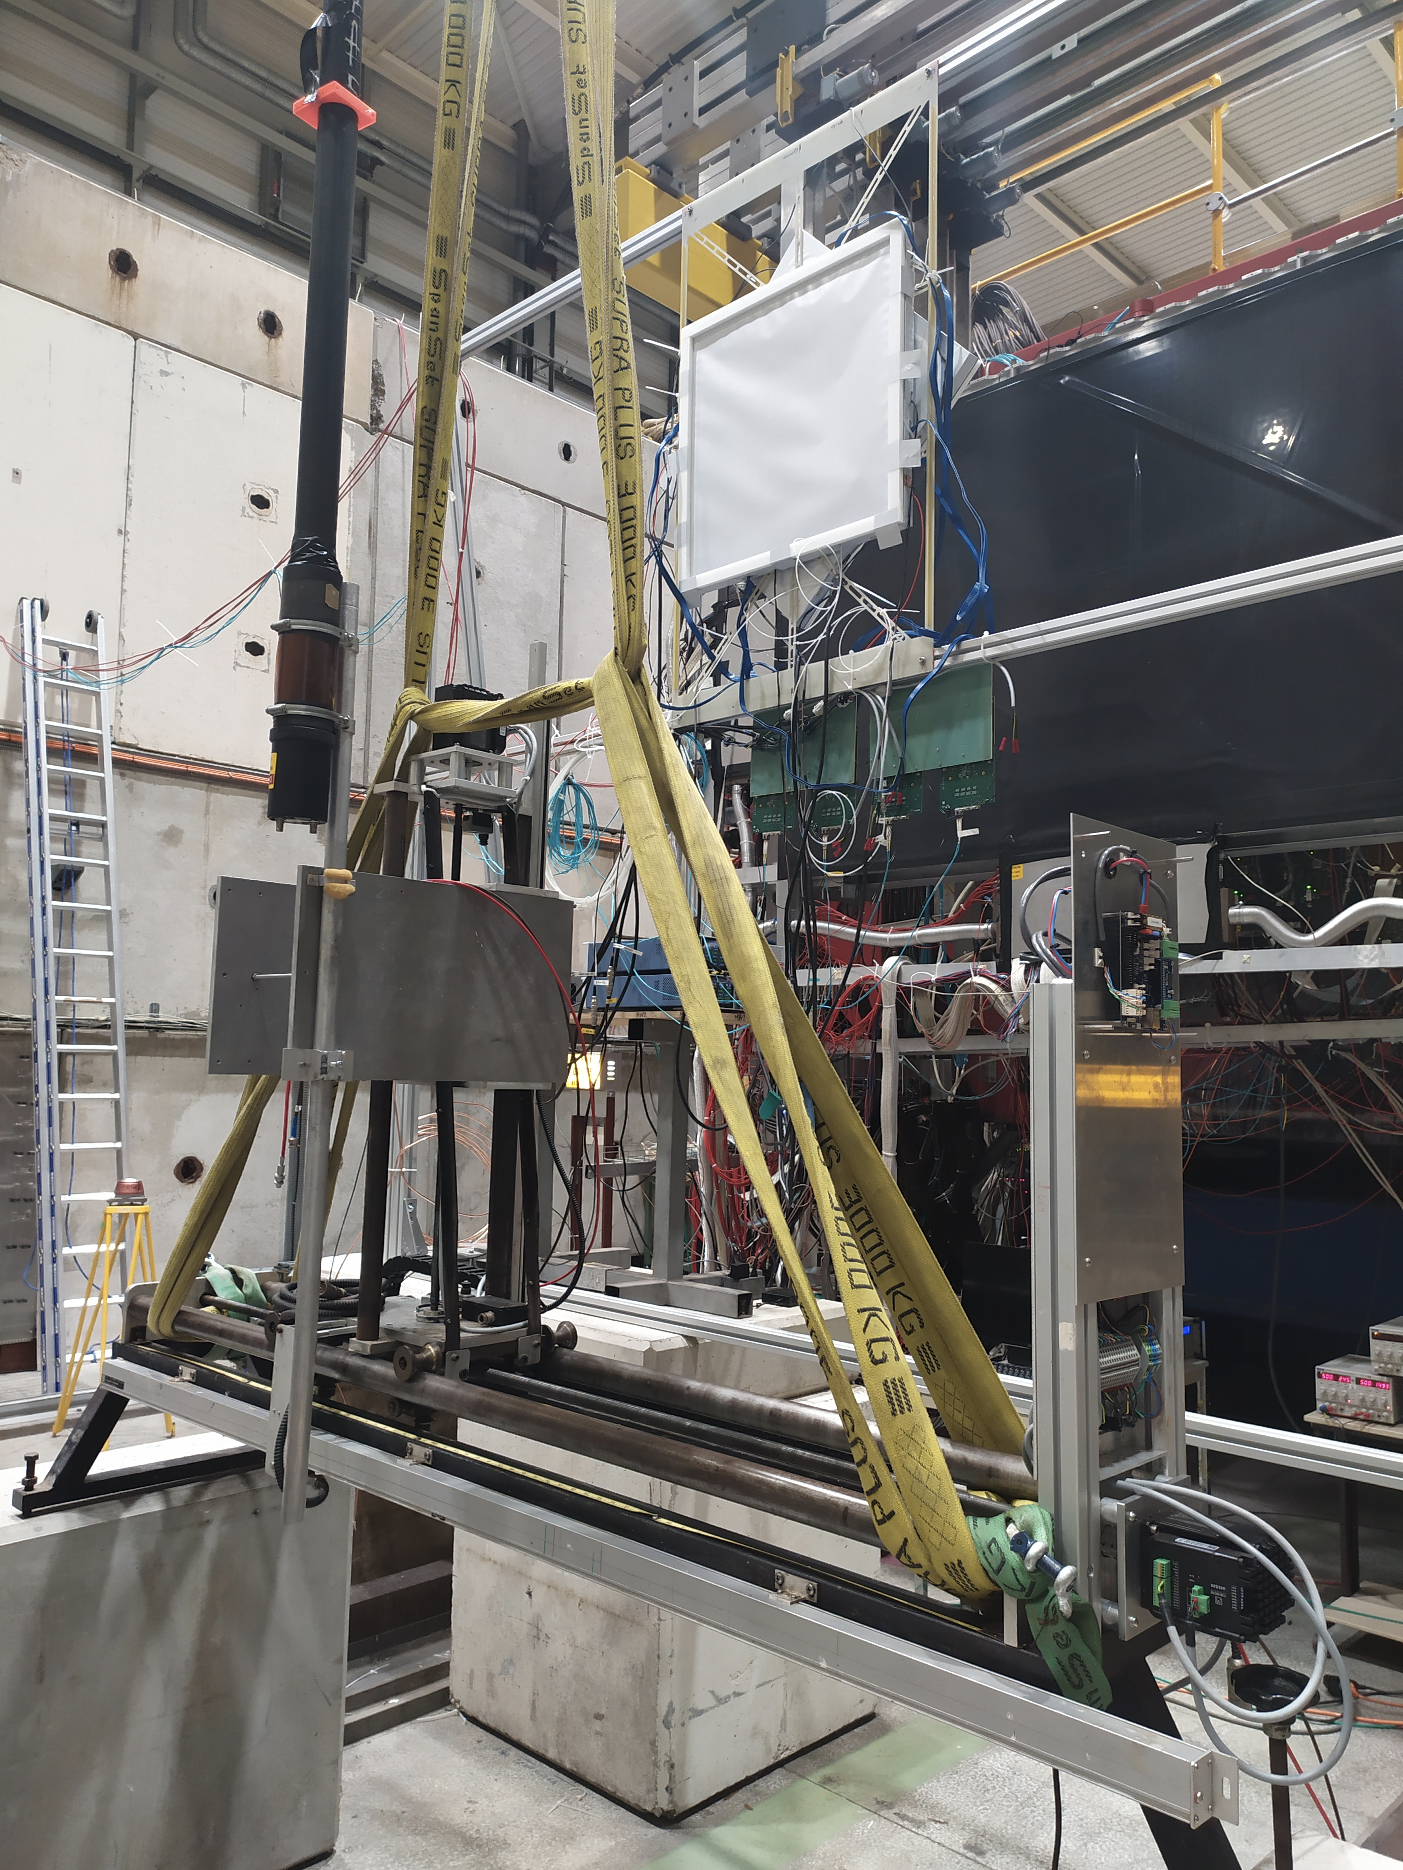
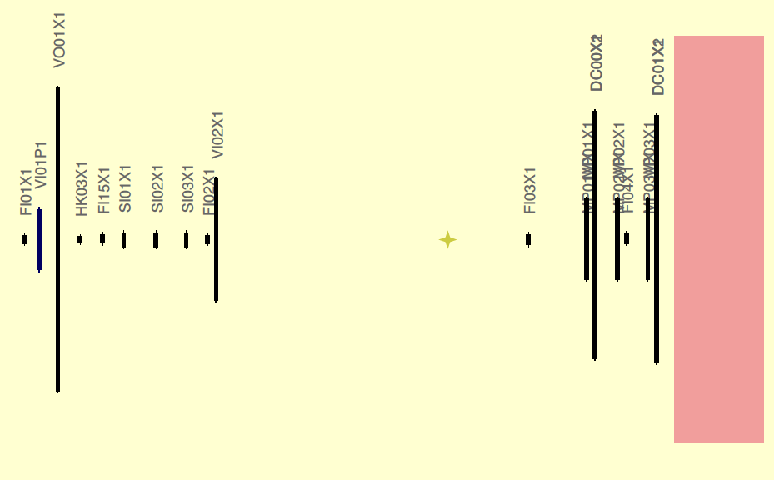
Changeover to APX + UTS
  Change over from SIDIS to APX setup:
  Target dipole OFF, SOLENOID MODE, polarisation measurement, switch off magnet to destroy polarisation, restart solenoid and do test. Switch on magnets and do some measurements
  Survey of SCIFI1, SCIFI15 —> movement —> survey of the new position (SCIFI1, SCIFI15, Veto)
  Chicane was removed
  Beam Killers installed and surveyed

Slide 9
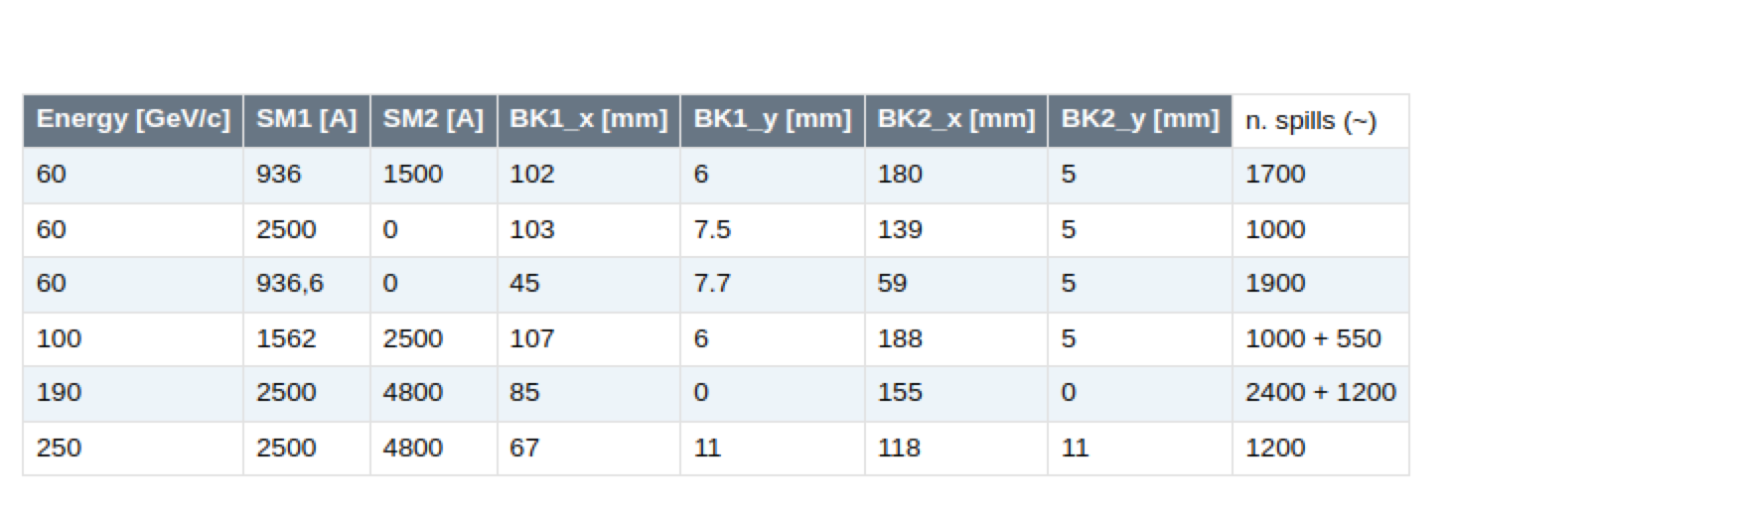
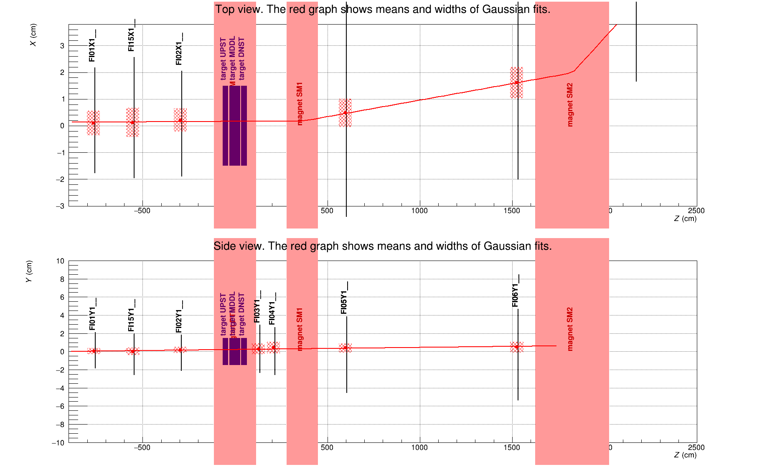
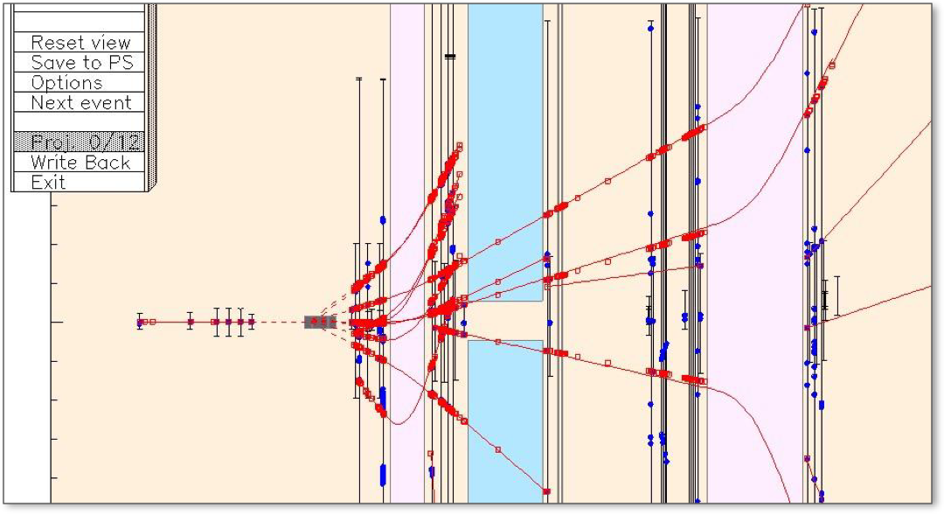
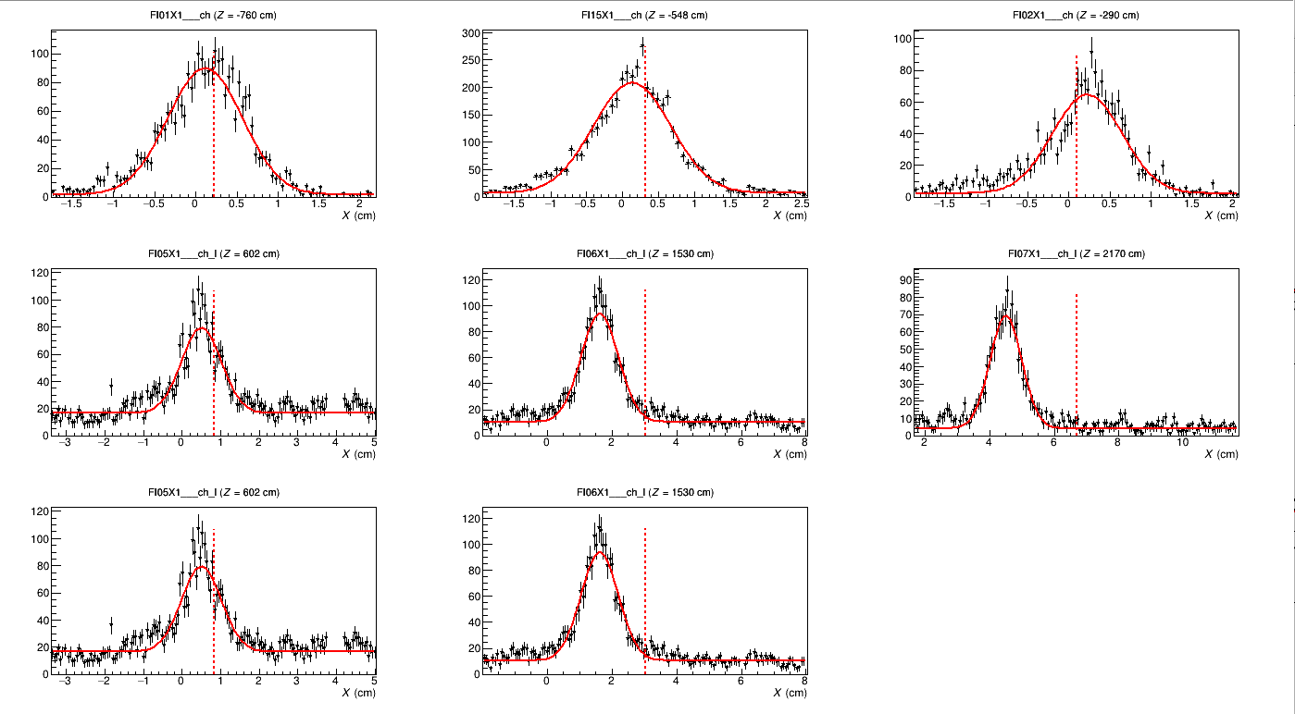
APX
positive hadron beam
T6 intensity 70.0e+11 p/spill
Symmetry 99%
Ion chamber 2: about 5e+05/spill
Beam tuning done with Dipanwita:
M2A.AMBER.000 2022 AMBER 60 GeV/c
M2A.AMBER.001 2022 AMBER 250 GeV/c
M2A.AMBER.002 2022 AMBER 100 GeV/c
M2A.AMBER.003 2022 AMBER 100 GeV/c

Slide 10
2023 – Preliminary PRM set-up
We intend to be ready with PRM set-up in the period 15-30/08 in order to collect 1 month of useful data in Sep. 2023

Slide 11
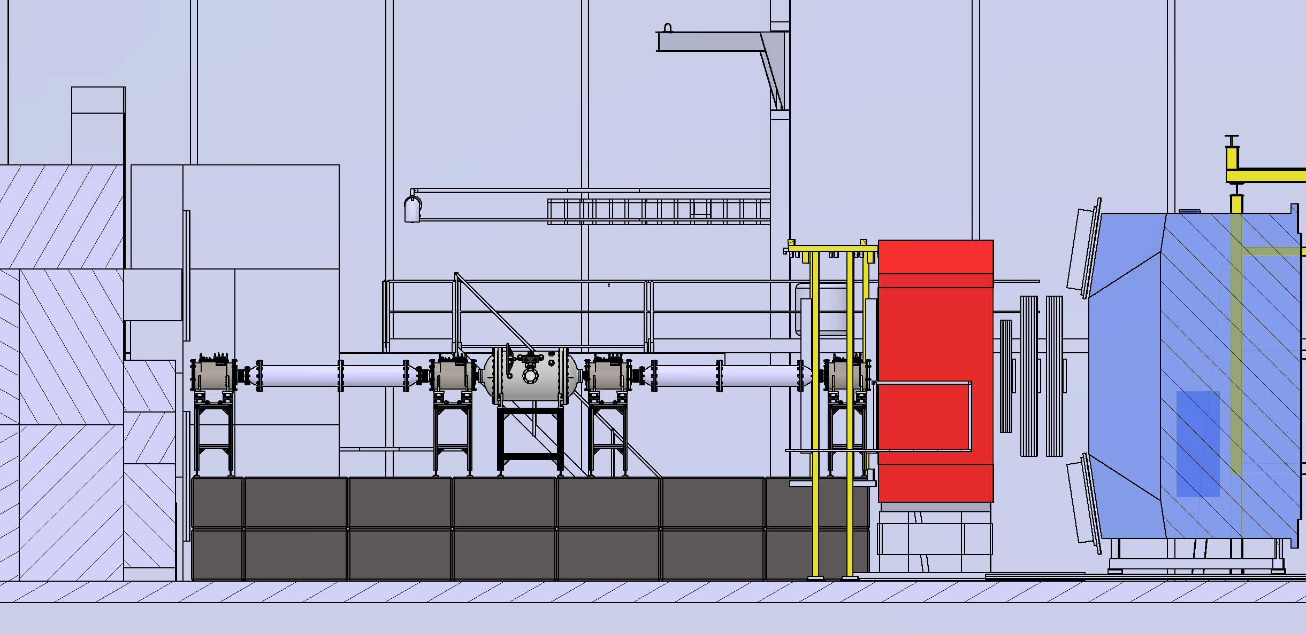
2023 – Preliminary PRM set-up

Slide 12
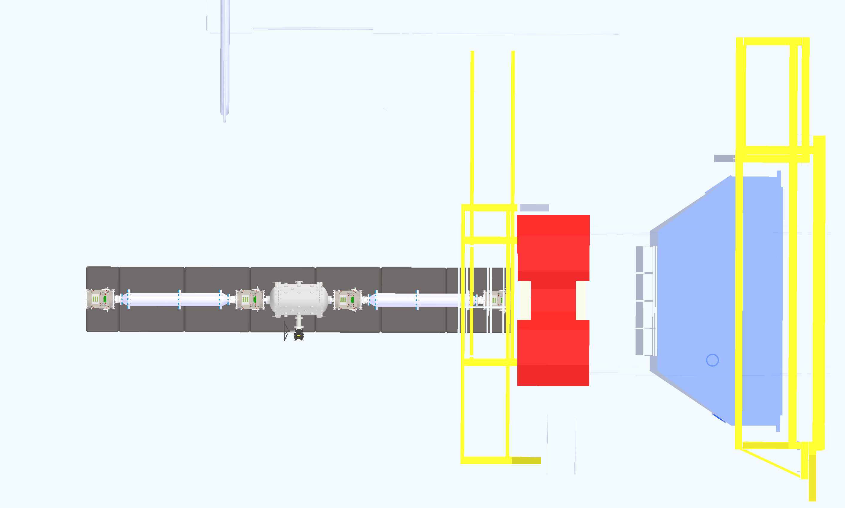
2023 – Preliminary PRM set-up

Slide 13
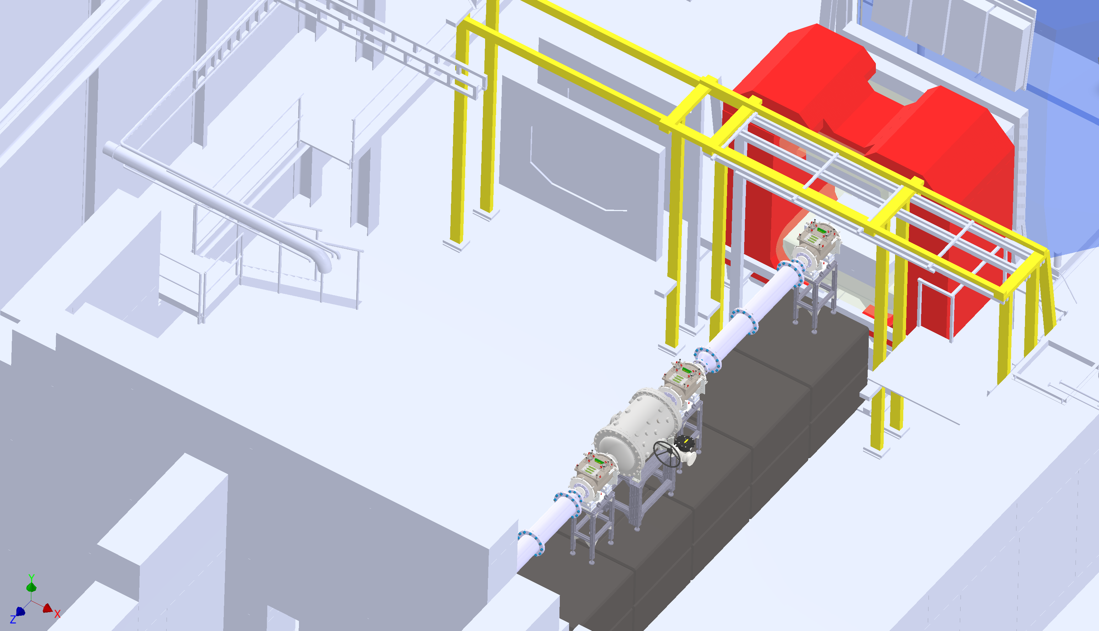
2023 – Preliminary PRM set-up

Slide 14
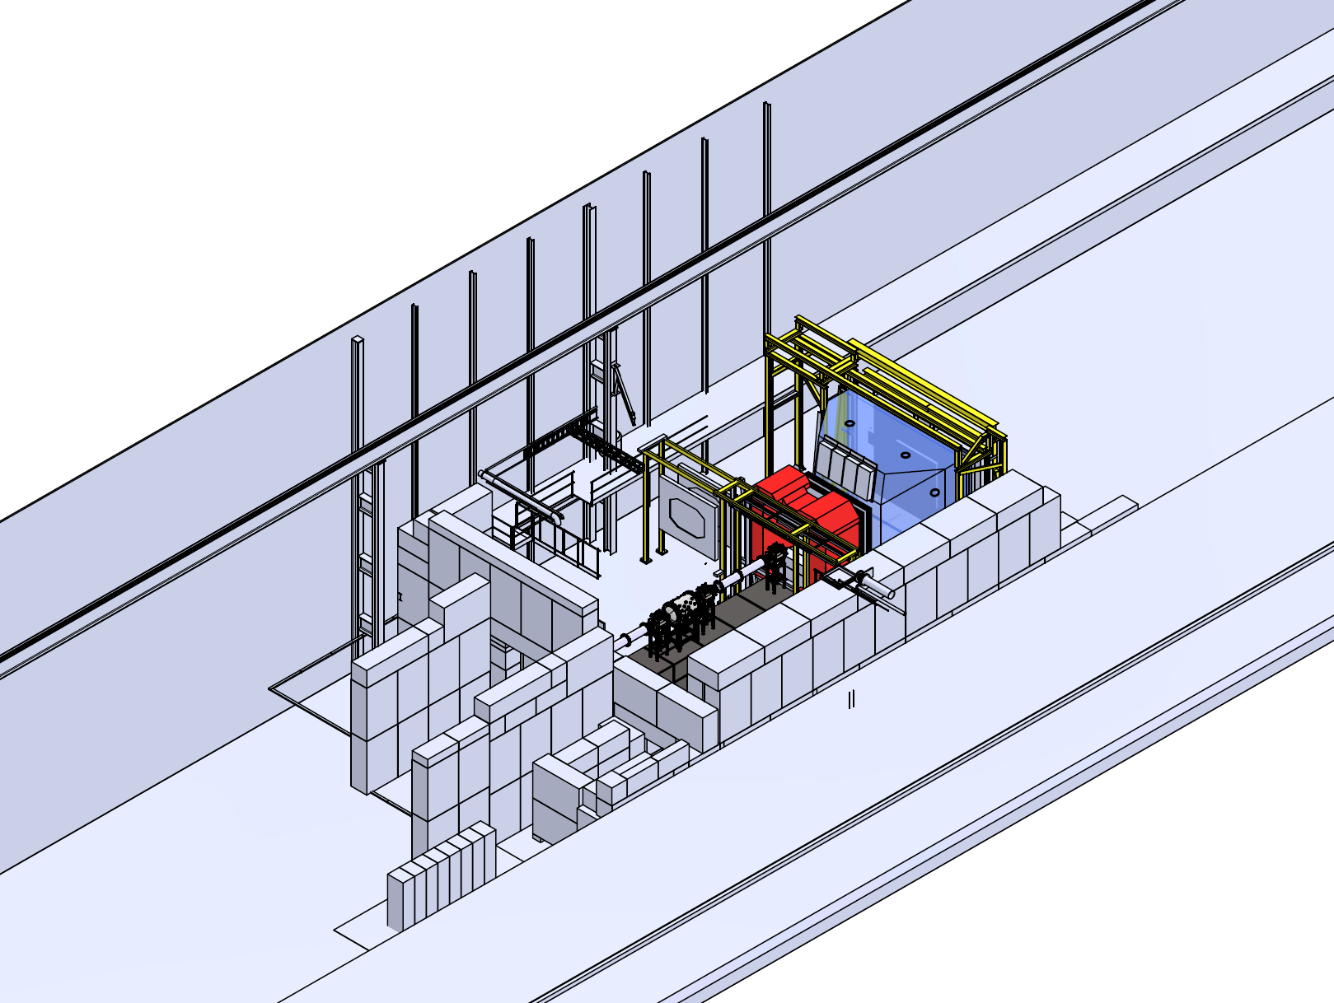
2023 – Preliminary PRM set-up

Slide 15
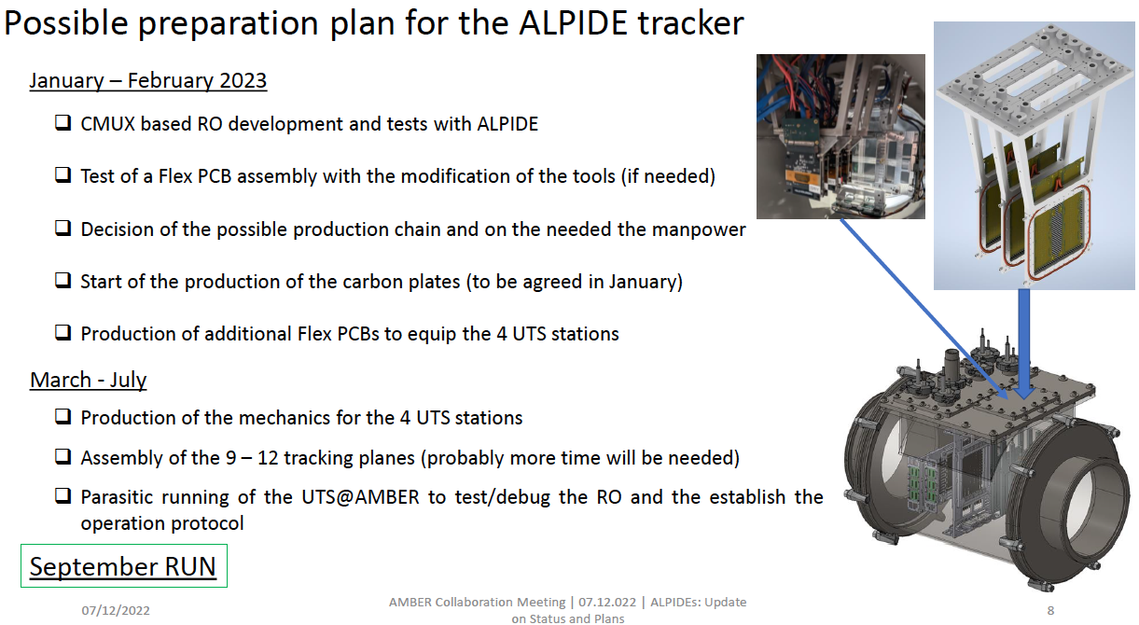
ALPIDE Silicons in 2023

Slide 16
Spares

Slide 17
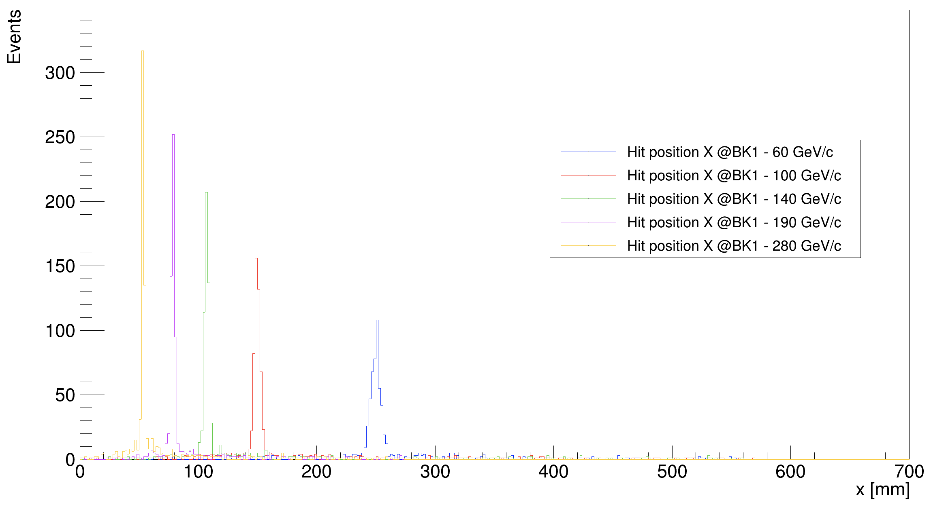
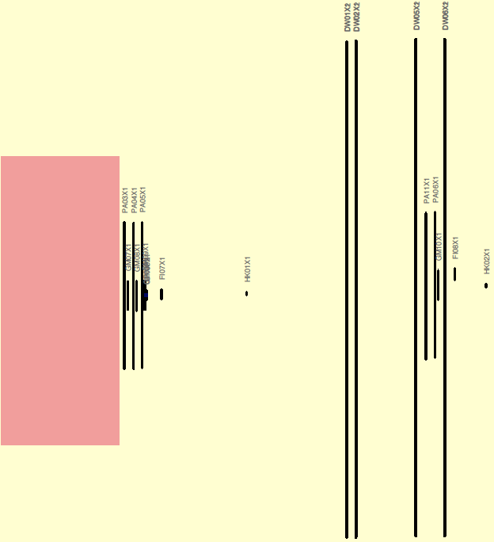
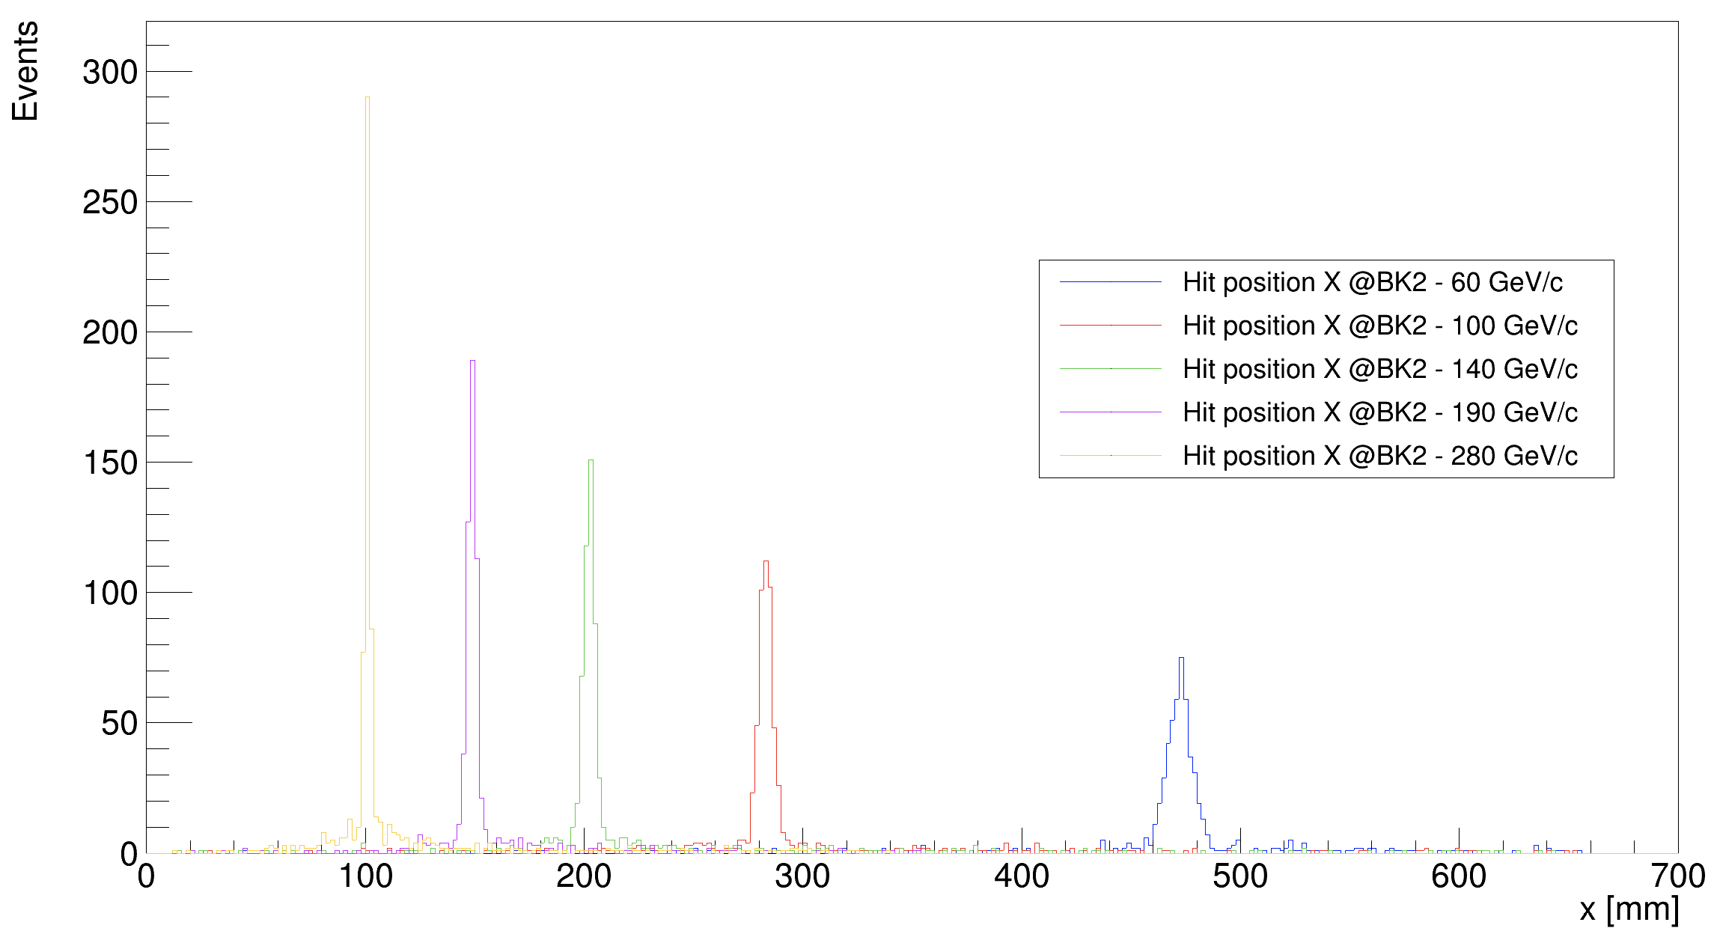
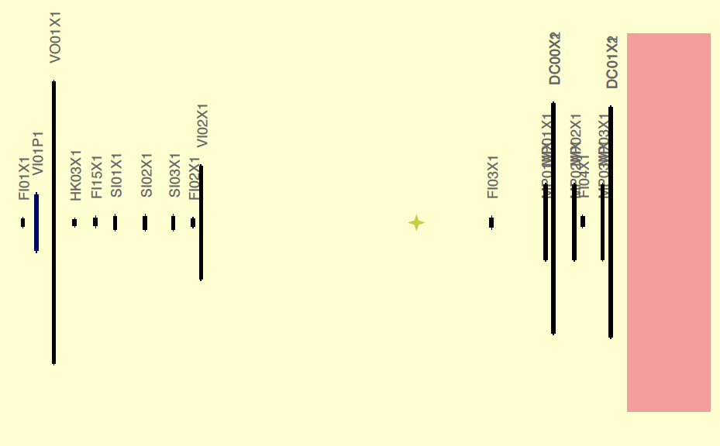
Attivita di Analisi e MC (AXS I) (TO)
Trigger elements & beam
How to do the measurement:
beam trigger + hodoscope veto —> ensures that the particle
reaches the experiment within the geometrical target acceptance
beam killers —> remove non-interacting beam particles
Need to scale the magnet current at low beam momenta
Optimal position of the beam killer
For the different beam momentum
All MC results confirmed in May 2022 test

Slide 18
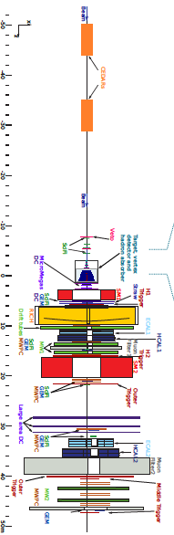
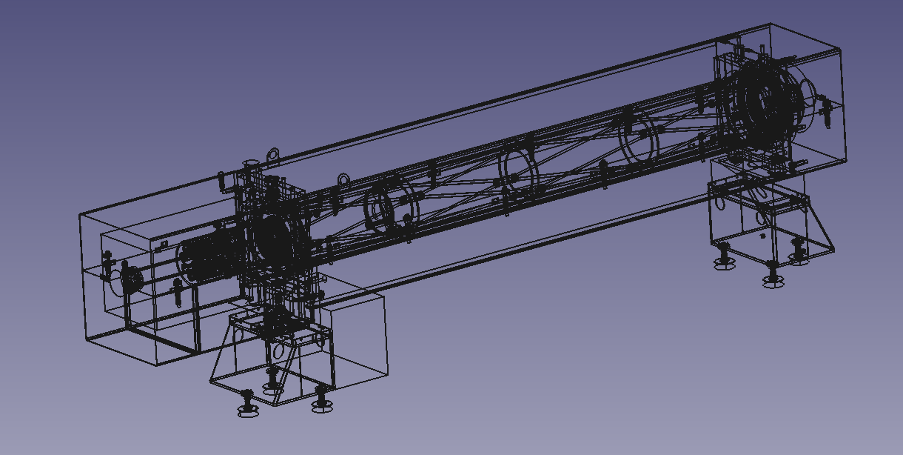
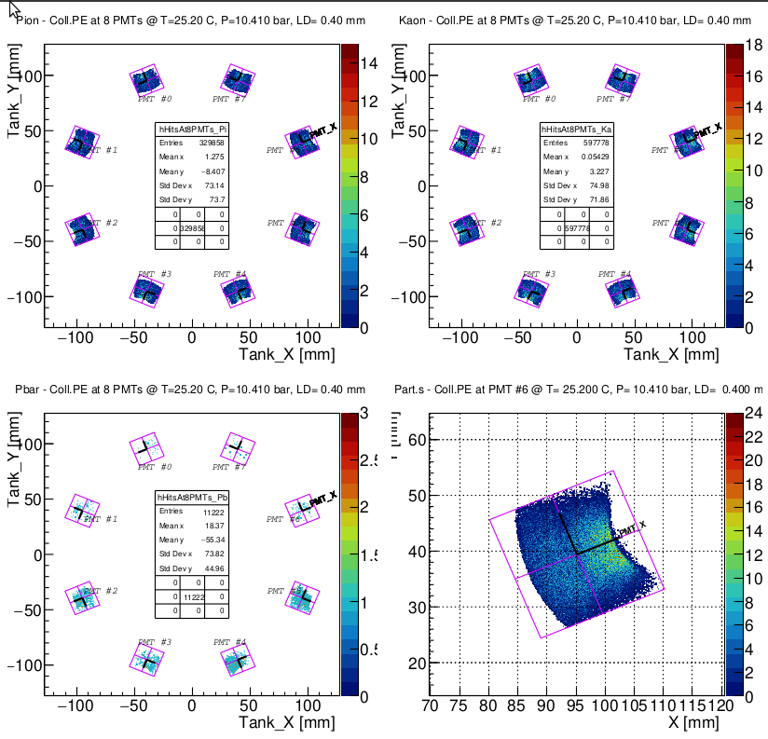
Attivita di Analisi e MC (AXS & DY)
CEDARs implementation in Tgeant (TO)
CEDARs (Cherenkov Differential counter with Achromatic
Ring Focus) is an essential part of the beam PID in the AMBER
Experiment (AXS and DY programs).
Recently CEDAR CAD description imported in TGEANT software.
Production and transport of Cherenkov photons in CEDAR is
simulated in a separate code (Flavio Tosello (TO)). This code in
encapsulated now in the TGEANT.
It is extremely useful tool for AXS and DY MC and analysis.
Code validation is nearly finished

Slide 19
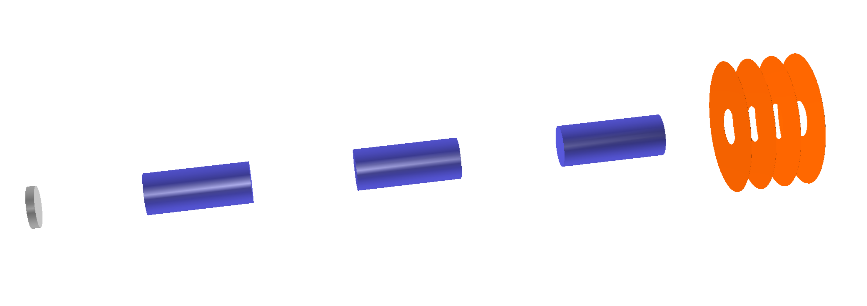
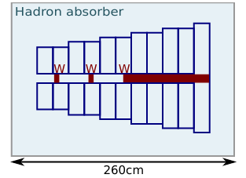
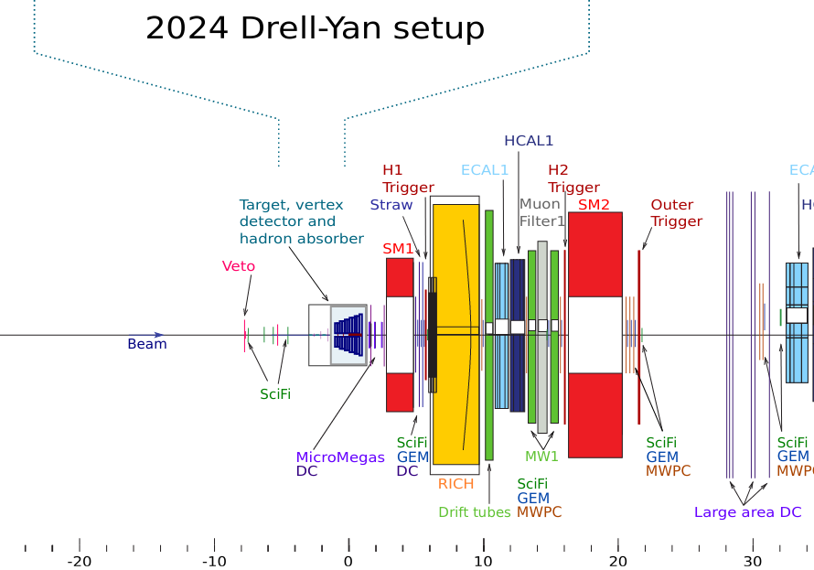
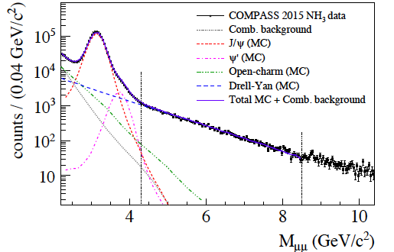
Drell-Yan experiment preparation I
Drell-Yan process is a low cross-section process:
High intensity hadron beam
Hadron absorber to protect Spectrometer from a very high secondary flux
Vertex Detector to compensate loses in resolution because of the absorber in order to improve mass and space resolution

Slide 20
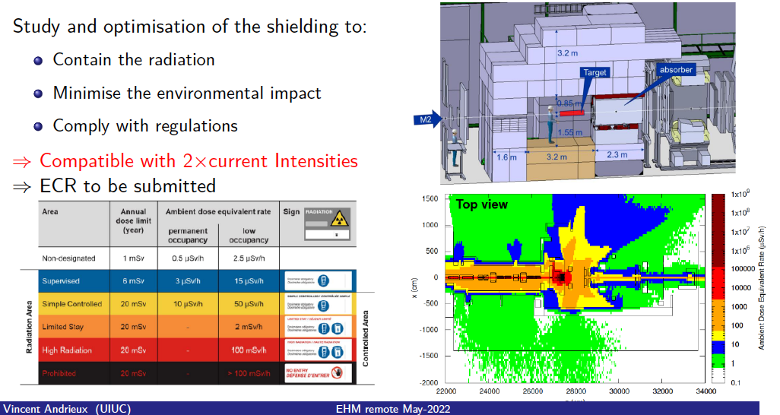
Drell-Yan experiment preparation
Toward doubling of the incoming beam intensity (TO)

Slide 21
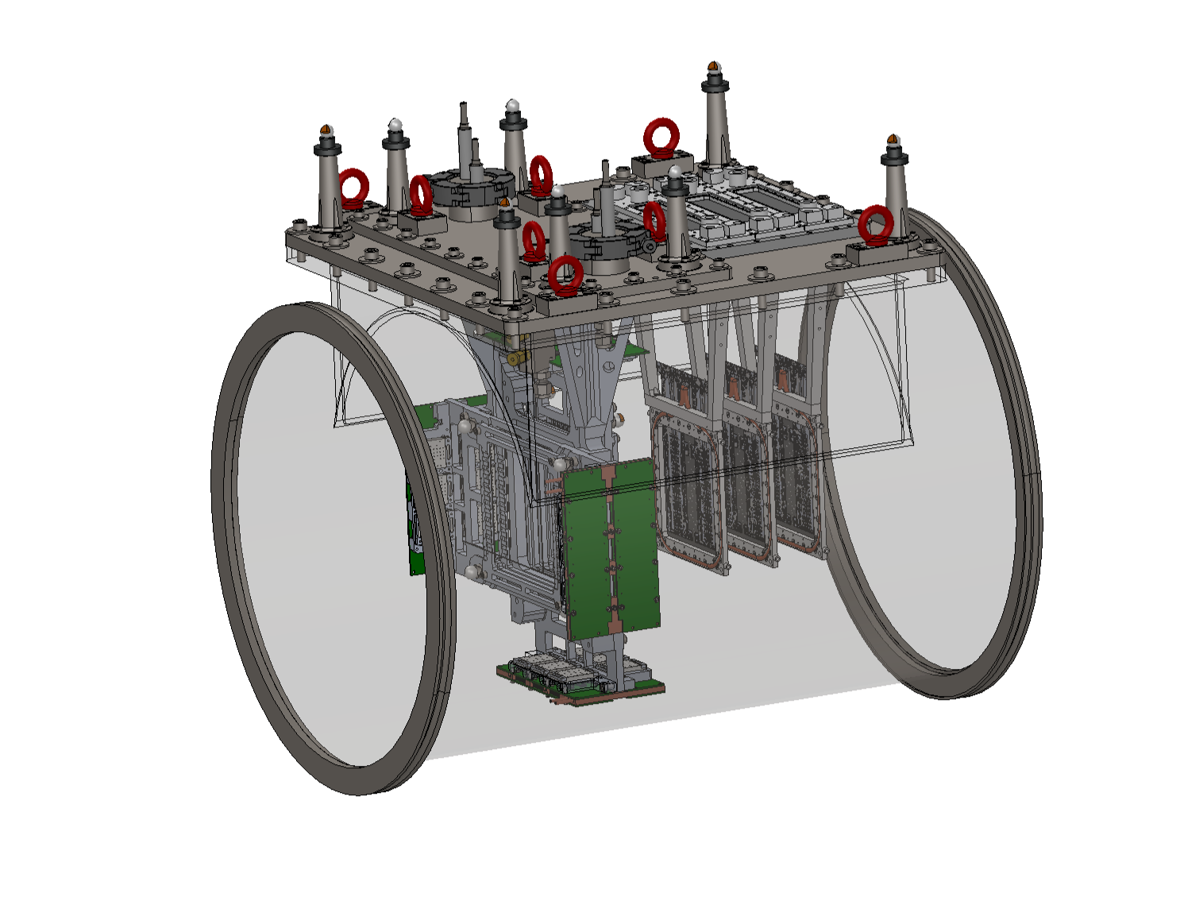
Unified Tracking Station

Slide 22
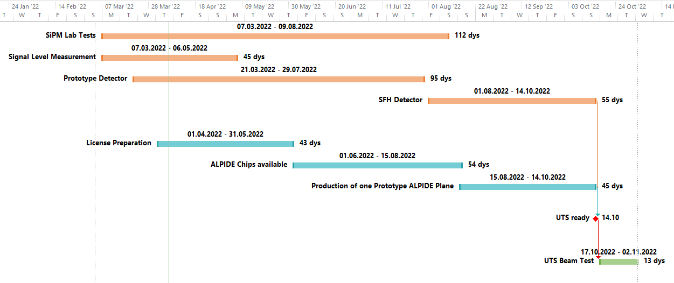
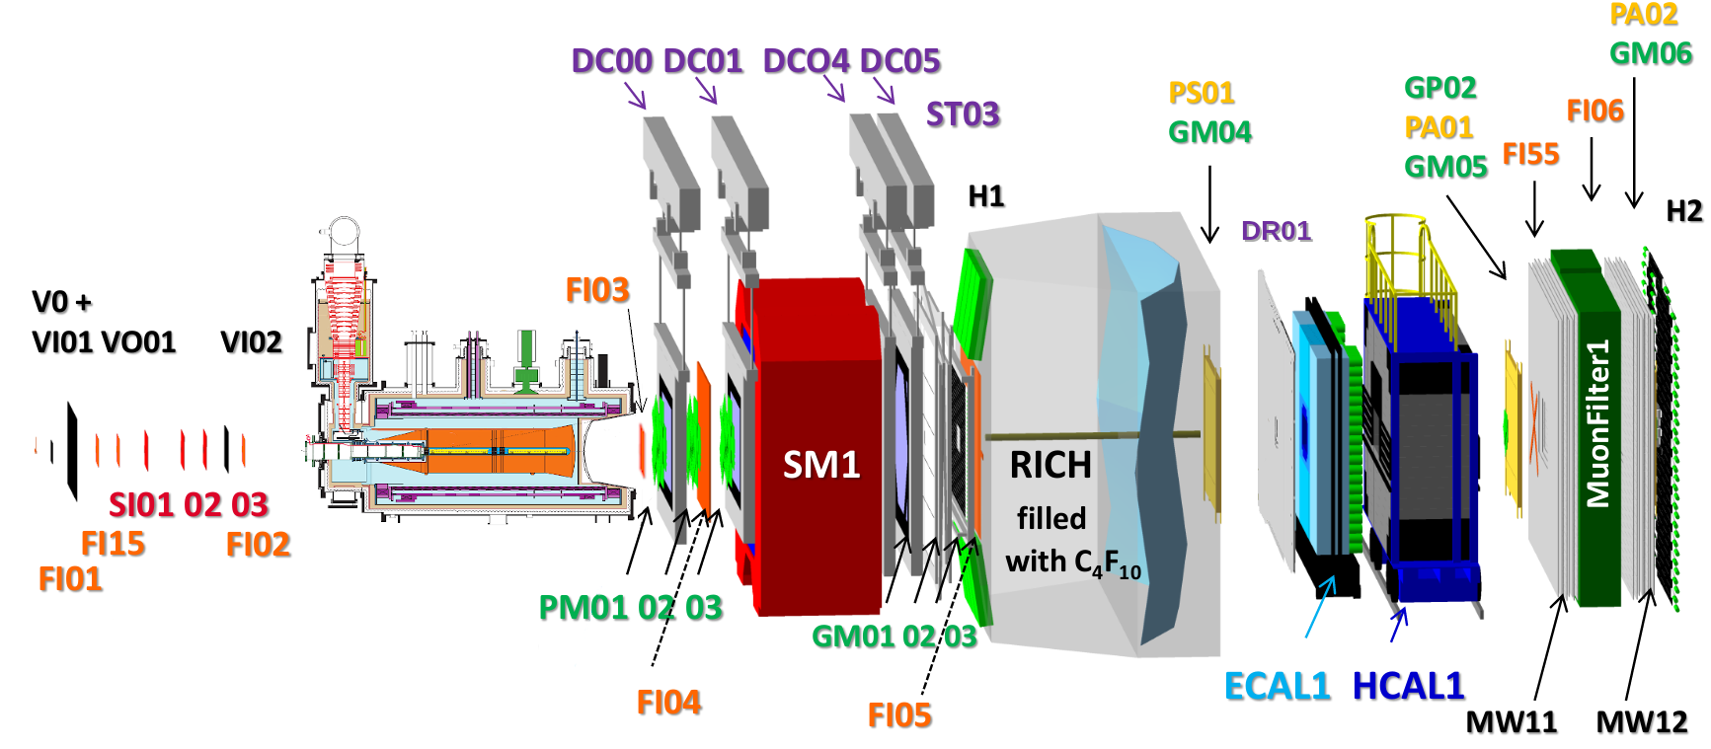
PRM test run 2022 (interleaved with last period of the COMPASS data taking)
COMPASS could take data with a test setup installed upstream of the target region
Possible schedule: last double-week period before AMBER AP week, i.e. end October
Installation of UTS during MD 19. October
Data taking during last repolarization phase ~ end October

