Slide 1
Flux concentrator from SuperKEKB to ILC
2023/4/21
KEK iCASA positron group
Y. Enomoto

Slide 2
Recent topics
2022/9 New group to develop positron source for ILC launched in KEK iCASA (Innovation Center for Applied Superconducting Accelerators)
2023/4 5 years budget for selected time-critical work packages* was approved
  *Source, SRF, nano-beam
IDT phase
Pre-lab phase
Construction phase
Physics experiment
Aug. 2020
IDT
IDT
Pre-lab
ILC construction
by ILC Lab.
Experiment
at ILC
International
Development
Team under ICFA
Pre-lab organized
by MoU’S among
the relevant labs.
ILC lab. based on
the Governmental
agreement
Joint R&D
(ILC technology network)
Int. Expert Panel
+ governmental
discussions

Slide 3
ILC Technology Network
Time-critical WPs
ML&SRF
(Main linac &
Superconducting RF)
Sources
DR
(Damping ring)
BDS
(Beam Delivery System)
Dump
WP-prime 1
Cavity production
WP-prime 4
Electron source
WP-prime 12
System design
WP-prime 15
Final focus
WP-prime 17
Main dump
WP-prime 2
Cryomodule design
Undulator positron scheme
WP-13
Collective effect
WP-prime 16
Final doublet
WP-18
Photon dump
WP-5
Undulator
WP-prime 3
Crab cavity
WP-prime 14
Injection/extraction
WP-prime 6
Rotating target
WP-prime 7
Magnetic focusing
with Americas and Europe
KEK members in charge
E-driven positron scheme
SRF
Sources
Nanobeam
WPP | 1 | Cavity production
WPP | 2 | CM design
WPP | 3 | Crab cavity
WPP | 4 | E- source
WPP | 6 | Undulator target
WPP | 7 | Undulator focusing
WPP | 8 | E-driven target
WPP | 9 | E-driven focusing
WPP | 10 | E-driven capture
WPP | 11 | Target replacement
WPP | 12 | System design
WPP | 14 | Injection/extraction
WPP | 15 | Final focus
WPP | 16 | Final doublet
WPP | 17 | Main dump
WP-8 : Y. Morikawa
WP-9 : Y. Enomoto
WP-10 : M. Fukuda
WP-11 : Y. Enomoto
WP-prime 8
Rotating target
WP-prime 9
Magnetic focusing
WP-prime 10
Capture cavity
KEK’s main WPs
WP-prime 11
Target replacement
H. Hayano support us mainly on capture cavity design
ATF collaboration

Slide 4
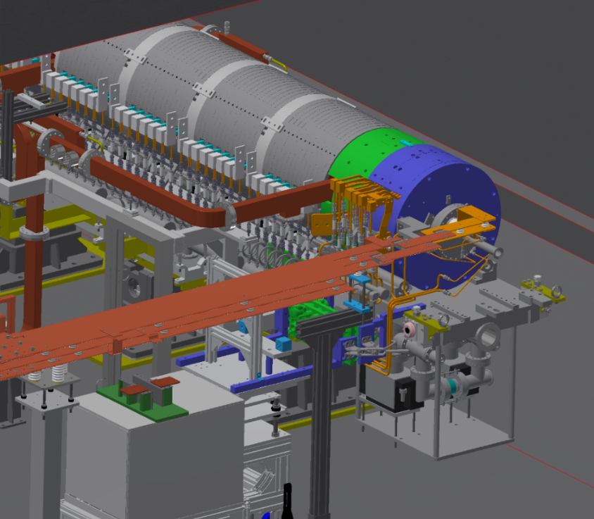
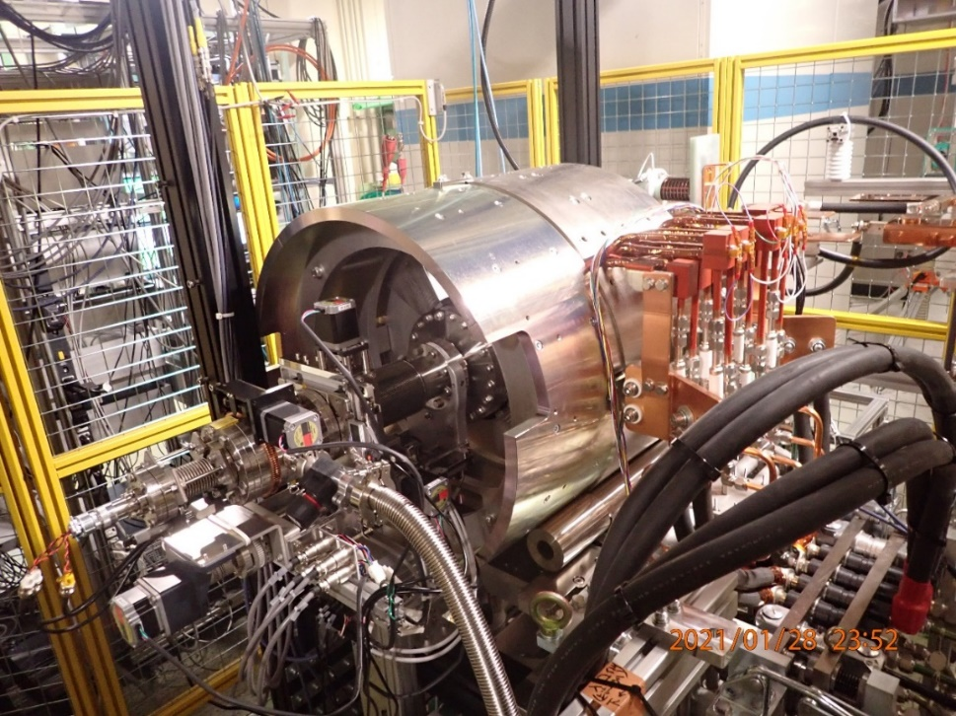
Main mission of positron source group
Goals of ILC positron group in KEK till 2027 is demonstrate our design
  Prepare
    engineering design report (EDR)
    3D CAD model
    Drawings for manufacturing
  Arrange test environment
  Construct prototype and test it
3D model and test bench of positron source for SuperKEKB
We are going to prepare similar ones for ILC

Slide 5
five years development plan for positron source
FY |  | 2022 |  | 2023 |  |  |  | 2024 |  |  |  | 2025 |  |  |  | 2026 |  |  |  | 2027
year |  |  | 2023 |  |  |  | 2024 |  |  |  | 2025 |  |  |  | 2026 |  |  |  | 2027
Quarter |  | Q4 | Q1 | Q2 | Q3 | Q4 | Q1 | Q2 | Q3 | Q4 | Q1 | Q2 | Q3 | Q4 | Q1 | Q2 | Q3 | Q4 | Q1 | Q2 | Q3 | Q4 | Q1
Test bench
High power test bench
W-Cu connection
Target unit | 1st unit
 | 2nd unit
 | 3rd unit
FC base | 1st unit
 | 2nd unit
magnet | Solenoid + ST
 | Power supply
Chamber, vacuum, support
Acc. Structure | Dummy
 | 1st unit
 | 2nd unit
FC power supply
RF power supply
Design
Manufacuring
test
5 years budget start from FY2023

Slide 6
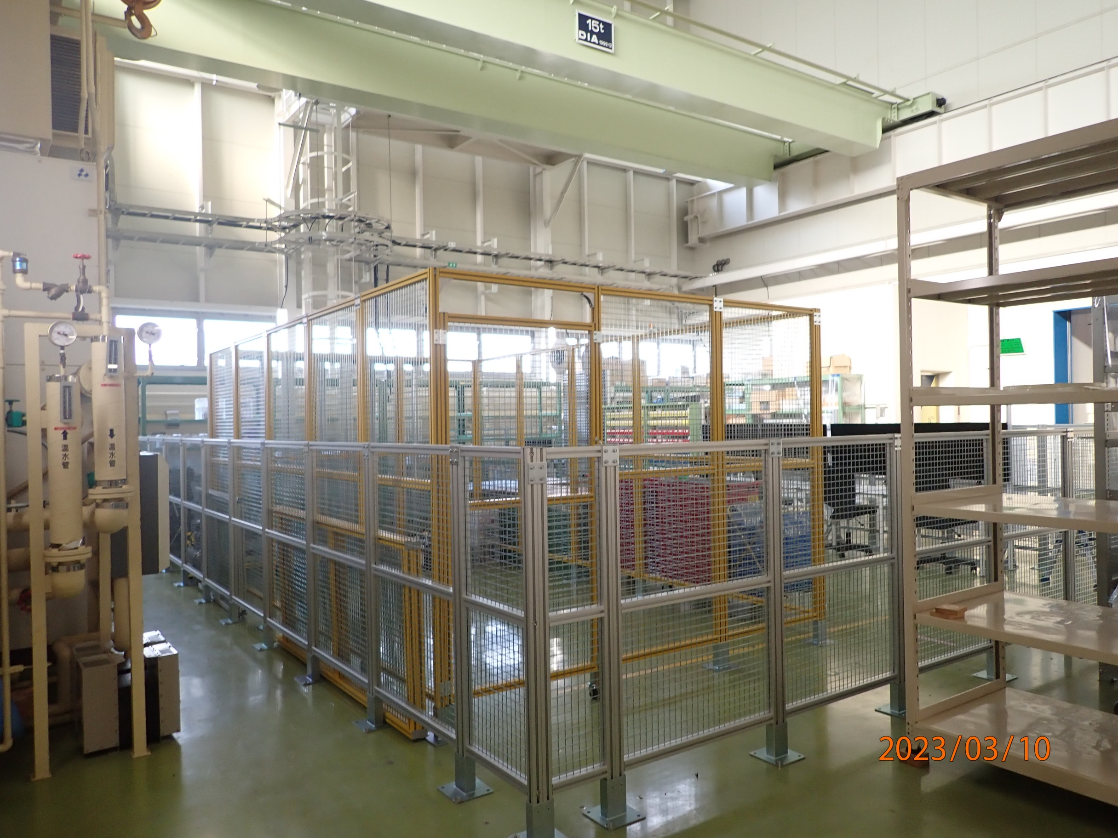
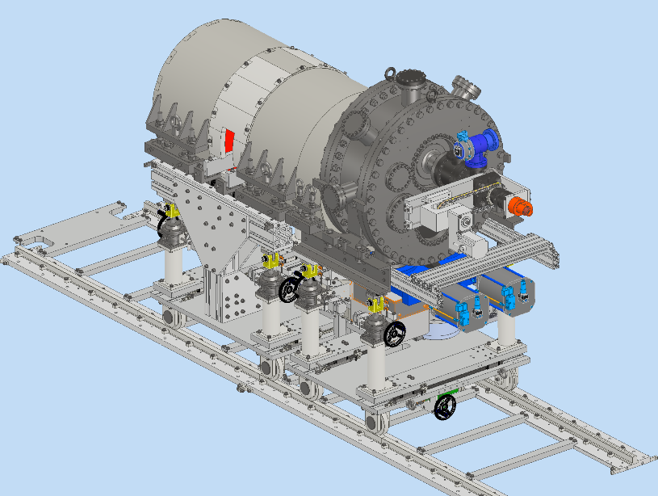

Slide 7
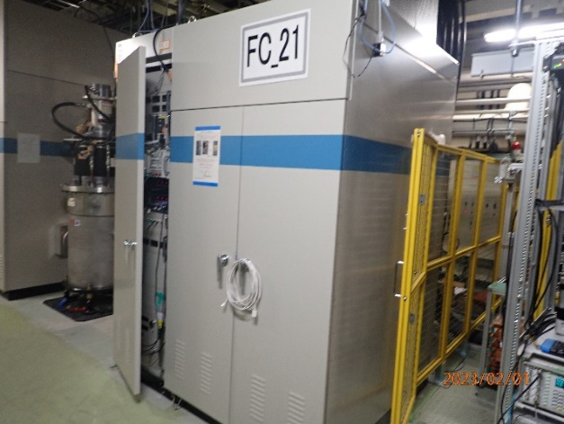
Comparison SKEKB and ILC
Make use of past experiences in the SuperKEKB
  Total system design, building up test bench, temperature measurement of FC
  Magnetic, thermal, tracking simulation using CST
Present parameter is not realistic from the viewpoint of ohmic loss and huge power requirement for the pulsed power supply
  20 times of the SuperKEKB (FC@100Hz)
  50 times of the SuperKEKB (PS@300Hz)
  Optimization of the parameter is necessary
Is Shorter pulse length possible?
  Need higher voltage
  Discharge risk
  Flat top control of PS
  PS, load, transmission line are not independent
Present model is very rough model
  Need realistic simulation
 | ILC | SKEKB | BINP design | BINP operation*
Primary Current |  | 12 kA
Secondary current | 25 kA | 12 kA | 120 kA | 0.73 x 120kA
Peak Bz | 5 T | 3.5 T (+1 T from DC magnet) | 10 T | 7.3 T
Pulse width | 25 us | 5 us | 26 us | 26 us
repetition | 300 Hz** 100 Hz | 50 Hz | 50 Hz | 12.5 Hz
Ohmic loss | (41 kW) 14 kW | 0.7～0.8 kW (measured) | 4 kW | 0.5 kW
Beam loss | 4 kW | Small | Small | Small
Total loss＠Load | (45 kW) 18 kW | 0.7～0.8 kW (measured) | 4 kW | 0.5 kW
Power for power supply | 630 kW 210 kW | 12 kW
*Reference for BINP operation
・RuPAC2016 WEXMH01
・IPAC2016 THPOR018
・RuPAC2021 TUA02
**assume half sine
Energy recovery power supply is necessary
Pulsed power supply for the FC in SuperKEKB W1800 x D1500

Slide 8
Bunch structure
ILC
M. Kuriki, OHO seminar 2021
Create positron for 66 ms
Store them in the DR for 199.3 ms
Extract them to main linac for 0.7 ms
20 pulse / train
66 bunch / pulse
1320 bunch / train
Repetition 5 Hz
FC must keep field variation below the requirement to keep bunch-by-bunch charge variation
Minimum current pulse width is about 500 ns
Flat top control is necessary to satisfy short pulse length to reduce ohmic loss and flat field
66
…….
train
3.3 ms✕20 = 66 ms
pulse

Slide 9
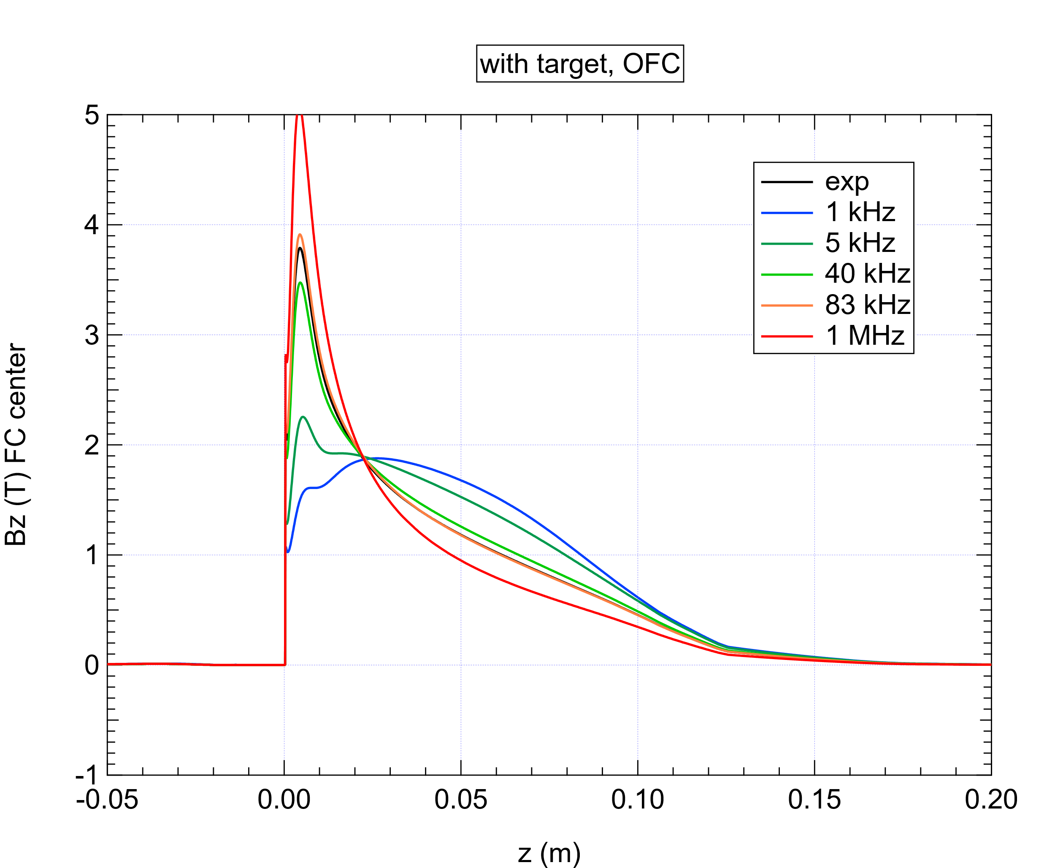
Pulse width dependence
SuperKEKB
Half sine pulse width
Exp
500 us
100 us
12.5 us
6 us
0.5 us
Magnetic field shape is determined by skin depth
It is important to use realistic current waveform for simulation.
Present design value of pulse width is 25 us for ILC

Slide 10
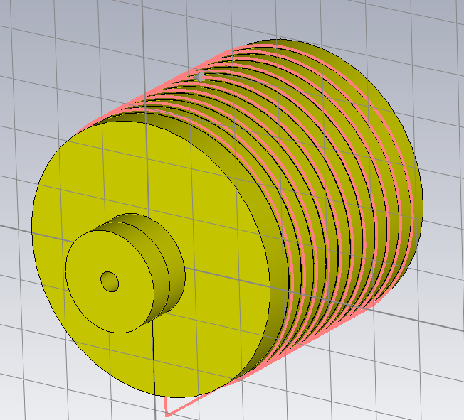
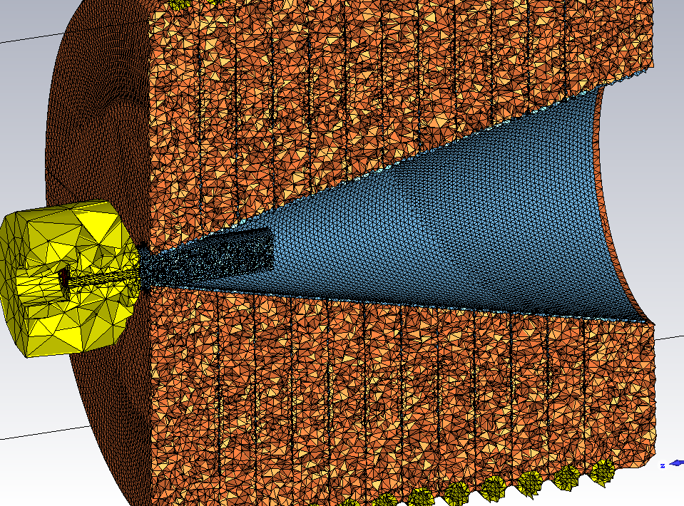
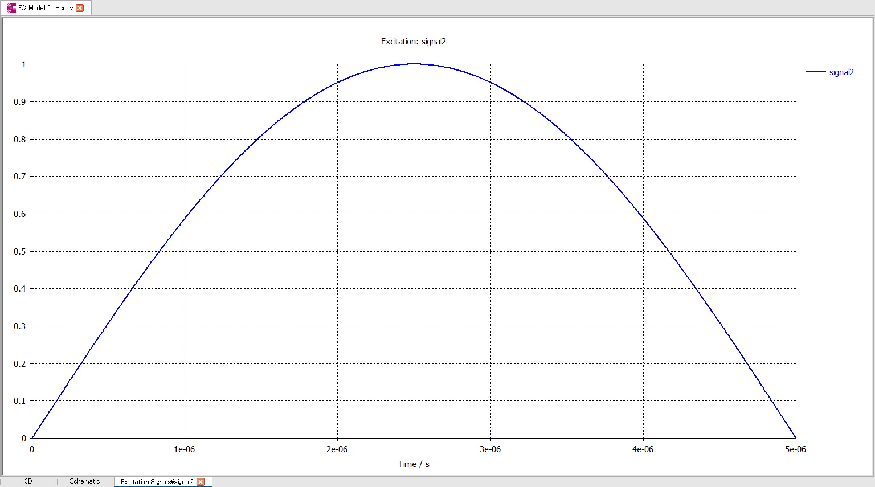
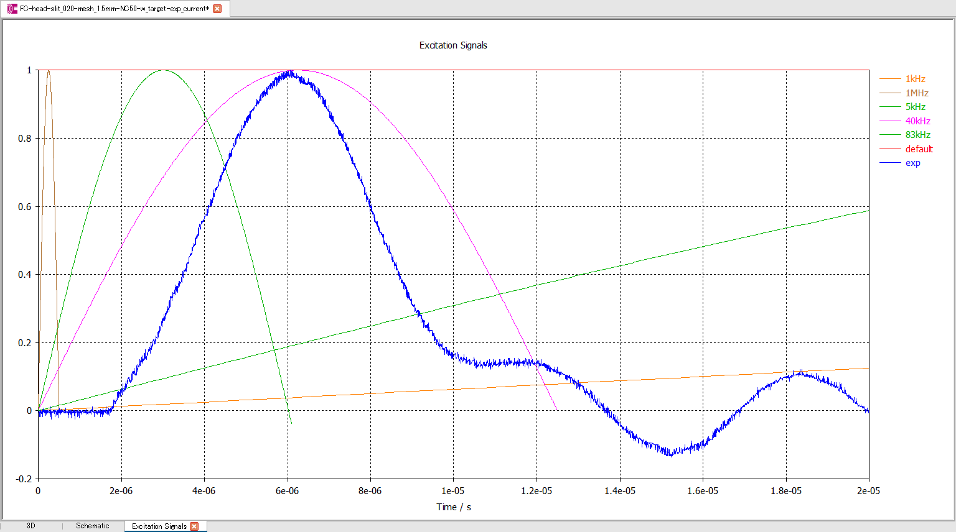
Transient Magnetic field simulation for FC
SuperKEKB
~ 2014
Now
Excitation current
Simulation using realistic model and measured current shape was established

Slide 11
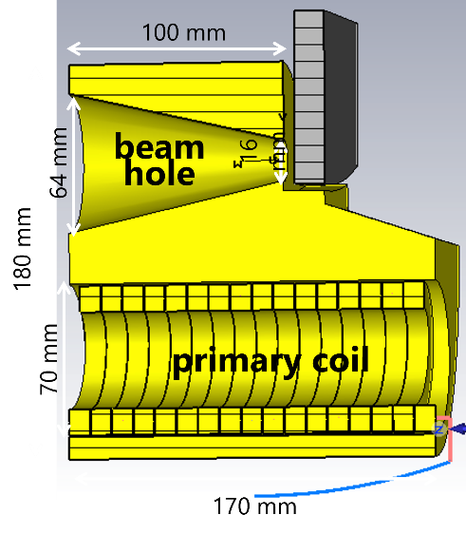
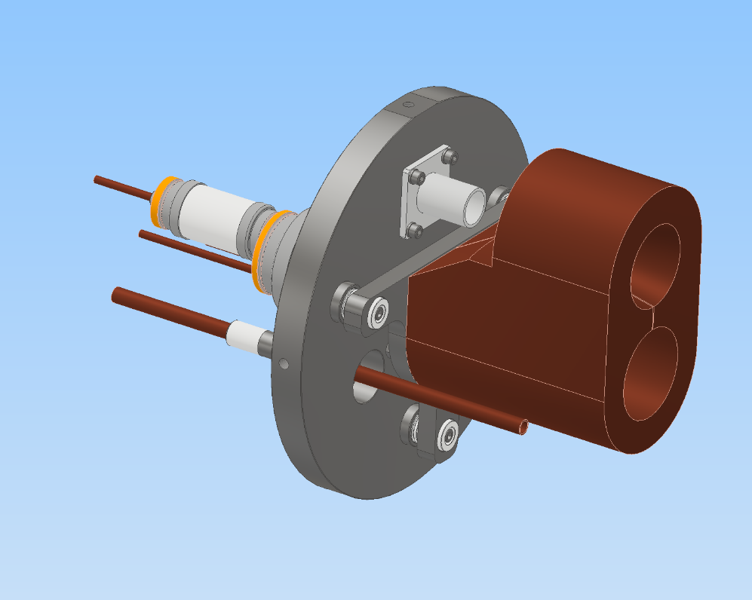
From conceptual model to engineering model
ILC
P. Martyshkin
Conceptual design and its simulation looks work
Before going to detailed simulation, prepare “realistic” model ←（now）
Once the model design finished, it will be imported to CST and ansys
Detail design will be modified taking into account simulation results
Iterate several times…
☑Mechanical design
□Electric feedthrough
experiences in SuperKEKB
□Cooling water pass
completely new issue

Slide 12
Simulation flow of positron source
Target particle generation (Gambet, Fluka)
Particle dist.
Single particle
Target thermal(ansys)
Energy deposit
Transient
FC thermal(CST)
Target structure(ansys)
Thermal exp.
Ohmic loss
Transient
Static, transient
FC mag. field(CST)
Magnetic field
Transient
Tracking (CST)
Target ~ entrance of 1st ACC
Particle dist.
Solenoid mag. Field.(CST)
Single, PIC
Magnetic field
Static
Tracking (CST)
1st ACC entrance ~ exit
Acc. Structure (SuperFish, CST)
EM field
Frequency domain
Single, PIC
FC mag. field(ansys maxwell)
Transient
Particle dist.
Magnetic field
FC structure (ansys)
Transient
Loretz force
Tracking (GPT)
1st ACC exit ~ chicane
FC thermal (ansys)
Transient
Ohmic loss

Slide 13
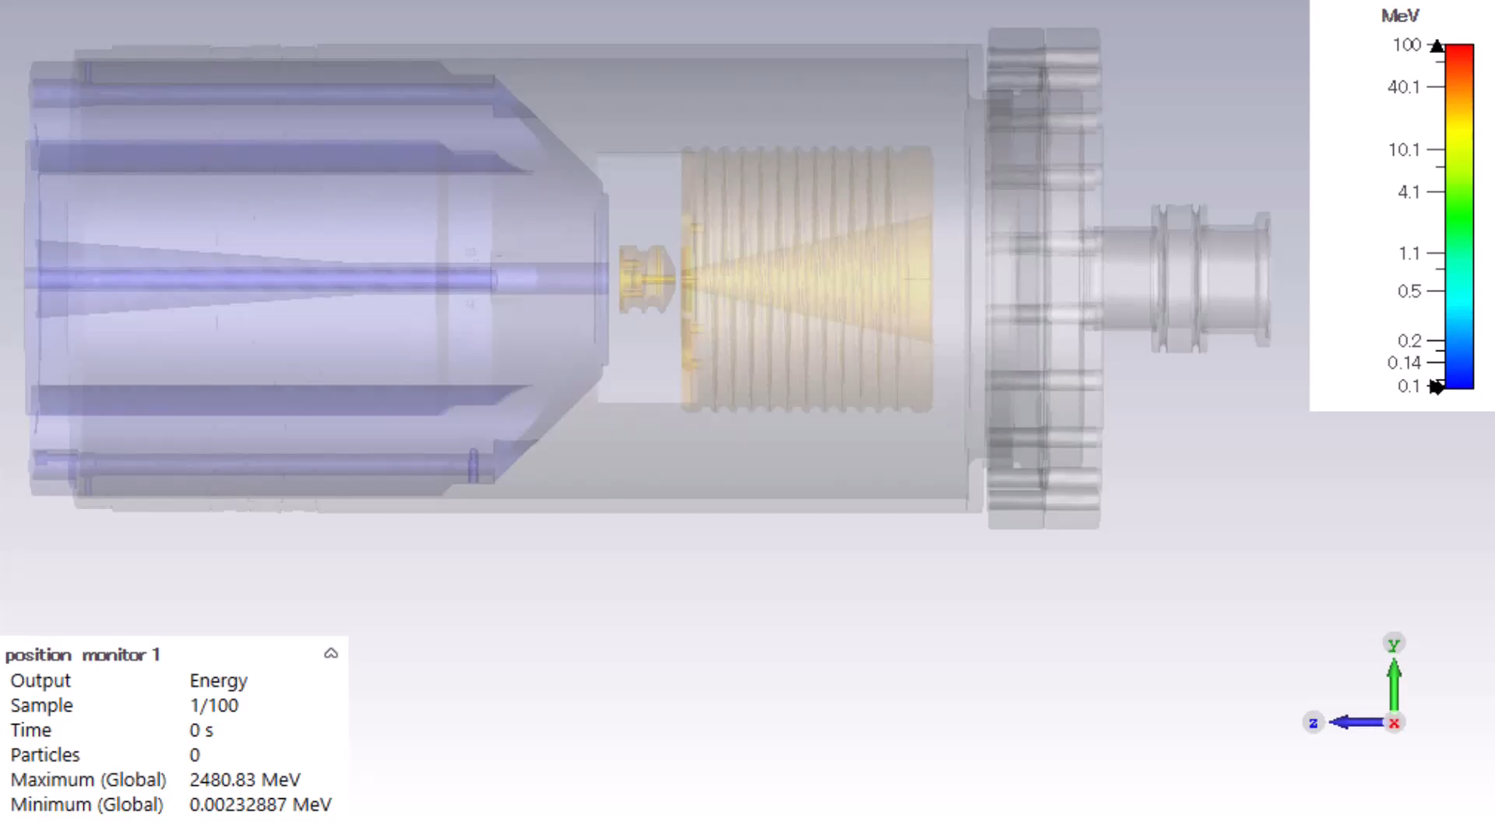
Particle tracking from targe to the entrance of 1st acc structure

Slide 14
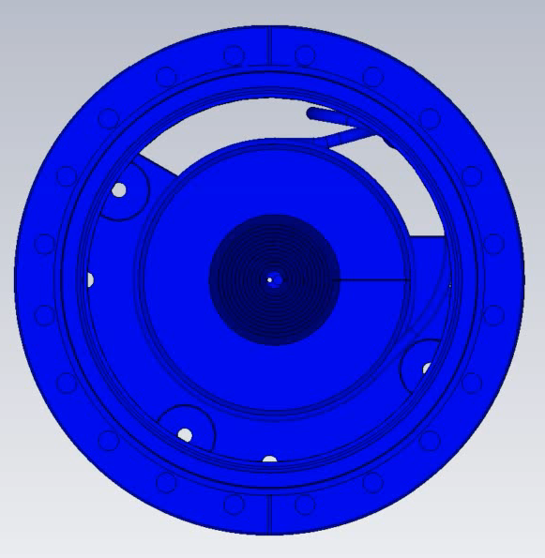
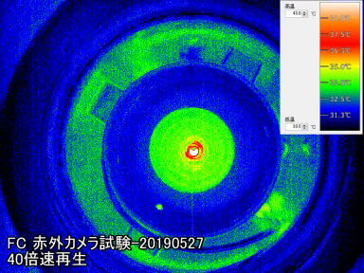
FC temperature change by ohmic loss measurement (left) and simulation (right)

Slide 15
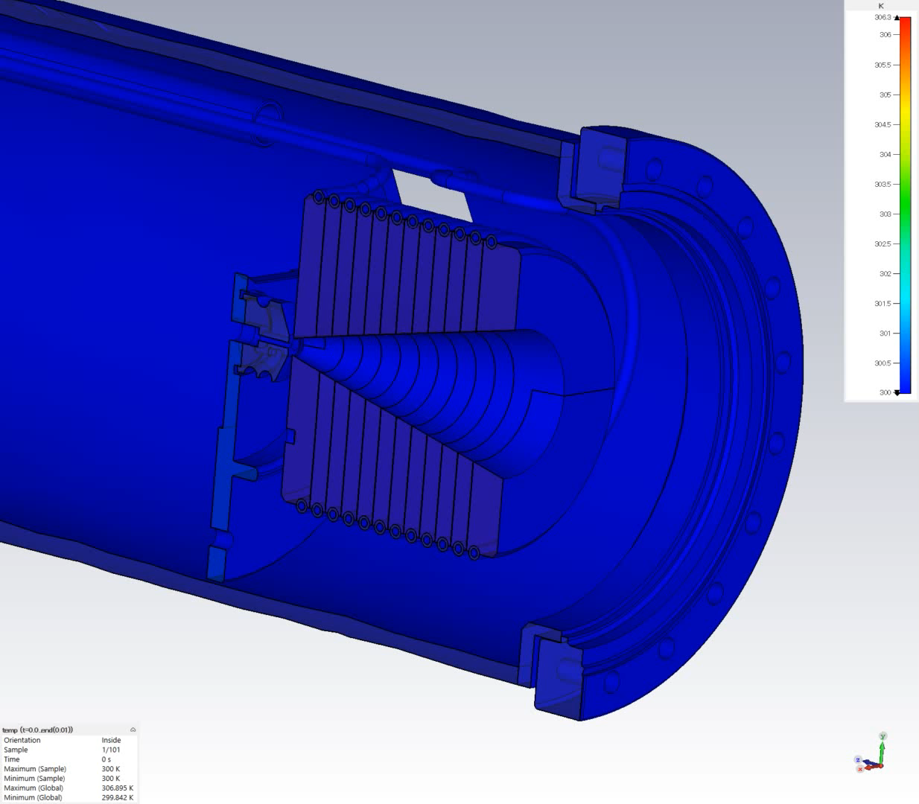
Simulation method have already established through the experiences of SuperKEKB positron source development
Apply the same method for new FC design for ILC

Slide 16
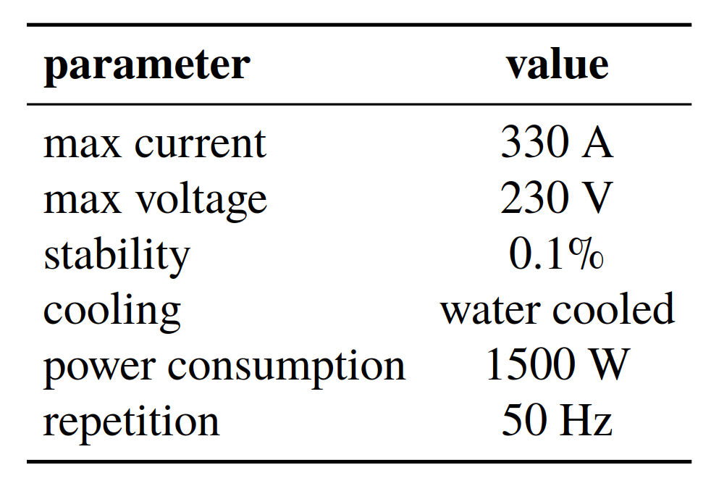
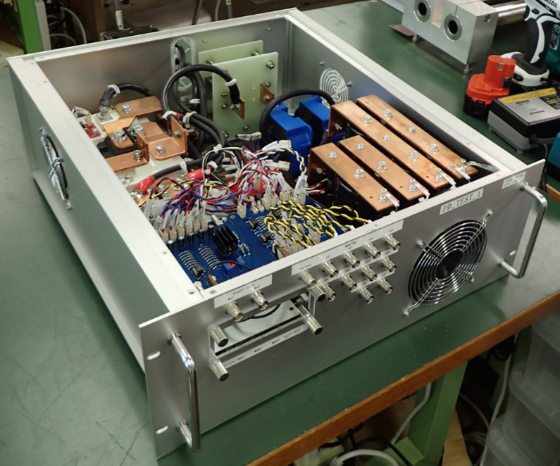
Energy recovery pulse driver for Q magnet
Operation principle of the circuit
Turn on both IGBTs and current flow from both of capacitors.
Turn off IGBT 1 and control gate voltage of IGBT 2 to keep constant current
Turn off both IGBTs and stored energy is recovered to the capacitor (C_HV).
Parameters are very different from those for FC power supply.
But the same circuit is considered as one of a possible solution.

Slide 17
Energy consumption balance
Measured consumed energy includes loss in puled driver circuit and DC power supplies to charge capacitors
  True energy recovery efficiency (ratio of recovered energy and stored energy in inductance is better than 80.1%
Recovered energy
Power (W)
Stored energy in inductance
Consumed energy (measured)
Loss in coils
Loss in cable
Total energy
Total energy recovery efficiency = 100 x (1 - P_{measured} / P_{total} ) = 68.5%
L energy recovery efficiency = 100 x (1- P_{measured} / P_{L} ) = 80.1%

Slide 18
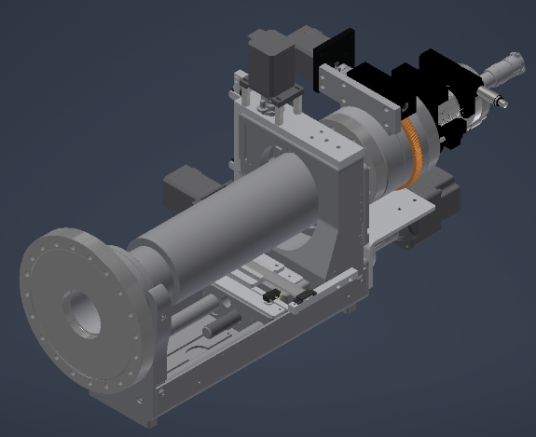
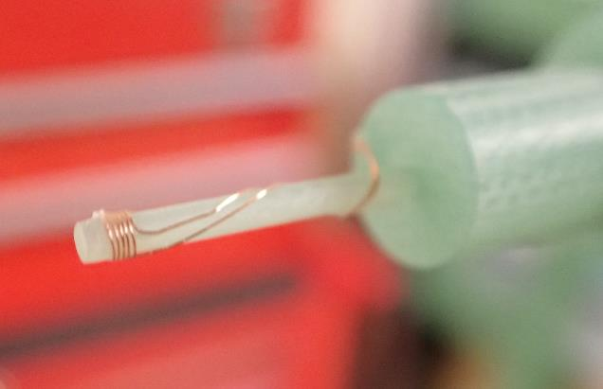
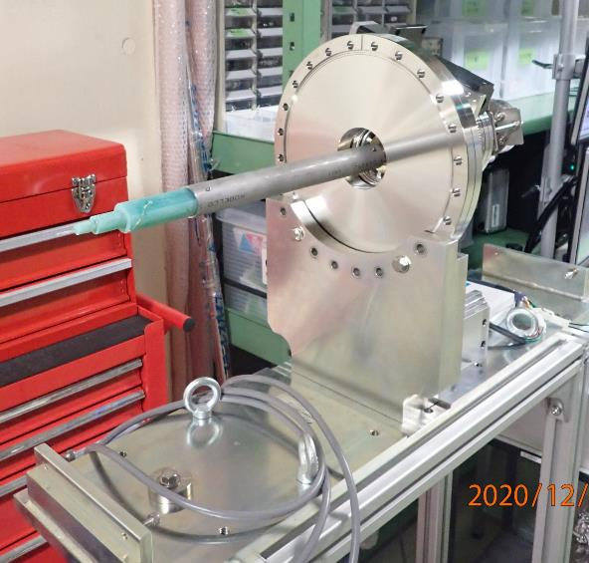
Magnetic field measurement
XYZ stage with motor drive
Rotary stage with motor drive
XYZ positions are monitored by linear gauge by 10um precision
Pick up coil is mounted on FRP rod.

Slide 19
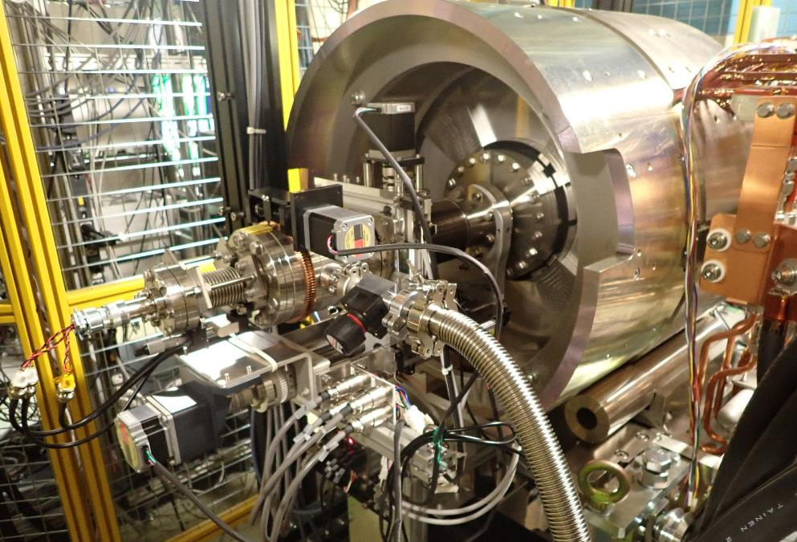
Looking from downstream side with the measurement system attached

Slide 20
Comparison between simulation and measurement
Vertical axis is normalized at peak value to 100%
Target exit surface is z = 0
Distance between FC and target is 2 mm
Solid line shows simulation using CST

Slide 21
Summary
Simulation method for designing FC is ready
Magnetic field measurement is ready
Requirement for ILC is very high
  Present parameter is not realistic
parameter optimization to reduce power is necessary
  Max. voltage of power supply, pulse width, load inductance and resistance, peak current, magnetic field profile and peak value are not independent
  Total design consideration including power supply is important
To reduce power for both FC and power supply,
  Need flat-top control
  Reduce pulse width
  Need Higher voltage
    Reduce load inductance
    Counter measure for discharge
  Need energy recovery power supply
Our plan
  FY2023 design and simulation
  FY2024 prototype manufacturing
  FY2025~ full power pulsed power supply (300 Hz compatible)

Slide 22
Outlook and Collaboration
Many common point and method between FCC and ILC, SuperKEKB
  Not only FC but target, acc. Structure….
Similar development phase
  From conceptual design to engineering design
New group launched and new budget approved
Now it’s time to start new collaborative work!

Slide 23
Back up

Slide 24
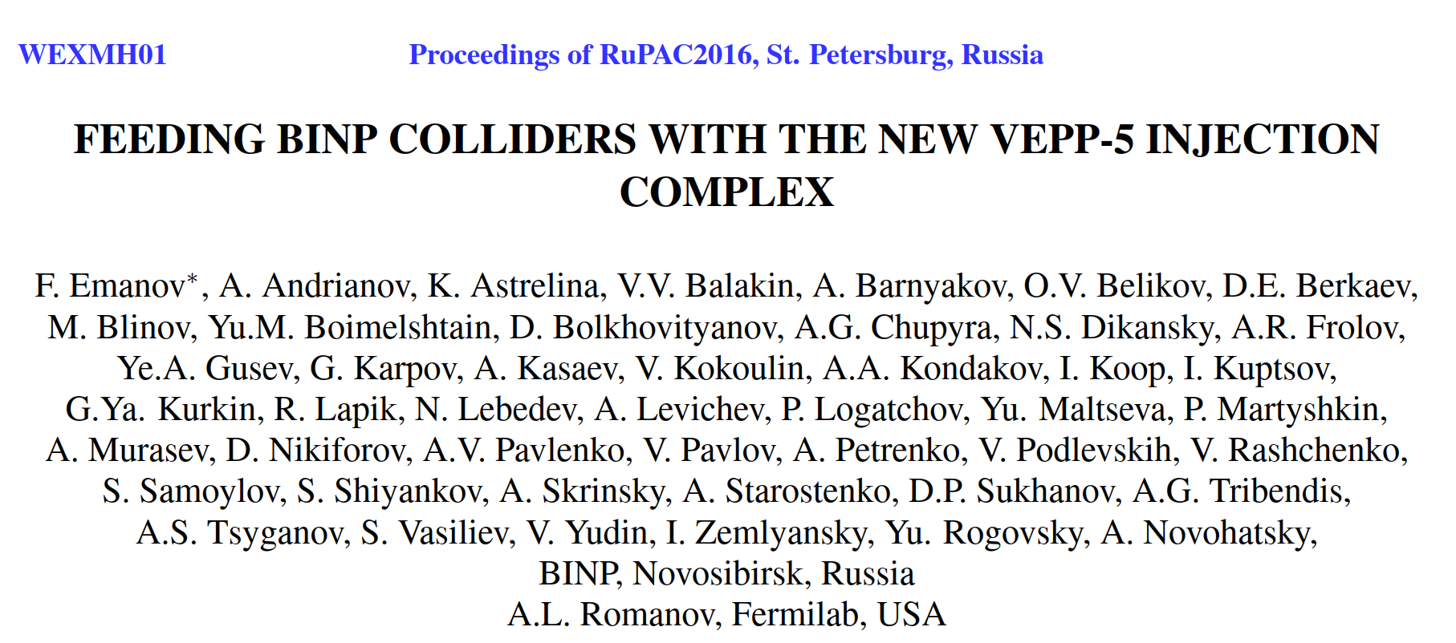
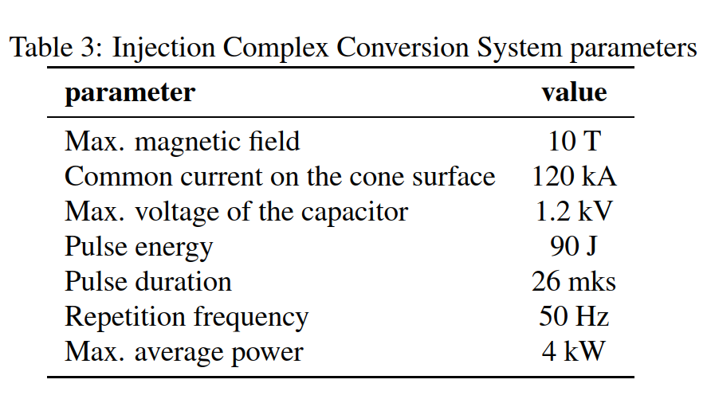
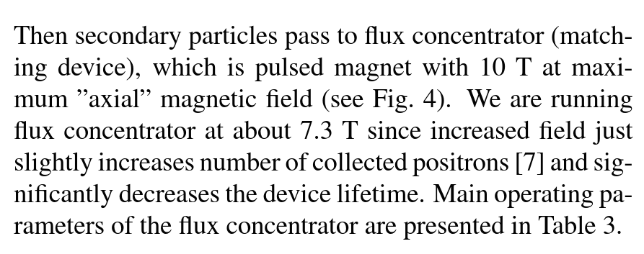
BINP FCのdesign parameter
us
In the case of 7T operation, ohmic loss is ½ of 10T operation
As is usual with accelerator operation, design and real parameters are different

Slide 25
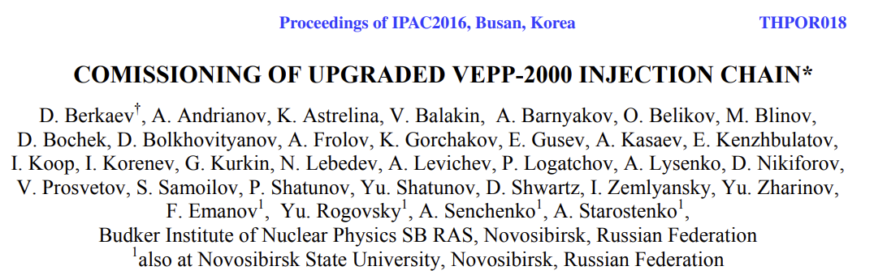
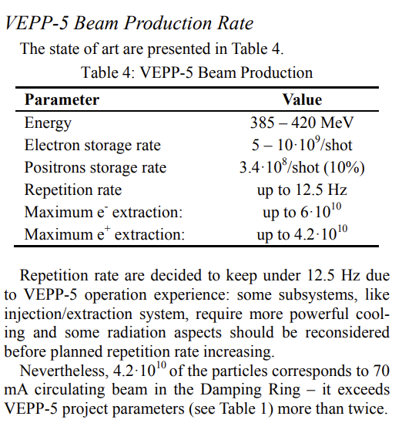

Slide 26
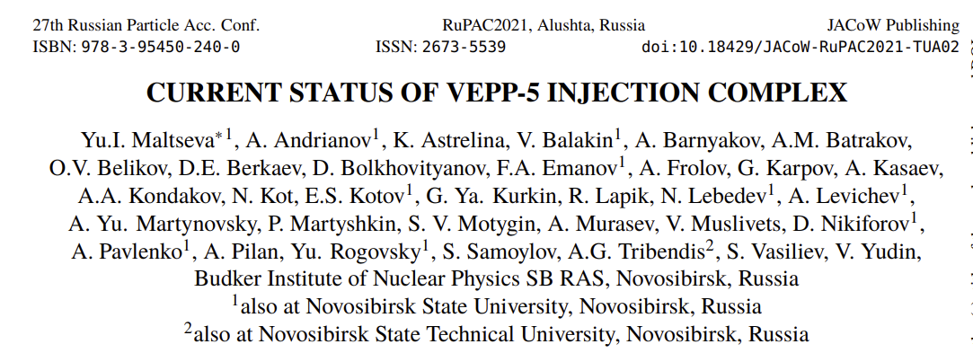
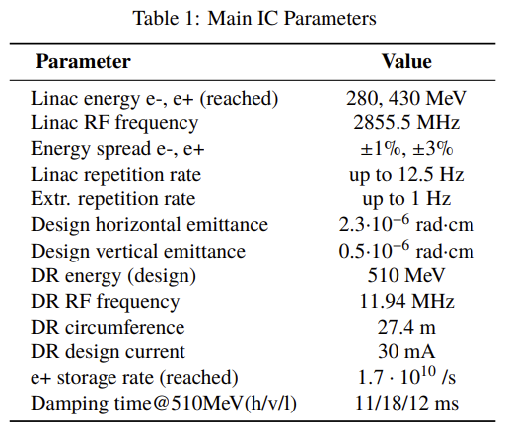
2016～2021
12.5 Hz, 7.3 T
Compared with 50 Hz, 10 T
(12.5/50) x (7.3/10)² ～ 1/8

Slide 27
Circuit diagram of power supply for FC
T. Natsui
1 pulse energy stored in the capacitor = ½CV² = ½ x 1.4 uF x 18.5 kV² = 240 J
In the case of 50 Hz, average power = 240 J x 50 Hz = 12 kW
Power in the inductance of FC： ohmic loss = 11.2 kW : 0.8 kW = 93.3 : 6.6
Suppose the same ratio for the ILC case, 12 kW * (14 kW / 0.8 kW) = 210 kW
Including charging efficiency, control, cooling etc., roughly speaking, 5% of the total power is consumed in the FC, in the case of ILC, total power requride = 14 kW x 20 = 280 kW
Need the same amount of cooling water to dump whole neregy

