Slide 1

WP3 - Positron source: target and capture system
I. Chaikovska on behalf of the WP3 team

Slide 2

FCC-ee positron source: requirements
Accepted e⁺ yield is a function of primary beam characteristics + target + capture system + DR acceptance
The complete filling for Z running => Requirement ~2.4 ⨯ 10¹⁰ e⁺/bunch (4 nC)
N_{e-}/bunch ⨯ η^{e+}_{Accepted} ≥ 4 nC/bunch ⨯ 2
*A safety margin of 2 is currently applied for the whole studies and meant to account for the e+ source design (primary beam, target, capture system) and transport efficiency to the collider ring.
How do we treat the injection losses in the DR ? What is their expected value ?
All the studies are focused on the operation scheme: 6 GeV, 2 bunches/pulse, 200 Hz rep. rate, the e+ bunch charge is 4 nC ➜ ~ 9.6 ⨯ 10¹² e⁺/s (⨯2)

Slide 3
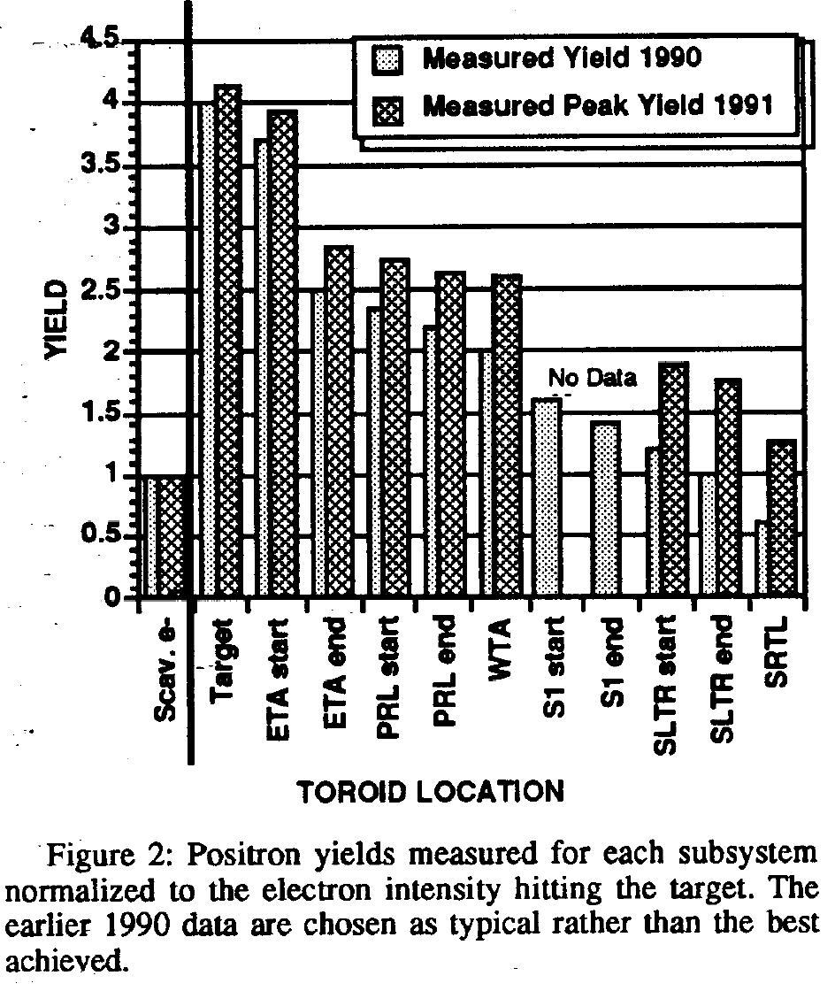
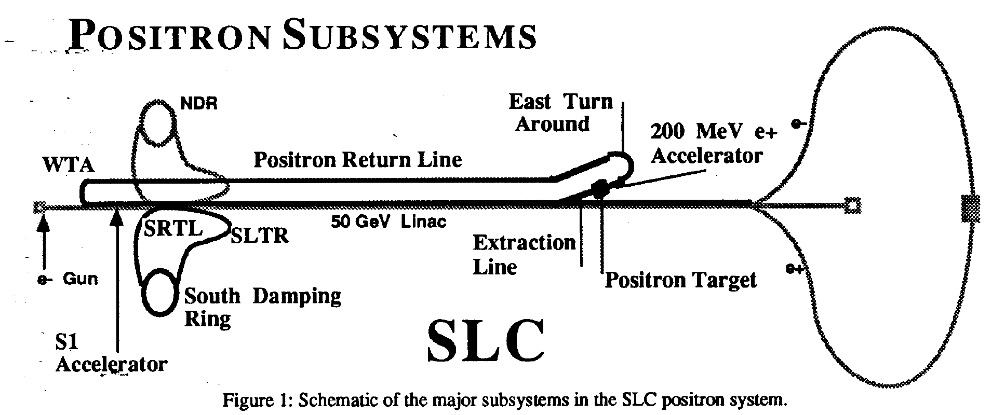
Safety margin for the e+ source (SLC experience)
P. Krejcik, J. Corbett, S. Ecklund, P. Emma et al., SLAC-PUB-5786 (1992)
SLC design: 2 e+/e- in the acceptance of the DR. Initial commissioning: 0.35 (0.5 max) in the IP. Eventually after the upgrades and optics studies => 0.7 (0.9 max)
The actual yield immediately following the capture section is 4 e+/e-, but decreases to 2.5 after two 180 deg. bends and a 2-km transport line and eventually to ~1 after the DR.
“SDR has been a major bottleneck in the e+ system yield” (gradually max achieved ~70%)

Slide 4
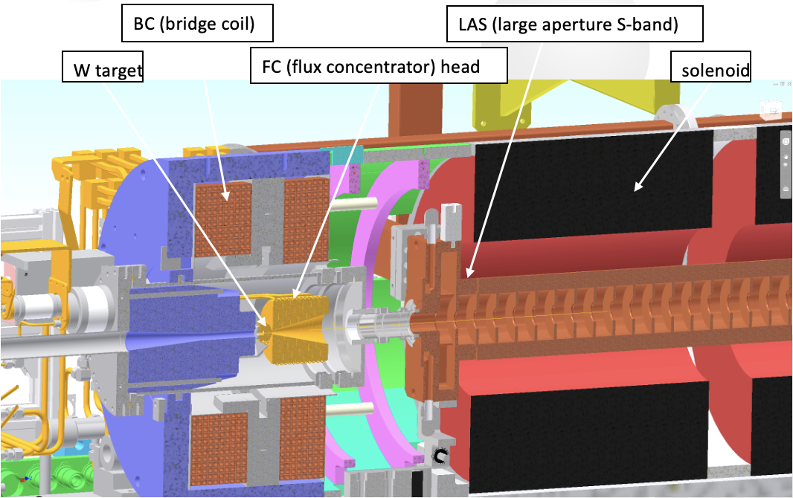
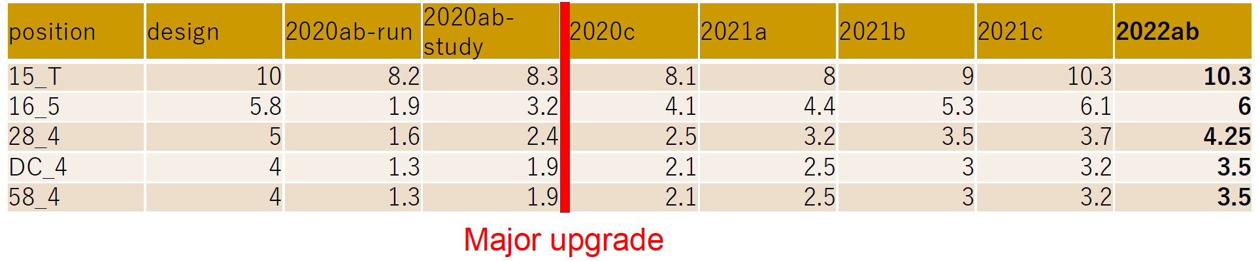
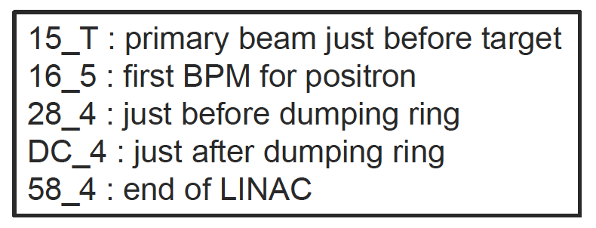
Safety margin for the e+ source (SuperKEKB experience)
e- drive beam: 3.5 GeV, 2 bunches/pulse, 10 nC, 50 (25) Hz
Y. Enomoto (KEK)
The positron source of SuperKEKB is the world’s highest intensity positron source currently in operation.
SuperKEKB design : 0.4 e+/e- @ linac end
Evolution of the yield for 2 years: 0.16 → 0.34
DR injection efficiency is ~80%
0.34 e+/e-

Slide 5
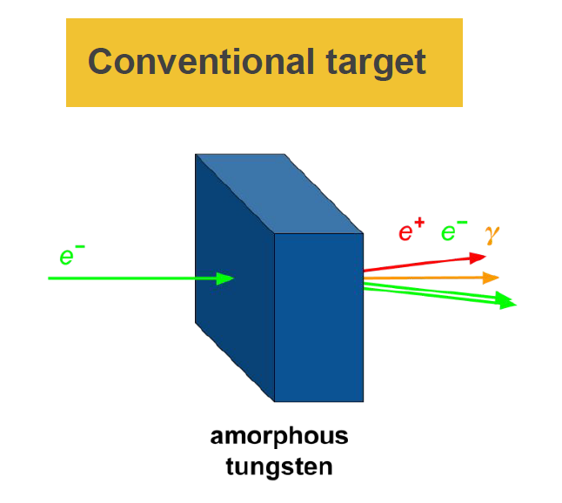
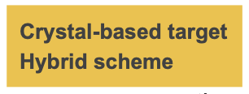
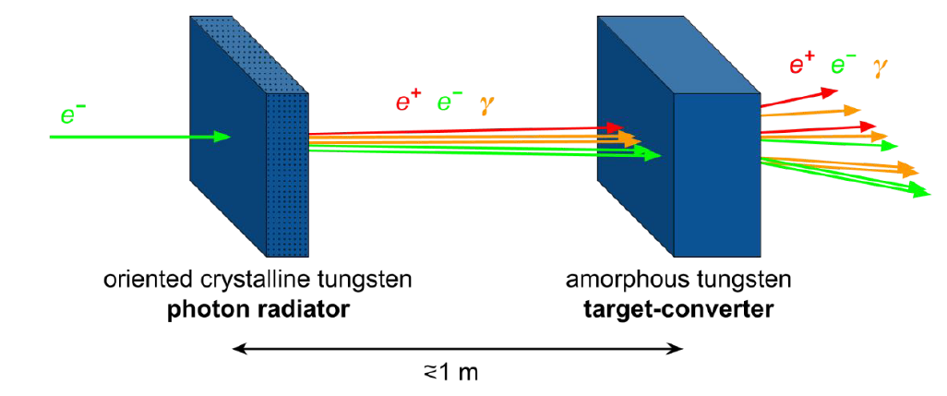
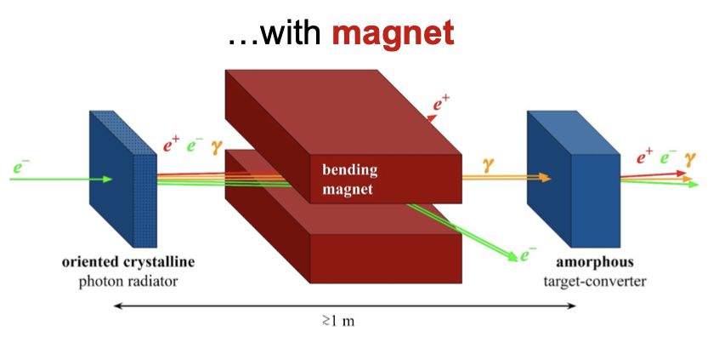
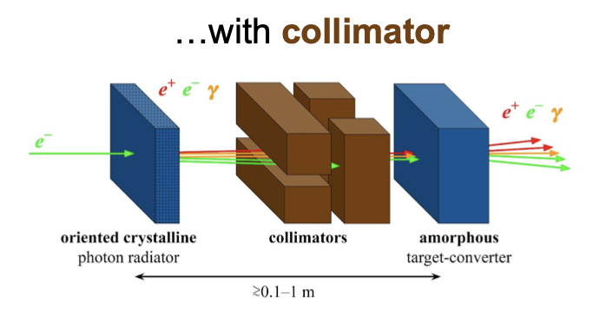
FCC-ee: positron production
Schemes under consideration now
Update of the Gean4 simulations
Y. Zhao (CERN)
Conventional scheme: bremsstrahlung and pair conversion (mainly studied until now)
Hybrid scheme (crystal-based positron source) use the intense radiation emitted by high energy (some GeV) electrons channeled along a crystal axis => channeling radiation.
Target-converter shape (c.f. N. Vallis for P3). Once validated, similar target can be used for FCC-ee.
L. Bandiera (INFN/Ferrara)

Slide 6
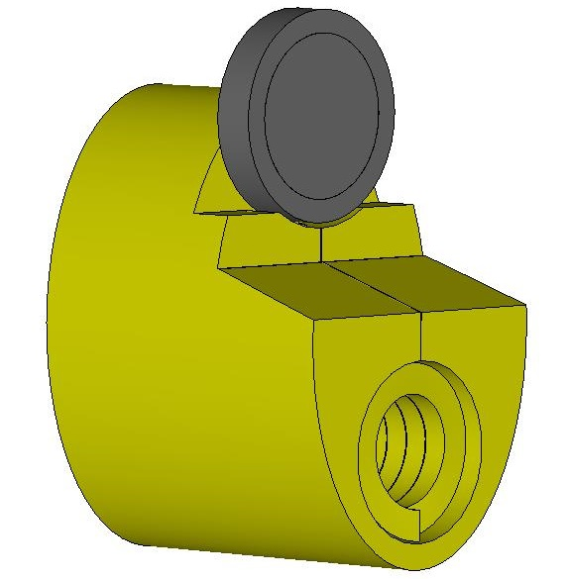
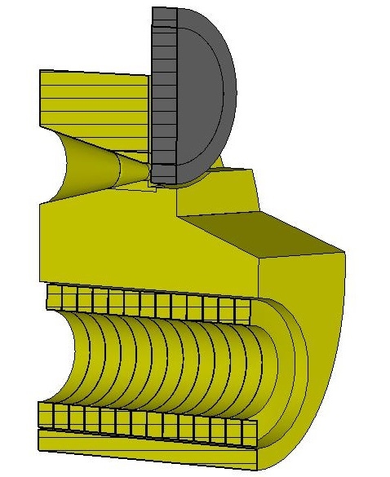
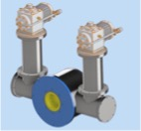
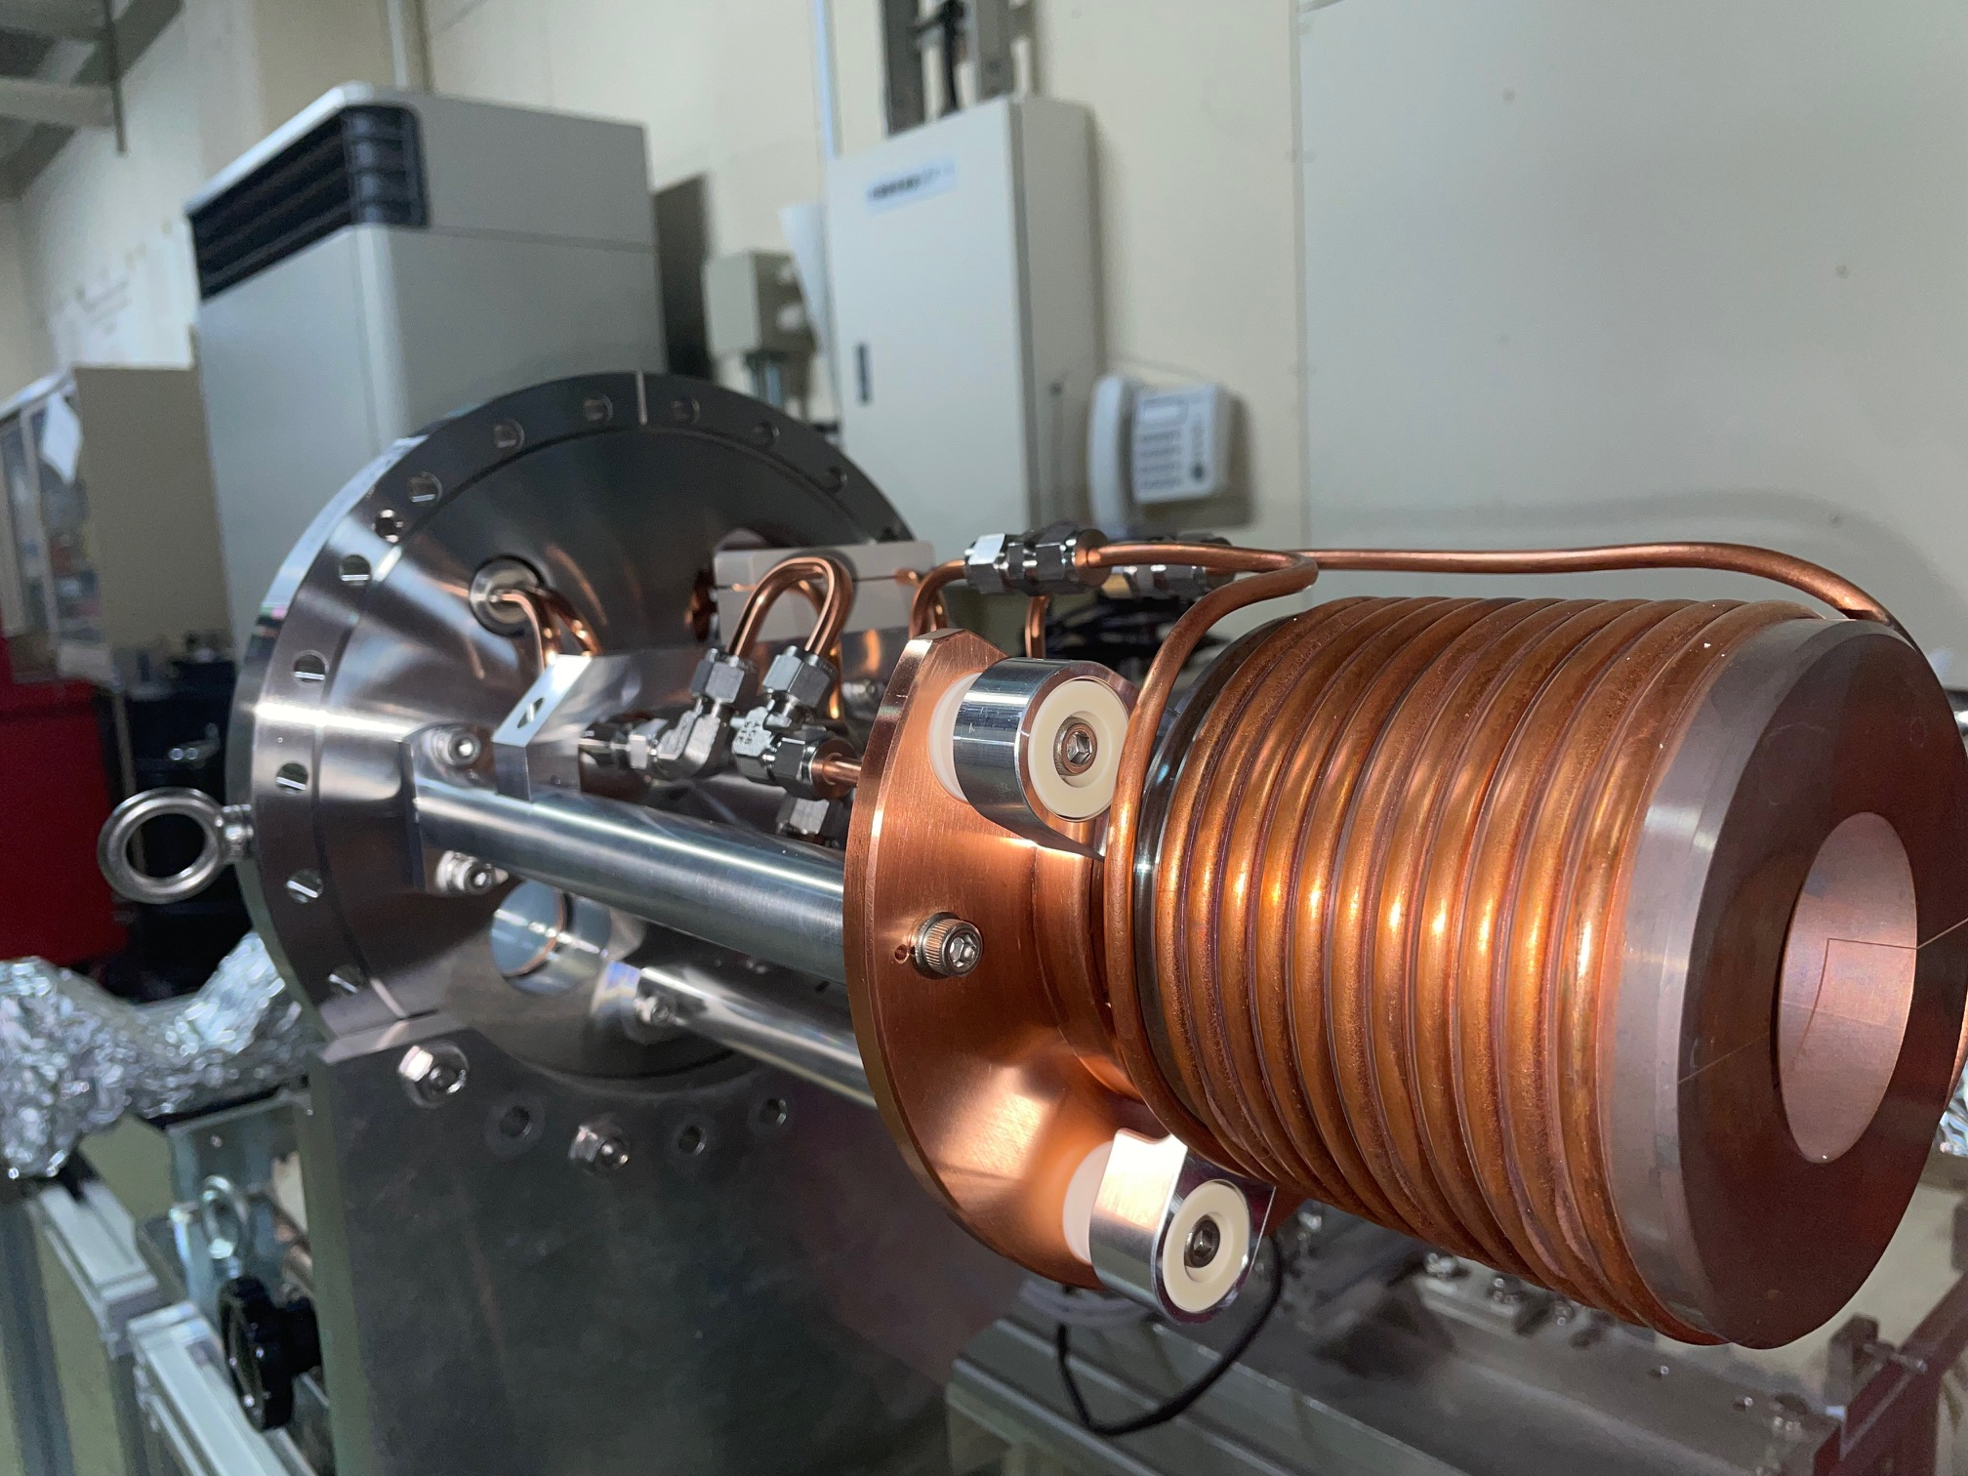
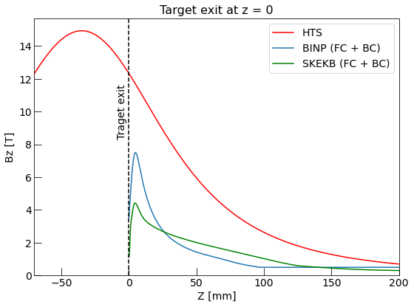
Positron capture
Flux Concentrator (FC)
HTS solenoid
Original FC design is done by BINP
The SuperKEKB capture system is under investigation in application to the FCC-ee
P3 design is adopted as for now
Current studies show potential need of additional iteration on the HTS solenoid field profile
SuperKEKB
FC: lower peak field and aperture, fixed target position, challenging power source working at 200 Hz, robust and reliable solution…
HTS: higher peak field and aperture, flexibility on the field profile and target position, DC operation, innovative solution in application for e+ capture…

Slide 7
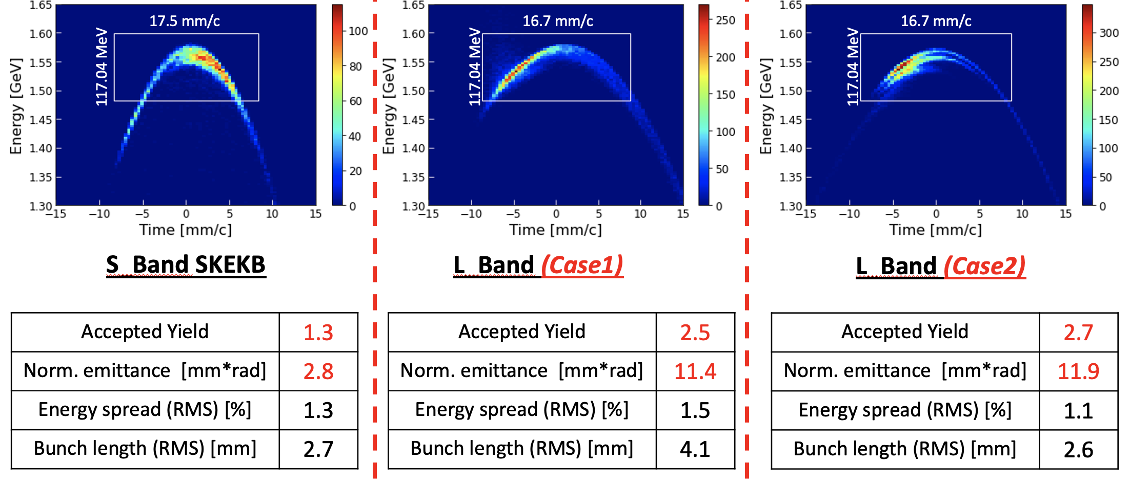
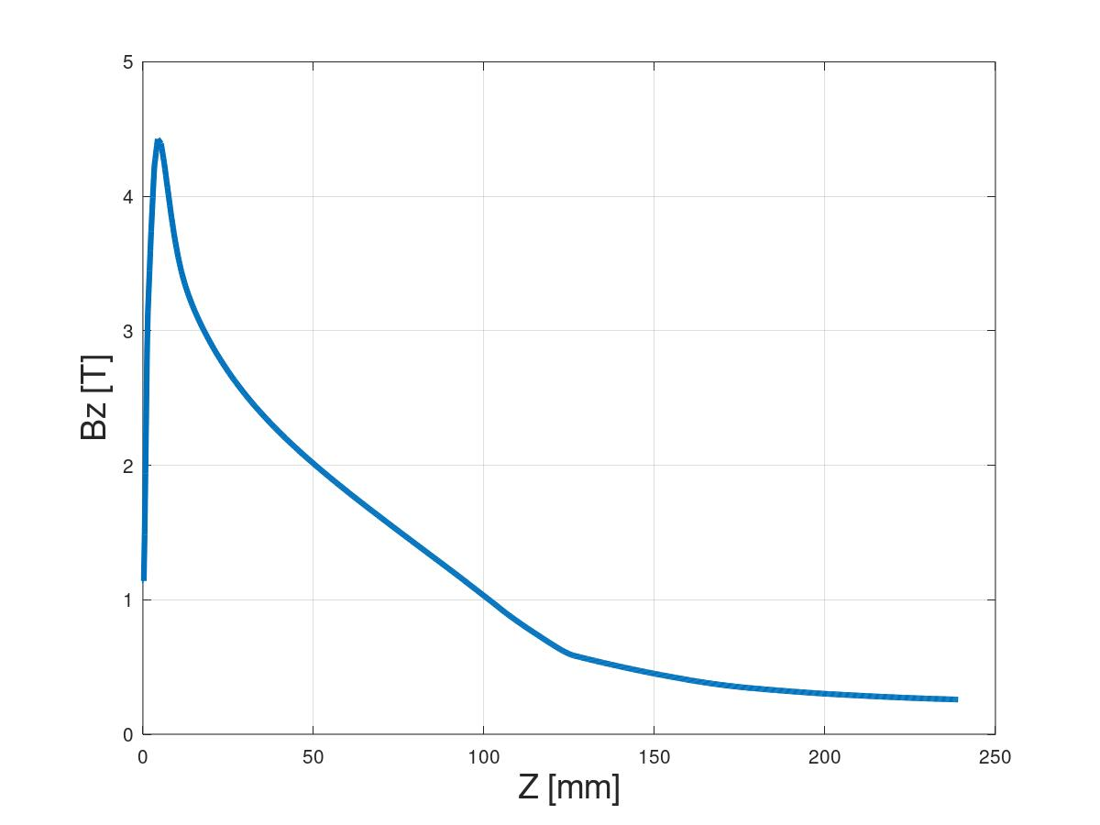
Positron capture (FC)
FCC-ee FC original design is made by BINP, 3D field map is available. No drawings and technical details.
FC-based capture system successfully works at SuperKEKB. It can be used as a starting point for the FCC-ee capture system studies. The first simulations were carried out.
Next step: investigate the scaling of the FC parameters to boost the capture efficiency.
F. Alharthi (IJCLab)
SuperKEKB FC + BC

Slide 8

R&D on the FC: joint effort and roadmap
Y. Enomoto (KEK)
FC is currently considered as a baseline for the FCC-ee and also for the ILC e- driven source and CLIC project. FC-based capture system successfully works at SuperKEKB.
Compared to SuperKEKB FC, high rep. rate (200-300 Hz) and ideally higher max. field value/aperture are requested.
Discussions are needed how to joint the effort and proceed with the FC R&D for the future colliders.
Collaborative work is very essential !

Slide 9
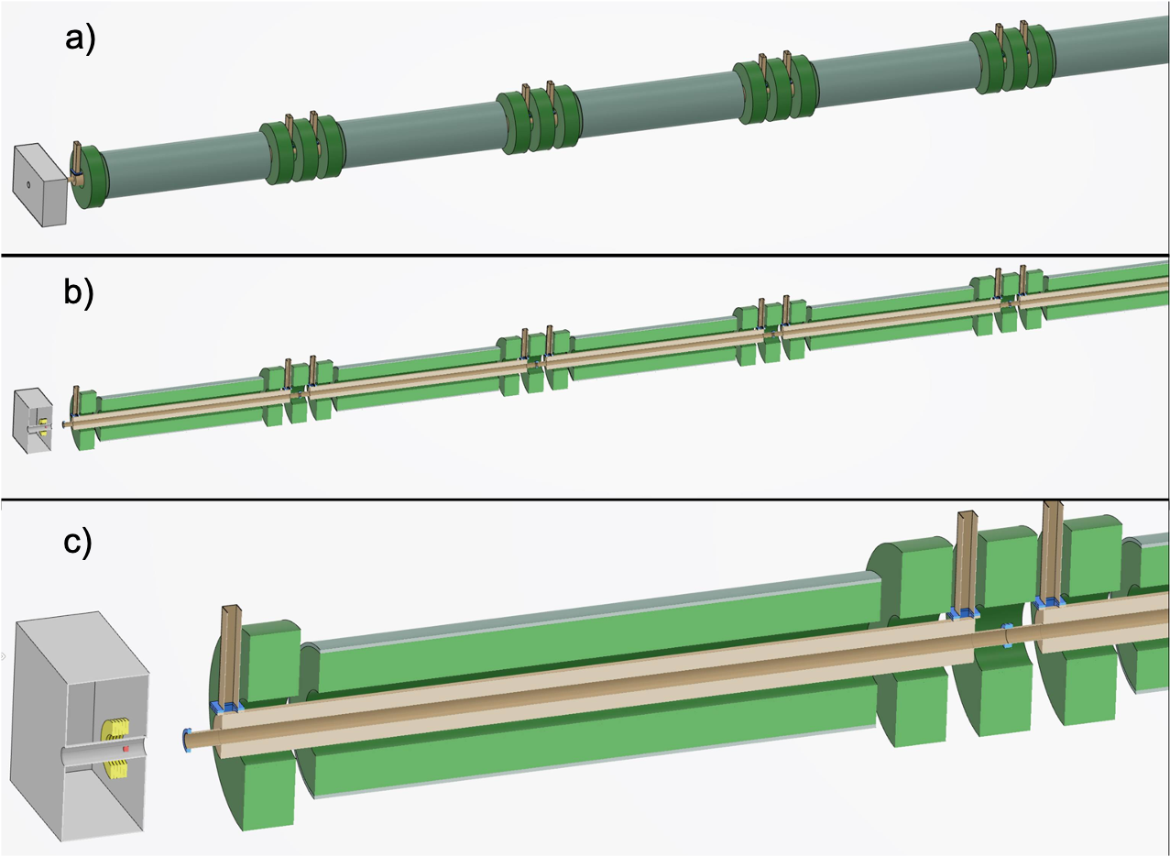
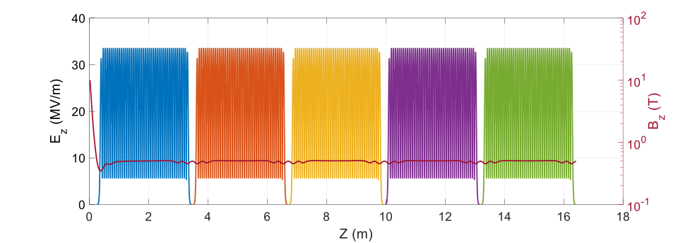
HTS-based capture system ’-version 0’
Capture system “-version 0”
Positron production: conventional scheme
Matching Device is based on the SC solenoid (5 HTS coils, 72 mm bore including shielding)
Capture Linac is based on the L-band TW RF structures ( 2 GHz, 3-m long, Ф = 60 mm)
NC long solenoid B = 0.5 T (realistic design conf. 2)
Positron capture section –v0
Update on the solenoid design: conventional configuration based on the short coils (R. Zennaro) => capture system ’-version 1’ => to be updated in cernbox WP3 repository.

Slide 10
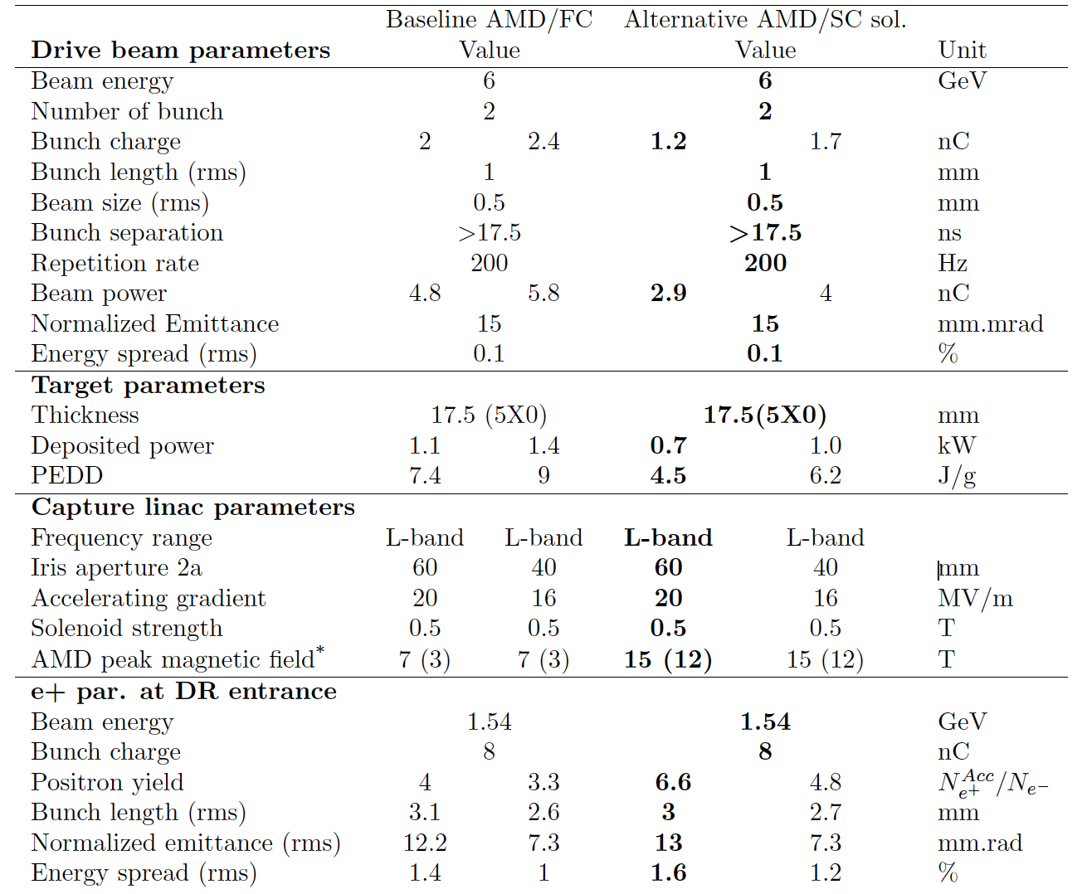
Positron capture: FC (BINP) and HTS-based capture system ’-version 0’
Baseline option is the FC-based capture system
Optimization studies toward better performance:
Overall parameter scanning (target thickness, distances, etc. )
AMD field profile
RF structure length
Distance between the target and the first RF structure
GIOTTO overall optimization
Y. Zhao (CERN)
F. Alharthi (IJCLab)
V. Mytrochenko (IJCLab)
A. Bacci and M. Rossetti-Conti (INFN/Milano)
Results from the CHART Scientific Report 2022
Y. Zhao (CERN)

Slide 11
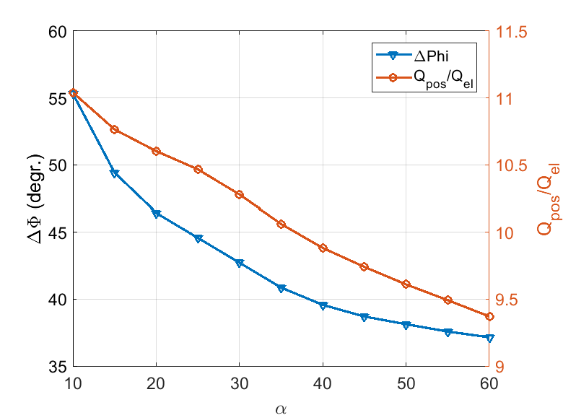
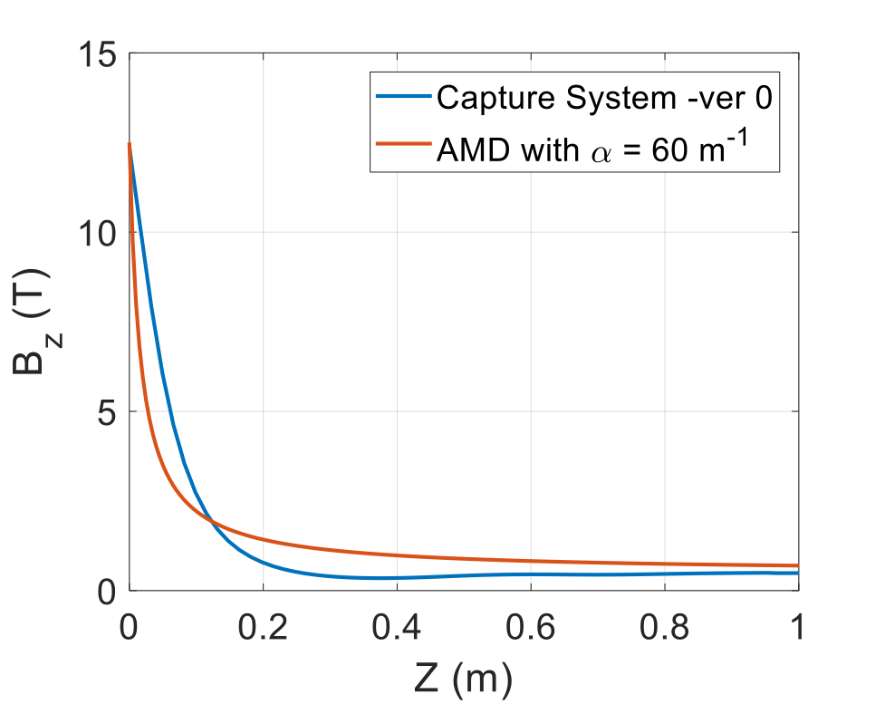

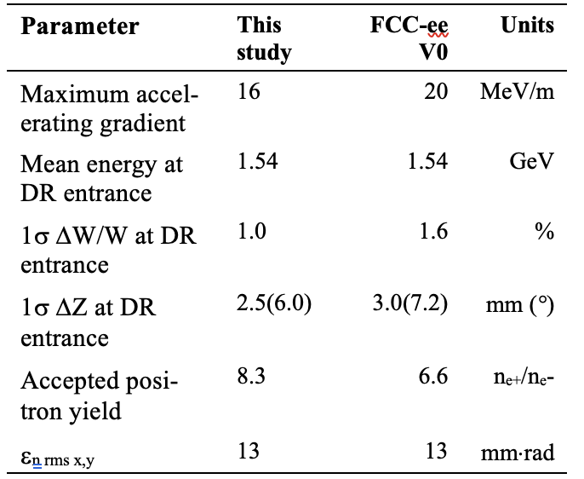
Optimization studies toward better performance
V. Mytrochenko (IJCLab)
AMD field profile
RF structure length
Distance between the target and the first RF structure and possibility of installing the additional DC solenoid in this region are under investigation.

Slide 12
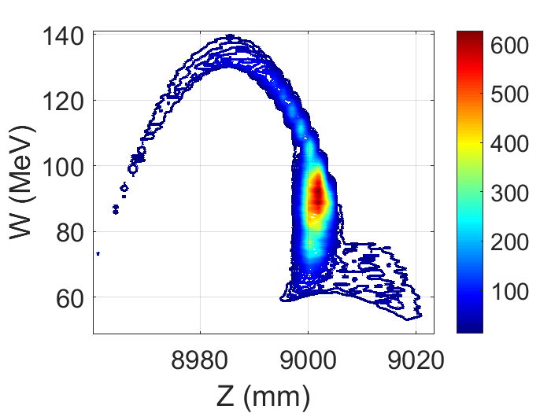
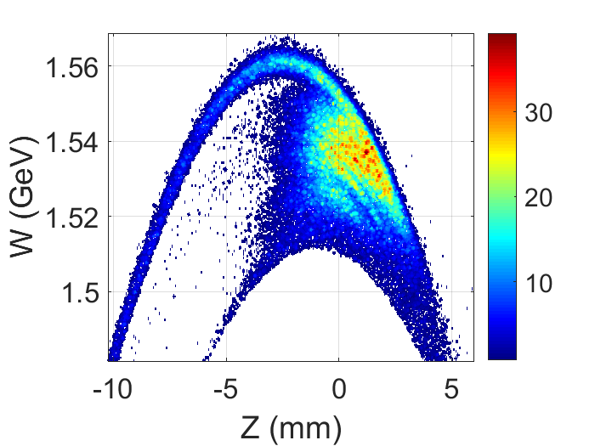
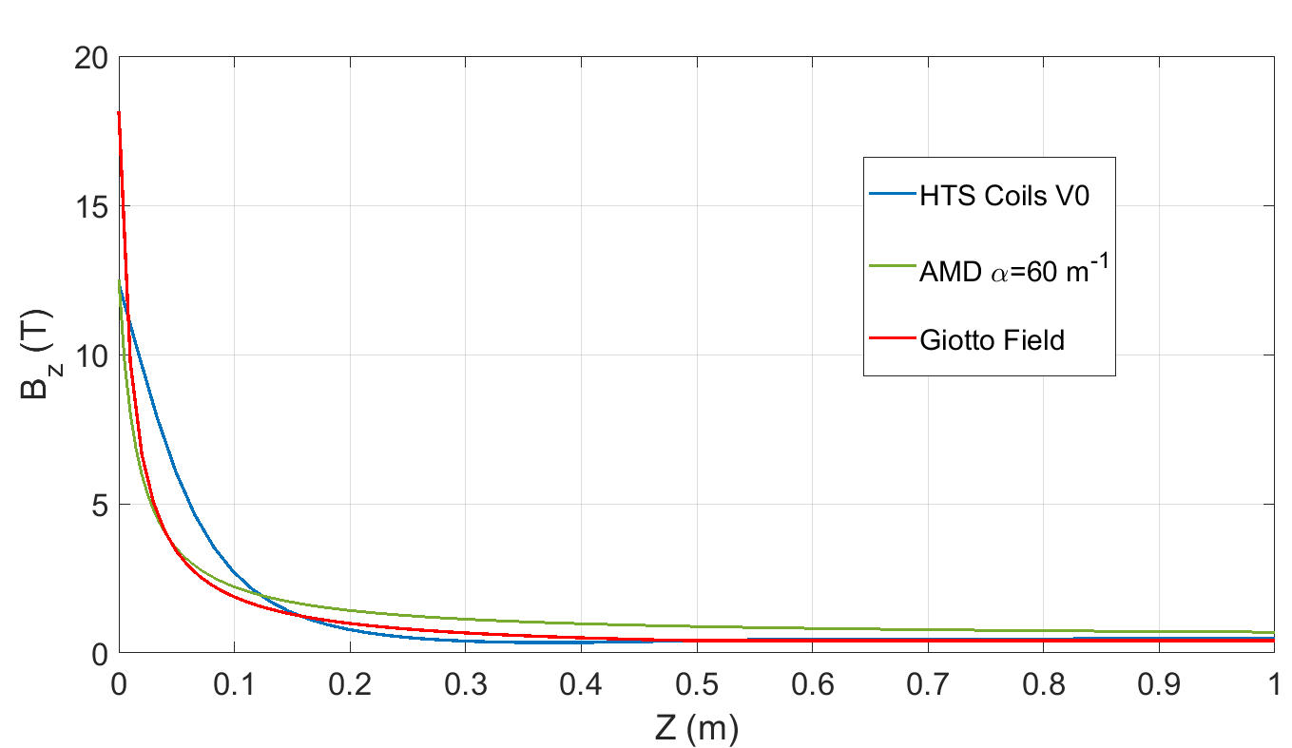
The first GIOTTO results (work in progress)
A. Bacci and M. Rossetti-Conti (INFN/Milano)
This results
∆ W/W (1σ) = 0.99 %,
∆ Z (1σ) = 2.4 mm
Beam size (1σ) = 8.7 mm
Acc. Yield = 7
ε_{n rms x,y} = 9.6⋅10³ mm⋅mrad
Optimized AMD a = 60 m⁻¹
∆ W/W (1σ) = 1 %,
∆ Z (1σ) = 2.5 mm
Acc. Yield = 8.3
ε_{n rms x,y} = 13⋅10³ mm⋅mrad
Capture system -V0*
∆ W/W (1σ) = 1.6 %,
∆ Z (1σ) = 3 mm
Acc. Yield = 6.6
ε_{n rms x,y} = 13⋅10³ mm⋅mrad
*results based on the previous
G4 simulations

Slide 13
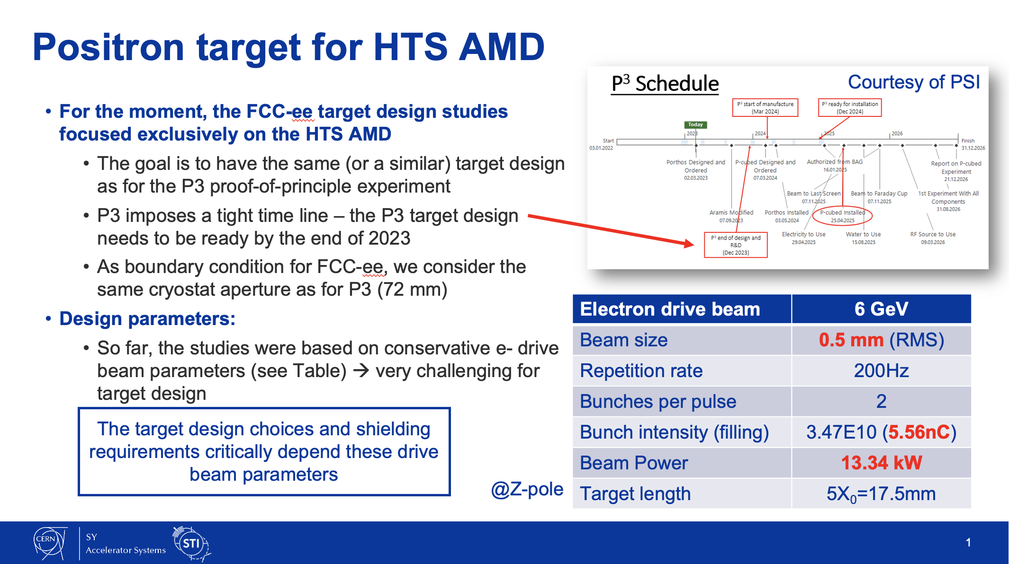
CERN-STI group

Slide 14
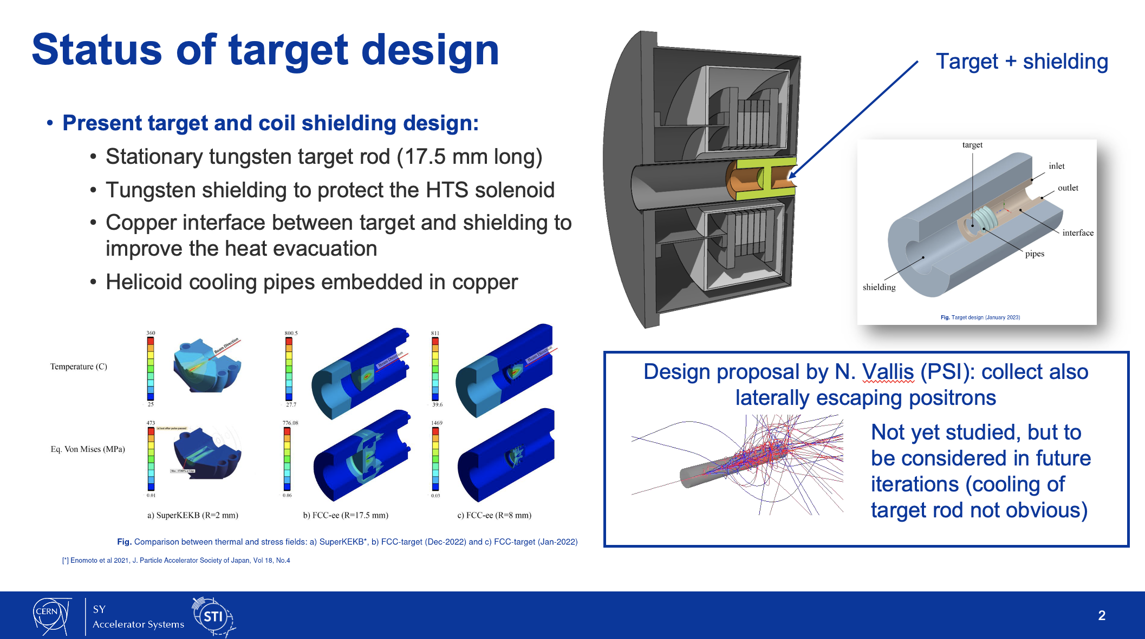
CERN-STI group

Slide 15
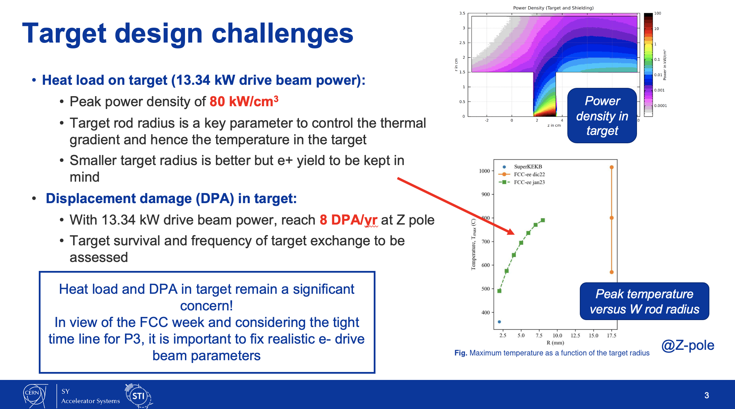
CERN-STI group

Slide 16
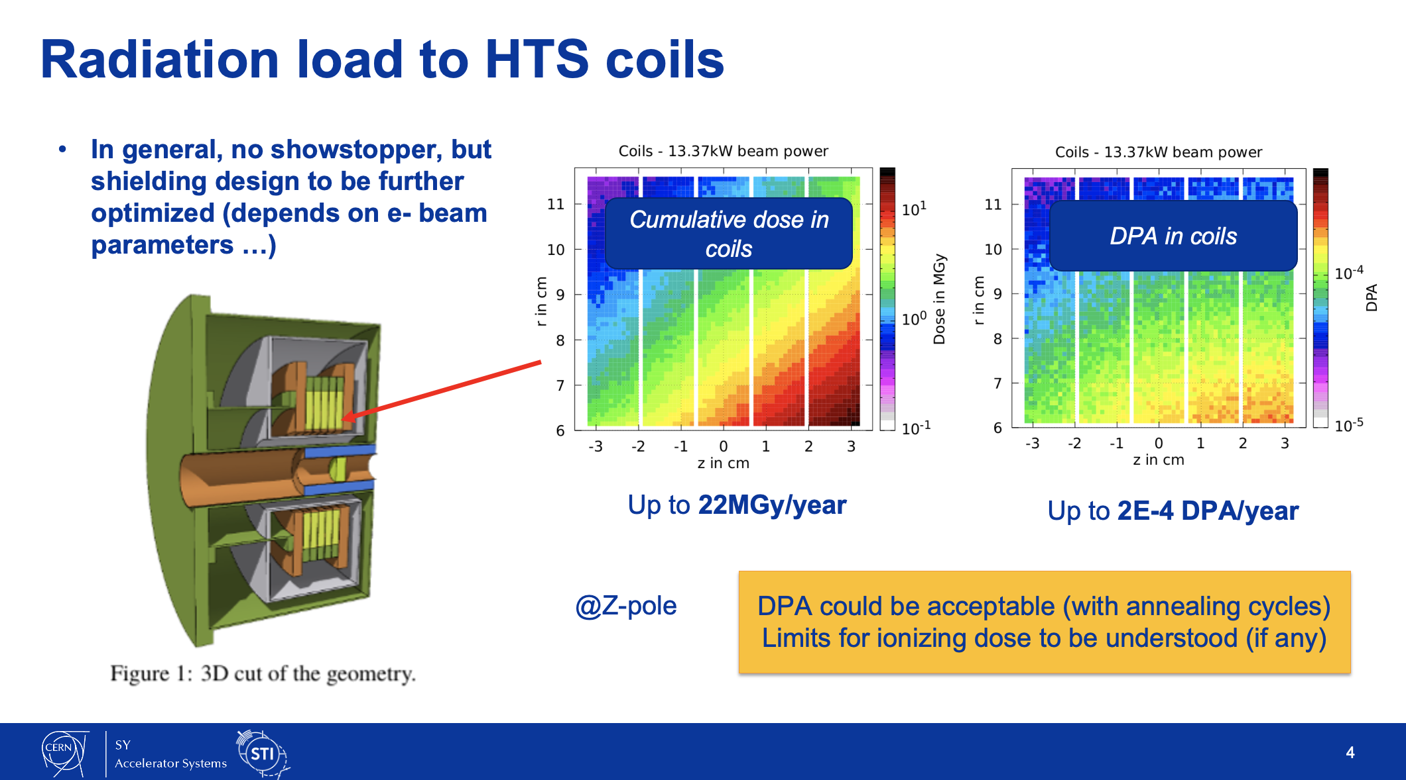
CERN-STI group

Slide 17
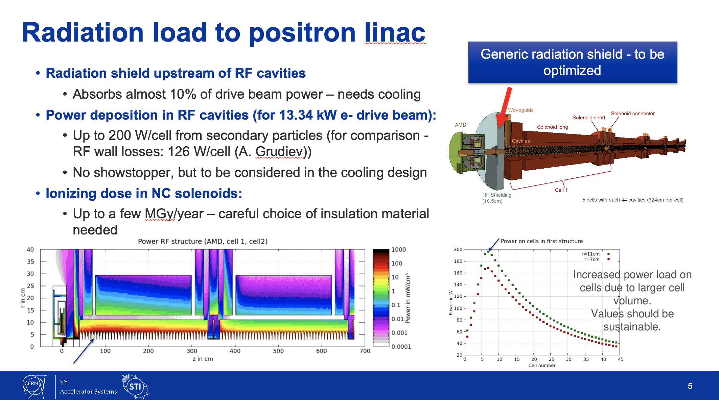
CERN-STI group

Slide 18
Towards the mid-term project review
WP3: Positron source: target and capture system
❖ Baseline for the positron source and comparison between a solution with SC solenoid and FC – May 2023
❖ Baseline for the capture system – May 2023
in progress
Fix two configurations: FC-based and HTS solenoid-based capture system to proceed with the “final” performance evaluation and the cost estimate exercise
  SuperKEKB FC (FC and drive-beam parameters, consideration on the complexity of the target design)
  HTS solenoid (drive-beam parameters, target design)
To proceed with the studies the input from the DR is essential.

Slide 19
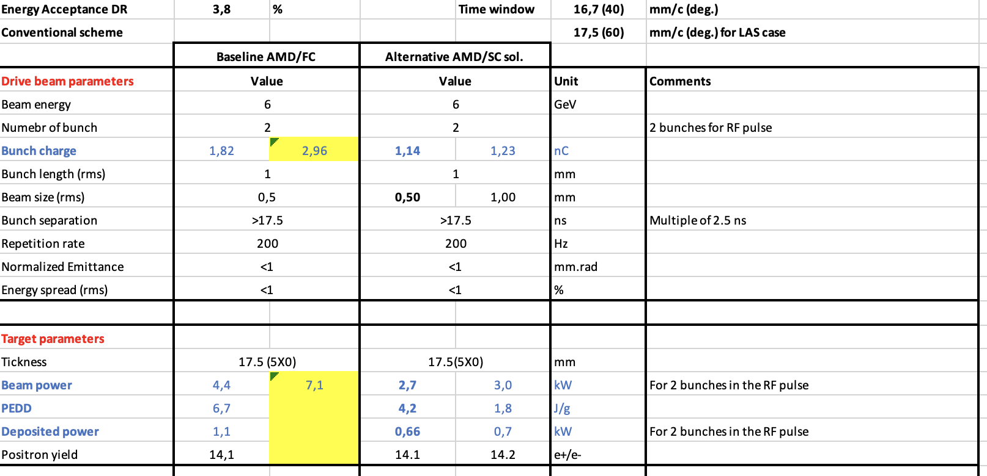
Parameter table for the mid-term project review (to be finalized)
BINP
SKEKB
CS –v0

Slide 20
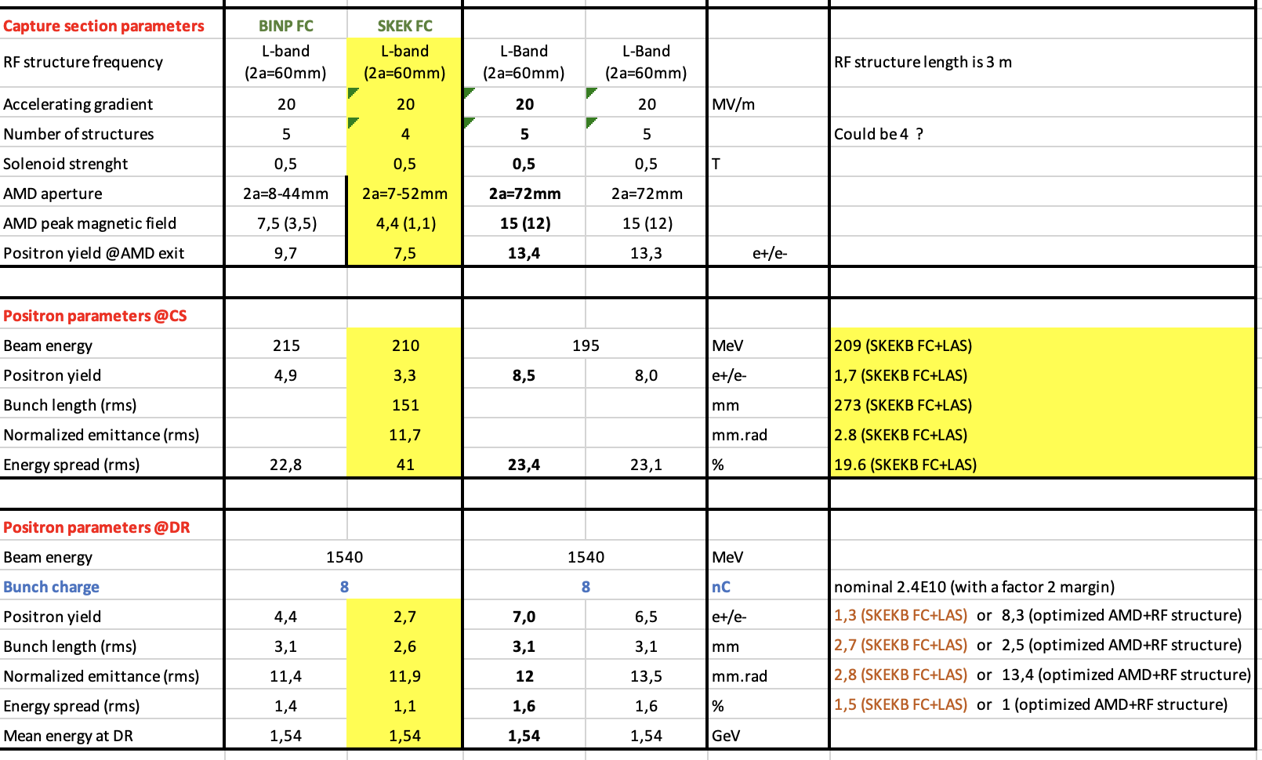
e- drive beam parameters

Slide 21
Summary/Discussion
In view of the mid-term review => present and evaluate two schemes: FC-based capture system and HTS-based capture system. Cost estimate.
In order to provide the results on the radiation/thermal load and target design, we should ‘fix’ the parameters of the e- drive beam. It will allow the CERN-STI group to proceed with their studies (FCC week).
So far we have assumed a factor of 2 as the safety margin for the e+ source design (still under discussion, could be eventually smaller than 2).
Questions related to the acceptance of the DR in application to e+ yield. How do we proceed in general?
  Currently, to estimate the accepted e+ yield (~7 e+/e-), we are applying the energy/time window cut (±3.8%, ~17 mm). Are these values reasonable and match the DR design? Do we keep using it or should change them?
  Given the large normalized emittance (~10 mm.rad), we would like to understand which safety factor does WP4 suggest to use at this stage or we should rely on the tracking results only (can be done before the FCC-week ?).

