Slide 1
RF Power Sources and Module Layouts for All Linacs
Jean-Yves Raguin :: Paul Scherrer Institut
FCC-ee Pre-Injector: CHART Collaboration Meeting
Frascati, Italy, 20 April 2023

Slide 2
FCC-ee linacs injectors
~
1
0
0
m
~
3
0
0
m
E
l
e
c
t
r
o
n
S
P
S
(
P
B
R
)
o
E
r
C
H
E
L
i
n
a
s
c
o
u
r
c
e
20 GeV
6
G
e
e
V
-
L
i
n
a
c
1
.
5
4
G
e
V
C
o
m
m
o
n
L
i
n
a
c
1
.
5
4
G
e
e
V
+
L
i
n
a
c
D
E
R
~
C
1
0
B
0
m
C
s
1
6
0
1
6
m
3
.
5
4
G
e
V
5
m
S
3
m
t
o
r
e
d
t
i
m
e
4
0
m
s
P
o
s
i
t
r
o
n
s
o
u
r
c
e
Positron linac (p-linac) op. freq. and rep. rate: 2004 MHz, 200 Hz
Electron linac (e-linac) op. freq. and rep. rate: 2806 MHz, 200 Hz
Common linac (c-linac) op. freq. and rep.rate: 2806 MHz, 400 Hz
High energy linac (HE-linac) option rep. rate: 2806 MHz or 5611 MHz, 200 Hz

Slide 3
S-band klystrons
Manufacturer | Type | Frequency [MHz] | Peak power [MW] | Pulse length [µs] | Rep. Rate [pps] | Average power [kW]
SLAC | 5045 | 2856 | 65 | 3.5 | 180 | 41
SLAC | 2 prototypes built for DESY in mid90s | 2998 | 150 | 3 | 60 | 27
CPI | VKS-8265A SLAC 5045 copy | 2856 | 65 | 3.5 | --
CPI | VKS-8245C | 2998 | 45 | 4.5 | 100 | 20
Canon ETD * | E37320 | 2856 | 80 | 4 | 60 | 19
Canon ETD | E3729 | 2856 | 70 | 4 | 50 | 14
Canon ETD | E3730A | 2856 | 50 | 4 | 50 | 10
Canon ETD | E37340 | 2856 | 50 | 4 | 150 | 30
Canon ETD | E37333 | 2998 | 70 | 3 | 100 | 21
Thales ED | TH2128 A/C/D | 2856 | 45 | 4.5 | 100 | 20
Thales ED | TH2100 C | 2998 | 45 | 4.5 | 100 | 20
* 12 tubes for PLS Linac

Slide 4
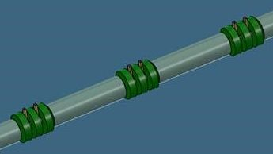
RF module type#1 layout for positron linac
Klystron - rep. rate 200 Hz, RF pulse length 5 µs
Required number of modules: 7
SLED
2.21 m
0.2 m
2 GHz - 20 MV/m
2 GHz - 20 MV/m
3.24 m
RF module length: 6.48 m

Slide 5
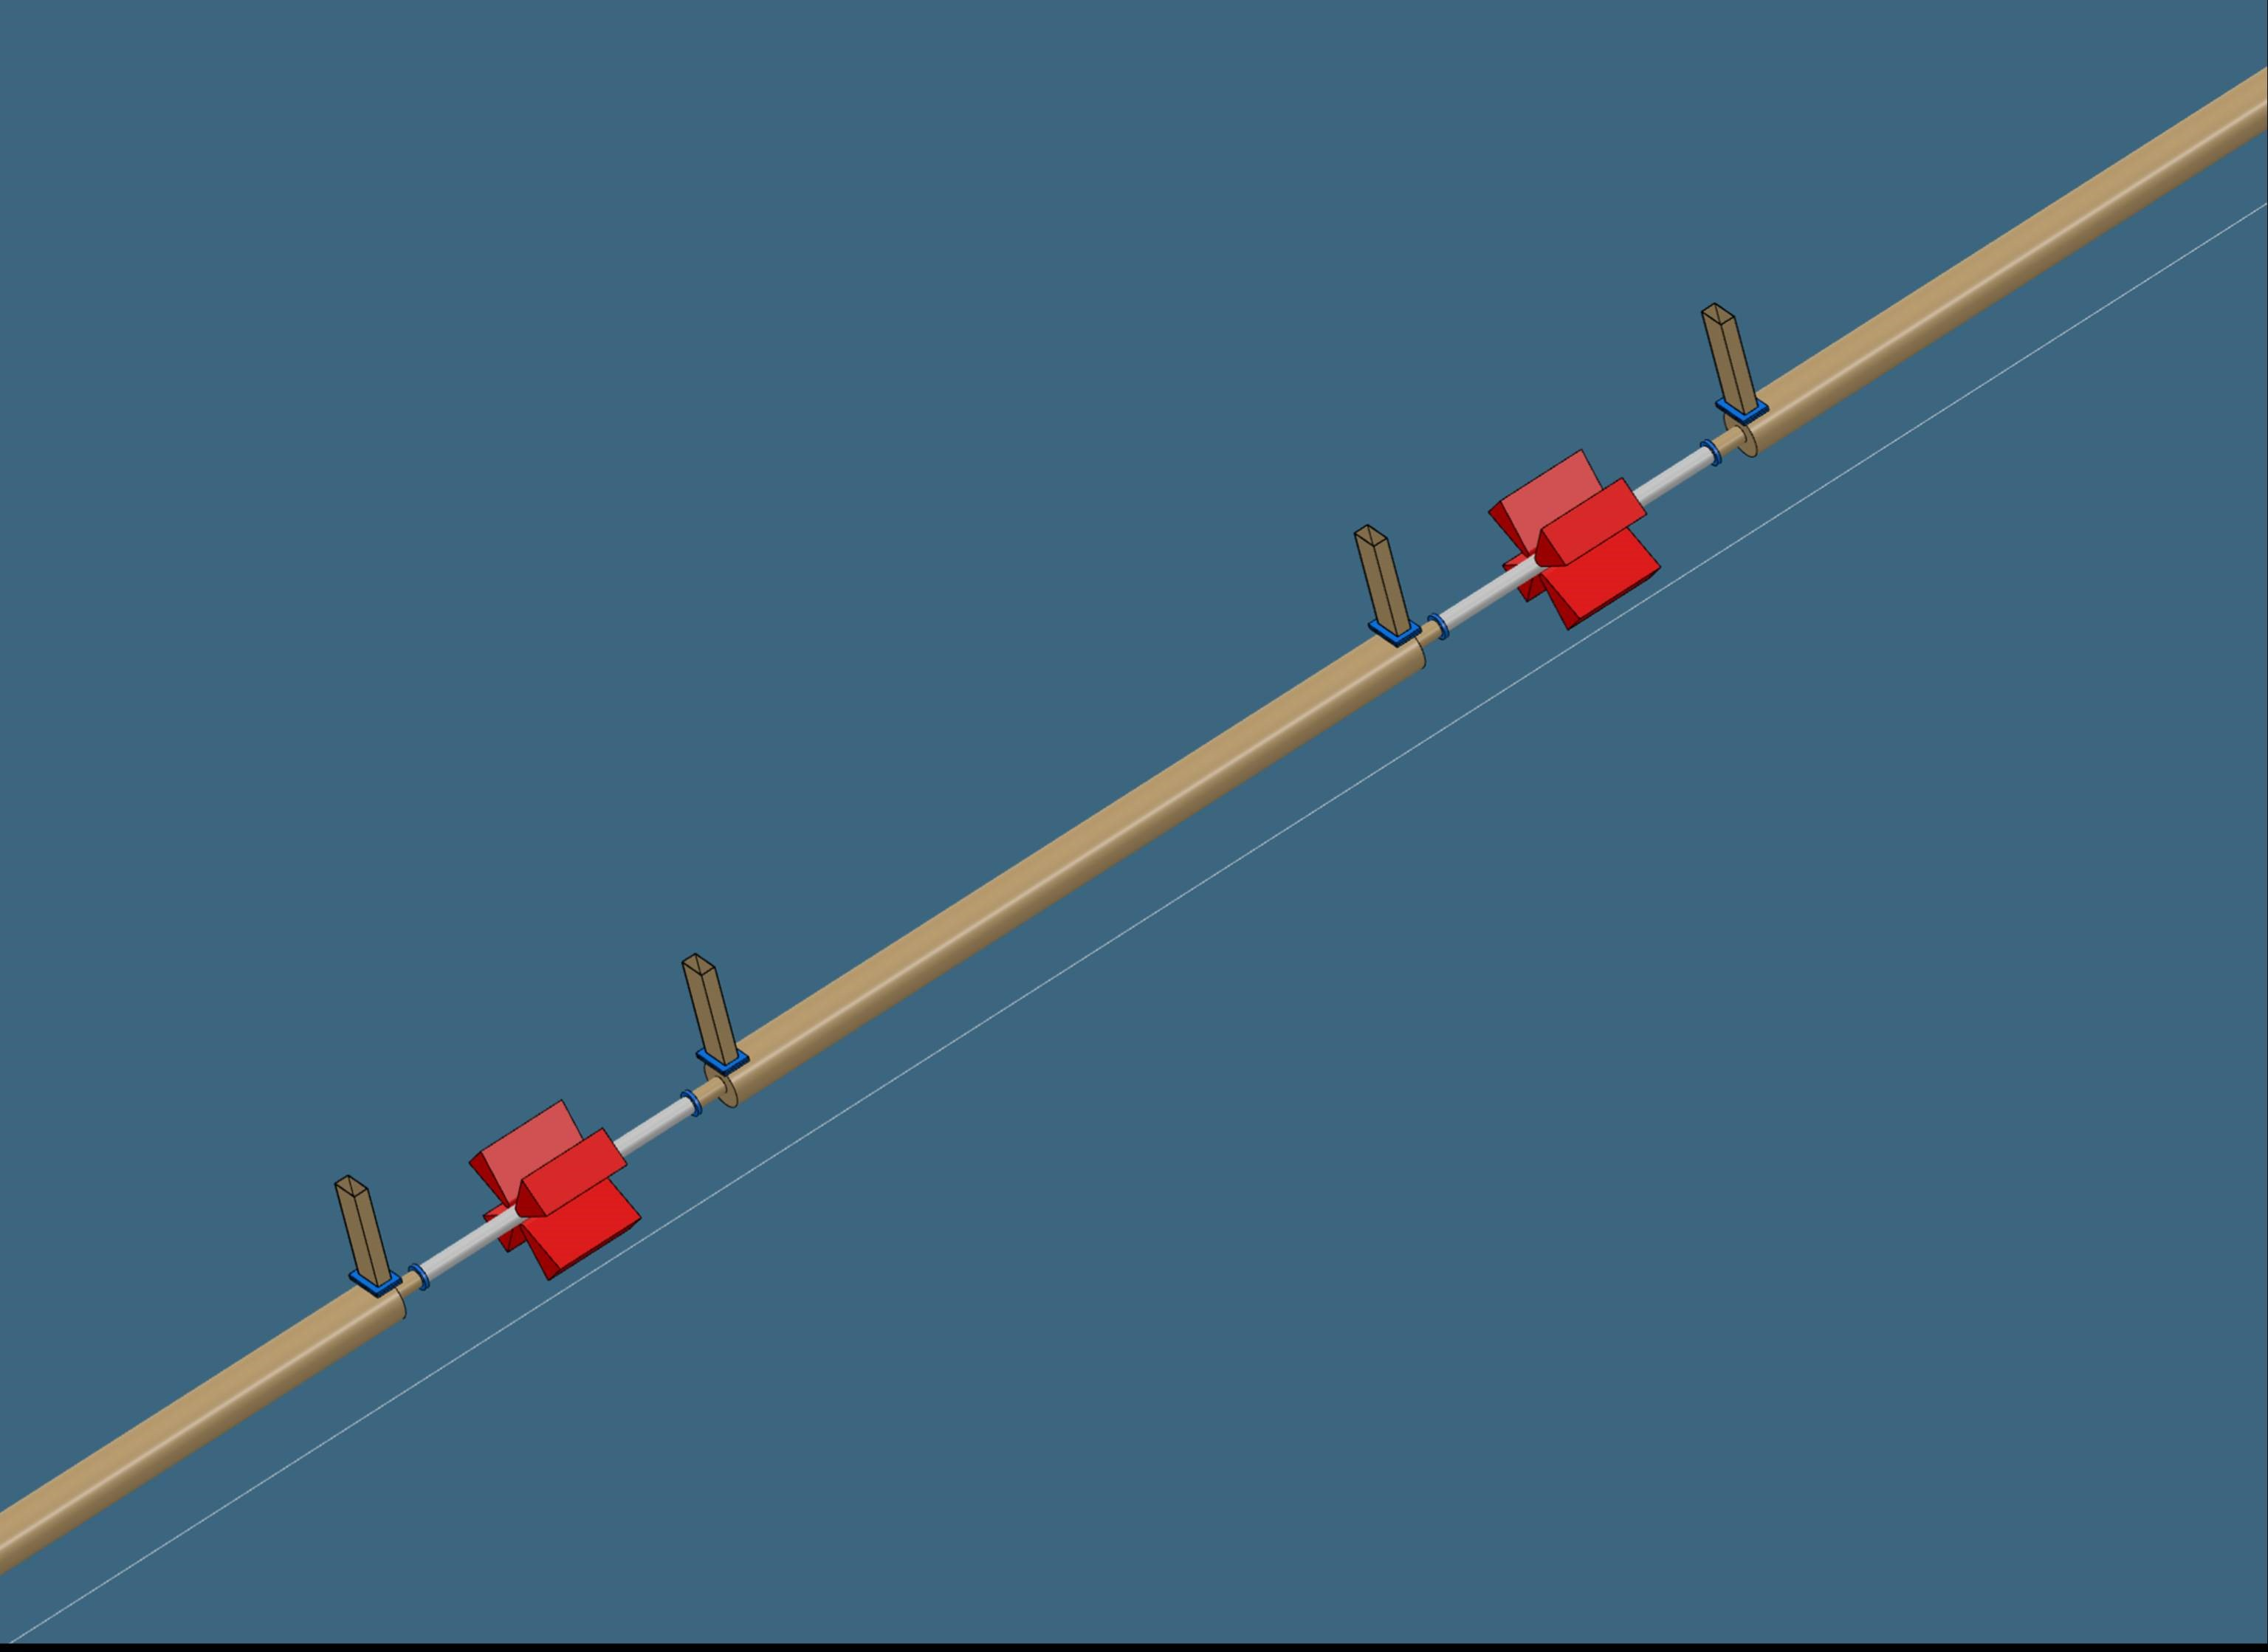
RF module type#2 layout for positron linac
Klystron - rep. rate 200 Hz, RF pulse length 5 µs
Required number of modules: 7
SLED
0.35 m
2 GHz - 20 MV/m
2 GHz - 20 MV/m
3.24 m
1.16 m
RF module length: 8.8 m

Slide 6
p-linac – RF module specification
 |  | Comments
Accelerating structure | F3 | Tab. 1, Pommerenke et al., pp. 707-710, LINAC 2022
Repetition rate [Hz] | 200
Frequency [MHz] | 2004
Aperture radius [mm] | 30 | Constant aperture, tapered iris thickness
Length [m] | 3
Filling time [ns] | 447
SLED coupling | 17
Klystron RF pulse length [µs] | 5
Average gradient [MV/m] | 20
Klystron power per structure [MW] | 30
RF voltage per structure [MV] | 60
Energy gain per structure [MeV] | 60 | On-crest operation
Structure average power [kW] | 31
Klystron output power specification [MW] | 80 | Assuming 15 % WG losses and operation at 90 % kly. output power spec.
Number of structures per klystron | 2
Number of structures for 1.54 GeV energy gain | 28 | Including capture linac 0-200MeV CHART Scientific Report 2022 p.31, Tab. 3
Number of modules | 14 | Including capture linac 0-200MeV

Slide 7
RF module layout for electron linac
Klystron - rep. rate 200 Hz, RF pulse length 3 µs
SLED
0.25 m
2.8 GHz – 28 /32 MV/m
2.8 GHz – 28 / 32 MV/m
3.75 m
3.75 m
RF module length: 7.5 m

Slide 8
e-linac – RF module specification
 |  | Comments
Accelerating structure | a/λ=0.15 | Tab. 2, Pommerenke et al., pp. 707-710, LINAC 2022
Repetition rate [Hz] | 200
Frequency [MHz] | 2806
Aperture radius [mm] | 16.1 | Average
Length [m] | 3
Filling time [ns] | 486
SLED coupling | 15
Klystron RF pulse length [µs] | 3
Average gradient [MV/m] | 28 / 32
Klystron power per structure [MW] | 27 / 35
RF voltage per structure [MV] | 84 / 96
Energy gain per structure [MeV] | 84 / 96 | On-crest operation
Structure average power [kW] | 16 / 21
Klystron output power specification [MW] | 70 / 92 | Assuming 15 % WG losses and operation at 90 % kly. output power spec.
Number of structures per klystron | 2
Number of structures for 1.34 GeV energy gain | 16 / 14 | Doesn’t including Pre-Pre-injector linac 0-200MeV
Number of modules | 8 / 7 | Doesn’t including Pre-Pre-injector linac 0-200MeV

Slide 9
RF module layout for common linac
Klystron - rep. rate 400 Hz, RF pulse length 3 µs
Same structure and same FODO cell
than for the e- linac
SLED
0.25 m
2.8 GHz – 25 MV/m
2.8 GHz – 25 MV/m
3.75 m
3.75 m
RF module length: 7.5 m

Slide 10
c-linac – RF module specification
 |  | Comments
Accelerating structure | a/λ=0.15 | Tab. 2, Pommerenke et al., pp. 707-710, LINAC 2022
Repetition rate [Hz] | 400
Frequency [MHz] | 2806
Aperture radius [mm] | 16.1 | Average
Length [m] | 3
Filling time [ns] | 486
SLED coupling | 15
Klystron RF pulse length [µs] | 3
Average gradient [MV/m] | 25
Klystron power per structure [MW] | 21.5
RF voltage per structure [MV] | 75.7
Energy gain per structure [MeV] | 75 | 82° off-crest operation
Structure average power [kW] | 26
Klystron output power specification [MW] | 57 | Assuming 15 % WG losses and operation at 90 % kly. output power spec.
Number of structures per klystron | 2
Number of structures | 62 | CHART Scientific Report 2022 p.16, Fig. 10
Number of modules | 31

Slide 11
Linacs summary and RF cost estimates
Linac | RF freq. [MHz] | Number of structures | Number of RF modules | Acc. gradient [MV/m] | Rep. Rate [Hz] | Kly. power spec. [MW]
p-linac | 2004 | 28 | 14 | 20 | 200 | 80
e-linac | 2806 | 16 / 14 | 8 / 7 | 28 / 32 | 200 | 70 / 92
c-linac | 2806 | 62 | 31 | 25 | 400 | 57
Cost model assumption:
  Cost acc. structure: 140 kCHF
10.6
: e-linac 70 - assumes 800 kCHF for modulator and 250 kCHF for klystron
: e-linac 92 - assumes 850 kCHF for modulator and 280 kCHF for klystron
9.9

Slide 12
HE-linac – S-band option – Kly. spec. 70 MW
 |  | Comments
Accelerating structure | a/λ=0.15 | Tab. 2, Pommerenke et al., pp. 707-710, LINAC 2022
Repetition rate [Hz] | 200
Frequency [MHz] | 2806
Aperture radius [mm] | 16.1 | Average
Length [m] | 3
Filling time [ns] | 486
SLED coupling | 15
Klystron RF pulse length [µs] | 3
Average gradient [MV/m] | 27.8 / 19.4
Klystron power per structure [MW] | 26.7 / 13.0
RF voltage per structure [MV] | 83.3 / 58.3
Energy gain per structure [MeV] | 83.3 / 58.3 | On-crest operation
Structure average power [kW] | 16 / 7.8
Klystron output power specification [MW] | 70 | Assuming 15 % WG losses and operation at 90 % kly. output power spec.
Number of structures per klystron | 2 / 4
Number of structures for 14 GeV gain | 168 / 240
Number of modules | 84 / 60

Slide 13
S-band option – Kly. spec. 70 MW – RF costs
Same structure than for e-linac
Klystron output power specification of 70 MW
Cost model assumption:
  Cost acc. structure: 140 kCHF
Options | Number of structures | Acc. gradient [MV/m] | Number of RF modules | Total acc. length [m]
2 acc. struct. per module | 168 | 27.8 | 84 | 504
4 acc. struct. per module | 240 | 19.4 | 60 | 720
111.7
96.6
: Assumes 800 kCHF for modulator and 250 kCHF for klystron

Slide 14
S-band option – Kly. spec. 70 MW – RF costs
221.7
134.2
: Assumes 800 kCHF for modulator and 250 kCHF for klystron
21.2
26.2

Slide 15
HE-linac – S-band option – Kly. spec. 92 MW
 |  | Comments
Accelerating structure | a/λ=0.15 | Tab. 2, Pommerenke et al., pp. 707-710, LINAC 2022
Repetition rate [Hz] | 200
Frequency [MHz] | 2806
Aperture radius [mm] | 16.1 | Average
Length [m] | 3
Filling time [ns] | 486
SLED coupling | 15
Klystron RF pulse length [µs] | 3
Average gradient [MV/m] | 31.5 / 22.4
Klystron power per structure [MW] | 34.3 / 23.2
RF voltage per structure [MV] | 94.6 / 67.3
Energy gain per structure [MeV] | 94.6 / 67.3 | On-crest operation
Structure average power [kW] | 20.6 / 10.4
Klystron output power specification [MW] | 92 | Assuming 15 % WG losses and operation at 90 % kly. output power spec.
Number of structures per klystron | 2 / 4
Number of structures for 14 GeV gain | 148 / 208
Number of modules | 74 / 52

Slide 16
S-band option – Kly. spec. 92 MW – RF costs
Same structure than for e-linac
Klystron output power specification of 92 MW
Cost model assumption:
  Cost acc. structure: 140 kCHF
Options | Number of structures | Acc. gradient [MV/m] | Number of RF modules | Total acc. length [m]
2 acc. struct. per module | 148 | 31.5 | 74 | 444
4 acc. struct. per module | 208 | 22.4 | 52 | 624
104.3
87.9
: Assumes 850 kCHF for modulator and 280 kCHF for klystron

Slide 17
S-band option – Kly. spec. 92 MW – RF costs
235.0
140.8
: Assumes 850 kCHF for modulator and 280 kCHF for klystron
17.5
20.7

Slide 18
HE-linac – C-band option – Kly. spec. 50 MW
 |  | Comments
Accelerating structure | a/λ=0.12 !
Repetition rate [Hz] | 200
Frequency [MHz] | 5712
Aperture radius [mm] | 6.4 | Average
Length [m] | 2
Filling time [ns] | 329
BOC coupling | 10
Klystron RF pulse length [µs] | 3
Average gradient [MV/m] | 47.8 / 33.4
Klystron power per structure [MW] | 18.3 / 8.9
RF voltage per structure [MV] | 94.6 / 66.0
Energy gain per structure [MeV] | 94.6 / 66.0 | On-crest operation
Structure average power [kW] | 11 / 5.3
Klystron output power specification [MW] | 50 | Assuming 19 % WG losses and operation at 90 % kly. output power spec.
Number of structures per klystron | 2 / 4
Number of structures for 14 GeV gain | 148 / 212
Number of modules | 74 / 53

Slide 19
C-band option – Kly. spec. 50 MW – RF costs
SwissFEL BOC and acc. structure – 5712 MHz !
Klystron specs: 50 MW, 100 Hz rep.rate, 3 µs RF pulse length
BOC specs.: β=10, Q₀=216,000, M=2.12 R_{eff}=247 MΩ/m
Cost model assumption:
  Cost acc. structure: 140 kCHF
Options | Number of structures | Acc. gradient [MV/m] | Number of RF modules | Total acc. length [m]
2 acc. struct. per module | 148 | 48 ! | 74 | 293
4 acc. struct. per module | 212 | 33 | 53 | 419
94.0
82.2
: Based on modulator, klystron and acc. struct. cost for SwissFEL

Slide 20
C-band option – Kly. spec. 50 MW – RF costs
321.2
196.0
: Based on modulator, klystron and acc. struct. cost for SwissFEL
28.3
35.4

Slide 21
Klystron specifications summary – Cost request
Klystron abbreviation | Linac | Frequency [MHz] | Peak power specification [MW] | Rep. Rate [Hz] | RF pulse length [µs] | Average power [kW] | Required numbers
Kly_p | p-linac | 2004 | 80 | 200 | 5 | 40 | 14
Kly_e 92 | e-linac 92 HE-linac 70 – S band option | 2806 | 95 | 200 | 3 | 57 | > 50
Kly_e 70 | e-linac 70 HE-linac 70 – S band option Same as Kly_c? | 2806 | 70 | 200 | 3 | 42 | > 50
Kly_c | c-linac Same as Kly_e 70? | 2806 | 60 | 400 | 3 | 72 | 31
Kly_HE_C | HE-linac – C band option | 5611 | 50 | 200 | 3 | 30 | > 50

Slide 22
Wir schaffen Wissen – heute für morgen
We create knowledge today – for use tomorrow

