Slide 1
WP1 status and RF design
Alexej Grudiev on behalf of WP1
20/04/2023
FCC-ee Pre-Injector: CHART Collaboration Meeting
INFN Frascati, April 20-21, 2023

Slide 2
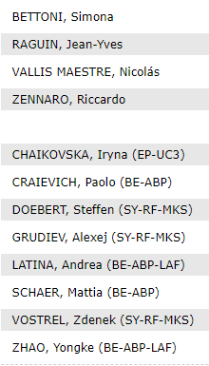
Joint WP1 meetings since last collaboration meeting

Slide 3
Some details on Who is doing What
Task 1.1: electron source and Pre-Pre-injector design
Steffen, Zdenek (Master student, till 1/09/2023 ) (CERN)
Task 1.2: RF design of linacs
Alexej, Adnan (Fellow, from 1/06/2023) (CERN)
Task 1.3: Beam dynamic design of the linacs
Simona, Mattia (PSI)
Task 1.4: RF module design and cost
Jean-Yves (PSI)
Great Support from
Riccardo and Paolo (PSI), Andrea and Yongke (CERN), Iryna (IJCLab)

Slide 4
Baseline layout
HE Linac
Common Linac
2.8 – 5.6 GHz
200 Hz
Electron source
2.8 GHz
200 Hz
2.8 GHz
2 x 200 Hz
SPS (PBR)
20 GeV
eLinac
6 GeV
BR
1.54 GeV
pLinac
1.54 GeV
EC
DR
Positron source
2.0 GHz
200 Hz
BC
200 Hz
positron
Common linac at 400 Hz
200Hz + 200 Hz
200 Hz electron
V_{rf}
5
10
t [ms]
40
0

Slide 5
Parameters at BR injection
parameter | Baseline | Alternative | Comments
Ring for injection | BR | SPS or PBR | Destination
Injection energy [GeV] | 20 | 6 | Fixed
Bunch population [1e10] | 2.5 |  | 4 nC
Number of bunches | 2 | 2
Repetition rate [Hz] | 200 | 200
Bunch spacing [ns] | 25 |  | Sub-harmonics of 400 MHz, 2.5ns
Normalized transverse emittances (RMS): γε_x,y [um] | <10, <10
Energy spread (RMS) [%] | ~0.1 |  | Can be adjusted by energy compressor
Bunch length (RMS) [mm] | ~1
Stability at injection in BR for bunch length ~ 1 mm will be studied by BR team.
If longer bunches are required, TL will be adapted to stretch them.

Slide 6
Nominal beam parameter evolution
parameter | e-source | eLinac | Common | HE linac | TL | comments
Injection energy [GeV] |  | ~0.2 | 1.54 | 6 | 20
Energy gain [GeV] | ~0.2 | ~1.52 | 4.46 | 14 | 0
Extraction Bunch population, (charge) [1e10, (nC)] | 4.13, (5.0) | 3.0, (4.8) | 2.88, (4.6) | 2.75, (4.4) | 2.5, (4.0) | 5% margin on each step. 10% for TL+BR
Extraction Normalized transverse emittances (RMS): γε_x,y [um] | <4.0 | <5.1 | <6.4 | <8 | <10 | 20% margin on each step. 20% for TL+BR
Energy spread (RMS) [%] |  |  |  |  | 0.1 – 0.5 | Can be adjusted by energy compressor
Bunch length (RMS) [mm] |  |  |  |  | 1 -- 10
Positrons from DR
Bunch length and energy spread specification are given at 20 GeV.
At lower energy stages they can be different depending on what is better for linacs or e-source.

Slide 7
Electron source and pre-pre-injector
Baseline Layout provide required parameters
It is being updated for 2.8 GHz and 3m long accelerating structure with A/lambda=0.15
More details in talk by Zdenek

Slide 8
RF design status
2.0 GHz RF structure for p-linac is designed (Hermann, LINAC22)
3m long, constant aperture radius = 30mm,
2D-field map of full-length structure is calculated and used in BD
2.8 GHz RF structure for e- and c-linacs is designed (Hermann, LINAC22)
3m long, <a/lambda> = 0.15
Also, to be used in pre-pre-injector
C-band, 5.6 GHz RF structure is a viable option for high energy linac (still to be designed based on the required aperture from the BD)
~3m long, <a/lambda> ~ 0.25 (?)

Slide 9
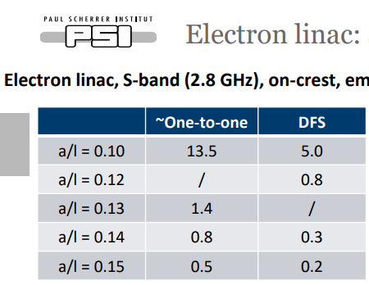
Beam dynamics in e- and c-linacs
Final emittance is < 5.1 mm mrad
More details in the talk by Simona
Final emittance is < 6.4 mm mrad

Slide 10
HE-linac beam dynamics design (work in progress)
Option 1(S-band): 2.8 GHz, a/lambda=0.15, 30 MV/m
It is essentially e-linac (200 Hz) RF modules for the energy gain from 6 to 20 GeV
Option 2(C-band): 5.6 GHz, a/lambda=0.25(under evaluation, TBC), 40 MV/m
This is work in progress
More details in the talk by Simona

Slide 11
Preliminary Linac parameter summary
 | e- linac | Common linac | HE linac | HE linac
Repetition Frequency (Hz) | 200 | 400 | 200 | 200
RF Frequency (GHz) | 2.8 | 2.8 | 2.8 | 5.6
Gradient (MV/m) | 28 | 25 | 30 | 40
a (mm) (a/l) | 16.1 (0.15) | 16.1 (0.15) | 16.1 (0.15) | 13.4 (0.25)
Length structures (m) | 3 | 3 | 3 | 3
Phase (deg) | 90 | 90 | 90 | 90
N. Structures | 16 | 60 | 156 | 118
N. correctors | 16 | 60 | 156 | 118
Max. strength correctors | << 20 T.mm | << 20 T.mm | < 20 T.mm | < 20 T.mm
N. BPM | 16 | 60 | 156 | 118
N. Quadrupoles | 16 | 60 | 156 | 118
K1 (1/m²) = 1/(B*rho)*G | 1.51 | 1.51 | 1.51 | 1.51
Length quads (m) | 0.25 | 0.25 | 0.25 | 0.25
Total length (m) | 60 | 225 | 585 | 442.5
C-band linac is 142.5 m shorter (30%)

Slide 12
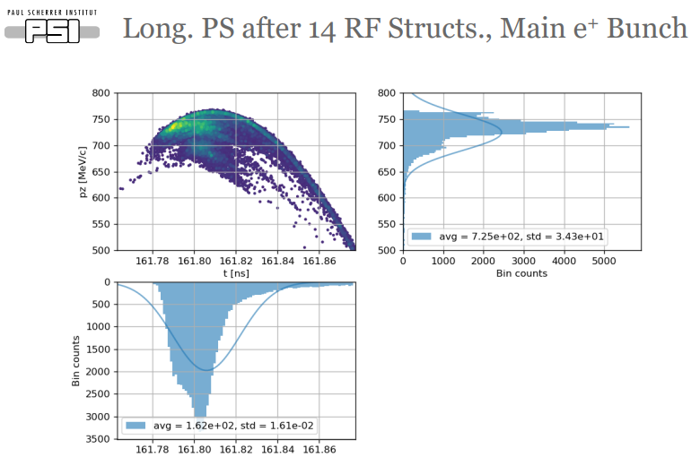
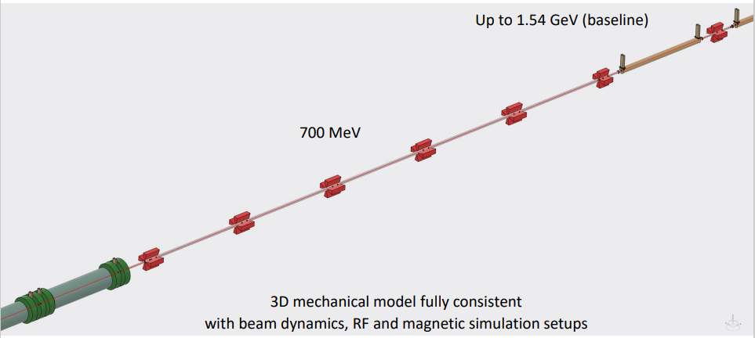
Positron linac beam dynamics design
Positron linac baseline
Electron separation chicane at ~200 MeV
Solenoidal focusing up to ~700 MeV
Quadrupolar focusing till 1.54GeV
More details in the talk by Mattia

Slide 13
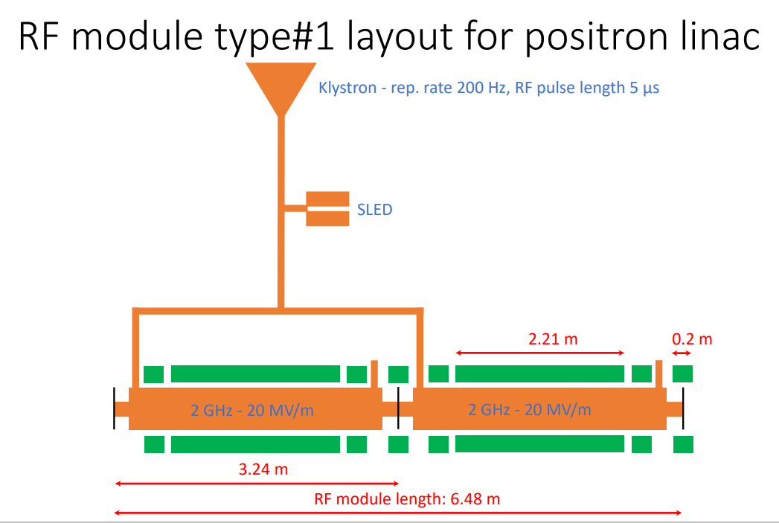
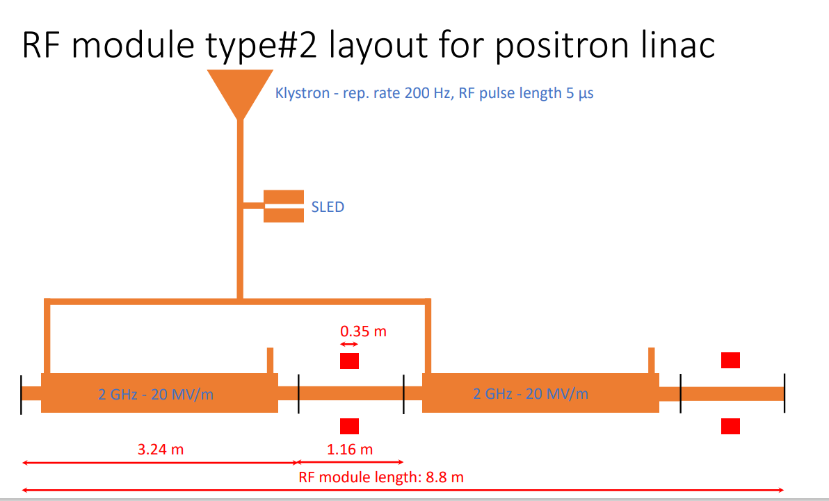
Preliminary layout of the positron linac
14 RF modules
e-/e+ separation
Energy compression
Matching
T
#1
#1
#1
#1
#1
#1
#1
#1
#2
#2
#2
#2
#2
#2
2m
15m
?m
Capture linac: ~15m
Solenoid focusing: ~40m
quad focusing: ~53m
125m

Slide 14
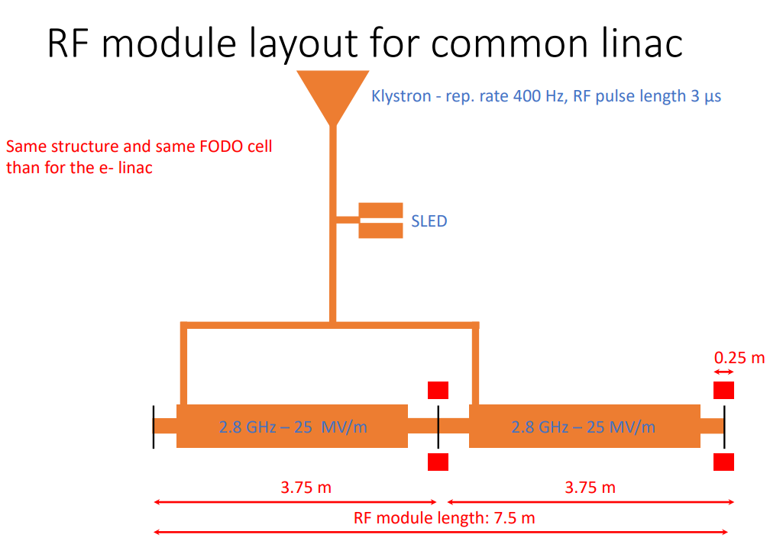
Layout of electron and common linacs
8 RF modules
30 RF modules
Positron injection
…
6 GeV
G
1.5 E
E
E
E
E
E
E
E
E
E
E
E
E
E
E
E
E
E
E
?m
?m
e- source: ~10m
Electron linac: 60m
Common linac: 225m

Slide 15
Baseline layout with length estimates
HE Linac
X m
Y m
585 – 442.5 m
Common Linac
70 m
225 m
2.8 – 5.6 GHz
200 Hz
Electron source
2.8 GHz
200 Hz
2.8 GHz
2 x 200 Hz
SPS (PBR)
20 GeV
eLinac
6 GeV
BR
1.54 GeV
pLinac
1.54 GeV
2.0 GHz
200 Hz
EC
DR
Positron source
BC
125 m
X + Y + (880 or 737.5) m, overall length < ~1 km
More details about cost and power in the linacs in the talk by Jean-Yves

Slide 16
Summary and milestones
Done
Done
In progress
Started

Slide 17
Back up

Slide 18
Energy compressor after HE linac
Required R56
Question to the transfer line designers
for the moment we assume it is possible to do energy compression after the HE linac so we do not need to minimize energy spread in HE linac design

