Slide 1
SPS as FCC-ee pre-booster H. Bartosik, O. Etisken, Y. Papaphilippou CHART Collaboration meeting FCC-ee Injector Studies Mini-Workshop INFN Frascati National Laboratories, 20-21 April 2023

Slide 2
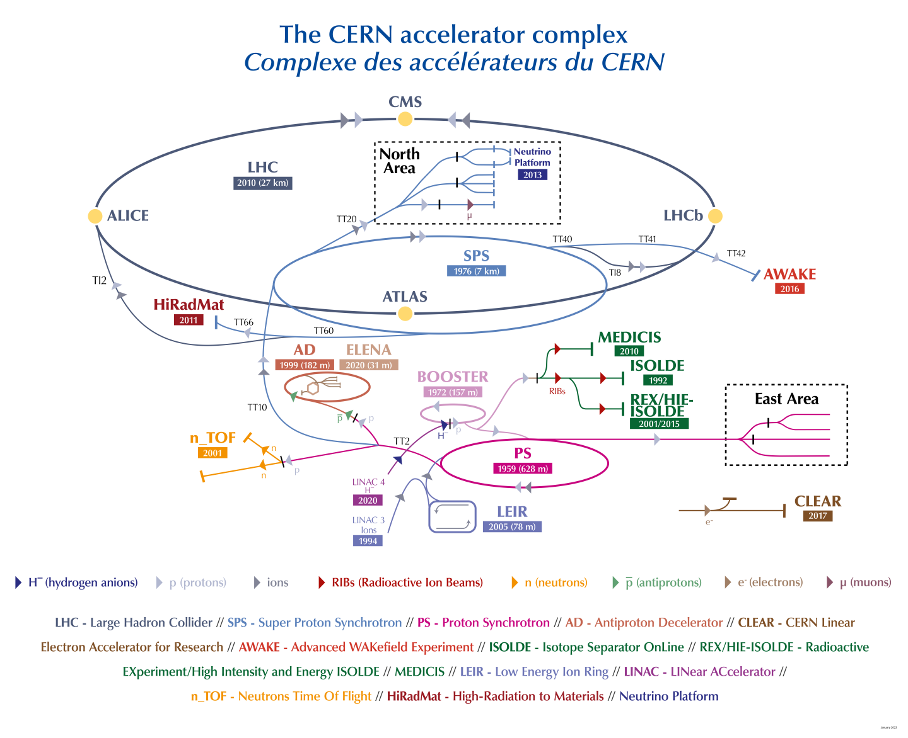
Introduction
Super Proton Synchrotron (SPS) serves the North Area with slow extracted beam and is presently used as LHC injector (protons and ions)

Slide 3
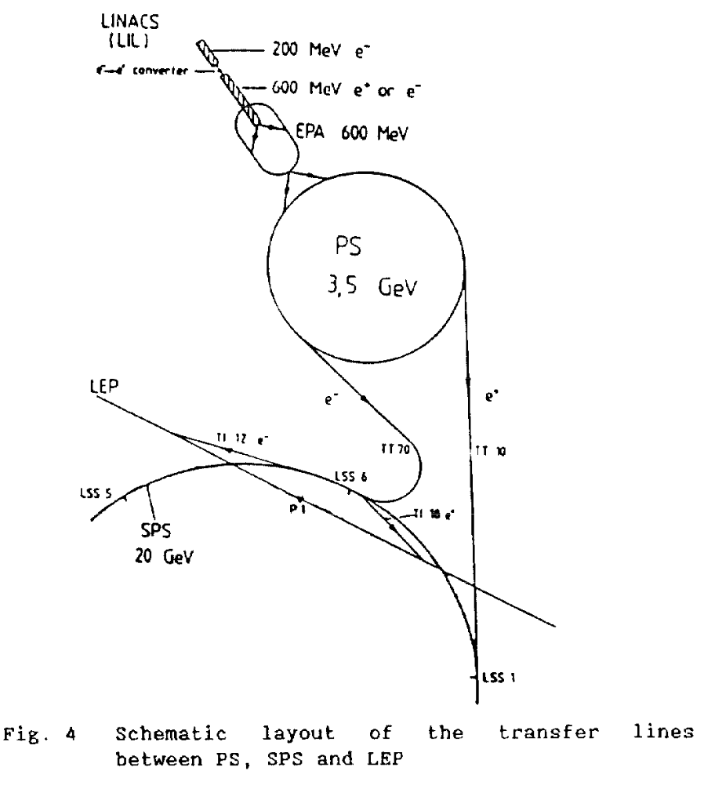
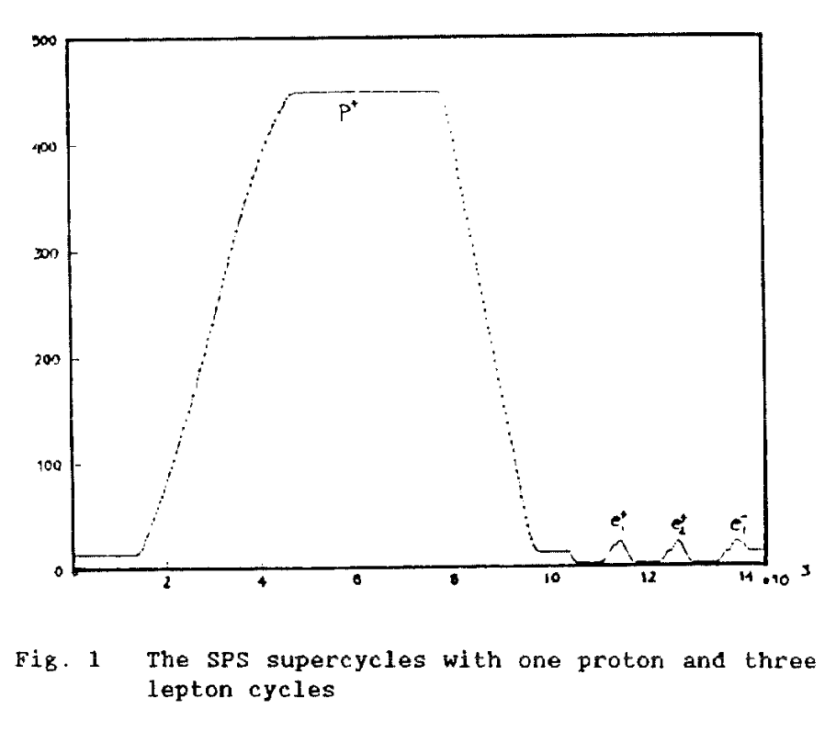
Introduction
Super Proton Synchrotron (SPS) serves the North Area with slow extracted beam and is presently used as LHC injector (protons and ions)
The SPS served as injector for LEP in the past (3.5 GeV to 20 GeV)
K. Cornelis, R. Schmidt, Commissioning the SPS as LEP injector

Slide 4
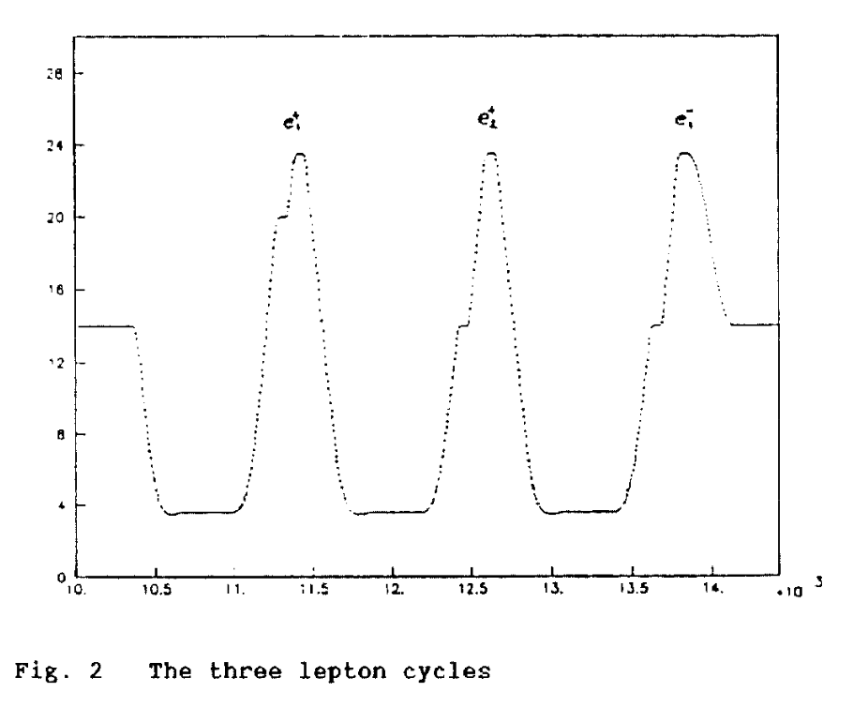
Introduction
Super Proton Synchrotron (SPS) serves the North Area with slow extracted beam and is presently used as LHC injector (protons and ions)
The SPS served as injector for LEP in the past (3.5 GeV to 20 GeV)
K. Cornelis, R. Schmidt, Commissioning the SPS as LEP injector

Slide 5
Introduction
Super Proton Synchrotron (SPS) serves the North Area with slow extracted beam and is presently used as LHC injector (protons and ions)
The SPS served as injector for LEP in the past (3.5 GeV to 20 GeV)
To achieve precision of ΔI/I < 10⁻³ for dipoles and quadrupoles at injection, low-level current control loops were switched between proton and lepton cycles
Synchrotron radiation required installation of masks both inside and outside the vacuum chamber to protect main magnets, as well as shutters in front of proton extraction septa
SPS travelling wave cavities are “directional” and could only be used for positrons – additional 200 MHz standing wave cavities were installed for electrons, and another one at 352 MHz for acceleration of positrons to 20 GeV with active feedback system to compensate beam induced voltage for protons
K. Cornelis, R. Schmidt, “Commissioning the SPS as LEP injector”

Slide 6
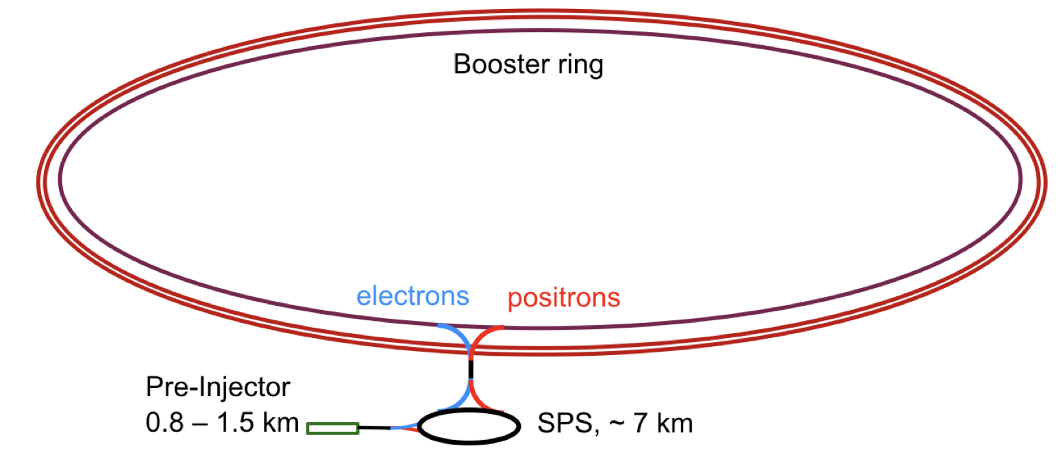
SPS as FCC-ee pre-booster
Lots of work already done by O. Etisken, Y. Papaphilipou and F. Antoniou
Will summarize the main results in the following slides – mostly based on material provided by O. Etisken and Y. Papaphilippou

Slide 7
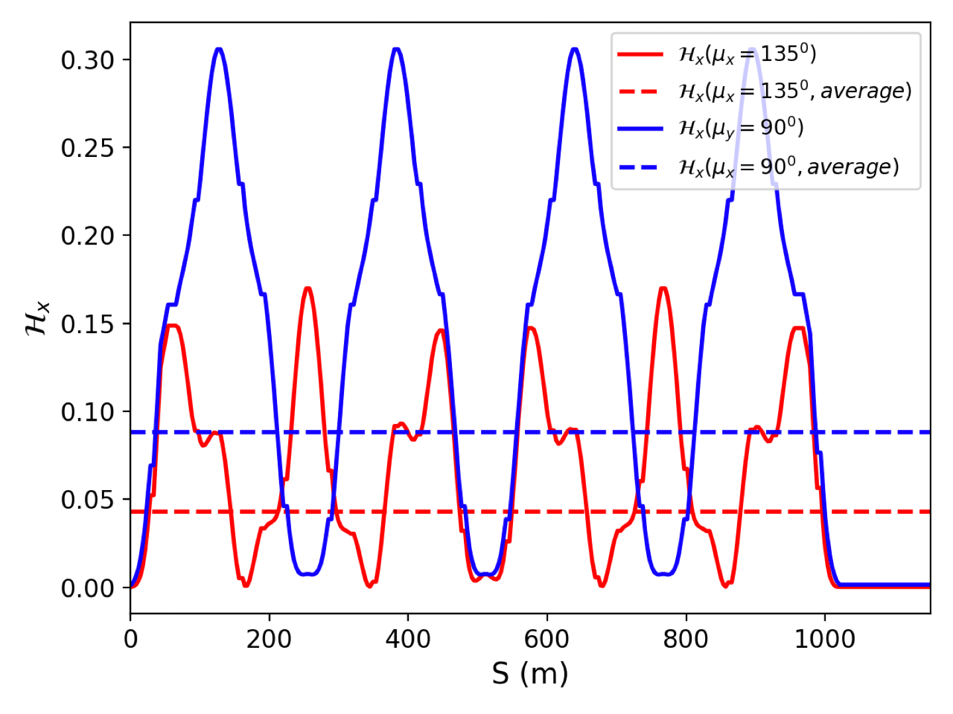
Optimization of SPS optics
SPS consists of regular FODO cells with 6-fold symmetry
For protons running with 90 deg phase advance
Horizontal phase advance at 135 deg optimizes horizontal emittance
But still too large emittance @ extraction (booster requirement) and damping time @ injection (instabilities)​
SPS Parameters * *phase advance is close to 135⁰ |  | Requirements
SPS Bending radius [m] | 741.63
SPS injection energy [GeV] | 6
SPS extraction energy [GeV] | 16
Dipole length | 6.26
Bending field @ injection [Gauss] | 269.811
Bending field @ extraction [Gauss] | 899.3703
Emittance @ injection [m.rad] | 4.8x10⁻⁹
Emittance @ extraction [nm.rad] | 34 | 5
Energy Loss / turn @ injection [MeV] | 0.154
Energy Loss / turn @ extraction [MeV] | 7.8
Transverse Damping time @ injection [s] | 1.79 | 0.1
Natural chromaticity h/v | -72/-40
Energy acceptance at @ injection | 1%

Slide 8
Installation of damping wigglers
Required horizontal emittance at extraction and damping time at injection can be achieved with wiggler of length 23 m and 3.5 T peak field
Energy loss per turn is however very large (>60 MeV)
Damping wigglers (short damping time) also needed to mitigate coherent instabilities, in addition to feedback system​

Slide 9
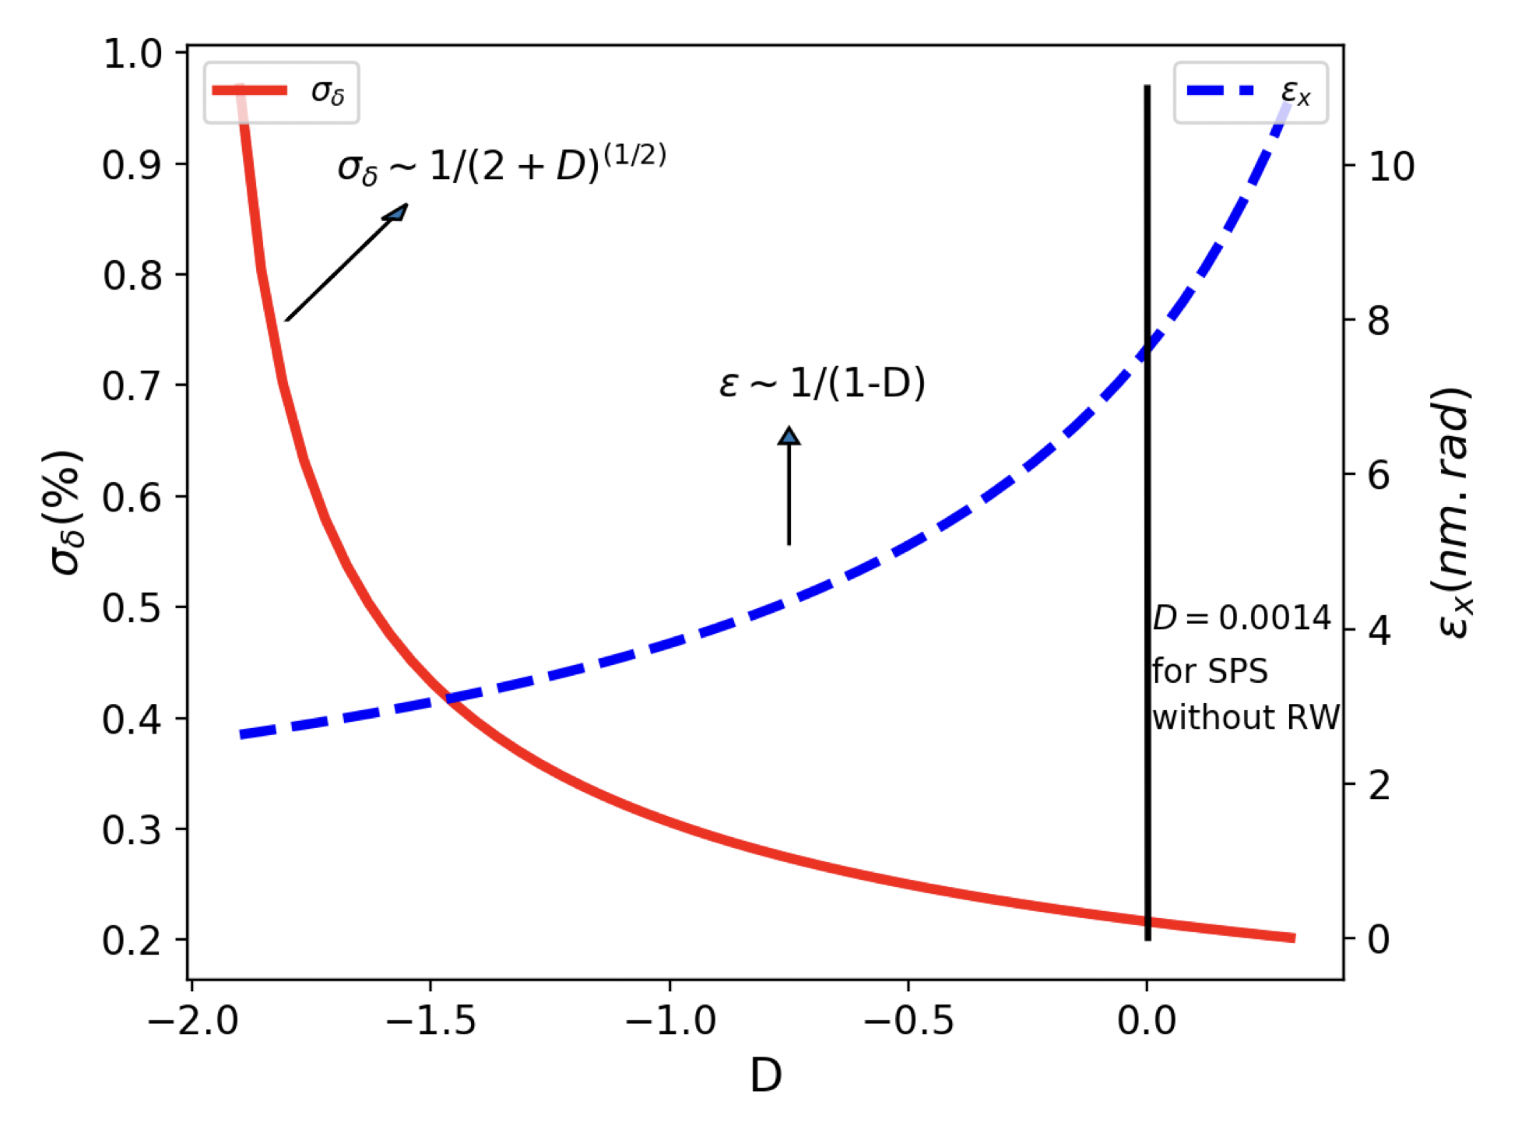
Robinson wiggler
The required emittance at extraction can be achieved, while keeping the energy loss per turn in acceptable levels, by using a combination of damping and Robinson wiggler magnets
The Robinson wiggler modifies the damping partition number D so that the horizontal emittance is decreased, while the energy spread is increased
There is an energy spread limit (0.3%) imposed by the acceptance of the main BR

Slide 10
Energy acceptance
The SPS energy acceptance at the PBR injection energy (defined by the mechanical aperture) is 1.0% at injection for the chosen phase advance
The minimum RF voltage required for 1.0% energy acceptance is 15 MV at injection and increases up to 45 MV at extraction energy

Slide 11
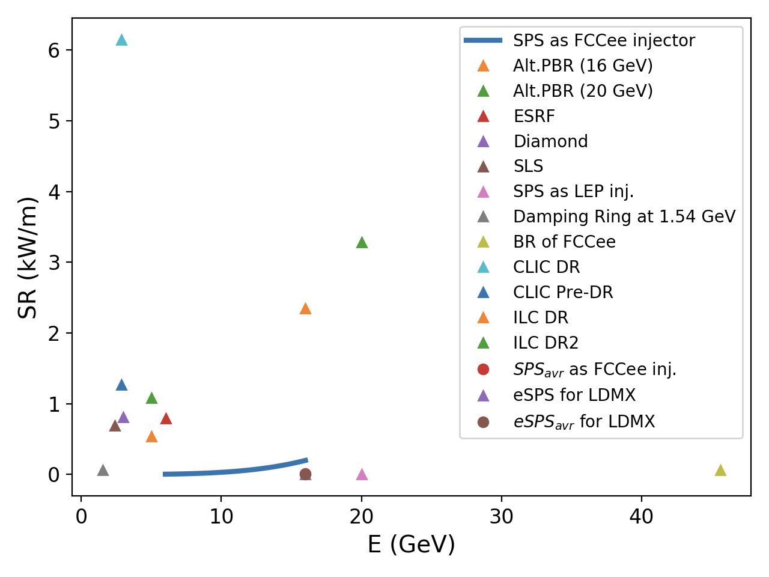
Synchrotron radiation power
The existing SPS vacuum chambers cannot sustain the SR power
Need absorbers and possibly new vacuum system with cooled chambers
During LEP times had masks
Ongoing studies by vacuum experts
Special absorbers for wiggler magnets also to be implemented
Parameters | SPS for LEP | SPS for FCC
Extraction energy [GeV] | 20 | 16
SR due to dipole magnets only (W/m) | 1.85 | 198
Average SR due to dipole magnets only (W/m) | 0.024 | 8.1
SR due to dipole and damping wiggler (W/m) | - | 809
Average SR due to dipole and damping wiggler (W/m) | - | 107
Beam current (mA) | 0.45 | 7-160

Slide 12
Extraction energy considerations
The extraction energy was originally planned as 20 GeV
As this option leads to a very large energy loss per turn, different extraction energy options were investigated and the table summarizes the results
It becomes clear that the 16 GeV option provides a reasonable energy spread, energy loss per turn and emittance at the same time
 | 20 GeV option |  |  |  | 18 GeV option |  |  |  | 16 GeV option
 | @ injection |  | @ extraction |  | @ injection |  | @ extraction |  | @ injection |  | @ extraction
 | w/ wiggler | w/o wiggler | w/ wiggler | w/o wiggler | w/ wiggler | w/o wiggler | w/ wiggler | w/o wiggler | w/ wiggler | w/o wiggler | w/ wiggler | w/o wiggler
Emittance* (nm.rad) | 1.03 | 4.88 | 5.92 | 54.25 | 0.95 | 4.88 | 5.60 | 43.9 | 0.73 | 4.88 | 5.64 | 34.7
Energy loss per turn (MeV) | 9.96 | 0.15 | 128.0 | 19.09 | 6.97 | 0.15 | 73.9 | 12.5 | 3.49 | 0.15 | 31.5 | 7.82
Damping time** (s) | 0.012 | 1.79 | 0.003 | 0.048 | 0.01 | 1.79 | 0.005 | 0.06 | 0.03 | 1.79 | 0.01 | 0.09
Energy spread*** (%) | %0.3 | %0.01 | %0.60 | %0.06 | %0.35 | %0.01 | %0.5 | %0.05 | %0.3 | %0.01 | %0.38 | %0.05
RF Voltage (MV) | 35 |  | 160 |  | 30 |  | 90 |  | 25 |  | 40
Damping wiggler B[T] / L [m] | 6 / 12.15 |  |  |  | 5 / 12.15 |  |  |  | 3.5 / 12.15
Robinson wiggler B[T] / L [m] | 0.5 / 12 |  |  |  | 0.5 / 12 |  |  |  | 0.5 / 6

Slide 13
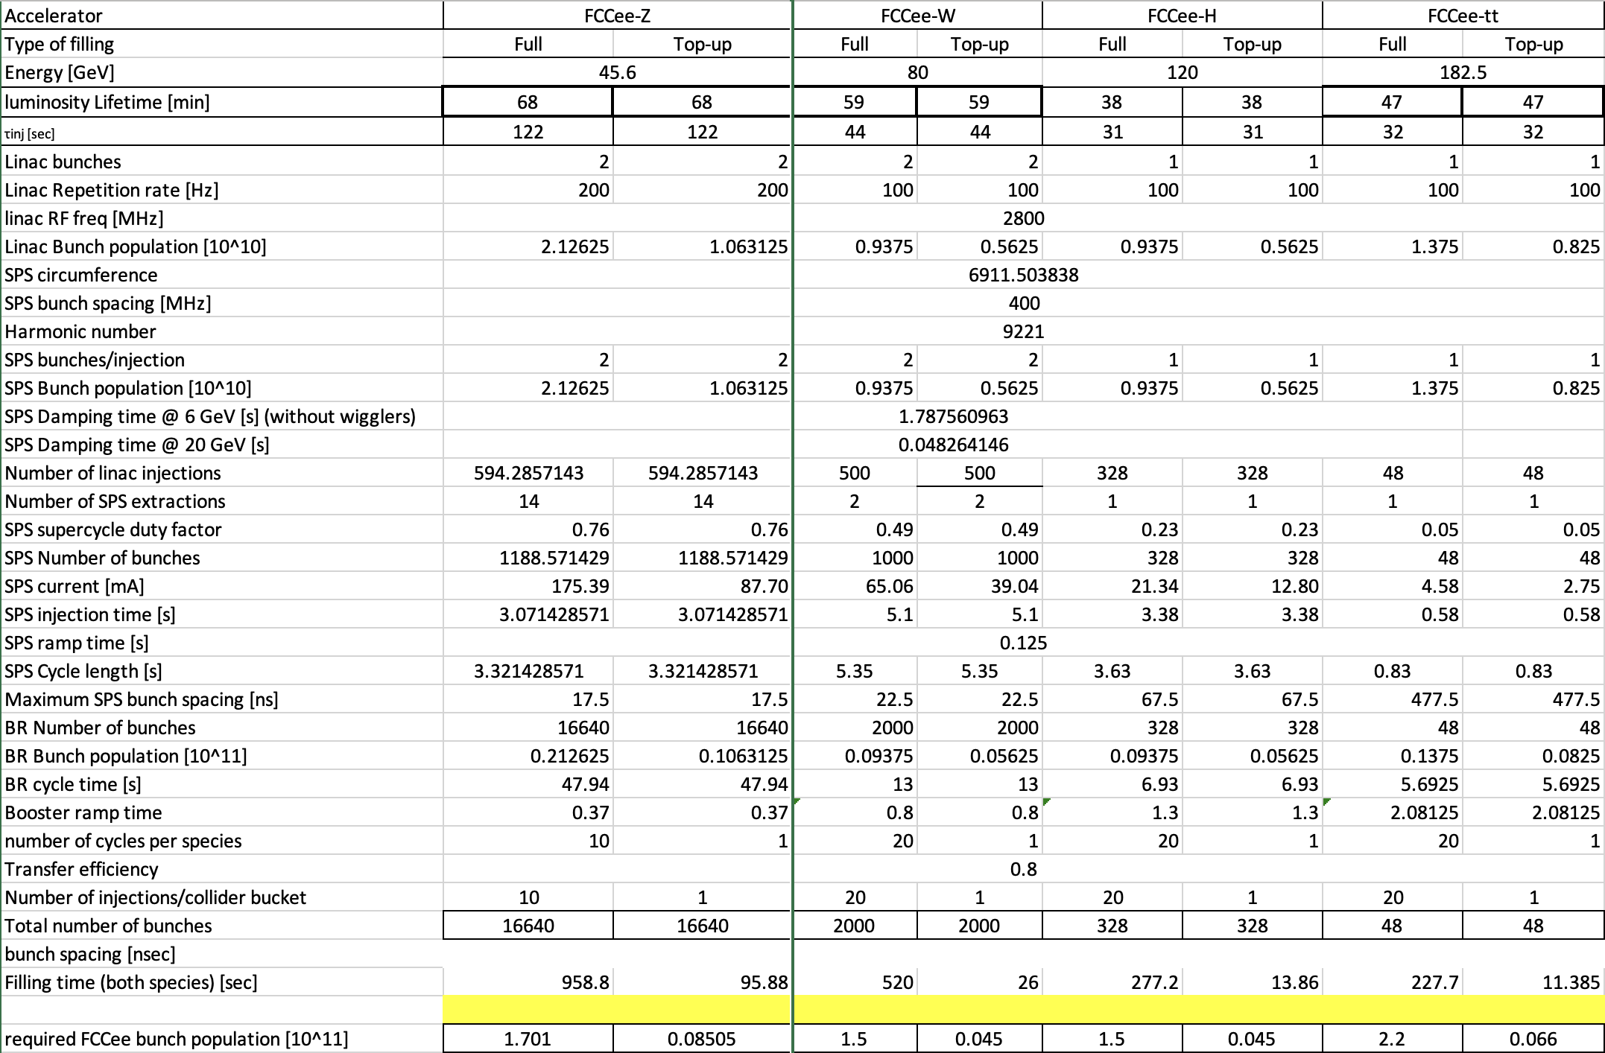
Filling time studies

Slide 14
Other points
Aperture
Studies performed indicate Dynamic Aperture is OK (but errors not included yet) even for off axis injection
Acceptable emittance in horizontal and vertical planes are 15 and 60 nm.rad respectively assuming 0.3% rms energy spread of incoming beam
Injection schemes
ON-axis injection: short pulse kicker (10-20 ns) is possible with high repetition rate (100-200 Hz) according to PSI kicker specialist
OFF-axis injection: seems also feasible
Collective effects
Assessement for various collective effects highlighted potential limitation from TMCI
SPS vacuum needs to be considerably improved to cope with fast ion instability even with radiation damping and feedback system

Slide 15
To be done for the mid-term review
Goal
Develop optimized parameters that can be compared with the HE Linac option, including cost estimate for required SPS modifications
Is 16 GeV enough for the Booster?
With low energy damping ring, no need for strong damping in SPS and thus relaxed RF requirements?
Can we reduce total intensity per SPS-to-BR transfer to reduce instantaneous SR power and maybe avoid need of new vacuum system, and be less demanding for instabilities?
To be further studied
How to cope with synchrotron radiation
Regulation of SPS main magnets at very low injection field
Required RF power and additional RF system
Collective effects (impedance driven instabilities, e-cloud, fast ion instability)
Injection schemes, filling schemes and optimized bunch parameters

Slide 16
Thank you very much
for your attention!

Slide 17
Assumed parameter requirements
Paramaters | Requirements
Injection energy [GeV] | 6
Extraction energy [GeV] | 16
Damping time @injection (hor.) [s] | 0.1
Geo. emittance @extraction (hor.) [nm.rad] | 5
Energy acceptance @injection [%] | 1.5
Dynamic aperture @injection (hor.) [mm] | 6.5
Energy spread @extraction [%] (rms.) | 0.3

Slide 18
Studies of collective effects
Parameters | Alternative PBR | SPS as PBR
ΔQ_{y} - @inj. | 0.0032 | 0.0005
ΔQ_{y} - @eq. | 0.028 | 0.018
ΔQ_{y} - @ext. | 1.6 x 10⁻⁴ | 1.6 x 10⁻⁵
Emit. growth by IBS at inj. (%) | 9 | 6
Z₀|| [Ω] | 1 | 6.4
(Z₀||/n)_{th} [Ω] - @inj. | 57.92 | 1167
(Z₀||/n)_{th} [Ω] - @eq. | 1.44 | 31.14
(Z₀||/n)_{th} [Ω] - @ext. | 10.11 | 100
Z₀|| [Ω] | 1 | 6.4
Z_{t}⊥ [MΩ/m] | 0.79 | 9.77
Z_{th} [MΩ/m] @inj. | 5.28 | 29.6
Z_{th} [MΩ/m] @eq. | 8.95 | 7.10
Z_{th} [MΩ/m] @ext. | 37 | 8.97
ΔQ_{ion} | 0.002 | 0.009
τ_{inst} [t_{rev}] | 134 | 61
𝜌_{neutr}[10¹¹/m³] | 12.55 | 7.06
𝜌_{th} [10¹¹/m³] @inj. | 2.84 | 11.30
𝜌_{th} [10¹¹/m³] @eq. | 1.62 | 1.43
𝜌_{th} [10¹¹/m³] @ext. | 1.68 | 3.67
ΔQ_{x} @neut. (Inj/Eq.) | 0.003 | 0.035
ΔQ_{y} @neut. (Inj/Eq.) | 0.005 | 0.035
ΔQ_{x} @neut. (Ext.) | 0.001 | 0.01
ΔQ_{y} @neut. (Ext.) | 0.002 | 0.01
Stupakov parameter | 568 | 3.78
𝜎_{z} [cm] | 0.59 | 4.1
Condition 1 [cm] | 0.015 | 5000
Condition 2 | 6433 | 18525

