Slide 1
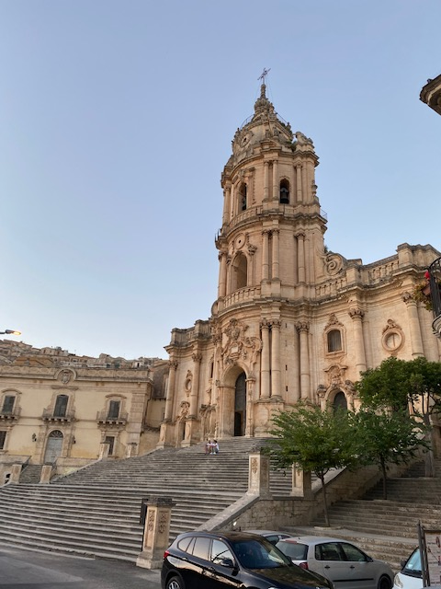
Recent studies on
Neutrino oscillations
A. Yu. Smirnov
Max-Planck-Institut fur Kernphysik,
Heidelberg, Germany
MAYORANA Workshop
Modica, Sicily , July 13, 2023

Slide 2
Content
Space-time localization diagrams
Coherence, entanglement and wave packets
Propagation and quantum decoherence
Refractive neutrino mass and oscillations

Slide 3
Δm₄₁² = 1 - 2 eV²
Space-time
LSND
localization diagrams
reflect computations of oscillation
amplitudes in QFT,
visualizes various subtle issues

Slide 4
Space-time localization diagram
E.Kh. Akhmedov, D. Hernandez, A.Y.S. 1201.4128 [hep-ph]
A.Y.S. 2212.10242 [hep-ph]
Produced and propagated neutrino state
|ν^{P}> = ψ₁^{P}|ν₁ > + ψ₂^{P}|ν₂ >
ψ_{i}^{P} = ψ_{i}^{P}(x – v_{i}t)
the wave packets with time width σ_{t}^{P},
v_{i} - group velocities
Detected state
|ν^{D}> = ψ₁^{D}|ν₁ > + ψ₂^{D}|ν₂ >
ψ_{i}^{D} = ψ_{i}^{D}(x – x_{D}, t – t_{D})
- the detection WP, time width σ_{t}^{D}
Amplitude: projection of propagated state onto detection state.
For simplicity ψ_{i}^{D}(x – x_{D}, t – t_{D}) = δ (x – L) ψ_{i}^{D}(t –t_{D})
L- baseline
A (L, t_{D}) = <ν^{D}|ν^{P}> = Σ_{i} A_{i}(L, t_{D}) = Σ_{i} dt ψ_{i}^{D*} (t –t_{D}) ψ_{i}^{P}(L – v_{i}t)
generalized WP

Slide 5
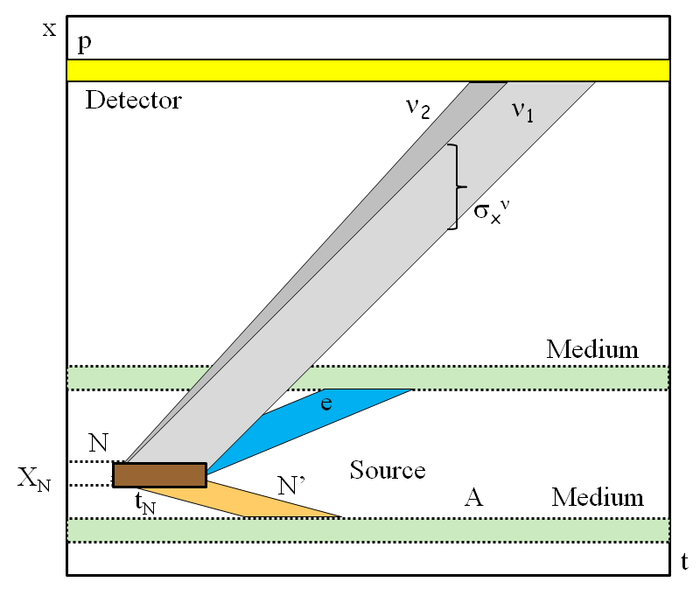
Space-time localization diagram
Oscillation probability
P (L) = dt_{D}|A(L, t_{D})|² =
dt_{D} [|A₁(L, t_{D})|² + |A₂(L, t_{D})|²]
x
+ 2Re dt_{D} A₁(L, t_{D})*A₂(L, t_{D})
distance
interference
Here we considered elementary processes of interactions
t
time
Further integration over interval of baseline L due to finite sizes of the source and detector
N → N’ + e⁻ + ν
The slopes of bands are determined by group velocities

Slide 6
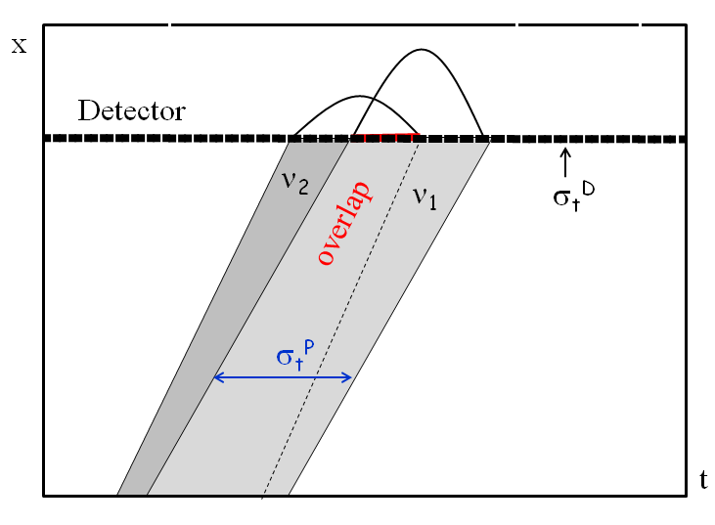
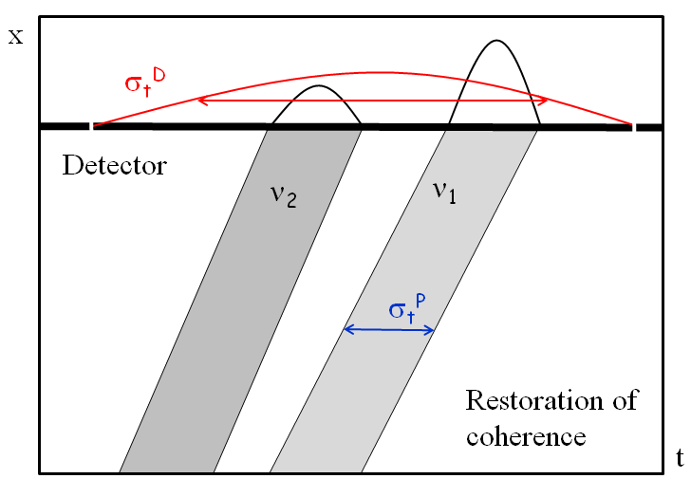
Detection
two extreme cases
σ_{t}^{D} << σ_{t}^{P}
σ_{t}^{D} >> σ_{t}^{P}
short detection coherence time
long detection coherence time
ψ_{i}^{D} (t – t_{D}) ~ δ (t –t_{D})
A_{i}(L, t_{D}) ~ ψ_{i}^{D}(L/v - t_{D})
A_{i}(L, t_{D}) ~ ψ_{i}^{P}(L – v_{i}t_{D})
Interference is determined by overlap of produced WP
restoration of coherence if
σ_{t}^{D} >> t_{sep}

Slide 7
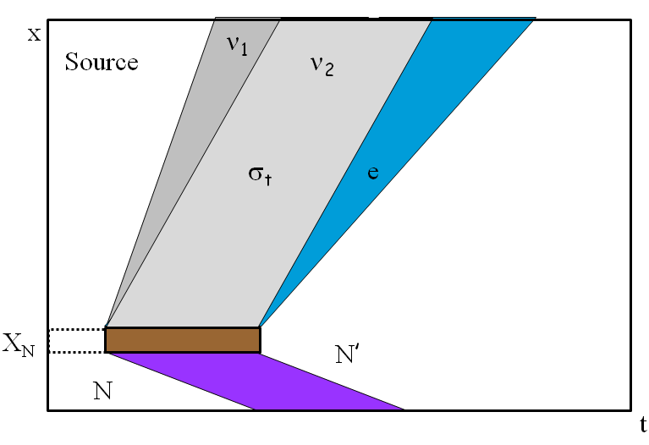
Production
E.Kh. Akhmedov and A.Y.S.
[hep-ph]
WP’s are determined by localization region of the production process: by overlap of localization regions of all particles involved but neutrinos.
Consider β decay,
N → N’ + e⁻ + ν
If N’ and e⁻ are not detected or
their interactions can be neglected
localization of process is given by localization of atom N
distance
The latter is determined by time
between two collisions of N, t_{N}
σ_{x} ~ v_{ν}t_{N} ~ X_{N} c/v_{N}
time
enhancement factor for
length of neutrino WP

Slide 8
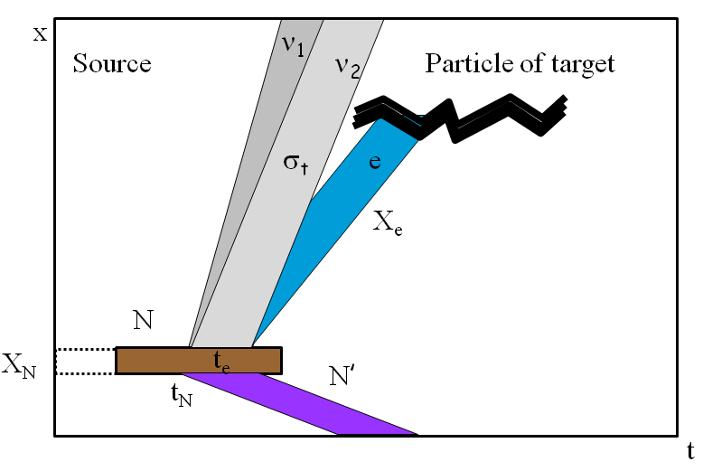
Entanglement and correlations
If N’ or/and e⁻ are detected or interact, this may narrow their WP’s
and consequently the neutrino WP.
If e⁻ is detected during time interval t_{e} < t_{N}, the size of ν WP
will be determined by t_{e}
t_{coll}
If e⁻ interacts with particles of medium which have very short time between collisions t_{coll}, then σ_{x} ~ ct_{coll}
distance
Similar to the EPR paradox
time
ν emission and interactions of e⁻ should be considered as unique process;
contributions to its amplitude from different e-interactions regions
appear with random phases ξ_{k} → incoherent
A_{tot} = A_{k} e^{i}
ξ_{k}

Slide 9
Wave packets and QFT
Eventually the oscillation probability depends on localization of external particles and baseline L.
L. Stodolsky
Neutrino WP are “unnecessary”, at least in setups without time tagging
Neutrinos play the role of transmitter of information from production region to the detection region
Complete QFT consideration which confirms these statements including results on decoherence:
R. Krueger , T Schwetz 2303.15524 [hep-ph]

Slide 10
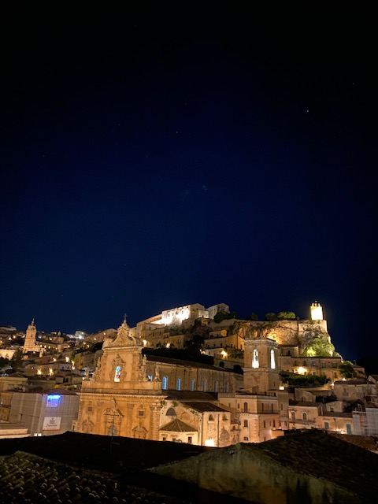
Δm₄₁² = 1 - 2 eV²
Propagation decoherence
LSND
Recent activity is related to reactor and Ga source oscillation searches, attempts to measure size of neutrino WP

Slide 11
Observing propagation decoherence
x –t space: separation of wave packets of mass states due to difference of group velocities
equivalent to integration over the energy uncertainty
Ψ
f(E)
σ_{x}
σ_{E} ~ 1/ σ_{x}
x
E
Suppression of interference → damping of oscillations
Survival probability :
P_{ee} = P_{ee} + ½ D(E, L) sin² 2θ cos φ
Damping factor for Gaussian WP
D(E, L) = exp [- ½(L/L_{coh})²]
Coherence length
L_{coh} = σ_{x}
E²
Δm²
Information is not lost
and can be restored at detection

Slide 12
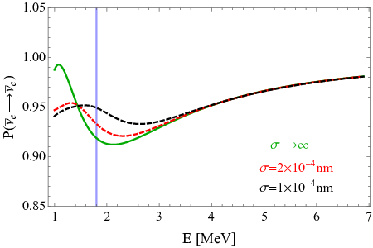
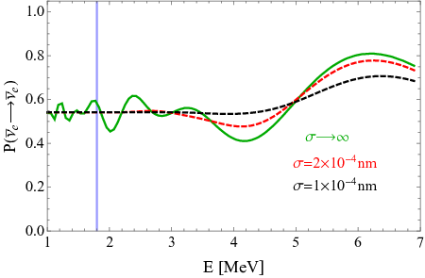
Decoherence of reactor neutrinos
A de Gouvea, V De Romeri,
C.A. Termes, 2104.05806
[hep-ph]
Bound on size of the WP
Daya Bay, RENO
KamLAND
Expected
damping effect
Absence of decoherence (damping) effect means
Δm²
2E²
L << L_{coh}
σ_{x} > L
Analysis of data:
σ_{x} > 2.1 x 10⁻¹¹ cm (90% C.L.)
The bound corresponds to the energy resolution of detectors δ_{E}
σ_{x} ~ 1/δ_{E}

Slide 13
Other studies
Daya Bay: decoherence due to finite momentum spread σ_{p}
σ_{p} /p < 0.23 (95% C.L.)
F.P. An, et al,
1608.01661 [hep-ex]
for p = 3 MeV: σ_{x} ~ 1/σ_{E} = 2.8 x 10⁻¹¹ cm
JUNO in future may set the limit
J. Wang et al.
2112.14450 [hep-ex]
σ_{p} /p < 10⁻² (95% C.L.)
→ σ_{x} > 2.3 x 10⁻¹⁰ cm
Decoherence in oscillations of active – eV scale sterile
C.A.Arguelles et al,
2201.05108 [hep-ph]
Damping effects in various experiments computed
for σ_{x} = 2.1 x 10⁻¹¹ cm (as found in A de Gouvea et al).

Slide 14
WP’s of reactor neutrinos
Source: β-decays of fragments N of nuclear fission
N → N’ + e⁻ + ν
N quickly thermalize → in equilibrium with medium in the moment of decay → the average velocity:
v_{N} ~ [3T/ m_{N}]^{-1/2}
If N’ and e⁻ are not detected or their interactions can be neglected,
localization of ν production process is given by localization of N.
σ_{x} ~ v_{ν}t_{N} ~ X_{N} c/v_{N}
t_{N} - time between two collisions of N with other atoms
t_{N} ~ [σ_{AA} n_{U} v_{N}]⁻¹
σ_{AA} geometric cross-section σ_{AA} ~ π(2r_{vdW}) ²
Van der Waals radius
n_{U} - number density of Uranium
σ_{x} = 2.8 x 10⁻³ cm

Slide 15
Effect of accompanying particles
Duration of ν production process
is given by the shortest mean free time among particles involved
Consideration of x-t localization
of interactions of accompanying particles.
Electrons have the shortest
Chain of k processes of secondary interactions till equilibration (thermalization)
σ_{t} = t_{e} = X_{e}/v_{e}
X_{e} is determined by ionization
of uranium, σ_{eU}
...
e + A → e’ + A’
A
ν_{i}
X_{e} = (n_{U} σ_{eU})⁻¹
t_{e}
N
σ_{x} = 2 x 10⁻⁵ cm
σ_{t} ~ t_{N} /2^{k}
“short cut” estimation: can be considered as the upper bound
σ_{x} = (5 – 10)x 10⁻⁵ cm

Slide 16
Implications
1.
σ_{x} / σ_{x}^{exp} = 10⁵ - 10⁶
σ_{x} >> σ_{x}^{exp}
2.
Corresponding energy uncertainty
σ_{E} ~ 1 eV
while energy resolution δ_{E} ~ 10⁵ eV
To be sensitive to WP separation energy resolution function should be known with better that 10⁻⁵ accuracy
3.
For Cr source:
σ_{x} = 1.4 x 10⁻⁴ cm
4.
Large Δm² does not help since oscillatory pattern shows up at L ~ l_{ν}
but L_{coh} ~ l_{ν} ~ 1/Δm²
→ Δm² cancels in damping factor
5.
If some additional damping is found, it is due to some new physics and not due to WP separation
6.
Experiments with L ~ L_{coh} ? Lower energies? Widening lines?

Slide 17
Quantum
Δm₄₁² = 1 - 2 eV²
decoherence
LSND
non-inversible,
no restoration

Slide 18
Quantum decoherence
Valentina De Romeri, et al
2306.14699 [hep-ph]
Interactions with (stochastic) environment. Neutrinos – sub-system
Open quantum system framework.
E.g. Fluctuating nature of space-time in quantum gravity.
Dissipative term in equation for the density matrix … D
D = || Γ_{ij} || in the mass basis →
Damping factors at the oscillatory terms (phase dependent)
in the oscillation probabilities (similar to separation of WP effect)
E
E₀
n
n = -2 … +2
exp [- Γ_{ij}(E) L]
Γ_{ij}(E) = Γ_{ij}(E₀)
n = 2 – QG,
n = - 4 WP separation
Analysis of experimental data:
Γ_{ij} (1 GeV) < 8x10⁻²⁷ GeV, 90% CL (n = 2) from MINOS
different dependence on energy, masses
L_{coh}(1 GeV) = 1/ Γ_{ij} = 2.5 x 10⁷ km

Slide 19
Decoherence in Stochastic GW background
Pulsar timing array (PTA): NANOGrav, EPTA, PPTA, CPTA
3 – γ
2
f – frequency, nHZ range
GW strain:
h_{c}(f) = A* (f year)
γ = 2.5 – 4.2
A* = (3 - 10) x 10⁻¹⁵
Origins: inspiral supermassive BH binaries, cosmic strings, phase transitions, inflation
G. Lambiase et al,
2306.16977 [astro-ph.HE]
Damping oscillatory terms
exp [- Γ_{ij}(f_{min} , f_{max} , L )]
3
64 (γ -1)
|A* |²
(l_{ij} /2π year)²
1
(f_{min} year) ^{γ-1}
Γ_{ij}(f_{min} , f_{max} , L)] =
Strong decoherence at E < E_{th} determined from condition Γ_{ij} > 1
3
γ - 1
1/2
1
16 (f_{min} year) ^{(γ-1 )/2}
E_{th} = Δm₂₁² year |A* |
For f_{min} = 30 nHz, γ = 4 → E_{th} = 20 keV

Slide 20
Oscillations and
Δm₄₁² = 1 - 2 eV²
nature of neutrino mass
LSND
Neutrino mass - dynamic characteristic generated by interactions
Neutrino condensate,
Refractive mass ...

Slide 21
Refractive neutrino mass
the simplest example
Target (DM): complex scalar field φ with mass m_{φ}
Mediator: χ_{k} – light Majorana fermions with masses m_{χk}
at least two χ are needed to explain data
Lagrangian:
L = g_{αk} ν_{αL} χ_{kR} φ + ½ m_{χk} χ_{kR}^{T}χ_{kR} + h.c.
k = 1,2, α = e, μ, τ
g_{αk} < 10⁻⁷
bound from SN, ...
We assume zero VEV <φ> = 0
The interaction can be generated via mixing of φ with SM Higgs boson
No usual vacuum mass or this mass is subdominant

Slide 22
Refraction on scalar DM
S. F Ge and H Murayama, 1904.02518 [hep-ph]
Ki-Yong Choi, Eung Jin Chun, Jongkuk Kim,
1909.10478 [hep-ph]
Elastic forward scattering of ν on background scalars φ with fermionic χ mediator
2012.09474 [hep-ph]
ν_{L}
Effective potential
ν_{L}
φ
V^{B}
ν_{L}
χ
χ
φ
φ
Wolfenstein
limit
φ
ν_{L}
Resonance: s = m_{χ}²
1/E tail
0
for φ at rest the resonance ν energy:
E_{R} =
m_{χ}²
2m_{φ}
resonance
0
E_{R}
E

Slide 23
Energy dependence of Matter potential
|V|
~
If mediator is light as well as target particle is light, the 1/E dependence shows up at low explored energies.
The same dependence as vacuum mass term in the Hamiltonian of evolution
Wolfenstein limit
Ki-Yong Choi, Eung Jin Chun,
Jongkuk Kim, 1909.10478,
2012.09474 [hep-ph],
Shao-Feng Ge
1/E
Can substitute neutrino mass?
resonance
E
Generic feature
of scattering

Slide 24
Refractive mass squared
Manibrata Sen, AYS, 2306.15718 [hep-ph]
Introduce the refractive mass squared as
V = m_{ref}²/2E
|Δm_{ref} ²|
existing
observations
So that the potential has the form of usual vacuum contribution
true mass²
m_{ref}² = 2EV
relic ν
m_{ref}² = constant –
checked down to 0.1 MeV
E_{R}
E
The decrease of m_{ref}² with E allows to avoid
the cosmological bound
on sum of neutrino masses
~ constant m_{ref}² explains oscillation data
→ E_{R} << 0.1 MeV
Large number density of target particles is required →
form substantial part of whole DM

Slide 25
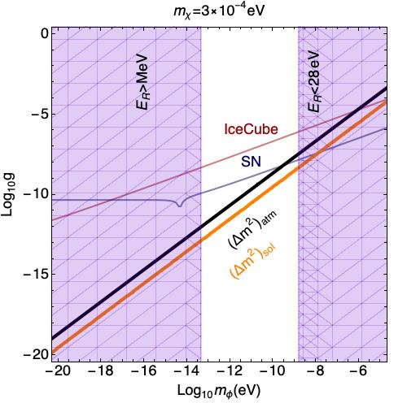
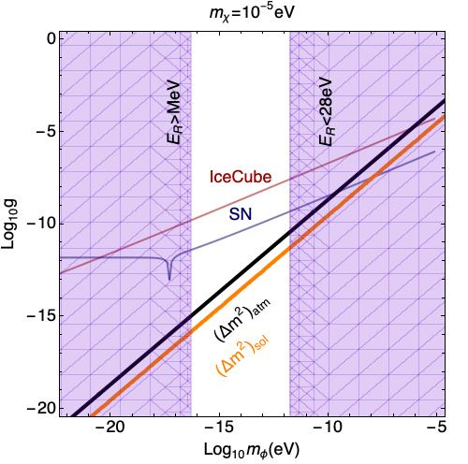
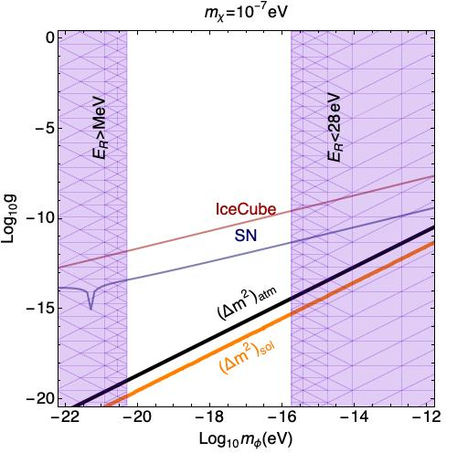
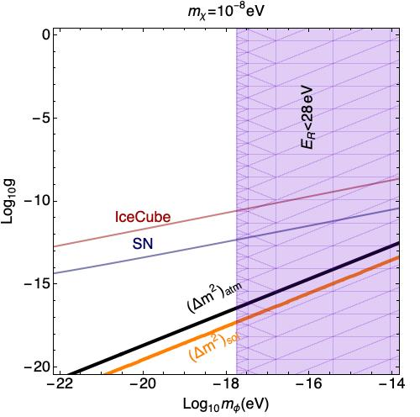
Viable ranges of parameters
Bounds and
regions required for explanation of
oscillation data
by refraction in
g – m_{φ} plane for
different values of m_{χ}
oscillations
cosmology

Slide 26
Perturbativity and resummation
Radius of interactions below resonance : r_{χ} = 1/m_{χ}
Large number of scatterers φ within interaction volume.
Processes with many φ should be taken into account
ν φ φ ◊ ν φ φ
ν φ φ φ ◊ ν φ φ φ ...
ν χ ν χ ν
Expansion parameter
V
m_{φ}
Δm_{atm}²
2E m_{φ} – m_{χ}²
ζ = =
φ φ* φ φ *
ζ increases with decrease of energy and becomes ζ = 1 already above resonance
Unusual setup
d << r_{χ} << λ_{φ}
d = n^{1/3} - distance between scatterers
λ_{φ} = 2π/k_{φ} = 2π/vm_{φ} - de Broglie wave of φ
v ~ 10⁻³ - virial velocity in Galaxy

Slide 27
Coherent classical field
System of φ with large occupation number can be treated as a classical scalar field
ρ_{φ}
2πv³
1/4
Condition
λ_{φ}³n_{φ} >> 1
m_{φ} << 2π
m_{φ} << 30 eV is well satisfied
In terms of QFT such a scalar field φ_{c} can be introduced as an expectation value of the field operator in the coherent state:
φ_{c} = <φ_{coh}| φ |φ_{coh} >
dk
(2π) ³
k = m_{φ} v
|φ_{coh}> = exp [f_{a}(k)a_{k} ⁺ + f_{b}(k)b_{k}] |0 >
It can be parameterized as
φ_{c}(x) = F(x t) e^{-iΦ}
F² ~ ρ_{φ} /m_{φ}²

Slide 28
Neutrino mass in classical field
In the Lagrangian: φ ◊ φ_{c}
L = g_{αk} χ_{kR} ν_{αL} φ_{c}* + h.c.
mass terms m_{αk} = g_{αk} φ_{c}*
Mass matrix in the basis (ν_{f,} χ^{c}_{L}) = (ν_{e}, ν_{μ}, ν_{τ} , χ₁ , χ₂)
0 g_{αk} φ_{c}*
g_{kα} φ_{c}* diag (m_{χ1} , m_{χ2})
M =
The Hamiltonian
1
2E
|F| ² Σ_{k} g_{αk} g_{βk}∗ g_{αk} F m_{χk} e^{iΦ}
g_{kα}∗ F* m_{χk} e^{-iΦ} M_{χ}²
1
2E
H = M M⁺ =
M_{χ}² = f( |F|², | g_{αk}| ², m_{χk}² )

Slide 29
Oscillations in classical field
Active neutrino mass matrix squared – no dependence of
the refractive mass on energy, no resonance.
Above resonance coincides with mass squared computed by scattering
May have time variations
Cosmological bound ?: some other mechanism
ν - η mixing → additional bounds

Slide 30
Summary
Space-time localization diagrams visualize (uncover) the key aspects of neutrino oscillations (coherence entanglement ...)
Effect of propagation decoherence (damping) is unobservable in the present reactor and source experiments. If some additional damping is found → due to new physics
Quantum decoherence irreversible – quantum gravity,
oscillations in stochastic GV → damping of oscillations
Neutrino scillations can test nature and origins of neutrino mass
Which is dynamical characteristic
Important study: search for time, space and energy
Dependences of oscillation parameters.

Slide 31
Backup

Slide 32
Propagation decoherence and energy resolution
**
integration over the energy resolution of setup – another sources of damping
E.Kh. Akhmedov and A.Y.S.
2208.03736[hep-ph]
R(E_{r} , E) energy resolution in experimental set-up (width δ_{E} ):
- spectrum of produced neutrinos (line), or
- energy resolution of a detector
f(E, E) – WP of produced neutrino in energy representation
acts on oscillations as R does, and can be attached to R(E_{r}, E)
Effective resolution function
R_{eff} (E_{r} , E) = dE R(E_{r} , E) |f(E, E)|²
For Gaussian f and R, R_{eff} is also Gaussian with width
δ_{E}² + σ_{E}²
The problem: to disentangle the two contributions

Slide 33
F(E)
Refraction mass vs. VEV mass
Refraction mass is different in different space-time points and also depends on energy:
m_{ref}² (x, t, E) = n_{φ}(x, t) f(E)
E.g. m_{ref}² is different in solar system, center of Galaxy, intergalactic space
The average m_{ref}² (z) in the Universe increased in the past.
In contrast, the VEV mass is determined by minimum of the potential,
And it is not redshifted. Still it can depend on t and x, e.g. in the presence of topological defects and due to thermal corrections to the potential in the Early Universe

Slide 34
Oscillations in GV background
H_{vac} → H_{vac} + H_{g} → H_{vac} [I + (A₊ h ₊ + A_{x} h_{x} )]
In contrast to QG case decoherence strengthens with decrease of energy

Slide 35
Landscape of studies 2021- 2023
About 100 +70 papers with “Neutrino oscillations “ in titles
Coherence,
Entanglement in neutrino oscillations
Collective neutrino oscillations
Micro vs. macro description
Quantumness, Tests of quantum mechanics
Oscillations in modified metric, gravity
Oscillations in gravitational waves background
Mater, medium effects in presence of new interactions (long range forces, DM ),
Modification of QM, evolution equation
Effects of Lorentz invariance violation,
Equivalence principle violation
Parameter symmetries
…
Topics:
All aspects, components, characteristics of oscillations are under investigation. They can be classified as…

Slide 36
Vacuum and properties of oscillations
G.Dvali , L Funcke,
1602.03191 [hep-ph]
Neutrino vacuum condensate due to gravity. Order parameter
<Φ_{αβ} > = <ν_{α}^{T}Cν_{β} > ~ Λ_{G} = meV - 0.1 eV
Cosmological phase transition at T ~ Λ_{G}
Neutrinos get masses m_{αβ} ~ < Φ_{αβ} >
(Charged lepton masses generated by usual Higgs field)
m ~ U(θ)^{T} <Φ> U(θ)
<Φ> = diag (Φ₁₁, Φ₂₂, Φ₃₃),
mixing matrix
T < Λ_{G}
Relic neutrinos form bound states φ = (ν_{α}^{T}ν_{β} )
decay and annihilate into φ (neutrinoless Universe)
Symmetry of system SU(3)xU(1) spontaneously broken by neutrino condensate - φ are goldstone bosons
φ get small masses due explicit symmetry breaking by WI via loops

Slide 37
Mixing and topological defects
G.Dvali , L Funcke,
T Vachaspati
2112.02107 [hep-ph]
Symmetry breaking:
string-wall network
SU(3) → Z₂ x Z₂ → I
global strings
domain walls
Length scale of strings ~ inter-string separation
ξ = 10¹⁴ m ( λ/a_{G})
Λ_{G}
1 meV
7/2
(self-coupling of string field Φ/scale factor of phase transition)
Travelling around string winds VEV <Φ> by the SU(3) transformation:
< Φ (θ_{S}) > = ω(θ_{W})^{T} <Φ > ω(θ_{W})
ω(θ_{W}) path - O(3) transformation with angles θ_{W} = (θ_{W}¹², θ_{W}¹³, θ_{W}²³).
After the path ω lepton mixing changes as
U = U(θ) ω(θ_{W})
over length ξ, θ_{W} = O(1)
Solar system moves through the frozen string-DW background with v = 230 km/sec. For 6 years (operation of Daya Bay)
d = vt = 4 x 10¹³ m - comparable with expected ξ

