Slide 1
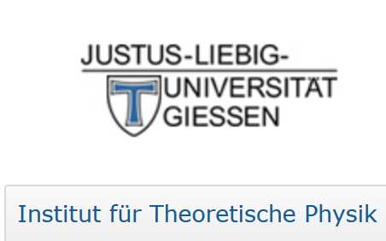




Nuclear Double Charge Exchange Reactions by
Isotensor Interactions
Horst Lenske
Institut für Theoretische Physik, JLU Gießen

Slide 2
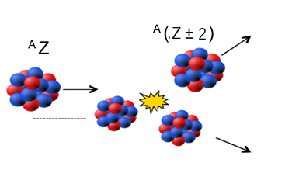
The Topic:
Double Charge Exchange Reactions

Slide 3
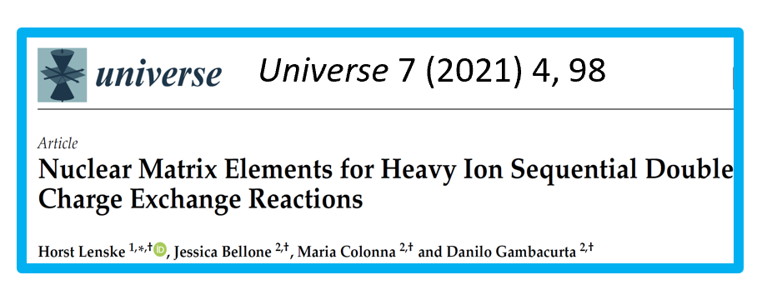
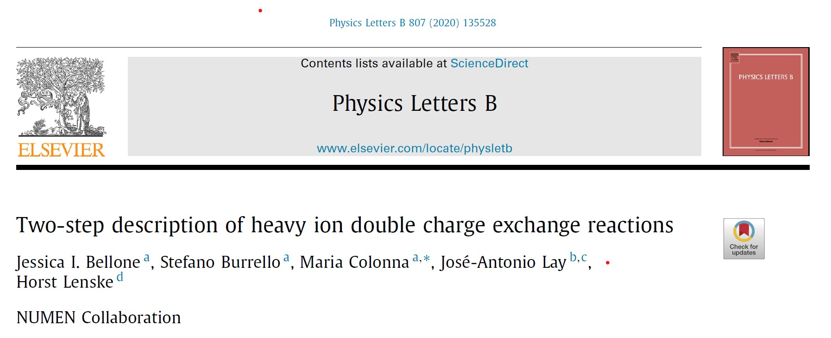

Agenda:
Charged current physics with LOW ENERGY heavy ion beams
DCE Theory Overview
Direct DCE: Mesonic „Majorana“ (MDCE) Double Charge Exchange
MDCE Pion-Nucleon Box Diagrams
Exploratory Investigations
Outlook
Prog.Part.Nucl.Phys. 128 (2023) 103999

Slide 4
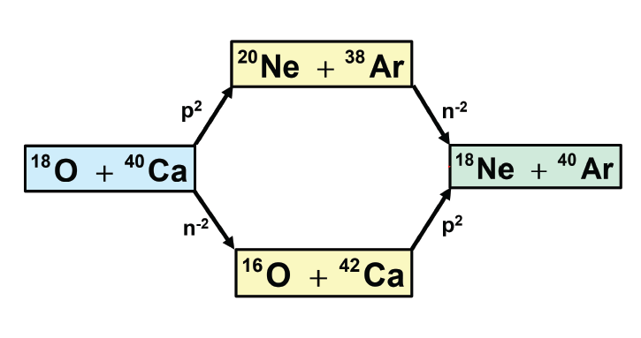
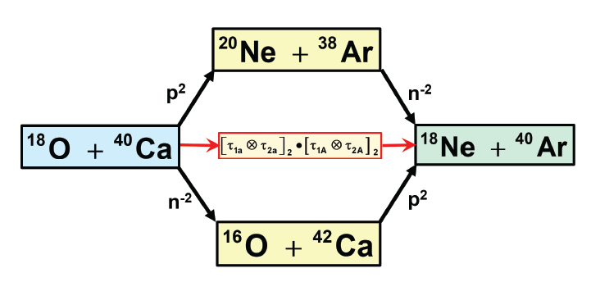
Heavy Ion DCE Reaction Mechanism
(Semi-) Direct DCE Reaction Mechanism by Meson Exchange

Slide 5
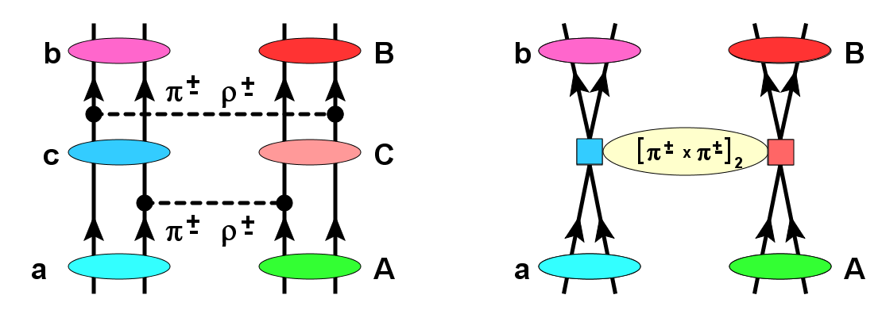
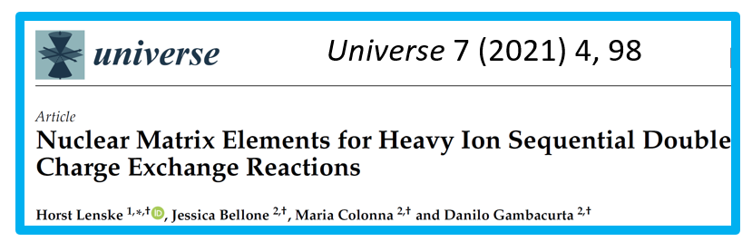
Mesonic Nuclear Double Charge Exchange (DCE) Reactions
Sequential semi-direct SCE
Direct Majorana DCE
DSCE Cross Sections
Prog.Part.Nucl.Phys.
109 (2019) 103716
From DSCE to NME
Prog.Part.Nucl.Phys.
128 (2023) 103999
DSCE
MDCE
→ 2ν2β
→ 0ν2β
σ^{DSCE}(E) ∼ 1/E²
σ^{MDCE}(E) ∼ 1

Slide 6
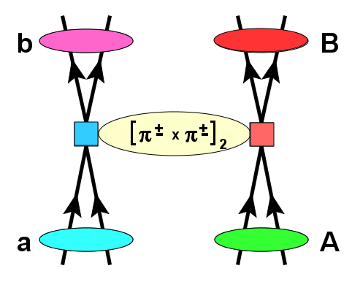
Quest for an Isotensor interaction ∼ [τ₁xτ₂]₂:
Conversion of two units of charge in a single step?
Mesonic Majorana DCE (MDCE) Scenario

Slide 7
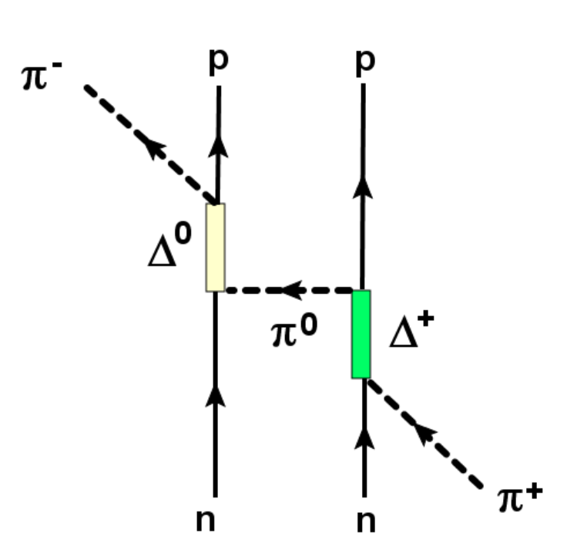
Effective Rank-2 Isotensor Interaction
Searches for elementary Isotensor I=2 mesons were unsuccessful
Dynamically generated Isotensor Interactions!
(π+,π-) DCE reactions
H.L. et al., PPNP 98 (2019) 103716

Slide 8
The MDCE Scenario:
Virtual Isotensor Interactions and 2-Nucleon Processes

Slide 9
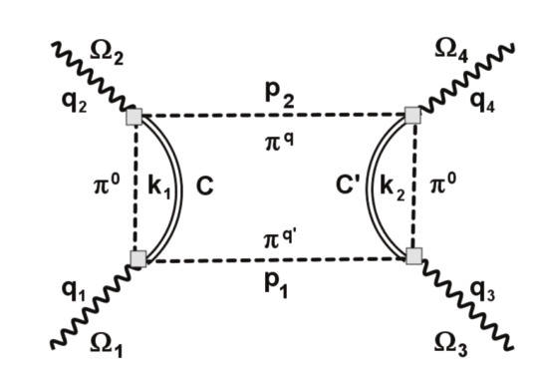
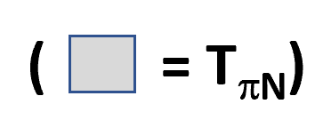
DCE by Double Meson Exchange and Pair-Correlation
Interaction by πN T-matrix, not NN T-matrix
MDCE
Box Diagrams
Ω_{1,2}≈(pn⁻¹) ↔ Ω_{3,4}≈(np⁻¹)
On-shell counterpart:
(π⁺,π⁻) and (π⁻,π⁺)
DCE reactions
Two-Nucleon nn ↔ pp Process
Final states are 2p2h-configurations w.r.t. the parent nuclei
DCE by dynamically generated rank-2 Isotensor Interaction!

Slide 10
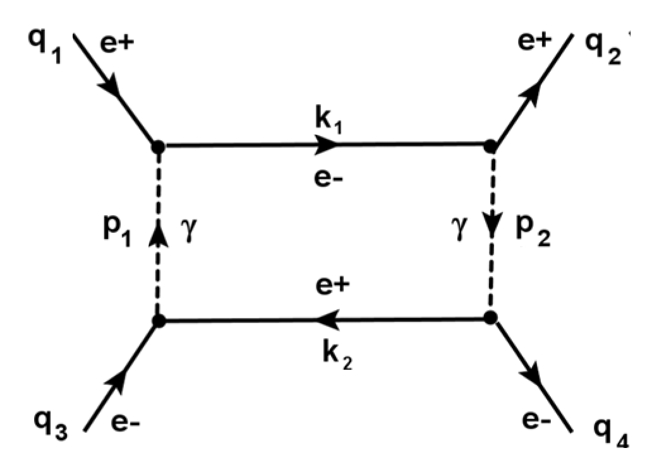
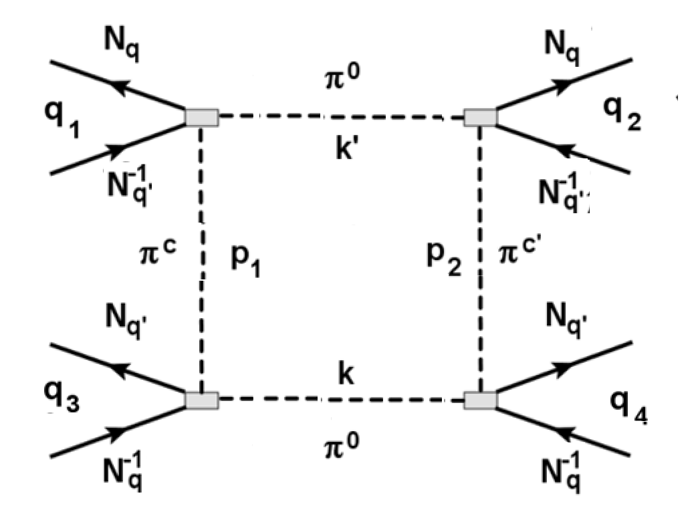
The MDCE Box Diagrams
e⁺e⁻ Bhabha Scattering QED Box
One independent momentum variable k or p
Integral over product of 2 lepton and 2 photon Propagators
Closed form by Mellin-Barnes Integrals
MDCE Isotensor Hadronic Box
External N⁻¹N momenta are fixed by k,k‘ and p_{1,2}
Meson Potentials and Nuclear Vertices
Numerical Evaluation

Slide 11
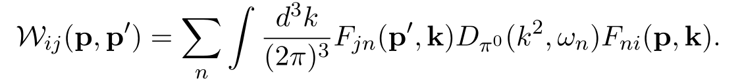


MDCE Isotensor Transition Kernel
MDCE-NME in projectile and target: two SCE-type vertices connected by π⁰ exchange
2-Nucleon Mechanism fostered by 2-body correlations

Slide 12
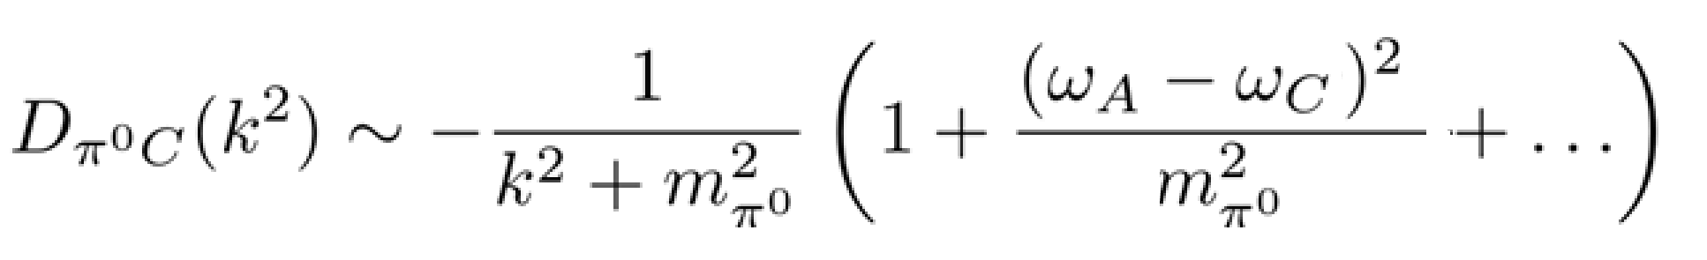
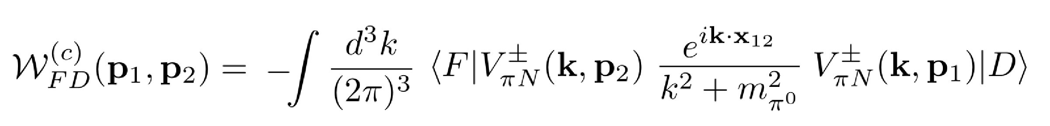
MDCE Vertices in Closure Approximation
Pion Mass → NATURAL SEPARATION SCALE! → keep the 1st term only → Closure
MDCE Leading Order Transition Form Factor in Closure Approximation

Slide 13
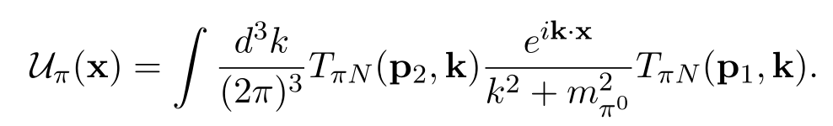
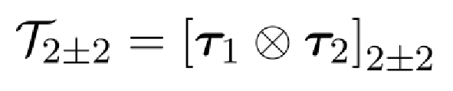
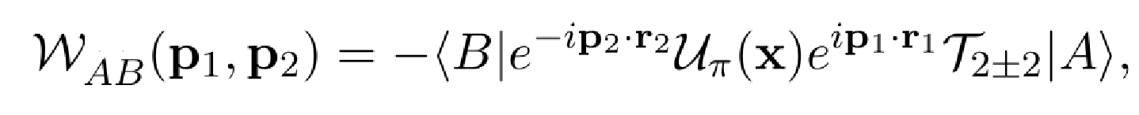
The MDCE Pion Potential and the Nuclear Transition Amplitude
Rank-2 Isotensor 2-body Operator
[T_{πN} x T_{πN} ] → 6 potentials: U₀₀(x), U₁₁(x), U₂₂(x), U₀₁(x), U₀₂(x) and U₁₂(x)
plus 2-body spin operators: 1_{s}x1_{s,} 1_{s} x σ, σ‘ x 1_{s}, [σ ‘ x σ]_{0,1,2}
…and a rich multipole structure

Slide 14
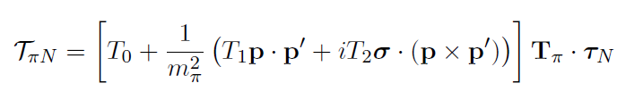
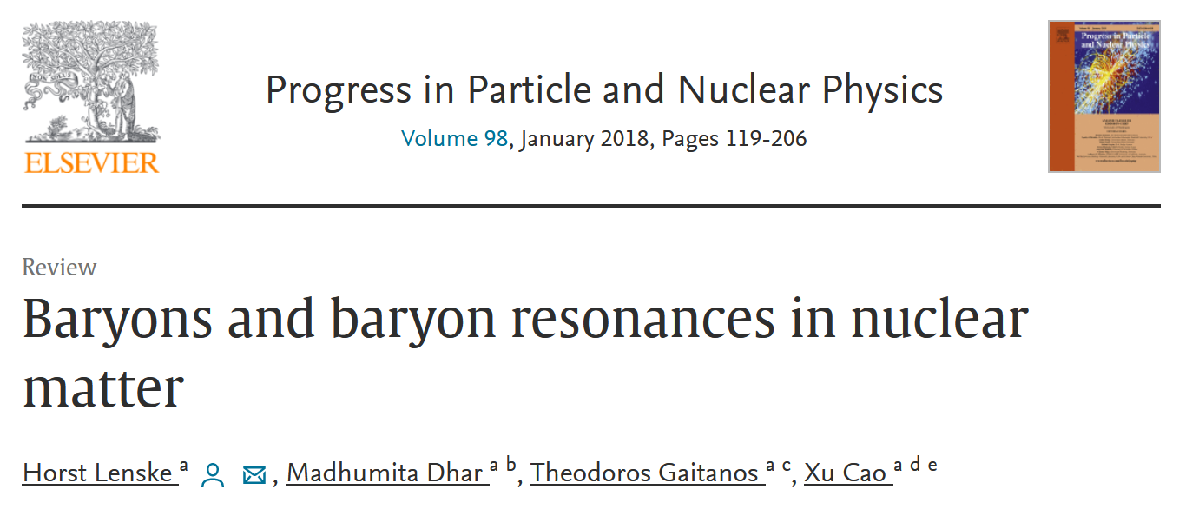
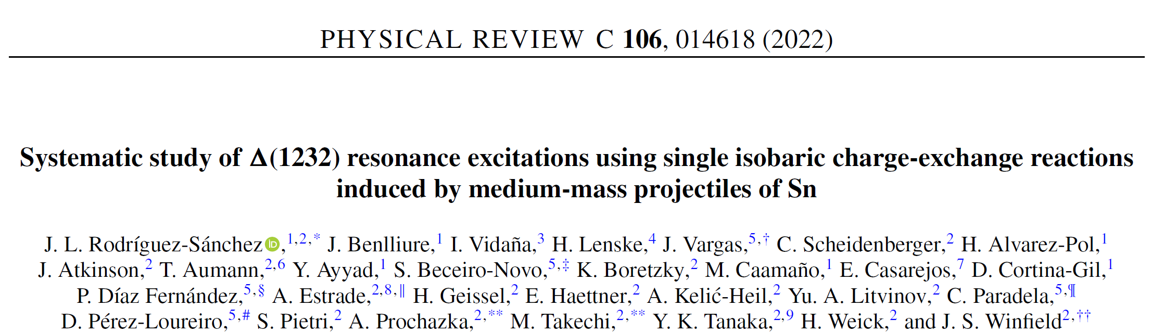
Pion-Nucleon Interactions

Slide 15
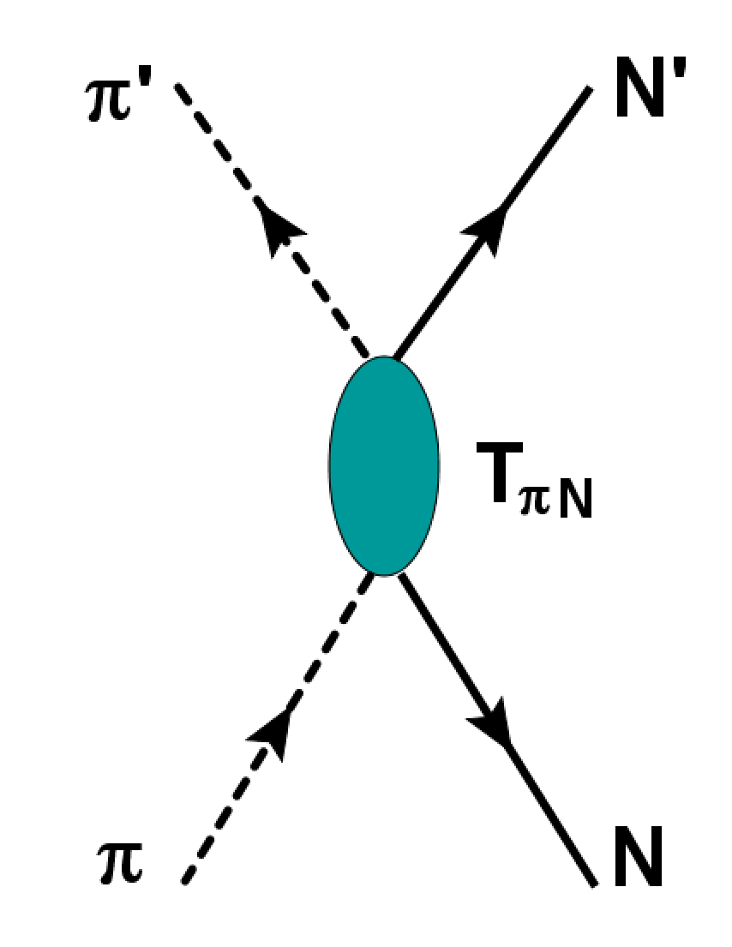
The Pion-Nucleon T-Matrix at T_{lab} ≤ 500 MeV
s ≤ (1500 MeV)²
S₁₁, S₃₁^{*)}
P₁₁, P₃₁, P₃₁, P₃₃^{*)}
Relevant for MDCE:
πN s-wave and p-wave interactions
Partial wave scattering amplitudes:
S₁₁, S₃₁, P₃₁, P₁₁, P₁₃ , P₃₃ ^{*)}
^{*)} Spectroscopic Notation: L_{2I2J}
Isospin: I=1/2,3/2
Angular Momentum: J=|L+s|=1/2,3/2,5/2…

Slide 16
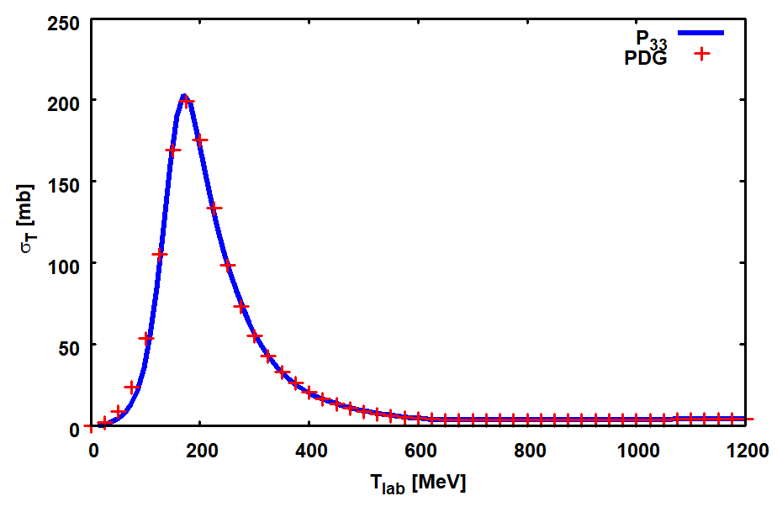
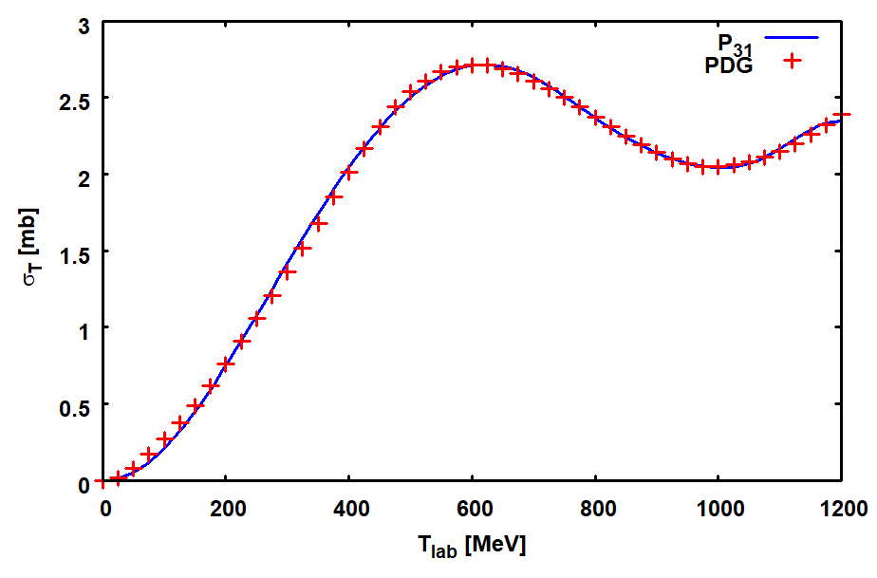
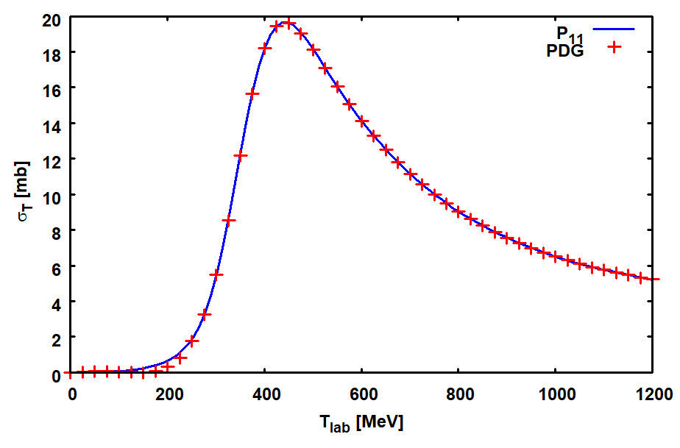
π⁻N total Cross Sections
P₃₃
P₃₁
Relevant partial waves:
P₃₃,P₁₁,P₃₁,S₁₁,S₃₁
(Notation: L_{2I2J})
T₀ ~{S₁₁,S₃₁}
T_{1,2} ~{P₁₁,P₃₁,P₃₁}
Delta-Resonance
Δ₃₃(1232)
Delta-Resonance
Δ₃₁(1750)
P₁₁
Review on the Giessen π+N
CC approach:
H.L. et al., PPNP 98 (2018) 119
Roper-Resonance
N*(1440)

Slide 17
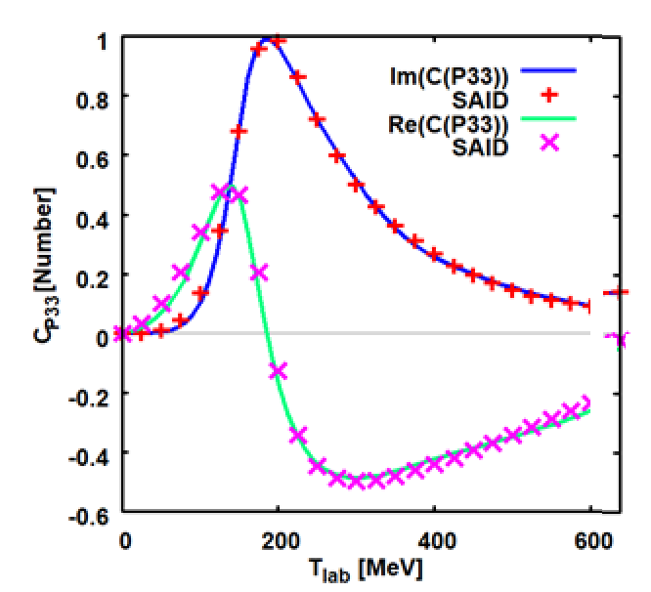
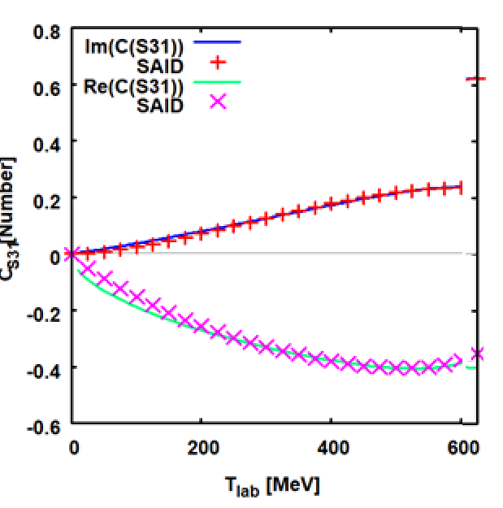
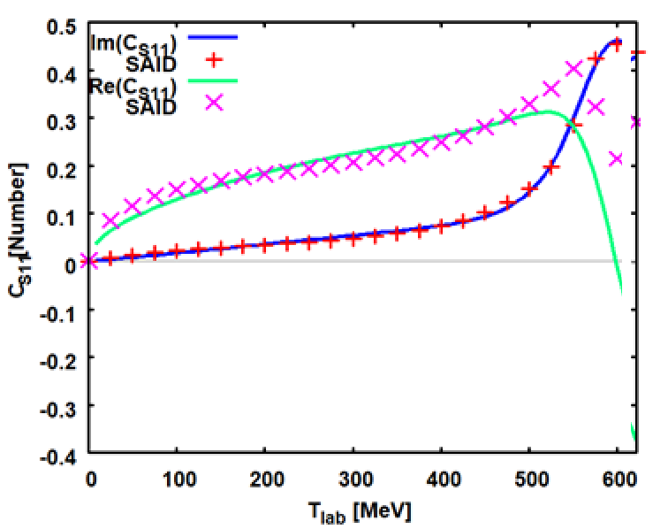
On-Shell Pion-Nucleon Scattering Amplitude
Potential Model
S₃₁
P₃₃
S₁₁
H.L. et al., PPNP 98 (2018) 119

Slide 18
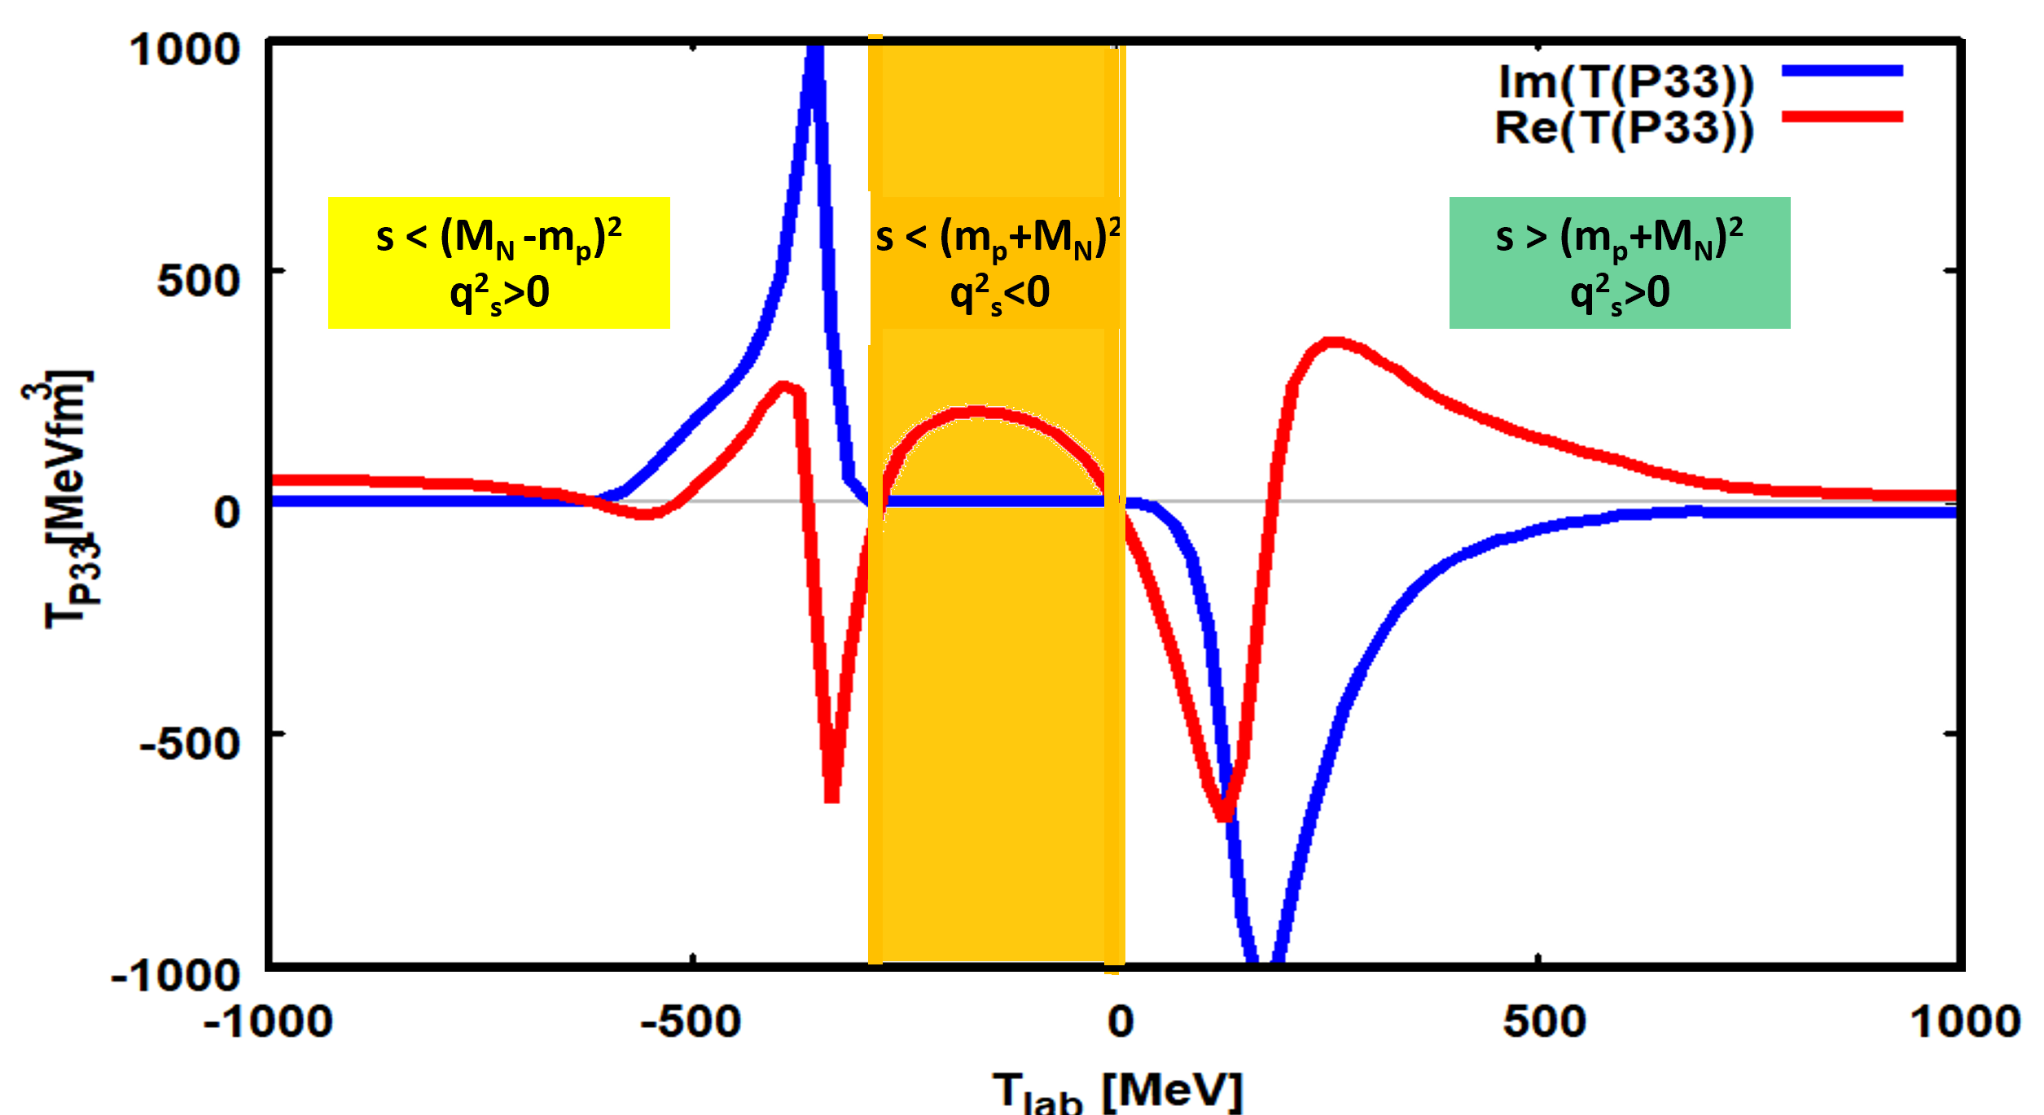
Kinematical Regions of Importance for Hadronic DCE Reactions
sub-threshold ←
→ super-threshold
$$s_{πN}$$
$$s_{πN}$$
Pionic DCE reactions
Deep-inelastic nuclear MDCE →
MDCE by (virtual) 2-pion processes

Slide 19
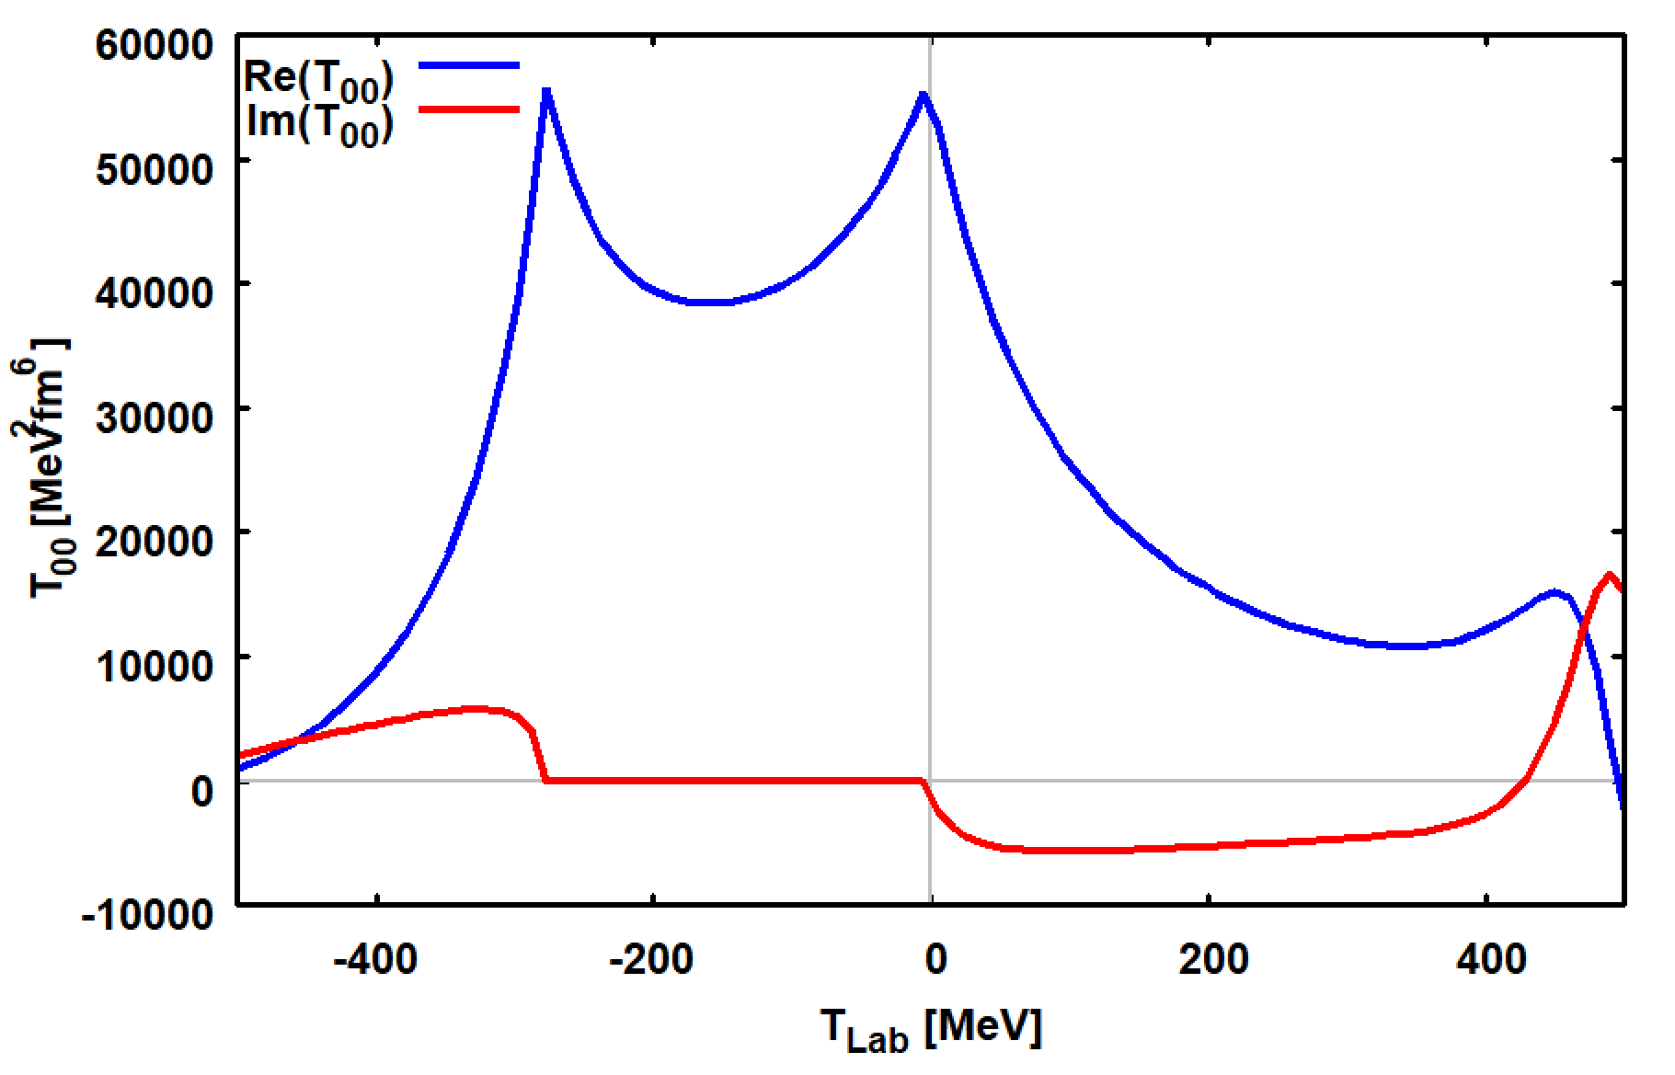
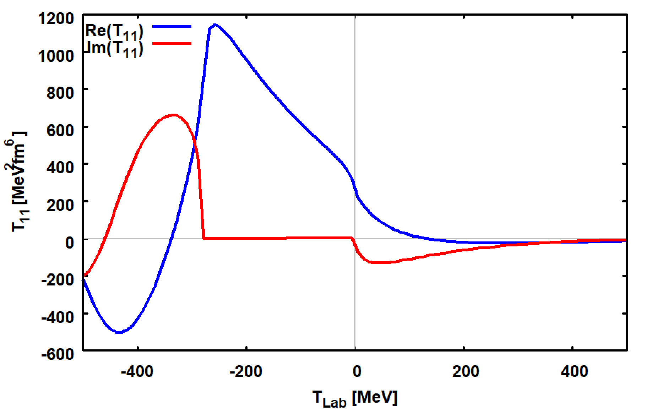
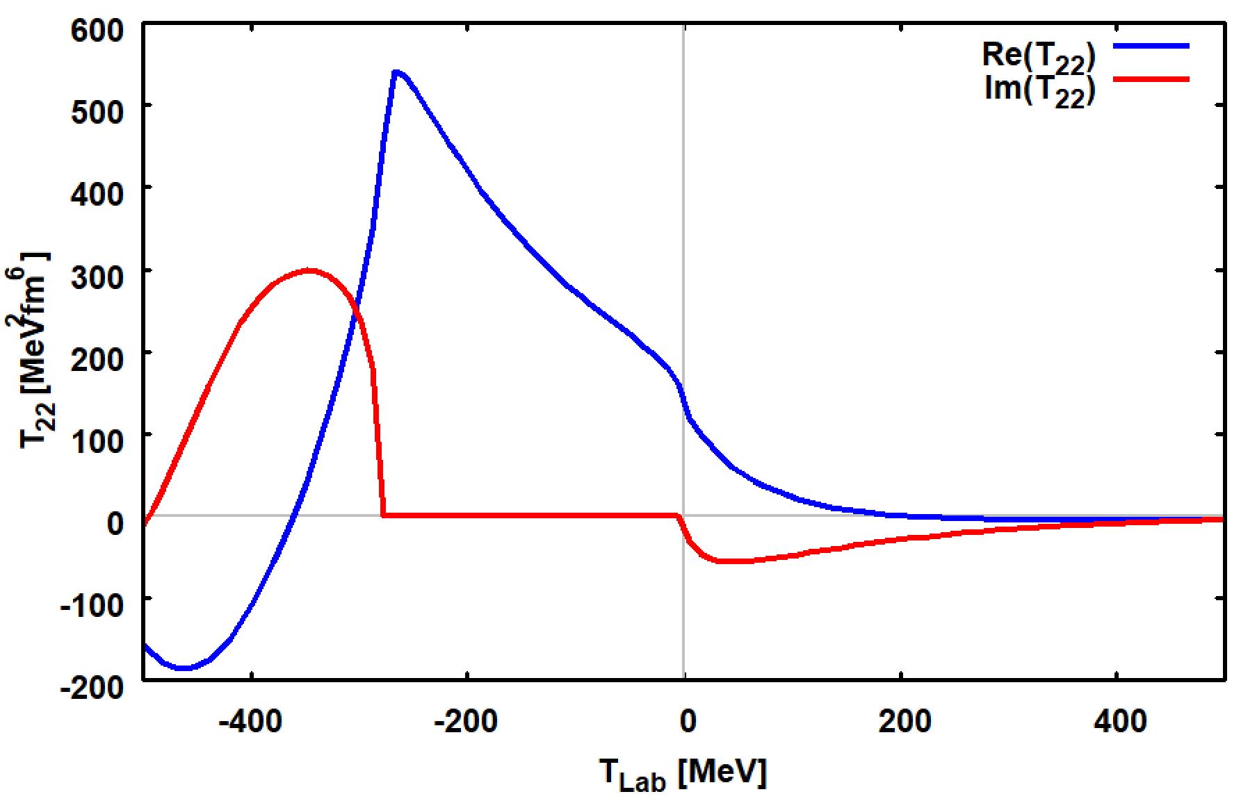
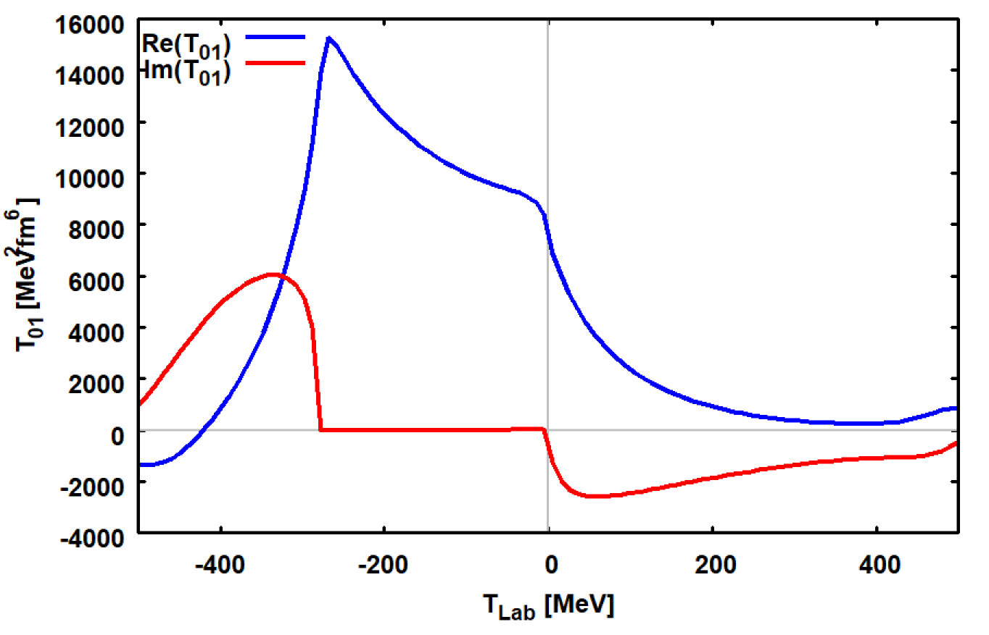
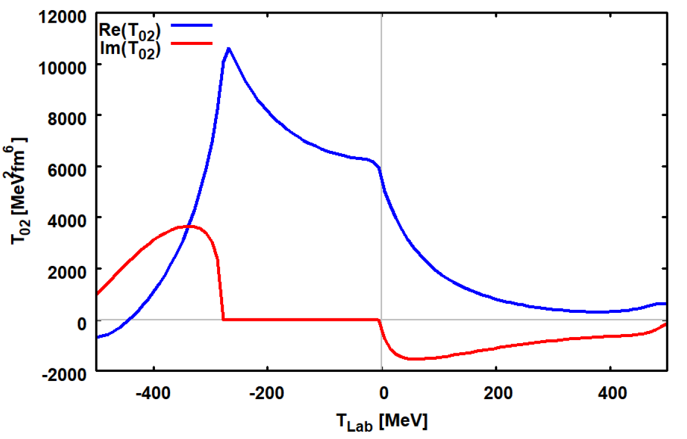
MDCE Amplitudes: T_{nm}=T_{n}T_{m}
T₀₀
T₁₁
T₂₂
T₀₁
T₀₂

Slide 20
Pion Potentials
U_{π}
U_{π}

Slide 21
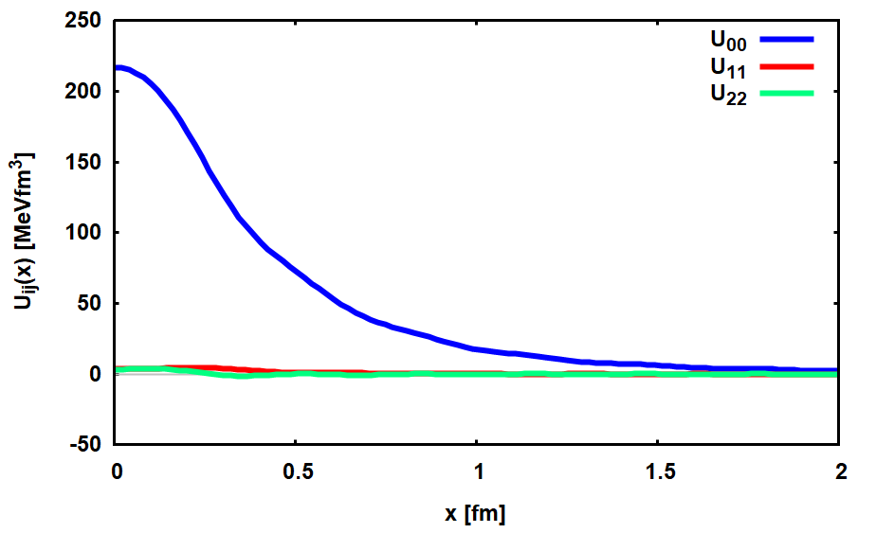
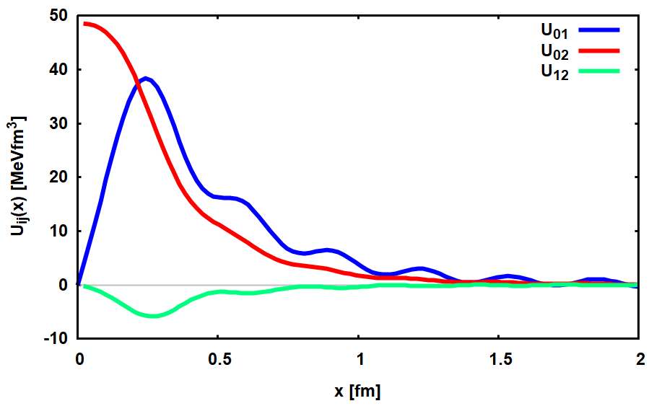
Pion Potentials at low Momenta
p₁=p₂=30 MeV/c
Diagonal U_{ii}(x)
Mixed U_{ij}(x)
Dominance of S-wave Components

Slide 22
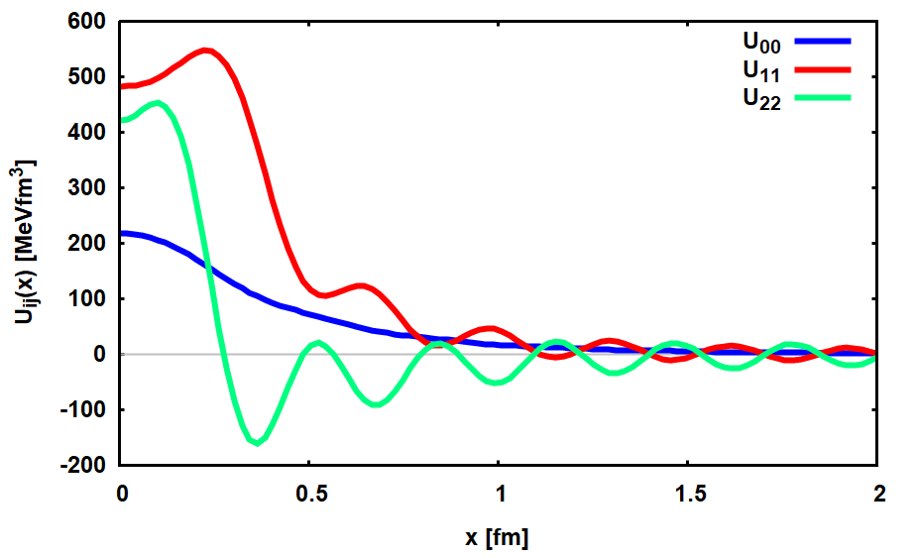
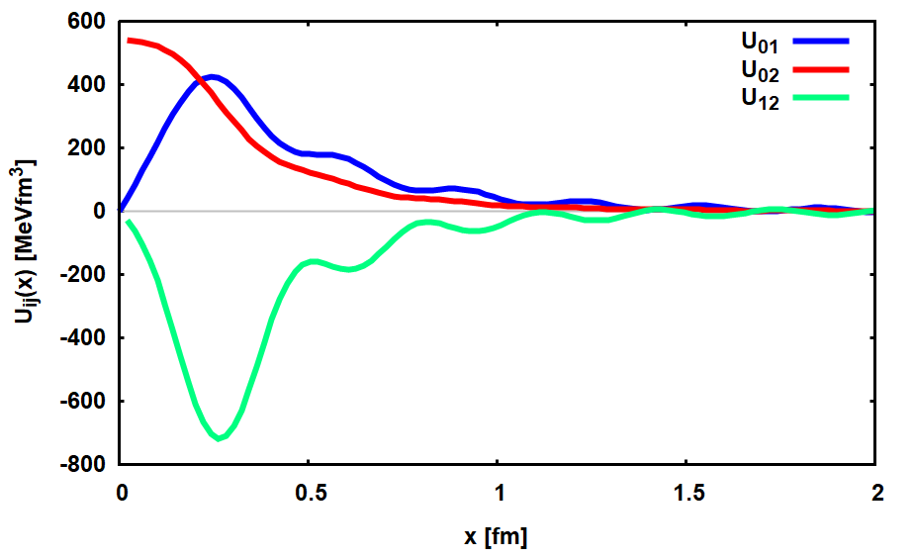
Pion Potentials at high Momentum Transfer
p₁=p₂=300 MeV/c
General Feature:
Short-Range NN-Correlation – x_{NN} ~ 0.5 fm
Diagonal U_{ii}(x)
Mixed U_{ij}(x)
Dominance of P-wave Components

Slide 23
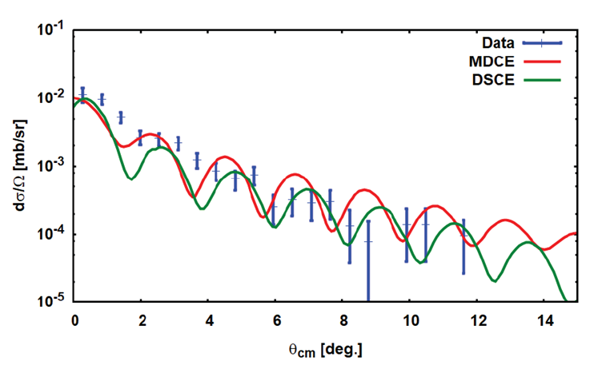
Heavy Ion DCE Reactions
¹⁸O+⁴⁰Ca → ¹⁸Ne+⁴⁰Ar
T_{lab} = 15 AMeV
q_{tr} ≈ 10…500 MeV/c (!)
2-step DSCE: intermediate states with J^{π}≤5±
1-step MDCE: ⁴⁰Ca(0⁺)→⁴⁰Ar([n⁻²p²]0⁺) : J=0+ with L=S=0 & [L=2 x S=2]₀₊
MDCE Preliminary!
Data: F. Cappuzzello et al., EPJ A51 (2015)

Slide 24
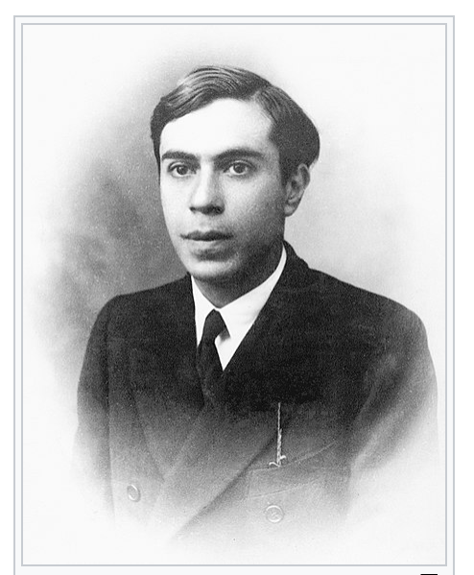
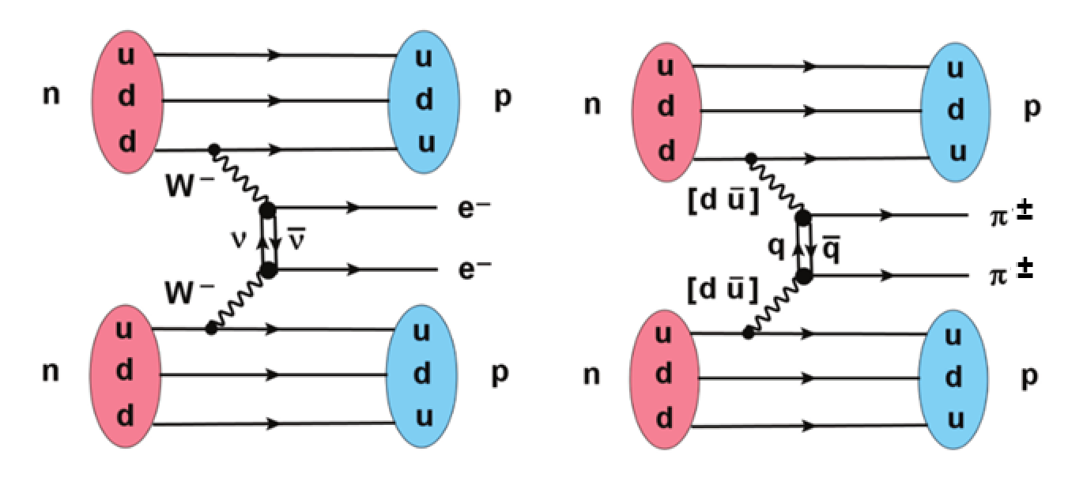
MDCE and 0ν2β Double Beta-Decay
The Majorana Aspect
Ettore Majoran
*Aug., 5, 1906, at Catania
disappeared, Mar, 1938
+ 1959 in Venezuela?
+ in a Sicilian monastery?
‘‘‘‘‘‘
Topological Correspondence on the Diagrammatic Level
MDCE as Probe for Nuclear for Wave Functions in 0ν2β-NME

Slide 25
Summary and Outlook
  DSCE reactions ↔ analogue of 2ν2β – decay
  MDCE reactions ↔ analogue of 0ν2β – decay
  Induced rank-2 IsoTensor interaction ↔ generic for heavy ion DCE reactions
  MDCE box diagrams and pion potentials
  Pion-nucleon scattering and MDCE interactions
  Nuclear structure aspects of DCE physics – „Multi-Methods“ Approach
  Precision spectroscopy with heavy ion beams
…in collaboration with the NUMEN theory group:
J. Bellone, M. Colonna, D. Gambacurta
and A. Gargano (Naples), J.-A. Lay (Valencia), and E. Santopinto (Genova)
Supported by DFG, grant Le439/16, INFN, and AvH

Slide 27
¹⁸O→ ¹⁸F
SCE Spectroscopy:
ccQRPA Response Functions
⁴⁰Ca → ⁴⁰K
4⁻
4⁺
Fermi (S=0) and Gamow-Teller (S=1) Transition Operators:
3⁺
3⁻
1⁺
1⁻
…including DCP self-energies and continuum effects

