Slide 1


Short base-line neutrino oscillation searches with the ICARUS detector
Alberto Guglielmi
INFN Padova
on behalf of the ICARUS Collaboration
H2020, M. Sklodowska-Curie
R&I No. 822185, 858199, 101003460, 101081478
MAYORANA 2023 Workshop, Modica, July 13th 2023

Slide 2
ICARUS Collaboration at SBN
P. Abratenko¹⁹, A. Aduszkiewicz²¹, F. Akbar²³, M. Artero Pons¹⁵, J. Asaadi²⁴, M. Babicz², W.F. Badgett⁵, L.F. Bagby⁵, B. Baibussinov¹⁵, B. Behera⁴, V. Bellini⁷, O. Beltramello², R. Benocci¹³, J. Berger⁴, S. Berkman⁵, S. Bertolucci⁶, M. Betancourt⁵, K. Biery⁵, M. Bonesini¹³, T. Boone⁴, B. Bottino⁸, A. Braggiotti¹⁵, J Bremer², S. Brice⁵, V. Brio⁷, C. Brizzolari¹³, J. Brown⁵, H. Budd²³, A. Campani⁸, A. Campos²⁷, D. Carber⁴ , M. Carneiro¹, H. Carranza²⁴, D. Casazza⁸, A. Castro³, M. Cicerchia¹⁵, S. Centro¹⁵, G. Cerati⁵, M. Chalifour², A.Chatterjee²⁶,D. Cherdack²¹, S. Cherubini¹¹, N. Chitirasreemadam²⁵, T. Coan¹⁸, A. Cocco¹⁴, M. R. Convery¹⁷, S. Copello¹⁶, A. De Roeck², S. Di Domizio⁸, D. Di Ferdinando⁶, L. Di Noto⁸, M. Diwan¹, S. Donati²⁵, J. Dyer⁴, S. Dytman²², S. Dolan², F. Dolek²⁷, L. Domine¹⁷, R. Doubnik⁵, F. Drielsma¹⁷, C. Fabre², A. Falcone¹³, C. Farnese¹⁵, A. Fava⁵, F. Ferraro⁸, F. Garcia¹⁷, C. Gatto¹⁴, M. Geynisman⁵, D. Gibin¹⁵, A. Gioiosa²⁵, W. Gu¹, M. Guerzoni⁶, A. Guglielmi¹⁵, S. Hahn⁵, A. Heggestuen⁴, B. Howard⁵, R.Howell²³, J. Hrivnak², C. James⁵, W. Jang²⁴,L. Kashur⁴,W. Ketchum⁵, J.S. Kim²³, D.H. Koh¹⁷, U. Kose², J. Larkin¹, G. Laurenti⁶, G. Lukhanin⁵, A. Maria²⁶, C. Mariani²⁷, C. Marshall²³, S. Martinenko¹, N. Mauri⁶, A. Mazzacane⁵, K.S. McFarland²³, D.P. Mendez¹, G. Meng¹⁵, A. Menegolli¹⁶, O.G. Miranda³, D. Mladenov², A.Mogan⁴, N. Moggi⁶, N.Montagna⁶, A. Montanari⁶, C. Montanari^{5,b}, M. Mooney⁴, G. Moreno Granados³, J. Mueller⁴, M. Murphy²⁷, D. Naples²², M. Nessi², T. Nichols⁵, S. Palestini², M. Pallavicini⁸, V. Paolone²², R. Papaleo¹¹, L. Pasqualini⁶, L. Patrizii⁶, G. Petrillo¹⁷, C. Petta⁷, V. Pia⁶, F. Pietropaolo^{2,a}, F. Poppi⁶, M. Pozzato⁶, A. Prosser⁵, G. Putnam²⁰, X. Qian¹, A. Rappoldi¹⁶, R. Rechenmacher⁵, L. Rice²², E. Richards²², F. Resnati², A.M. Ricci²⁵, A.Rigamonti², G.L. Raselli¹⁶, M. Rosemberg¹⁹, M. Rossella¹⁶, C. Rubbia⁹,G. Savage⁵,A. Scaramelli¹⁶,D. Schmitz²⁰,A. Schukraft⁵, F. Sergiampietri², G. Sirri⁶, J. Smedley²³, A. Soha⁵,L. Stanco¹⁵,J. Stewart¹,N.B. Suarez²², H.Tanaka¹⁷, M. Tenti⁶, K.Terao¹⁷ , F. Terranova¹³, V.Togo⁶, D.Torretta⁵, M.Torti¹³, Y.T. Tsai¹⁷, S.Tufanli², T. Usher¹⁷, F.Varanini¹⁵, S. Ventura¹⁵, M.Vicenzi¹, C. Vignoli¹⁰, B.Viren¹, D. Warner⁴, Z. Williams²⁴, P. Wilson⁵, R.J. Wilson⁴, J. Wolfs²³, T. Wongjirad¹⁹, A. Wood²¹, E. Worcester¹, M. Worcester¹, M. Wospakrik⁵, H. Yu¹, J. Yu²⁴, A. Zani¹², C. Zhang¹, J. Zennamo⁵, J. Zettlemoyer⁵, S. Zucchelli⁶, M. Zuckerbrot⁵
1. Brookhaven National Lab., USA
2. CERN, Switzerland
3. CINVESTAV, Mexico,
4. Colorado State University, USA
5. Fermi National Accelerator Lab., USA
6. INFN Bologna and University, Italy
7. INFN Catania and University, Italy
8. INFN Genova and University, Italy
9. INFN GSSI, L’Aquila, Italy
10. INFN LNGS, Assergi, Italy
11. INFN LNS, Catania, Italy
12. INFN Milano, Milano, Italy
13. INFN Milano Bic. and University, Italy
14. INFN Napoli, Napoli, Italy
15. INFN Padova and University, Italy
16. INFN Pavia and University, Italy
17. SLAC National Accelerator Lab., USA
18. Southern Methodist University, USA
19. Tufts University, USA
20. University of Chicago, USA
21. University of Houston, USA
22. University of Pittsburgh, USA
23. University of Rochester, USA
24. University of Texas (Arlington),USA
25. INFN Pisa and University, Italy
26. Ramanujan Faculty Phys. Res. India
27. Virginia Tech Institute
12 INFN groups, 12 US institutions, CERN, 1 Mexican institution, 1 Indian Institution
a On Leave of Absence from INFN Padova
b On Leave of Absence from INFN Pavia
Spokesperson: C. Rubbia, GSSI

Slide 3
Neutrino related anomalies ?
Neutrino masses and oscillations represent today a main experimental evidence of physics beyond SM. Being some of their fundamental properties still unknown, they are naturally one of main portals towards beyond the SM!
    Despite the well-established 3-flavour ν mixing picture, several anomalies have been collected so far hinting to existence of additional ν states:
    anti−νe appearance: in anti-νμ accelerator LSND experiment where anti-νe -> e+ + n with neutron resulting n + p into d + γ.
    νe disappearance: SAGE, GALLEX experiments with Mega-Curie radioactive sources showing an observed/predicted rate R = 0.84±0.05, recently confirmed at 4σ by BEST exp.
    anti-νe disappearance of near-by nuclear reactor experiment, initially R = 0.934±0.024, but not easy…
…pointing out to sterile neutrinos hypothesized by Bruno Pontecorvo in a 1957 seminal paper…
Bruno Pontecorvo

Slide 4
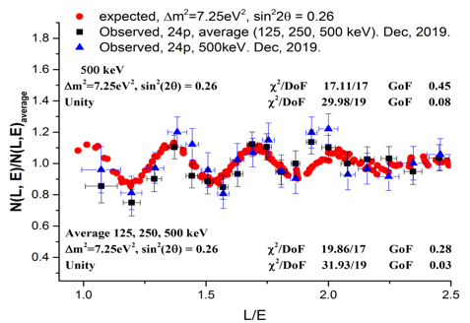
New evidence for oscillations of sterile neutrinos at reactor ?
In 2019 Neutrino-4 experiment (A.P. Serebrov et al.) at Dimitrovgrad SM-3 reactor gave evidence of neutrino oscillation into sterile-νs showing a disappearance signal with a clear L/Eν ~ 1-3 m/MeV modulation
Neutrino signal (blue and black ) compared with expectation (red ) for Δm², sin²2θ values as a function of L/E
3 years data taking moving the segmented liquid scintillator detector from 6.4 to 11.9 m distance from the reactor core in 24 steps resulted in
Reactor On - Off : 223 events/day with Signal/Background ~ 0.54
Δm₁₄² = 7.25± 1.09 eV² with sin² (2θ₁₄) = 0.26 ± 0.08 stat ± 0.05
suggesting sterile neutrinos as candidate for Dark Matter with a quite obvious contribution due to the high density of relic sterile-νs with 𝑚𝜈₄ = 2.7 eV.

Slide 5
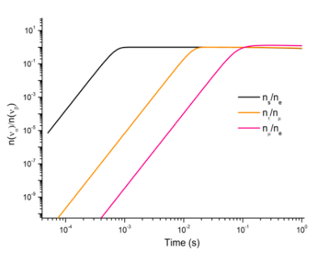
Sterile neutrinos as the origin of Dark Matter ?
Combined analysis of Neutrino-4 (P.R. D 104, 032003, 2021), GALLEX, SAGE and BEST data:
Δm₁₄² = 7.3 eV² sin² (2θ₁₄) = 0.36 at 5.8 σ C.L. (A.P. Serebrov et al. arXiv:2302.09958)
sterile-ν / νe
  Assuming for relic sterile neutrinos a 2.7 eV mass and the same density of active ones at the time of all neutrinos freeze-out (h: Hubble constant)
  Ω(𝜈₄) ≈ (2.7 eV ⁄1 eV) ⋅ 0.01 h⁻² ⋅ 5.1
    => sterile νs should contribute to energy density of Universe at 5.3 % level, (27 % in case of two additional sterile ν states).
Process of neutrinos decoupling
  Could the dark matter be explained in terms of an extended Standard Model with right-handed neutrinos m_{νe}^{R} = 2.7 eV, m_{νμ}^{R} = 0.56 keV, m_{ντ}^{R} = 9.4 keV ? (A.P. Serebrov et al, arXiv:2306.09962).
An obvious reason for considering sterile-ν as DM candidate is the absence of interaction between sterile-ν and matter: the scattering of strongly/weakly interacting particles on clusters of sterile-νs occurs only due to gravitational interaction.

Slide 6
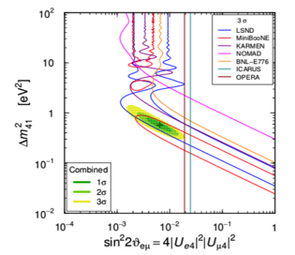
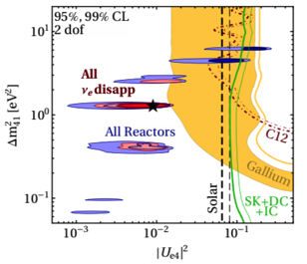
The sterile neutrino puzzle
  Several experiments performed at reactors and accelerators to study “ν anomalies”, e.g. the recent result of MicroBooNE (arXiv:2210.10216), but:
    A clear tension between appearance and disappearance experiments which are characterized by different neutrino energy range and detection technique is evident.
(anti-)ν_{μ} → ν_{e} Appearance
(anti-)ν_{e} Disappearance
(arXiv:2106.05913)
    Measuring both appearance /disappearance in the same experiment using a detector with optimal ν id. and backgr. rejection is mandatory to disentangle physics scenario;
    Far to near detector neutrino spectra comparison is crucial for the control of backgr. and beam/detector systematics.

Slide 7


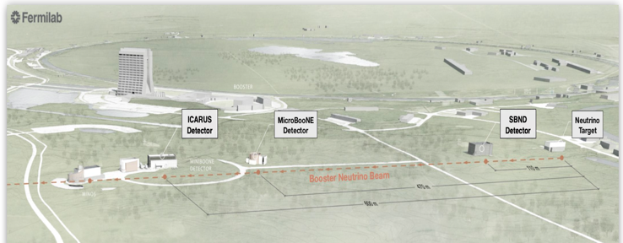
Short Baseline Neutrino (SBN) at FNAL BNB and NuMi beams: a definitive answer to sterile neutrinos ?
ICARUS
600m baseline
470t active volume
data taking
SBND
110 m baseline
112t active volume
under completion
BNB
φ(ν)/MeV/m²/10⁶ POT
Booster Neutrino Beam (BNB)
  arxiv:1503.01520
  ICARUS and SBND LAr-TPC’s installed at 600 and 110 m from Booster target, searching for sterile-ν oscillations both in appearance and disappearance channels.
  Furthermore, high-statistics ν-Ar cross-section measurements and event identification/reconstruction studies:
    ~10⁶ events/y in SBND < 1 GeV from Booster
    ~10⁵ events/y in ICARUS > 1 GeV from off-axis NuMI beam.
BNB

Slide 8
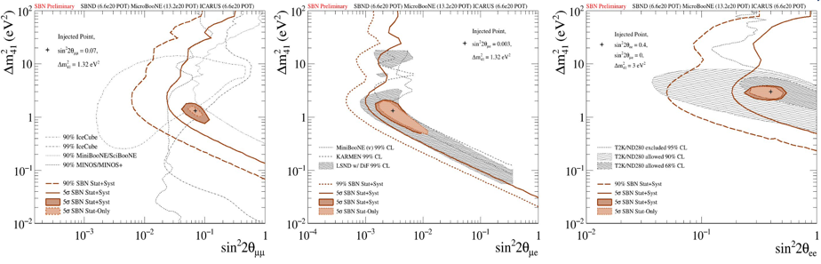
SBN Program: sterile neutrino sensitivity, 3 years (6.6 x10²⁰ pot)
Combined analysis of events collected far by ICARUS at far site and by SBND at near using the same LAr-TPC event imaging technology greatly reduces the expected systematics:
      High νe identification capability of LAr-TPCs rejecting NC event background;
      “Initial” BNB beam composition and spectrum provided by SBND detector.
νμ disappearance
νe appearance
νe disappearance
5σ coverage of the parameter area relevant to LSND anomaly
Probing the parameter area relevant to reactor and gallium anomalies.
Unique capability to study neutrino appearance and disappearance simultaneously

Slide 9
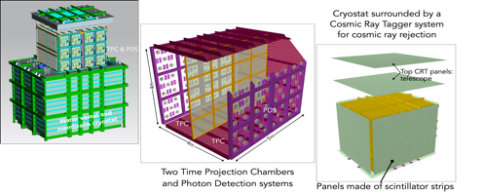
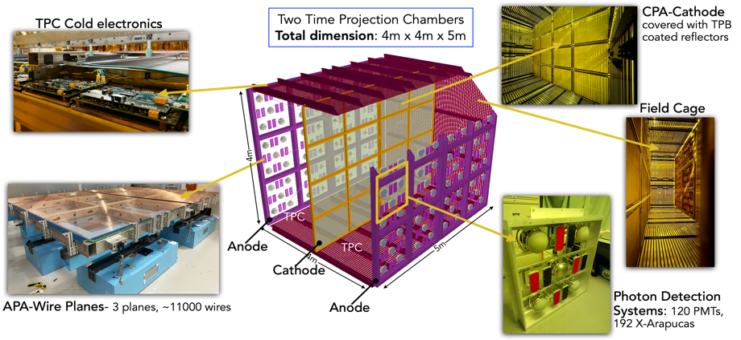
SBN Near detector: SBND at 110 m from target
Two LAr-TPCs with central Cathode, 112 t LAr active volume equipped with cold electronics;
Photon detection systems of scintillation light produced by charged particles in LAr;
The cryostat is surrounded by a Cosmic Tagger system for cosmic ray rejection.

Slide 10
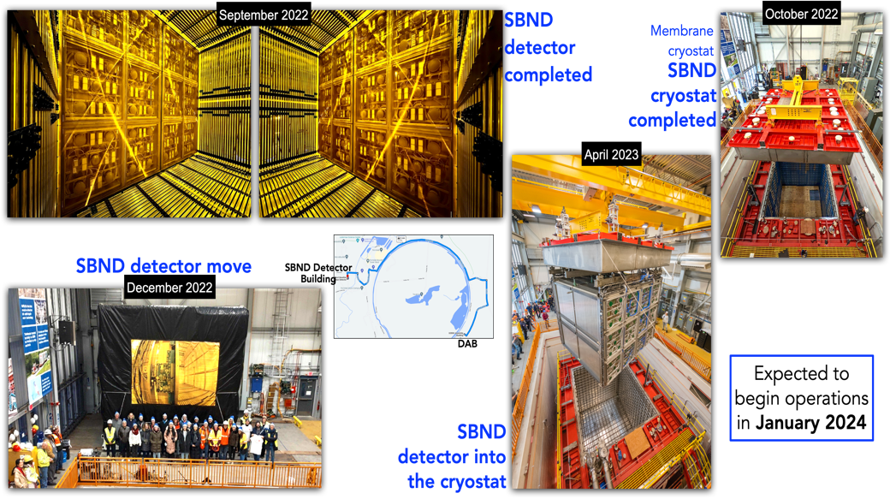
SBND STATUS

Slide 11
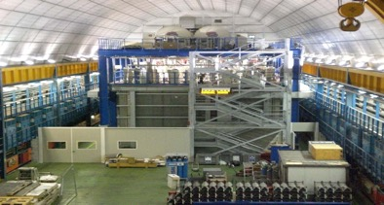
The remarkable evolution of ν-detectors: the ICARUS LAr-TPC
Liquid Argon Imaging technology LAr-TPC, an ‘’electronic bubble chamber’’ to unambiguously reconstruct each ionizing track in complex neutrino events, was first proposed by C. Rubbia in 1977 as an alternative to Cherenkov detectors:
A long R&D culminated in the first large-scale successful experiment ICARUS-T600, 0.76 kt ultra-pure LAr at Gran Sasso INFN Lab exposed underground to CNGS νs investigating sterile neutrinos!
      Tracking device: 3D event topology with Δx ~ mm³, e- by charged particles can drift undisturbed for meters with E_{D}= 0.5 kV/cm if LAr is sufficiently pure
      Full sampling homogeneous calorimeter: E measurement by charge signal integration;
      Measurement of local energy deposition dE/dx: remarkable e/γ separation, 0.02 X₀ sampling, Χ₀=14 cm, a powerful PID by dE/dx vs range.
      Scintillation light by charged particles provides fast signals for timing/triggering.
T300
T300
… paving the way for Long-Baseline experiments!
Notes:
CERN

Slide 12
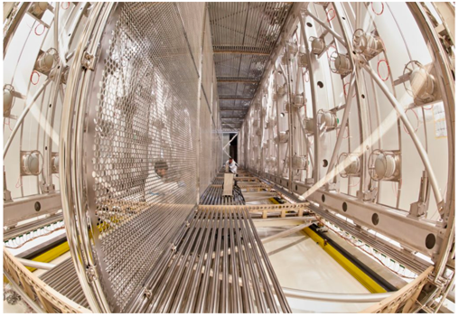
ICARUS at Fermilab
2018: ICARUS is installed at Fermilab after an extensive overhauling in view of the shallow depth operations:
Structure of one module with 2 TPC chambers
2 modules, 2 TPC chambers per module with a central cathode (1.5 m drift, E_{D}= 0.5 kV/cm);
3 readout wire planes per TPC, 54000 wires at 0, ± 60⁰, 3 mm pitch, in total;
360 8” photomultipliers, TPB coated, to detect the scintillation light;
LAr/GAr purified by copper filters and molecular sieves for water absorption.
Wires planes
Central cathode
E-field cage
PMTs
2022: ICARUS at Fermilab is filled, activated and commissioned!
Notes:
CERN

Slide 13
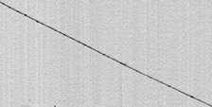
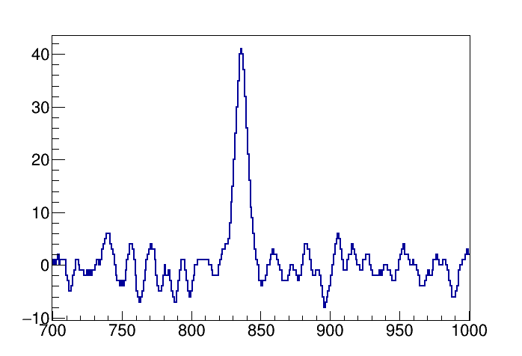

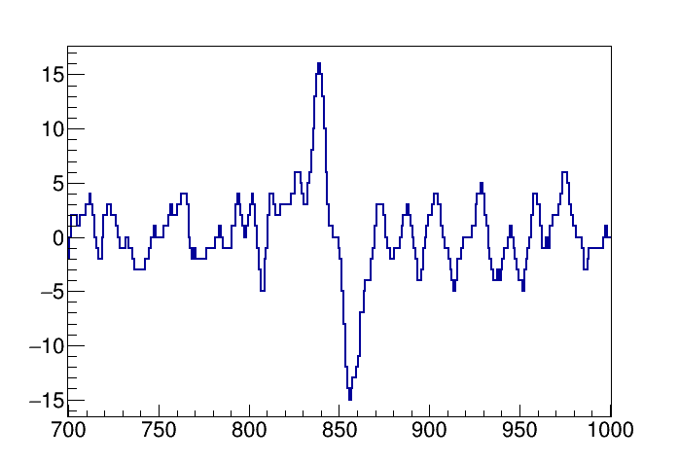
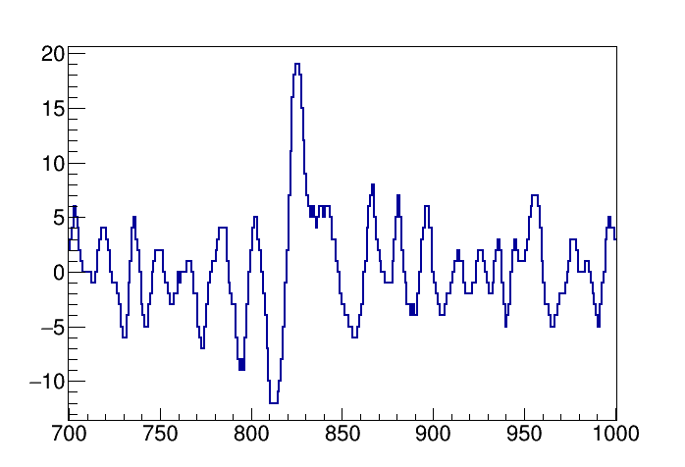
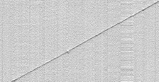
Upgrade of TPC read-out electronics
Front-end based on analogue low noise, charge sensitive pre-Amp;
Signal shaping ~1.3 μs matching e- transit time between Induction-1, 2 and Collection wire planes (3 mm apart) improving hits position resolution;
Compact layout with both analog/digital electronics in a single board.
Collection
10 liter mini-crate on a feed-through hosting 9 boards (576 wires).
0.75 m Wires
Induction-2
Wire signal [ADC]
ICARUS Signal to Noise ratio
0.8 m Drift direction
0.45 m Wires
Induction-1
    S/N > 10 in Collect./Ind-2 views for mip vertical μs tracks.
1.1 m Wires
Time [t-sample]
Recorded cosmic muon track: bipolar shape of e-signals traversing wire planes recognized in Induct.-1, 2 views.

Slide 14
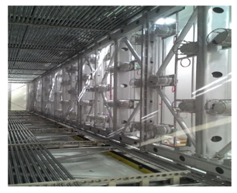
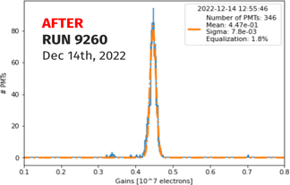
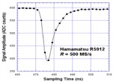

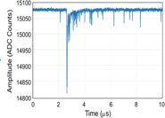

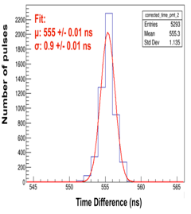
Upgrade of the light collection system
360 Hamamatsu 8“ PMT (5% coverage, 15 phe/MeV) installed behind the wire planes, 90 PMTs per TPC chamber:
  Continuous read-out, digitization, discrimination and waveform recording of PMTs signals (V1730 digitizers);
  PMT signals sampled every 2 ns, recorded in 10 µs windows.
V1730 Digitizer
Global
Trigger
PMT
Trigger
Logic
N. of PMTs
LVDS
Preliminary
Data
recording
(10 μs)
Argon scintillation light
Optical
Link
Gain (x10⁷ electrons)
A3818
N. of pulses
  PMT gain equalized at ~ 0.45 10⁷±1% with λ ~ 405 nm laser and measuring ~4 mV PMT response to single photoelectron;
  PMT timing to Trigger signal with 1 ns resolution by laser to perfectly determine the time of collected events.
Δt = t_{PMT} – t_{TRIGGER} (ns)

Slide 15
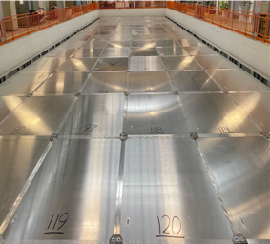
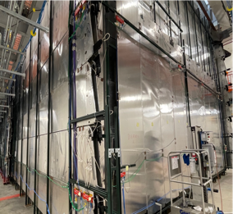
Cosmic-ray background mitigation in ICARUS
ICARUS LAr-TPC is installed in a pit exposed to cosmic rays where electrons produced by γ’s via Compton Scatt./Pair Prod. can mimic a genuine ν_{e} CC interaction:
  Cosmic muons entering ICARUS are identified in time/position by 4π Cosmic Ray Tagger (CRT) detector surrounding LAr-TPCs as matched to TPCs and PMTs;
  Cosmic γ’s and neutrons suppressed by 2.85 m concrete overburden installed above CRT.
CRT: a double layer scintillation bars (~1000 m²) with SiPMs, tagging incoming cosmics with ~95% efficiency
Top CRT
Side CRT

Slide 16
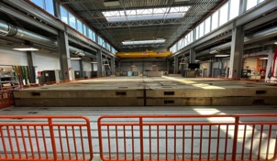
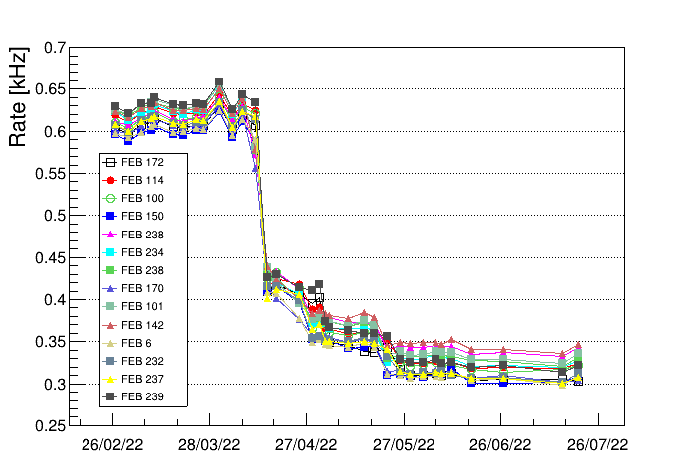
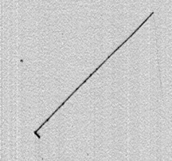
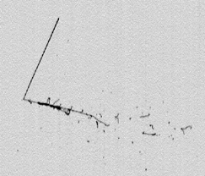
Run 1: first ICARUS physics run, June 9th – July 10th 2022
June 7th ‘22: overburden installed over the CRT
Rate of cosmic rays measured during the overburden installation
Layer
1
Layer
2
Layer
3
Cosmics imping ICARUS are reduced by a factor ~2 with 3 concrete layers overburden;
ICARUS started operating in physics mode on June 9th as triggered by PMTs signals in coincidence with BNB, NuMi beam spills;
Free e-lifetime was measured at ~4.5 ms (3 ms) in East (West) cryostat by μ’s signal attenuation along the drift;
Collected event statistics: 4.1 10¹⁹ POT BNB , ~6.8 10¹⁹ POT NuMI
  Typical BNB CCQE νμ candidate, E_{DEP} ~200 MeV
  Contained NuMI CCQE νe candidate, E_{DEP} ~800 MeV
COLLECTION View
COLLECTION View
Upward going exiting muon , L∼80 cm
64 cm Drift direction
Stopping upward going hadron, L ∼43 cm
76 cm Drift direction
Vertex
Vertex
Downward going proton, L ∼3 cm
Electron developing into e.m. shower
60 cm Wires
72 cm Wires

Slide 17
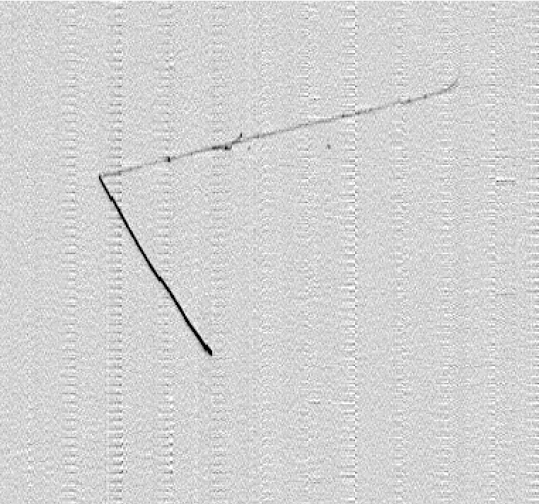
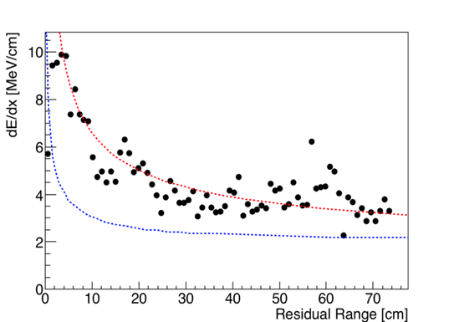
First collected neutrino events: a BNB QE νμ CC candidate
Selection of ν_{e} events
COLL
  Neutrino interaction vertex well inside the active LAr volume. Two tracks are produced:
    Track 1: downward going muon candidate, exiting on bottom (confirmed by δ rays)
    Track 2: stopping proton.
Beam direction
Track 1 L = 75 cm
Muon with δ−rays exiting on the bottom
0.9 m Drift direction
ICARUS Preliminary
Track 2 L = 74 cm
Stopping proton
Measured dE/dx along track 2
1.2 m Wires
From the study of dE/dx vs range, track 2 is compatible with a proton: E_{DEP}~ 340 MeV, E_{K} =370 MeV (if evaluated from range).
Expected dE/dx vs range for muon, proton

Slide 18
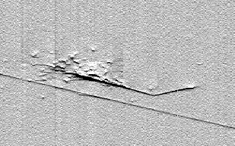
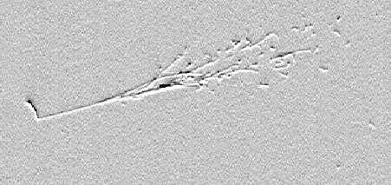
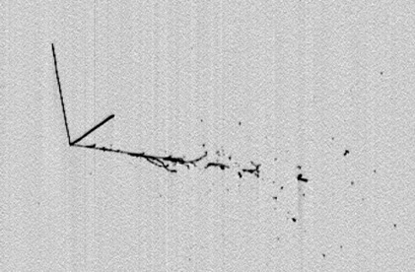
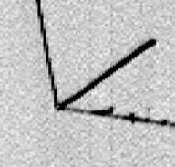
NuMI νe CC candidates
Selection of ν_{e} events
IND1
IND2
QE νe CC event contained candidate, E_{DEP}~870 MeV:
  proton candidate is upward going/stopping L= 13 cm;
  e-shower is downward going.
Electron
0.7 m Drift direction
0.5 m Drift direction
Proton
Proton
Electron
Overlapped cosmic track
0.7 m Wires
Beam direction
1.0 m Wires
COLL
  νe CC event candidate fully contained in active LAr, E_{dep}~830 MeV:
    The electron shower, E_{DEP}~570 MeV is downward going;
    Track 1: upward going, stopping proton candidate, L = 23.7 cm; Track 2: stopping hadron, L = 33.4 cm.
Track 2
Track 1
0.92 m Drift direction
Electron
1 m Wires
Slide# : 18

Slide 19
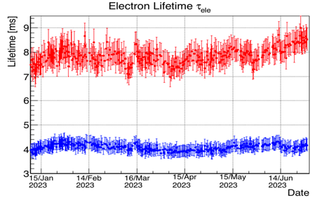
Run 2 Data taking: December 20th 2022 - July 16th 2023
  Run-2 started last December 20th, taking data with both BNB, NuMI beams after a detector setting/tuning with cosmic rays:
    Free e-lifetime increased in West Cryo to 8.5 ms corresponding to ~ 40 p.p.t. of [O2] residual impurities by regenerating LAr filter => optimal track detection eff. (1 ms drift)
West
East
(Filter to be regenerated )
  P. Abratenko et all: ICARUS at the Fermilab Short-Baseline Neutrino program: initial operation
  Eur. Phys. J. C (2023) 83:467
Data taken Dec 2022 - present
  ICARUS has collected in the Run-2 an event statistics corresponding to: 2.05 10²⁰ POT BNB - 2.74 10²⁰ POT NuMI
  Steady data taking with DAQ uptime > 95 %,
  excellent stability on long runs at BNB rep.
  rate > 4 Hz.
BNB
NuMI

Slide 20
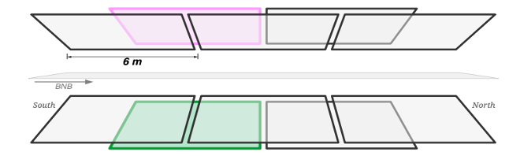
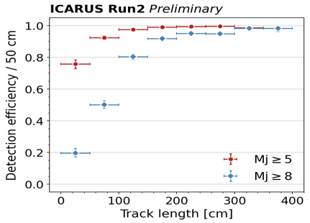
Triggering the neutrino events
  ICARUS trigger system relies on PMT light in coincidence with the beam spills, 1.6 μs BNB and 9.5 μs NuMI, using the Early Warning signals of proton beam extractions:
Beam events are collected requiring at least 5 fired PMT pairs (Mj =5) inside one of the 6 m longitudinal slices (30 PMTs left + 30 PMTs right);
PMT and CRT signals also recorded in 2 ms around the trigger to recognize cosmics crossing LAr-TPCs in 1 ms e-drift time
PMT
TPC Left
TPC Right
ν beam
.
cathode
PMT
30 PMTs
30 PMTs
30 PMTs
ν beam
30 PMTs
30 PMTs
30 PMTs
  Trigger efficiency measured selecting vertical cosmic muons by TPC tracks matched to CRT signals:
    ~ full efficiency is found for in-spill events above 1 m track length (E_{DEP}~ 200 MeV ),
    Out-of–spill cosmics are recognized with 90% eff. for L > 1.5 m requiring >= 8 fired PMT pairs.

Slide 21
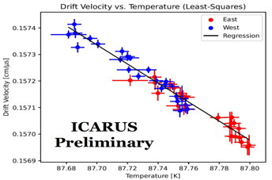

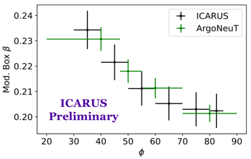
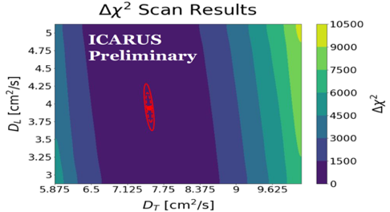
Detector Physics measurements
Accurate measurements of main detector parameters with cosmic rays are improving the global understanding of LAr-TPC detectors:
1.574
Drift velocity Vs T
  e- drift velocity as a function of cryogenic temperature of LAr;
1.572
  dE/dx ionization by stopping muons/protons to extract the TPC electronic calibration factors and α, β parameters of e- recombination vs the track angle φ wrt electric field;
Drift velocity (mm/μs)
1.570
87.70
Temperature (K)
87.80
α=0.91±0.07, W_{ion}=23.6 eV
dQ/dx: measured ionization density
Recombination parameter β
β (MeV/cm)⁻¹
68% CL
φ (degrees)
  e- longitudinal D_{L} and transverse D_{T} diffusion in LAr by measuring width and sharing among close wires of wire signals: first D_{T} measurement in this electric field range!
95% CL

Slide 22
ICARUS Research Program
The exciting new result from Neutrino-4 experiment, which could change the whole sterile neutrino story, requires a prompt investigation by ICARUS with Booster and NuMI beams:
  Before the joint operation with SBND, ICARUS is initially focused on ν_{μ}CC quasi elastic interactions with BNB. A similar study of ν_{e}CC quasi elastic interactions with NuMI will be carried out later.
In parallel, the study of ν_{e}, ν_{μ} events from NuMI will also allow ICARUS to measure ν-Ar interaction cross sections and optimize ν reconstruction/identification in an energy range of interest for DUNE. In addition, the NuMI beam will allow a search for sub-GeV Dark Matter signals and other Beyond Standard Model (BSM) signals.
Then SBN program should definitely clarify the question of sterile neutrinos exploiting the BNB beam and comparing the ν_{e} and ν_{μ} interactions observed at different distances from target by ICARUS and SBND LAr-TPCs.
Event reconstruction and analysis tools developed for the single detector analyses will be exploited in the next stage for the joint SBN program.

Slide 23
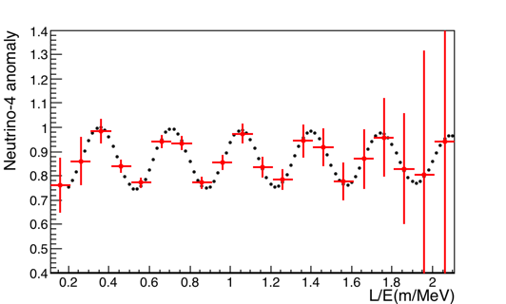
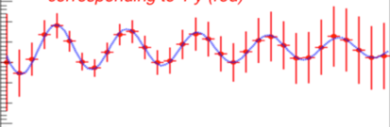
ICARUS search for Neutrino-4 claims at FNAL
Remarkable ICARUS similarities to NEUTRINO-4 allow to settle sterile-ν claims with initial ICARUS-only run, focusing on well-defined QECC νµ, νe fully contained events:
  Oscillations should produce disappearance pattern of νµ in BNB and νe in NuMI in the same L/E ~ 1-3 m/MeV range but with events collected with ~100 times the energy;
  L/Eν effect mostly related to Eν with L large/~constant for both BNB and NuMI 6⁰ off-axis where νe are mostly produced by kaons decaying close to target at ~800 m distance.
Prediction for Neutrino-4 best fit (black) at BNB
Expected measured νμ oscillation pattern with statistical errors (red)
Δm²₁₄=7.25 eV², sin²2θ₁₄=0.26
Prediction for Neutrino-4 best fit (blue) at NuMI
Expected measured νe oscillation pattern with statistical errors (red)
νμ survival oscillation probability at Booster: ~8500 QE events with >50 cm contained μ track, ~8.4 x 10¹⁹ pot (Run1+Run2~2.4 10²⁰ pot) ΔE/E ~ 3 %.
νe survival oscillation probability at NuMI: ~ 5200 QE events with contained E.M. shower, ~9 x 10²⁰ pot (Run1+Run2~ 3.3 10²⁰ pot) .
Analysis complemented with a beam-off event sample (collected in parallel with the beam on) will allow to observe the Neutrino-4 modulation!

Slide 24
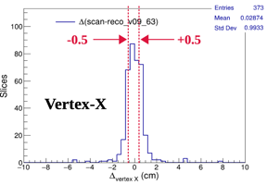
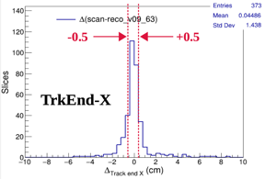
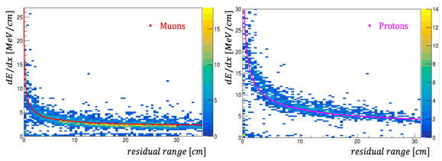
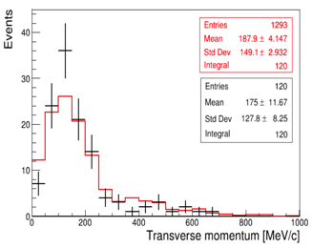
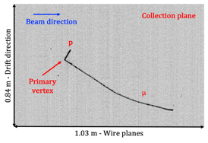
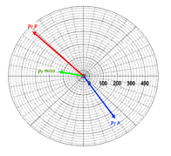
Check of event reconstruction with visually selected νμCC events
  Automatic procedures for selecting 1μ 1p νμCCQE interactions fully contained in LAr active volume are under tuning/validation:
    Reconstructed ν interaction vertex and μ end-point (x_{reco}) within ~2 cm from the measured one (x_{scan}) ;
    Demonstrating particle identification and kinematic reconstruction capabilities in the transverse plane
x_{reco}-x_{scan} (cm)
x_{reco}-x_{scan} (cm)
dE/dx Vs Residual range
dE/dx Vs Residual range
muons
protons
Total transverse
momentum, 1μ 1p events
Residual range (cm)
Residual range (cm)
data
P_{Tp}~460 MeV
An example of 1μ1p event
MC expectation
85 cm – drift direction
P_{Tmiss}~130 MeV
Transverse momentum
reconstruction
P_{Tμ}~340 MeV
1 m – wire direction

Slide 25
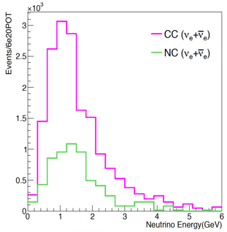
ICARUS physics searches with NuMI beam
Further exploitation of NuMI Off-Axis beam, νe ~ 5% of νμ due to 6⁰ from ICARUS:
  High statistics precision measurements of ν-Ar cross sections (~10⁵ νe events/year) and tests of interaction models in the few hundred MeV to few GeV energy range, of use to SBN oscillation studies and DUNE.
  Develop a rich Beyond Standard Model search program: Higgs portal scalar, ν tridents, light dark matter, heavy neutral leptons …
Oscillation probability at DUNE
𝝼_{μ} from NuMI at ICARUS
𝝼_{e} from NuMI at ICARUS

Slide 26
Conclusions ? waiting for news!
ICARUS detector installation and commissioning has been completed: full time neutrino beam run started on June 9th 2022 and resumed last December exploiting regularly both Booster and NuMI beams, total collected event statistics: ~2.5 10²⁰ BNB, ~3.4 10²⁰ NuMI.
Early phase of ICARUS data taking is primarily devoted to the study of the Neutrino-4 claims looking for the νμ disappearance in the Booster beam and then νe disappearance in the NUMI off-axis beam. Data collected are being actively analyzed, first results expected by this year.
Other relevant physics goals of ICARUS with data collected in standalone mode from BNB and NuMI beams include:
  Measurement of ν-Ar interaction cross-sections in a range of interest for DUNE;
  Search for sub-Gev Dark Matter signals;
After the first year ICARUS-only operations, the SBND LAr-TPC detector is expected to be added at shorter distance from the Booster target to perform with ICARUS a definitive 5 σ analysis of sterile neutrinos.
ICARUS is well on its way for
intriguing physics searches with SBN and beyond!

Slide 27
BACK-UP

Slide 28
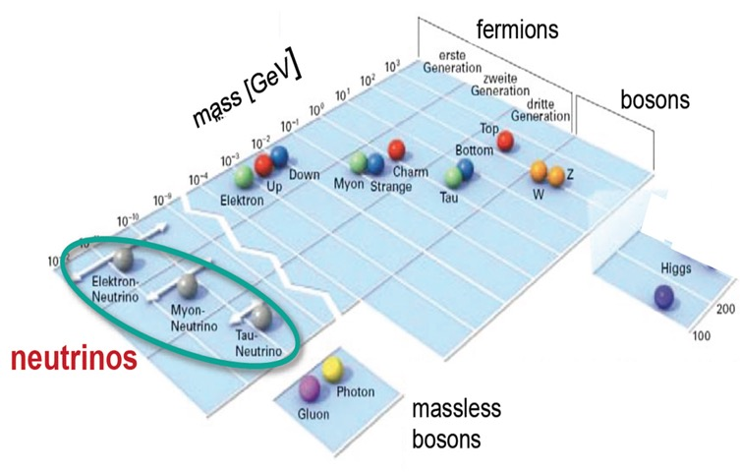
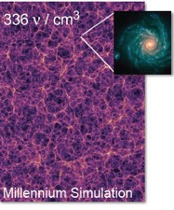
The high energy frontier
Neutrino masses and oscillations represent today a main experimental evidence of physics beyond SM. Being some of their fundamental properties still unknown, νs are naturally one of main portals towards beyond-SM physics.
νs :the most abundant
massive particles in the Universe, 336 ν/cm³
But: mass hierarchy, δ_{CP},
ν mass values, Dirac/Majorana ν ?
The incredible smallness of ν masses compared to other elementary fermions points to some specific scenario awaiting to be elucidated.

Slide 29


New evidence for oscillations of sterile neutrinos at reactor ?
Neutrino-4 experiment (A.P. Serebrov et al.) at Dimitrovgrad SM-3 reactor showing a disappearance, L/Eν ~ 1-3 m/MeV modulation
.
Neutrino signal (blue and black ) compared with expectation (red ) for Δm², sin²2θ values as a function of L/E
Background event
  Neutrino event signature: anti-νe + p -> e⁺+n followed by delayed n capture by gadolinium in liquid scintillator.
  Background: fast n emitted in interaction of high E cosmic μs with matter around the detector, n + p -> p + n

Slide 30




Recent neutrino oscillation results at accelerator beams
A significant excess of electron-like events in both beam polarities has been observed by MiniBooNE (818 tons pure mineral oil) at FNAL Booster beam:
381.2±85.2 evts (4.5 σ) 12.84 10²⁰ pot (ν)
79.3 ± 28.6 evts (3.4 σ) 11.27 10²⁰ pot (anti-ν)
Phys. Rev. Lett. 121, 221801
νe 12.84×10²⁰ pot
νe 11.27×10²⁰ pot
Best fit:
Δm²=0.041 eV²
sin²2θ=0.958
OPERA 90% CL
KARMEN2 90% CL
MiniBooNE ν+ν
4σ
3σ
99%
95%
The 2ν oscillation parameter region indicated by MiniBooNE overlaps the initial LSND result, increasing the significance to 6 σ for LSND + MB combined analysis.
However a large part of this region already investigated/excluded by ICARUS LAr-TPC experiment at LNGS exposed to CNGS beam!
EPJ C(2013) 73: 2599
90%
68%
ICARUS 90% CL
99% CL

Slide 31


ICARUS LAr-TPC: an ideal detector for ν physics
      Tracking device: precise 3D event topology with ~ mm³ resolution for any ionizing particle;
      Full sampling homogeneous calorimeter: total E reconstruction by charge integration with excellent accuracy for contained events; momentum of escaping μ is measured by Multiple Scattering with Δp/p ~15% below 2.5 GeV/c depending on the used track length;
      Measurement of local energy deposition dE/dx: remarkable e/γ separation: 0.02 X₀ sampling, Χ₀ = 14 cm, and a powerful particle identification by dE/dx vs range.
Δp/p as measured with stopping μs for different used μ track length
JINST (2017) 12P04010
dE/dx (MeV/cm) vs. residual range (cm) for p,π,μ compared to Bethe-Bloch
Low energy electrons:
σ(E)/E = 11%/√ E(MeV)+2%
Electromagnetic showers:
σ(E)/E = 3%/√ E(GeV)
Hadron showers:
σ(E)/E ≈ 30%/√ E(GeV)
p
AHEP (2013) 260820
π
μ

Slide 32







Unique feature of ICARUS: e/γ separation, π⁰ reconstruction
Three ‘’handles’’ to separate e/γ and ν_{e} CC event (e-initiated EM showers) from NC background with π⁰ (γ-initiated showers):
  γ conversion gap from primary vertex;
  Reconstructing π⁰ invariant mass;
  dE/dx on each wire: single vs double mip
Collection
Induction 2
Gap ~ 2.3 cm
dE/dx of sub-Gev γ
Collection
CNGS νe CC
Evolution in Collection view from single mip to EM shower is evident from dE/dx on individual wires.
Induction2
Single mip
11 cm
Single electron at int. vertex well identified also in Induction2
25 cm

Slide 33

Ongoing analyses with NuMI beam
Selection of charged current νμ interactions from NuMI beam inside fiducial volume:
  Reject events tagged as clear cosmic by Pandora and close to vertical;
  Muon candidate: contained track L>50 cm identified by PID or exiting with L>100 cm;
  TPC event-PMT signal matching (inclusive only);
  At least a contained proton identified by PID (for the 1μNp selection).
μ track
Clear event excess from the beam
θ_{NuMI}
NuMI Beam direction

