Slide 1
Double-γ decay process and its links with 2β0ν
Jose Javier Valiente Dobón
Laboratori Nazionali di Legnaro (INFN) Padova, Italy.

Slide 2
Overview
0νββ decay - role of Nuclear Physics
How to approach the NME?
  Double-gamma decay
Double Isobaric analogue states (DIAS) ⁴⁸Ti
Double-gamma decay - semiconductors
Double-gamma decay - scintillators
Summary

Slide 3
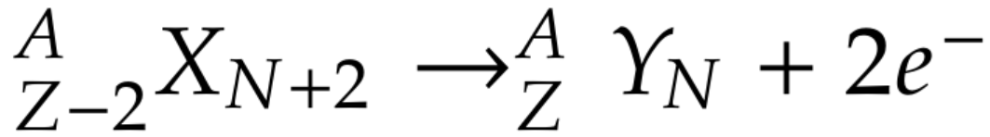
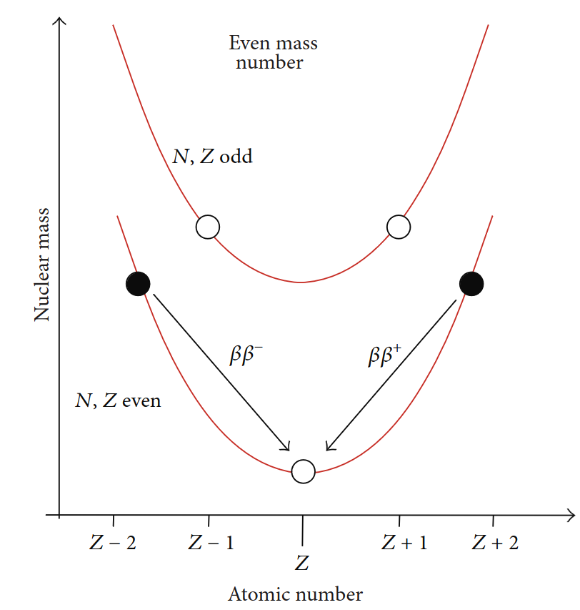
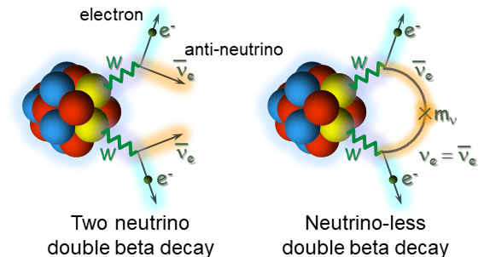
0νββ decay - role of Nuclear Physics
Candidates are even-even nuclei which, due to pairing force, are lighter than the odd-odd (A,Z-1) nucleus:
⁴⁸Ca, ⁷⁶Ge, ⁸²Se, ⁹⁶Zr, ¹⁰⁰Mo,
¹¹⁶Cd, ¹³⁰Te, ¹³⁶Xe, ¹⁵⁰Nd
1 of 11

Slide 4
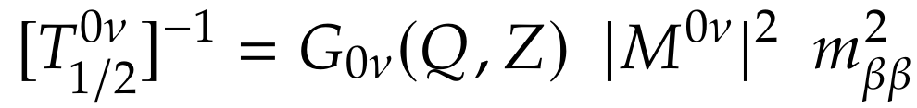
0νββ decay - role of Nuclear Physics
New Physics parameter
Phase space Factor
Nuclear Matrix Element (NME) brings the large uncertainties in DBD half-lifes

Slide 5
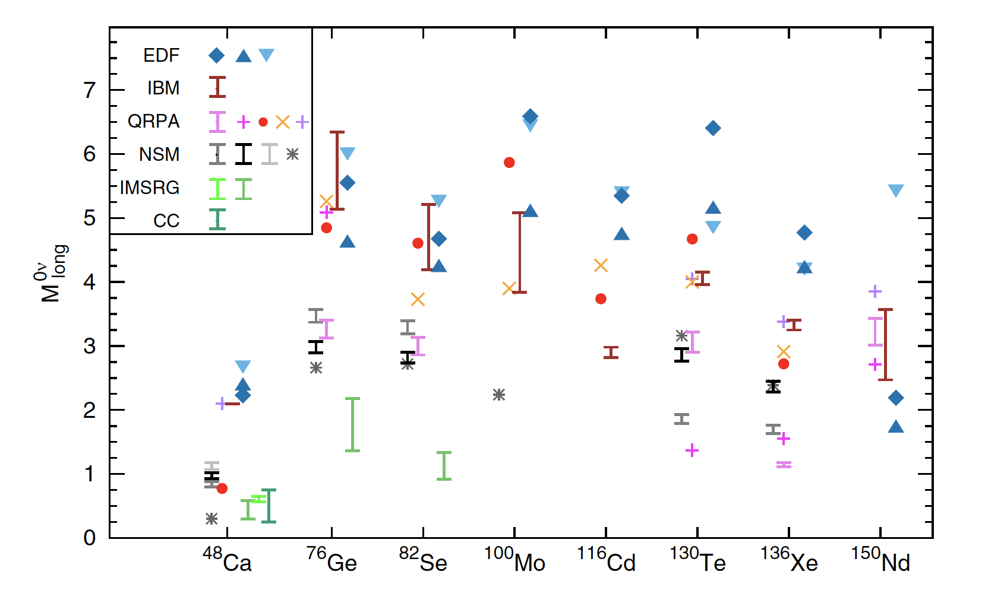
Theoretical NME
Theoretical Nuclear Matrix Elements (NME) disagree by more than a factor of 2. Maybe also quenching is needed.
In the case of ⁴⁸Ca the uncertainty in the M^{0v} → more than an order of magnitude in the T_{1/2}
Agostini, Benato, Detwiler, Menéndez and Vissani Rev. Mod. Phys 95 (2023).

Slide 6

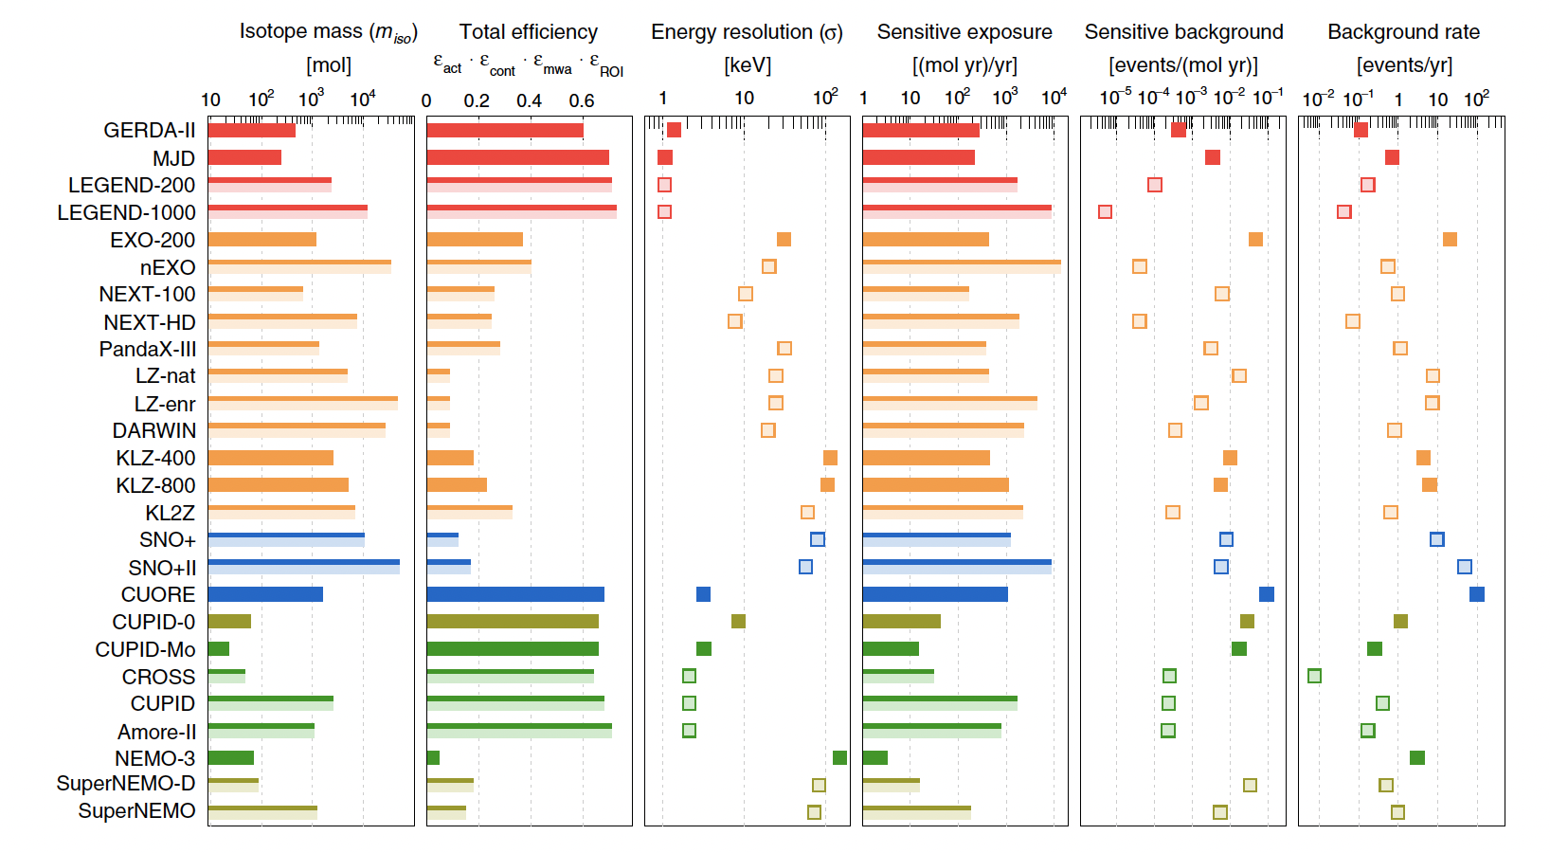
Direct experimental approaches
Agostini, Benato, Detwiler, Menéndez and Vissani Rev. Mod. Phys 95 (2023).

Slide 7
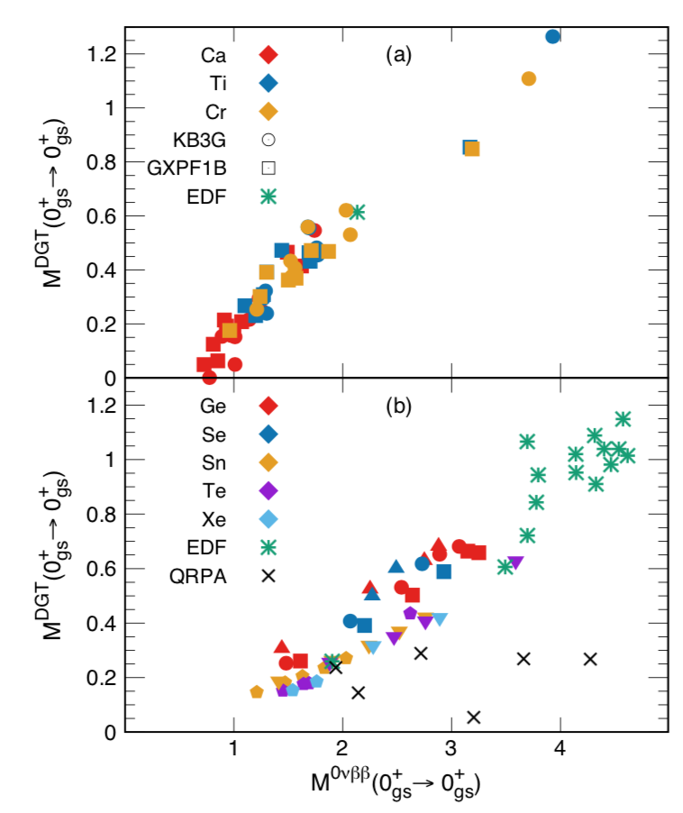

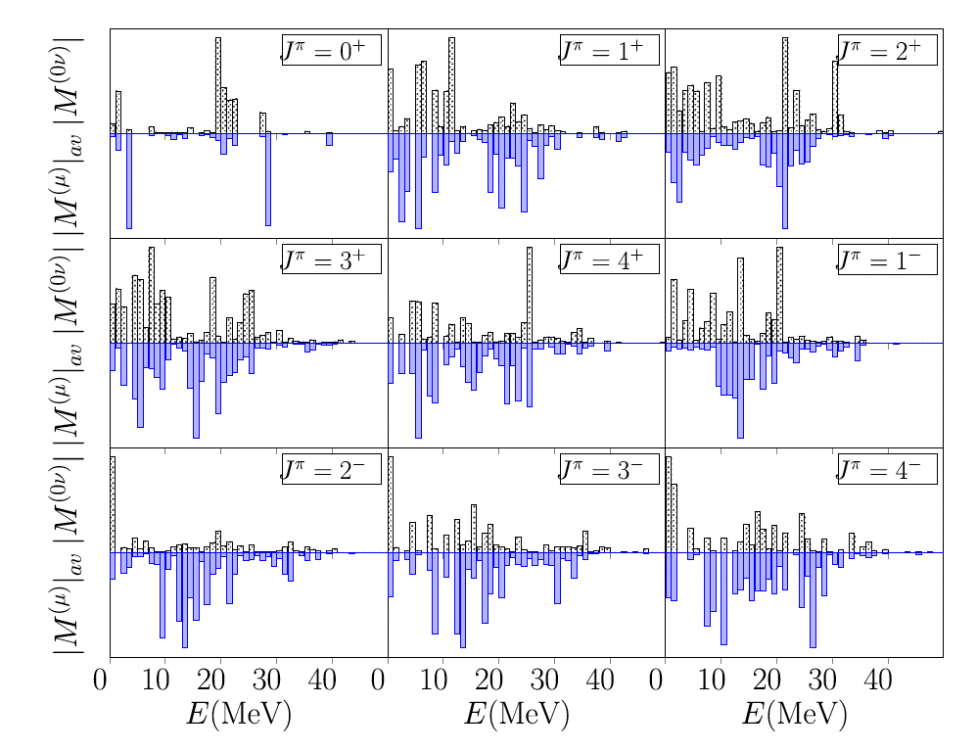
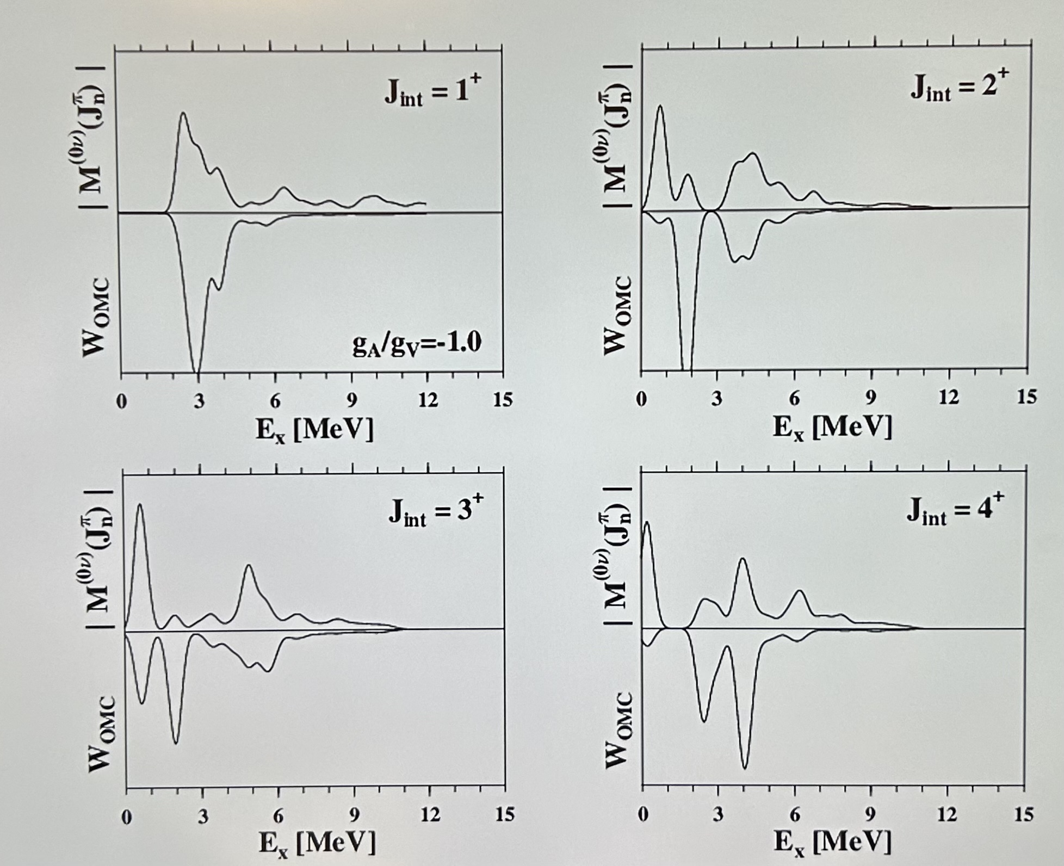
Indirect experimental approaches
Double Gamow Teller
Double Charge Exchange
Muon capture
F. Cappuzzello, et al. Eur. Phys. J. A (2015) 51: 145
M. Kortelainen and J. Suhonen J. P. G30 (2004) 2003; L. Jokiniemi and J. Suhonen PR C 102, 024303 (2020)
N. Shimizu J. Menendez, K. Yako PRL120, 142502 (2018)

Slide 8
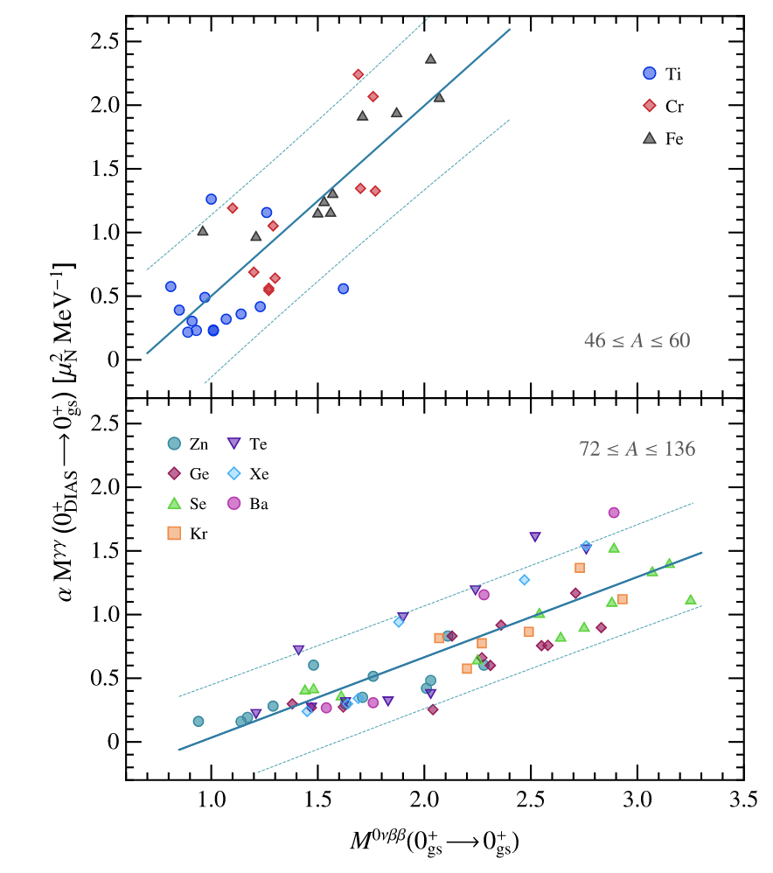
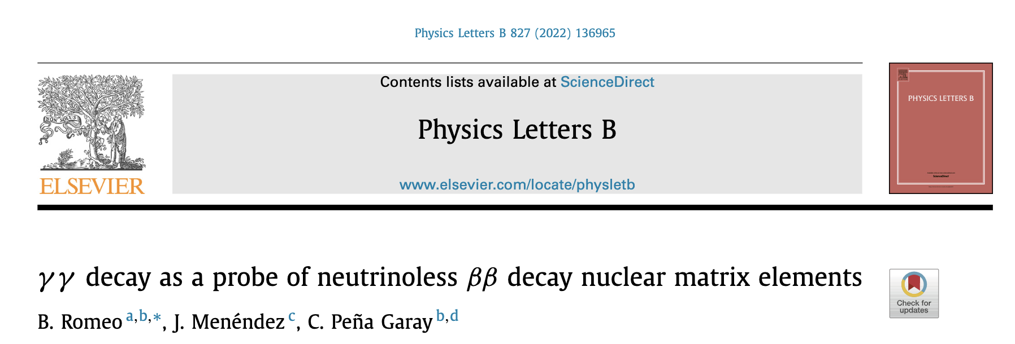
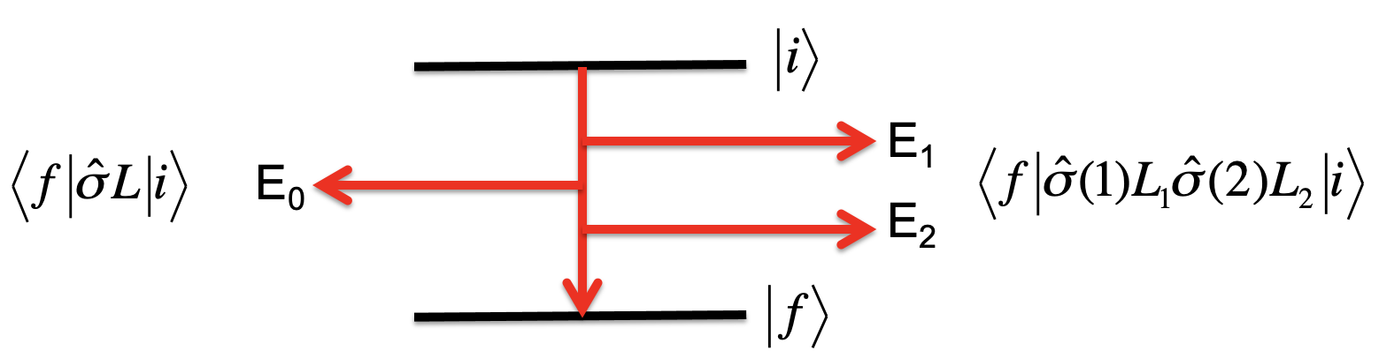
Indirect experimental approaches
go another way
Double gamma decay

Slide 9
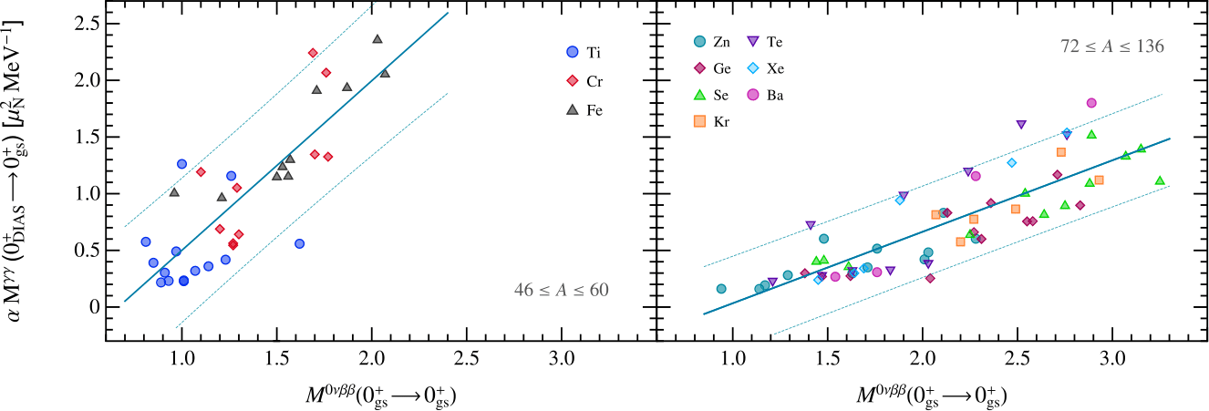
Correlation 2γ with 0νββ
Strong correlation between NMEs of 2ɣ-decays from DIAS to g.s. and 0νββ decays found.
The correlation holds if we consider M1M1 decays with equal-energy gammas.
[B. Romeo et al., Phys. Lett. B 827 (2022)]
Strong constraints on M^{0ν}

Slide 10
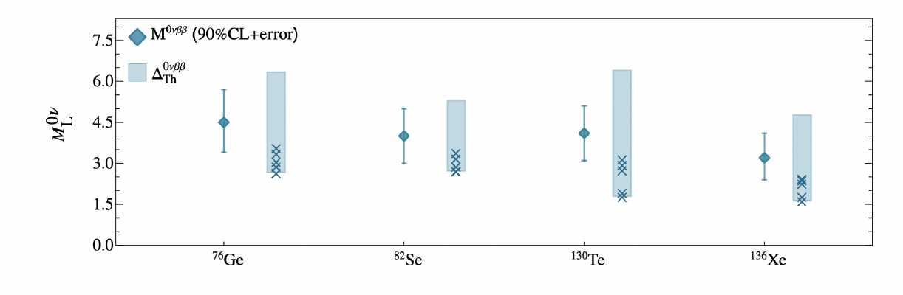
Correlation 2γ with 0νββ
Beatriz Romeo MEDEX conference proceedings (Prague June 2022).

Slide 11
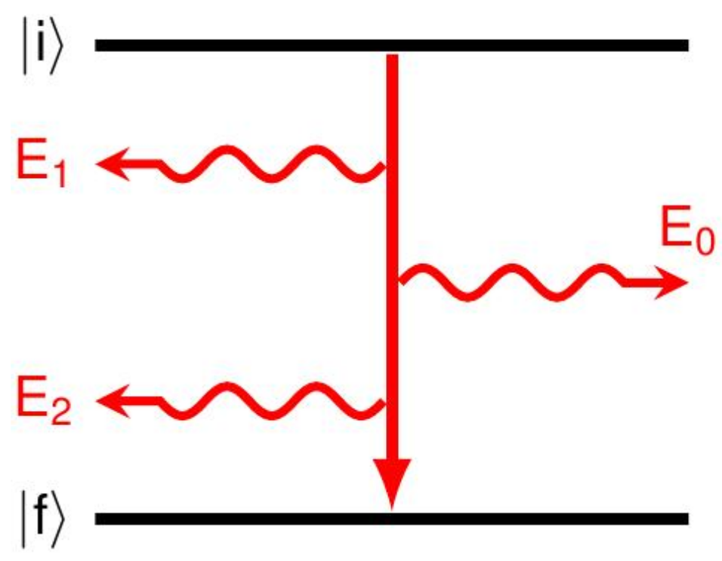
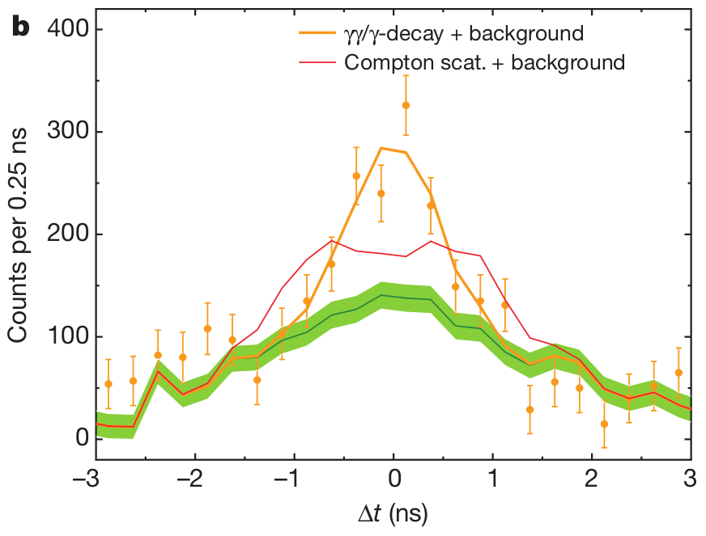
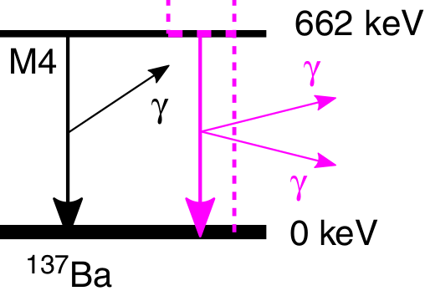
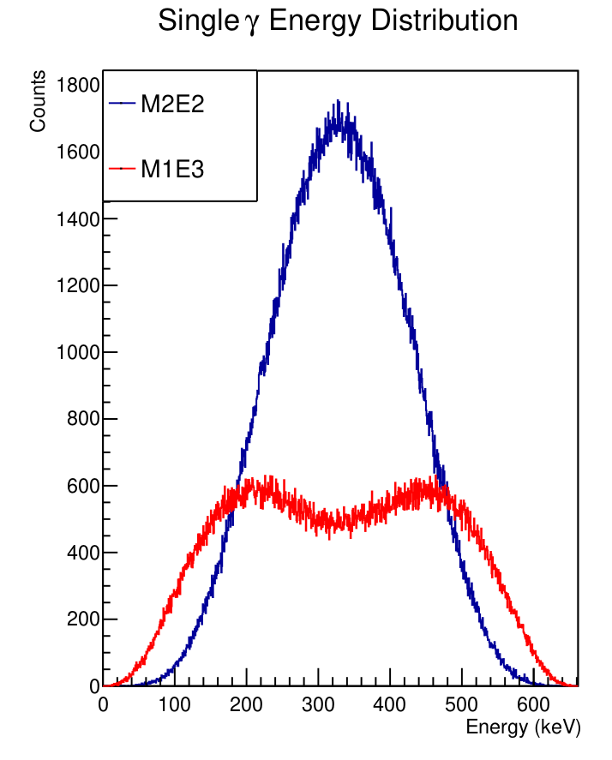
The double γ process
Second order EM
E₀ = E₁ + E₂
E₁, E₂ are continuous
In 2015, a Nature paper reported its observation in competition with single-gamma decay in ¹³⁷Ba: Γ_{ɣɣ}/Γ_{ɣ} ≈ 10⁻⁶
Using good time properties of scintillators
The two-photon decay process is a second order process in quantum electrodynamics (QED) → excited nuclear state emits two gamma-ray energy-quanta of continuous energy
Theoretically the γγ-decay process is treated as a second-order perturbation

Slide 12
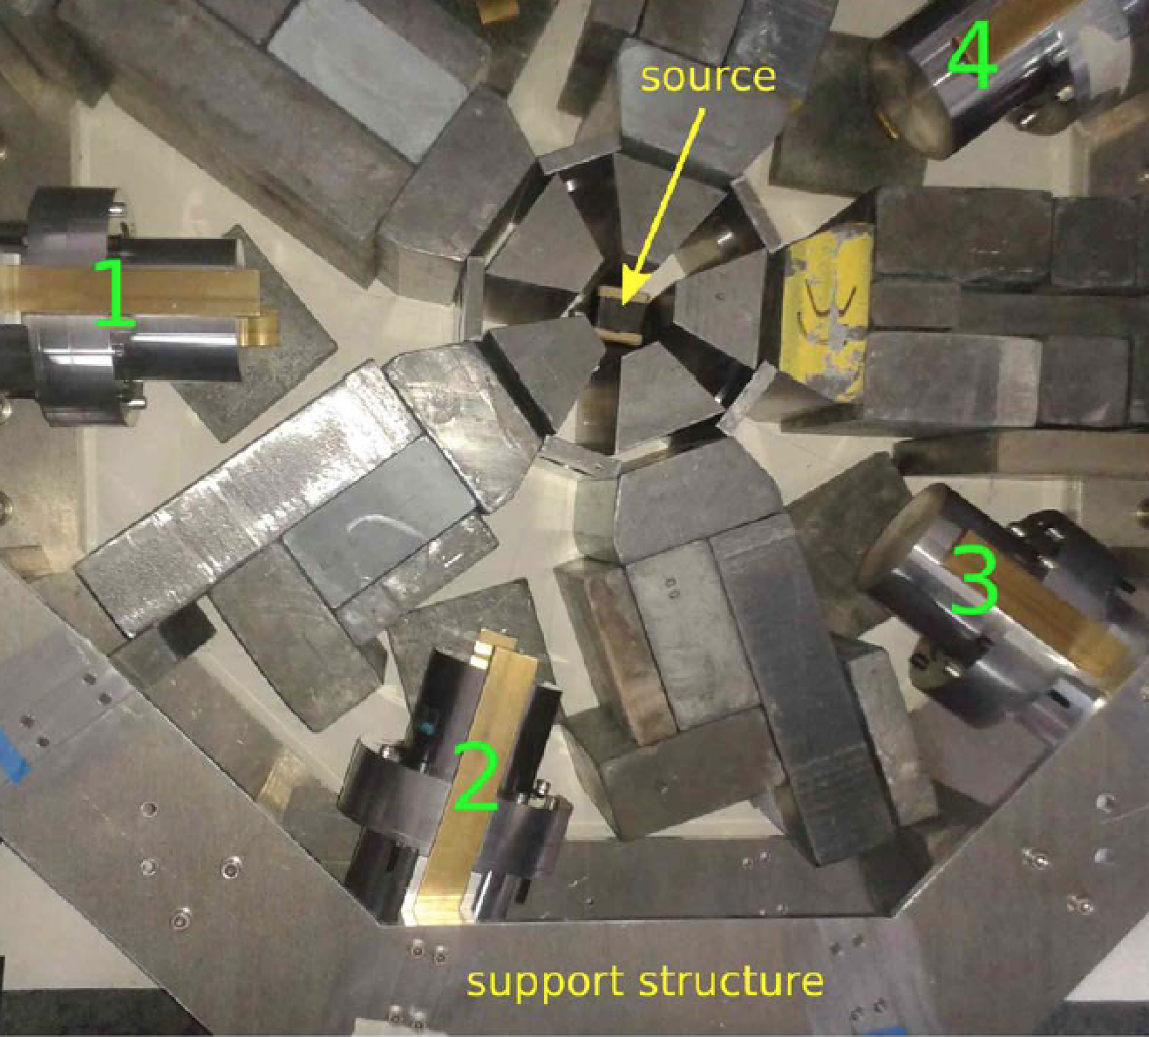
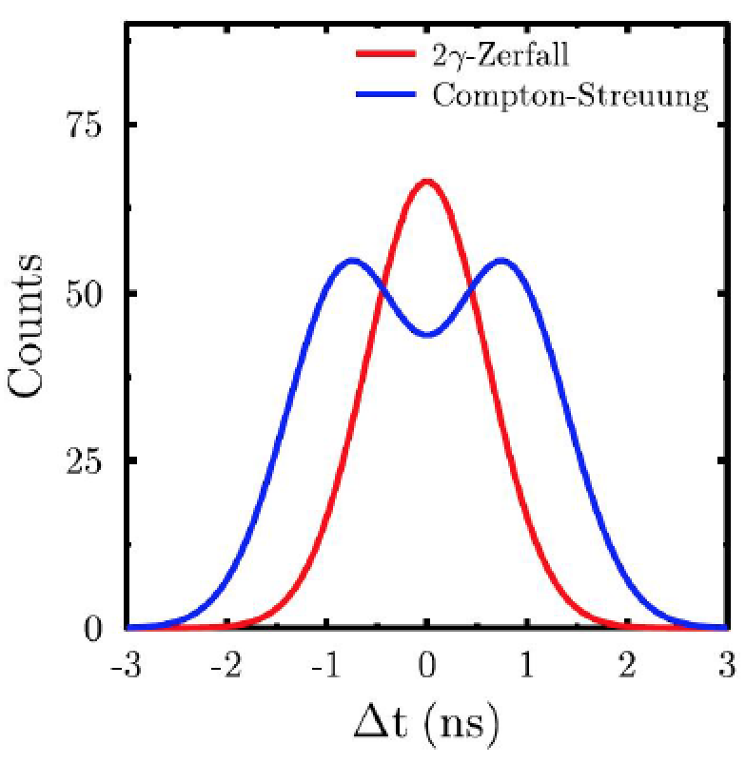
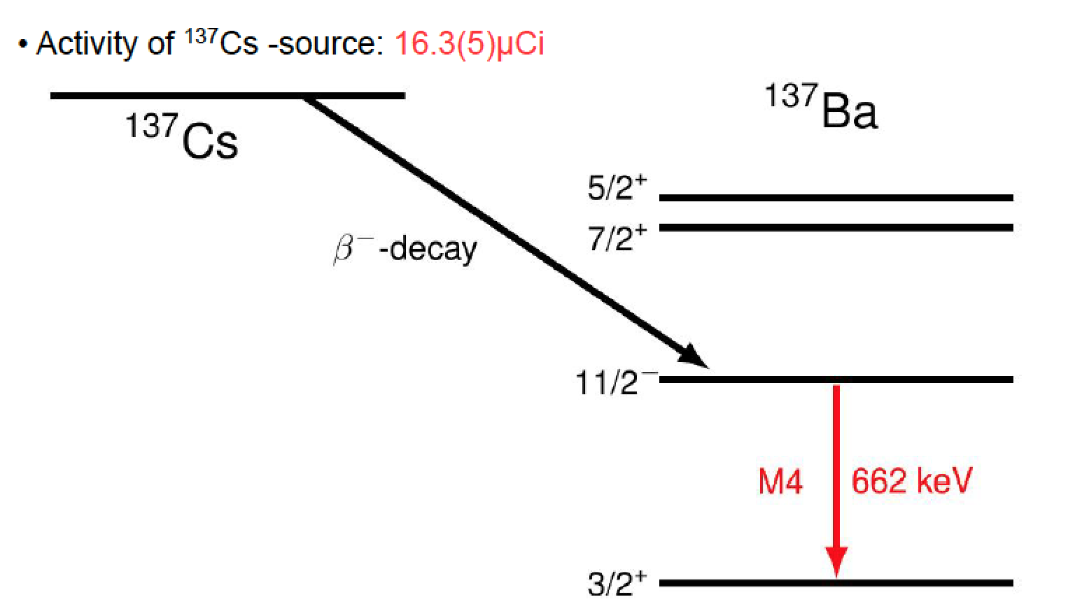
Overcoming experimental challenges
5 detector pairs 72°
5 detector pairs 144°
¹³⁷Cs
Use of fast LaBr₃:Ce scintillators
Courtesy of N. Pietralla

Slide 13
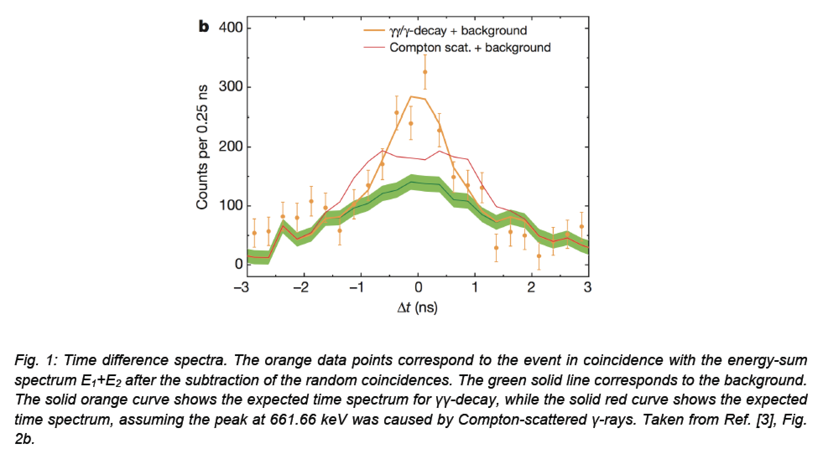
Timing reveals the competitive γγ/γ
The time spectrum originates from a real double gamma decay and not from Compton scattering
C. Waltz et al., Nature 526, 406 (2015)

Slide 14
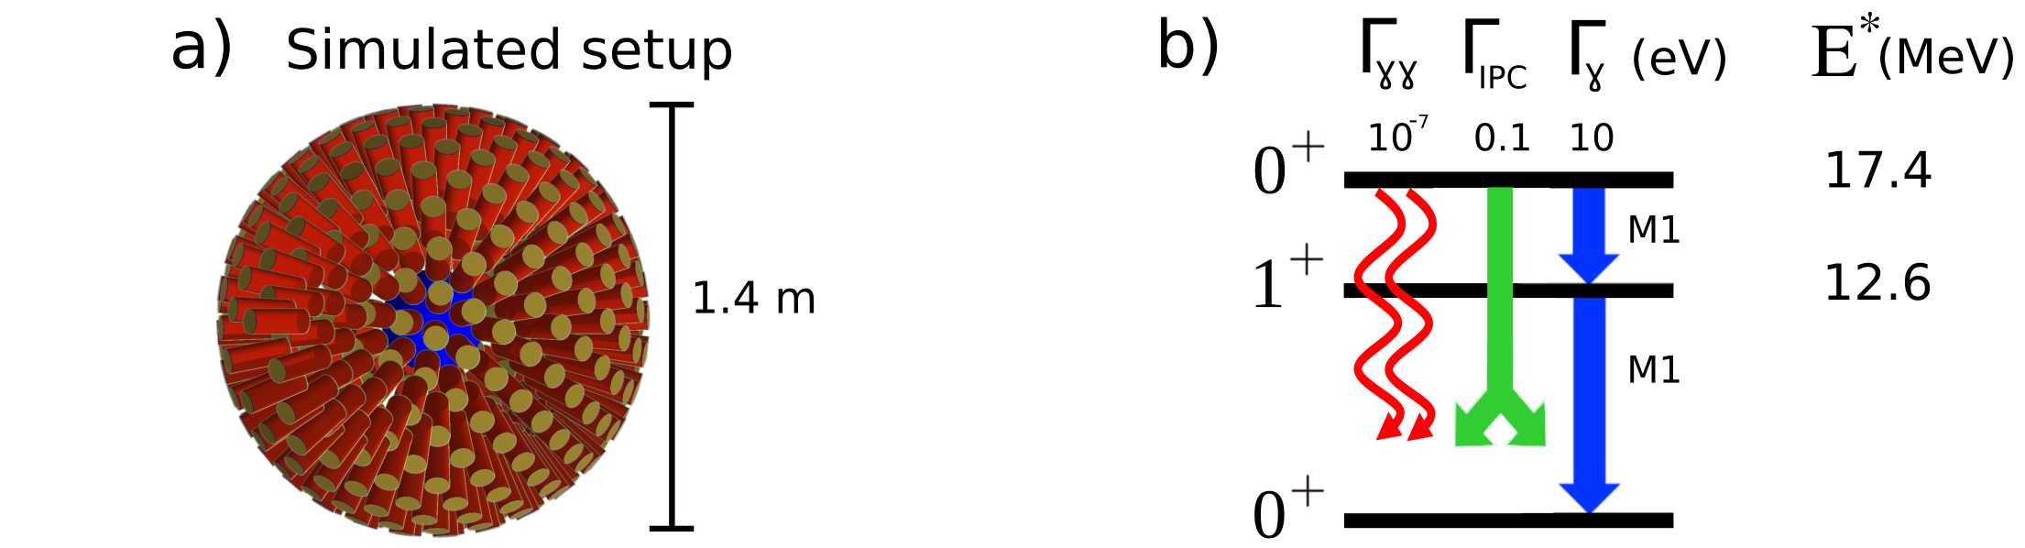
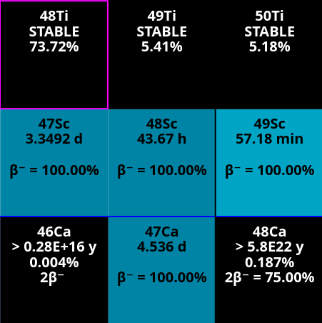
DIAS candidates: ⁴⁸Ti
Best candidate: ⁴⁸Ti → mimic 0νββ ⁴⁸Ca decay
2γ has the same initial and final states as in 2β0ν
The 17 MeV 0⁺ DIAS is known
Particle unbound, but particle decay is highly suppressed (isospin forbidden).
PROS
Difficult to populate (high energy 0⁺)
Extremely small double-gamma decay width:
            Γ_{ɣɣ} / Γ_{tot} ≈ 10⁻⁸
CONS
Need to know the width of the T=4 state in ⁴⁸Ti
How to populate efficiently the 0⁺ (T=4)?
How to be sensitive to the 2γ?
??

Slide 15
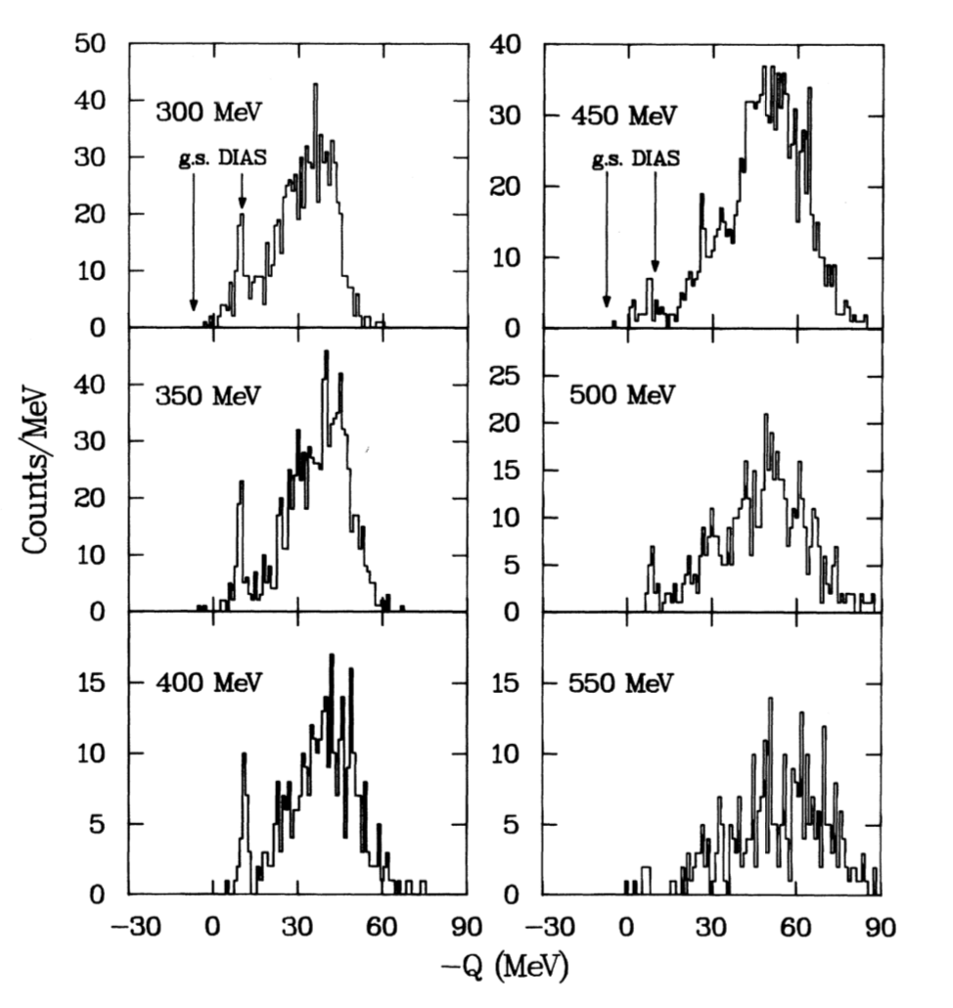
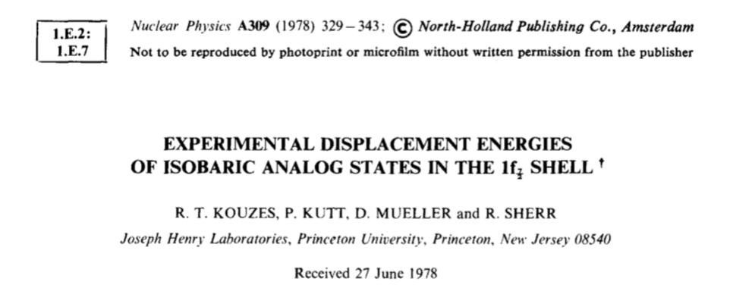
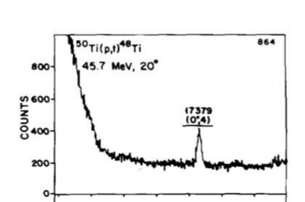
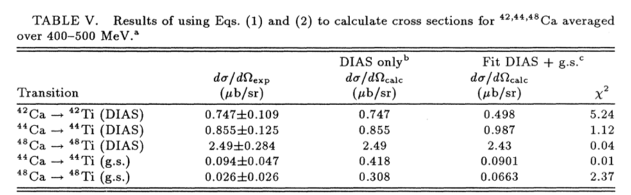
How to populate the DIAS - 2γ
⁵⁰Ti(p,t)⁴⁸Ti Q = -10.6 MeV
⁴⁶Ca(⁴He,2n)⁴⁸Ti Q = -8.36 MeV
⁴⁸Ca(³He,3n)⁴⁸Ti Q = -5.01 MeV
⁴⁸Ca(²⁰Ne,²⁰O)⁴⁸Ti Q = -6.50 MeV
…..
DCX ⁴⁸Ca(π+,π-)⁴⁸Ti
A.L. Williams PRC43 766 (1991)

Slide 16
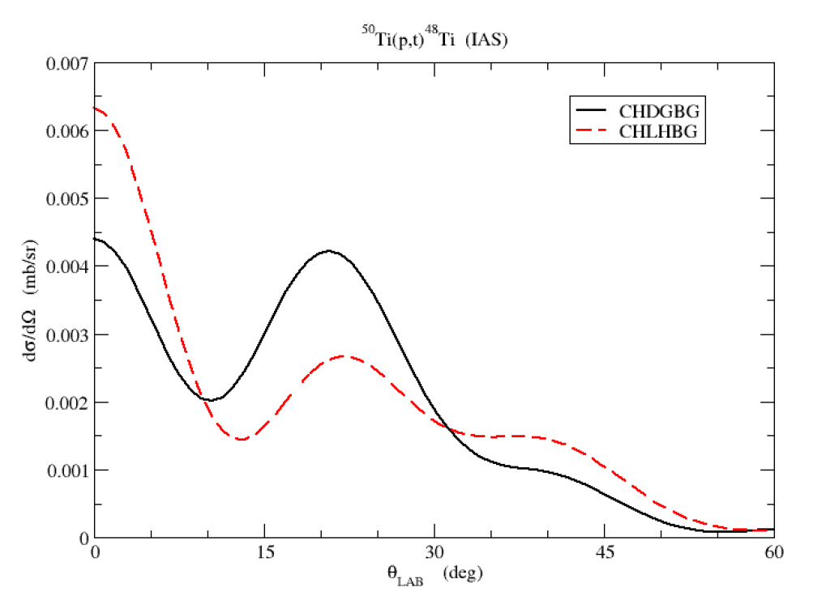
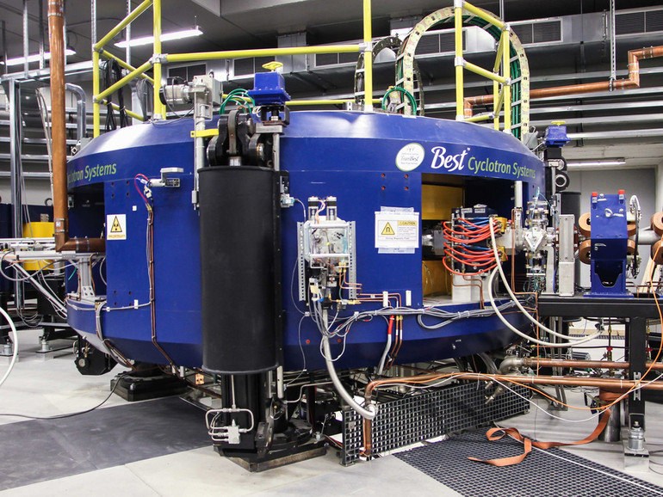
How to populate the DIAS - 2γ
Laboratori Nazionali di Legnaro (INFN)
SPES Cyclotron → 40-70 MeV - 200 μA of protons
~200 nb
⁵⁰Ti(p,t)⁴⁸Ti Q = -10.6 MeV

Slide 17
Experimental challenges
The competitive γγ/γ decay process is at least five-six orders of magnitude smaller than the single gamma decay.
Due to the nature of gamma radiation with matter, large probability to have a Compton effect that mimics the γγ/γ decay process E₀ = E₁ + E₂
Two gamma rays with E₀ deposit partial energies → ΣE_{i} = E₀
Gamma natural background
E₀

Slide 18
Experimental challenges
The competitive γγ/γ decay process is at least five orders of magnitude smaller than the single gamma decay.
Due to the nature of gamma radiation with matter, large probability to have a Compton effect that mimics the γγ/γ decay process E₀ = E₁ + E₂
Two gamma rays with E₀ deposit partial energies → ΣE_{i} = E₀
Gamma natural background

Slide 19
Experimental challenges
The competitive γγ/γ decay process is at least five orders of magnitude smaller than the single gamma decay.
Due to the nature of gamma radiation with matter, large probability to have a Compton effect that mimics the γγ/γ decay process E₀ = E₁ + E₂
Two gamma rays with E₀ deposit partial energies → ΣE_{i} = E₀
Gamma natural background
1 : 1 000 000
E₁ + E₂ = E₀

Slide 20
Experimental challenges
The competitive γγ/γ decay process is at least five orders of magnitude smaller than the single gamma decay.
Due to the nature of gamma radiation with matter, large probability to have a Compton effect that mimics the γγ/γ decay process E₀ = E₁ + E₂
Two gamma rays with E₀ deposit partial energies → ΣE_{i} = E₀
Gamma natural background
⁴⁰K,etc …
1 : 1 000 000
E₁ + E₂ = E₀

Slide 21
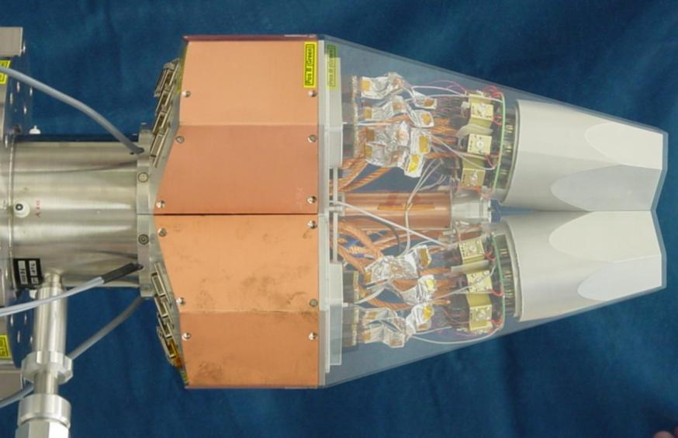
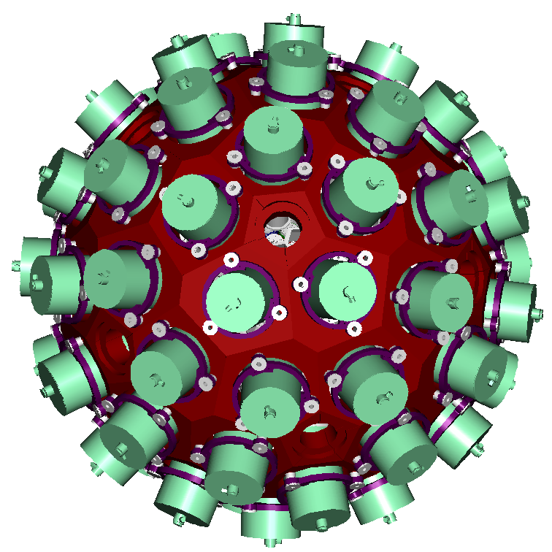
AGATA spectrometer
80 mm
90 mm
6x6 segmented cathode
Cold FET for all signals
180 hexagonal crystals
60 triple-clusters
Amount of germanium 362 kg
Solid angle coverage 82 %
36-fold segmentation 6480 segments
Singles rate >50 kHz
Efficiency: 43% (M_{γ}=1) 28% (M_{γ}=30)
Peak/Total: 58% (M_{γ}=1) 49% (M_{γ}=30)

Slide 22
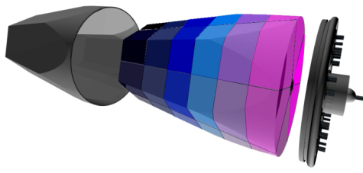
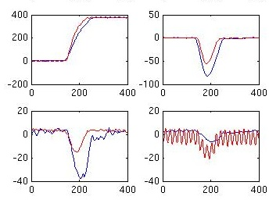
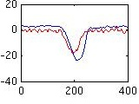
Flow chart for AGATA
Event building
of time-stamped hits and ancillaries
Highly segmented
HPGe detectors
•
•
•
Identified
interaction points
Reconstruction of
γ-rays from the hits
•
•
•
γ
•
•
(x,y,z,E,t)_{i}
Synchronized digital electronics to digitize (14 bit, 100 MS/s) and process the 37 signals generated by crystals
Pulse Shape Analysis
of the recorded waves
Analysis of gammas
and correlation with other detectors
HARDWARE
SOFTWARE

Slide 23
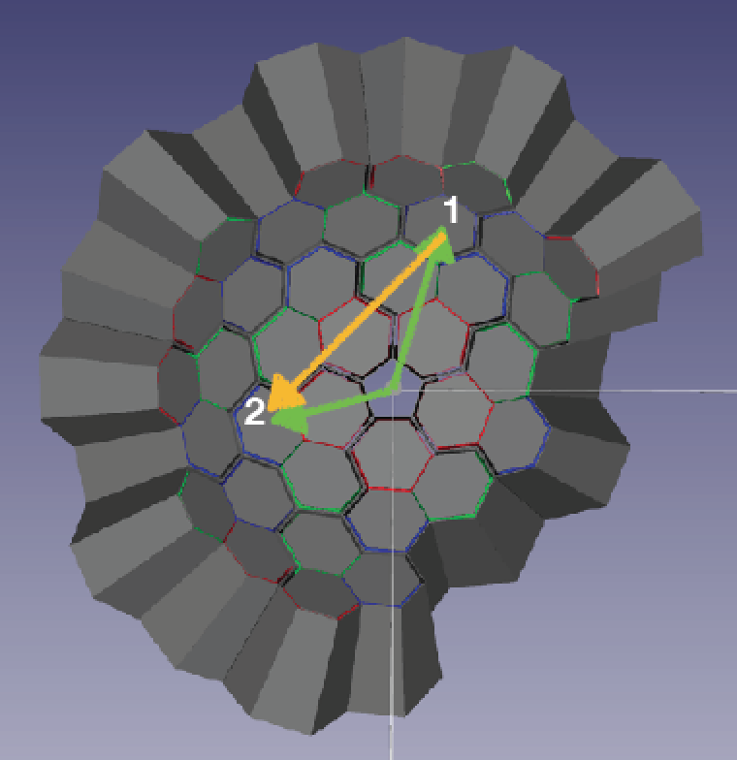
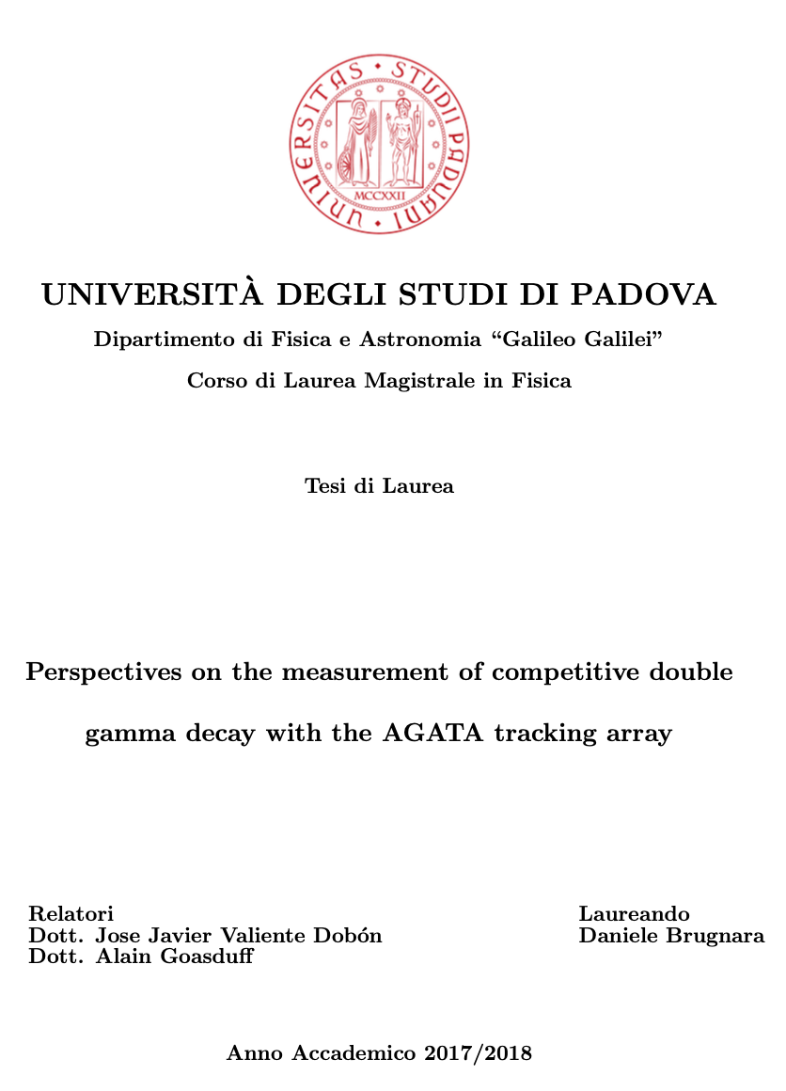
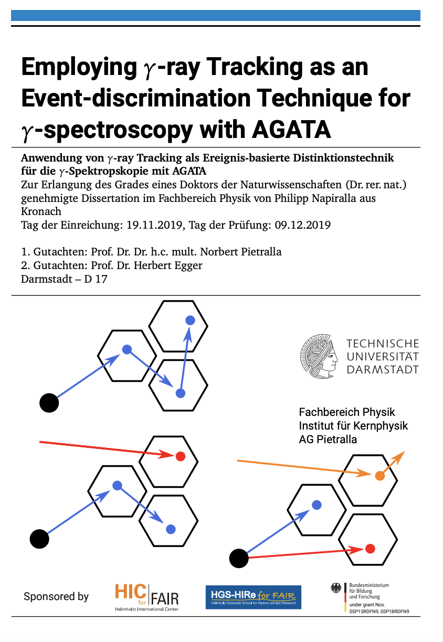
Double ɣ study with AGATA
Double gamma
Compton scattered

Slide 24
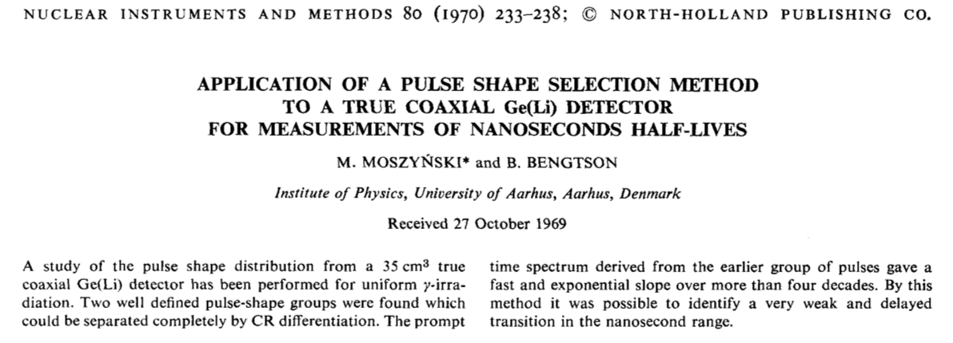
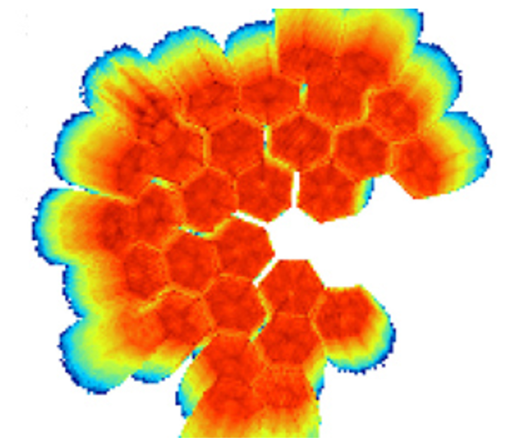
Why AGATA for the (“γγ/γ”) decay?
Possibility to improve the timing from highly segmented HPGe detectors by using PSA techniques or maybe NN techniques?
Position sensitivity and PSA to get spatially a difference between Compton scattered events and real double gamma events.
.
.
E₂
θ₁
E₁

Slide 25
AGATA distance vs. timing
One gamma → Fold=2
Clusterization space 8 degrees
Double gamma
Compton scattered
Clusterization space full AGATA

Slide 26
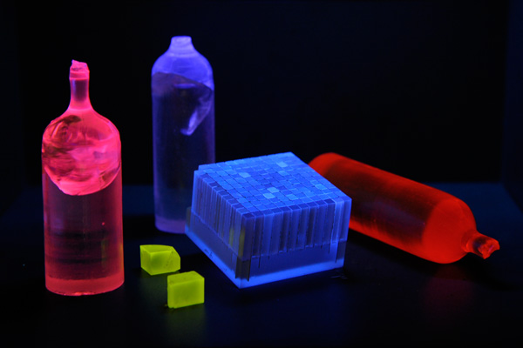
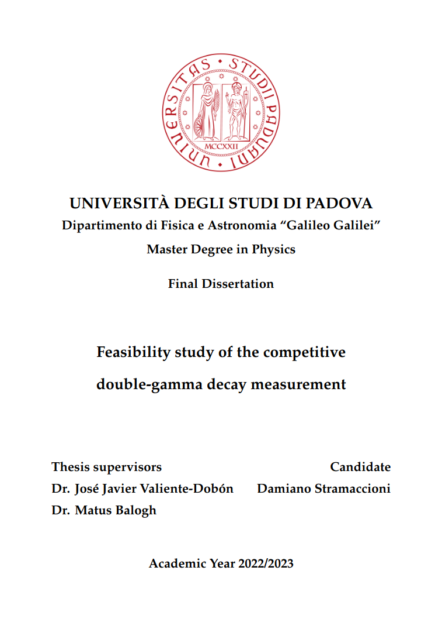
Double ɣ study with Scintillators

Slide 27
Fast scintillators simulations
Define setup & data processing
→ Maximise the 2ɣ detection efficiency
Analysis of simulation outputs
→ Isolate the M1M1 2ɣ decays,
identifying the competing processes
Step 1
Step 2
SETUP REQUIREMENTS:
Good efficiency
Small BR → little statistics expected
Good time resolution
Distinguish 2ɣ from competing processes
302 3.5”x8” cylindrical LaBr₃ in spherical configuration
ΔT = 880 ps
Detector face is 50 cm from target
Reaction chamber: radius 17cm, 2mm thick

Slide 28
Competing processes: IPC & ɣ-cascade
We could extract the BR simply measuring how many 2ɣ-decay events
are observed, but two main competing processes can mimic them:
Internal Pair Creation (IPC), i.e. simultaneous emission of an e⁻e⁺ pair carrying the full transition energy.
Γ_{ɣɣ}/Γ_{IPC} ≈ 10⁻⁶
Ɣ-cascade, i.e. 2ɣ cascade through an intermediate state. Theoretical calculations predict most of the intensity to go to the 12.6 MeV state.
Γ_{ɣɣ}/Γ_{ɣ} ≈ 10⁻⁸
⁴⁸Ti

Slide 29
Competing processes: IPC & ɣ-cascade
We could extract the BR simply measuring how many 2ɣ-decay events
are observed, but two main competing processes can mimic them:
Internal Pair Creation (IPC), i.e. simultaneous emission of an e⁻e⁺ pair carrying the full transition energy.
Γ_{ɣɣ}/Γ_{IPC} ≈ 10⁻⁶
Ɣ-cascade, i.e. 2ɣ cascade through an intermediate state. Theoretical calculations predict most of the intensity to go to the 12.6 MeV state.
Γ_{ɣɣ}/Γ_{ɣ} ≈ 10⁻⁸
How can we distinguish
them from 2ɣ decays?
⁴⁸Ti

Slide 30
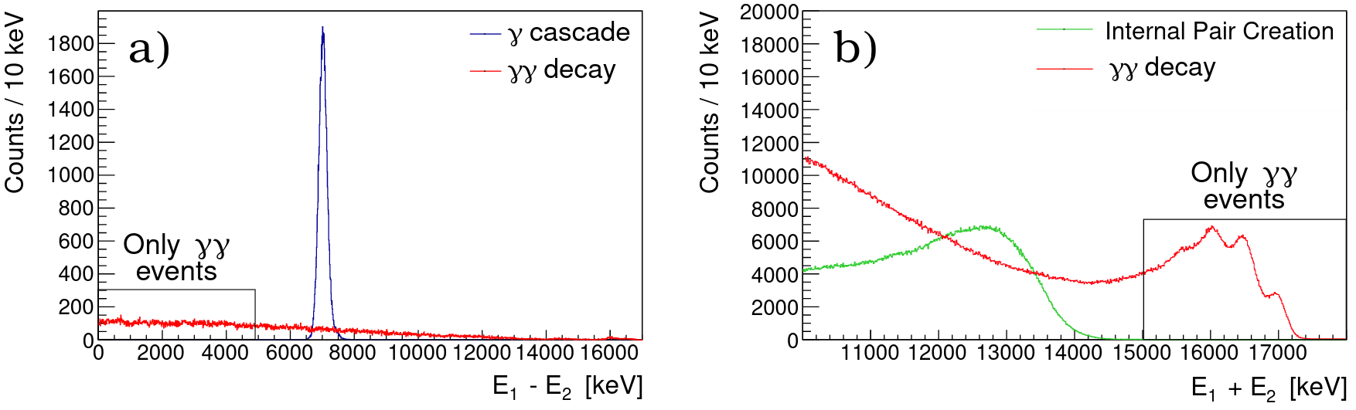
Competing processes: IPC
IPC: e⁺/e⁻ charged particles, we expect a total energy loss
ΔE ≈ 2 MeV in scattering chamber + detector capsule
For multiplicity 2 events the energy E₁+E₂ spectra they deposited in the array are quite different
e⁻
e⁺

Slide 31
Competing processes: IPC
IPC: e⁺/e⁻ charged particles, we expect a total energy loss
ΔE ≈ 2 MeV in scattering chamber + detector capsule
For multiplicity 2 events the energy E₁+E₂ spectra they deposited in the array are quite different
ΔE
e⁻
ΔE
ΔE
e⁺
ΔE
We can remove these events with an energy threshold E₁+E₂ > 15 MeV

Slide 32
The gammas emitted in cascade will have a definite energy. In most of the cases, their energies will be 5 MeV and 12 MeV.
Competing processes: ɣ-cascade
ɣ-cascade: gammas emitted in cascade will have a discrete energy. In most cases 4.8 MeV and 12.6 MeV.
For multiplicity 2 events and setting an energy gate E₁+E₂ > 16.9 MeV, the energy difference
E₁-E₂ spectra are quite different
Ɣ1
12
MeV
5
MeV
ɣ2
?

Slide 33
Competing processes: IPC & ɣ-cascade
ɣ-cascade: gammas emitted in cascade will have a discrete energy. In most cases 4.8 MeV and 12.6 MeV.
For multiplicity 2 events and setting an energy gate E₁+E₂ > 16.9 MeV, the energy difference
E₁-E₂ spectra are quite different
Ɣ1
12
MeV
5
MeV
ɣ2
?
We can remove these events setting
an energy limit E₁ - E₂ < 2 MeV
We are only interested in those!

Slide 34
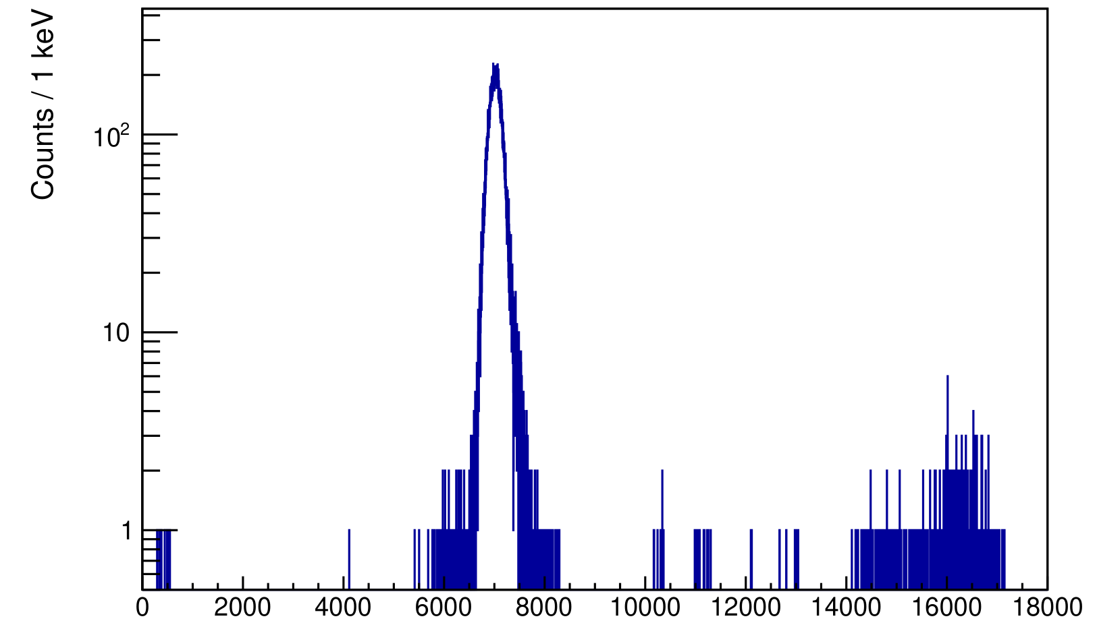
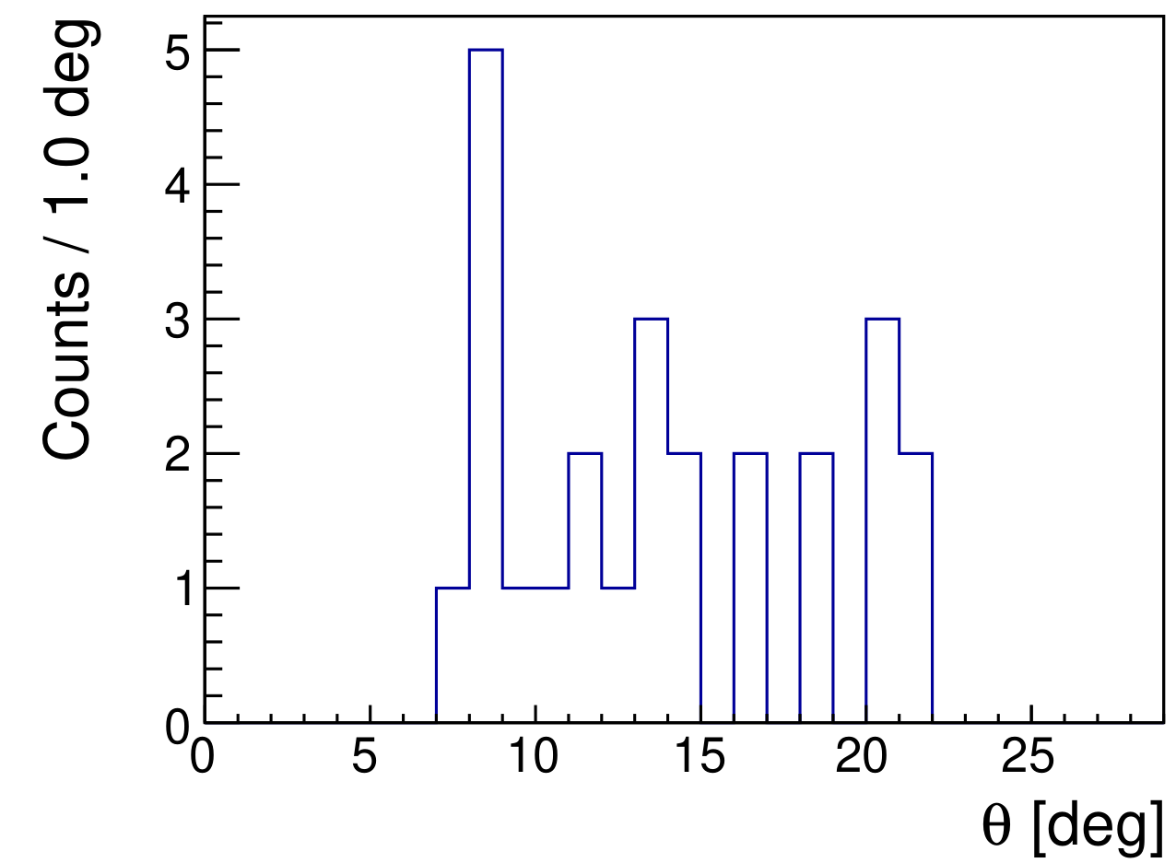
Competing processes: ɣ-cascade issues
Problem with ɣ-cascade: if 2ɣ correlation angle is low, the 12.6 MeV gamma can deposit 8.7 MeV in one detector, scatter on it and deposit the rest where the other gamma hit
Fake 2ɣ events!
.
Ɣ1
θ
ɣ2
?

Slide 35
Competing processes: ɣ-cascade issues
Problem with ɣ-cascade: if 2ɣ correlation angle is low, the 12.6 MeV gamma can deposit 8.7 MeV in one detector, scatter on it and deposit the rest where the other gamma hit
Fake 2ɣ events!
θ_{min}
.
Ɣ1
θ
ɣ2
?
We can remove these events setting
an angle limit θ > 25°

Slide 36
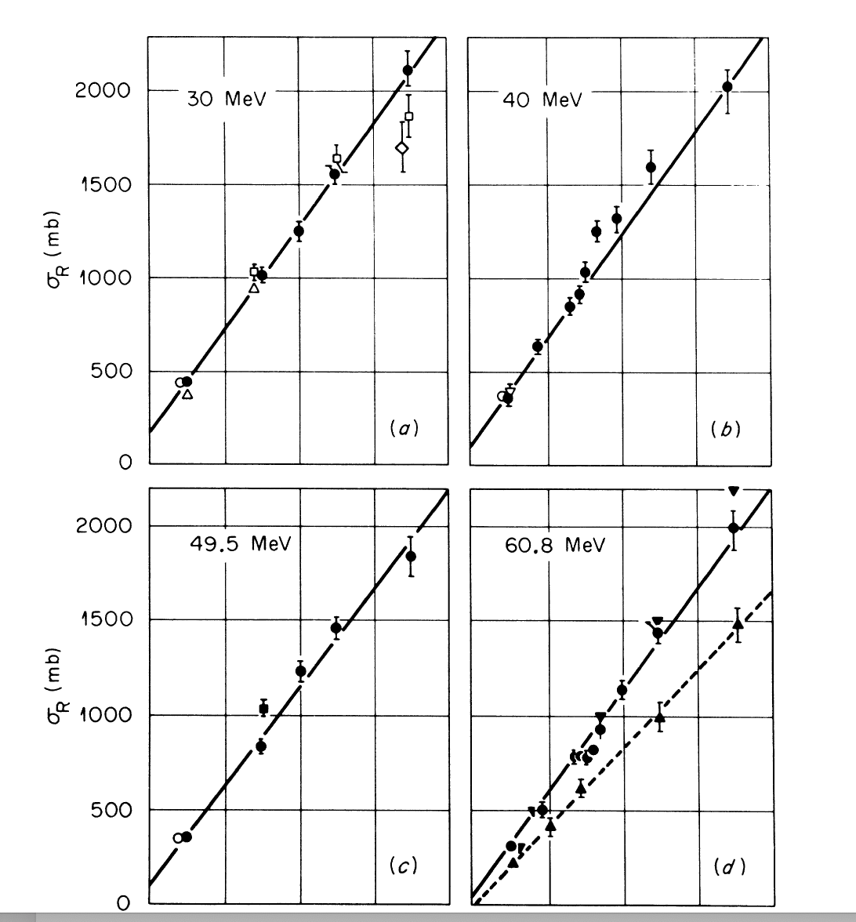
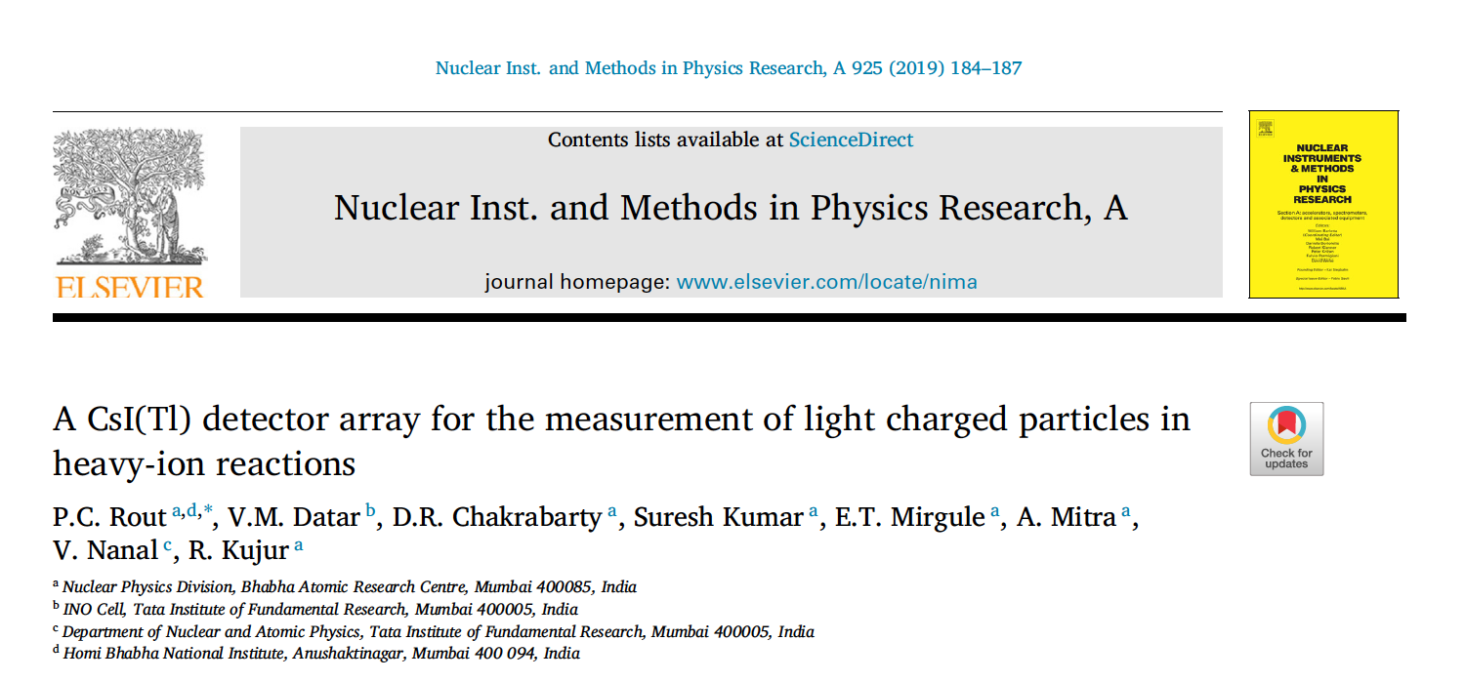
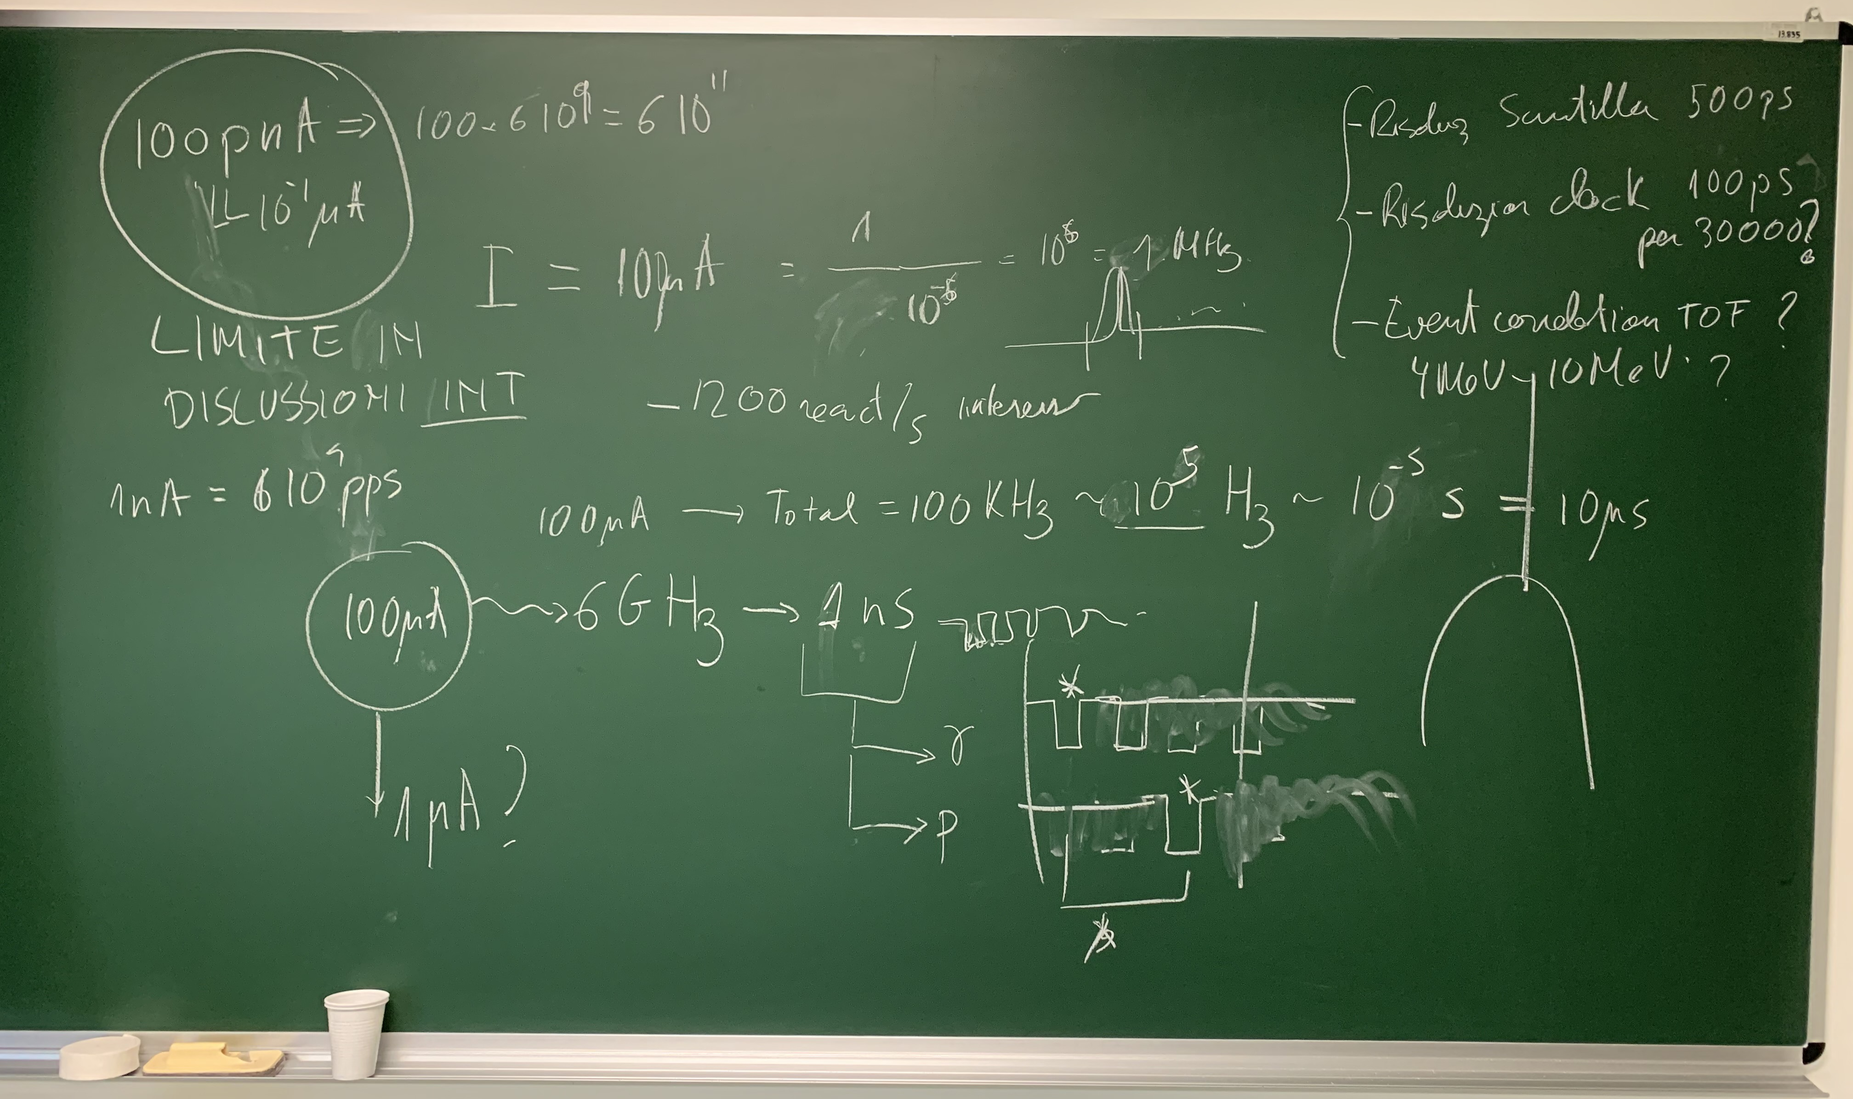
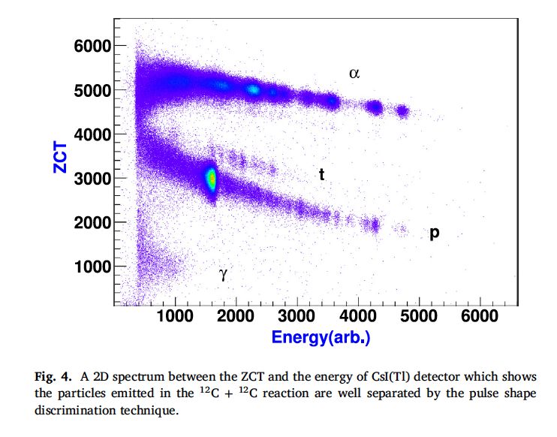
Large experimental challenges!
Laboratori Nazionali di Legnaro (INFN) SPES Cyclotron → 40-70 MeV – up to 200 μA of protons
Total XS = 900 mb
XS _{(DIAS/ALL)} ~ 10⁻⁷
CsI detectors for trition identification
Clock resolution 100 ps for more than 30000 channels!!

Slide 37
Summary
Double-gamma decay process can help on the NME of 0νββ?
  Experimental study of DIAS double gamma decay
  Theoretical description → correlation γγ and 0νββ
Observation of the competitive double gamma decay using LaBr:Ce
Semiconductor detectors like HPGe AGATA might not be the best candidates for the search due to limits in PSA at the 10⁻⁶ level.
Scintillators (high efficient) might be the best experimental setup – Initial preparatory studies ongoing. Genesis.
Perform the preparatory experiments: determine experimentally the cross sections to populate the DIAS and the relative Brs of interest

Slide 38
END

Slide 39
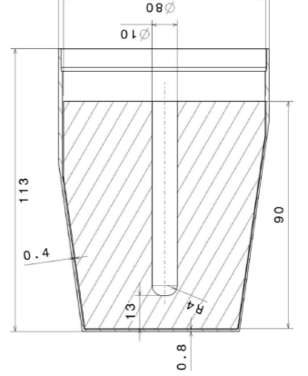




AGATA detectors
80 mm
90 mm
6x6 segmented cathode
Volume ~370 cc Weight ~2 kg
(shapes are volume-equalized to 1%)
Cold FET for all signals
Energy resolution
Core: 2.35 keV
Segments: 2.10 keV
(FWHM @ 1332 keV)
A. Wiens et al. NIM A 618 (2010) 223
D. Lersch et al. NIM A 640(2011) 133
AGATA capsules
Manufactured by Canberra France
AGATA Asymmetric Triple Cryostat
Manufactured by CTT

Slide 40


Any chance with HPGe detectors?
Search of (“γγ/γ”) decay with Compton suppresed γ-ray arrays
W. Beuschet al., Helv. Phys. Acta33, 363 (1960)
J. Krampet al., NPA 474, 412 (1987)
V.K. Basenkoet al., Bull. Russ. Acad. 56, 94 (1992)
C.J. Lister et al., Bull. Am. Phys. Soc. 58(13), DNP.CE.3 (2013)
AGATA was built to be used in RIB facilities, which needs are beyond the capability of the best Compton-suppressed Detector Arrays:
Low intensity for the nuclei of interest
High background levels
Large Doppler broadening
High counting rates
High γ-ray multiplicities

Slide 41

AGATA simulations
Distance between interactions: Tracking only fold 2 events
Traveling outside the Ge shell
Double gamma
Compton scattered
Tracking parameter d(γ1,γ2) ≤ 2.5cm → can not be a single event
Probability of being a single event is ~ 5%

Slide 42
Program to study γγ-2β0ν
Double-gamma decay process can help on the NME of ββ0ν?
  Theoretical description → correlation γγ and ββ0ν
  Experimental study of IAS double gamma decay
Experimental systematic study of some some of the most promising ββ0ν cases: ¹³⁶Xe, ¹³⁰Te, ⁸²Se, ⁷⁶Ge, ⁴⁸Ca
  IAS state
  Branching ratios
  Gamma/Double gamma decay
  Eventually M1M1 measurement
  Reactions to be used and cross sections.
  → Consider worth to present a ERC

Slide 43
Program to study γγ/γ with AGATA
The plan is to first re-measure the energy and angular distributions from the Nature publication with a higher precision and as a proof of concept
¹³⁷Cs with a ~ 300 kBq activity 3-4 KHz singles (data ~ 1Tb hour)
one-month source run, this would give us approximately 1.2 10¹¹ full energy 662-keV events
expected to have 10⁵ double-gamma counts in the data set, can go down to 10⁴ (N.B. 10³ events were used over two months in order to measure the γγ/γ-decay branching ratio with an energy resolution of roughly 3%)
Possibility to measure linear gamma-polarization (B. Alikhani et al., NIM A 675, 144 (2012) & P.G. Bizzeti et al., Eur. Phys. J. A. 51 (2015))
Go for ⁶⁰Co )expected branching 10⁻⁸ → QPM predicts the dominance of E1-E1 over M1-M1 γγ/γ decay of the 2⁺ state at 1332 keV of ⁶⁰Ni
Letter sent to ASC, ACC, project manager of AGATA, AGATA@GANIL (4/7/2017).

Slide 44



Energy and angular distributions
Good agreement microscopic quasiparticle–phonon calculations (second-order perturbation ) under the assumption that only α_{E2M2} α_{M1E3} contribute
5/2⁺
7/2⁺
M2
E3
C. Waltz et al., Nature 526, 406 (2015)
11/2⁻
E2
M1
M4
3/2⁺
¹³⁷Ba
Differential branching ratio

Slide 45
Summary
Observation of the competitive double gamma decay using LaBr:Ce
Measurement of the energy sharing, angular distributions between the two emitted gamma rays and branching ratio 2.1 (3) 10⁻⁶ for ¹³⁷Ba
Double-gamma decay process can help on the NME of 0νββ?
  Experimental study of IAS double gamma decay
  Theoretical description → correlation γγ and 0νββ
Electric polarizability α_{D} related to equation of state – nuclear simmetry energy? Possible theoretical link?
For the future: proof of principle with AGATA with a ¹³⁷Cs source → later study ⁶⁰Co, other sources
Detail study of timing algorithms
Detail study of the tracking algorithms: forward tracking as well as new approaches as Bayesian tracking.

Slide 46
END

Slide 47



Gamma decay from DIAS
Total width Γ = 40(15) eV. Although the state is mainly unbound to isospin-forbidden proton and α emission, it also de-excites to the ground state via γ transitions, with Γγ ≈ 2 eV
2γ ?
S. Triambak, PhD thesis Notre Dame (2017)
The isospin selection rules follow as a direct consequence ∆T = 0, ±1 for allowed γ transitions → otherwise isotensor components besides the isoscalar-isovector components.
³¹P target with an ≈ 6 μA, 3.285 MeV proton beam

Slide 48


Double gamma and 2β0ν
Genesis
Initial discussions at LNL between (Javier&Javier)
Presentation INT (USA) March 2018
Presentation SFB (Germany) 2018
Proposal presented to the LNS PAC → rejected
Proposal presented to be presented iThemba
arXiv:2102.11101v1 [nucl-th] 22 Feb 2021

Slide 49

DCX reactions and 2β0ν
Feasibility
DCE mediated by strong interaction, ββ0ν by weak interaction
DCE includes sequential multinucleon transfer mechanism
BUT
Same initial and final wave functions
Similar operator …
⁴⁰Ca(¹⁸O,¹⁸Ne)⁴⁰Ar @ 270 MeV
The idea of NUMEN is to go to more relevant cases such as: ⁷⁶Ge, ¹¹⁶Cd, ¹³⁰Te, ¹³⁶Xe
There are experimental challenges:
Large beam intensities
β⁻β⁻ requires a radioactive beam (¹⁸Ne,¹⁸O)
Some cases, not enough energy resolution → γ detectors
Measured: dσ(DCE)/dΩ= 11μb/sr
Competing processes are at the 1% level
F. Cappuzzello, et al. Eur. Phys. J. A (2015) 51: 145

Slide 50
DGT and 2β0ν
Presentation on 7th March (2017) INT: Double Gamow-Teller transitions
and its relation to neutrinoless 2β decay (N. Shimizu, J. Menendez, and K. Yako) → PRL (Accepted 2nd March 2018).
Original interaction
arXiv:1709.01088 [nucl-th]
Exp. Challenge: 0⁺ → 0⁺ 0.03 per mil of total DGT
⁴⁸Ca → NME, dominated by M0ν , is well correlated with the average energy of the DGT GR (so far never measured experimentally)
Linear correlation DGT transition to the final g.s. and the 0νββ decay NME. The correlation origins in the dominant short-range character of both transitions.

Slide 51


Energy and geometry of γ vs. γγ
Due to the dynamics of the Compton-scattering, a single photon (blue arrows) depositing the energy E1 can
only interact outside of the cone. If the next
measured interactions are inside the cone, it is
very likely that they stem from an additional
photon (green arrows). The opening angle of the
cone strongly varies with the amount of interac-
tions in the cluster of E1 , the incident photon
energy E0 and the allowed interval width .
Energy dependency
1 gamma
2 gamma

Slide 52
Why AGATA for the (“γγ/γ”) decay?
Possibility to improve the timing from highly segmented HPGe detectors by using PSA techniques or maybe NN techniques?
Position sensitivity and PSA to get spatially a difference between Compton scattered events and real double gamma events.
.
.
E₂
θ₁
E₁

Slide 53
Why AGATA for the (“γγ/γ”) decay?
Possibility to improve the timing from highly segmented HPGe detectors by using PSA techniques or maybe NN techniques?
Position sensitivity and PSA to get spatially a difference between Compton scattered events and real double gamma events.
.
.
E₂
θ₁
E₁

Slide 54

Idea of γ-ray tracking
Compton Suppressed
ε_{ph} ~ 10%
N_{det} ~ 100
50% of solid angle taken by the AC shields
large opening angle ➔
poor energy resolution at high recoil velocity
Ω ~ 40%
θ ~ 8º
Ge Sphere
ε_{ph} ~ 50%
N_{det} ~ 1000
Ω ~ 80%
θ ~ 3º
too many detectors needed to avoid summing effects
opening angle still too big for very high recoil velocity
Tracking Array
Ω ~ 80%
θ ~ 1º
Smarter use of Ge detectors
segmented detectors
digital electronics
time stamping of events
analysis of pulse shapes
tracking of γ-rays
ε_{ph} ~ 50%
N_{det} ~ 100
Pulse Shape Analysis θ_{eff} ~ 1º
Gamma-ray Tracking N_{eff} ~ 10000

Slide 55





Examples of signals for 2 events
Eγ = 1172 keV net-charge in A1
x10
1 A 6 1 B 6 1 C 6 1 D 6 1 E 6 1 F 6 CC
Eγ = 1332 keV net-charge in C4, E1, E3
x10
Tomography of interactions in the crystal: non uniformities due to PSA

Slide 56



Timing with HPGe detectors
HPGe timing resolution 8 - 10ns → electric noise + signal changes shape depending on the gamma-ray interaction positions.
Constant Fraction Discriminator (CFD) → perfectly rising time front

Slide 57


NN algorithms for timing?
P.A. Söderström et al. an example for n/gamma discrimination
A feed-forward neural network was created based on the ROOT TMultiLayerPerceptron class. Designed with 75 input nodes (first 75 sampling points) - two hidden layers of 20 and 5 nodes → output one node 0 gamma ray and 1 neutron.

Slide 58

AGATA simulations
To make some considerations we will consider the configuration at GANIL 2018
(by Alain Goasduff)
12 Agata Triple Cluster placed at backward angles
AGATA at the nominal position, i.e. 23.5 cm from the target
No anti-Compton shield between the HPGe.

Slide 59


AGATA simulations
One unique gamma of 662 keV
Threshold in the photo electric events
Tracking

Slide 60

“Multiplicity” for 1 gamma 662 keV
Rejected by the tracking

Slide 61
AGATA
N.B. non measured + rejected by tracking
Full systematic optimization of the tracking parameters → one unique gamma
Study of of tracking parameters with two gamma events
Realistic event generators (energy sharing & angular distribution)

Slide 62
Energy and geometry of γ vs. γγ
Due to the dynamics of the Compton-scattering, a single photon (blue arrows) depositing the energy E1 can
only interact outside of the cone. If the next
measured interactions are inside the cone, it is
very likely that they stem from an additional
photon (green arrows). The opening angle of the
cone strongly varies with the amount of interac-
tions in the cluster of E1 , the incident photon
energy E0 and the allowed interval width .
Energy dependency
1 gamma
2 gamma

Slide 63



Bayesian algorithms for tracking
Conditioned probability
Tracking is a key ingredient in the search of γγ/γ → new tracking concepts Bayesian

Slide 64
Requirements of a γ-tracking array
efficiency, energy resolution, dynamic range, angular resolution, timing, counting rate, modularity, angular coverage, inner space
Quantity | Target Value | Specified for
Photo-peak efficiency (e_{ph}) | 40 % 20 % 10 % | E_{γ} = 1 MeV, M_{γ} = 1, β < 0.5 E_{γ} = 1 MeV, M_{γ} =30, β < 0.5 E_{γ} =10 MeV, M_{γ} = 1
Peak-to-total ratio (P/T) | 60 - 70 % 40 - 50 % | E_{γ} = 1 MeV, M_{γ} = 1 E_{γ} = 1 MeV, M_{γ} = 30
Angular resolution (Δθ_{γ}) | better than 1° | for ΔE/E < 1% at large β
Maximum event rates | 50 kHz | Per crystal
Inner diameter | 23,5 cm | for ancillary detectors
simulations

Slide 65


M1 operator vs. GT
The magnetic dipole operator (M1) and the Gamow-Teller (GT) operator are similar in that they have the same major componnts of the isovector (IV) spin στ term, although transitions originate from the electromagnetic and weak interactions. GT is a pure IV spin type while the M1 operator contains not only the IV spin term but also the isoscalar (IS) spin σ and orbital l terms and the IV orbital lτ term.

Slide 66


NME: occupation numbers
Two nucleon transfer reactions
Double beta decay with 2ν
Study of the initial and final wave functions for nuclei of interest in the 2β0ν (¹³⁶Ba-¹³⁶Xe: PRC 94, 054314 (2016)).
  using transfer reactions ex. (³He,⁴He) and (p,d) one deduces the spectrosopic factors
Talk 29/03/2018 by B. Kay

Slide 67

NME: transfer reactions BGT
Talk on 27/3/2018 by Dieter Frekers

Slide 68
Competitive double gamma decay
The two-photon decay process is a second order process in quantum electrodynamics (QED) → excited nuclear state emits two gamma-ray energy-quanta of continuous energy
Theoretically the γγ-decay process is treated as a second-order perturbation
First time observed competitive double-gamma (“γγ/γ”) decay (Walz et al., nature 526, 406 (2015))
Energy sharing of the two gamma rays
Angular distribution
Branching ratio Γγγ/Γγ = 2.1 10⁻⁶ in ¹³⁷Ba
Determination of the matrix elements involved in the γγ process→ QP calculations
E₁
E₀
E₂

Slide 69

Competitive double gamma decay
The two-photon decay process is a second order process in quantum electrodynamics (QED) → excited nuclear state emits two gamma-ray energy-quanta of continuous energy
Theoretically the γγ-decay process is treated as a second-order perturbation
First time observed competitive double-gamma (“γγ/γ”) decay (Walz et al., nature 526, 406 (2015))
Energy sharing of the two gamma rays
Angular distribution
Branching ratio Γγγ/Γγ = 2.1 10⁻⁶ in ¹³⁷Ba
Determination of the matrix elements involved in the γγ process
E₁
E₀
E₂

Slide 70

DIAS candidates: ⁴⁸Ti
2γ has the same initial and final states as in 2β0ν
The magnetic dipole operator (M1) and the Gamow-Teller (GT) operator are similar. They have the same major components of the isovector (IV) spin στ term.
Electromagnetic interaction vs. weak interaction
The matrix elements in both cases have an energy denominator → in the 2β0ν the dependece is mainly dominated by the neutrino momentum transfer
DIAS ⁴⁸Ca g.s.
T=4 ~ 17 MeV
(T=4) 0⁺ IAS of ⁴⁸Ca particle decay is isospin forbidden and also the direct decay to the ⁴⁸Ti g.s.
Need to know the width of the T=4 state in ⁴⁸Ti
How to populate efficiently the 0⁺ (T=4)?
How to be sensitive to the 2γ?

