Slide 1
Modular symmetries
For single modulus field τ the modular transformation γ
a τ + b
c τ + d
τ → γτ =
The 2x2 matrices of integer numbers
a b
c d
with determinant ad – bc = 1
form the group Γ = SL(2, Z) [special, linear, integer ...]
Modular group Γ_{N} is finite subgroup of Γ, quotient group of the level N:
Γ_{N} = Γ / Γ (Ν)
Isomorphic to the groups considered previously:
Γ₃, Γ₄, Γ₅ are isomorphic to A₄, S₄, A₅, correspondingly

Slide 2
,.
Transformations
In SUSY, the chiral superfields transform as
k_{I}
ϕ^{I} → (cτ + d) ρ(γ) ϕ^{I}
k_{I} is the weight of multiplet
ρ(γ) is the representation of γ element of the group Γ_{N}
Appearance of the weight factor in transformations is new element which leads to new consequences

Slide 3
Yukawa couplings are modular forms
- functions of modulus field τ
- Form multiplets of the group Γ_{N} and transform as superfields:
k_{Y}
Y_{i}(τ) → Y_{i}(γτ) = (cτ + d) ρ(γ)_{ij} Y_{j}(τ)
k is the weight of multiplet
ρ(γ) is the representation of γ element of the group Γ_{N}
dimension of the multiplet is determined by the level N and weight k
Level N characterizes reduction of Γ = SL(2, Z) to finite subgroup

Slide 4
An Example of Modular form
Dependence Y_{i}(τ) is determined by transformation properties
For instance for N = 3 and k_{f} = 2, Y_{i} form triplet with components
Y₁(τ) = 1 + 12q + 36q² + ...
Y₂(τ) = - 6q^{1/3} (1 + 7q + ... )
Y₃(τ) = - 18 q^{2/3} (1 + ... )
i2π τ
q = e
Data fit:
τ = 0.0117 + i 0.995
Y_{i} = (1, - 0.74, - 0.27)
weak hierarchy

Slide 5
Invariant superpotentials
Invariance of terms of the superpotential
α Y ϕ₁ ϕ₂ ϕ₃
α - constant
requires
ρ₁ x ρ₂ x ρ₃ x ρ_{Y} = I
for product of representations
Σ_{ι} k_{i} + k_{Y} = 0
for weights
The latter condition acts to some extent as Froggatt- Nielsen symmetry it gives additional restrictions, forbids some term →texture zeros

Slide 6
Models
J Griado and F. Feruglio
1807.01125 [hep-ph]
flavon
L E^{c} N^{c} Y ϕ
A₄ 3 1, 1’, 1’’ 3 3 3
k 1 -4 -1 2 3
Y lowest order
modular form
τ and ϕ are fixed by fitting on m₃ /m₂, 1-2 mixing and 1-3 mixing
Predictions:
sin ² θ₂₃ = 0.46
δ /π = 1.434
α₂₁/π = 1.7
α₃₁/π = 1.2

Slide 7
Gui-Jun Ding, S.F. King, Xiang-Gan Liu
1907.11714 [hep-ph]
Models
No flavons
Flavor from single modulus field τ
L E^{c} N^{c} Y
A₄ 3 1, 1’’, 1’ 3 3
k 2 2 0 -2
Higher order modular forms Y⁽²⁾, Y⁽⁴⁾ , Y⁽⁶⁾ constructed as products of Y⁽²⁾
All Yukawas are modular forms
τ is fixed by fitting 12 mixing and 13 mixing
Predictions:
sin ² θ₂₃ = 0.58
m₁ = 0.0946 eV
Cosmological bound?
δ /π = 1.6
m₂ = 0.0950 eV
α₂₁/π = 0.15
m₃ = 0.1071 eV
α₃₁/π = 1.00
Normal ordering
m_{ee} = 0.095 eV

Slide 8
From Model building to Symmetry building
Minimal simpest versions do not reproduce data well.
Generic predictions of masses: weak hierarchy,
often quasi-degenerate, Majorana CP-phases
More parameters needed.
Several moduli, flavons,
Different representations of the same dimension, fine tuning
of corresponding couplings
Different way of construction of finite groups
In the end: # parameters is comparable to # of observables
Use modular symmetry in wrong way?

Slide 9
Comparison
F. Feruglio and A. Romanino, Rev. Mod. Phys. 93 (2021), 1. 015007
1912.0602
Usual Yukawa coupling
Y L N^{c} H_{u}
Y -constant
Linear traditional flavor symmetry
Y Π_{i} φ_{i} L N^{c} H_{u}
φ_{i} – flavons (dimensionless)
transformation under G –flavor symmetry group:
Y → Y,
φ_{ι} → ρ_{i}(g) φ_{ι}
L → ρ_{L}(g) L,
N^{c} → ρ_{N} (g)N^{c}
Invariance: ρ_{L}(g) ρ_{N}(g) Π_{i} ρ_{i}(g) contains singlet
Modular symmetry
All the factors including coupling transform as
k_{f}
α Y(τ) L N^{c} H_{u}
f(τ) → (cτ + d) ρ_{f}(γ) f(τ)
Invariance: Π_{f} ρ_{f}(g) contains singlet and
Σ_{f} k_{f} = 0
Y Π_{i} φ_{ι} → α Y(τ)

Slide 10
Eclectic flavor symmetry
H.P Nilles, A.Baur, S. Ramos-Sanchez, P.K. Vaudrevange, A. Trautner..
Explicit top-down construction from heterotic string theory compactified on orbifold T² /Z₃
All symmetries used in bottom up approach:
G_{traditional} , G_{modular} , G_{R} , CP
Z₂^{CP} CP transformations
Z₉^{R} discrete R symmetry
appear simultaneously in non-trivially unified fashion
Kahler potential (kinetic terms) is involved and introduce additional parameters, freedom

Slide 11
Neutrino mass and big picture:
Δm₄₁² = 1 - 2 eV²
Leptons, Quarks
LSND
Unification
Lecture III

Slide 12
νMSM
M.Schaposhnikov, …
νMSM with UV completion at the string-Planck scale:
No new physics below M_{Pl}
BAU
Phenomenological scheme
- small neutrino mass via seesaw
lepton asymmetry via oscillations
N₂, N₃ can be produced in
B-decays (BR ~ 10⁻¹⁰ ), etc., SHiP
L
R
N₂, N₃
0.1 - few GeV
split ~ few kev
WDM
N₁
N₁ decouples from generation of
light neutrino mass
3 - 10 kev
radiative decays → 3.5 keV line?
Symmetry: degenerate pair N₂, N₃ massless state N₁
Symmetry breaking: N₂, N₃ splitting and kev mass of N₁

Slide 13
Δm₄₁² = 1 - 2 eV²
Remarks on
Sterile neutrinos
LSND

Slide 14
(3 + 1) scheme
ν_{e}
ν_{s}
ν_{μ}
ν_{τ}
LSND/MiniBooNE: vacuum oscillations
ν₄
P ~ 4|U_{e4} |² |U_{μ4} |²
restricted by short baseline exp.
BUGEY, CHOOZ, CDHS, NOMAD
mass
Δm²₄₁
For reactor and source experiments
ν₃
Δm²₃₁
P ~ 4|U_{e4}|² (1 - |U_{e4}|²)
ν₂
ν₁
Δm²₂₁
Strong perturbation of 3ν pattern:
δm_{αβ} ~ m₄U_{α4} U_{β4} ~ Δm₃₂²
- additional radiation in the Universe
- bound from LSS?

Slide 15
eV scale steriles and ν - mass matrix
m_{ee} … m_{es}
… … …
m_{es} … m_{ss}
m_{ss} = 1 – 3 eV
BEST, Gallium,
LSND, MiniBooNE Neutrino 4
sin² θ_{es} ~ m_{es}/m_{ss} ~ 0.02 - 0.1
Correction to the mass matrix of active neutrinos
δm = sin²θ_{S} m_{S} ~ (0.02 – 0.3) eV
at the level of largest elements (~ 0.03 eV) of the 3ν mass matrix
ν_{S} effect is not a small perturbation of 3ν picture and its symmetries
To reproduce oscillation data it requires cancellations, fine tuning (cancellation), and should be included in theory/symmetry constructions from the beginning
On the other hand it allows to explain difference of the quark and lepton mixings, large lepton mixing

Slide 16
Large flavor mixing from steriles
ν_{e}
ν_{μ}
ν_{τ}
m_{ee} m_{eμ} m_{eτ}
… m_{μμ} m_{μτ}
… … m_{ττ}
m_{eS}
m_{μS}
m_{τS}
no contribution from S
to ββ_{0ν} decay, but S do
contribute to oscillations
Mass
matrix
ν_{S}
… … …
m_{SS}
m_{ν} = m_{a} + m_{ind}
eV scale seesaw
0.2 0.4 0.4
… 2.8 2.0
… … 3.0
2.0 2.0 4.5
… 2.0 4.5
… … 10.0
m_{a} =
m_{ind} =
m_{SS}
1 eV
10⁻² eV
10⁻² eV
produce dominant
μτ-block with small determinant
Enhance lepton mixing
m_{eS} m_{μS} m_{τS} may have certain symmetry
Generate TBM mixing

Slide 17
Bounds on the eV sterile neutrinos
BEST, reactors, LSND/MB
m_{ee}⁰ … m_{es}⁰
… … …
m_{es}⁰ … m_{ss}⁰
After decoupling of sterile neutrino:
m_{ee} = m_{ee}⁰ - ¼ sin² 2θ₄₁ Δm₄₁²
oscillations of active
neutrinos, Cosmology
sterile neutrino
ββ_{0ν} - decay
16(m_{ee}⁰ - m_{ee})²
sin⁴ 2θ₄₁
Δm₄₁² <
m_{ee}⁰ < 0.156 eV (90% C.L.)
KamLAND-Zen , S. Abe et al.
2203.02139 [hep-ex]
sin² 2θ₄₁ = 0.4
Δm₄₁² < 2.4 eV²
disfavour
BEST,
Neutrino-4
For NH: m_{ee} ~ m₂ sin² θ₂₁ = 2.5 10⁻³ eV
For quasi-degenerate: m_{ee} < 0.03 eV
Δm₄₁² < 1.6 eV²

Slide 18
Leptons vs. Quarks
Complementarity

Slide 19
Leptons vs. quarks
Leptons
Quarks
ν₃
t
mass
mass
ν₂
c
ν₁
u
ν_{f} = U_{PMNS} ν_{mass}
U_{d} = V_{CKM}⁺ U_{u}
U_{u} = (u, c, t)
Mixings of quarks and leptons are strongly different but still related
θ₁₂^{l} + θ₁₂^{q} ~ π/4
Sum up to maximal mixing angle
kind of complementarity
Observation:
θ₂₃^{l} + θ₂₃^{q} ~ π/4
QLC

Slide 20
Quark-Lepton Complementarity: Prediction
C. Giunti, M. Tanimoto
H. Minakata, A Y S
Z - Z. Xing
J Harada
S Antusch , S. F. King
Y Farzan, A Y S
M Picariello ,etc.
U_{PMNS} = V_{CKM}⁺ U_{X}
U_{X} special matrix close to bi-maximal or TBM matrix:
U_{BM} = U₂₃(π/4) U₁₂(π/4)
U_{X} =
θ₁₃^{X} ~ 0
U_{TBM} = U₂₃(π/4) U₁₂(θ_{TBM})
V₁₂⁺ U_{X} = V₁₂⁺(θ_{C}) U₂₃(π/4) U₁₂
permutation - to reduce the lepton mixing matrix to the standard form gives 1-3 rotation matrix with
sin θ₁₃~ ½ sin θ_{C}

Slide 21
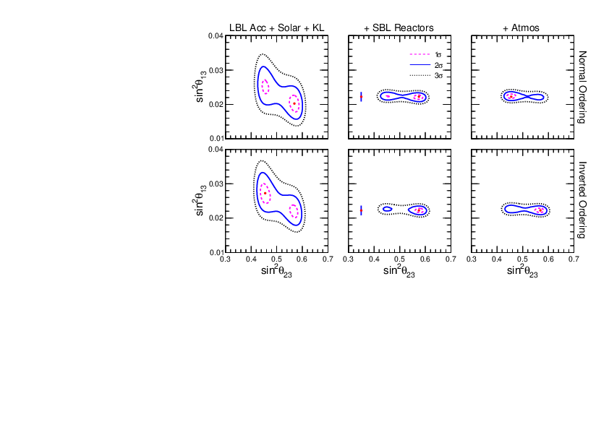
Prediction for 1-3 mixing
More general relation:
sin²θ₁₃ = sin²θ₂₃ sin²θ_{C} (1 + O(λ²))
0.04
0.03
0.02
0.01
θ_{C} - Cabibbo angle
for sin² θ_{C}
predictions
sin² θ₁₃
Difference can be due to deviation of θ₁₂^{l} from θ_{C}
related to difference of q and l- masses
global fit
0.03 0.04 0.05 0.06 0.07
sin² θ₂₃
Renormalization effects
from GUT to low energies

Slide 22
Predictions for δ_{CP}
B. Dasgupta, A Y.S. ,
N.P. B884 (2014) 357
1404.0272 [hep-ph]
If U_{X} = U_{BM}, U_{TBM} , then U_{lept} ~ V_{CKM} can be the only source
of CP violation. Leads to the relation
sin θ₁₃^{q}
sin θ₁₃
λ³
λ = sin θ_{C}
sinδ_{CP} = - sinδ_{CP}^{q} cosθ₂₃
λ
0.93
0.75
λ²
sin δ_{CP} ~ λ² ~ 0.046 or δ_{CP} = 2.6º
δ_{CP} ~ - δ_{CP} or π + δ_{CP}
Leptonic CP is small because the leptonic 1-3 mixing is large

Slide 23
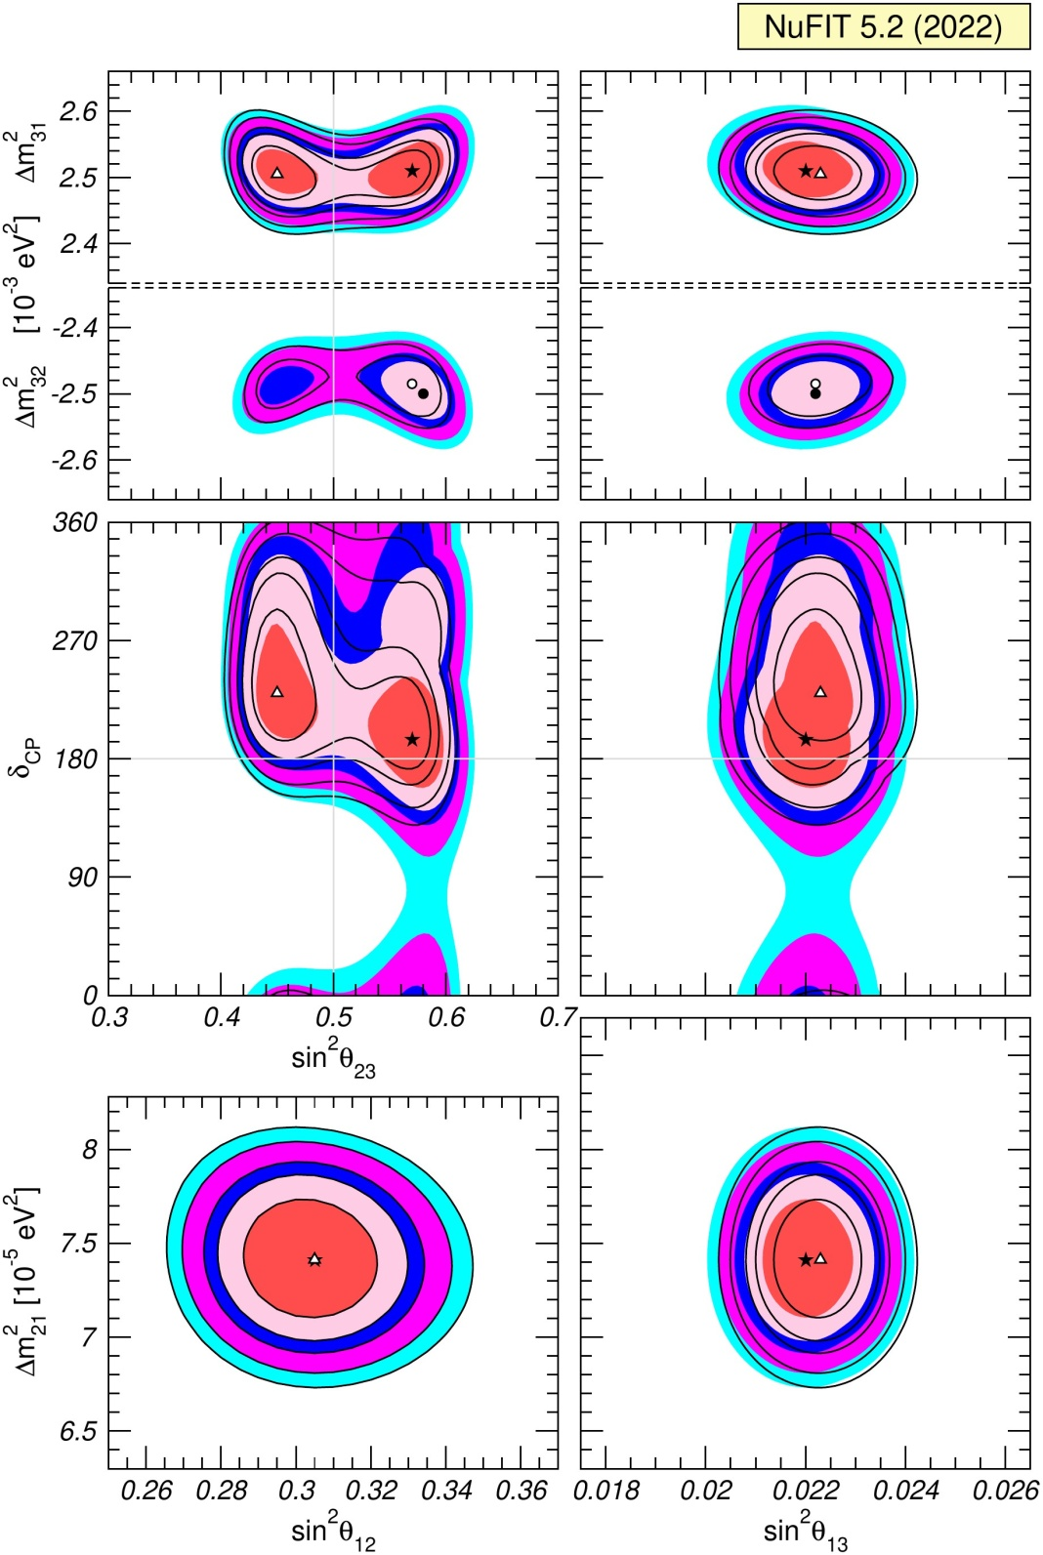
Experiment: CP-phase is close to π?
NOvA-T2K 2σ tension
NOvA: δ_{CP} = 0.82π, T2K δ_{CP} = 1.5π
Global fits
NuFIT 5.2 (2022),
www.nu-fit.org

Slide 24
Setup
Dark sector
SM + ν_{R}
Singlets (fermions, bosons) of GUT
L-R
Neutrino
portal
Sterile
neutrinos
P-S
Axions, Majorons, DM
GUT
Origins of smallness of neutrino mass and large (maximal mixing)

Slide 25
Symmetries and set-up
Patrick Ludl A.S
Neutrino
CKM
Hidden
sector
Visible
sector
fermions 1_{S}^{i}
SM →
SO(10)
bosons 1_{H}^{j}
G_{Yukawa}
Portal
G_{basis}
G_{basis}
G_{portal}
G_{hidden}

Slide 26
U_{x} from the dark sector
U_{PMNS} ~ V_{CKM}⁺ U_{X}
Common sector for quarks
and leptons. Implies
From the dark sector coupled
to neutrinos. Responsible for large neutrino mixing
smallness of neutrino mass
m_{l} ~ m_{d}
m^{D}_{ν} ~ m_{u}
Q - L unification, GUT
may have special symmetries which lead
to BM or TBM mixing
CKM physics, hierarchy,
of masses and mixings Froggatt-Nielsen (?), relations between masses and mixing

Slide 27
SO(10) GUT + ...
RH-neutrino
16
u_{r} , u_{b} , u_{j} , ν
d_{r} , d_{b} , d_{j} , e
u_{r}^{c}, u_{b}^{c}, u_{j}^{c}, ν^{c}
d_{r}^{c}, d_{b}^{c}, d_{j}^{c}, e^{c}
S
S
S
S
S
S
S
S
S
S
S
S
S
- Enhance mixing
Produce zero order mixing
- Screen Dirac mass hierarchies
S
S
S
S
S
S
S
S
S
S
S
S
S
S
S
S
Hidden sector

Slide 28
GUT/Planck realization of flavor symmetries
SO(10) GUT
Gives very small corrections to mixing
G_{f}
Explicit
spontaneous
G_{basis}
G_{hidden}
10_{H}
16_{f}
16_{H}
S_{f}
1_{H}
G_{basis} = Z₂ x Z₂
M_{S} ~ M_{Pl}

Slide 29
Mass scales: double seesaw
0 m_{D}^{T} 0
m_{D} 0 M_{D}^{T}
0 M_{D} M_{S}
ν
ν^{c}
S
M_{S}
M_{S} >> M_{D} - double seesaw
M_{R} = M_{D}^{T} M_{S}⁻¹ M_{D}
For light neutrinos
m_{ν}= m_{D}^{T} M_{D}^{-1T} M_{S} M_{D}⁻¹ m_{D}
Dirac screening: if m_{D} = AM_{D}, A = const
m_{ν} = A²M_{S}
→ determines U_{x}
Structure of m_{ν} is determined by M_{S}, it does not depend on
the Dirac mass matrix structure
Easy to realize

Slide 30
Yukawa interactions
Patrick Ludl, A.S
1507.03494 [hep-ph]
SO(10)
Hidden sector interactions
Visible sector
Portal
interactions
10_{H}
16_{F}
16_{H}
S_{F}
1_{H}
m_{D}
M_{D}
M_{S}
Y_{ij} 16_{F}^{i} 16_{F}^{j} 10_{H}^{u}
Y_{ij}’ 16_{F}^{i} S^{j} 16_{H}
h_{ijk} S^{i} S^{j} 1_{H}^{k}
Y ~ y (<φ> /Λ)^{n}
For third generation: n = 0, the mass
is generated at the renormalizable level
Second Higgs 10-plet should be introduced to produce the CKM mixing

Slide 31
Communication to the Hidden world
Patrick Ludl, A.S
1507.03494 [hep-ph]
Information about flavor structures in the hidden sector should be communicated (transferred ) to the observable sector
Visible sector
Portal
Hidden sector
10_{H}
16_{F}
16_{H}
S_{F}
1_{H}
Flavor structures depend on basis
Minimal way – to communicate info about bases
in the Hidden (S) and visible sectors (16):
Introduce the same basis symmetry
for F and S and prescribe certain charges for them
G_{basis}
G_{basis} = G_{intrinsic} = Z₂ x Z₂
( subgroup)

Slide 32
SO(10) GUT with G_{dark} = S₄
Xun-Jie Xu , A.S
Visible sector Portal Dark sector
U_{CKM}
U_{X}
G_{dark} = S₄
Basis
fixing
symmetry
Z₂ x Z₂
10_{H}
16_{F}
16_{H}
S_{F}
1_{H}
(0, 1)
(1, 0)
(1, 1)
(0, 1)
(1, 0)
(1, 1)
Non-trivial charges
mass hierarchy
no mixing
Z₂ x Z₂ S₄
CKM mixing -
additional structure
M_{S} ~ M_{Pl}
Spontaneously broken by flavons
Double seesaw
M_{D} ~ M_{GUT}
M_{S} ~ M_{BM}→ BM mixing
m_{D} ~ M_{D} = diag
δ_{CP} = 144 - 210⁰ (NO)

Slide 33
m_{D}
LHC-filic L-R models
P.S.Bhupal Dev,
R.N. Mohapatra,
0910.3924 [hep-ph]
SU(2)_{L} x SU(2)_{R} x U(1)_{B-L}
x P
with GUT embeddings
with q-l similarity
m_{q} ~ m_{l} ~ m^{D}_{ν}
V.Brdar, A. Yu.S
JHEP 02 (2019) 045
Fields L_{L} L_{R} χ_{L} χ_{R} S
B – L -1 -1 1 1 0
Higgs bi-doublet
ν_{l}
l
ν_{l}
l
Φ
inverse seesaw
L
R
M_{D} ~ M_{R} ~ PeV
χ_{L}
χ_{R}
Higgs
doublets
μ ~ 10 keV
S
flavor symmetry in μ
Dark
sector
singlet
breaks
L-R symmetry
μ
with Majorana mass terms

Slide 34
m_{D}
Model with L and R singlets
SU(2)_{L} x SU(2)_{R} x U(1)_{B-L}
x P
V.Brdar, A. Yu.S
JHEP 02 (2019) 045
1809.09115 [hep-ph]
Higgs bi-doublet
ν_{l}
l
ν_{l}
l
Φ
invariant under global U(1)
L
R
broken by μ-terms
χ_{L}
χ_{R}
keV scale sterile neutrino
- DM
S_{L}
S_{R}
μ_{LR}
μ
μ

Slide 35
Δm₄₁² = 1 - 2 eV²
Refractive
LSND
Neutrino mass

Slide 36
A simple model
Target (DM): complex scalar field φ with mass m_{φ}
Mediator: χ_{k} – light Majorana fermions with masses m_{χk}
At least two χ are needed to explain data
L = g_{αk} ν_{αL} χ_{kR} φ + ½ m_{χk} χ_{kR}^{T}χ_{kR} + h.c.
k = 1,2, α = e, μ, τ
g_{αk} < 10⁻⁷
bound from SN, ...
We assume zero VEV < φ > = 0
The interaction can be generated via mixing of φ with SM Higgs boson

Slide 37
Refraction on scalar DM
S. F Ge and H Murayama, 1904.02518 [hep-ph]
Ki-Yong Choi, Eung Jin Chun, Jongkuk Kim,
1909.10478 [hep-ph]
Elastic forward scattering of ν on background scalars φ with fermionic χ mediator
2012.09474 [hep-ph]
ν_{α}
Effective potential
ν_{α}
ν_{β}
φ
V
χ_{k}
χ_{k}
φ
φ
Wolfenstein
limit
φ
ν_{β}
Resonance: s = m_{χ}²
1/E tail
0
for φ at rest the resonance ν energy:
E_{R} =
m_{χ}²
2m_{φ}
For small m_{φ} resonance at low,
observable energies
resonance
A.Y.S. , V. Valera, 2106.13829 [hep-ph]
0
E_{R}
E

Slide 38
Refraction mass squared
Introduce the effective or refractive mass squared as
V = m_{ref}²/2E
|Δm_{ref} ²|
existing
observations
m_{ref}² = 2EV
true mass²
m_{ref}² = constant –
checked down to 0.1 MeV
relic ν
E_{R}
E
→ E_{R} << 0.1 MeV
The decrease of m_{ref}² with E allows to avoid
the cosmological bound
on sum of neutrino masses
~ constant m_{ref}² explains oscillation data
Large number density of target particles is required →
form substantial part of whole DM

Slide 39
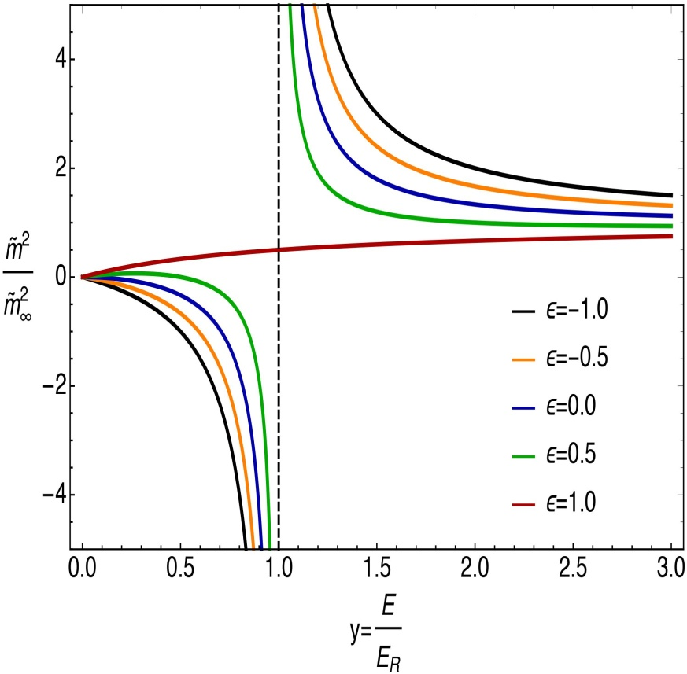
Refraction mass squared
m_{ref}² = 2EV
Near resonance
y(y - ε)
y² -1
m_{ref}² = m_{as}²
asymptotics →
where
m_{ref}²/m_{as}²
(n_{φ} + n_{φ})
m_{φ}
1
m_{as}² = Σ_{k} g_{αk} g_{βk}∗
is the refraction mass squared
in asymptotics y → infty
m_{as}² = Σ_{k} g_{αk} g_{βk}∗
ρ_{φ}
m_{φ}²
ρ_{φ} = m_{φ} (n_{φ} + n_{φ}) is the energy
density in φ
m_{as}² is identified with observable mass squared

Slide 40

Neutrinos: between
the two deserts

Slide 41
Two deserts
M_{Pl}
10²⁰
10¹⁰
10⁰
10⁻¹⁰
10⁻²⁰
10⁻³⁰
10⁻⁴⁰
GeV
M_{GUT}
in log scale
Upper desert
14 – 17 orders
It was believed:
due to smallness neutrino mass is related to physics above the HE desert
SM
V_{EW}
m_{e}
m_{ν}
V_{EW}²
M_{Pl}
Λ^{1/4}
The same argument:
due to smallness
neutrino mass may originate from physics
in the LE desert
Lower desert
> 30 orders
m_{γ}
V_{EW}³
M_{Pl}²
m_{fuzzy}
Both are involved?
t_{U}⁻¹
H₀

Slide 42
In conclusion
Nature of neutrino mass: vacuum mass, neutrino condensates, refractive mass related the nature of Dark matter and the Cosmological evolution? Combinations ?
Tests: searches energy, time, space dependences of oscillation parameters
Majorana versus Dirac?
Mixing determined by flavor symmetries? Modular symmetries?
Two or more different contributions to masses?
GUT –Planck scenario – very appealing
Neutrinos: probe physics in two deserts

Slide 43
Δm₄₁² = 1 - 2 eV²
Back-up
LSND

Slide 44
Potential: standard computations
Σ_{k}
(1 - ε) (y - 1)
(y - 1)² + ξ_{k}²
1 + ε
y + 1
V_{αβ} = V⁰_{αβk}
+
g_{αk} g_{βk}∗
2m_{χ}²
V⁰_{αβk} = (n_{φ} + n_{φ})
n_{φ} and n_{φ} – the number densities of φ and φ∗
For simplicity m_{χ1} = m_{χ2} = m_{χ}
y = E/E_{R}
E_{R} = m_{χ}²/2m_{φ}
ε = (n_{φ} – n_{φ})/(n_{φ}+ n_{φ})
C-asymmetry of the φ gas
g²
4π
ξ = Γ/E_{R}
Γ = m_{χ}
width of resonance
ξ << 1 can be neglected

Slide 45
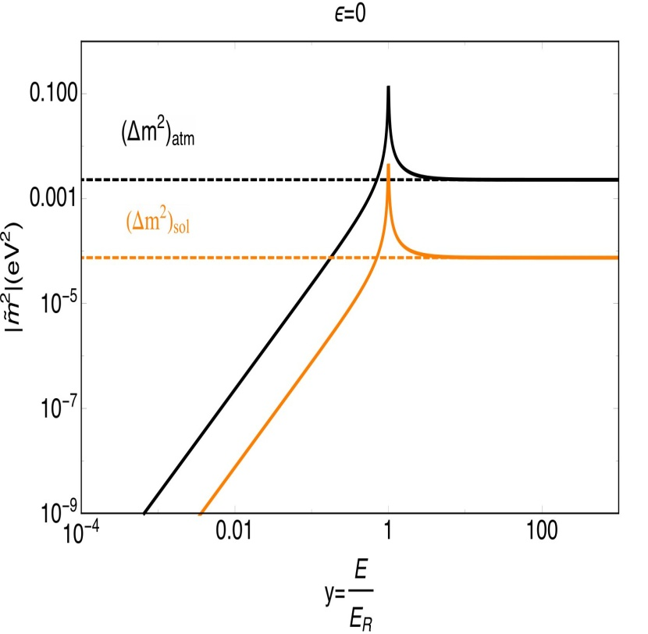
Properties of m_{ref}²
y << 1
m_{ref}²/m_{as}² = y(y - ε) = - εy
reproducing the Wolfenstein result
For C-symmetric background
m_{ref}²/m_{as}² = y² - decreases faster
|m_{ref}²|( eV²)
y >> 1
1 – ε /y , ε = 0
1 + y⁻² , ε = 0
m_{ref}²/m_{as}² =
converges to constant faster
For antineutrinos ε → - ε
m_{as}² (ν) = m_{as}² (ν)
m_{as}² has all the properties of usual mass

Slide 46
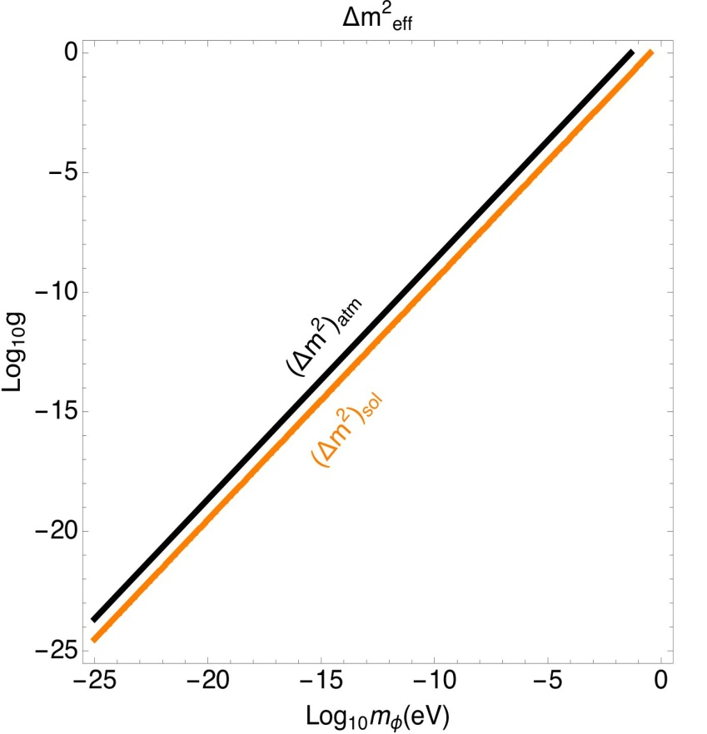
Fitting the oscillation data
Nearly TBM mixing can be obtained for
g_{e1} = g_{μ1} = g_{τ1} = g₁
g_{e2} = 0, g_{μ2} = - g_{τ2} = g₂
Masses (normal hierarchy)
m₁ = 0
Δm_{sol}²
3ρ_{φ}
g₂ = m_{φ}
Δm_{atm}²
2ρ_{φ}
g₂
g₁ = m_{φ}
g₁
g_{i}
These results do not depend on m_{χ}
m_{χ} is determined by m_{φ} and
the resonance energy:
ρ_{φ} = 0.3 GeV cm⁻³
m_{χ} = 2m_{φ}E_{R}
m_{φ} , eV
Required g as functions of m_{φ}

Slide 47
Perturbativity and resummation
Radius of interactions below resonance : 1/m_{χ}
Large number of scatterers φ within interaction volume.
Processes with many φ should be taken into account
ν φ φ ◊ ν φ φ
ν φ φ φ ◊ ν φ φ φ ...
ν χ ν χ ν
Expansion parameter
V
m_{φ}
Δm_{atm}²
2E m_{φ} – m_{χ}²
ζ = =
φ φ* φ φ *
ζ Increases with decrease of energy and becomes ζ = 1 already above resonance

Slide 48
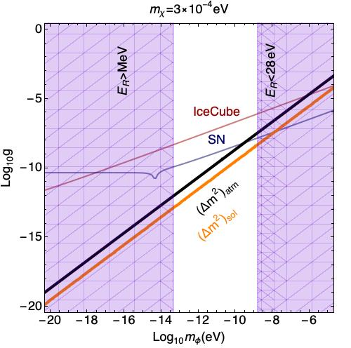
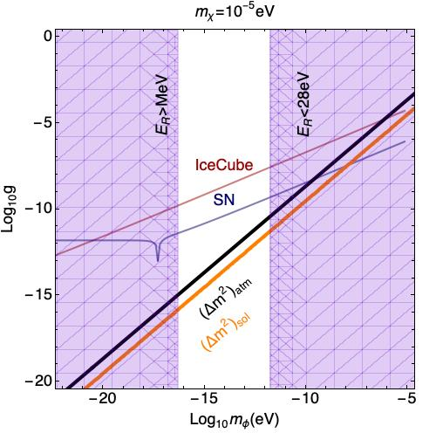
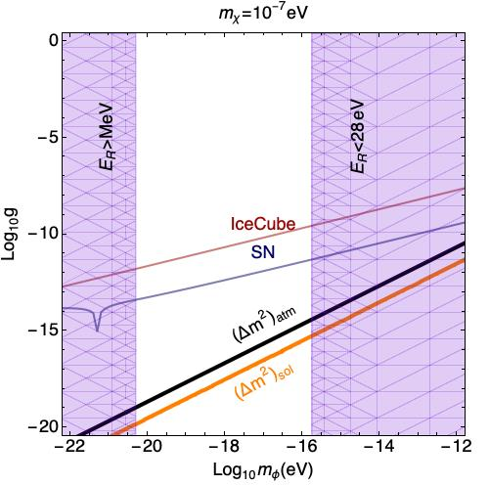
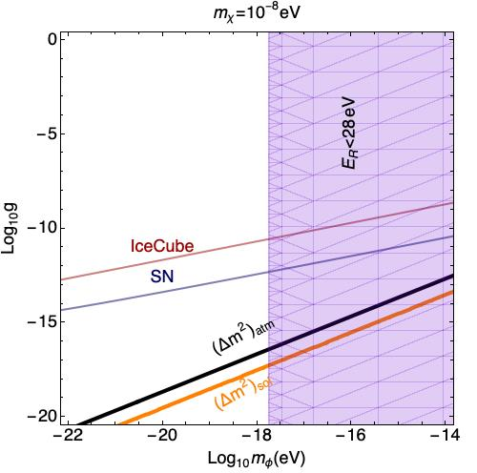
Viable ranges of parameters
Bounds and
regions required for explanation of
oscillation data
by refraction in
g – m_{φ} plane for
different values of m_{χ}
oscillations
cosmology

Slide 49
F(E)
Refraction mass vs. VEV mass
Refraction mass is different in different space-time points and also depends on energy:
m_{ref}² (x, t, E) = n_{φ}(x, t) f(E)
E.g. m_{ref}² is different in solar system, center of Galaxy, intergalactic space
The average m_{ref}² (z) in the Universe increased in the past.
In contrast, the VEV mass is determined by minimum of the potential,
And it is not redshifted. Still it can depend on t and x, e.g. in the presence of topological defects and due to thermal corrections to the potential in the Early Universe

Slide 50
Evolution of the refractive mass
In epoch, z, the average refraction mass of relic neutrinos in the Universe
m_{ref}² (z) ~ ξ m_{as}² (loc) (1 + z)⁴ E(0)/E_{R} [(E(0)/E_{R} (1 + z) – ε]
ξ ~ 10⁻⁵ - inverse of
local over-density of DM
redshift of
energy and density
energy dependence
of mass at small y
m_{as}² (loc) = Δm_{atm}²
E(0) ~ 5 10⁻⁴ eV - present average energy of relic neutrinos
For large enough E_{R} the mass m_{ref}² (z) can satisfy the cosmological bound on sum of neutrino masses from structure formation
→ lower bound on E_{R}

Slide 51
Coherent classical field
System of φ with large occupation number can be treated as a classical scalar field
λ_{φ}³n_{φ} >> 1
λ_{φ} = 2π/k_{φ} = 2π/vm_{φ}
- de Broglie wave of φ
Condition
v ~ 10⁻³ - virial velocity in Galaxy
ρ_{φ}
2πv³
m_{φ} << 2π
1/4
m_{φ} << 30 eV is well satisfied
In terms of QFT such a scalar field φ_{c} can be introduced as an expectation value of the field operator in the coherent state:
φ_{c} = <φ_{coh}| φ |φ_{coh} >
dk
(2π) ³
k = m_{φ} v
|φ_{coh}> = exp [f_{a}(k)a_{k} ⁺ + f_{b}(k)b_{k}] |0 >
It can be parameterized as
φ_{c}(x) = F(x t) e^{-iΦ}
F² ~ ρ_{φ} /m_{φ}²

Slide 52
Neutrino mass in classical field
In the Lagrangian: φ ◊ φ_{c}
L = g_{αk} χ_{kR} ν_{αL} φ_{c}* + h.c.
mass terms m_{αk} = g_{αk} φ_{c}*
Mass matrix in the basis (ν_{f,} χ^{c}_{L}) = (ν_{e}, ν_{μ}, ν_{τ} , χ₁ , χ₂)
0 g_{αk} φ_{c}*
g_{kα} φ_{c}* diag (m_{χ1} , m_{χ2})
M =
The Hamiltonian
1
2E
|F| ² Σ_{k} g_{αk} g_{βk}∗ g_{αk} F m_{χk} e^{iΦ}
g_{kα}∗ F* m_{χk} e^{-iΦ} M_{χ}²
1
2E
H = M M⁺ =
M_{χ}² = f( |F|², | g_{αk}| ², m_{χk}² )

Slide 53
Properties of the Hamiltonian
3x3 flavor block has the same form as refraction matrix m_{as}²
Additional time dependence can appear in F:
|F|² ~ ρ_{φ}/m_{φ}² cos² m_{φ}t
for real field
A.Berlin, 1608.01307, F. Capozzi et al, 1702.08464, G. Krnjaic, ei al, 1705.06740 [hep-ph], V. Brdar et al 1705.09455 [hep-ph], ...
For C-asymmetric background the amplitude of oscillations can be suppressed
Averaging?
No resonance dependence of mass on energy
No decrease of the mass with energy below resonance
ν − χ mixing

Slide 54
Bounds on resonance energy
The structure formation bound at z = 1000:
m_{ref}²(1000) ~ ( Σm_{ν})² < 10⁻² eV ²
For y << ε
Δm_{atm}²
(Σm_{ν}) ²
E_{R} > E(0) ξ ε (1 + z)⁴
E_{R} > 1.2 ε keV
For ε = 0
Δm_{atm}²
Σm_{ν}
E_{R} > E(0) [ ξ (1 + z)⁵ ]^{1/2}
E_{R} > 30 eV
The bound on refractive masses should be reconsidered
(group velocities, mass in density perturbations, etc…)

Slide 55
Effect of classical component
Berlin,
1608.01307 [hep-ph]
Solution of equation of motion for classical field has t and x dependence:
2 ρ (x)
m_{φ}
φ_{c}(t, x ) ~ cos(ωt – k x)
ω ~ m_{φ}, k = m_{φ} v,
v ~ 10⁻³ – virialized velocity in the Galaxy
φ_{c} generates the mass term
m’ ν_{L}f_{R} + h. c. with
m’ = g φ_{c}
Oscillating mass with period
T_{osc} = 2π/m_{φ} = 4 10⁻¹⁵ sec (1 eV/m_{φ})
Loss of coherence due to velocity dispersion Δv ~ v ?
Δω = m_{φ} vΔv ~ m_{φ} v²
2π
Δω
τ_{coh} = = 4 10⁻⁹ sec (1 eV/m_{φ})
System transforms into a cold gas of individual scatterers.
Still in some aspects can be considered as classical field without time variations

Slide 56
Effective mass due to interactions with dark matter
H. Davoudiasl, et al
1803.0001 [hep-ph]
L = - g_{X} φ X X - g_{ν} φ ν ν - m_{X} X X - ½ m_{φ}² φ²
φ - very light scalar field; produces a long (astronomical) range forces
X – DM particle (fermion of GeV mass scale) - source of φ.
m_{ν} = g_{ν} φ
From equation of motion for φ, with negligible neutrino contribution to generation of φ
- g_{X} n_{X}
m_{φ}²
n_{X} = <X X> is the number density of X
φ =
m_{φ} = 10⁻²⁰ - 10⁻²⁶ eV is mass of scalar
g_{X} g_{ν} ρ_{X}
m_{φ}² m_{X}
m_{ν} (0) =
ρ_{X} - energy density of DM
g_{X} = g_{ν} = 10⁻¹⁹ → m_{ν} = 0.1 eV
Mass depends on local density of DM and different in different parts of the Galaxy and outside

Slide 57
Resolving problem of mass increase with z
If neutrinos, as source of φ, are not neglected, eq. of motion gives
- g_{X} n_{X}
m_{φ}² + g_{ν}² n_{ν}/<E_{ν}>
H. Davoudiasl, et al
1803.0001 [hep-ph]
φ =
In the Early Universe before structure formation neutrino term
(in denominator) can dominate, then
- g_{X} n_{X} <E_{ν}>
g_{ν} n_{ν}
(m_{ν} = g_{ν} φ )
m_{ν}(1000) =
Forces between neutrinos and DM are repulsive. In later epochs DM clumps can drive out of Galaxy the neutrino background which leads to m_{ν}(0) >> m_{ν}(1000)
Density of relic neutrinos in Galaxy and in solar system
can be strongly suppressed. PTOLEMY ?

Slide 58
Remark
LSND / MiniBooNE
RAA, Gallium
m_{S} = 0.1 – 10 eV
θ_{S} ~ 0.1
Adding such a neutrino is not small perturbation of the 3nu picture.
Correction to the mass matrix of active neutrinos
δm ~ sin² θ_{S} m _{S} ~ (2-5) 10⁻² eV
- at the level of largest elements
Should be included
in theory construction
in the beginning
For two and more steriles cancellation of their contributions can be arranged
Future bound
sin² θ_{S} < 10⁻³ eV / m _{S}
will allow to consider them as perturbation

Slide 59
How to test?
Hopeless?
Further precise measurements of
the 1-3 and 2-3 mixings (octant)
Nothing should be observed at LHC which is responsible for neutrino masses
If something is observed against (excludes) framework
Proton decay
Special value of CP-phases
Light sterile neutrinos
Dark matter
May or may not help
Inflation
Leptogenesis

Slide 60
Similar…
Neutrino masses from the Double seesaw with
M_{S} ~ M_{PL}, M_{D} ~ <16_{H} > ~ M_{GUT}
m_{D}, M_{D} = diag
δ_{CP} = 144 - 210⁰ (NO)
Similar non-SUSY structure with 10_{H} , 16_{H}, 45_{H}
(responsible for gauge symmetry breaking)
A. Preda, G. Senjanovic,
M. Zantedeschi,
2201.02785[hep-ph]
High dimensional operators, correspond to the integrated out Dark sector but with Λ ~ 10 M_{GUT} , M_{GUT} ~ 4 10¹⁵ GeV
M_{D} ~ <16_{H} > ~ M_{I} ~ 5 10¹⁴ GeV
Unification is achieved by strong mass splitting in 45_{H} with weak
tripled and color octet, as well as in 10_{H} with scalar quark doublet having masses below 10 TeV
accessible to LHC ?

Slide 61
Connections
to other phenomena, and anomalies
(g-2)_{μ}
Dark Matter
B-anomalies
ν
XENON1T
H₀
ANITA
Gravitational
Dark Energy
waves
Axions, ALPs
Baryon asymmetry
Combinatorics
of explanation,
joint description

Slide 62
Way to proceed?
Additional input needed
1. Learn more from “strings”
Modular symmetries,
Swampland....
2. Further analyse the data search for regularities
Use other representation of data
(m, θ) = (mº, θº) + corrections
3. Explore connections and anomalies
GW
KOTO
MB/LSDN
Combinatoric of explanation
Joint description
ANITA
XENON1T
ν
H₀
B-anomalies
DE
(g-2)_{μ}
DM
Higgses
Axions, ALPs
COVID-19

Slide 63
(g-2)_{μ}
Model building without
model builder
m_{ν}
B-anomalies
R_{K*}
Lepton
non-universality
R_{D*}
Systematic way to search for connection is to use effective FT
Opening
Closure
H
H
L
L
L
L
New interactions with new (often exotic) particles
gauge inv. operators
constructed out of SM
fields , with ΔL =2
D5 operator
m_{ν}
Contribute to
R_{K*}
(g -2)_{μ}
R_{D*}
UV completion

Slide 64
Unification
After all, Grand Unification is the best BSM physics
Unification of forces, understanding why strong interactions
are strong, weak interactions are weak, etc.
unification of quarks and leptons, explanation of charges
SO(10) perfect embedding of all fermions
m_{q} ~ m_{l} ~ m^{D}_{ν}
Not complete, something important is still missing,
but this produces small perturbation of the main picture
e.g. Hidden sector interacting via different portals
Testability is not the problem of NATURE.
It is our problem.
Simplicity, minimality are more important

Slide 65
δ_{CP} = π?
B. Dasgupta, A Y.S. ,
Nucl.Phys. B884 (2014) 357
1404.0272 [hep-ph]
Framework:
U_{PMNS} ~ V_{CKM}⁺ U_{X}
If the only source
of CP violation
No CPV (of BM type)
sinθ₁₃ sin δ_{CP} = (-cos θ₂₃) sinθ₁₃^{q} sinδ_{q}
λ
λ³
δ_{q} = 1.2 +/- 0.08 rad
sin δ_{CP} ~ λ³/s₁₃ ~ λ²
~ 0.046
sin δ_{q} = 0.93
δ_{CP} ~ - δ or π + δ
where δ = (s₁₃^{q} /s₁₃) c₂₃ sin δ_{q}
Leptonic CP is small because the leptonic 1-3 mixing is large

Slide 66
Justification
H. Minakata, A Y S, Z - Z. Xing
J Harada, S Antusch , S. F. King
Y Farzan, A Y S, M. Picariello …
The data are in a good agreement with the relation
between the lepton and quark mixing matrices:
S. Petcov, AYS, 1993
U_{PMNS} ~ U_{l}⁺ U_{X}
C. Giunti, M. Tanimoto
U_{l} ~ V_{CKM}
U_{X} = U_{BM} , U_{TBM}
Γ_{α}
quark mixing matrix
diagonal
phase matrix
matrices of special form
dictated by symmetry
U_{X} = U₂₃(π/4)U₁₂ , θ₁₃^{X} ~ 0
reproduces approximately the quark-lepton complementarity, QLC
and gave prediction for 1-3 mixing
sin θ₁₃~ ½ sin θ_{C}
In general,
sin²θ₁₃ = sin²θ₂₃ sin²θ_{C} (1 + O(λ²))

Slide 67
A HE scenario
Still favorable
Planck scale Dark sector
SM + ν_{R}
Singlets (fermions, bosons) of GUT
Neutrino
portal
L-R
Flavons,
moduli
P-S
Light Dark sector
Origins of smallness of neutrino mass and large (maximal mixing)
Sterile
neutrinos
GUT
Axions, Majorons, DM
Seesaw, double seeesaw...

Slide 68
Mixing and masses from the dark sector
U_{PMNS} = V_{lept}⁺ U_{X}
Common sector for quarks
and leptons:
From the dark sector coupled
to neutrinos. Responsible for large neutrino mixing
smallness of neutrino mass
U_{lept} ~ V_{CKM}
Implies
Q - L unification, GUT
may have special symmetries which lead to BM or TBM mixing
CKM physics, hierarchy,
of masses and mixings, relations between masses and mixing
U_{X} = U_{BM} , U_{TBM}

Slide 69
Complementarity
LSND
prediction
Δm₄₁² = 1 - 2 eV²

Slide 70
Modular vs. usual discrete symmetries
Comparing with usual approach with flavons
Y₁ (<τ>) , Y₂ (<τ>) ... Y_{n} (<τ>)
<χ₁>, <χ₂>, ... , <χ_{n}>
For a given N, k, Y - known functions of the same VEV
- Flavon VEV’s depend on parameters of potential and not controlled by symmetry. Independent for different representations
Can do the same as modular symmetry constructions

Slide 71
QLC
Similarity of mass hierarchy of quarks and charged leptons
Famous equality m(b) = m(τ) at GUT scale
Puzzle: strongly different patterns of quarks and lepton mixings
But relations:
data
θ₁₂^{l} ~ π/4 - θ₁₂^{q}
33.4⁰ ~ 45⁰ - 13⁰
θ₂₃^{l} ~ π/4 - θ₂₃^{q}
Lepton mixing ~ maximal minus quark mixing
Quark – lepton complementarity
H. Minakata , AYS
1 >> θ₁₃^{l} >> θ₁₃^{q}
The relations are approximate and at low energy scale. Renormalization, corrections ...

Slide 72
Intrinsic symmetries
C.S.Lam
1403.7835 [hep-ph]
B. Bajc, AS
1507.03494 [hep-ph]
of SO(10)
Hidden sector interactions
Visible sector
Portal
interactions
10_{H}
16_{F}
16_{H}
S_{F}
1_{H}
Y_{ii} 16_{F}^{i} 16_{F}^{i} 10_{H}^{u}
Y_{jj}’ 16_{F}^{j} S^{j} 16_{H}
h_{ijk} S^{i} S^{j} 1_{H}^{k}
[ Z₂ ]³
[ U(1) ]³
[ Z₂ ]³
16_{F}^{i} → -16_{F}^{i}
For the mass matrix
in the diagonal basis
better seen in the diagonal
yukawa coupling basis

