Slide 1
Mass, mixing and
flavor symmetries

Slide 2
Three neutrinos and three problems
New problems appear when there are more than 1 object
three neutrinos
Mixing
Mass ordering
Relative CP phases
Mass ratios
type of spectrum

Slide 3
Flavor and mixing

Slide 4
Flavors and mixing
Flavor neutrino states:
Mass eigenstates
ν_{e}
ν_{μ}
ν_{τ}
ν₁
ν₂
ν₃
m₁
m₂
m₃
e
μ
τ
Mixing
Flavor states – Weak
interaction states
Flavor
states
Mass
eigenstates
Combinations of mass
states described by mixing matrix U_{PMNS}
ν_{f} = U_{PMNS} ν_{mass}

Slide 5
Mixing: dual role
ν_{e}
ν_{μ}
ν_{τ}
|U_{μ3}|²
|U_{τ3}|²
ν₃
|U_{e3}|²
mass
|U_{e2}|²
ν₂
ν₁
|U_{e1}|²
ν_{e}
ν_{μ}
ν_{τ}
Flavor content of the mass states
Mass content of
the flavor states
ν_{mass} = U_{PMNS} ⁺ ν_{f}
ν_{f} = U_{PMNS} ν_{mass}

Slide 6
Vacuum mixing
ν_{f} = U_{PMNS} ν_{m}
ν_{e}
ν_{μ}
ν_{τ}
U_{e1} U_{e2} U_{e3}
U_{μ1} U_{μ2} U_{μ3}
U _{τ1} U_{τ2} U_{τ3}
ν₁
ν₂
ν₃
=

Slide 7
Standard parametrization
U_{PMNS} = U₂₃I_{δ} U₁₃I_{−δ} U₁₂
I_{M}
I_{δ} = diag (1, 1, e^{iδ})
Dirac phase matrix
1 0 0
0 c₂₃ - s₂₃
0 -s₂₃ c₂₃
c₁₃ 0 s₁₃e^{-iδ}
0 1 0
-s₁₃e^{iδ} 0 c₁₃
c₁₂ s₁₂ 0
-s₁₂ c₁₂ 0
0 0 1
I_{M}
iα₂₁ /2
iα₃₁ /2
I_{M} = diag (1, e , e )
- matrix of Majorana phases
Not unique parametrization
Convenient for phenomenology, especially for oscillations in matter
Insightful for theory?

Slide 8
Mixing angles
ν_{e}
ν_{μ}
ν_{τ}
|U_{μ3}|²
|U_{τ3}|²
Mixing parameters
ν₃
tan²θ₁₂ = |U_{e2}|² / |U_{e1}|²
|U_{e3}|²
sin²θ₁₃ = |U_{e3}|²
MASS²
tan²θ₂₃ = |U_{μ3}|² / |U_{τ3}|²
Δm²₃₁
|U_{e2}|²
ν₂
ν₁
Δm²₂₁
|U_{e1}|²
Mixing matrix:
FLAVOR
ν_{f} = U_{PMNS} ν_{mass}
Normal mass hierarchy
ν_{e}
ν_{μ}
ν_{τ}
ν₁
ν₂
ν₃
Δm²₃₁ = m²₃ - m²₁
= U_{PMNS}
Δm²₂₁ = m²₂ - m²₁
U_{PMNS} = U₂₃I_{δ} U₁₃I_{−δ} U₁₂

Slide 9
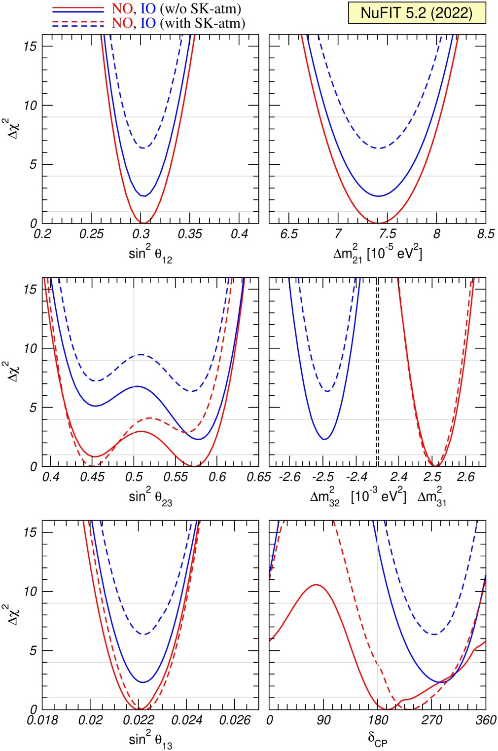
Data. Global fit
NO preference smaller than 2σ
Octant? With SK atmospheric lower octant is preferable
NO: CP-phase close to π

Slide 10
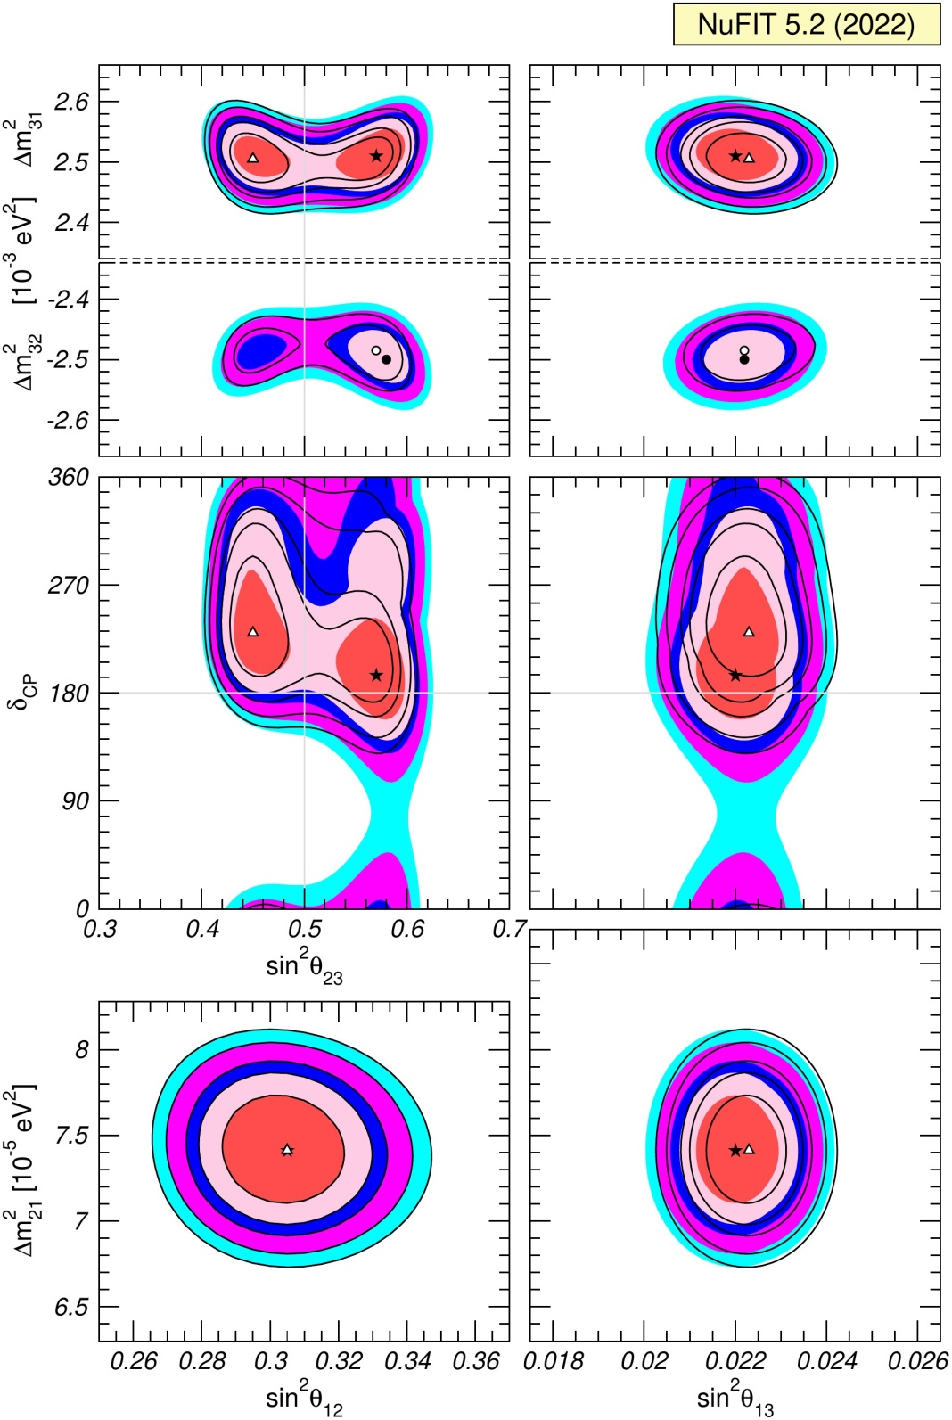
Global fit

Slide 11
TBM: deviations and implications
Tri-bimaximal mixing
P. F. Harrison, D. H. Perkins,
W. G. Scott
0.30
2/3 1/3 0
- 1/6 1/3 - 1/2
- 1/6 1/3 1/2
0.15
U_{tbm} = U₂₃(π/4) U₁₂
U_{tbm} =
0.78
sin²θ₁₂ = 1/3
0.62
0.30 - 0.31
Accidental, numerology,
useful for bookkeeping
Not accidental
Lowest order approximation
which corresponds to weakly
broken (flavor) symmetry
of the Lagrangian
Accidental symmetry
(still useful)
There is no relation of mixing
with masses (mass ratios)
with some other physics
and structures associated
flavons other new particles

Slide 12
λ
Mass hierarchies
m_{h} > Δm₃₁² > 0.045 eV
at m_{Z}
up down charged neutrinos
quarks quarks leptons
1
m₂
m₃
>
Δm₂₁²
Δm₃₂²
10⁻¹
~ 0.18
10⁻²
Neutrinos have
the weakest mass
hierarchy (if any)
among fermions
mass ratios
10⁻³
10⁻⁴
Related to large
lepton mixing?
10⁻⁵
Koide
relation
m_{u} m_{t} = m_{c}²
sinθ_{C} ~ m_{d}/m_{s}
Gatto–Sartori-Tonin relation

Slide 13
Mixing and mass matrices
Origin of mixing:
off-diagonal mass matrices
M_{l} = M_{ν}
Mixing matrix
Diagonalization:
Mass spectrum
for Majorana
neutrinos
M_{l} = U_{lL}m_{l}^{diag} U_{lR}⁺
M_{ν} = U_{νL}m_{ν}^{diag} U_{νL}^{T}
m_{l} ^{diag} = (m_{e}, m_{μ}, m_{τ})
m_{ν}^{diag} = (m₁, m₂, m₃)
CC in terms of mass eigenstates:
l γ ^{μ} (1 - γ₅) U_{PMNS}ν_{mass}
U _{PMNS} = U_{lL}⁺ U_{νL}
Flavor basis:
M_{l} = m_{l}^{diag}
U _{PMNS} = U_{νL}

Slide 14
Decoupling of masses and mixing
Shape invariance
equalities,
zeros
Relations
between
elements
Mass matrix
Mixing
of neutrinos
Absolute values of matrix elements
(in the flavor basis)
Masses
Opens up a possibility that symmetry is behind TBM
Decoupling is always possible, but the key is that relations should be simple to be consequences of simple symmetries

Slide 15
Relations and symmetries
Mixing: very special structure which is not related to mass ratios
For TBM: m₁₂ = - m₁₃ , m₂₂ = m₃₃ , m₁₁ + m₁₃ = m₂₂ + m₂₃
S₄
,
sin θ_{C}
1 – 2 sin² θ_{C}
For Cabibbo mixing:
m₁₂ = (m₁₁ - m₂₂)
~ 1/4
Relation between matrix elements which
leads to Cabibbo mixing independently of values of matrix elements
symmetry which produces the relation dihedral D14
C. Hagedorn, 1204.0715

Slide 16
Mass Ordering
ν_{e}
ν_{μ}
ν_{τ}
ν₃
ν₂
Δm²₂₁
ν₁
MASS²
MASS²
Δm²₃₂
Δm²₂₃
ν₂
ν₁
Δm²₂₁
ν₃
FLAVOR
FLAVOR
Normal mass ordering
Inverted mass ordering

Slide 17
Theories of mass ordering
Fundamental:
principle, symmetry
Accidental: selection of values of parameters
Quasi-degenerate
→ symmetry
m₂
m₃
Δm₂₁²
Δm₃₂²
Δm
m
Δm₂₁²
2 Δm₃₂²
~ = 0.18
~ = 1.6 10⁻²
the weakest
hierarchy
m₂
m₃
but 1-2 mixing strongly deviates from maximal
θ ~
Similar to quark spectrum
rescaling
Pseudo-Dirac + 1 Majorana
See-saw
Quark-lepton symmetry
Flavor symmetries
Broken L_{e} – L_{μ} – L_{τ} symmetry
Unification

Slide 18
Pattern of mass matrices
For Majorana neutrinos
Normal hierarchy
Inverted hierarchy
α₂₁ = 0
Value of mass →
α₂₁ = π
Strong dependence
of structure of mass matrix on the Majorana phases
- different patterns
→ different possible
symmetries
For two different
Majorana phases

Slide 19
Predicting mass hierarchy
In models with residual (discrete) flavor symmetries mixing does not depend on mass at least in the symmetry limit.
The same mixing pattern can be obtained for NH and IH
The type of hierarchy is fixed by field content
(scalar sector), auxiliary symmetries, etc.
Radiative mechanisms have different preferences
those which are related to charged leptons prefer NH
broken (L_{e} – L_{μ} – L_{τ}) symmetry - IH
Seesaw type I with quark-lepton analogy (symmetry) leads to NH
Establishing NH would favor the line with
similarity with quark sector, high scale seesaw, etc.
If so, one would expect the first quadrant,
θ₂₃ < π/4

Slide 20
Flavor symmetries

Slide 21
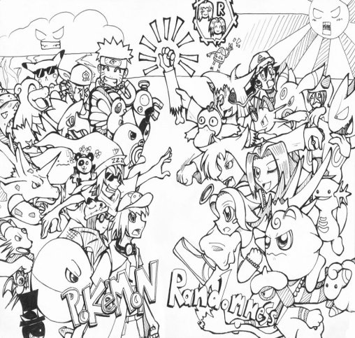
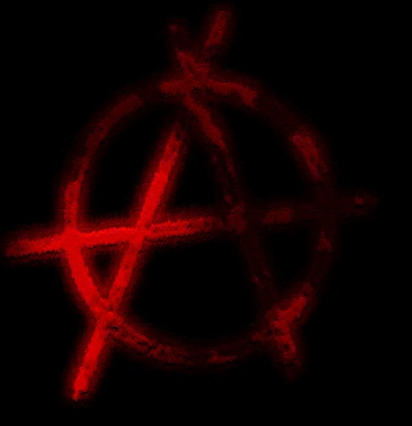
Mixing and symmetries
Not much to add
- String landscape
- Multiverse?
from symmetry
to anarchy and
randomness
with intermediate possibilities
Complicated constructions,
especially if quarks are included

Slide 22
Realizations, problems
Simple groups like S₄ , A₄ x Z₂ can establish equalities of elements of mass matrix required by TBM

Slide 23
Deriving the TBM-symmetry
C.S. Lam
Invariance of mass matrices in the flavor basis:
Neutrinos
V_{i}^{T} m_{TBM} V_{i} = m_{TBM}
V_{i} = S, U_{i}
-1 2 2
… -1 2
.. … -1
0 0
0 0 1
0 1 0
S =
1
3
U =
ν_{μ} −ν_{τ} -permutation
charged leptons
diagonal due to symmetry
1 0 0
… ω² 0
… … ω
T =
ω = exp(-2iπ/3)
T⁺ (m_{e}⁺ m _{e})T = m_{e}⁺ m _{e}
S, T, U –elements of S₄

Slide 24
S - symmetry
4
Order 24, permutation of 4 elements
Symmetry of cube
Generators: S, T
Presentation:
S⁴ = T³ = (ST²)² = 1
Irreducible
representations:
1 , 1’ , 2, 3, 3’
Products and
invariants
3 x 3 = 3’ x 3’ = 1 + 2 + 3 + 3’
3 x 3’ = 1’ + 2 + 3 + 3’
New flavor
structure
1’ x 1’ = 1
2 x 3 = 2 x 3’ = 3 + 3’
2 x 2 = 1 + 1’ + 2
1’ x 2 = 2

Slide 25
S_{ν}
Residual symmetries approach
E. Ma,
C. S. Lam ....
Mixing appears as a result of different ways of the flavor symmetry
breaking in the neutrino and charged lepton (Yukawa) sectors.
S₄
T’
G_{f}
A₄
T₇
Residual symmetries
of the mass matrices
Z_{m}
G_{l}
G_{ν}
Z₂ x Z₂
or Z₂
M_{l}
M_{ν}
Intrinsic symmetries
of mass matrices
which do not depend
on values of masses
Symmetry transformations
in mass bases
T
U, S_{ν}
S_{ν} M_{ν} S_{ν} ^{T} = M_{ν}
Discrete finite groups
Flavons to break symmetries
CP-transformations
can be added

Slide 26
Intrinsic symmetries
Realized for arbitrary values of neutrino and charged lepton mass
can not be broken, always exist
In the mass basis
for Majorana neutrinos
for charged leptons
m = diag( m₁, m₂, m₃)
m_{l} = diag( m_{e}, m_{μ}, m_{τ} )
G_{ν}
G_{l}
iφ_{e}
iφ_{μ}
iφ_{τ}
S₁ = diag (1, -1, -1)
T = diag(e , e , e )
S₂ = diag (- 1, 1, -1)
φ_{α} = 2π k_{α}/m
S_{i}² = I
Z₂ x Z₂
T^{m} = I
Z_{m}
The Klein group
Σ φ_{α} = 0
can use subgroup
Intrinsic symmetries as residual symmetries

Slide 27
Invariance
m₁
m₂
m₃
ν₁
ν₂
ν₃
ν₁ ν₂ ν₃
ν → S_{i}ν

Slide 28
Symmetry group condition
D. Hernandez, A.S.
1204.0445
If intrinsic symmetries are residual symmetries of the unique symmetry group (follow from breaking of unique group)
→ bounds on elements of mixing matrix
S_{i} and T are elements of covering group.
By definition product of these elements (taken in the same basis) also belongs to the finite discrete group:
( U_{PMNS} S_{i} U_{PMNS}⁺ T)^{p} = I
p -integer
For each i the equation gives two relations between mixing parameters
Two such equations for i = 1,2 fix the mixing matrix completely → TBM
Z₂ x Z₂
TBM
In general, the condition allows to fix mixing matrix up to several possibilities

Slide 29
A₄ symmetry
E. Ma
G Branco, H P Nilles
A₄
Symmetry group of even permutations
of 4 elements
Symmetry of tetrahedron
Generators: S, T
Presentation
of the group:
no U = A_{μτ}
S² = 1
T³ = 1
(ST)³ = 1
Irreducible representations: 3, 1, 1’, 1’’
Products and
invariants
3x3 = 3 + 3 + 1 + 1’ + 1’’
1’ x 1’’ ~ 1

Slide 30
A_4 symmetry breaking
A₄
``accidental’’ symmetry
due to particular
selection of flavon
representations and
configuration of VEV’s
T
S
A_{μτ}
M_{l}
diagonal
M_{ν}
TBM-type
In turn, this split originates from
different flavor assignments of
the RH components N^{c} and l^{c}
and different higgs multiplets

Slide 31
An A₄ model
G. Altarelli
D. Meloni
symmetry
Yukawa sector mass terms
A₄
Z₄
Charged lepton
Neutrinos
3
1
i
-1
-i
L
L
1
i
n
k
i
φ_{T}
ξ’
H_{d}
H_{u}
i
1’
l^{c}
i
i
1
N^{c}
1, i, -1
-1
at multiplets
flavons
1’’
φ_{S}
M
n = 1, 2, …k = 0, 1
ξ
1
< φ_{T} > = v _{S}(0, 1, 0)
1
< φ_{S} > = v _{S} (1, 1, 1)
Flavon sector
U(1)_{R}
Particular selection
of representations
φ_{T}
φ_{S}
ξ
ξ’
0
2
φ_{T}⁰
φ_{S}⁰
ξ⁰
Driving fields
Vacuum alignment
-1
1
1
GUT-scale or higher?

Slide 32
Generic problem
m = F(Y, v)
Mechanism of
mass generation
VEV’s
Yukawa
couplings
VEV alignment
different contributions
high order corrections
follow from independent sectors:
TBM
Yukawa sector
Scalar potential
tune by additional symmetries
All these
components
should be
correlated
``Natural’’ – consequence
of symmetry?
one step constructions do not work

Slide 33
More problems
No connection to masses
Mass hierarchy from additional symmetries
U(1) Froggatt- Nielsen mechanism
n
φ
Λ
power n is determined by U(1) charges of the corresponding operators
Discrete symmetries – restricted possibilities to explain mass spectrum (degenerate, partially degenerate spectra)
Missing representations problem

Slide 34
Relating to mass degeneracy
Symmetry which left mass matrices invariant for specific mass spectra:
Partially degenerate spectrum
m₁ = m₂ , m₃
D. Hernandez, A.S.
Transformation matrix
S_{ν} = O₂
G_{ν} = SO(2) x Z₂
Relation:
m₁
m₂
sin²2θ₂₃ = +/- sin δ = cos κ = = 1
maximal
+/- π/2
Majorana phase
1-2 mixing is undefined
Small corrections to mass matrix lead to 1-2 mass splitting
and 1-2 mixing

Slide 35
CP-violation, phase
Certain values of δ follow from the flavor symmetries without additional assumptions
Specific transformations which can be responsible (control) value of the phase
Non-trivial CP phase : from generalized CP transformations
when also flavor is changed
Usually maximal CP violation is predicted

Slide 36
S_{n} D
Flavor and CP symmetry
G_{f}x H_{CP}
T’
A₄
S₄
Flavons
Δ(96)
Δ(48)
Residual symmetries
of the mass matrices
G_{l}x H^{l}_{CP}
G_{ν}x H^{ν}_{CP}
Δ(27)
M_{l}
M_{ν}
R. Mohapatra, C C Nishi,
F. Feruglio, C. Hagedorn,
R. Ziegler, E Ma, G-J. Ding, S.F. King, C. Luhn,
A. J. Stuart, Y-L. Zhou,
G_{ν} = Z₂ x Z₂
→ no CP violation δ = 0
G_{ν} = Z₂
→ usually δ = 0, +/- π/2 , π
C. Hagedorn, et al
δ may depend on free parameter and take any value
Y. Farzan, A.S.

Slide 37
Linear, Modular, Eclectic

Slide 38
Modular symmetries as flavor symmetries
F. Feruglio
Gui-Jun Ding, S.F. King, Xiang-Gan Liu, S. Petcov, A V. Titov, M. Tanimoto ,
T. Nomura, H. Okada, T Kobayashi, O.Popov Y. Shimizu, P Novichkov,
J. Penedo, T Osaka, A. Romanino, I. De Medeiros Varzielas, X Wang, S. Zhou ...
Motivated by string theory
Symmetry related to (orbifold) compactification of extra dimensions and primary realized on the moduli fields τ which describe geometry of the compactified space.
Hope was to
Reduce number of parameters, more predictive - ?
Connect masses and mixing - ?

Slide 39
Modular symmetries
For single modulus field τ the modular transformation γ
a τ + b
c τ + d
τ → γτ =
The 2x2 matrices of integer numbers
a b
c d
with determinant ad – bc = 1
form the group Γ = SL(2, Z) [special, linear, integer ...]
Modular group Γ_{N} is finite subgroup of Γ, quotient group of the level N:
Γ_{N} = Γ / Γ (Ν)
Isomorphic to the groups considered previously:
Γ₃, Γ₄, Γ₅ are isomorphic to A₄, S₄, A₅, correspondingly

Slide 40
,.
Modular group
Γ_{N}
In SUSY, the chiral superfields transform as
k_{I}
ϕ^{I} → (cτ + d) ρ(γ) ϕ^{I}
k_{I} is the weight of multiplet
ρ(γ) is the representation of γ element of the group Γ_{N}
Appearance of the weight factor in transformations is new element which leads to new consequences

Slide 41
Modular forms
- another key element of formalism
f_{i}(τ) - holomorphic functions of modulus field τ
Transformation properties are similar to those of superfields
k_{f}
f_{i}(τ) → f_{i}(γτ) = (cτ + d) ρ(γ)_{ij} f_{j}(τ)
f_{i}(τ) form multiplet of Γ_{N} whose dimension is determined by level N and weight k_{f}
For instance for N = 3 and k_{f} = 2, f_{i} form triplet with components
Y₁(τ) = 1 + 12q + 36q² + ...
Y₂(τ) = - 6q^{1/3} (1 + 7q + ... )
i2π τ
q = e
Y₃(τ) = - 18 q^{2/3} (1 + ... )
Data fit:
τ = 0.0117 + i 0.995
Y_{i} = (1, - 0.74, - 0.27)
weak hierarchy

Slide 42
Yukawa couplings are modular forms
- holomorphic functions of modulus field τ
- Form multiplets of the group Γ_{N} and transform as superfields:
k
Y_{i}(τ) → Y_{i}(γτ) = (cτ + d) ρ(γ)_{ij} Y_{j}(τ)
k is the weight of multiplet
ρ(γ) is the representation of γ element of the group Γ_{N}
dimension of the multiplet is determined by the level N and weight k
they are fixed by symmetry
Dependence Y_{i}(τ) is determined by transformation properties

Slide 43
Invariant superpotentials
Invariance of terms of the superpotential
α Y ϕ₁ ϕ₂ ϕ₃
α - constant
requires
ρ₁ x ρ₂ x ρ₃ x ρ_{Y} = I
for product of representations
Σ_{ι} k_{i} + k_{Y} = 0
for weights
The latter condition acts to some extent as Froggatt- Nielsen symmetry it gives additional restrictions, forbids some term →texture zeros

Slide 44
Models
J Griado and F. Feruglio
1807.01125 [hep-ph]
flavon
L E^{c} N^{c} Y ϕ
A₄ 3 1, 1’, 1’’ 3 3 3
k 1 -4 -1 2 3
Y lowest order
modular form
τ and ϕ are fixed by fitting on m₃ /m₂, 1-2 mixing and 1-3 mixing
Predictions:
sin ² θ₂₃ = 0.46
δ /π = 1.434
α₂₁/π = 1.7
α₃₁/π = 1.2

Slide 45
Gui-Jun Ding, S.F. King, Xiang-Gan Liu
1907.11714 [hep-ph]
Models
No flavons
Flavor from single modulus field τ
L E^{c} N^{c} Y
A₄ 3 1, 1’’, 1’ 3 3
k 2 2 0 -2
Higher order modular forms Y⁽²⁾, Y⁽⁴⁾ , Y⁽⁶⁾ constructed as products of Y⁽²⁾
All Yukawas are modular forms
τ is fixed by fitting 12 mixing and 13 mixing
Predictions:
sin ² θ₂₃ = 0.58
m₁ = 0.0946 eV
Cosmological bound?
δ /π = 1.6
m₂ = 0.0950 eV
α₂₁/π = 0.15
m₃ = 0.1071 eV
α₃₁/π = 1.00
Normal ordering
m_{ee} = 0.095 eV

Slide 46
From Model building to Symmetry building
Minimal simpest versions do not reproduce data well.
Generic predictions of masses: weak hierarchy, often quasi-degenerate,
Majorana CP-phases
More parameters needed.
Several moduli, flavons,
Different representations of the same dimension, fine tuning
of corresponding couplings
Different ways of construction of finite groups
In the end: # parameters is comparable to # of observables
Use modular symmetry in wrong way?

Slide 47
Modular vs. usual discrete symmetries
Comparing with usual approach with flavons
Y₁ (<τ>) , Y₂ (<τ>) ... Y_{n} (<τ>)
<χ₁>, <χ₂>, ... , <χ_{n}>
For a given N, k, Y - known functions of the same VEV
- Flavon VEV’s depend on parameters of potential and not controlled by symmetry. Independent for different representations
Can do the same as modular symmetry constructions

Slide 48
Comparison
F. Feruglio and A. Romanino, Rev. Mod. Phys. 93 (2021), 1. 015007
1912.0602
Usual Yukawa coupling
Y L N^{c} H_{u}
Y -constant
Linear traditional flavor symmetry
Y Π_{i} φ_{ι} L N^{c} H_{u}
φ_{ι} – flavons (dimensionless)
transformation under G –flavor symmetry group:
Y → Y,
φ_{ι} → ρ_{i}(g) φ_{ι}
L → ρ_{L}(g) L,
N^{c} → ρ_{N} (g)N^{c}
Invariance: ρ_{L}(g) ρ_{N}(g) Π_{i} ρ_{i}(g) contains singlet
Modular symmetry
All the factors including coupling transform as
k_{f}
α Y(τ) L N^{c} H_{u}
f(τ) → (cτ + d) ρ_{f}(γ) f(τ)
Invariance: Π_{f} ρ_{f}(g) contains singlet and
Σ_{f} k_{f} = 0
Y Π_{i} φ_{ι} → α Y(τ)

Slide 49
Eclectic flavor symmetry
H.P Nilles, A.Baur, S. Ramos-Sanchez, P.K. Vaudrevange, A. Trautner..
Explicit top-down construction from heterotic string theory compactified on orbifold T² /Z₃
All symmetries used in bottom up approach:
G_{traditional} , G_{modular} , G_{R} , CP
Z₂^{CP} CP transformations
Z₉^{R} discrete R symmetry
appear simultaneously in non-trivially unified fashion
Kahler potential (kinetic terms) is involved and introduce additional parameters, freedom

Slide 50
Back-up

Slide 51
Relations between mixing parameters
D. Hernandez, A.S.
1204.0445
Symmetry group condition
( U_{PMNS} S_{i} U_{PMNS}⁺ T )^{p} = I
P -integer
Equivalent to
Tr ( U_{PMNS} S_{i} U_{PMNS} ⁺ T ) = a
Tr (W_{iU}) = a
a = Σ_{j} λ_{j}
λ_{j}^{p} = 1
j = 1,2,3
λ_{j} - three eigenvalues
of element W_{iU}
Z₂ x Z₂
TBM

Slide 52
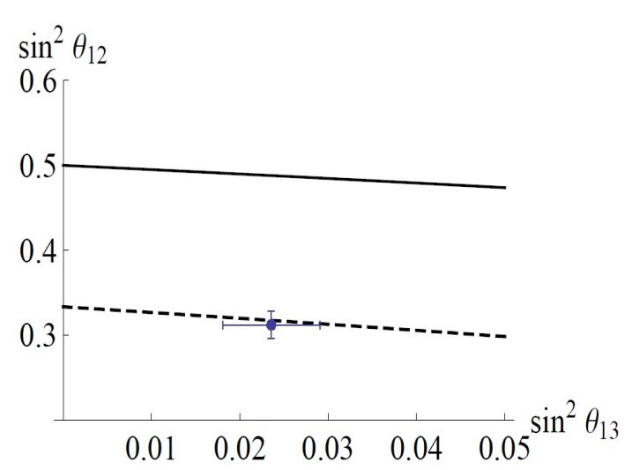
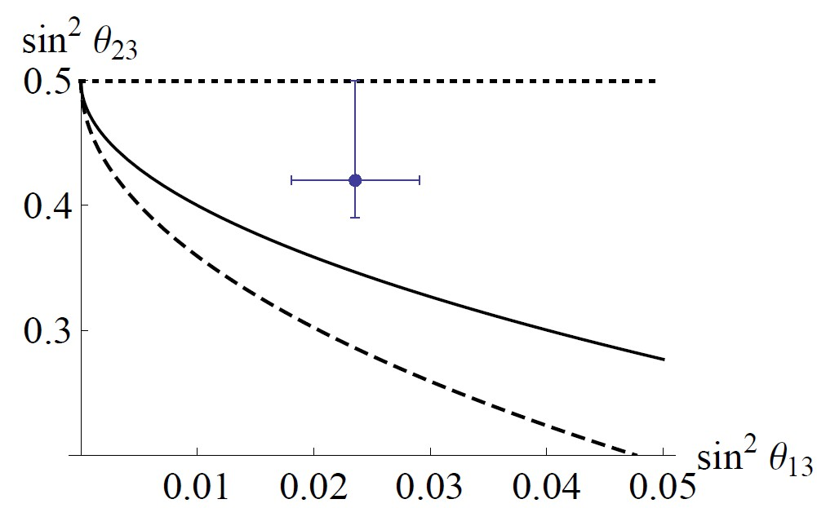
An example
G_{ν} = Z₂
Two relations
D. Hernandez, A Y S.
1304.7738 [hep-ph]
for column of the mixing matrix:
|U_{βi}|² = |U_{γi}|²
1 + a
4 sin² (πk/m)
|U_{αi}|² =
S₄
a = Tr(U_{PMNS} S_{i} U_{PMNS} ⁺ T)
k, m, p integers which
determine symmetry group
δ = +/-103⁰
TBM₁
Schemes with non-zero 1-3 mixing can be obtained
TBM₂
TBM

Slide 53
Outcome

Slide 54
How to test?
Hopeless?
Further precise measurements of
the 1-3 and 2-3 mixings (octant)
Nothing should be observed at LHC which is responsible for neutrino masses
If something is observed against (excludes) framework
Proton decay
Special value of CP-phases
Light sterile neutrinos
Dark matter
May or may not help
Inflation
Leptogenesis

Slide 55
3ν - paradigm
All well established/confirmed
results fit well a framework
with
- three neutrinos
- interactions described
by the standard model
- with masses and mixing
It is widely believed that
Connection exists
Zero conserved
Majorana
charges
nature
Smallness
Large
ν_{R}
Where is
of masses
mixing

Slide 56
Neutrinos and DM
Is the (hot) component
of the DM
RH neutrinos as DM particles
Neutrino portal connects DM and neutrinos
Mechanism of generation of small neutrino masses is related to DM
DM particles participate (appear in loops) in generation of neutrino mass
The same symmetry is responsible
for smallness of neutrino mass and stability of the DM
Refraction on DM produces the effective neutrino mass

Slide 57
(g-2)_{μ}
Model building without
model builder
m_{ν}
B-anomalies
R_{K*}
Lepton
non-universality
R_{D*}
Systematic way to search for connection is to use effective FT
Opening
Closure
H
H
L
L
L
L
New interactions with new (often exotic) particles
gauge inv. operators
constructed out of SM
fields , with ΔL =2
D5 operator
m_{ν}
Contribute to
R_{K*}
(g -2)_{μ}
R_{D*}
UV completion

Slide 58
We can not exclude that neutrino oscillations are explained the refractive mass squared
Refraction in cold gas: energy dependent mass at low energies: avoid the cosmological bound on sum of neutrino masses from structure formation
Refraction in classical coherent field: energy independent mass:
Problem with cosmology? Late formation of the field?
Nature of neutrino mass can be related the nature of Dark matter and the Cosmological evolution

Slide 59
Flavor neutrinos
Flavor neutrinos:
ν_{e}
ν_{μ}
ν_{τ}
are neutrinos associated with or
correspond to certain charged leptons
The correspondence is established
by the charged current weak interactions
e
μ
τ
Flavor is characteristic of interactions
Flavor states -- Weak interaction states
In the presence of vacuum mixing (masses) - ambiguity :
Two ways to determine flavor states
Theoretically
Phenomenologically
at the Lagrangian
(weak current) level

