Slide 1

Neutrino Mass and mixing:
theoretical aspects
A. Yu. Smirnov
Max-Planck Institut fur Kernphysik,
Heidelberg, Germany
MAYORANA School
Modica, July 6, 2023

Slide 2
Three lectures on three neutrinos
Nature of neutrino mass and its smallness
Mass, mixing and flavor symmetries
Mass and big picture: quarks and leptons, unification, connections

Slide 3
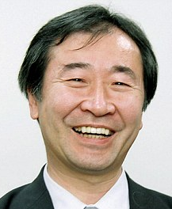

The Nobel prize in physics 2015
Takaaki Kajita
Arthur B. McDonald
“ for the discovery of neutrino oscillations, which shows that neutrinos have mass”
But how do we know that
the mass is behind oscillations?

Slide 4
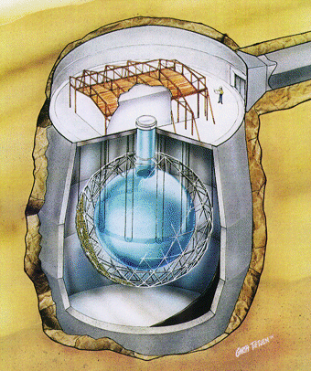
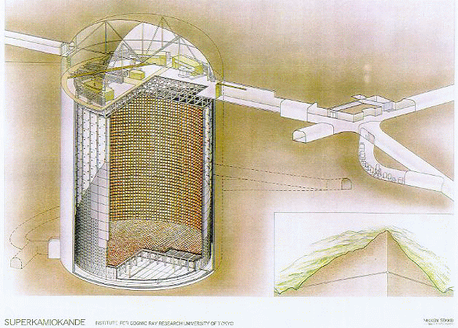
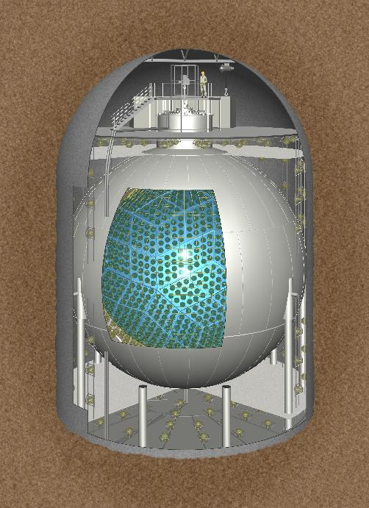
SuperKamiokande, SNO
KamLAND
| ν_{μ} > = cosθ | ν₂ > + sinθ | ν₃>
Mass states are orthogonal and normalized:
< ν _{i} | ν _{k} > = δ_{ik}
iφ
A(ν_{μ} ) = <ν_{μ} |ν (x,t)> = cos²θ g₂(x – v₂ t) + sin²θ g₃(x – v₃t) e

Slide 5
Neutrino mass?
Indeed, oscillation of atmospheric neutrinos (Takaaki Kajita) and adiabatic conversion of Solar neutrinos (Arthur B. McDonald) were discovered.
But how do we know that the mass is behind oscillations?
What is needed to realize oscillations?
production of state which is a coherent mixture
of states which acquire different phases in the course of propagation
- Different phases are due to different dispersion relations
E = E(p)
For this no mass or difference of masses is needed

Slide 6
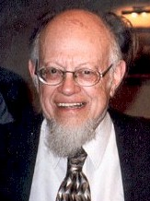
Oscillations without mass
Lincoln Wolfenstein 1978
Oscillations of massless neutrinos
Introduced:
Non-standard interactions of neutrinos –
non-diagonal in the flavor basis →
produce potentials
E_{i} = p + V_{i}
Introduced 4 –fermionic (local) interactions
→ imply heavy mediators
→ no energy dependence of the oscillation effects

Slide 7
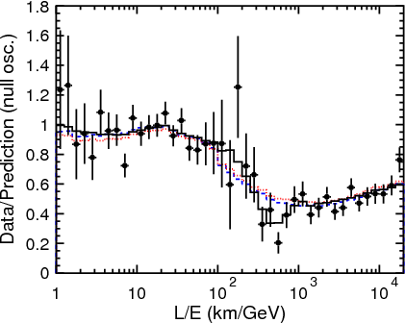
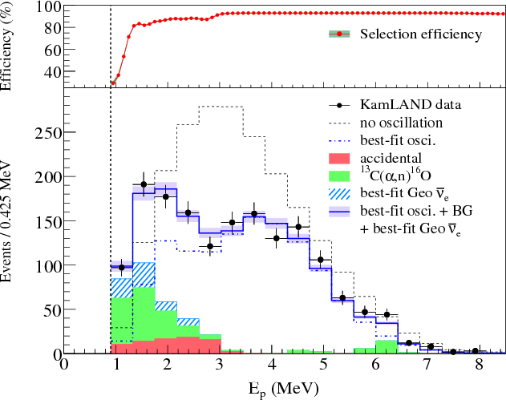
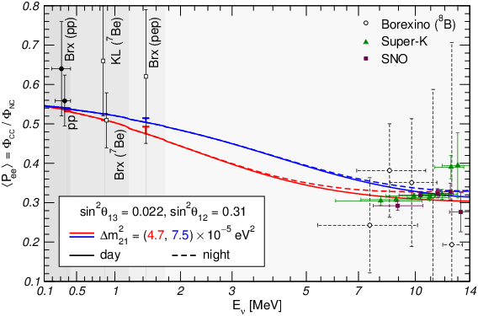
The energy dependence found !
KamLAND
SK
Sun
also MINOS, Daya Bay, RENO ...
in agreement with the presence of the mass term in the Hamiltonian of evolution:

Slide 8
Mass and oscillations
Hamiltonian of evolution responsible for oscillations
H = E = p² + |m|² = p + |m|²/2E
m is usual (vacuum) mass that appears in equation of motion in vacuum
(inertial mass)
For 3 neutrinos:
m → M
3x3 mass matrix
|m|² → MM⁺
Matter potential if
oscillations occur in matter
MM⁺
2E
H = p I + + V
Term with 1/E dependence in H
Leads to energy dependence of
oscillation effects

Slide 9
Mass and oscillations
It is this energy dependence of the oscillation effects which led to conclusion that neutrinos have a mass
Few comments:
Oscillations of relativistic neutrinos probe (mass)²
and not directly (mass)
The mass changes chirality while mass square does not.
Mass operator of neutrinos has gauge charge and appears as a result of symmetry breaking. Mass squared is gauge invariant and does not require the symmetry breaking
In oscillations there is no direct probe of mass,
any contribution to the Hamiltonian of evolution which has A/E form
with constant A can reproduce the oscillation data.

Slide 10
Matter potential
L. Wolfenstein, 1978
for ν_{e} ν_{μ}
ν_{e}
e
Elastic forward
scattering
V_{e}, V_{μ}
potentials
W
e
ν_{e}
V ~ 10⁻¹³ eV inside the Earth
difference of potentials
Refraction index:
V = V_{e} - V_{μ} = 2 G_{F} n_{e}
n - 1 = V/p

Slide 11
Energy dependence of Matter potential
Even in the SM:
C. Lunardini, A.S.
V
~
1/m_{W}² , s << m_{W}²
V ~
1/2m_{W}E, s >> m_{W}²
Above resonance V ~ 1/E → potential can substitute the mass term
Wolfenstein limit
If mediator is light as well as target particle is light, the 1/E dependence shows up at low explored energies.
1/E
resonance
E
Ki-Yong Choi, Eung Jin Chun,
Jongkuk Kim, 1909.10478,
2012.09474 [hep-ph],
Generic feature
of scattering

Slide 12
Refractive mass squared
m_{ref}² 2E
H = p I + V(E) = p +
|Δm_{ref} ²|
existing
observations
m_{ref}² = 2EV
m_{ref}² = constant –
far above resonance
E_{R}
E
~ constant m_{ref}² explains oscillation data
Then why do we say that neutrino has a mass?
What is this mass?
Manibrata Sen, AYS, 2306.15718 [hep-ph]
m_{vac} or m_{ref}
Depends on number density of scatterers

Slide 13
Vacuum mass vs. Refractive mass
Exists in vacuum:
no background, no interactions.
Appears in background
due to interactions, scattering on the background
Lorentz invariant
Appears in equation of motion,
propagator, dispersion relation
Affects kinematics (decays, resonances)
Determines the group velocity
No dependence on energy
Energy dependence -
due to radiative corrections , RGE effect
Depends on energy and density of background
If go deeper, the difference may not be so significant

Slide 14
Δm₄₁² = 1 - 2 eV²
Standard model
LSND
and neutrino masses

Slide 15
Neutrinos in SM
Chiral components
ν_{e}
e
ν_{μ}
μ
ν_{τ}
τ
I_{W} = 1/2
I_{3W} = 1/2
ν _{L} = ½(1 - γ₅) ν
L
L
L
ν _{R} = ½(1 + γ₅) ν
?
ν_{e} ν_{μ} ν_{τ}
neutrino flavor states, form EW doublets
(charged currents) with definite charged leptons,
ν_{l}
l
ν_{l}
ν_{l}
l = e , μ , τ
Neutral
current
interaction
W
Z
g
2 2
g
4
l γ ^{μ} (1 - γ₅)ν_{l} W⁺_{μ} + h.c.
ν_{l} γ ^{μ} (1 - γ₅)ν_{l} Z_{μ}
Conservation of lepton numbers L_{e}, L_{μ}, L_{τ}

Slide 16
Where are the right handed neutrinos?
To a large extend this is the key point for ν mass consideration
RH neutrinos
(if exist)
ν _{R} = ½(1 + γ₅) ν
singlets of gauge symmetry =
have zero EW charges: I_{W} = I_{3W} = 0
Q_{EM} = 0
no gauge interactions in the SM
can have Yukawa interactions with Higgs doublet:
h ν_{R} L_{L} iτ₂ H + h.c. = h ν_{R} (ν_{L} H⁰ – l_{l} H⁺) + h.c.
Do they exist?
- Aesthetics: why not, if other SM fermions have?
- Justified in plausible gauge extensions of SM: B – L and L - R symmetric models
U(1)_{B-L} → SU(2)_{L} x SU(2)_{R} x U(1)
- Gravitational anomaly cancellations

Slide 17
Why we should consider other possibilities?
Can neutrino mass be of the same origins as masses of other fermions in SM?
Where are the RH neutrinos?
Smallness of neutrino mass and Large mixing may testify
that origin of neutrino masses may differ from masses of other fermions

Slide 18
Dirac mass terms
L = … - m_{D} ν_{R} ν_{L} + h.c.
4 component → Dirac equation
connects left and right
Electroweak
properties:
(I, I₃, Y) = ( ½, ½, -1 )
Invariant under
transformation
ν_{L} → e^{iα} ν_{L}
U(1) symmetry – lepton number
ν_{R} → e^{iα} ν_{R}

Slide 19
Majorana mass term
Instead of independent RH component
ν_{R} → ν_{L}^{C}
charge conjugation:
ν_{L}^{C} = C (ν_{L})^{T}
C = iγ₀ γ₂
L = … - ½ m_{L} ν_{L}^{T}Cν_{L} + h.c.
→ two component massive neutrino
Electroweak properties
of the mass term
(I, I₃, Y) = ( 1, 1, - 2 )
No invariance under
ν_{L} → e^{iα} ν_{L}
Lepton number of the mass operator: L = 2 and - 2 (for h.c.)
mass term violates lepton number by |ΔL| = 2
Processes with lepton number violation
by |ΔL| = 2 with probabilities
Γ ~ m_{L}²
ββ_{ον}

Slide 20
From Majorana mass to Majorana neutrino
Truly neutral
particle = antiparticle
ν_{M}^{C} = ν_{M}
In general:
ν_{M}^{C} = e^{iβ} ν_{M}
β is the Majorana phase
In terms of chiral
components:
ν_{M} = ν_{L} + e^{iβ} ν_{L}^{C}
L = … - ½ m_{M} ν_{M} ν_{M} = - ½ m_{M} e^{iβ} ν_{L}^{T} C ν_{L} + h.c.
The Majorana phase can be attached to the mass
Majorana phase does not enter dispersion relation → oscillations

Slide 21
Majorana neutrino
*
Other differences from Dirac, Weyl neutrinos apart from mass?
Can nature be established in other ways apart from neutrinoless double beta decay i.e. |ΔL| = 2 processes?
C. W. Kim …
Majorana condition Φ^{C} = Φ ◊ Interactions with Z⁰ have axial vector γ_{μ} γ₅ structure

Slide 22
Dirac + Majorana
If right components exist, the Majorana mass terms for them:
L = … - ½ M_{R} ν_{R}^{T}Cν_{R} + h.c.
(I, I₃, Y) = (0, 0, 0)
→ mass term does not violate the EW symmetry
|ΔL| = 2
General form of mass
terms (matrix)
m_{L} m_{D}
m_{D}^{T} M_{R}
ν_{L}
N_{L}
N_{L} = ν_{R}^{C}
Limits:
m_{L} = M_{R} = 0
Dirac neutrino = two Majorana neutrinos
with equal but opposite sign masses +/- m_{D}
m_{L} = M_{R} << m_{D}
Pseudo Dirac neutrino
M_{R} >> m_{D}
Seesaw

Slide 23
Neutrino mass and EW Symmetry breaking
x
H
Higgs doublet
Dirac
m_{D} = h <H>
>
>
ν_{L}
ν_{R}
x
Majorana
Δ
Higgs triplet
m_{L} = f <Δ >
>
<
Elementary or composite
higgs with I_{W} = 1
ν_{L}
ν_{L}
x
x
H
H
m_{L} = f <H> <H>
>
<
ν_{L}
ν_{L}

Slide 24
Standard
“m ”
Oscillations
Adiabatic conversion
+
Model
ν
Physics BSM responsible for m_{ν}
can be introduced in such a way that feedback on SM is negligible
Dirac mass
Majorana mass
Effective mass
1
Λ
Y Lν_{R} H
LL HH
m_{ν} (E, n, ..)
generated by interactions with medium, e.g. DM
D5 Weinberg operator

Slide 25
Δm₄₁² = 1 - 2 eV²
Smallness of
LSND
neutrino masses

Slide 26
As other fermions in SM?
m = h <H>
h is constant yukawa coupling
Confirmed by LHC with single Higgs boson
Why not the same for neutrinos?
h ~ 2 10⁻¹³
Still OK
In the first approximation in SM m_{ν} = 0.
Neutrino mass as correction to (perturbation of) the SM ?
Weinberg approach

Slide 27
Smallness of mass
m₃
<H>
~ 2 10⁻¹³
Special
comparing within generation:
m₃
m_{τ}
~ 3 10⁻¹¹
Similar for other generations
if spectrum is hierarchical
Normal?
Neutrinos: no clear generation structure and correspondence light flavor – light mass, especially if the mass hierarchy is inverted or spectrum is quasi-degenerate
Mass gap
m₃
m_{e}
m_{e}
m_{t}
~ 3 10⁻⁶
~ 3 10⁻⁶
gap
10⁻³
10⁰
10³
10⁶
10⁹
10¹²
mass, eV

Slide 28
Two aspects of smallness
Suppression wrt. the EW scale
Finite value
Why there is no usual scale Dirac masses?
Mechanisms unrelated
to suppression of usual Dirac masses
1. No RH component → Dirac mass can not be formed
Seesaw type II,
Radiative mechanisms
2. Symmetry forbids
Dirac mass term
3. Some mechanisms
of suppression of mass,
finite value of m is negligible
See-saws type-I does
both things simultaneously: incomplete suppression

Slide 29
EFT and the neutrino mass
S. Weinberg
Only observed SM particles (multiplets) are involved.
New physics should be parametrized by high dimensional
(non-renormalizable) operators in the Hamiltonian.
Analogy with Fermi theory of WI at low energies
Next to the SM operators (D4) is the D5 operator
1
generates the Majorana neutrino mass
LLHH
Λ
<H>²
Λ
Large scale
of new physics
Other new physics appears in order Λ² → strongly suppressed
That’s all?
Will we learn more?
Violation of universality, unitarity

Slide 30
Higher dimension operator
D=5 operator can be suppressed by symmetry
H → i H
H_{n-1}
1
Λ^{n-1}
H₂
. . .
L L H^{n}
H₁
H_{n}
allows to reduce the scale of new physics
responsible for neutrino mass generation
<H> ^{n}
Λ^{n-1}
m_{ν} =
ν
ν
1
Λ^{n-1}
m_{ν} = Π_{i = 1…n} <H_{i}>

Slide 31
Δm₄₁² = 1 - 2 eV²
Mechanisms of smallness
of neutrino masses
LSND

Slide 32
Smallness of m
ν
New large
New
mass scale
symmetries
Extra
See-saw
mechanism
dimensions
Forbid the usual
Dirac mass terms
Overlap mechanism
Radiative generation
different localization
of the left and right
components
High dimension
operators
small VEV
``Chiral mismatch’’

Slide 33
See-saw
P. Minkowski
T. Yanagida
M. Gell-Mann, P. Ramond, R. Slansky
S. L. Glashow
R.N. Mohapatra, G. Senjanovic
x
H
H
x
m_{ν}
ν
M_{R}
Y
>
x
<
Y
m_{D} = Y<H>
m_{D}
N
N
ν
ν
N
M_{R}
Mass matrix:
M_{R}
ν N
ν
N
0 m_{D}
m_{D}^{T} M_{R}
- Minimal in terms of new particles and assumptions,
- natural extension of SM,
- employing properties
(neutrality) of neutrinos and symmetries
1
M_{R}
if M_{R} >> m_{D}
m_{ν} = - m_{D}^{T} m_{D}

Slide 34
Scale of seesaw
1
m_{ν}
q – l similarity: m_{D} ~ m_{q} ~ m_{l}
M_{R} = - m_{D}^{T} m_{D}
for the third generations
M_{R} ~ 2 10¹⁴ GeV
M_{GUT} ~ 10¹⁶ GeV
for the heaviest in the presence of mixing
M_{GUT}²
M_{Pl}
M_{R} ~ 10⁸ - 10¹⁴ GeV
double seesaw
10¹⁶ - 10¹⁷ GeV
many heavy singlets (RH neutrinos)
…string theory
N ~ 10²
Also in favor of high scale:
Gauge coupling unification
Leptogenesis
UV completion of the Weinberg operator: Λ ~ M_{R}

Slide 35
See-saw and L-R
ν_{L}
ν_{R}
m_{D}
M_{R}
Naturally embedded into SU(2)_{L} x SU(2)_{R} x U(1)_{B-L}
Φ
ν_{L}
ν_{R}
Δ_{R}
M_{R}
Δ_{L}
< Δ_{R}>
m
W_{R}
Seesaw scale is determined by the scale of L- R symmetry violation
< Δ_{L}> = 0
→ type II
Type I + II

Slide 36
Implications for Higgs physics
What is wrong with seesaw?
RH neutrinos have Majorana masses which are not protected by EW symmetry and therefore large

Slide 37
ν- mass and Higgs physics
J Elias-Miro et al,
1112.3022 [hep-ph]
introduces new mass scale
<< M_{Pl}
Renormalization of quartic Higgs coupling λ (making it more negative)
H
ν_{L}
F. Vissani
hep-phl9709409
ν_{L}
ν_{R}
H
H
H
H
ν_{R}
ν_{R}
ν_{L}
y²
(2 π )²
δm_{H}² ~ M_{R}² log (q /M_{R})
M_{R}³ m_{ν}
(2 π v)²
Affects stability and lifetime
of the EW vacuum
~ log (q /M_{R})
M_{R} < 10⁷ GeV
M_{R} < 10¹³ - 10¹⁴ GeV

Slide 38
Neutrino option?
Brivio, M. Trott,
1703.10924 [hep-ph]
Both Higgs mass term and quartic
coupling (absent at tree level)
are generated by neutrino loops
RH neutrino masses is the origin
of the EW scale
M_{R} = 10⁷ - 10⁹ GeV
y = 10⁻⁶ - 10^{-4.5}
Dirac Yukawa coupling

Slide 39
See-saw type-II
H
H
M. Magg and C. Wetterich
G. Lazarides, Q Shafi and C Wetterich
R. Mohapatra, G. Senjanovic,
f
Δ
Seesaw for VEV’s:
h_{Δ}
<Δ> = <H>² f/M_{Δ}²
ν
ν
m_{ν} = h_{Δ} <Δ > = h f <H>² /M_{Δ} ²
Natural smallness of VEV
Light triplet?

Slide 40
Extended seesaws
R. N. Mohapatra, PRL 56,
6, (1986) 561
R. N. Mohapatra and
J W F Valle PRD 34, 5,
(1986) 1642
New fermions – singlets of L-R symmetry
ν_{L}
ν_{R}
S
μ
m_{D}
M_{D}
M_{R} >> m_{D}
No representations/interactions which give Majorana mass of ν_{R}

Slide 41
Double Seesaw
R.N. Mohapatra
J. Valle
Three additional singlets S which couple to RH neutrinos
0 m_{D}^{T} 0
m_{D} 0 M_{D}^{T}
0 M_{D} M_{S}
ν
ν^{c}
S
M_{S} - scale of B-L violation
M_{S} >> M_{D}
M_{R} = M_{D}^{T} M_{S}⁻¹ M_{D}
can be very
hierarchical
1
M_{D}^{T}
1
M_{D}
m_{ν}= m_{D}^{T} M_{S} m_{D}
If M_{S} ~ M_{Pl}, M_{D} ~ M_{GU}
M_{R} ~ M_{GU}²/M_{Pl} ~ 10¹⁴ GeV
explains
intermediate scale
If m_{D} =A M_{D}
m_{ν} ~ M_{S}
Screening of Dirac structures:
m_{ν} may have completely different structure from m_{D}

Slide 42
Inverse Seesaw
R.N. Mohapatra
J. F. Valle
Decreasing scale of seesaw physics
0 m_{D}^{T} 0
m_{D} 0 M_{D}^{T}
0 M_{D} μ
ν
ν^{c}
S
μ - scale of B-L violation
μ << m_{D} << M_{D}
m_{ν} = m_{D}^{T} M_{D}^{-1T} μ M_{D}⁻¹ m_{D}
the same as in the double seesaw
If
μ ~ keV
M_{D} ~ few TeV within LHC reach
ν^{c} and S form pseudo Dirac neutrino

Slide 43
Scotogenic model
E. Ma, hep-ph 0601225
No RH neutrinos. Why?
H
x
x
H
New elements:
η⁰
λ
higgs doublet ( η⁺ , η⁰ )
- fermionic singlets N_{k} - discrete symmetry Z₂
η⁰
M_{k}
x
ν_{α}
h_{ακ}
h_{βκ}
ν_{β}
Under Z₂ new particles are odd,
SM particles are even
N_{k}
η⁰ has zero VEV
h²
16π²
r ln r
r -1
If Z₂ is exact then
η⁰ or lightest N_{k} are stable and can be Dark Matter particles
m_{ν} = M_{k}
r = M_{η}²/ M_{k}²
For M_{k} = 10 GeV : h = 10⁻⁶

Slide 44
Overlap in extra dimensions
small Dirac masses due to
overlap suppression:
Right handed components are localized
differently in extra dimensions
Grossman
Neubert
Arkani-Hamed,
Dvali, Dimopoulos
Warped extra D
Flat extra D
Hidden
brane
Visible
brane
3D brane
wave functions
f_{R}
f_{L}
f_{L}
overlap
f_{R}
overlap
0
π
m ε f_{L} f_{R} + h. c.
amount of overlap in extra D

Slide 45

Neutrino condensate
Small neutrino masses from gravitational θ-term
G. Dvali and L. Funcke,
Phys.Rev. D93 (2016) no.11, 113002 arXiv:1602.03191 [hep-ph]
No ββ_{0ν} decay due to large q² the vertex does not exist ?
Neutrino mass generation
through the neutrino condensate via non-perturbative interaction
ββ_{0ν} decay - unique process where neutrinos are highly virtual
Neutrino condensation
Due to nonperturbative gravitational interaction <νν>
Analogy with quark condensate)

Slide 46
Vacuum and properties of oscillations
G.Dvali , L Funcke,
1602.03191 [hep-ph]
Order parameter
<Φ_{αβ} > = <ν_{α}^{T}Cν_{β} > ~ Λ_{G} = meV - 0.1 eV
Cosmological phase transition at T ~ Λ_{G}
Neutrinos get masses, in flavor basis m_{αβ} ~ < Φ_{αβ} >
(charged leptons mass generated by usual Higgs field)
m ~ U(θ)^{T} <Φ> U(θ)
<Φ> = diag (Φ₁₁, Φ₂₂, Φ₃₃),
U(θ) - mixing matrix
T < Λ_{G}
Relic neutrinos form bound states φ = (ν_{α}^{T}ν_{β} ),
decay and annihilate into φ (neutrinoless Universe)
Symmetry of system, SU(3)xU(1), spontaneously broken by neutrino condensate - φ are goldstone bosons
φ get small masses due explicit symmetry breaking by WI via loops

Slide 47
Mixing and topological defects
G.Dvali , L Funcke,
T Vachaspati
2112.02107 [hep-ph]
string-wall network
Symmetry breaking:
SU(3) → Z₂ x Z₂ → I
Length scale of strings ~ inter-string separation
ξ = 10¹⁴ m ( λ/a_{G})
Λ_{G}
1 meV
7/2
(self-coupling of string field Φ/scale factor of phase transition)
Travelling around string winds VEV <Φ> by the SU(3) transformation:
< Φ (θ_{S}) > = ω(θ_{W})^{T} <Φ > ω(θ_{W})
ω(θ_{W}) path - O(3) transformation with angles θ_{W} = (θ_{W}¹², θ_{W}¹³, θ_{W}²³).
After the path ω mixing changes as
U = U(θ) ω(θ_{W})
over length ξ: θ_{W} = O(1)
Solar system moves through frozen string-DW background with
v = 230 km/sec. For 6 years (operation of Daya Bay) d = vt = 4 x 10¹³ m
- comparable with expected ξ

Slide 48
Δm₄₁² = 1 - 2 eV²
Back-up
LSND

Slide 49
ν- mass and Higgs physics
Simplest seesaw implies new physical scale
M_{R} ~ m_{D}² /m_{ν} ~ 10¹⁴ GeV
<< M_{Pl}
F. Vissani
hep-phl9709409
ν_{L}
H
H
J Elias-Miro et al,
1112.3022 [hep-ph]
ν_{R}
y²
(2π )²
δm_{H}² ~ M_{R}² log (q/M_{R})
M_{R}³ m_{ν}
(2π v)²
M. Fabbrichesi
~ log (q /M_{R})
Cancellation?
New physics below Planck scale
Small Yukawas,
Leptogenesis ?
M_{R} < 10⁷ GeV
“Partial” SUSY?

Slide 50
Zee-mechanism
x
No RH neutrinos
new bosons: singlet η⁺ , doublet H₂
H₂
(H₁)
η⁺
μ
H₁
(H₂ )
m _{ν} = A [(f m² + m² f ^{T} ) −
− v (cos β)⁻¹ ( f m f ₂ + f₂ ^{T} m f ^{T} ) ]
x
ν_{α}
f_{αβ}
l_{βL}
l_{βR}
f₂
ν_{β}
(ν_{γ} )
A = sin2θ_{Z} ln (M ₂ /M₁)/ (8π² v tan β)
m = (m_{e} , m_{μ}, m_{τ})
If only H₁ couples with leptons
X-G He
P. Frampton, M. C. Oh
T. Yoshikawa
0 m _{eμ} m _{eτ}
0 m _{μτ}
0
Can not reconcile
two large mixings
one small mixing and
hierarchy of Δm²
- inverse hierarchy of f_{αβ}
- f_{αβ} < 10 ⁻⁴

Slide 51
Zee-Babu mechanism
K.S. Babu,
C. Macesanu
μ
No RH neutrinos
new scalar singlets η⁻ and k⁺⁺
η⁻
η⁻
k⁺⁺
f_{αβ}
h_{βγ}
f_{γβ}
m_{ν} ~8 μ f m_{l} h m_{l} f I
x
x
ν_{α}
l_{βL}
l_{βR}
l_{γ R}
l_{γ L}
ν_{β}
m_{l} = diag (m_{e}, m_{μ}, m_{τ})
f and h are matrices of the
couplings in the flavor basis
Features:
- the lightest neutrino mass is zero
- neutrino data require
inverted hierarchy of couplings h
- f, h ~ 0.1
Testable:
- new charged bosons
- decays μ −> γ e , τ −> 3 μ
within reach of the
forthcoming experiments

Slide 52
Clockwork mechanism
fast
rotation
slow
rotation
Strong hierarchy (small quantities)
without small parameters
G. Giudice, et al
Ibarra et all , 1711.02070 [hep-ph]
ν_{L}
Y H
one massless state mostly
here
ψ_{Rn}
ψ_{Rn-1}
ψ_{R2}
Mixing of massless state
in ψ_{Rn} is suppressed
by factor q^{n} , q > 1
ψ_{Ln-1}
ψ_{R1}
ψ_{L2}
ψ_{R0}
ψ_{L1}
ψ_{L0}
1
q^{n}
m_{ν} = Y<H>
Yukawa coupling with massless state Yq^{-n}

Slide 53
How it works
ν_{L}
ψ_{L0} ψ_{L1} ψ_{L2} ... ψ_{Ln-1}
ψ_{R0} ψ_{R1} ψ_{R2} ... ψ_{Rn-1} ψ_{Rn}
YH
m m’ m m’ m m’ m’ m m’
q = m’/m > 1
gear
ψ_{L0} ψ_{L1} ψ_{L2} ... ψ_{Ln-1}
Σ
ψ_{R0}
ψ_{R1}
ψ_{R2}
...
ψ_{Rn}
Mixing of the massless state in ψ_{Rn}
0 0 0 ...
-q 1 0 0 ...
0 -q 1 0 ...
.... 1
0 ... 0 ... -q
q^{n}
q^{n-1}
q^{n-2}
...
1
x
1/N
m_{ν} = Y<H>/N
Suppression factor
Massless state
( q^{n} ψ_{R0} + q^{n-1} ψ_{R1} + q^{n-2} ψ_{R2} + ... + ψ_{Rn})/N
q² - 1
q^{n} q² - q^{-2n}
Normalization:
N² = Σ_{0....n} q^{2j}

Slide 54
Origins of (finite) mass
x
x
Hard mass related to the EW scale
H
H
Gauge
invariance
small effective coupling
ν
ν
small induced VEV formed
by large VEV’s (seesaw II)
…
x
x
Soft mass
VEV created at
small scales
x
Δ
x
melting at T ~ VEV
ν
ν
MAVAN
Environment dependent
masses; relic neutrinos
…
x
x
Gravitationally induced mass
x
Melting couplings
Similarly for Dirac neutrinos

Slide 55
What is the mass?
Mass term changes of chirality of fermion:
ν_{L}
ν_{R}
x
In the SM mass generated due to coupling with classical scalar field in its lowest energy state, Vacuum expectation value VEV of the Higgs field:
m = h <H₀>
= value of the field in the minimum of potential
Variations:
m = h <Δ₀>
triplet for Majorana
m = h² <H₀>² /M_{R}
Seesaw
In oscillations: no change of chirality: (spin state does not change)
ν_{L}
ν_{R}
ν_{L}
x
x
effects ~ m²
m
m

Slide 56
Summary

Slide 57
Seesaw mechanism
m_{ν} = - m_{D} (M_{R} )⁻¹ m_{D} ^{T}
m_{D} = U_{L} (m_{D} ^{diag}) U_{R}⁺
B Dasgupta A.S
In the simplest SO(10): U_{L} = V_{CKM}*
then U_{x} is the matrix which diagonalizes
M_{X} = - m_{D}^{diag} U_{R}⁺ (M_{R})⁻¹ U_{R}* m_{D}^{diag}
that is
M_{X} = U_{X} M_{X}^{diag} U_{X}^{T} = U_{X} m_{ν}^{diag} U_{X}^{T} ~ m_{TBM}
M_{R} = - m_{D}^{diag} (m_{TBM})⁻¹ m_{D}^{diag}
very hierarchical, generated by seesaw itself?
→ Double seesaw

Slide 58
“Usual” mass?
In vacuum:
In presence of interactions:
- appears in equation of motion
- decays
in propagator,
dispersion relation
- resonances
- affects kinematics
of processes
Lorentz invariant
- oscillations
Determines the group velocity
- ββ_{ον} –decays if
L number is broken
Energy dependence of mass due to radiative corrections , RGE effect
For fermions, mass term connects their left and right components
Cosmology: non-relativistic neutrinos, structure formation
Refractive mass?

Slide 59
D5 operator and UV-completion
S. Weinberg
If no new particles at the EW scale, after decoupling of
heavy degrees of freedom →
set of non-renormalizable operators
1
Λ
L L H H
H
H
x
ν
ν

