Slide 1
WP 3 – Access for accelerators Task 3.4 “Applications”
Urszula Gryczka
09.02.2023

Slide 2
WP 3 – Access for accelerators Task 3.4 “Applications
Infrastructure
This TA task groups 2 RIs with 2 installations devoted to testing of R&D ideas for applications using ultra-low energy electron beams for industrial applications and chemistry and using powerful electron beams for accelerators R&D, components testing and medical applications.
Institute of Nuclear Chemistry and Technology (INCT), Warsaw, Poland – RAPID infrastructure
http://www.ichtj.waw.pl/drupal_eng/?q=node/170
CERN
CLEAR -Linear Electron Accelerator for Research
https://clear.cern/

Slide 3
WP 3 – Access for accelerators Task 3.4 “Applications
RAPID - Centre for Radiation Research and Technology
The Center enables irradiation with electron beams in the energy range from 0.2 to 10 MeV and average power from 0.1 to 20 kW, and gamma irradiators with Co-60 (Gamma Chamber 5000 source) to develop the conditions of experimental research, tracking the course of selected radiation processes, as well as modeling and optimization of processes of technological importance.
Unique apparatus for conducting nanosecond impulse radiolysis.
Modern scientific apparatus, among others for paramagnetic resonance spectroscopy (EPR), designed for the characterization of polymeric materials.

Slide 4
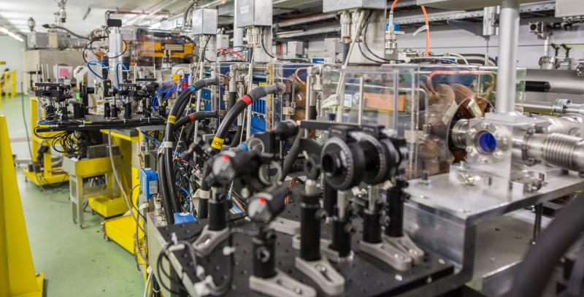
WP 3 – Access for accelerators Task 3.4 “Applications
Is a versatile accelerator instalation, including 200 MeV electron linac accelerator followed by an experimental beam line and operated as multi-purpose user facility,
Focused on accelerator R&D and component studies for existing and future accelerators,
X-band studies for linear accelerators and also novel concepts as plasma and THz acceleration.
Dosiemtry studies and expliring potential application of Very High Energy electron Beam (VHEE) to radiotherapy
CLEAR also provides unique training possibilities, as well as irradiation test capability.
CLEAR - Linear Electron Accelerator for Research

Slide 5
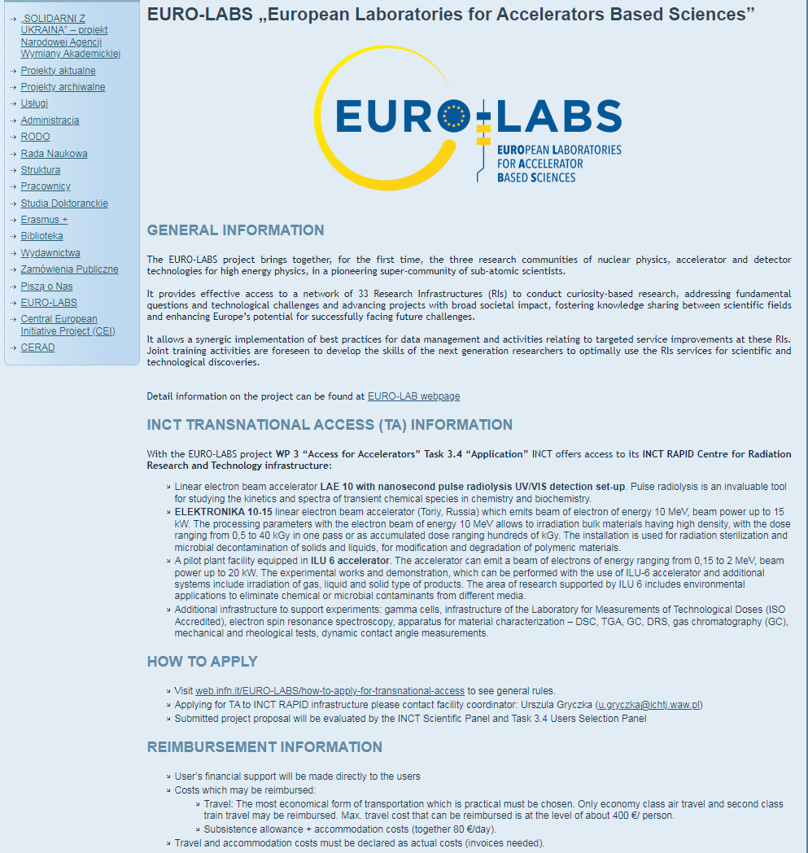
WP 3 – Access for accelerators Task 3.4 “Applications
INCT access :
INCT total access offered – 600 access units (hours)
Estimated number of users – 60
Target users: research groups working in the field of radiation chemistry, developing industrial application of electron beams of energy up to 10 MeV.
Internal projects evaluation procedure: One representative of each installation and RAPID facility coordinator were appointed to the INCT internal projects evaluation group (5 members) which aims to assess the feasibility of each project with the use of RAPID infrastructure.
First meeting scheduled on 27.02.2023
Details on webpage:
http://www.ichtj.waw.pl/drupal/?q=node/1267

Slide 6
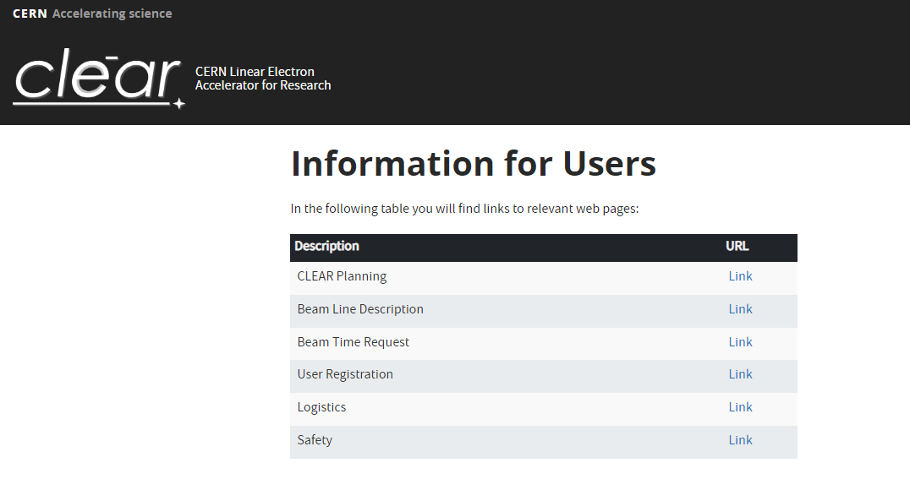
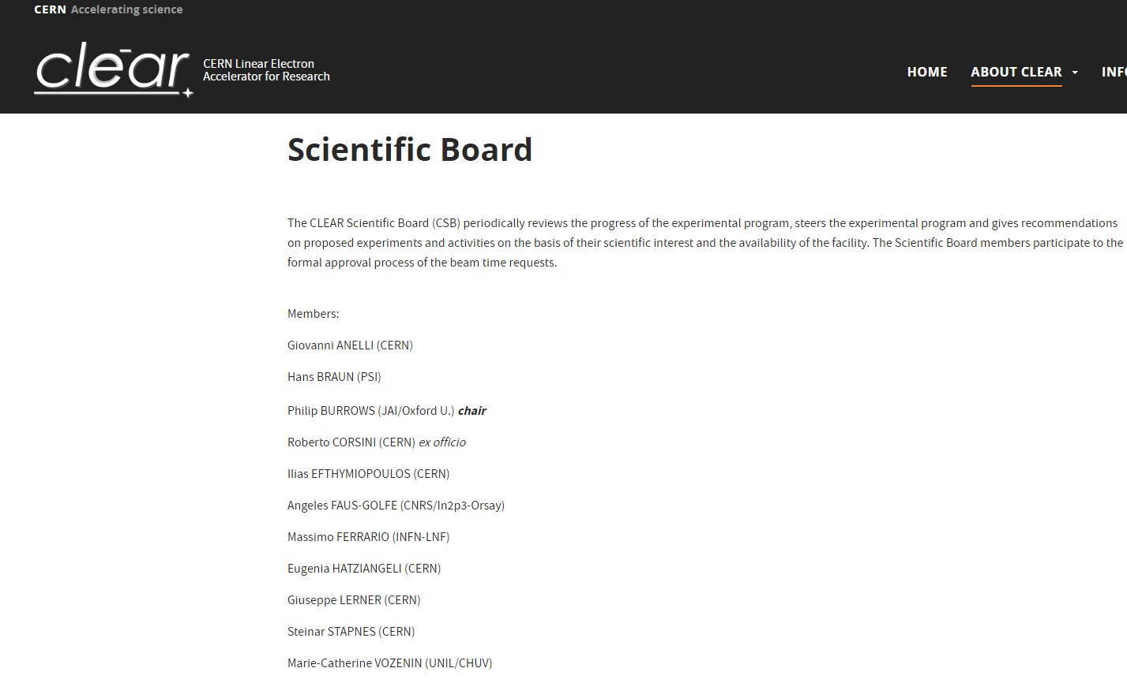
WP 3 – Access for accelerators Task 3.4 “Applications
CLEAR access :
INCT total access offered – 1200 access units (hours)
Estimated number of users – 90
Target users: research teams from the accelerator and HEP community, from fields like electronics R&D for space applications, and from radiotherapy studies for cancer treatmeent
Internal projects evaluation procedure: the users will asked to fill both, Euro-labs application form and CLEAR experiment request form, for the project evaluation by the CLEAR Scientific Committee
Details on webpage:
https://clear.cern/content/information-users

Slide 7
WP 3 – Access for accelerators Task 3.4 “Applications
TASK 3.4 Users Selection Panel
Memebers
Ilias Efthymiopoulos – WP 3 coordinator (CERN)
Urszula Gryczka – task leader/ RAPID facility coordinator (INCT)
Roberto Corsini – CLEAR facility coordinator (CERN)
Angeles FAUS-GOLFE – extarnal expert (CNRS/In2p3-Orsay)
Rob Edgecock – external expert (HUD)
First meeting is planned to be organized at the beginning of March

