Slide 1
INFN4LS meeting
7/2/2022
Status of PNRR-MAD-2022-12376889
Federico Giove

Slide 2
DEVELOPMENT OF ADVANCED MRI METHODS AND OF TAILORED SIGNAL PROCESSING FOR THE QUANTITATIVE CHARACTERIZATION OF NEURODEGENERATIVE DISEASES THROUGH NOVEL BIOMARKERS IDENTIFICATION
Partners:
Fondazione Santa Lucia IRCCS
Azienda Ospedaliero Universitaria Policlinico-Riuniti Foggia
INFN

Slide 3
OBJECTIVE AND AIMS
To develop heteronuclear MR combined with 1H MRI to identify biomarkers of pathophysiological alterations in AD
early diagnosis… prognostic value
interplay with neuroinflammation
energetics
characterization
flexible technology

Slide 4
Aim 1: develop integrated MRI-based metrics, including heteronuclear MRI, for the non-invasive in vivo characterization of
Alzheimer's disease pathophysiology
MRI
UTE (FLORET): K-space trajectory optimization
9.4T: role of microstructure in relaxation properties
Multi-compartment models
TSC: Combined MRI and XRF: multicompartment correlation of 23Na amount (post mortem): CSF, GM, WM, amyloid deposits
IF? Relaxation based methods (IR), combination with 1H-MRI (partial volume)
Denoising
DL, feed forward CNN
Artifacts, background, resolution/information
K-space
19F and 23Na

Slide 5
Aim 2: test the association between 23Na MRI metrics and inflammation and neurodegenerative processes in AD patients
MRI
Use optimized approaches on 650 AD + 50 HC
.. Together with micro/structural (dWI, cortical thickness) and neuroinflammation (fingerprinting, qSM) metrics
… and ASL to test vascular involvement
Biomarkers
CSF and blood markers of inflammation/neurodegenmeration (cytokines, tau, p-tau, neurofilaments)
PET
Flutemetamol: Amyloid deposition (20 patients)

Slide 6
Aim 3: test the role of 23Na MRI metrics as a neuroimaging marker of cognitive dysfunction and neurophysiological alterations in AD.
MRI
Functional MRI (rs networks)
Neurochemical profiling
Neuropsychology
Tests (integrity of executive functions, episodic memory)
PET
FDG: metabolism (20 patients)
TMS
Cortical plasticity

Slide 7
BUDGET
 | FSL | PoliFoggia | INFN | Total
 | MoH | MoH | MoH | MoH
Staff | 357000 | 123400 | 115100 | 595500
Supplies | 103760 | 70000 | 42740 | 216500
Model costs | 30000 | 0 | 0 | 30000
Travel | 17840 | 0 | 5660 | 23500
Publications | 29800 | 0 | 9500 | 39300
Dissemination | 17840 | 2000 | 5660 | 25500
Overhead | 41760 | 14600 | 13340 | 69700
TOT | 598000 | 210000 | 192000 | 1000000
No cofunding, no extisting staff costs

Slide 8
STAFF - EXISTING
FSL | Profile
Giovanni Carlesimo (PI) | Neurologist
Federico Giove | Physicist
Laura Serra | Psychologist
Silvia Capuani | Physicist
Michela Fratini | Physicist
Francesco Di Lorenzo | Neurologist
Gianluca Pozzi | Chemist
Roberto Cuccurello | Neurobiologist
Alessandra Gianoncelli | Physicist
Giuliana Tromba | Physicist
Giusy Olivito | Neurologist
INFN | Profile
Giacomo Cuttone | Physicist
Cecilia Voena | Physicist
PoliFoggia | Profile
Elena Carapelle | Radiologist

Slide 9
STAFF - TBH
FSL | Profile
Sabrina Bonarota | Neuropsychologist
TBD | Physicist (AI)
TBD | (Blood, CSF)
TBD | Physicist (9.4T MRI)
TBD | TBD (clin)
TBD | TBD (Data proc)
TBD | TBD (Data proc)
INFN | Profile
Laura Maugeri | Physicist (XRF)
Maria Guidi | Physicist (MRI)
PoliFoggia | Profile
TBD | Whatever (patients management)
???

Slide 10
GANTT
MONTH |  | 1 | 2 | 3 | 4 | 5 | 6 | 7 | 8 | 9 | 10 | 11 | 12 | 13 | 14 | 15 | 16 | 17 | 18 | 19 | 20 | 21 | 22 | 23 | 24
Aim 1: To develop integrated MRI-based metrics, including heteronuclear MRI, for the non-invasive in vivo characterization of Alzheimer’s disease pathophysiology.
Task1: Optimization of 23Na MRI at 3T and 9.4T
Task2: Development of methods for quantitative X-nuclei MRI processing and interpretation
Task3: Development and testing of X-nuclei AI-based MRI denoising
Aim 2: To test the association between 23Na MRI metrics and inflammation and neurodegenerative processes in AD patients
Task 4: Development of analysis pipeline
Task 5: Enrollement
Task 6: Human data acquisition (PET, MRI, biomarkers, neuropsychological assessment, TMS)
Task 7: Human data processing
Aim3: To test the role of 23Na MRI metrics as a neuroimaging marker of cognitive dysfunction and neurophysiological alterations in AD.
Task 8: Development of analysis pipeline
Task 9: Enrollement
Task 10: Human data acquisition (PET, MRI, biomarkers, neuropsychological assessment, TMS)
Task 11: Human data processing

Slide 11
STATUS/SHORT TERM TIMELINE
Agreement Coordinator/MoH: signed
CE request submitted in 10 days
Expected approval by 28/2
Transmit to MoH official start date: 20/4
Including declarations by all units:
no double funding
accept agreement terms
CE approval
CUP
Translation in Italian (!!!!)
Project starts (funds available): 20/5
Duration can be extended by 6 months

Slide 12
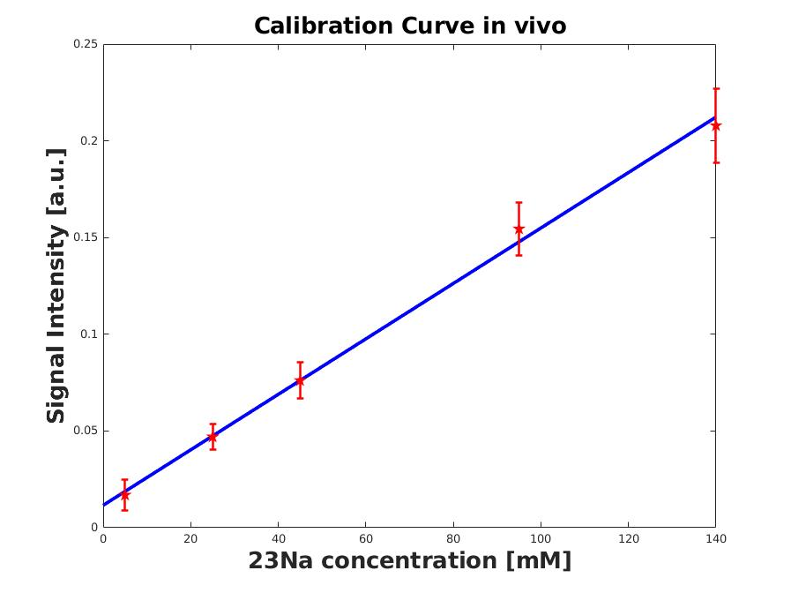
PRELIMINARY DATA
UNLM unbiased denoising

Slide 14
