Slide 1








Towards tests of causal nonlinear quantum mechanics using light-pulse atom interferometry
Tejas Deshpande
Quantum Technologies for Fundamental Physics (Erice)
September 5, 2023

Slide 2
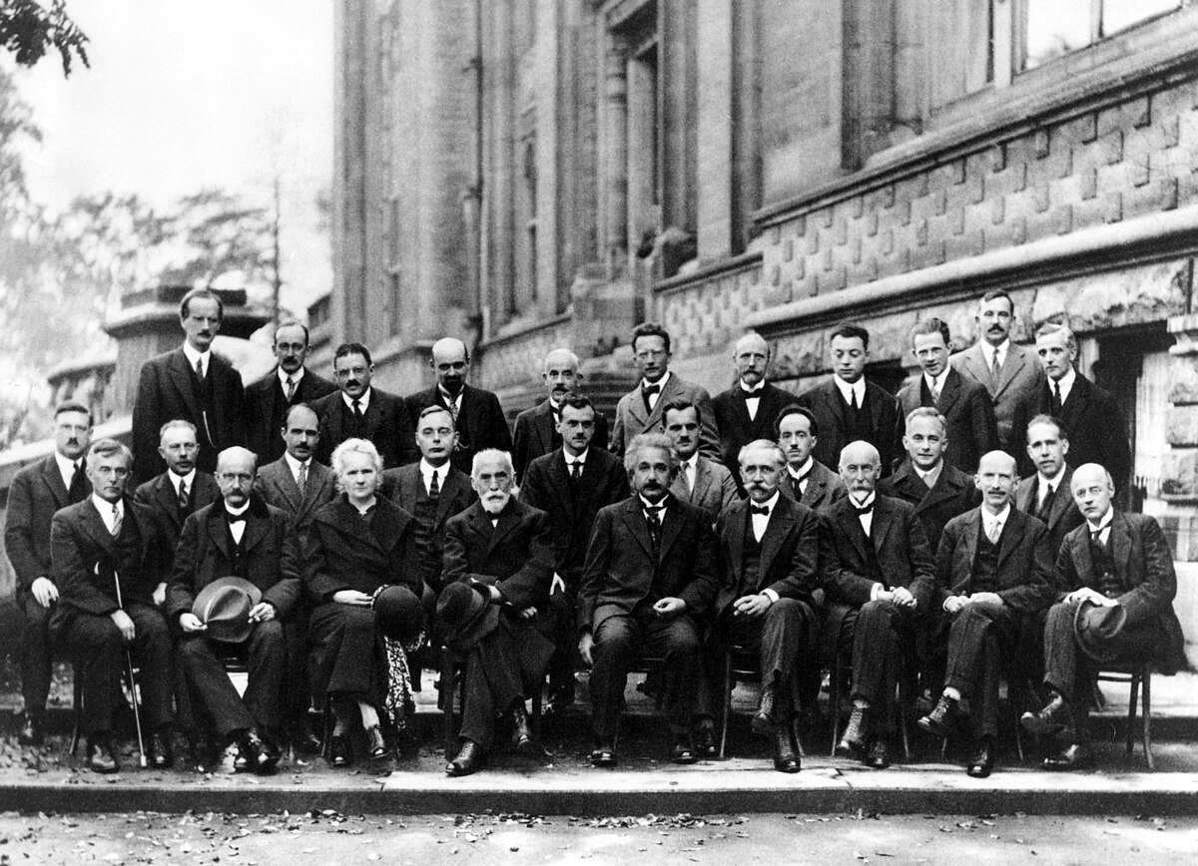
The Copenhagen interpretation of quantum mechanics
Ad hoc hypothesis: wave function collapse
Ambiguity of observer (e.g. quantum cosmology)
“Could the wave function be collapsed by the observations of a mouse?” - Albert Einstein
“...whether the wave function of the world awaited the appearance of a physicist with a PhD before collapsing.” - John Bell

Slide 3
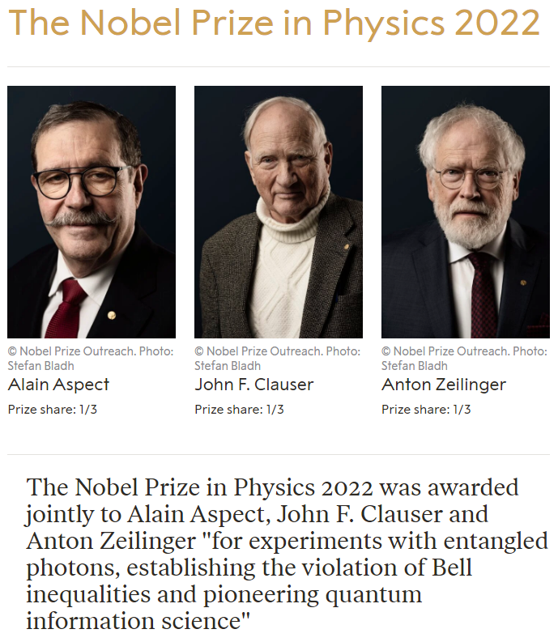
Developments in quantum foundations research
Einstein-Podolsky-Rosen paper (1935)
Bell’s theorem on local hidden variables (1964)
Kochen-Specker contextuality (1967)
Nobel prize in 2022

Slide 4
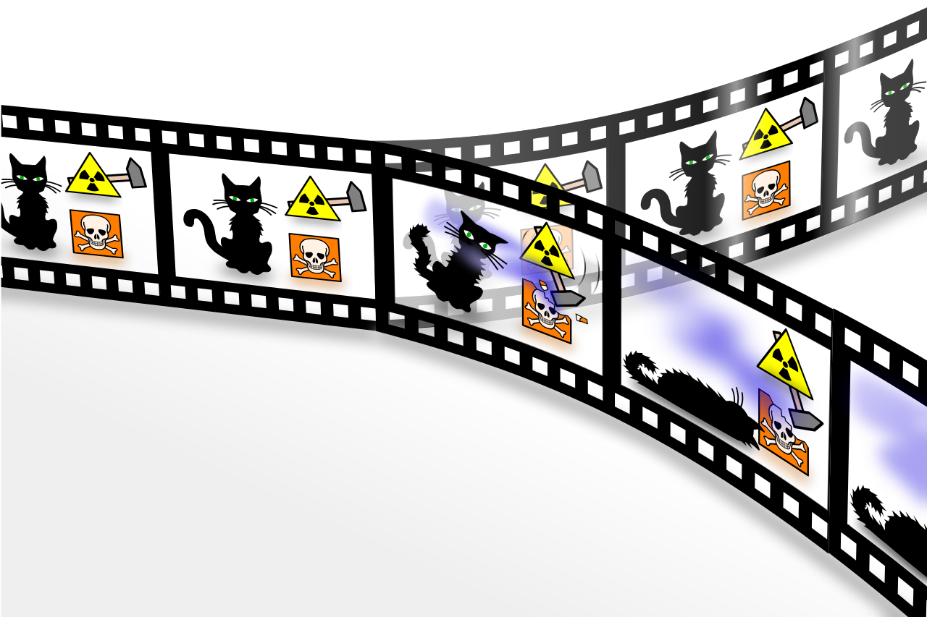
Everett’s many-worlds interpretation
Proposed by Hugh Everett III (1957)
No wave function collapse
Multiverse
Quantum gravity?
Tests with gravity using atom interferometry

Slide 5
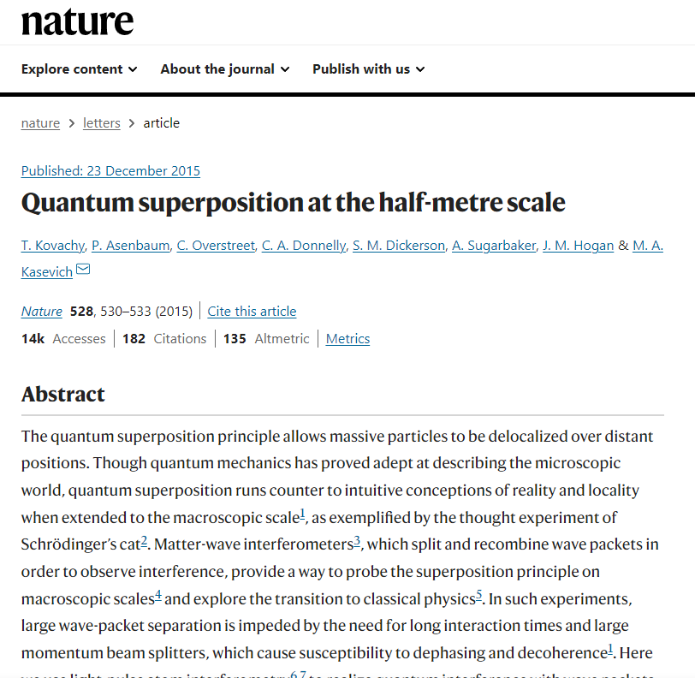
Fundamental tests of gravity using atom interferometry
Quantum superposition at half meter scale

Slide 6
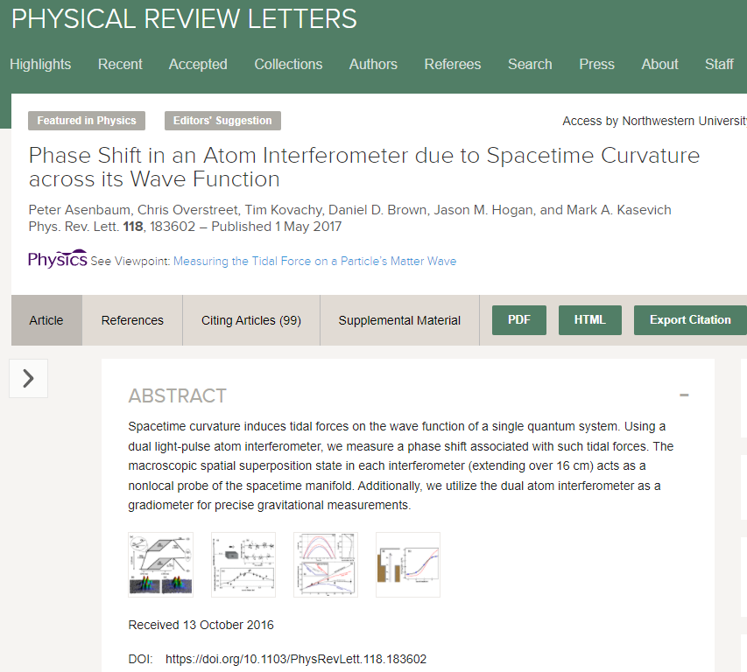
Fundamental tests of gravity using atom interferometry
Quantum superposition at half meter scale
Spacetime curvature across wave function

Slide 7
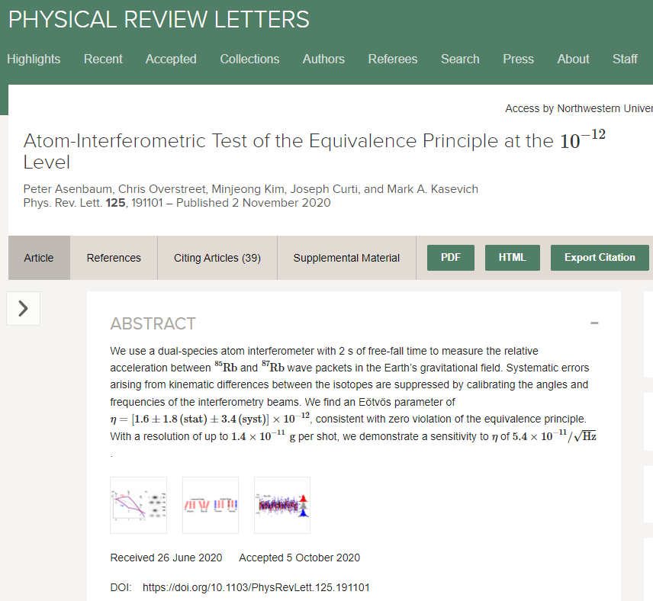
Fundamental tests of gravity using atom interferometry
Quantum superposition at half meter scale
Spacetime curvature across wave function
Quantum equivalence principle tests to 10⁻¹² Eotvos ratio

Slide 8
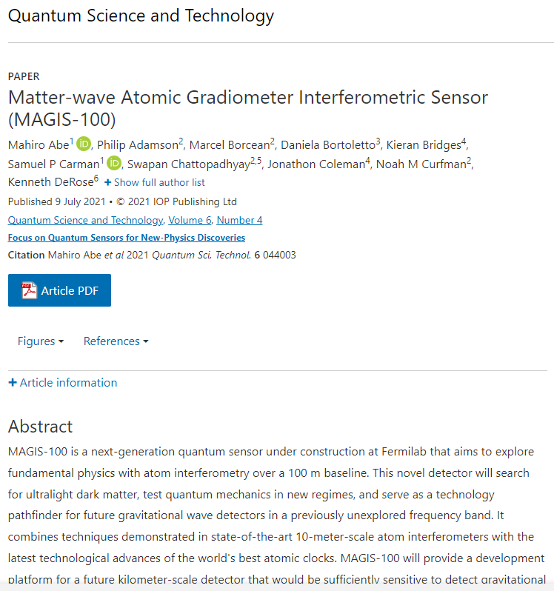
Fundamental tests of gravity using atom interferometry
Quantum superposition at half meter scale
Spacetime curvature across wave function
Quantum equivalence principle tests to 10⁻¹² Eotvos ratio
Gravitational wave & dark matter detection (MAGIS-100)

Slide 9
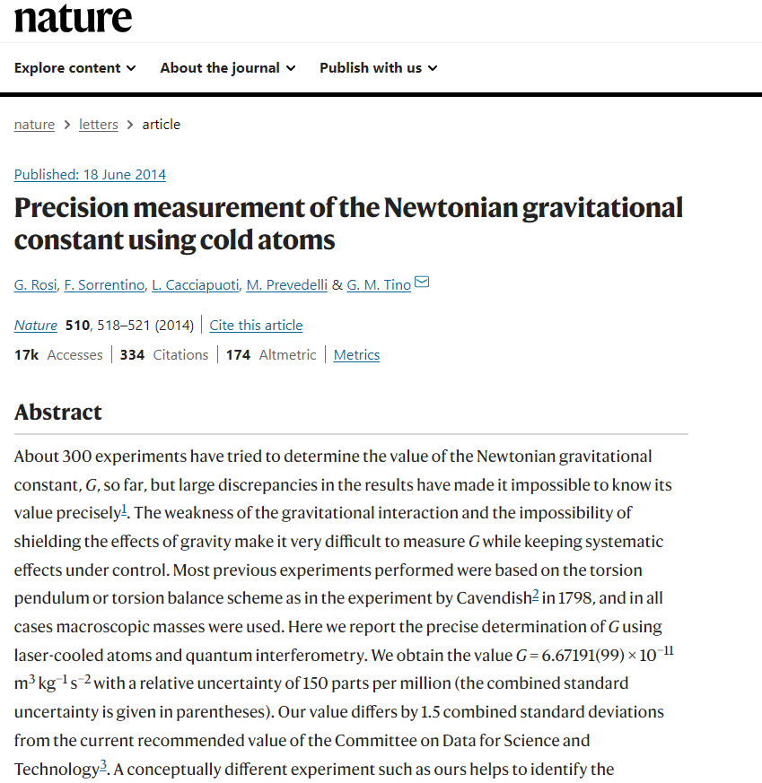
Fundamental tests of gravity using atom interferometry
Quantum superposition at half meter scale
Spacetime curvature across wave function
Quantum equivalence principle tests to 10⁻¹² Eotvos ratio
Gravitational wave & dark matter detection (MAGIS-100)
Precision measurements of G

Slide 10

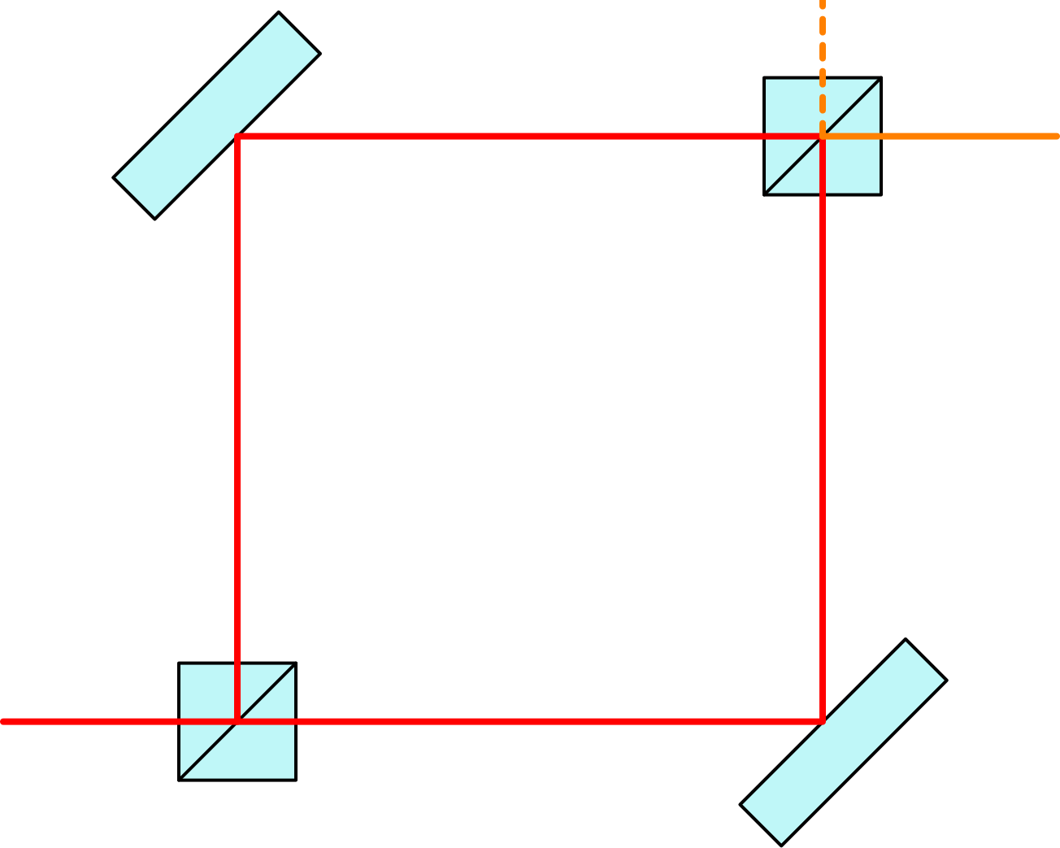
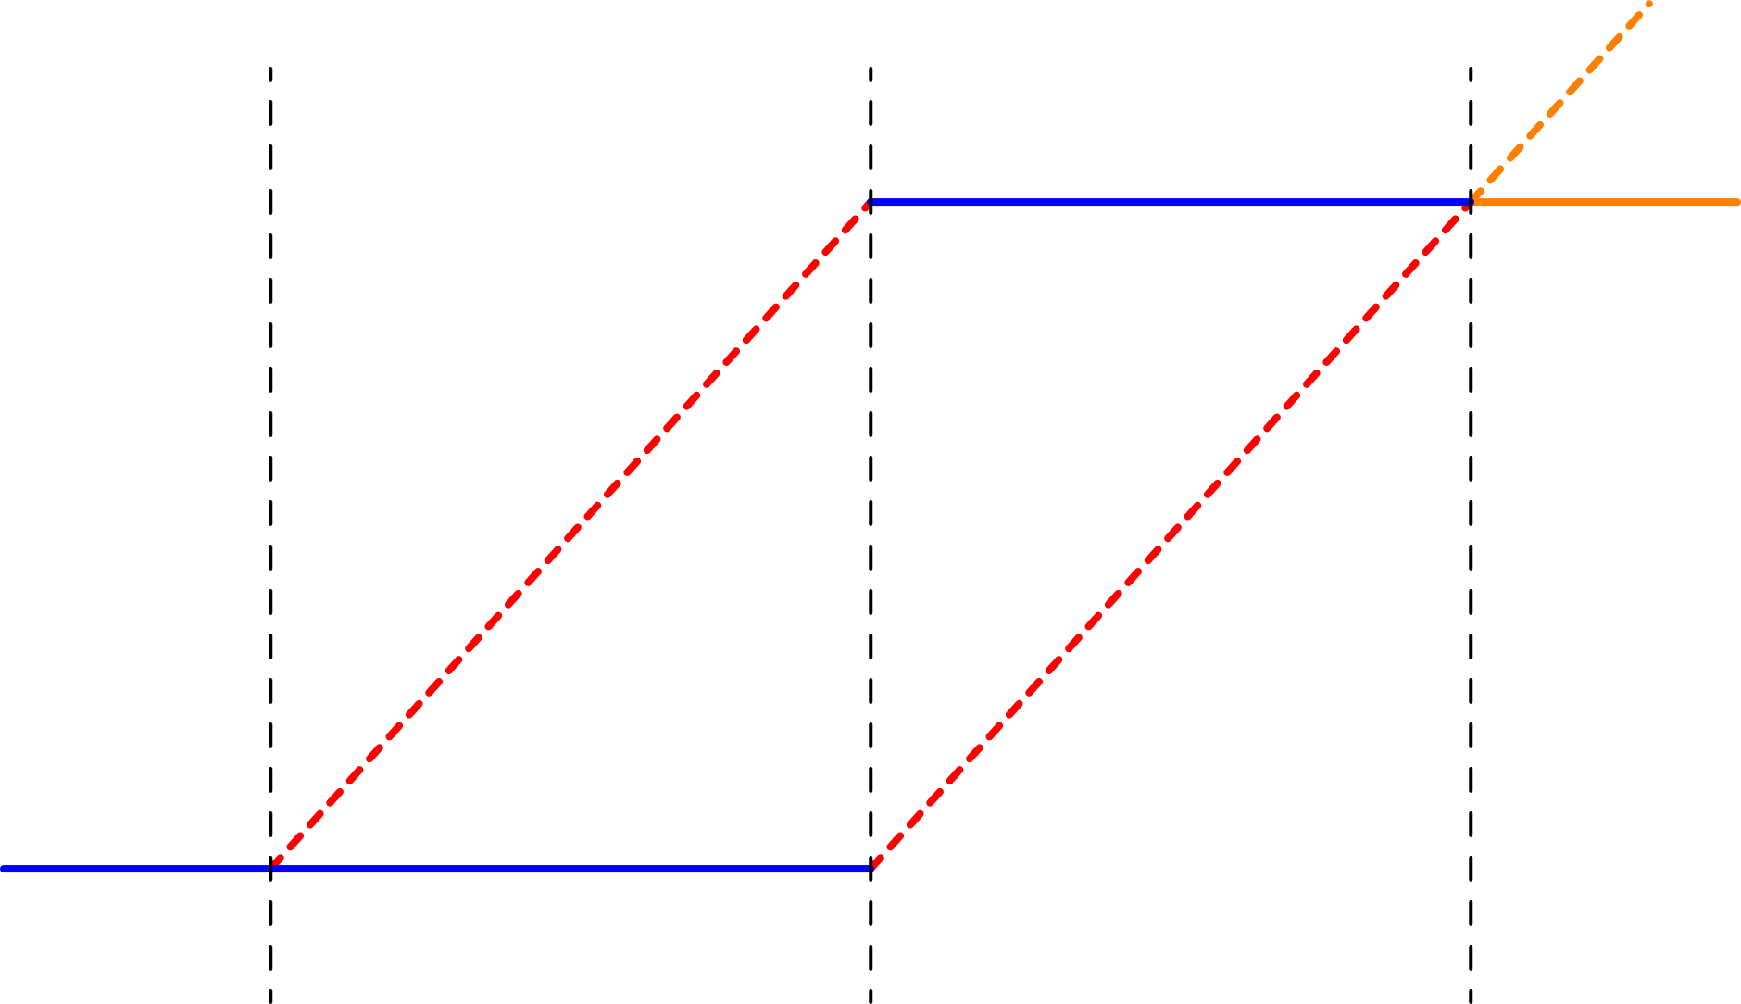

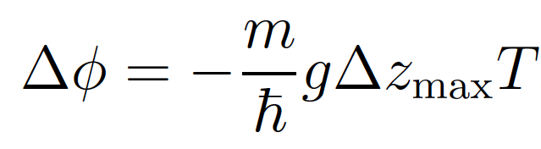




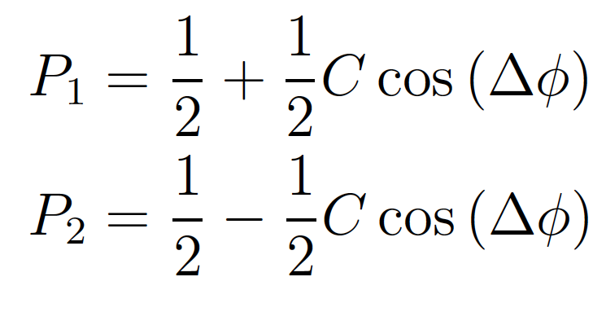
Introduction to atom interferometry
Optical Mach-Zehnder interferometer
Atom interferometer
Beamsplitter
Mirror

Slide 11
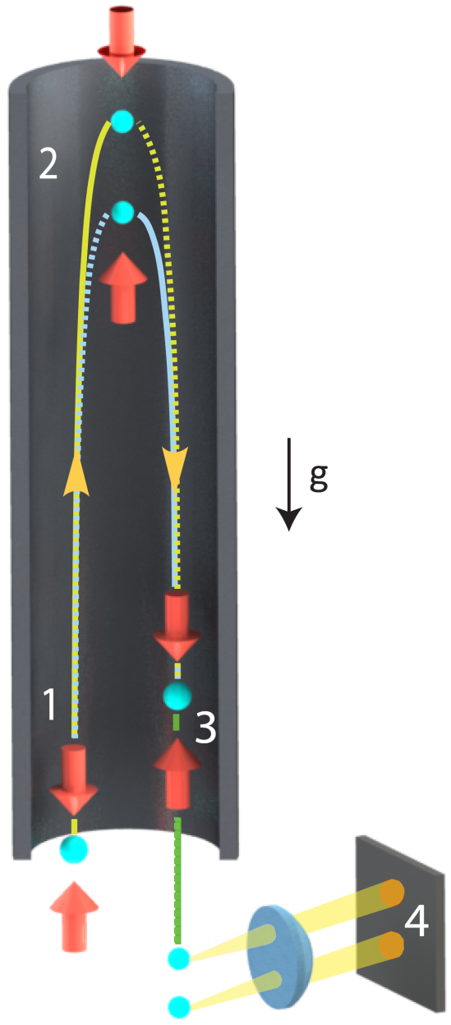
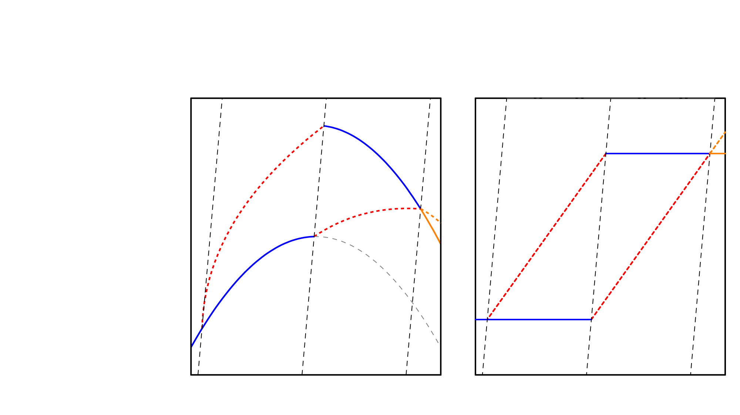



Spacetime diagram formalisms for atom interferometry
Lab frame
Freely falling frame

Slide 12
















Overview of electronic properties of Strontium
(2-photon Bragg)
(Gravitational wave)

Slide 13






Atom optics: lasers as beamsplitters and mirrors for atoms
Beamsplitter
Mirror
(1) Light absorption:
(2) Stimulated emission:

Slide 14
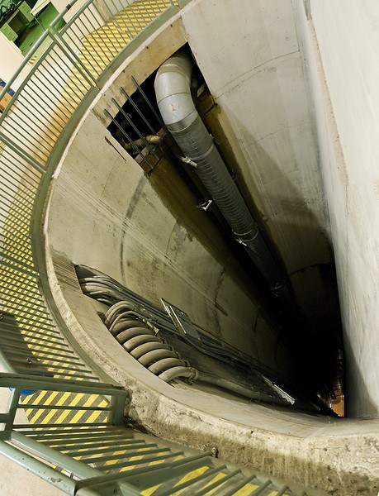
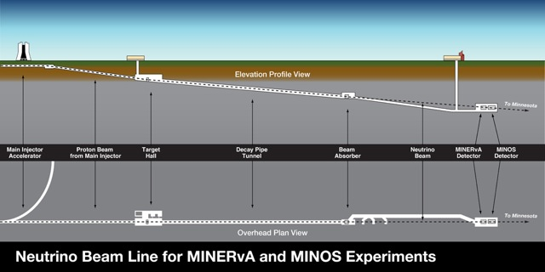
Overview of MAGIS-100 experimental facility
Matter-wave Atomic Gradiometer Interferometric Sensor
100 m shaft

Slide 15
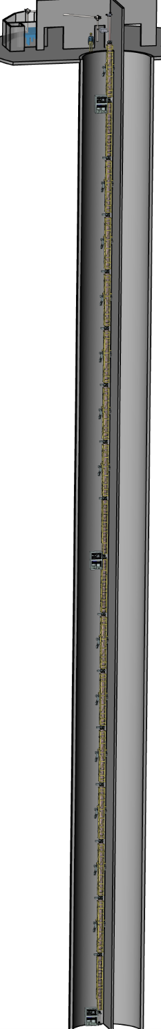
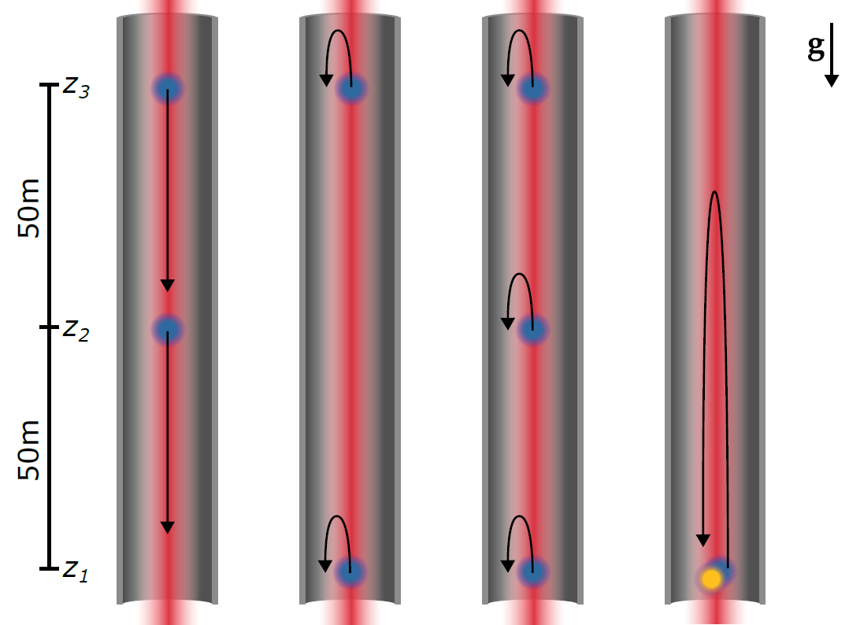
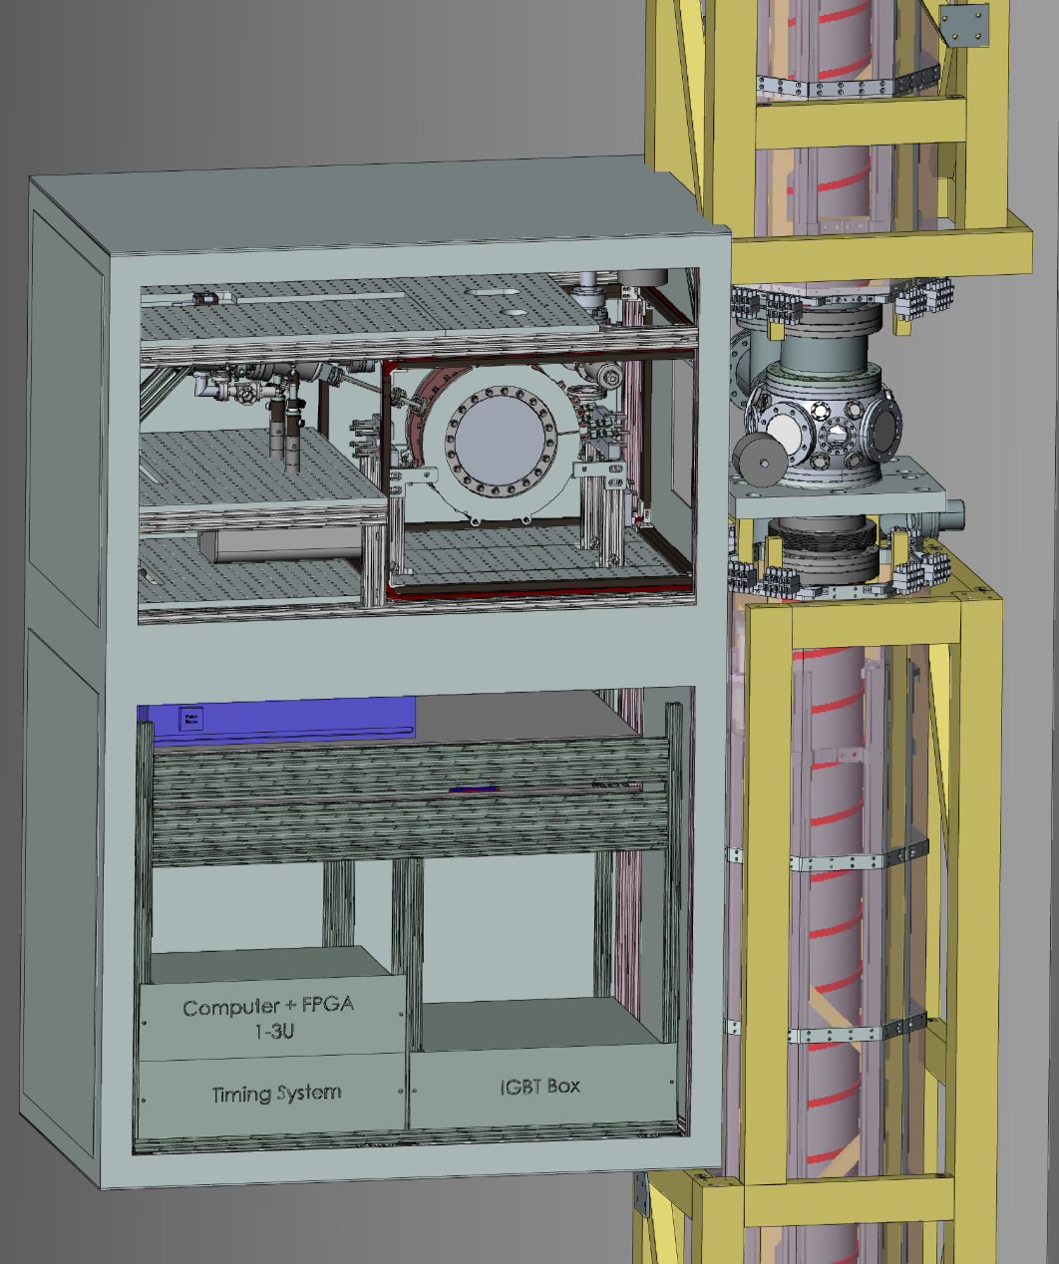

100 meter atom interferometer (MAGIS-100) system overview
Ground-level laser lab
Strontium atom source enclosure
Top atom source
Middle atom source
Bottom atom source

Slide 16
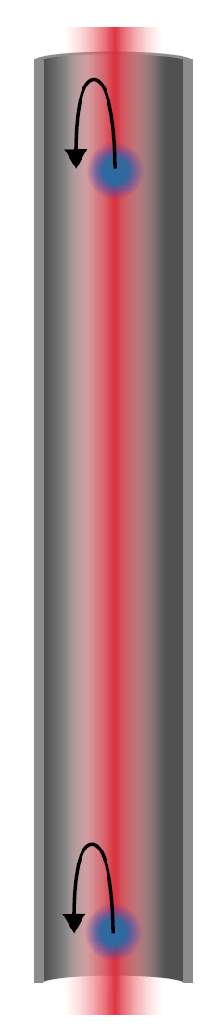
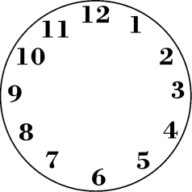
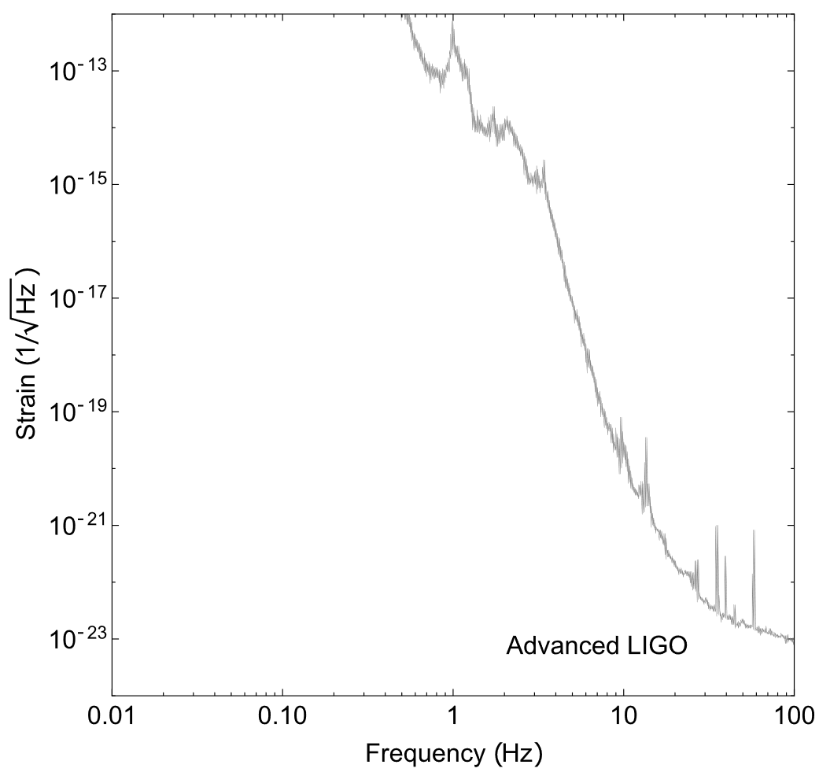

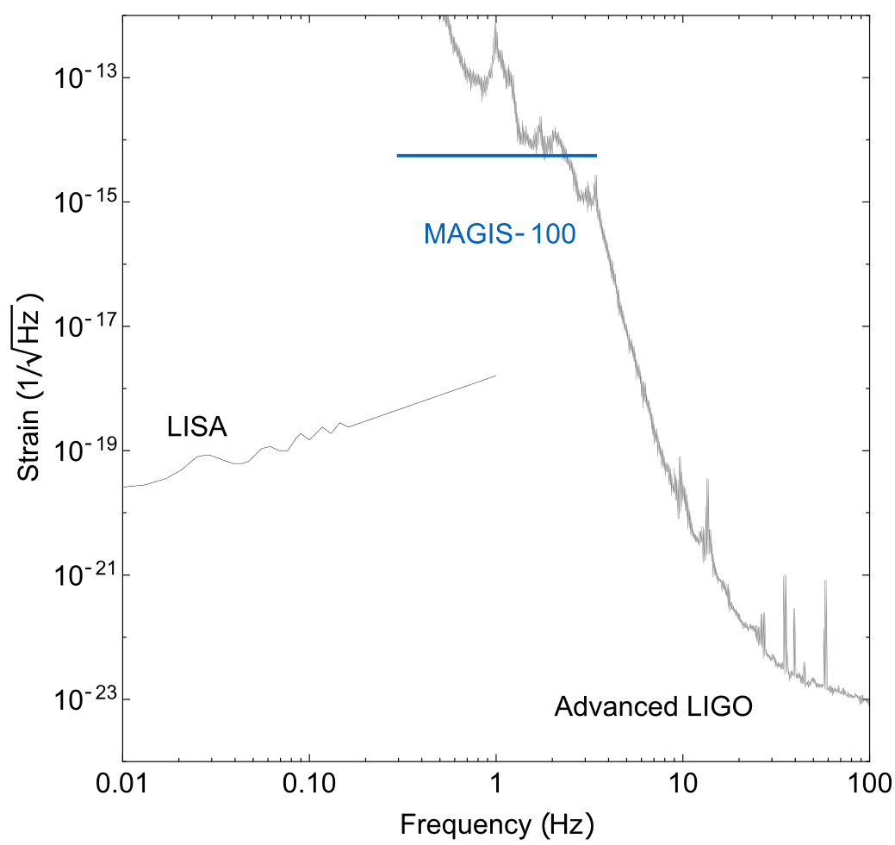
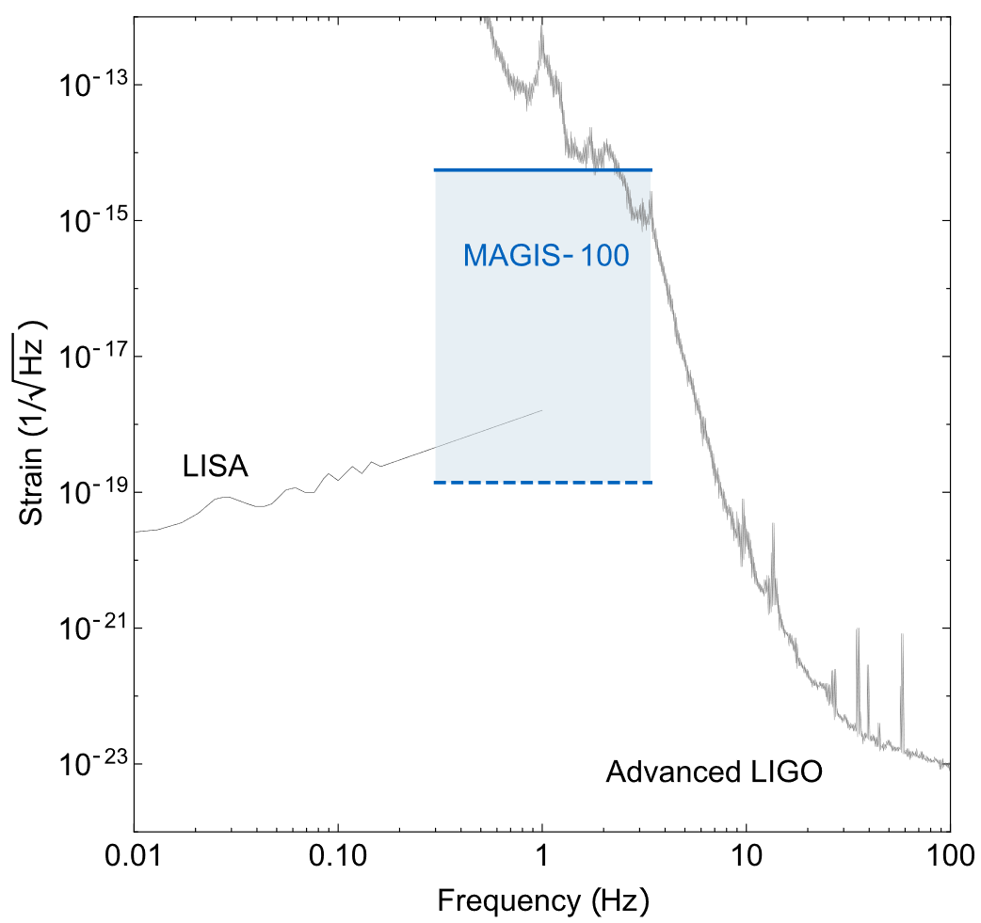
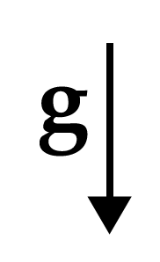

Gravitational wave detection with MAGIS scheme
Strain
LIGO: Laser Interferometer Gravitational-Wave Observatory
LISA: Laser Interferometer Space Antenna
MAGIS: Matter-wave Atomic Gradiometer Interferometric Sensor

Slide 17
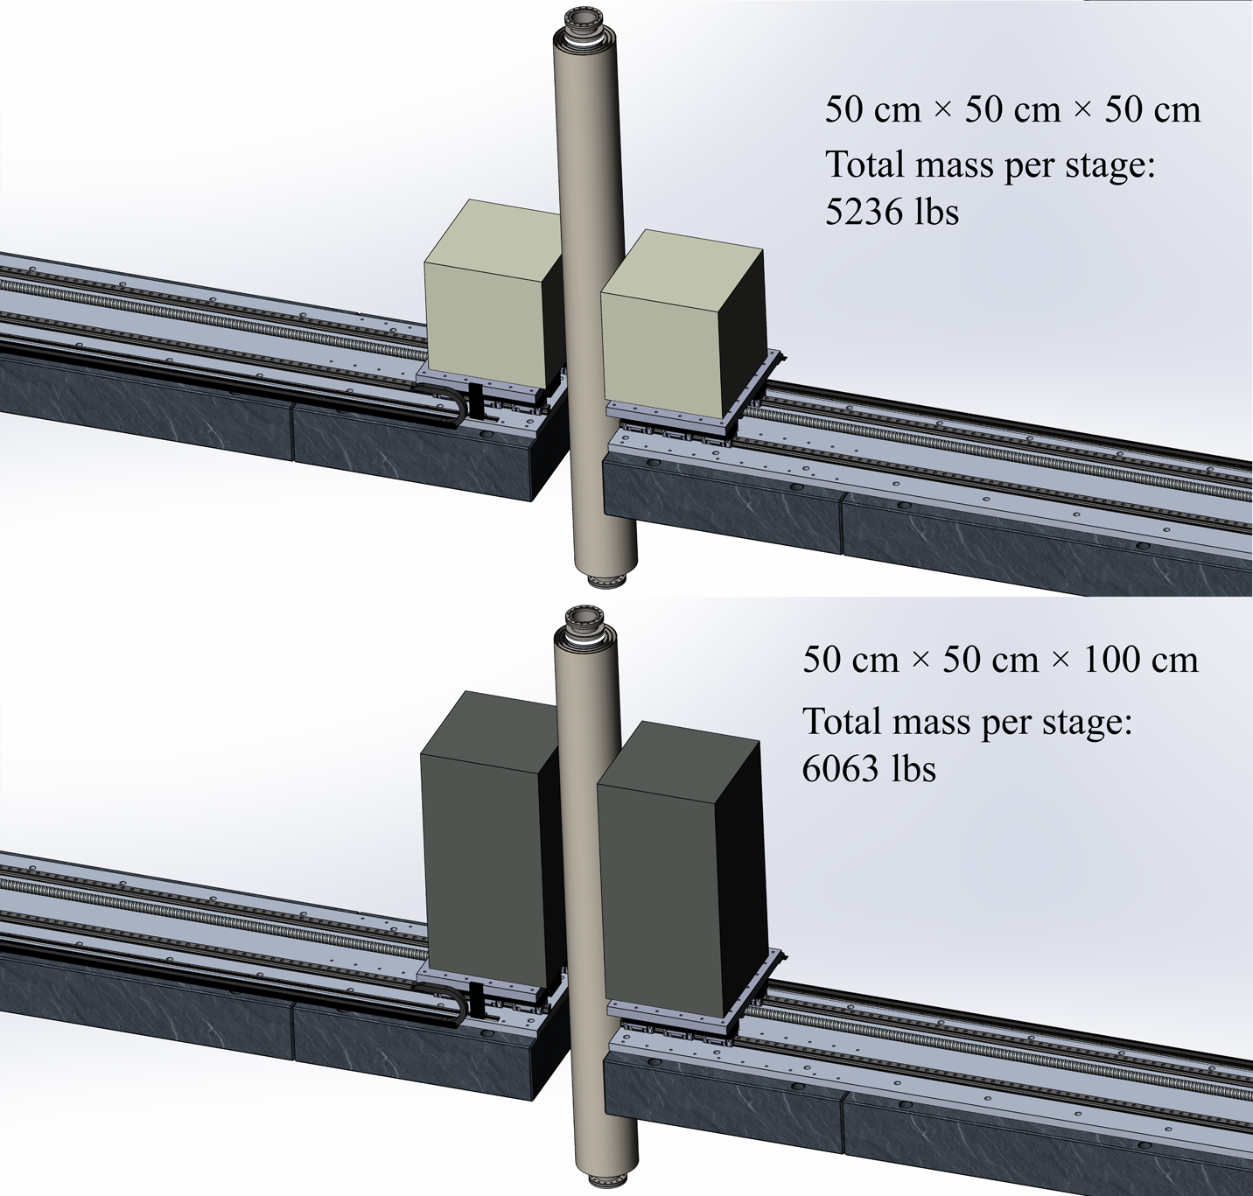
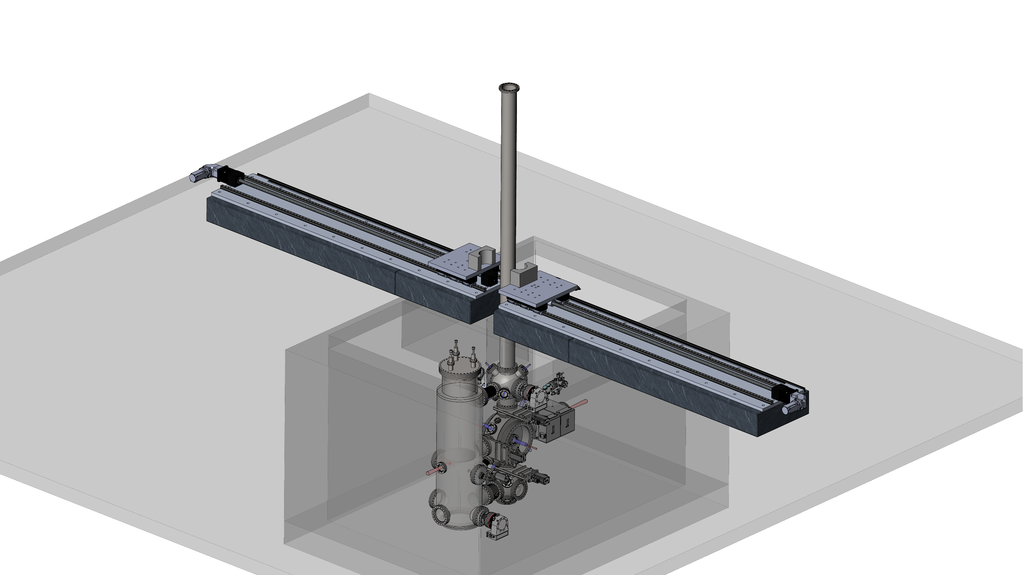
Overview of atomic fountain at Northwestern University
3 m

Slide 18
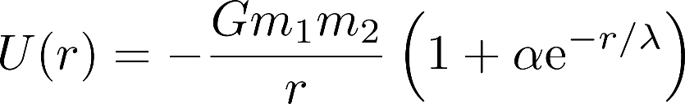
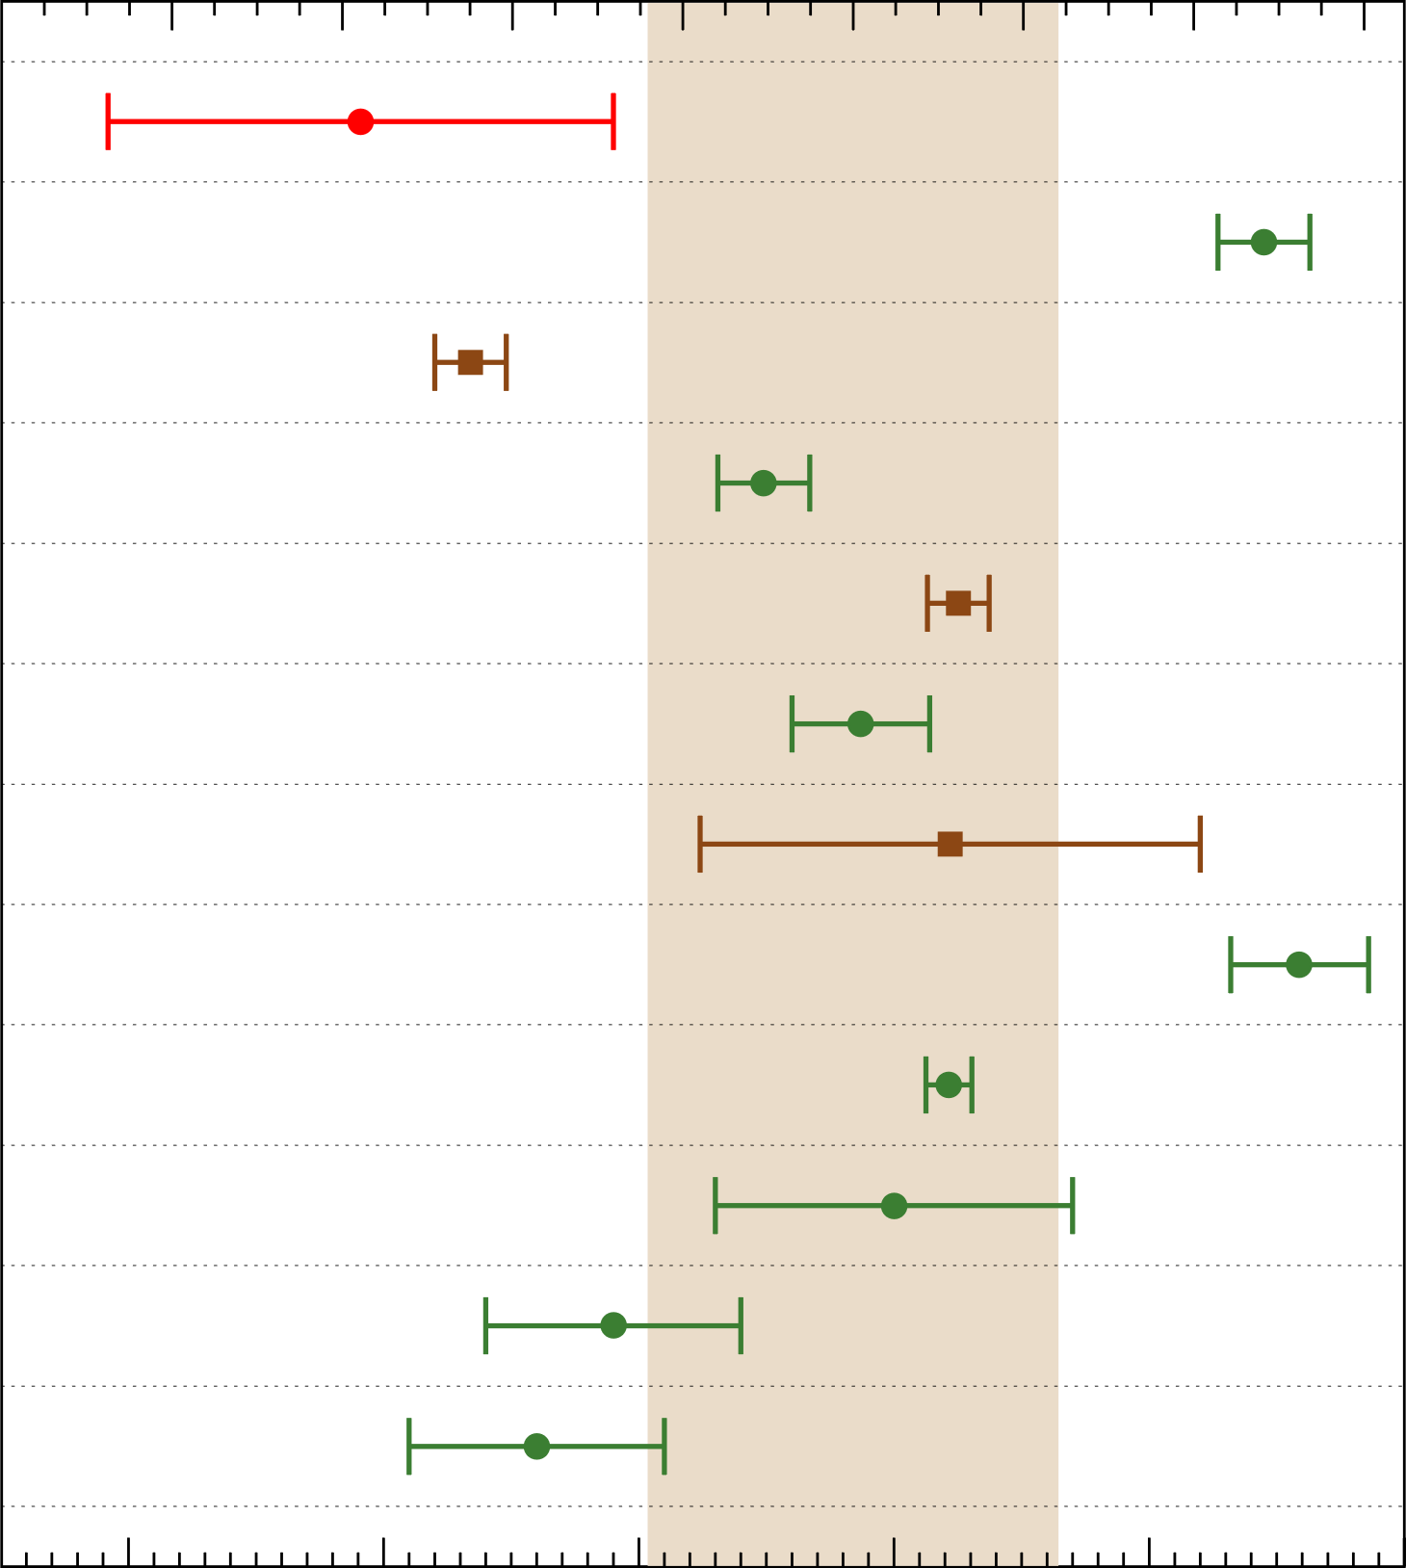


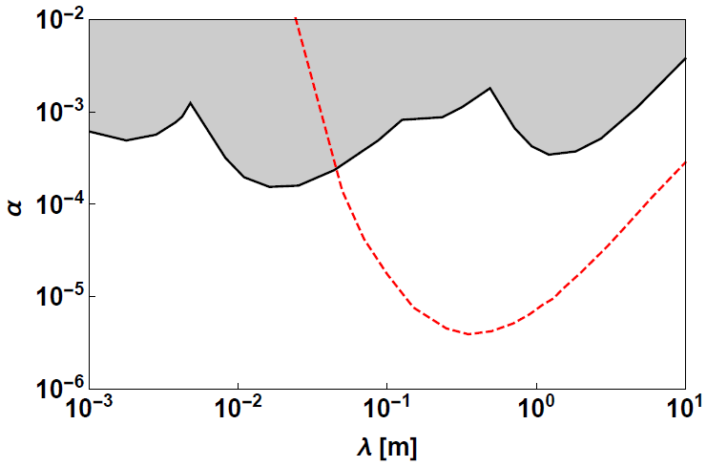





Newton’s gravitational constant and inverse square law

Slide 19
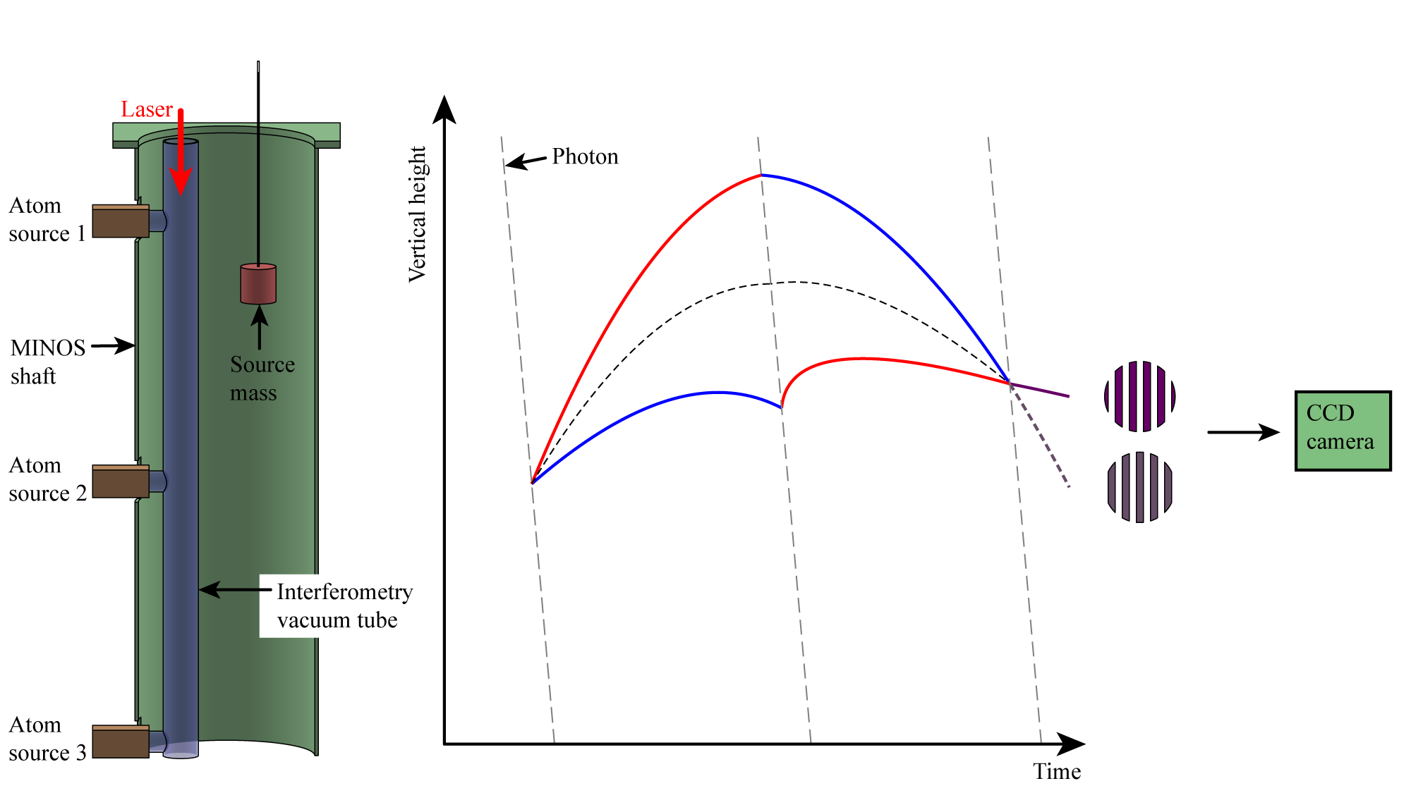
Introduction to gradiometer mode of atom interferometer

Slide 20
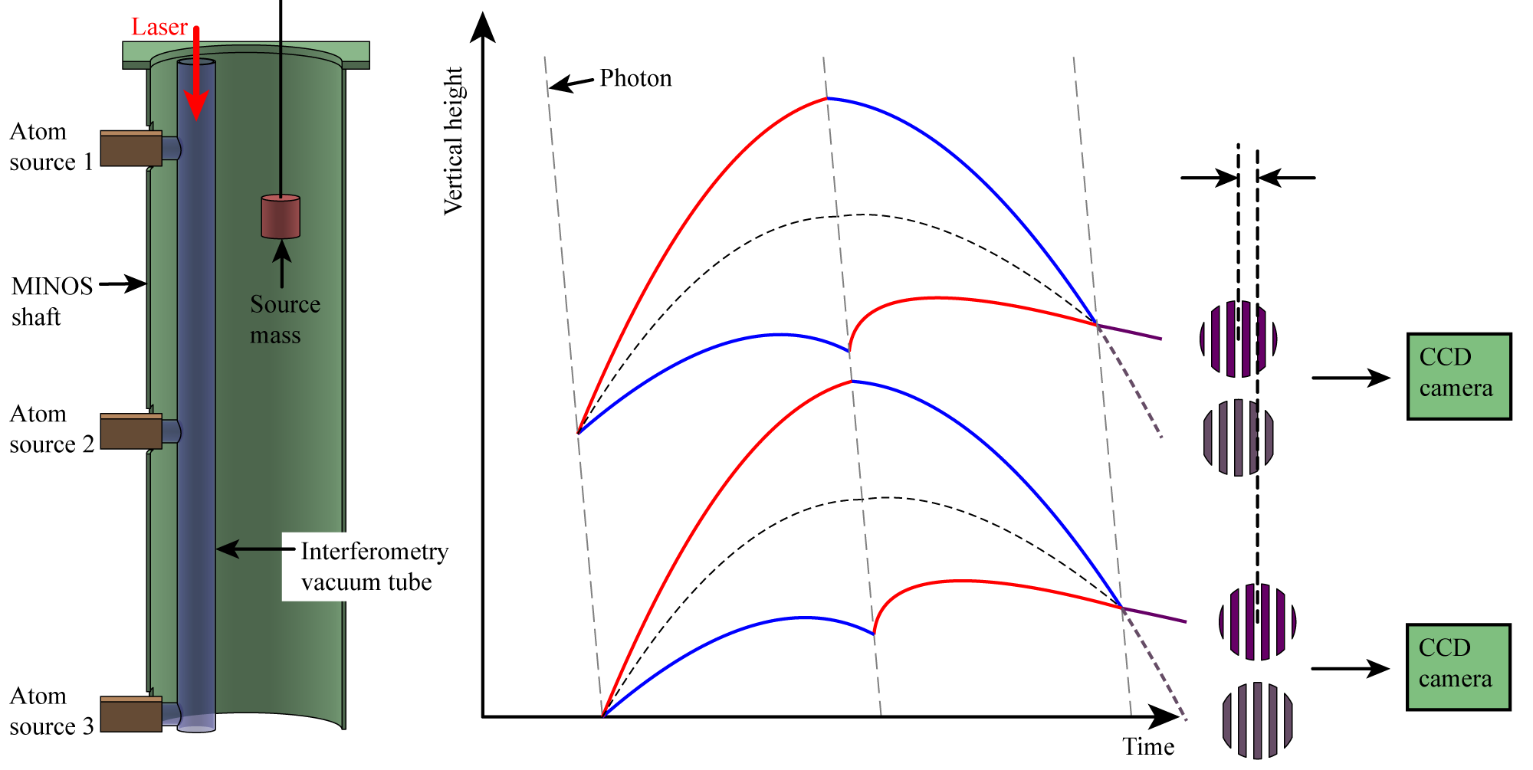

Introduction to gradiometer mode of atom interferometer

Slide 21
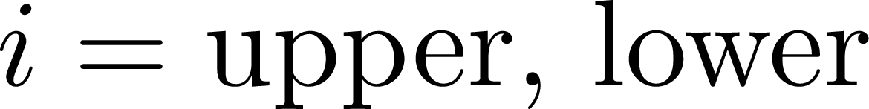
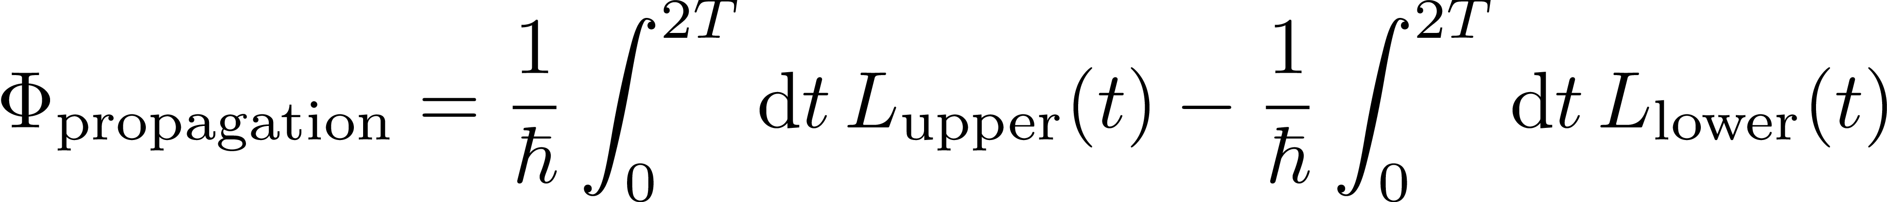
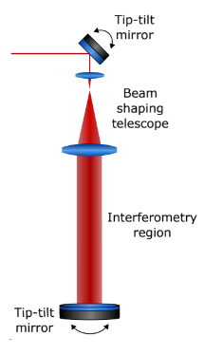
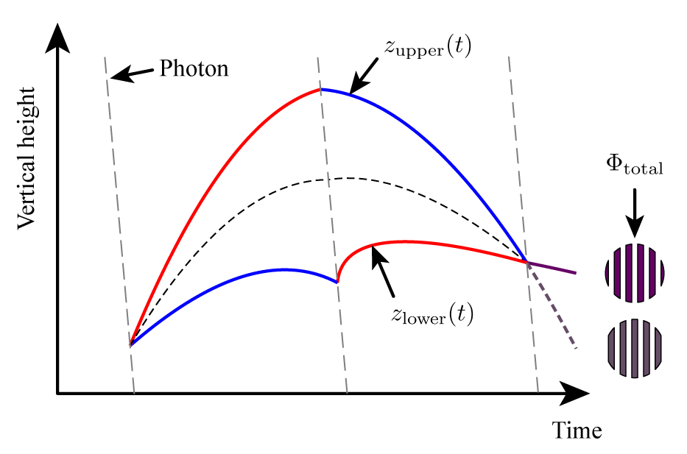
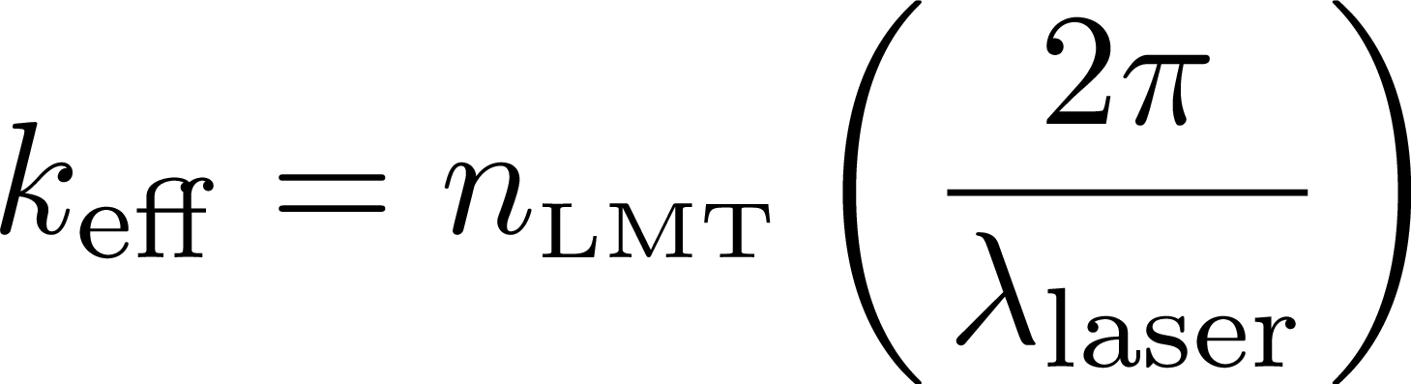

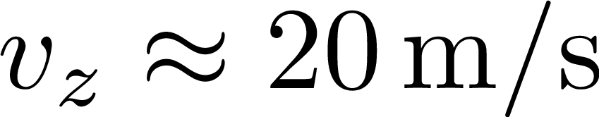
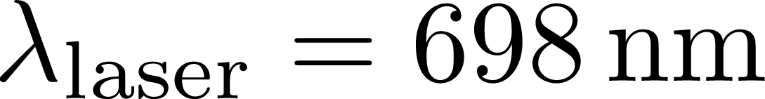
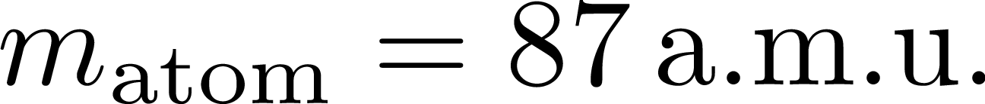
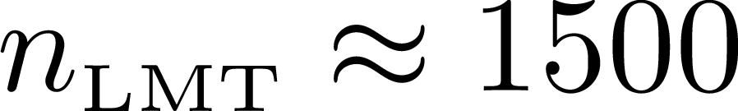



Detour: information carried by atom interferometer phase shift

Slide 22
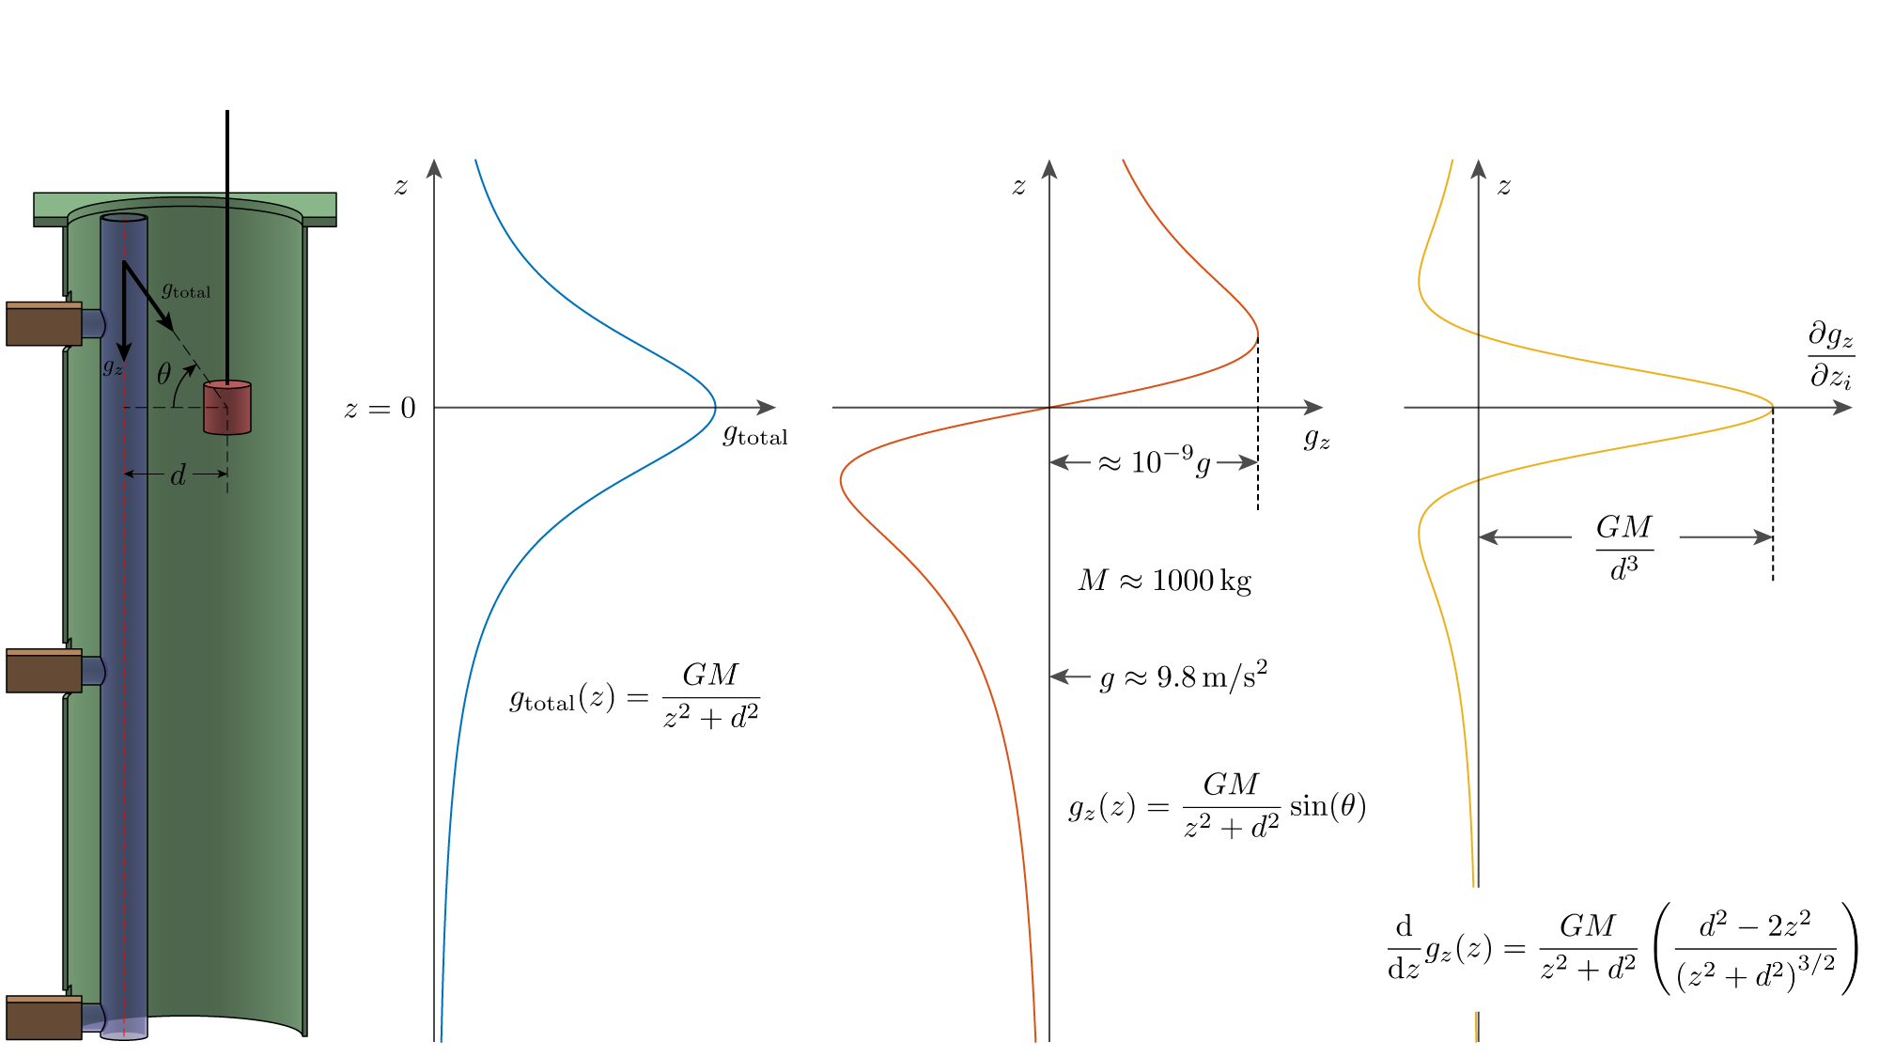
Measurement of gravity gradient from gravitational source mass

Slide 23
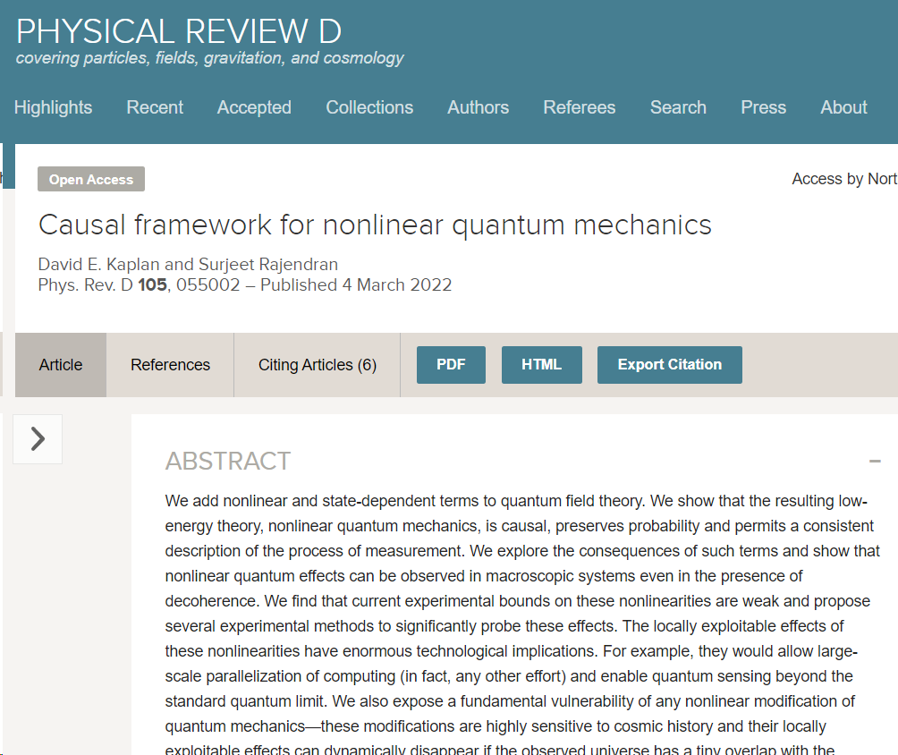
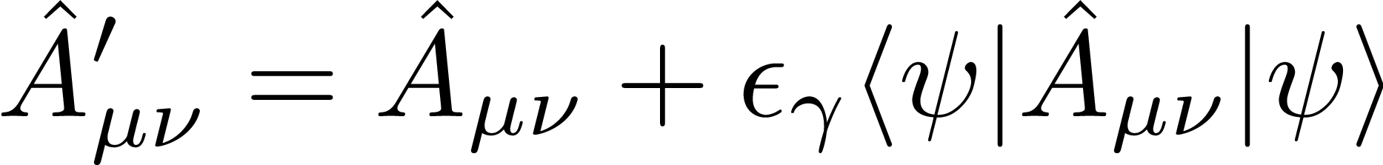
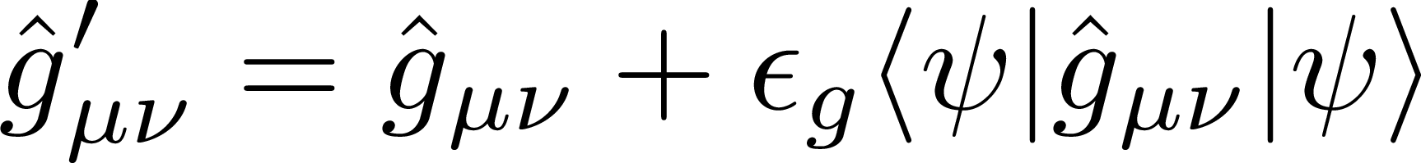
Nonlinear quantum mechanics: theory
Theory: Kaplan and Rajendran

Slide 24
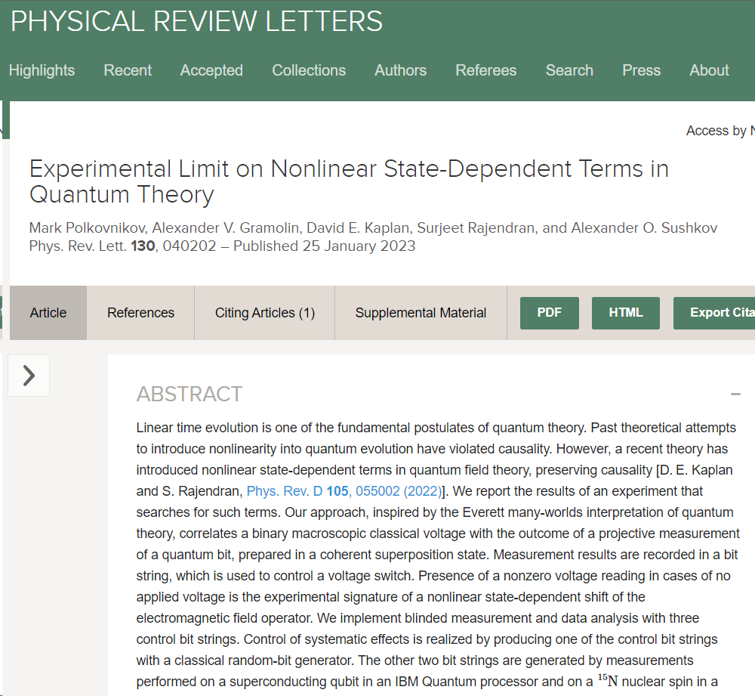
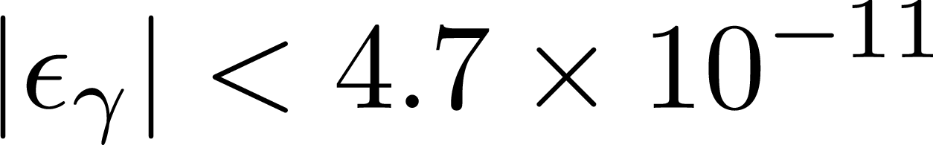
Nonlinear quantum mechanics: nuclear spins and qubits
Theory: Kaplan and Rajendran
Experiment: Sushkov group (Boston University)

Slide 25
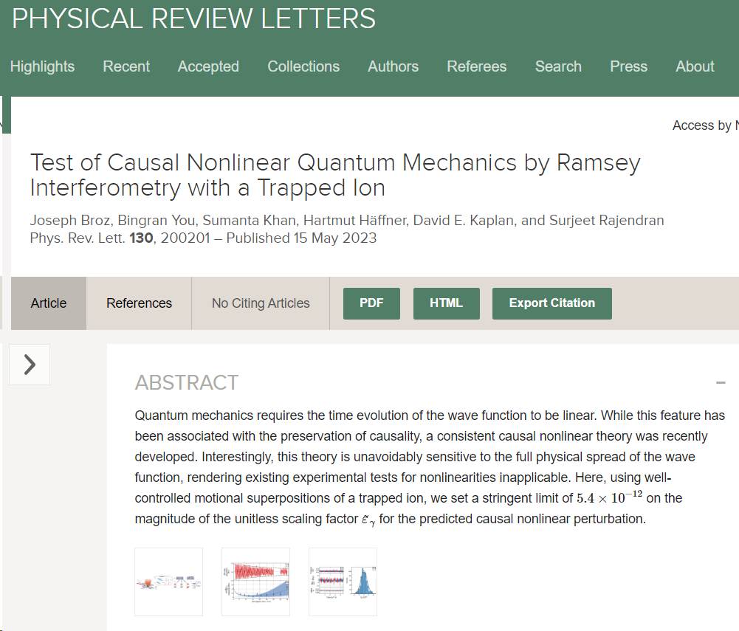
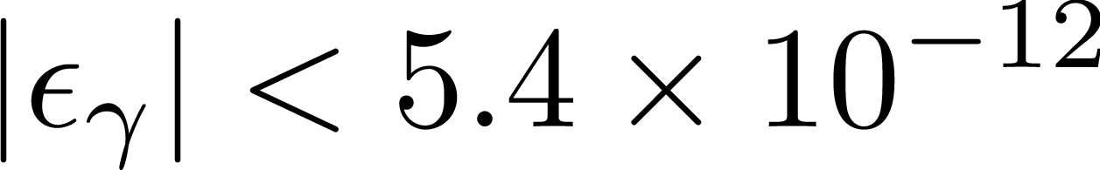
Nonlinear quantum mechanics: ion interferometer
Theory: Kaplan and Rajendran
Experiment: Sushkov group (Boston University)
Experiment: Häffner group (Berkeley)

Slide 26
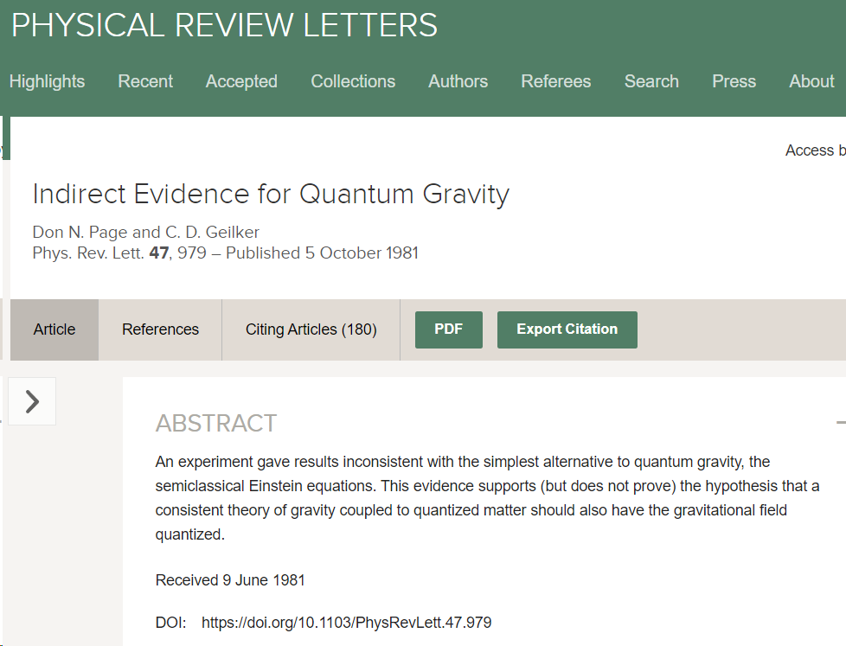

Nonlinear quantum mechanics: gravity
Theory: Kaplan and Rajendran
Experiment: Sushkov group (Boston University)
Experiment: Häffner group (Berkeley)
Experiment: Page and Geilker

Slide 27


Nonlinear quantum mechanics: gravity
Theory: Kaplan and Rajendran
Experiment: Sushkov group (Boston University)
Experiment: Häffner group (Berkeley)
Experiment: Page and Geilker

Slide 28











New projected bounds on nonlinear quantum mechanics
Universe’s wave function
Atom interferometer phase shift
Phase resolution
Bound on gravitational nonlinear quantum mechanics parameter with signal to noise ratio of 10

Slide 29
Summary
Ground-level laser lab
Atom interferometry a valuable tool for tests of gravity and quantum mechanics
Repurpose MAGIS-100 for nonlinear quantum mechanics test
Bounds on nonlinear parameter sooner with fountain at Northwestern University
Improvement from previous bounds (1981) by 6 orders of magnitude
Top atom source
Middle atom source
3 m
Bottom atom source

Slide 30











Acknowledgements: MASIS-100 collaboration

Slide 31








Acknowledgements: lab members at Northwestern University
Graduate students
Jonah Glick
Yiping Wang
Ken DeRose
Kefeng Jiang
Sharika Saraf
Prof. Timothy Kovachy
(Principal Investigator)
Postdocs
Undergraduate students
Zilin Chen
Garrett Louie

Slide 32


Acknowledgements: theory
Surjeet Rajendran
David Kaplan

Slide 33
Thank you for your attention

