Slide 1



Lithium Niobate Waveguides for Quantum Applications
Mirko Lobino
Università di Trento
Dipartimento di Ingegneria Industriale
Erice, 04/09/2023

Slide 2
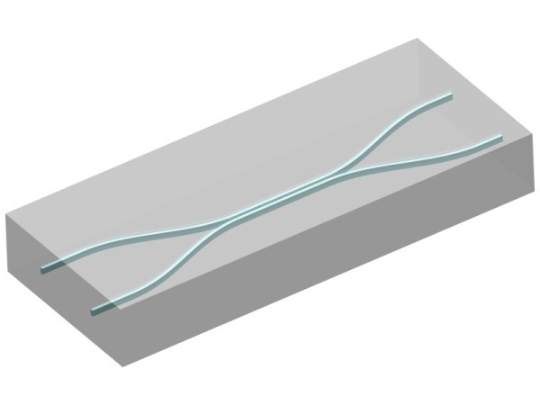


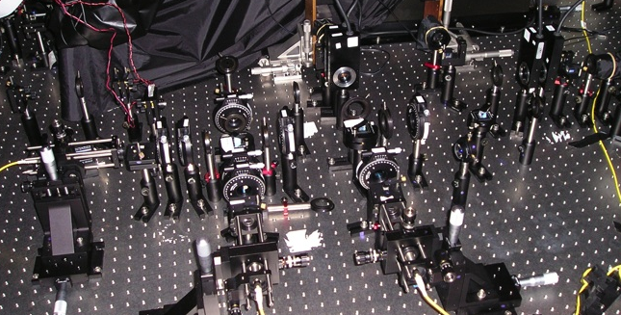
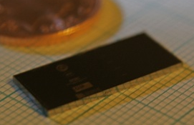
Outline
Lithium niobate for integrated quantum photonics
Multimode integrated circuits
Generation of Squeezed Vacuum
Future Directions and Conclusions
A. Politi, M. J. Cryan, J. G. Rarity, S. Yu & J. L. O’Brien. Science, 320, 646 (2008)
N. K. Lanford et al., Phys. Rev. Lett. 95, 210504 (2005)

Slide 3
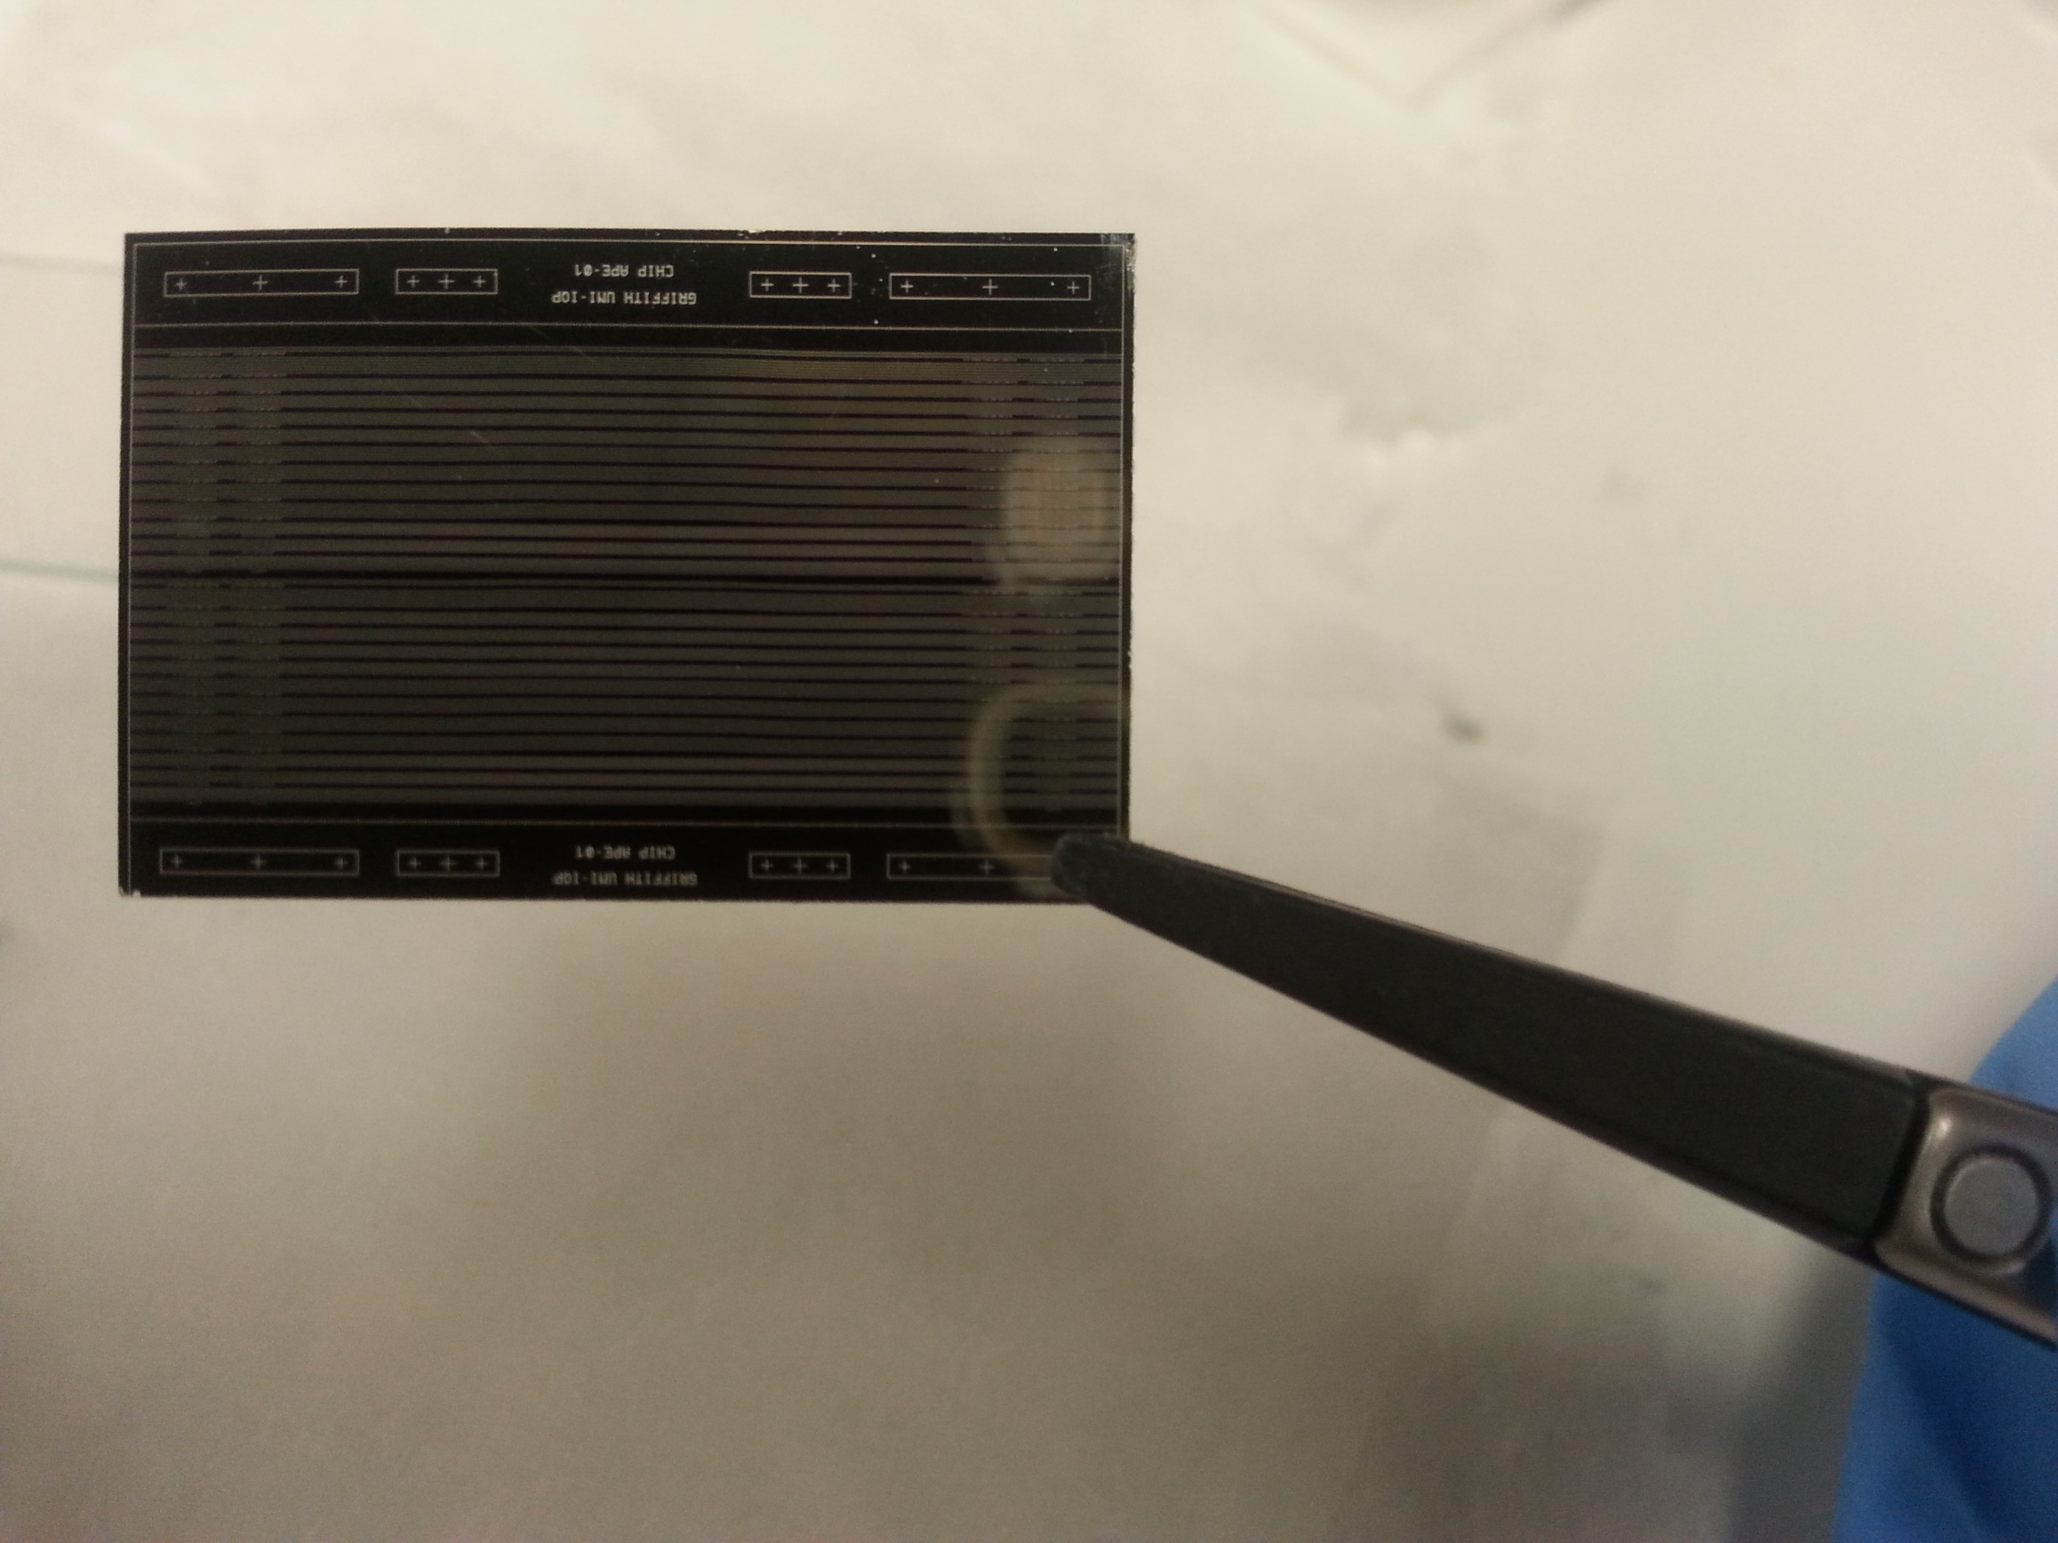
LiNbO₃ Integrated Photonics
Integrated Quantum Photonics:
implementation of photonic quantum circuits in
photolithography patterned waveguides
Image of a waveguide chip fabricated at Griffith University-IQP
PROPERTIES OF LITHIUM NIOBATE:
High transparency range (0.35 μm < λ < 4.5 μm), low propagation losses at 1550 nm
High electro-optic coefficient (30 pm/V) and second order susceptibility (20 pm/V)
Compatibility with periodic poling technique to achieve quasi phase matching
WAVEGUIDE CIRCUITS
+
PERIODIC POLING
+
ELECTRODES DEPOSITION
GENERATION OF QUANTUM STATES VIA SPDC
IN QUASI-PHASE MATCHED PPLN WAVEGUIDES
+
ELECTRO-OPTIC TUNABLE CIRCUITS FOR THE ACTIVE MANIPULATION OF QUANTUM STATES

Slide 4
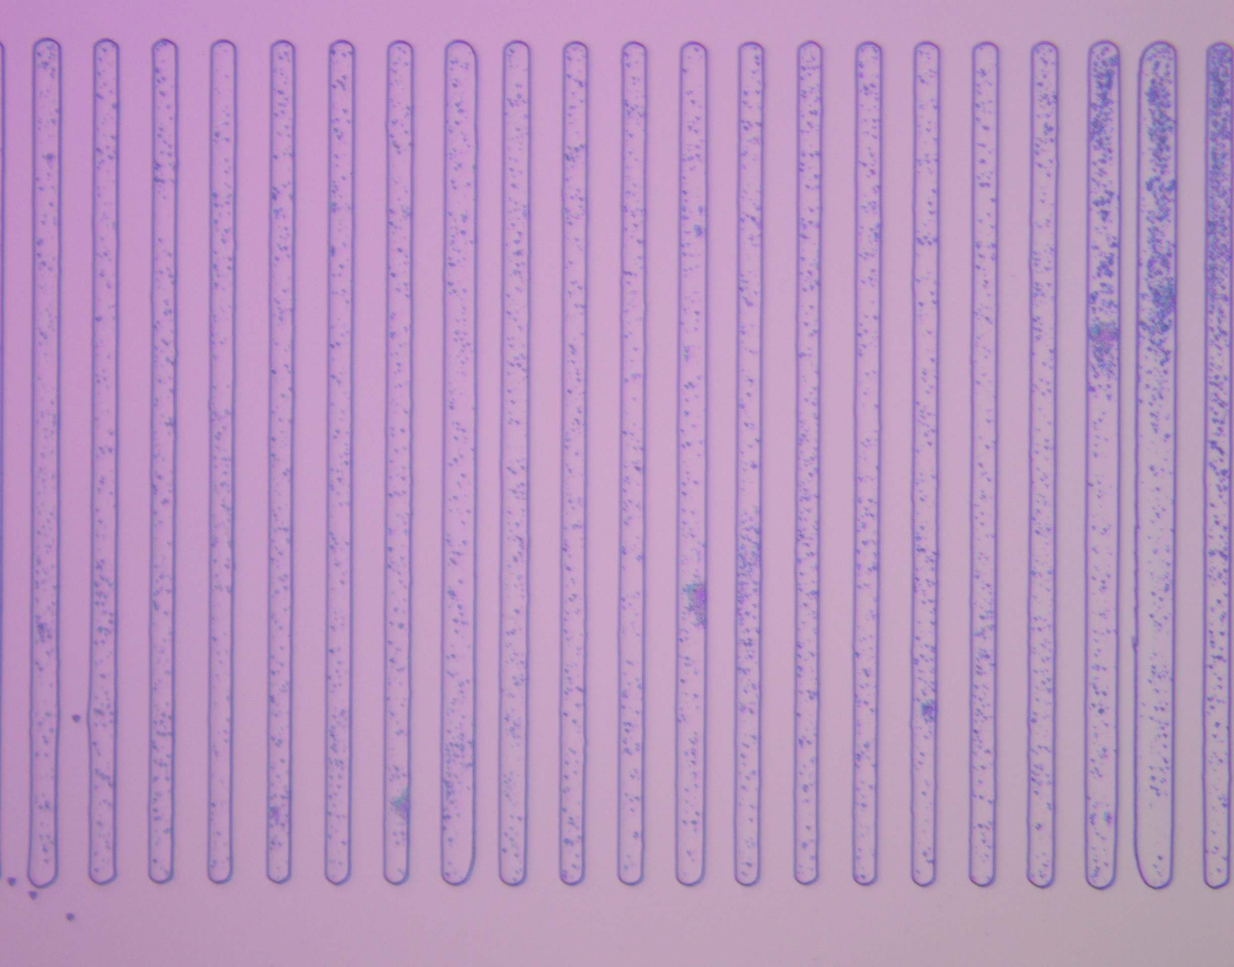
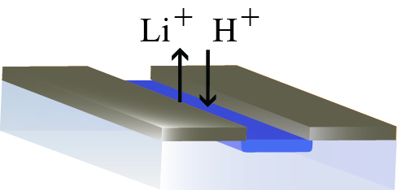
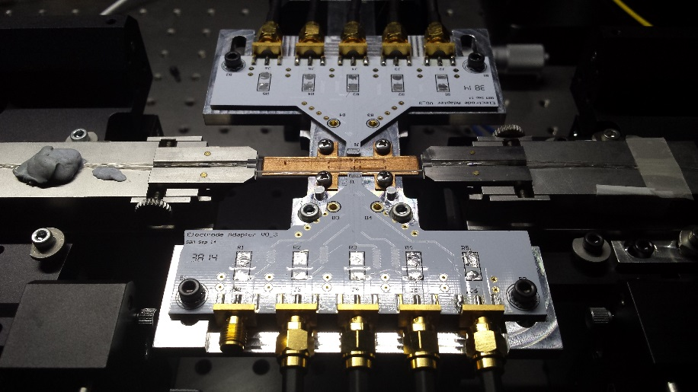
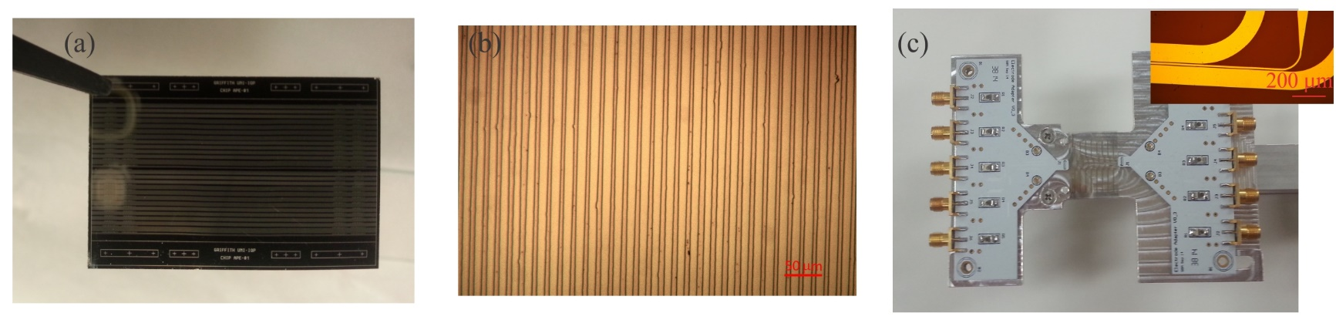
Waveguide Fabrication
Periodically Poling for Quasi Phase Matching
Proton Exchange (benzoic acid, T=170 C)
And Reverse Proton Exchange
Ti
LiNbO₃
Higher refractive index core
Electrodes Fabrication
Notes:
3 phases
Thin high contrast layer with poor optical properties, anneal to diffuse protons into substrate, creates a gradient index profile that is highly asymmetric, to symmetrise we return lithium ions to the surface, burying the waveguide. This gives symmetric, low propagation loss waveguide with nonlinear properties close to that of the substrate. I worked on characterisation of the reverse proton exchange step in planar waveguides.

Slide 5
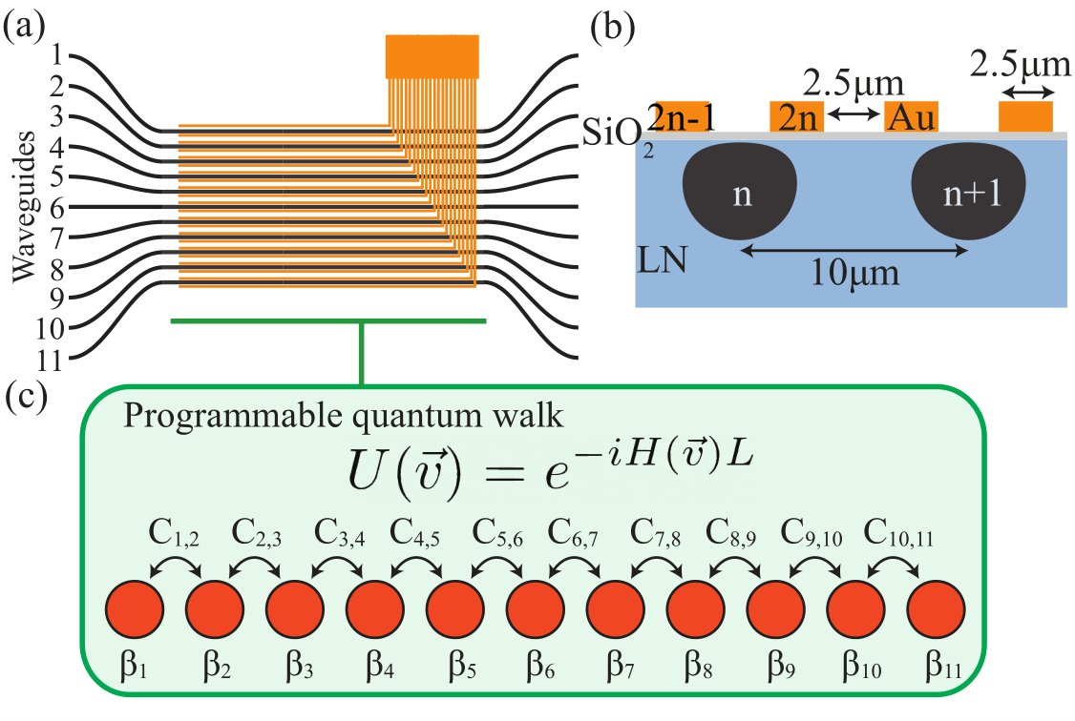
Implementing transformations over many modes
Hard to analytically predict what each electrode will do
Problem: how to implement a desired transformation?

Slide 6
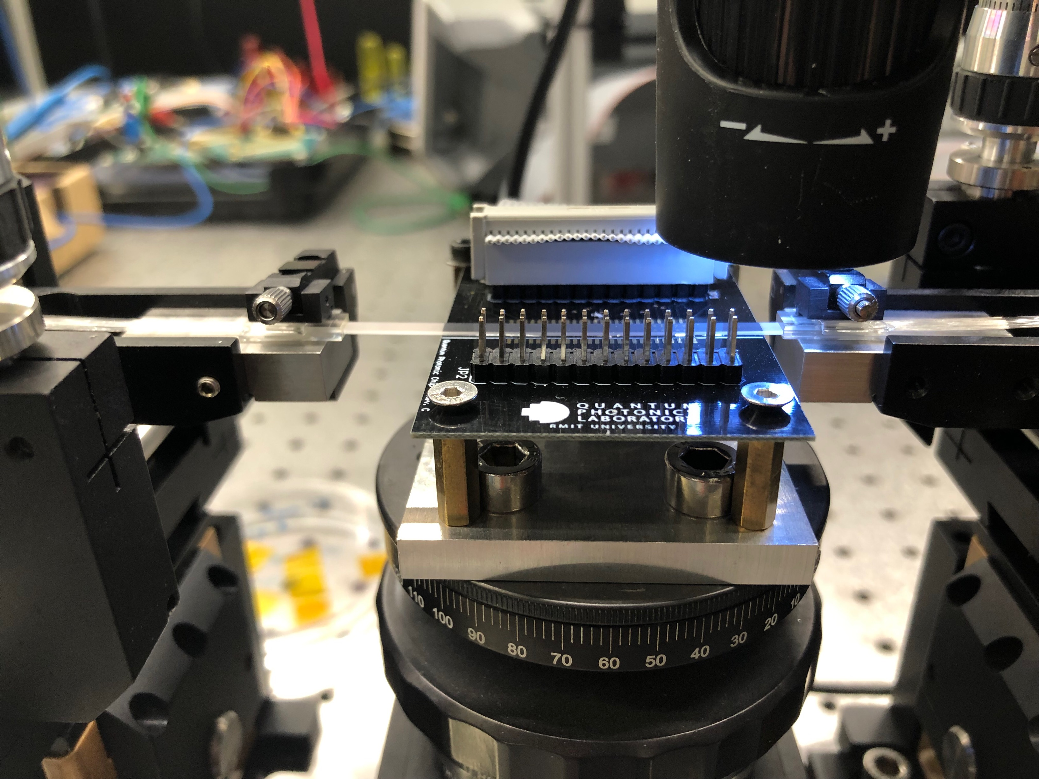
Controlling Electrooptical Circuits
arxiv:2206.12201

Slide 7
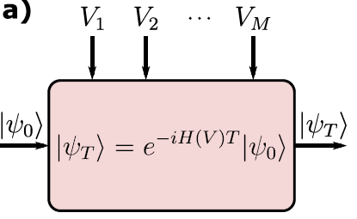



Identification - Whitebox
Curve-fitting / Parameter estimation
Full Physics picture
Device​
Collaboration with A. Peruzzo
Notes:
Typically people take data and fit a model. But the model is generally incorrect, missing some aspects of the physics of the device

Slide 8
Identification - Blackbox
A highly non-linear function
Ex: Neural network
Universal Approximation Theorem
No Physics
Output control
Device​
Collaboration with A. Peruzzo
Notes:
Neural networks can help controlling a device but don’t provide a physical insight

Slide 9
Identification - Graybox
Best of the two worlds!
How much Black vs White?
Device​
Collaboration with A. Peruzzo
Notes:
GB is the best of the two worlds: idetifies a model and uses is for control. This provide solution to other problems such as characterizing the environment

Slide 10
Experimental Graybox Quantum Control
Collaboration with A. Peruzzo
Notes:
First experimental demonstration of a graybox controller

Slide 11
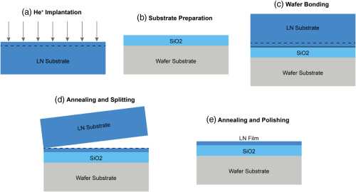
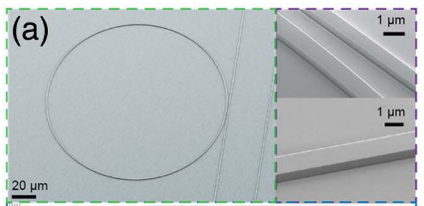
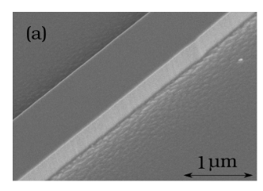
New waveguide: Thin film LN
Image from: M. Zhang, C. Wang, R. Cheng, A. Shams-Ansari, and M. Loncar, Optica, vol. 4, no. 12, Aug. 2017
Image from: Di Zhu et al., Adv. Opt. Photonics, Vol. 13, Issue 2, pp. 242-352, Jun. 2021
Pattern Resist to Form Mask
Etch Substrate
Remove Mask
Image from:
I. Krasnokutska, J.-L. J. Tambasco, X. Li, and A. Peruzzo, Opt. Express, vol. 26, no. 2, p. 897, Jan. 2018
Notes:
Thin high contrast layer with poor optical properties, anneal to diffuse protons into substrate, creates a gradient index profile that is highly asymmetric, to symmetrise we return lithium ions to the surface, burying the waveguide. This gives symmetric, low propagation loss waveguide with nonlinear properties close to that of the substrate. I worked on characterisation of the reverse proton exchange step in planar waveguides.

Slide 12
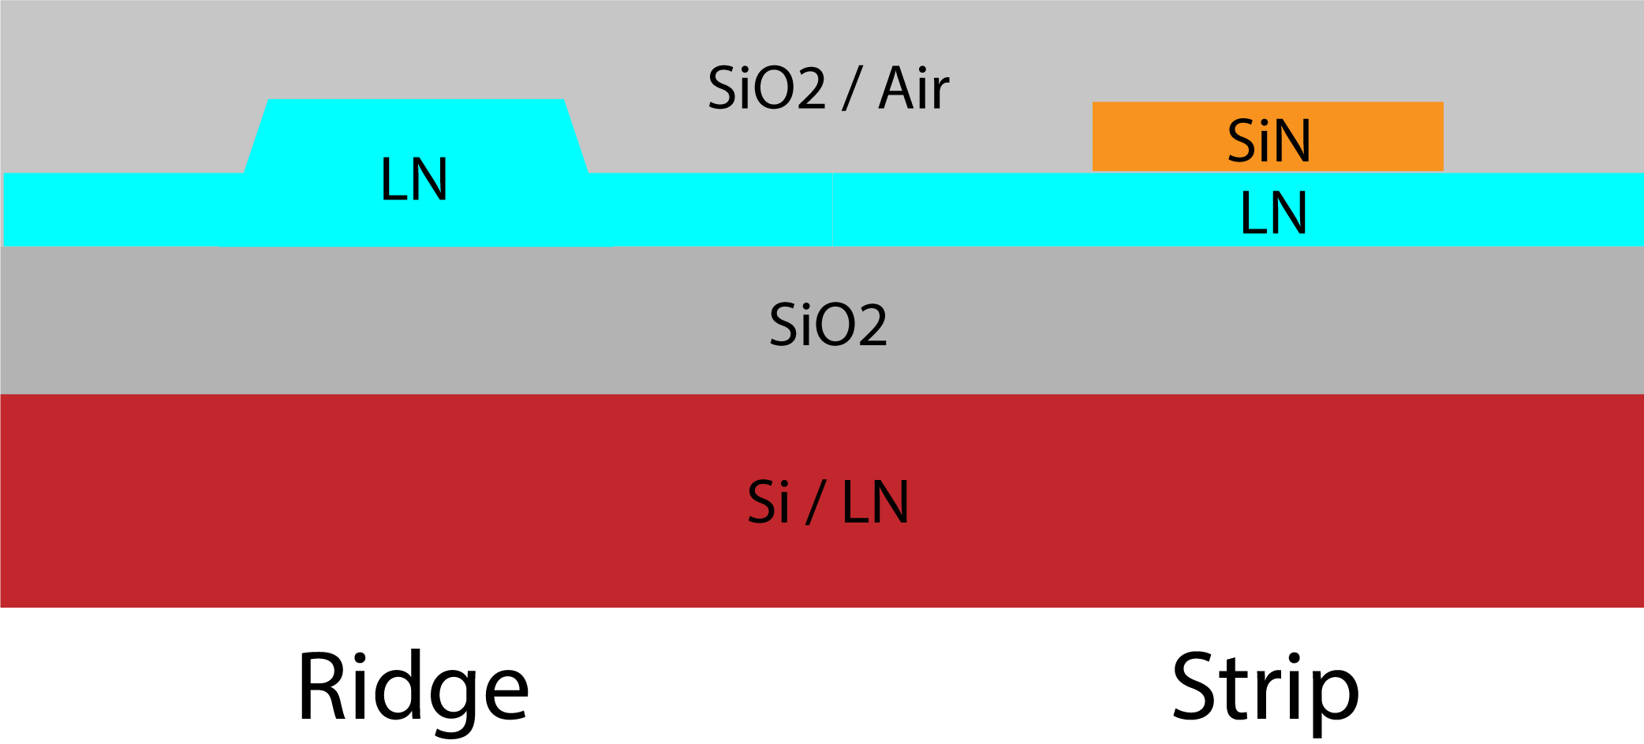
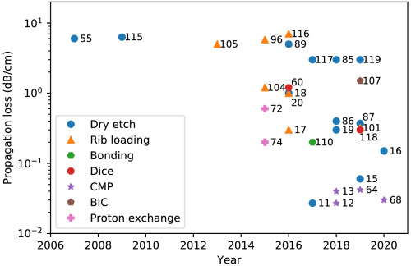




Strip loaded waveguide
High mode confinement (typically <1um²) Small bending radius (<100um) nonlinear conversion efficiency (4000 - 7000% /Wcm²) Less susceptible to lateral leakage Ultra-low propagation loss (3dB/m @1550nm) [1] | Nonlinear conversion efficiency (1000-4000% /Wcm²) Nonlinear phase matching more tolerable to fabrication errors Fabrication of SiN well established Domain inversion for periodic poling can be done pre or post waveguide fabrication Low propagation loss (0.2dB/cm @ 1550nm) [2]
Nonlinear phase matching highly susceptible to fabrication errors Fabrication of ultra-low loss waveguides difficult in practice Domain inversion prior to etching introduces additional losses due to differential etch rates between domains leading to increased losses and reduce efficiencies | Larger bending radius (>300um²) Shorter wavelengths prone to lateral leakage
Image from: Di Zhu et al., Adv. Opt. Photonics, Vol. 13, Issue 2, pp. 242-352, Jun. 2021
[1] M. Zhang, C. Wang, R. Cheng, A. Shams-Ansari, and M. Lončar, Optica, vol. 4, no. 12, p. 1536, Dec. 2017.
[2] A. N. R. Ahmed, S. Shi, M. Zablocki, P. Yao, and D. W. Prather, Opt. Lett., vol. 44, no. 3, p. 618, Feb. 2019.
Collaboration with A. Mitchell

Slide 13
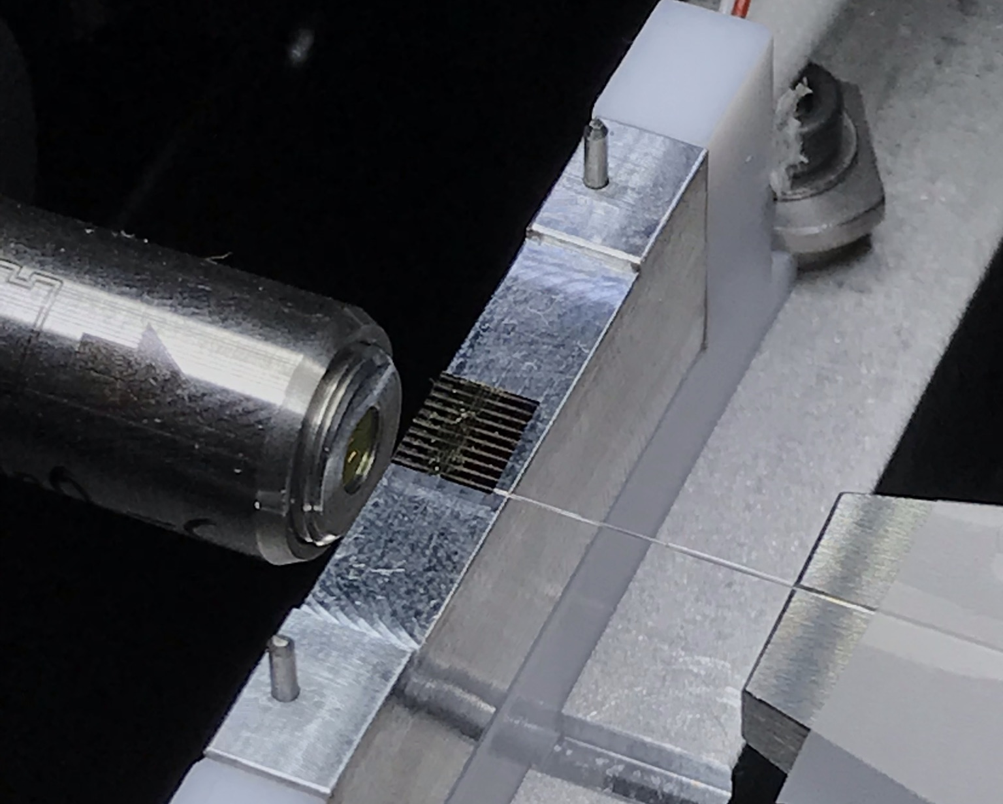
Thin film LN
10um
~5mm
Collaboration with A. Mitchell

Slide 14
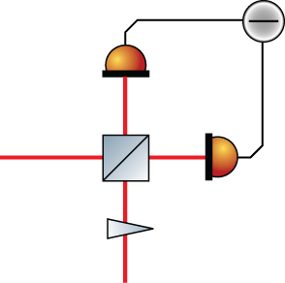
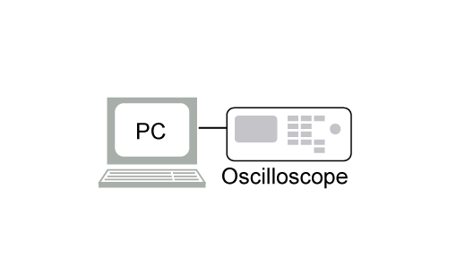
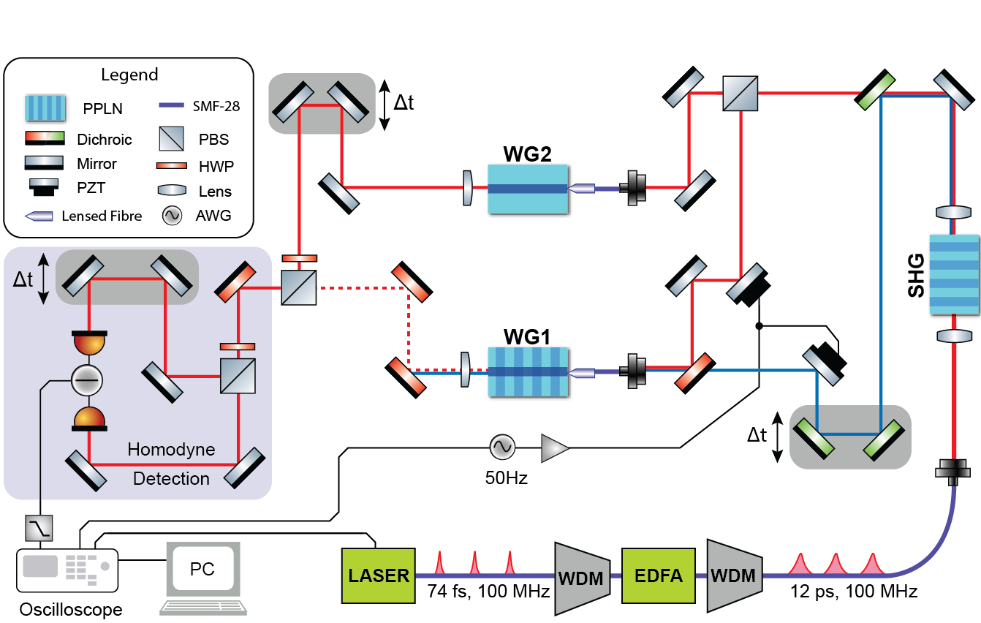

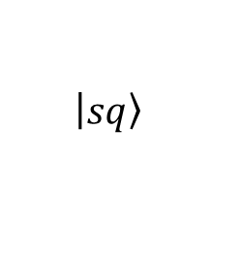
Pulsed Squeezing Experiment
TFLN Waveguides
BULK LN
SPDC
$$\left|\left.sq\right\rangle \right.$$
780nm
SHG
1560nm
1560nm
$$θ$$
LO
Peace et al, J. Phys-Photonics 4, 035002(2022)

Slide 15
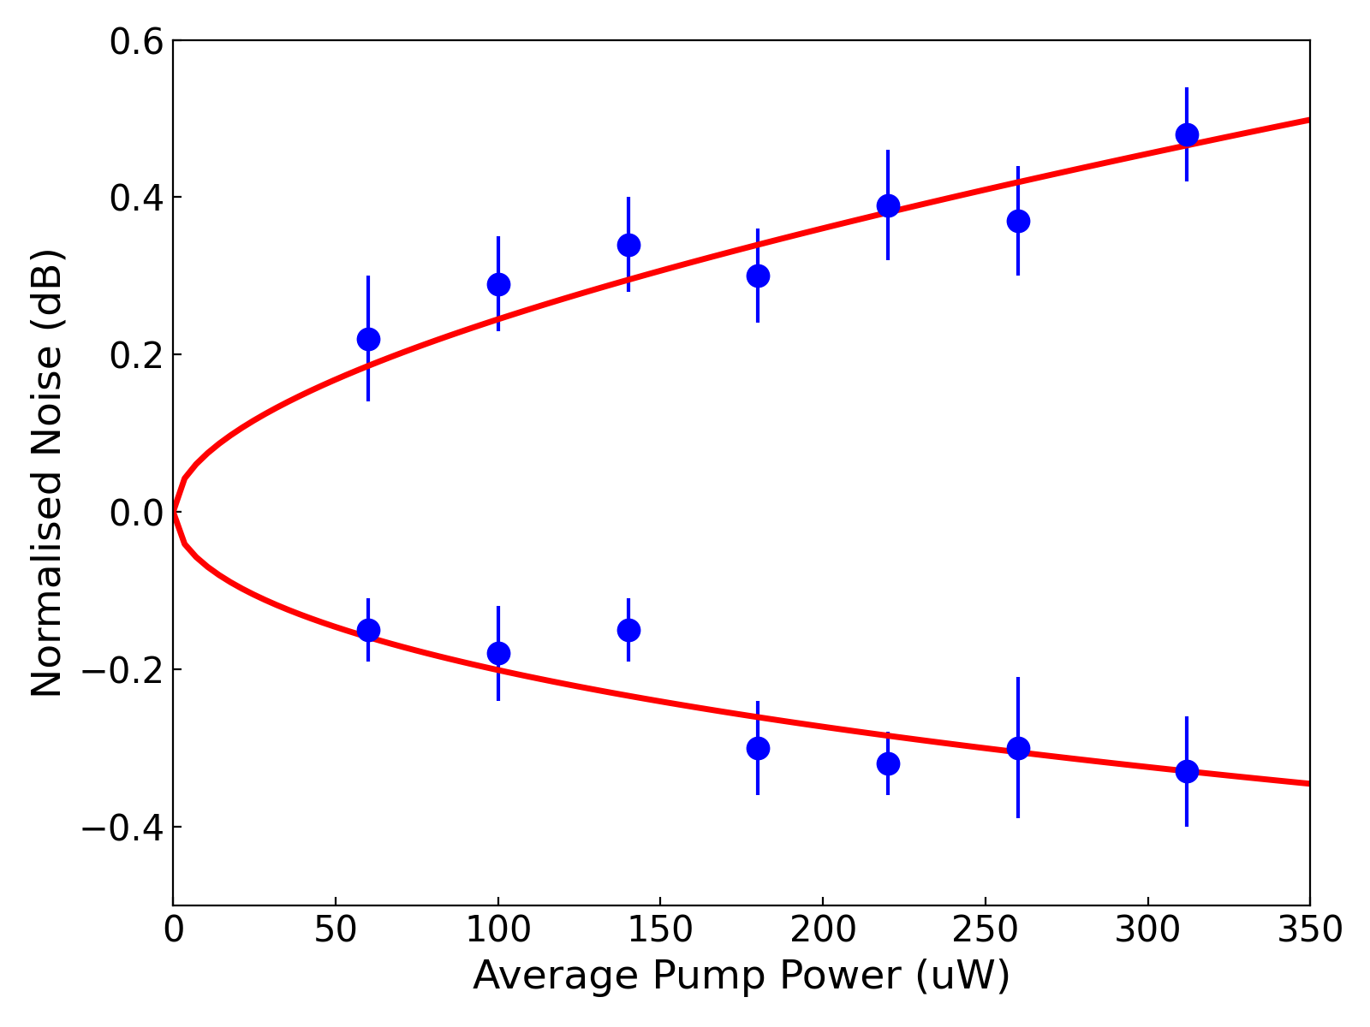

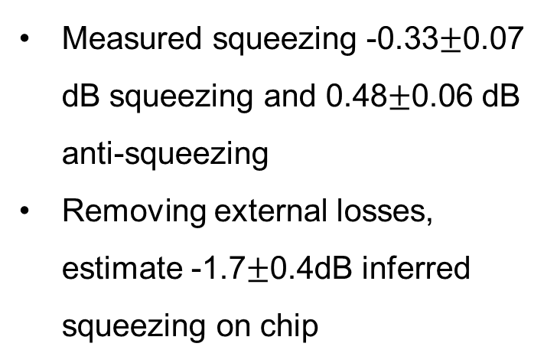

Squeezing Measurement
Estimate total detection efficiency, $η_{det}$ of 23%
$$S_{±}=η_{det}\exp\left(±2r\right)+1−η_{det}$$
Measured squeezing -0.33$±$0.07 dB squeezing and 0.48$±$0.06 dB anti-squeezing
Removing external losses, estimate -1.7$±$0.4dB inferred squeezing on chip
$$η_{SHG}=18\%/W$$
Peace et al, J. Phys-Photonics 4, 035002(2022)

Slide 16
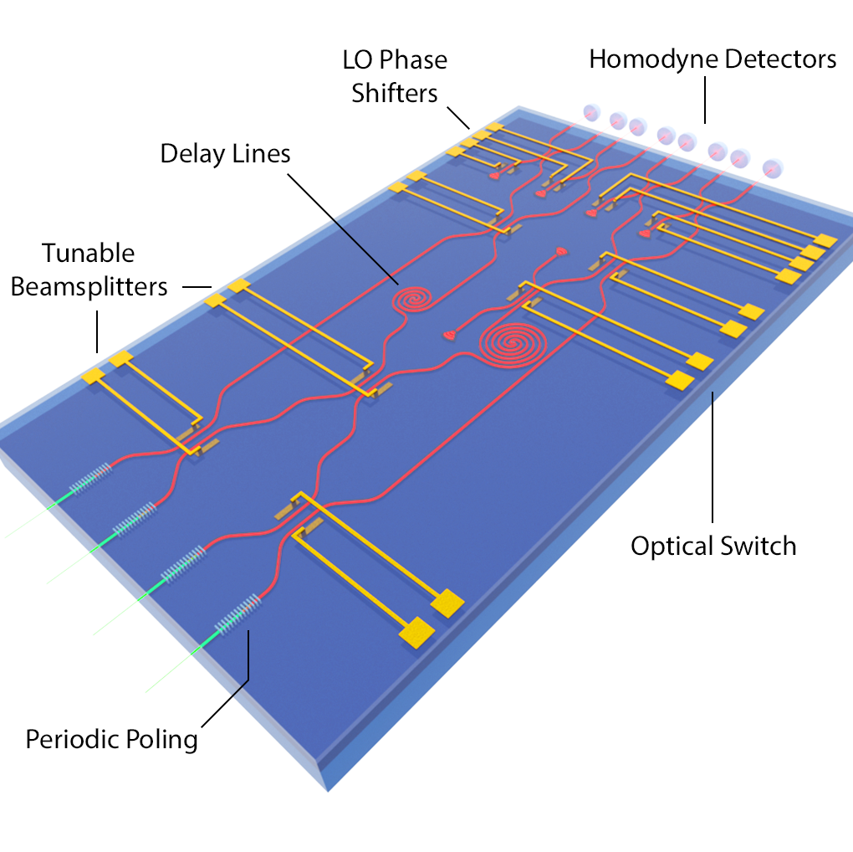
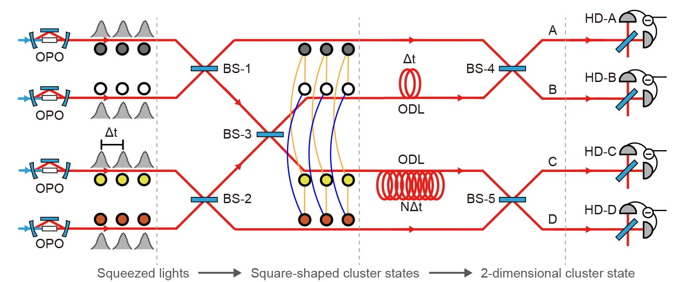
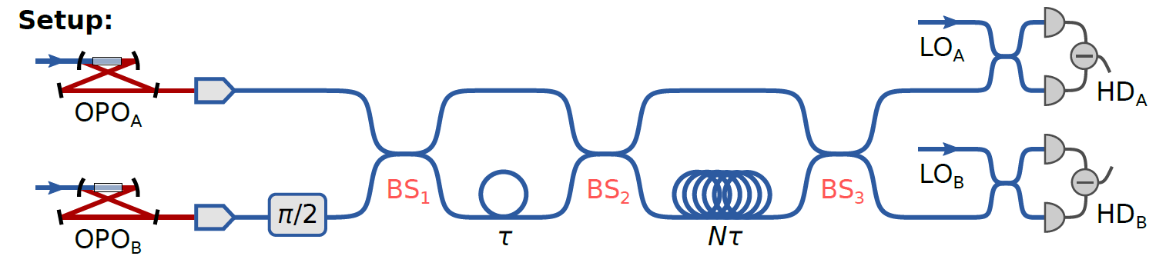
Why are we doing this?
Development of an integrated photonic platform for CV quantum computation. (Menicucci, Phys. Rev. A 83, 062314 (2011))
Major impediment → Losses!
Image from: W. Asavanant et al, Science (80-. )., vol. 366, no. 6463, pp. 373–376, Oct. 2019
Image from: G. Moody et al., J. Phys. Photonics, Aug. 2021.
Chapter 24 – Continuous Variables Computing with Lithium Niobate Photonics, D. Peace, R. Cernansky and M. Lobino
Image from: M. V. Larsen, X. Guo, C. R. Breum, J. S. Neergaard-Nielsen, and U. L. Andersen, Science (80-. )., vol. 366, no. 6463, pp. 369–372, Oct. 2019.

Slide 17
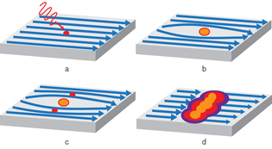
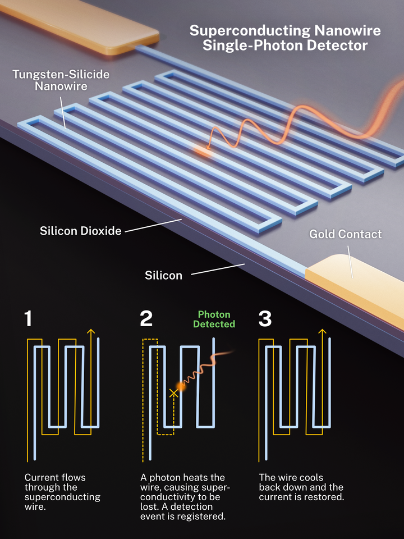
Integrated superconducting detectors
They represent the state of the art in single photon detection
A superconducting nanowire is driven close to its critical current
https://archive.ll.mit.edu/publications/labnotes/nanowirephotondetector.html
https://www.nist.gov/image/superconducting-nanowire-single-photon-detector

Slide 18

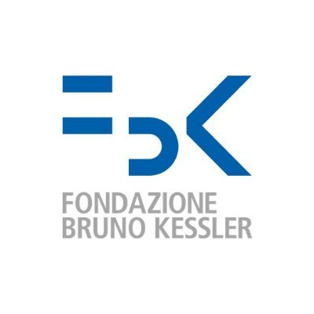
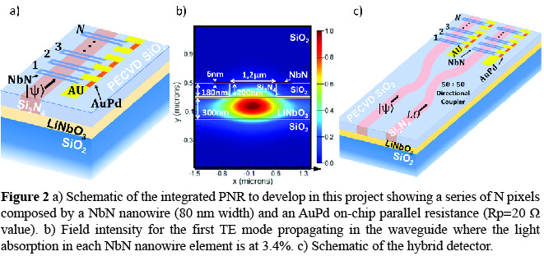
INFN experiment: UNIDET

Slide 19
Summary
Versatility of lithium niobate for photonic devices
Graybox control to multimode circuits
Thin film lithium niobate for nanophotonics devices

Slide 20

Thank You

