Slide 1
Quantum sensor networks with high efficiency transduction
Silvia Zorzetti
Superconducting Quantum Materials and Systems (SQMS) Center, Fermi National Accelerator Laboratory

Slide 2
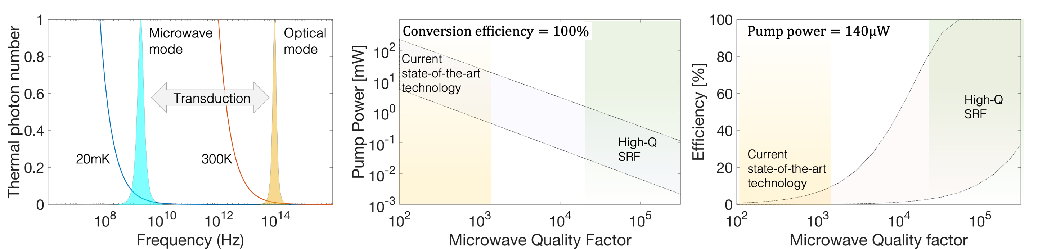
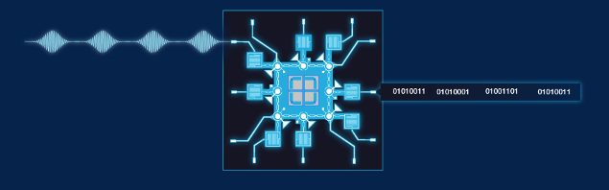

Introduction to Quantum Transduction
Superconducting
qubits/sensors
Optical
communication
Transducer
Microwave
Optical
∼GHz
~200 THz
Cryogenic temperature
Room temperature

Slide 3
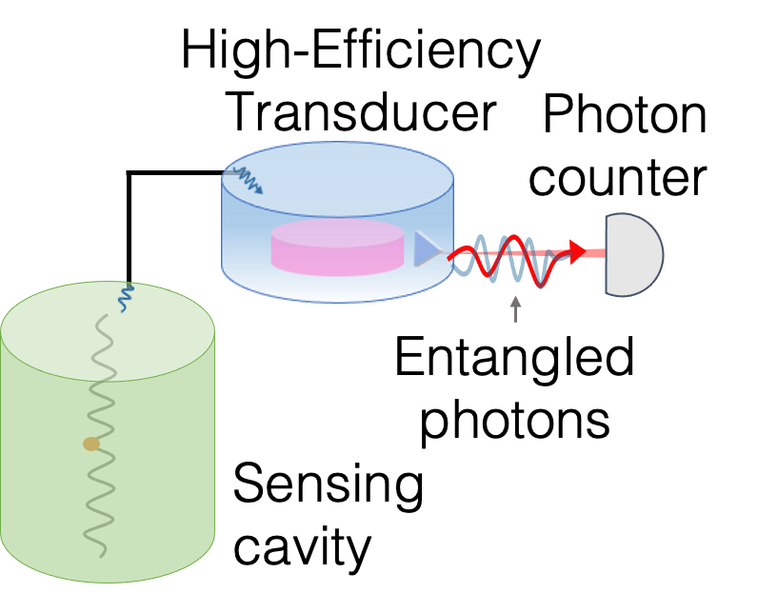
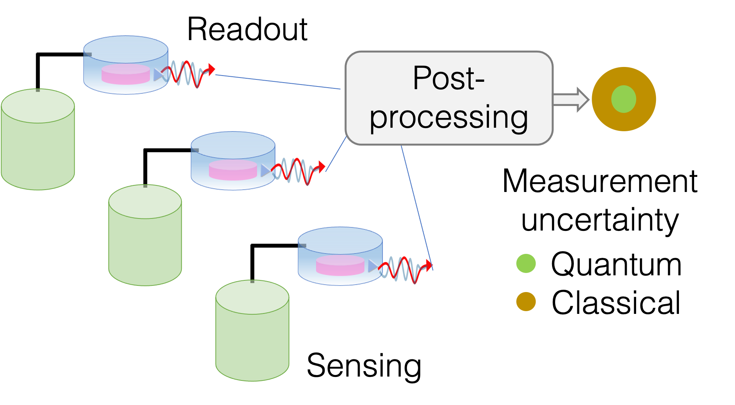
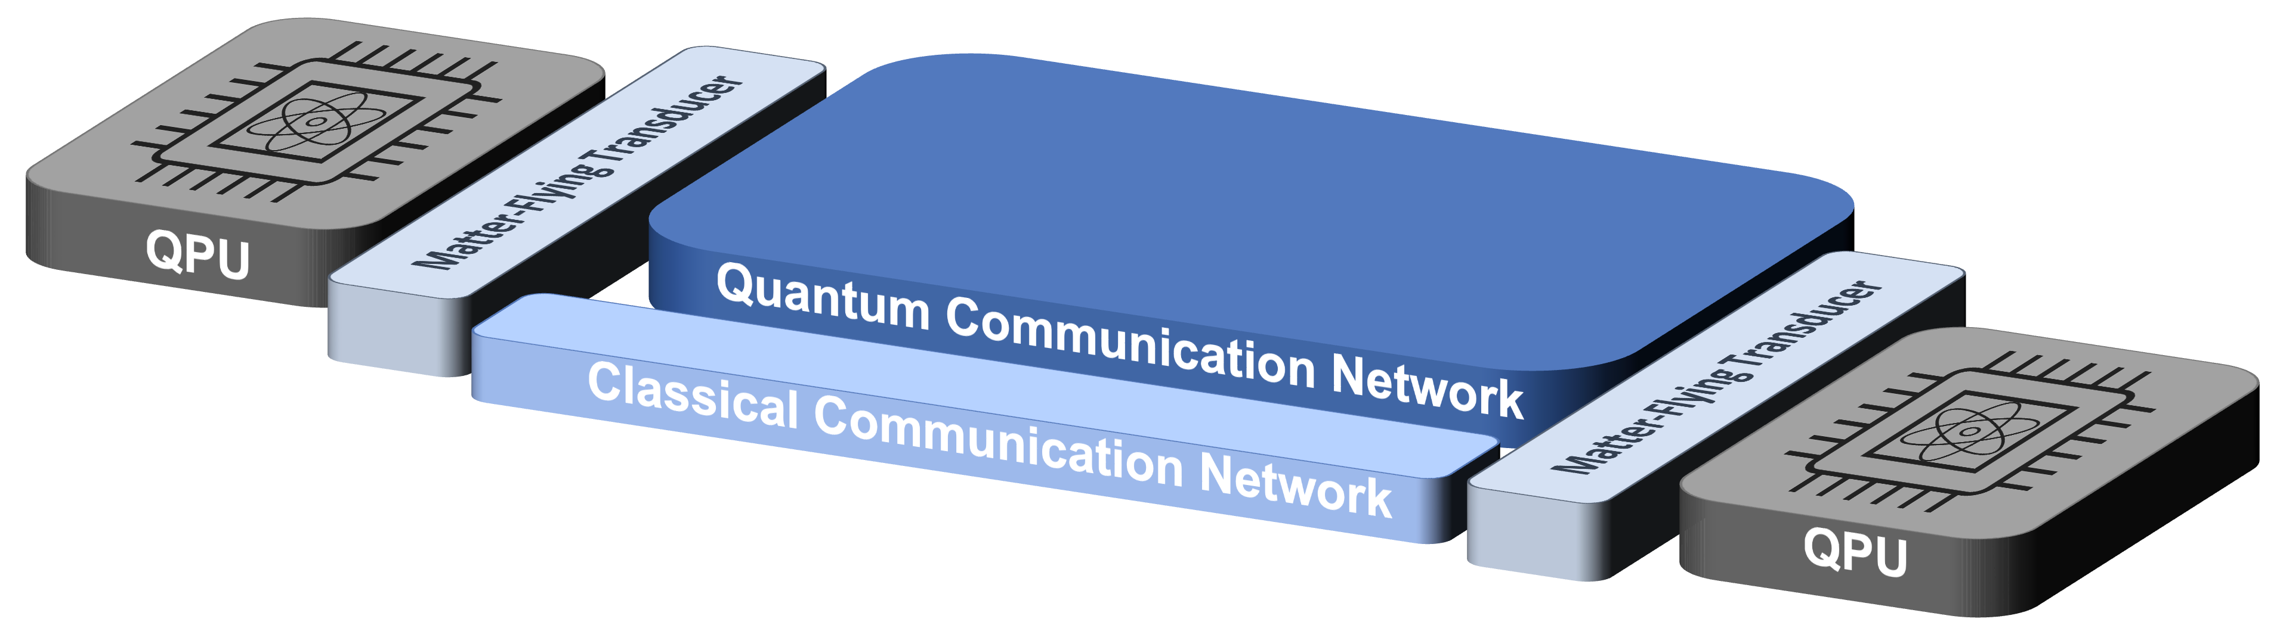
Quantum transduction in computing and sensing
Single microwave
photon counter
Superconducting
qubits/sensors
Optical
communication
Transducer
Microwave
Optical
∼GHz
~200 THz
Cryogenic temperature
Room temperature
Enable sensor networks and
coherent postprocessing
Remote entanglement
generation

Slide 4


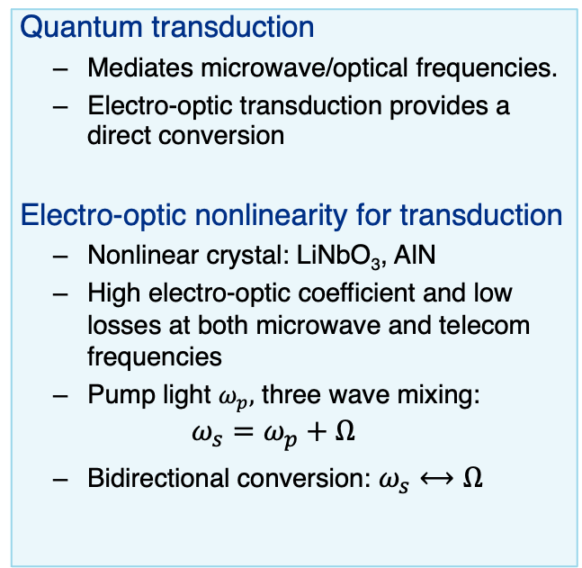






Introduction to Quantum Transduction
Quantum transduction
  Mediates microwave/optical frequencies.
  Electro-optic transduction provides a direct conversion
Electro-optic nonlinearity for transduction
  Nonlinear crystal: LiNbO₃, AlN
  High electro-optic coefficient and low losses at both microwave and telecom frequencies
  Pump light $ω_{p},$ three wave mixing:
  $$ω_{s}=ω_{p}+Ω$$
  Bidirectional conversion: $ω_{s}⟷Ω$
Superconducting
qubits/sensors
Optical
communication
Transducer
Microwave
Optical
∼GHz
~200 THz
Cryogenic temperature
Room temperature
$$ω_{FSR}$$
$$ω_{FSR}$$
$$Ω$$
$$Ω$$
$$0$$
$$Ω$$
$$ω_{p}$$
$$ω_{s}$$

Slide 5
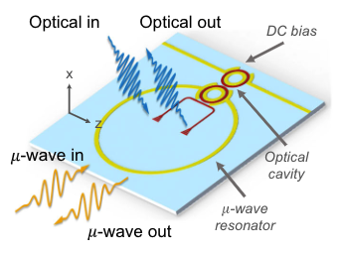
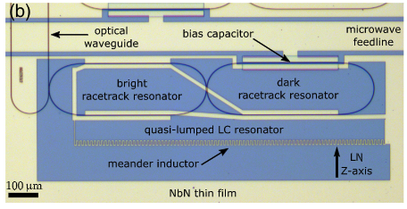
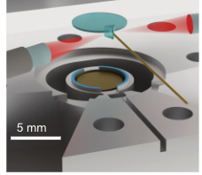
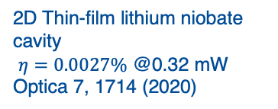
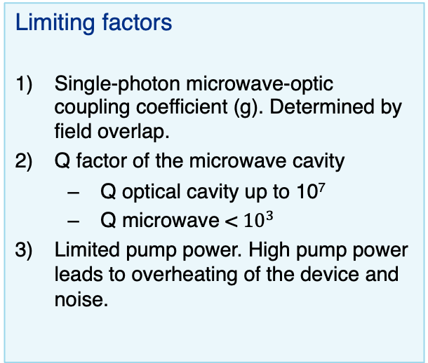
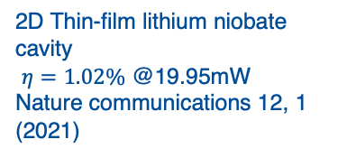
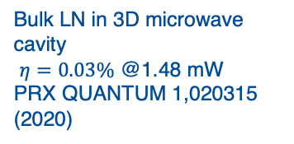
Electro-optic direct frequency conversion
Limiting factors
Single-photon microwave-optic coupling coefficient (g). Determined by field overlap.
Q factor of the microwave cavity
  Q optical cavity up to 10⁷
  Q microwave < ${10}^{3}$
Limited pump power. High pump power leads to overheating of the device and noise.
2D Thin-film lithium niobate cavity
$η=0.0027\%$ @0.32 mW
Optica 7, 1714 (2020)
2D Thin-film lithium niobate cavity
$η=1.02\%$ @19.95mW
Nature communications 12, 1 (2021)
Bulk LN in 3D microwave cavity
$η=0.03\%$ @1.48 mW
PRX QUANTUM 1,020315 (2020)

Slide 6
Electro-optic direct frequency conversion
2D Thin-film lithium niobate cavity
$η=0.0027\%$ @0.32 mW
Optica 7, 1714 (2020)
2D Thin-film lithium niobate cavity
$η=1.02\%$ @19.95mW
Nature communications 12, 1 (2021)
M-O coupling
Bulk LN in 3D microwave cavity
$η=0.03\%$ @1.48 mW
PRX QUANTUM 1,020315 (2020)

Slide 7
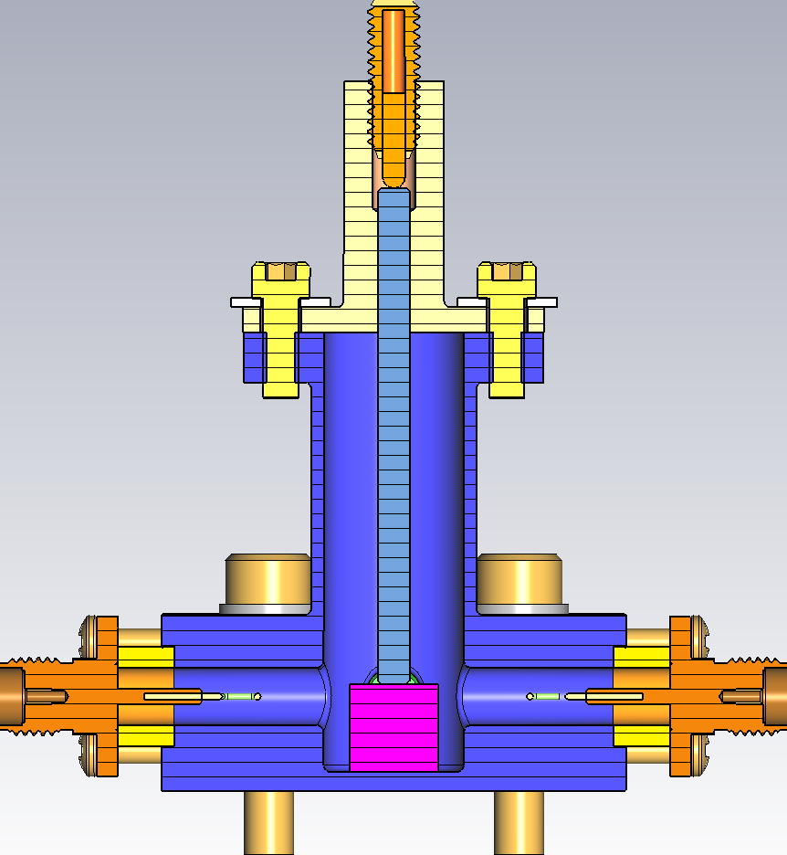
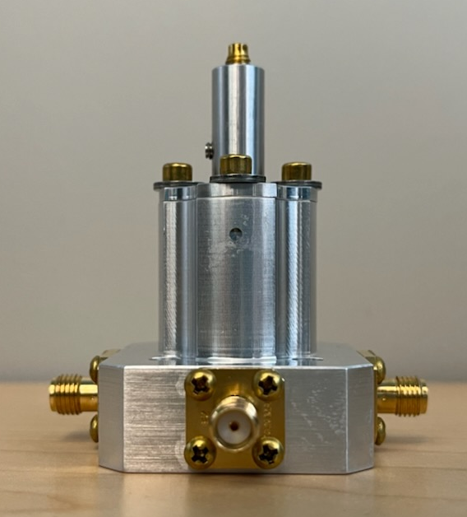
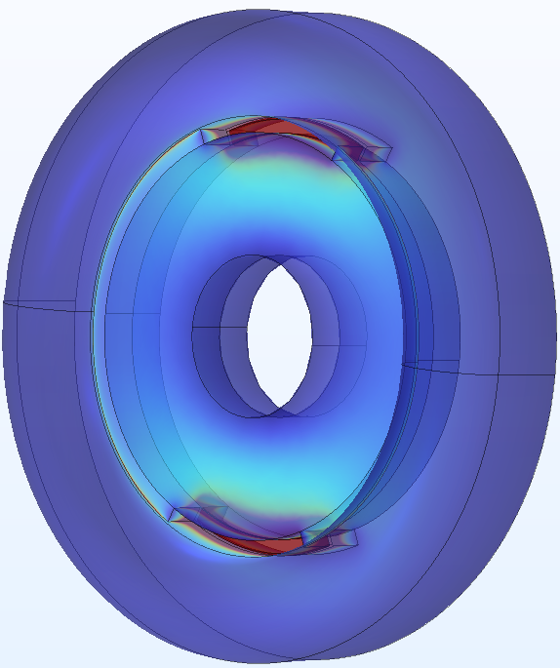
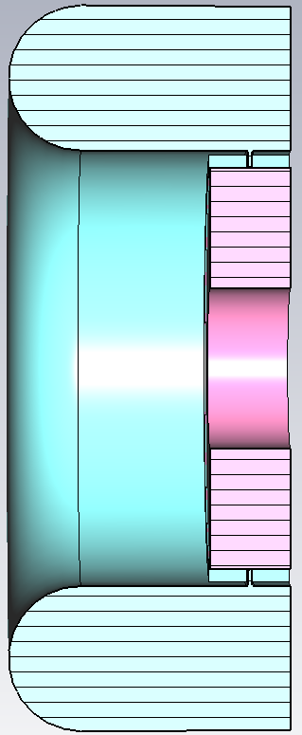
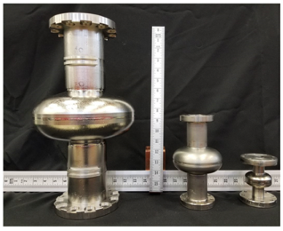

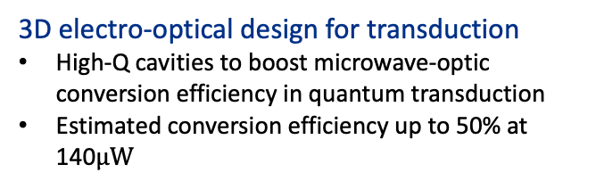
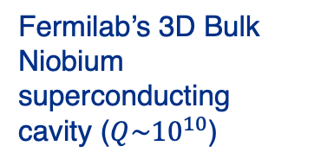
3D electro-optical quantum transduction
Characterization of Electro-optic materials
First precise measurements of loss tangent and permittivity of lithium niobate (LN) at millikelvin temperatures
Fermilab’s 3D Bulk Niobium superconducting cavity ($Q\sim {10}^{10}$)
$$ε=\left(\begin{matrix}ε_{⊥} & 0 & 0 \\ 0 & ε_{⊥} & 0 \\ 0 & 0 & ε_{∥}\end{matrix}\right)$$
Phys. Rev. B 107, L220302 (2022)
3D electro-optical design for transduction
High-Q cavities to boost microwave-optic conversion efficiency in quantum transduction
Estimated conversion efficiency up to 50% at 140$μW$
Npj Quantum Information, 8 149 (2023)
Applications
Sensing: photon-counting in the optical regime
Communication: increase entanglement rate
ArXiv in preparation – with Prof. Zhuang
Physical Review Applied, 13, 034032 (2020).
IEEE QCE23 – with Prof. Cacciapuoti
Notes:
Mension anisotropic

Slide 8
3D electro-optical quantum transduction
Characterization of Electro-optic materials
First precise measurements of loss tangent and permittivity of lithium niobate (LN) at millikelvin temperatures
Fermilab’s 3D Bulk Niobium superconducting cavity ($Q\sim {10}^{10}$)
$$ε=\left(\begin{matrix}ε_{⊥} & 0 & 0 \\ 0 & ε_{⊥} & 0 \\ 0 & 0 & ε_{∥}\end{matrix}\right)$$
Phys. Rev. B 107, L220302 (2022)
3D electro-optical design for transduction
High-Q cavities to boost microwave-optic conversion efficiency in quantum transduction
Estimated conversion efficiency up to 50% at 140$μW$
This talk
Npj Quantum Information, 8 149 (2023)
Applications
Sensing: photon-counting in the optical regime
Communication: increase entanglement rate
ArXiv in preparation – with Prof. Zhuang
This talk
Physical Review Applied, 13, 034032 (2020).
IEEE QCE23 – with Prof. Cacciapuoti
Notes:
Mension anisotropic

Slide 9
3D electro-optical quantum transduction
Characterization of Electro-optic materials
First precise measurements of loss tangent and permittivity of lithium niobate (LN) at millikelvin temperatures
Fermilab’s 3D Bulk Niobium superconducting cavity ($Q\sim {10}^{10}$)
$$ε=\left(\begin{matrix}ε_{⊥} & 0 & 0 \\ 0 & ε_{⊥} & 0 \\ 0 & 0 & ε_{∥}\end{matrix}\right)$$
Phys. Rev. B 107, L220302 (2022)
3D electro-optical design for transduction
High-Q cavities to boost microwave-optic conversion efficiency in quantum transduction
Estimated conversion efficiency up to 50% at 140$μW$
Npj Quantum Information, 8 149 (2023)
Applications
Sensing: photon-counting in the optical regime
Communication: increase entanglement rate
ArXiv in preparation – with Prof. Zhuang
Physical Review Applied, 13, 034032 (2020).
IEEE QCE23 – with Prof. Cacciapuoti
Notes:
Mension anisotropic

Slide 10
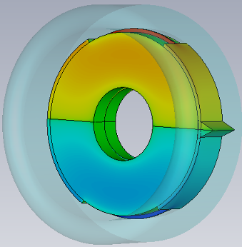


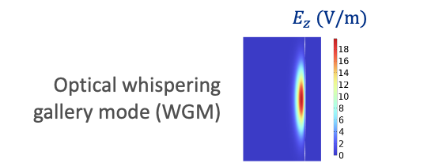
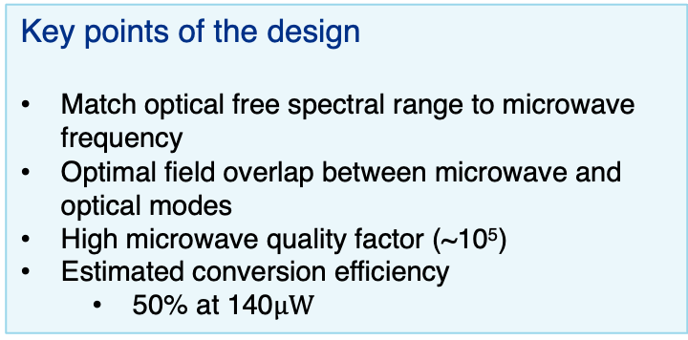
3D cavity Electro-Optic Design
Hybrid resonant cavity
Key points of the design
Match optical free spectral range to microwave frequency
Optimal field overlap between microwave and optical modes
High microwave quality factor (~10⁵)
Estimated conversion efficiency
  50% at 140$μW$
Optical coupler
Emax on the rim of the optical resonator
Optical whispering gallery mode (WGM)

Slide 11
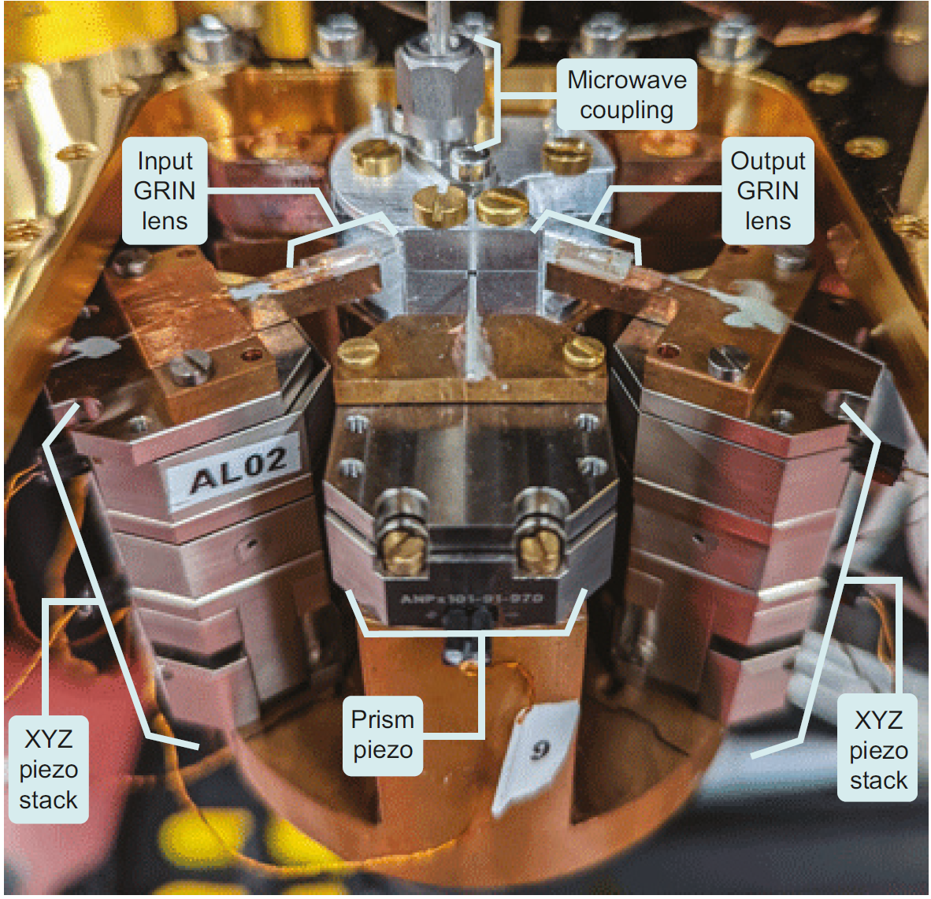
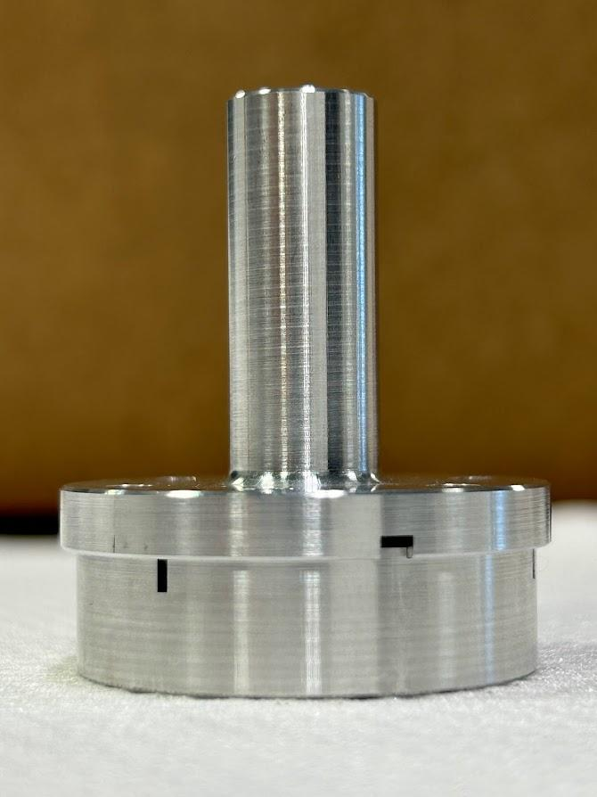
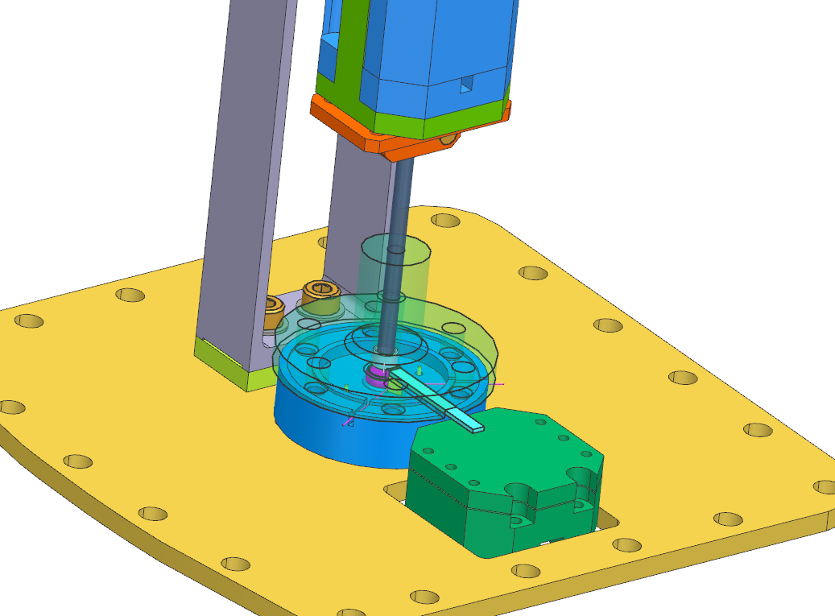
Hardware challenges
Alignment
Optical components in system needing positioning capabilities for alignment
Total 6 critical dimensions of control for coupling problem (including dynamic polarization control)
Optical coupling
Optical coupling maintained during cooldown through monitoring waveform
Thermal quasiparticle
The laser pump will induce thermal quasiparticle and increase the system temperature
Microwave tuning
Optical coupling
Typical WGM optical coupling setup with 8 piezo stages for 20mK *
Laser
Microwave tuning
Our transduction microwave cavity
Optical coupling
Draft cryogenic transduction setup
Laser
* Sahu R. Cavity quantum electrooptics – Fink Group IST

Slide 12
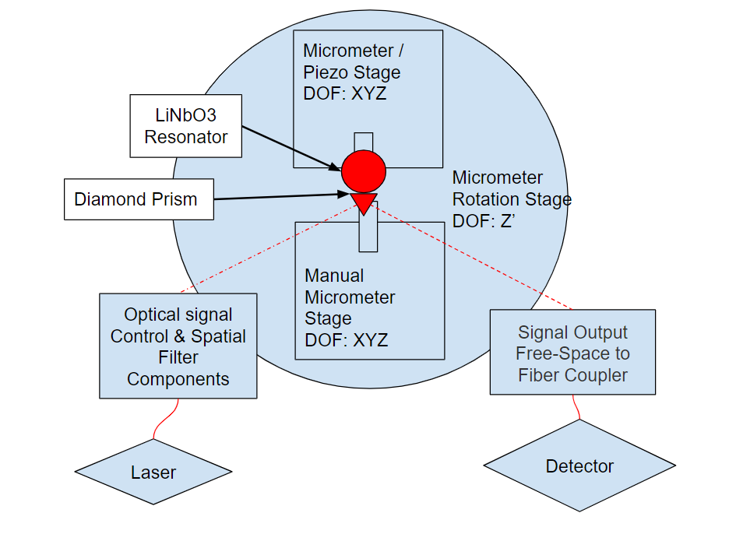
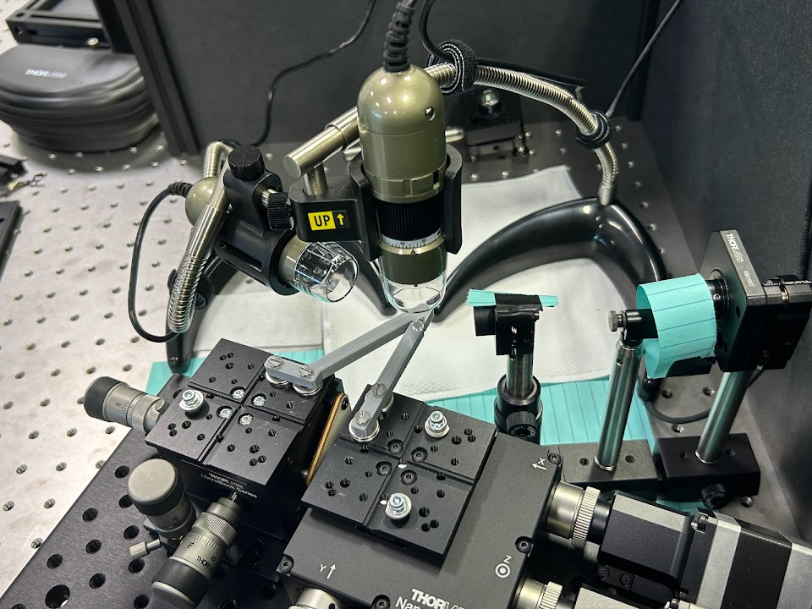
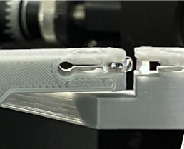
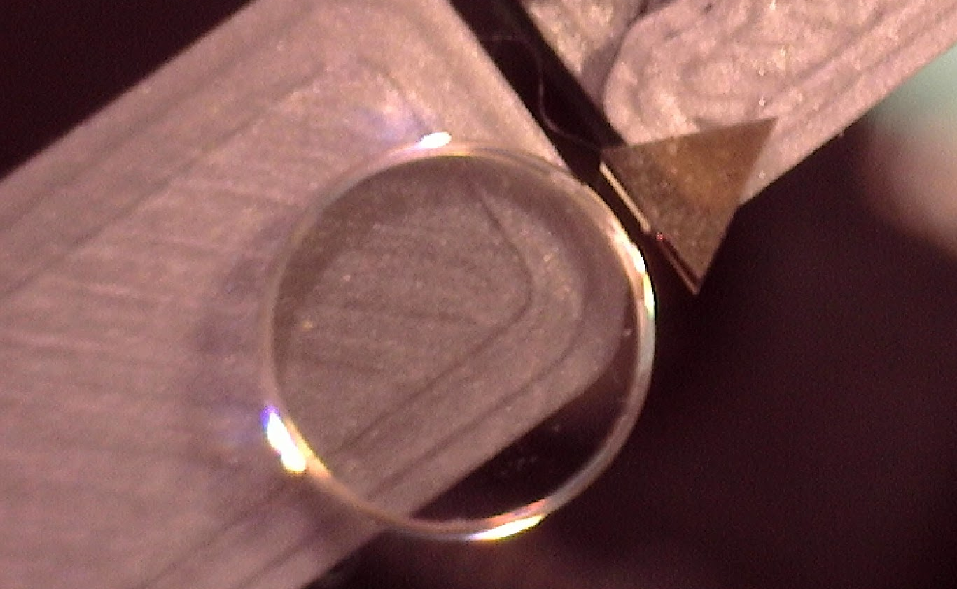
Positioning/Alignment System
Achieving optimal optical coupling to resonator requires precise positioning control
Piezo and motor translation and rotation stages
Manual kinematic mounts for lenses (2 DOF)
Digital microscopes for top and side views
Mechanical System Block Diagram
LiNbO3 crystal and coupling prism on brackets
Optical Table Setup for visible laser alignment
with two digital microscopes
Custom holders for crystal and prism

Slide 13
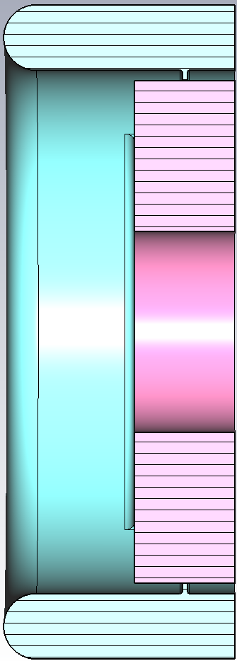
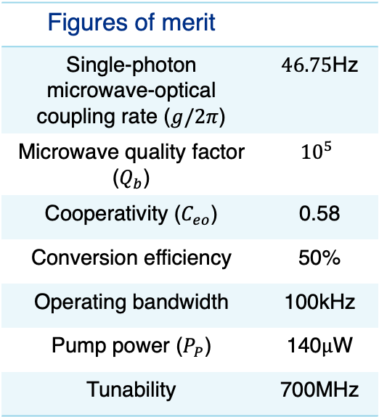
Evaluation
Figures of merit
Single-photon microwave-optical coupling rate ($g/2π$) | $46.75$Hz
Microwave quality factor ($Q_{b}$) | $${10}^{5}$$
Cooperativity ($C_{eo}$) | 0.58
Conversion efficiency | 50%
Operating bandwidth | 100kHz
Pump power ($P_{P}$) | 140$μ\text{W}$
Tunability | 700MHz
Quantum Communication
Trade-off between MO coupling and efficiency. High efficiency and low pump power leads to entanglement without need of further purification
Quantum Sensing
High microwave quality factor leads to high conversion efficiency
Quantum Computing
Operating bandwidth is within acceptable values for superconducting qubits
Low pump power —> low thermal quasiparticle poisoning
Increase the operating range
** Wang et al. Npj Quantum Information, 8 149
Notes:
Sample the TM110 mode

Slide 14
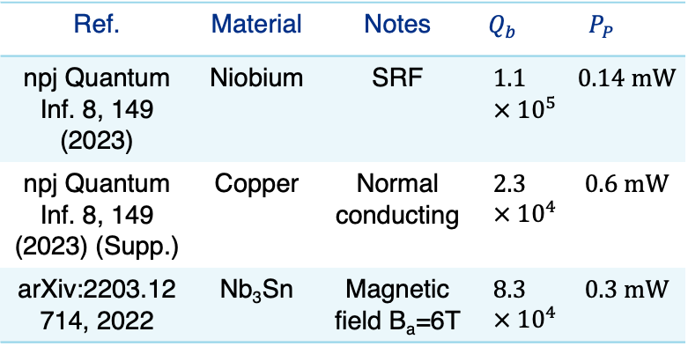
Evaluation
Figures of merit
Single-photon microwave-optical coupling rate ($g/2π$) | $46.75$Hz
Microwave quality factor ($Q_{b}$) | $${10}^{5}$$
Cooperativity ($C_{eo}$) | 0.58
Conversion efficiency | 50%
Operating bandwidth | 100kHz
Pump power ($P_{P}$) | 140$μ\text{W}$
Tunability | 700MHz
Operation under very different environmental conditions and close to the sensing cavity with a high magnetic field.
Ref. | Material | Notes | $$Q_{b}$$ | $$P_{P}$$
npj Quantum Inf. 8, 149 (2023) | Niobium | SRF | $$1.1 × {10}^{5}$$ | $$0.14 mW$$
npj Quantum Inf. 8, 149 (2023) (Supp.) | Copper | Normal conducting | $$2.3 × {10}^{4}$$ | $$0.6 mW$$
arXiv:2203.12714, 2022 | Nb₃Sn | Magnetic field B_{a}=6T | $$8.3 × {10}^{4}$$ | $$0.3 mW$$
Optical mode
Notes:
Sample the TM110 mode

Slide 15
3D electro-optical quantum transduction
Characterization of Electro-optic materials
First precise measurements of loss tangent and permittivity of lithium niobate (LN) at millikelvin temperatures
Fermilab’s 3D Bulk Niobium superconducting cavity ($Q\sim {10}^{10}$)
$$ε=\left(\begin{matrix}ε_{⊥} & 0 & 0 \\ 0 & ε_{⊥} & 0 \\ 0 & 0 & ε_{∥}\end{matrix}\right)$$
Phys. Rev. B 107, L220302 (2022)
3D electro-optical design for transduction
High-Q cavities to boost microwave-optic conversion efficiency in quantum transduction
Estimated conversion efficiency up to 50% at 140$μW$
Npj Quantum Information, 8 149 (2023)
Applications
Sensing: photon-counting in the optical regime
Communication: increase entanglement rate
ArXiv in preparation – with Prof. Zhuang
Physical Review Applied, 13, 034032 (2020).
IEEE QCE23 – with Prof. Cacciapuoti
Notes:
Mension anisotropic

Slide 16
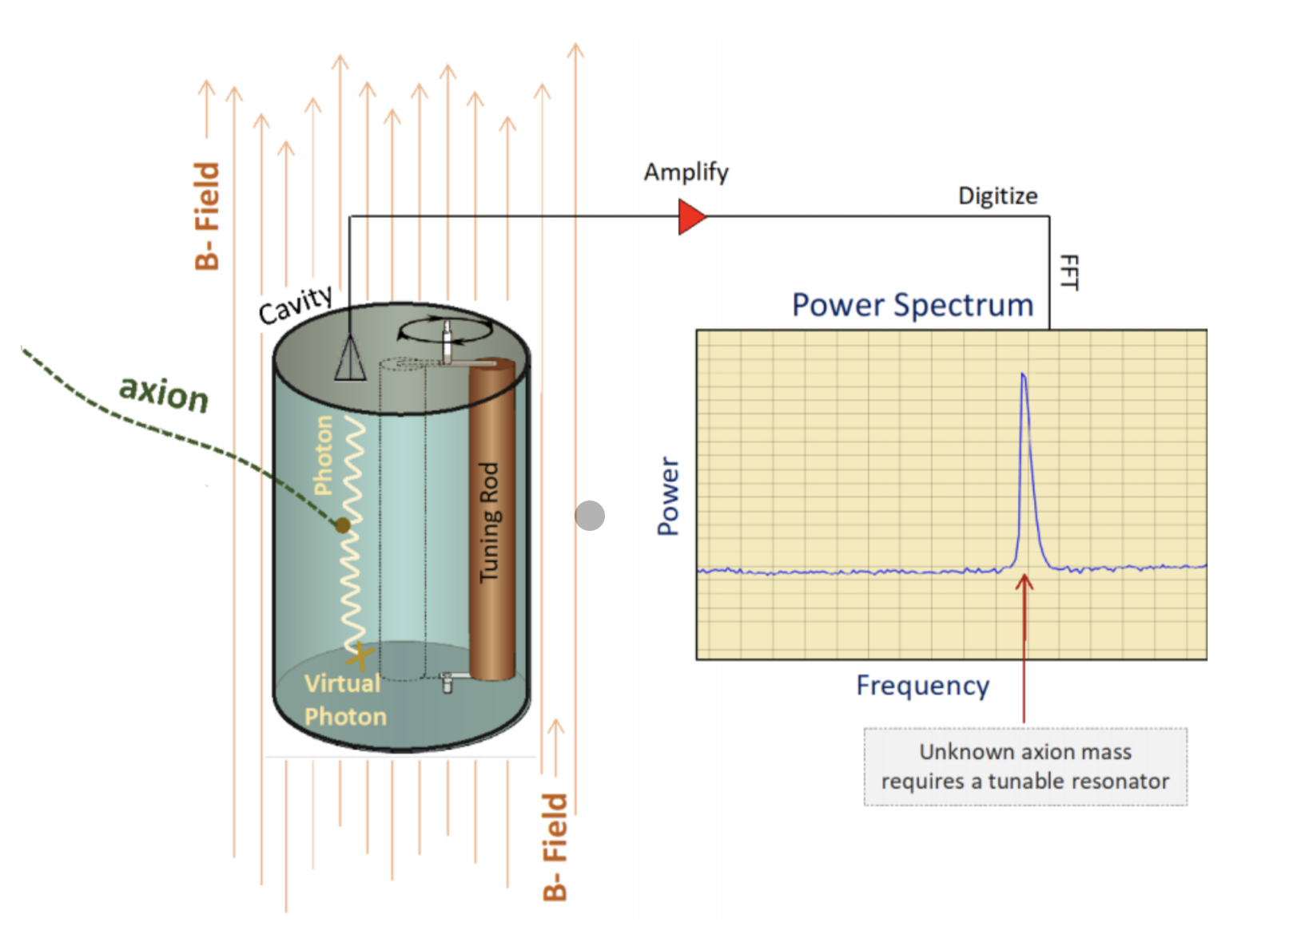
Haloscope using transduction - motivation
M-O transducer as a parametric amplifier
Optical single photon counter
Haloscope with homodyne detection is commonly used but not optimal
Need of microwave single photon counters
Dissipation due to long RF cables
Use microwave-optical transducers for ultra-low noise parametric amplification
Low dark photon count → system temperature ~ cavity temperature → SNR and scan-rate improvement

Slide 17
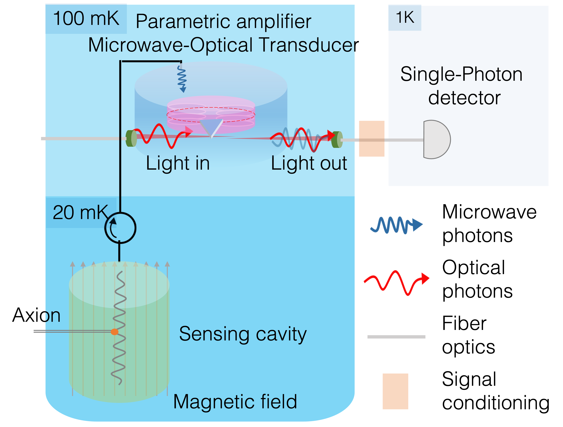
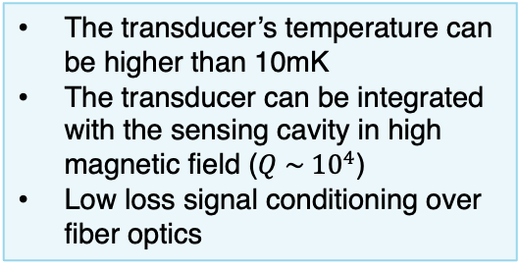
HALOscope using Teleportation-based Transduction And Photon-counting (HALO-TTAP)
The transducer’s temperature can be higher than 10mK
The transducer can be integrated with the sensing cavity in high magnetic field ($Q \sim {10}^{4}$)
Low loss signal conditioning over fiber optics
ArXiv in preparation – SQMS/Fermilab and A. Brady (U. Arizona) , Zhuang, (USC)

Slide 18
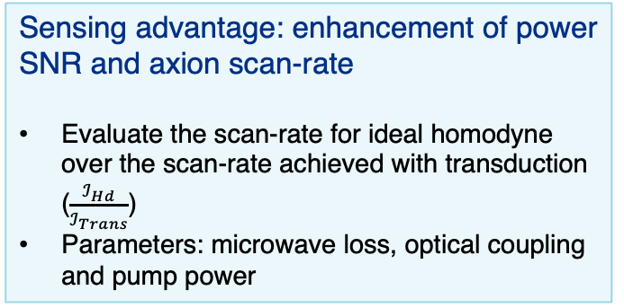
HALO-TTAP advantage
Sensing advantage: enhancement of power SNR and axion scan-rate
Evaluate the scan-rate for ideal homodyne over the scan-rate achieved with transduction ($\frac{ℐ_{Hd}}{ℐ_{Trans}}$)
Parameters: microwave loss, optical coupling and pump power

Slide 19
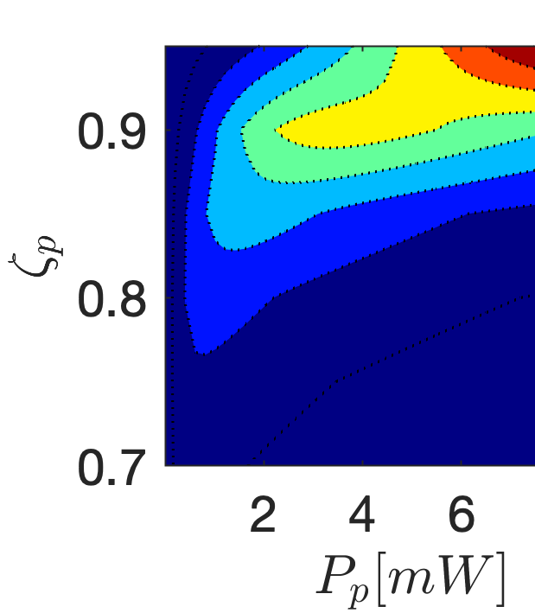
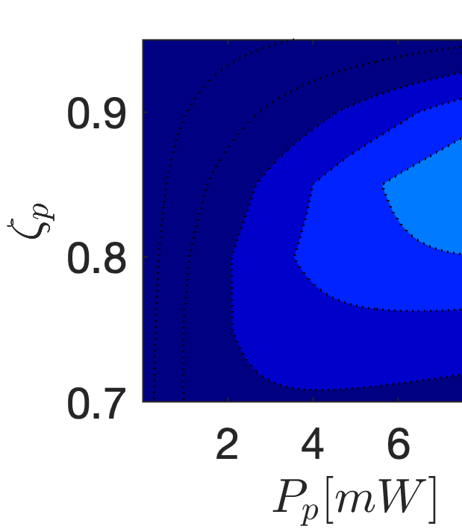
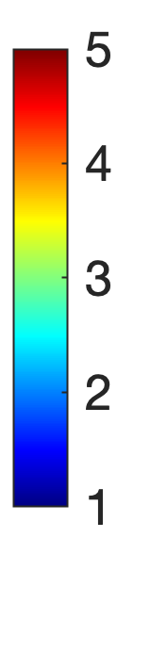




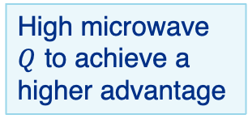
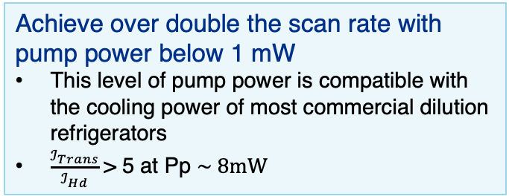
HALO-TTAP advantage
High microwave $Q$ to achieve a higher advantage
$$Q_{b}={10}^{4}$$
$$Q_{b}={10}^{3}$$
Achieve over double the scan rate with pump power below 1 mW
This level of pump power is compatible with the cooling power of most commercial dilution refrigerators
$\frac{ℐ_{Trans}}{ℐ_{Hd}}$> 5 at Pp $\sim 8mW$
$$\frac{ℐ_{Trans}}{ℐ_{Hd}}>2, P_{P} \sim 1mW$$
$$\frac{ℐ_{Trans}}{ℐ_{Hd}}>2, P_{P} \sim 8mW$$

Slide 20
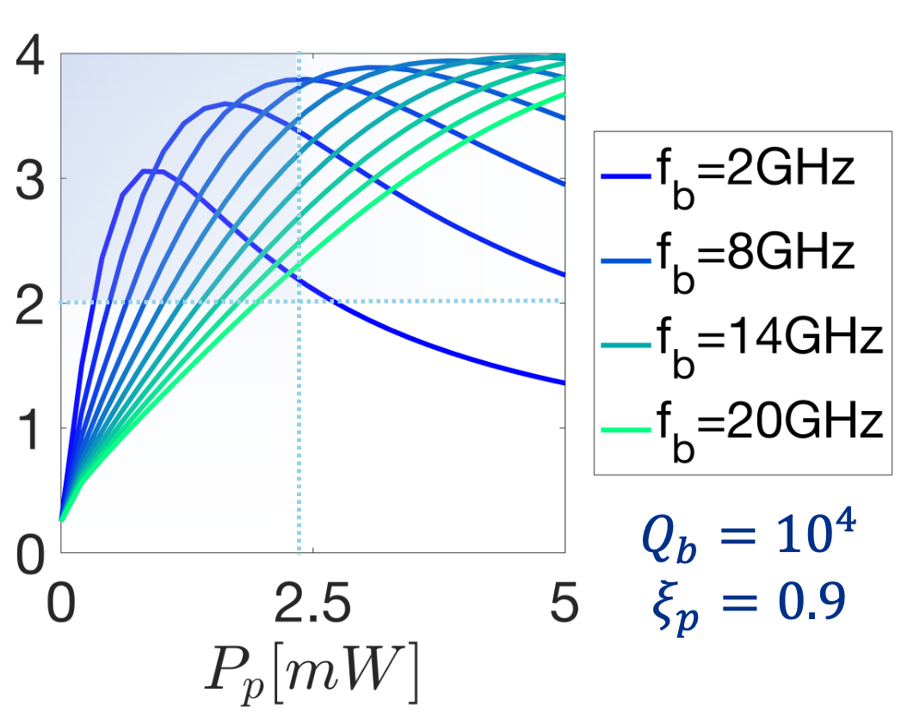

HALO-TTAP advantage
Scan rate improvement is possible over a wide range 2—20 GHz
$$Q_{b}={10}^{4}$$
$$\frac{ℐ_{Trans}}{ℐ_{Hd}}$$
Achieve over double the scan rate with pump power below 1 mW
This level of pump power is compatible with the cooling power of most commercial dilution refrigerators
$\frac{ℐ_{Trans}}{ℐ_{Hd}}$> 5 at Pp $\sim 8mW$
$$\frac{ℐ_{Trans}}{ℐ_{Hd}}>2, P_{P} \sim 1mW$$

Slide 21
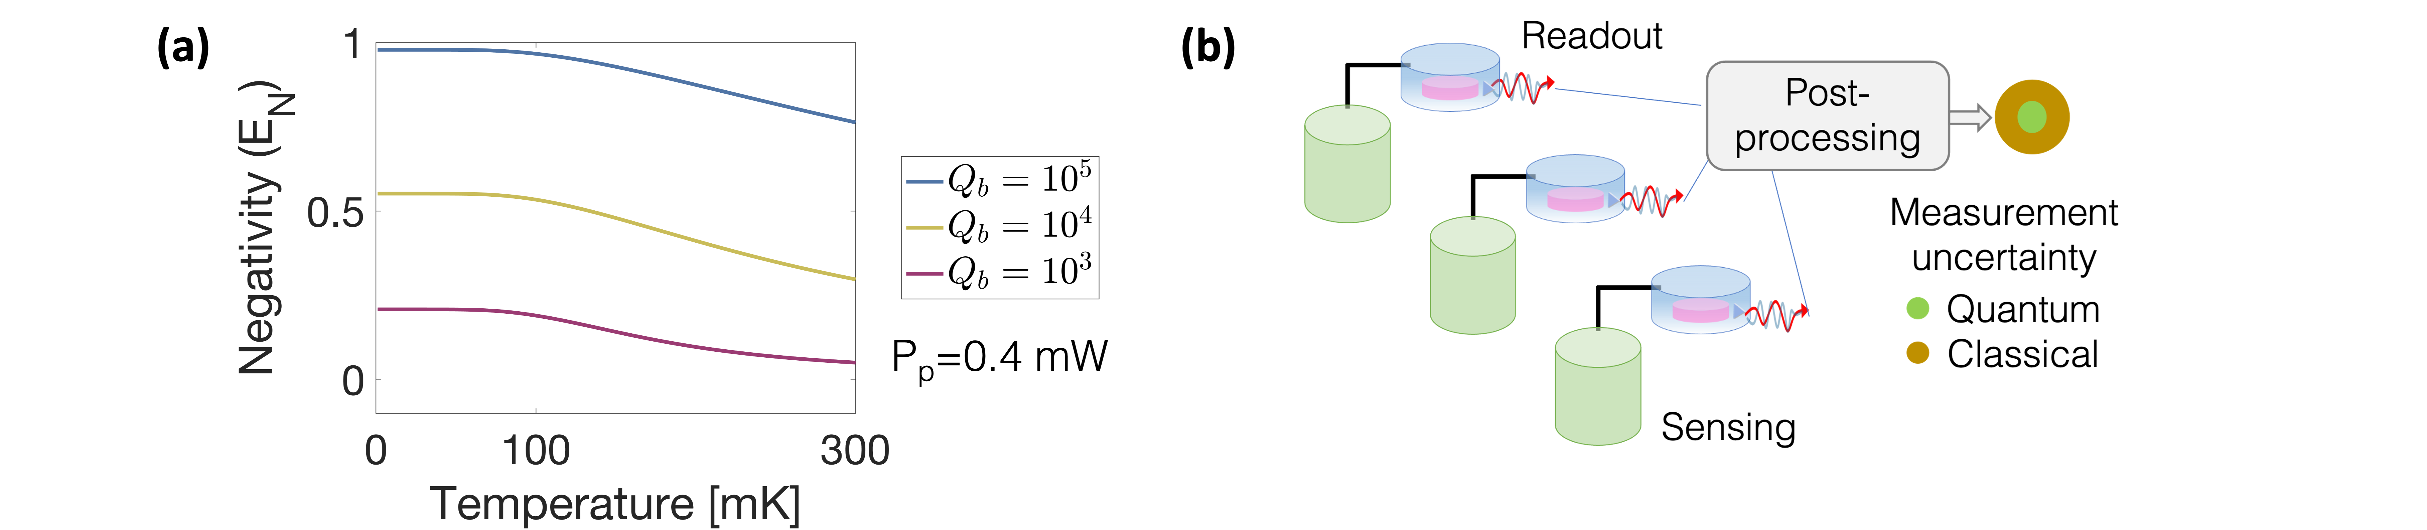
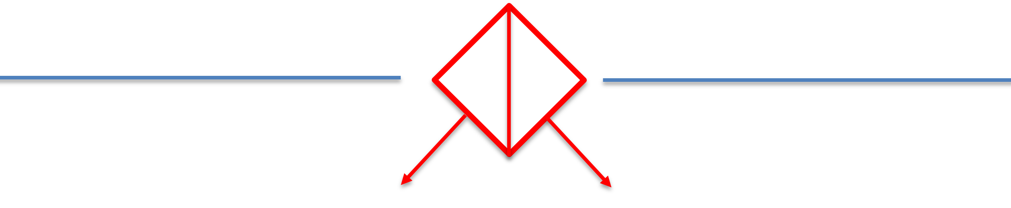
Other applications in quantum computing and sensing
Entangled microwave-optical photons
Sensor network with joint post-processing
Gravitational waves
Coherent post-processing of dark matter
Remote entanglement generation
Quantum networks
Interconnecting superconducting qubits
IEEE QCE23 – with Prof. Cacciapuoti, UniNa

Slide 22
Thank you!

Slide 23
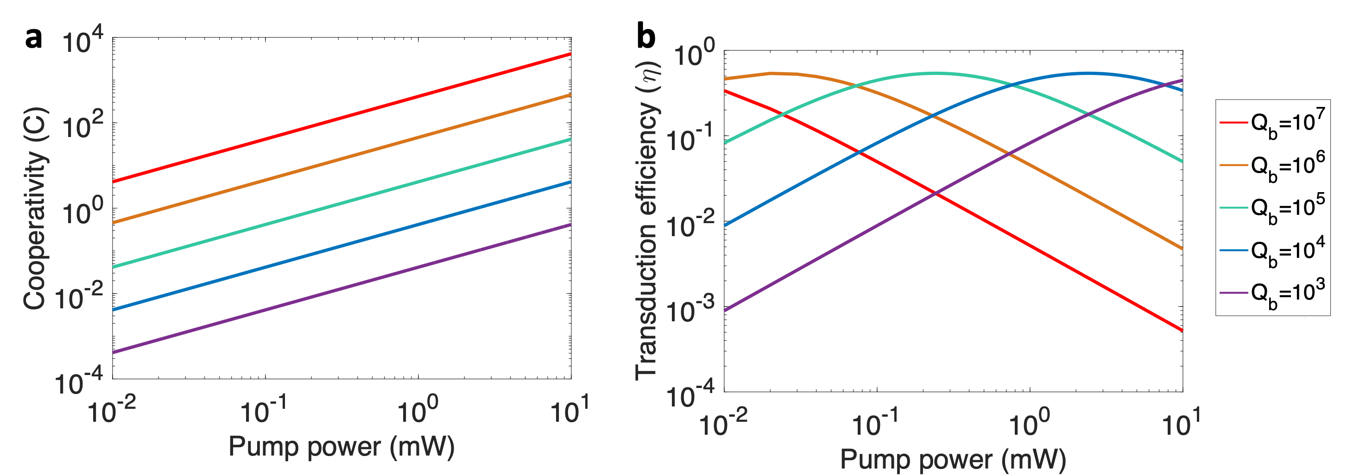
3D cavity Electro-Optic
← Pump power limit
← Pump power limit
Maximum efficiency →
Maximum efficiency →
Figures of merit

Slide 24
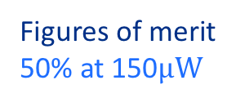
3D cavity Electro-Optic
← Pump power limit
← Pump power limit
← Maximum efficiency
← Maximum efficiency
Figures of merit
50% at 150$μW$

Slide 25
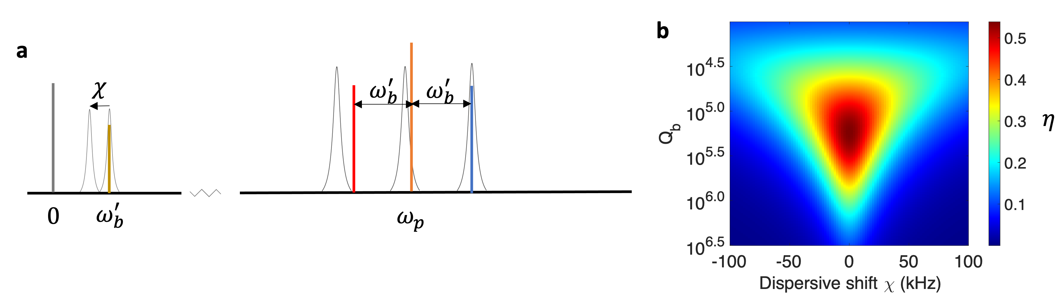
3D cavity Electro-Optic
← Pump power limit
← Pump power limit
← Maximum efficiency
← Maximum efficiency
Figures of merit
50% at 150$μW$
Transduction in a superconducting QED system with a qubit

Slide 26
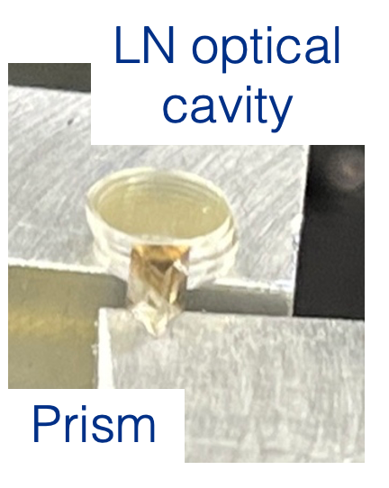
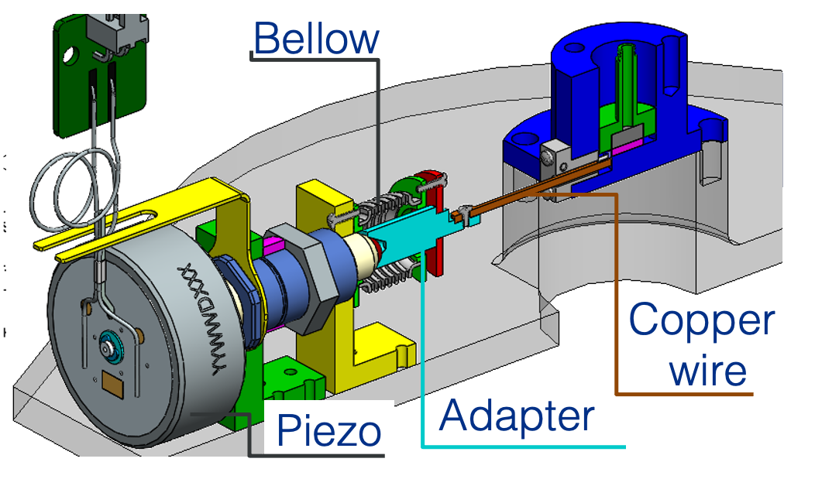

Optical coupling
Microwave Q

Slide 27



Haloscope using transduction
Evaluate the scan-rate using a Fisher information approach
Ideal homodyne:
Transduction based photon-counting:
N_{T}, N_{Trans}: Thermal noise of the sensing cavity and the transduction cavity
$\frac{I_{Hd}}{I_{Trans}}$: to evaluate the advantage of this approach
arXiv in preparation in collaboration with Prof. Quntao Zhuang at USC and Dr. Brady at University of Arizona

Slide 28

3D electro-optical quantum transduction
Characterization of Electro-optic materials
First precise measurements of loss tangent and permittivity of lithium niobate (LN) at millikelvin temperatures
Fermilab’s 3D Bulk Niobium superconducting cavity ($Q\sim {10}^{10}$)
$$ε=\left(\begin{matrix}ε_{⊥} & 0 & 0 \\ 0 & ε_{⊥} & 0 \\ 0 & 0 & ε_{∥}\end{matrix}\right)$$
Phys. Rev. B 107, L220302 (2022)
3D electro-optical design for transduction
High-Q cavities to boost microwave-optic conversion efficiency in quantum transduction
Estimated conversion efficiency up to 50% at 140$μW$
Npj Quantum Information, 8 149 (2023)
Applications
Sensing: photon-counting in the optical regime
Communication: increase entanglement rate
ArXiv in preparation – with Prof. Zhuang
Physical Review Applied, 13, 034032 (2020).
IEEE QCE23 – with Prof. Cacciapuoti
Notes:
Mension anisotropic

Slide 29




Measurement of LiNbO₃’s permittivity and loss tangent at mK
Aluminum cavity
Approach
Experimental Setup
Frequency shift:
$$Δf=\frac{df}{dε_{⊥}}Δε_{⊥}+\frac{df}{dε_{∥}}Δε_{∥}$$
Loaded Q factor:
$$\frac{1}{Q_{L}}=\frac{1}{Q_{0}}+\frac{1}{Q_{d}}+\sum_{i=1}^{4}{\frac{1}{Q_{ext,i}}}$$
$$\frac{1}{Q_{d}}=p_{⊥}\tan{δ_{⊥}}+p_{∥}\tan{δ_{∥}}$$
TE mode $→ε_{⊥} , \tan{δ_{⊥}}$
TM mode $→ε_{∥} , \tan{δ_{∥}}$
The principal axis of LN is aligned with the z axis
$$ε=\left(\begin{matrix}ε_{⊥} & 0 & 0 \\ 0 & ε_{⊥} & 0 \\ 0 & 0 & ε_{∥}\end{matrix}\right)$$
LN sample

Slide 30



Measurement of LiNbO₃’s permittivity and loss tangent at mK
LiNbO₃ property at 50mK
$$\tan{δ_{⊥}}=(1.73±0.24)×{10}^{−5}$$
$$\tan{δ_{∥}}=(1.28±0.21)×{10}^{−5}$$
$(ε_{⊥},ε_{⊥}$, $ε_{∥})=\left(47, 47, 28\right)$
arXiv:2302.12916

