Slide 1
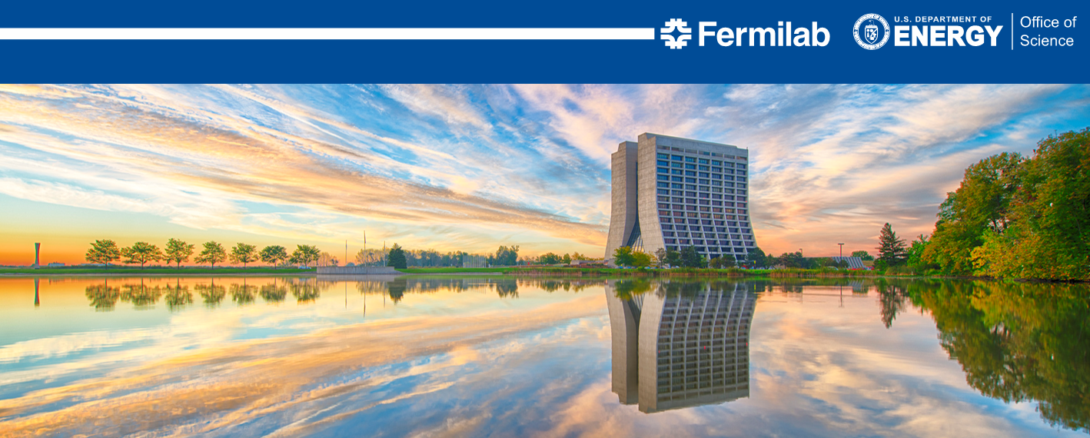
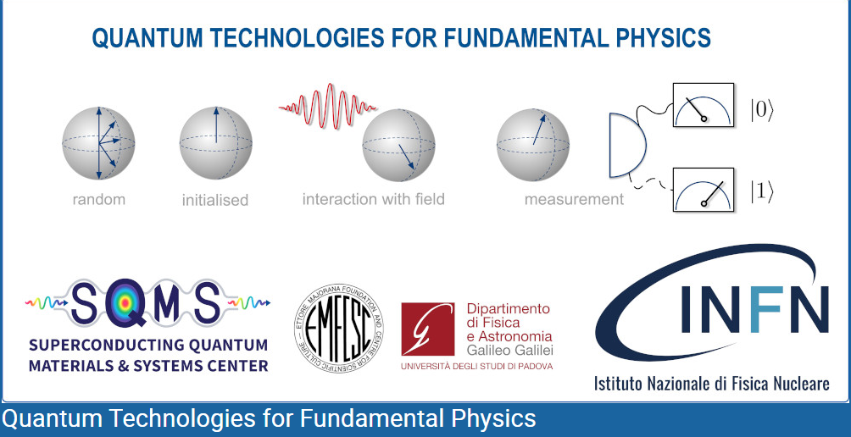
Frequency stability of the SRF cavities
(microphonics)
Yuriy Pischalnikov,
“Quantum Technologies for Fundamental Physics”
Session “Cavities and quantum technologies for GW”
Erice, Italy, September 1-7, 2023

Slide 2
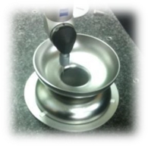
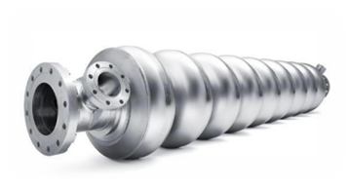
Resonance Control for SRF Cavities (for accelerators)
Cavity made from thin Nb sheets (cooling down at high gradient). External vibration (microphonics) or/and Lorentz forces will change cavity shape== frequency;
To keep SRF cavity’s accelerating gradient at required level LLRF system could overcome cavity’s resonance shift by pumping more RF power. This approach very expensive and to keep cost of RF-plant at reasonable cost the SRF cavity equipped (in addition to slow/coarse tuner) with fast tuning (piezo) system that can actively compensate LFD and slow frequency drift & microphonics

Slide 3
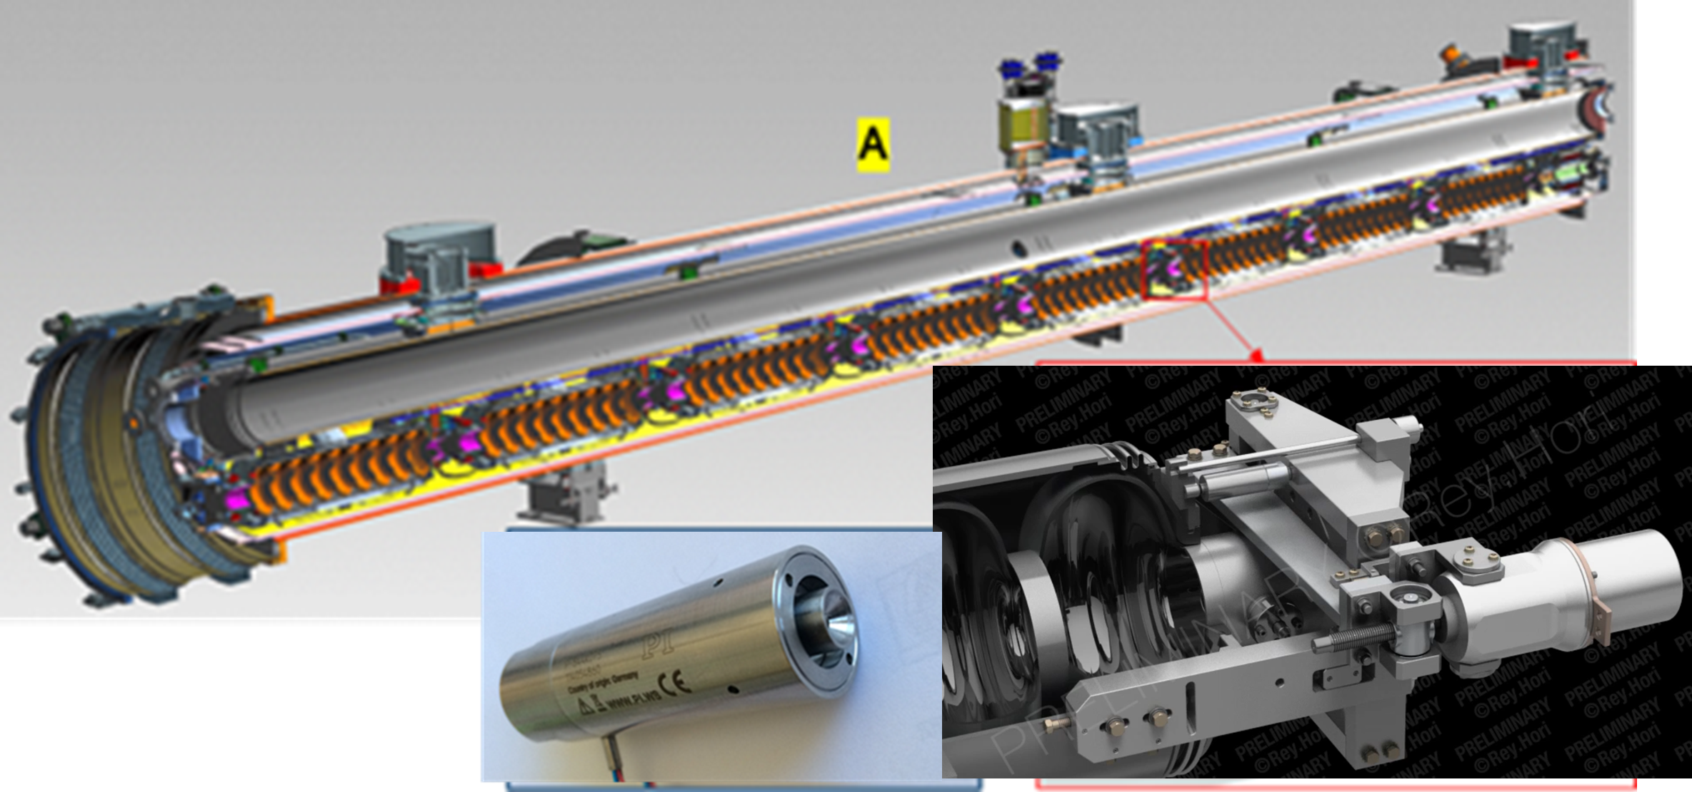
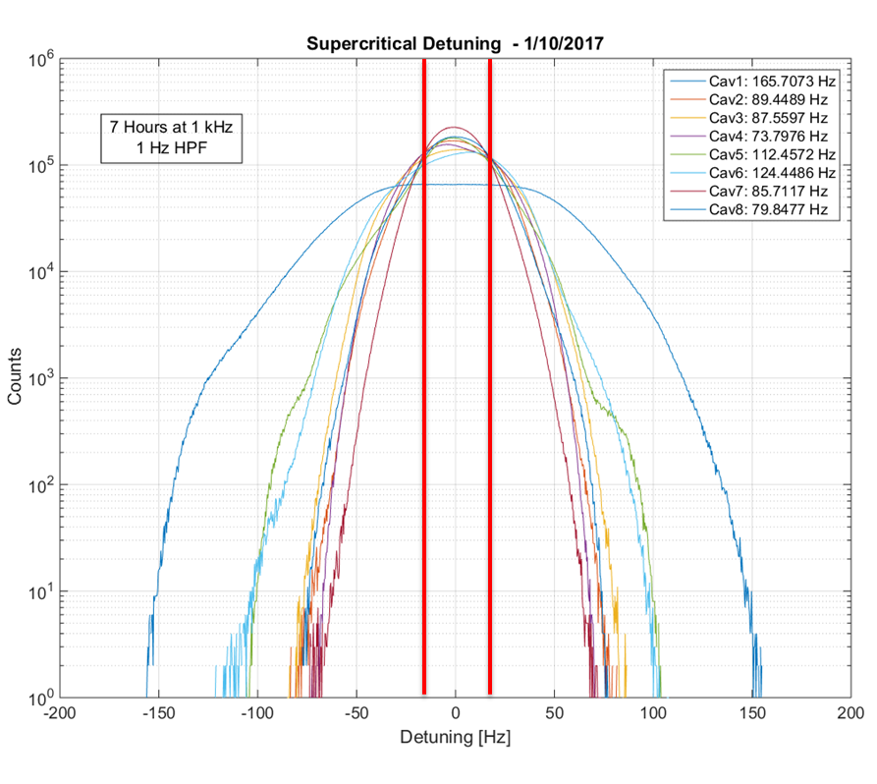
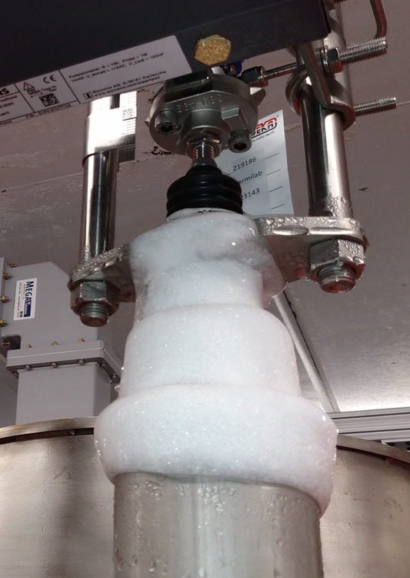
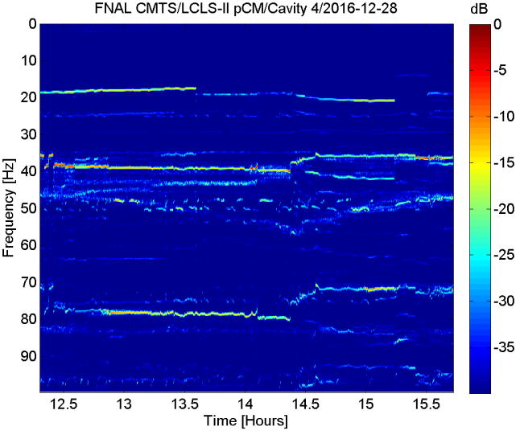
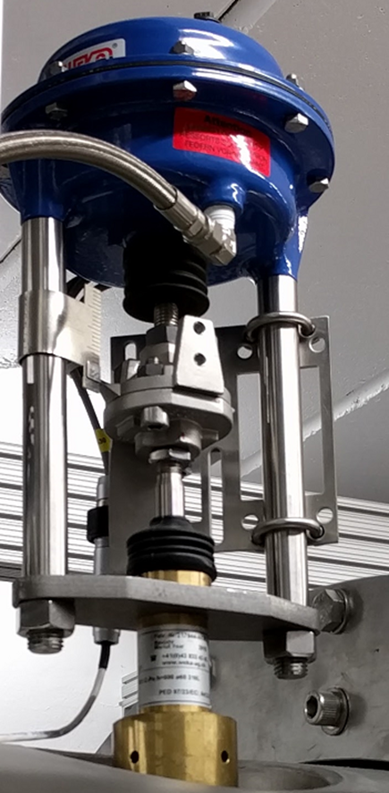
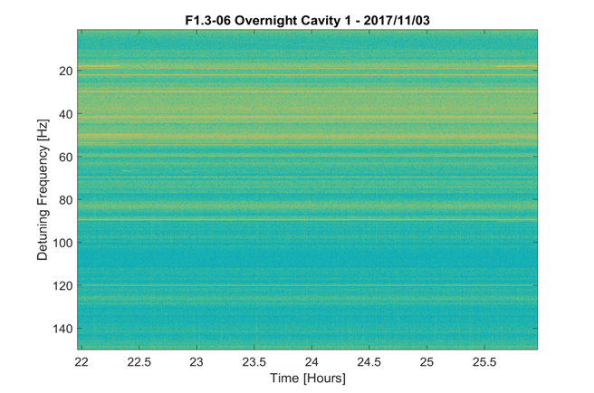
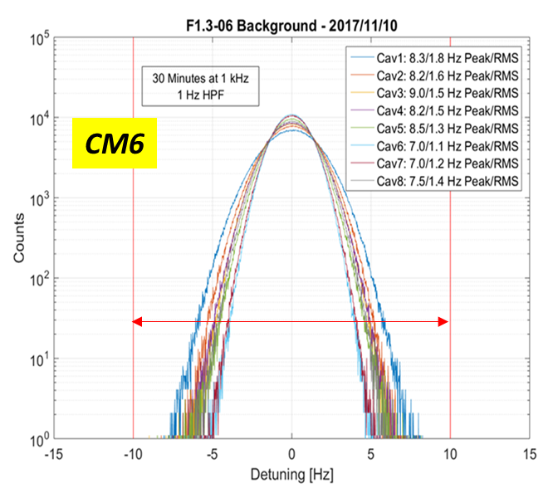
Passive Microphonics mitigation at LCLS II project
Cryogenic Valve modification & other changes in cryogenic flow led to significant (~15times) reduction of cavity detuning. Spectrum of the microphonics more looks like external (stable) vibrations
Cryo-flow induced vibrations
(Thermo Acoustic Oscillations)
were main source that led to significant (150Hz peak-to-peak) microphonics at pCM.
Vibration lines shift rapidly frequency and amplitude
10 Hz

Slide 4
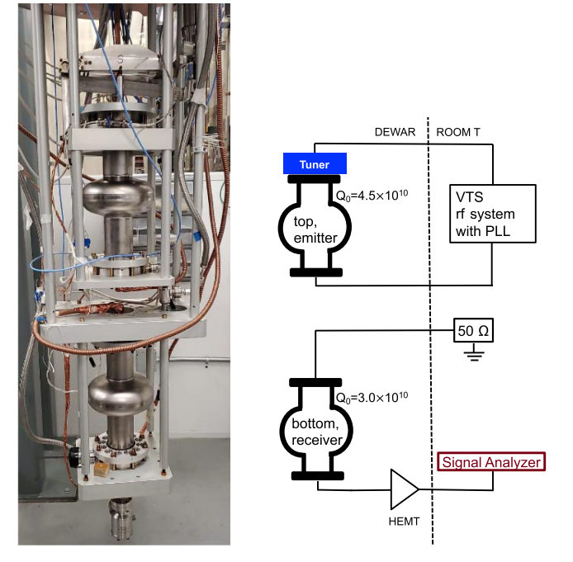
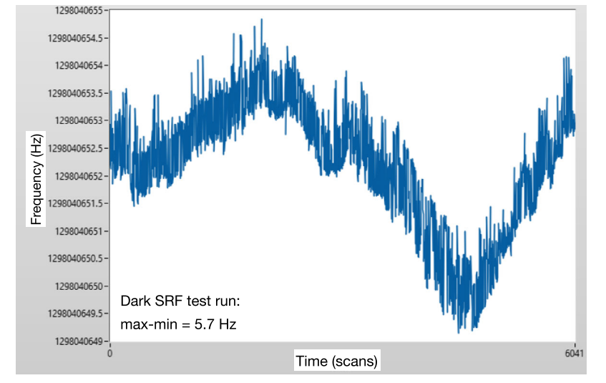
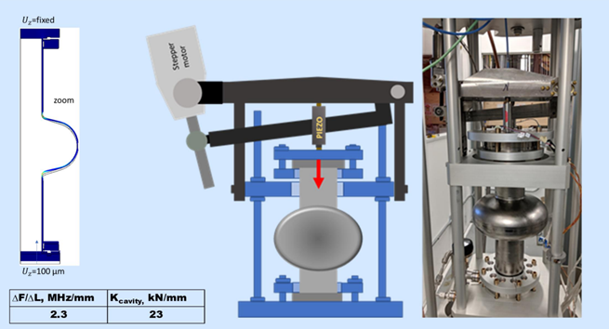
1,3 GHz two single cell cavities at VTS
Search for Dark Photons with SRF Cavities
A. Romanenko, et al.
PhysRevLett.130.261801
Emitter cavity frequency stability with E_{acc}=6.4MV/m
T=1.4K
5.7Hz
1.5hour
SRF cavity tuner designed for LCLS II project :
Slow/coarse tuner with stepper motor-
range 5MHz & resolution 5Hz/step
Fast/fine tuner with piezo-actuator-
Range 12kHz & resolution ~0.1Hz

Slide 5
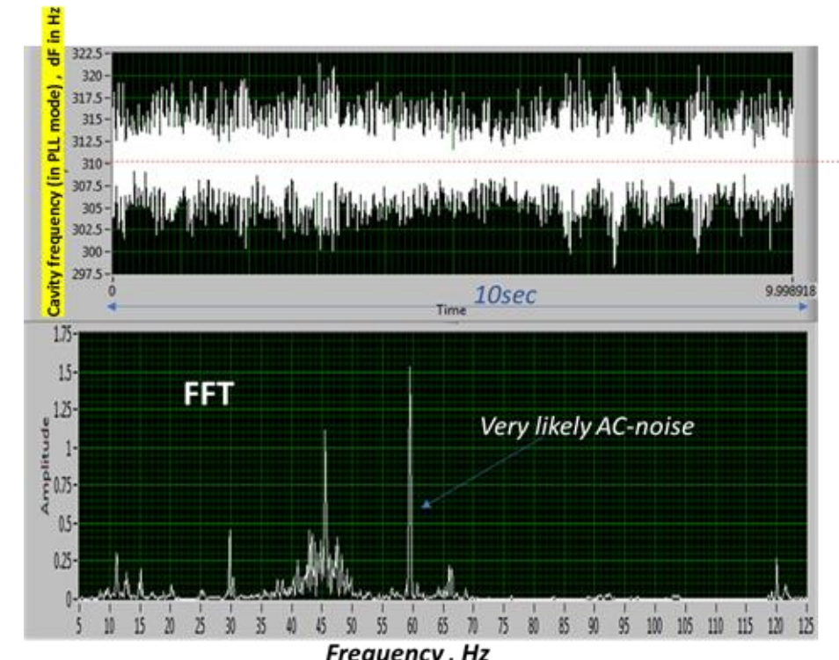
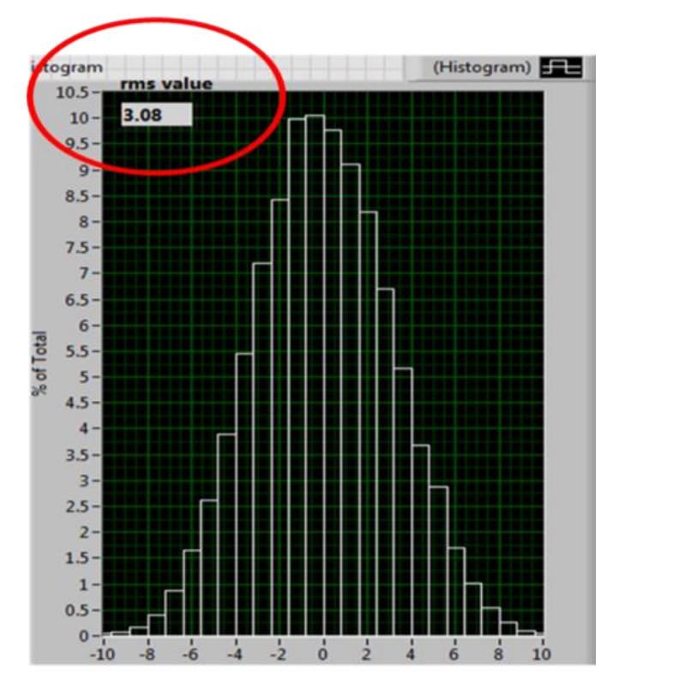
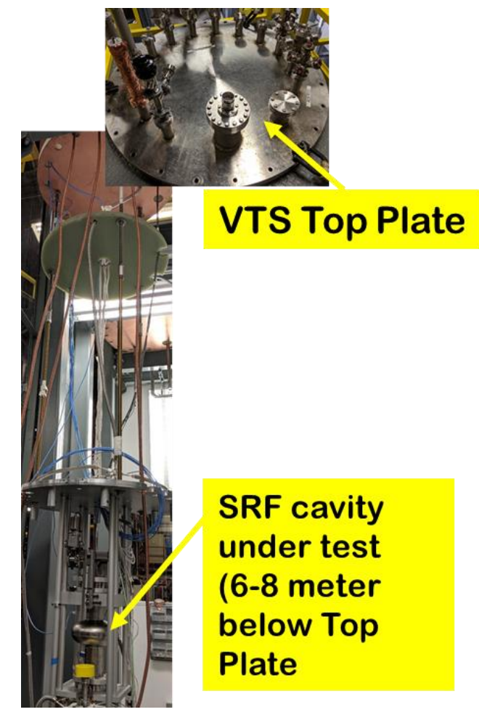
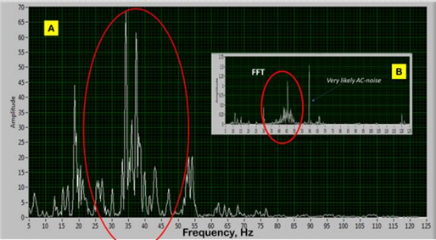
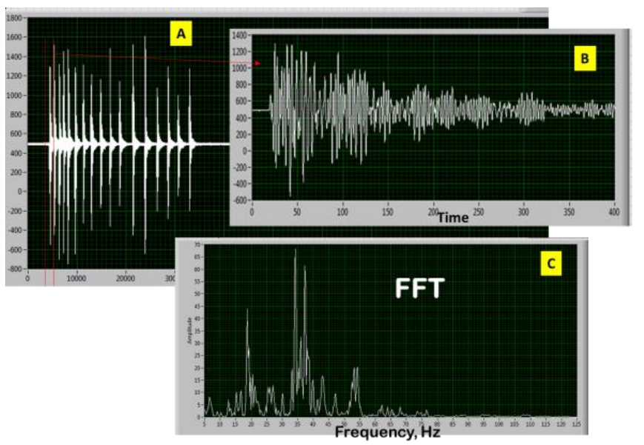
Microphonics at VTS with two 1.3GHz DarkPhoton Setup
Cavity detuning during 10 sec.
The 60Hz narrow line deleted from data.
rms ~3.1Hz
A-from external hits
B- microphonics during operation

Slide 6
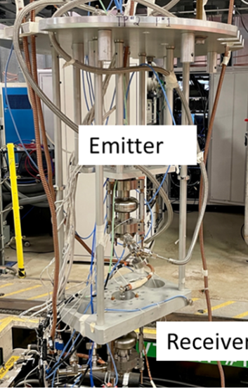
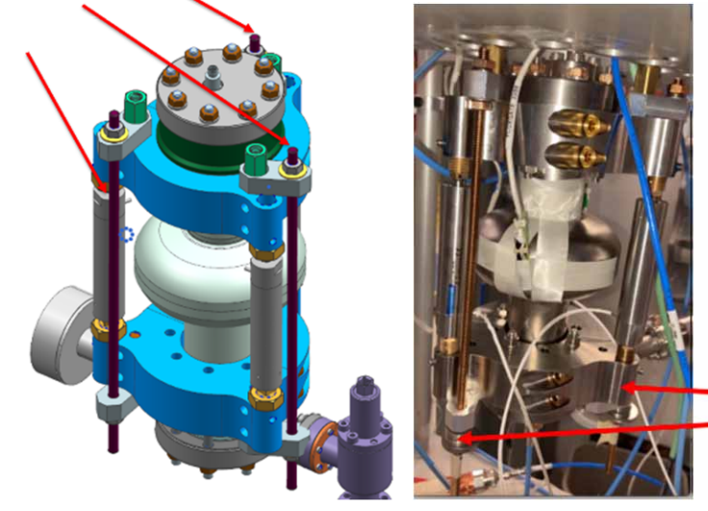
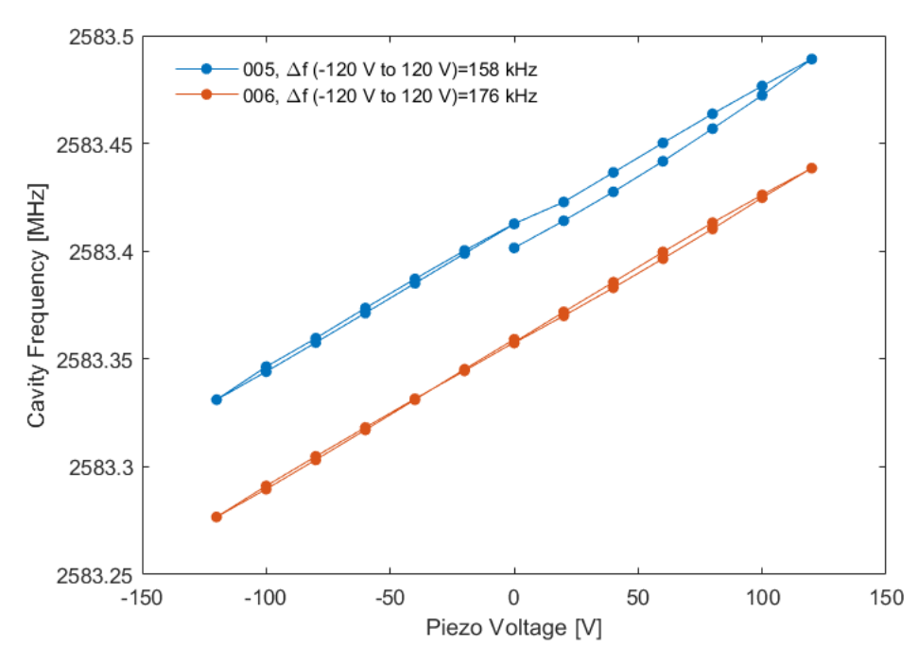
2.6GHz cavities setup /VTS testing
Two 2.6GHz single cell cavities with “piezo-only” tuners.
Objectives: extend DarkPhoton experiment to DR (T=20mK)
Parameters:
df/dL ~10kHz/um
df/dp ~ 25Hz/torr
LFD ~ 2.5Hz/MV²
Cavity tuning range ~180kHz
(Vpiezo -120V to +120V)
Yuriy Pischalnikov | Quantum Technologies for Fundamental Physics, Erice, Italy, Sep 1-7, 2023

Slide 7
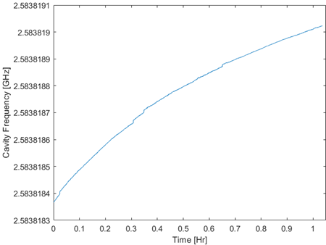
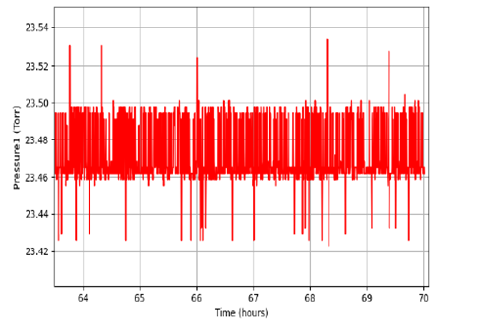
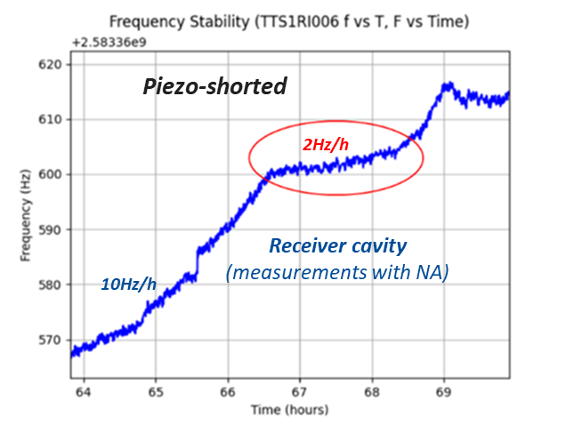
2.6GHz cavities setup
Emitter Cavity
(PLL & frequency counter)
Possible contributions into cavity frequency shift
660Hz/h
Piezo creep
df/dP
Stability of piezo-amplifier
Stability of E_{acc}&LFD
df/dT
E_{acc}=15MV/m
Piezo DC Voltage =108V
Pressure inside the VTS Dewar
dp~0.1torr
Yuriy Pischalnikov | Quantum Technologies for Fundamental Physics, Erice, Italy, Sep 1-7, 2023

Slide 8
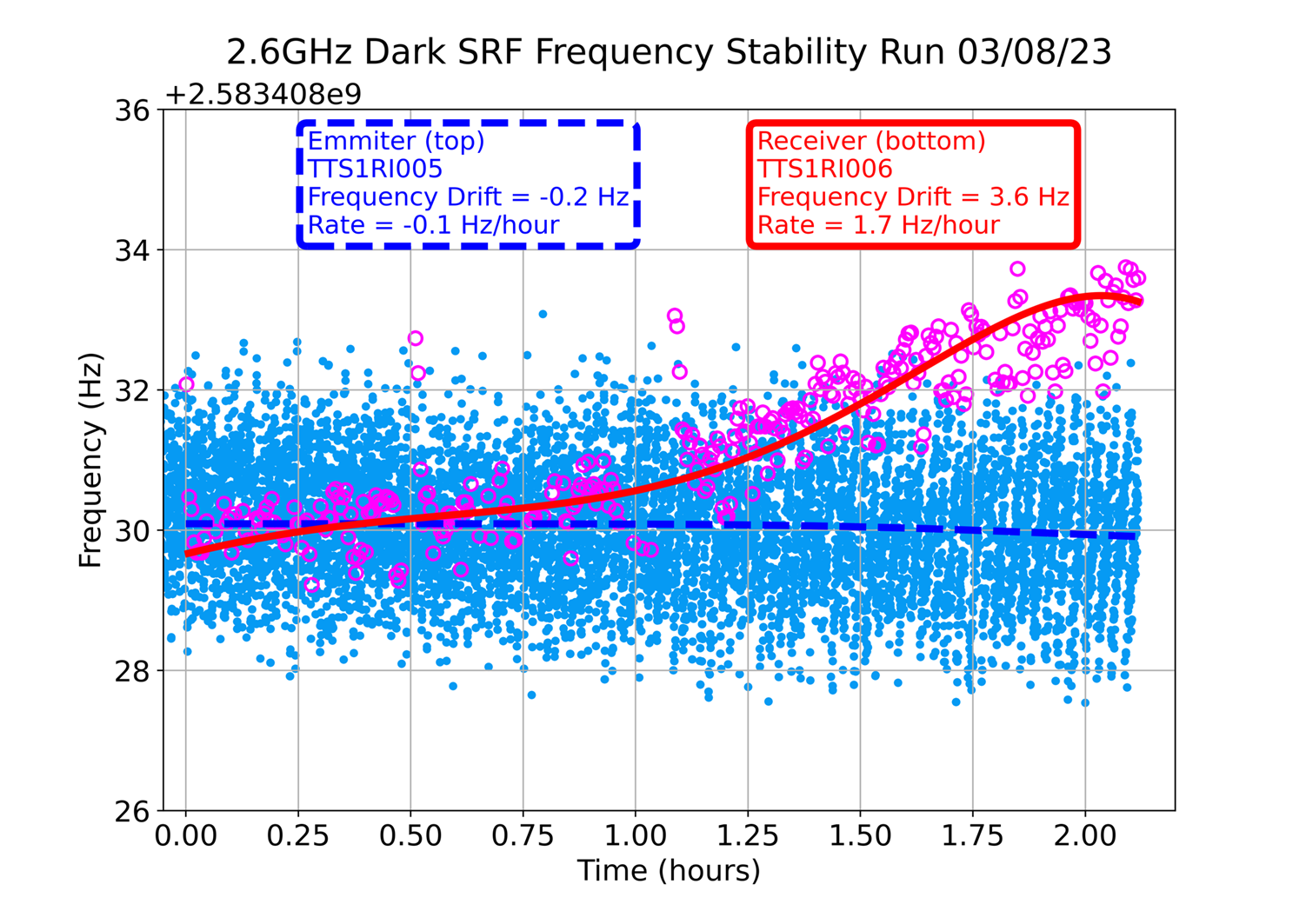
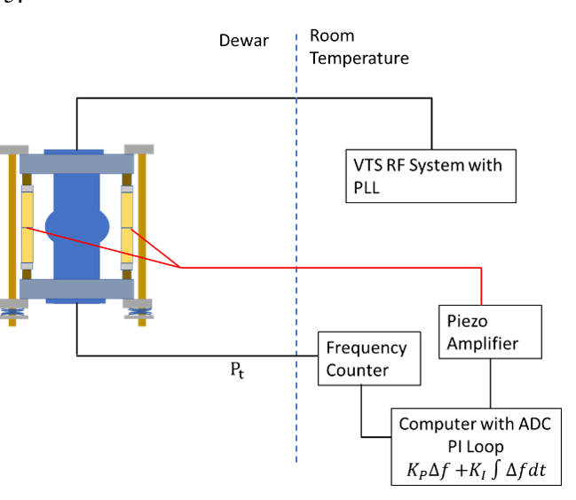
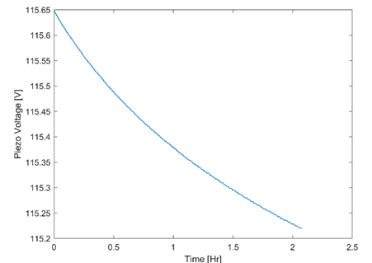
2.6GHz cavities Stability with PI loop on the Emitter Cavity
dV=0.42V
df~320Hz
(750Hz/Vpiezo)

Slide 9
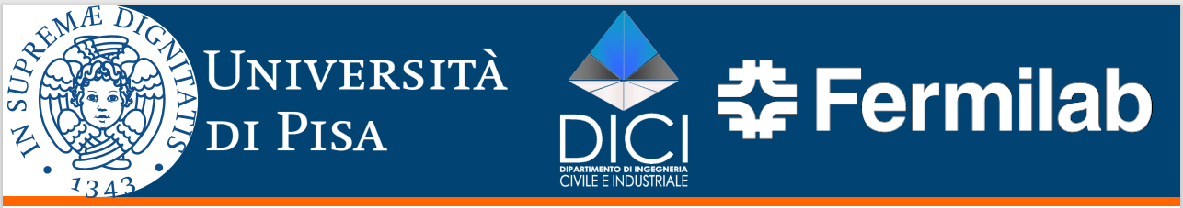
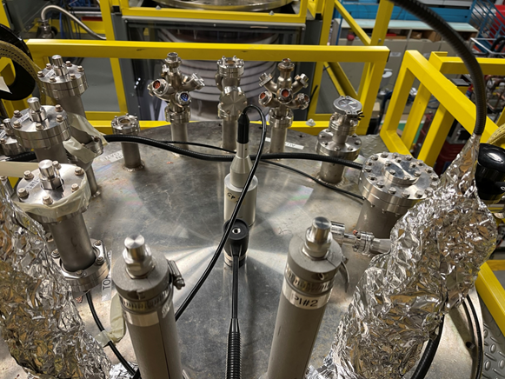
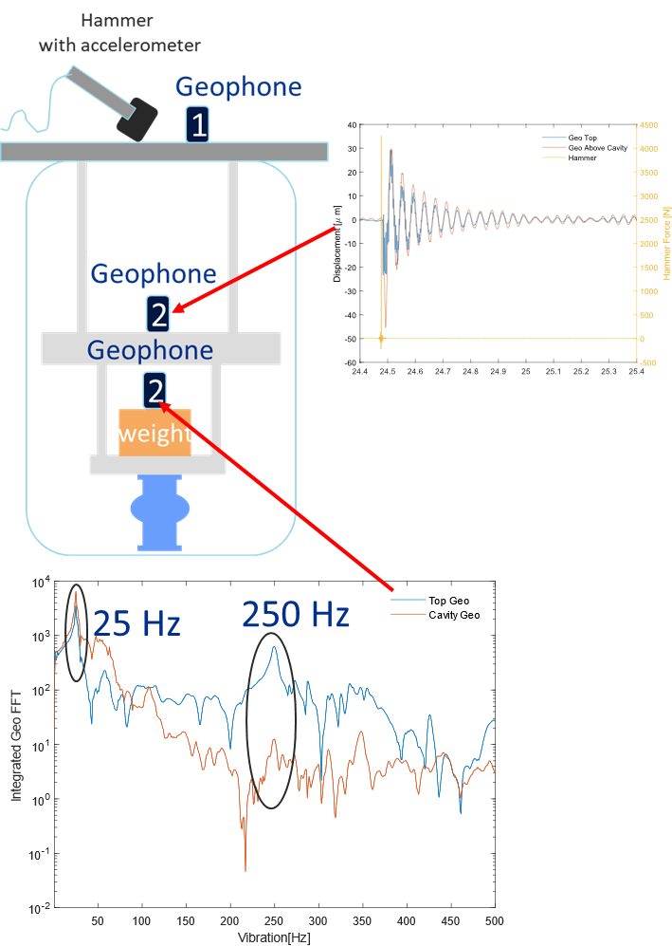
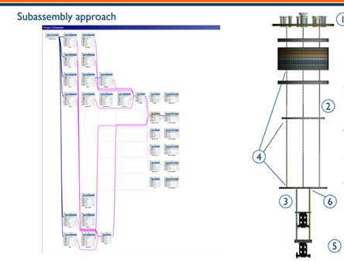
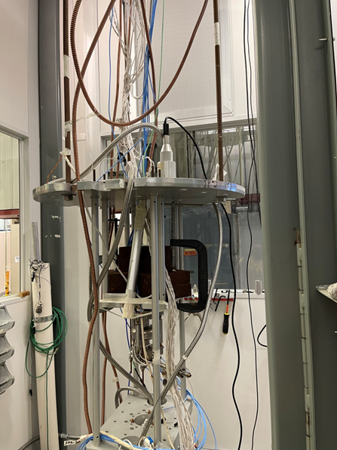
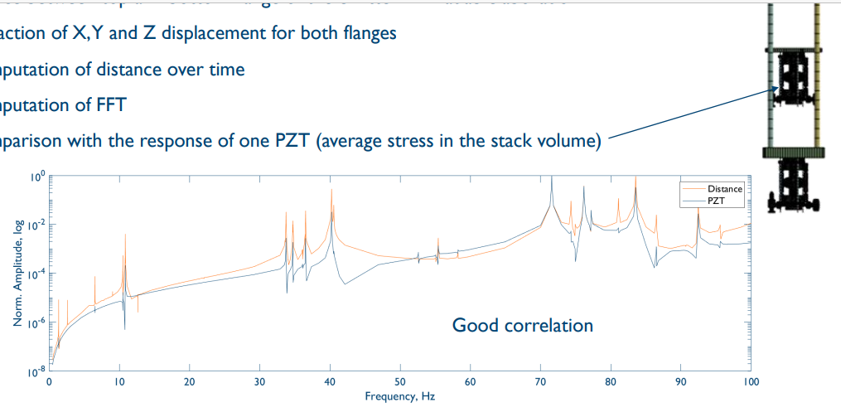
Efforts for passive mitigation of the external vibrations
Objectives: By combinations of experimental studies at FNAL and simulation by team from University of Pisa to design the mechanical system that will be able to mitigate penetration of the vibration from external sources on the SRF cavities installed into VTS.
PAOLO NERI
University of Pisa
Department of Civil and Industrial Engineering, Largo Lucio Lazzarino 1, 56126 Pisa, Italy
FNAL VTS system
(experiment)
Yuriy Pischalnikov | Quantum Technologies for Fundamental Physics, Erice, Italy, Sep 1-7, 2023

Slide 10
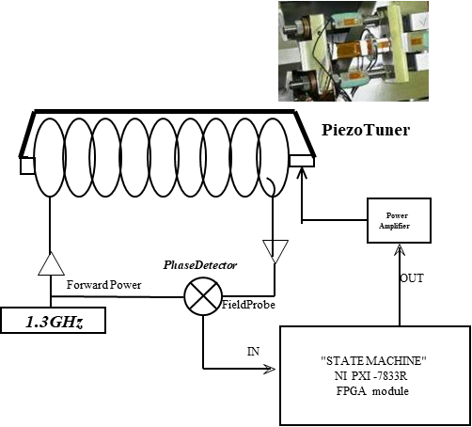
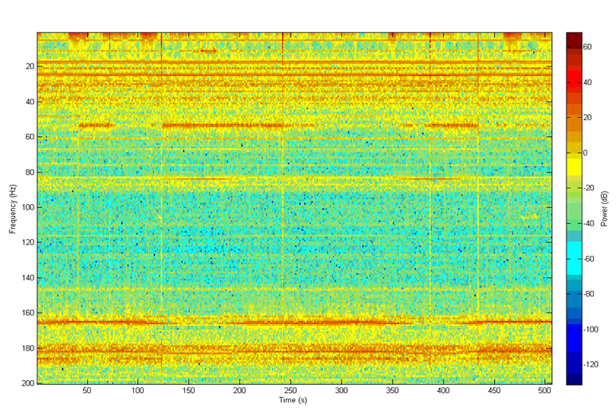

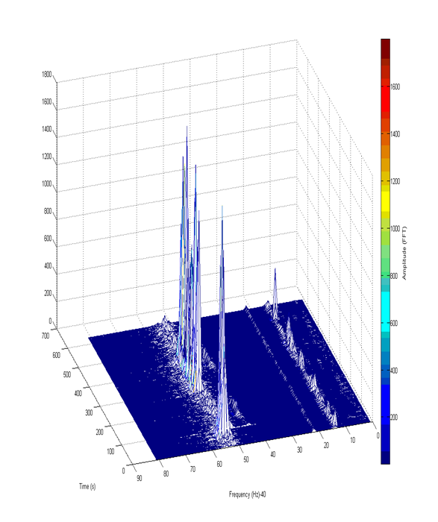
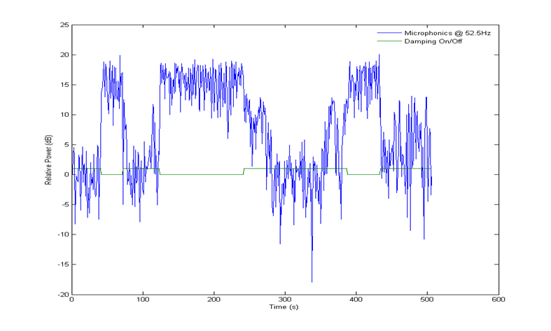
Active Compensation of Microphonics
Experience from 2007 with CC2 (9 cell 1.3GHz at HTS in CW mode)
Single Resonance (I) cavity bandwidth ~200Hz
T=4K, 52Hz Resonance compensation
Piezo OFF
Piezo ON
Yuriy Pischalnikov | Quantum Technologies for Fundamental Physics, Erice, Italy, Sep 1-7, 2023

Slide 11
Summary
From FNAL experience with SRF cavities (1.3GHz & 2.6GHz) cooled-down at VTS:
  slow frequency drift from 2-10 Hz/hour up to 300Hz/hour
  (it is not clear main contribution into this drift – it could be piezo-ceramic actuator “creep” or cavity’s df/dp, etc.)
  microphonics on the level of rms=3Hz, with main vibration frequency in the range of 20-60Hz…
We demonstrated that implementation of feed-back (PI) control algorithm applied to piezo-actuator could stabilized cavity frequency drift to the level of 0.2Hz (for 1 hour period).
For microphonics mitigation (compensation of the cavity vibration from external sources) passive method is first & major line of defense. Efforts for development of passive mechanical filters is underway.
Active compensation (feed-back algorithms and piezo-actuators) could deliver microphonics compensation but could work only for cavities with RF inside (emitter for Dark Photon experiments). Stability of feed-back algorithm could be issues.
Yuriy Pischalnikov | Quantum Technologies for Fundamental Physics, Erice, Italy, Sep 1-7, 2023

