Slide 1
Opportunities for SRF Cavities in the ADMX-EFR Project
Quantum Technologies for Fundamental Physics Workshop
Erice, Italy
Gianpaolo (GP) Carosi
Sept 3rd, 2023
https://quantum.llnl.gov

Slide 2
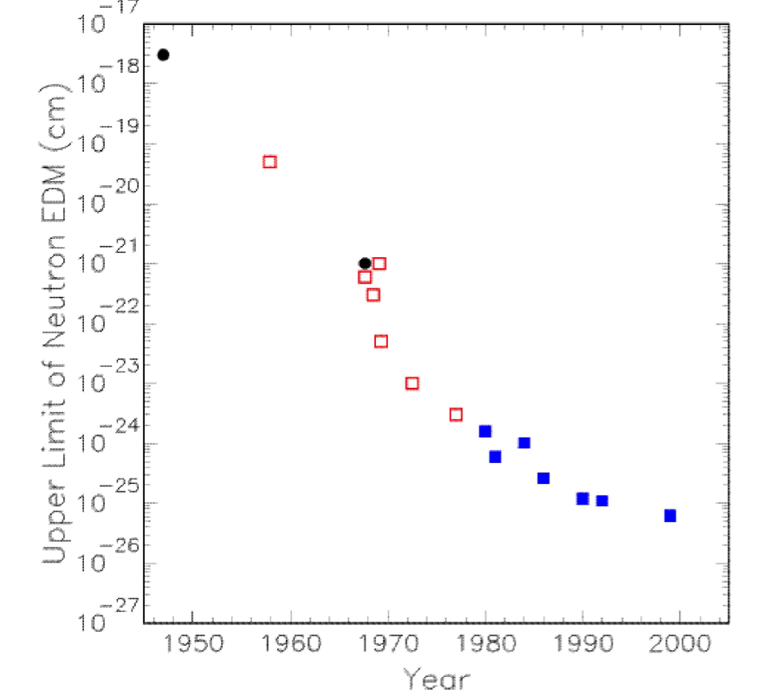
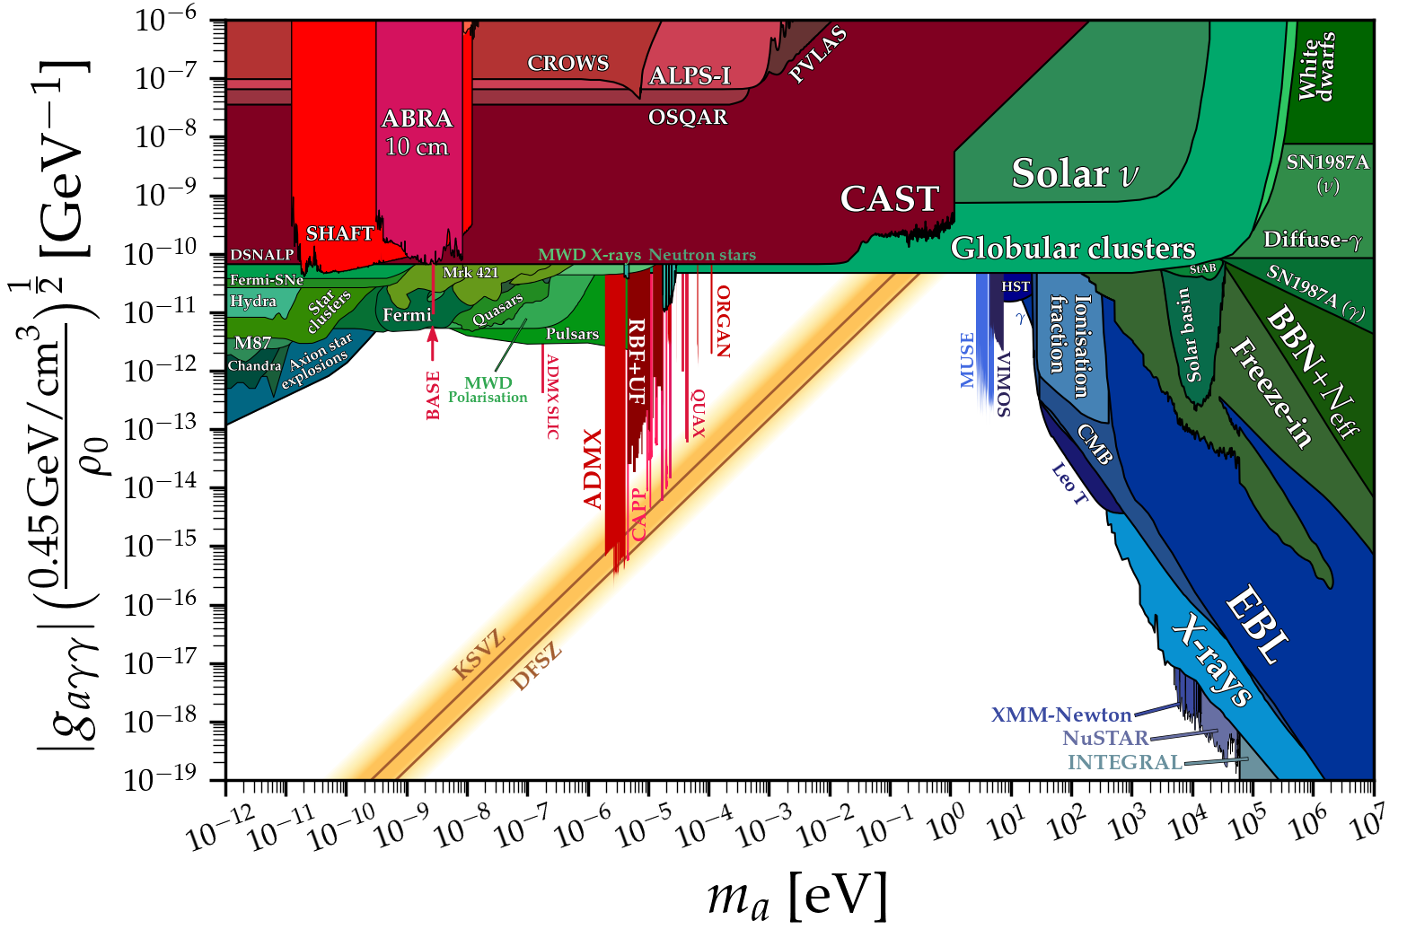
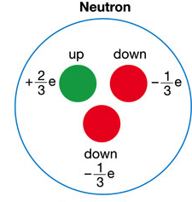
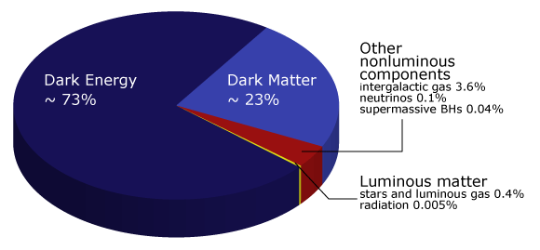
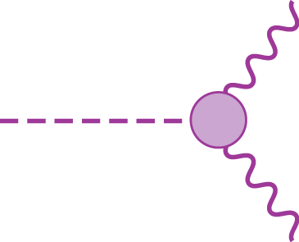
Axions: A solution to two major mysteries in physics and cosmology
Strong-CP problem
Strange absence of measurable neutron electric dipole moment
Axion coupling to two photons a key detection technique
Dark Matter
a
Curtesy of Cirian O’Hare

Slide 3
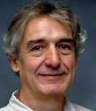
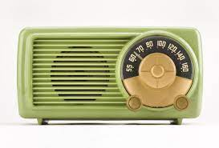
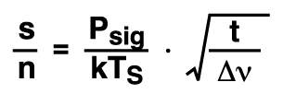
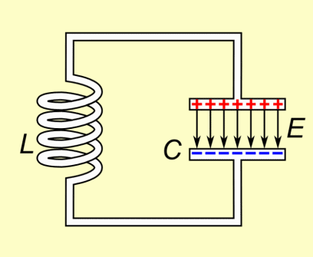
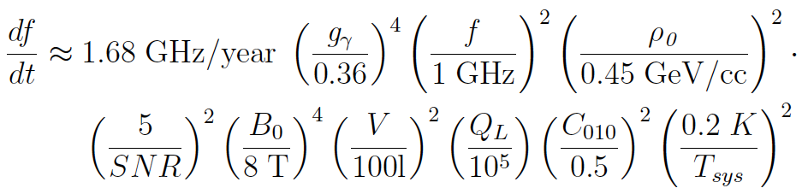
Axion Dark Matter Searches: The Haloscope Technique
Pierre Sikivie
P_{sig} ~ ( B²V Q_{cav}C₀₁₀ )( g² m_{a} ρ_{a} ) ~ 10⁻²⁴ W
System noise temp.
T_{S} = T_{phys} + T_{N}
T_{Quant} ~ 48 mK @ 1 GHz
t = Integration time limited to ~ 100 sec

Slide 4
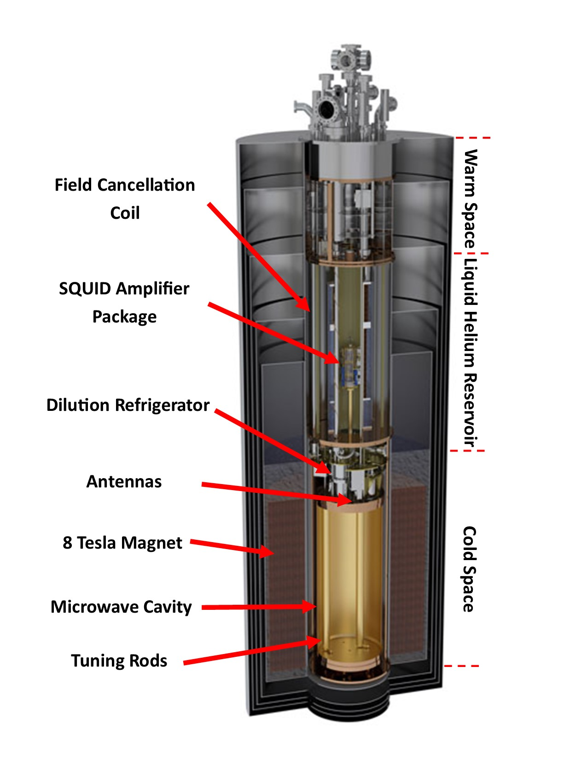
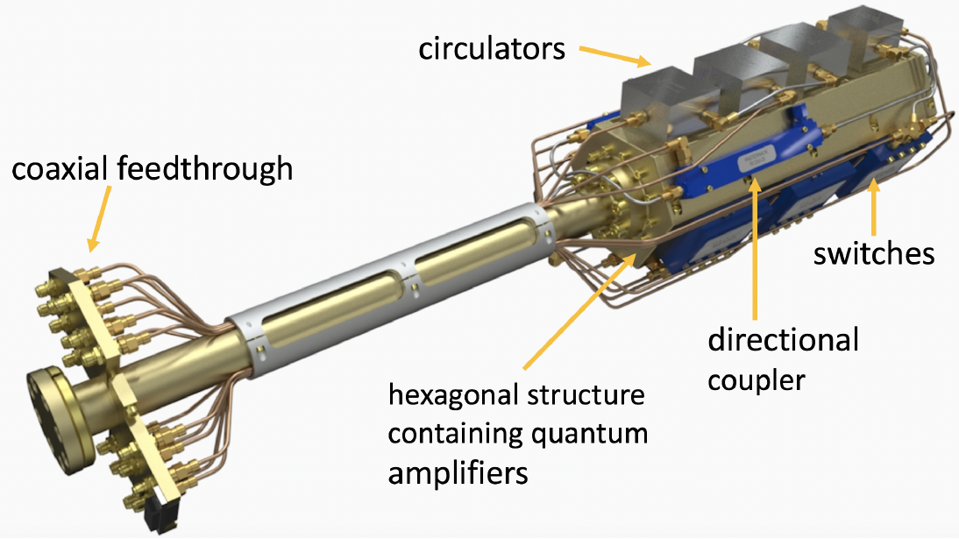
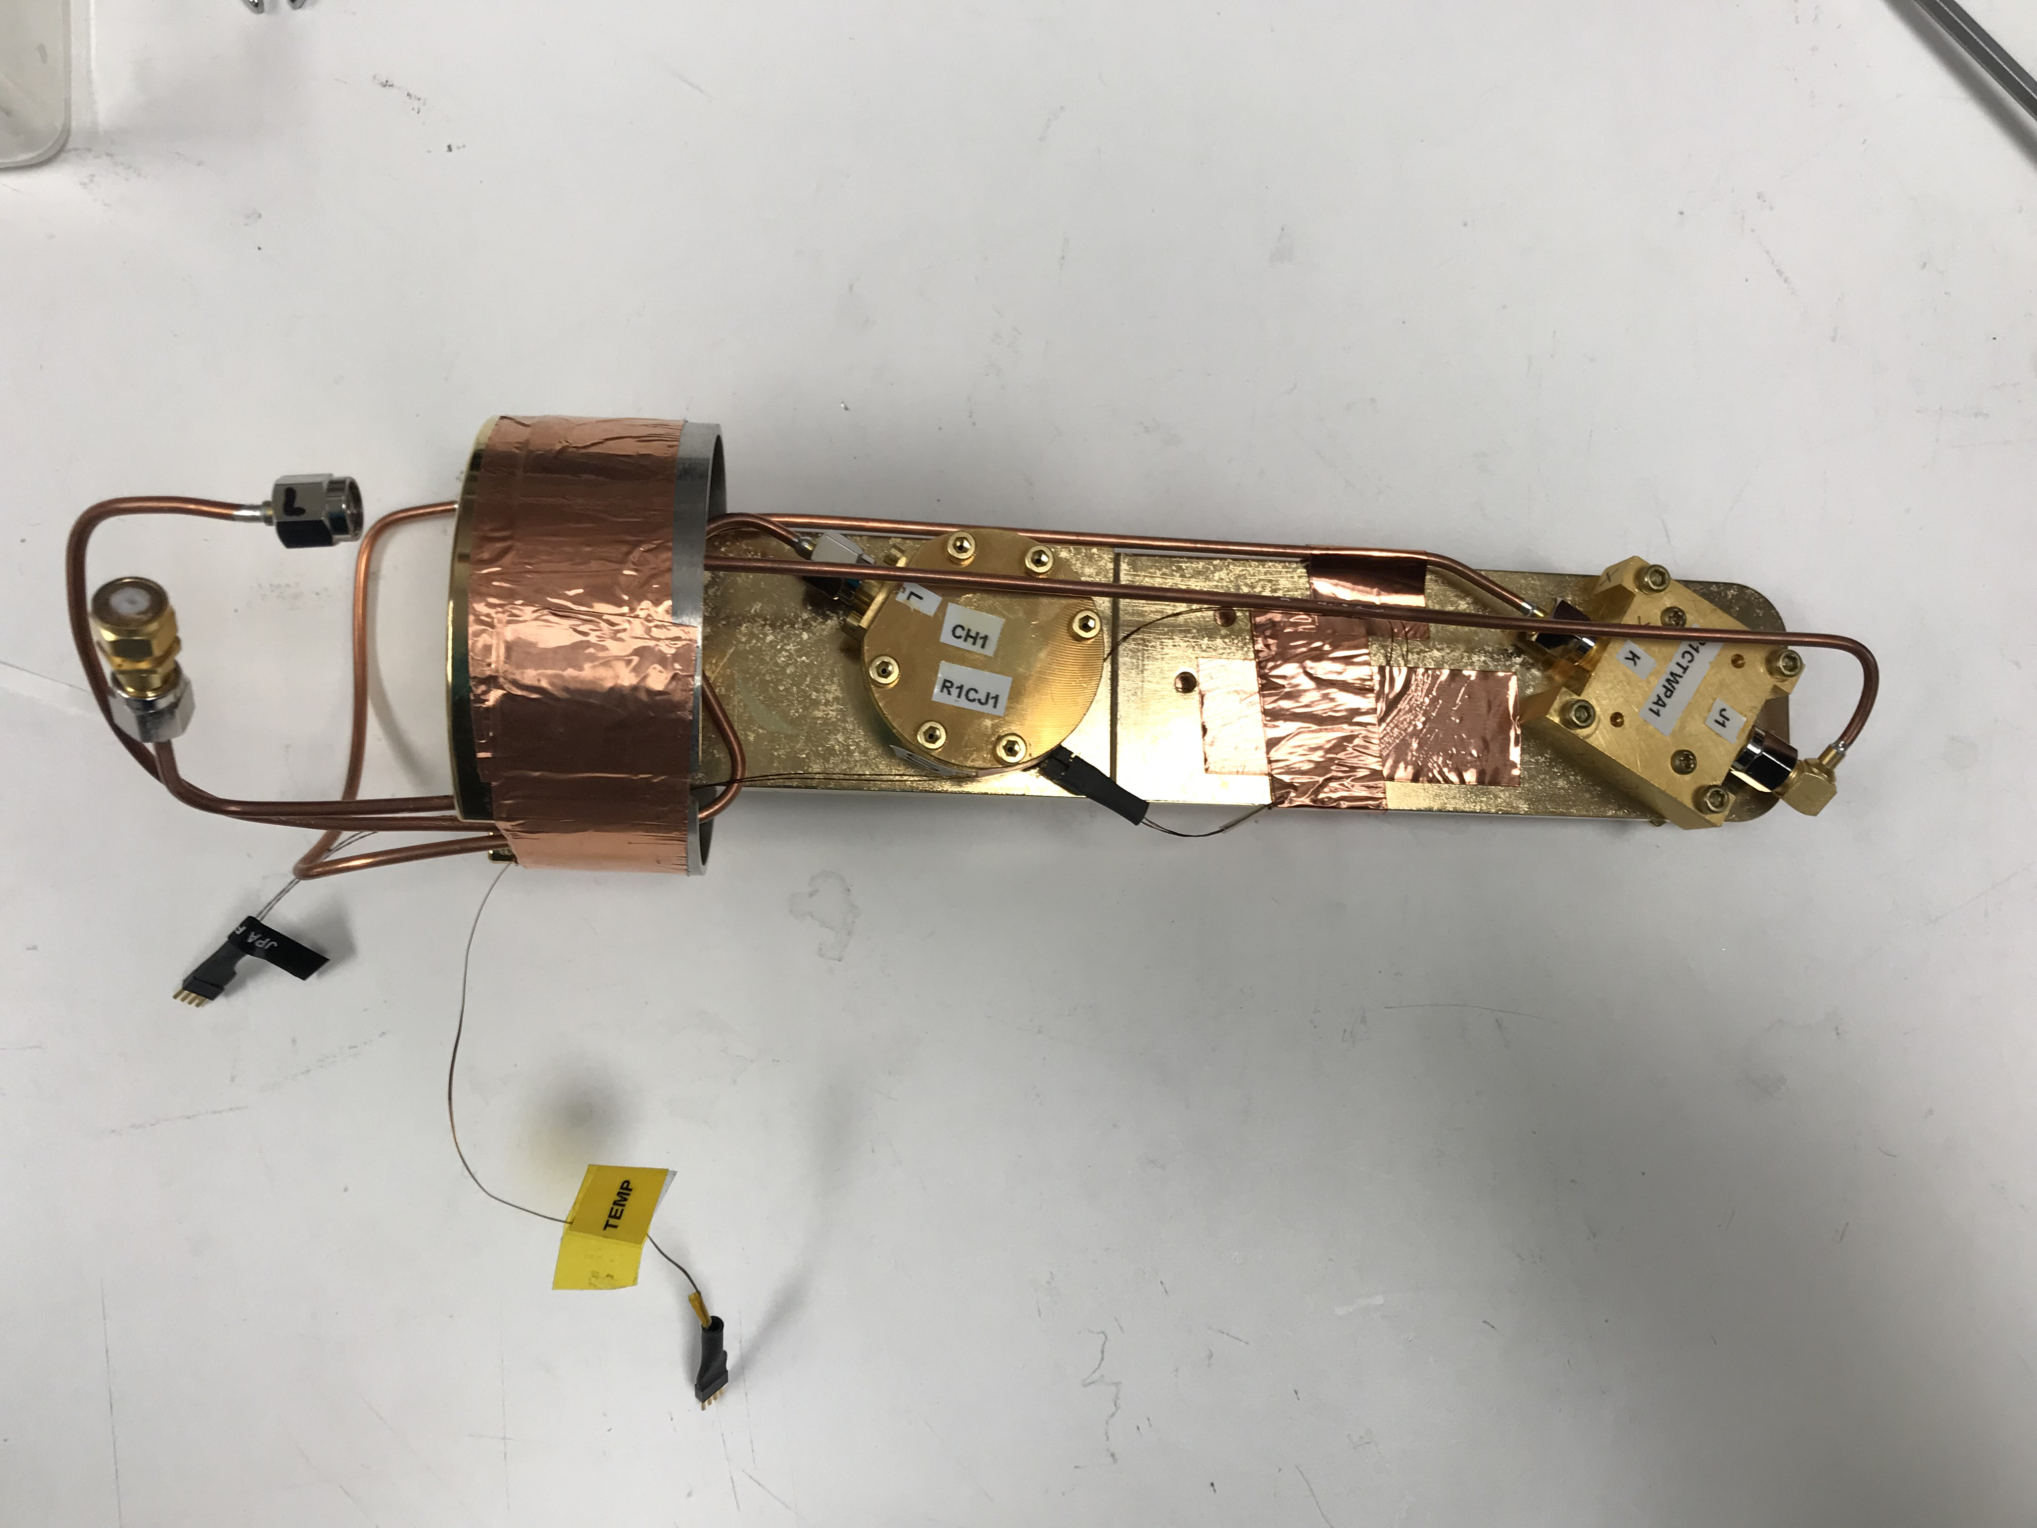
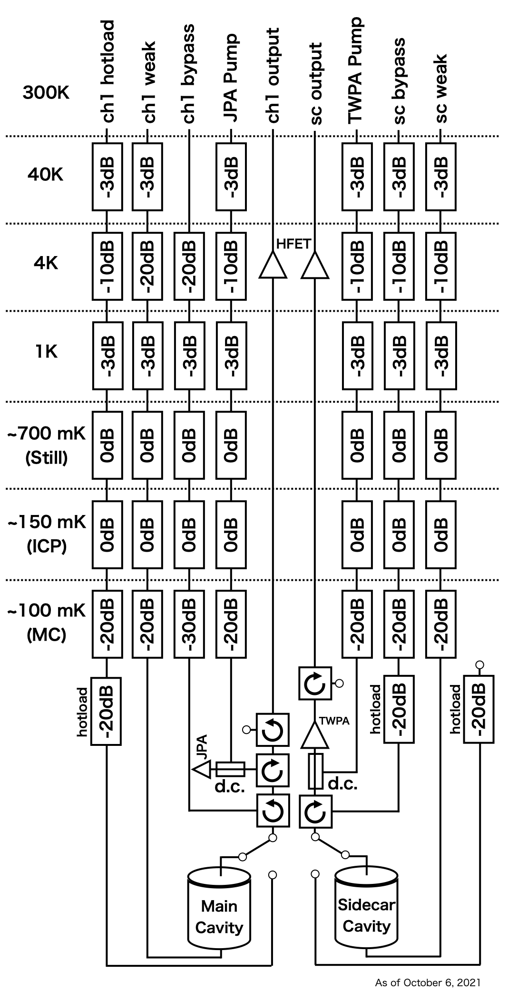
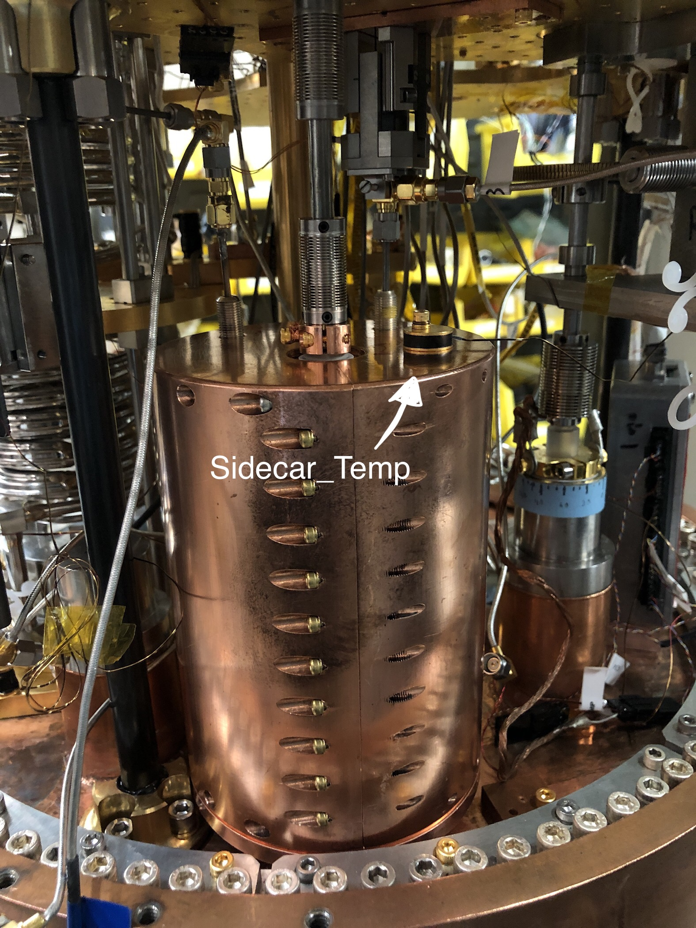
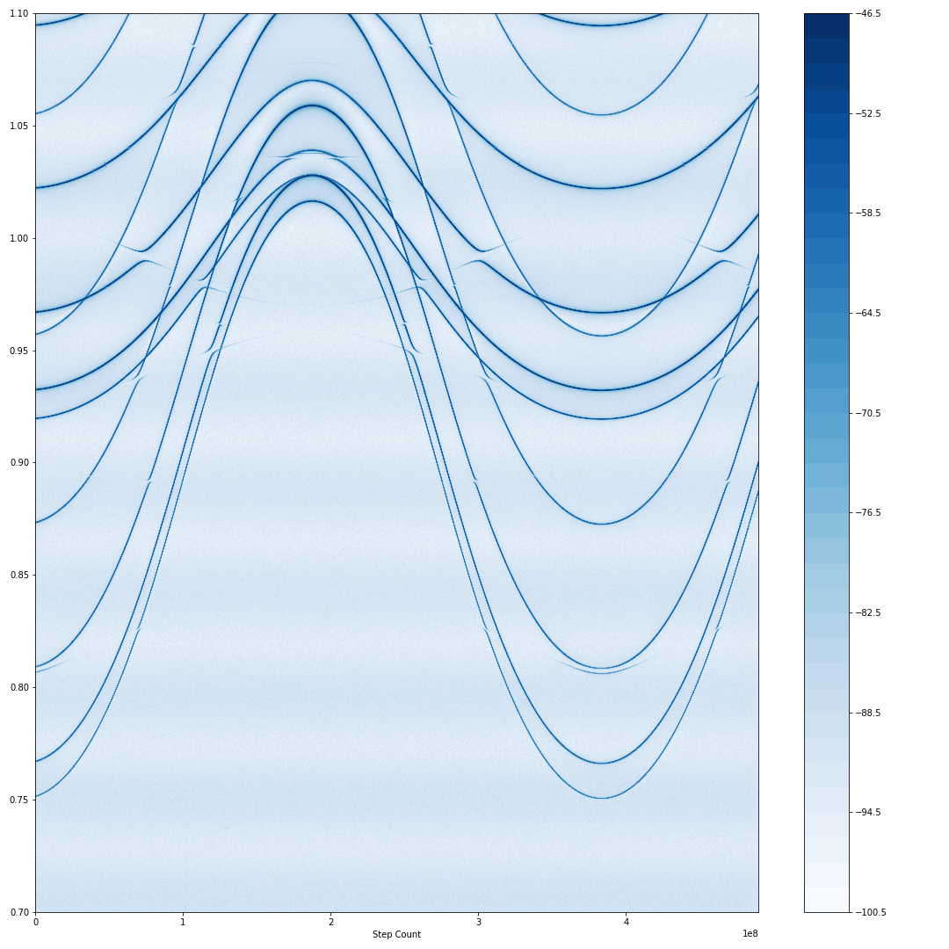
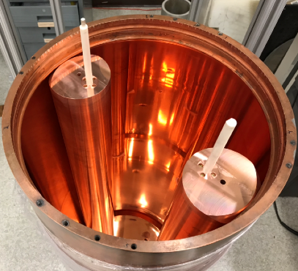
ADMX Currently Operating Project: Experimental Layout
JPA (UCB)
TWPA (LL)
1020 MHz
Sidecar
TM₀₁₀-like mode
S21 transmission vs rod angle
750 MHz
Cavity 1B
Cavity 1C
Cavity 1C Mode Map
Located at the University of Washington

Slide 5
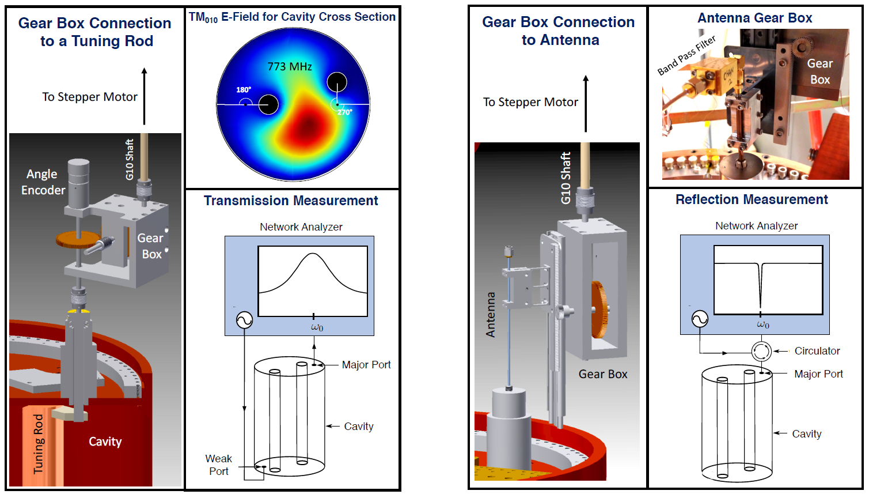
ADMX Operations: Tuning & Coupling
Cavity 1B
Located at the University of Washington

Slide 6
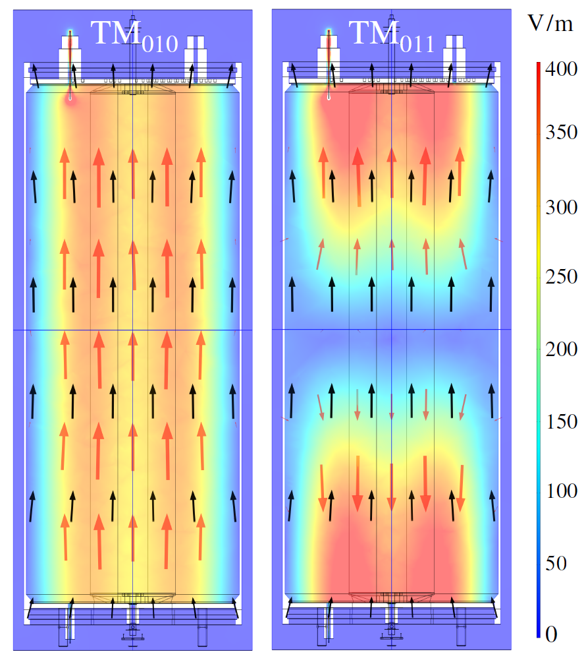
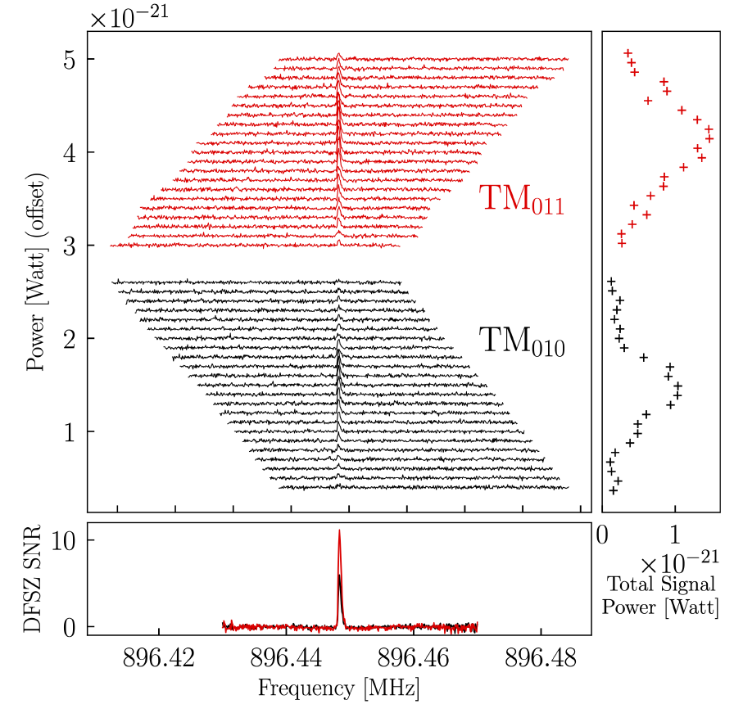


ADMX Run 1C: Saw Persistent Signal at 896.45 MHz!
Signal had line-shape consistent with axion!
Power went away off resonance (not RFI)!
Seen in TM₀₁₁ mode as well
Fake axion from Blind Injection team
Cavity 1B
Located at the University of Washington

Slide 7
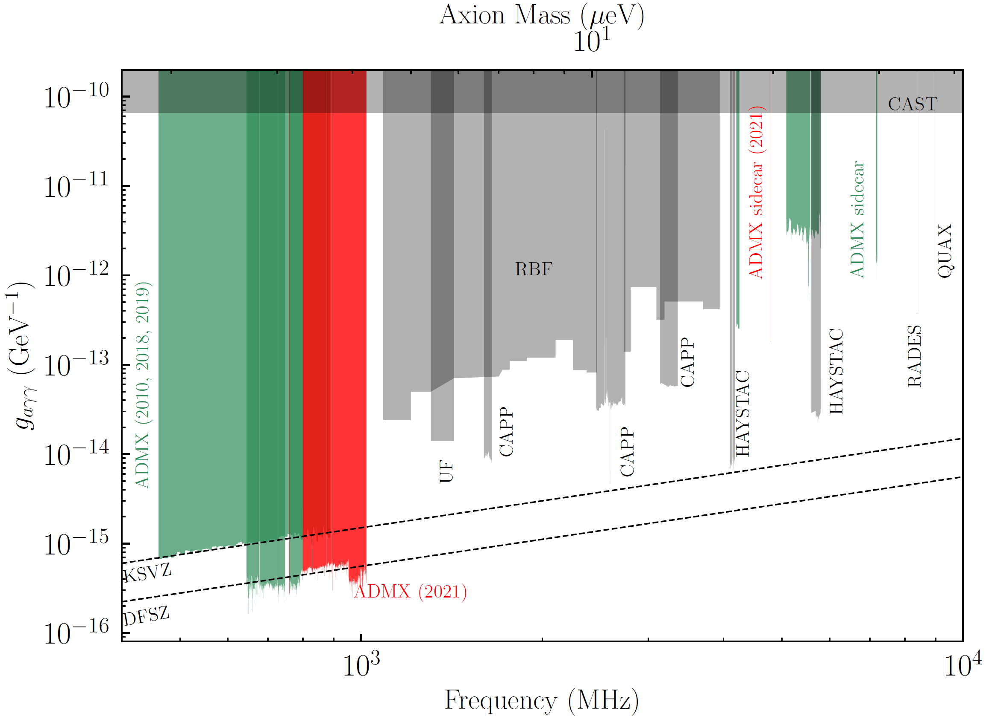

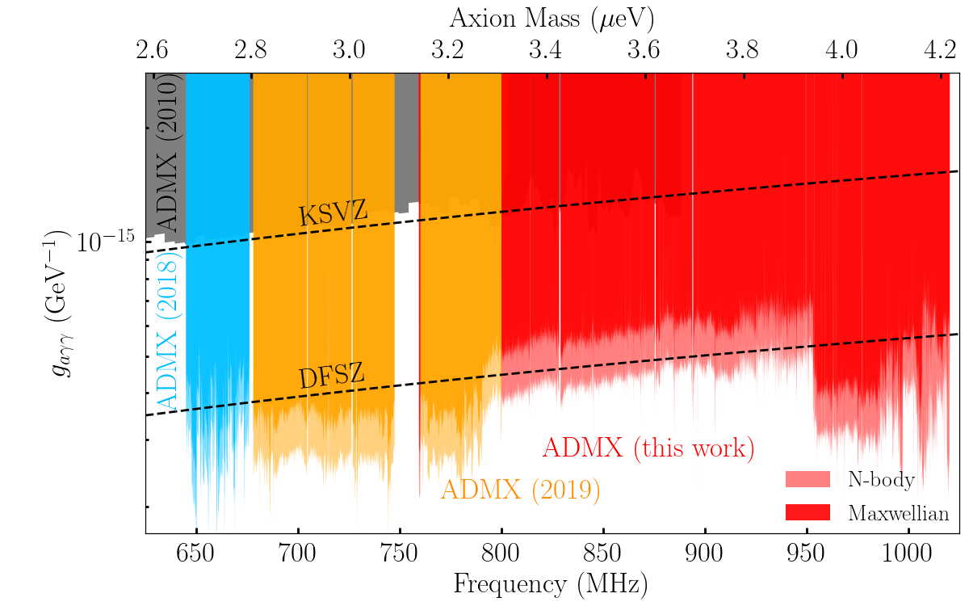
ADMX-G2 results and near term plans
Previous ADMX limits
  Operations in phases that match the cavity tunable bandwidths
  Previous runs with sets of two tuning rods (runs 1A, 1B, 1C)
> 10⁵
ADMX future reach
2021 published limits (new region to DFSZ being analyzed)

Slide 8
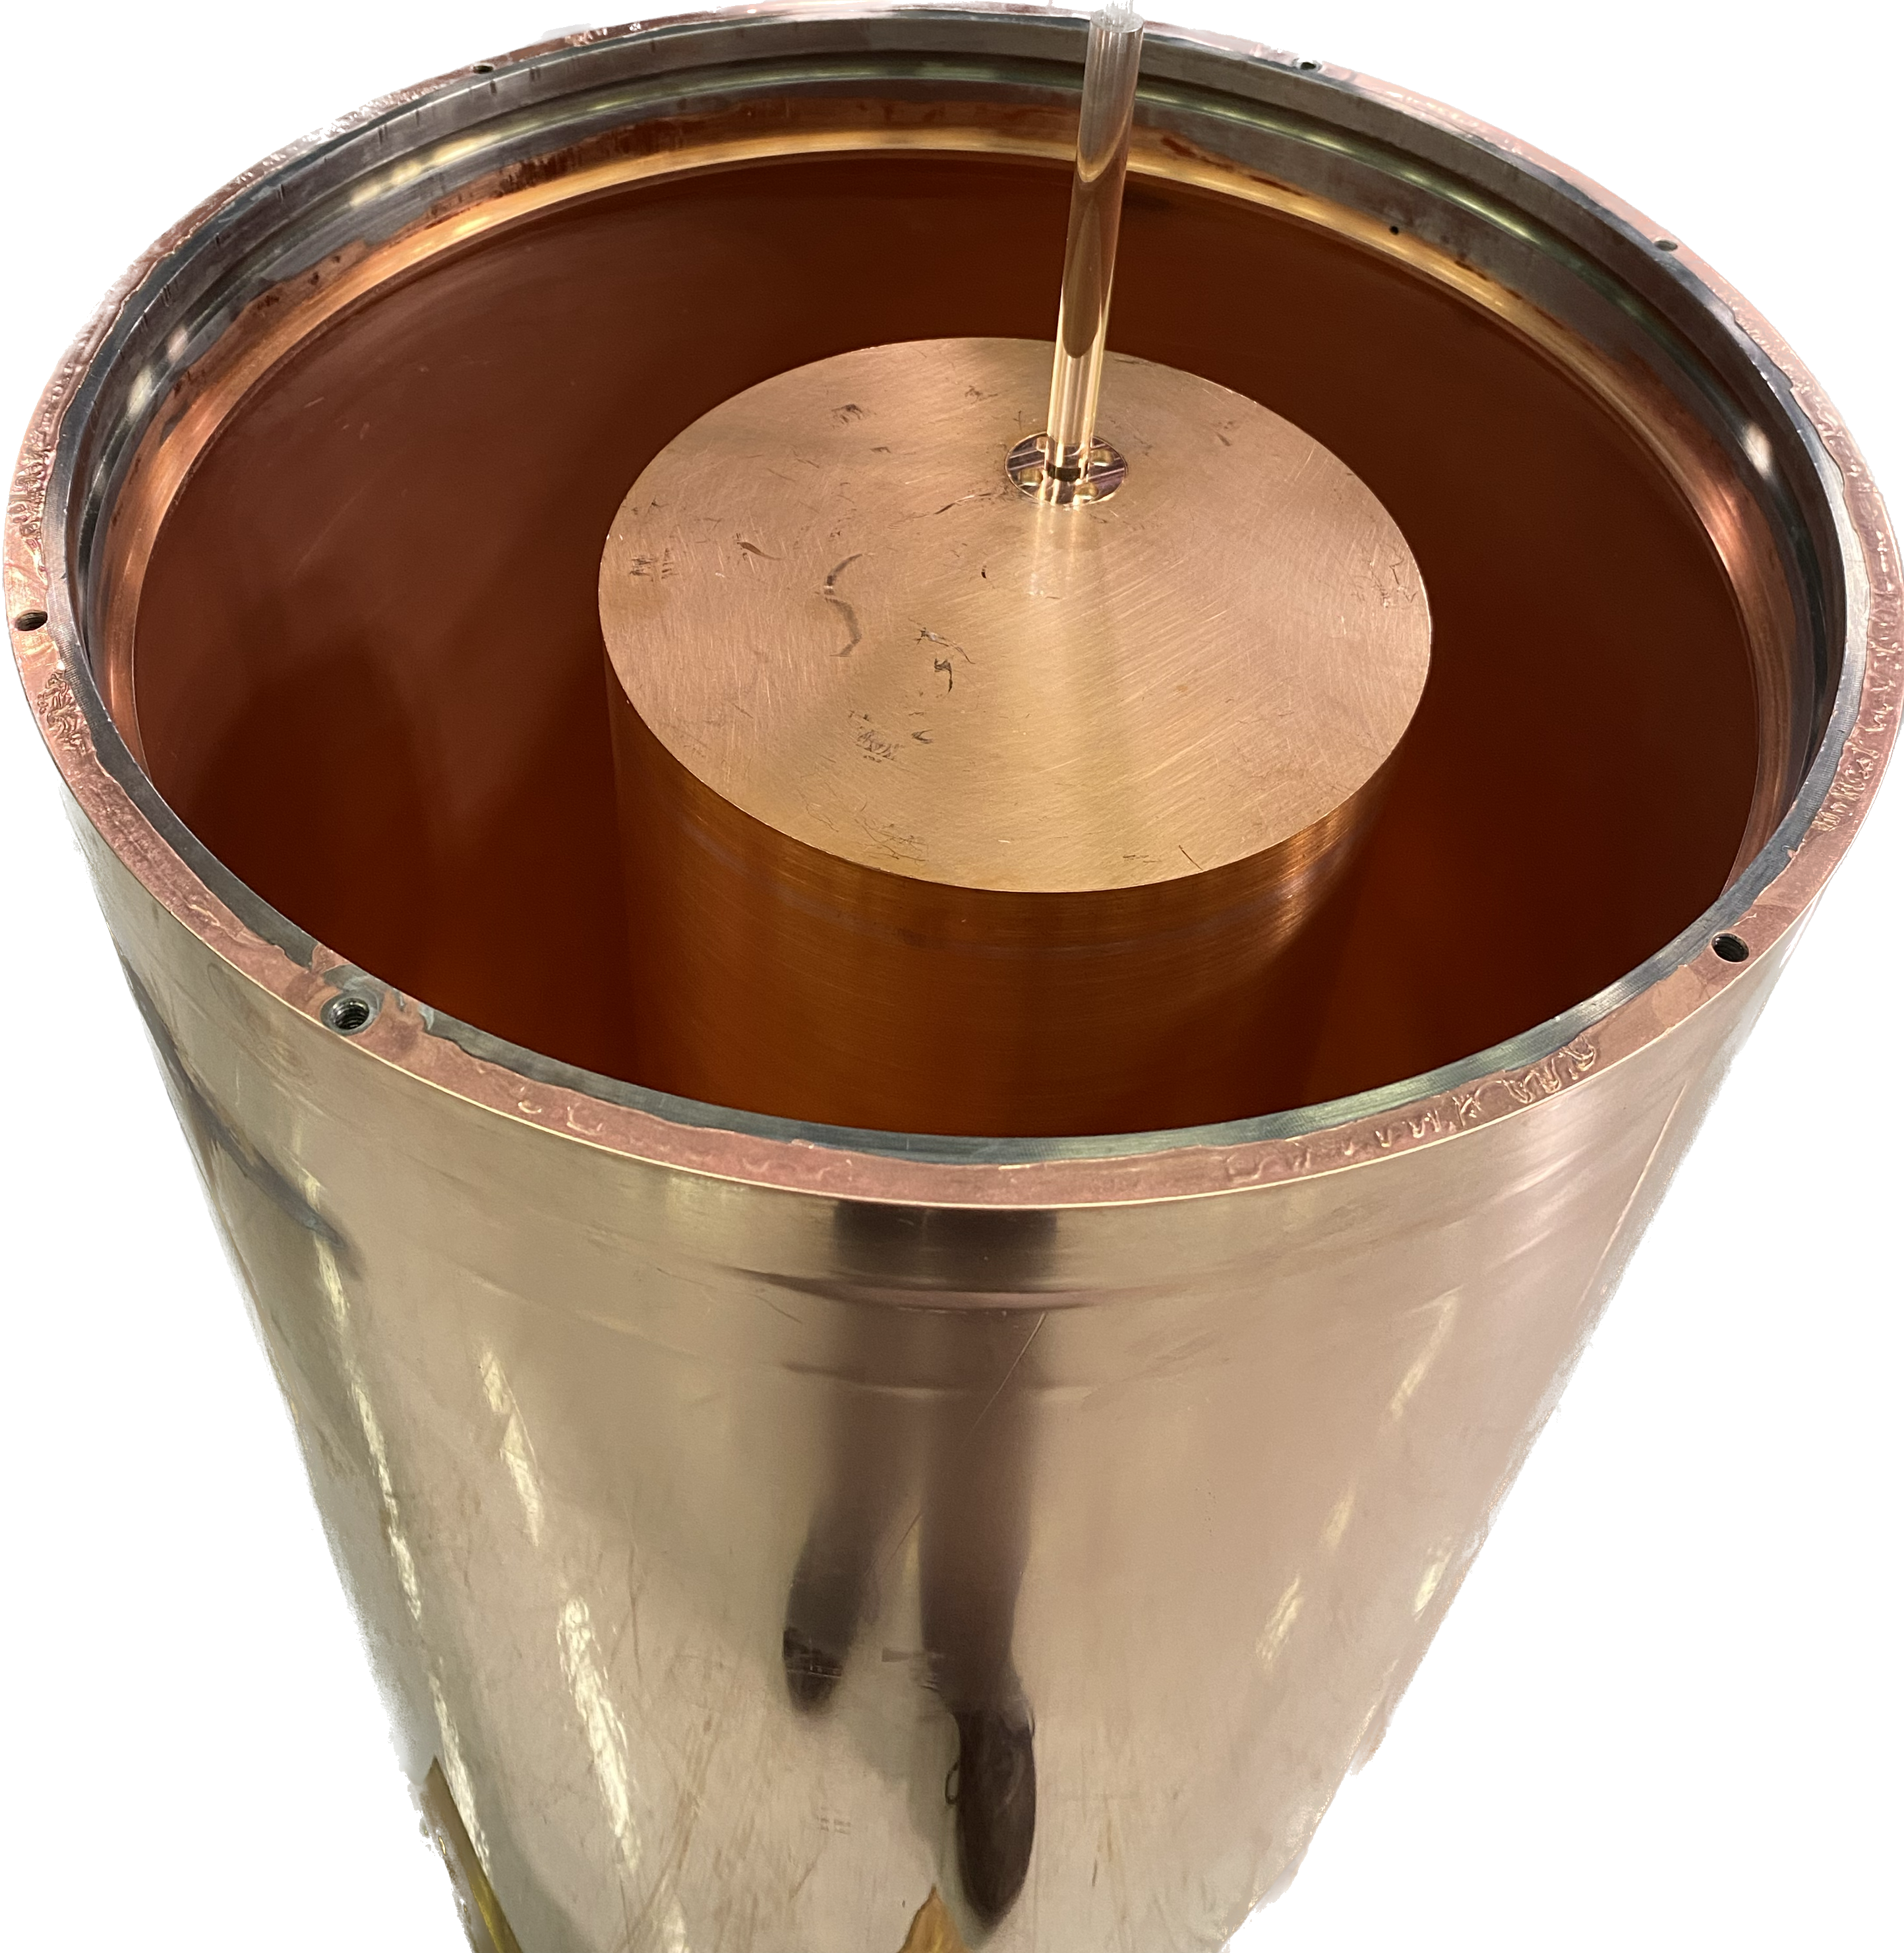
ADMX-G2 results and near term plans
Previous ADMX limits
  Operations in phases that match the cavity tunable bandwidths
  Previous runs with sets of two tuning rods (runs 1A, 1B, 1C)
  Upcoming 1D (single rod) 1-1.4 GHz
ADMX future reach

Slide 9
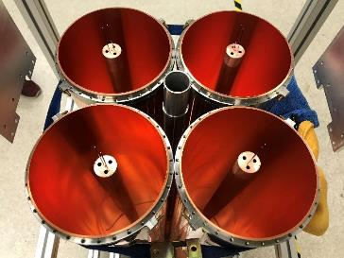
ADMX-G2 results and near term plans
Previous ADMX limits
  Operations in phases that match the cavity tunable bandwidths
  Previous runs with sets of two tuning rods (runs 1A, 1B, 1C)
  Upcoming 1D (single rod) 1-1.4 GHz
  Switch to frequency locked 4-cavity array for 1.4-1.9 GHz
ADMX future reach

Slide 10
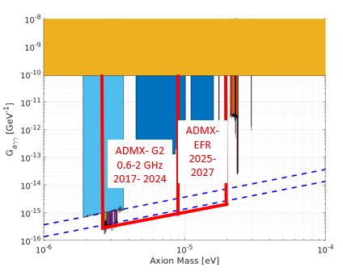
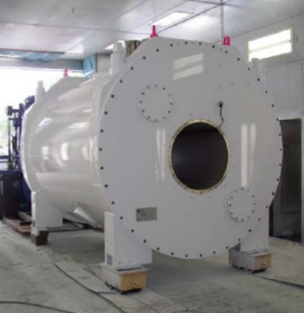
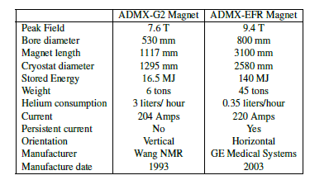
ADMX-Extended Frequency Range (2-4 GHz)
DOE HEP sponsored Dark Matter New Initiative project
Picks up where ADMX-G2 ends (~1.9 GHz)
Currently in Design and Prototyping Phase
Aiming for construction start FY25. Aimed to be installed at Fermilab!
New MRI magnet being acquired
(9.4 T – 800 mm bore)
> 8x stored energy of ADMX-G2
ADMX-G2
0.6-2 GHz
2017-2026
2027-2029
9.4 T 800 mm bore MRI magnet

Slide 11
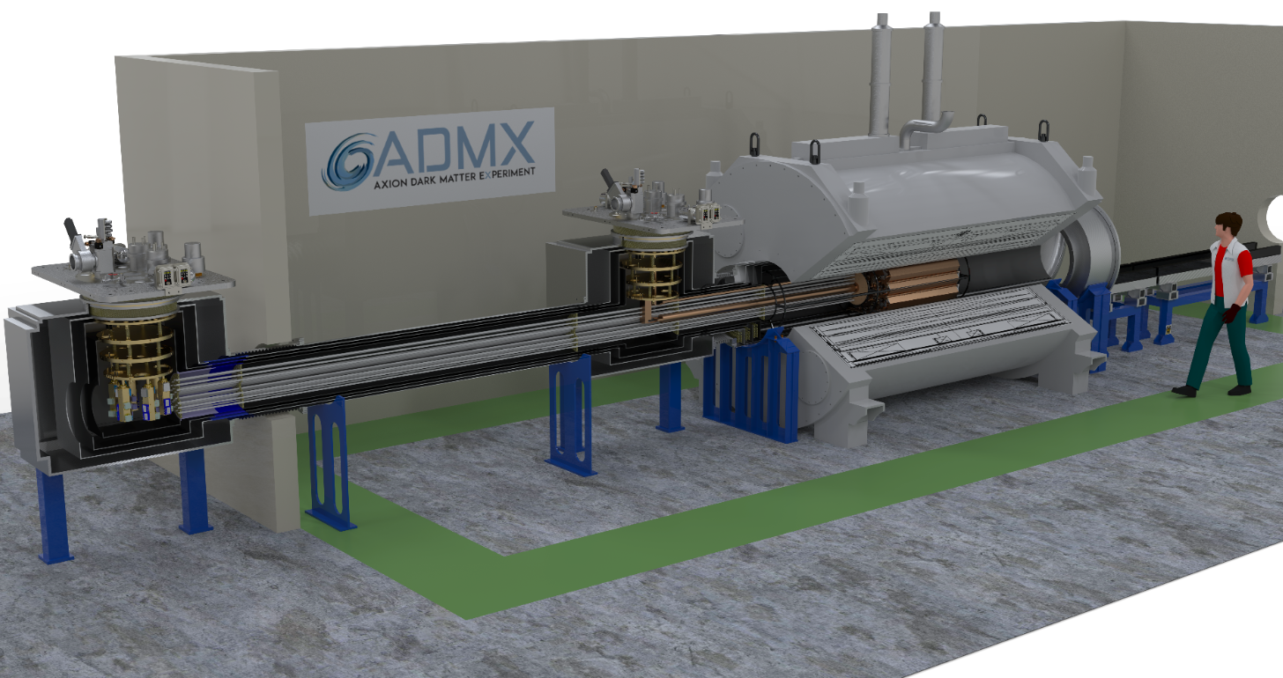
ADMX-Extended Frequency Range
Passive Magnetic shield
Warm Electronics 300K, 0.01 G
MRI Magnet 9.4 T
Photon Transport
Resonator Array 100 mK
Resonator Dilution Fridge
Cold Electronics Dilution Fridge 25 mK, < 0.01 G

Slide 12
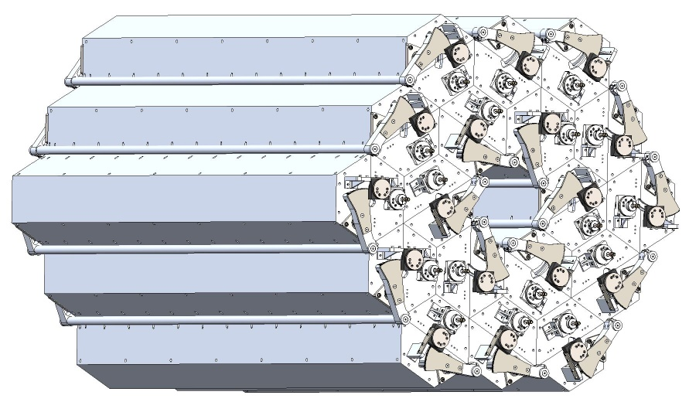
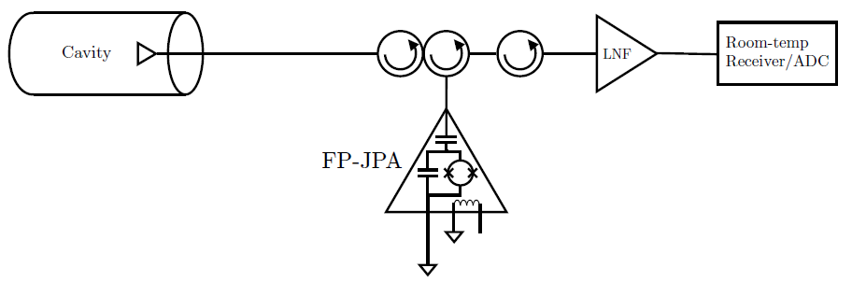

Overall System Concept
18 cavities each instrumented with their own quantum amplifier chain and readout.
In-phase amplitude combing digitally at room temperature
Takes full advantage of coherence of axion signal relative to incoherent noise
    SNR goes as $√$N cavities coherently combined.
    Scan rate goes as SNR² ~ N. Factor of 18 x faster scanning than non-locked individual cavities
Maximal flexibility, system repeatability and mass production
…

Slide 13
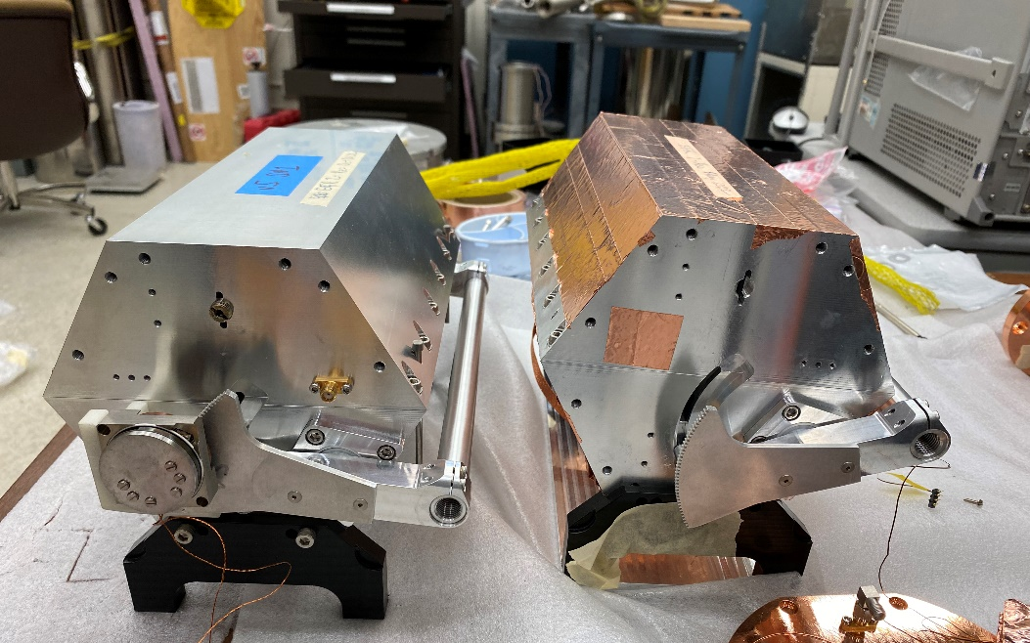
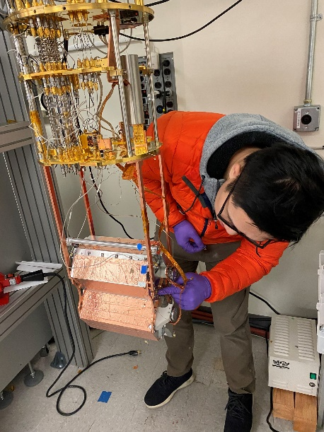
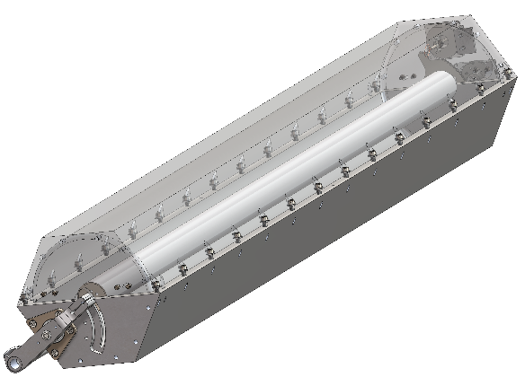
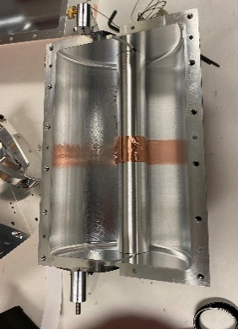
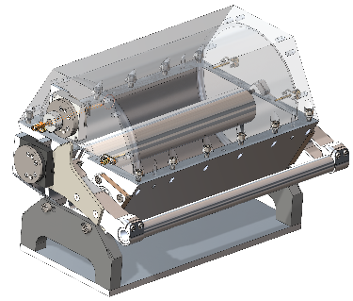
Resonator Design currently clamshell cavity
Current baseline cavity cell is ~1 m long copper cavities with copper tuning rods.
Two sets of tuning rods diameters (2-3 & 3-4 GHz with same clamshells)
Piezoelectric actuators for frequency tuning & antenna coupling
Postdoc Nick Du mounting scale length prototypes in dilution refrigerator
Scale length single cavity cell (~ ¼ m long)
Full length single cavity cell (~ 1m long)
Tuning rod wired for thermal time-constant studies of sapphire axles

Slide 14
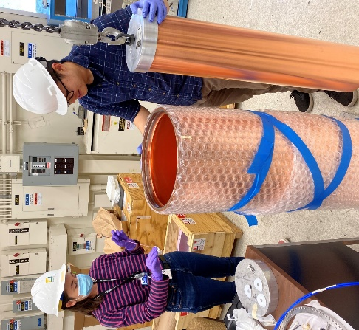
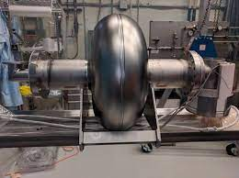
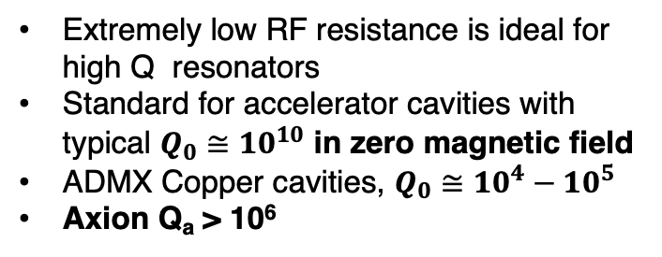
What about using superconductors for cavities?
Extremely low RF resistance is ideal for high Q resonators
Standard for accelerator cavities with typical $Q_{0}≅{10}^{10}$ in zero magnetic field
ADMX Copper cavities, $Q_{0}≅{{10}^{4}−10}^{5}$
Axion Q_{a} > 10⁶
Accelerator Cavity. Image credit: Fermilab SQMS
ADMX Copper Cavity (Run 1D)

Slide 15
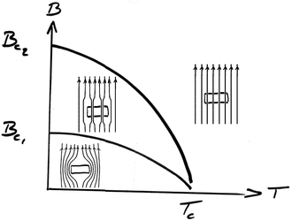
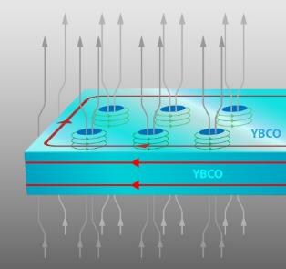
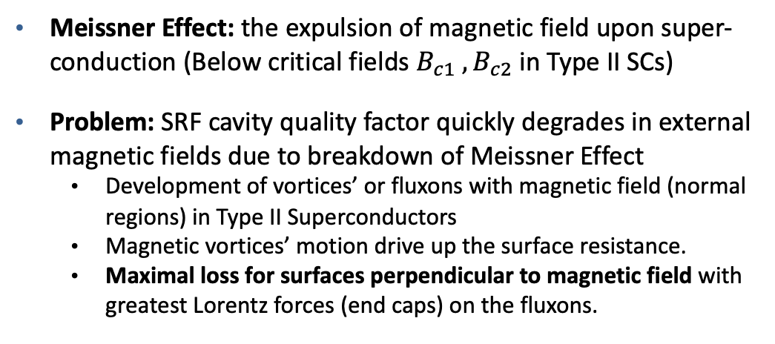



The Challenge for ADMX SRF cavities
Meissner Effect: the expulsion of magnetic field upon super-conduction (Below critical fields $B_{c1} , B_{c2}$in Type II SCs)
Problem: SRF cavity quality factor quickly degrades in external magnetic fields due to breakdown of Meissner Effect
  Development of vortices’ or fluxons with magnetic field (normal regions) in Type II Superconductors
  Magnetic vortices’ motion drive up the surface resistance.
  Maximal loss for surfaces perpendicular to magnetic field with greatest Lorentz forces (end caps) on the fluxons.
Image: Type 2 Superconductors Phase Diagram, Wikipedia
$$\overset{⃑}{F} =\overset{⃑}{I}×\overset{⃑}{B}$$
0
0
$$\overset{⃑}{F_{⊥}} =\left|I\right|\left|B\right|\sin{\frac{π}{2}}=\left|I\right|\left|B\right|$$
$$\overset{⃑}{F_{∥}}=IB(sin{0+\sin{\frac{π}{2}(\hat{r}−\hat{r}))≈0}}$$
Notes:
primary types used for superconducting magnets and cavities

Slide 16
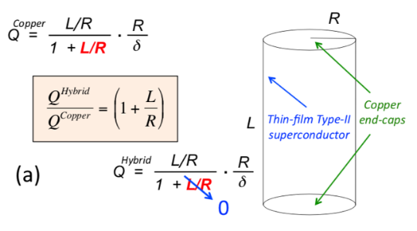
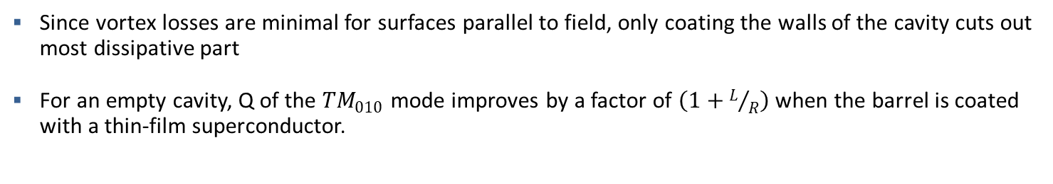
Possible Solution: Hybrid Material Cavity
Wall contribution goes to zero
Since vortex losses are minimal for surfaces parallel to field, only coating the walls of the cavity cuts out most dissipative part
For an empty cavity, Q of the ${TM}_{010}$ mode improves by a factor of $\left(1+L/R\right)$when the barrel is coated with a thin-film superconductor.

Slide 17
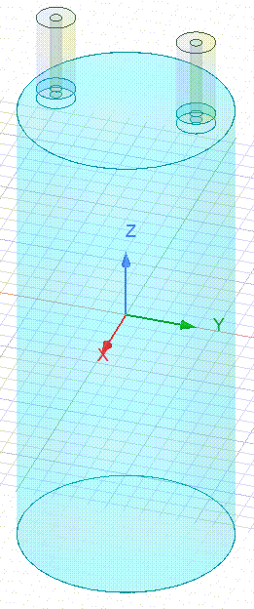


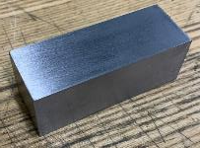
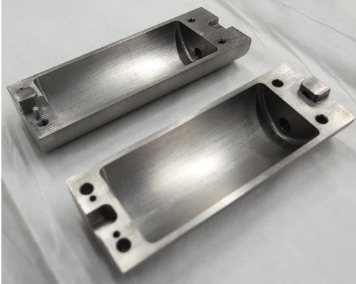


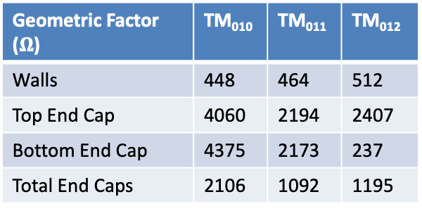

Test Cavity Geometries:
Multi-mode Measurements with NbTi Clamshell
Cavity machined out of NbTi Square stock
Looked at first 3 TM modes Q
HFSS simulations of the cavity structure yields the geometric factor estimate for each mode and sub-surface
This over-constrained problem allows us to calculate the wall vs. endcap resistance
TM₀₁₀
$$f_{0}=9.95GHz$$
TM₀₁₁
$$f_{0}=10.37GHz$$
TM₀₁₂
$$f_{0}=11.47GHz$$
Geometric Factor ($Ω$) | TM₀₁₀ | TM₀₁₁ | TM₀₁₂
Walls | 448 | 464 | 512
Top End Cap | 4060 | 2194 | 2407
Bottom End Cap | 4375 | 2173 | 237
Total End Caps | 2106 | 1092 | 1195

Slide 18
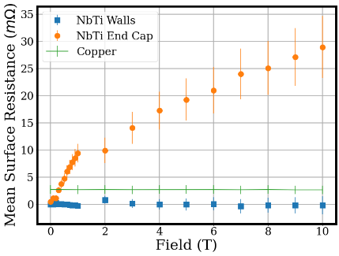
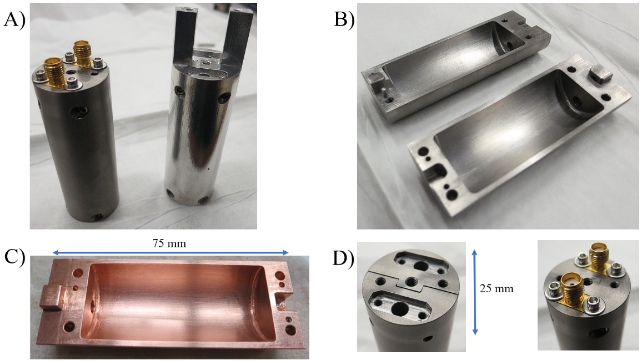

NbTi Clamshell Cavity RF losses in Field: endcaps vs walls
Applied method to show the endcap degradation in a Bulk NbTi clamshell cavity
NbTi: $B_{c2}>14 T$ , $T_{c}≅8.3 K$
Thesis work of UW grad student Tom Braine
T. Braine et al. Multi-mode analysis of surface losses in a superconducting microwave resonator in high magnetic fields. Rev Sci Instrum 1 March 2023; 94 (3): 033102. https://doi.org/10.1063/5.0122296

Slide 19

Simulations allow calculation of Geometric Factors
Q ~ Geometric Factor / Surface loss (Rs)
Rs_{Cu} = 2.9 mOhm at cryogenic temps
Q_{total} ~ 3e2 Ohm/2.9 mOhm
Q_{total} ~ 10⁵ (all Copper Cavity)
Rs: Walls & Rods << lids
Eliminating Wall & Rod contributions due to parallel field and assuming losses dominated by copper endcaps
Q_{lids} ~ 8e3/2.9 mOhm
Q ~ 2.75e6 (x 27.5 higher Q)
Optimalization of shape of endcaps will likely allow lower RF losses (higher Q)
Need to maintain high form-factor & minimize number of mode-crossings
ADMX-EFR Geometric Factors as function of frequency (current design)
All
Lids
Walls
Rods
Notes:
Move to back up.

Slide 20







B-field tolerant SRF cavity development worldwide
Worldwide there has been excellent progress on field-tolerant SRF cavities for axion searches
3 potential materials (NbTi, Nb3Sn, and YBCO)
NbTi sputtered cavities as inspired by QUAX group
Nb3Sn on Niobium led by SQMS (Sam Posen & Anna Grasselino)
Nb3Sn on Copper collaboration with Florida Statue U. (Lance Cooley)
HTC (EuBCO+APC) superconducting cavities CAPP
See updated results in yesterday's poster by Giovanni Marconato
QUAX group (Italy)
CAPP group (Korea)
Recent SQMS results with Nb3Sn

Slide 21



Near term ‘Hybrid’-SRF ADMX Sidecar (Installing now)
Sidecar is a ‘test’-bed for new axion tech atop the main experiment cavity
Copper clamshell design with piezo-actuated rotor and TWPA readout
Tuning rod is hollow Nb with a Nb₃Sn coating. (1.75” Diameter) from SQMS!
Copper Cavity Produced by U. Sheffield.
Nb3Sn Tuning Rod from SQMS
Fermilab Nb3Sn coating furnace with 9-cell cavity

Slide 22


ADMX-EFR Run Times Estimates
Skipped (Mode Crossings)
$$\sim (10 ± 3)\%$$
Instantaneous scan rate to be updated as results of prototyping become clearer.
3 cavity configuration (0.99, 1.00 and 1.005 m) allows to fill in mode-crossings.

Slide 23

ADMX-EFR Run Times Estimates
total runtime:
3 years
Threshold:
Q ~ Copper Cavity
skips mode crossings
Objective:
Q ~ 3 x Q Copper Cavity
Includes mode crossings
Increased sensitivity reach
Q > 27 x Q_{copper} would allow same DFSZ experiment with only 4 cavities (save cost)
Could run 2-3 GHz & 3-4 GHz simultaneously
Could drive down < DFSZ sensitivity (or < 50% fractional halo density at DFSZ)

Slide 24
ADMX-EFR Run Times Estimates
total runtime:
3 years
Threshold:
Q ~ Copper Cavity
skips mode crossings
Objective:
Q ~ 3 x Q Copper Cavity
Includes mode crossings
Increased sensitivity reach
Excited to work with partners such as SQMS to develop the best field-tolerant SRF cavities possible to maximize ADMX-EFR scan rate and sensitivity!

Slide 25
















Thank You!
Acknowledgements:
This work was supported by the U.S. Department of Energy through Grants No DE-SC0009800, No. DE-SC0009723, No. DE-SC0010296, No. DE-SC0010280, No. DE-SC0011665, No. DEFG02-97ER41029, No. DE-FG02-96ER40956, No. DEAC52-07NA27344, No. DE-C03-76SF00098 and No. DE-SC0017987. Fermilab is a U.S. Department of Energy, Office of Science, HEP User Facility. Fermilab is managed by Fermi Research Alliance, LLC (FRA), acting under Contract No. DE-AC02-07CH11359. Additional support was provided by the Heising-Simons Foundation and by the Lawrence Livermore National Laboratory and Pacific Northwest National Laboratory LDRD offices.

Slide 26
Backup slides

Slide 27


Livermore Center for Quantum Science
Anticipation of important impacts for our missions
    New paradigms for computing
    Direct simulation of complex quantum phenomena
    Unprecedented precision in sensing
A quantum testbed with “white box” access used by
a range of Lab researchers
In-house expertise for device design and fabrication
Current program priorities
    Understand device physics and improve hardware
    Connect quantum effects with the classical world
    Integrate quantum into other capabilities through codesign
https://quantum.llnl.gov

Slide 28



ADMX started at LLNL
Built off pioneering experiments at U. of Florida and Rochester/Brookhaven/Fermilab in late 1980s
ADMX started with the purchase of large (8T 60-cm bore) Solenoid from Wang NMR (located in Livermore over by Costco). 16 MJ of stored energy (220 amps)
Installed in B436 in the early 1990s and took data there with continuous upgrades until 2010.
I joined as postdoc in 2006

Slide 29


Moved to the U. of Washington in 2010
Currently operates at the Center for Particle and Nuclear Astrophysics (CENPA) as one of the 3 DOE HEP “Generation 2” Dark Matter projects (alongside LZ and SuperCDMS-SNOLAB)

Slide 30




ADMX: Sidecar operations
Sidecar Publications:
Christian’s thesis
TWPA paper
Number of Piezo Steps
Attocube Rotor on 1K plate

Slide 31


JPA (Main Cavity ~ 1 GHz) + TWPA (Sidecar Cavity: 4-6 GHz)
TWPA Gain vs Frequency
JPA
Packaged in the same paddle as the JPA
TWPA
Gain in dB
Sidecar 1C band
Frequency (GHz)
LLNL acquired TWPAs through contacts with IARPA group. Qualified in Megaman

Slide 32





How do we measure Quality factor and Resistance?
Each mode has an associated Q
How we measure: $Q=\frac{f_{0}}{∆f},$
  From Scattering Parameters taken on a VNA
  S21: input at port 1, measure port 2.
Physical definition: $Q_{0}=ω\frac{U_{cav}}{P_{loss}}=\frac{G_{s}}{R_{s}}$
$G_{s}$ measures the mode field structure’s overlap with the cavity interior surface
Image credit: S parameters, Wikipedia original graphic by Jon Bauman
S21
$G_{s}$ can be defined for the sub-surfaces of the cavity as well such that:
$$S_{tot}=S_{1}+S_{2}+…+S_{n}$$
$\frac{1}{G_{tot}}=$ $\frac{1}{G_{1}}$+ $\frac{1}{G_{2}}$+…+ $\frac{1}{G_{n}}$
$$\frac{1}{Q_{tot}}= \frac{G_{1}}{R_{1}}\text{+ }\frac{G_{2}}{R_{2}} \text{+…+ }\frac{G_{n}}{R_{n}}$$
$$G_{s}=μ_{0}ω\frac{\int{{\left|\overset{⃑}{H}\right|}^{2}dV}}{\int{{\left|\overset{⃑}{H}\right|}^{2}dS}}$$

Slide 33






Decomposition Matrix (2x2 case)
1. Measure 2 modes’ Q on VNA: $Q_{1}$, $Q_{2}$
2. Calculate the four geometric factors in HFSS:
$G_{1,1}$, $G_{1,2}$, $G_{2,1}$, $G_{2,2}$
3. Python Notebook does the rest:
Geometric Factor of total surface for each mode, and corresponding total mode resistance:
Weight matrix:
$$C_{ms}=\left[\begin{matrix}\frac{G_{1,2}}{G_{1,1}+G_{1,2}} & \frac{G_{1,1}}{G_{1,1}+G_{1,2}} \\ \frac{G_{2,2}}{G_{2,1}+G_{2,2}} & \frac{G_{2,1}}{G_{2,1}+G_{2,2}}\end{matrix}\right]$$
$$G_{n}=\frac{G_{n,1}G_{n,2}}{G_{n,1}+G_{n,2}}$$
$${\overset{⃑}{R}}_{m}=\left[\begin{matrix}G_{1}/Q_{1} \\ G_{2}/Q_{2}\end{matrix}\right]$$
Invert mode resistances to surface resistances:
$${\overset{⃑}{R}}_{s}=C_{ms}^{−1}{\overset{⃑}{R}}_{m}$$

Slide 34


Current Research done:
Testing Apparatuses at LLNL
Main Test System: Quantum Designs™ Physical Properties Measurement System (PPMS)
  16 T Magnet
  1” Bore, 100 mm field Height
  2 K Cryostat
Left: Top down of PPMS System with RF probe inserted.
Right: PPMS RF Probe extraction from bore

