Slide 1


Quantum noise in Gravitational Wave Detectors
Jean-Pierre Zendri`
INFN Sezione di Padova
On behalf of the Virgo collaboration
Workshop on
Quantum Technologies for Fundamental Physics
Erice, 1-6 September 2023

Slide 2
Motivation
Typical strain power spectral density

Slide 3
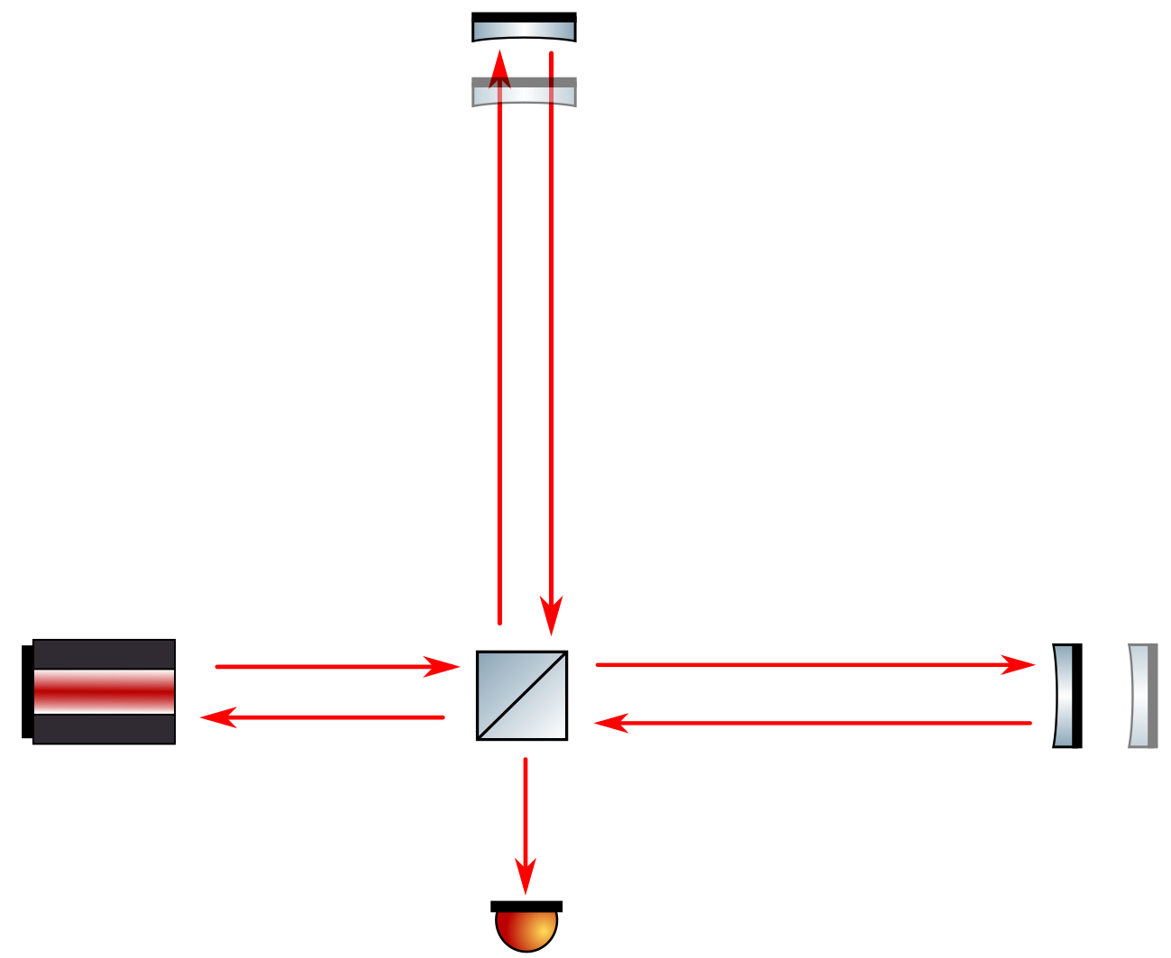
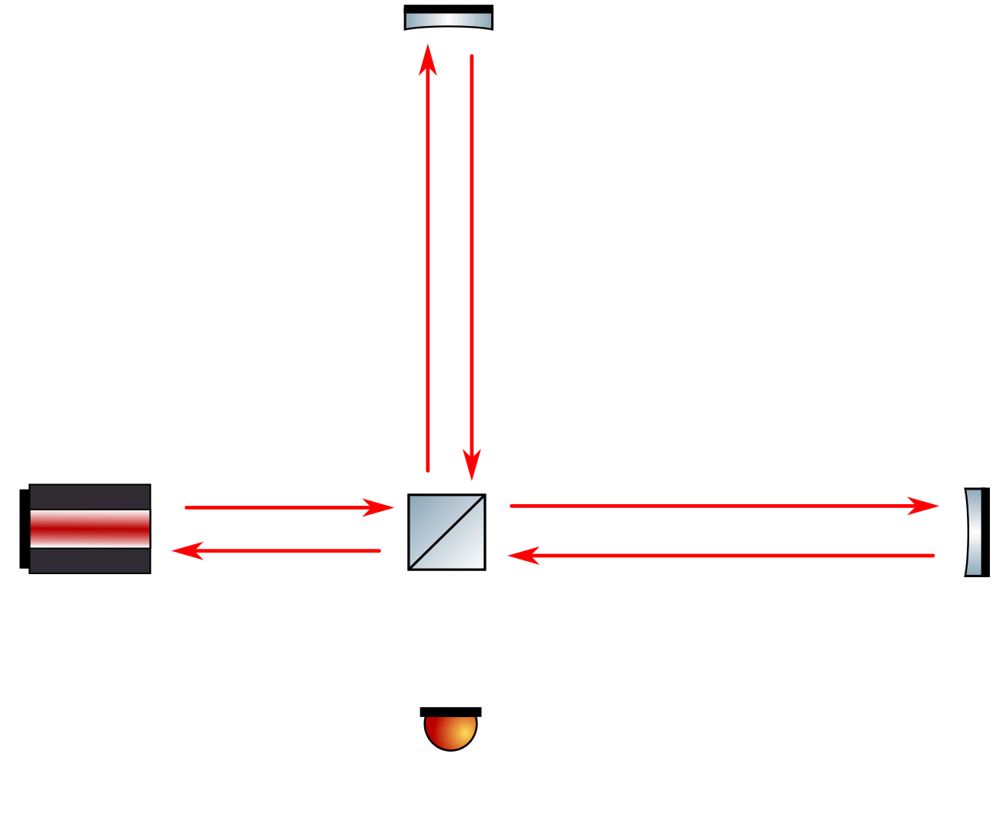
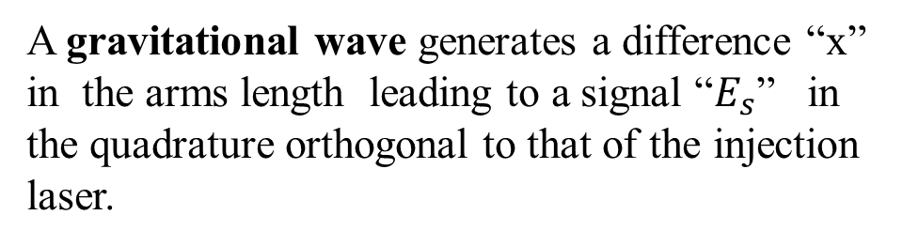





Michelson Interferometers: GW signal
$$E_{Las}=X_{1}Cos\left(ω_{0}t\right)$$
Symmetric Detector configuration
  BS 50:50
  Same arm length
The injected laser beam does not reach the photodetector “PD”
M1
x/2
$E_{L}$/$\sqrt{2}$
x/2
A gravitational wave generates a difference “x” in the arms length leading to a signal “$E_{s}$” in the quadrature orthogonal to that of the injection laser.
Laser
$$E_{L}$$
$E_{L}$/$\sqrt{2}$
BS
M2
PD
$$E_{S}={−X}_{1}\frac{ω_{0}x}{c}Sin\left(ω_{0}t\right)$$

Slide 4
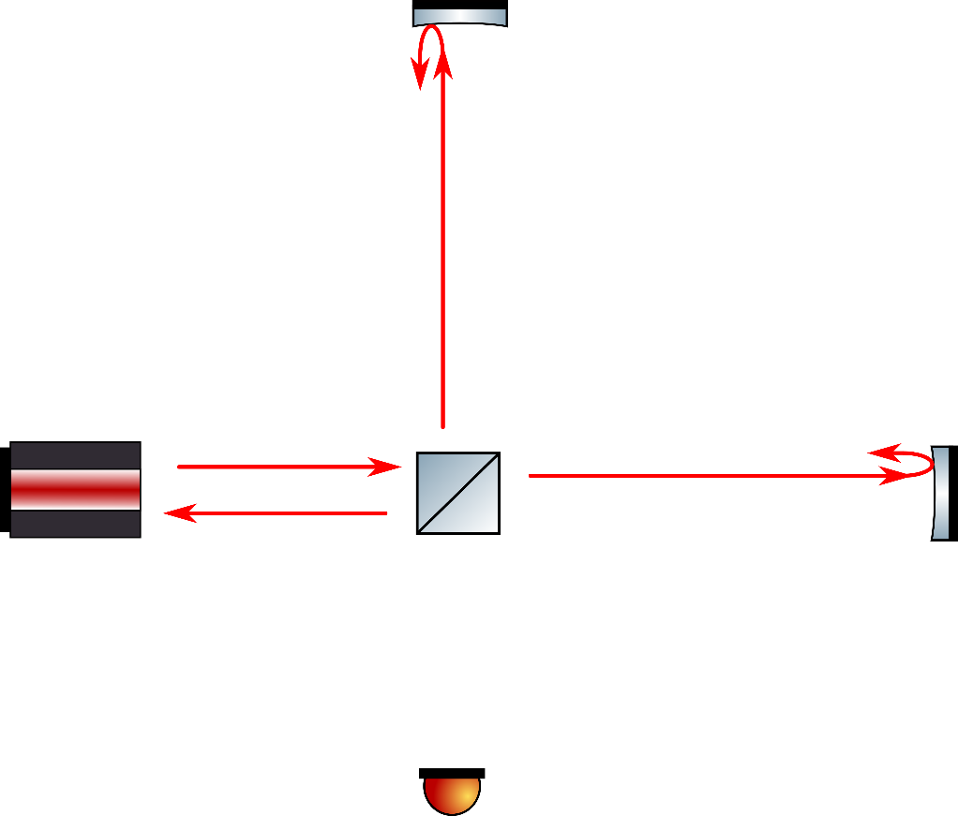
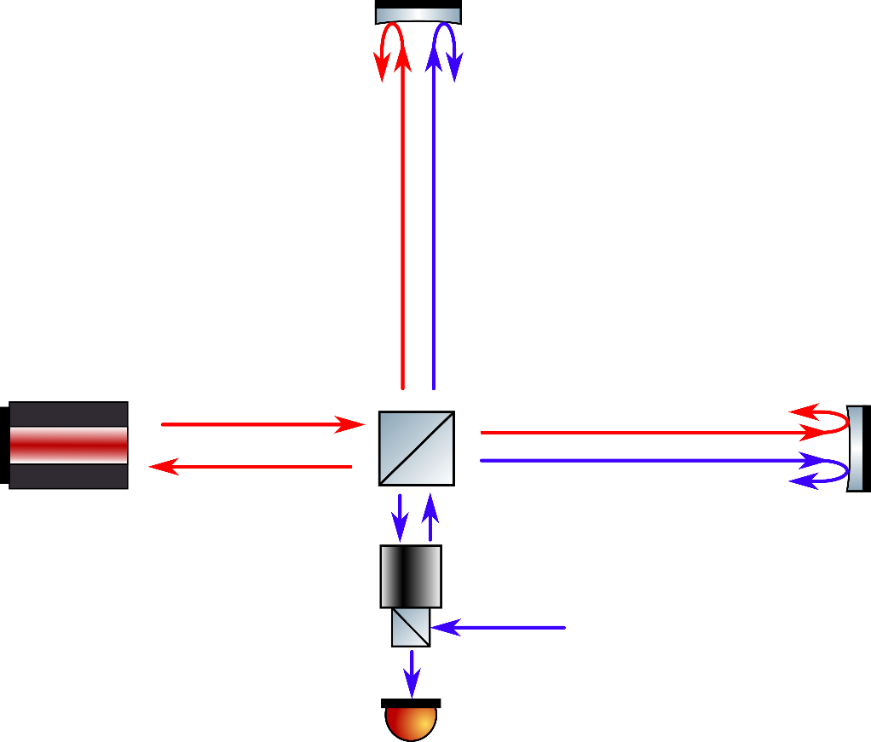






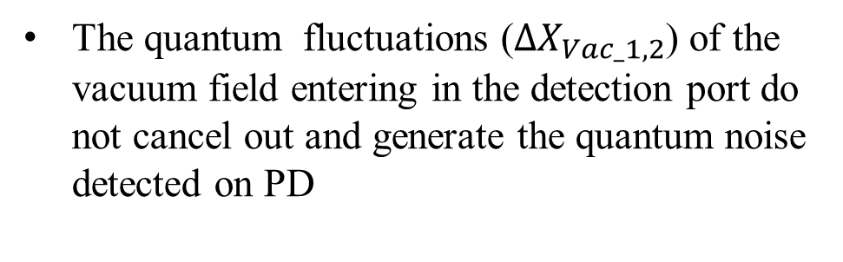


Michelson Interferometers: Quantum Noise
$${\hat{E}}_{L}=\left[X_{1}+{\hat{∆X}}_{1}\right]Cos\left(ω_{0}t\right)+\left[{\hat{∆X}}_{2}\right]Sin\left(ω_{0}t\right)=X_{1}\left[1+{\hat{∆X}}_{1}/X_{1}\right]Cos\left(ω_{0}t−{\hat{∆X}}_{2}/X_{1}\right)$$
The input laser amplitude ($ΔX_{1}$) and phase ($ΔX_{2}$) fluctuations are constrained by QM :
$$ΔX_{1}ΔX_{2}≥1$$
For a symmetric interferometer and assuming equal mass mirros$ΔX_{1,2}$ do not generate any signal in the dark port
M1
$$F_{RP}$$
$E_{L}$/$\sqrt{2}$
$E_{Vac}$/$\sqrt{2}$
Laser
$$E_{L}$$
$E_{L}$/$\sqrt{2}$
BS
${−E}_{Vac}$/$\sqrt{2}$
$$F_{RP}$$
The quantum fluctuations ($ΔX_{Vac_1,2}$) of the vacuum field entering in the detection port do not cancel out and generate the quantum noise detected on PD
$$E_{Vac}$$
PD
$${\hat{E}}_{Vac}=\left[{\hat{∆X}}_{Vac_1}\right]Cos\left(ω_{0}t\right)+\left[{\hat{∆X}}_{Vac_2}\right]Sin\left(ω_{0}t\right)$$
C.M. Caves, Phys. Rev. D 23, 1693 (1981)

Slide 5
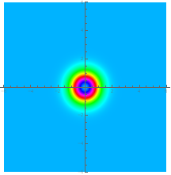
















Michelson Interferometers: Standard Quantum Limit
$$m$$
Quantum noise generators
$$F_{RP}$$
$${\hat{∆X}}_{Out_{1}}=Exp[2iΩτ]{\hat{∆X}}_{Vac_{1}}(Ω)$$
Back action noise
$$L$$
$${\hat{∆X}}_{Out_{2}}={A\left(Ω\right)h(Ω)+Exp[2iΩτ](\hat{∆X}}_{Vac_{2}}(Ω))$$
$${\hat{∆X}}_{Out_{2}}={A\left(Ω\right)h(Ω)+Exp[2iΩτ](\hat{∆X}}_{Vac_{2}}(Ω)+κ{ \hat{∆X}}_{Vac_{1}}(Ω))$$
$E_{Vac}$/$\sqrt{2}$
Signal
Shot noise
Laser
$$m$$
$$P_{Laser}$$
Optomechanical coupling κ$∝{(P}_{laser}×1/(mΩ^{2}))$
BS
${−E}_{Vac}$/$\sqrt{2}$
$$X_{2}$$
$$F_{RP}$$
Strain sensitivity assuming a coherent vacuum state
$$E_{Vac}$$
$$E_{Out}$$
$$X_{1}$$
$$S_{hh}(Ω)=\left(κ+\frac{1}{k}\right)\frac{h_{SQL}^{2}}{2}$$
PD
$${\hat{E}}_{Vac}=\left[{\hat{∆X}}_{Vac_1}\right]Cos\left(ω_{0}t\right)+\left[{\hat{∆X}}_{Vac_2}\right]Sin\left(ω_{0}t\right)$$
Back action
Shot noise
At minimum ($κ=1$) Standard quantum limit
$${\hat{E}}_{Out}=\left[{\hat{∆X}}_{Out_1}\right]Cos\left(ω_{0}t\right)+\left[{\hat{∆X}}_{Out_2}\right]Sin\left(ω_{0}t\right)$$
$$S_{hh−min}\left(Ω\right)=h_{SQL}^{2}=\frac{8ℏ}{mΩ^{2}L}$$

Slide 6
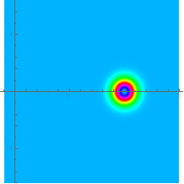
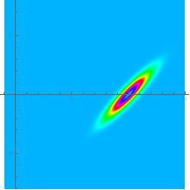
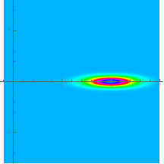
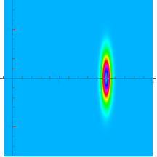
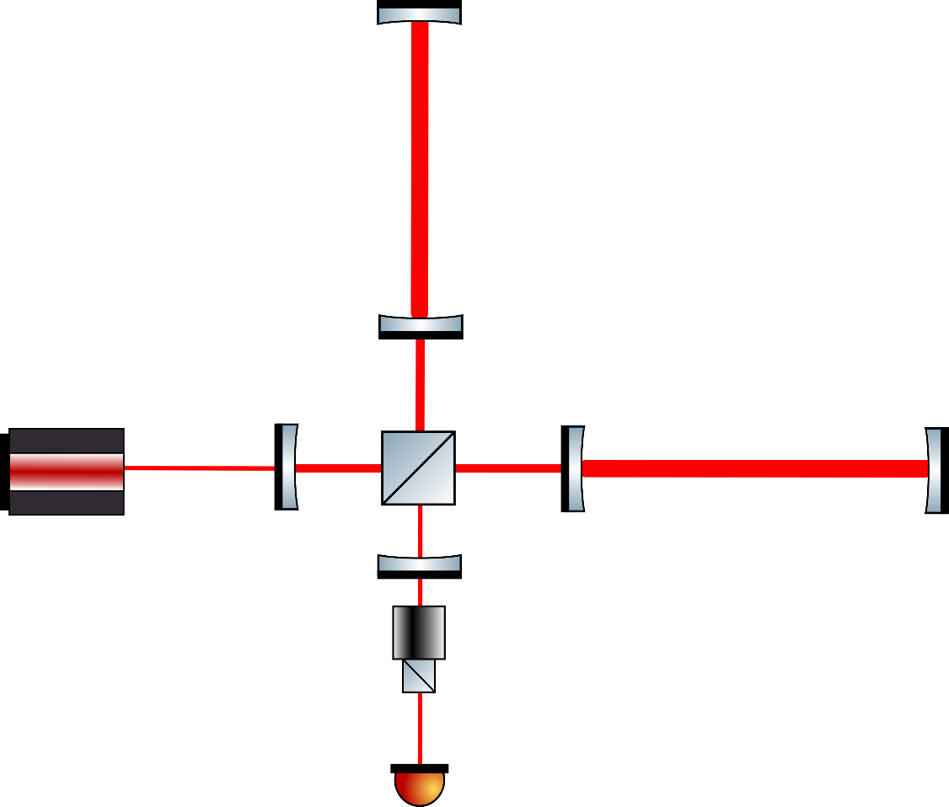
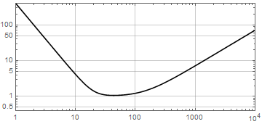
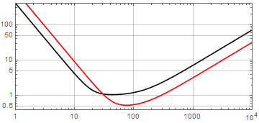
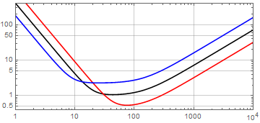
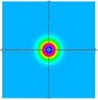
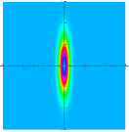
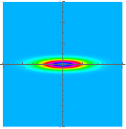
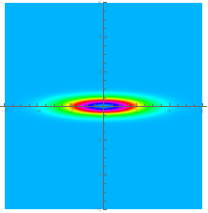
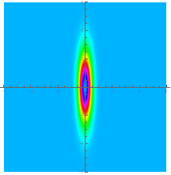

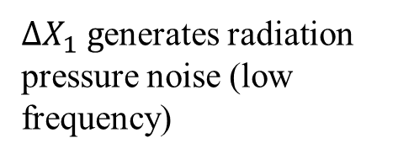
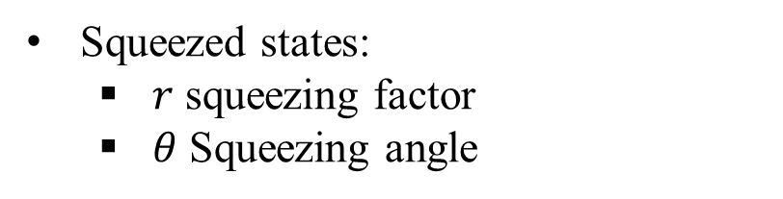


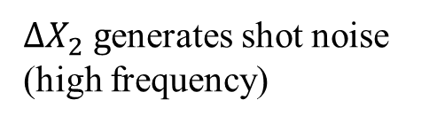





Michelson interferometer with squeezing
Coherent State
Squeezed State
Phase Squeezing
Ampl. Squeezing
Squeezed states:
  $r$ squeezing factor
  $θ$ Squeezing angle
$$X_{2}$$
$$X_{2}$$
$$X_{2}$$
$$X_{2}$$
$${∆X}_{1}$$
$${∆X}_{1}{∆X}_{2}=1$$
$${∆X}_{1}$$
$${∆X}_{1}$$
$${∆X}_{2}$$
$${∆X}_{SQZ}/{∆X}_{Cohe}=e^{−r}$$
$${∆X}_{2}$$
$$X_{1}$$
$$X_{1}$$
$${∆X}_{2}$$
$$X_{1}$$
$$X_{1}$$
$$θ$$
3.5 dB
3.5 dB
3.5 dB
Quantum noise can be manipulated with squeezed light
  $κ⟹κe^{∓r}$, $h_{SQL}⟹h_{SQL}$
  The SQL can be surpassed in a limited frequency region if $θ≠0, π/2$
$∆X_{2} g$enerates shot noise (high frequency)
$∆X_{1} g$enerates radiation pressure noise (low frequency)

Slide 7
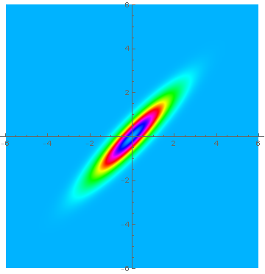
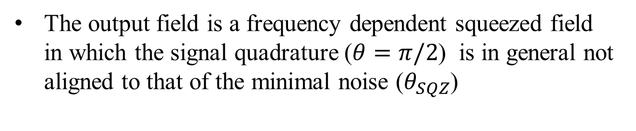



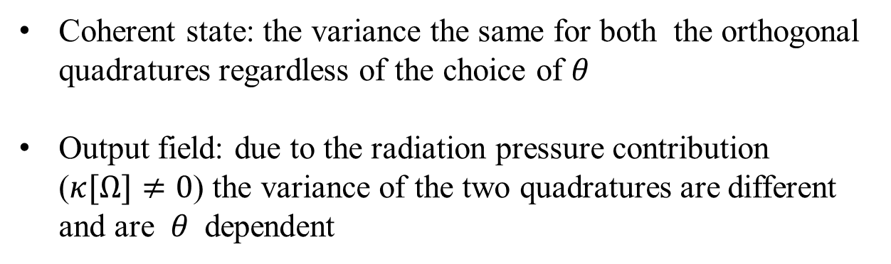

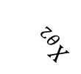
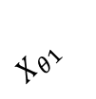




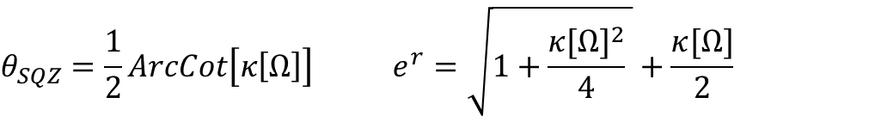
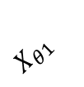
Michelson Interferometers: Ponderomotive squeezing
Input field
Coherent state: the variance the same for both the orthogonal quadratures regardless of the choice of $θ$
Output field: due to the radiation pressure contribution ($κ[Ω]≠0$) the variance of the two quadratures are different and are $θ$ dependent
$$X_{θ2}$$
$$X_{Vac2}$$
$$X_{θ1}$$
$$θ$$
$$X_{Vac1}$$
$${\hat{∆X}}_{Out_{1}}=Exp[2iΩτ]{\hat{∆X}}_{Vac_{1}}(Ω)$$
Output field
$${\hat{∆X}}_{Out_{2}}={Exp[2iΩτ](\hat{∆X}}_{Vac_{2}}\left(Ω\right)+κ[Ω]{\hat{∆X}}_{Vac_{1}}(Ω))$$
$$X_{θ2}$$
$$X_{out2}$$
$$X_{θ1}$$
The output field is a frequency dependent squeezed field in which the signal quadrature ($θ=π/2$) is in general not aligned to that of the minimal noise ($θ_{SQZ}$)
$$θ_{SQZ}$$
$$X_{out1}$$
$$θ_{SQZ}=\frac{1}{2}ArcCot\left[κ\left[Ω\right]\right] e^{r}=\sqrt{1+\frac{{κ[Ω]}^{2}}{4} }+\frac{κ[Ω]}{2}$$
Signal
Quadrature

Slide 8
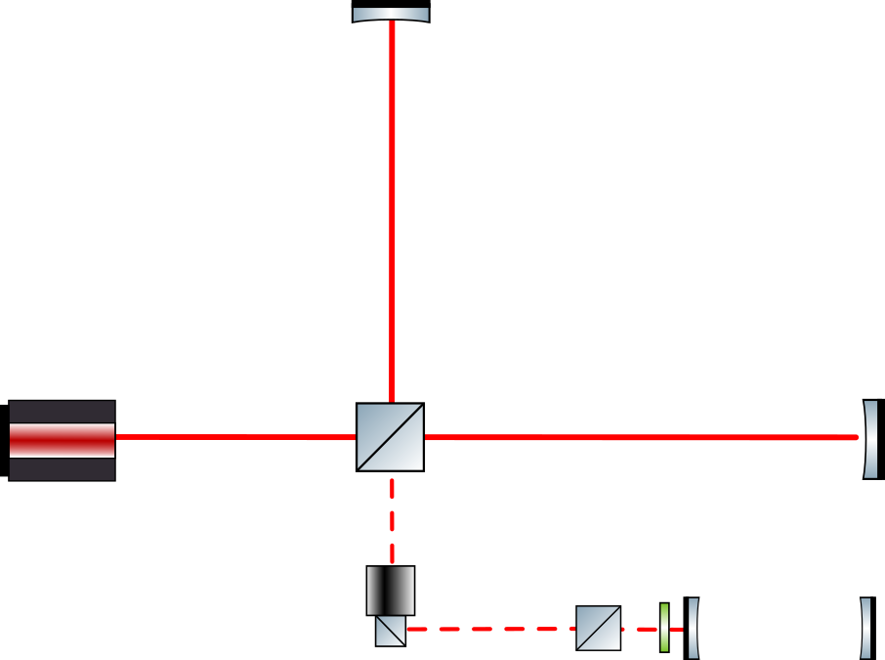
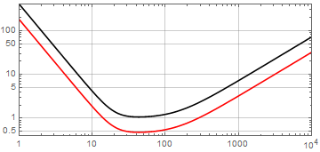
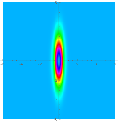
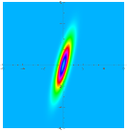
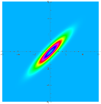
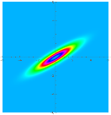
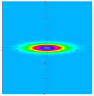
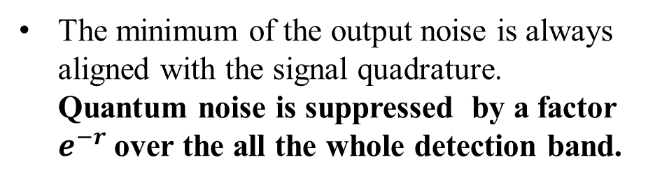
Frequency dependent squeezing (FDS)
The injected squeezing ellipse angle is rotate as a function of the frequency to compensate from the rotation resulting from the optomechanical coupling with the interferometer.
The minimum of the output noise is always aligned with the signal quadrature. Quantum noise is suppressed by a factor $e^{−r}$ over the all the whole detection band.
FDS source

Slide 9
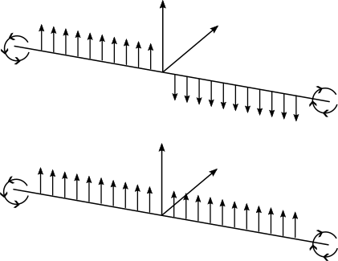
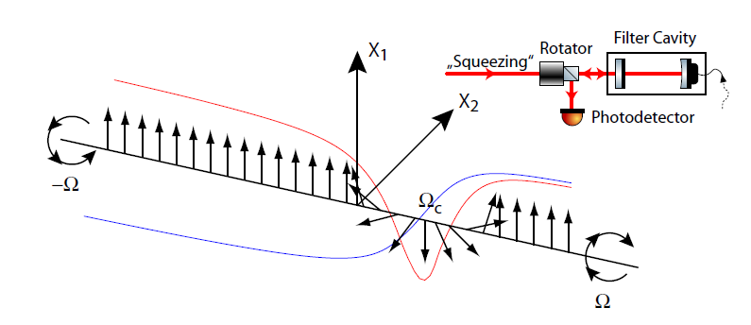

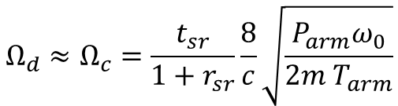

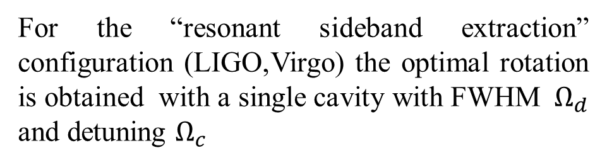








Frequency Dependent Squeezing with Filter Cavities
Phase Squeezing
$$X_{1}$$
$$X_{2}$$
Frequency dependent squeezing is generated by exploiting the dispersion in the reflection of a frequency independent squeezing source from adetuned optical cavity
-$Ω$
Amplitude Squeezing
$$Ω$$
$$X_{1}$$
$$X_{2}$$
For the “resonant sideband extraction” configuration (LIGO,Virgo) the optimal rotation is obtained with a single cavity with FWHM $Ω_{d}$ and detuning $Ω_{c}$
-$Ω$
Frequency dependent squeezing
$$Ω$$
$$Ω_{d}≈Ω_{c}=\frac{t_{sr}}{1+r_{sr}}\frac{8}{c}\sqrt{\frac{P_{arm}ω_{0}}{2m T_{arm}}}$$
$$P_{arm}:Power on$$
$$the arms$$
Phys. Rev. D 90, 062006 (2014)
For the next observation run for Virgo
$$Ω_{d}≈Ω_{c}=25 Hz$$
Phys. Rev. D 65, 022002 (2001)

Slide 10
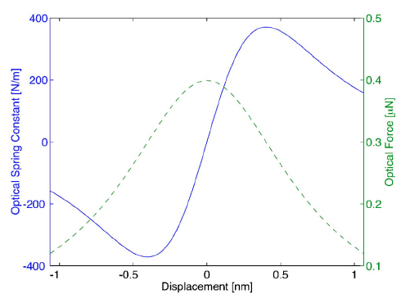

Real GW detectors
Dual Recycled configuration
Resonant sideband extraction scheme (LIGO and Virgo) the optomechanical coupling factor $κ is enhanced$($P_{arms}$ instead of $P_{laser}$) in the detector bandwidth $γ_{ITF}$
$$κ[Ω]=\frac{8ω_{0}P_{arms}}{mLc}\frac{γ_{ITF}γ}{Ω^{2}\left(γ_{ITF}^{2}{+Ω}^{2}\right)}$$
For the detuned configuration the mechanical susceptibility (and therefore $κ$) is affected by the optical spring
Arm cavity
PR mirror
Arm cavity
SR mirror

Slide 11
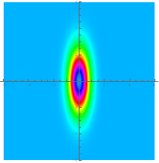
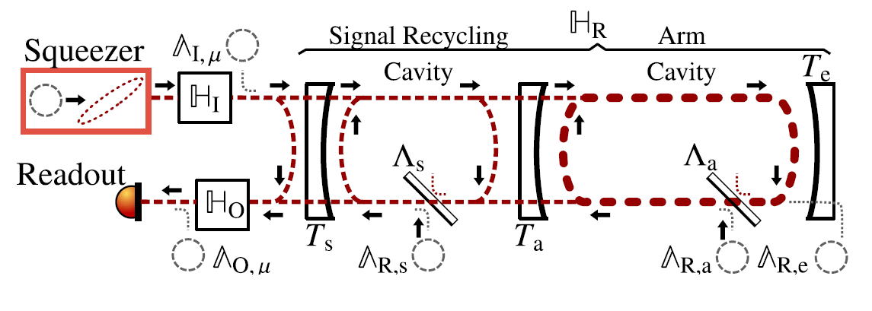




Squeezing degradation: quantum decoherence from lossses
  Beam Splitter model
Losses:$1−η$
  Loss mechanism
  Absorption, clipping and scattering
  Misalignment and geometrical mode mismatch
  Polarization error
  Photodetector quantum efficiency
  High order mode
IN
OUT
$$E_{SQZ}$$
$$\sqrt{η}{∙E}_{SQZ}+\sqrt{1−η}{∙E}_{Coh}$$
$$E_{Coh}$$
  Frequency dependent $losses η[Ω]$
  The total amount of losses tipically range between 20% and 40%
  In general not fully explained with the loss budget.
Phys. Rev. D 104, 062006 (2021)
Phys. Rev. D 104, 062006 (2021)

Slide 12
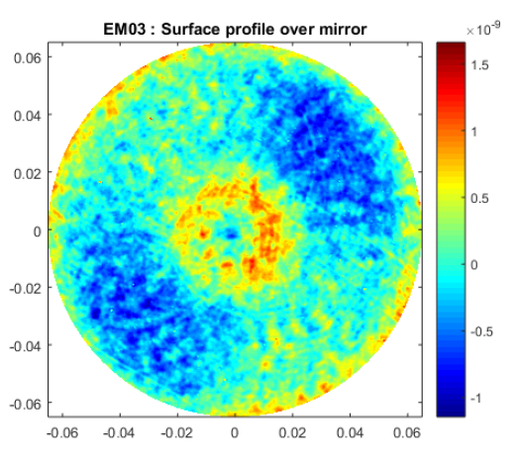
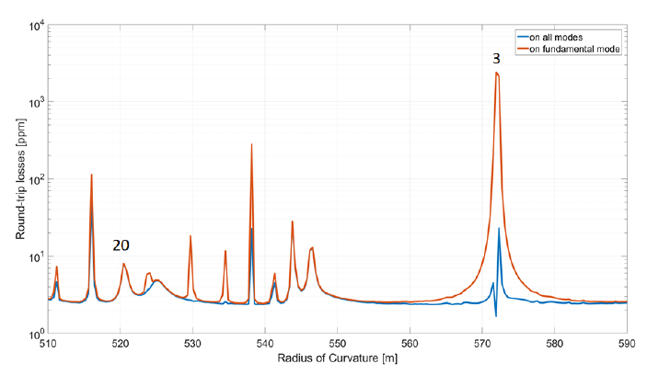

The role of the High Order Modes (HOM)
  Wavefront deformation
  Mirror roughness Map
  RTL versus mirror RoC
  The scattered light couple to the high order modes resulting in a loss in the fundamental mode.
  Particularly efficient mechanism if the resonance frequency of the HOM falls close to that of the fundamental mode.
  Mode Mismatch
  The mismatch cause a beam splitter like mixing between LG00 and HOM
  The two mode experience different phase evolution during propagation
  Another mismatch mix back the modes leading to an additional effective loss contribution which can also be negative (coherent cancellation)
  SQZ
  LG00
  HOM
  Gouy Phase
  ITF
  OMC
  Coher

Slide 13





Squeezing degradation: dephasing
$${∆X}_{1}$$
Generated by a phase jitter between the LO (ITF carrier) and the squeezed field which manifests with a squeezing angular ijtter.
The low frequency contribution (mainly deriving from seismic and acoustic noise) is suppressed with the coherent control loop to less than few mrad-rms.
At high frequencies contribution comes mainly from control sidebands unbalancing or interacting with the interferometer contrast defect
$$X_{1}$$
Produced 10 dB
$${∆X}_{1actul}$$
Phys. Rev. Lett. 125, 131101 (2020)
Typical values of the optical losses and angular jitter in GW detectors
3 dB
4 dB
5 dB
8 dB
6 dB
7 dB

Slide 14


The Virgo Gravitational wave detector
Virgo site
European Gravitational Observatory (EGO
Cascina, Italy
Virgo detector:
  Long arm (3km) cavities
  Located in Cascina (Italy)
Quantum noise reduction in Virgo
Observation Run O3 (Apr. 2019-Mar. 2020)
  Power recycled configuration
  Frequency Dependent Squeezing
Observation Run O4
  Dual recycled configuration
  Frequency dependent Squeezing
Virgo collaboration
  18 countires
  132 Institutes
  700 members

Slide 15

The Observation run O3
Power recycling configuration
Frequency independent squeezing injection

Slide 16




The AEI vacuum squeezed source
M.Mehmet and H.Vahlbruch, CQG 36, 015014 (2019)
The AEI squeezer in Cascina
~1meter
Squeezed states generated with parametric down conversion in $χ^{(2)}$crystals
Double resonant linear OPA cavity
Low residual phase noise (3.5 mrad RMS)
Up to 12 dB of squeezing measured in the audio band

Slide 17


The Observation run O3: results
Optical losses 43%, Phase noise 60 mrad
Phys. Rev. Lett. 123, 231108 (2019)
Amplitude SQZ injection
(for LIGO Phys. Rev. Lett. 123, 231107 (2019))
No SQZ injection
Phase SQZ injection
Up to 3 dB of shot noise reduction
5-8 % BNS horizon enhancement
Long term stability
First evidence of squeezed light enhanced quantum radiation pressure noise on a 42 Kg test mass
Phys. Rev. Lett. 125, 131101 (2020)
(for LIGO Nature 583, 43 (2020)

Slide 18

Filter Cavity Length Optimization for Virgo
Cavity length-dependent squeezing degradation sources
FC round trip losses (yellow):
  Optical losses
  Mixes the two quadratures thereby corrupte squeezing with anti-squeezing
Phase noise (pink): produced by the residual cavity length fluctuations which generate detuning variations
Target parameters
Linewidth | 25 Hz
FC Round trip losses | 40 ppm
Residual FC length noise | 1 pm
Mode mismatch | 2%
Cavity length-independent degradation sources
Mode mismatch between the squeezed beam and the FC
All other sources (injection and detection losses) assumed to be frequency independent
The optimal FC length is about 300 meters corresponding to finesse of 10000

Slide 19


Virgo FDS source
Filter Cavity
BS
NI
North Arm
SR
Det

Slide 20

Virgo FDS source
Filter Cavity Mirrors
BS
NI
North Arm
SR
Det
IM suspension system
IM vacuum tank
Last suspension stage
Mirrors: Diameter 150 mm, Thickness 90 mm, Roughness <0.58 nm RMS

Slide 21

Virgo FDS source
BS
NI
North Arm
SR
Suspended Quantum Bench 2
Det
Suspended Quantum Bench 1

Slide 22

Virgo FDS source
BS
NI
North Arm
SR
External Quantum Bench 1
Plus SQZ board
Det

Slide 23

Virgo Filter Cavity exprimental layout and controls
Filter Cavity control with Green

Slide 24

Virgo Filter Cavity exprimental layout and controls
Diagnostic Configuration

Slide 25

Virgo Filter Cavity exprimental layout and controls
Science configuration

Slide 26


Virgo FDS source: results
Phys. Rev. Lett. 131, 041403 (2023)
 | Target | Achieved
Lock accuracy [Hz rms] | 1 | 1
Round Trip losses [ppm] | 60 ppm | 50-90
Mode mismatch | 2% | 1.5%
Round trip optical Losses |  | 10%
Phase noise |  | 40 mrad
Squeezing degree measured at homodyne angle
Expected quantum noise suppression in Virgo @ 40 W (simplified model)
ITF losses 16% (independently estimated)
DET losses 6% (estimated)

Slide 27












EPR-FDS squeezing
$$Sidebands entaglement$$
$$OPO$$
Pump: $2ω_{0}+∆$
Signal: $ω_{0}$
Idler: $ω_{0}+∆$
Advantage:
No needs of filter cavity
Drawback:
3dB loss of squeezing
Not trivial implementation of low noise homodyne detection
$$ω_{0}+∆$$
$$OPO$$
$$Κ[ω]$$
$$ω_{0}$$

Slide 28


EPR squeezing: experimental demonstrators
FDS experimentally demonstrated on table top experiments (with no radiation pressure effect)
Nature Photonics 14, 223 (2020)
Nature Photonics 14, 240 (2020)
EPR demosntrator with a suspendet interfe rometer with two 350 mm long arm cavities being developed in Cascina (Virgo site). The quantum radiation pressure noise contribution is expected to be observable.
Mirror mass: 300 gr.

Slide 29






Dechoerence mitigation:Internal squeezing
Proof of concept
arXiv:2303.09983
1)Low readout losses dominant: parametric deamplification
Signal
Max 6 dB
Applicable for GW detectors?
>6 dB
2)Low internal losses dominant: parametric amplification
Several technological problems to deal with
To be combined with quantum back-action evading techniques
Cohe
Same SNR as input
SQZ
gain
Loss

Slide 30






Speed meters
Zero Area Sagnac interferometer
The generalized momentum “p” is a quantum non demolution observable (not affected by back action)
$$\left[\hat{p}\left(t\right),\hat{p}′(t′)\right]=0$$
The momentum of the test mass is a quasi quantum non demolution observable
$$x_{b}$$
Input
laser
Two basic schemes
  Michelson interferometer plus external “sloshing” cavity
  Speed meter
https://link.springer.com/article/10.1007/s41114-019-0018-y
$$x_{a}$$
Photodetector
$$δφ≈x_{a}\left(t\right)+x_{b}\left(t+τ\right)−x_{b}\left(t\right)−x_{a}\left(t+τ\right)≈$$
$$≈\left[{\dot{x}}_{b}−{\dot{x}}_{a}\right]τ$$
Large scale proof of principle still lacking
New configurations compatible with the michelson interferometer configuration are are being considered
$τ$: propagation time

Slide 31
Summary
The operation of the GW detectors beyond the Standard Quantum Limit has been demonstrated using Frequency Dependent Squeezing.
In the medium term improvements are expected by working on minimizing the sources of squeezing degradation.
On longer timescales alternative schemes could be considered (speed meters, internal squeezing, EPR..).

Slide 32
Quantum noise in Gravitational Wave Detectors
THANKS
for the attention

Slide 33
Back-up SLIDES

Slide 34

Coherent Control Loop
1. The phase difference between the pump and the Control field is imprinted in the $2Ω$ beat note (error signal) and is stabilized.
2. The phase between the Control field and the LO is extracted from thei beat signal and is stabilized.

Slide 35
O3 Loss budget
Interferometer Losses (5-11)%
  Optics
  Arm cavities losses
  alignment
Detection Losses (13-24)%
  In vacuum Faraday
  OMC losses
  Mode matching ITF Output Mode cleaner
  Quantum efficiency of PDs
  Dark noise
Injection Losses (5-13)%
  Faraday
  Optics
  Alignment
  Mode matching to Output mode cleaner
Squeezer Losses (2.5-3.5) %
  OPA escape efficeincy
  Alignment

Slide 36



Stray light issue
Stray light
The back reflected light that recpmbine with the ITF can spoil the detector sensitivity. Required less than10⁻²⁰ W of recombined power
Main contribution from OPO refelection
Injection Path
Stray ligth Path
Example (O3)

Slide 37
Stray light issue
Stray light
The back reflected light that recpmbine with the ITF can spoil the detector sensitivity. Required less than10⁻²⁰ W of recombined power
Main contribution from OPO refelection
Injection Path
Stray ligth Path
Example (O3)

Slide 38


FDS: Thermal detuning
A different thermo-optical response of the green and IR coatings generated a time dependent cavity detuning driven by thermal drifts
For the Virgo FC mirrors about 110 Hz/K
It is required to stabilize the mirror temperature within 10-20 mK

