Slide 1
DOE Introductory Remarks:
National QIS Research Centers and Superconducting Quantum
Materials and Systems Center
Quantum Technologies for Fundamental Physics
Erice, Italy ∙ September 1-7, 2023 https://agenda.infn.it/event/34296/
Abid Patwa
U.S. Department of Energy
Office of High Energy Physics

Slide 2
DOE Office of Science Research Portfolio
The delivery of scientific discoveries and major scientific tools to transform our understanding of nature
and to advance the energy, economic, and national security of the United States
Science-Mission driven:
Biological and Environmental
Research (BER)
Understanding complex biological, climatic, and
environmental systems
Fusion Energy Sciences (FES)
High Energy Physics (HEP)
Nuclear Physics (NP)
Building the scientific foundations for a fusion energy source
Understanding how the universe works at its most fundamental level through research, projects, and facilities operations
Discovering, exploring, and understanding all forms
of nuclear matter
Understanding, predicting, and ultimately controlling matter and energy flow at the electronic, atomic, and molecular levels
Advanced Scientific Computing
Research (ASCR)
Delivering world leading computational and networking capabilities to extend the frontiers of science and technology
Basic Energy Sciences (BES)

Slide 3


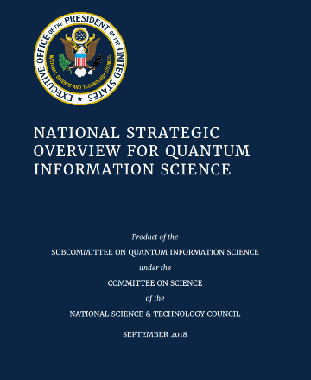

DOE’s 5 National Quantum Information Science
Research Centers
DOE’s Office of Science addresses its mission by fostering world-leading science and technology programs and initiatives, including at each of the five QIS Research Centers
Q-NEXT • Next Generation
Quantum Science and Engineering
(David Awschalom, Lead: ANL)
Website: https://q-next.org/
C²QA • Co-design Center for Quantum Advantage
(Andrew Houck, Lead: BNL)
Website: https://www.bnl.gov/quantumcenter/
SQMS • Superconducting Quantum Materials and Systems Center
(Anna Grassellino, Lead: FNAL)
Website: https://sqmscenter.fnal.gov/
Significant Impact to Advance Quantum Research
Major Cross-Cutting Challenge
Science and Technology Innovation Chain
QIS Ecosystem Stewardship
Multi-Disciplinary Leadership
Well-Structured Plan and Metrics
Collaborative Management Structure
QSA • Quantum System Accelerator
(Rick Muller, Lead: LBNL)
Website: https://quantumsystemsaccelerator.org/
QSC • The Quantum Science Center
(Travis Humble, Lead: ORNL)
Website: https://qscience.org/
National Quantum Initiative
Act, passed by U.S. Congress
and signed by the President,
December 2018
https://science.osti.gov/Initiatives/QIS/QIS-Centers

Slide 4
DOE Office of Science and QIS
National QIS Research Centers are a critical part of our QIS Portfolio and leverage Office of Science’s unique strengths to advance basic science and quantum-based technologies
All of Office of Science,
All of QIS
DOE team approach in processing the funding
Cross-program coordination of QIS within DOE’s Office of Science
Office of Science-wide and QIS-wide scope, management, and expected impacts
Community Engagement
Formal Request For Information as a prelude to the funding opportunity announcement
Stewardship role
Office of Science website: https://science.osti.gov/
Initiatives/QIS
Coordination & Partnerships
Foster coordination and collaborative partnerships among world-leading institutions, including international, through flexible arrangements
Focus on all levels of the S&T innovation chain
Executive Council
QIS Science & Technology (S&T) Innovation Chain
Advance Key Technical Areas of Interest
QIS Ecosystem Stewardship
Instrumentation and Facilities
Management Structure

Slide 5

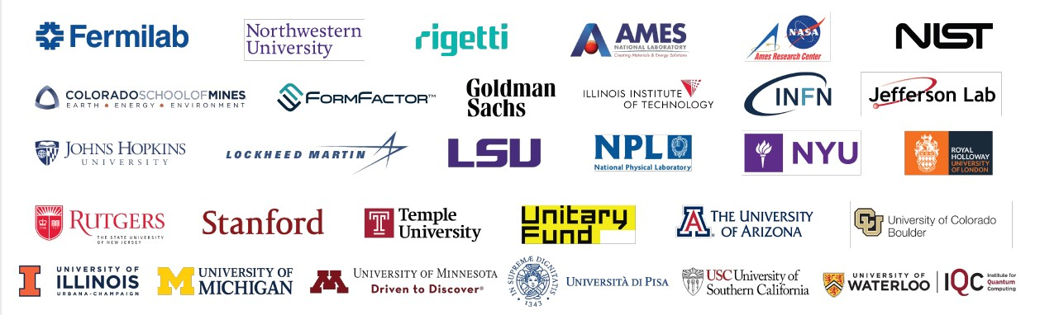
SQMS Center
Today,
SQMS is the largest DOE-supported Quantum Center
Brings together more than 450 collaborators across 30 institutions from
academia, DOE national laboratories, and industry
Including major international collaborators from world-leading institutes in Italy and the United Kingdom

Slide 6
National QIS Research Centers: Goals and Progress
Efforts at each National QIS Research Center, including SQMS, are goal-driven and collaborative at a scale and of a type that is different compared to those from other mechanisms of research support
  For e.g., they are not single-investigator or small-group research efforts
Synergies across disciplines, research sectors, and approaches leading to significant advancements and discoveries
  The Centers produce a synthesis across — not just a collection of — various research efforts
Focus on advancing the core thrusts defined by each Center’s vision and goals
  Develop and advance quantum platforms and testbeds to enable quantum computing for the benefit of the broader community
A key aspect of each Center is its ability to develop and implement new and unique prototypes, tools, and approaches, and make these available to the broader science and technology community, where appropriate
Regularly assess and discuss the progress towards individual Center’s milestones and goals, as well as each Center’s impact, by way of annual progress reports, review materials, and other documents
  Includes the mid-term reviews held in Feb-Mar 2023 to evaluate progress, goals, and impacts (more next slide…)
Progress towards collective goals across the Centers are developed and discussed by the Centers’ Executive Council and by a dedicated QIS Centers’ Working Group in DOE’s Office of Science

Slide 7
SQMS Center: Mid-Term Progress Review
Mid-Term Progress Review of each of the five QIS Centers held by DOE during February-March 2023
  Evaluated each Center on five merit criteria: technical areas, S&T innovation chain, ecosystem stewardship, management structure, and instrumentation and facilities
SQMS reviewed strongly across all 5 criteria elements – some excerpts of the review committee included:
  “SQMS leverages the expertise of Fermilab and a large number of collaborating institutions. …well established goals and achievements in, and with first-rate infrastructure for, quantum SRF cavity measurements and sensor development.”
  “The Center has a strong effort on moving basic research to industry. …Industry partners are engaged with the work at each level of the S&T chain. …SQMS uses its strong collaboration with industry to ensure that research efforts align with industry’s interests and address core challenges.”
  “Excellent summer internship program. …The Center has organized multiple summer schools and workshops,
  and has participated in the QIS Career Fair organized by the C²QA Center.”
  “…Well-defined and strong management team is in-place with a “science first” approach that is united to define ambitious goals, while creating and maintaining an equitable and inclusive environment (‘we are ONE SQMS’).”
  “Based on the reported advancements and breakthroughs, SQMS is currently very well-positioned to play a
  leading role in QIS research as well as the broader QIS ecosystem.”

Slide 8
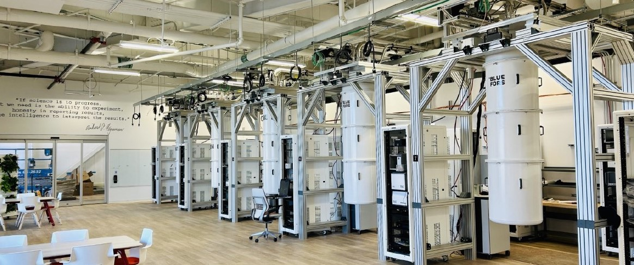
SQMS: First-Rate Infrastructure and Facilities
The Quantum Garage at SQMS (Fermilab), together with nanofabrication tools and material science capabilities, are among the largest and most advanced in the world to accelerate QIS research and innovation

Slide 9
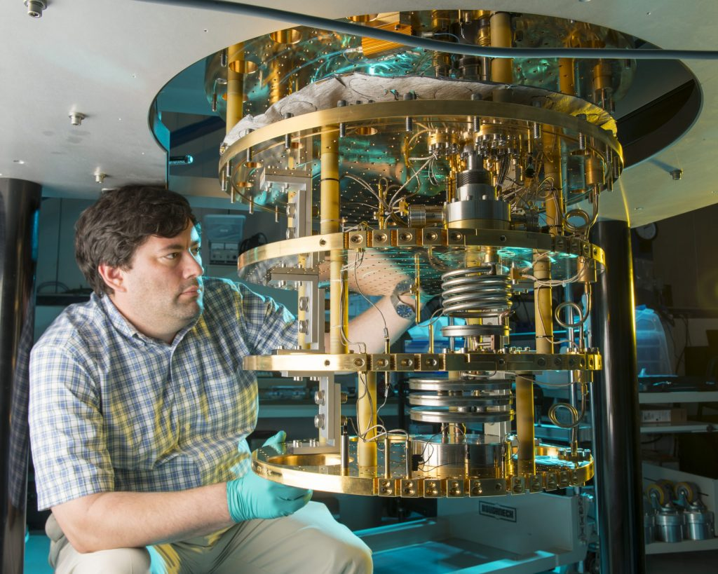
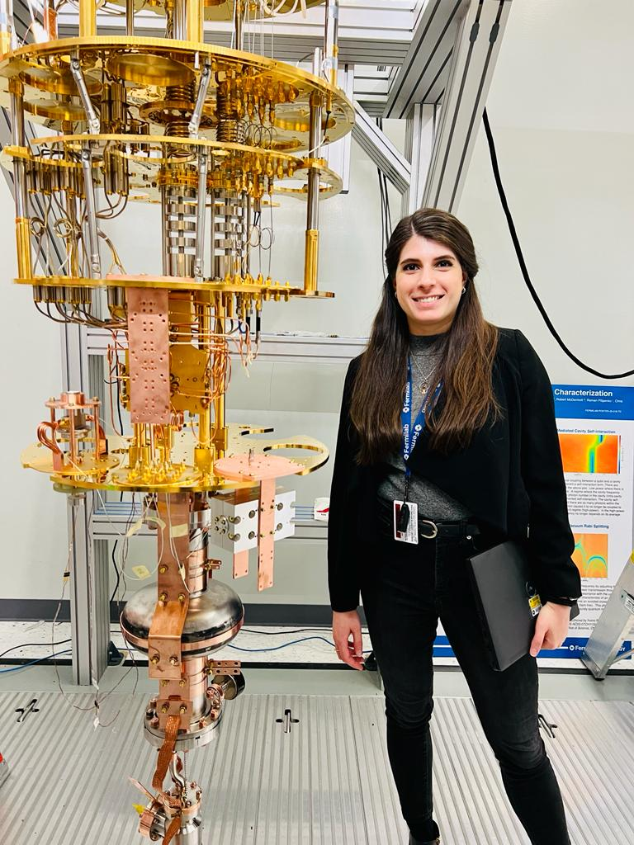
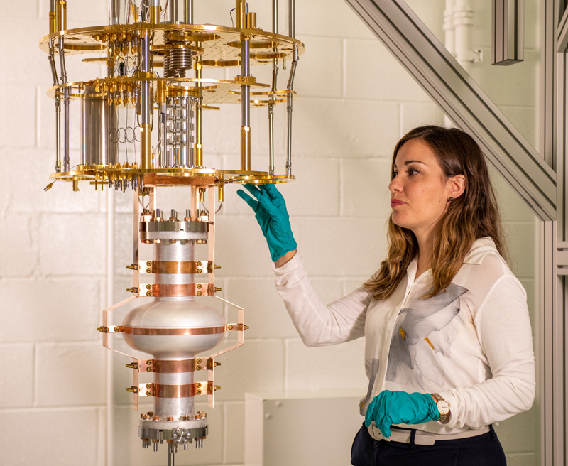
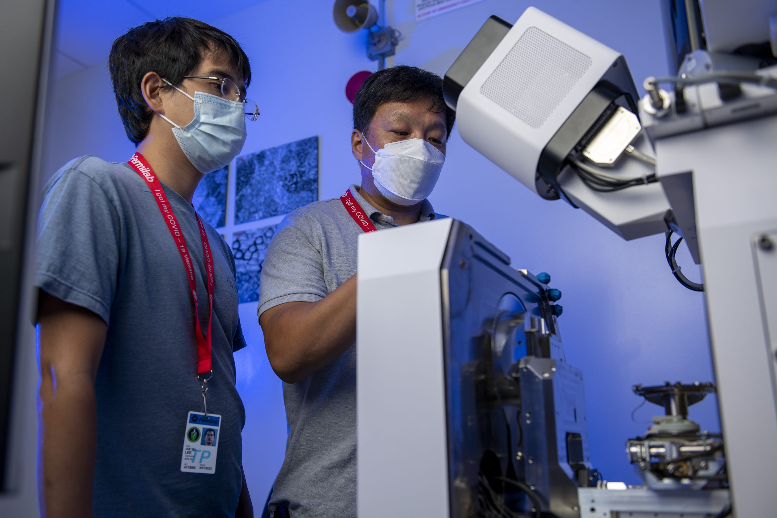
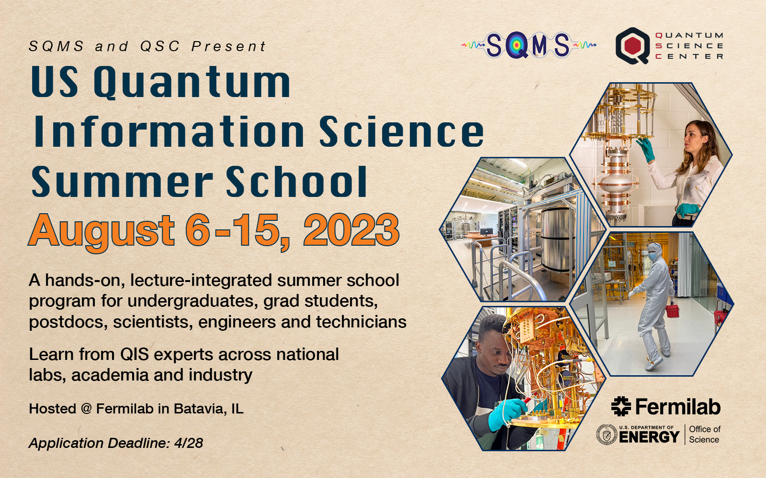
SQMS: Initiatives and Achievements
Key initiatives include
Develop and deploy the first quantum computer
  Enabled by SQMS team’s expertise in superconducting radiofrequency accelerator technology and cryogenics
Developing and deploying quantum sensors for fundamental physics and demonstrate qubits of record performance
  Realize pilot experiments to advance sensitivity of dark matter searches, precision experiments, & gravitational waves
Representative achievements include
Science: world’s most stringent limits on dark photon searches using high-Q SRF cavities (PRL 130, 261801, June 26, 2023)
Technology: first 9-qubits quantum processor installed and
to-be-operated at the SQMS laboratory
Active workforce development initiatives, including
          Largest U.S. summer school for QIS, hosted at SQMS Fermilab in August 2023
          40 instructors and top experts in QIS
          Educated 150 students and professionals through lectures & laboratory experience

Slide 10
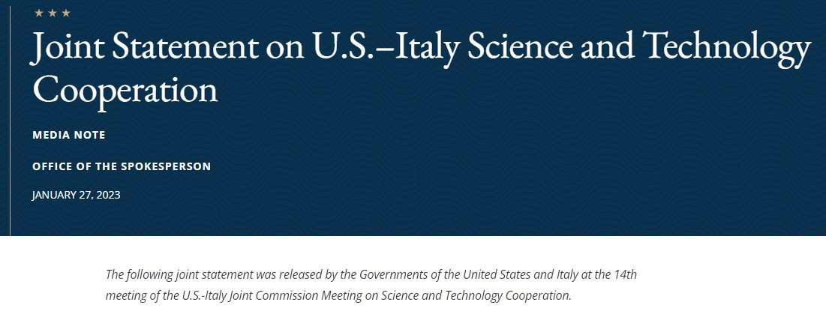


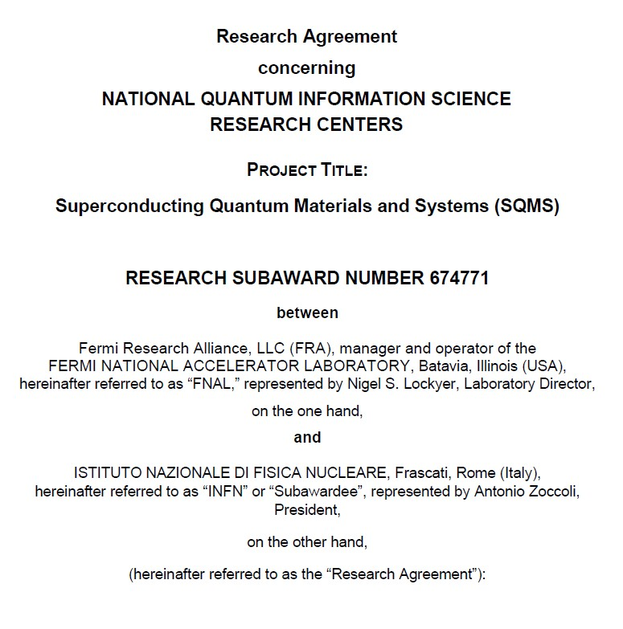
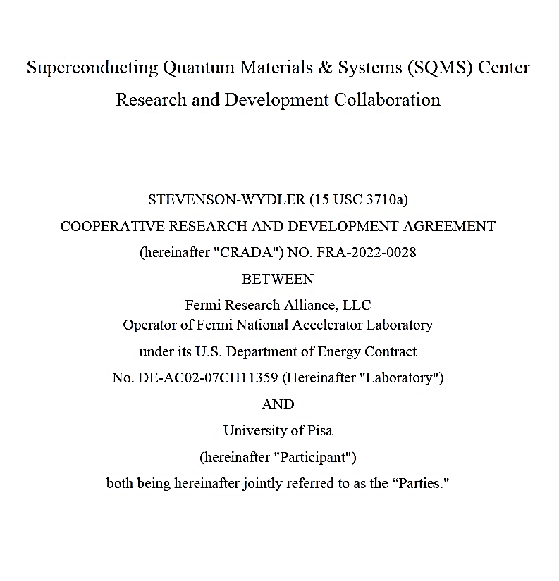
U.S.-Italy Cooperation in Quantum
Strong and long-standing partnership between Italy and the
United States in science & technology cooperation
U.S.-Italy Joint Commission Meeting (JCM) held in Rome in
January 2023 reaffirmed the continued cooperation in S&T, including in QIS research
Key partnership agreements collaboratively advance SQMS research
Research Agreement between Fermilab and INFN (Istituto Nazionale Di Fisica Nucleare), signed Feb. 4, 2021
  Expertise and critical contributions in underground quantum devices and materials testbed; dark sector particle searches testbeds; and in quantum workforce development initiatives
Cooperative Research and Development Agreement (CRADA) between Fermilab and the University of Pisa, to-be-signed very soon
  Expertise and critical contributions in quantum computing devices testbed; quantum devices for dark matter and gravitational waves searches; mechanical studies of SQMS’s large dilution refrigerator; and algorithms & simulation development
The following joint statement was released by the Governments of the United States and Italy at the 14th meeting
of the U.S.-Italy Joint Commission Meeting on Science and Technology Cooperation.
. . .
The JCM, launched 25 years ago, provides a regular opportunity to exchange views on some of the most
important science and technology endeavors in our countries and to prioritize future collaboration. This JCM convened representatives from government agencies and research institutions in Italy and the United States to discuss environmental and climate sciences; particle and nuclear physics and astrophysics; health
research; and emerging technologies. The two delegations agreed that science and technology cooperation
is inspired by democratic values, equity, fair competition, freedom of inquiry, openness, research integrity,
and transparency. Both sides endorsed continued research cooperation, including opportunities to enhance
collaboration in physics and astrophysics; Earth science, applications, and observations; health and life
sciences; climate change and mitigation; advanced materials; quantum information science; digital
transition and artificial intelligence; and energy transition.

Slide 11




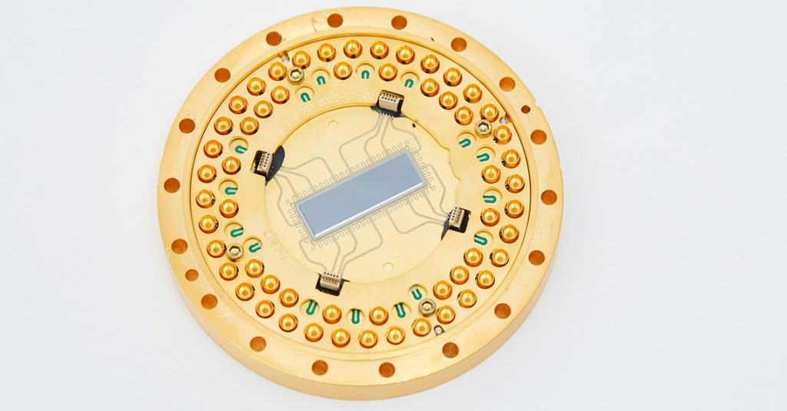
AT A GLANCE
RESEARCH
SPANS
30
ACADEMIC, NATIONAL LABORATORY, AND
INDUSTRIAL INSTITUTIONS
BUILT ON
PILLARS
3
DEMONSTRATION OF WORLD-RECORD ACCELERATOR CAVITY LIFETIMES IN THE QUANTUM REGIME
ABILITY TO SCALE UP TO LARGE & COMPLEX MACHINES
CONTINUE THE LEGACY OF ANSWERING FUNDAMENTAL QUESTIONS IN PHYSICS WHILE ADVANCING NEW TECHNOLOGIES
MORE THAN
450
COLLABORATORS ACROSS THE U.S.
AND AROUND THE GLOBE
173
NEW HIRES
(TO-DATE, CENTER-WIDE)
EXTERNAL STUDENTS
TRAINED THROUGH
SQMS SCHOOLS AND
INTERNSHIPS
SQMS
SUPERCONDUCTING QUANTUM
MATERIALS AND SYSTEMS CENTER
BY THE NUMBERS
MORE THAN
500
150
OVER
STUDENTS & POSTDOCS ADVANCING SQMS GOALS AND MISSION
100
OVER
200
COMPANIES
ENGAGED
WITH SQMS
(MEMBERS + VENDORS)
OVER
Hosted by DOE’s Fermi National Accelerator Laboratory, SQMS’s mission is to develop beyond-the-state-of-the-art quantum computers and sensors applying technologies developed for the world’s most advanced particle accelerators.
EXPERIMENTS OR INITIATIVES IN QUANTUM RESEARCH
160
PUBLICATIONS
(PEER-REVIEWED JOURNALS + ARXIV)
OVER
$125 million
>100,000
SQUARE FEET OF SQMS FACILITY & OFFICE SPACE IN USE
2 billion
U.S. FEDERAL
FUNDING FOR RESEARCH OVER
5-YEAR PERIOD
MEDIA IMPRESSIONS
TO-DATE
10
NEW FACILITIES / TESTBEDS UNDER DEVELOPMENT OR IN PROCUREMENT
JUST IN FY 2023, PUBLISHED
JOURNAL PAPERS
50

Slide 12
Summary Remarks
QIS Research Centers build on DOE’s long history of stewarding major science and technology initiatives – i.e., the National Nanotechnology Initiative; in Energy – e.g., Bioenergy Research Centers, Energy Frontier Research Centers; in Computing – e.g., Exascale Computing Project, …
Centers are an integral and leading part of the DOE Office of Science’s portfolio and embody a national imperative in terms of urgency, scale, and impact
SQMS has quickly become an internationally recognized world leader in QIS
Strong partnerships across many boundaries: agencies, international, industry, labs, and academia
Excellent progress and impact being made — including stimulating new initiatives as well as the large number of publications by SQMS collaborators — as attested by this year’s DOE Mid-Term Progress Review
DOE appreciates all your work, and I hope you have a pleasant and productive workshop

Slide 13


