Slide 1
X17 @ n_TOF
Riccardo mucciola

Slide 2
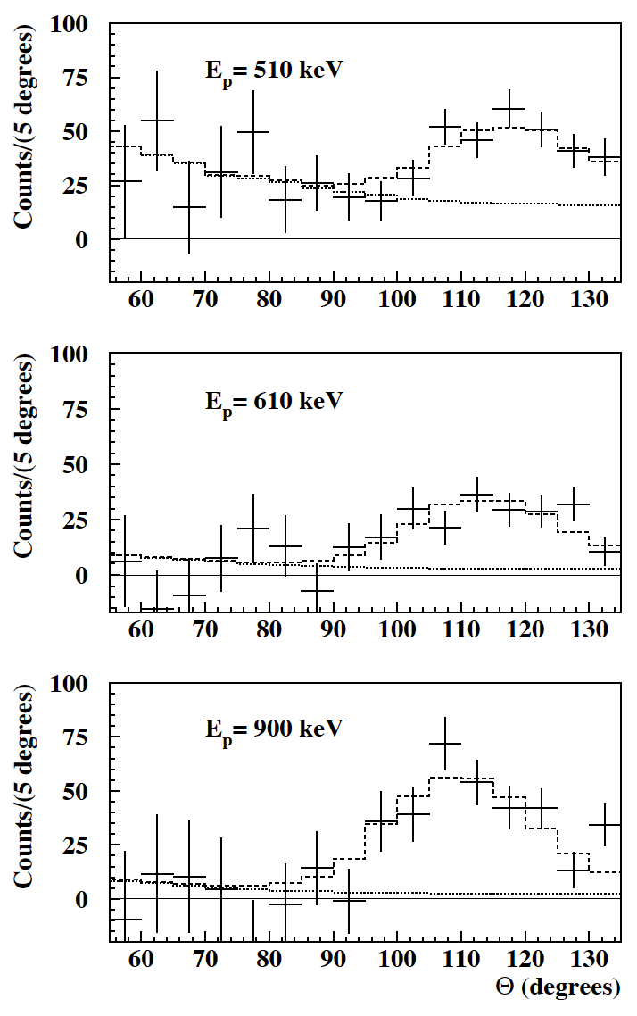
X17 ATOMKI results
A significant anomaly has been recently in the emission of electron-positron pairs in the ⁷Li(p,e⁺e⁻)⁸Be and ³H(p,e⁺e⁻)⁴He reactions:
Krasznahorkay, A.J.; et al.:
"Observation of Anomalous Internal Pair Creation in 8Be: A Possible Indication of a Light, Neutral Boson".
Physical Review Letters. 116 (42501): 042501 (2016).
Krasznahorkay, A.J.; et al.:
"A new anomaly observed in 4He supports the existence of the hypothetical X17 particle".
Physical Review C 104, 044003 (2021).
This anomaly has been interpreted as the signature of a BOSON (hereafter X17) not foreseen in the standard model of particle physics.
X17 boson could be a mediator of a fifth force, characterized by a strong coupling suppression of protons compared to neutrons.
This evidence/scenario is presently not confirmed or excluded by other experiments or groups.

Slide 3
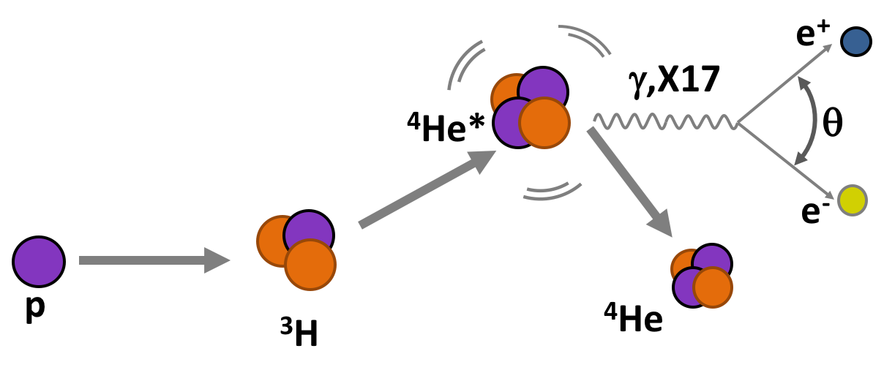
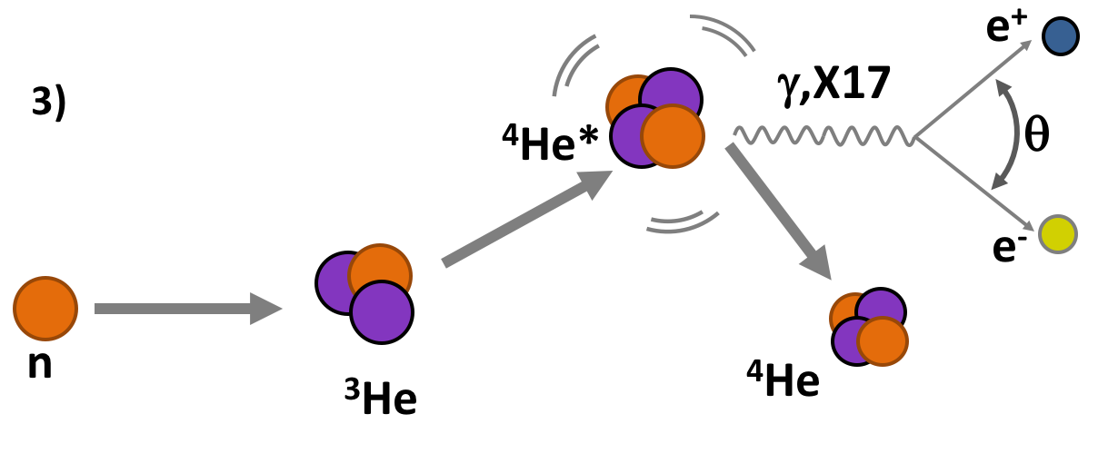
X17 @ n_TOF
Basic idea: new study of excited ⁴He exploiting the conjugated reactions:
³H(p,e⁺e⁻)⁴He
³He(n,e⁺e⁻)⁴He
OBJECTIVES:
Probing X17 existence
X17 Mass, quantic numbers, coupling, life-time, ..
Proto-phobic nature of the fifth force.
Data Vs Theoretical nuclear physics

Slide 4
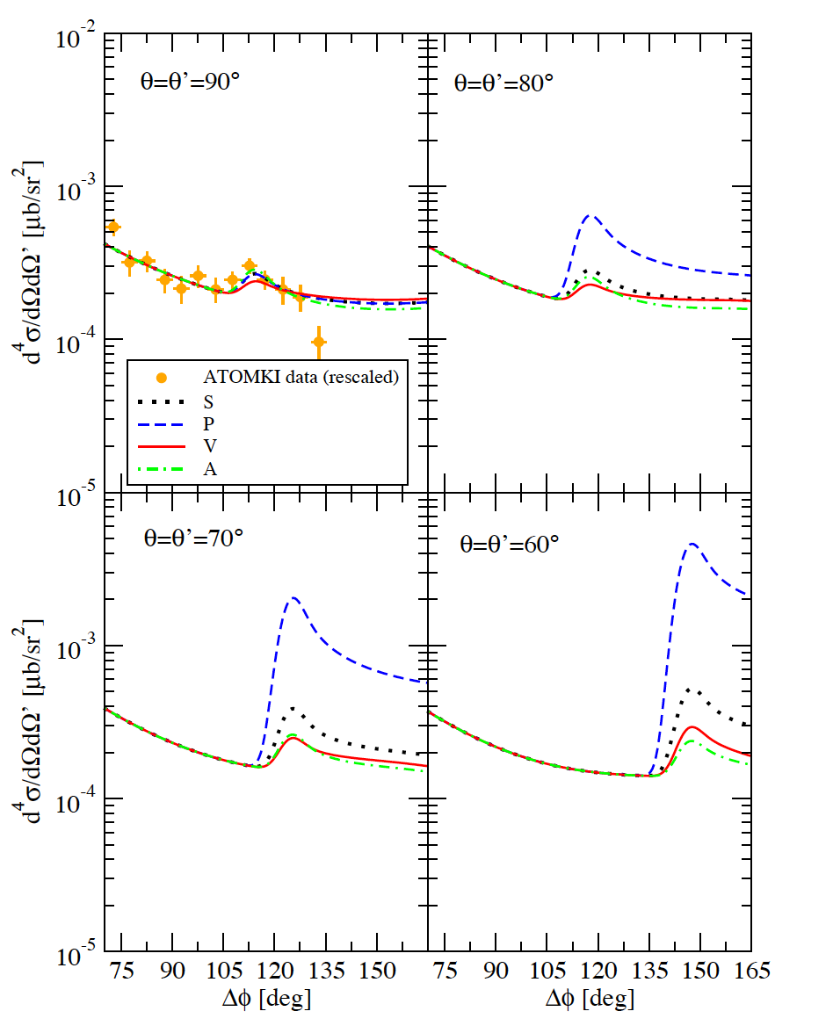
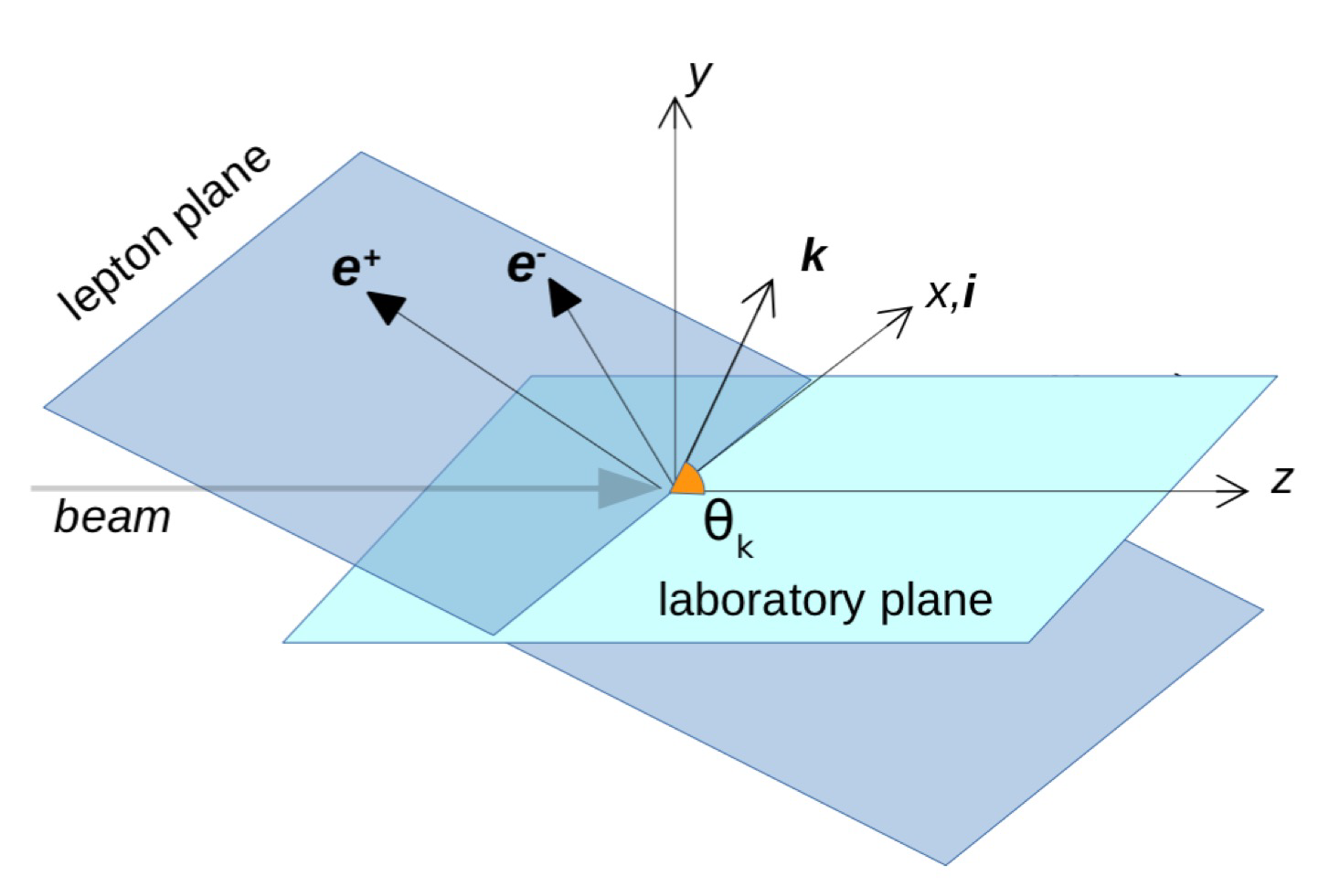
Theoretical calculations
M. Viviani et al.: PRC 105, 014001 (2022)
Theoretical calculations for kinematical signature for different X17 boson (scalar, pseudo-scalar, vector, axial).,
Calculation for different center-of-mass energies.

Slide 5
Theoretical calculations
M. Viviani et al.: PRC 105, 014001 (2022)
Theoretical calculations of expected counts at different lepton plane angles,
Calculation for different natures of the X17 boson (scalar, pseudo-scalar, vector, axial).
Wide energy range (protons and neutron beams) to explore all resonances with different J^{π}
Large detector acceptance for statistics and kinematics

Slide 6
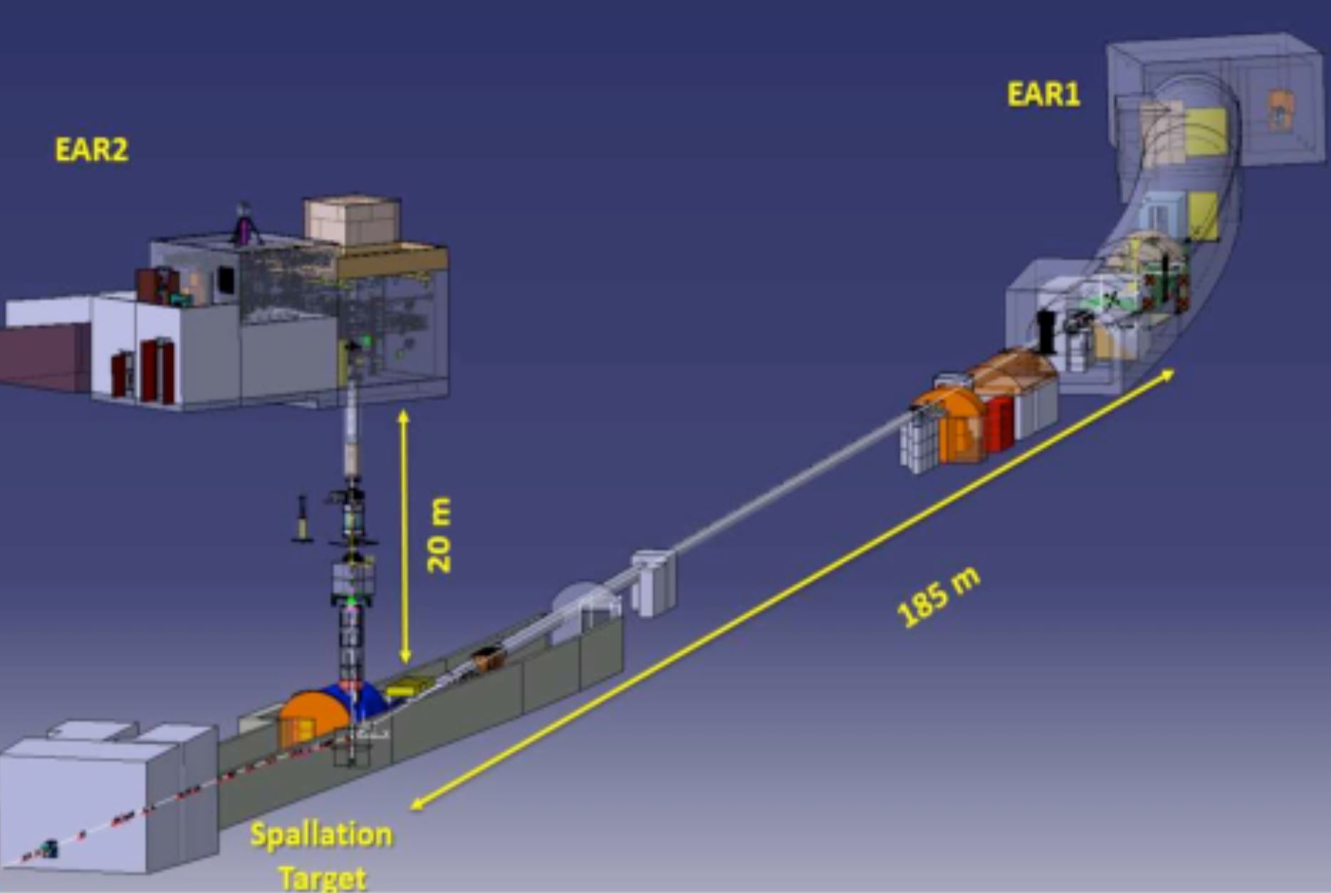
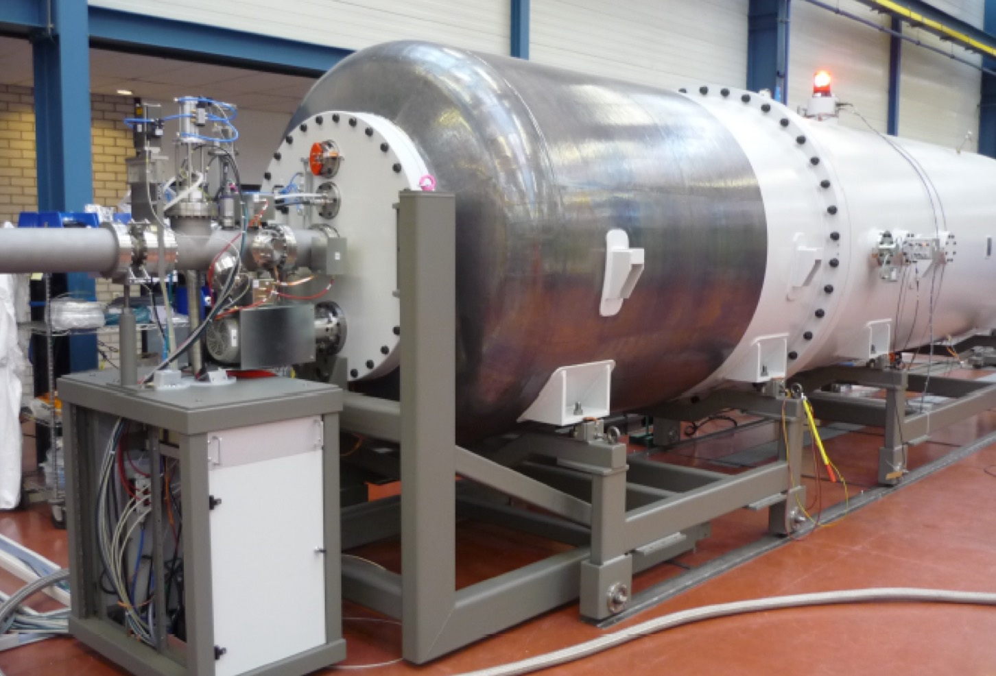
Facilities
n_ToF @ CERN: pulsed neutron beam in a wide energy range (thermal<En<100 MeV).
Time of flight to establish the single neutron energy (10-108 eV)
LUNA-MV @ LNGS: high intensity proton beam and low background
Terminal Voltage ~ 0.2 – 3.5 MV
I max ~ 100 μA of protons
Underground operation
³He(n,X17)⁴He
Measurements:
2022-24 (CERN LoI approved)
³H(p,X17)⁴He
Measurements:
2023-25 (LoI in preparation)

Slide 7
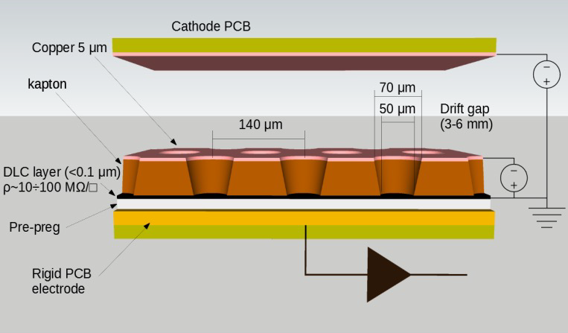
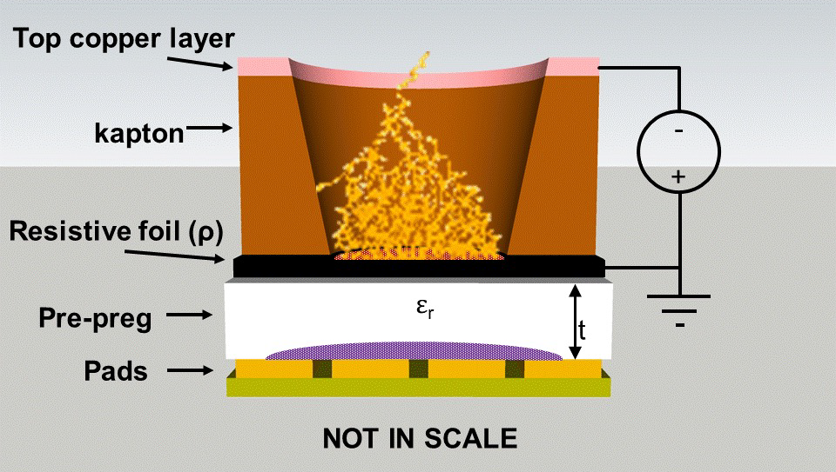
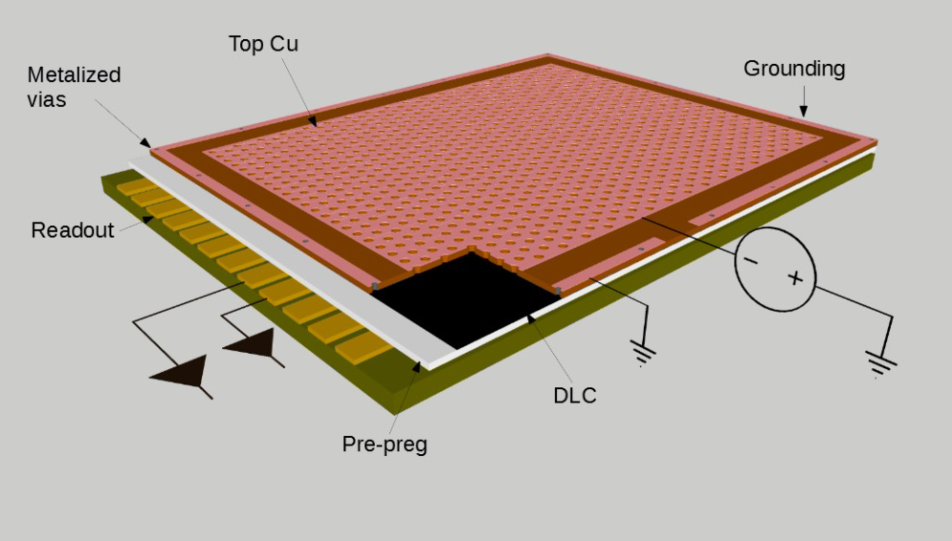
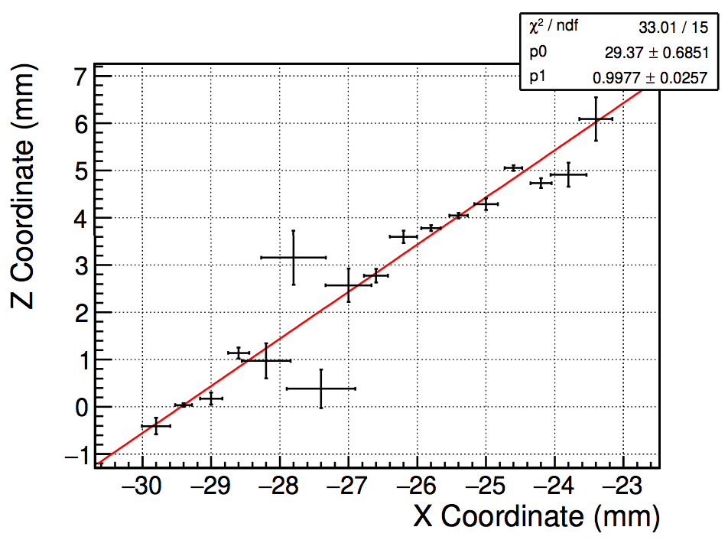
uRwell detector
uTPC with drift gap and uRwell
Active area of 38x46 cm2
Ar/CF4/CO2 (60:20:20) gas mixture
3D track reconstruction
Under construction at CERN

Slide 8
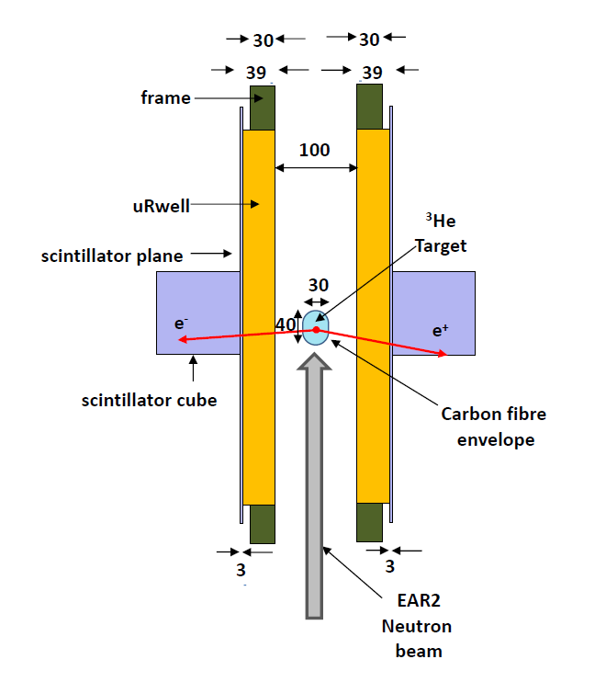
Demonstrator
Demonstrator funded by INFN
Two uRwell detectors and two scintillator cubes
Capsule holding ³He gas
Test at EAR2 @ n_TOF in 2023

Slide 9
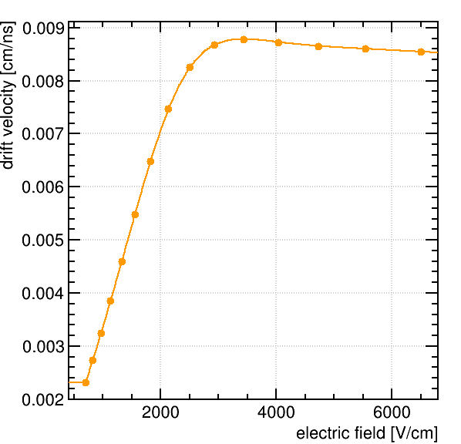
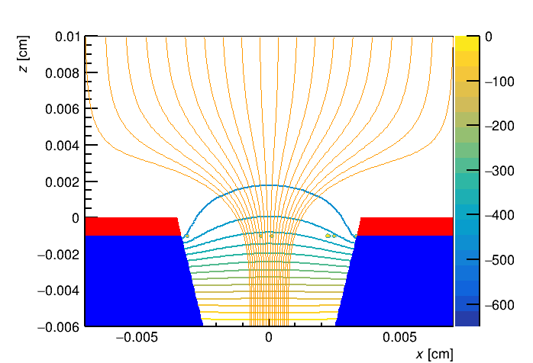
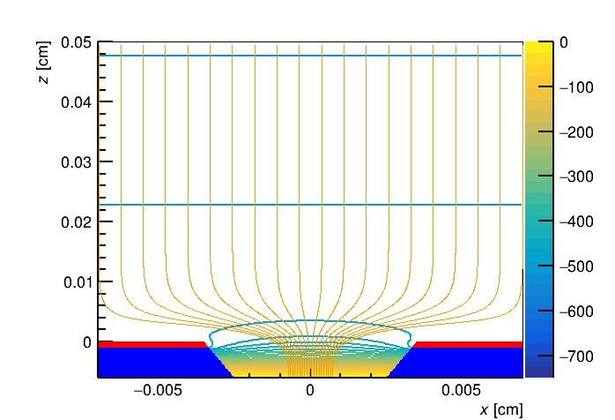
uRwell Simulations
GARFIELD simulations to study detector performances
Electric field and electrons drift velocities simulated
The track reconstruction in a magnetic field is being studied

Slide 10
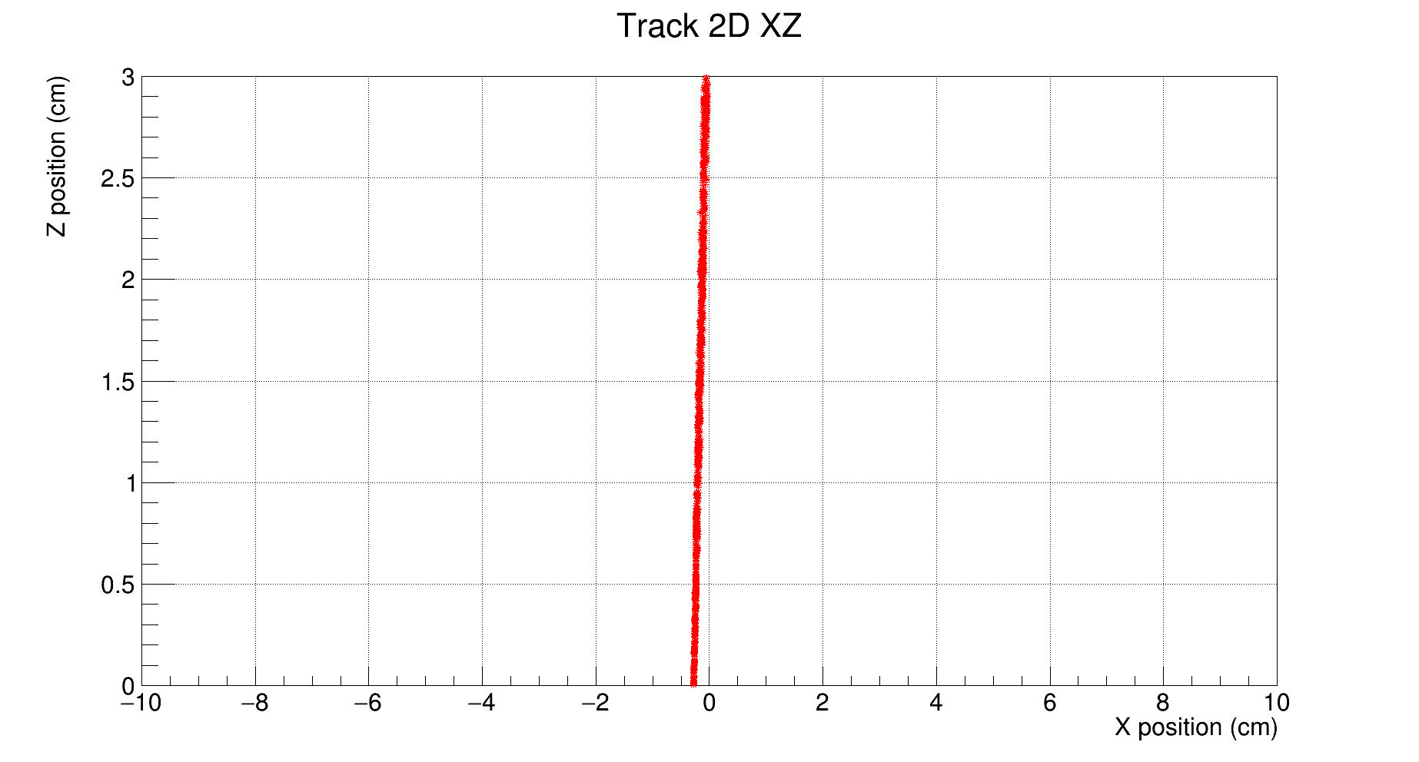
Garfield tracks
Tracks of different energies (2-18 MeV)
Magnetic field of 500 G
No visible curvature in the perpendicular plane

Slide 11
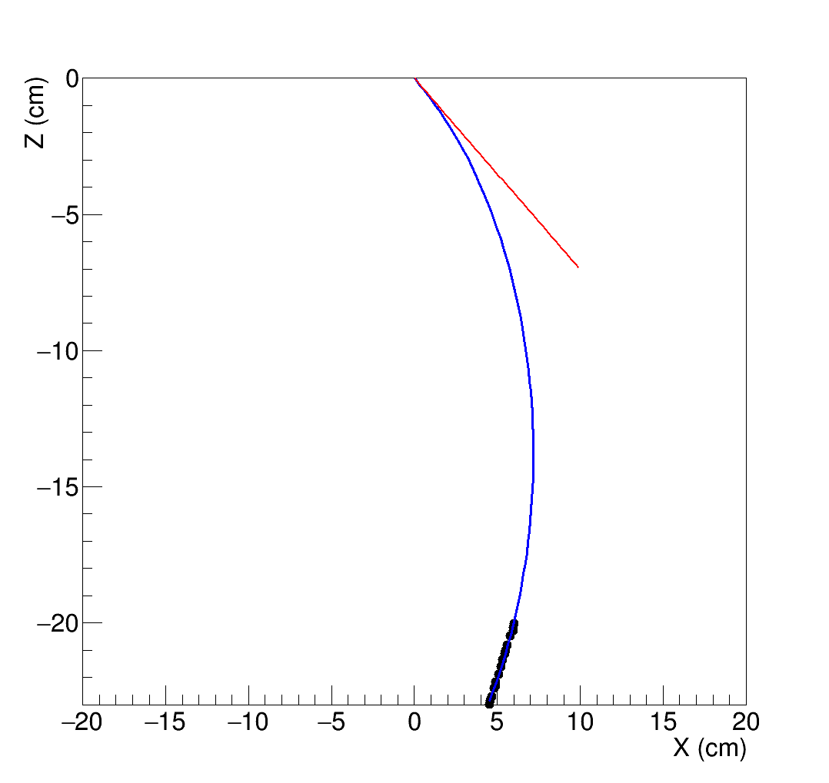
Energy reconstruction
Assume interaction vertex at the origin
Fit circumference arc using straight track and vertex
Tangent (red line) used for angle determination (see later)
PRELIMINARY

Slide 12
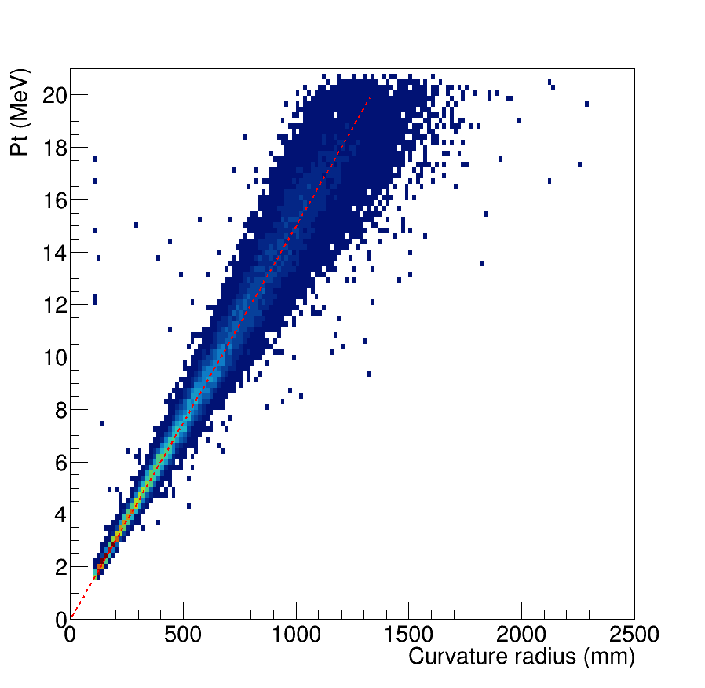
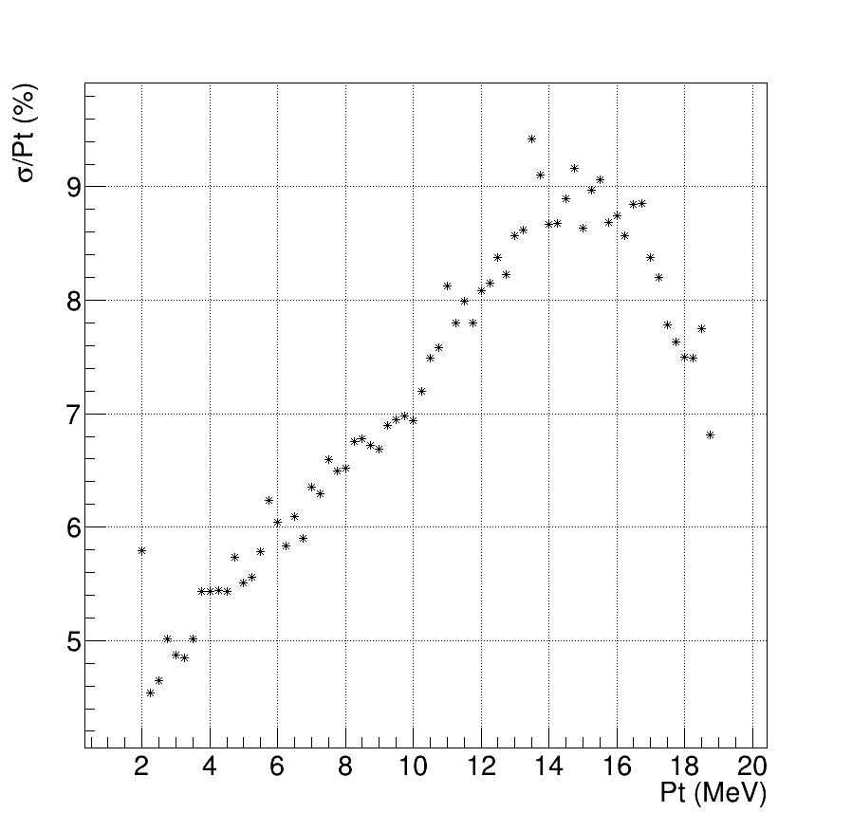
Energy reconstruction
PRELIMINARY

Slide 13
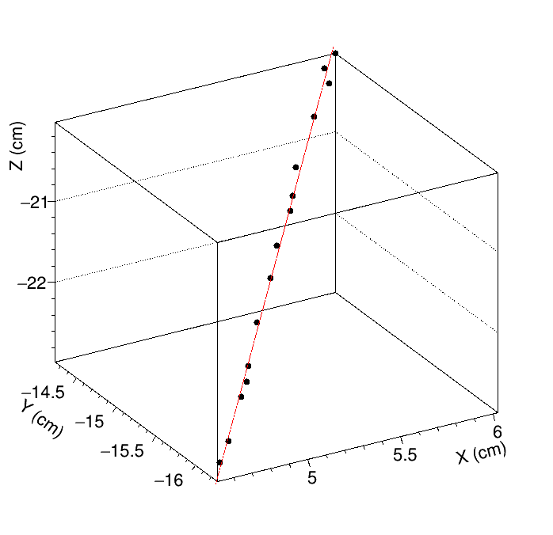
Emission Angle Reconstruction
Theta reconstructed using linear fit of the track
Phi reconstructed using tangent to circumference at emission vertex
PRELIMINARY

Slide 14
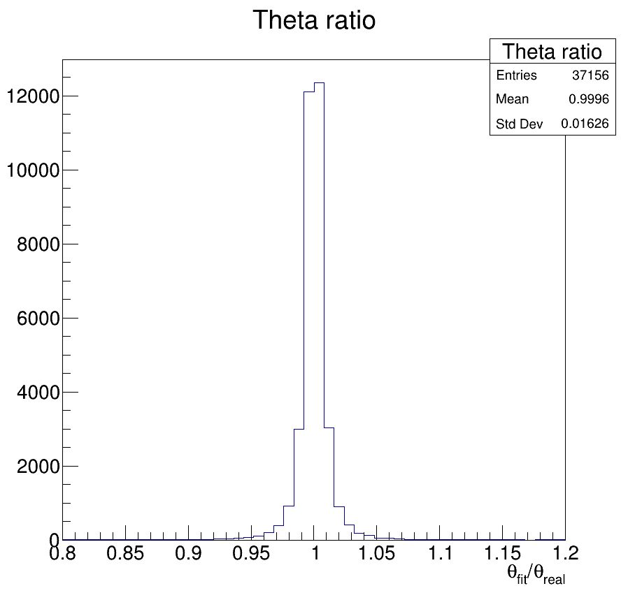
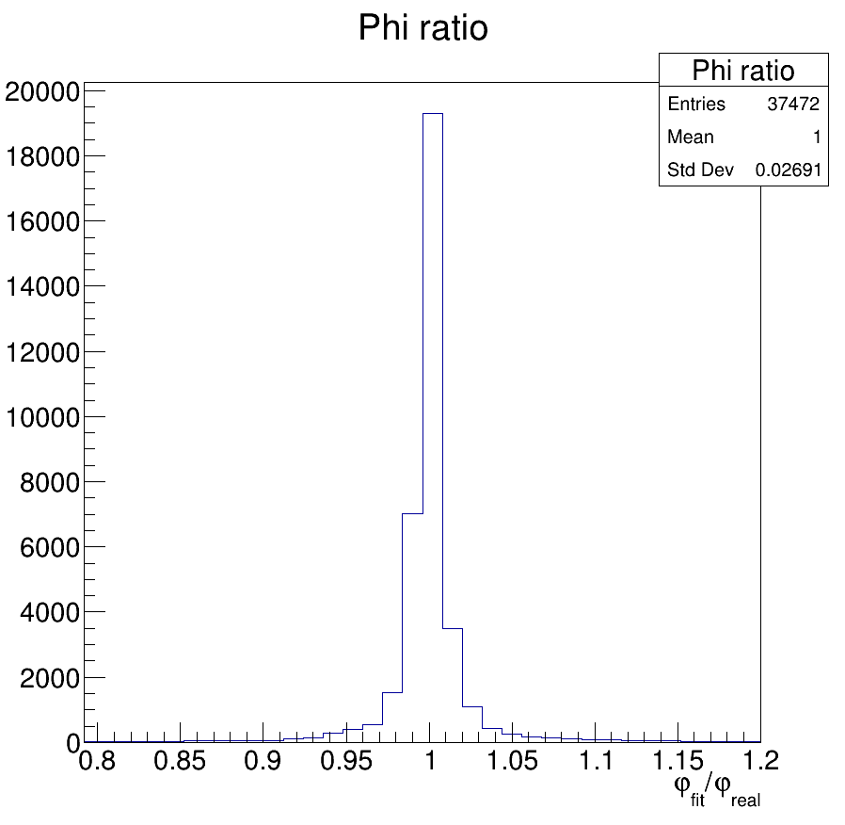
Angles Recontruction
PRELIMINARY

Slide 15
Conclusions
New detection setup for X17 based on uRwell to reach high angular acceptance,
Search of X17 mainly via ³He(n, e⁺e⁻)⁴He reaction,
Simulations to study the feasibility of measurements with magnetic field are ongoing.
Demonstrator will be tested at EAR2 @ n_TOF at the end of 2023,
Possible measurements with protons beam at other facilities (e.g., LUNA),
Physics program will start in 2024->2025.

Slide 16
The X17 Team
E. Cisbani (ISS ROMA)
N. Colonna (INFN BARI)
G. De Angelis (ISS ROMA)
M. D'incecco (LNGS)
G. Gervino (UNITO)
C. Gustavino (INFN ROMA)
C. Massimi (UNIBO)
P. Mastinu (INFN LNL)
B. A. Mohammadzadhe (INFN ROMA)
A. Mengoni (ENEA BO)
R. Mucciola (UNITO)
C. Petrone (IFIN-HH)
F. Santavenere (ISS ROMA)
M. Viviani (INFN PISA)
And others...
Thank you
for your attention!

Slide 17
Backup

Slide 18
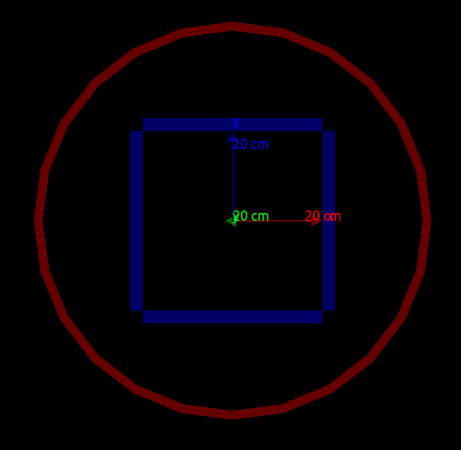
Geant4 setup
Simulations performed with Geant4 to study high number of events:
2/4 uRwell detectors,
20 cm from beam,
Magnetic field of max 500 G parallel to beam direction.

Slide 19
Simulations
SIMULATION:
SETUP with all used materials
Realistic n_TOF beam
IPC/X17 events rate (normalized to ATOMKI data)
OUTPUT:
Acceptance/efficiency/MS
Signal/Noise
Detector performance
e+e- ID and 4-momenta
X17 invariant mass

