Slide 1

IBL
ATLAS Italia / Referee
CERN, March 2nd 2010
G. Darbo – C. Meroni
INFN / GE – MI
Agenda:
http://agenda.infn.it/conferenceDisplay.py?confId=3428

Slide 2
Outline
piani aggiornati IBL e loro approvazione da LHCC
implicazioni della nuova schedula sui programmi IBL italiani
modifica piano finanziario ed eventuali richieste urgenti alla CSN1

Slide 3
IBL Speed-up
Background
  FE-I4 success push up optimism:
    Quick move from R&D and prototyping phase to pre-production.
  LHC shutdown schedule:
    If we cannot make for 2013 is it still interest to have IBL in 2017, 2018?
  nSQP project
    If Pixel detector is taken to surface IBL installation is simplified.
IBL community promptly reacted and made aggressive 2013 IBL installation schedule:
  Almost 2 years shorter than in TDR, no no explicit contingency in the schedule
  Some technology critical solutions need to be proven quickly
Pixel Extended IB (IBL) endorsed the challenge of the new schedule
  IB is aware of the risks that any major technical delays can become a show stopper
  IB encourage the whole IBL community to focus strongly to the project with the support of all ATLAS.
  Go to definite MoU after June sensor review. Distribute to FA’s in summer.
Project presented to LHCC in Sept.2010, answer to referee Dec.2010.
  Expected approval soon (no news, ATLAS management triggered for an answer).

Slide 4
TDR / Speedup Schedules
Speed up schedule
  Very aggressive in module – stave line
    fast exit from prototyping to pre- and production
  Success of FE-I4 pushes for minimum changes for final version (9/6/2011)
  Sensor pre-production of conservative and innovative designs started before decision and qualification of prototypes (Planar n-on-n and 3D).
    Sensor review and decision mid June 2011.
  Working on other speed ups
  No contingency built in

Slide 5
IBL plan for 2013 : Key milestones
Milestone | Date
Sensor & FEI4 : | FEI 4 V2 submission in June
Preproduction sensors at IZM / Review Production batch 1 sensors (equivalent to installed) Production batch 2 sensors (spare for total of >2x installed) | Sept 21, 2011 / June 2011 Nov 16, 2011 April 6, 2012
Modules | Thin modules until July
First module ready for loading 270 DC/540 SC modules completed All modules completed (including spares) | Jan 30, 2012 June 28, 2012 Oct 4, 2012
Staves | Flex until June & “Stave 0” until Oct
First production flex batch available First 5 staves completed All bare staves + flex completed and qualified | Dec 2, 2011 April 20, 2012 July 2, 2012
All staves (14 BL quality + spares) loaded and qualified | Nov 26, 2012
Integration
Beam pipe received Integration staves to beam pipe completed in SR1 Final IBL surface tests completed and ready for installation | August, 2012 April 30, 2013 July 1, 2013
Key to start first IBL final modules
Key to have production modules in time
Important for X0!
Delays with this will delay the stave completion
Demonstrate that staves fully work
Have all staves in hand when we start intervention
Install!

Slide 6
ATLAS EB Support it, but keep Performance
Speed up presented to ATLAS EB (25/2/2011)
  ATLAS EB supports it. It will be presented to ATLAS Week and CB next Friday.
Speed up, but not sacrifice detector performance.
  Maintain TDR requirements
    Material budget < 1.54 % of X₀ → Action: has put in place an “X₀” task force
      Critical: Module thinning qualification and aluminium Flex Hibrid
    Geometrical acceptance in Z > 97.4%
    …
  Remember that IBL will stay till HL-LHC (2021…)
    Integrated luminosity: 330 fb⁻¹ (it will be more than before)
    NIEL dose: 5x10¹⁵ n_{eq}/cm², TID: 250 Mrad
    Peak luminosity: 2.2 x 10³⁴ cm²s⁻¹
Work on speedup schedule, but have checkpoints (end of 2011, …):
  Verify that IBL performance and physics reach are better with IBL than without:
    2014 ÷ 2017 and 2018 ÷ … running periods.
  Watch status of milestones, specially on module and stave advancement
  Check if keeping schedule compromise performance.

Slide 7
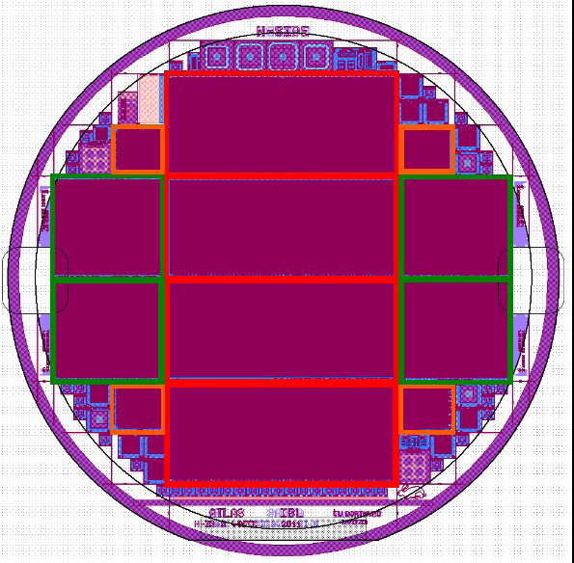
Sensor Pre-production
Sensor pre-production
  CNM (3D): started first batch – processing 36 w,
  delivery 30/10/2011,
    second batch will start 4 weeks after the first one
    we can buy if we want).
    Masks same as prototype.
  FBK (3D): started first batch. Second batch is starting
  (we can buy if we want).
    Delivery of both batches end of June.
    Mask also the same as prototype and same wafer
    floorplan as CNM.
  CiS (Planar): mask layout finalizing.
    Thinning started (4-6 w), processing of wafers
    (16-18 w) will start (15/3/11) and pre-prd completed
    31/7/11.
Production
  For planar can be finished by the end of this year if
  started by summer
  For 3D, depend on yield (number of batches) –
  In discussion with CNM and FBK production plans
  meeting schedule. Constraints are 36 w (CNM)/
  20 w (FBK)
FEI4

Slide 8
Resources for Speed-up (M&O-B/Project)
Resource planning
Spending profile: 1MCH more in 2011.
  Cash flow buffered by ATLAS
Resources at Institute level:
  Cash flow for local orders
  Manpower re-planning
Large common orders timeline
  Sensor Pre-production – 28/2/2011 (240 kCH)
  FE-I4 – 15/5/2011 (600 kCH)
  Sensor production – 30/6/2011 (>250 kCH)
  Bump-bonding (30/9/2011) (>500÷650 kCH, need to know)
1.05 MCH

Slide 9
Impact on INFN Funding profile
Common orders
Note: the Sensor pre-production (36k€) is urgent for paying the contract with FBK (already started the work)
Local procurements:
  Discussion started on Italian responsibilities: manpower + fund profile
    Need to see what we need with urgency (spring)
  INFN committed to:
    Bump-bonding qualification (MI/GE) -> urgent
    Sensors (UD)
    Stave mechanics (MI)
    PP2 (MI) -> cost increase
    Flex & Module production (GE) -> criticality in the flex, aggressive schedule for modules
    ROD (BO/GE) -> increase manpower
    Power supply procurement

