Slide 1
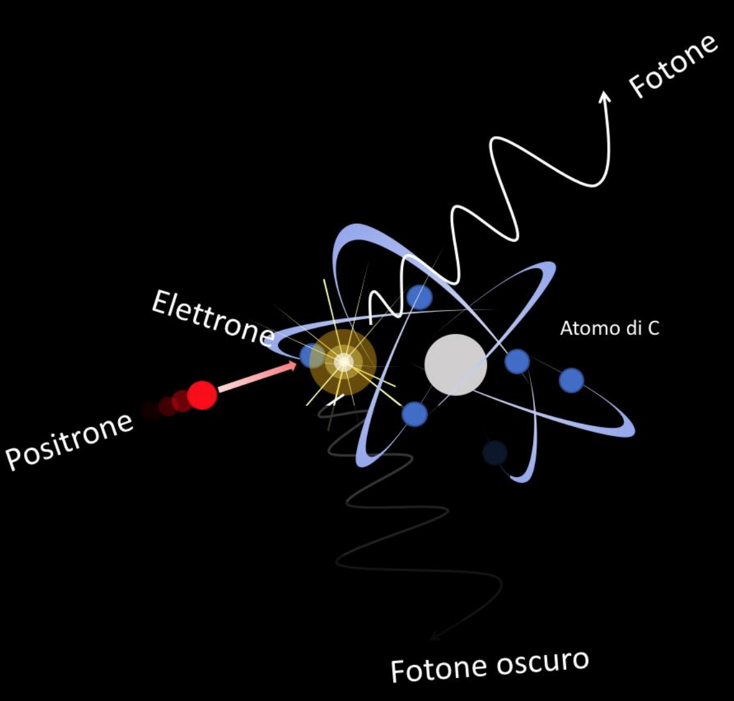
PADME run III physics goals
Mauro Raggi, Sapienza Università di Roma e INFN Roma

Slide 2
Outline
Vector and scalar cases for the X17 scenario
Vector e⁺e⁻ −> e⁺e⁻
PseudoScalar e⁺e⁻ −> γγ
Vector and scalar cases for <17 MeV mass FIP particles.
Can we use the total sample in a combined way?
the case for e⁺e⁻ −> γV->γe⁺e⁻
the case for e⁺e⁻ −> γS->γγγ
Multi lepton cases : e⁺e⁻ −> e⁺e⁻e⁺e⁻
Do we have big enough production rates?
Do we have acceptance? what kind of DS intermediate states?
Background free X₁₇ searches at sqrt(s)= 2*M_{X17}?

Slide 3
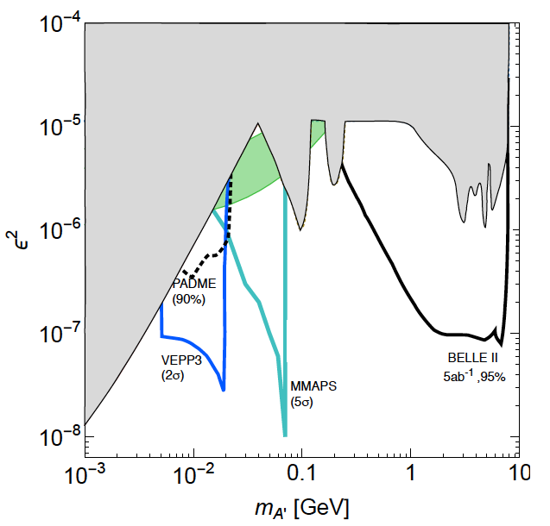
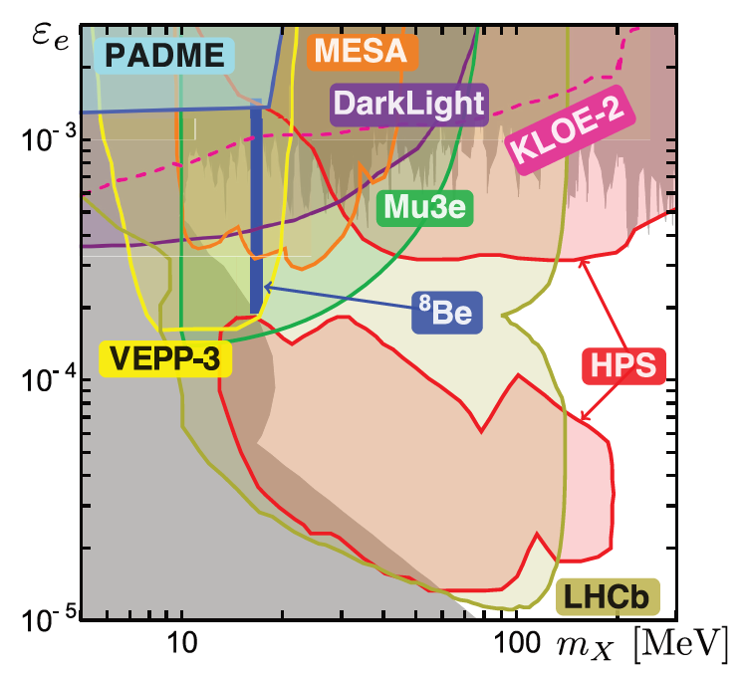
Dark sectors candidates at PADME
Dark Photon A’ arXiv:1608.08632v1
Axion Like Particles JHEP07(2018)092
BE anomaly- X boson PHYS.REV.D 95, 035017 (2017)
e⁺e⁻→γA’ e⁺e⁻→γa
Invisible decays:
A’→χχ, a→χχ
e⁺e⁻→γA’ e⁺e⁻→γa ALPs final states: a → γγ, ee, χχ
e⁺e⁻→X₁₇ → e⁺e⁻
Final state X₁₇→ee
Dark higgs: e⁺e⁻→h’A’ dark higgs decay: h’→A’A’, A’→ee,χχ
Final State: A’A’A’ → e⁺e⁻ e⁺e⁻ e⁺e⁻

Slide 4
PADME total collected data sample
Data collected at different energies from 260MeV to >300
gran total close to 5E11 POT
can we use this as a single big sample in the associated production production?
Some special runs at 400 MeV
can be used for cross section measurements?

Slide 5
Producing A’ with positrons
With e⁺ beams 3 production mechanisms allowed:
A-strahlung same as electrons O(α³) :
Two additional production mechanisms in e⁺ beams
b) Associate annihilation production O(α²)
c) Resonant annihilation production O(α)
Positron beams

Slide 6
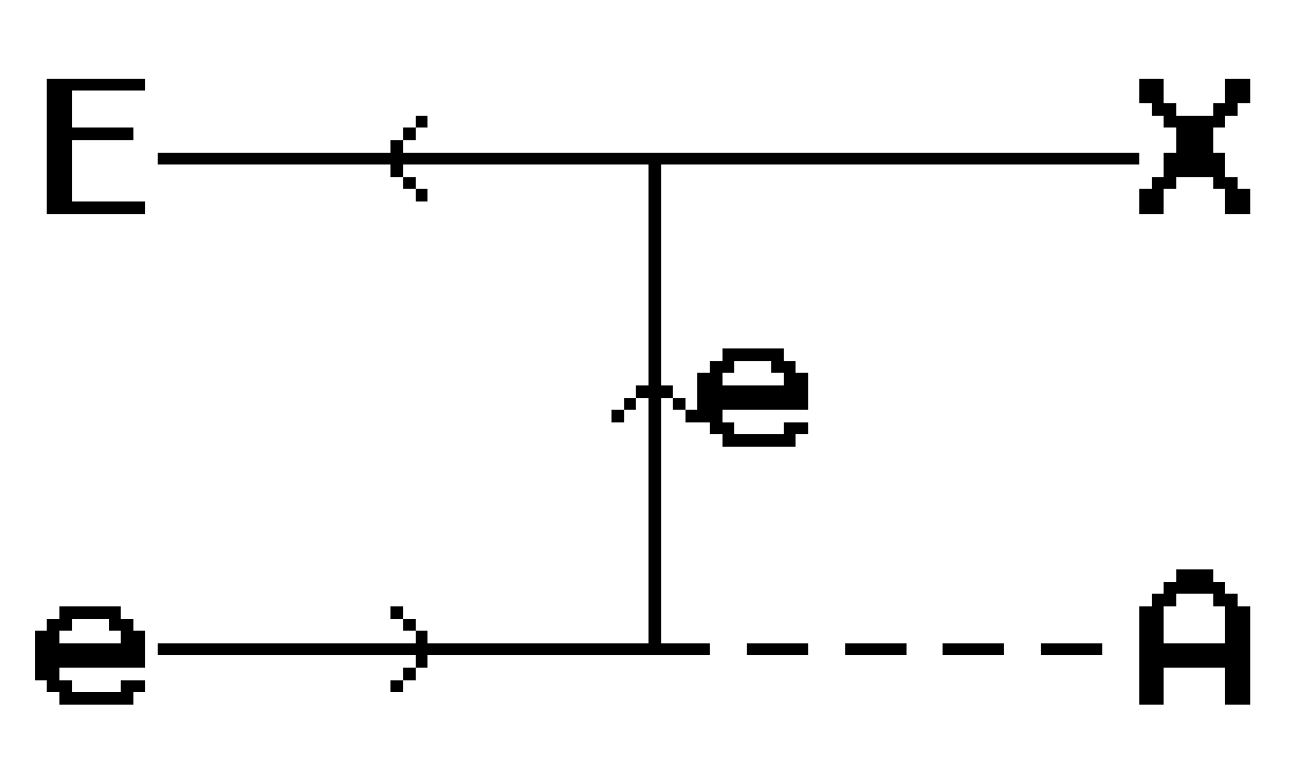
ALPs production at PADME
Coupling to photon only
ALPs production via ALPs-strahlung
ALPs production via γγ fusion
Coupling to electron only

Slide 7
A’ visible decays: A’→e⁺e⁻ a→e⁺e⁻
Production process | Name | a^{X} | Fin. state | Detectors | Main BG | Sens. Est.
1.e⁺N→e⁺NA’→e⁺Ne⁺e⁻ | A’-stra. | 3 | e⁺e⁺e⁻ | Ecal+ETag | PileUp+Trident | None
2.e⁺e⁻→γA’→γe⁺e⁻ | ass.an | 2 | γe⁺e⁻ | Ecal+ETag | Rad-BhaBha | None
3.e⁺e⁻→A’→e⁺e⁻ | Res.an | 1 | e⁺e⁻ | Ecal+ETag | BhaBha | X17
A-stra.: Production cross section high, but very high background from QED
Can measure e⁺e⁻ invariant mass distribution.
Need to study tagging efficiency at 3 clusters and combinatory BG
In principle masses up to >100 MeV are accessible
2γ-annihilation: lower cross section but can use Ecal to measure A’ mass.
Strong BG suppression comparing missing mass of recoil γ and ee mass
Helps in rejecting radiative BhaBha, γ−conversion and trident BG.
Mass reach limited to <17 MeV in Run III
Resonant Annihilation: golden mode for sqrt(s)=17 MeV
Sensitivity very good see L. Darme’ et al. Phys. Rev. D 106, 115036

Slide 8
Invisible decays: A’→χχ a→χχ
Production process | Name | α^{X} | Fin. state | Detectors | Main BG | Sensitivity
e⁺N→e⁺NA’→e⁺Nχχ | A’-stra. | 3 | e⁺+E_{miss} | Veto+Ecal | Brem+missing γ | Need 1e
e⁺e⁻→γA’→γχχ | 2γ-ann | 2 | γ+E_{miss} | Veto+Ecal | Brem, ee→γγ | 2014
e⁺e⁻→A’→χχ | Res.an | 1 | Nothing | Veto+Ecal | None | Needs 1e
A-stra.: impossible in the present configuration of the experiment
Single Positron rate in the experiment too high
May be interesting in single e⁺ mode but ε² already covered by NA64
In principle masses up to >100 MeV are accessible
2γ-annihilation: main goal of the experiment Run II
Bump hunt possible by computing missing mass to the recoil γ
Background from Brems+missing e+ and ee→γγ(γ) + missing γ
Mass reach limited to 17 MeV for Run III Statistics just 10 lower wrt Run II but much lower BG?
Resonant Annihilation: very high cross section but a very narrow mass region
Impossible except in single particle mode.

Slide 9
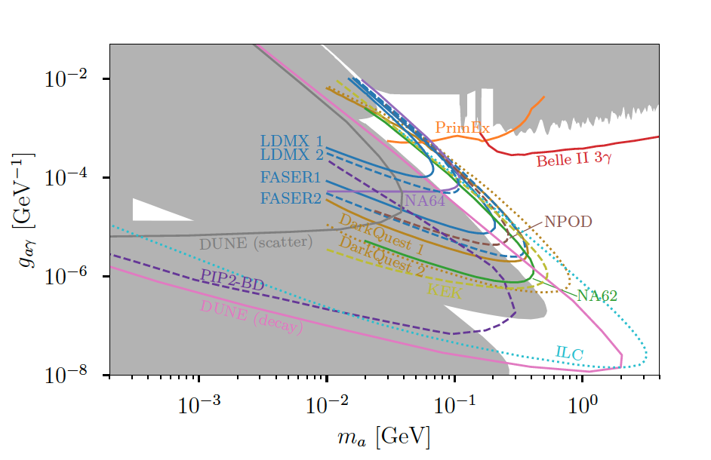
ALPs decays to photon
Revised constraints and Belle II sensitivity for visible and invisible axion-like particles
J. Dolan, T. Ferber, C. Hearty, F. Kahlhoefer
2017
2020
JHEP12(2017)094
Exploring Dark Sector Portals with High Intensity Experiments arXiv:2207.06905v3
B. Batell, N. Blinov, C. Hearty, R. McGehee
Process | Name | a^{X} | Fin. state | Detectors | Main backgr. | Sensitivity
1.e⁺N→e⁺Na→e⁺Nγγ | a-stra. | 3 | e⁺γγ | Ecal+Veto | ee->2γ +PileUp | None
2.e⁺e⁻→γa→γγγ | 2γ-ann | 2 | γγγ | Ecal only | ee->3γ | None
3.e⁺e⁻→a→γγ | Res.an | 1 | e⁺e⁻ | Ecal | ee->2γ | X17
e⁺e⁻→γa→γγγ: can we access the gap in the circle by using both Run II and Run III data
LEP exclusion revision is a the key issue to be addressed.

Slide 10
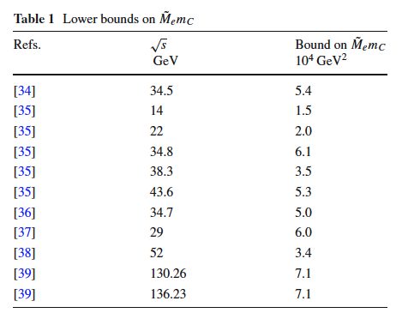
Bhabha cross sections
LEP measurements are extremely precise but at sqrt(s)~100GeV
At Lower CM energies we have many determination of the differential CS
Tristan 57 GeV
Pluto @ PETRA 34.7 GeV (differential 2.6% error)
Tasso PLUTO JADE and MARK-J @Petra sqrt(s) 12-47 GeV
ADONE 1971 (1.4-2.4 GeV ~5% precision)
At extremely low energy Askin et. al 1953 ee->ee @1-1.6MeV (prec 10%)
It was used to constrain deviations from QED (aka QED cut-off parameter)
Nothing below 1 GeV to my knowledge
Eur. Phys. J. C (2021) 81:1115

Slide 11
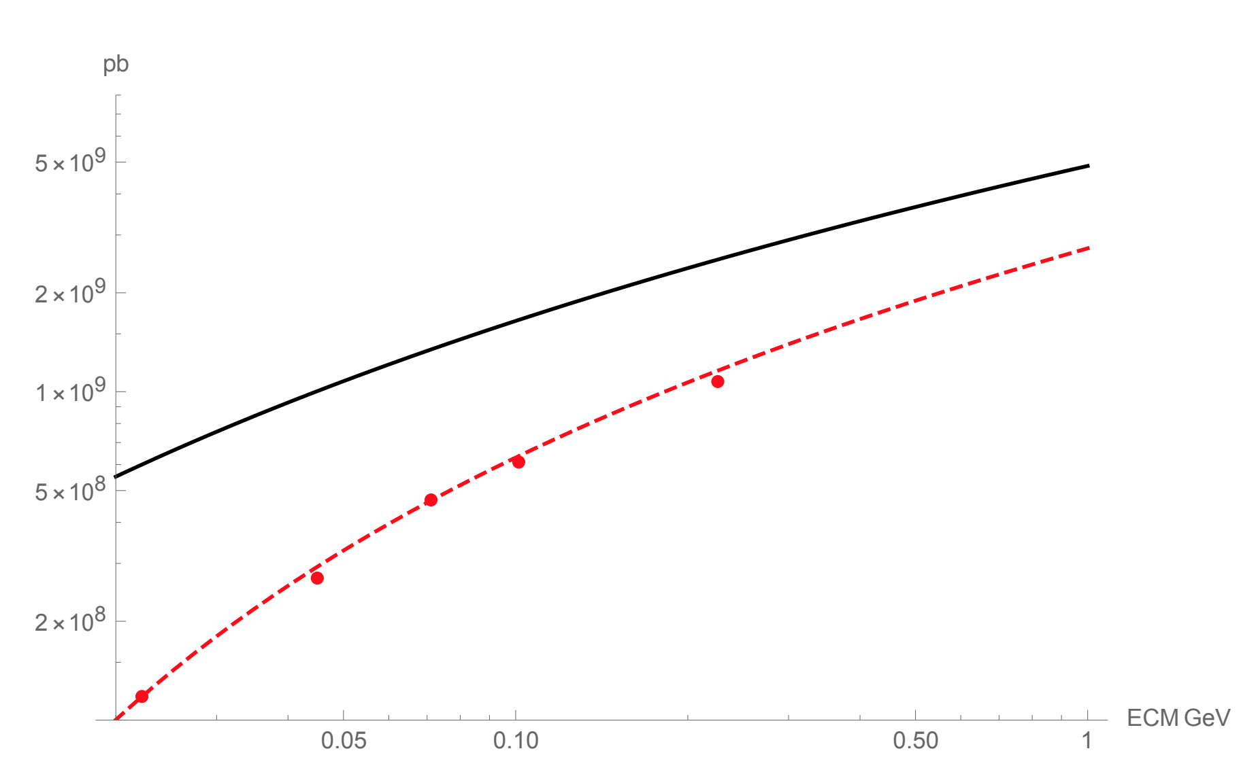
4 leptons cross section measurement
SM process e⁺e⁻ ->2(e⁺e⁻) never measured in SM
Cross section is sizable and not very well known
Few 10⁸ pb
We expect hundreds of events in PADME RUN III
Acceptance is an issue if need to reconstruct 4 leptons.
Is the measurement possible at PADME?
Are there interesting DS ehancements?
https://link.springer.com/article/10.1007/JHEP04(2021)163

Slide 12
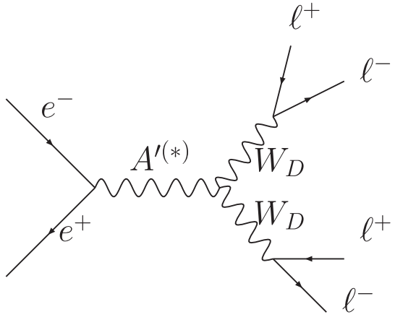
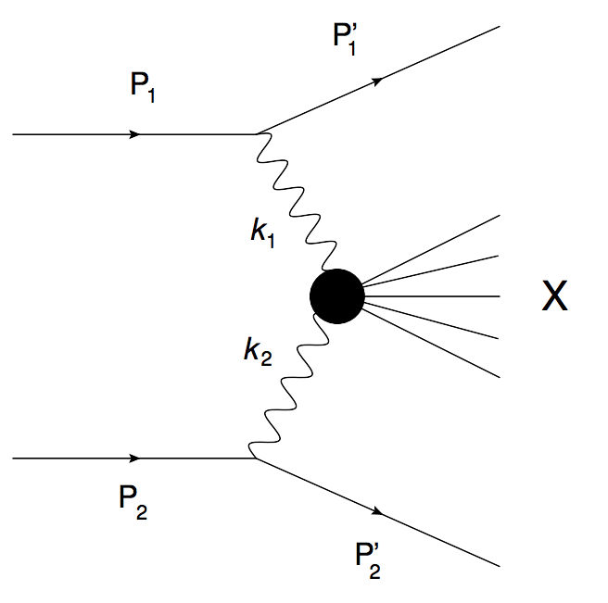
Multi leptons dark modes?
Higgsed dark sector with dark bosons W_{D} coupled to leptons
Probing dark forces and light hidden sectors at low-energy e⁺e⁻ colliders R. Essig, P. Schuster, and N.Toro PRD 80, 015003 (2009)
Can the X in the SM diagram be exchanged with a DS particle ALPs?
a?

Slide 13
Conclusions
PADME main goal in Run III is to test X17 vector hypothesis
see L. Darme’ talk for details
There are few more interesting dark sector observables
ALPs with pure photon coupling
ALPs with photon and electrons coupling
We can also perform the best measurement of CS of different processes:
e⁺e⁻ -> γγ better luminosity measurement wrt Run II measurement
e⁺e⁻ -> e⁺e⁻ there is nothing below 1 GeV
e⁺e⁻ -> e⁺e⁻ e⁺e⁻ there is nothing at all

