Slide 1
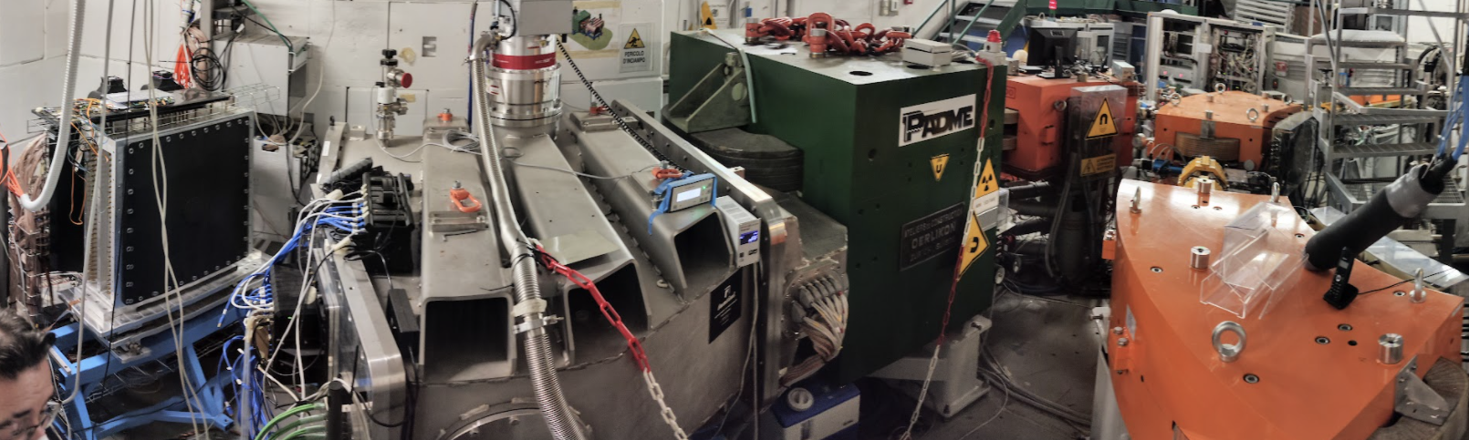
PADME experiment geometry and beam characteristics
P. Valente – Run III Analysis Workshop
19/1/2023

Slide 2
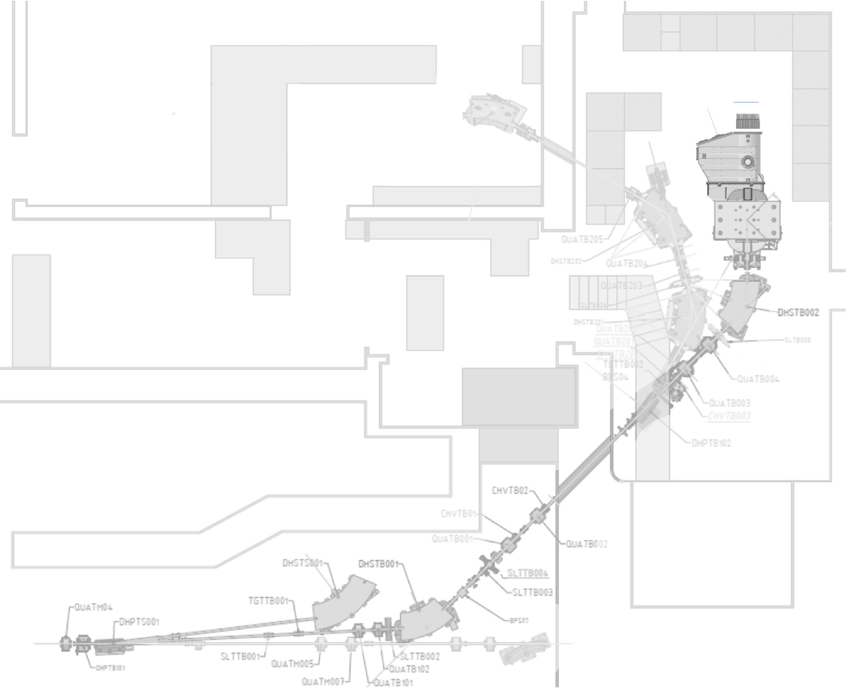
BTF beam-line and PADME
TimePix
Lead Glass
PADME detectors
ECal
ETag
Vacuum
vessel
PADME dipole off (residual $B<$10G)
Target
BTF diagnostics
Lead Glass
FitPix
45$°$ dipole 2 (steering), R=1.72 m
quadrupoles
BTF-1 hall
60$°$ dipole
linac spectrometer
Beam transport and focussing
3$°$ dipole
quadrupoles
3$°$ dipole
collimators
Momentum selection
Beam from linac
45$°$ dipole 1*
on + off, 49 pulses/s
on + on, 1 pulse/s
*bending by 42$°$, R=1.84 m

Slide 3
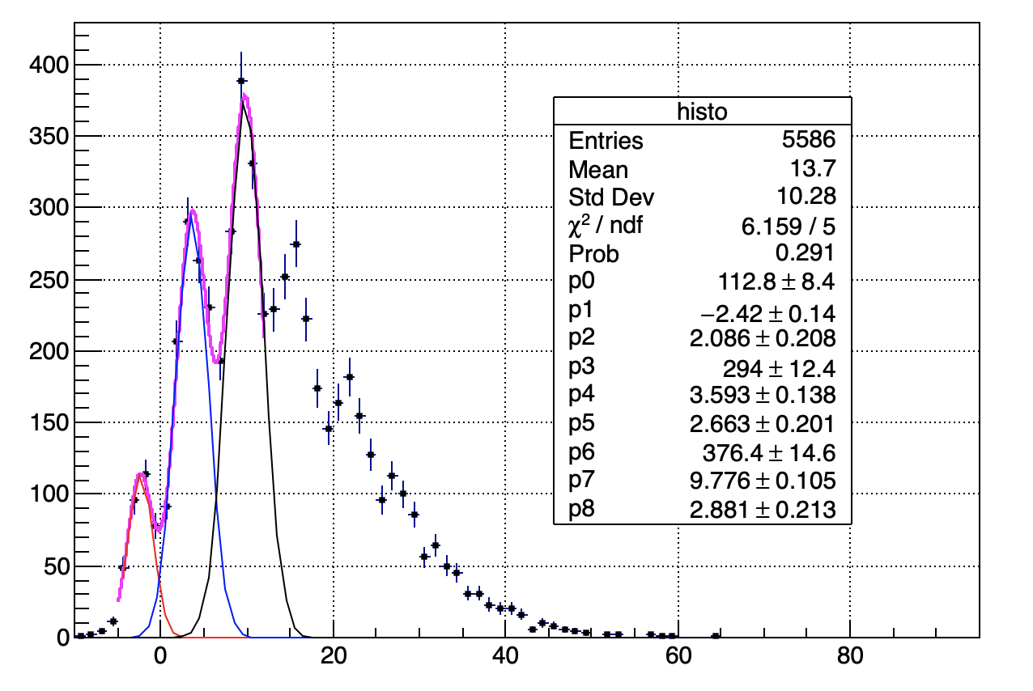
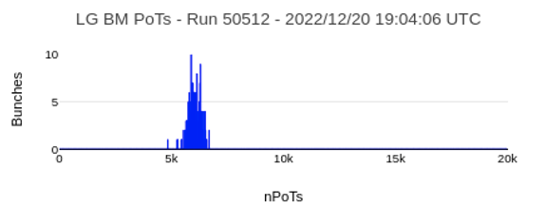
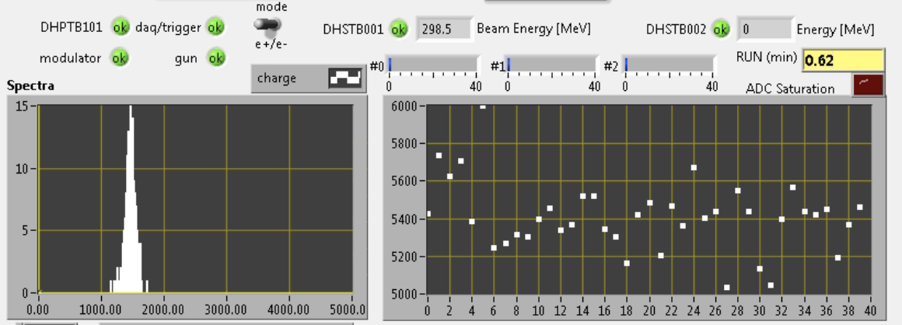
dipole 2 on
Lead glass: 10.5$×\text{10.5}×$37 cm³
Single PMT, 1024$×$1 ns samples
200 ns
Lead Glass
200 ns
Lead Glass
dipole 2 off
FitPix
Current monitor
BTF-1 hall
256$×$256 pixels, 55$×$55 $μ$m² each
Typical spot: 1$×$1 mm²
(but not same focus as on PADME target)
Hall probe inside dipole 1 gap
(stable within 0.2 G during each scan point)

Slide 4
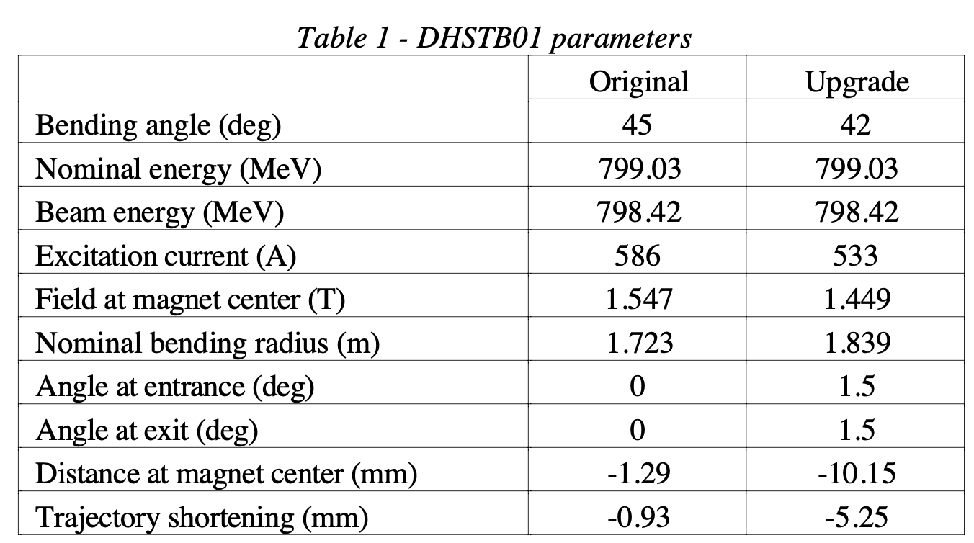
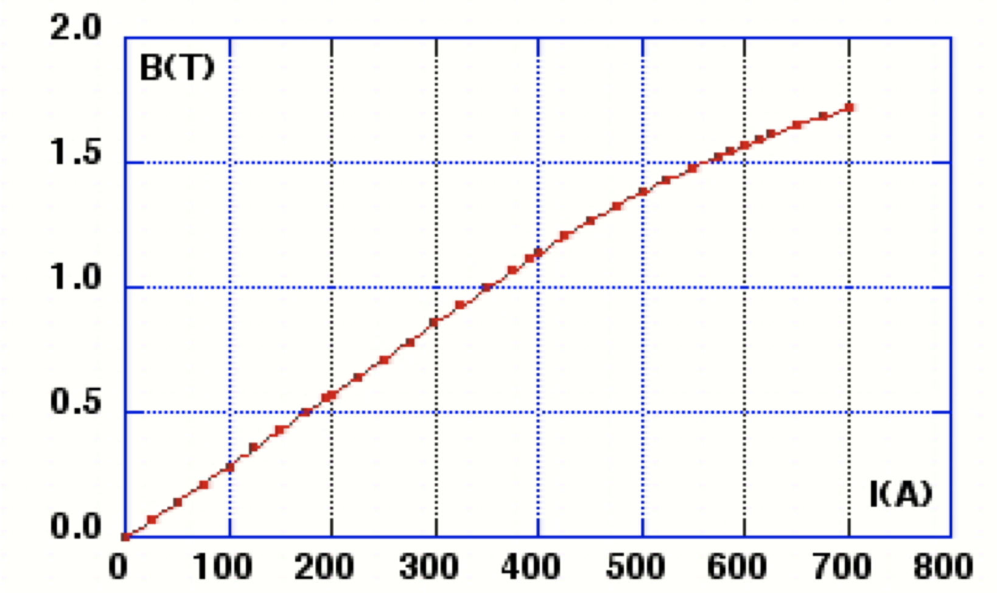
$p$[MeV$/c$]=0.0551318$×B$[Gauss]
*bending by 42$°$
G. Mazzitelli, M. A. Preger, C. Sanelli, F. Sgamma, P. Valente
DAFNE technical note BTF-1 (2003)
$B$[Gauss] =27.16 + 28.446 $×i$[Ampere]

Slide 5
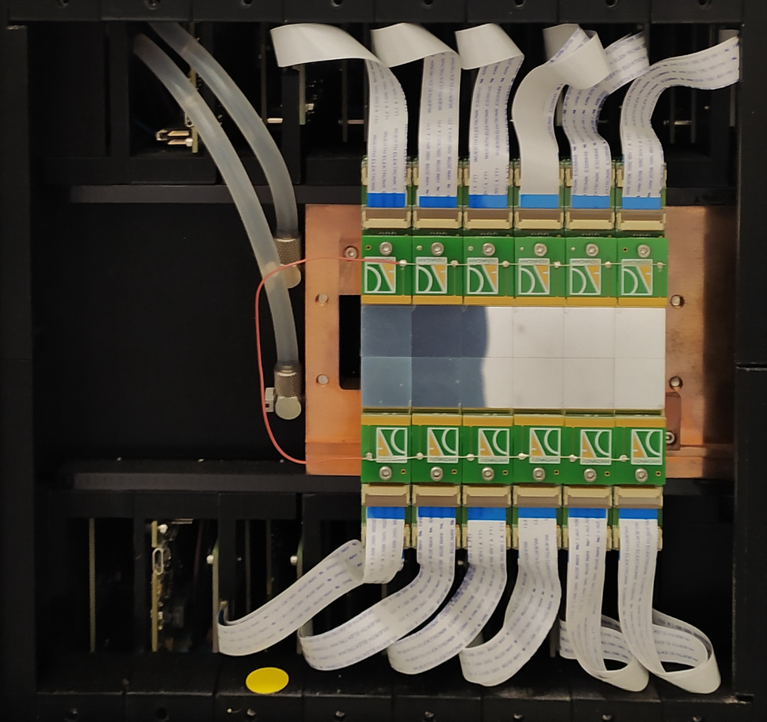
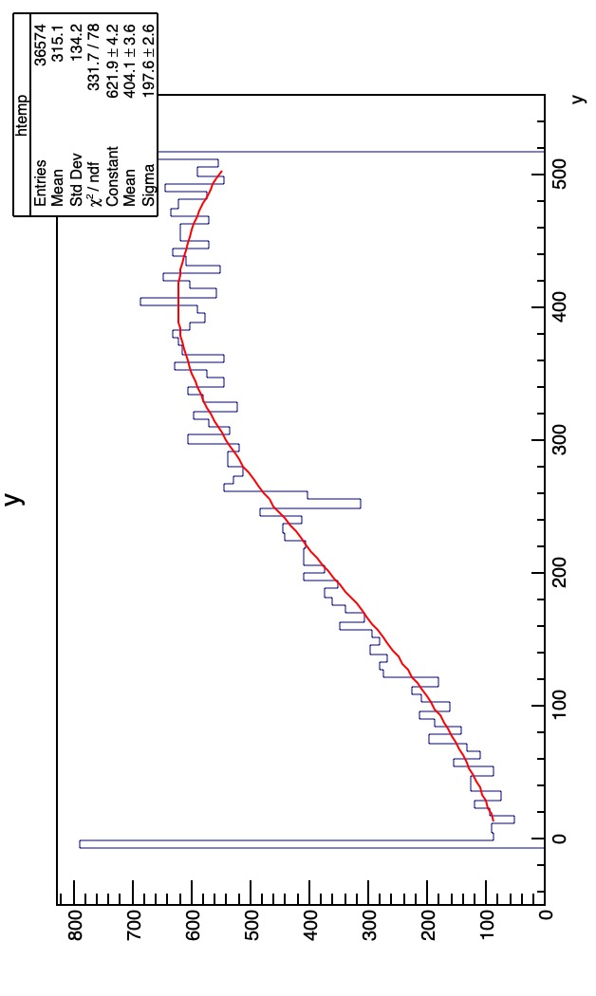
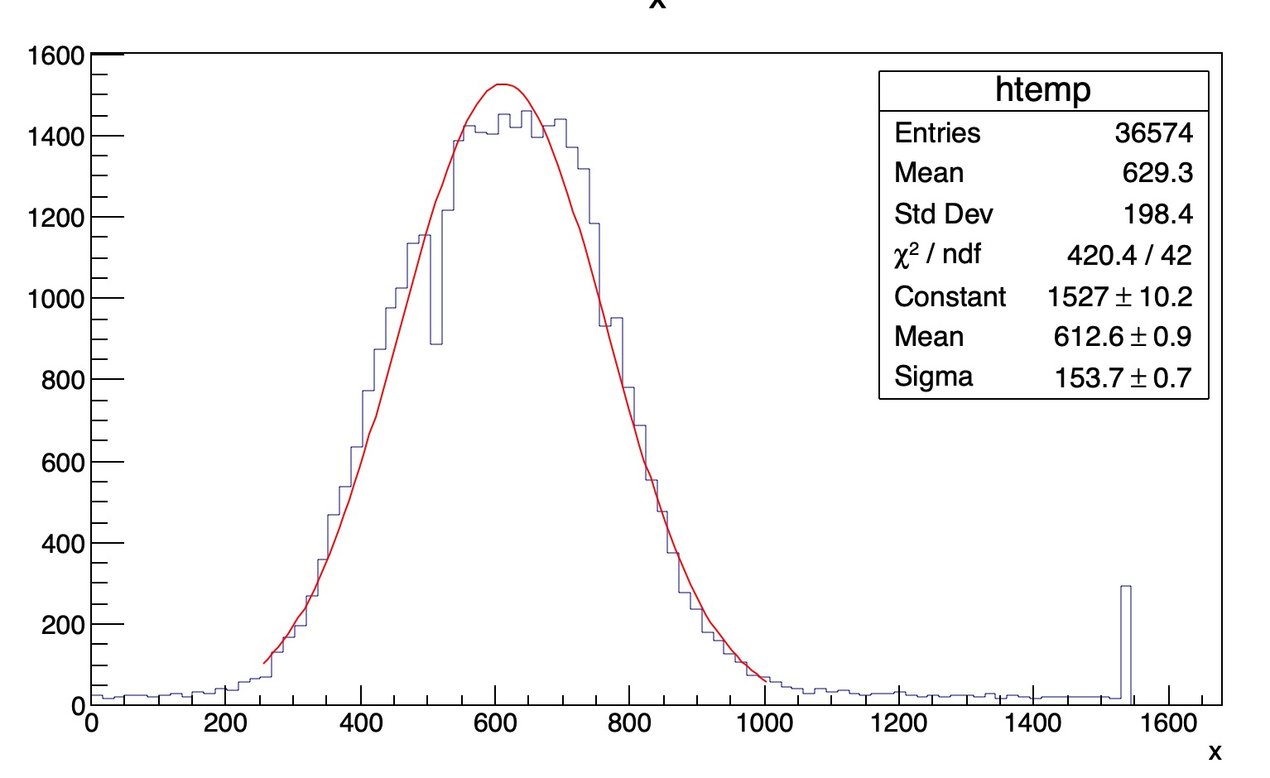
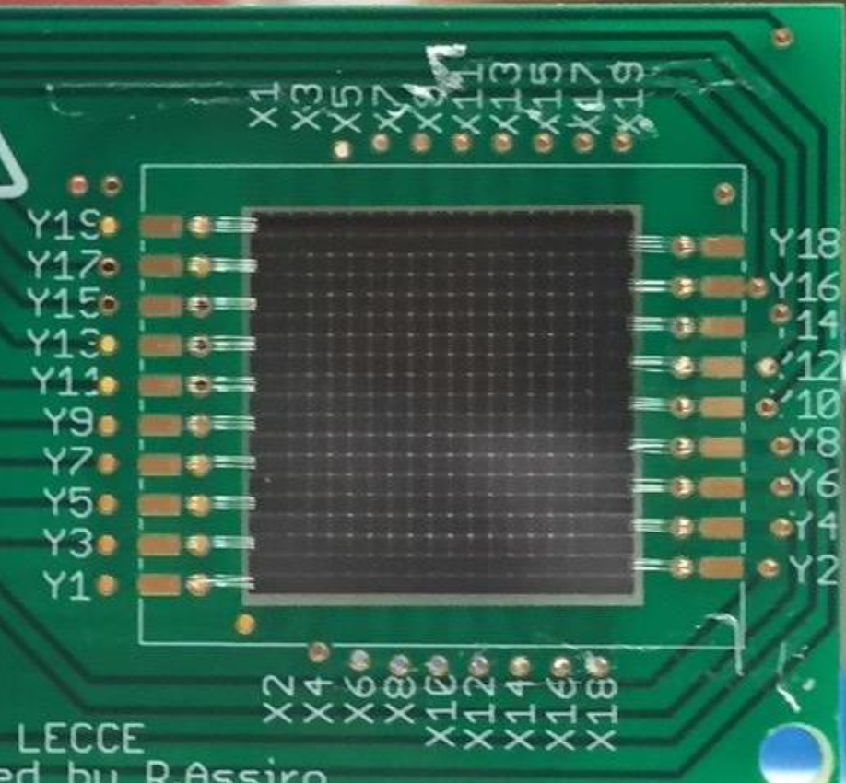
TimePix
Lead Glass
ECal
ETag
6$×$2 array of TimePix3
256$×$256 pixels, 55$×$55 $μ$m² each
(but not integrated in the general DAQ)
Target
Target to:
TimePix = 425 cm
dipole 2 exit = 60 cm
BTF-1 hall
CVD diamond, 100 $μ$m thick
15$+$15 strips, 1 mm wide

Slide 6
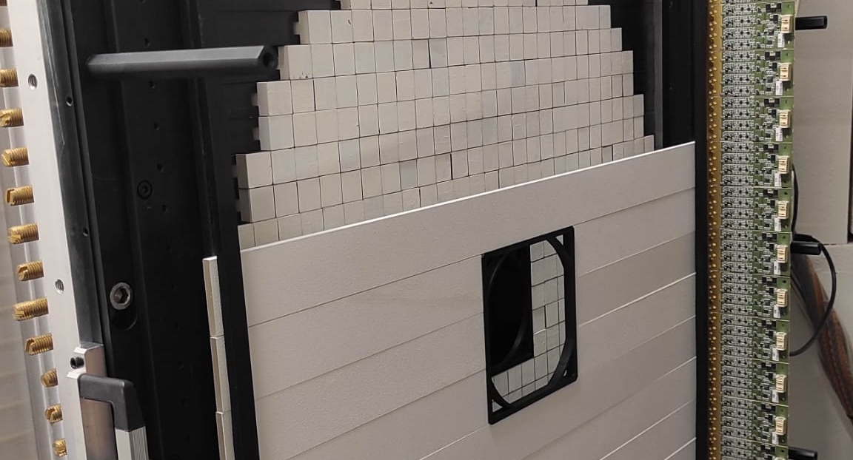
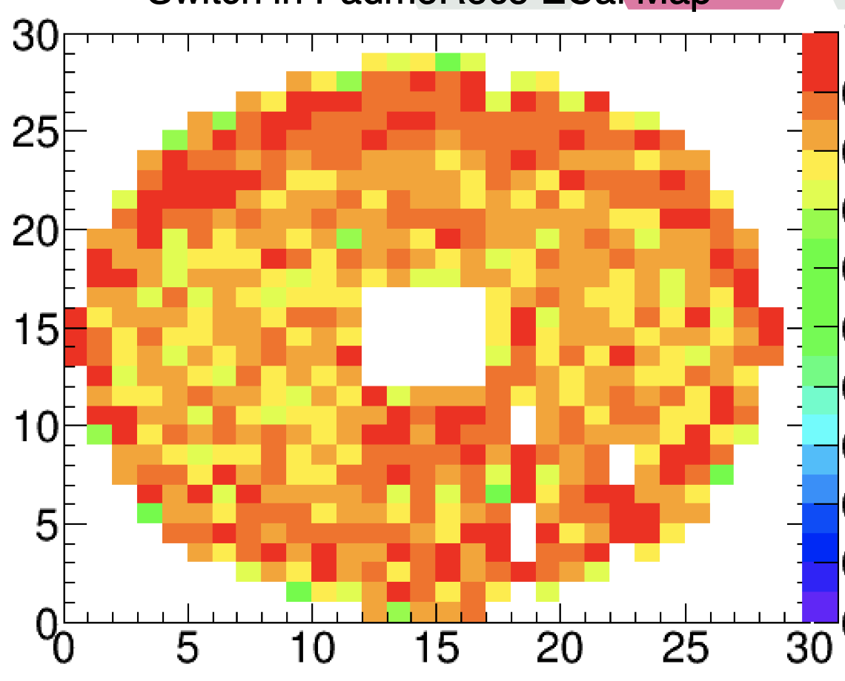
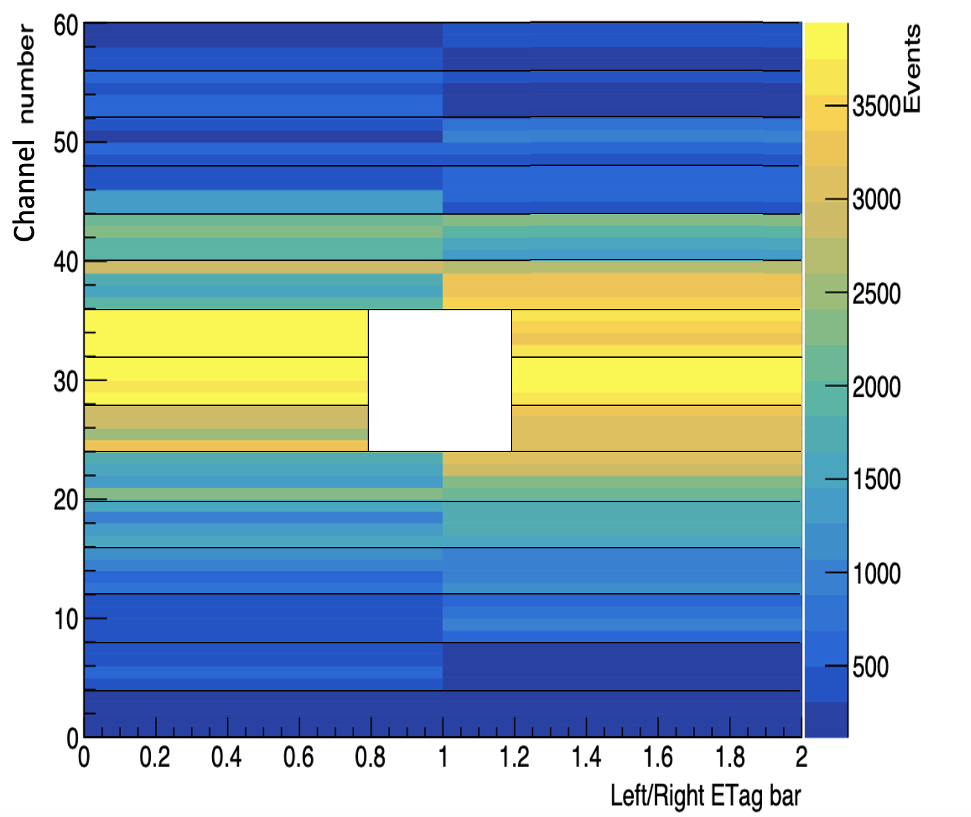
626 BGO crystals, 21$×$21$×$230 mm³
Readout by 19 mm PMTs
Measures:
Energy, time, position of $e$/$γ$
$σ_{E}/E$=2%$/\sqrt{E [GeV]}$
$σ_{t}$=1-2 ns
$σ_{CoG}$= 7 mm ($x$ and $y$)
TimePix
Lead Glass
ECal
ETag
Target
Measures:
Time, position of $e$
$σ_{t}<$0.5 ns
4 cm granularity in $y$
BTF-1 hall
6 long $+$ 2$×$3 short + 6 long bars
Readout by 4 SiPMs on left and right edges
(double readout long bars only)
Target to:
Etag = 360 cm
ECal = 365 cm

Slide 7
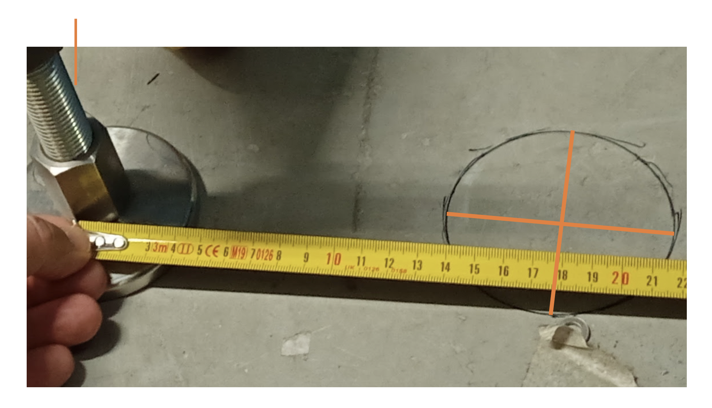
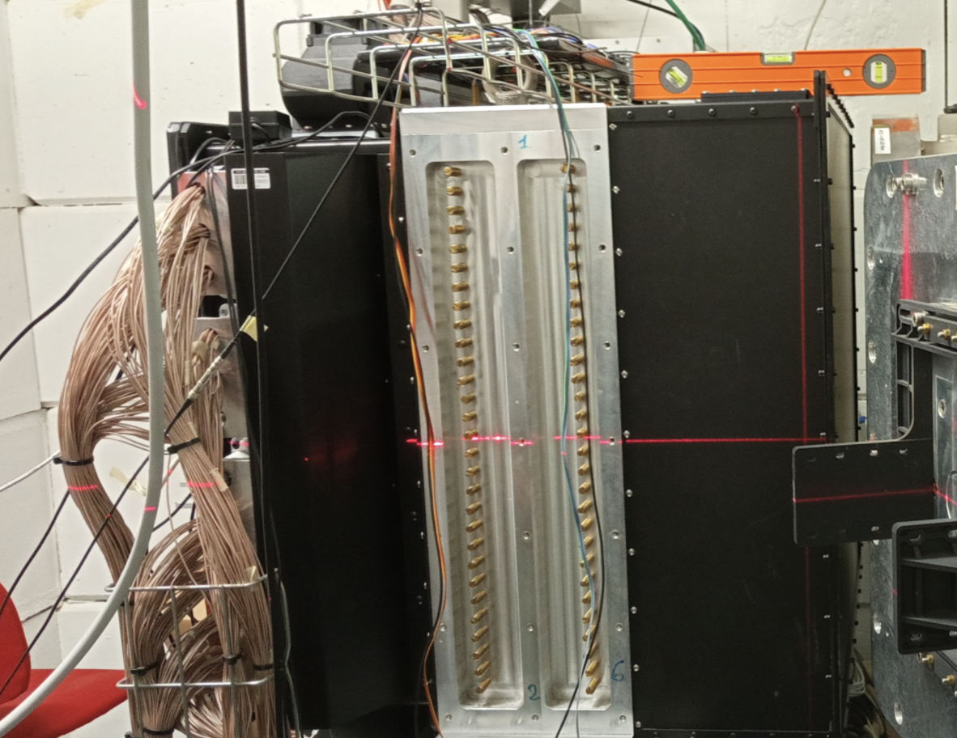
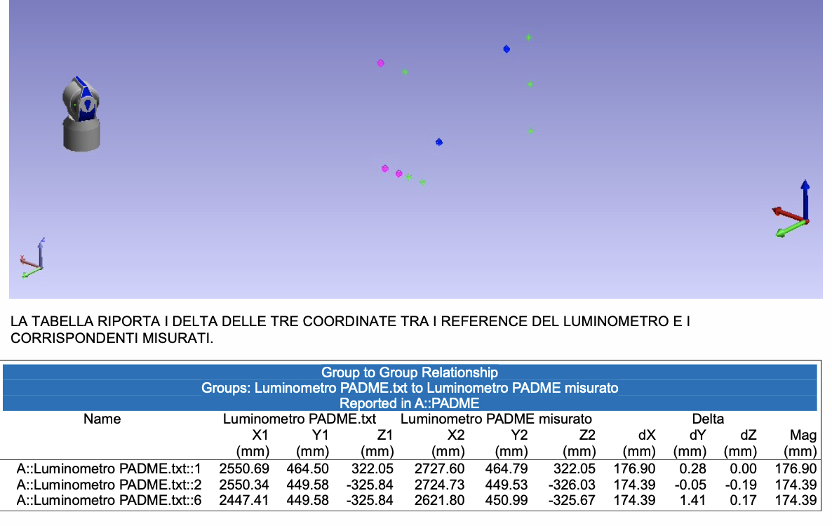
With respect to Run II ECal moved away from target by
17.8 cm (straw man measurement)
176.9 mm/174.4 mm door/wall side (survey)
ETag
box

Slide 8
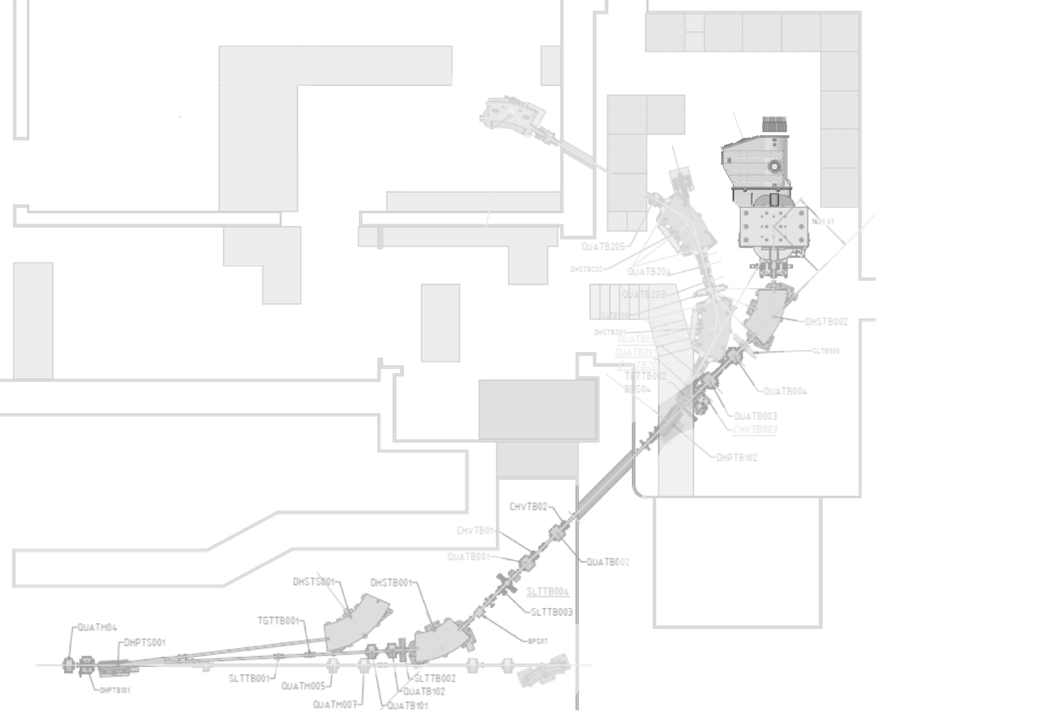
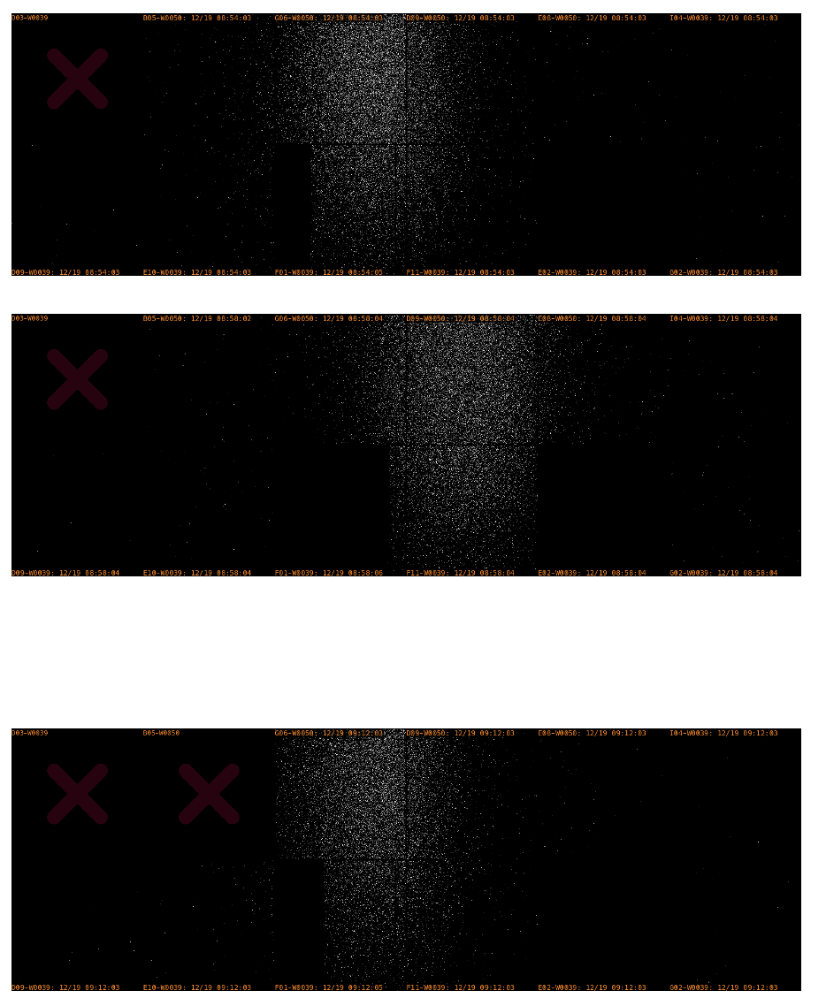
In a spectrometer line the horizontal position of a particle with momentum $p=p_{0}(1+δ)$ with $δ=∆p/p_{0}$, will be offset by $∆x=D_{x}δ$, where $D_{x}$is the dispersion function; $D_{x}≈Lφ$ ($L$ is the arm length and $φ$ the deflection angle)
The beam spot size is given by:
$$σ_{x}=\sqrt{εβ+{\left(\frac{D_{x}σ_{p}}{p}\right)}^{2}}$$
If the geometric beam size in absence of dispersion can be neglected,$\sqrt{εβ}≪$ $\frac{D_{x}σ_{p}}{p}$, we can get the spread from:
$$\frac{σ_{p}}{p}≈1/D_{x}∙σ_{x}$$
From a no-target run (otherwise Coulomb scattering would be not negligible) we estimate: $\frac{σ_{p}}{p}≈$ 0.24%
TimePix
$$∆x$$
Target
$$p_{0}$$
Dipole 1: 200.2 A $→$ 200.7 A and back
Can also be computed from collimators’ gaps/distances
[Nucl. Instrum. Meth. A515 (2003) 524]:
$\left|\frac{∆E}{E}\right|=\frac{h}{2ρ}+\sqrt{2}\left(\frac{R_{x}}{L_{1}}+\frac{H}{2L_{1}}\right)≅\frac{h}{2ρ}+\sqrt{2}\frac{H}{L_{1}}$
With H=h=2 mm we get 0.22%
Large spread beam
from Linac
$$p_{0}−δ$$

Slide 9
0.3 A/176.075 A= $1.7∙{10}^{−3}→$ 0.47 MeV/276.3 MeV
$∆θ=42°∙\frac{π}{180°}∙1.7∙{10}^{−3}=$ 1.25 mrad
$∆x≈$1 mm
Distance $≈$0.8m
(dipole 2-to-Target $≈$0.6 m)
A, C, D
+0.5 MeV selected energy
B, E
F: +1.7 MeV «linac» energy

Slide 10
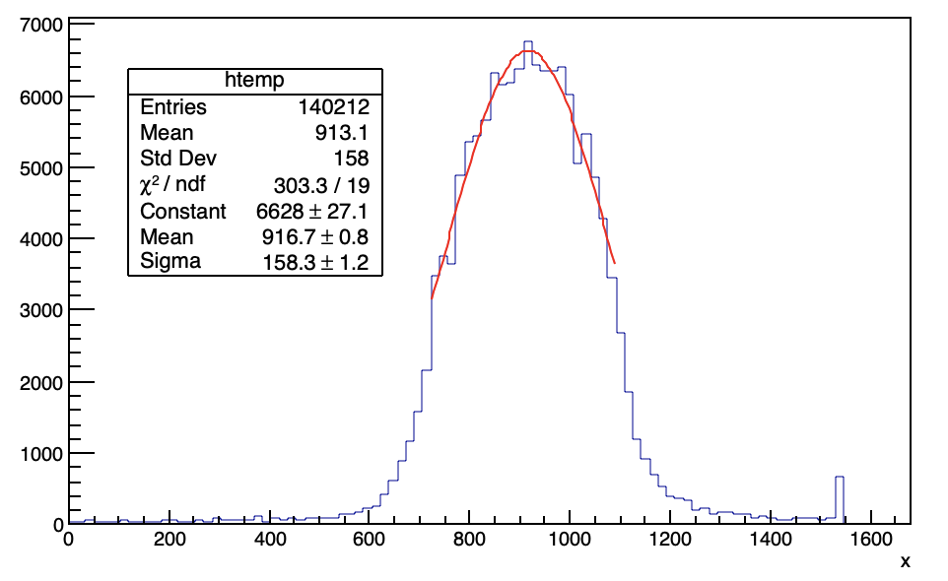
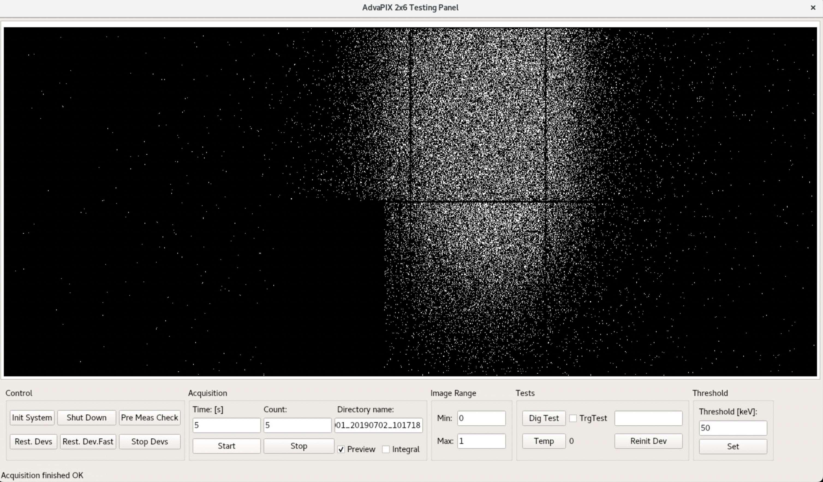
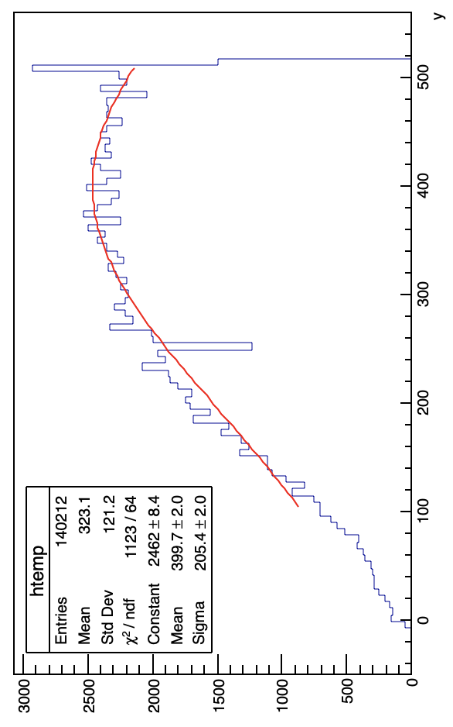
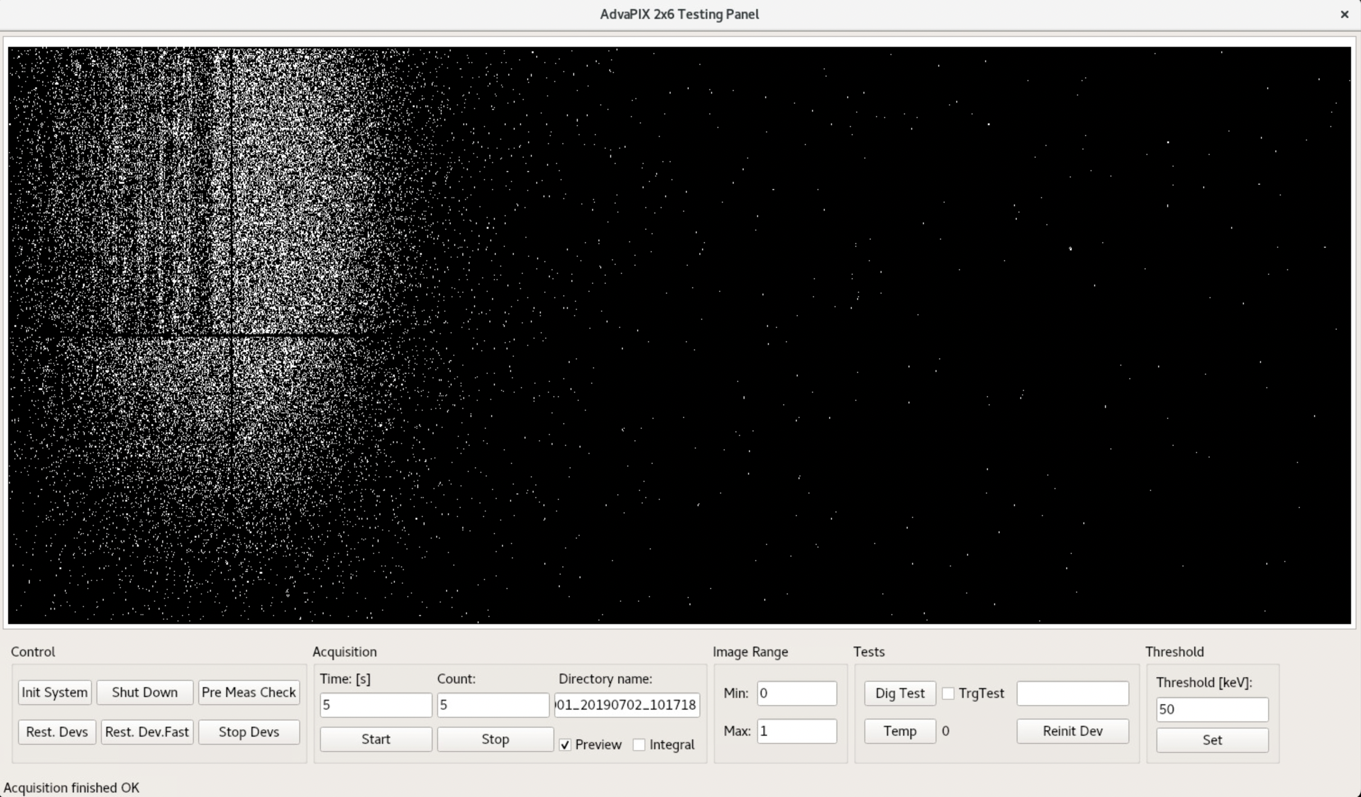
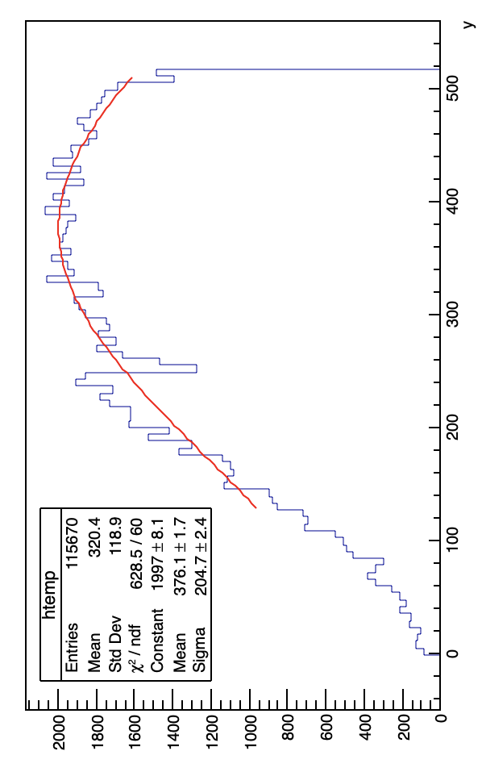
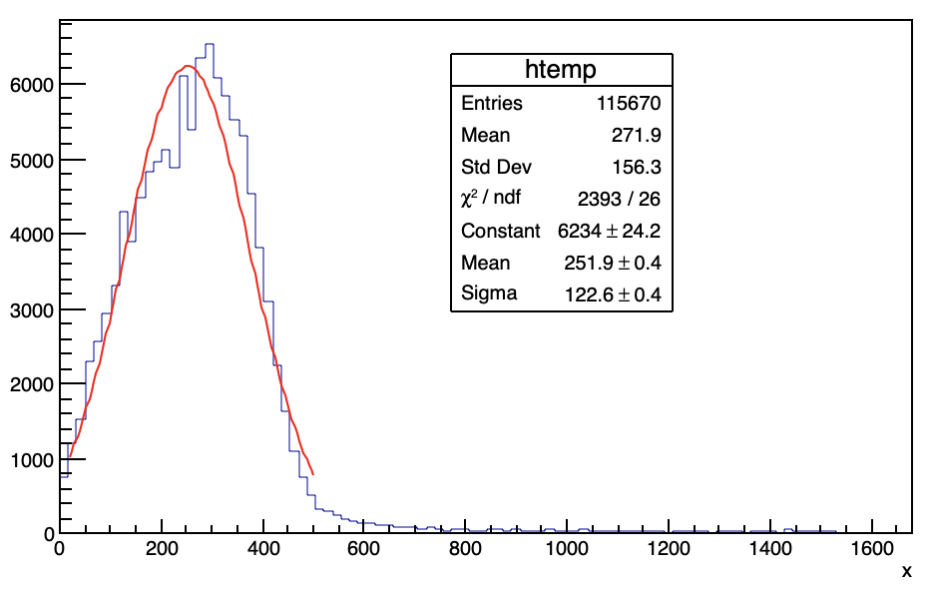
No target
293.7 MeV
50.4 mm
296.7 MeV
13.8 mm
3 MeV/296.7 MeV $→δ={10}^{−2}$
$∆θ=42°∙\frac{π}{180°}∙1∙{10}^{−2}=$7.33 mrad
$∆x=$36.6 mm
distance$≈$5 m
(dipole 2-to-TimePix $≈$4.85 m)

Slide 11
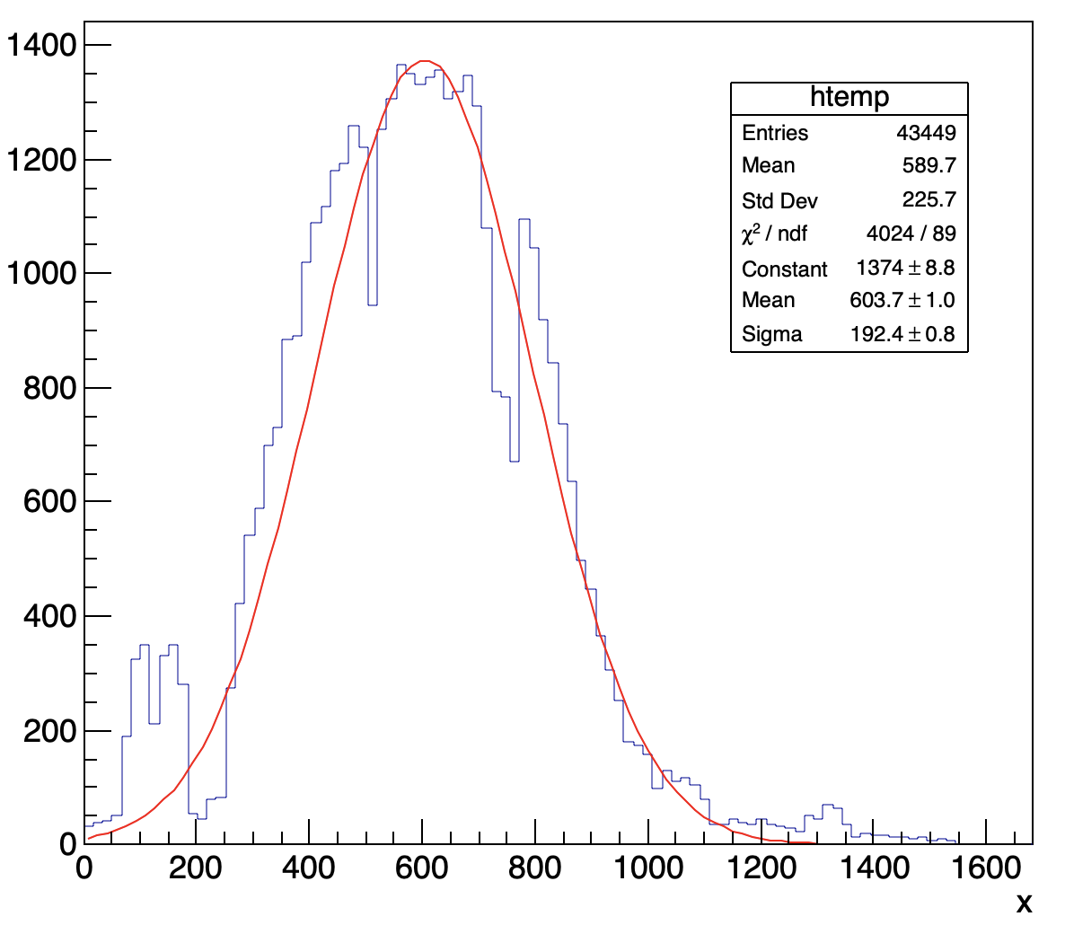
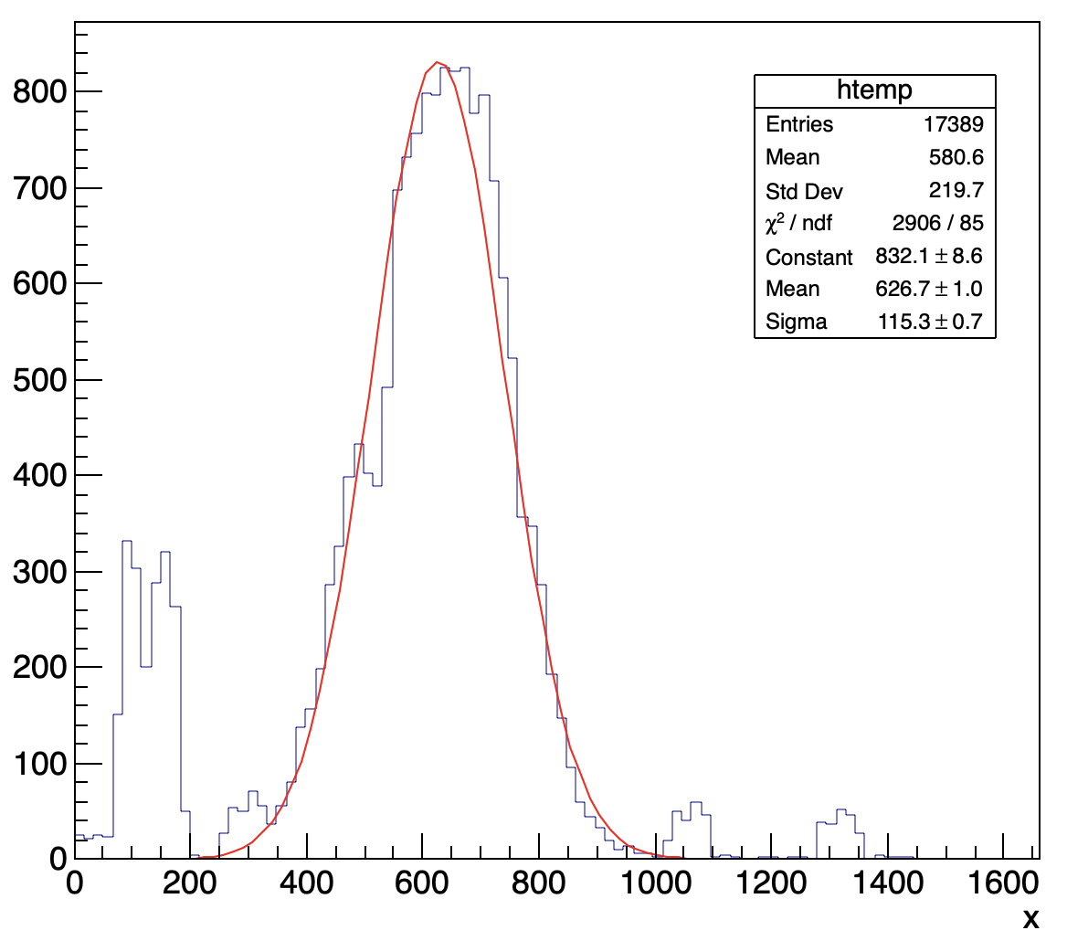
280 MeV, target in
280 MeV, target out
$$σ_{x}=10.6 mm$$
$$σ_{x}=6.3 mm$$
$$σ_{MS}=8.5 mm$$
$\frac{14.1}{280}\sqrt{\text{0.1/121.3}}=1.45 mrad$; $1.45 mrad ×5 m=7.2 mm$

Slide 12
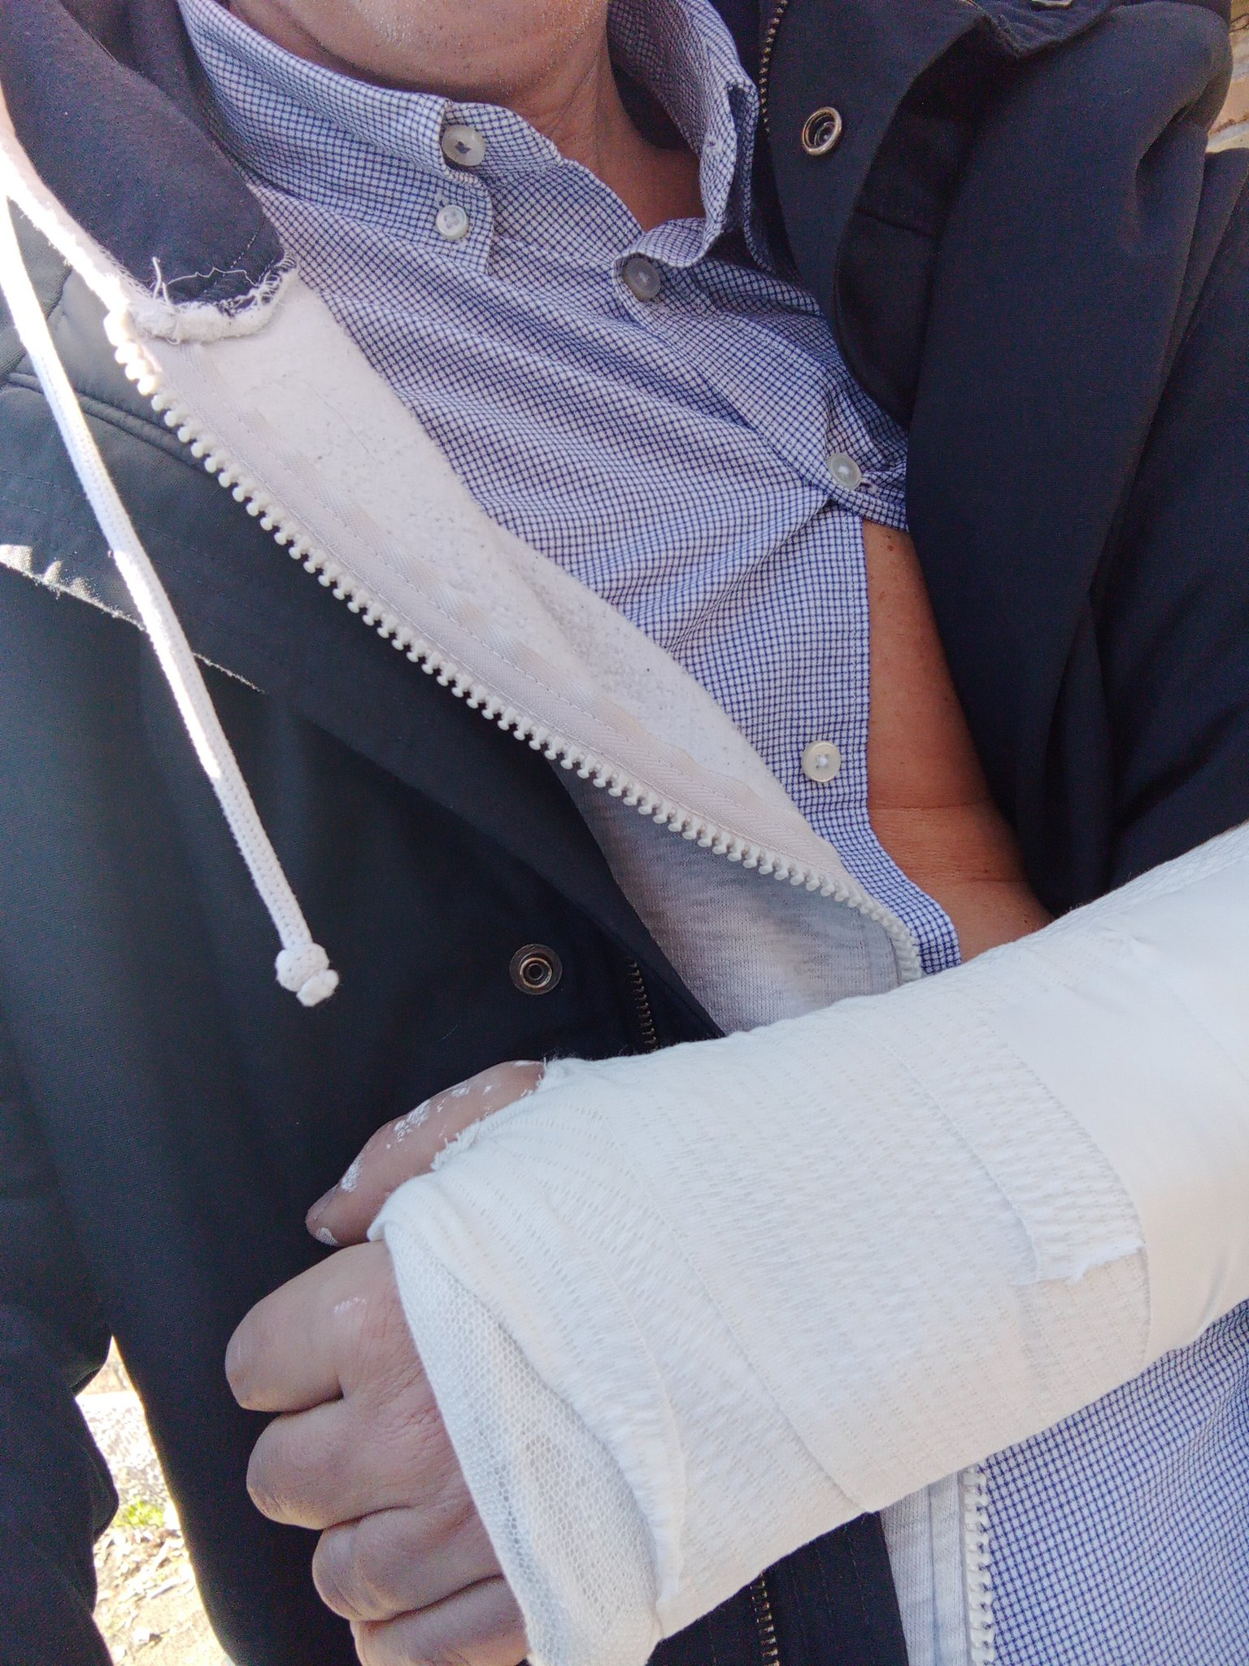
Sorry:
some useful information is surely still missing
I will keep updating this presentation as much as I can
Feel free to ask

