Slide 1
The design of a dual-mode transverse deflecting structure
Hanyu Gong, SINAP/SSRF
Wencheng Fang, Jianhao Tan, Cheng Wang, Zhentang Zhao, SARI/SSRF
15th Workshop on Breakdown Science and High Gradient Technology
HG2023
17 Oct, 2023

Slide 2
Outlines
Introduction of the dual-mode TDS (transverse deflecting structure)
Overall design
RF design and optimization
Regular cell
Dual-frequency coupler
High-frequency isolator
Results

Slide 3
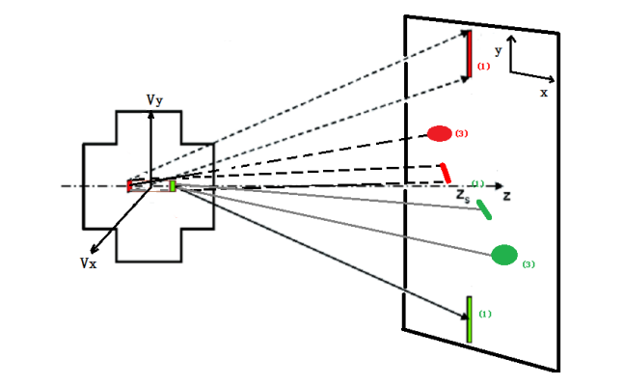
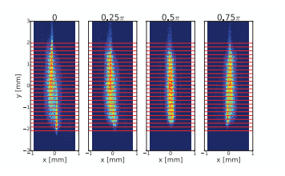
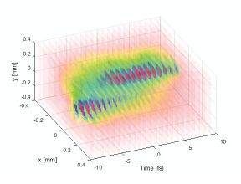
Introduction
Variable polarization is the research frontier of next-generation TDS (transverse deflecting structure) .
CERN has proposed a variable-polarization TDS design to reconstruct the 3D charge distribution.

Slide 4
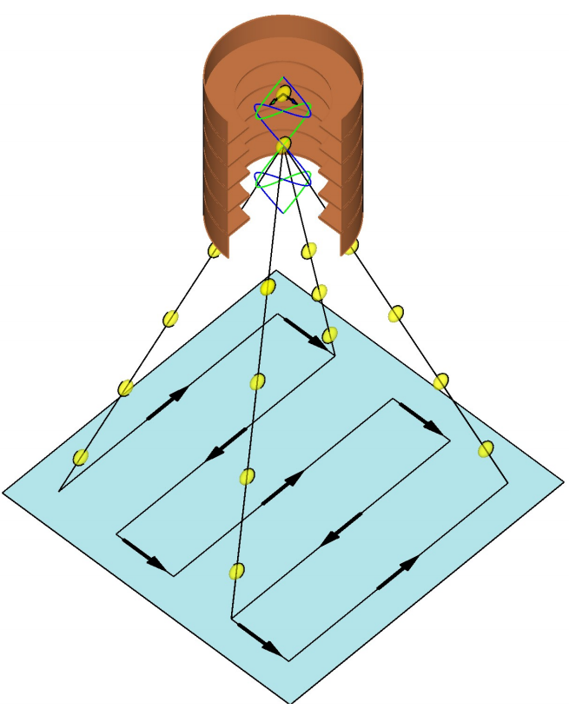
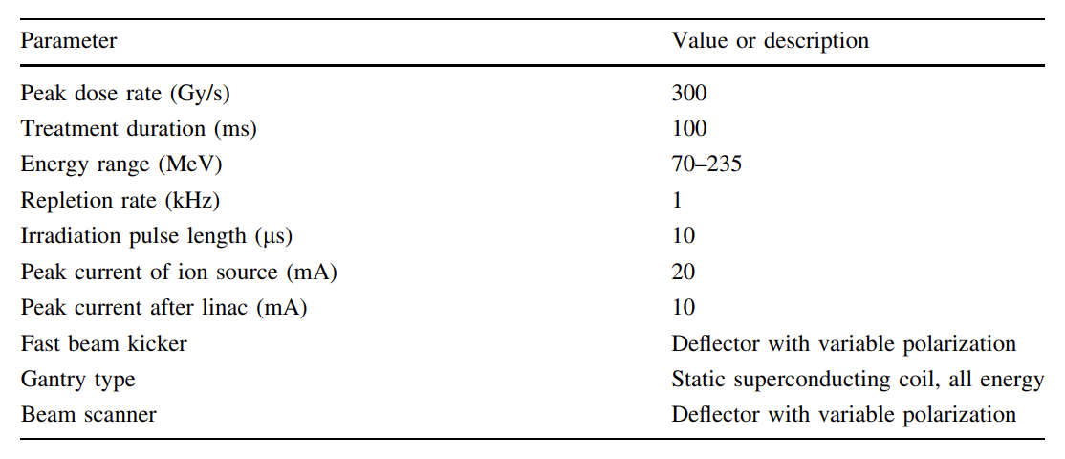
Introduction
FLASH
The ultra-high dose rate radiotherapy that delivers all treatment doses of approximately 30 Gy in an ultra-short time (less than 100ms).
Can protect healthy tissues compared with the conventional irradiation of the same total dose.
Switching of the kick angle should be completed in less that 1 ms.

Slide 5
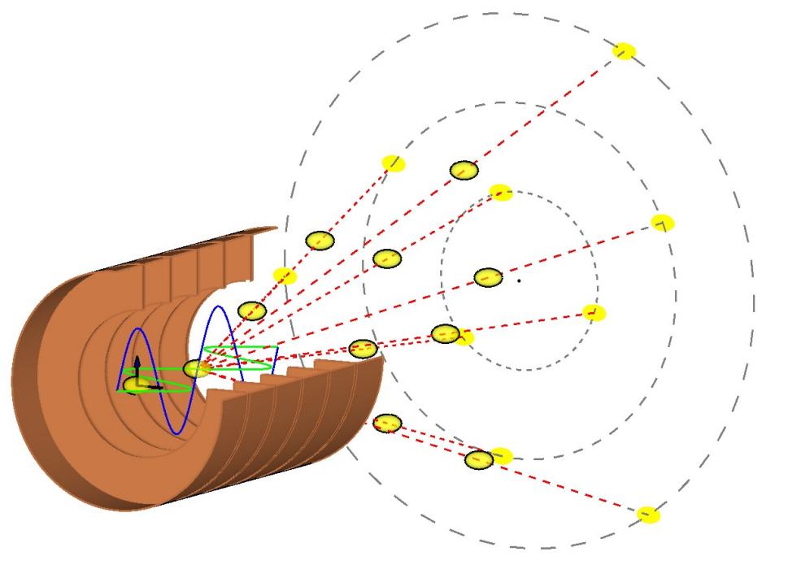
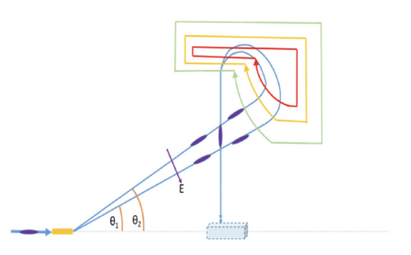
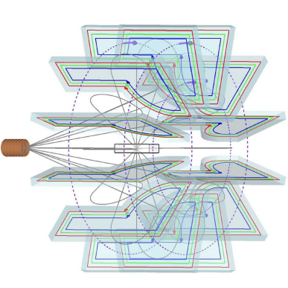
Introduction
A new design for a variable polarization TDS was proposed at SSRF/SXFEL.
Two deflecting modes have mutually perpendicular polarized directions and operate in one TDS.
No mechanical motion and no magnetic field variation
The time scale for switching is about 100 ns to 1 µs.

Slide 6
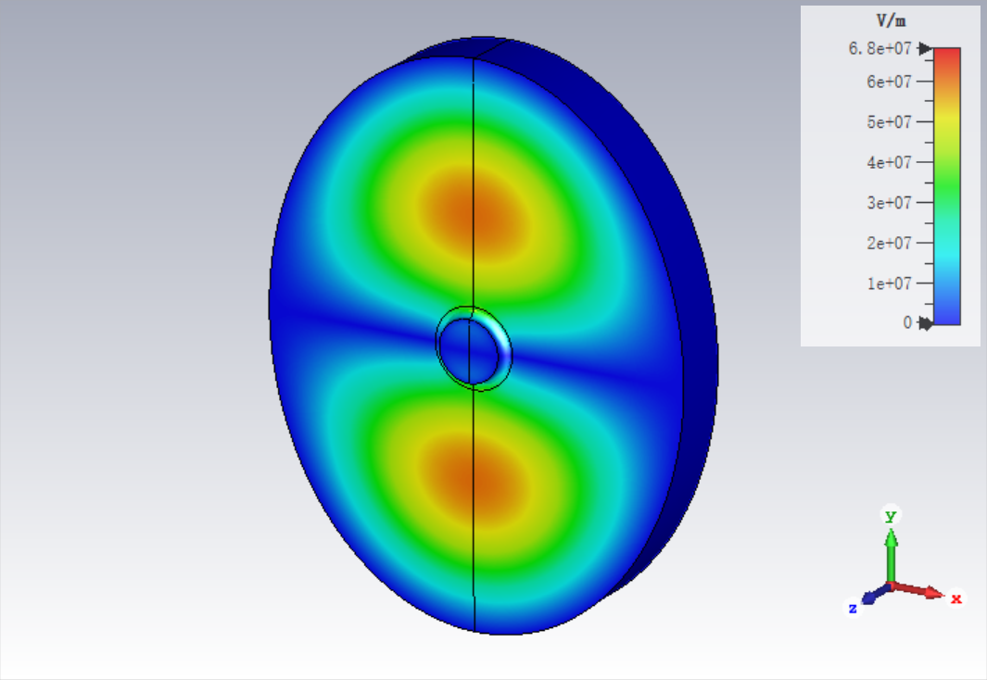
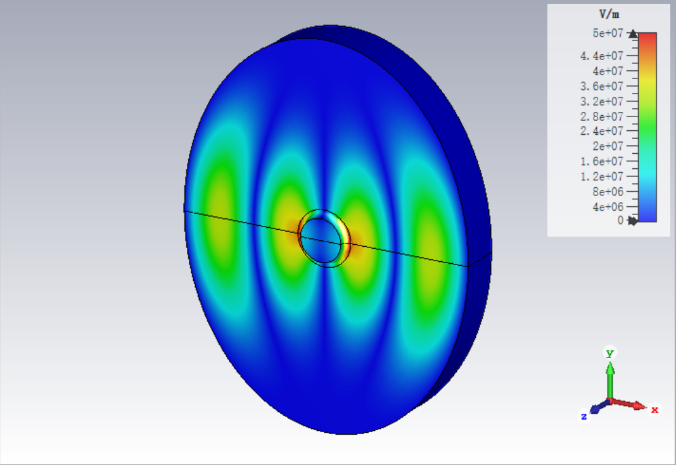
Overall design
Deflecting modes - HEM₁₁ and HEM₁₂
Travelling wave
The phases of the deflecting fields are synchronized with the bunch
Adjusting the magnitude and proportion of the deflecting voltage to kick the bunch to any required angle.

Slide 7
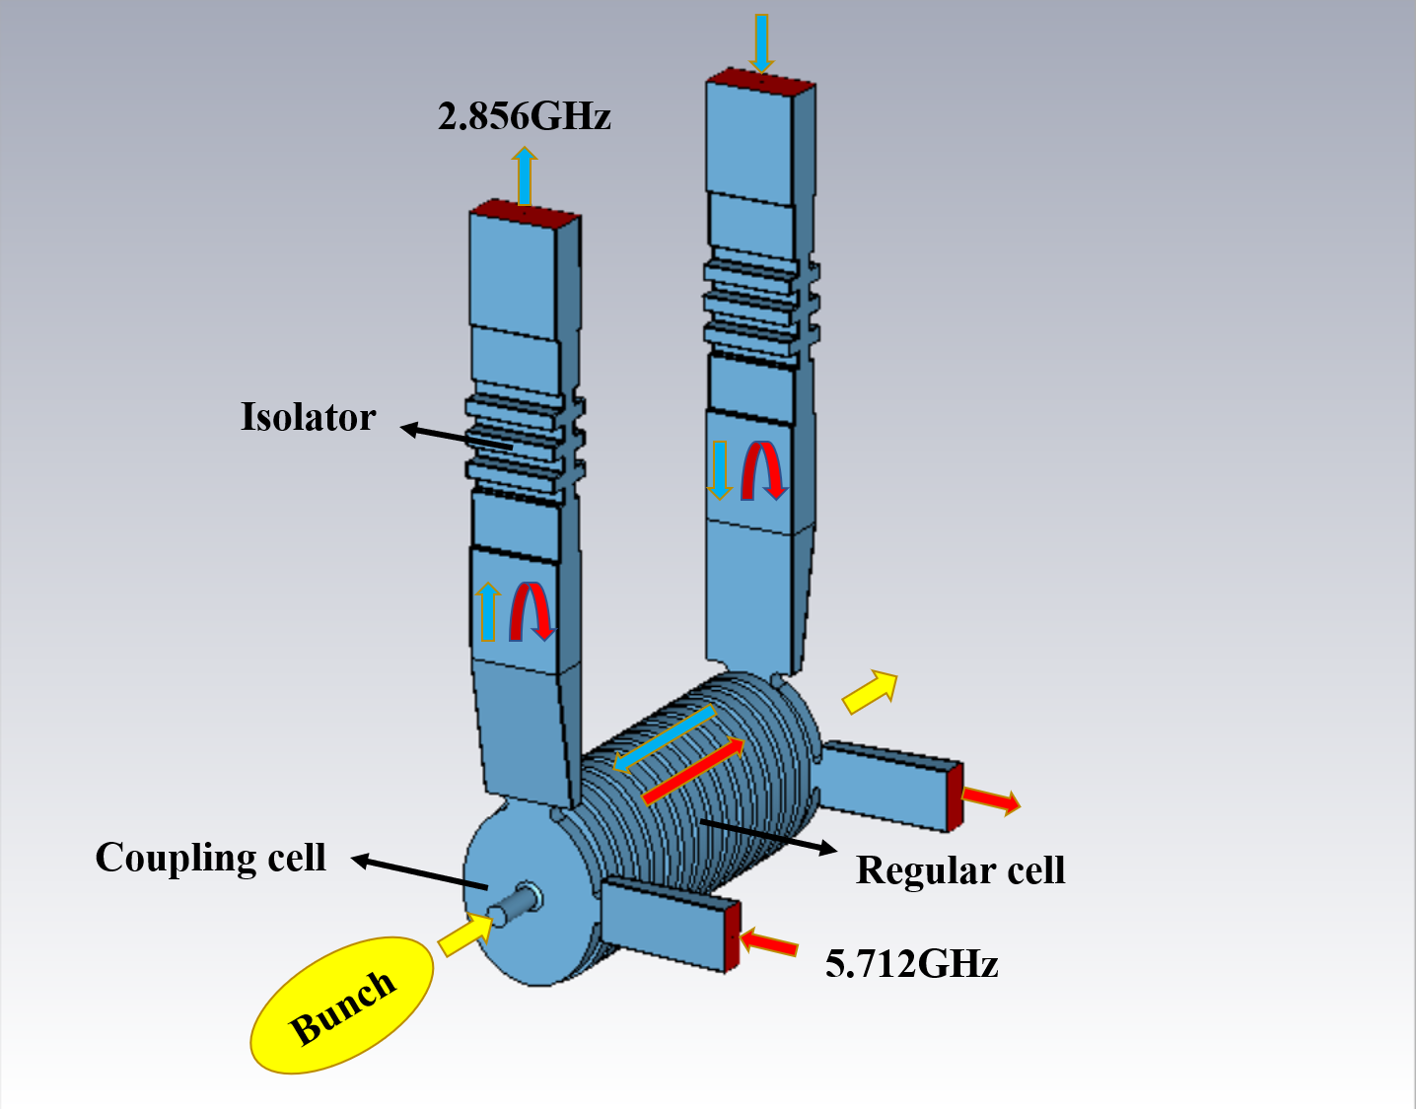
Overall design
Two power sources
Independent ports on the couplers
High-frequency isolator
Controlled by LLRF ststem

Slide 8
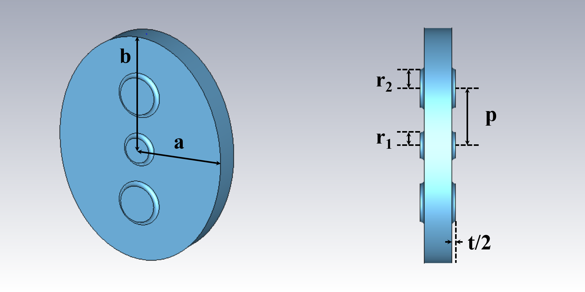
Regular cell
Prototype - classical S-band LOLA structure
Elliptical cell
An additional pair of side coupling holes
HEM₁₁ operates in the forward TW regime
HEM₁₂ operates in the backward TW regime

Slide 9
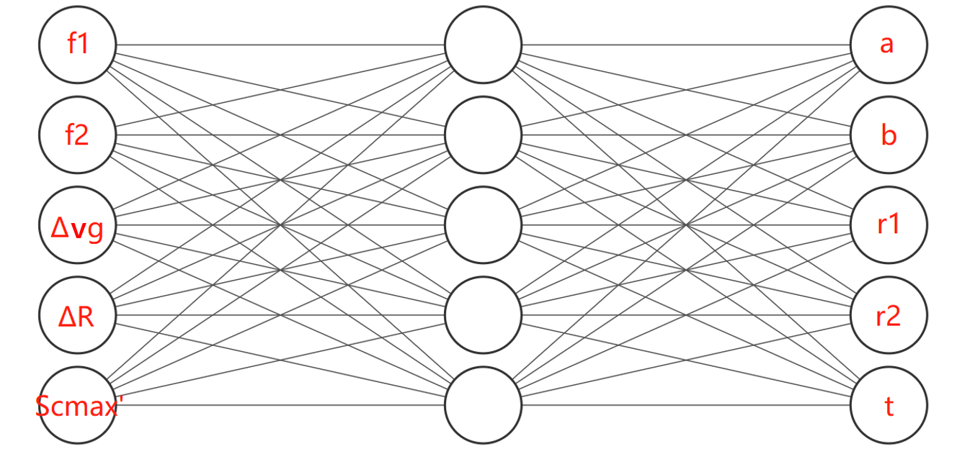
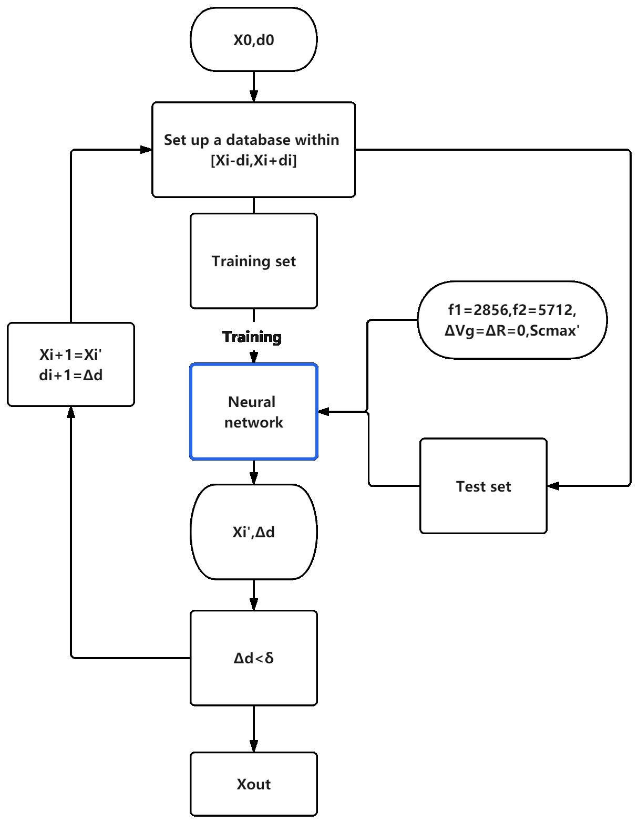
Optimization
Two modes are affected simultaneously
Neural network algorithm
Predict the geometric parameters according to the required specification
A multi-step optimization is adopted to improve the optimization speed

Slide 10
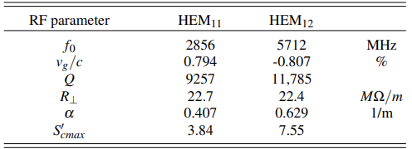
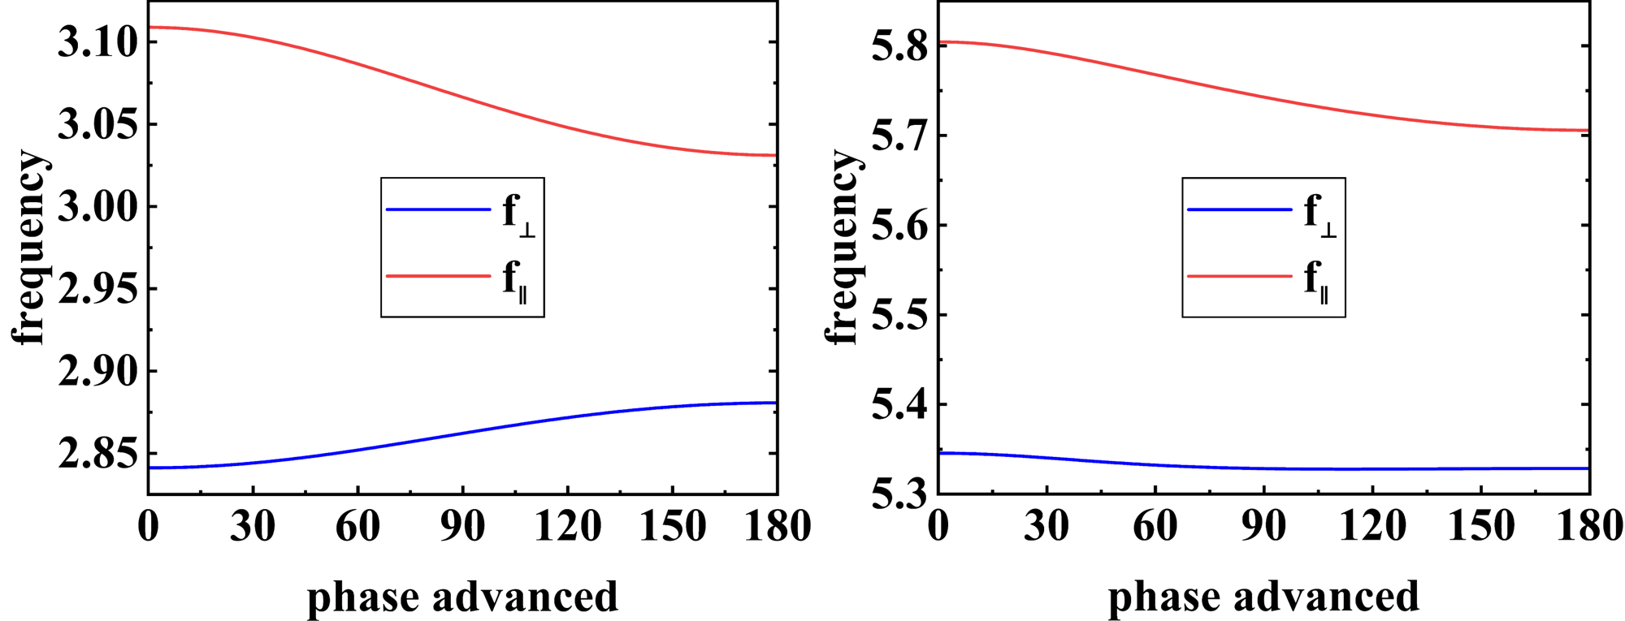
Result
Have similar working frequency, group velocities and transverse shunt impedance
Normalized maximum modified Poynting vector is reduced.
Both have been separated from their perpendicular polarized modes

Slide 11
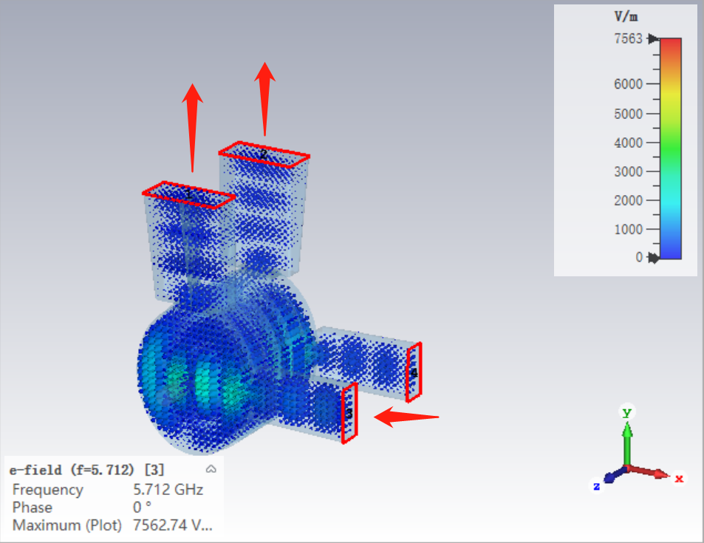
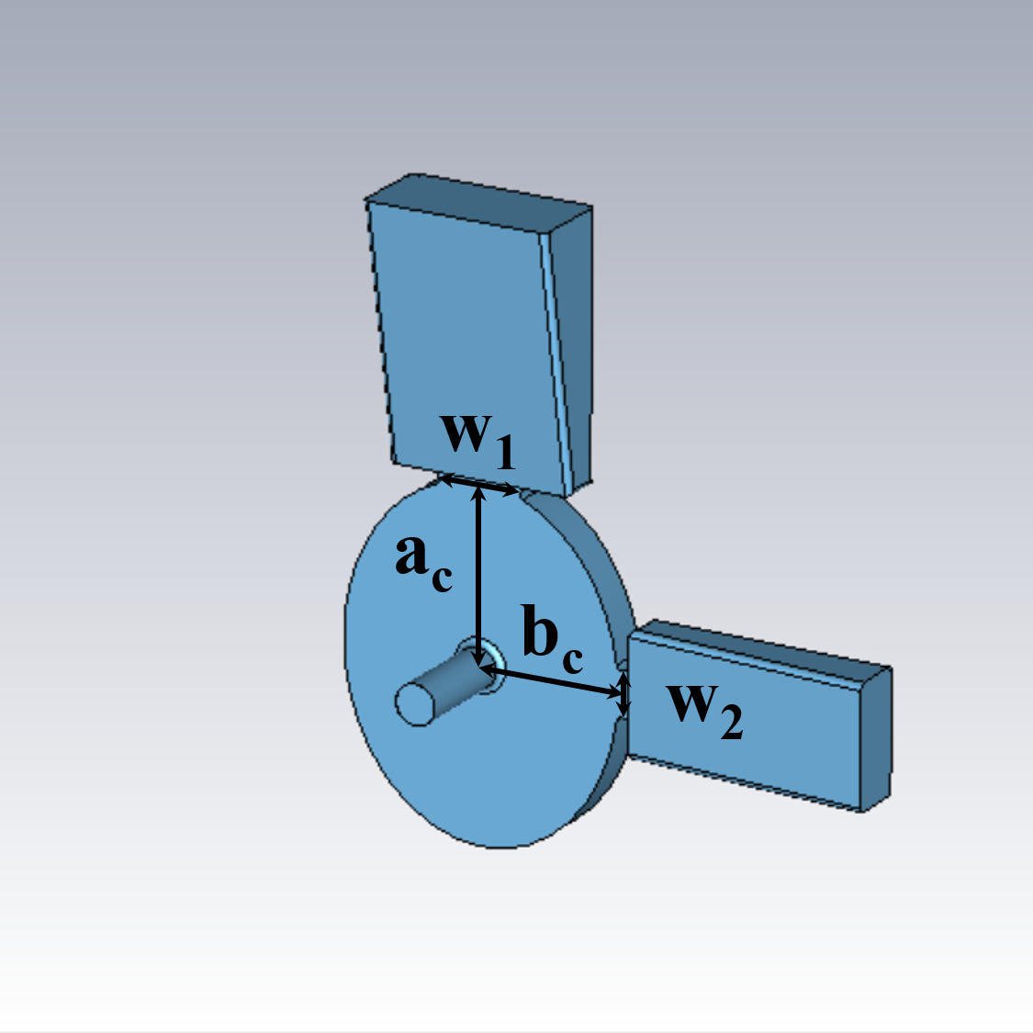
Dual-frequency coupler
The structure is consistent with the regular cell
Two coupling ports
Part of the high-frequency signal will overflow from the low-frequency ports

Slide 12
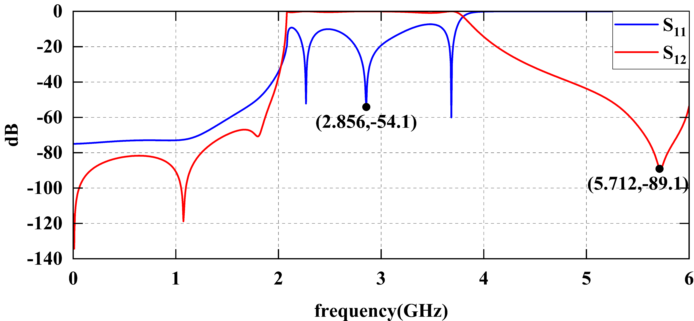
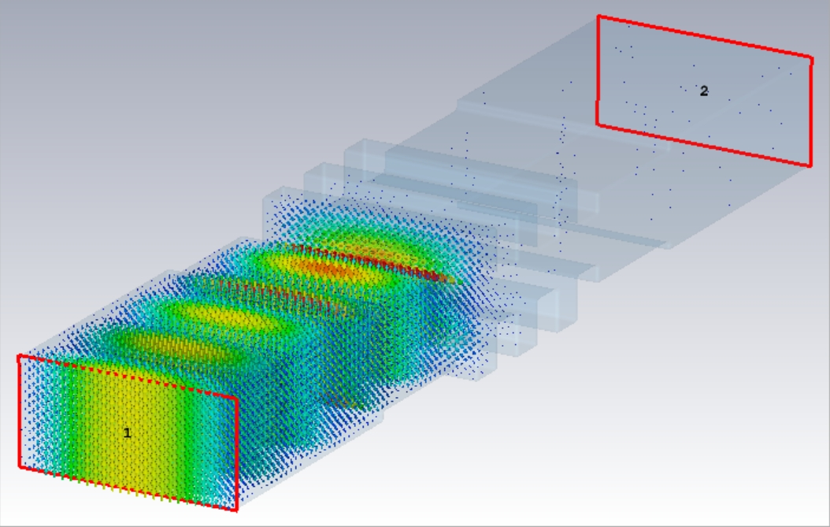
High-frequency isolator
Essentially a low-pass filter
Passband at 2856MHz
Stopband at 5712MHz.

Slide 13
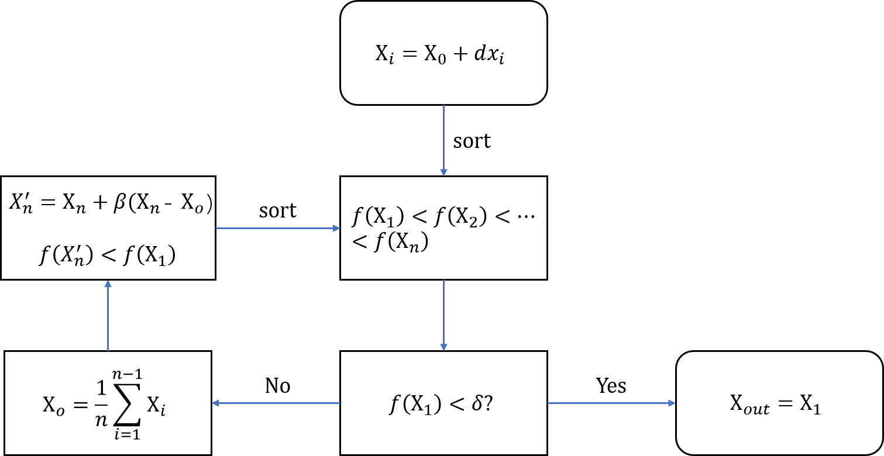
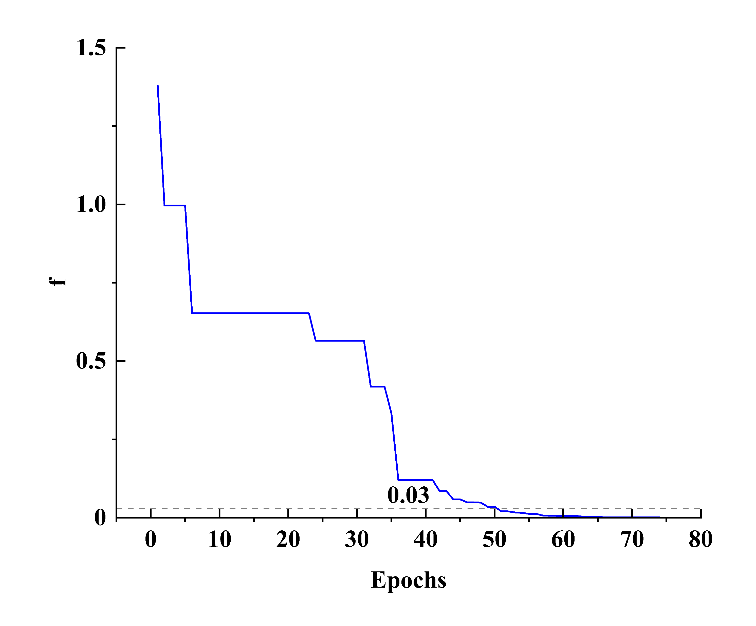
Multiple-objective optimization for tuning
The grid of the whole tube is huge
High time cost to establish network
Multiple-objective algorithm
Objective function f = S_{11,1} + S_{11,2}
f drops below 0.03 after 50 iterations

Slide 14
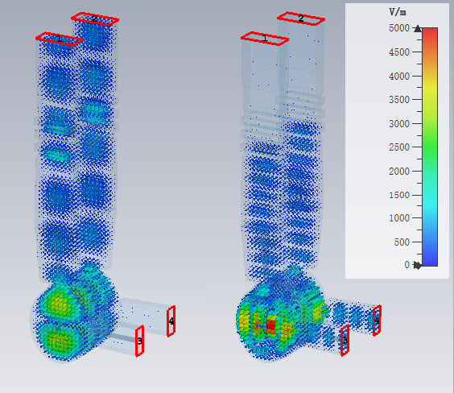
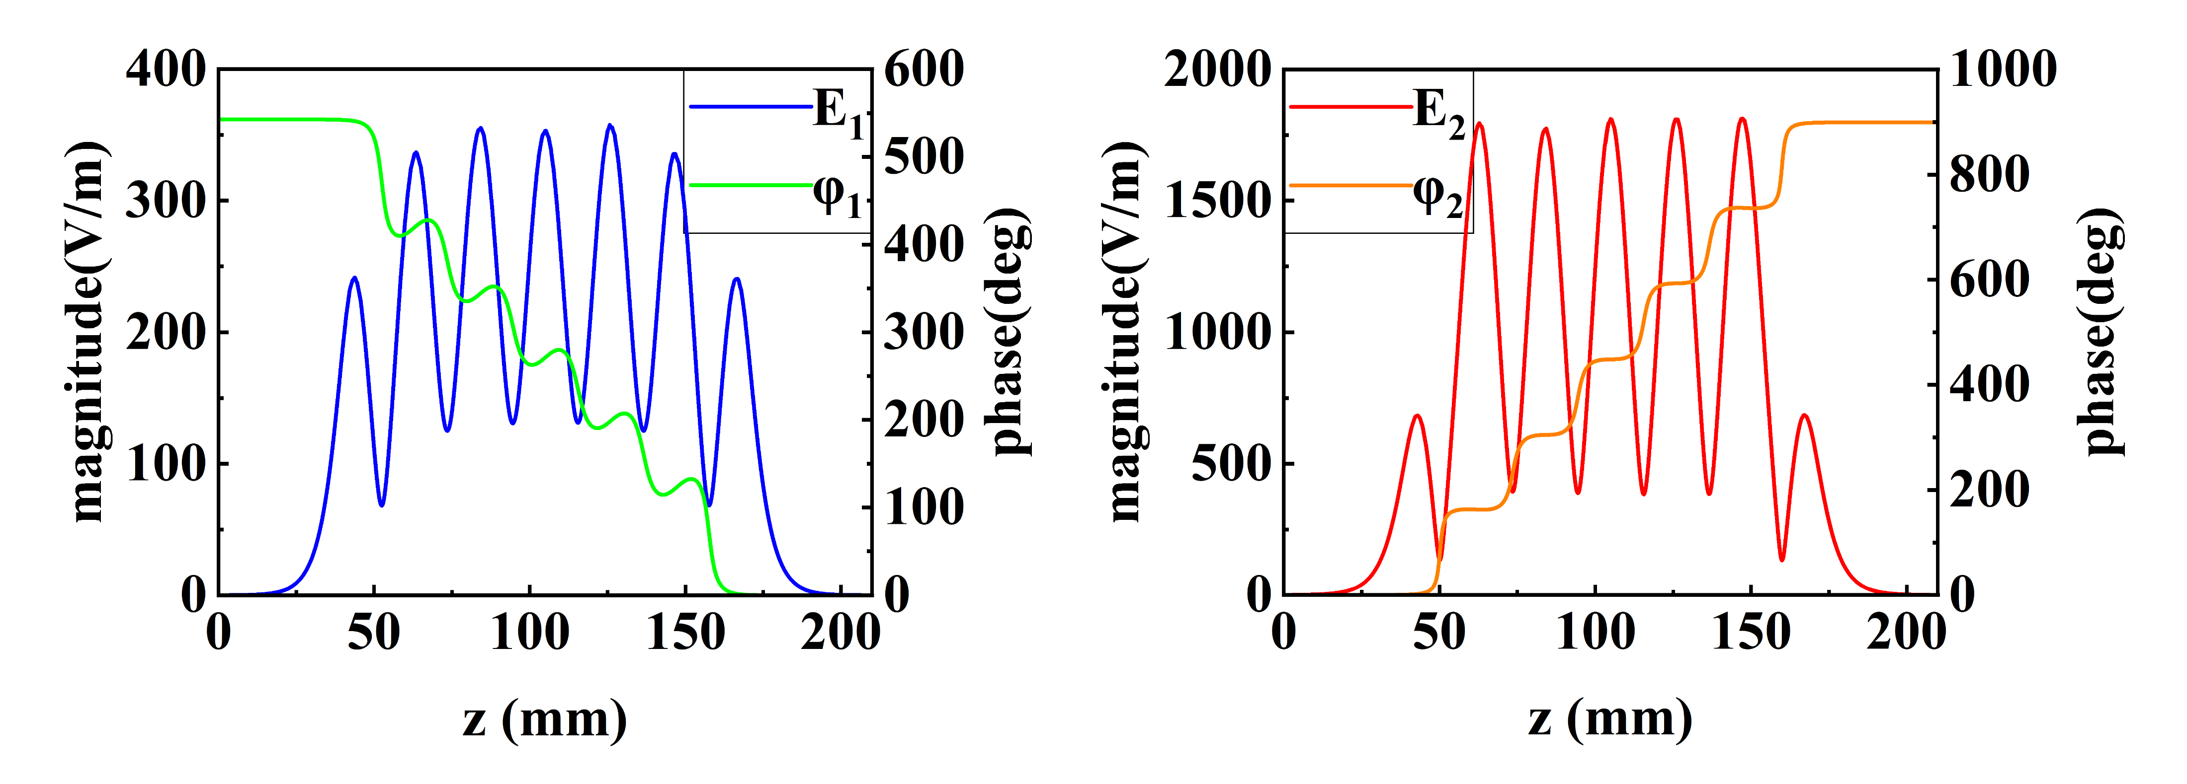
Result
Both modes are successfully excited
The high-frequency isolator provides good total reflection to the HEM₁₂ mode.
Electric field maximum flatness is better than 99%

Slide 15
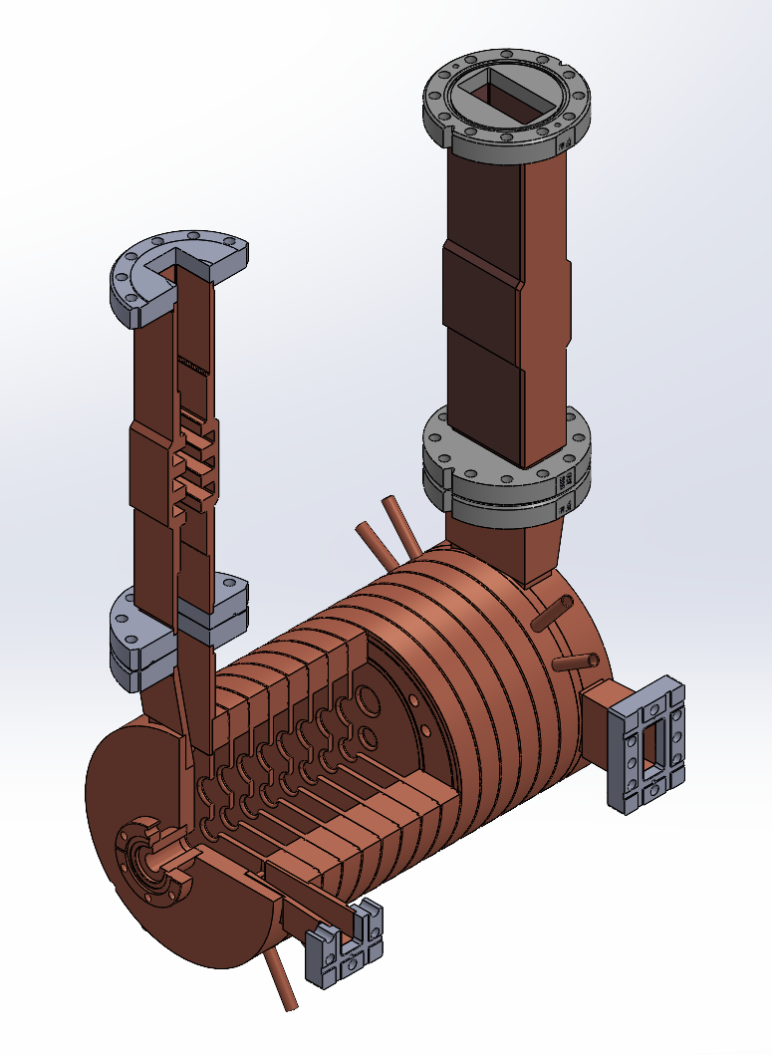
Prospect
The deflecting voltage is more than 20 MV/m with 50 MW input power
The engineering design is completed and under fabrication

Slide 16
Plan
High power test
Beam test
6D phase-space reconstruction

Slide 17
Summary
The dual-mode TDS can provide a variably polarized deflecting voltage more than 20 MV/m and switch the deflecting direction in less than 1 µs.
The HEM₁₂ mode is innovatively adopted as the deflecting mode.
A new type of inter-cavity coupling is adopted.
An isolator is added to avoid the overflow of high-frequency power.
Neural network and multiple-objective algorithm are successfully used to improve the optimization speed and precision.

Slide 18
Thank you！

