Slide 1
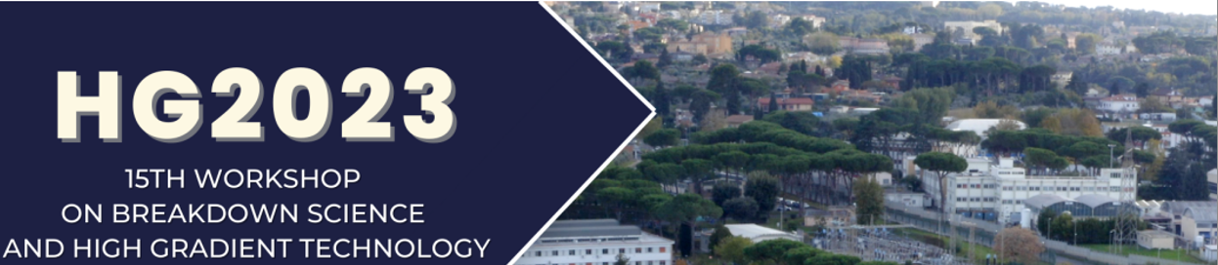
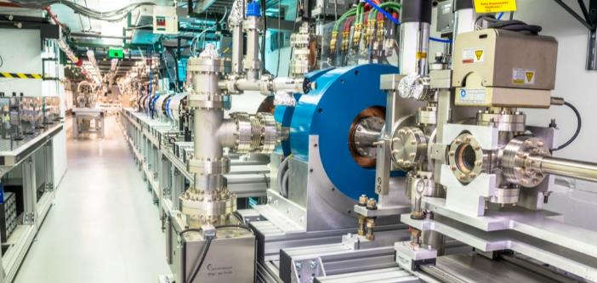
Short-pulse RF research at the AWA facility
JOHN POWER
On behalf of the AWA facility at Argonne National Laboratory
Oct 17, 2023
https://www.anl.gov/awa

Slide 2
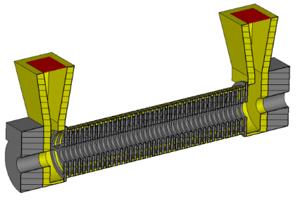
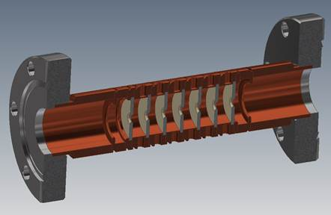
Next-Generation Accelerator technology at the AWA
enabling
GV/m STRUCTURE WAKEFIELD acceleration
to produce
bright GeV-class electron beams
at the
Argonne Wakefield accelerator
BASIC RESEARCH
….. on 3 THEMES (next slide)
DEVELOPING APPLICATIONS
….. NEAR-TERM & MID-TERM as stepping-stones towards a LONG-TERM e+/e- LC.

Slide 3
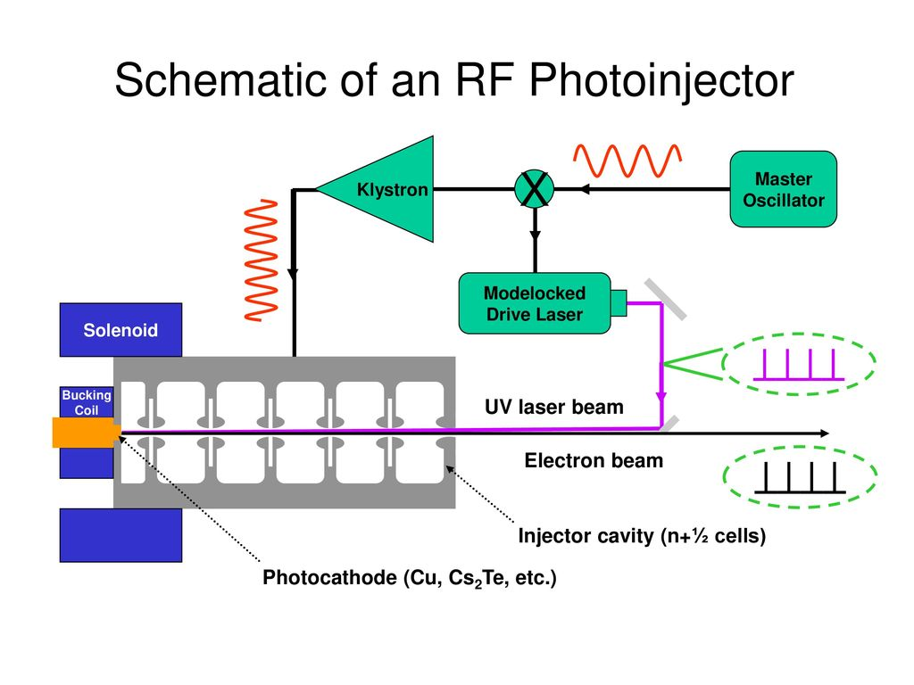
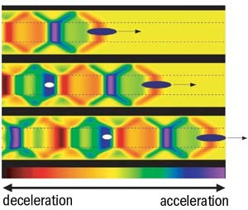
AWA Research themes
Timeless research themes
APPLICATION
THEME 1
THEME 2
THEME 3
Beam Production
Beam Manipulation
Advanced Acceleration
e.g. SWFA
10 TeV Linear Collider
  10 GeV Compact XFEL
10 MeV UED
not exhaustive
e.g. RF Photoinjector
e.g. Double Emittance Exchange
Beam manipulation and control.
Beam Diagnostics.
High-brightness sources
High-charge sources
Novel cathodes
Structure Wakefield Acceleration
        Two beam acceleration
        Collinear wakefield acceleration
Plasma Wakefield Acceleration

Slide 4

e-beam Driven Structure Wakefield Acceleration (SFWA)
Collinear Wakefield Acceleration
Two Beam Acceleration
main beam
MB
main beam
Accelerator
drive beam
DB
drive beam
Power Extraction and Transfer Structure (PETS)
PWFA-like
Klystron-like
A. Zholents, et al, NIMA 829, 190-193 (2016)​
A. Zholents, et al, Proceedings of IPAC2018​
CLIC CDR​: https://project-clic-cdr.web.cern.ch/CDR_Volume1.pdf​
W. Gai, C. Jing, J.G. Power, JPP 78, 339-345 (2012)​

Slide 5
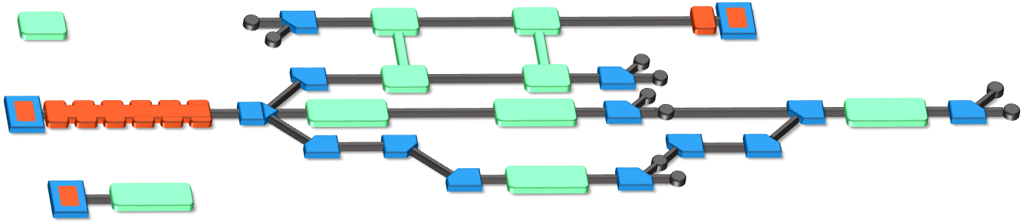
The Argonne Wakefield Accelerator (AWA) Facility
Beam Test Facility to enable novel acceleration
https://www.anl.gov/awa
Witness RF photoinjector (15 MeV)
Provides two-beam capability
Bright beams for low-energy experiments
Drive RF Photoinjector (65 MeV)
  single bunch: 100nC
  bunch train: 600 nC
Experimental Switchyard
Highly reconfigurable
6D phase space manipulation
Argonne Cathode Test Stand (2-4 MeV)
Cathode research and diagnostics
Physics of high-gradient breakdown
Laser
100 mJ (IR), 10 mJ (UV),
300 fs – 6 ps (UV)
temporal shaping

Slide 6


??
$$BDR∝E^{30}τ^{5}$$
??
The long and
winding road
to
High-Gradient
Kilpatrick
(1970s)
Juwen Wang
(1980s)

Slide 7
Limits to high gradient operation
Structure (most studied):
X-band, NCRF, 100<pulse length<1000 ns, OFE Copper BDR = 1e−6 m⁻¹
RF Breakdown guidelines
E_{surf} < 250 MV/m,
Pulse heating: ΔT < 50 ⁰C,
Power: abs(Sc) < 5 MW/mm²
Stored Energy: U < 1 J
Simakov, Dolgashev, Tantawi, “Advances in high gradient normal conducting accelerator structures, NIMA, Volume 907, 2018, https://doi.org/10.1016/j.nima.2018.02.085
RF Breakdown ← main problem
Field emission/dark current (unwanted beam loading and ionizing radiation can blind beam diagnostics, etc.)
Excessive conditioning time

Slide 8
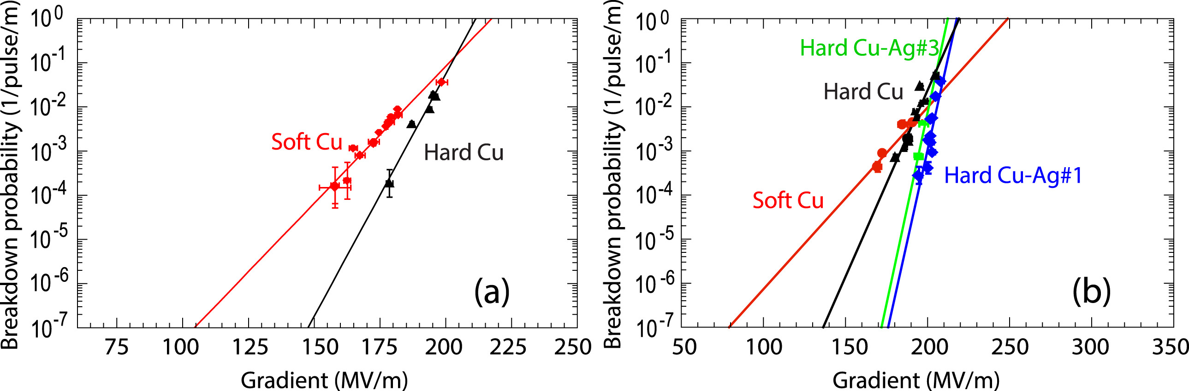
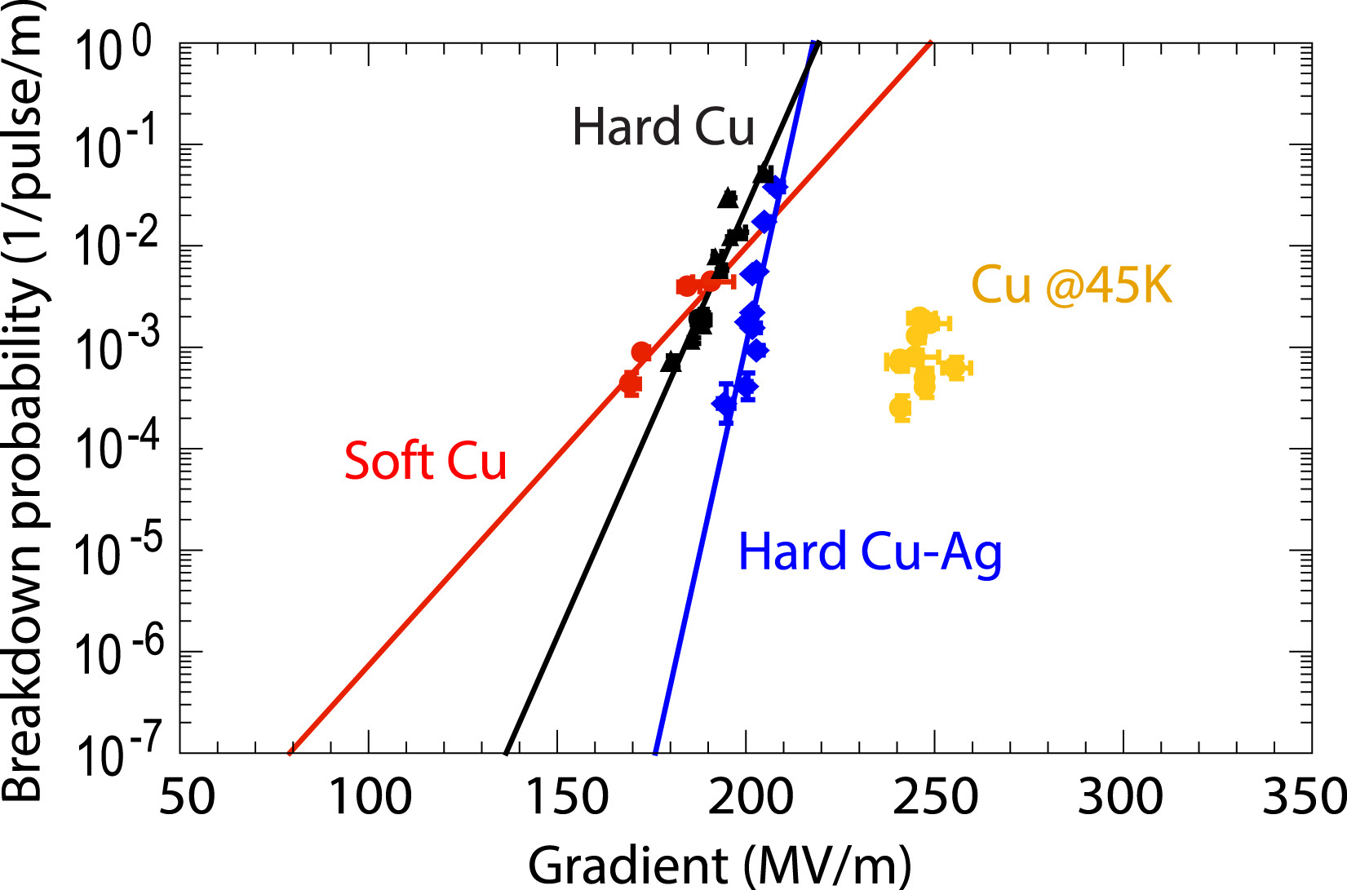
3 promising paths to higher gradients
1
Material: Hard bi-metallic alloy (SLAC: Cu:Ag 0.8% Ag)
2
Temperature: cryogenic temp (SLAC/UCLA/LANL: cold copper)
3
Short RF pulse
(ANL/Tsinghua/PSI)
Notes:
Not exhaustive list …

Slide 9
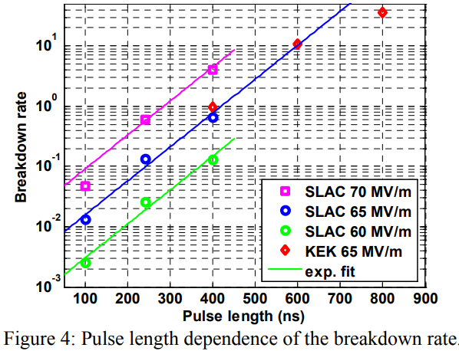
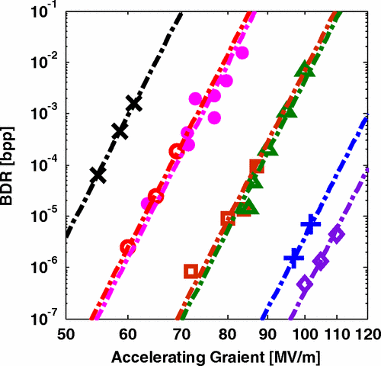
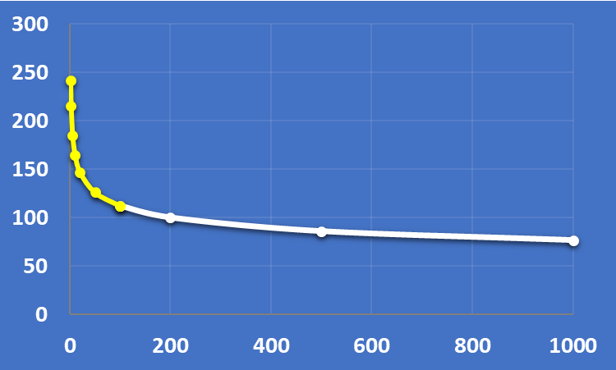
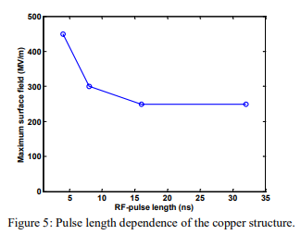


The Short Pulse RF Advantage
3
$$BDR∝E^{30}τ^{5}$$
S. Doebert et al.,PAC’05
https://accelconf.web.cern.ch/p05/PAPERS/ROAC004.PDF
A. Grudiev, S. Calatroni, and W. Wuensch
Phys. Rev. ST Accel. Beams 12,102001 (2009)
3e−7/m, 100 MV/m, 200ns
Scaling Law
0.1 μs
1 μs
long pulse regime
$$E (\frac{MV}{m})$$
Short pulse < 100 nsec
PSI: 90 nsec TW gun
Tsinghua: Short ~50 nsec
AWA/Euclid/NIU: Ultrashort ~10 nsec
klystron
CLIC 2003
TBA
New physics? Empirical scaling law, underlying mechanism may change
Challenges: Challenges to operate in the short-pulse regime: broadband couplers, efficiency, stability, etc.
H. H. Braun, et al., “High-power testing of 30 GHz accelerating Structures at CTF II”, CLIC Note 475
W. Wuensch, et al., “A demonstration of high-gradient acceleration”, PAC’03

Slide 10
TBA: RF power generation: PETS
Two Beam Acceleration
Accelerator
main beam
drive beam
Power Extraction and Transfer Structure (PETS)

Slide 11
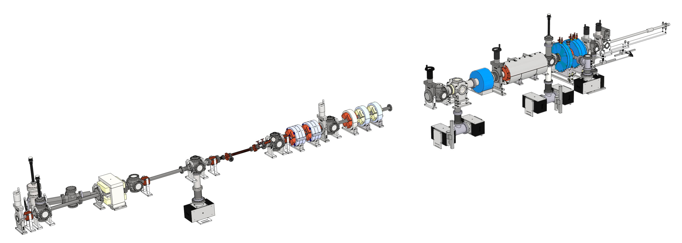
short pulse rf generation
TBA drive beam PETS
ZONE1
(Drive RF photoinjector)
Drive bunch train
-5 GW beam power
-100A, 6 nsec
……..
ZONE3a
(PETS)
…
magnets & diagnostics
1.3 GHz Drive gun (Cs₂Te photocathode)
  High charge bunch train (up to 600 nC)
  Final beam energy: ~65 MeV
…
Short RF pulse
(2 Hz)
11.7 GHz
  disk-loaded waveguide: 400 MW
  Metamaterial: 565 MW
Dielectric PETS: 80 MW
26 GHz
Notes:
X-band test has become a general capability of AWA (work underway for 26 GHz to THz)

Slide 12



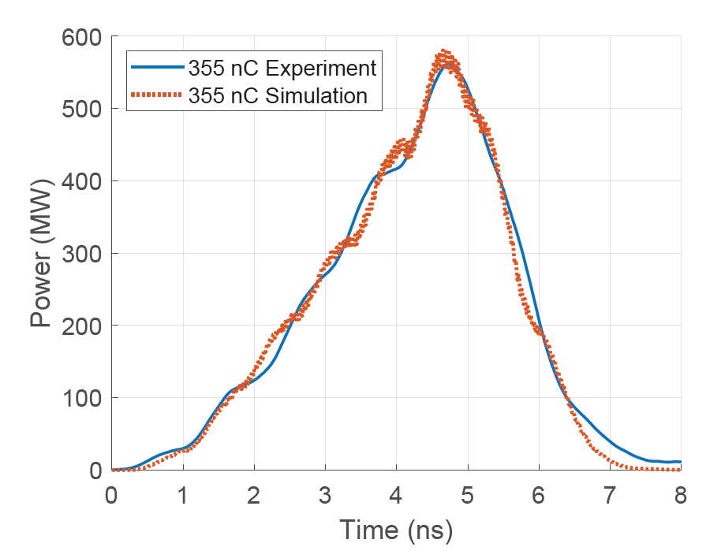
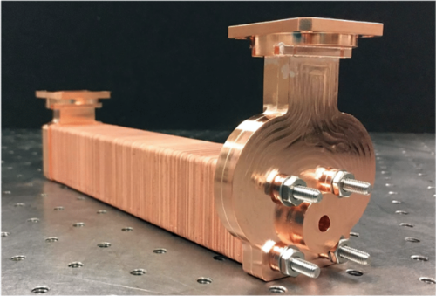
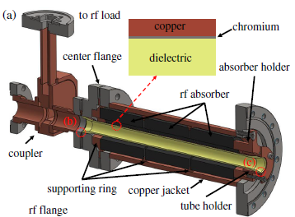
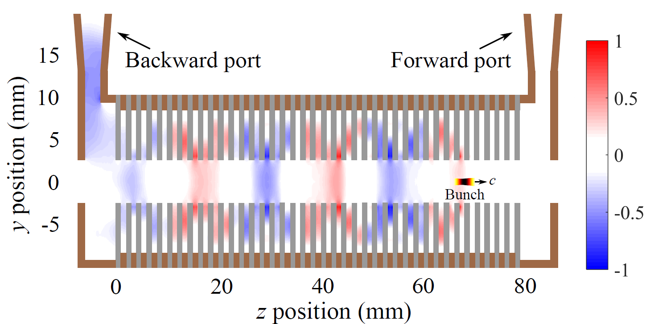
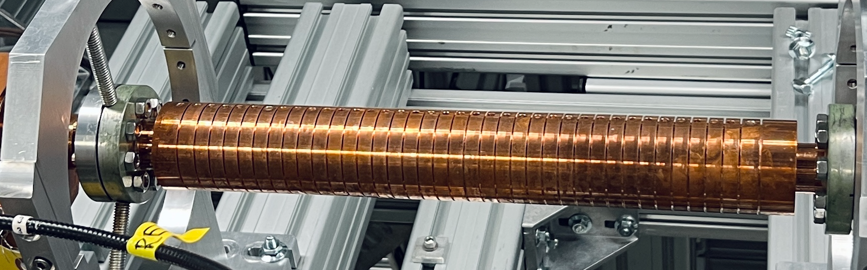
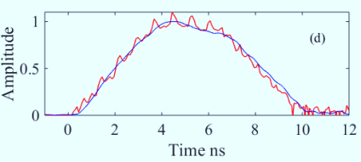
PETS results at AWA
MTM X-band PETS (565 MW)
Dielectric X-band PETS (200 MW)
DOI: 10.1103/PhysRevAccelBeams.23.011301
  Highest peak power as 565 MW from a train of eight bunches with a total charge of 355 nC
J. Picard et al., PRAB 25, 051301 (2022)
1000 MW
900 MW
800 MW
700 MW
600 MW
500 MW
400 MW
300 MW
200 MW
100 MW
0 MW
AWA energy upgrade
15 MeV → 65 MeV
X-band MTM (2021)
Metallic X-band PETS (400 MW)
X-band metallic (2020)
X-band MTM (2019)
C-band
dielectric
(2008)
X-band metallic (2018)
C-band
dielectric
(2000)
X-band dielectric (2018)
K-band dielectric (2010)
J. Shao et. al., https://accelconf.web.cern.ch/ipac2019/papers/MOPRB069.pdf
2000 2005 2010 2015 2020 2025

Slide 13
TBA: high-gradient structures: accelerator
Two Beam Acceleration
Accelerator
main beam
drive beam
Power Extraction and Transfer Structure (PETS)

Slide 14
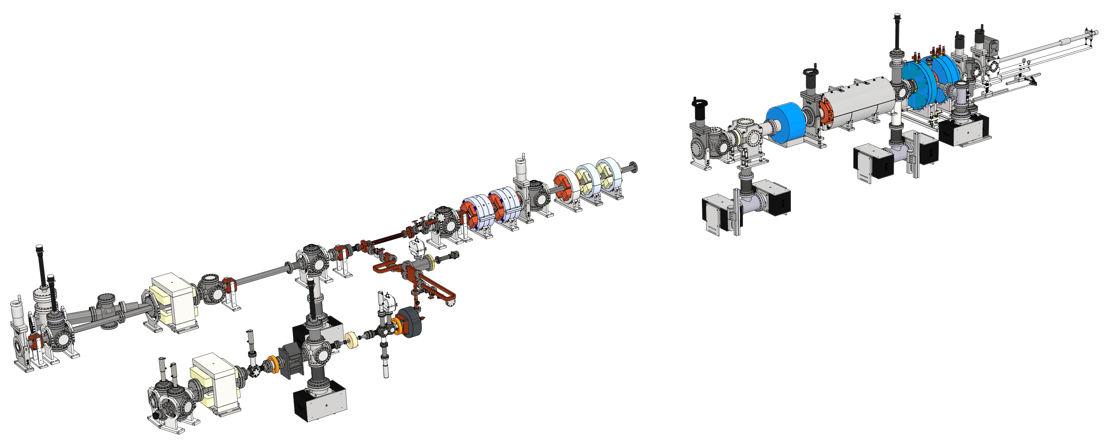
High gradient structure test stand
…
ZONE3a
(PETS)
ZONE1
(Drive RF photoinjector)
Beam on YAG1
…
Example:
X-band gun beamline
high gradient test stand

Slide 15
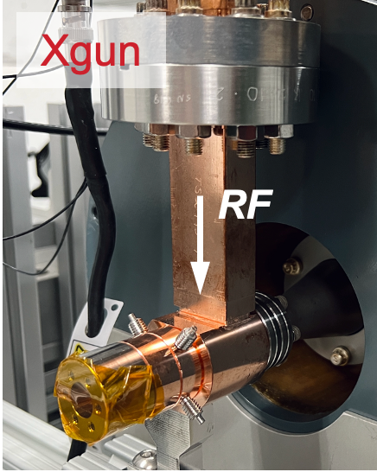
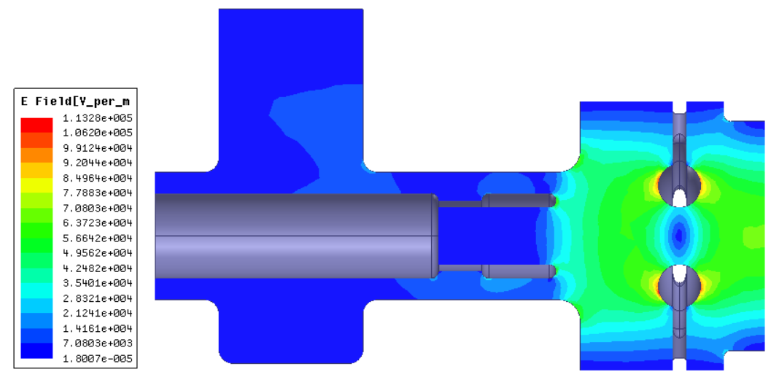
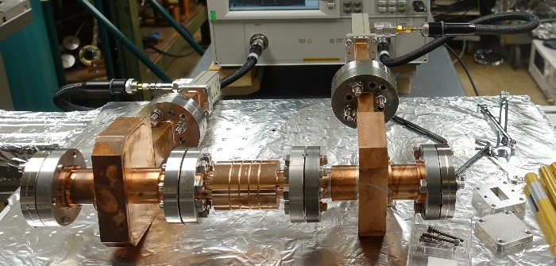
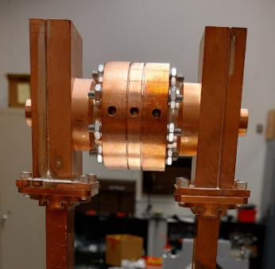
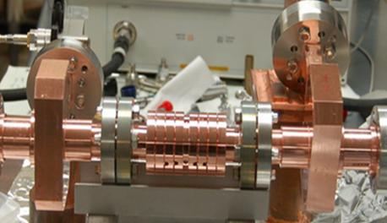
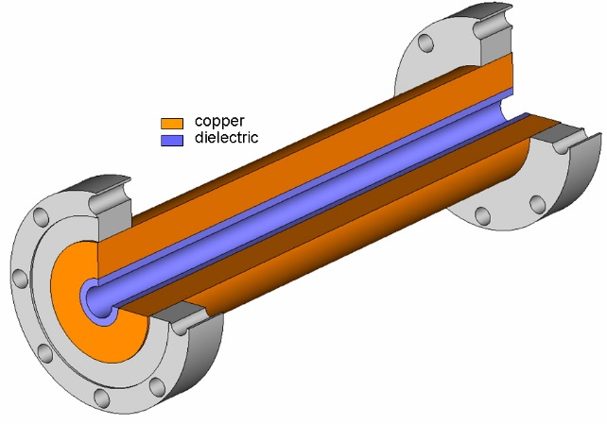
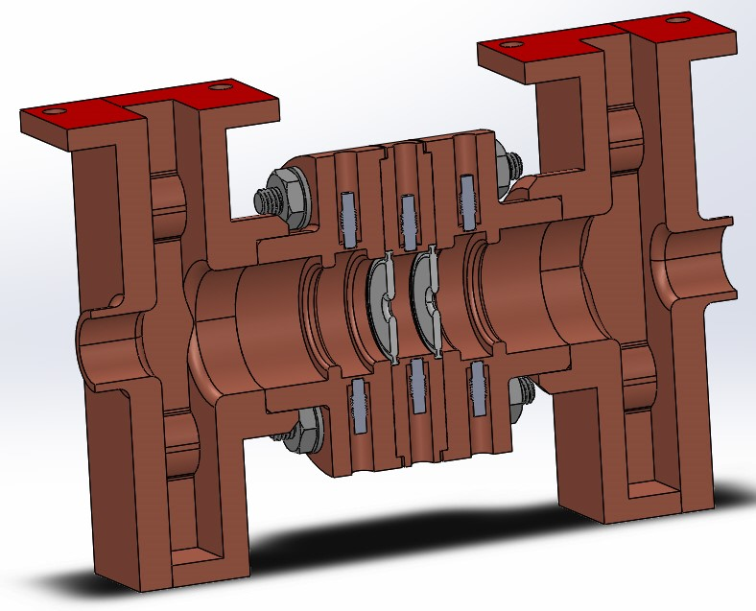
HIGH GRADIENT ACCELERATING STRUCTURES
400 MV/m
350 MV/m
300 MV/m
250 MV/m
200 MV/m
150 MV/m
100 MV/m
50 MV/m
0 MV/m
X-band PC Gun (2021)
AWA energy upgrade
15 MeV → 65 MeV
X-band metallic (2021)
1.5 cell X-band Photocathode Gun
X-band MTM (2023)
C-band TBA
DLA (2008)
W-band CWA metallic (2015)
X-band metallic (2018)
X-band TBA DDA (2022)
C-band TBA
DLA (2000)
C-band CWA
PBG (2009)
K-band TBA DLA (2018)
Metamaterial Accelerator
2000 2005 2010 2015 2020 2025
Single-cell Disk Loaded Waveguide
Dielectric Loaded Accelerator (DLA)
Single-cell Dielectric
Disk Accelerator (DDA)
3-cell Disk Loaded Waveguide

Slide 16


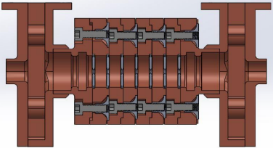
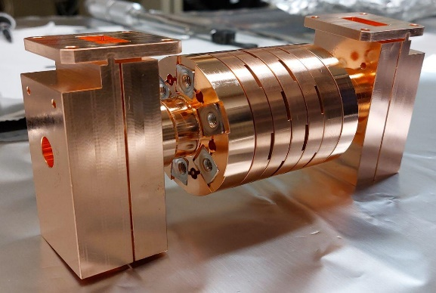
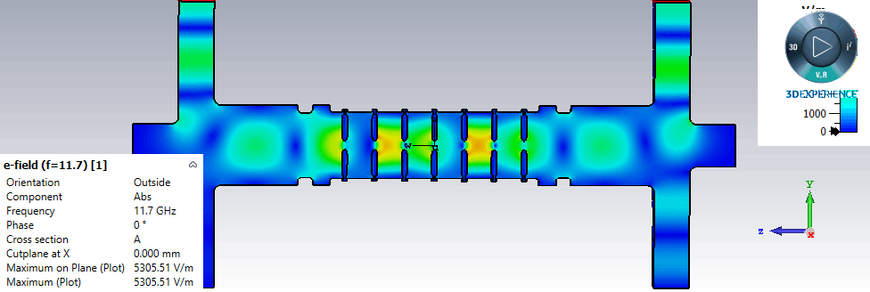
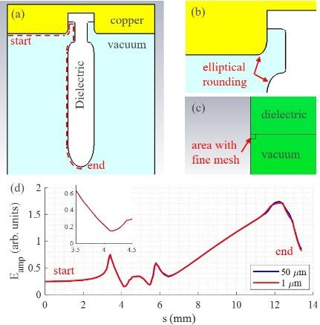
100 MV/m Dielectric Disk Accelerator
Next step: Multicell DDA
Special attention to triple junction design
Clamped structure, like single cell.
RF design and fabrication are completed
High-power test results (Summer 2023)
AWA drive gun arcing limited run to 293 nC
PETS = 222 MW
Gradient ~78 MV/m (no arcing, no multipactor)
Drive Gun working now, will continue testing in November
See poster: Sarah Weatherly
16

Slide 17
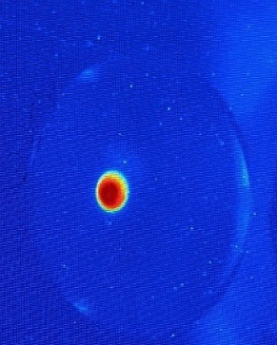
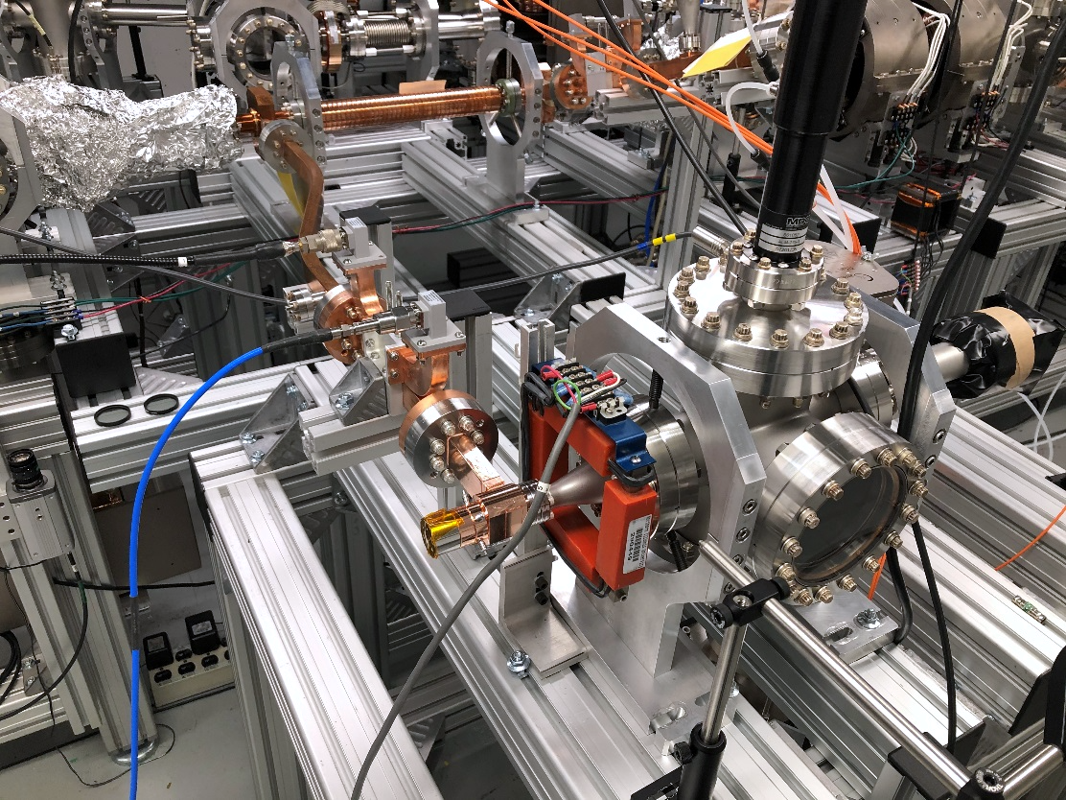
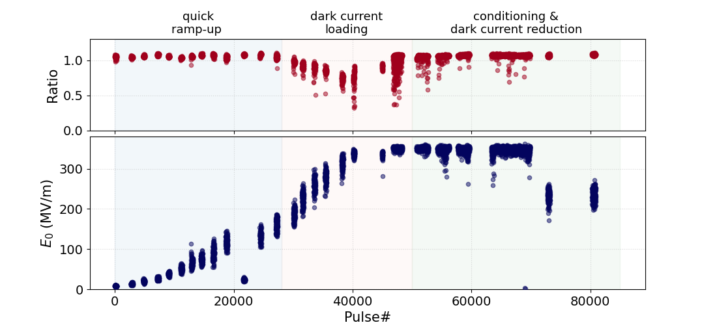
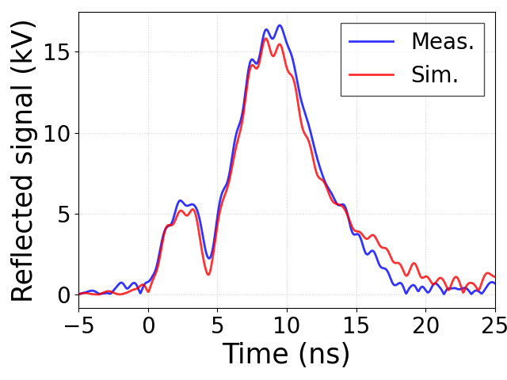
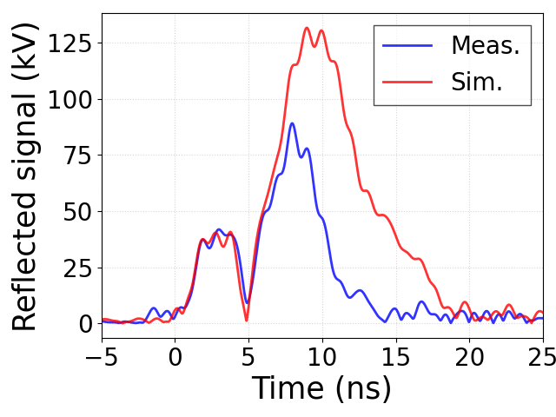
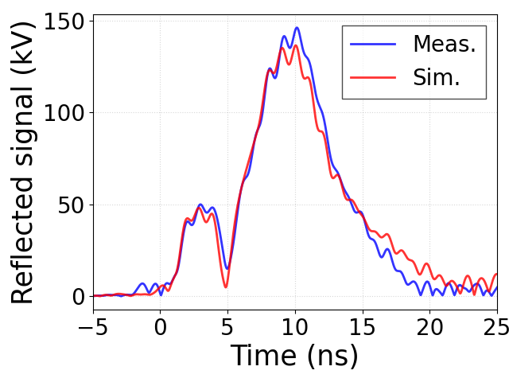
Initial rf conditioning of Xgun*
First beam
Xgun conditioning
test stand
Faraday cup & YAG
RF
Xgun
Gun performance
  387 MV/m on the photocathode
  BDR ~4e-6 (estimated)
  Ultra low dark current (<1pC per RF pulse)**
quick ramp-up
dark current loading
conditioning & dark current reduction
**J. Shao et. al., 10.1103/PhysRevLett.115.264802
*W.H.Tan et. al., Phys. Rev. Accel. Beams 25, 083402, August 2022 (2022)
Notes:
Shao’s PRL ref from 2015 that shows field emission depends on stored energy.

Slide 18
SHORT-PULSE REGIME
X-band RF test stand (500 MW, 2 Hz)
  RF power generation
    565 MW metamaterial PETS
    400 MW metallic PETS
    200 MW dielectric PETS
  High-gradient structures
    300 MV/m X-band TW accelerating metallic accelerator
    400 MV/m X-band photocathode gun
    100 MV/m X-band TW dielectric disk accelerator
    100 MV/m X-band transverse deflector
      Discovery of BIAR regime (see HG2022 Jiahang Shao)
Next Steps
  Test Xgun V1 to higher gradients … once Xgun V2 is working
  Generate higher-charge drive dunch trains
  Demonstrators
    100 MeV high-brightness Xgun photoinjector beamline
    500 MeV demonstrator
  Upgrade AWA drive beam energy from 65 MeV to ~130 MeV
summary

Slide 19
Big Thanks to our team!
Gongxiaohui Chen (AWA) Scott Doran (AWA) Alex Ody (AWA) Wanming Liu (AWA) John Power (AWA) Charles Whiteford (AWA) Eric Wisniewski (AWA) Gwanghui Ha (was at AWA, now at NIU) Jiahang Shao (was at AWA, now at IASF) Maomao Peng (was at AWA) | Chunguang Jing (Euclid Techlabs / AWA) Ernie Knight (Euclid Techlabs) Sergey Kuzikov (Euclid Techlabs) Ben Freemire (Euclid Techlabs) Sergey Antipov (Euclid Techlabs, now at PALM Scientific) Xueying Lu (NIU / AWA) Philippe Piot (NIU / AWA) Emily Frame (NIU) Wei Hou Tan (NIU, now at SLAC) Sarah Weatherly (IIT)
We also thank funding agencies: DoE HEP and SBIR programs and ANL LDRD.

Slide 21
extras

Slide 22
Short-pulse high-power test at AWA
BD type I
BD type II
- Distorted main pulse
- Disappeared after conditioning
- Likely to be caused by multipacting
- Blocked secondary pulse and normal main pulse
- Probability decreases after conditioning
- Likely to be caused by RF breakdown
H. Xu et al., PRAB 22, 021002 (2019)
Main pulse
Main pulse
Secondary pulse
Secondary pulse

Slide 23

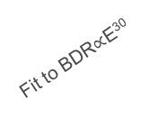
Results discussion (I)
Comparison of short and long pulse results
Accelerating gradient of the normal cell and the input matching cell reaches 270 MV/m and 310 MV/m
Surface field of the input matching cell reaches 500 MV/m
Gradient improved at least twofold using short pulse (limited conditioning period, only secondary pulse taken into consideration)
BDR vs. pulse length doesn’t follow the empirical scaling law in short-pulse regime
$${(\frac{54 ns}{6 ns})}^{1/6}$$
Fit to BDR$∝$E³⁰
New physics of RF breakdown in short-pulse regime

Slide 24
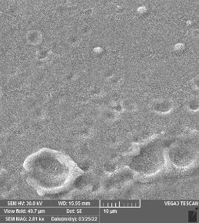
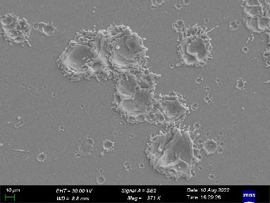
Results discussion (II)
Breakdown Insensitive Acceleration Regime (BIAR)
0 ns
RF causes BD and plasma generation
RF pulse
after ~10 ns
Plasma expansion to block RF transmission
ANL: ϕ10-20 μm
Tsinghua: ϕ30-100 μm
Transmitted RF pulse and accelerated beam not influenced by RF breakdown
Reduced structure damage due to limited energy available for breakdown avalanche

Slide 25
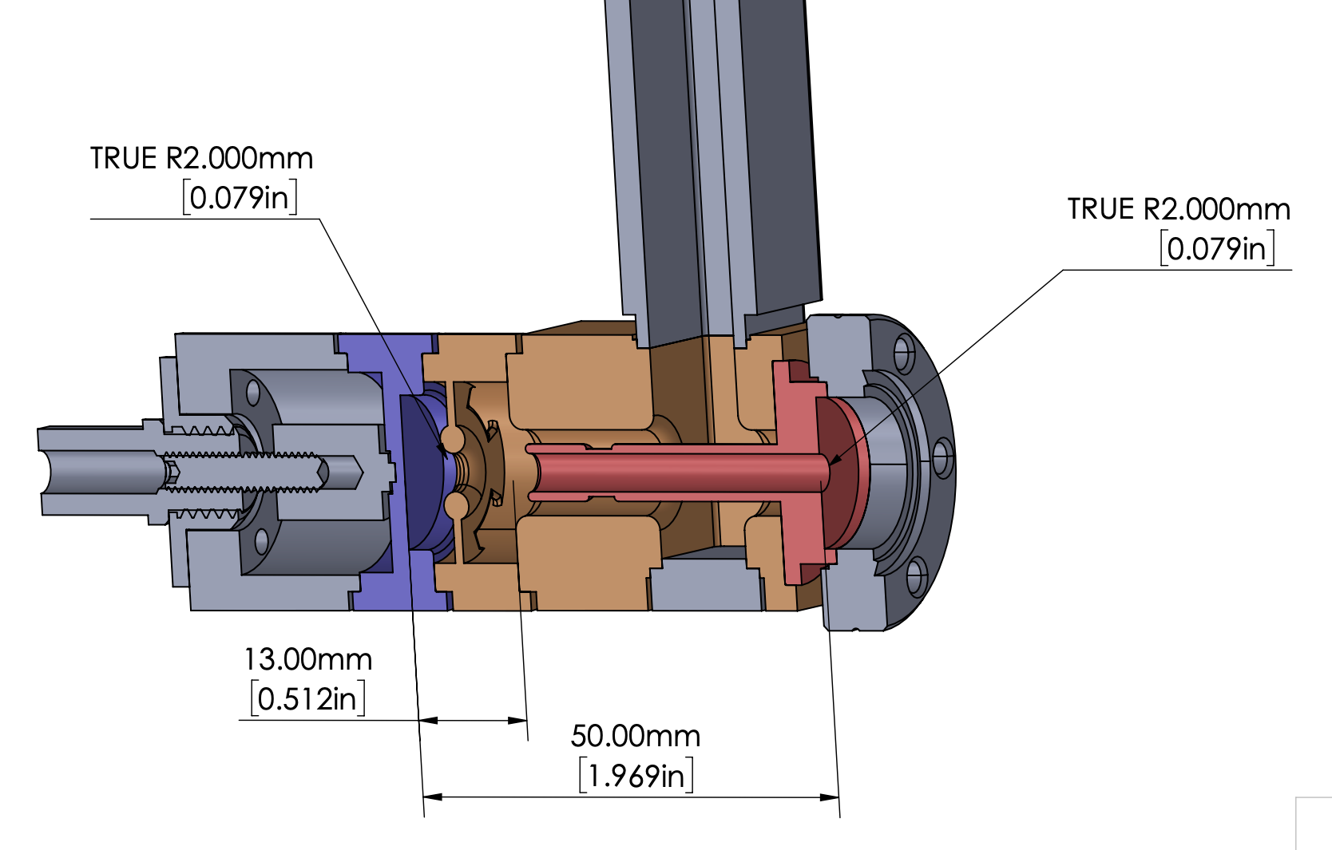
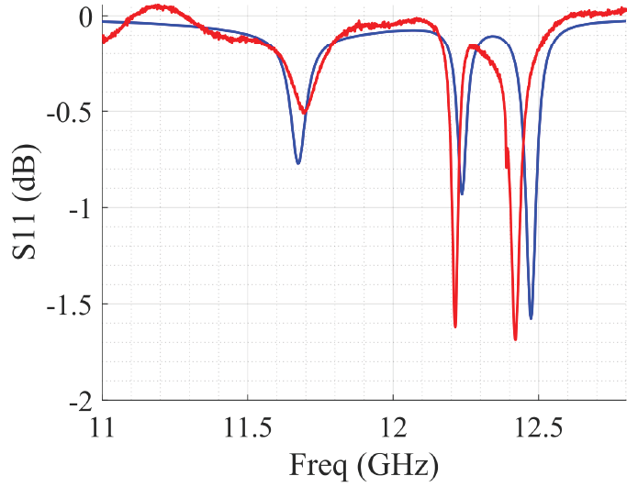

Xgun: 1.5 cell RF photocathode gun
RF
RF Design
IRIS DISK
COAXIAL RF-INPUT COUPLER
Parameter | Value
Frequency | 11.7 GHz
Mode | π
t_fill | 5.4 nsec
RF pulse length | 9ns (3 ns rise, 3 ns flat, 3 ns, fall)
Power | 250
Cathode Field | 470
beam
Cathode is the Cu backwall
1.5-CELL
XGUN
RF
S11 simulation (CST)
S11 measurement (N.A.)
Overcoupled $π$-mode @11.7 GHz
S. Kuzikov et al., (IPAC21)
An X-band Ultra-high Gradient Photoinjector
https://accelconf.web.cern.ch/ipac2021/papers/wepab163.pdf
25/36

Slide 26
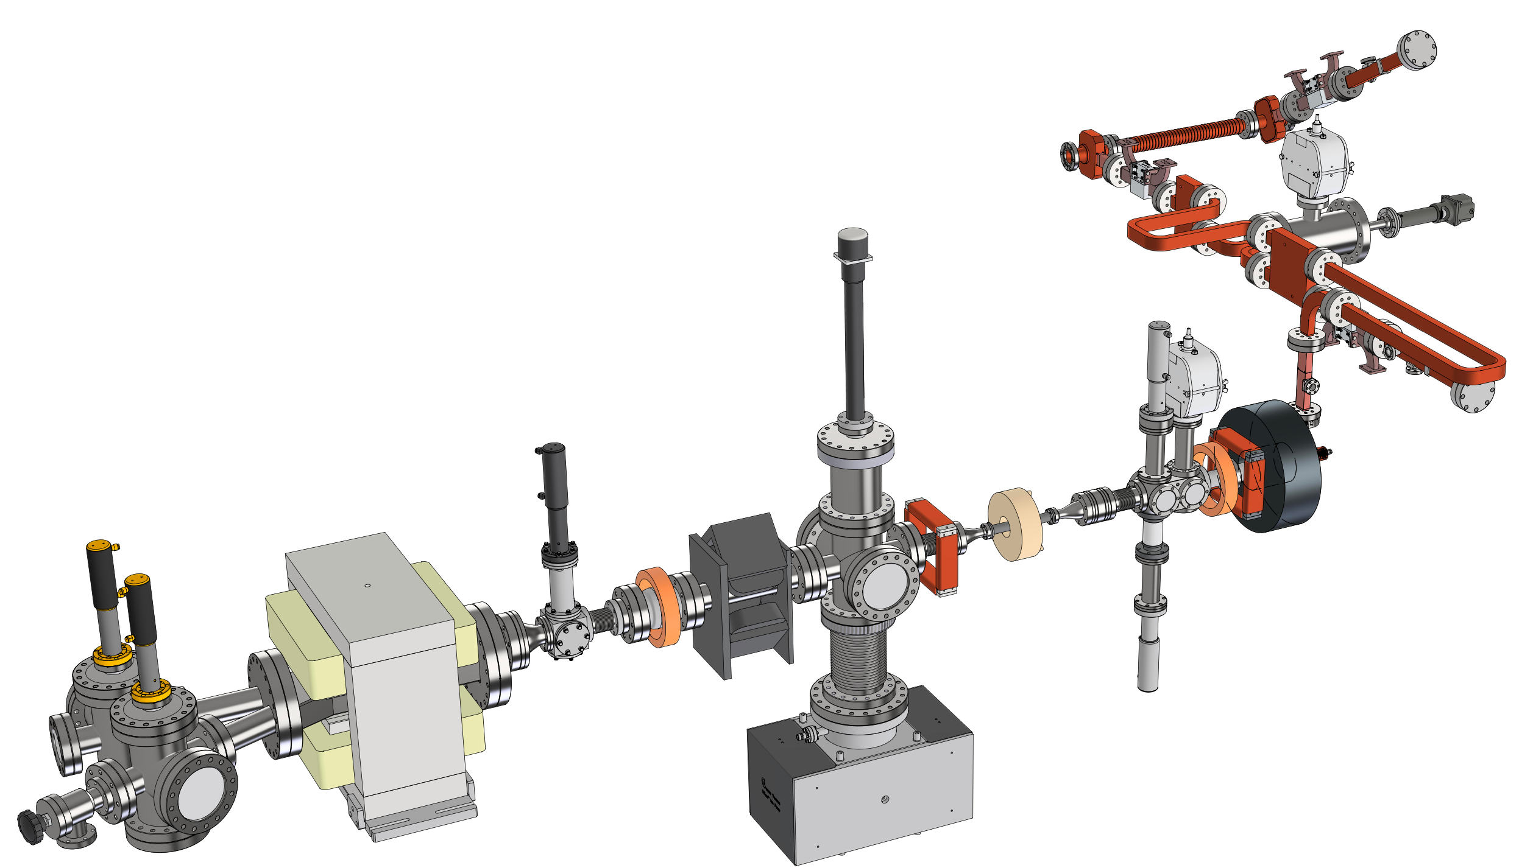
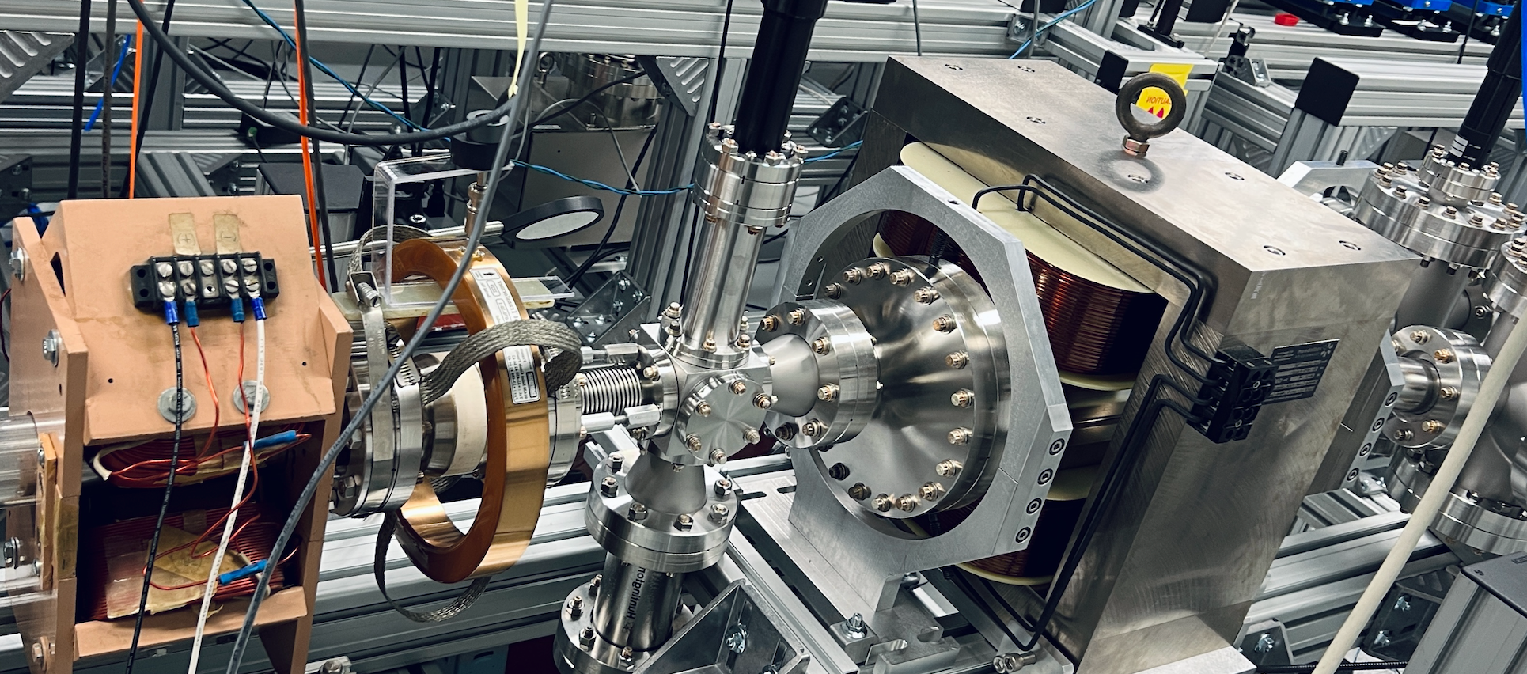
Xgun beamline
[1] M. Peng, et al., (IPAC 19)
Generation of high power short rf pulses using an X-band metallic power extractor driven by high charge multi-bunch train. https://accelconf.web.cern.ch/ipac2019/papers/MOPRB069.pdf
current configuration
PETS
drive bunch train
power splitter
spectrometer
quad
RF
YAG &
Pepper pot
imaging
solenoid
RF
rf load
YAG
(energy meas.)
spectrometer
dipole
quad
BPM
main solenoid
(w/ iron plate)
laser injects from
the 1st viewport
ICT
Xgun
[2] J. Shao, et al., (IPAC 21)
High-power test of a highly over-coupled X-band rf Gun driven by short rf pulses
https://accelconf.web.cern.ch/ipac2021/papers/thpab331.pdf
Xgun beam

Slide 27
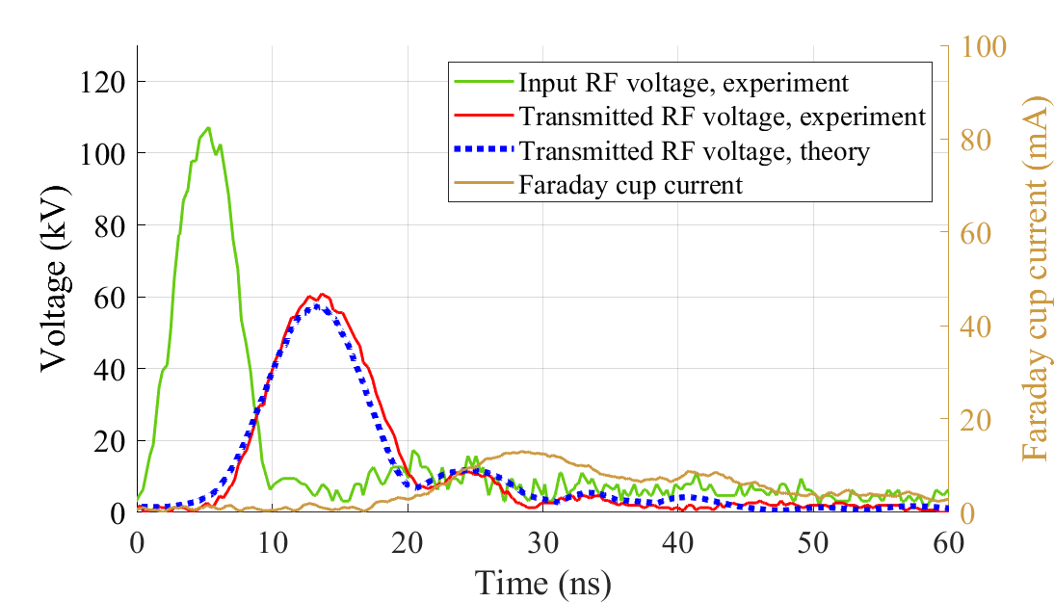
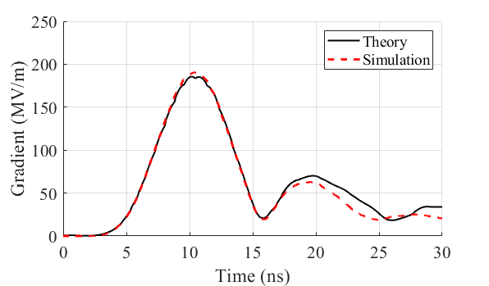
Metamaterial accelerator
Efficient structure design to explore gradient limitation
  190 MV/m peak gradient from 115 MW input RF
  11.7 GHz structure optimized for 6 ns FWHM RF pulses extracted from the drive beam
  Breakdown Insensitive Accelerating Regime (BIAR)

Slide 28
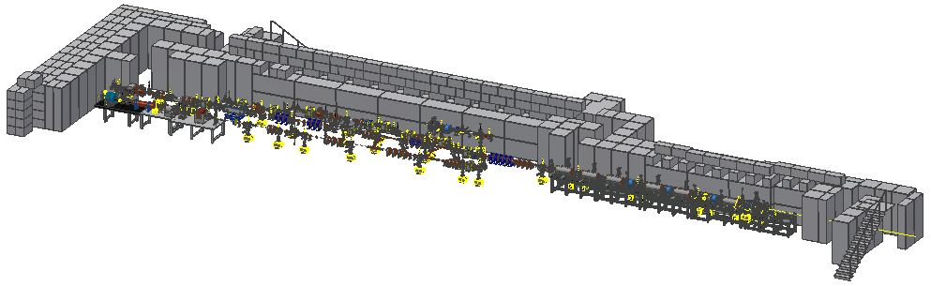
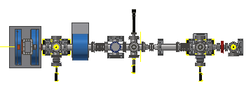

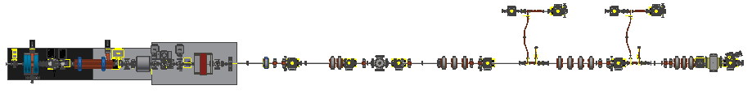
The Argonne Wakefield Accelerator
5 Zones
The AWA Bunker
Zones 2-5 are experimental areas
Zones 2, 4, and 5 have ~ 1 m experimental area
Zones 3A & 3B are fully re-configurable
EXPERIMENTAL AREA
ACT
Drive
AWA Vacuum and Experimental Zones
Witness
28/36

Slide 29


XFEL in biar?
Advantages:
Short pulses
Drive beam can generate RF at multiple frequencies
Automatically sync’ed
Challenges:
Still in research phase
Kickers
Waveguides
TBA---9GeV Compact FEL in BIAR regime
Fast filled accelerator
Yuliang Jiang, et al, PRAB 24, 112002 (2021)

Slide 30


WHY AAC? … Why SWFA?
SWFA 3 TeV linear collider
e⁻
e⁺
AAC Roadmap: PWFA, LWFA, SWFA
IP
AAC technology is versatile
Long-term
  1-10 TeV e+e- linear collider
  Higg’s Factory
Mid-term
  XFEL light sources
  Inverse Compton sources
Near-term
  Compact accelerators for societal applications or Stewardship (E.g. Industrial, Security, Medical applications.)
3TeV
SWFA XFEL
1
10
10
1
SWFA
  Positron acceleration
  Takes advantage of much existing technology from today’s accelerators
  Recent progress (few MV/m → 300 MV/m at X-band, exploring GV/m …)
30

