Slide 1

19 Oct 2023, 11:50 – 12:10
Developments of Dielectric-Assist Accelerating structure at C-band and beyond
Daisuke Satoh, Chief Researcher.
National Institute of Advanced Industrial Science and Technology (AIST)
Tetsuo Abe, associate professor.
High energy accelerator research organization (KEK)
The 15th Workshop on Breakdown Science and High-Gradient Technology (HG2023)

Slide 2
【Outline】
Motivation
Operation principle of DAA structure
Proof of principle study
✓Design and fabrication
✓Low power test
✓High power test
Toward improving DAA performance
Research plan
Dielectric assist accelerating structure, DAA

Slide 3
【Motivation】
【Comparing the Q₀ of the metal cavity and the dielectric resonator】
Normal conductor
Superconductor
Metallic
cavity
10⁴
10⁵
10⁸
10¹⁰
Q₀
Dielectric resonator
Temperature
High
Low
Low-loss Dielectric
（Al₂O₃, MgO etc…）
N. McN Alford, et al., J Eur. Ceram. Soc. 21, 2605 (2001)
1-order higher Q₀@RT
Dielectric loaded cavity has potential to become a high Q value and high Z_{sh}
Started the development of a high power efficiency accelerating structure focusing on the low RF loss characteristics of the dielectric.
Dielectric Assist Accelerating (DAA) Structure

Slide 4
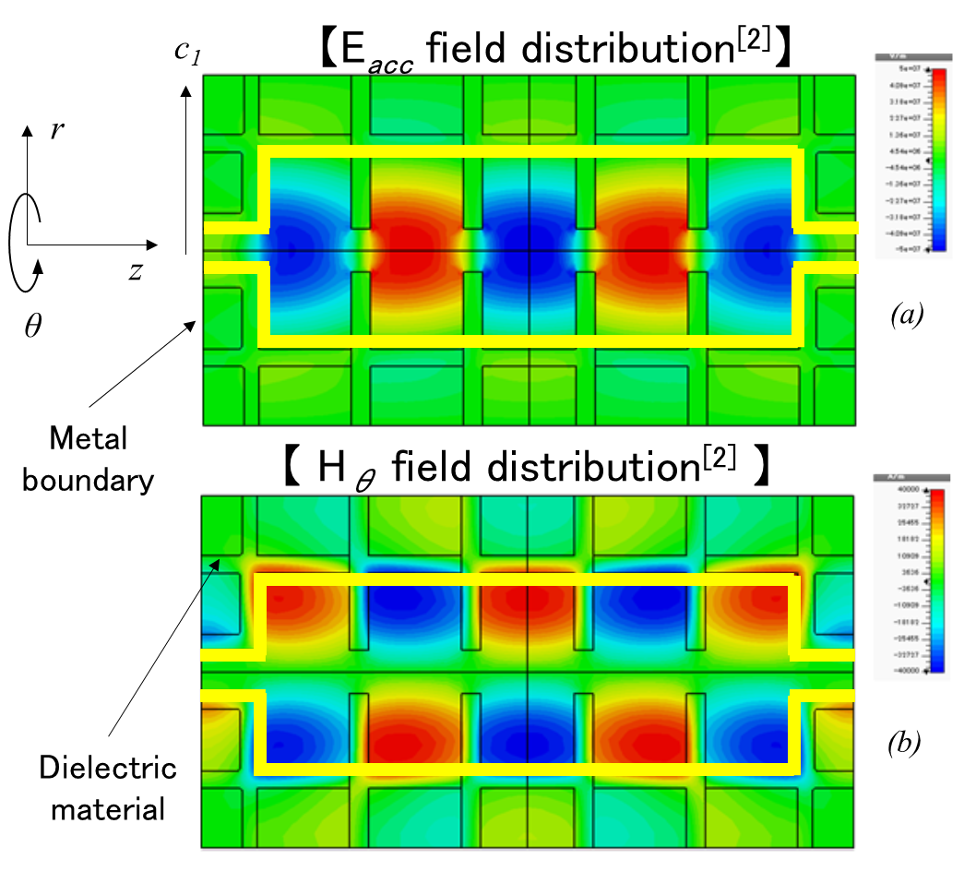
【 Operation principle of DAA structure】
【Conceptual diagram of DAA structure】
Dielectric cylinder
Dielectric disk
DAA consists of dielectric cylinders and disks with irises which are periodically arranged in a metallic enclosure.
Higher order TM_{02n} mode is used for beam acceleration.
→ Wall loss on conducting surface is drastically reduced in DAA structure
[1] D. Satoh, et al., PRAB 19, 011302 (2016)
[2] D. Satoh, et. al., PRAB 20, 091302 (2017)
TM₀₁ – π mode like
Patent : PCT/JP2016/087683

Slide 5
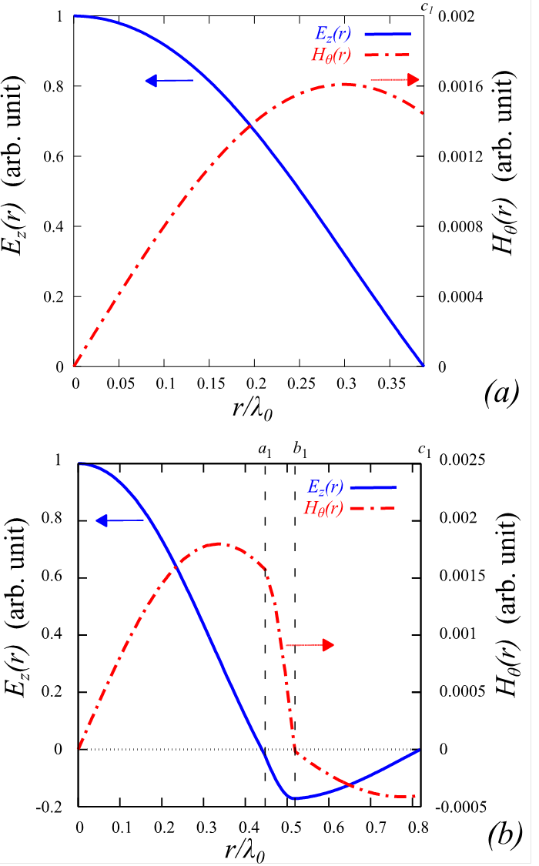
【 Mechanism of high-Q₀ 】
Wall loss on a conducting cylinder: P_{wall}
P_{wall} ∝c₁ ×|H_{θ}(c₁)| ²
* c₁: inner radius of conductive cylinder
【Pillbox cavity】
【DAA structure】
【Pillbox cavity】
c₁ = 0.39λ₀
|H_{θ}(c₁)|
|H_{θ}(r_{max})|
= 0.89
【DAA】
c₁ = 0.82λ₀
|H_{θ}(c₁)|
|H_{θ}(r_{max})|
r_{max}
= 0.23
r_{max}
|H_{θ}(c₁)| in DAA structure is almost 1/4 that of pillbox cavity
→ The wall loss on conducting cylinder is drastically reduced !

Slide 6
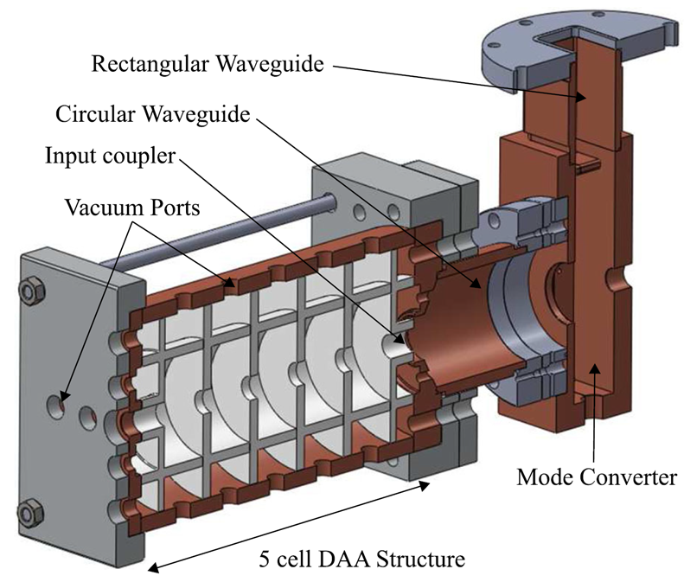
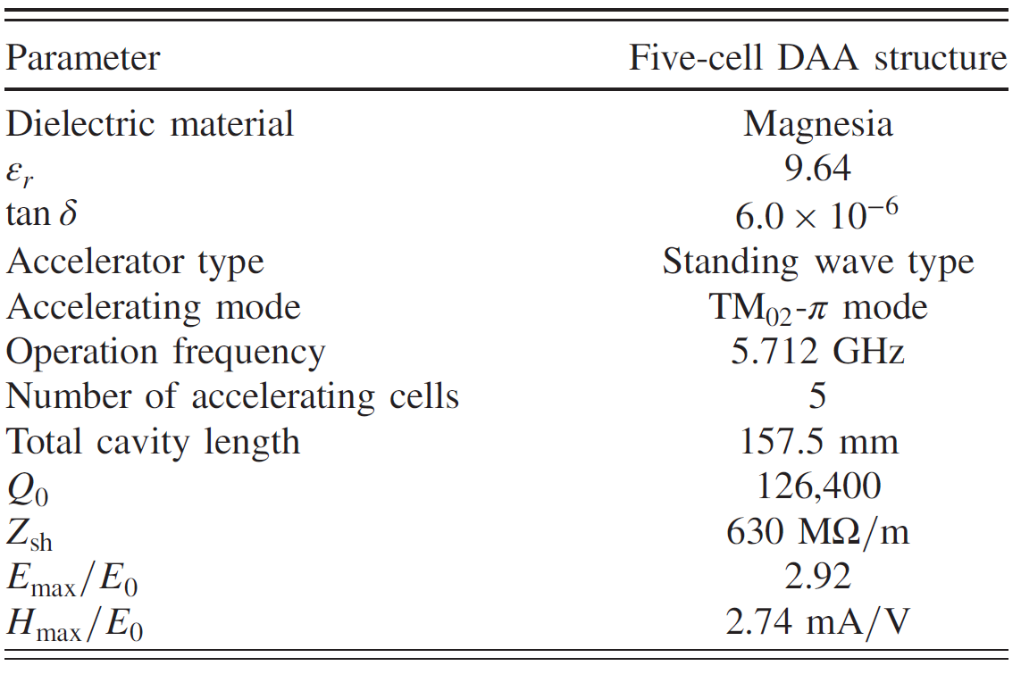
【 Design and Fabrication of prototype 】
【5 cell DAA structure^{[2]}】
【Dielectric cells^{[2]}】
【DAA structure assembly^{[2]}】
【Cavity parameters^{[2]}】
[2] D. Satoh, et. al., PRAB 20, 091302 (2017)

Slide 7
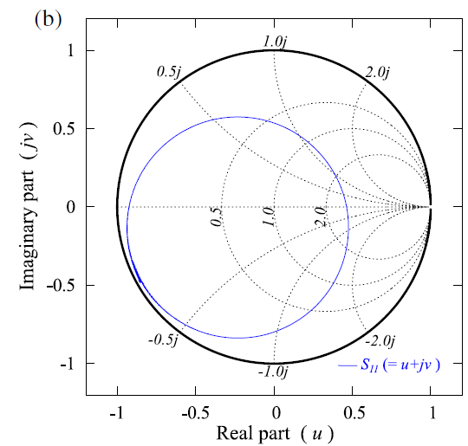
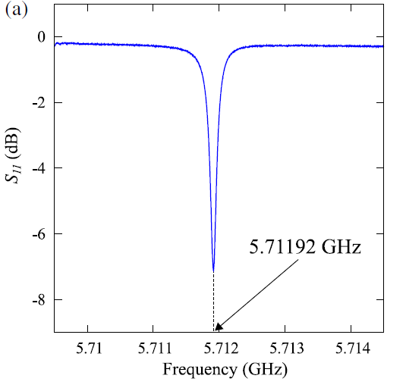
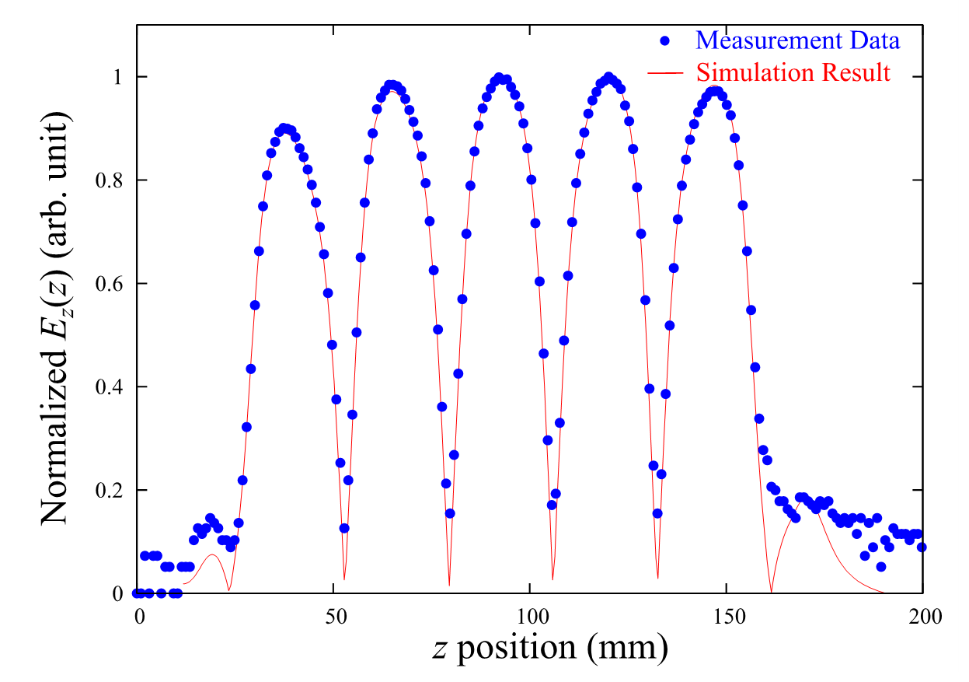
【 Low-power test of the prototype 】
【Experimental Results^{[2]}】
【E_{acc} field along beam axis^{[2]}】
Parameters | Designed values | Measured values
f₀ (GHz) | 5.7120 | 5.71192
Q₀ | 125,000 | 119,314
Q_{ext} | 48,803 | 46,246
Q_{L} | 35,112 | 33,328
β | 2.56 | 2.58
Z_{sh} = 617 MΩ/m
[2] D. Satoh, et. al., PRAB 20, 091302 (2017)

Slide 8
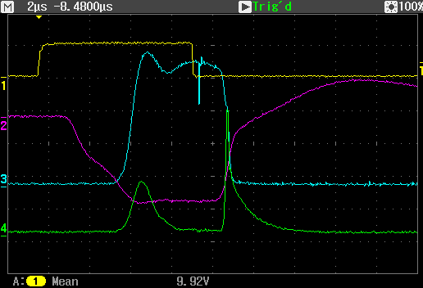
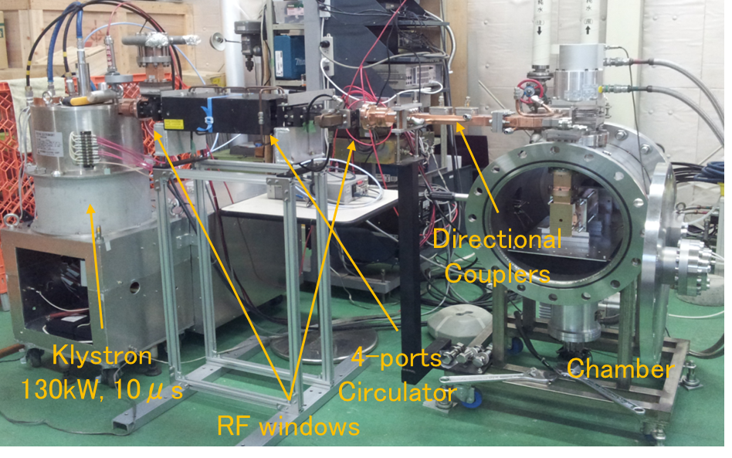
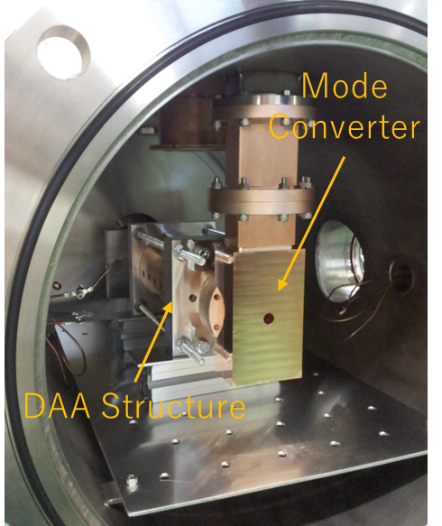
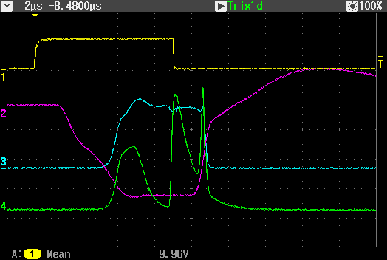
【 High power test of the prototype】
【Test stand @KEK】
【Results】
High power tests were performed with pulse width of T_{p} = 2 - 7.5 μs.
Trig.
KL HV
P_{foward}
P_{reflection}
E_{acc,max} = 2 MV/m (@ T_{p} = 2 μs) achieved.
But, it did not rise to any higher E_{acc,max} after operating for more than 6×10⁶ shots.
The longer the pulse width, the slower the progress of cavity conditioning and the lower E_{z, max} was.
Multipactor

Slide 9
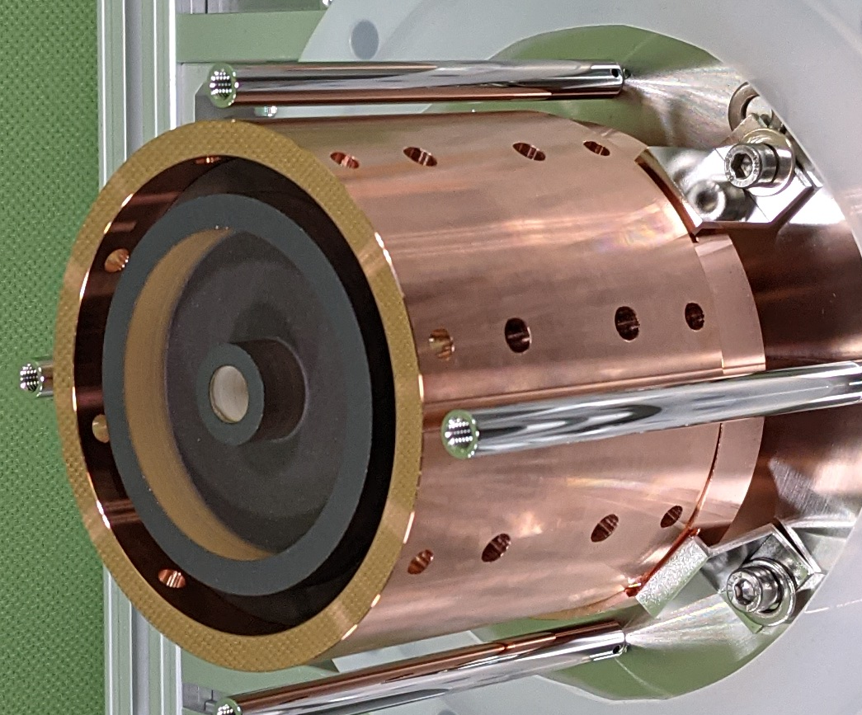
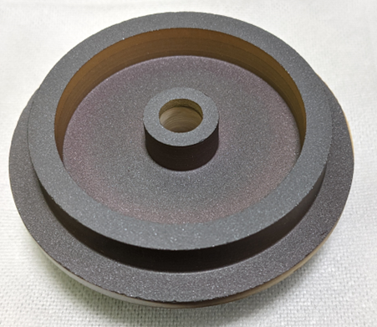
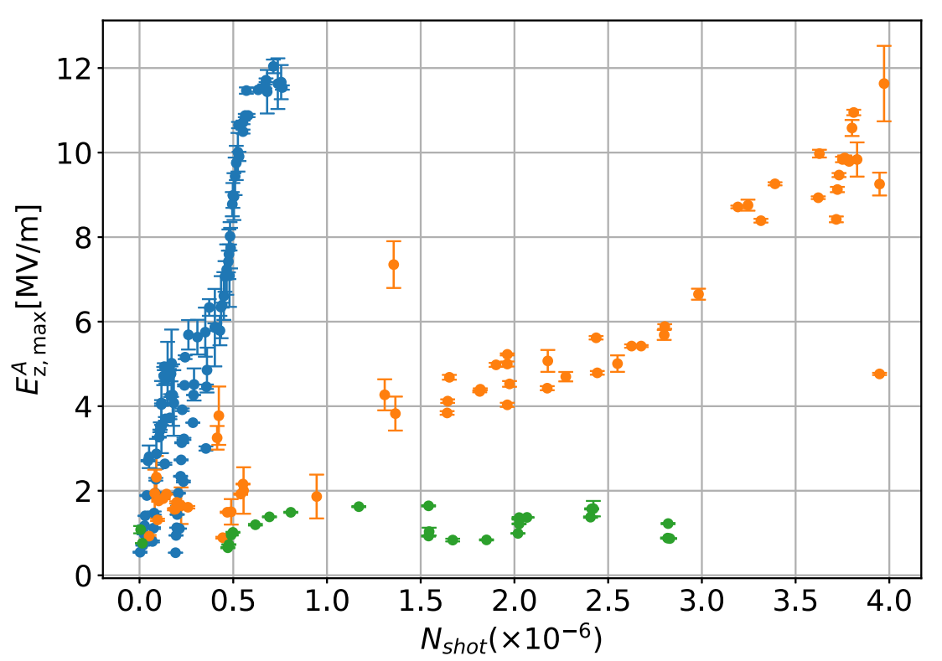
【 Diamond like carbon coating on DAA】
DLC coating is known to reduce secondary electron yield while not increasing dielectric losses.
H. Xu et al., PRAB 22, 021002 (2019).
【Secondary electron yield of MgO and DLC surface】
【DLC coated dielectric cell & DAA structure】
【Low power test^{[3]}】
Q₀-uncoated : 112,000
Q₀-DLC(a-C:H) : 113,000
Maintaining a high Q₀ value !
【High power test of DLC-DAA structures^{[3]}】
DLC, T_{p} = 0.5 μs
Succeeded in significantly reducing SEY of MgO !
E_{acc,max} = 11 MV/m (@ T_{p} = 5.4 μs) achieved.^{[3]}
However, a large breakdown caused irreversible deterioration in accelerator performance.
DLC, T_{p} = 5.4 μs
bare, T_{p} < 2.5 μs
[3] S. Mori, M. Yoshida, D. Satoh, PRAB 24, 022001 (2021)

Slide 10
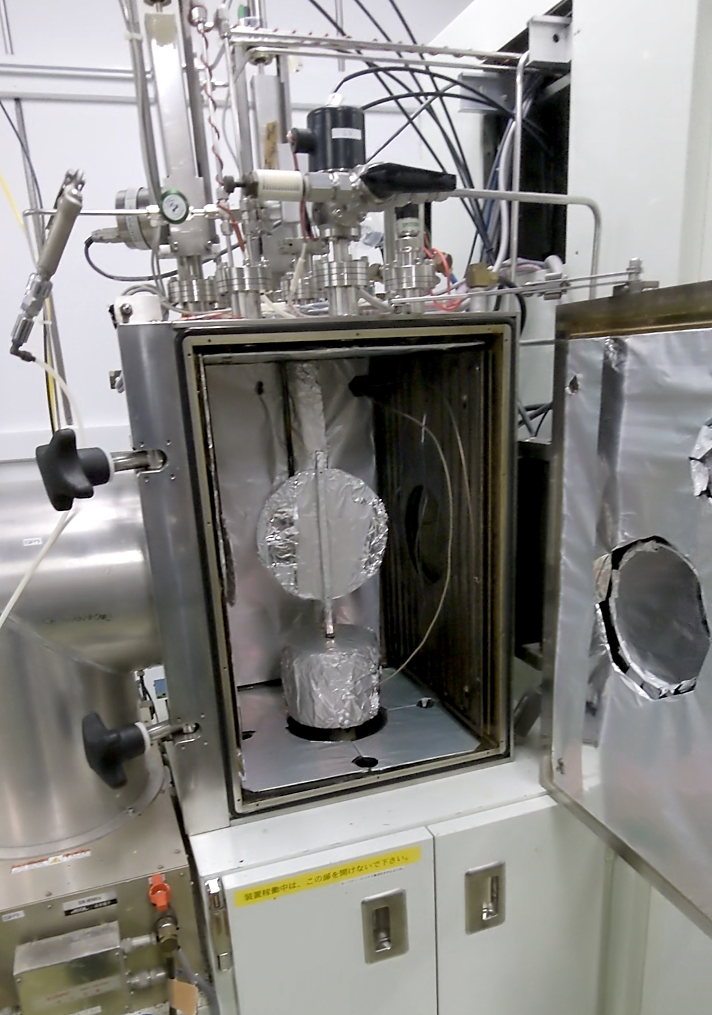
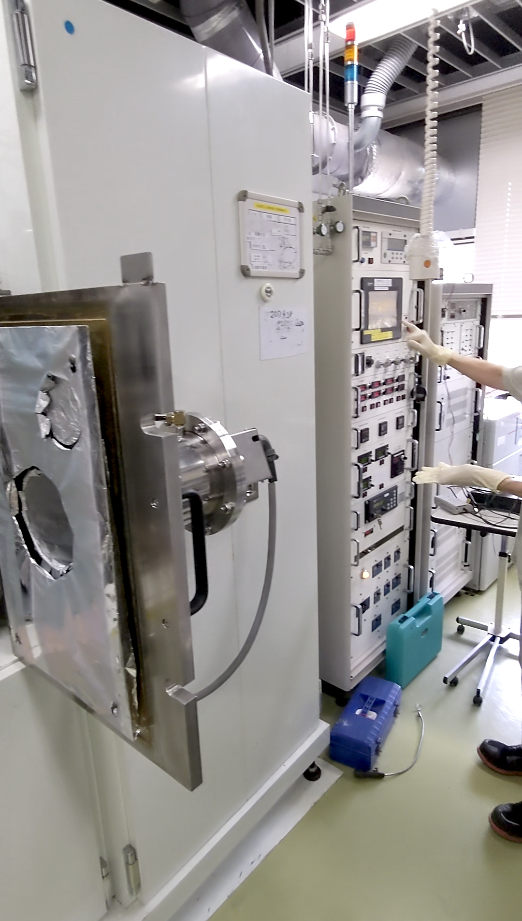
【 Toward improving DAA performance】
【 Optimization of DLC coating】
【 Dielectric cells after high power tests 】
Diamond
New work
Previous work
a-C
a-C:H
GLC
PLC
Graphite
Ref [3]
【DLC film forming equipment】
Discharge traces were observed on the edge and surface of the dielectric disk and on the outer wall surface of the dielectric coaxial structure.
CVD
Ion gun
A deep understanding of discharge phenomena in these points of DAA structures is important for higher gradient.

Slide 11
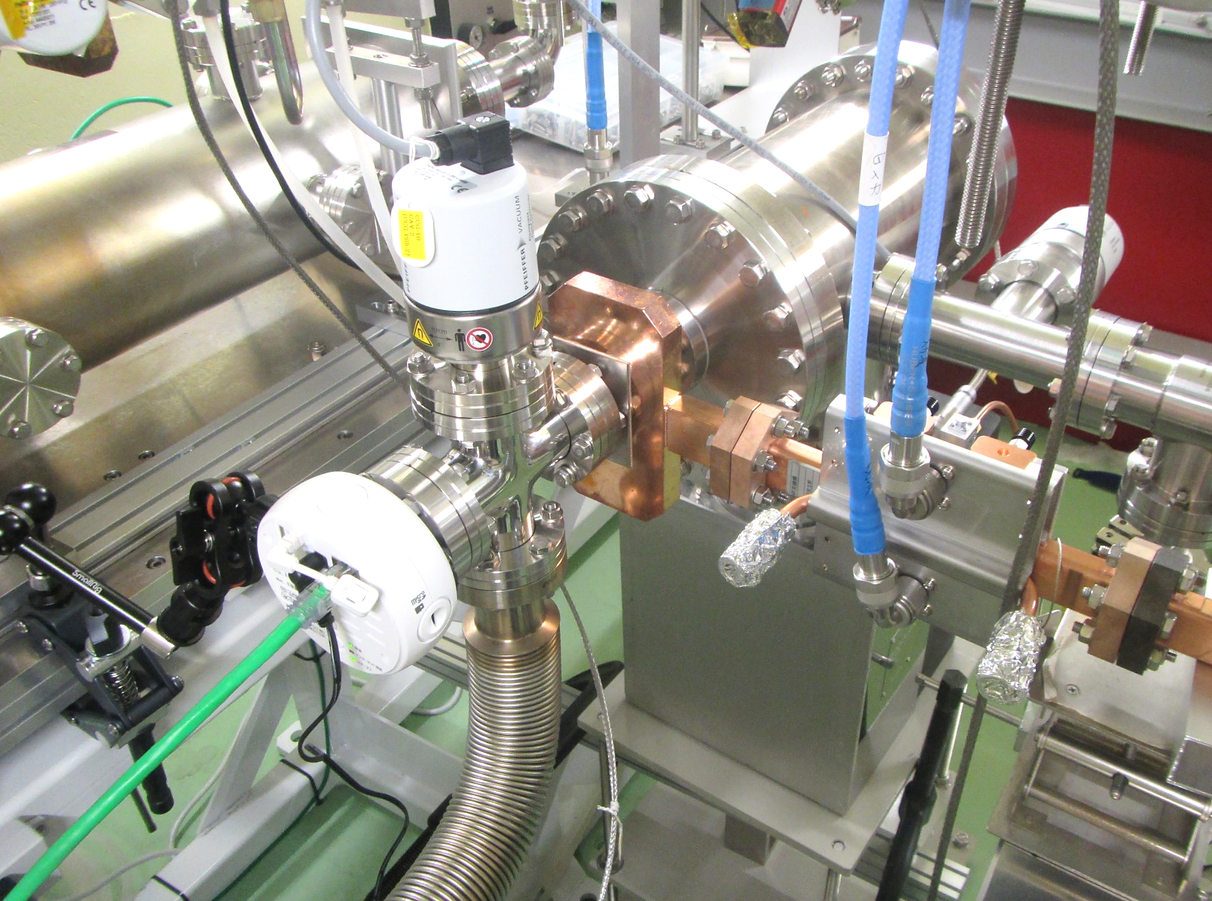
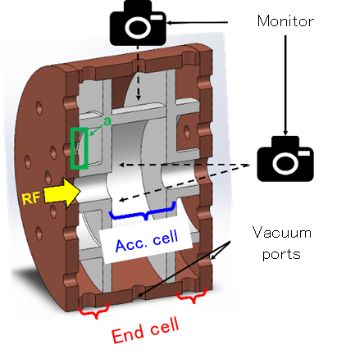
【X-band DAA @Nextef2】
High gradient was realized by beam-driven and short pulse dielectric accelerators
●320 MV/m@422GHz, - B.D. O’Shea et al., Nat. Comm. 7, 12763 (2016).
●102 MV/m@X-band, - B. Freemire et al., PHYS. REV. ACCEL. BEAMS 26, 071301 (2023)
→ Short pulse excitation by X-band＋step pulse input → high Z_{sh} + high E_{acc}
Very short pulse
【 Single cell X-band DAA structure】
【 Nextef2/Shield-B@KEK】
【 Step-pulse input 】
DAA
On-axis camera
TM₀₁ mode launcher
【 previous study @KEK】
Parameters | MgO
ε_{r} | 9.64
tanδ | 6.0×10⁻⁶
Frequency | 11.424 GHz
Q₀ | 6.55×10⁵
Z_{sh} | 600 MΩ/m
Side-view camera
Acc. structure
Discharge
Observation of discharge occurring in DAA cavities from many point.
Update of the internal structure based on the observation record to achieve higher gradient.

Slide 12
【 Summary】
We proposed the DAA structure and have been performed a proof-of-principle study.
The DLC coating lowerers the SEY of MgO cells while maintaining a low tanδ. → E_{acc,max} = 11 MV/m (@ T_{p} = 5.4 μs)
It is important to understand in detail where and what causes the discharge in the DAA structures in order to further increase the Eacc.
A new research program is currently underway to develop an X-band DAA structures (2023); short pulse excitation of the DAA structures with step-pulse input and monitoring of the discharge inside the cavity is planned for April 2024.

Slide 13
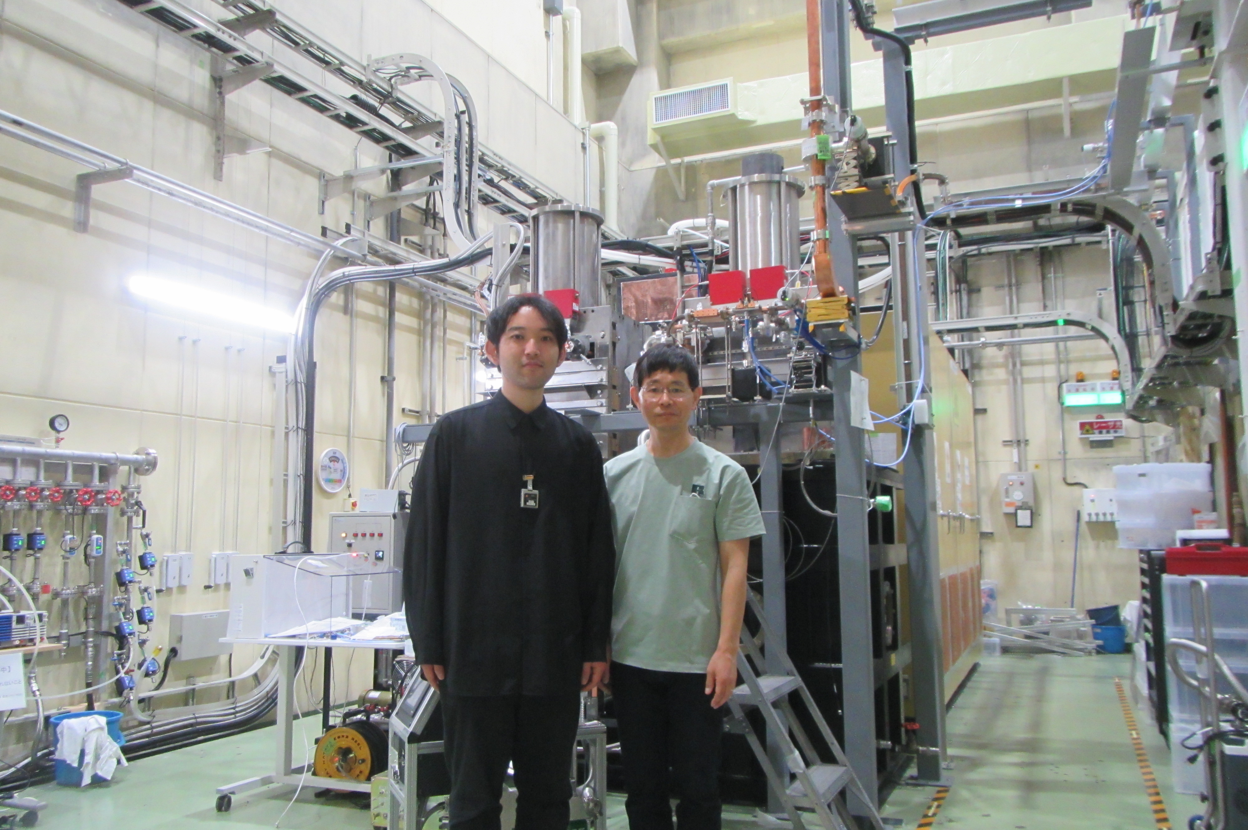
【Special Thanks】
N. Hayashizaki (Tokyo Thech.), S. Mori, Y. Yamamoto, M. Yoshida, T. Natsui, N. Toge (KEK), S. Miura, N. Shigeoka (MHI), H. Ogawa, Y. Hakuta, H. Mano(AIST)
【Acknowledgment】
This work has been supported by 【MEXT Development of key element technologies to improve the performance of future accelerators Program】 Japan Grant Number JPMXP1423812204 and Grant in Aid for JSPS Fellows Grant No. 13J08681, 16H02134, 19K20609 and 22684010, .
Thank you for your attention.

Slide 14
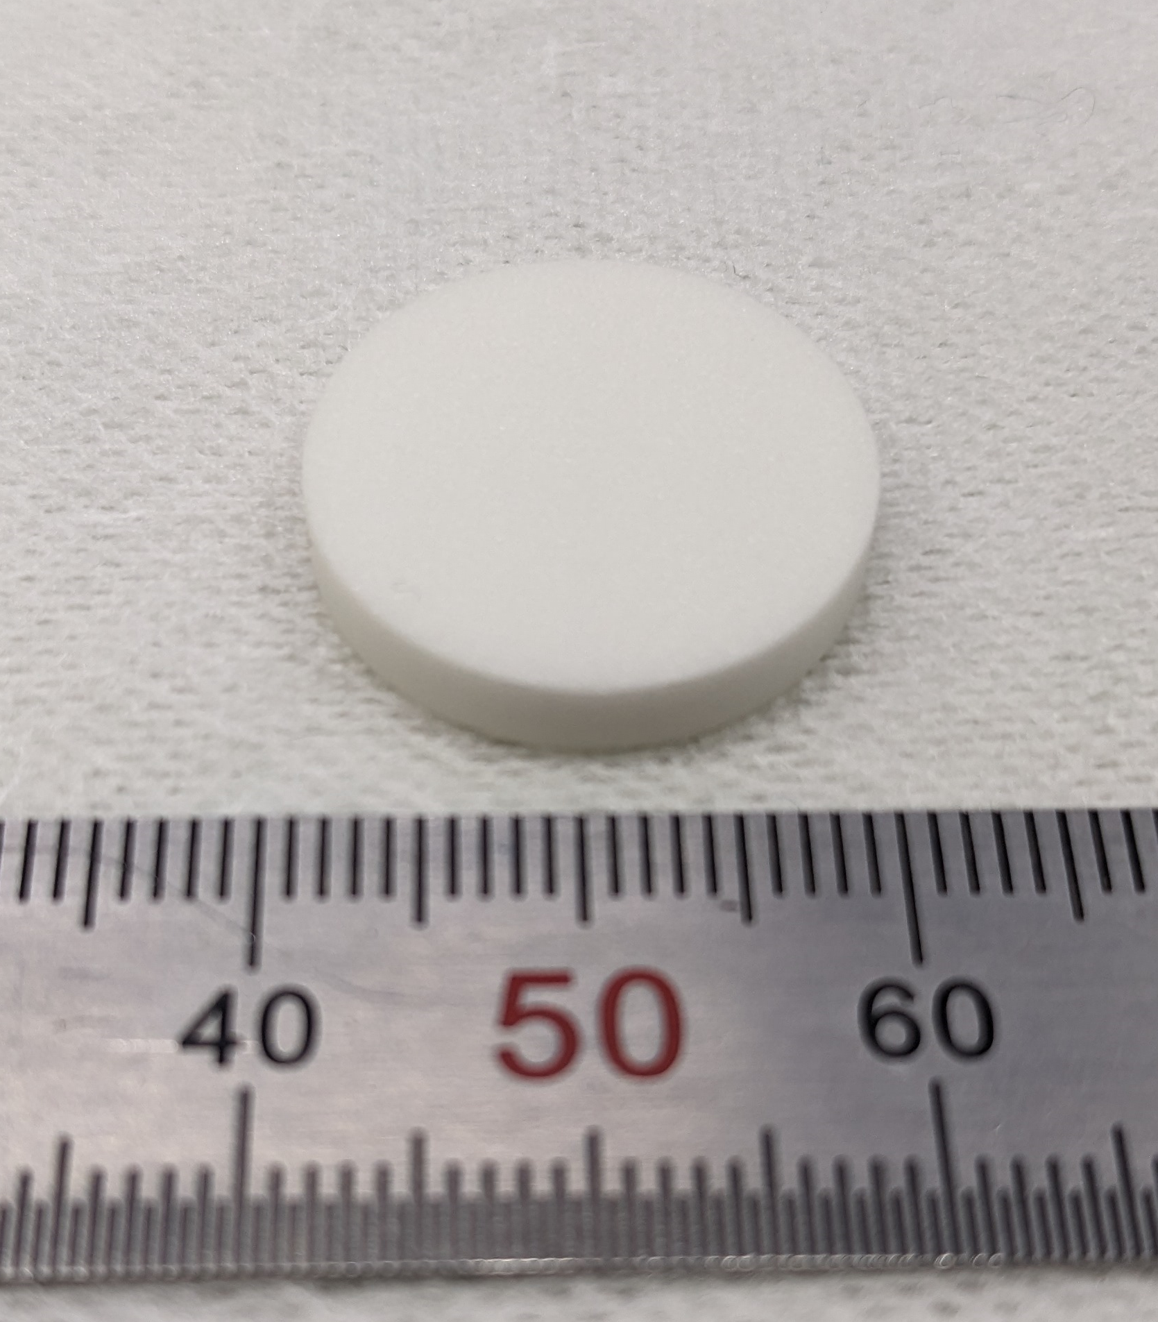
【 Improvement of the power efficiency】
【 Optimum dielectric material selection】
【cooling】
BMT sample
Ba(Mg, Ta)O₃
(BMT) Ceramics
Under development
6.6×10⁻⁷@27K
MgO
Parameters | BMT | MgO
ε_{r} | 24.2 | 9.64
tanδ | 2.5×10⁻⁵ | 6.6×10⁻⁷@27K
Acc. type | Standing wave type
Acc. Mode | TM₀₂ - π mode
Num. of Acc. cells | 5
Frequency | 5.712 GHz | 5.712 GHz
Temperature | 20 ℃ | 27 Kelvin
Q₀ | 121,200 | 7.65×10⁶
Z_{sh} | 870 MΩ/m | 3.8 GΩ/m
The cryogenic temperature operating DAA structure is expected to have 6 times higher Q₀ and Z_{sh} than that of RT operating DAA prototype.
Shunt impedance can be improved by 38% compared to the prototype.
[4] D. Satoh et al., Nucl. Instrum. Methods Phys. Res. B, 459, 148 (2019).
14

