Slide 1
Studies and commissioning results of the PolariX TDS system at SwissFEL
Fabio Marcellini on behalf of the PolariX team:: Paul Scherrer Institute
15th Workshop on Breakdown Science and High Gradient Technology (HG2023)

Slide 2
Outline
PolariX TDS collaboration: novel concept based on variable streaking plane
PolariX TDS at PSI: System description and component characterization
Operation experience:
  RF setup and commissioning with beam
  Suppression of the kick in the plane orthogonal to the streaking plane
  First measurements of streaked beam with variable polarization.
  Conditioning and breakdown analysis.
Analysis and optimization of the TDS efficiency as a function of the RF pulse shape.
Notes:
Here there is the outline of my talk.
I start to introduce the TDS as diagnostic tools and I will give you some motivations for high-resolution time-resolved diagnostic.
Then I will talk about the collaboration that led to the realization and experimental verification of the possibility of having a variable polarization deflector.
Most important part the implementation of the TDS in ATHOS beam line
And then a summary with some conclusions.

Slide 3
DESY-CERN-PSI Collaboration
The PolariX TDS has been developed in the framework of a collaboration among CERN, DESY and PSI.
As a result, 7 TDS have been produced:
  1 TDS in FLASHForward
  2x TDSs installed in FLASH II
  2x TDS installed in SINBAD-ARES (DESY)
  2x TDSs installed in Athos, the Soft X-rays beamline in SwissFEL

Slide 4



Credits and contributions
P. Craievich, J. Alex, H.-H. Braun, R. Ganter, Z. Geng, R. Kalt, T. Kleeb, T. G. Lucas, F. Marcellini, R. Menzel, M. Pedrozzi, E. Prat, S. Reiche, K. Rolli, R. Sieber, W. Tron, R. Zennaro,
Grudiev, W. L. Millar, N. Catalan-Lasheras, G. McMonagle, S. Pitman, V. del Pozo Romano, K. T. Szypula, and W. Wuensch
B. Marchetti, R. Assmann, F. Christie, B. Conrad, R. D’Arcy, M. Foese, P. Gonzalez Caminal, M. Hoffmann, M. Huening, R. Jonas, O. Krebs, S. Lederer, D. Marx, J. Osterhoff, M. Reukauff, H. Schlarb, S. Schreiber, G. Tews, M. Vogt, A. de Z. Wagner, and S. Wesch

Slide 5
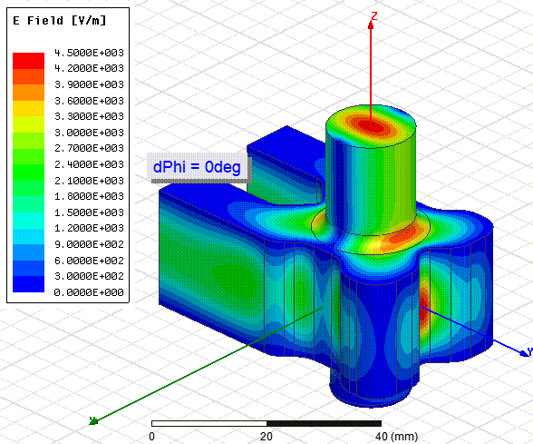
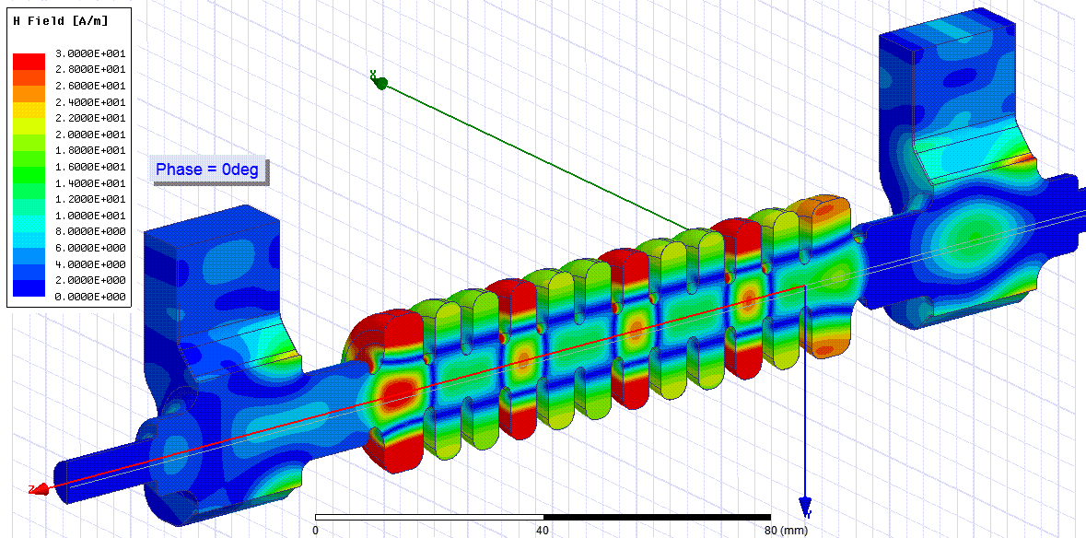
Novel Concept with Variable Polarization – X band
Key Component
E- Rotator: E-plane TE11 rotating mode launcher
Key Technology:
PSI high-precision tuning-free assembly procedure
Polarization of deflecting field in the structure depends on the relative phase difference at the two TDS input ports.
References:
Grudiev, CLIC-Note-1067, 2016
P. Craievich et al., Phys. Rev. Accel. Beams, 2020
B. Marchetti et al., Sci. Rep., 2021

Slide 6
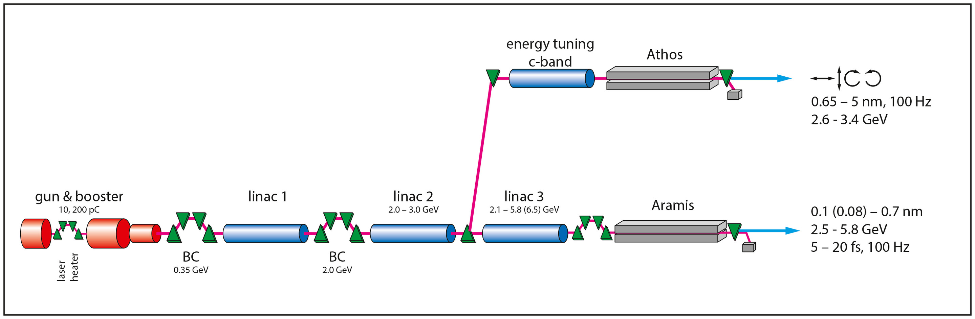
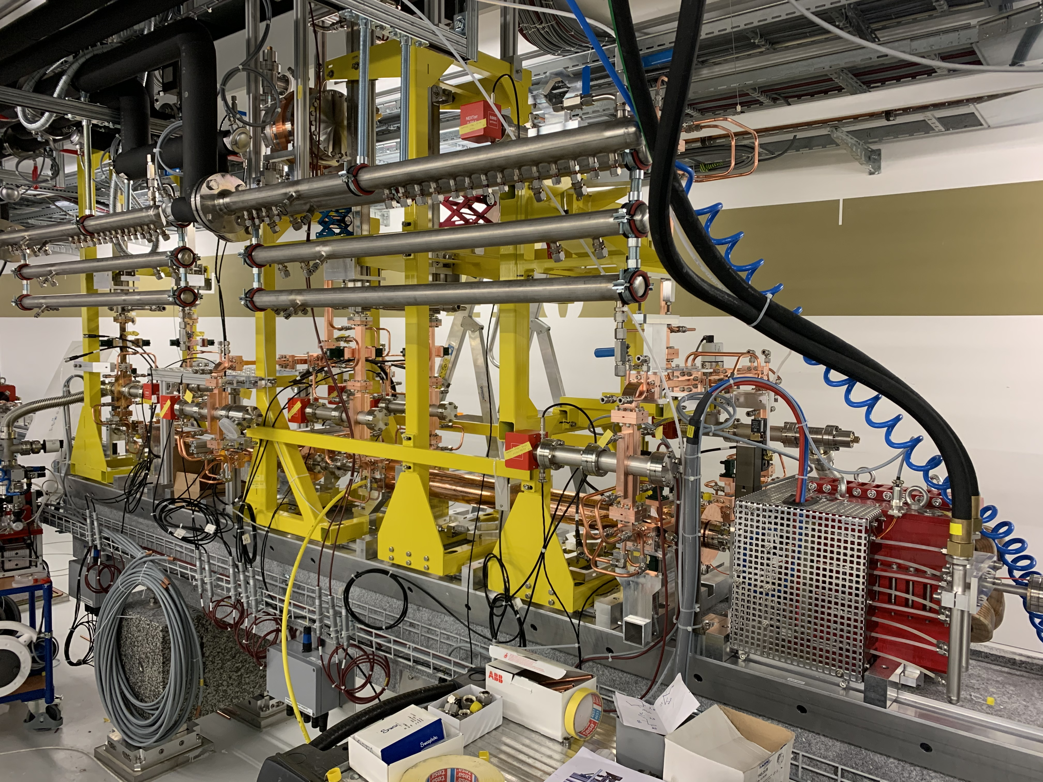
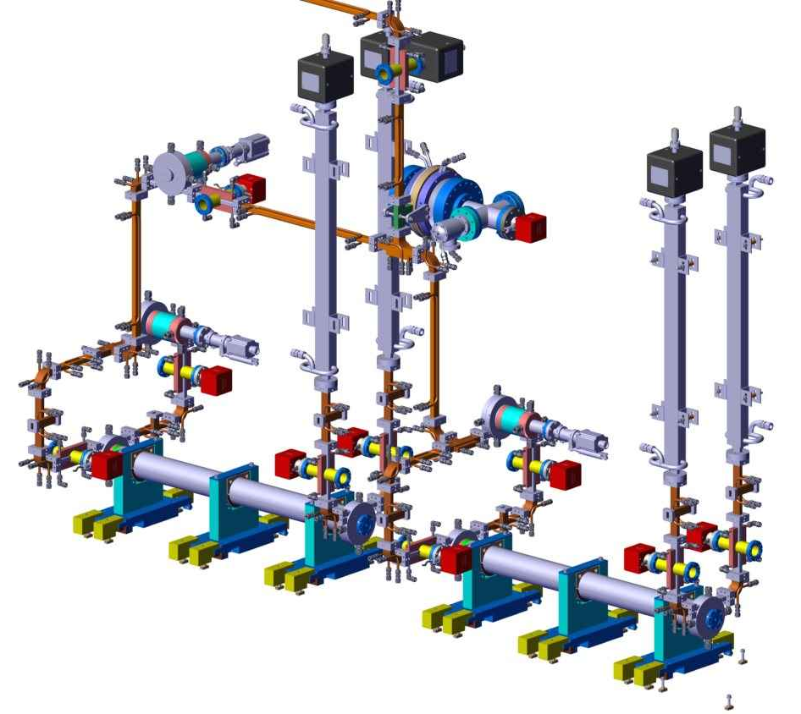
PolariX in ATHOS
PolariX TDS placed downstream the ATHOS undulators
PSI HV modulator: develop and built in-house (400 kV, 3 us)
  based on the Linac 1 and 2 design (Ampegon)
  Investment for future renewal of the injector modulators (S-band and X-band)
Klystron: CPI VKK-8311 50 MW X-band.
Waveguide RF components including the XBOC, phase shifters and directional couplers designed and built at PSI.
Two TDSs (120 cells version) built at PSI.

Slide 7
TDS RF measurements
On axis bead pulling, phase difference between input ports 0°
Cell to cell phase advance, phase difference between input ports 0°
Insertion and return loss measured for different polarizations
Average cell to cell phase advance measured at different polarization.
Peak to peak phase adv. 0.03°.→ very good cell rotational symmetry.

Slide 8
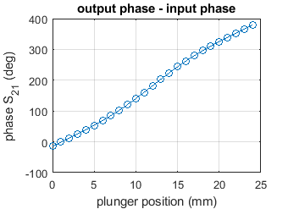
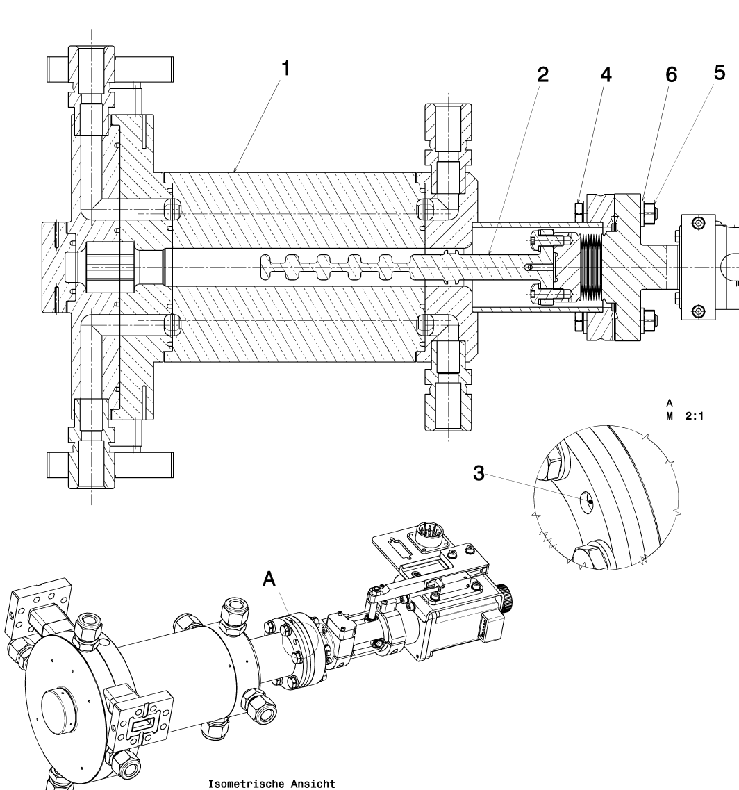
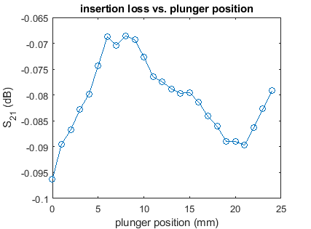
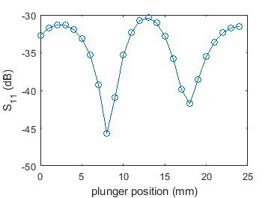
X-band phase shifter measurements

Slide 9
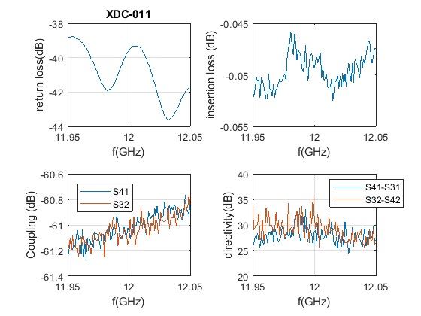
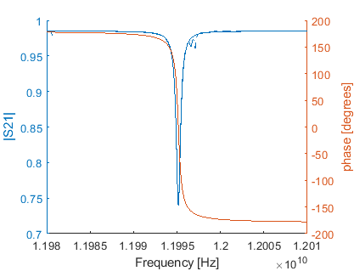
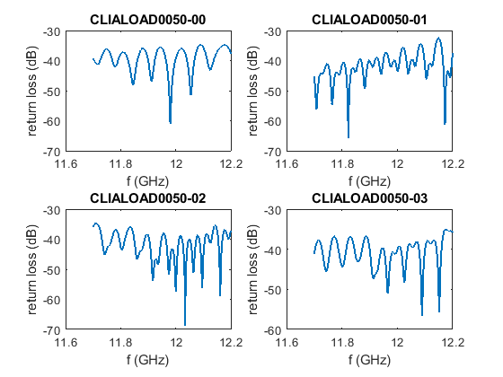
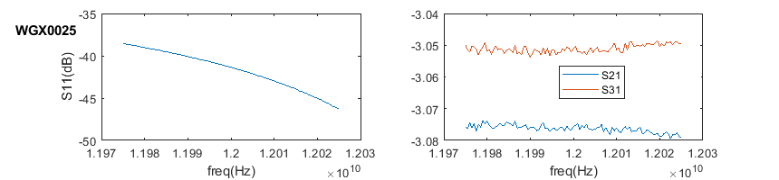
Other X-band components
BOC
Directional
couplers
3-dB splitters
Loads

Slide 10
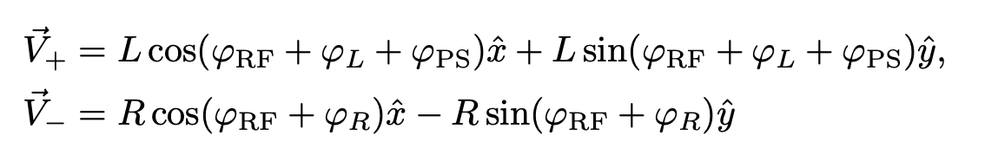
RF setup and commissioning with beam 1/3
When the TDS system commissioning started, we observed the beam kicked in the plane orthogonal to the streaking plane.
Possible sources of the kick are TDS input power unbalance or misaligned phases of the 3 phase shifters.
Deflecting field is the sum of two rotating modes, one clockwise and the other counter clockwise
(single TDS or L₁=L₂, R₁=R₂, φ_{L1}= φ_{L2}, φ_{R1}= φ_{R2})
Three BPMs after TDS and before spectrometer, to measure the beam position after interaction with the TDS.
All quads and correctors downstream the TDS switched off.
Ideally the TDS input amplitudes are balanced (L=R) and the polarization plane depends on the difference between the input phases (φL+φPS-φR).

Slide 11
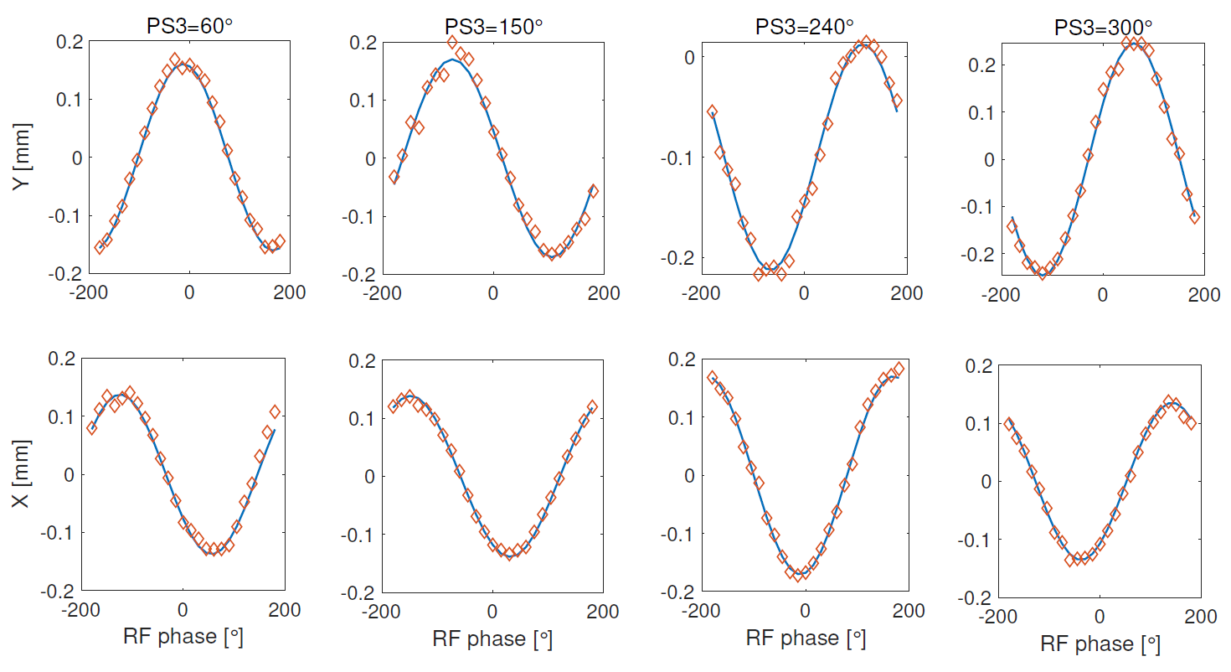
RF setup and commissioning with beam 2/3
Positions measured with BPMs are proportional to:
Vx = R1 cos(φRF + φR1) − L1 cos(φRF + φPS1 + φL1)+R2 cos(φRF + φPS3 + φR2) + L2 cos(φRF + φPS3 + φPS2 + φL2)
Vy = R1 sin(φRF + φR1) − L1 sin(φRF + φPS1 + φL1)+ R2 sin(φRF + φPS3 + φR2) + L2 sin(φRF + φPS3 + φPS2 + φL2)
The 8 unknowns can be found from at least 8 independent equations, i.e. from 8 measured beam position obtained varying the phases of PS1, PS2 or PS3.
Example:
Beam centroid positions (X and Y) as a function of the global RF phase for different phases of PS3. Red diamonds are the measurement data, blue line is the result of the fitting obtained with analytical expression.
Unknowns estimated by applying a least-squares algorithm to fit experimental data.

Slide 12
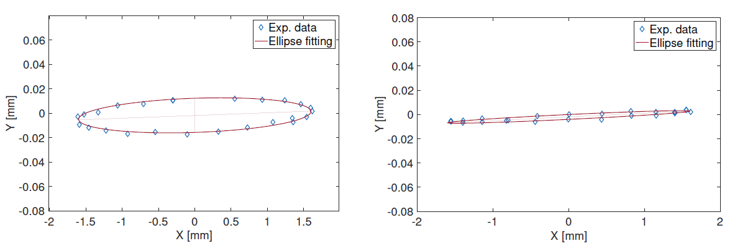
RF setup and commissioning with beam 3/3
As a result of the fit, the estimated amplitude imbalances between the two branches of the input couplers were found to be 0.18 dB and 0.22 dB in TDS1 and TDS2, respectively.
A set of 3 phase shifter phases giving beam deflection in one plane only could be calculated with the analytical model.
Applying the calculated set of PSs phases, the orthogonal kick was almost completely canceled.
Blue diamonds: bunch centroids (X and Y) as a function of global RF phase for two different PS settings before and after kick suppression.
Red line: ellipse fitting using analytical expression.

Slide 13
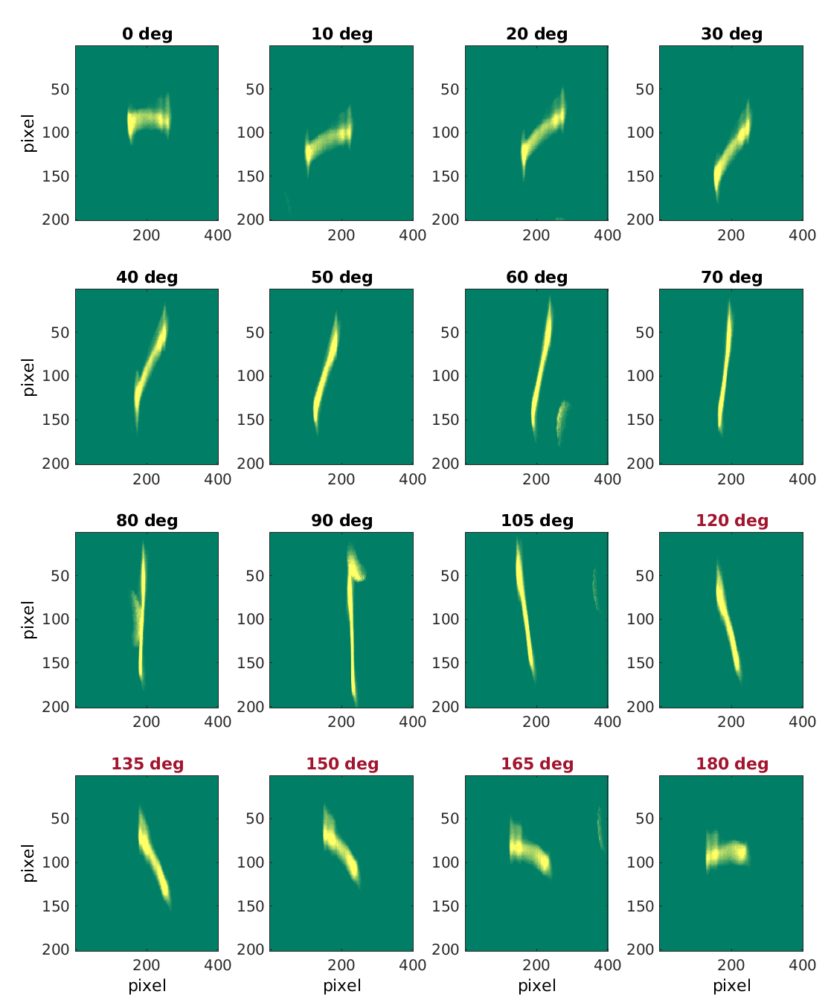
Variable polarization – first measurements
Images on screen S1, just upstream the spectrometer, showing that the streaking is actually performed on the different polarization planes.
Polarization angles in black: integrated deflecting voltage 85 MV Polarization angles in red: 72.8 MV.
System not yet fully conditioned, need to reduce klystron output power for some polarization angles.

Slide 14
Conditioning and breakdown analysis
Results of the first systematic conditioning performed in July ’23.
Target klystron output power: 34MW
Courtesy of Thomas Geoffrey Lucas

Slide 15
Conditioning and breakdown analysis
Courtesy of Thomas Geoffrey Lucas

Slide 16
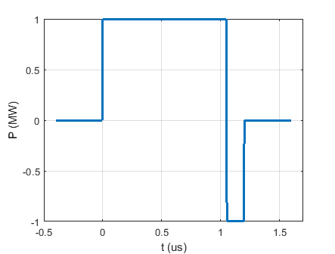
Analysis and optimization of the TDS efficiency as a function of the RF pulse shape.
Short summary of a recent summer student (Riccardo Sansone) work.
    Structure filling time: 130 ns
    Maximum RF pulse length: 1.2 us
Ideal vs. actual (measured through a directional coupler at the klystron output) RF pulse.
For consistent comparison in both cases pulse energy is normalized to 1.2 J

Slide 17
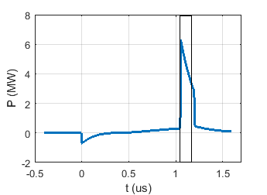
Ideal pulse – flat in amplitude and phase
Klystron output
BOC frequency response
BOC output
β = 7.0714;
Q_{L}=18378;
f₀=11.995158GHz;
Waveguide attenuation not considered.
We are operating with the phase inversion time at 1.05us → compressed pulse length is 150 ns.
Deflecting voltage (V_{Ʇ}) produced by the compressed pulse propagating along a single TDS is 12.4MV.
Without compression V_{Ʇ} = 6MV.

Slide 18
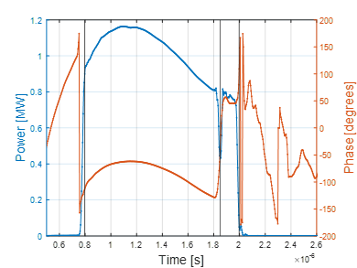
Actual pulse shape
Same calculations with the real pulse shape gives V_{Ʇ} = 10.3 MV (-17%).
In case of ideal pulse we could have the same V_{Ʇ} with 30% less power.
Considering the actual pulse amplitude and an ideally flat phase, or vice versa, ideal amplitude and actual phase, we found that amplitude and phase have similar weigth in lowering the efficiency.
First try to modulate the LLRF signal to get a flatter RF pulse.
V_{Ʇ} increases by about 8% (calculated, not yet measured with beam).

Slide 19
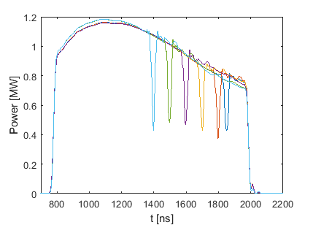
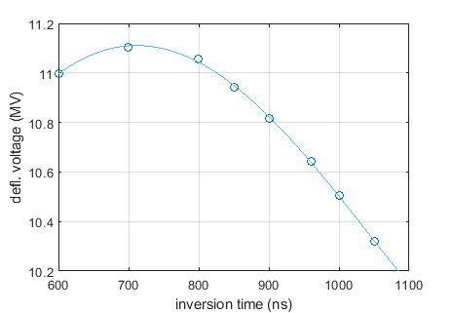
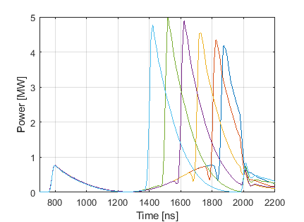
Actual pulse, different phase inversion time
Due to the slope in the RF pulse it seems beneficial bringing forward the phase inversion time.
Without applying any flattening of the pulse by means of LLRF, and simply moving the phase inversion time, deflecting voltage increased by about 7% .

Slide 20
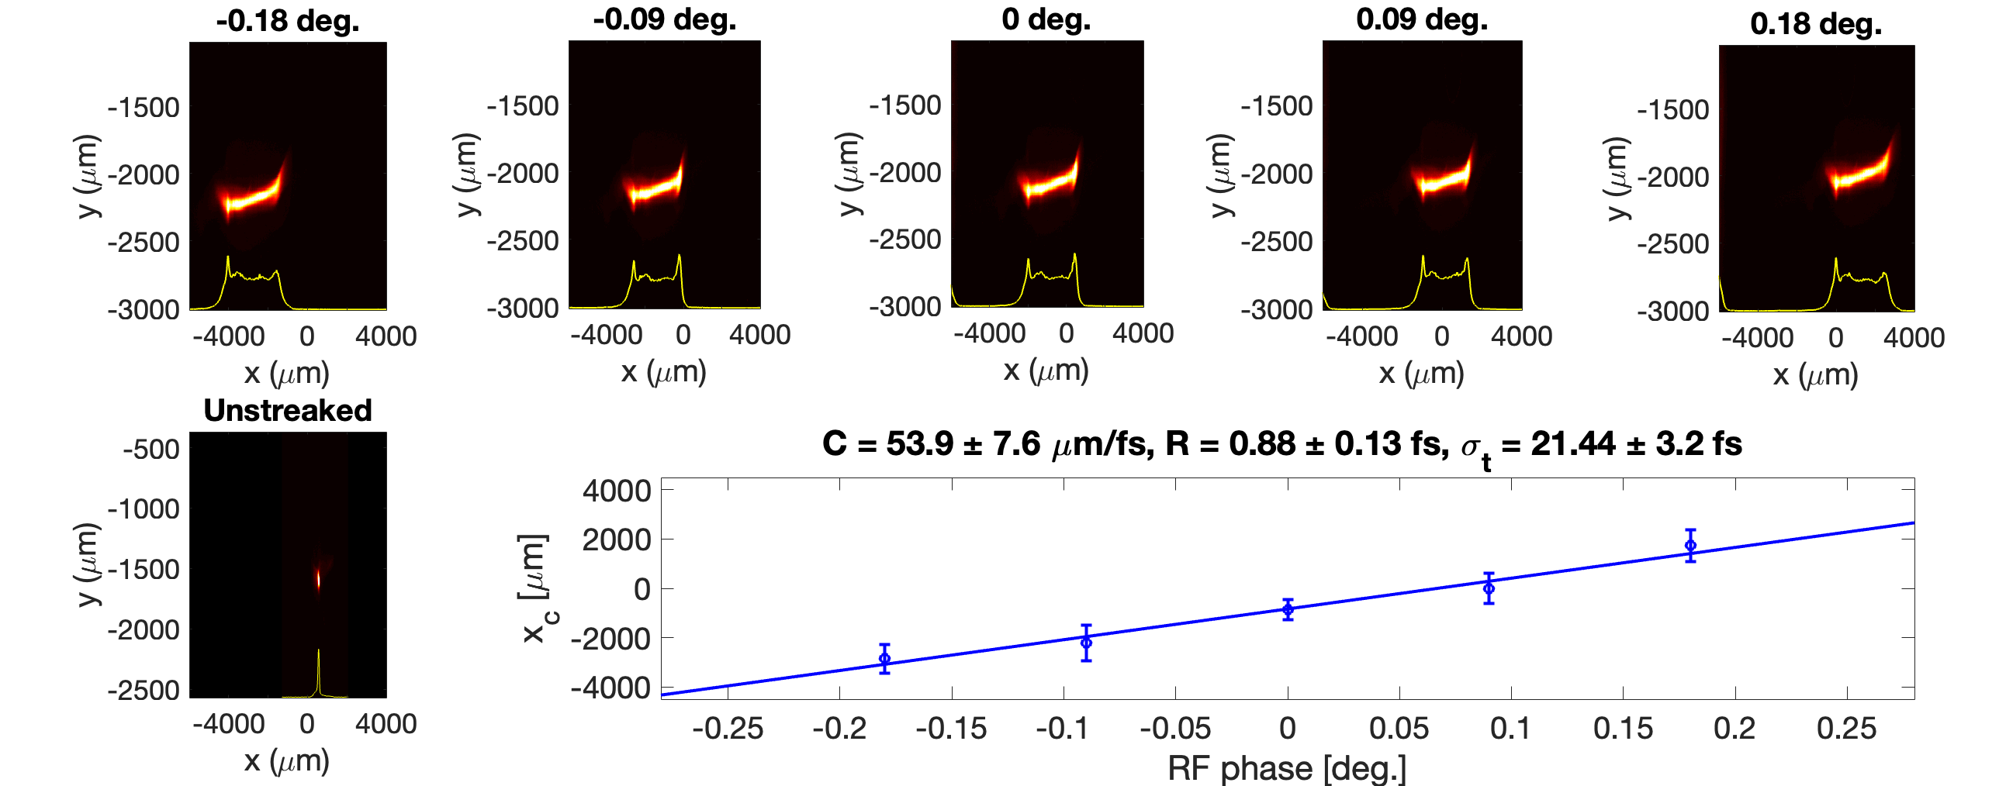
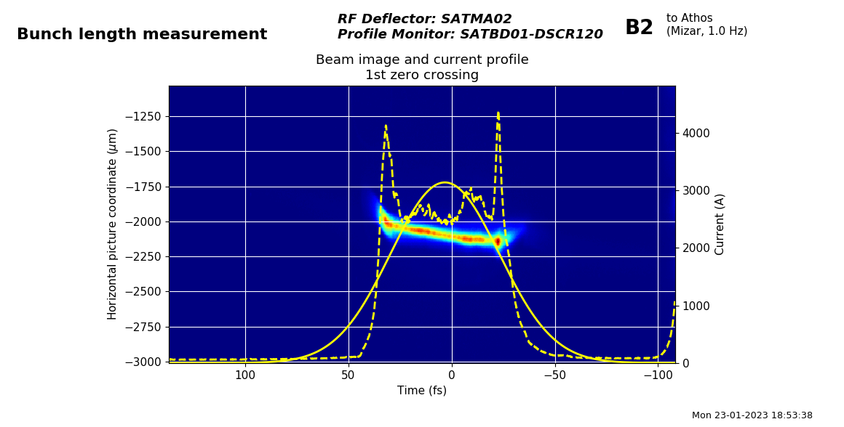
Calibration, resolution and bunch length
The absolute calibration factor C between the transverse coordinate on a screen and the time coordinates within the electron bunch is obtained by measuring the dependence of the transverse position of the centroid of the streaked beam on the RF phase
Time coordinates are obtained by dividing the transverse coordinates on the screen by the calibration
Bunch length is simply obtained as the streaked beam size divided by the calibration factor C
Resolution R= s₀/C < 1fs
σ₀ = 47.7 ± 0.6 μm
Deflecting voltage 85 MV, s₀ = 47.7 ± 0.6 μm
Courtesy of Paolo Craievich

Slide 21
Conclusions
TDS-based diagnostics systems are essential tools for the commissioning and optimisation of linac-based FELs. Temporal resolution below 1 fs already obtained. Goal: <0.5 fs at different streaking planes.
TDS with variable polarization allows reconstruction of full 5-D phase space (already performed at FLASH Forward).
For the X-band TDS system in Athos many high power components have been produced in house at PSI and they are working reliably.
Unexpected kick of the beam has been observed during the first phase of the system commisioning.
Unbalanced amplitudes of the TDS inputs have been identified as the cause of the kick.
A solution to suppress the kick has been found and successfully implemented.
The consequences of a not flat RF pulse and some ideas to optimize the system efficiency (V_{Ʇ} / P_{klystron}) have been recently studied.

Slide 22
Wir schaffen Wissen – heute für morgen
Many thanks for your attention!

