Slide 1
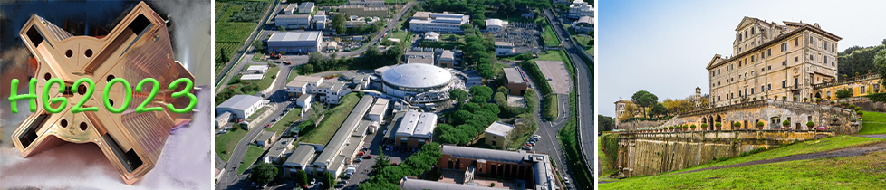


MeV-scale simulations and fabrication tests of silicon slot and woodpile-based waveguides for Dielectric Laser Accelerators
Giuseppe Torrisi
giuseppe.torrisi@lns.infn.it
MIniaturised aCceleRatOrs Network
μICRON
On behalf of MICRON collaboration, INFN Comm-V
15th Workshop on Breakdown Science and High Gradient Technology (HG2023) 16–20 Oct 2023 INFN Frascati National Laboratories

Slide 2

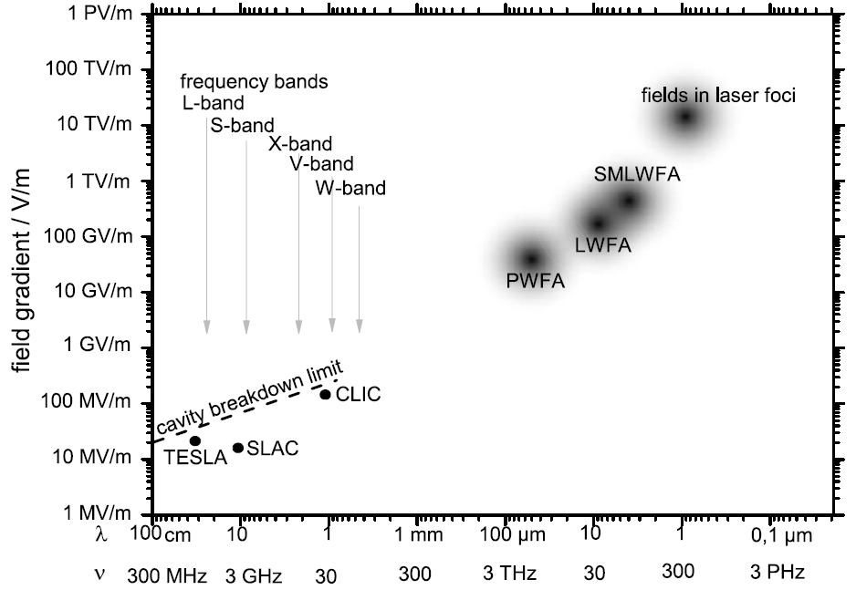
DLA
Co-prop. schemes
Design
Conclusions
AIM of this session:
To examine Novel Schemes to go “beyond the X-band”
schematic overview of the accelerating gradient for different types of accelerators
laser-plasma interaction
[1] R. Joel England et al., Rev. Mod. Phys. 86, 1337-2014
[2] R. J. England, D. Filippetto, G. Torrisi et al; “Laser-Driven Structure-Based Accelerators”,
arXiv:2203.08981 [physics.acc-ph], 2022 White Paper for Snowmass 2021
Topical Group AF06 - Advanced Acceleration Concepts ]
[3]E. Nanni, et al., Nat Commun 6, 8486 (2015).
[4] F. Lemery, et al.” Commun Phys 3, 150 (2020).

Slide 3
DLA
Co-prop. schemes
Design
Conclusions
AIM of this session:
To examine Novel Schemes to go “beyond the X-band”
schematic overview of the accelerating gradient for different types of accelerators
laser-plasma interaction
on-chip optical-wavelength
DLA [1,2]
This talk
THz-driven
DLW LINAC [2,3]
[1] R. Joel England et al., Rev. Mod. Phys. 86, 1337-2014
[2] R. J. England, D. Filippetto, G. Torrisi et al; “Laser-Driven Structure-Based Accelerators”,
arXiv:2203.08981 [physics.acc-ph], 2022 White Paper for Snowmass 2021
Topical Group AF06 - Advanced Acceleration Concepts ]
[3]E. Nanni, et al., Nat Commun 6, 8486 (2015).
[4] F. Lemery, et al.” Commun Phys 3, 150 (2020).

Slide 4
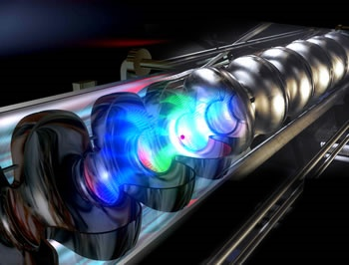
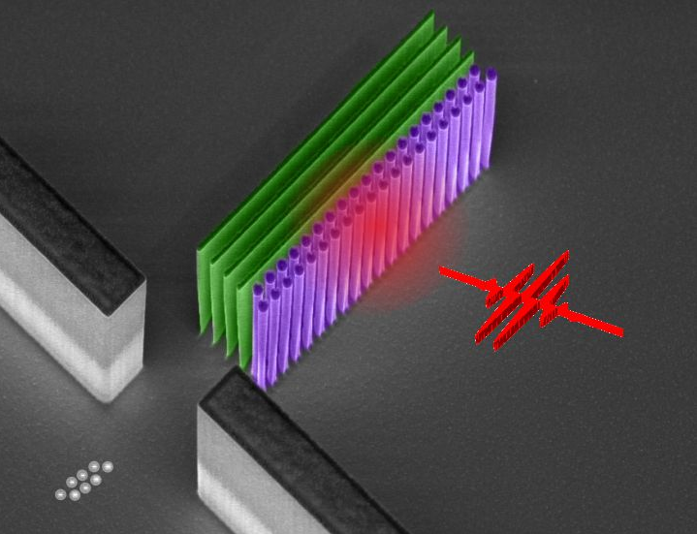
Laser particle accelerators: from RF to laser drive – based on the same operating principle
DLA
Co-prop. schemes
Design
Conclusions
RF cavity (TESLA, DESY)
Conventional linear
accelerator (RF)
Laser-based dielectric
accelerator (optical)
Based on
(Supercond.) RF cavities
Quartz grating structures
Surface breakdown:
200 MV/m
Damage threshold:
10 GV/m
Peak field limited by
Max. achievable
gradients
100 MeV/m
= 0.1 GeV/m
5 GeV/m
= 5 000 MeV/m
Principle: a nearfield scheme generates the required electromagnetic mode to continuously accelerate charged particles in vacuum – the particle is surfing the mode

Slide 5
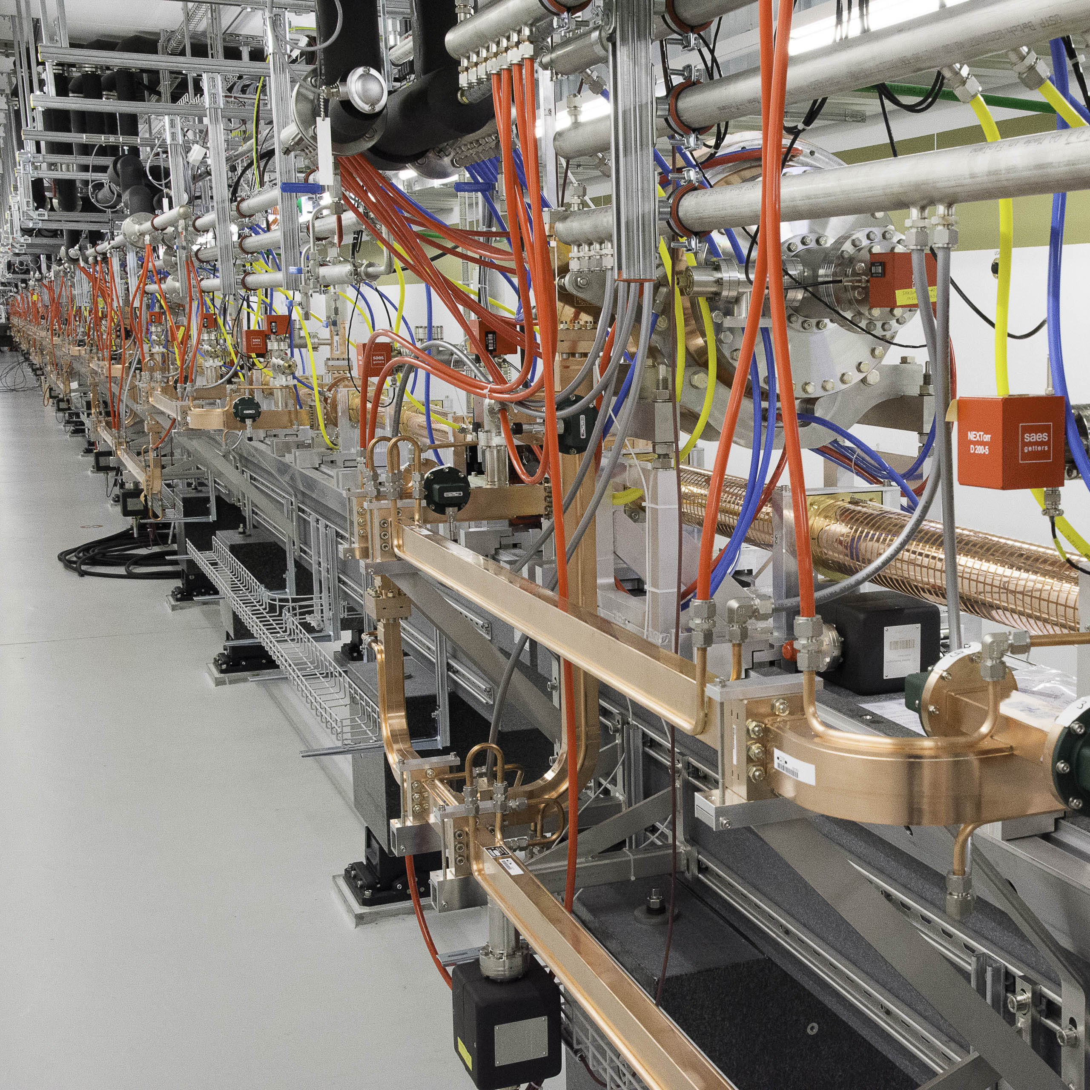
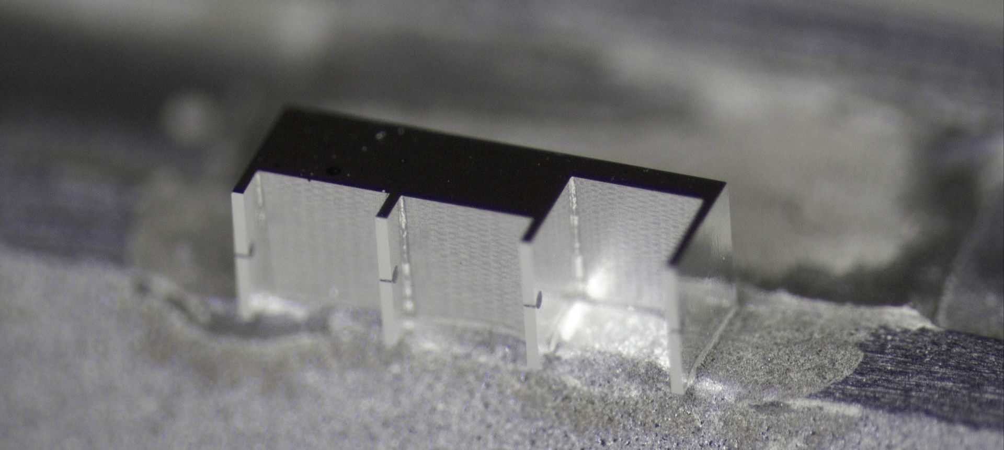
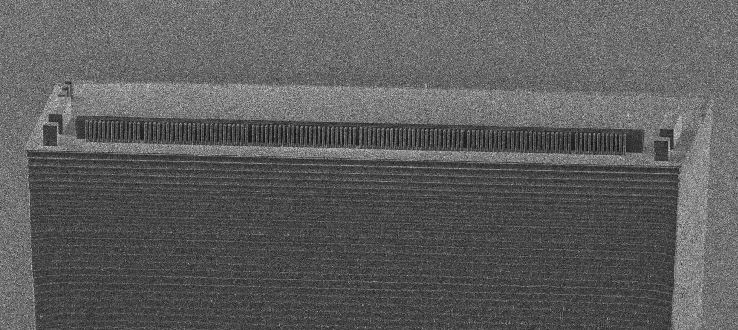
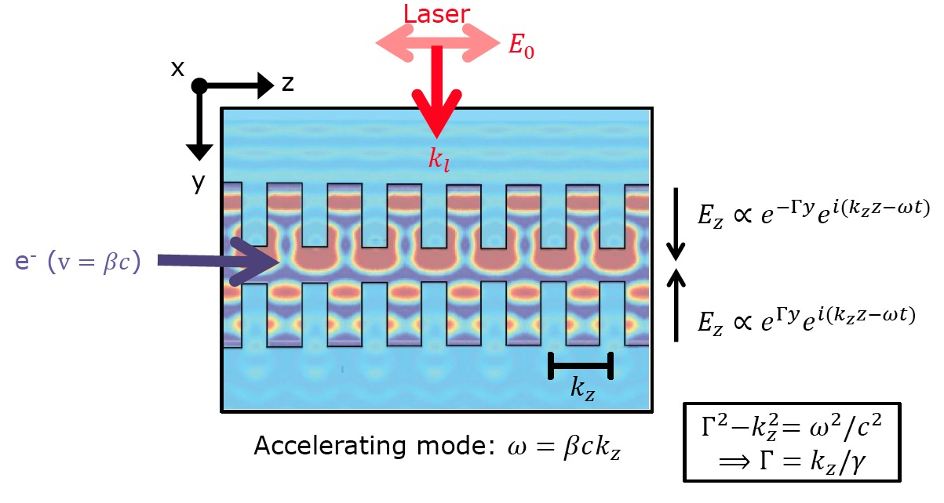
From Radio Frequencies to Infrared Light
DLA
Co-prop. schemes
Design
Conclusions
Simple idea: Use scale-invariance of Maxwell equations and shrink down size of particle accelerators by 4 orders of magnitude.
Replace RF power (cm-wavelength) with laser (um-wavelength)
Material properties are frequency dependent -> dielectrics
Beam dynamics challenges
Parameter | RF | DLA
Power Source | Klystron | laser
Wavelength | 2-10 cm | 1-10 µm
Bunch Length | 1-5ps | 10-100 as
Bunch Charge | 0.1- 4 nC | 1-10 fC
Norm. Emittance | 0.1-1 µm rad | 1-10 nm rad
Rep Rate | 1-1000 Hz | 100 MHz
Material | Metal | Dielectric
Unloaded Gradient | 10-50 MV/m | 1-10 GV/m
[Rasmus Ischebeck, Structure-based accelerators (e.g. ACHIP) and advanced radiation generation schemes, talk @the 2022 EuroNNAc Italy 18- 24 September 2022] [https://agenda.infn.it/event/28376/contributions/178676/
DLA Operating Principle
DLA typical parameters

Slide 6

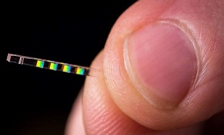
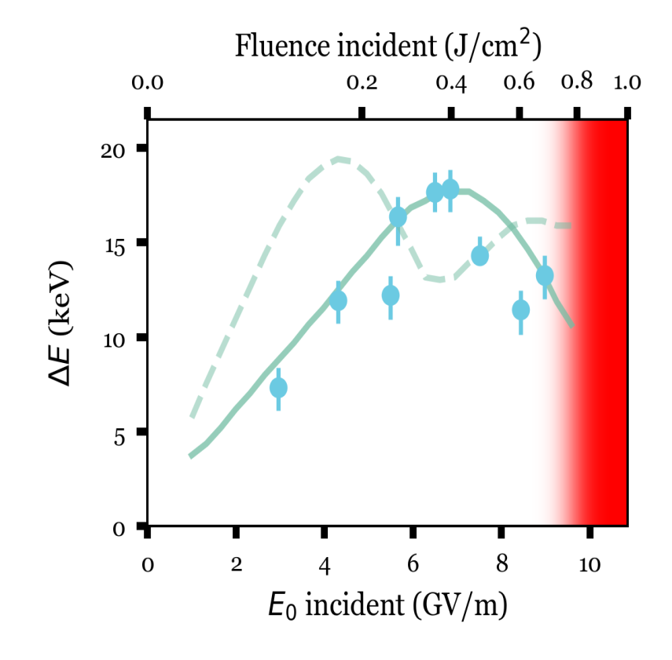

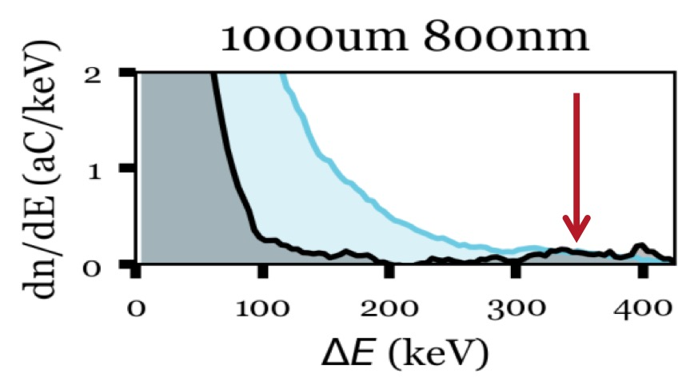
Experiments have demonstrated record gradients and energy gain
DLA
Co-prop. schemes
Design
Conclusions
SLAC/UCLA: 0.85 GeV/m*
SLAC/UCLA: 0.3 MeV energy gain**
pulse front
tilted laser
E₀
k₀
gradient
800 nm
e-
G_{eff} = 850 MV/m
Interaction length > 500 um
electron energy spectrum
Kerr
saturation
* D. Cesar et al, Communications Physics 1(4), 1-7 (2018)​​
** D. Cesar et al, Optics Express 26 (22), 29216 (2018)
Notes:
D. Cesar, S. Custodio, J. Maxson, P. Musumeci, X. Shen, E. Threlkeld, R. J. England, A. Hanuka, I.V. Makasyuk, E. Peralta, K.P. Wootton, and Z. Wu, "Nonlinear response in high field dielectric laser accelerators," Nature Communications Physics 1(4), 1-7 (2018).​​
D. Cesar, J. Maxon, P. Musumeci, X. Shen, R. J. England, K. P. Wootton, and S. Tan, "Enhanced energy gain in a dielectric laser accelerator using a tilted pulse front laser," Opt. Exp. 26 (22), 29216 (2018).

Slide 7
Limiting Factors for MeV Energy Gain
DLA
Co-prop. schemes
Design
Conclusions
Laser-electron interaction time
Total structure length
Dynamic effects – over longer lengths, e- will defocus
Extending Structure Length Non-Trivial: Nanofabrication techniques are typically not concerned about long range wafer distortions
Small beam apertures (Wakes, Halo)
Long-distance transport
Focusing and beam transport
Power delivery
Instrumentation and feedbacks
[Pietro Musumeci, Accelerator on a chip program overview
invited talk @the 2022 edition of the EuroNNAc European Network for Novel Accelerators La Biodola Bay, Isola d'Elba, Italy 18- 24 September 2022]
https://agenda.infn.it/event/28376/contributions/179636/
[Rasmus Ischebeck, Uwe Niedermayer with contributions by the ACHIP collaboration ”Dielectric Laser Accelerators,” Townhall Meeting High Gradient Acceleration Plasma/Laser 30-3-2021]

Slide 8

DLA
Cross-prop. schemes
Design
Conclusions
[New Acceleration Concepts.
“Dielectric Laser Acceleration”, Joel England (SLAC) Snowmass AF6 Meeting Sept 23, 2020]
Cross-propagating schemes
“transverse-illuminated” Phase Reset Device
→
short interaction region
(few µm)
Laser
→
beam
low energy gain per stage
(few keV)
Laser
→
cascading stages of acceleration is
very challenging
[N. V. Sapra et al; Science, 367, 6473, 79-83 2020]
[E. A. Peralta et al; Nature, 503(7474):91–94, 2013.]
[Kent P. Wootton et al; Opt. Lett., 41(12):2696, 2016]
[D. Cesar et al; Nature Comm. Phys., 1(4):1–7, 2018]
[K. J. Leedle et al; Opt. Lett., 40(18):4344, 2015]
beam

Slide 9
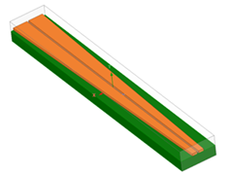
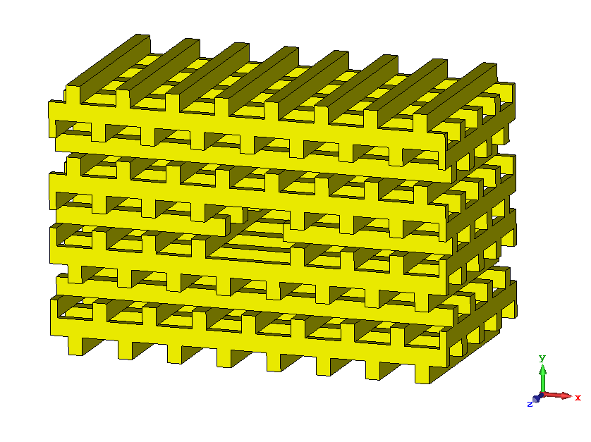
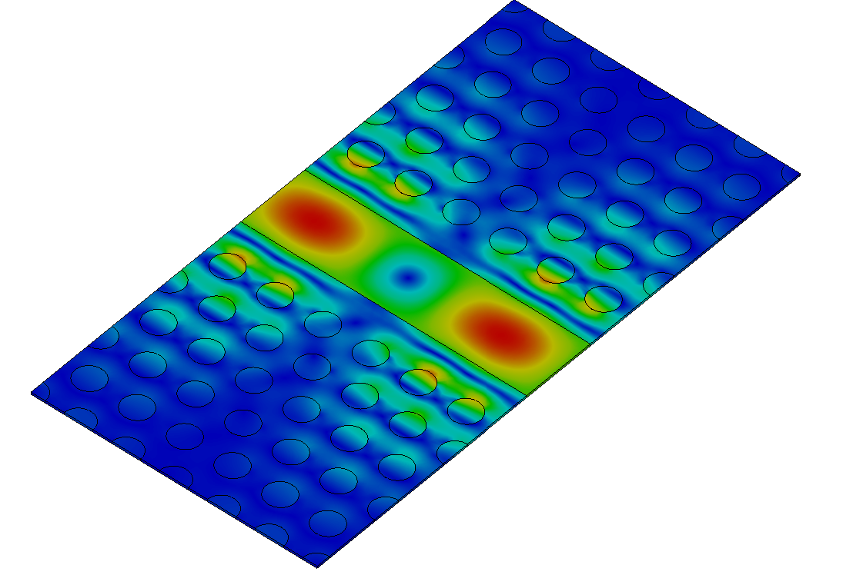
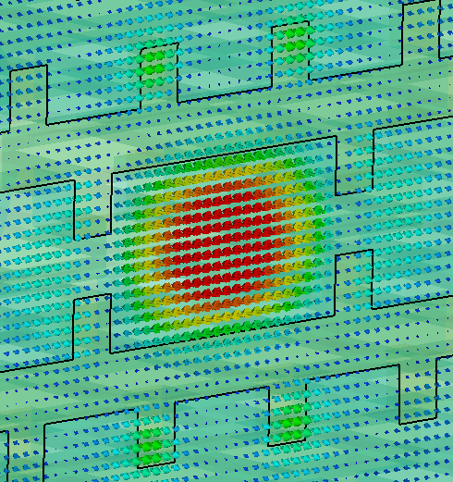
This talk
DLA
Co-prop. schemes
Design
Conclusions
Co-propagating/Collinear schemes
Hollow-core waveguides for high power handling
Collinear co-propagating laser and particle beam
High interaction impedance Z_{c} and accelerating gradient
Continuous wave (CW) laser operation (1-5 µm)
E_{z}
Laser
DLA high-Q photonic-crystal cavity
[courtesy of C2N]
e-beam
laser power flow propagates in the same direction as the electron beam
co-propagation designs have the potential to increase the interaction length between electrons and the laser beam.
E_{z}
beam
Laser
Laser
e-beam
[G. S. Mauro et al., " in IEEE MTT, 68, 5, 1621-26, 2020]
[G. S. Mauro et al;. 15th Metamaterials Conf. (Aug. 2021)]
[Ziran Wu et al; Phys. Rev. ST Accel. Beams 17, 081301

Slide 10
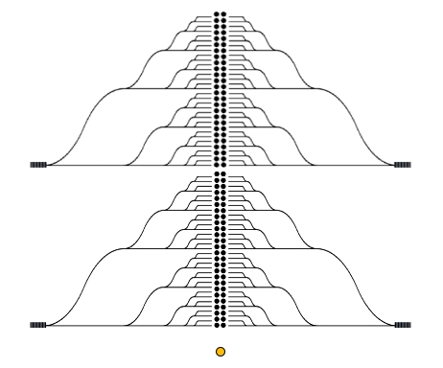
side-pumped configurations
Power Delivery
DLA
Co-prop. schemes
Design
Conclusions
Cross-propagating schemes
vs
Copropagating schemes
CW collinear hollow-core scheme Power Delivery
[Tyler W. Hughes et al. Phys. Rev. Applied, 9:054017, 2018]
quasi-1D topology, based on hollow-core waveguides
reaching a final energy scales linearly with the structure length L
CW Laser
Particle
pulsed Laser
Particle
require a complex 2D feeding network with a large footprint proportional to L²
the input facet becomes a bottleneck for damage and nonlinear effects
Dispersion Management is needed
CW DRAWBACKS:
Power Losses
Efficiency

Slide 11
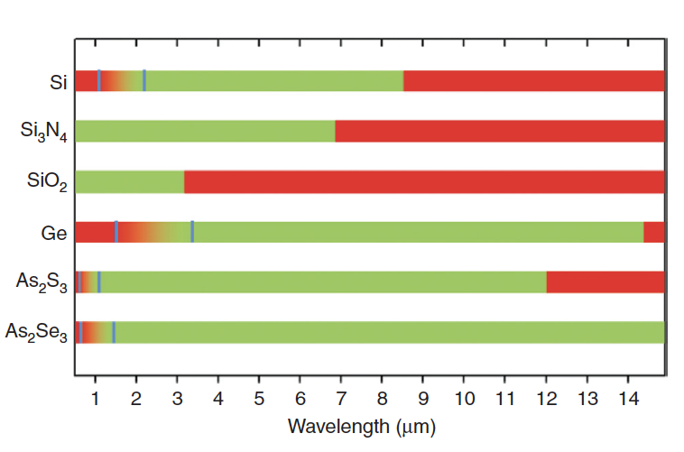
DLA
Co-prop. schemes
Design
Conclusions
CW DRAWBACKS
[DOI: 10.1515/nanoph-2013-0020 Nanophotonics 2014; 3(4-5): 247–268]
Red bars indicate high-loss wavelength bands for each material
In silicon:
Kerr nonlinearity
For example, at 2 µm, the Kerr nonlinear coefficient of 7.62 m²/W would result in a refractive index variation of 0.4% for large power (200 W). it can be considered and addressed.
2. two-photon absorption (TPA).
TPA phenomenon, that leads to a prohibitively high losses. Multiple options can be explored to mitigate the effects of
TPA. The pump wavelength can be slightly changed to take advantage of the fact that silicon exhibits no TPA beyond 2.2 μm.

Slide 12
DLA
Co-prop. schemes
Design
Conclusions
Copropagating schemes for Dielectric Laser Accelerators
What we mean for schemes?
We require
an optical waveguide that is constructed of dielectric materials
transverse size on the order of a wavelength
supports a mode with speed-of-light phase velocity in vacuum.
R.J. England et al., Dielectric laser accelerators, Rev. Mod. Phys., 2014
Our goal:
  Definition of guidelines for the design of
  optical dielectric accelerating waveguides

Slide 13
DLA
Co-prop. schemes
Design
Conclusions
For particles that are sub-relativistic, the beam velocity β = v/c changes rapidly as the particle accelerates
phase velocity tapered structures:
match the phase velocity of the accelerating wave to the electron beam velocity
One of the Key focus areas identified for scaling to multi MeV energy gains
chirped DLA geometry in which the excited accelerating mode has a phase velocity that increases as nonrelativistic electrons are accelerated (here we use lithography-based structural chirping of chirped DLA geometry)

Slide 14
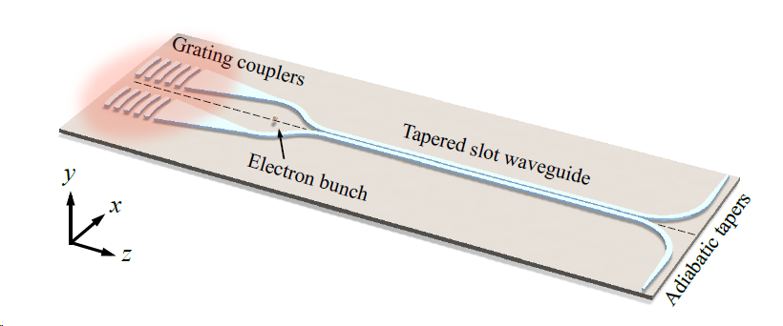
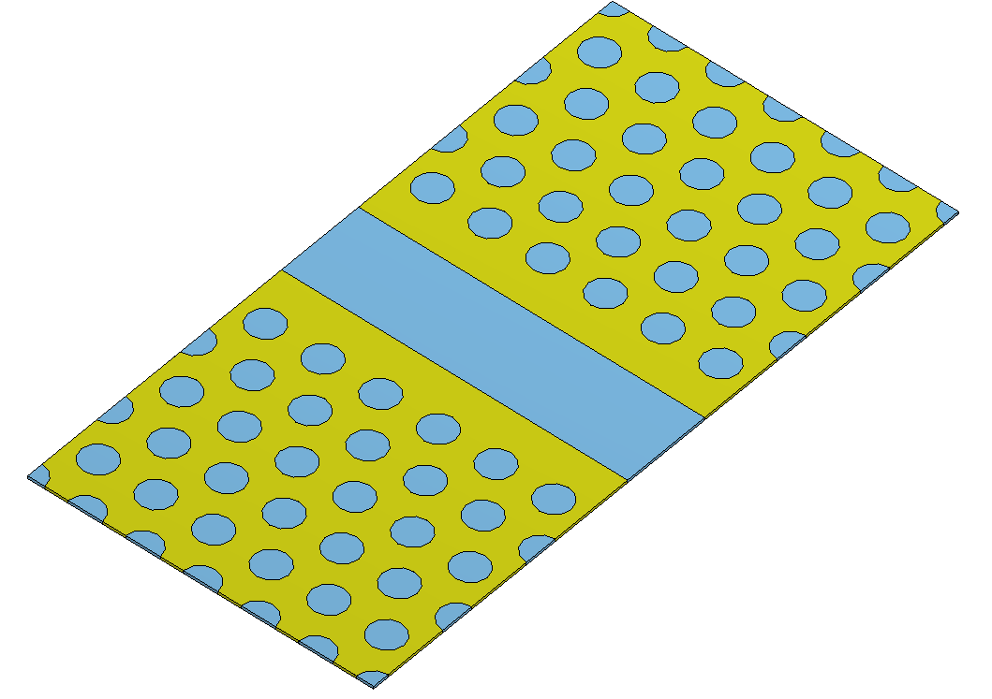
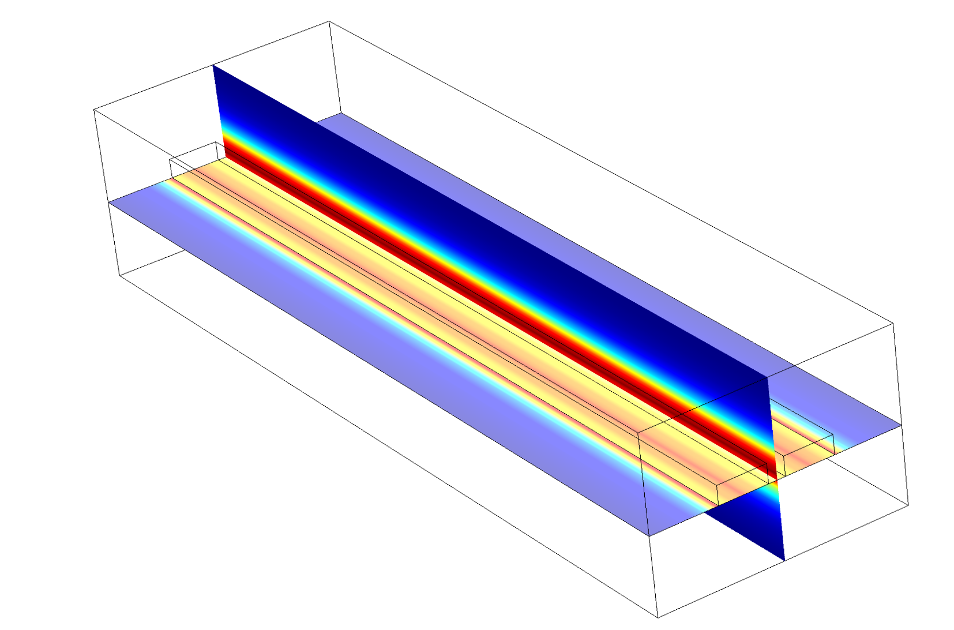
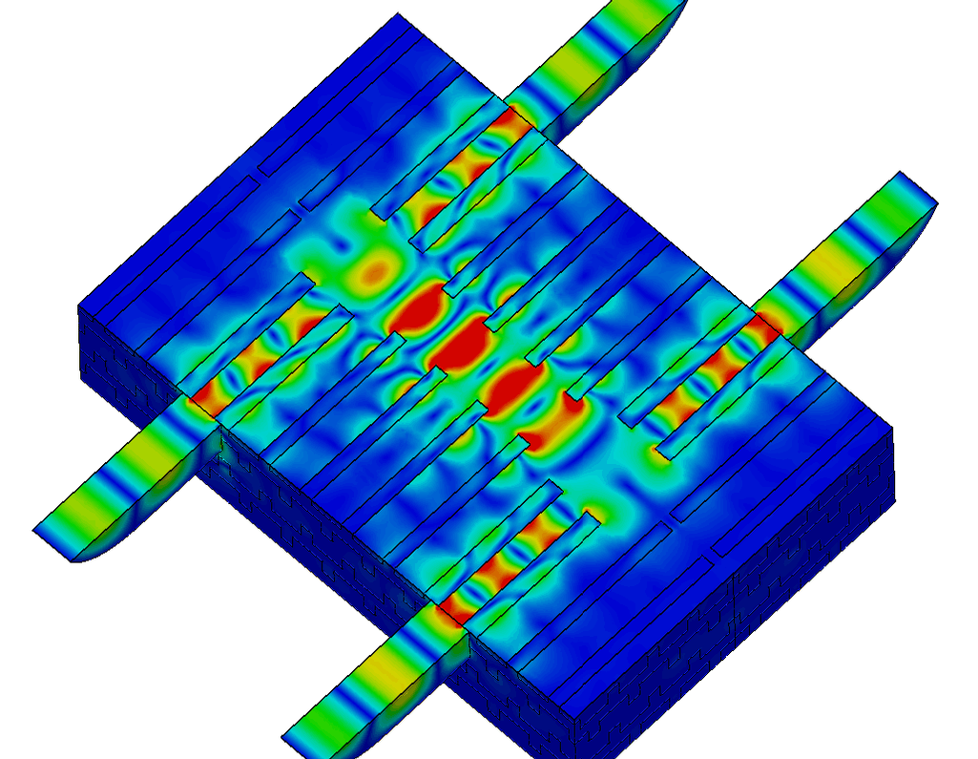
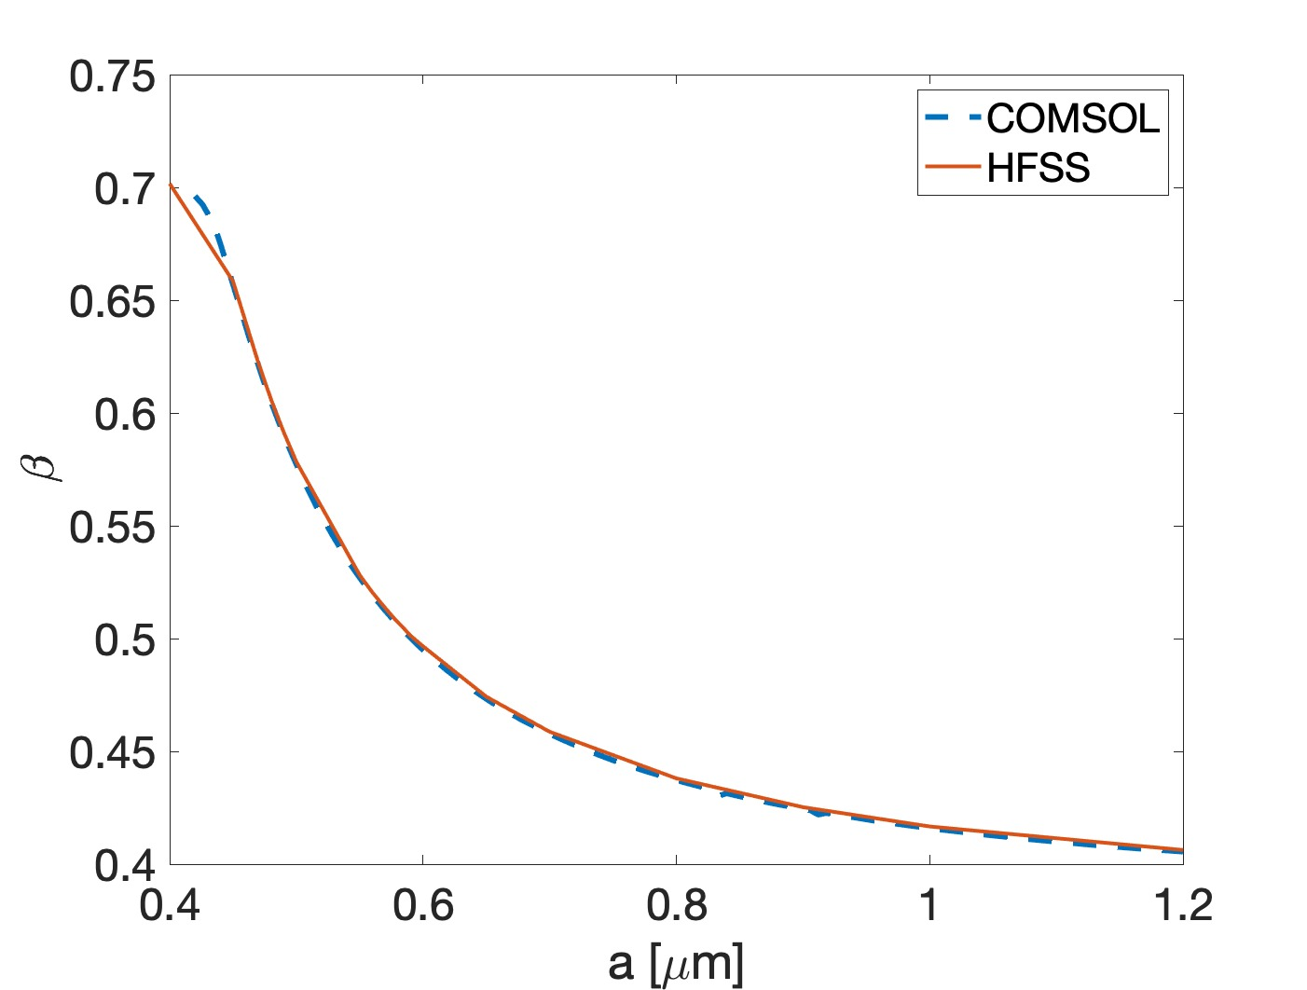
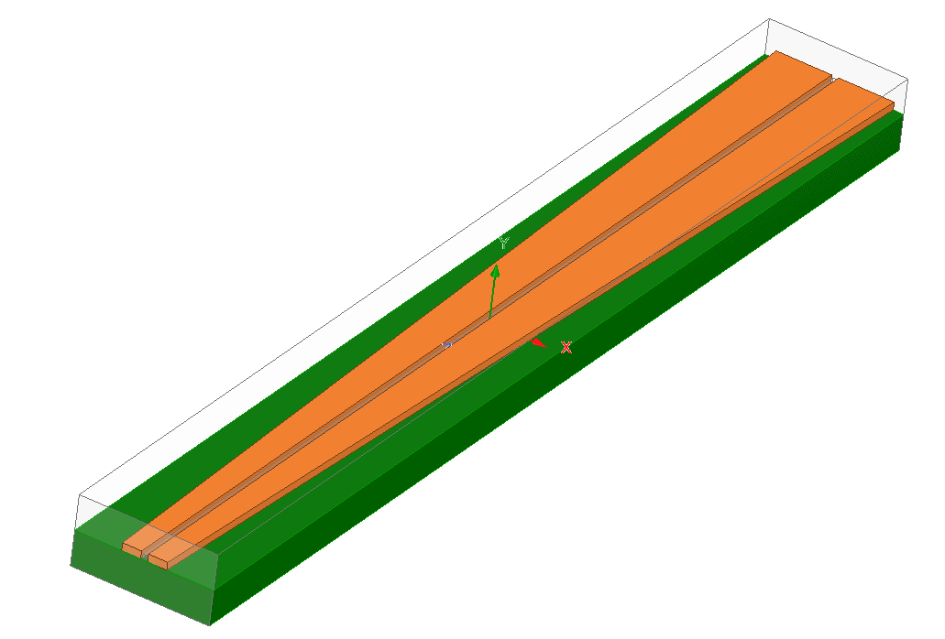
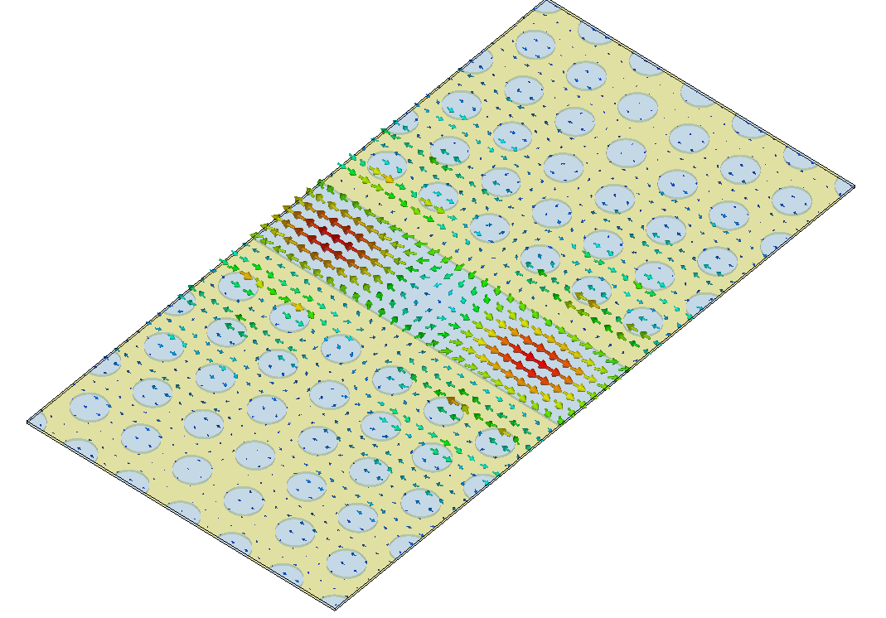
DLA
Co-prop. schemes
DESIGN
1) Slot waveguide
2) 2D PhC waveguide
3) 3D PhC Woodpile
Conclusions
1) Slot waveguide
2) 2D Photonic Crystal (PhC) waveguide
3) 3D PhC Woodpile

Slide 15
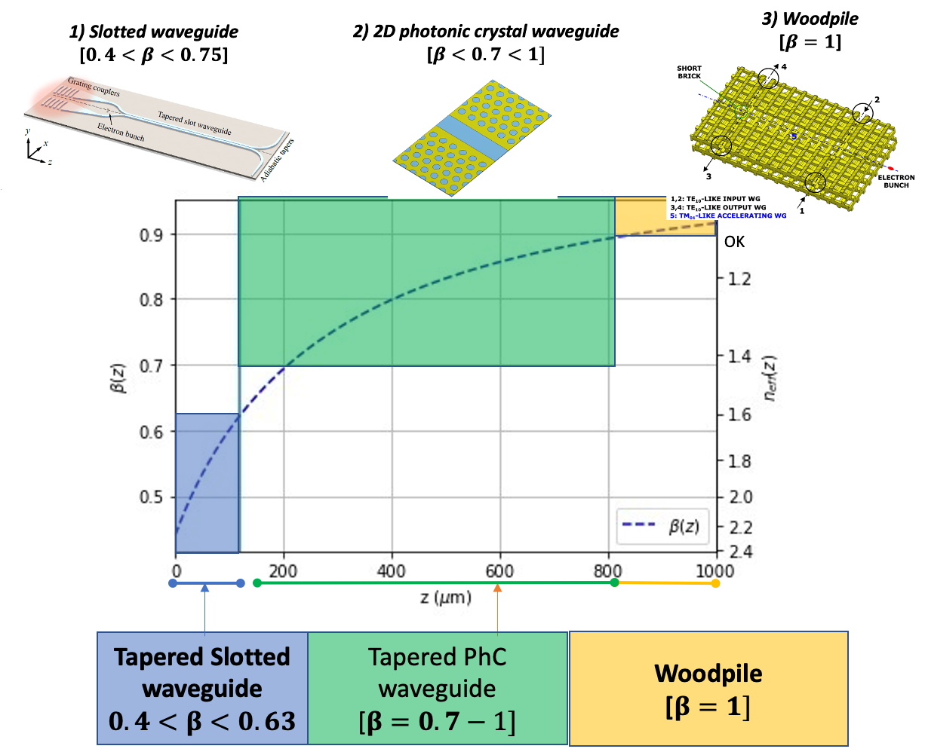
DLA
Co-prop. schemes
DESIGN
1) Slot waveguide
2) 2D PhC waveguide
3) 3D PhC Woodpile
Conclusions
each one is different and optimized for a specific region of energy variation

Slide 16
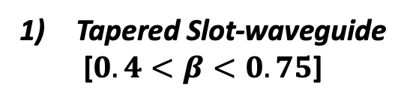
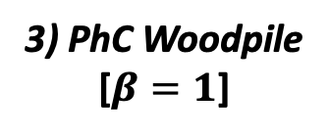
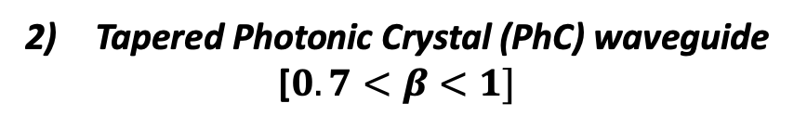
DLA
Co-prop. schemes
DESIGN
1) Slot waveguide
2) 2D PhC waveguide
3) 3D PhC Woodpile
Conclusions
Tapered Slot-waveguide
[$0.4<β<0.75$]
Tapered Photonic Crystal (PhC) waveguide
[$0.7<β<1]$
3) PhC Woodpile
[$β=1$]

Slide 17
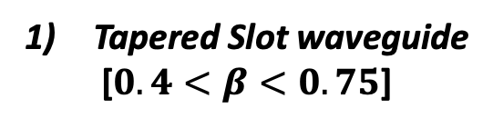
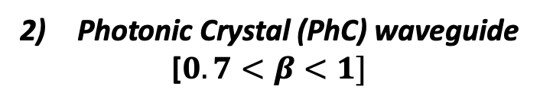
DLA
Co-prop. schemes
DESIGN
1) Slot waveguide
2) 2D PhC waveguide
3) 3D PhC Woodpile
Conclusions
Tapered Slot waveguide
[$0.4<β<0.75$]
Photonic Crystal (PhC) waveguide
[$0.7<β<1]$
3) PhC Woodpile
[$β=1$]

Slide 18
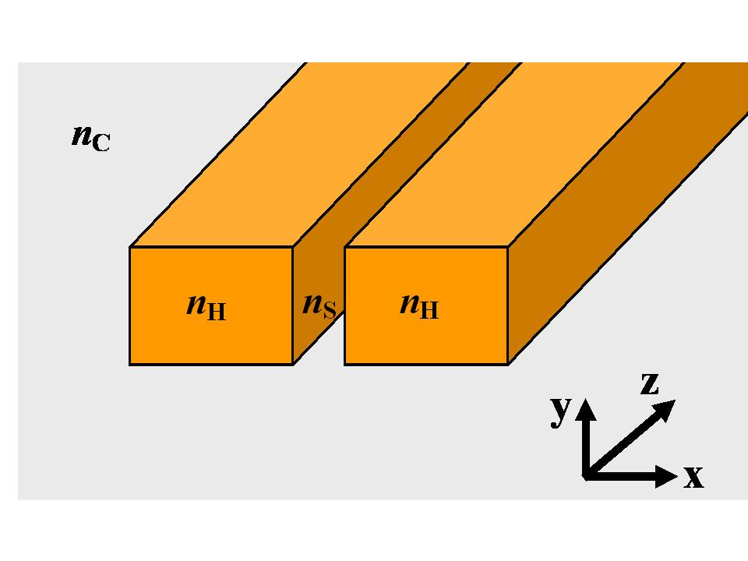
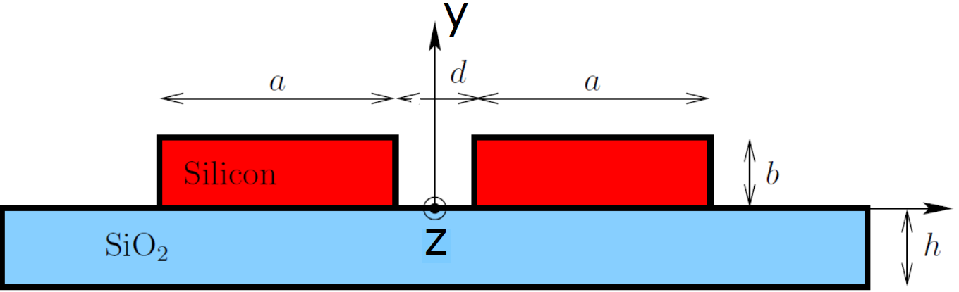
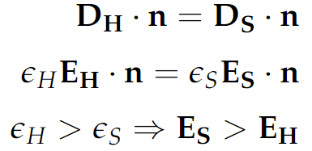
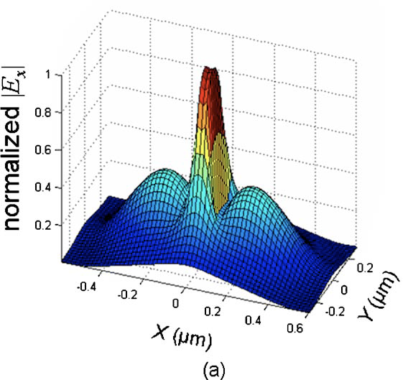
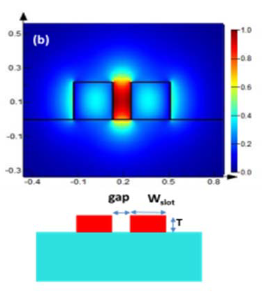
DLA
Co-prop. schemes
DESIGN
1) Slot waveguide
2) 2D PhC waveguide
3) 3D PhC Woodpile
Conclusions
Slot waveguides
- by inserting a slot within the central part of a Si wire
- consists of two strips of high-index material that enclose a sub-wavelength low-index slot region
Schematic of a slot waveguide
Interface conditions
for the Electric displacement field
normal component
Discontinuities of the normal components of the electric field at the high-index-contrast interfaces between silicon area and the slot lead to a partial mode confinement effect within the slot, i.e. within the low-index material

Slide 19
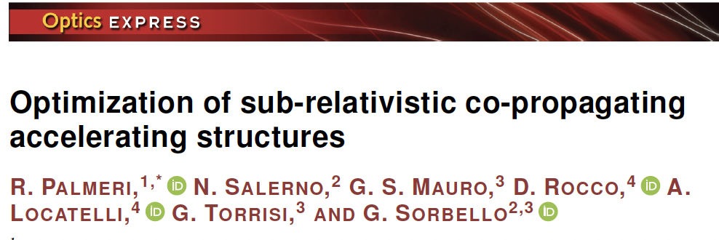
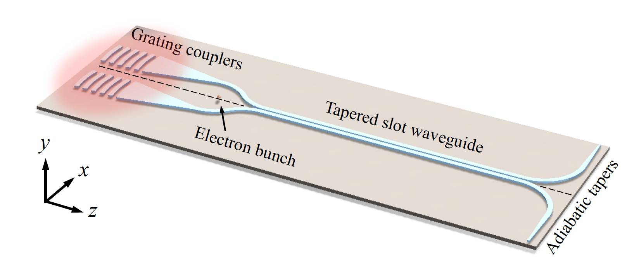
DLA
Co-prop. schemes
DESIGN
1) Slot waveguide
2) 2D PhC waveguide
3) 3D PhC Woodpile
Conclusions
tapered slot waveguide DLA structure for sub-relativistic electron acceleration with continuous phase synchronization
It shows 10 keV of energy gain within 30 µm (0.33 GeV/m)
[“Design of a tapered slot waveguide dielectric laser accelerator for sub-relativistic electrons”
Zhao et al., Opt. Express 26, 22801, 2018]

Slide 20


Synchronicity
DLA
Co-prop. schemes
DESIGN
1) Slot waveguide
2) 2D PhC waveguide
3) 3D PhC Woodpile
Conclusions
For a varying particle velocity, we need a non-uniform slot waveguide
Electron traveling with velocity v_{e}(z)
Wave with phase velocity v_{ϕ}(z)
SYNCHRONOUS CONDITION IS FULFILLED WHEN:

Slide 21
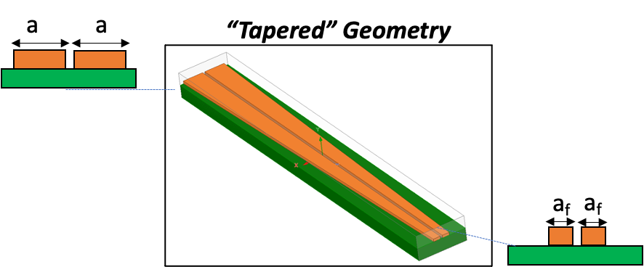

Synchronicity
DLA
Co-prop. schemes
DESIGN
1) Slot waveguide
2) 2D PhC waveguide
3) 3D PhC Woodpile
Conclusions
For a varying particle velocity, we need a non-uniform slot waveguide
Electron traveling with velocity v_{e}(z)
SYNCHRONOUS CONDITION IS FULFILLED WHEN:
non-uniform slot waveguide

Slide 22

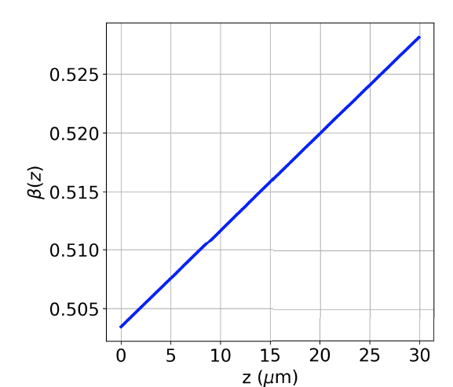

Tapered slot waveguide for sub-relativistic electrons
DLA
Co-prop. schemes
DESIGN
1) Slot waveguide
2) 2D PhC waveguide
3) 3D PhC Woodpile
Conclusions
a
a
“Tapered” Geometry
a_{f}
a_{f}
$β$ variation vs. rib width size a
Phase velocity variation along the waveguide
non-uniform
slot waveguide

Slide 23

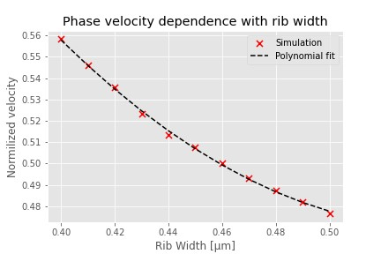
OPTIMUM TAPER PROFILE: Procedure
DLA
Co-prop. schemes
DESIGN
1) Slot waveguide
2) 2D PhC waveguide
3) 3D PhC Woodpile
Conclusions
1) KNOWING THE RELATION

Slide 24
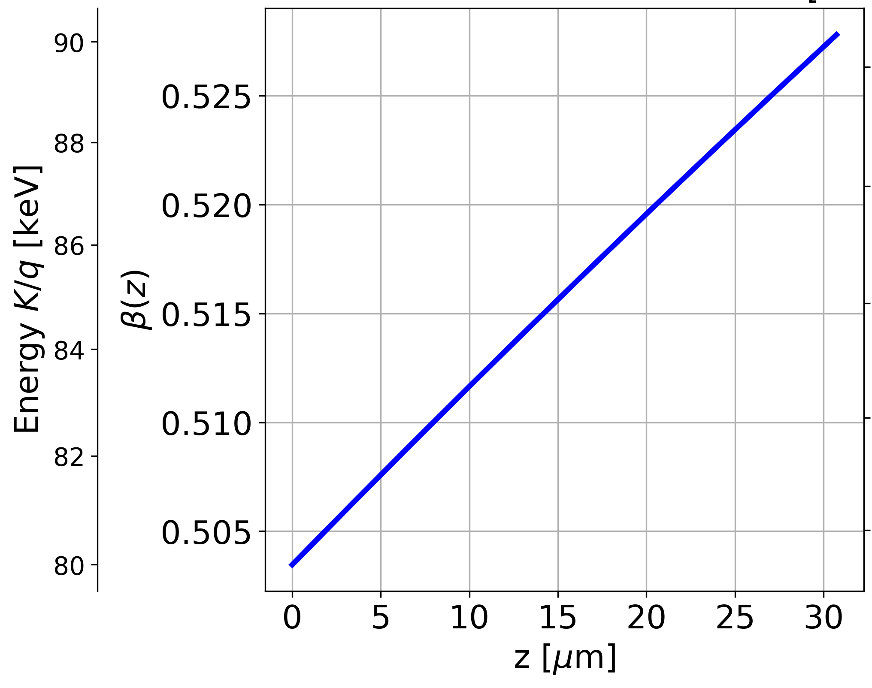
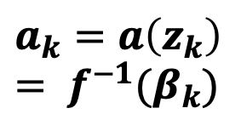



DLA
Co-prop. schemes
DESIGN
1) Slot waveguide
2) 2D PhC waveguide
3) 3D PhC Woodpile
Conclusions
OPTIMUM TAPER PROFILE: Procedure
a= 0.44 µm
THE CORRECT TAPER PROFILE CAN BE ACHIEVED BY:
$$z_{k}$$
$$=$$
$$z_{k−1}+∆z$$
$$E_{k}$$
$$=$$
$$E_{k−1}+∆W$$
$$E_{k}= \frac{mc^{2}}{\sqrt{1−β_{k}^{2}}}$$
$$a_{k}=a\left(z_{k}\right)= f^{−1}(β_{k})$$

Slide 25
DLA
Co-prop. schemes
DESIGN
1) Slot waveguide
2) 2D PhC waveguide
3) 3D PhC Woodpile
Conclusions
OPTIMUM TAPER PROFILE: Procedure
a= 0.44 µm
THE CORRECT TAPER PROFILE CAN BE ACHIEVED BY:
$$z_{k}$$
$$=$$
$$z_{k−1}+∆z$$
$$E_{k}$$
$$=$$
$$E_{k−1}+∆W$$
$$E_{k}= \frac{mc^{2}}{\sqrt{1−β_{k}^{2}}}$$
$$a_{k}=a\left(z_{k}\right)= f^{−1}(β_{k})$$

Slide 26
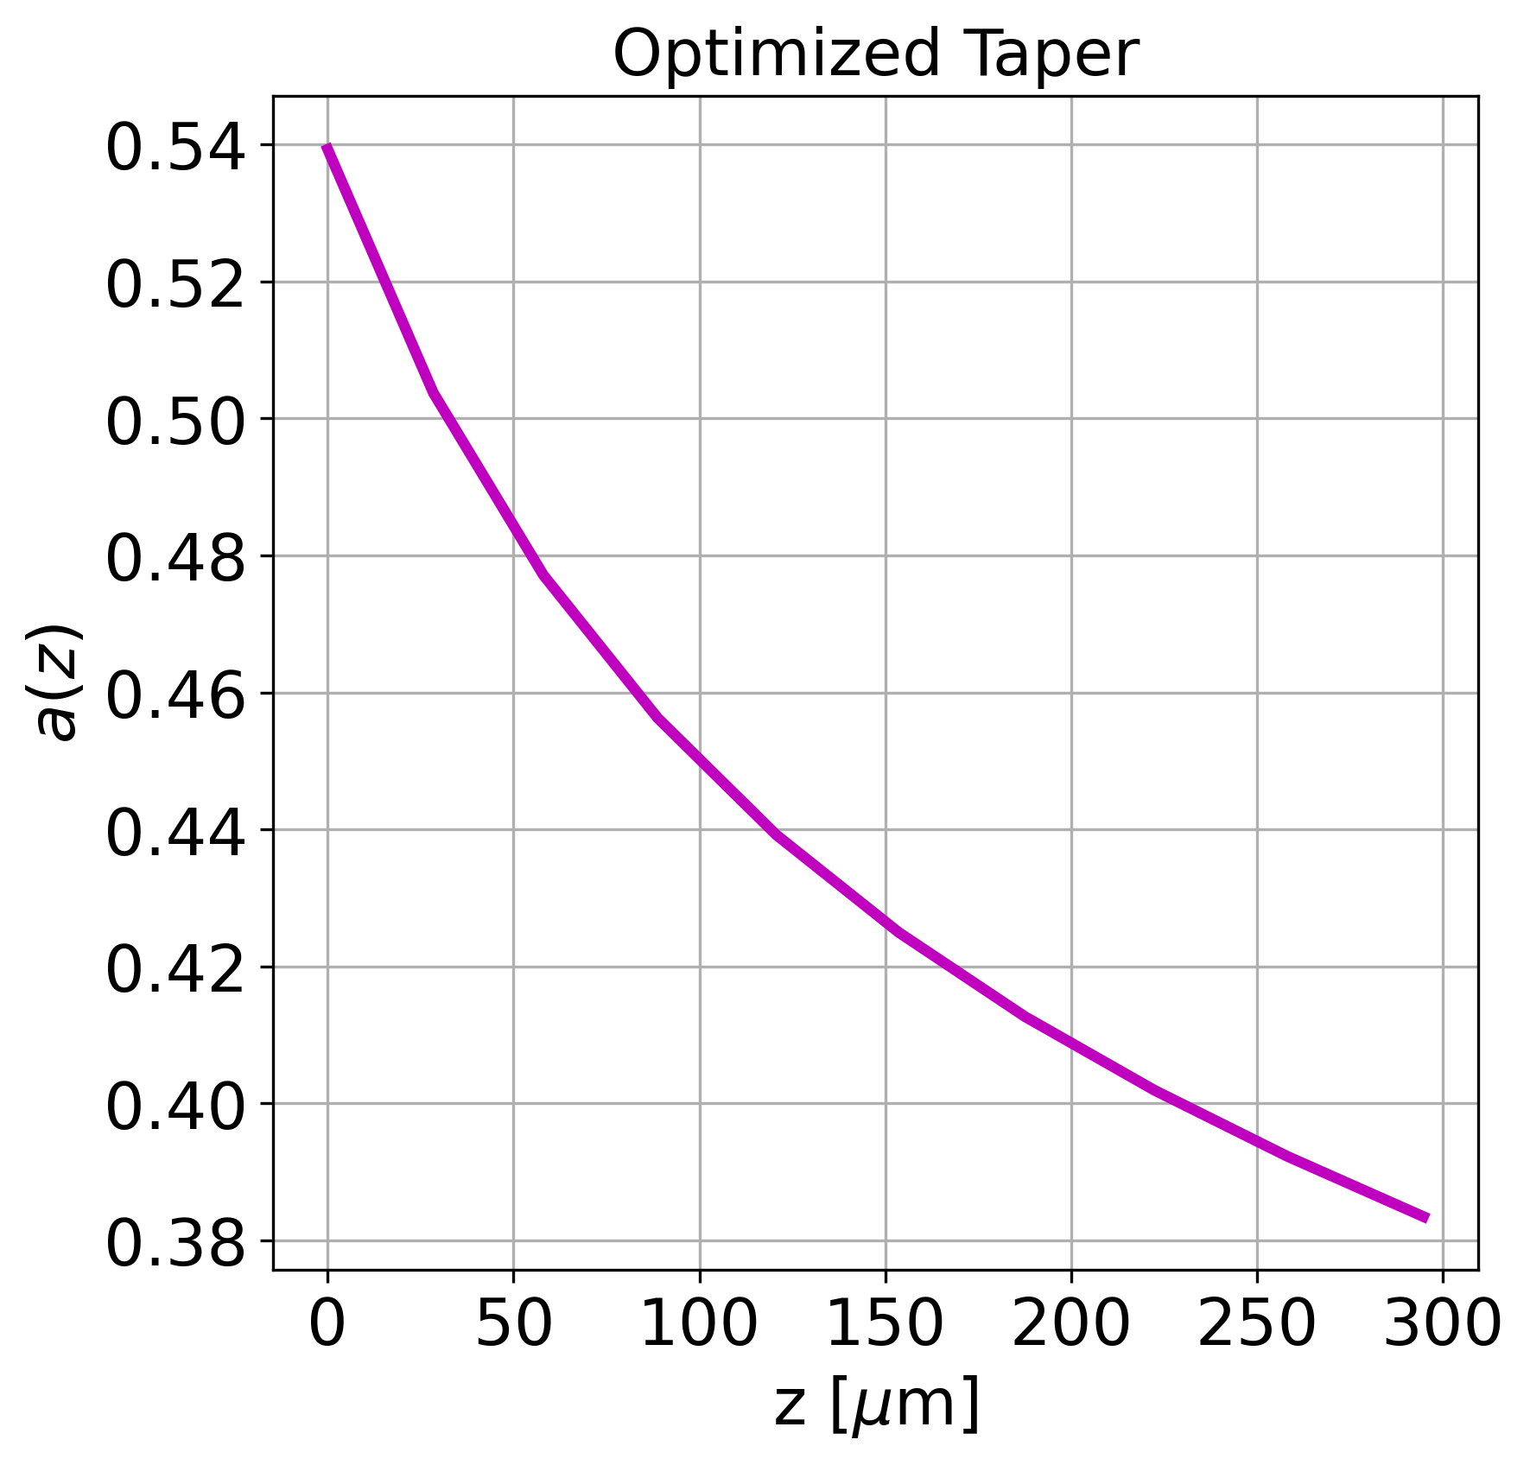
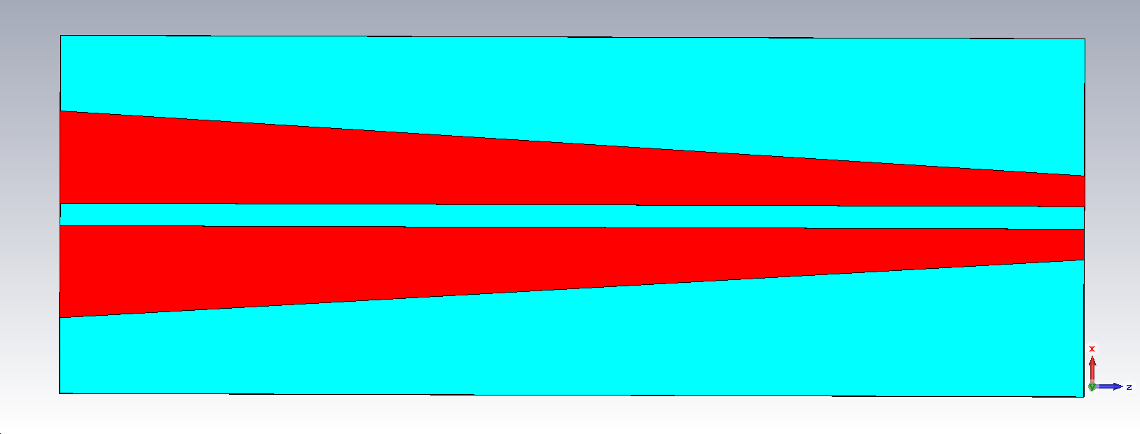
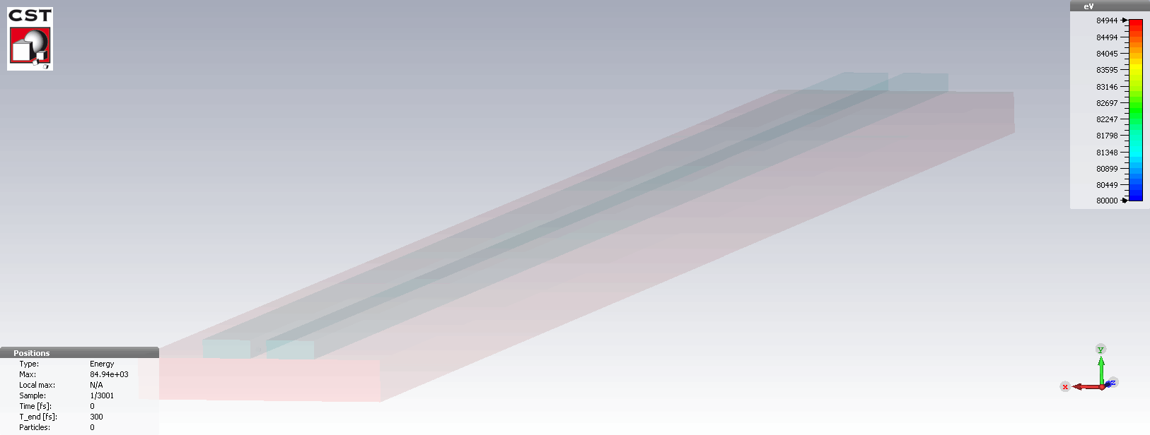
DLA
Co-prop. schemes
DESIGN
1) Slot waveguide
2) 2D PhC waveguide
3) 3D PhC Woodpile
Conclusions
Derived optimal taper

Slide 27
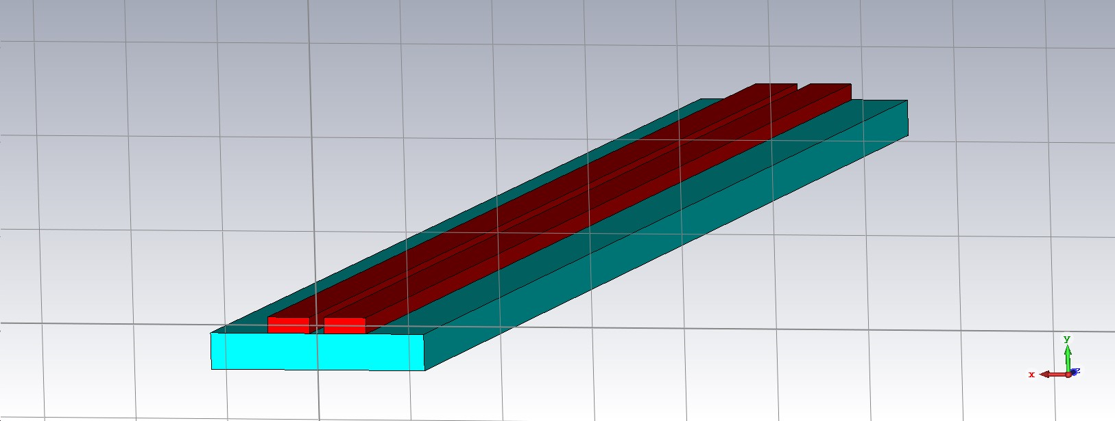
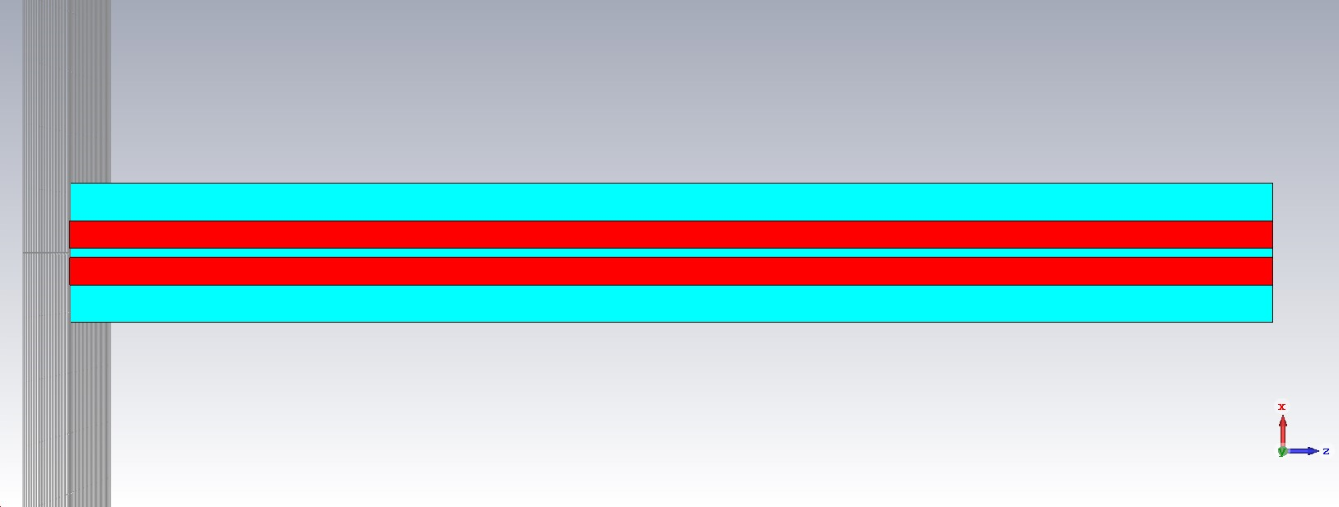


What happens for a uniform (NON-TAPERED) slot waveguide?
DLA
Co-prop. schemes
DESIGN
1) Slot waveguide
2) 2D PhC waveguide
3) 3D PhC Woodpile
Conclusions
Large Energy spread
No particle in the accelerating RF bucket!
PHASE SPACE AT ACCELERATOR’S EXIT

Slide 28



LINEARLY TAPERED SLOT WAVEGUIDE
DLA
Co-prop. schemes
DESIGN
1) Slot waveguide
2) 2D PhC waveguide
3) 3D PhC Woodpile
Conclusions

Slide 29




Performance comparison
DLA
Co-prop. schemes
DESIGN
1) Slot waveguide
2) 2D PhC waveguide
3) 3D PhC Woodpile
Conclusions

Slide 30
Reducing complexity in electromagnetics problems
Approximate solutions and approximate technique to solve guidance problems in dielectric waveguide –> EFFECTIVE INDEX METHOD
The effective index method (EIM) is used to reduce 3D structure to 2D for calculating the propagation constant (or effective refractive index) of a simpler two-dimensional structures in place of the starting complex 3D structure

Slide 31

DLA
Co-prop. schemes
DESIGN
1) Slot waveguide
2) 2D PhC waveguide
3) 3D PhC Woodpile
Conclusions
Effective Index Method (EIM)
The starting 3D problem has a stratification along y
b) The starting 3D structure can be divided in three regions where a 2D problem can be solved to compute the three effective indices: n_{eff1}, n_{eff2}, n_{eff3}, where n_{eff} = β/k0 , (β ≡ kz).
c) A 2D simpler problem can be solved having a stratification along x

Slide 32




Slot waveguides (“effective index” approximation)
DLA
Co-prop. schemes
DESIGN
1) Slot waveguide
2) 2D PhC waveguide
3) 3D PhC Woodpile
Conclusions
3D REAL
“2D “EFFECTIVE”

Slide 33



Simplex optimization
DLA
Co-prop. schemes
DESIGN
1) Slot waveguide
2) 2D PhC waveguide
3) 3D PhC Woodpile
Conclusions
Nelder - Mead method
  Local optimum in multidimensional space
    Quadratic taper profile $a\left(s\right)=p_{2}s^{2}+p_{1}s+p_{0}$
  Good for nonlinear optimization, but slow convergence rate
    No gradient is calculated!
  Optimization procedure
    NM algorithm chooses $p_{1}$ and $p_{2}$ ($p_{0}$ is fixed)
    Batch script calls COMSOL to calculate the 2D accelerating field
    Batch script evaluates the objective function
    Repeat until convergence ...
Comparison of the obtained acceleration profile and output energy with the different
optimization strategies.

Slide 34





Me & My Lab
DLA
Co-prop. schemes
DESIGN
Conclusions
Tapered Slotted
waveguide
$$0.4<β<0.63$$
Tapered PhC waveguide
[$β=0.7−1]$

Slide 35




DLA
Co-prop. schemes
DESIGN
1) Slot waveguide
2) 2D PhC waveguide
3) 3D PhC Woodpile
Conclusions
1) Slotted waveguide
[$0.4<β<0.75$]
2) Tapered 2D photonic crystal waveguide
[$0.7<β<1]$
3) Woodpile
[$β=1$]
OK
$\sim$ 1 GV/m
@ P_inj=1 kW

Slide 36






DLA
Co-prop. schemes
DESIGN
1) Slot waveguide
2) 2D PhC waveguide
3) 3D PhC Woodpile
Conclusions
2D photonic crystal waveguide design procedure
W
TM₀₁-like mode (longitudinal Electric field E_{x}$≠$0)
Phase of E_{x} along x vs. $\frac{ω}{c}x$
|E_{x}|
|E_{y}|
|E_{x}|
|E_{y}|
x

Slide 37









DLA
Co-prop. schemes
DESIGN
1) Slot waveguide
2) 2D PhC waveguide
3) 3D PhC Woodpile
Conclusions
Phase advancement variation by varying the defect size W
$β=$0.7774
$β=$0.85
$$β=1$$
W₁
W₂
W₃
$β=$0.7774
$β=$0.85
$$β=1$$

Slide 38

DLA
Co-prop. schemes
DESIGN
1) Slot waveguide
2) 2D PhC waveguide
3) 3D PhC Woodpile
Conclusions
1) Slotted waveguide
[$0.4<β<0.75$]
2) 2D photonic crystal waveguide
[$β<0.7<1]$
3) Woodpile
[$β=1$]

Slide 39

Me & My Lab
DLA
Co-prop. schemes
DESIGN
FABRICATION
Conclusions
Tapered Slotted
waveguide
$$0.4<β<0.63$$
Tapered PhC waveguide
[$β=0.7−1]$
Woodpile
[$β=1]$

Slide 40



Woodpile waveguide
DLA
Co-prop. schemes
DESIGN
1) Slot waveguide
2) 2D PhC waveguide
3) 3D PhC Woodpile
Conclusions
Composed by a “pile” of rectangular w × h bricks disposed in layers stacked in the vertical direction, each layer rotated of 90° with respect from the layer below, whose centers are distant a period d.
Creating a so called “defect channel”, one or more modes can be trapped inside the defect and thus a waveguide is obtained.
‘Hollow-core’defect channel
Woodpile waveguide
Electric field inside defect channel
G. S. Mauro et al., "Fabrication and Characterization of Woodpile Waveguides for Microwave Injection in Ion Sources," in IEEE Transactions on Microwave Theory and Techniques, vol. 68, no. 5, pp. 1621-1626, May 2020, doi: 10.1109/TMTT.2020.2969395.

Slide 41




DLA
Co-prop. schemes
DESIGN
1) Slot waveguide
2) 2D PhC waveguide
3) 3D PhC Woodpile
Conclusions
The periodic structure repeats in the stacking direction each four layers, creating a frequency band-gap where the EM propagation is suppressed.
The band-gap can be calculated considering an unit cell with periodic boundary conditions.
frequency band-gap
'Projected' band diagram of the accelerating waveguide, calculated along the defect propagating axis (z axis).
The confined TM01-like mode (red line) is clearly visible.

Slide 42

hollow-core woodpile coupler
DLA
Co-prop. schemes
DESIGN
1) Slot waveguide
2) 2D PhC waveguide
3) 3D PhC Woodpile
Conclusions
The side-coupler consists of:
a right-angled bend mode converter, from TE10-like launch mode to TM01-like mode suitable for particle acceleration;
an accelerating waveguide whose length can be tuned in order to obtain the final energy.
Wave is injected (and extracted) into the woodpile coupler by using two waveguide splitters (or optical fibers at optical frequencies).

Slide 43


DLA
Co-prop. schemes
DESIGN
1) Slot waveguide
2) 2D PhC waveguide
3) 3D PhC Woodpile
Conclusions
hollow-core woodpile coupler
From the electric field plot along the accelerating waveguide, it can be seen that:
the longitudinal component |Ez| is predominant;
the transversal components |Ex|, |Ey|, are almost equal to zero.
G. S. Mauro et al; Numerical Simulation of a Hollow-Core Woodpile-Based Mode Launcher for Dielectric Laser Accelerators Appl. Sci. 2022, 12(5), 2609; https://doi.org/10.3390/app12052609
Acc. gradient of 2 GV/m along hollow-core channel with 500 W input power.
TM01-like mode synchronous with
speed of light @ 193.66 THz.

Slide 44

Inspired by the RF METALLIC counterpart….
Courtesy of D. Alesini
X-band mode launcher
hollow-core woodpile coupler

Slide 45




Inspired by the RF METALLIC counterpart….
Standing-wave, multigap SW cavities-like, woodpile-based accelerating structure
Courtesy of D. Sertore,
woodpile cavities connected by
silicon ‘junction blocks’ of proper length.
superconducting cavities @1.3 GHz
λ₀ = 23 cm.
3-cell SW structure working in the TM₀₁₀-like mode, λ₀ = 5 μm.
Next step: design of a proper Dielectric cavity coupler.

Slide 46


DLA
Co-prop. schemes
DESIGN
TRANSITION
Fabrication
Conclusion
Preliminary example of sub-relativistic to relativistic PhC-based transition design
Sub-relativistic to relativistic (0.75 < β < 1)
Silicon triangular lattice PhC accelerating waveguide
E-field plot (back-to-back simulation)
Sub-relativistic (0.4 < β < 0.75) Silicon on Silica slotted waveguide

Slide 47




DLA
Co-prop. schemes
DESIGN
TRANSITION
Fabrication
Conclusion
Slotwg2PhCwg Transition
P_{IN} = 100 W

Slide 48
Fabrication overview
Me & My Lab
DLA
Co-prop. schemes
DESIGN
FABRICATION
Conclusions
Slot waveguide
Photonic Crystal (PhC) waveguide
3) PhC Woodpile
[$β=1$]

Slide 49

Fabrication overview
Me & My Lab
DLA
Co-prop. schemes
DESIGN
FABRICATION
Conclusions
Slot waveguide
Photonic Crystal (PhC) waveguide
3) PhC Woodpile
[$β=1$]
✓
✓
silicon waveguides can be readily/easliy fabricated from Silicon-on-Insulator (SoI) wafers using standard CMOS (complementary metal-oxide-semiconductor) processes.
Optical lithography and etching techniques are used to form the silicon waveguide.
cost efficient mass production environment for such integrated photonic devices.

Slide 50
Fabrication overview
Me & My Lab
DLA
Co-prop. schemes
DESIGN
FABRICATION
Conclusions
Slot waveguide
Photonic Crystal (PhC) waveguide
3) PhC Woodpile
[$β=1$]
✓
✓
silicon waveguides can be readily/easliy fabricated from Silicon-on-Insulator (SoI) wafers using standard CMOS (complementary metal-oxide-semiconductor) processes.
Optical lithography and etching techniques are used to form the silicon waveguide.
x
cost efficient mass production environment for such integrated photonic devices.

Slide 51


Woodpile structure fabrication - overview
Layer deposition (min. feature size: 450 nm)
General process involves building up the structure layer by layer, using silicon dioxide as a matrix in which silicon features are embedded.
Then, a selective etch is done to remove the silicon dioxide, resulting in a free standing structure of silicon and vacuum.
2. Direct laser writing (min. feature size: 100 nm)
By moving the focus of the laser beam three dimensionally, arbitrary 3D structures can be written into the volume of the material.
C. McGuinness, R.L. Byer, E. Colby, B.M. Cowan, R.J. England, et al., “Woodpile structure fabrication for photonic crystal laser acceleration”, AIP Conf. Proc. 1086 (2009) 1, 544-549, DOI: 10.1063/1.3080965;
I. Sakellari, E. Kabouraki, D. Gray, C. Fotakis, A. Pikulin, N. Bityurin, M. Vamvakaki, M. Farsari, "High-resolution 3D woodpile structures by direct fs laser writing," Proc. SPIE 8456, Nanophotonic Materials IX, 84560E (15 October 2012); https://doi.org/10.1117/12.930155.

Slide 52


DLA
Co-prop. schemes
DESIGN
FABRICATION
Conclusions
3D printing at the micro- / nano- scale
Two photon polymerization (TPP)
Femtosecond pulsed laser to induce resist polymerization
100x objective
Laser nanoFab
Single photon polymerization (standard): lower resolution, surface polymerization
M4D System by Laser nanoFab
TPP setup
Two photon polymerization (2PP) : higher resolution, polymerization inside volume

Slide 53

DLA
Co-prop. schemes
DESIGN
FABRICATION
Conclusions
CVD / PECVD deposition of Si
AIM: obtain the designed Dielectric PC structure starting from the TPP printed structure
Fabrication of the Si woodpile micrometric structure by covering the polymeric structure obtained by TPP with Si deposited by CVD techniques as
PECVD (a-Si:H)
LPCVD (a-Si:H or polySi)
PECVD

Slide 54



2PP Fabrication
Chemiresistive devices for room-temperature gas sensing applications: from LPs and ICPs to LDHs
DLA
Co-prop. schemes
DESIGN
FABRICATION
Conclusions
Lorenzo Vigna
2PP direct writing, which polymerizes the resin through a fs-laser
Sample preparation by drop-casting characterized by solvent evaporation
Development
54

Slide 55


2PP Fabrication
Chemiresistive devices for room-temperature gas sensing applications: from LPs and ICPs to LDHs
DLA
Co-prop. schemes
DESIGN
FABRICATION
Conclusions
Lorenzo Vigna
FESEM characterization
Drying process by using a CPD instrument
55

Slide 56
Latest Results
DLA
Co-prop. schemes
DESIGN
FABRICATION
Conclusions
start
56

Slide 57
DLA
Co-prop. schemes
DESIGN
1) Slot waveguide
2) 2D PhC waveguide
3) 3D PhC Woodpile
Conclusions
Conclusion
Dielectric laser accelerators (DLA) represents a significant advancement and promising opportunity for future high gradient accelerators
Co-propagating structures can scale well towards “useful” energies
Successful design and implementation DLA is challenging
The development of a 2D reduced model enables automatic optimization and simplifies the design process
Next steps:
prototype realization
overall numerical study of a co-propagating S2E structure

Slide 58
DLA
Co-prop. schemes
DESIGN
1) Slot waveguide
2) 2D PhC waveguide
3) 3D PhC Woodpile
Conclusions
MeV-scale simulations and fabrication tests of silicon slot and woodpile-based waveguides for Dielectric Laser Accelerators
G. Torrisi, A. L. Genre, G. S. Mauro, D. Mascali, S. Quevedo, G.R. Rizzoli, V. Bertana, S. L. Marasso and G. Sorbello
THANK YOU!
MIniaturised aCceleRatOrs Network
μICRON
15th Workshop on Breakdown Science and High Gradient Technology (HG2023) 16–20 Oct 2023 INFN Frascati National Laboratories

