Slide 1
European strategy for particle physics
WG5. RF sources and efficiency
I. Syratchev (CERN), G. Burt (ULAN) and M. Jensen (ESS)
20.10.2023

Slide 2
WG5 roles/objectives
To promote development/prototyping of the high efficiency RF power sources for the future large-scale particle accelerators in Europe. HL-LHC and FCC_{ee} is a primarily objective.
To support accelerators user community needs for high efficiency RF sources as a synergy with HEP, or as a specialized activity(ies) targeted for the novel/customized efficient devices development.
To intensify collaboration with industry and ensure the long-term industrial support for decades to come. For example, by providing attractive HE solution with added market value.

Slide 3
RF power sources for particle accelerators
S-band (3GHz)
Large scale particle accelerators can be operated with vast diversity of RF power sources.
The actual choice of the RF source type will be driven by practical consideration : tunnel integration, spatial and peak power density, cost/W and efficiency.
UHF/L-band (0.3-1.3GHz)
Injectors
User facilities:
Spallation sources
Storage rings&
Light sources
X-FEL
Large scale Particle
Accelerators:
LHC
ILC
CLIC
FCC
Muon_C
CEPC
HALHF
C-band (6GHz)
C-cube
X-band
(12 GHz)
Beam instrumentation
Compact facilities:
Medical
Technological
Industrial
(*SCRF)
Ka-band (30GHz+)
CW, Pulsed.
Klystron, IOT, tetrode, SSPA.
Exotic concepts
Very high gradient linacs
Pulsed.
Klystron.
CW, Pulsed.
Klystron, Gyro-devices.

Slide 4
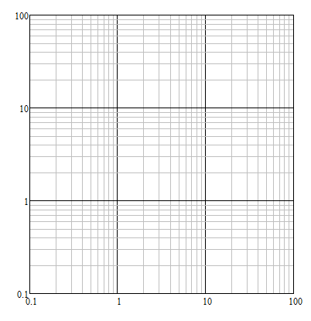
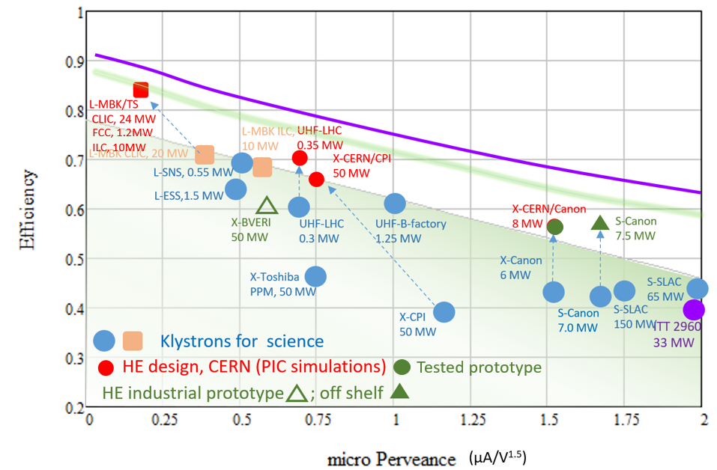
The klystron is a key element of almost all particle accelerators.
High Efficiency klystrons project at CERN&ULAN is targeted to improve efficiency and performance of these devices for various applications.
electron & proton rings
SC e/p Linacs
electron Linacs
high intensity
high gradient
PAL
C-cube
NLC
SLAC
HEP
CLIC’k
Muon_C
e-rings
injectors
PSI
SACLA
DEFT
CLIC
MBK
Beam diagnostic,
X-FEL
ILC
DESY
Ultimate limit
FNAL
Industrial/Medical
Peak power, MW
J-PARC
LHC
ESS
Magnetron
(oscillator)
FCC_{ee}
SLAC-BF
KEK
CEPC
Tetrode
LHC
HE klystrons at CERN
Klystrons
Pulsed
Continuous Wave
In fabrication
SSPA tower
IOT
single beam
Frequency, GHz

Slide 5
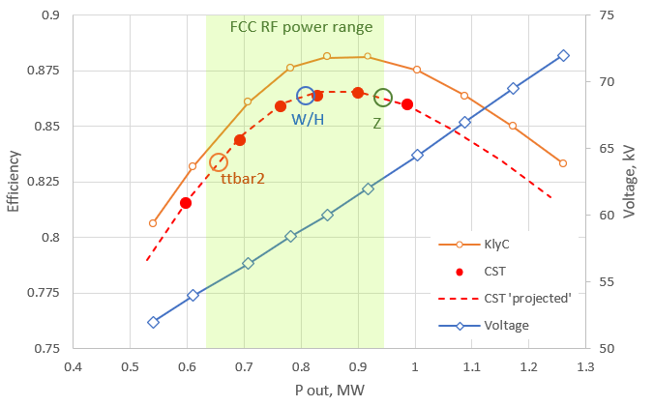
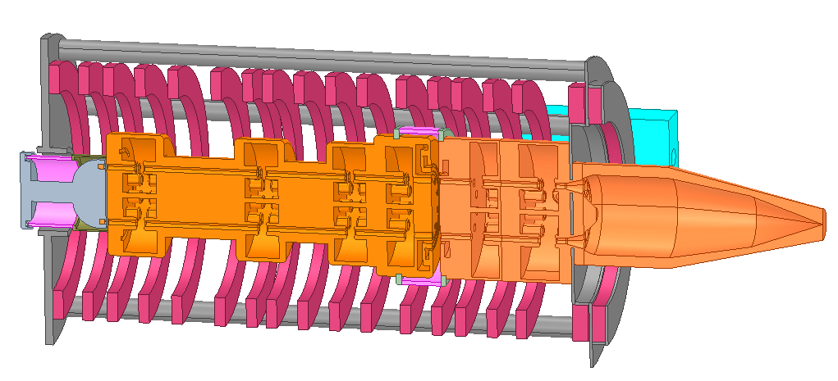
400 MHz HE Two-Stages MBK for FCC_{ee}. Performance summary.
Efficiency vs. saturated RF power at different klystron voltages
Featured:
Very efficient. 86% @ Z,W,H and 83% @ ttbar2.
Compact. Total length <3m.
Low Voltage. Up to 64kV @ 1 MW.
High RF power gain. 43dB @ 1MW.
Broadband. 3.5 MHz @ -1dB.
Robust. Can handle mismatch up to -15dB.
Project status @ CERN
RF circuit
Collector
Cathode
Solenoid
Special High Voltage isolated RF feedthrough (prototype).
Integration
Thermal/mechanical analysis

Slide 6
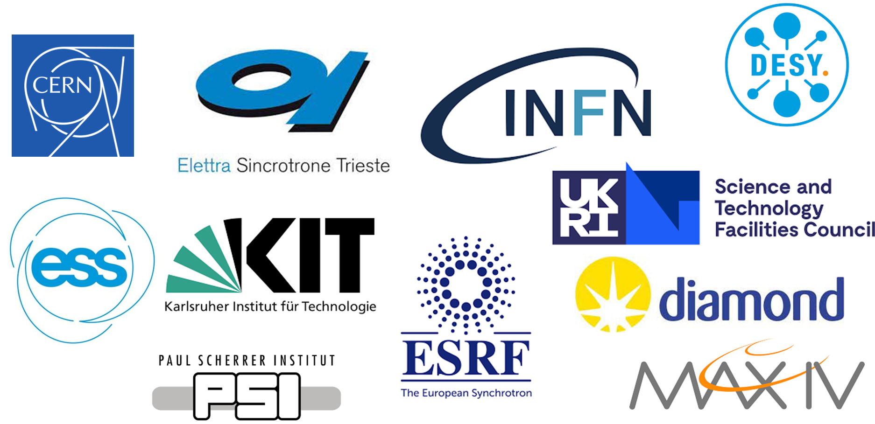
Data from the RF source questionnaire (Spring 2023)

Slide 7
Questionnaire
Do you plan to continue operation of your facilities with your existing RF power sources (YES/NO)?
If yes, do you have, or expect to have any potential problems with device delivery from qualified vendors in the case similar devices are required to be ordered?
If no, what would be the reason (e.g. replacing klystrons by SSPA or wise versa)?
Are you interested in the development of the new High Efficiency (HE) RF power sources that could replace your exiting devices, or can be adopted for extended demands of your accelerators (YES/NO)?
If yes:
Do you have any expertise in RF power sources development on site (YES/NO)?
Would you be interested in the development of HE RF power sources in collaboration with other Labs and industry (YES/NO)?
Would you be willing to participate in the funding of such developments in collaboration with other Labs (YES/NO)?

Slide 8
Sources Development
Future accelerators will require new RF source development, but industry is unlikely to lead the R&D.
Development of new tubes is happening at a limited number of Labs, but it is sufficiently covering current HEP request.
Lab’s new development implementation in industry is challenging (time and cost) due to limited number of vendors and their capacities.

Slide 9
Capabilities and development
Split 50-50 on who has RF source staff in house, most have either SSPA or tube expertise not both
Most are interested in high efficiency development
Funding situation is complex with most stating grants needed

Slide 10
Conclusions
The survey focused on current install base, and future requirements but also asked about development.
While sustainability is a future HEP driver, most user facilities are more focused on performance of existing machines and their beam lines upgrades. Would buy higher efficiency sources if available, but not actively developing them.
Many labs report a desire to swap out tubes for SSPA but the requirements are currently beyond state of the art in power/frequency. Often the drivers are instability, long lead times and increasing cost for tube manufacturers and not particular SSPA advantage.
There’s a strong need to bring labs and industry closer together in this field, which is happening albeit on a relatively small scale in terms of number of R&D organisations involved. CERN is leading in number of areas for HL-LHC, FCC and CLIC klystrons.

