Slide 1

Progress of the VIGAS Project in Tsinghua University
VIGAS: Very compact Inverse-compton-scattering GAmma-ray Source
Jiaru Shi
on behalf of VIGAS team in THU
2023.10.18

Slide 2
Outline
Introduction
Overview of VIGAS Accelerator System
Development and Prototyping of Key components
Progress of the project
Summary

Slide 3
introduction

Slide 4
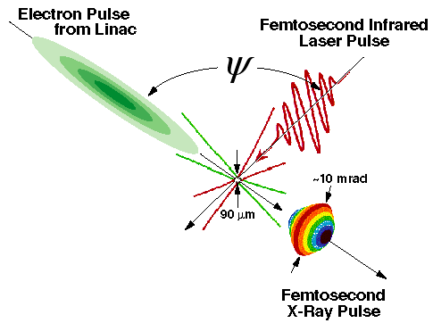
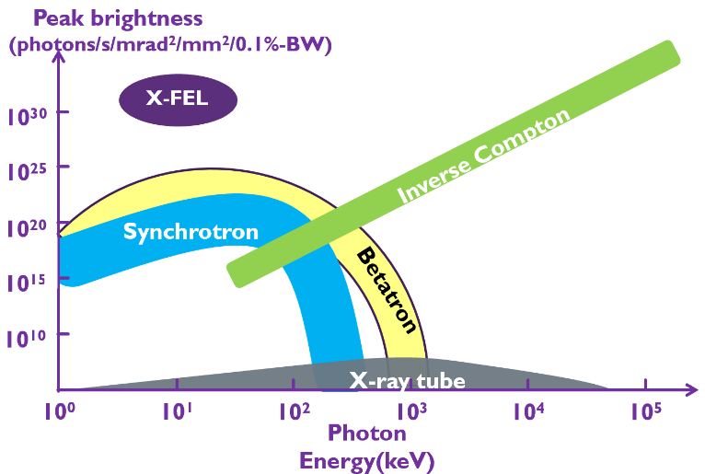
Introduction
VIGAS: Very compact Inverse-Compton-scattering GAmma-ray Source
ICS
Characteristics
Quasi-monochromatic
Continuously adjustable X-ray energy
Small source size ~10um
Controllable polarization
Ultra-short pulse length (fs~ps)
Advantages
High peak brightness
Gamma-ray
Compact
Affordable

Slide 5
introduction
Goals of VIGAS project:
Gamma-ray energy: 0.2~4.8 MeV continuously adjustable
Gamma-ray energy spectrum bandwidth(rms): <1.5% (w/ collimator)
Photon production (photon/s):
  >4×10⁸ @0.2~2.4 MeV; >1×10⁸ @2.4~4.8 MeV
Photon production in 1.5% bandwidth (photon/s):
  >4×10⁶ @0.2~2.4 MeV; >1×10⁶ @2.4~4.8 MeV
Polarity: adjustable from linear to circular

Slide 6
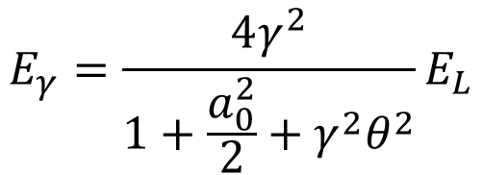
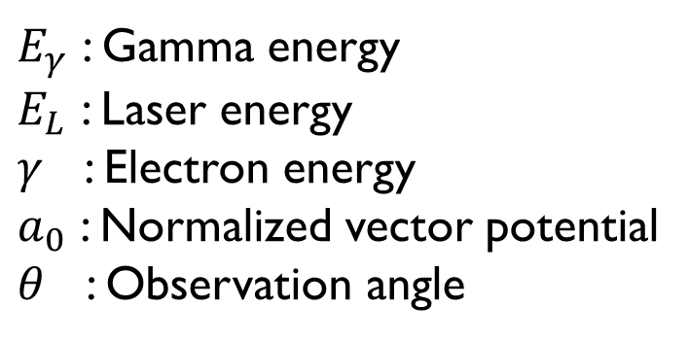
introduction
Gamma-ray energy: 0.2~4.8 MeV continuously adjustable
Collision angle between electron bunch and laser: 180 degree
$$E_{γ}=\frac{4γ^{2}}{1+\frac{a_{0}^{2}}{2}+γ^{2}θ^{2}}E_{L}$$
200 keV gamma-ray @800nm & 92MeV electron
2.4 MeV gamma-ray @800nm & 320MeV electron
4.8 MeV gamma-ray @400nm & 320MeV electron
$E_{γ}$ : Gamma energy
$E_{L}$ : Laser energy
$γ$ : Electron energy
$a_{0}$ : Normalized vector potential
$θ$ : Observation angle
Electron energy
  Maximum > 320 MeV
  Minimum < 92 MeV
Laser energy:
800 nm: 1.54 eV
400 nm: 3.08 eV

Slide 7
Introduction
Design parameters of accelerator system for VIGAS
Properties | Value
Electron energy | 50-350 MeV tunable
Charge | >= 200 pC
Normalized emittance | < 0.6 mm mrad
RMS bunch length | < 2 ps
RMS energy spread | < 0.3 %
RMS beam size at interaction point | < 20 um
Repetition | 10 Hz

Slide 8
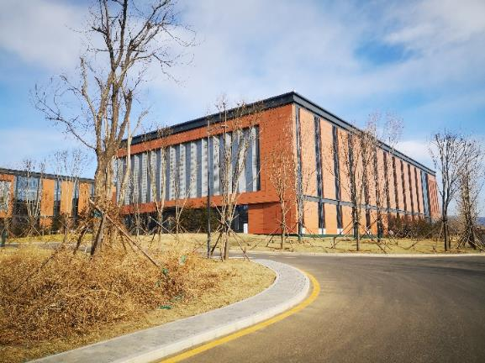
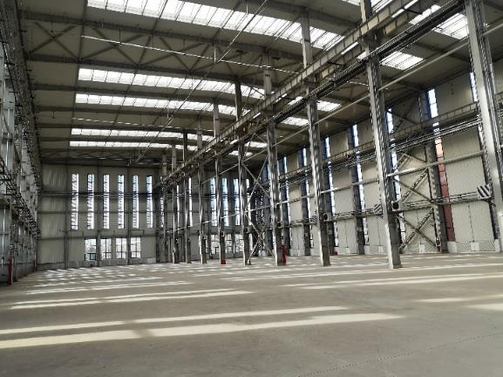

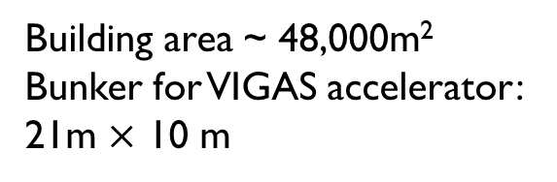
Introduction
VIGAS: 5-year project funded by NSFC, led by Prof. Tang Chuanxiang.
Building area ~ 48,000m²
Bunker for VIGAS accelerator:
21m $×$ 10 m

Slide 9
Overview of accelerator system
Notes:
Let’s go to the overview of accelerator system.

Slide 10
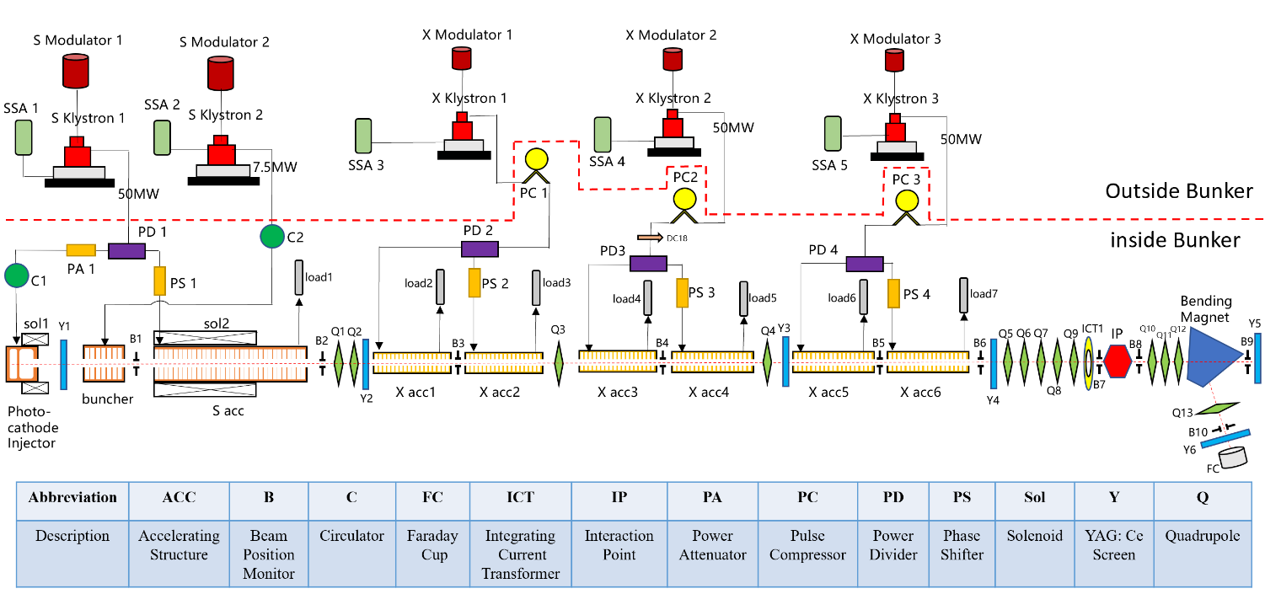
Overview of accelerator system
S band injector
X band linac
Interaction and diagnostics

Slide 11
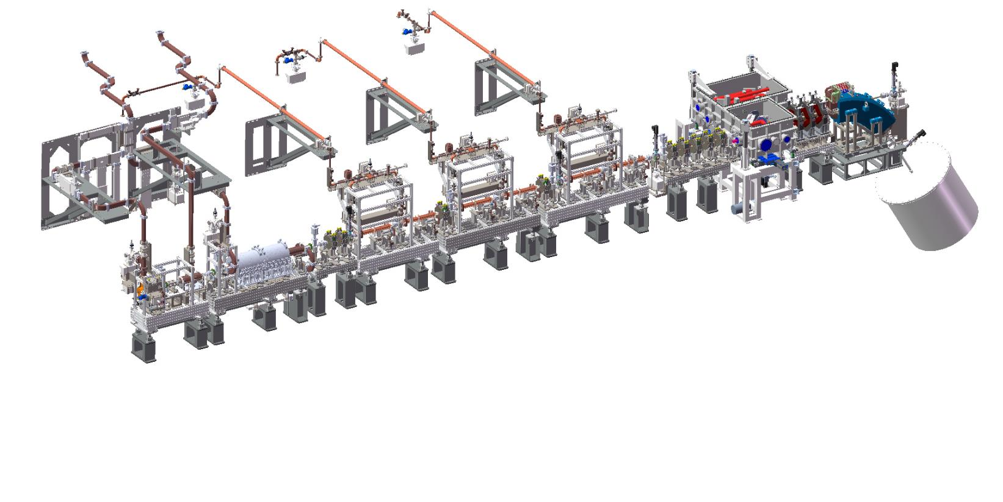
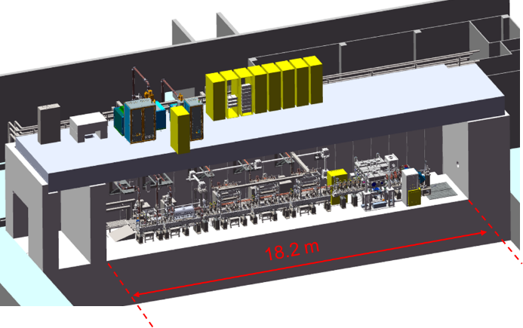
Overview of accelerator system

Slide 12
Beam dynamics and photon generation simulation
S-band injector and X-band main linac
  S-band RF buncher
  50-350MeV beam
  0.6mm*mrad
  < 2ps, E spread <0.3%
  Size <20um
  Transverse jitter <3um
  Rep. 10 Hz
In simulation (CAIN)
  Photons at 200pC, 10Hz
  2e9@800nm photons/s
  5e8@400nm photons/s
  For 1.5% bandwidth fact of 1/100
S-band RF buncher
Gamma Spectrum v.s. c angle
Case:360MeV-200pC-800nm
Beam parameters in simul.

Slide 13
S band injector

Slide 14
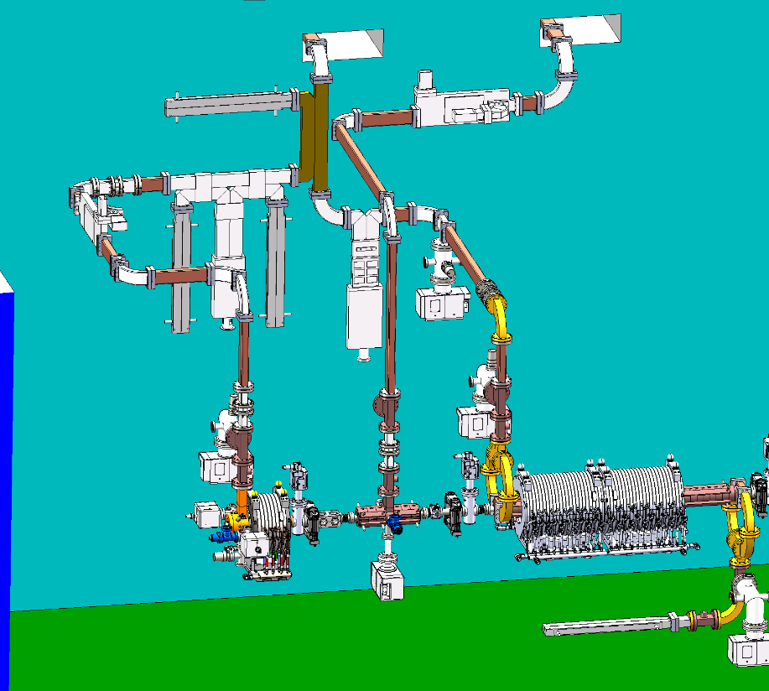
S BAND WAVEGUIDE SYSTEM
50 MW power from Canon E3730A feeds for photoinjector and S acc
  5dB power splitter
  Phase shifter for S acc phase control
7.5 MW power from Canon E3772A feeds for buncher
Consider RF loss due to waveguides and components:
Power splitter
circulator
Phase shifter
S acc
 | Transmitted power (MW) | Needed power (MW)
Photoinjector | 11.7 | 7
S acc | 29 | 21
buncher | 6.4 | 3
Power attenuator
photoinjector
buncher

Slide 15
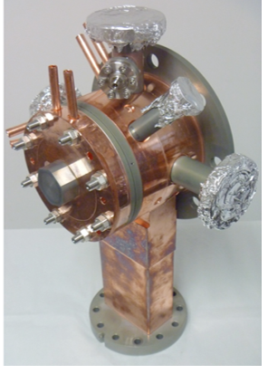
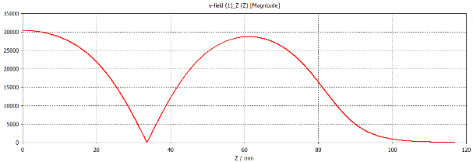
S band photoinjector
Parameters | Value | Unit
PI mode frequency | 2856 | MHz
Q₀ | 14000
Coupling coefficient | 1-1.3
Working field strength | 100-120 | MV/m
Emitting charge | >200 | pC
Cathode material | Copper
Quantum efficiency | 4x10⁻⁵
Emittance | <0.6 | um
Relative quadrupole field strength | <2×10⁻⁴
Zheng, Lianmin, et al. NIMA 834 (2016): 98-107.

Slide 16
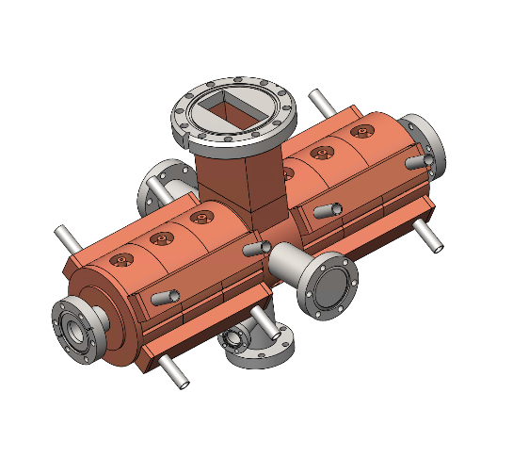
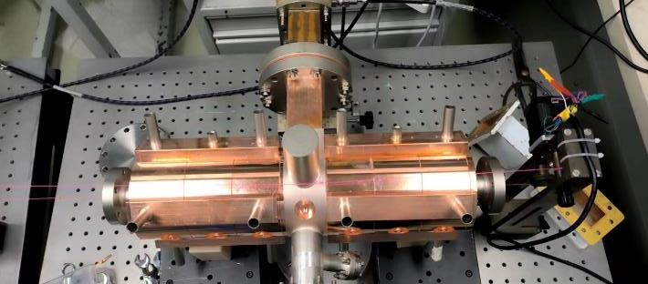
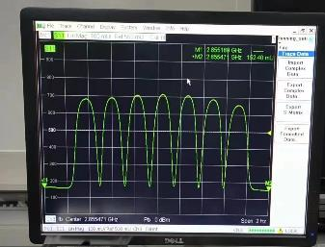
S band buncher
Parameters | Value | Unit
PI mode frequency | 2.856 | GHz
Q₀ | 17000
Coupling coefficient | 1.2
Shunt impedance | 50 | MΩ/m
Working field strength | 23 | MV/m
Relative quadrupole field strength | <5e-4
E field along axis

Slide 17
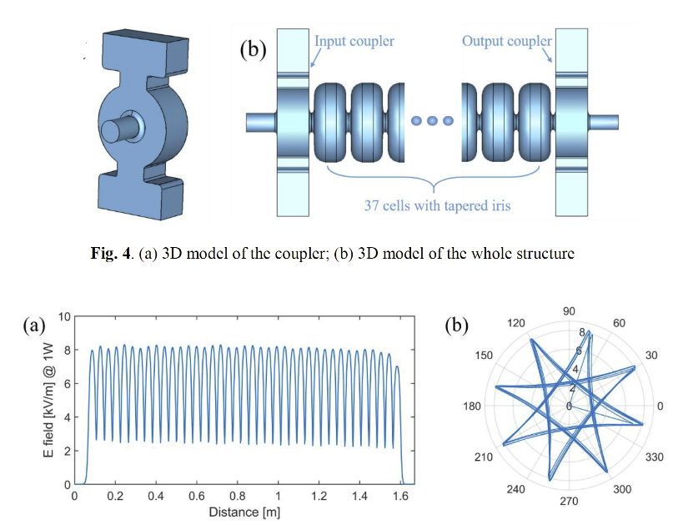

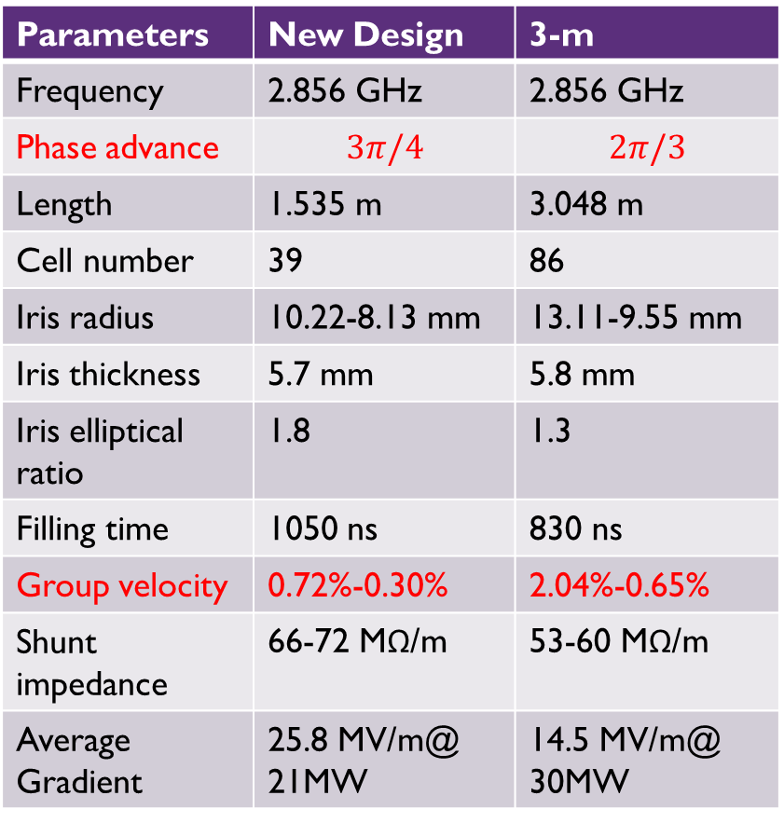
S BAND acc
Parameters | New Design | 3-m
Frequency | 2.856 GHz | 2.856 GHz
Phase advance | $$3π/4$$ | $$2π/3$$
Length | 1.535 m | 3.048 m
Cell number | 39 | 86
Iris radius | 10.22-8.13 mm | 13.11-9.55 mm
Iris thickness | 5.7 mm | 5.8 mm
Iris elliptical ratio | 1.8 | 1.3
Filling time | 1050 ns | 830 ns
Group velocity | 0.72%-0.30% | 2.04%-0.65%
Shunt impedance | 66-72 MΩ/m | 53-60 MΩ/m
Average Gradient | 25.8 MV/m@ 21MW | 14.5 MV/m@ 30MW
$3π/4$ mode
*Lin, Xiancai, et al. NST

Slide 18
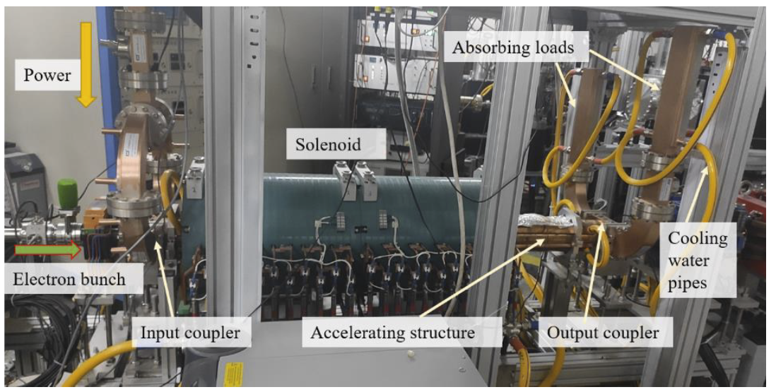
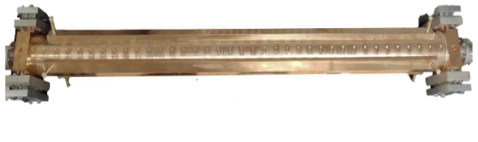
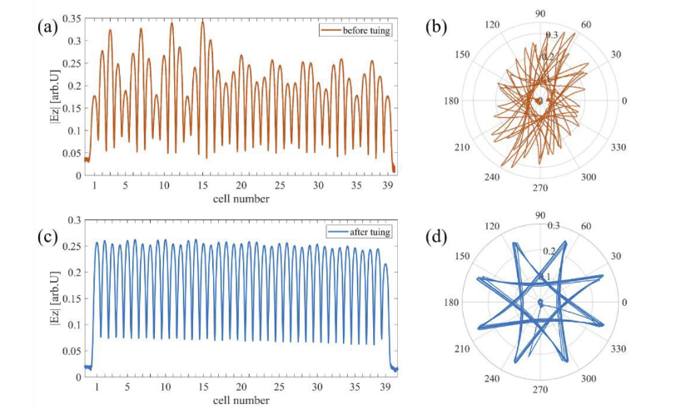
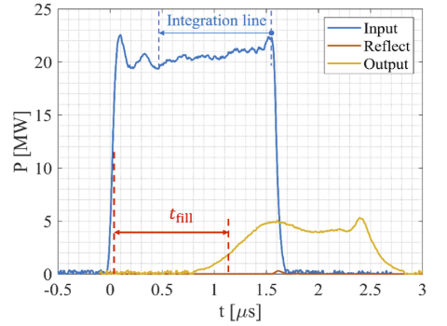
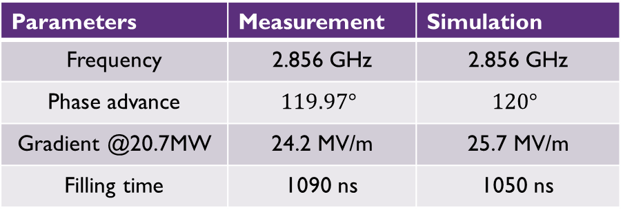
S BAND acc
High power tested
Conditioning:
  120 hours
  4 million pulses
Parameters | Measurement | Simulation
Frequency | 2.856 GHz | 2.856 GHz
Phase advance | $$119.97°$$ | $$120°$$
Gradient @20.7MW | 24.2 MV/m | 25.7 MV/m
Filling time | 1090 ns | 1050 ns
*Lin, Xiancai, et al. NST

Slide 19
X BAND LINAC

Slide 20
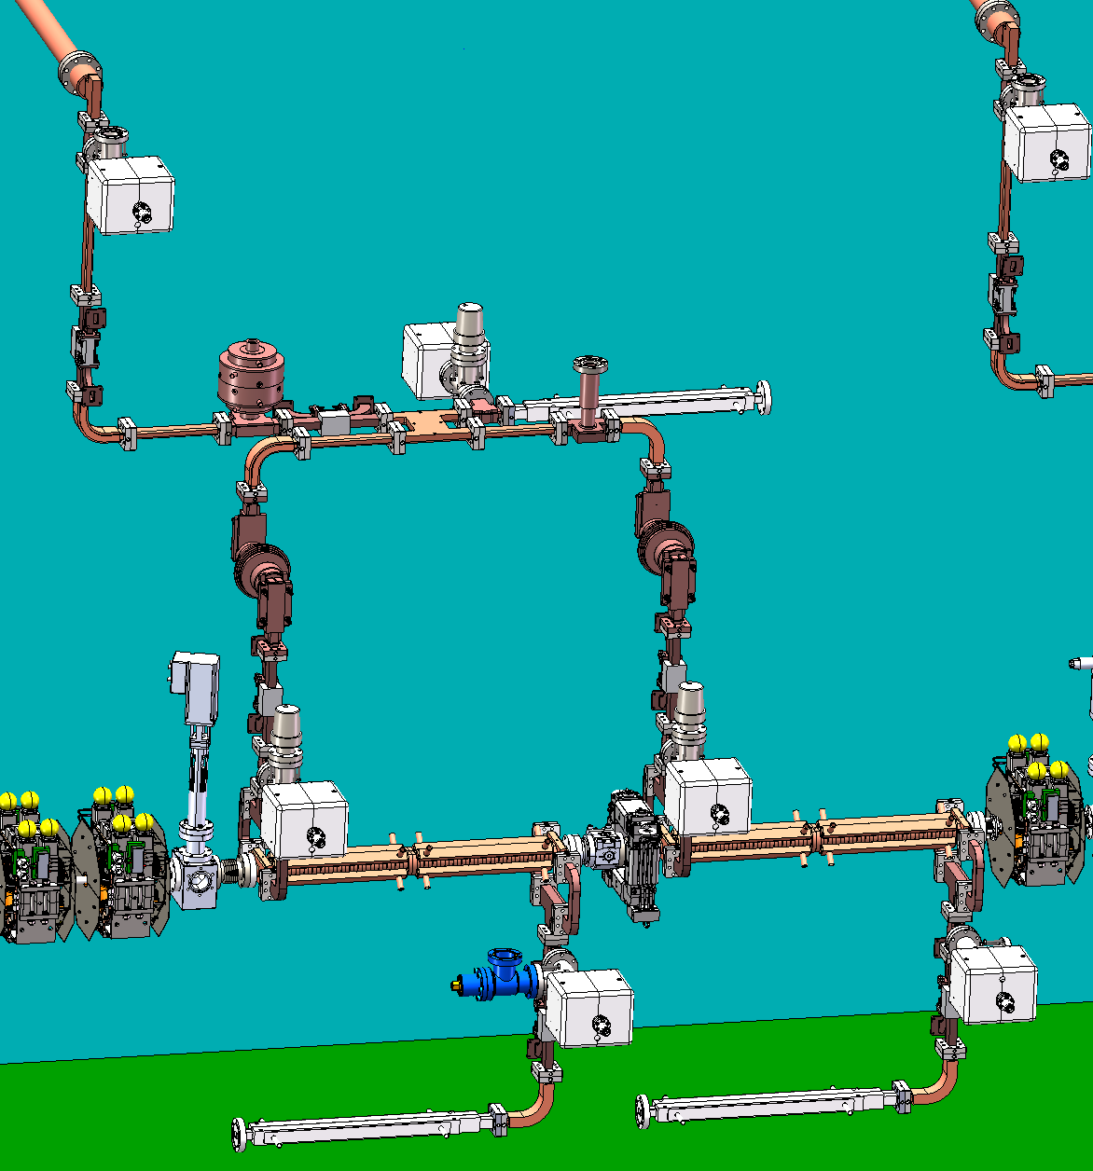
X band module
One klystron
  50 MW, 1.5us
One pulse compressor (SLED I type)
Two X band high gradient structures
  Average gradient >= 80 MV/m
  Energy gain per structure > 50 MeV
  Filling time < 150 ns
rf loss from klystron to Xacc ~ 0.9dB
91 MW at Xacc w/ PC gain factor as 4.5
Mode converter
Pulse compressor
Phase shifter
3dB hybrid
XT72 | 6 | P.C. | 3
mode convrt. | 6 | phase shifter | 3
circ. wg | 6 | D.C. | 24
RF window | 6 | pump. port | 21
E-bend (90) | 20 | RF load | 9
H-bend (U+90) | 24+6 | straight wg | 30
H-T | 12 | 3dB hybrid | 3
RF window
X band high gradient
structure
Rf load

Slide 21
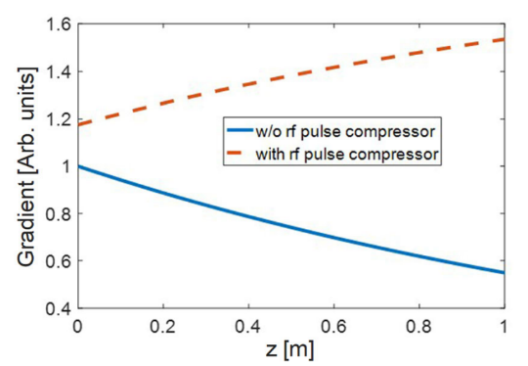
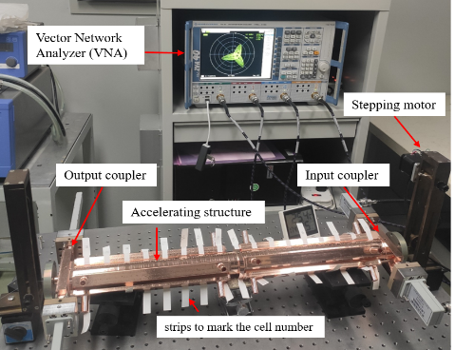
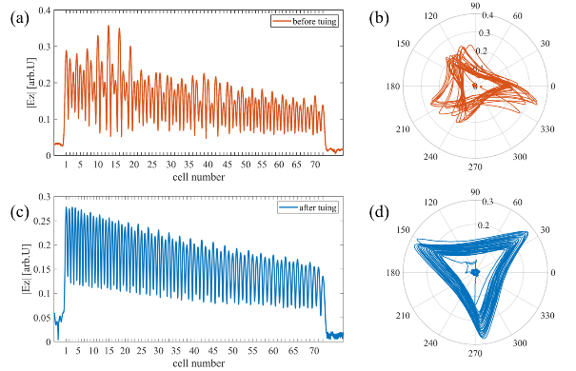
X band hg structure
The output pulse of a SLED-type pulse compressor decreases over time, which makes the field seen by the electron higher at the end of the linac when operating.
This effect was alleviated in a constant-impedance (CI) structure due to the power loss along the linac.
As a result, the CI structure has similar effective shunt impedance with the CG (constant-gradient) structure when operating with a pulse compressor.
Considering the cost, CI structure was adopted at the beginning.
[1]Liu, J., et al., NUCL SCI TECH 31(11): 1-11. [2] Lin, Xiancai, NST

Slide 22
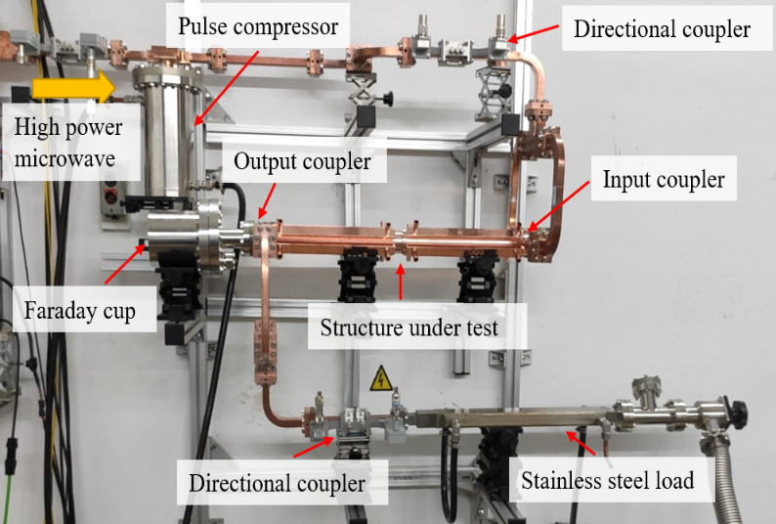
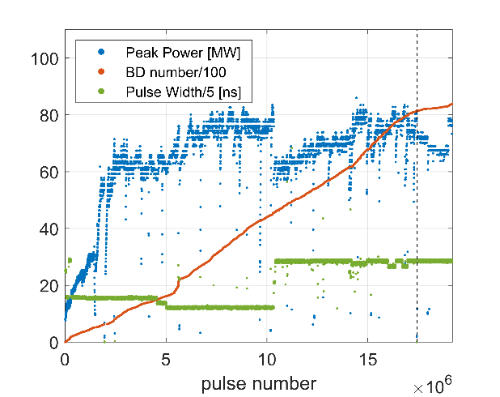
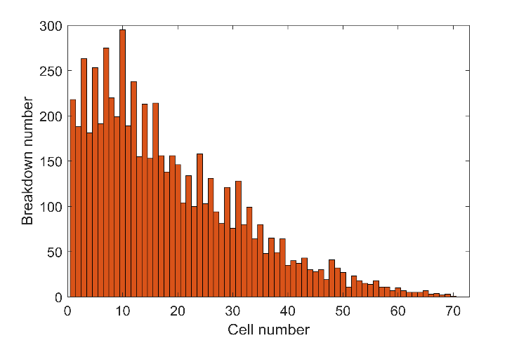
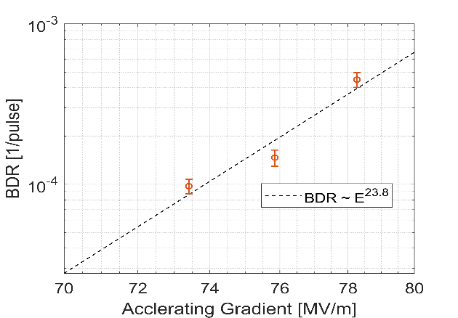
X band hg structure
High power test with pulse compressor on
17 M pules conditioning +2M pulses
Maximum gradient: ~ 80 MV/m @80 MW
Total breakdown number: 8.4×10^{3,}, BDR~E^30
Breakdown location strongly correlated to field in the structure
In the 1st cell, Esurf ~220MV/m Sc~5

Slide 23
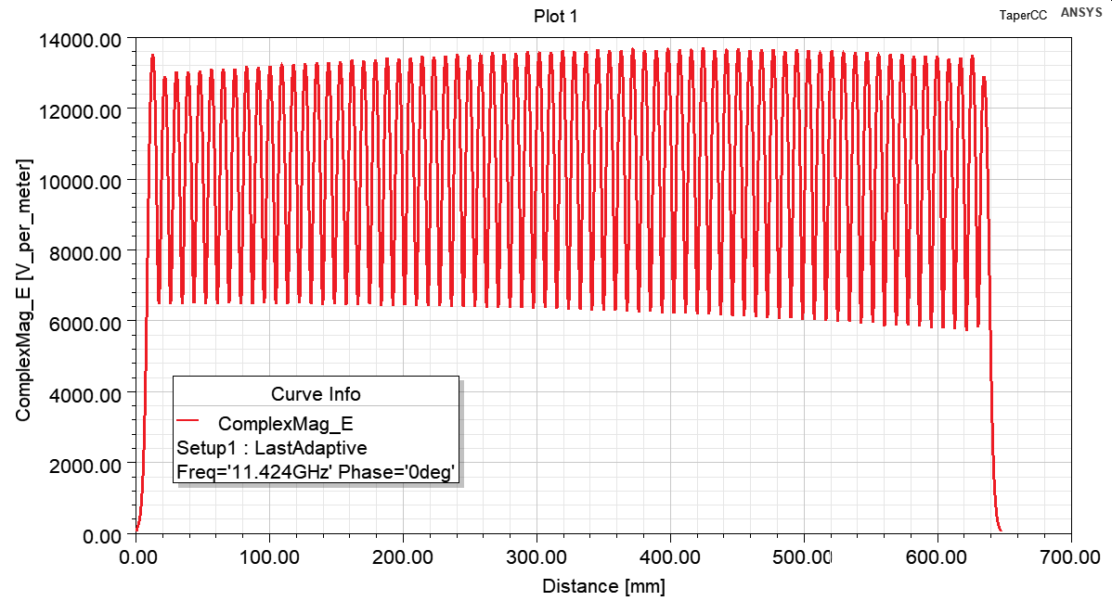
X band HG structure
We switch to CG scheme with maximum surface field 20% lower than CI
Parameters | CI | CG
Iris aperture a [mm] | 3.5 | 3.92 ~ 3.12
Iris thickness d [mm] | 1.8 | 1.8
Shunt imp. R [MΩ/m] | 101 | 93 ~ 109
Group velocity v_{g}/c | 2.20% | 3.22% ~ 1.46%
Quality factor Q | 6990 | 7020 ~6970
Filling time T_{f} [ns] | 95 | 97
E_{s} [MV/m] | 224 | 185
S_{c} [MW/mm²] | 5.65 | 4.50
β of pulse compressor | 3.5 | 3.5
Pin @80MV/m with pc [MW] | 81.3 | 80.1

Slide 24
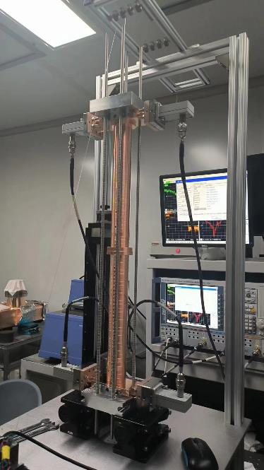
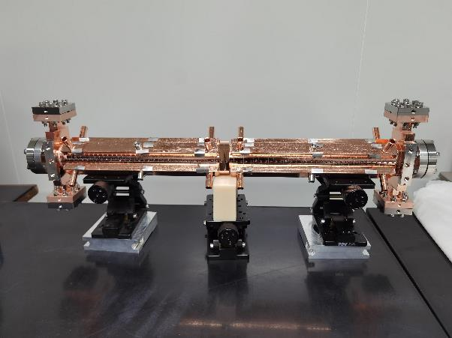
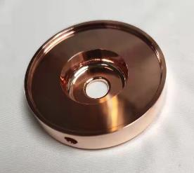
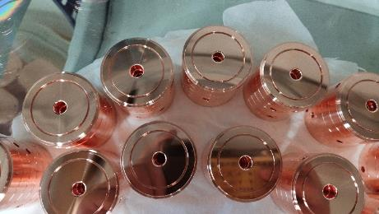
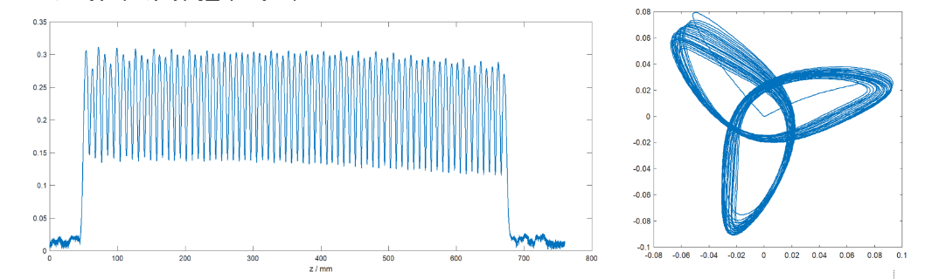
X band HG structure
COST: CG 20% higher than CI
(XT72#1): Tuning completed
High power test from Oct. 20
XT72 #1&#2 will be ready for installation by end of 2023.

Slide 25
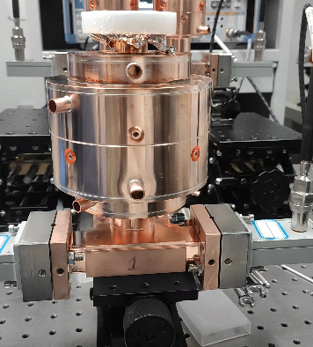
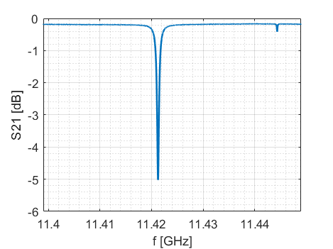
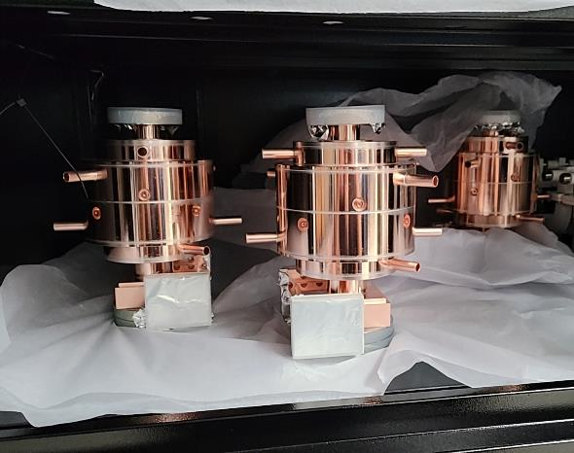
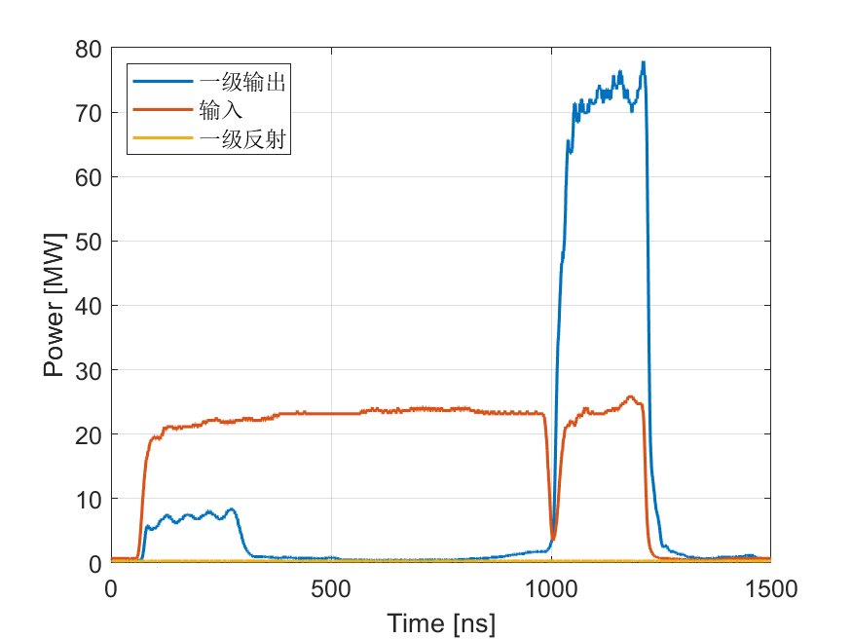
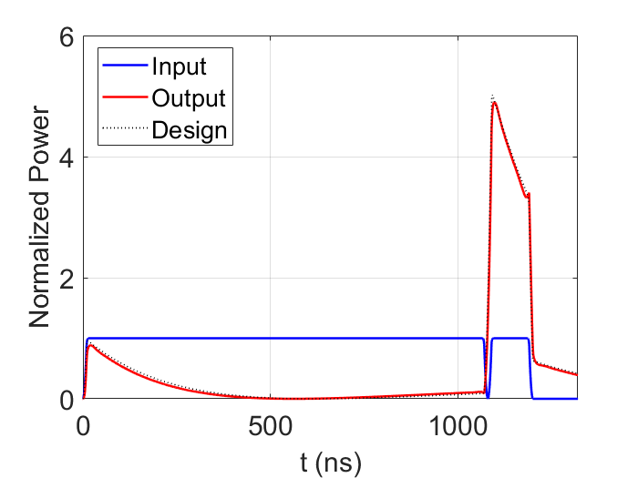
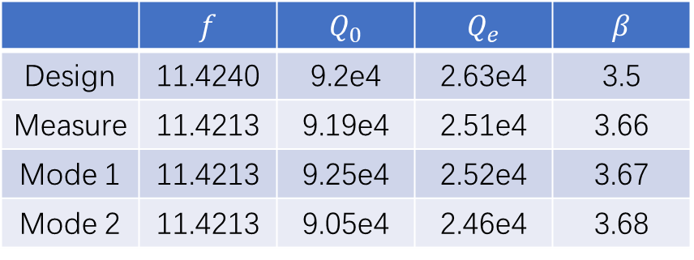
X-band Pulse Compressor
 | $$f$$ | $$Q_{0}$$ | $$Q_{e}$$ | $$β$$
Design | 11.4240 | 9.2e4 | 2.63e4 | 3.5
Measure | 11.4213 | 9.19e4 | 2.51e4 | 3.66
Mode 1 | 11.4213 | 9.25e4 | 2.52e4 | 3.67
Mode 2 | 11.4213 | 9.05e4 | 2.46e4 | 3.68
*Modes 1 and 2 are parameters of two polarization modes reconstructed from measured S-parameters (TE₁₁₄)
REF：Matthew Franzi et al. Phys. Rev. Accel. Beams 19, 062002 (2016)
High power tested with cc

Slide 26
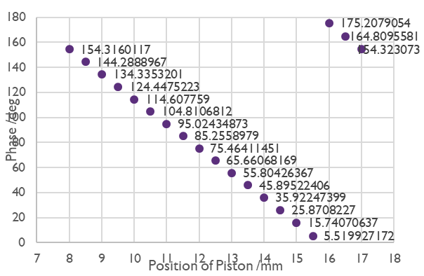
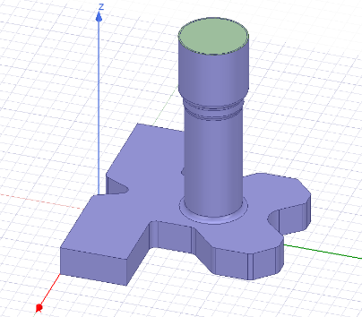
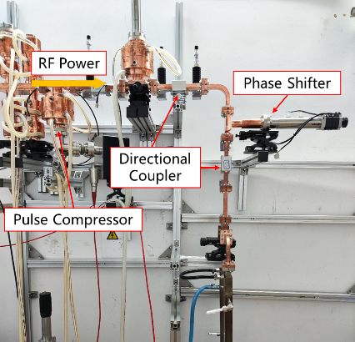
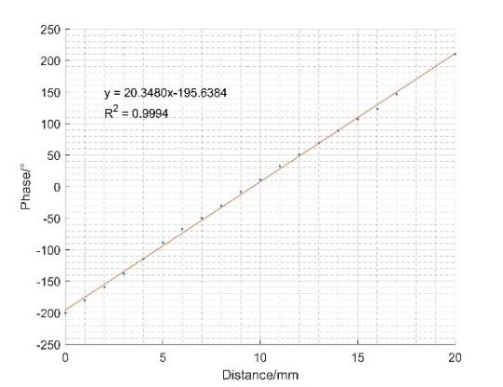
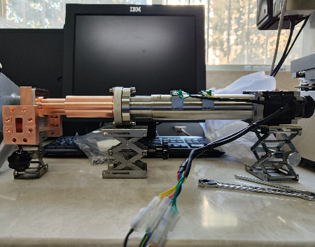
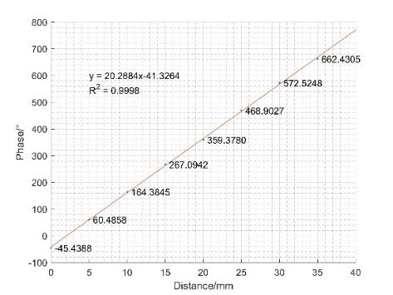
X-band Phase Shifter
Adjust phase between AS in module
RF phase v.s. position of piston 20°/mm
S11 < -25dB, S21 > -0.1dB
High-power tested to >85MW @150ns pulse width
VNA measurement
High power test
REF: Kamil Szypula et al., Status of prototype X-band RF components, HG2019

Slide 27
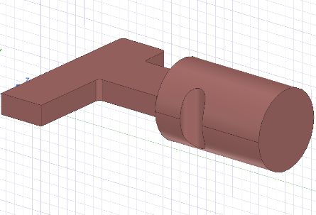







X-band Mode Converter
[1] S Kazakov et al.
Courtesy: V. Dolgashev
two converter directly
S11 ~ -32dB, S21 ~-0.12dB
two converter and one circular waveguide,
S11 ~ -30dB, S21 ~ -0.16dB

Slide 28





X-band RF Window
Low Power Test Results：
S11 is below -20dB
High Power Test Results：
Input power 60 MW, maximum electric field simulated at 40 MV/m
Total RF breakdown rate during test is 3e-4

Slide 29






X-band 3dB Hybrid
X-band Directional Coupler
1
2
4
3
1
2
3
4
The S11s < -30dB
The S21s = -3dB.
coupling ~ -61.5dB
direction: >30dB
Courtesy: Igor Syratchev

Slide 30



Progress
Clean room on campus for module installation
Module install, and Vacuum SEALED, Pumped
Between modules: valves, and bellows
RF windows

Slide 31



Progress
Bunker is under construction
Coming Soon…
  Modules move in as sealed.
  Alignment of the beam line.
  Klystrons install (Canon S OK, CPI X Feb/24 )
  Waveguide connection and cabling…

Slide 32
Summary
VIGAS as a compact ICS source, total length ~13.5m, up to 350MeV beam energy, 4.8MeV photon
Accelerator Design finalized
RF components, Pulse compressor, magnets, pipes, Sband structures… READY
X-band HG structure:
  CI prototype (XC72) tested at 80MV/m
  CG testing soon (XT72#1)
Module installation started.
Bunker ready in November.
Hope to start commissioning in the first quarter of 2024

Slide 33
Thanks for your attention

