Slide 1
Fast Modeling of Self-induced Field Effects in High Gradient Linacs
15th Workshop on Breakdown Science and High Gradient Technology,
16-20 Oct 23
Speaker: F. Bosco^{1,2,3*}
Co-authors: M. Carillo^{2,3}, E. Chiadroni⁴, L. Faillace⁴, A. Fukasawa¹, A. Giribono, L. Giuliano, G. Lawler¹, N. Majernik⁵, M. Migliorati^{2,3}, A. Mostacci^{2,3}, L. Palumbo^{2,3}, B. Spataro⁴, C. Vaccarezza and J. Rosenzweig¹
¹UCLA, Los Angeles, 90095 CA, USA
²La Sapienza University of Rome, 00161 Rome, Italy
³INFN-Sez. Roma1, 00161 Rome, Italy
⁴INFN-LNF, 00044 Frascati, Italy
⁵SLAC, Menlo Park, 94025, CA, USA
* fbosco@physics.ucla.edu
This work was supported by the U.S. National Science Foundation under Award PHY-1549132, the Center for Bright Beams
Notes:
Thank you for the introduction and for the opportunity of giving this talk here
Hi everyone I am Fabio Bosco from UCLA and today I am going to present my work on F

Slide 2
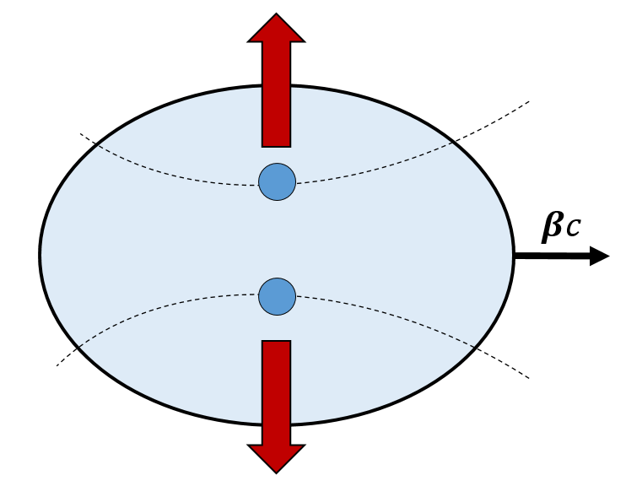
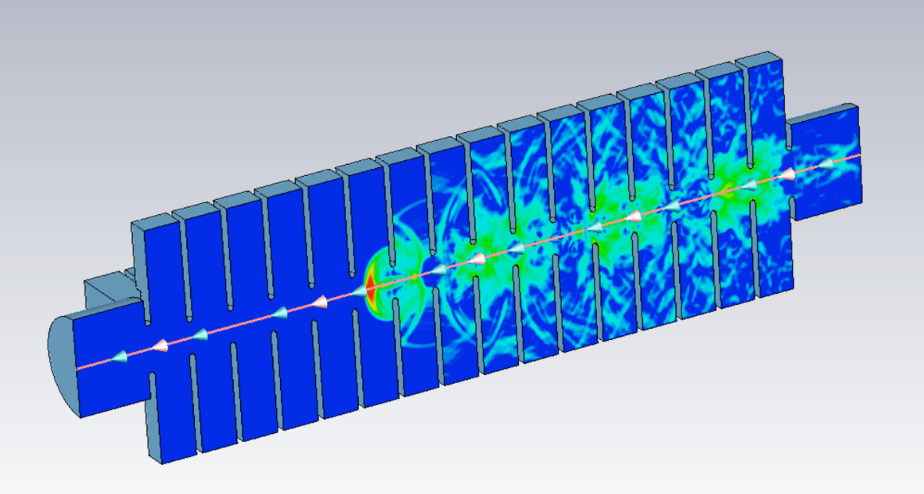
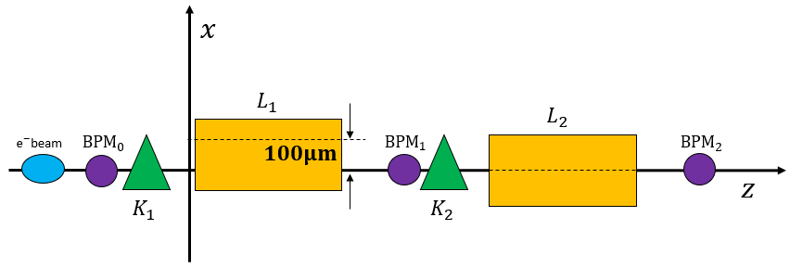
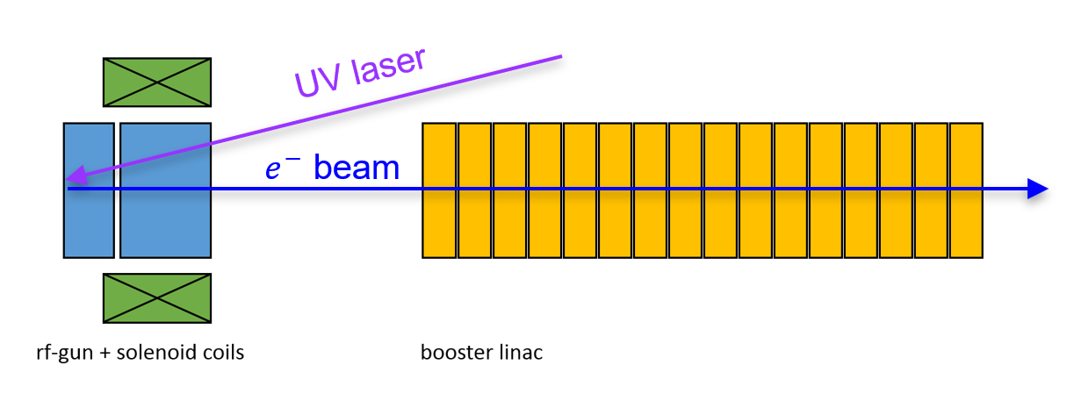
Outline
High gradient initiatives enabled by cryogenic RF structures
Beam dynamics challenges associated such structures
The development of MILES for a fast evaluation of collective effects
Models overview and validation
Example of applications
Notes:
Here is the outline for my presentation
I will start by discussing the framework and motivation behind this work with special emphasis on the challenges expected on the beam dynamics
Then I will present an overview of the simplified approaches that we utilize for a fast description of collective effects in linacs
And finally show some examples of applications where these models are adopted

Slide 3
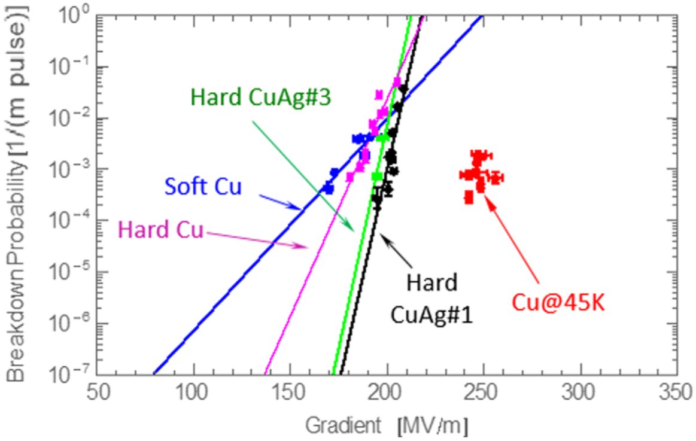
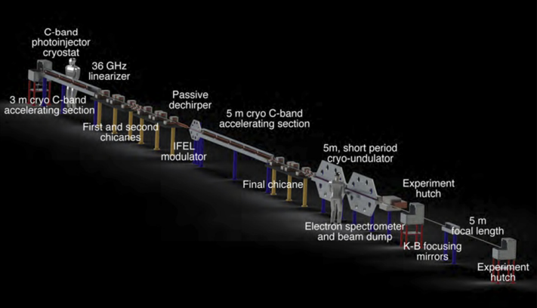
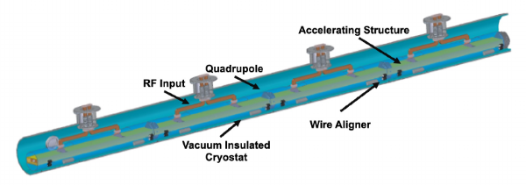
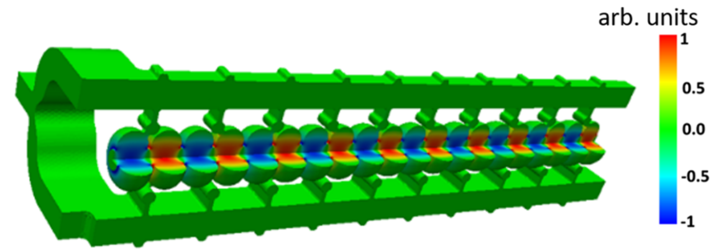
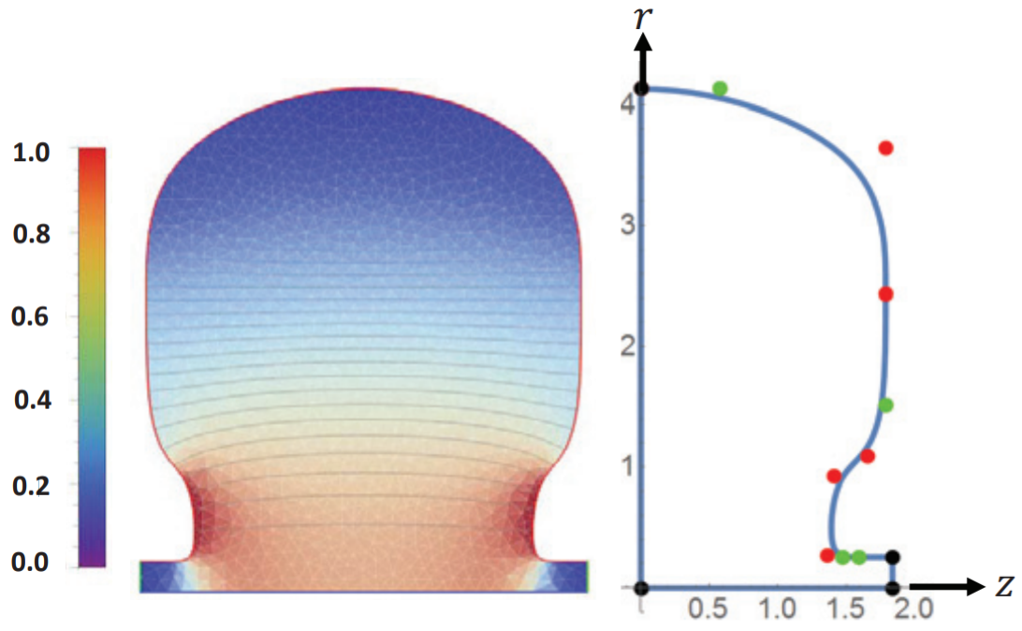
Cryogenic RF Initiatives
Scientific collaboration of research institutes in the fields of accelerators and beam physics
Interest in high brightness electron linac-based facilities exploiting advanced accelerator concepts
Compact, high brilliance radiation sources (FEL, ICS)
High luminosity $e^{+}e^{−}$ linear colliders for HEP
High gradient acceleration in RF Structures
Distributed coupling linacs: use of guiding manifolds
Optimized cavity topology to enhance the efficiency of acceleration
Cryogenic operation ($∼$77K) to reduce the breakdown probability rates
Main initiatives
Ultra-Compact X-rays Free Electron Laser (UC-XFEL): new paradigm for university-scale facilities
Cool Copper Collider ($C^{3}$): based on C-band ($∼$6 GHz) cryo-cooled, distributed coupling linacs ($∼125 MV/m$)
Notes:
Ucla takes part in research collaborations with strong motivation in investigating advanced accelerator concepts to design and realize facilities based on high brightness and high gradient electron linacs
The main initiatives are addressed to compact, particle-driven radiation sources such as FEL and ICS machines and high luminosity lepton colliders for hep
Here I summarized some of the high gradient concepts that characterize such activities
They encompass clever power distribution schemes in the accelerating strucutres, optimized cavity shapes for the maximization of the efficiency and the operation at cryogenic temperatures which mitigates breakdown effects and thus allows higher fields
Here I am quoting two of the main initiatives we are working on and where all such concepts are widely present: the UCXFEL is an ambitious design for small footprint Xrays FEL facilities whereas C3 is a proposal for a Higgs factory made by cband cryogenic distributed coupling linacs

Slide 4
Cryogenic RF Initiatives
Scientific collaboration of research institutes in the fields of accelerators and beam physics
Interest in high brightness electron linac-based facilities exploiting advanced accelerator concepts
Compact, high brilliance radiation sources (FEL, ICS)
High luminosity $e^{+}e^{−}$ linear colliders for HEP
High gradient acceleration in RF Structures
Distributed coupling linacs: use of guiding manifolds
Optimized cavity topology to enhance the efficiency of acceleration
Cryogenic operation ($∼$77K) to reduce the breakdown probability rates
Main initiatives
Ultra-Compact X-rays Free Electron Laser (UC-XFEL): new paradigm for university-scale facilities
Cool Copper Collider ($C^{3}$): based on C-band ($∼$6 GHz) cryo-cooled, distributed coupling linacs ($∼125 MV/m$)
Development and characterization of UCLA’s cryo-RF infrastructure,
G. Lawler WE@16:10
XFELs for chip metrology,
J. Rosenzweig TH@13:10
The $C^{3}$R&D plan,
E. Nanni WE@10:40
Notes:
Here is just some advertisement for related talks in this workshop
We already heard about C3 this morning from EN, we’ll hear about the applications of Xrays FELs for chip metrology tomorrow from JR and there is also a talk this afternoon UCLA cryo-RF infrastructure from GL

Slide 5
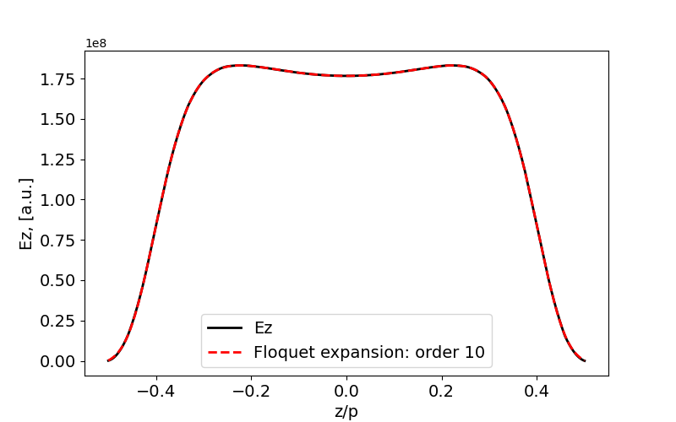
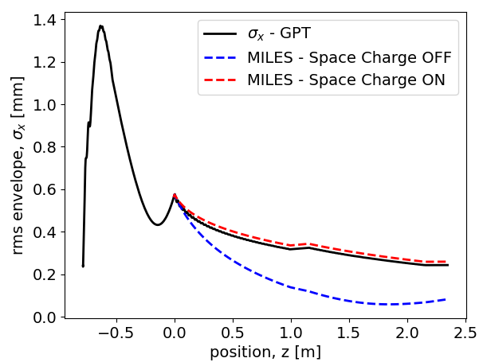
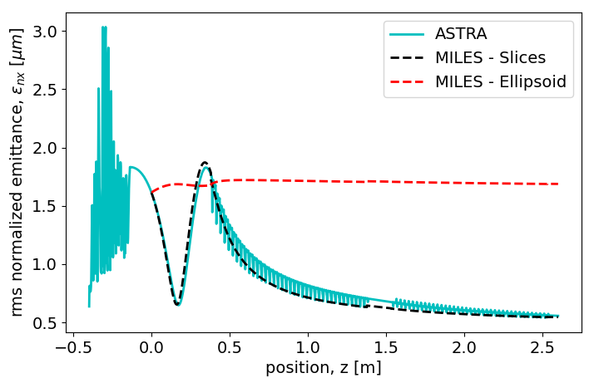
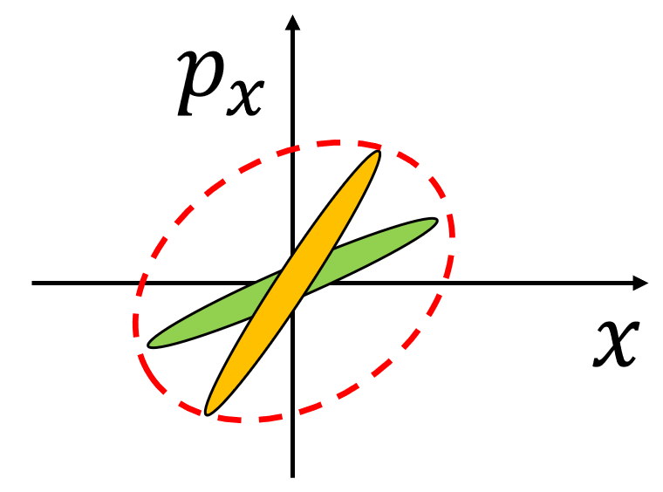
Beam Physics Challenges
Inherent focusing from high gradient RF linacs
1st order focusing: transitions from field-free to non-zero field regions
2nd order focusing: non-synchronous space harmonics in the accelerating cells
SRWF
Strong wakefields due to the small cell irises
Intra-beam coupling due to SRWFs (field diffraction from the irises)
Inter-beam coupling due to LRWFs (HOMs excitation)
LRWF
Notable impact from space charge mechanisms
Nominal focusing at injection too strong in absence of SC forces
Emittance compensation process and other slice-dependent effects
Notes:
There are important considerations associated with the operation of this type of high gradient structures
Impact of the inherent focusing from the RF fields that is enhanced by the space harmonics content found in this geometry
At the same time the small irises cause stronger wakefield interactions that introduce intra-beam coupling on the short-range time scale by diffractive mechanisms as well as mutual coupling among different bunches due to the excitation of HOMs
In addition to that, when such beams are injected into a linac booster from a gun, space charge effects are extremely relevant: not only are they responsible for important emittance dynamics but they also counteract the external focusing which would be anomalously strong if SC effects are neglected leading to overfocusing and non-laminar motion

Slide 6
The Code MILES
Dedicated tracking code
Motivation to investigate wakefields effects in linacs in presence of non-negligible space charge endangering the nominal beam quality
Use of simple semi-analytical models: flexible and time-efficient tool (factors $∼$1/40-1/10) with acceptable reduction of the accuracy
Main applications: investigation of misalignment effects and design of possible correction schemes
Miles Davis (May 26, 1926 – September 28, 1991)
MILES = Multi-bunch and Intra-beam effects in Linacs Evaluating Stability
F. Bosco et al., “Fast models for the evaluation of self-induced field effects in linear accelerators,” NIM-A vol. 1056, p. 168642, 2023 https://doi.org/10.1016/j.nima.2023.168642
Modeling overview and comparison with other codes
 | MILES approach | Commonly utilized approaches
Space Charge | Equivalelent ellipsoid or Multi-slice superposition | Particle in cell (PIC)
Wakefields | Algebraic formalism | Convolution integral or FFT equivalent
Notes:
The interest on performing customized studies on wakefield effects in this challenging environment has motivated us to develop a dedicated tracking code investigating wakefield effects in linacs while also including simple models for space charge forces
The code is named MILES after the jazz musician MD and is based on semi-analytical approaches for fast evaluations at the expense of an acceptable reduction of the accuracy when compared with more common and time-consuming approaches such as PIC and convolution integrals

Slide 7
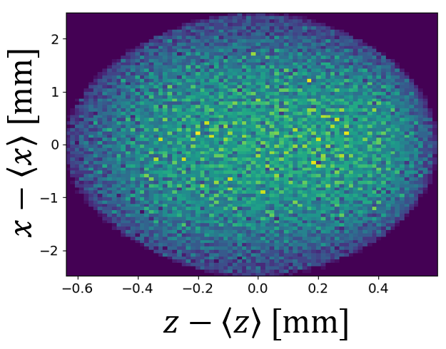
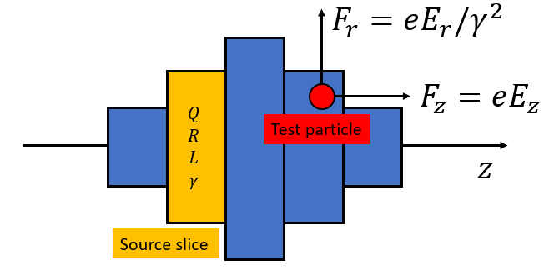
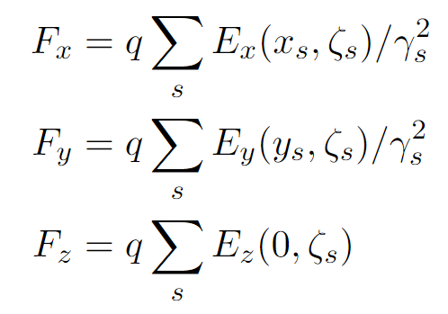
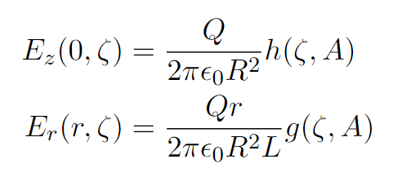
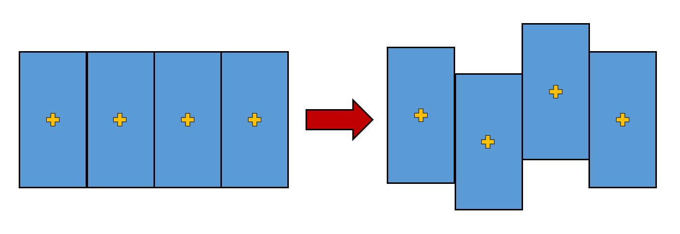
Modeling Space Charge Forces
Beams consist of large ensembles of charged particles exerting mutual repulsive forces
For arbitrary distributions, the strength of the force depends on both its shape and size
Exact solution typically utilizes particle in cell (PIC) approaches
Equivalent ellipsoid method
Multi-slice superposition method
An equivalent uniform ellipsoid is associated to the actual beam distribution
Self-induced forces are known analytically
Forces are linear: self consistent model
Divide the beam in cylindrical slices with individual size, energy and aspect ratio (HOMDYN approach generalized)
Field produced by each (uniform) slice is known analytically: forces are given by their superposition
Advantages
Very fast ($∼30$ times of 3D PIC )
Successfully reproduces rms size ($σ_{x},σ_{y},σ_{z}$) and energy spread ($σ_{E}$)
Limitations
Absence of correlation prevents the observation of emittance dynamics
Loss of axial symmetry in presence of strong transverse wakefield
Advantages/Limitations
Correlation between the planes describes the emittance dynamics
Allows description of more arbitrary geometries
More time-consuming but still faster than PIC
Notes:
In the next couple of slides I just want to mention the basics of the semi-analytical models we adopt to show what they look like as some of them might be familiar
A very simple and fast approach for space charge consists in using formulas for uniform ellipsoids
However, multi-slice approaches are much more indicated in order to take into account dynamics that are induced by slice dependent effects and to maintain validity when dipole SRWFs break the axial symmetry
The use of fields produced by uniform cylinders was made very popular by the code HOMDYN and here it is generalized by dividing the beam in many slices and superposing the forces produced by each slice

Slide 8
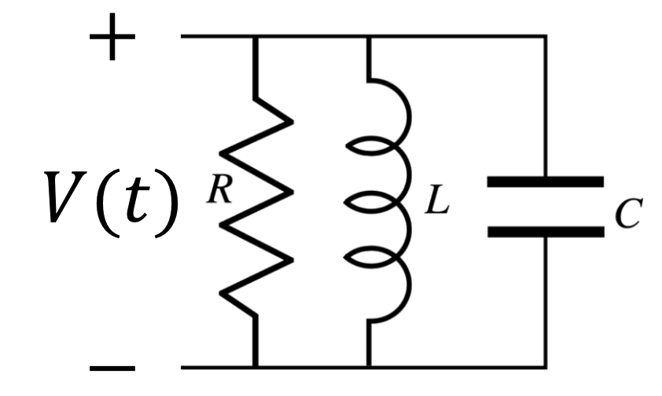
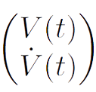
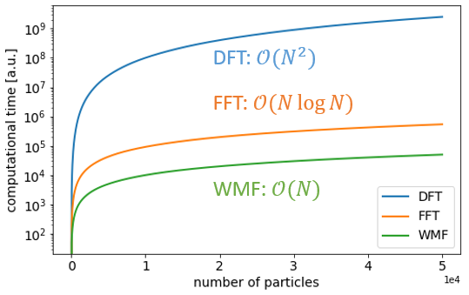
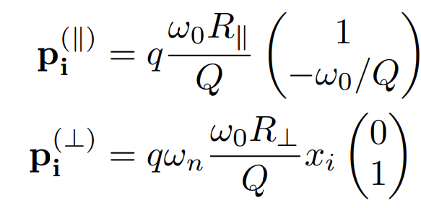
Modeling Wakefield Effects
Interaction of a particle with a cavity resonant mode
The change in momentum (energy/deflection) is described by the equivalent shunt circuit voltage
Evolution of the voltage state
Recursive formula
State after the $n$ charges have passed
$N$ particles $⇒$ $N−1$ operations
Perturbation:
Kick induced by the passing charges
Free-evolution:
Homogenous 2nd order differential equation
Notes:
Moreover, the approach we adopt for describing wakefield effects is based on the simple concept of charged particles interacting with a resonant cavity mode which allows to develop a dedicated algebraic formalism
The main advantage of such a formalism is that it provides recursive formulas for calculating the momentum kick that significantly reduce the number of operations with respect to the convolution integral approach or its FFT equivalent

Slide 9
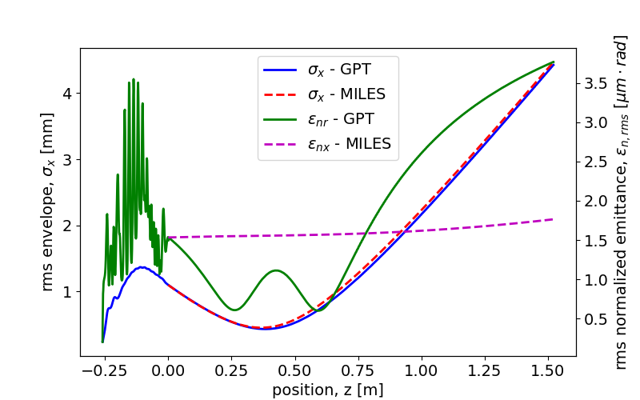
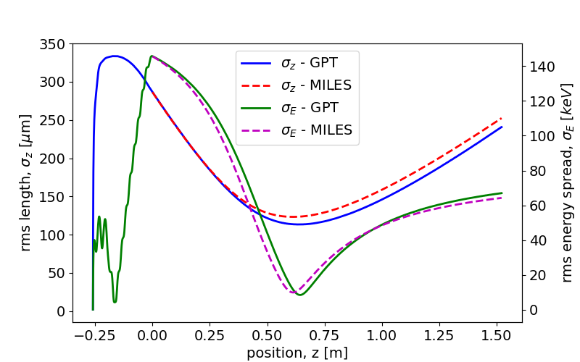
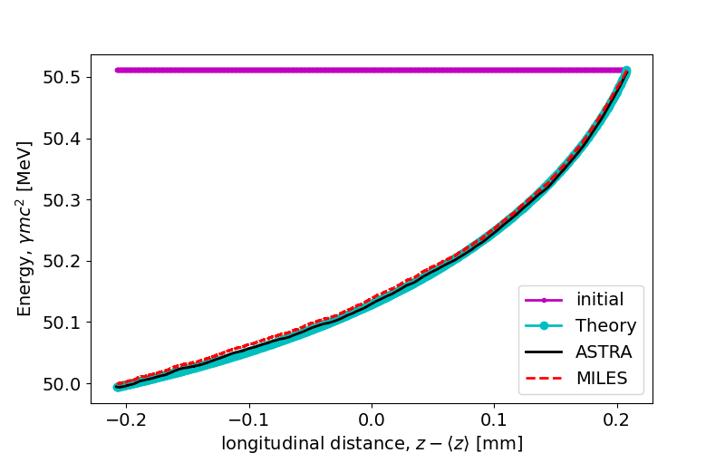
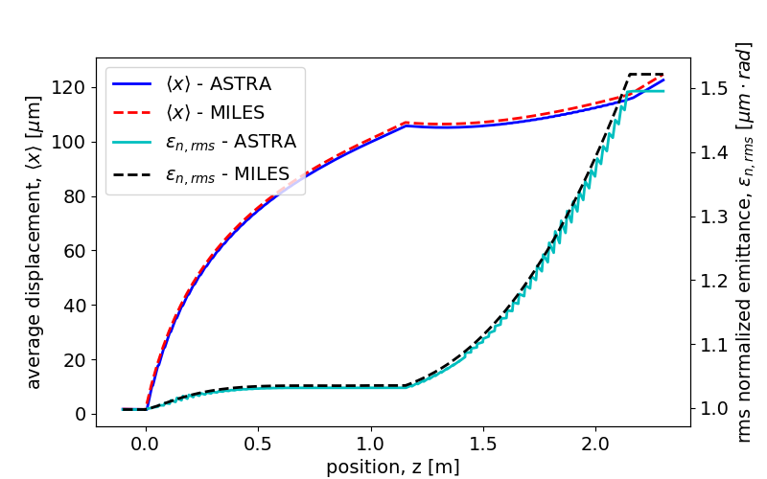
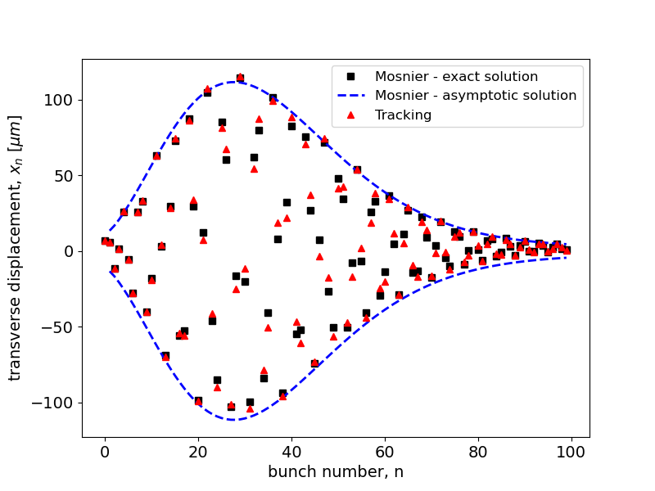
Model Validation
GPT-ASTRA-Theory
MILES
Space charge
$$σ_{z}$$
$$ε_{nx}$$
$$ε_{nx}$$
$$σ_{x}$$
$$σ_{E}$$
Ellipsoid: error < 4% (except emittance), $∼$1/40 execution time
Multi-slice: error < 3% with $∼$1/6 execution time
Wakefields
Extraction
Injection
Wakefield matrix: error < 2%, $∼$1/15 execution time
Notes:
This collection of plots is meant to validate our models in comparison with well known tracking codes like GPT and ASTRA
In the interest of time I will not comment this plots individually, as a general indication solid curves represent results obtained with reference tracking codes or theory and dashed curves are obtained with MILES leading to a good agreement and shorter run-times
Maybe the space charge plots on the top deserve some comment: you can notice that the ellipsoid method describes the beam size and energy spread correctly but due to the lack of correlation, it fails to track the emittance oscillation whereas the multi-slice approach allows to do so

Slide 10
Examples of Applications with Miles
Finding the working point for the injection into a booster linac Mitigation schemes for BBU effects in misaligned linacs Emittance dilution Transverse bunch oscillation
Notes:
We can move now to three examples where we used MILES in applications

Slide 11
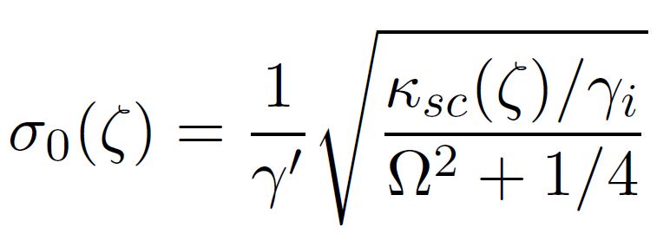
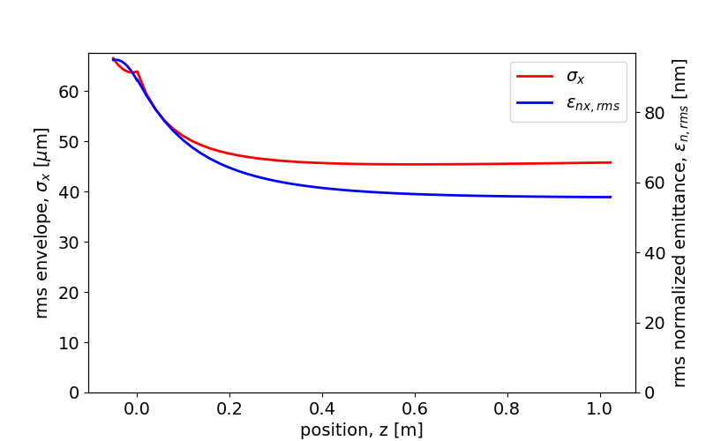
Injection in a Linac Booster - WP
Emittance compensation in a split RF photo-injector: RF gun + linac booster
Beam-linac matching: proper combination of acc. gradient, transverse focusing, current, energy and spotsize
Shift the injection position and adjust the avg accelerating field to minimize the final emittance
(total drift = 112 cm + d)
Notes:
The first example is based on the UCXFEL machine and takes into account the injection of the beam into a booster linac in the well-known split photoinjector configuration
This problem has a well-established injection condition where the beam and linac parameters are properly matched to obtain gentle focusing properties
Based on this starting point we performed several simulations with MILES changing the injection distance and adjusting the accelerating gradinet in the linac to estimate the configuration that minimizes the final emittance
For instance in our case we noticed that injecting a few centimeters after the beam waist results in a more effective compensation of the emittance at the expense of a slightly larger spotsize

Slide 12
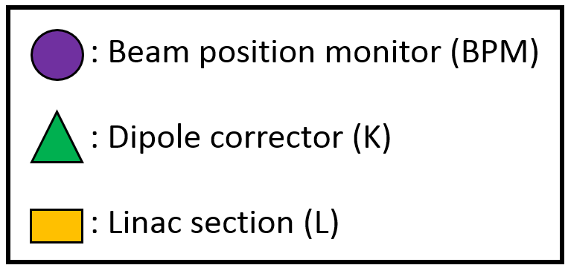
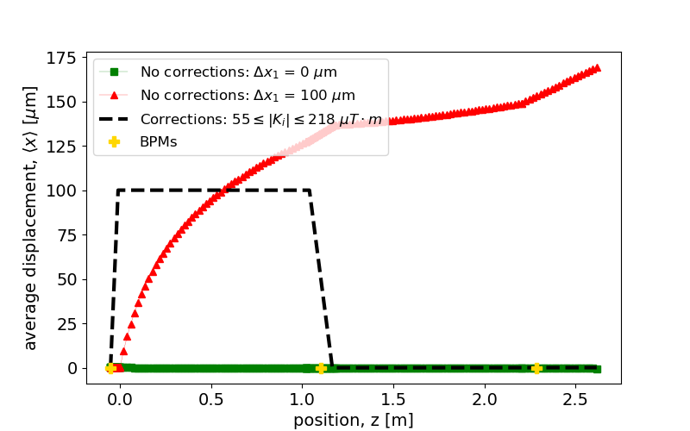
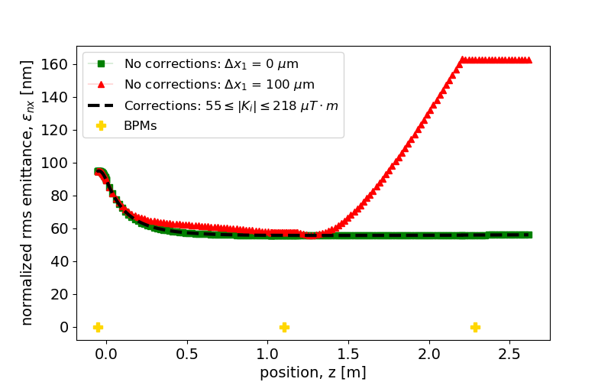
Beam Based Alignment (BBA)
Alignment errors cause off-axis motion: excitation of dipole wakes leads to emittance growth
Design of correction schemes: BPM readings are used to adjust the strength in the steering dipole correctors
Reference case from the UC-XFEL
Two section linac ($∼2 m$)
Section 1 is 100 $μm$ off-axis
$〈x〉$ vs $z$
$ε_{nx,rms}$ vs $z$
Moderate corrector strength (order of $∼50÷220 μT⋅m$)
Notes:
In this second example we consider the same machine configuration with an additional linac section but we assume that the first section is 100 um off axis
In this case the beam will propagate off-axis exciting dipole SRWF that, by deflecting each slice differently, increase the projected rms emittance
A possible correction technique for this problem is to introduce two steering magnets upstream each linac section so that we can control the offset and the angle every time the beam enters a new section
This procedure forces the beam to travel always on axis regardless of the misalignments so that dipole wakes are not excited and the emittance can be preserved

Slide 13
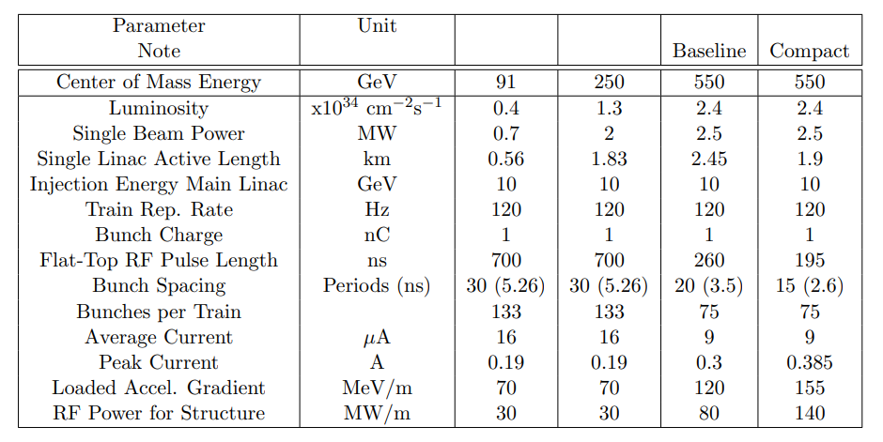
Long-range BBU in the $C^{3}$ Linac
BBU studies for the 250 GeV CM working point of the $C^{3}$ linear collider
Center of mass oscillations and beam loading effects in multi-bunch operation: sequence of point-like, structureless macro-particles carrying the whole bunch charge
Notes:
The final example takes into account the 250 GeV CM working point of the C3 linear collider
The relevant parameters for our purposes can be read from this column: I will be considering 133 bunches of 1 nC each and 5 ns spacing accelerated at 70 MeV/m up to the target energy of 125 MeV

Slide 14
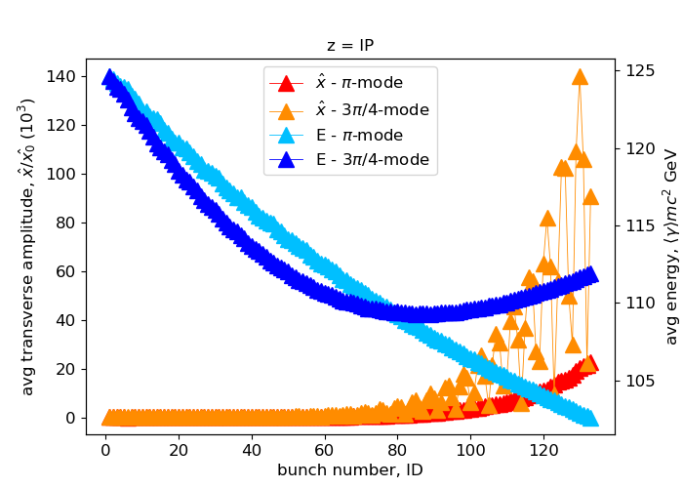
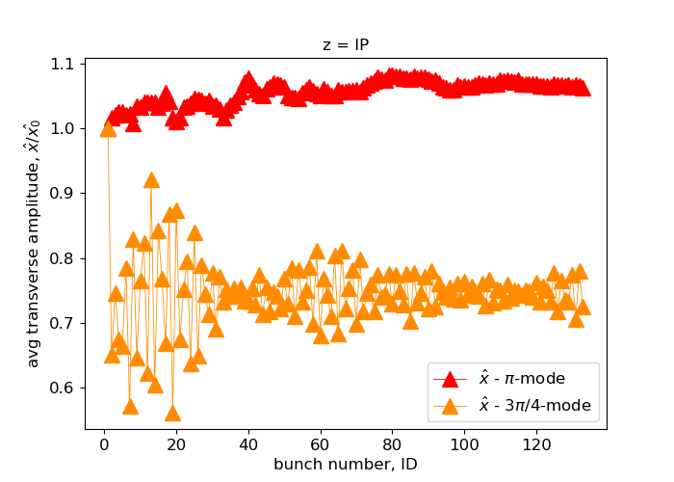
Long-range BBU in the $C^{3}$ Linac (2)
Beam Breakup and Beam loading
$700 ns$ RF-pulse (flat-top) filled with 133 bunches, $1 nC$ each, and $5.26 ns$ separation (30 RF-periods)
Acceleration at an avg gradient of $70 MeV/m$
Injection $100 μm$ off axis: excitation of dipole HOM
Detuning of the HOMs
Unstable motion if $f_{HOM}/f_{b}$ is close to an integer
Mitigation through frequency spread (or detuning)
Small variations of the geometry: HOMs exhibit different random frequencies in subsequent sections
Amplitude of the transverse oscillation for each bunch in the rf-pulse at the interaction point normalized to the first bunch’s amplitude
Notes:
Here we investigate the consequences of an injection error of 100 um
In absence of mitigation, the excitation of dipole HOMs induces large amplitude transverse beam oscillations here represented by the orange curve for each of the 133 bunches in the rf macro pulse at the end of the linac
How to mitigate this effect? The motion becomes highly unstable when the ratio of the HOM frequency and the bunch repetition rate is close to an integer as the mode and the pulsed beam fulfill a resonant condition
If small changes in the nominal geometry of the accelerating section are applied, modes will appear with slightly different frequencies in subsequent linac structures and such fluctuations break the coherent interplay of the pulsed beam with the mode
This concept is known as frequency spread and if applied to the previous case allows cancellation of BBU effects: all the bunches simply follow the evolution of the one in front

Slide 15
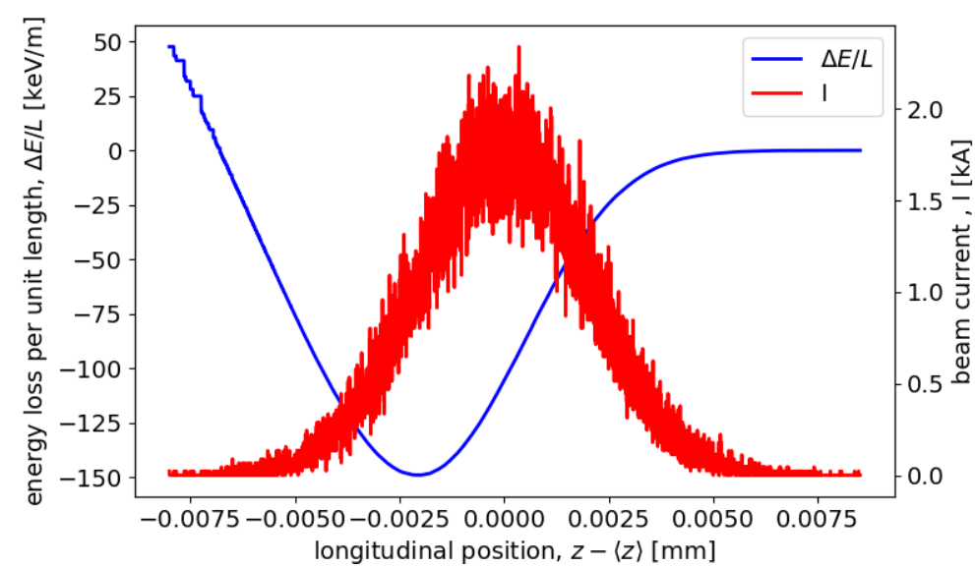
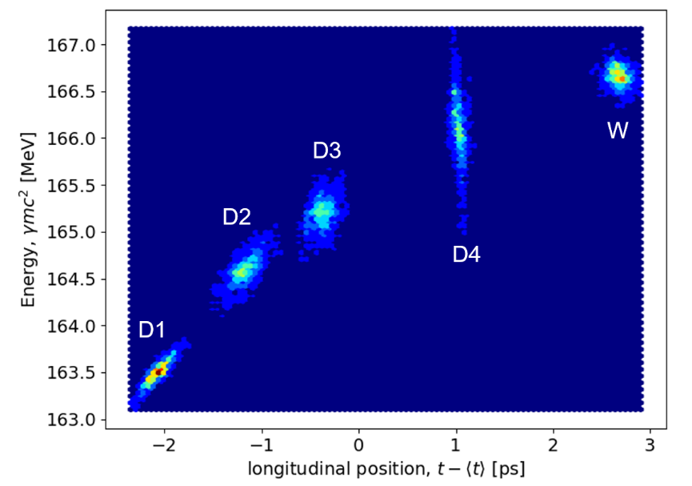
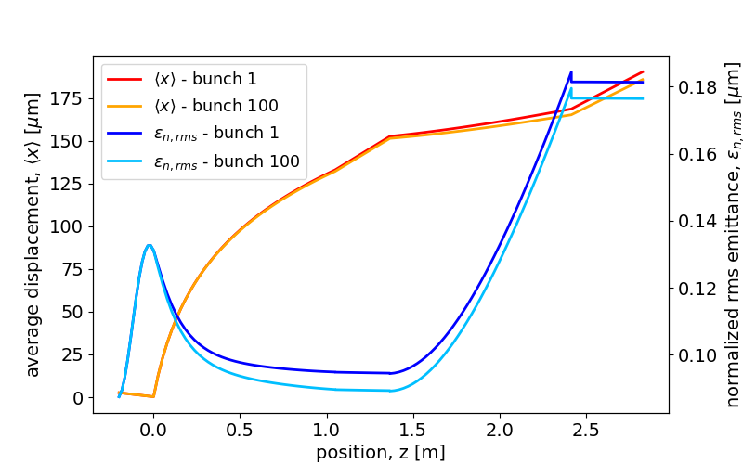
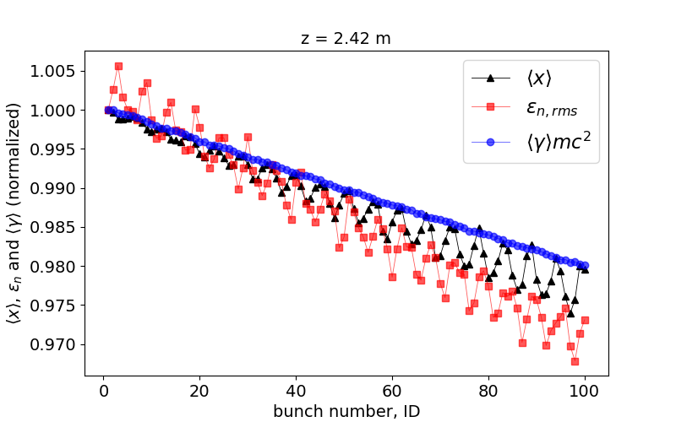
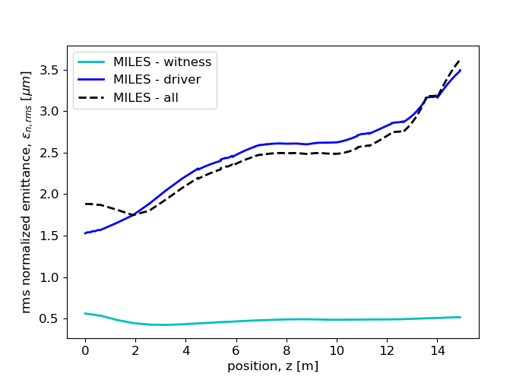
More Applications
Additional applications can benefit from the fast simulation framework developed in the code
Investigation of SR and LRWF effects simultaneously (e.g. multi-bunch operation of UCXFEL)
Energy spread induced by the resistive wall wakefields flat undulators (IPAC23)
SRWFs in multi-driver comb beams for PWFA injector schemes
BNS damping introduced by the slice-dependent transverse focusing in rectangular DWA slabs with alternating orientation
Notes:
Before concluding let me show a short list of additional problems that we have investigated or that we are currently approaching with MILES
One is the possibility of performing multi-bunch simulation where we take also the intra-beam effects into account and observe the interplay of long-range and short range effects
The acceleration of multi-pulse driver comb beams in injector schemes for plasma PWFA
And the use of alternating gradinet in rectangular dielectric slabs to introduce BNS damping for the suppression of single bunch BBU

Slide 16
Conclusions
15th Workshop on Breakdown Science and High Gradient Technology,
16-20 Oct 23
Acceleration in high gradient structures introduces several challenges for the beam dynamics
Strong self-induced electromagnetic fields require to be investigated to ensure the expected quality
MILES has proved to be an efficient tool for the evaluation of advanced facilities under design: successful benchmark with widely used codes
Example of applications we have worked on and new studies that we are aiming to perform
Thank you for your attention
(Questions are welcome)
fbosco@physics.ucla.edu
This work was supported by the U.S. National Science Foundation under Award PHY-1549132, the Center for Bright Beams
Notes:
Let us wrap up
High gradient structures are fundamental in advanced accelerator applications but they also introduce beam dynamics challenges
Especially associated with the strong self induced EM fields expected in high brightness beams
In this framework it is useful to have available a tool for a time-efficient evaluation of the machine under design that we are using intensively for diverse applications

Slide 17
Acknowledgements
INFN-LNF
D. Alesini
M. Behtouei
A. Cianchi
L. Faillace
M. Ferrario
A. Gallo
A. Giribono
B. Spataro
C. Vaccarezza
UCLA
G. Andonian
O. Camacho
A. Fukasawa
G. Lawler
W. Lynn
J. Mann
P. Manwani
P. Musumeci
S. O’Tool
J. Pan
J. Rosenzweig
Y. Sakai
O. Williams
M. Yadav
SLAC
Z. Huang
Z. Li
N. Majernik
E. Nanni
R. Robles
S. Tantawi
Cornell
J. Maxson
C. Pennington
C. Zhang
La Sapienza
M. Carillo
E. Chiadroni
L. Ficcadenti
D. Francescone
L. Giuliano
M. Migliorati
A. Mostacci
L. Palumbo
G. J. Silvi
LANL
P. Anisimov
D. Kim
E. Symakov
Notes:
I want to thank my supervisors prof. MM and LP but also I want to acknowledge all the people with whom I had positive scientific discussions during daily work, meetings and workshops

Slide 18
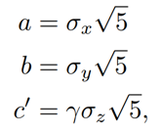
Ellipsoidal Space Charge
Hybrid gun exit
An equivalent uniform ellipsoid (beam-frame semi-axes $a,b,c$) can be associated to the actual distribution (lab-frame rms dimensions $σ_{x},σ_{y},σ_{z}$)
Courtesy of M. Carillo
The electrostatic field (beam-frame $K^{′}$) produced by an uniform ellipsoid of charge is known analytically: for a point inside the ellipsoid
A Lorentz transformation provides the forces in the laboratory-frame $K$ and thus the corresponding change in momentum (it only requires the evaluation of the field coefficients $A_{0}$-$C_{0}$)
Linearity preserves the uniform ellipsoidal distribution: self-consistent model
Notes:
Writing a new tracking code requires a careful validation process and, accordingly, MILES has been continuously submitted to benchmark tests in comparison with pre-existent codes and models from theory
As a demonstration, here I want to show the benchmark test for the space charge forces
As I mentioned, we apply the model for uniform ellipsoidal charge distributions for which the electrostatic field is known in the literature
Specifically, this equations hold for the beam reference frame, where particles are almost at rest, but can be extended to the laboratory frame by applying a Lorentz transformation

Slide 19
Ellipsoidal Space Charge (2)
$250 pC$ $e^{−}$ beam from the C-band hybrid photoinjector
Evolution in a field-free (drift) region with GPT (solid lines) and with the ellipsoidal model in MILES (dashed lines)
Limitations of the ellipsoidal model
!
Absence of correlation
The field coefficients $A_{0}$, $B_{0}$, $C_{0}$ are not slice dependent
Emittance dynamics induced by slices with different equilibrium-like solutions or plasma frequencies cannot be described thoroughly (e.g. double minimum, oscillations in Brillouin flow, compensation process)
Transverse plane: $σ_{x}$
M. Ferrario et al., Direct measurement of the double emittance minimum in the beam dynamics of the Sparc high-brightness photoinjector, Phys. Rev. Lett. 99, 234801 (2007).
L. Serafini and J. B. Rosenzweig, Envelope analysis of intense relativistic quasilaminar beams in rf photoinjectors: A theory of emittance compensation, Physical Review E 55, 7565 (1997).
Loss of axial symmetry
Transverse wakefields displace the slice centroids breaking the axial symmetry implied by the ellipsoid
Not valid in case of strong-BBU regime but still useful in presence of correction schemes mitigating the BBU
Longitudinal plane: $σ_{z}$, $σ_{E}$
Notes:
Let us look at an example: we consider the beam produced by the hybrid photo-injector and let it propagate in a long drift where it is exclusively subjected to space charge forces
The rms beam moments calculated using the software GPT are shown with solid lines for both the transverse and longitudinal plane. The corresponding quantities calculated with our ellipsoidal model are represented by dashed lines showing a very good agreement
A similar analysis is shown for the transverse beam envelope in a 2m long linac
The analysis shows that for the low energy regime nearby the injection it is crucial to include the effects of space charge forces: if they are not included the focusing is too strong and there is a significant deviation from the expected behavior

Slide 20
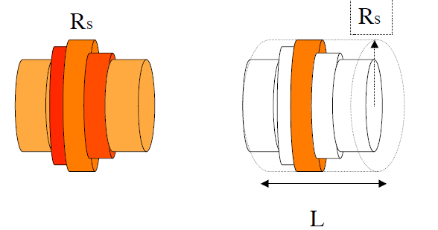
Suggestions from HOMDYN
HOMDYN (Higer Order Modes DYNamics) (*) assumes uniform cylindrical beams whose length and radius evolves in time
Slice envelopes and centroids evolve according to the system of equation below
Successfully describes the dynamics for beams using an LCLS-like working point: $∼$10 ps uniform cross-section and flat-top longitudinal: slight deviations from the original uniform cylinder are expected
A generalization is required for modern beams produced by short (tens of fs) laser pulses forming approximately ellipsoidal via the process of blowout
Slice radius evolution
($G(ζ_{s},A_{s})$ describes the slice-dependent space charge field)
Centroid evolution
(*)

Slide 21
From HOMDYN to MILES
HOMDYN
Forces acting on the s-th slice generated by an equivalent cylinder with properties
Charge $Q$ and length $L$ of the overall beam
Radius $R_{s}$, energy $γ_{s}mc^{2}$ and aspect ratio $A_{s}=R_{s}/γ_{s}L$ of the slice
MILES
Force acting on the i-th macro-particle given by the superposition of the field generated by all the slices with individual charge $Q_{s}$, length $L_{s},$ radius $R_{s}$, energy $γ_{s}mc^{2}$ and aspect ratio $A_{s}=R_{s}/γ_{s}L_{s}$

Slide 22
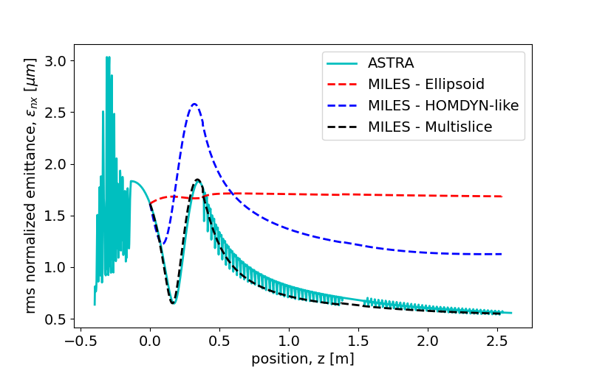
Emittance Dynamics - Comparison
250 pC electron beam produced by a hybrid gun and matched to its invariant envelope in a booster linac
Emittance dynamics: oscillations and compensation

Slide 23
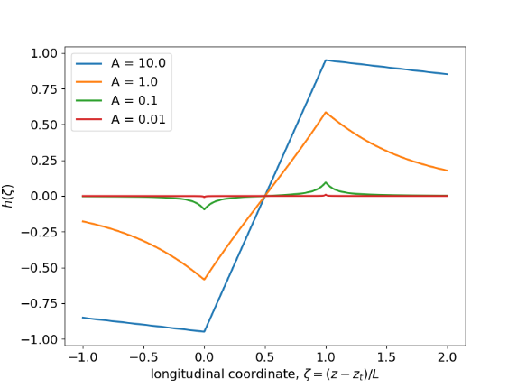
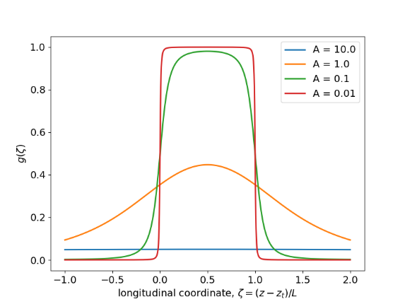
Set of Cylindrical Slices
Divide the beam in cylindrical slices with individual size ($R,L$), energy ($γmc^{2}$) and aspect ratio ($A=R/γL$)
Each slice produces a field in the surrounding space (assumptions: axisymmetric slice, $∂/∂θ=0$, and near-axis motion, $∂E_{z}/∂r=0$)
Each particle experiences a force given by the superposition of the fields produced by all the slices
250 pC electron beam produced by a hybrid gun and matched to its invariant envelope in a booster linac
Emittance dynamics: oscillations and compensation

Slide 24
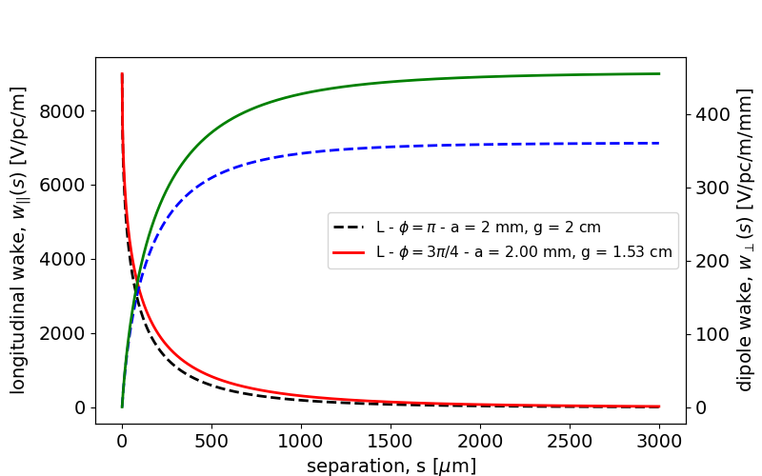
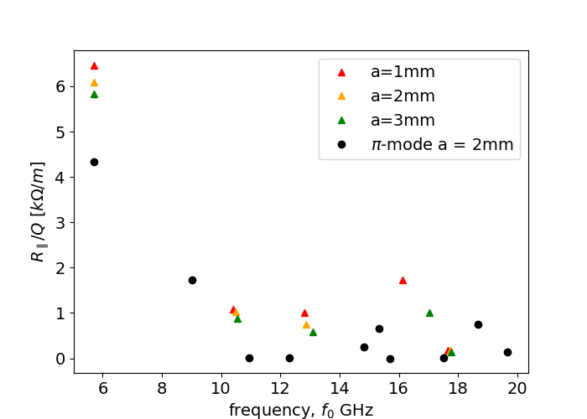
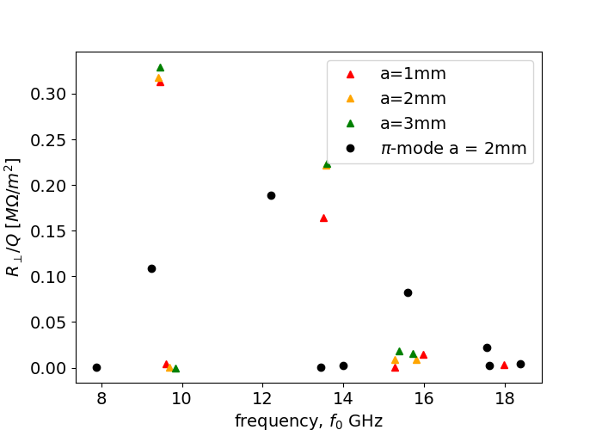
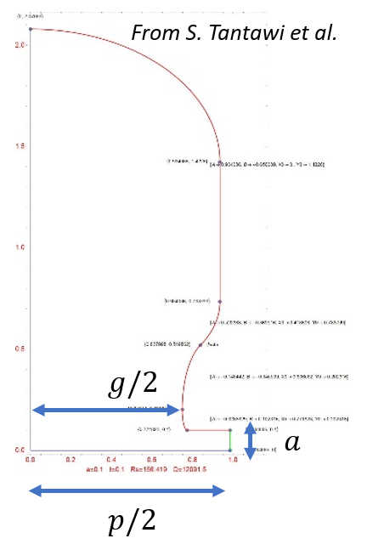
Wakefields in the $3π/4$ Structures
SRWF
LRWF
Monopole HOMs
Dipole HOMs
Dipole
Monopole
Solid - $3π/4$-mode
Dashed -- $π$-mode
= $3π/4$-mode
Notes:
We should start by a quantitative description of our wakefields
In the SR case the wakefunctions can be calculated by the geometric parameters of the cell and we can notice that such fields are sligthly stronger for the 3pi/4 mode (in solid lines)
And the same is true for the R/Q of the higher order modes so me must be prepared more serious problems

Slide 25
Modeling Space Charge Forces (2)
Equivalent ellipsoid method
Multi-slice superposition method
$250 pC$ $e^{−}$ beam from the C-band hybrid gun
Evolution in a field-free (drift) region with GPT (solid lines) and with the ellipsoidal model in MILES (dashed lines)
$250 pC$ $e^{−}$ beam produced by the hybrid gun and matched to its invariant envelope in a booster linac
Emittance dynamics: oscillations in the drift and compensation process in the linac
Transverse plane: $σ_{x}$, $ε_{nx }$
Injection in the booster
Longitudinal plane: $σ_{z}$, $σ_{E}$
M. Ferrario et al., Direct measurement of the double emittance minimum in the beam dynamics of the Sparc high-brightness photoinjector, Phys. Rev. Lett. 99, 234801 (2007).
Notes:
Here we can see some examples where our approach is compared to codes like GPT and ASTRA, both using PIC
In both cases we consider the beam produced by the hybrid photoinjector that, on the left, propagates in a long drift space and on the right is injected in a booster linac receiving emittance compensation
On the LHS MILES is using the Ellipsoidal model which, as anticipated, describes the transverse and the longitudinal dimensions as well as the energy spread correctly but it fails to reproduce the emittance oscillation
On the RHS the ellipsoidal model still fails in describing the evolution of the rms emittance however the multi-slice approach reproduces successfully both the oscillation in the drift and the compensation process

Slide 26
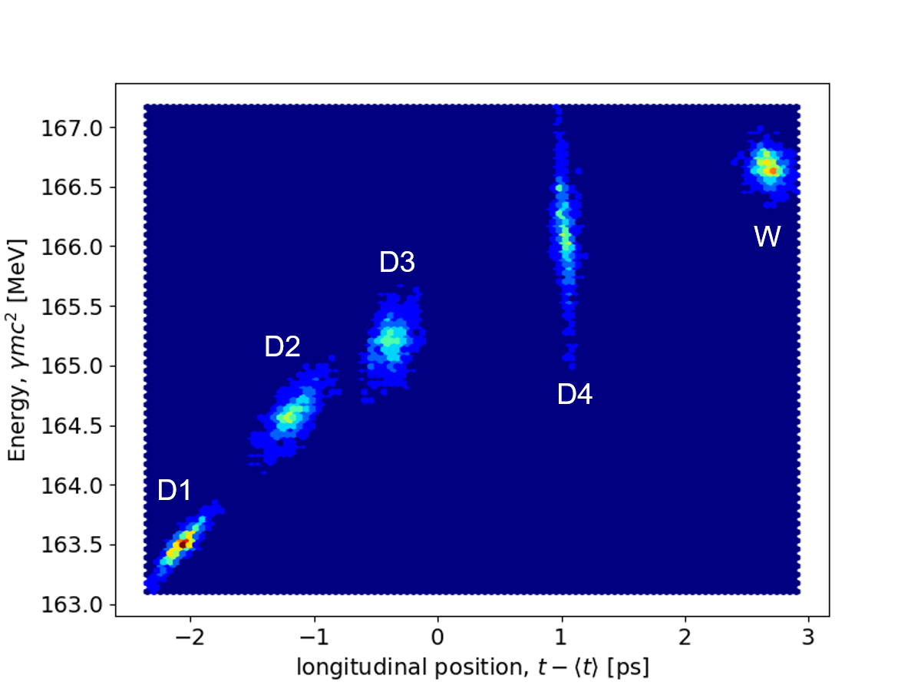
COMB Beams
Velocity bunching and beam manipulation
Acceleration of multi.pulse driver + witness (4D+W)
SRWF in X-band RF linacs

Slide 27
Motivation: Unique Beam Physics
Enhanced radial focusing in rf linacs
Strong wakefield interaction
Space-charge sensitivity
High accelerating gradient: $∼$50 MeV/m (room temp) and $∼$125 MeV/m (cryo-cooled)
1st - order focusing: transitions from field-free to non-zero field regions (a)
2nd - order focusing: non-synchronous space harmonics in the accelerating cells (b)
Small irises cause stronger wakefield interaction: C-band structures with $∼2mm$ iris radius ($∼0.038⋅λ_{rf}$)
Field diffracted in periodic accelerating structures (K. Bane’s theory) (c)
HOMs parasitically excited in the linac (d)
Beams produced by rf photoinjectors are in the 3-5 MeV energy range
Highly space charge-dominated nearby the injection in linac boosters
Nominal focusing anomalously strong in absence of SC forces (overfocusing)
(a)
SRWF
(c)
(b)
Injection in the booster
Note: $ν=η/8\cos\left(Δφ\right)$ with $η=1.12−0.5\cos\left(2Δφ\right)$
(d)
LRWF
Notes:
The motivation for such studies arises from the combination of photoinjectors and linac boosters with the properties described earlier which defines a unique and challenging scenario from the beam physics perspective
The optimized cell geometry of distributed coupling linacs enhances the accelerating gradient as well as the presence of non-synchronous space harmonics which are responsible for inherent radial focusing mechanisms introduced by the linac itself
Conversely, the small irises increase the impedance of the structures causing strong wakefields acting both within the same bunch or among different bunches
In addition to that, nearby the injection region our beams are highly space charge dominated so we need to take such effects into account. Such forces act against the external focusing which, as shown by this simple example with photoinjector + booster, results anomalously strong in absence of SC causing overfocusing and loss of laminarity
------
I want to focus on the challenging beam physics characteristics of the machines we aim to describe

Slide 28
Beam Brightness
The performance of advanced linac-based application relies on the high beam brightness: high current, low transverse emittances and narrow energy spectrum
A demanding example: efficient FEL radiation: $σ_{γ}/\left\langle γ\right\rangle <ρ$ and $ε_{nx}/\left\langle γ\right\rangle <λ_{r}/4π$ where $ρ∝B_{6D}$ is the Pierce parameter
Brightness is hard to preserve: must be high at source and not diluted by the linac
M. Reiser, Theory and Design of Charged Particle Beams,
John Wiley & Sons, New York, 1994
RF photoinjectors: a “recipe” for high brightness $e^{−}$ beams
Photo-emission: UV, sub-ps laser pulse illuminating a metallic photo-cathode
Acceleration: high field multi-cell standing wave RF cavity
Focusing: a solenoid magnets controls emittance and spotsize
Energy-boost: matching to a linac where the beam experiences gentle focusing and emittance compensation
Notes:
The 6D brightness is a quantity that provides information on the beam intensity, spectrum and solid angle as it depends on the peak current, the energy spread and the rms emittances.
The brightness is thus a measure of the 6D phase space density and crucially impacts the quality of the radiation in electron-driven light sources
In addition, the rms emittances account for the transverse phase space area as well as its distortion which allows to describe the confinement of the beam nearby the reference trajectory
High brightness electron beams are typically produced by rf photoinjectors where the photo-emission occurs inside a SW multi-cell cavity which rapidly accelerates the particles acting against the intense repulsive intra-beam forces
Photoinjectors also exist in the hybrid configuration which combines a SW and a TW section through a coupling cell
The SW section still provides for the energy gain, a solenoid magnet introduces transverse focusing and emittance control as in the case of conventional rf guns whereas the TW can provide longitudinal focusing
In fact, the peculiarity of this device is that the field in the two sections is 90 degrees out of phase which introduces an energy-time correlation so that, as the beam propagates in a drift space, it experiences a ballistic compresses which enhances the peak current with a positive impact on the brightness

Slide 29
M
LES

Slide 30
Collective Effects in Linacs
Space Charge Forces
Wakefield Interaction
Charged particles exert mutual repulsive forces
For two particles at distance $r$ traveling with velocity $βc$ one has radial force ($γ=1/\sqrt{1−β^{2}}$)
Field generated by the beam, diffracted by the discontinuities and acting back on the beam itself
Responsible for energy spread and transverse deflection
Slice-dependent deflection dilutes the projected rms emittance: BBU effects
For an arbitrary distribution, the strength of the force depends on both its shape and size
Generally slice-dependent
Courtesy of M. Migliorati
Space charge forces – PIC Methods
Solve Poisson equation in the beam frame
Lorentz field transformation in the lab frame
Integration of the equations of motion
Wakefield interaction – Convolution integral
Knowledge of the wake-function
Calculate the wake-potential (convolution integral with the current)
Notes:
To be clear, when we talk about fast algorithms we should mention the conventional approaches utilized to describe the two types of collective effects we are interested in
The strength of the space charge forces arising from the local field produced by the charge distribution itself, generally depends on both the shape and the size of the beam and therefore common models utilize PIC methods
On the other hand the wakefields arising from the interaction of the charges with surrounding environment and responsible for energy spread as well as transverse deflections are commonly described by the convolution between the charge density and the so-called wakefunctions accounting for the interaction between two charges

Slide 31
Modeling Space Charge Forces
Beams consist of large ensembles of charged particles exerting mutual repulsive forces
For arbitrary distributions, the strength of the force depends on both its shape and size
Exact solution typically utilizes particle in cell (PIC) approaches
Equivalent ellipsoid method
Multi-slice superposition method
An equivalent uniform ellipsoid is associated to the actual beam distribution
Self-induced forces are known analytically
Forces are linear: self consistent model
Divide the beam in cylindrical slices with individual size, energy and aspect ratio
Field produced by each (uniform) slice is known analytically ($∂/∂θ=0$, $∂E_{z}/∂r=0$)
Superposition of the fields produced by all the slices
Advantages
Very fast ($∼30$ times of 3D PIC )
Successfully reproduces rms size ($σ_{x},σ_{y},σ_{z}$) and energy spread ($σ_{E}$)
Limitations
Absence of correlation prevents the observation of emittance dynamics
Loss of axial symmetry in presence of strong transverse wakefield
Advantages/Limitations
Correlation between the planes describes the emittance dynamics
Allows description of more arbitrary geometries
More time-consuming but still faster than PIC
Notes:
For what concerns SC forces, the strength of such effects depends on the shape and the size of the distribution, and therefore their description utilizes PIC methods
Here I am showing two alternative semi-analytical methods:
The first one associates the actual beam to an equivalent uniform ellipsoid which produces well-known self induced forces
whereas the second one divides the beam in cylindrical slices with individual size and energy and producing a field in this form in the surrounding space
The force acting on each particle is then given by the superposition of the EM field produced by all the slices
The ellipsoid method is very fast and in many practical cases reproduces the rms beam dimension and energy spread correctly
However, since the forces are not slice-dependent, the model forbids to observe well-known emittance dynamics that are induced by the independent evolution of the beam slices
In addition, in presence of wakefields, the deflection introduced by the transverse wake will displace the centroid of each slice breaking the symmetry that is implied in the ellipsoidal model meaning that the model is not valid in strong-BBU regime unless correction schemes for the trajectories are introduced
The multi-slice approach overcomes both this limitations: it exhibits correlation between the planes and allows description of more arbitrary shapes. The drawback is that this method become more time consuming but remains faster than a PIC

Slide 32
Modeling Space Charge Forces (2)
Equivalent ellipsoid method
Multi-slice superposition method
$250 pC$ $e^{−}$ beam from the C-band hybrid photoinjector
Evolution in a field-free (drift) region with GPT (solid) and with the ellipsoidal model in MILES (dashed)
$250 pC$ $e^{−}$ beam produced by the hybrid gun and matched to its invariant envelope in a booster linac
Emittance dynamics: oscillations in the drift and compensation in the linac
Transverse plane: $σ_{x}$, $ε_{nx }$
Injection in the booster
Longitudinal plane: $σ_{z}$, $σ_{E}$
M. Ferrario et al., Direct measurement of the double emittance minimum in the beam dynamics of the Sparc high-brightness photoinjector, Phys. Rev. Lett. 99, 234801 (2007).
Notes:
Here we can see some examples where our approach is compared to codes like GPT and ASTRA, both using PIC
In both cases we consider the beam produced by the hybrid photoinjector that, on the left, propagates in a long drift space and on the right is injected in a booster linac receiving emittance compensation
On the LHS MILES is using the Ellipsoidal model which, as anticipated, describes the transverse and the longitudinal dimensions as well as the energy spread correctly but it fails to reproduce the emittance oscillation
On the RHS the ellipsoidal model still fails in describing the evolution of the rms emittance however the multi-slice approach reproduces successfully both the oscillation in the drift and the compensation process

Slide 33
Modeling Wakefield Effects (2)
Short-range wakefield (SRWF) effects in a distributed coupling linac
Longitudinal monopole and transverse dipole wake-functions from diffraction theory
Longitudinal interaction
Transverse interaction
$50 MeV$ rectangular beam propagating on-axis in a $∼1 m$ long linac section: long. phase-space
$5 MeV$ rectangular beam propagating in two linac sections with transverse offset $Δx_{1}=100 μm$ and $Δx_{2}=0$
Head
Injection
Extraction
Tail
Energy spread induced by the longitudinal SRWF in a linac section (longitudinal phase space)
Misaligned linac section: the beam propagates off axis exciting dipole wakes which cause emittance growth
Notes:
Here we consider an example where the SRWF excited in a distributed coupling linac cause mutual interaction among particles in the same bunch
The longitudinal and transverse binary interaction in a periodic accelerating structure is described by use of diffraction theory by means of well known wake-functions
In the first example the longitudinal wakefield excited in the linac affects the energy spread of an originally monochromatic beam modifying its projection on the LPS
In the second example a misaligned linac section causes the beam centroid to travel off-axis where dipole wakefields are excited causing a growth of the rms emittance
In both cases our model reproduces the expected behavior

Slide 34
Long-range BBU in the $C^{3}$ Linac (2)
$700 ns$ RF-pulse (flat-top) filled with 133 bunches, $1 nC$ each, and $5.26 ns$ separation (30 RF-periods)
Acceleration at an avg gradient of $70 MeV/m$
Injection $100 μm$ off axis causes excitation of dipole HOMs
Considerable beam loading, up to 16% energy difference
Amplitude of the transverse oscillation for each bunch in the rf-pulse at the interaction point normalized to the first bunch’s amplitude
Notes:
Here we investigate an injection error of 100 um in absence of mitigation techniques and
The plot shows the amplitude of the transverse oscillation and the energy for each one of the 133 bunches in the rf-macro pulse at the end of the linac.
Allow me a quick comment on the beam loading: I shouldn’t have included this effect as the loaded gradient already accounts for it. The reason why I did is to show that this effect is indeed strong and this energy droop is consistent with the beam power to rf power ratio
For the transverse oscillations, amplitudes are normalized to the value of the first bunch (which by causality doesn’t experience dipole wakes) showing grow factors ranging from 20k to 140k that require clearly require mitigation

Slide 35
Long-range BBU in the $C^{3}$ Linac (3)
Detuning of the HOMs
Unstable motion if the ratio $f_{HOM}/f_{b}$ is close to an integer (see Mosnier)
Mitigation through frequency spread (or detuning)
Small variations of the original cavity geometry: HOMs exhibit different random frequencies in subsequent linac sections
Amplitude of the transverse oscillation for each bunch in the rf-pulse at the interaction point normalized to the first bunch’s amplitude
Notes:
It is possible to demonstrate that the motion becomes highly unstable when the ratio of the HOM frequency and the bunch repetition rate is close to an integer as the mode and the pulsed beam fulfill a resonant condition
A possible mitigation scheme, known as frequency spread, consists in applying small changes to the nominal geometry of the cavity so that the mode will appear with different frequencies in subsequent linac sections
Such fluctuations break the coherent interplay of the pulsed beam with the mode
Repeating the previous simulation with frequency spread. We can observe that, since all the normalized amplitudes are close to 1, breaking the interaction pattern cancels the BBU-effects completely

