Slide 1
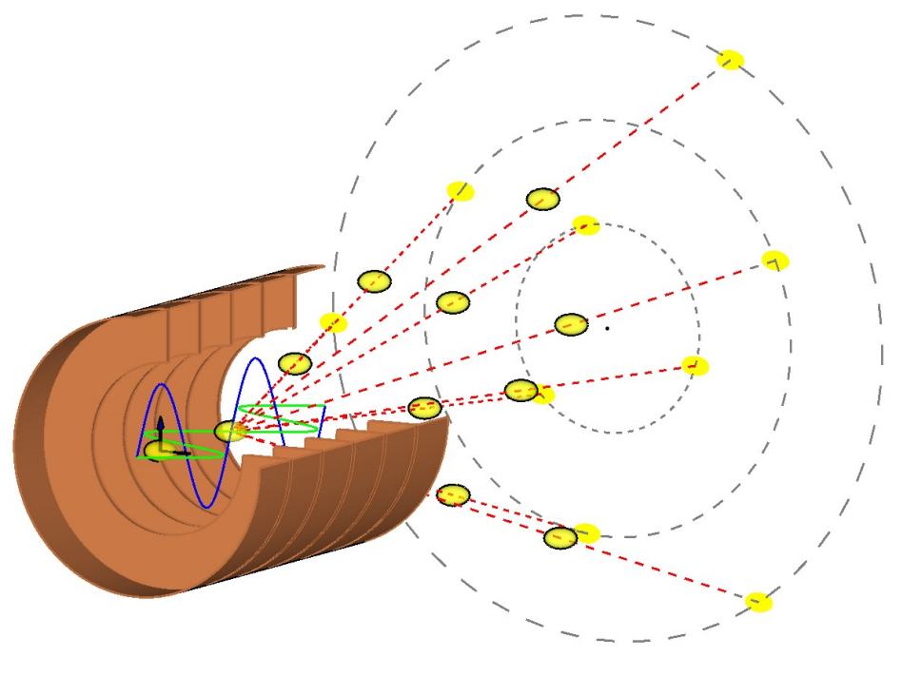
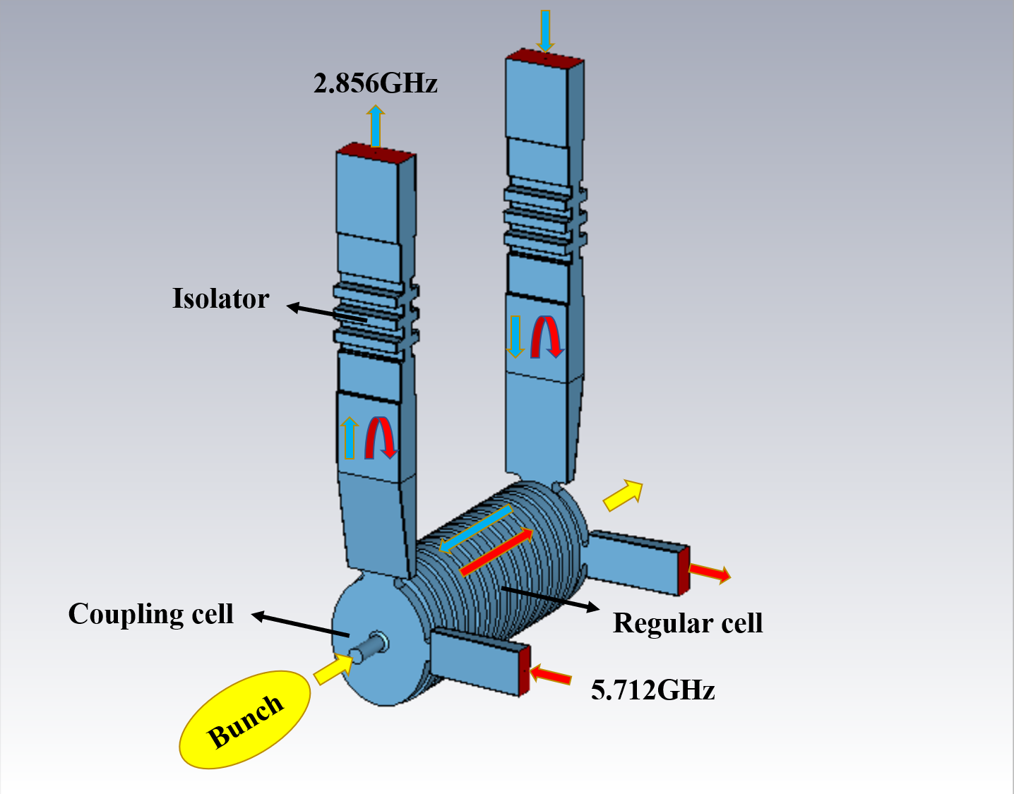
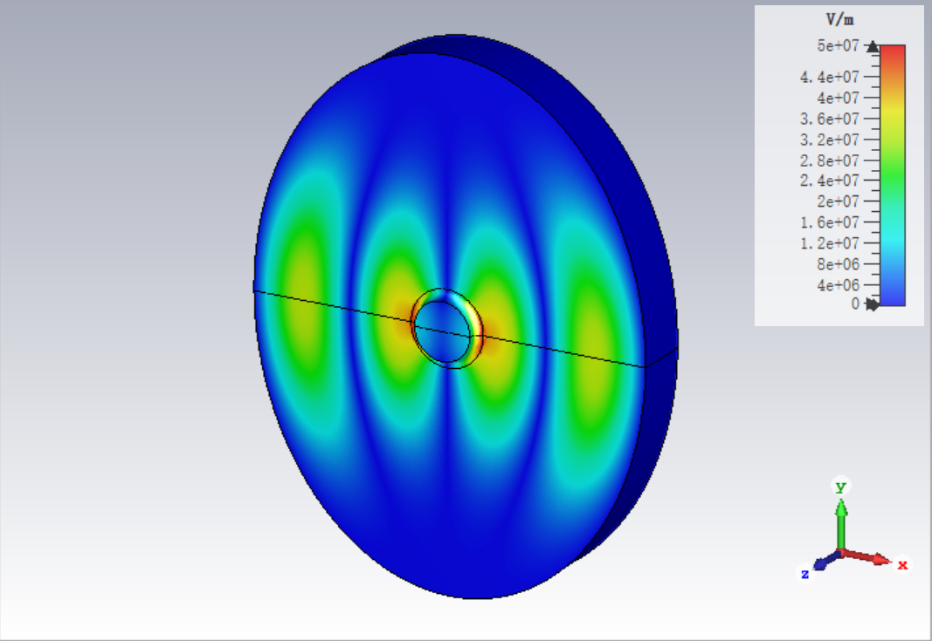
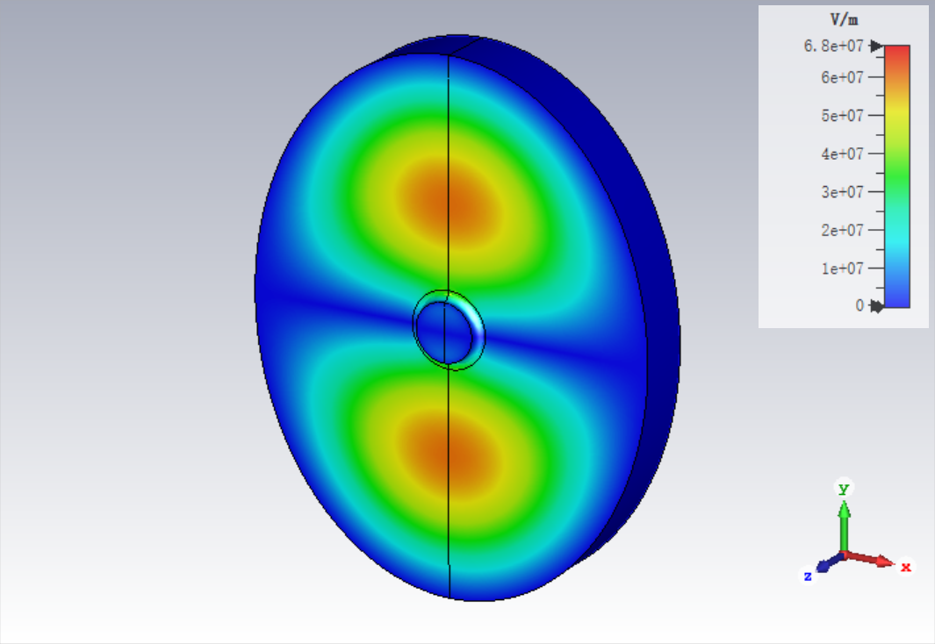
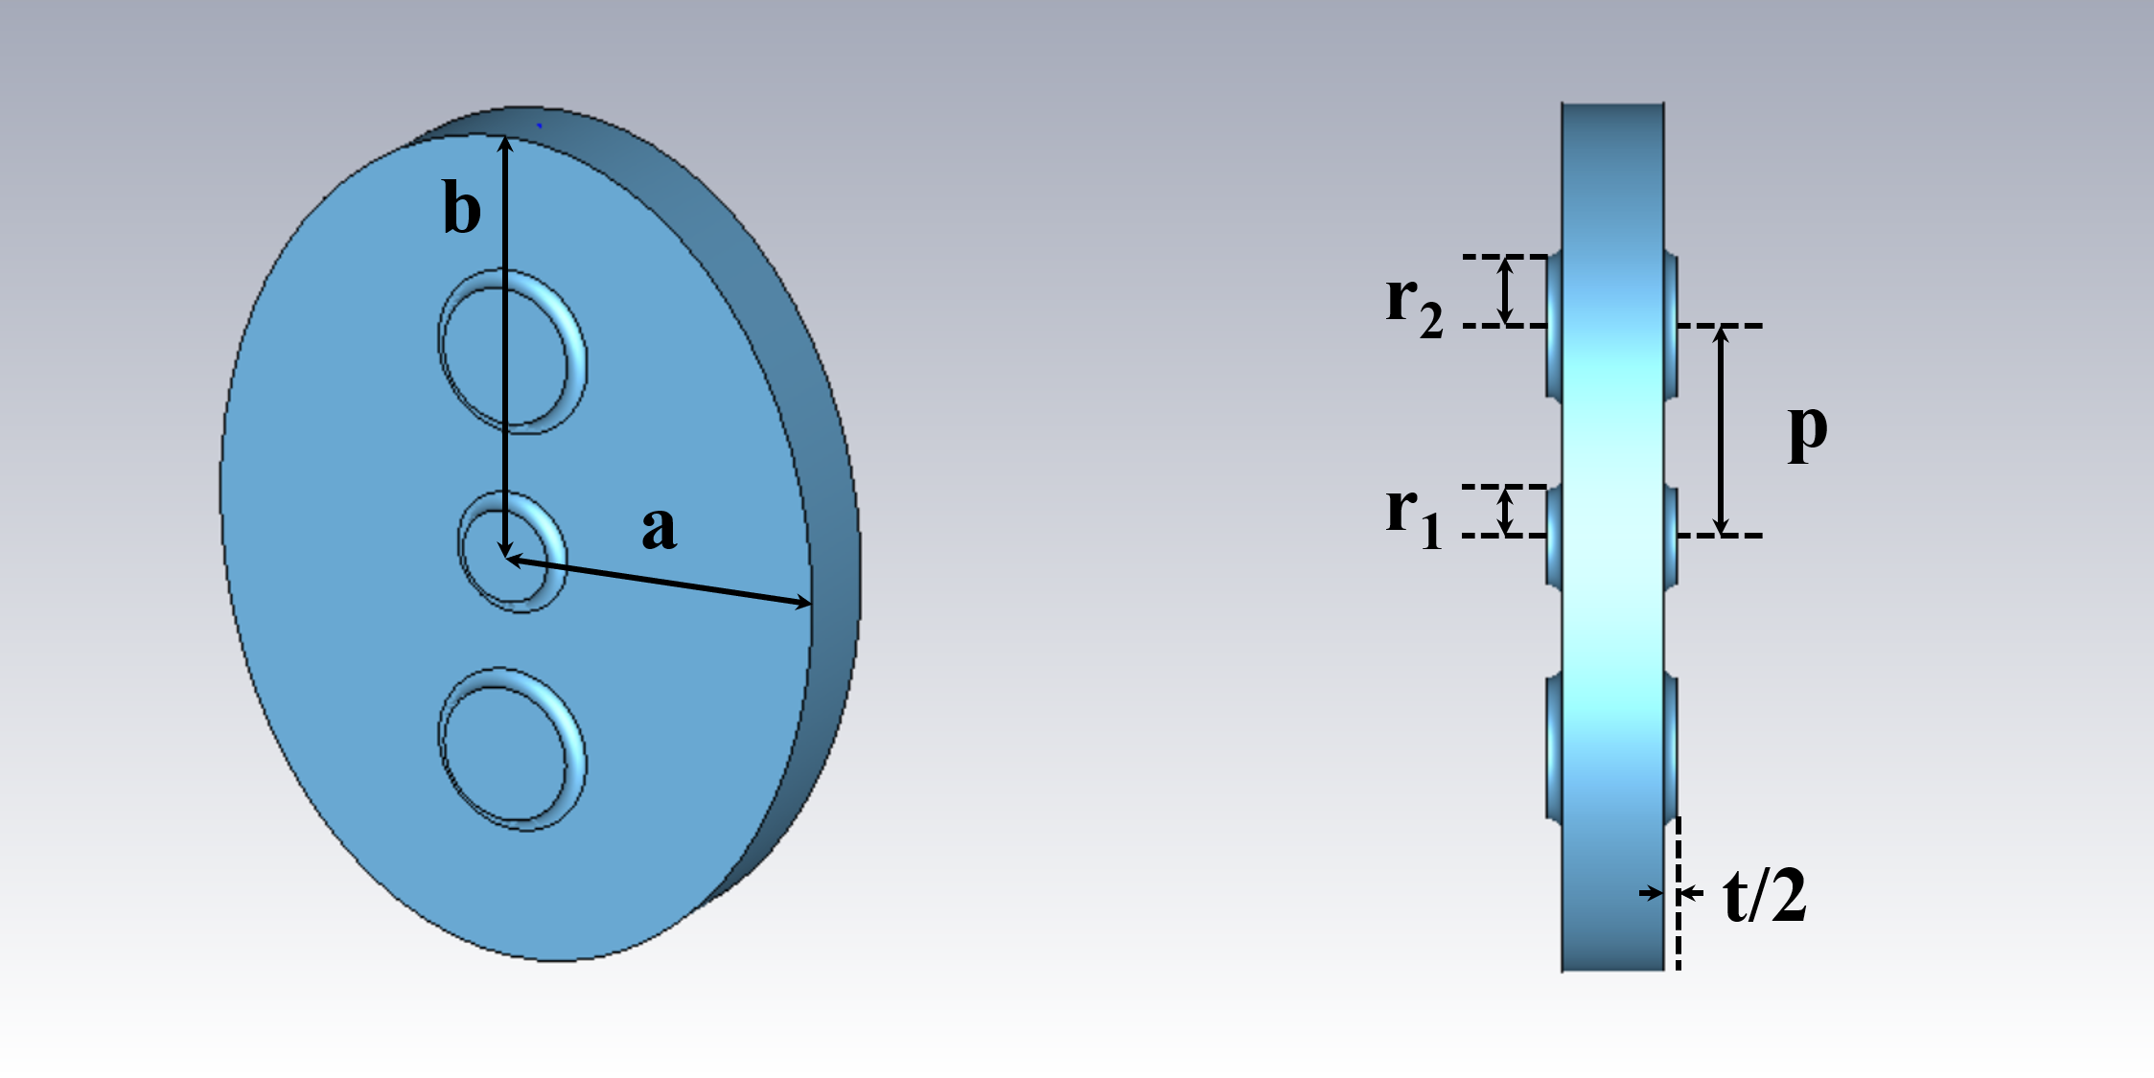
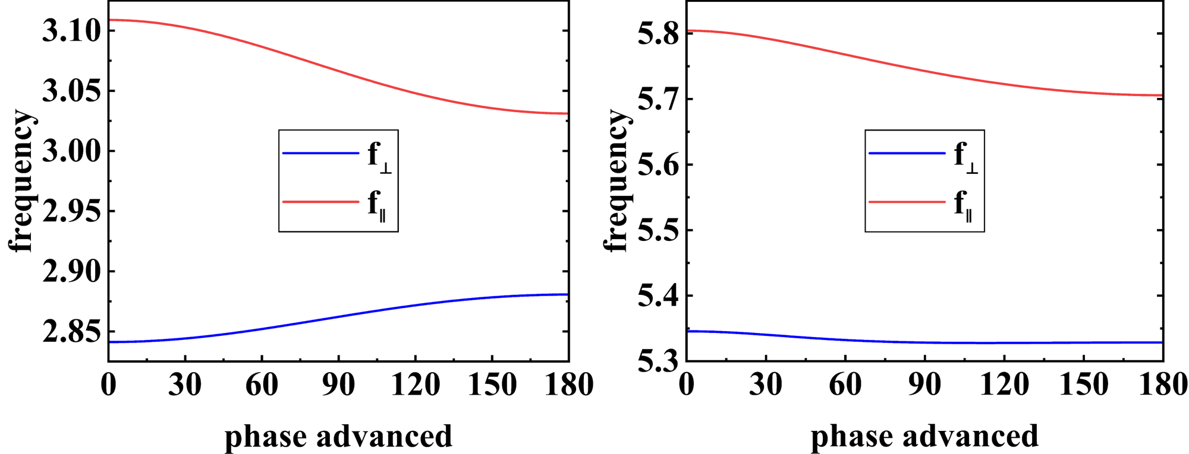
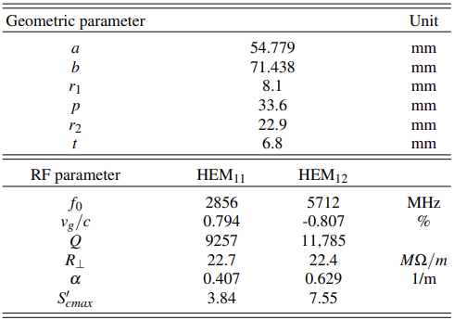
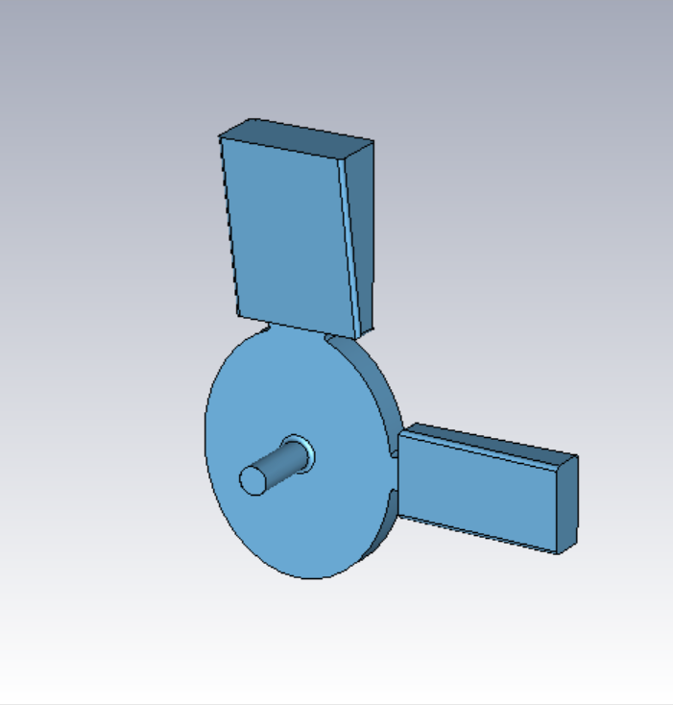
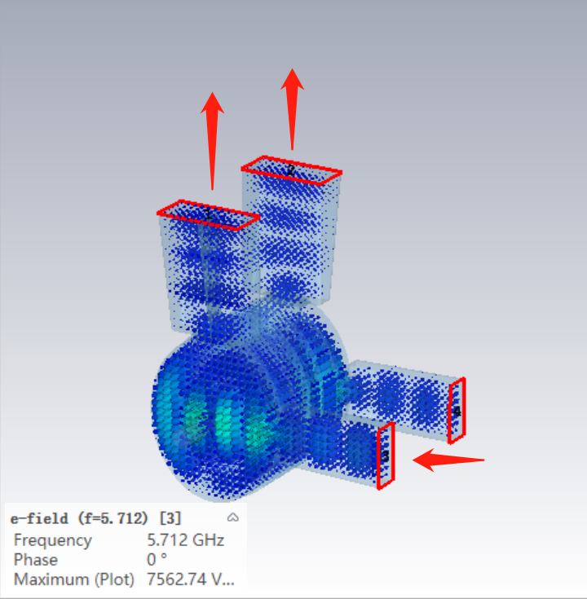
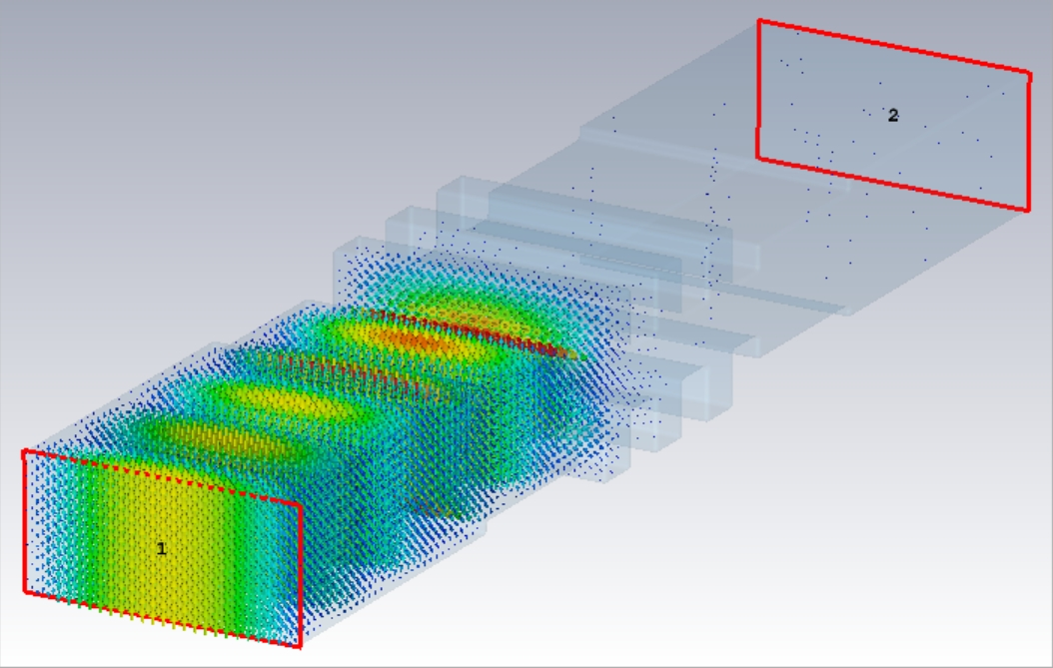
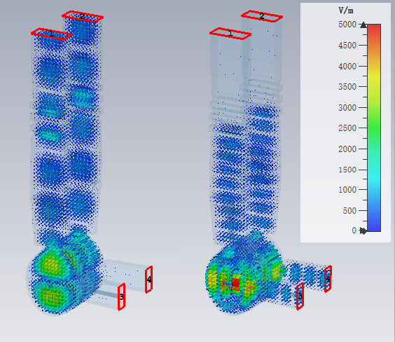
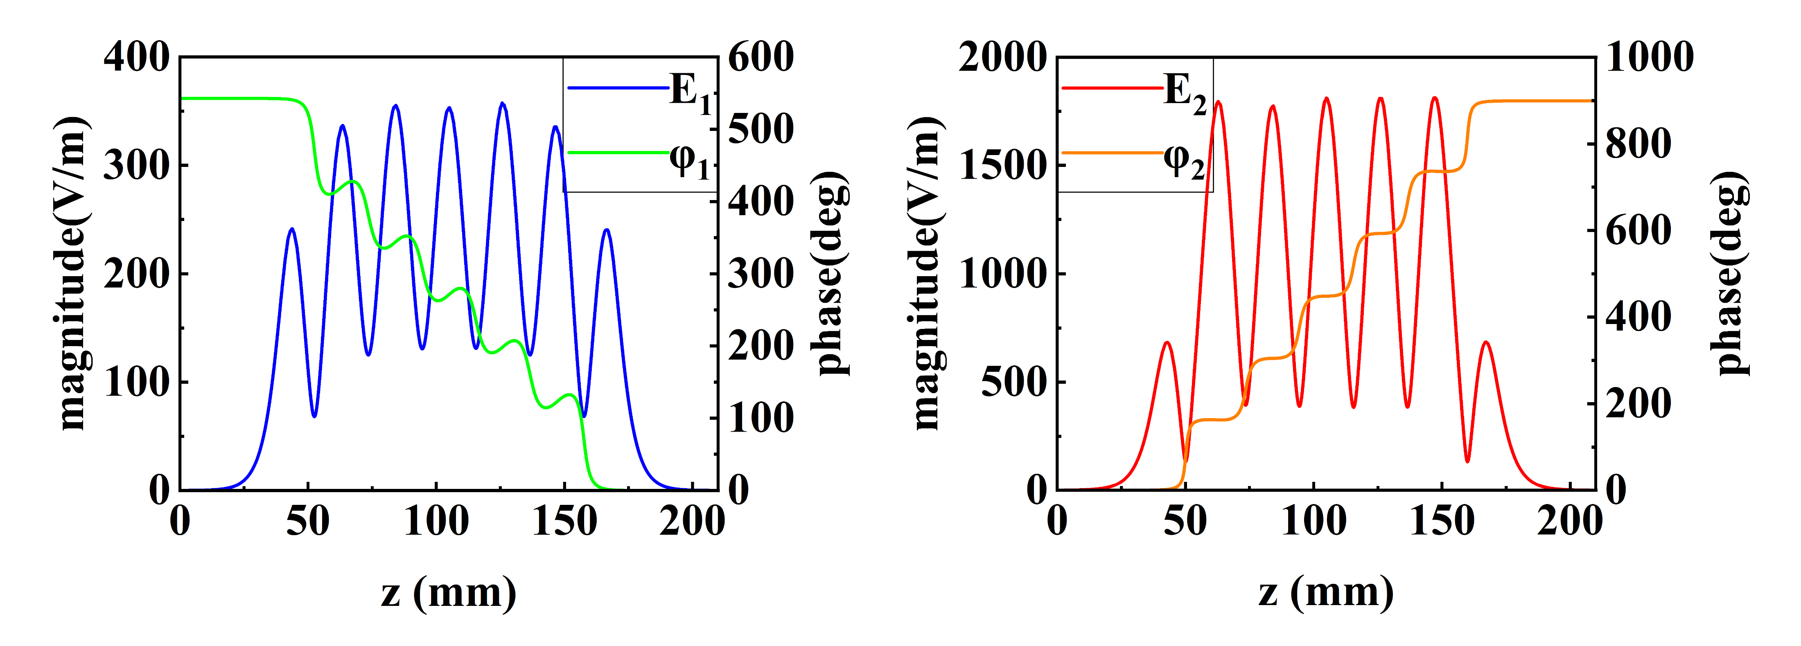
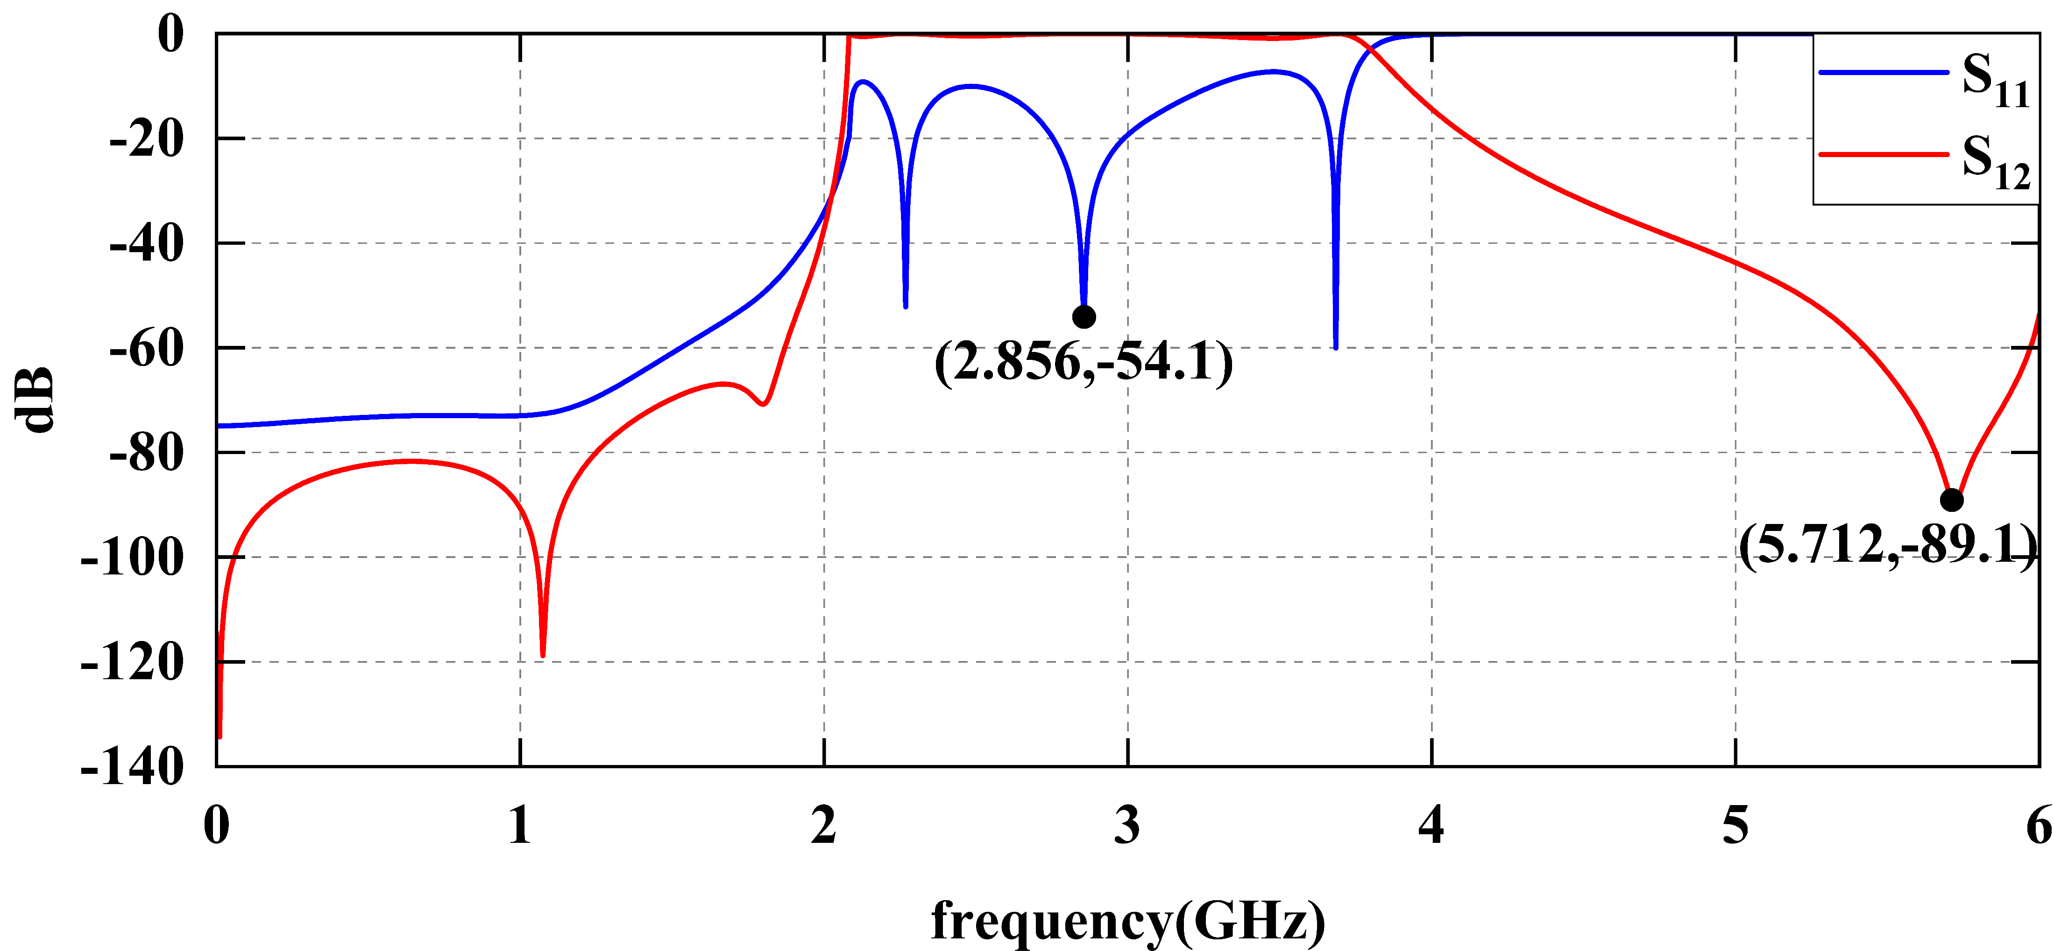
The design of a dual-mode transverse deflecting structure
Hanyu Gong, Wencheng Fang, Jianhao Tan, Cheng Wang, Zhentang Zhao
gonghanyu@sinap.ac.cn; fangwc@sari.ac.cn; tanjh@sari.ac.cn; wangc@sari.ac.cn; zhaozhengtang@sinap.ac.cn
INTRODUCTION
Variable polarization is now the research frontier of next-generation TDS (transverse deflecting structure) development.
To achieve the fast switching of bunches, a new design for a variable polarization TDS was proposed at SSRF/SXFEL.
This novel design provide technical support for fast solid angle switching in FLASH and 3-D distribution reconstruction in advanced beam diagnostics.
In the TTDS (two-mode TDS), two deflecting modes have mutually perpendicular polarized directions and operate in one structure.
The transverse deflecting voltage is expected to reach 20MV/m and the time scale for switching is about 100 ns to 1 µs.
OVERALL DESIGN
The HEM₁₁ and HEM₁₂ modes are chosen for the travelling wave deflection.
The phases of the two deflecting fields are synchronized with the bunch to generate a stable transverse deflecting force. By adjusting the magnitude and proportion of the deflecting voltage of the two modes, the bunch can be kicked to any required angle.
Two power sources and more ports on the couplers are required.
An isolator is added at the ports of the low frequency signal on the couplers to prevent an overflow of the high-frequency signal.
After consideration, we select the HEM₁₁ and HEM₁₂ modes as the operating modes in the vertical and horizontal directions, respectively; The working frequency are 2856 MHz and 5712MHz; The phase advances are 2/5π and 4/5π.
REGULAR CELL
Different from the classical LOLA structures, the regular cell uses an elliptical design to tune the two modes simultaneously and distinguish with their degenerate modes, which can fix the polarized direction.
An additional pair of side coupling holes is added in the polarized direction of the HEM₁₁ mode used for its coupling alone, which can reduce the mutual influence of the two modes and reduce the difficulty of optimization and tuning.
HEM₁₁ operates in the forward TW regime and HEM₁₂ operates in the backward TW regime, so the power is fed in the opposite direction.
Considering working frequency, group velocities, transverse shunt impedance and normalized maximum modified Poynting vector as the optimization targets. Since there are two operating modes, we decided to optimize with the help of neural network algorithm.
DUAL-FREQUENCY COUPLER AND HIGH-FREQUENCY ISOLATOR
The coupling cell also uses the elliptical design, and two coupling ports are designed on the cavity wall of the polarization direction of both modes.
After both ports are adjusted to match, part of the high-frequency signal will overflow from the low-frequency ports and will lead to power waste and damage to the power source. To fed the power of two frequencies independently, it is necessary to add an isolator at the HEM11-related ports.
The high-frequency isolator is a passband at 2856MHz and a stopband at 5712MHz.
The multiple-objective algorithm is used to tune and match the entire tube.
CONCLUSION
A new design of the TDS is proposed to provide a variably polarized deflecting field and switch the deflecting direction in less than 1 µs.
The TTDS is dual-mode operation, and HEM₁₂ is innovatively adopted as the deflecting mode in TDS to control the deflecting voltage of the two polarized direction independently.
A new type of inter-cavity coupling is adopted, and an isolator is added to avoid the overflow of high-frequency power.
Neural network and multivariate optimization algorithm are successfully used to improve the optimization speed and precision.
The design is finally completed and ready for manufacture.

