Slide 1
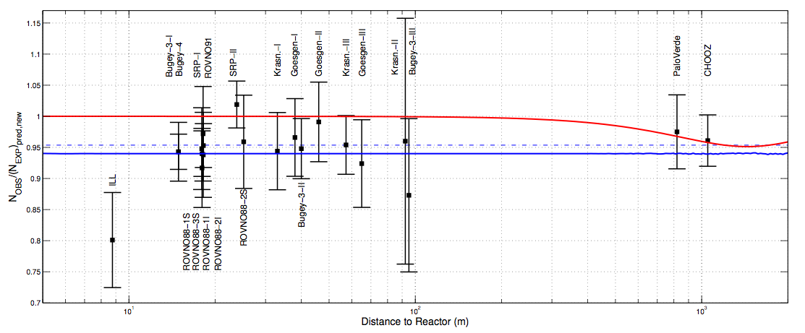
The Reactor Antineutrino Anomaly and implications
    D. Lhuillier (CEA-Saclay, Irfu/SPhN)

Slide 2
New Reactor Antineutrino Spectra
T.A. Mueller, D. Lhuiller*, M. Fallot, A. Letourneau, S. Cormon,
M. Fechner, L. Giot, T. Lasserre, J. Martino, G. Mention, A. Porta, F. Yermia.
CEA / Irfu & IN2P3 / Subatech
arXiv:1101.2663 [hep-ex], accepted for publication in Phys Rev C
* corresponding author
Notes:
2

Slide 3
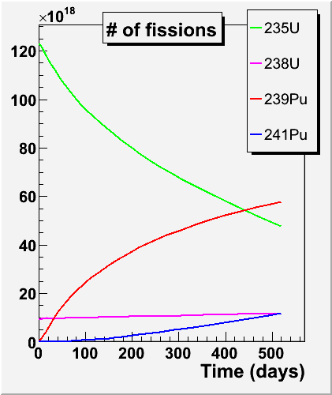
ν spectrum emitted by a reactor
The prediction of reactor ν spectrum is the dominant source of systematic error for single detector reactor neutrino experiments
Reactor evolution codes
Reactor data
Thermal power, δP_{th} ≤1%
Fraction of fissions from isotope k, δα_{k}=few % but large anti-correl @ fixed P_{th}
Nuclear databases
E released per fissions of isotope k, δE_{k}≈0.3%
ν spectrum per fission
This work !

Slide 4
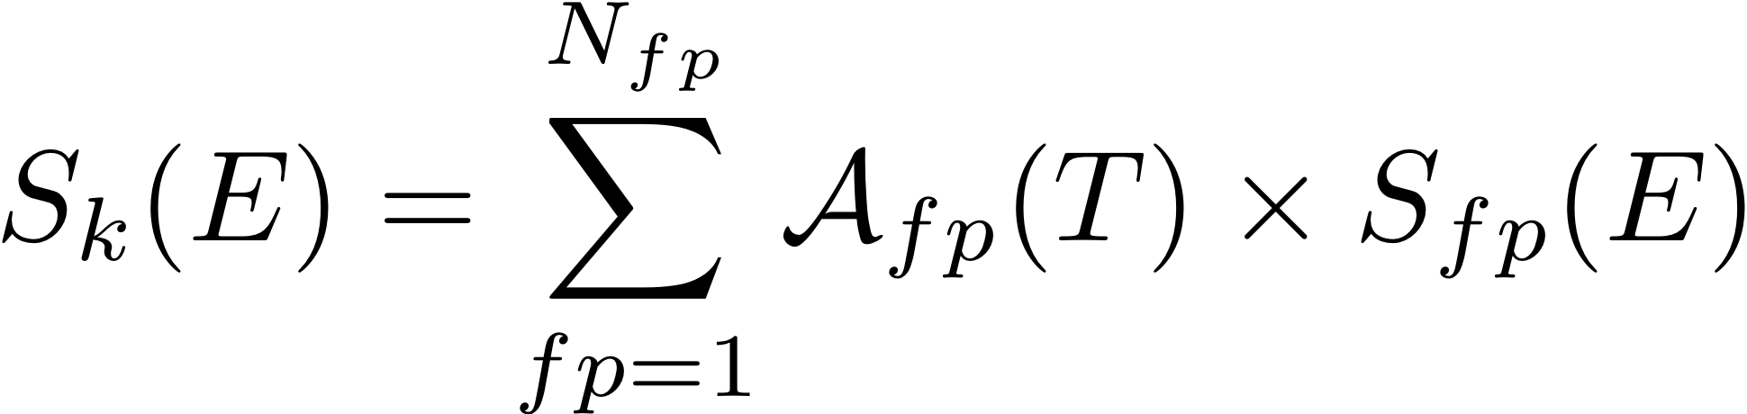
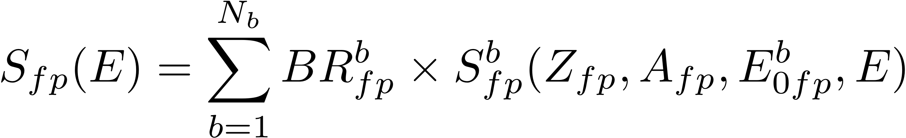
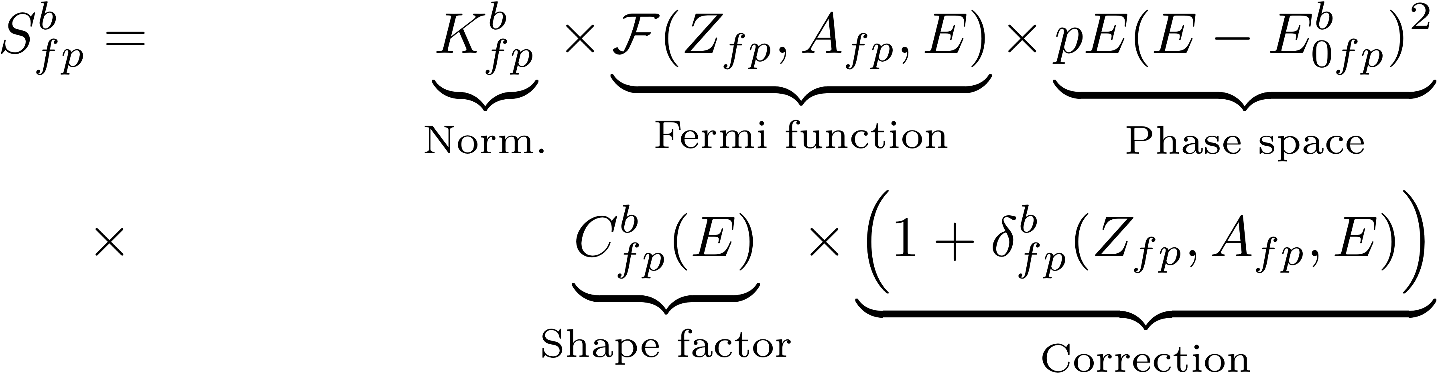
The guts of S_{k}(E)
Sum of all fission products’ activities
Sum of all β-branches of each fission product
Theory of β-decay

Slide 5
Complementary approaches to compute the ν flux
Integral measurements
of electron spectra
Ab initio
Sum of all fission products’ activities
fission product inventory (t)
fission rates (t)
Fission Yields (JEFF, ENDF, JENDL)
Life time
Sum of all β-branches of each fission product
Build total spectrum from sum of β-branches
Reference e-spectrum
for each
“parent” U/Pu isotope
(ILL data)
Complete β-decays schemes (ENSDF)
β-strength (Greenwood et al.)
Total β spectrum per nucleus (Rudstam et al.)
Masses (Q_{b})
Nuclear models …
Theory of β-decay
Full ab-inito
Our mixed approach
Effective

Slide 6
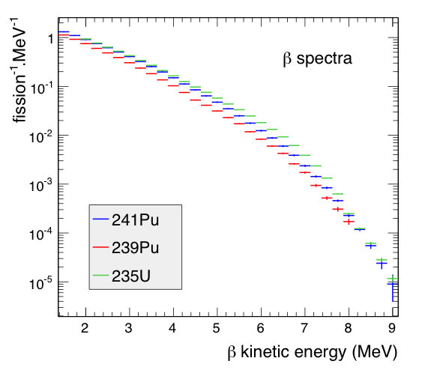
The ILL electron Data “Anchor point”
Accurate e⁻ measurements
@ ILL in Grenoble (1980-89):
  High resolution magn. Spectrometer
  Intense and pure thermal neutron spectrum from the core (not suitable for ²³⁸U
  which needs fast n)
  Calibration by extensive use of reference internal conversion electron lines
  Normalization syst 1.8%
Total electron spectra from the β-decays of ²³⁵U, ²³⁹Pu and ²⁴¹Pu fission products.
Unique reference to be met by any other measurement or calculation

Slide 7
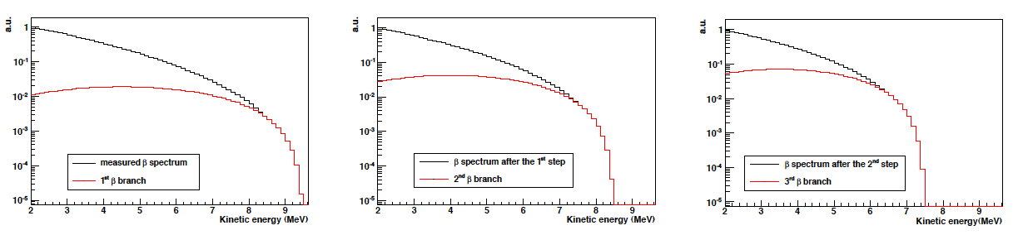
Effective method: conversion to ν spectra
Fit total e⁻ spectrum with a sum of 30 effective β branches chosen by iterative method (instead of 10,000+ real branches)
Conversion of the effective branches to ν spectra
K. Schreckenbach et al., Phys. Lett. 99B, 251 (1981).

Slide 8
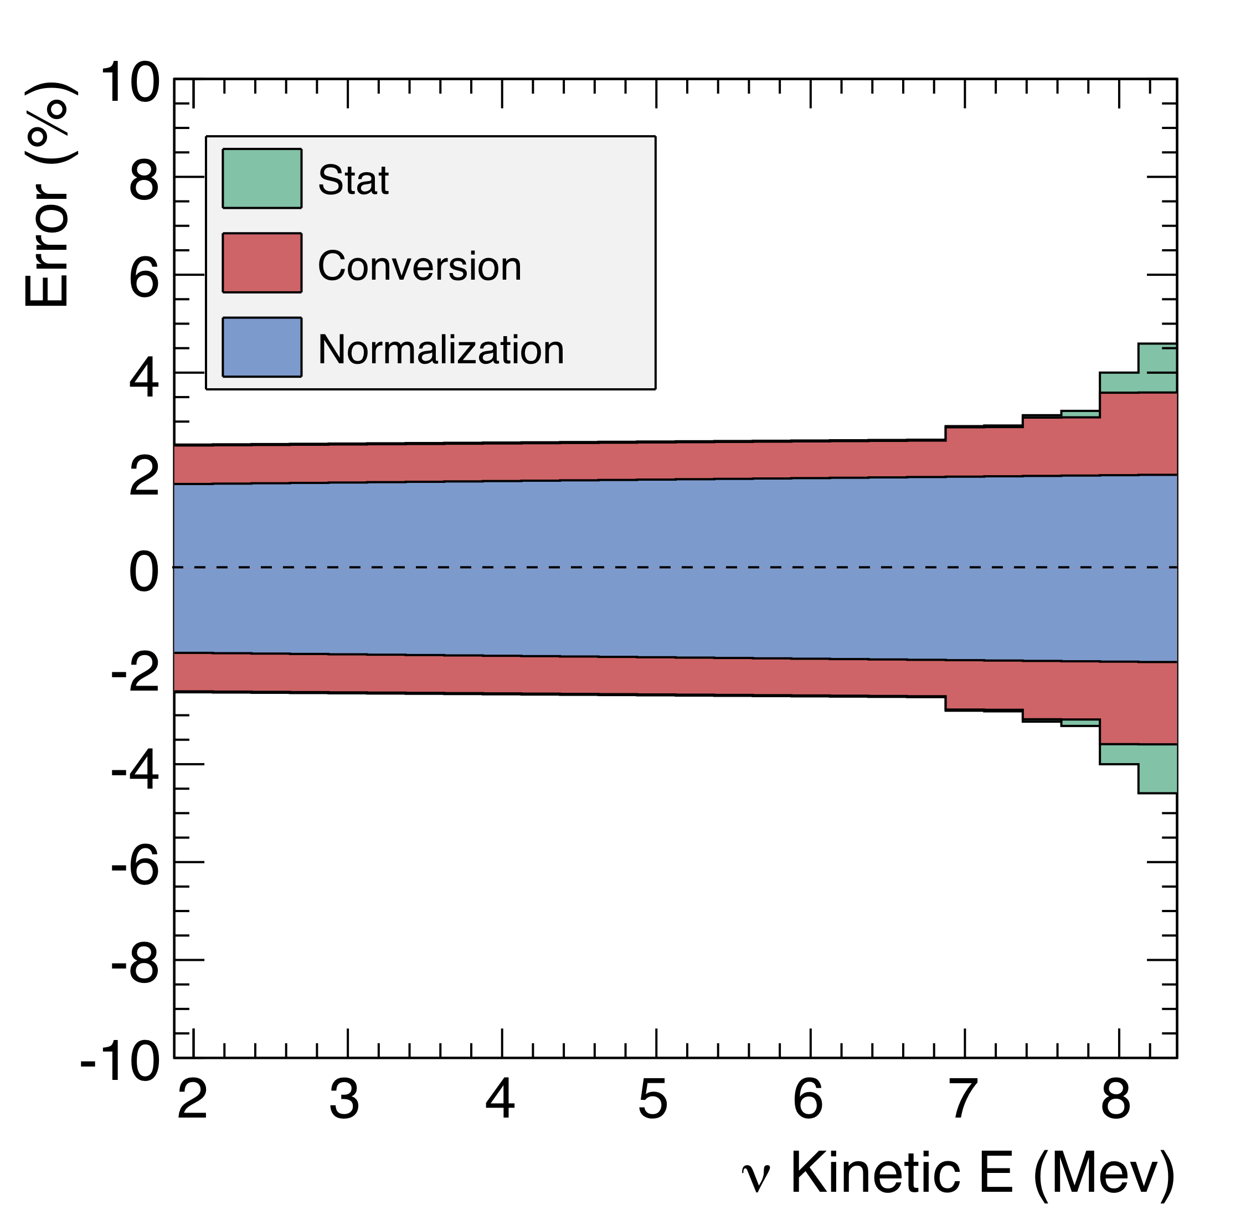
Effective method: conversion to ν spectra
Stack of quadratic sum of ²³⁵U errors:
Conversion error from envelop of numerical
studies
Complete theory included in the effective
branches but:
  What Z? : Mean fit on nuclear data Z=f(E0)
  - What A_{CW}? : effective correction on the ν-spectra
Can we do better ?

Slide 9
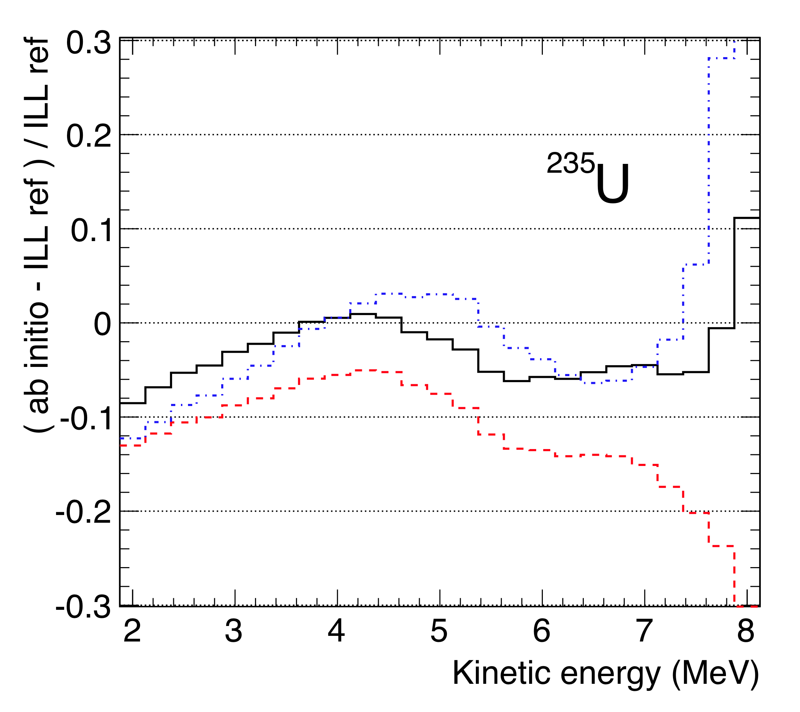
Full Ab Initio Attempt
MURE evolution code (Subatech Nantes): nuclear reactor fuel composition
BESTIOLE code (CEA Saclay): build up database of ~800 nuclei and 10000 β-branches
Residuals w.r.t. reference ILL e⁻ data
All data from ENSDF (β-branches) and JEFF (fission yields) databases
+
Complementary measurements of fission products spectra to tag and replace pandemonium candidates
+
Unmeasured nuclei described by gross-theory (JENDL database) + our own model based on ENSDF mean fits.
95+/-5% of the spectrum reproduced but still not meeting required precision
Estimate of ²³⁸U spectrum which couldn’t be measured @ ILL, using most complete data set (black curve)

Slide 10
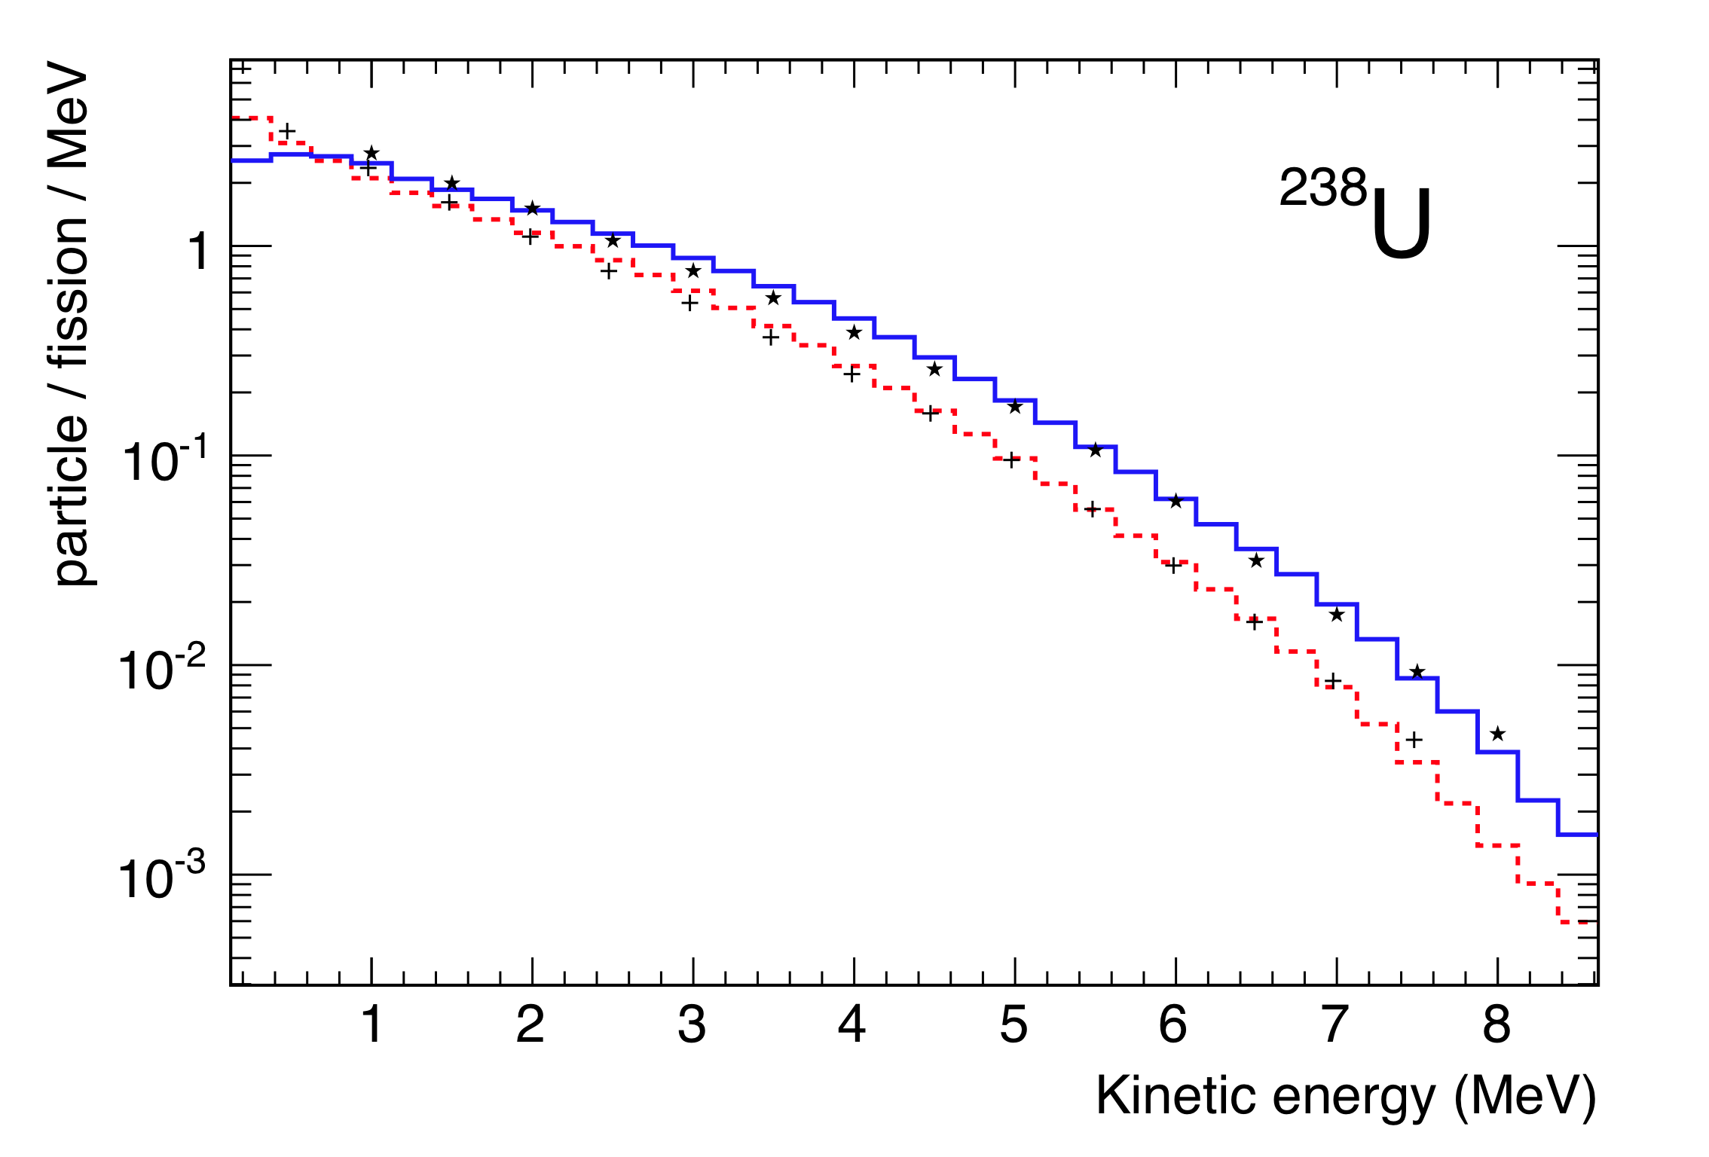
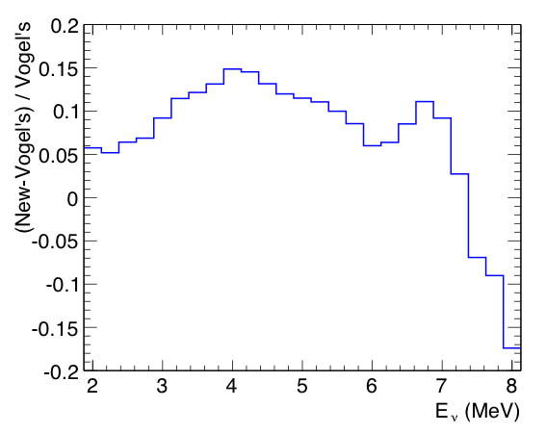
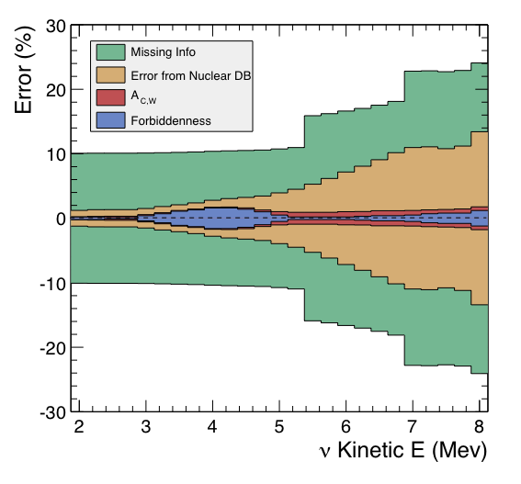
Application to ²³⁸U prediction
Stack of quadratic sum of ²³⁸U errors
ν
e⁻
Comparison with Vogel’s calculations, Phys. Rev. C24, 1543 (1981)
To be compared with upcoming FRM2 data
(N. Haag, K. Schreckenbach)

Slide 11
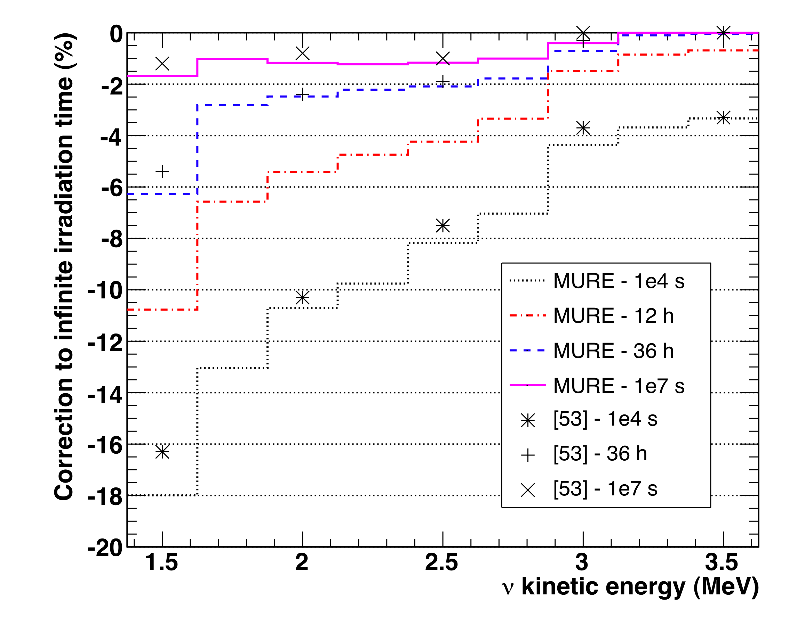
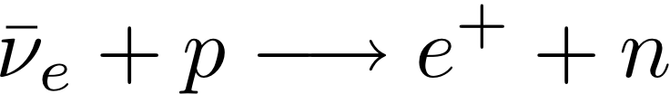
Off-Equilibrium Effects
MURE evolution code (IN2P3/Subatech)
ILL electron reference spectra : 12 hours to 1.5 days irradiation time
Neutrino reactor experiments irradiation time >> months
BUT 10% of fission products have a β-decay life-time long enough to keep accumulating after several days
→ need a correction through simulation
→ Not included prior to the CHOOZ experiment
Relative change of ν spectrum w.r.t. infinite irradiation time
Correction included by default in our new reference model
ILL conditions
ILL β
reactor ν
reaction threshold

Slide 12
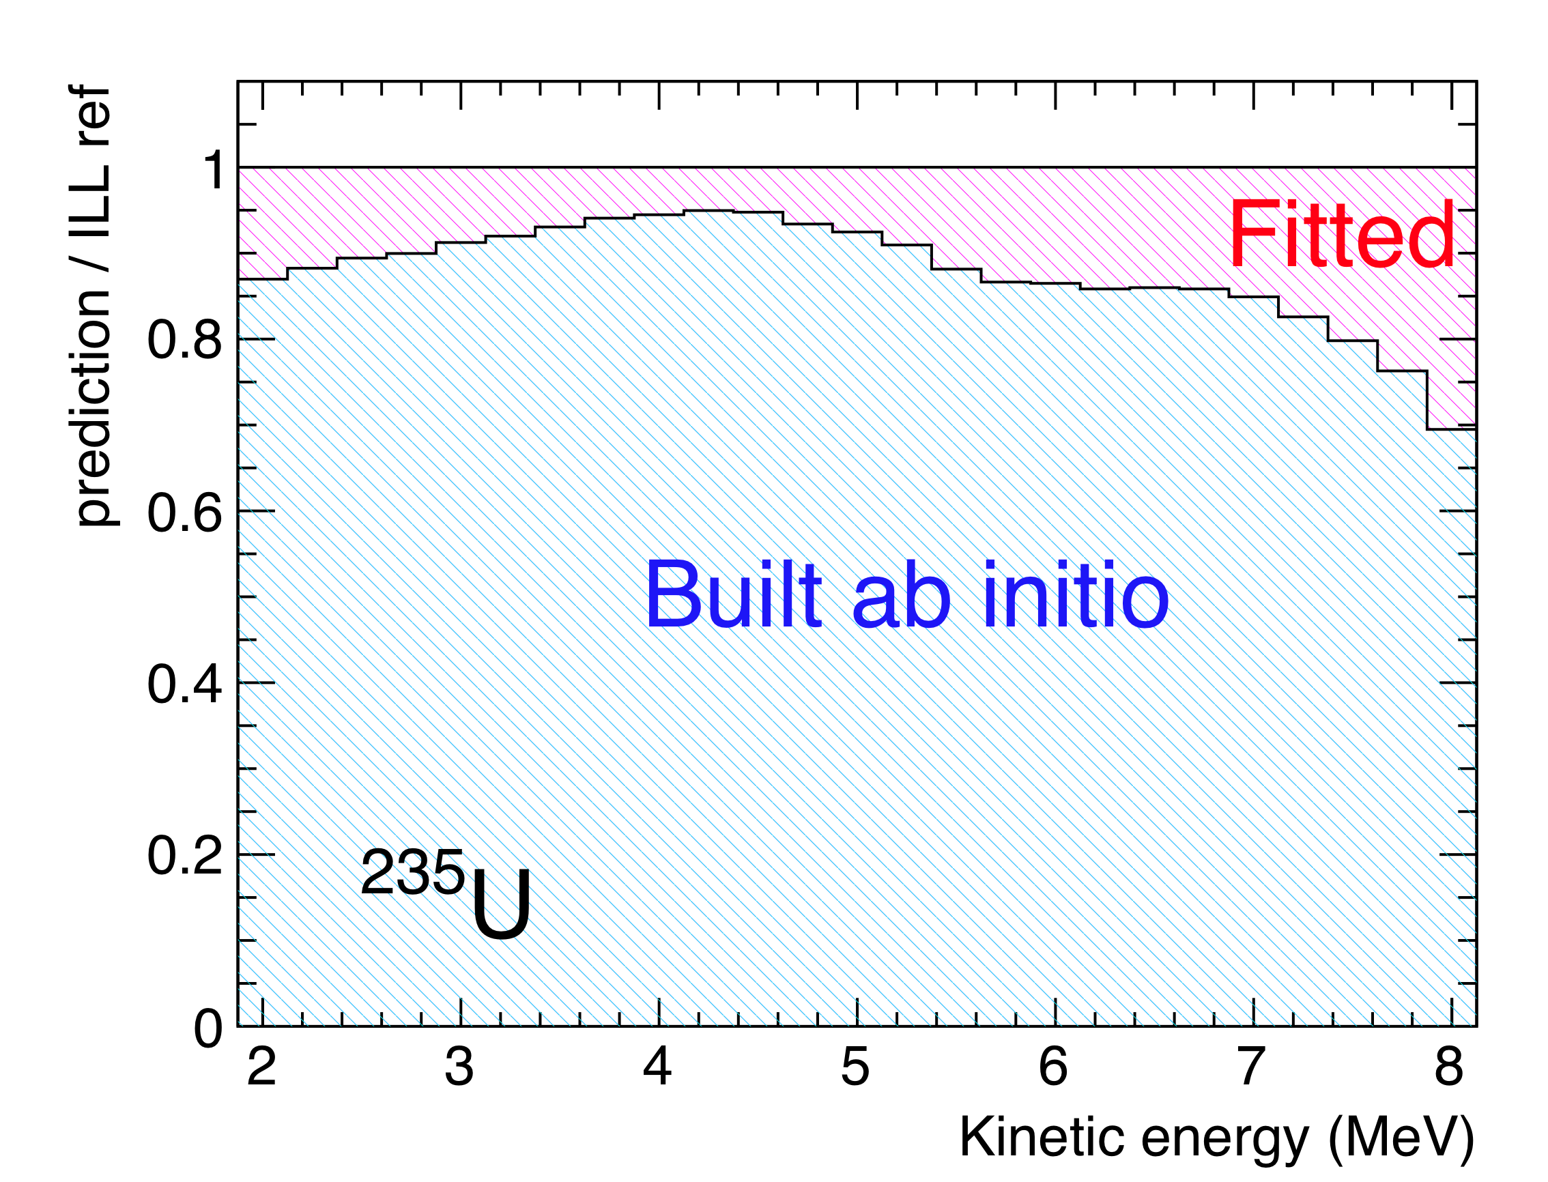
The New Mixed Conversion Approach
Prediction/ Reference ILL data
SAME ILL electron data anchor point
Fit of residual: five effective branches are fitted to the remaining 10%
→ Suppresses error of full ab initio approach
“true” distribution of all known β-branches reproduces >90% of ILL e⁻ data
→ Suppresses model dependence of virtual branches

Slide 13
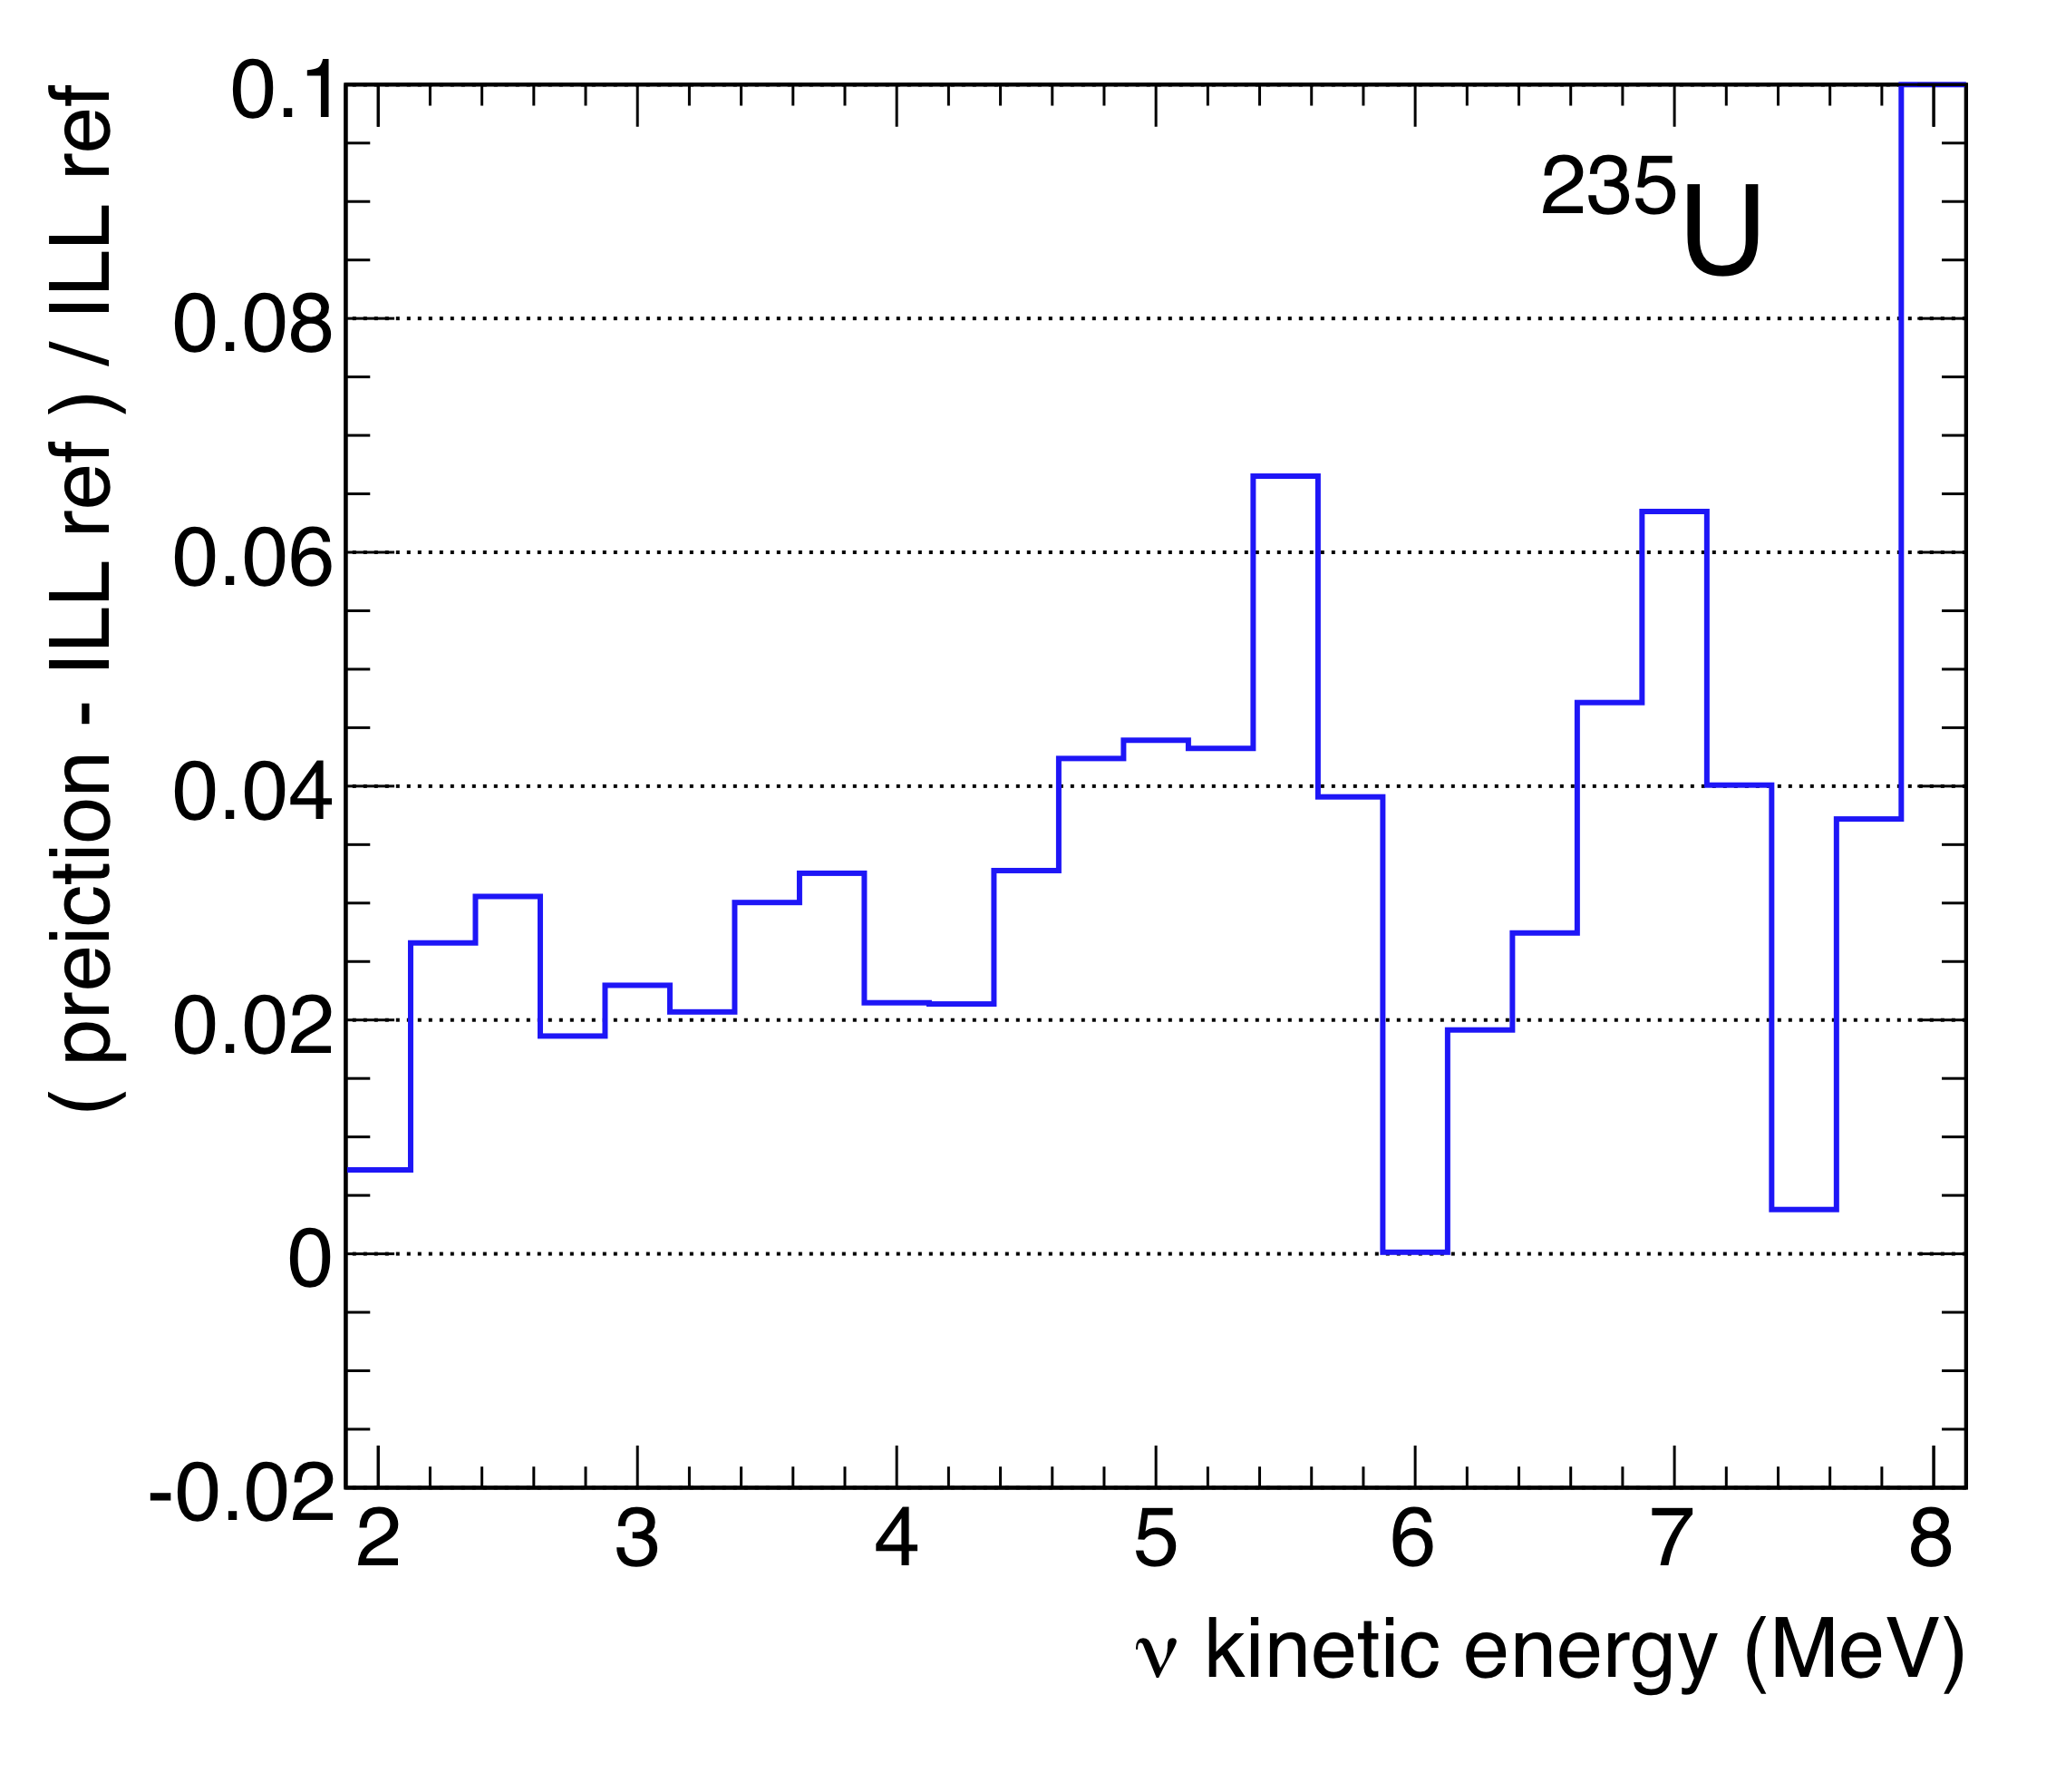
The New Mixed Conversion Approach
Residuals to reference ILL data
+3% normalization shift with respect to old ν spectrum
Similar result for all isotopes (²³⁵U, ²³⁹Pu, ²⁴¹Pu)
Stringent Tests Performed – Origin of the bias identified

Slide 14
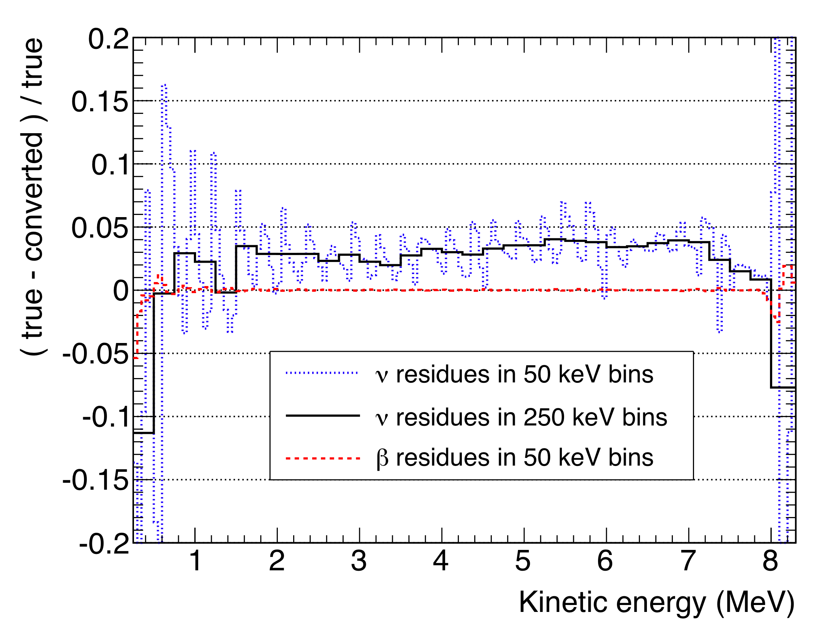
Consistency Check
Define “true” e⁻ and ν spectra from reduced set of well-known branches from ENSDF nuclei data base. “Perfect knowledge”
of both e and ν spectra.
Apply exact same OLD conversion procedure to true e⁻ spectrum.
Compare the converted ν spectrum to the true one.
OLD technique gives a 3% bias compared to the true ν spectrum
Converted spectrum 3%
below true ν spectrum
OLD effective conversion method biases the predicted ν spectrum at the level of -3% in normalization

Slide 15
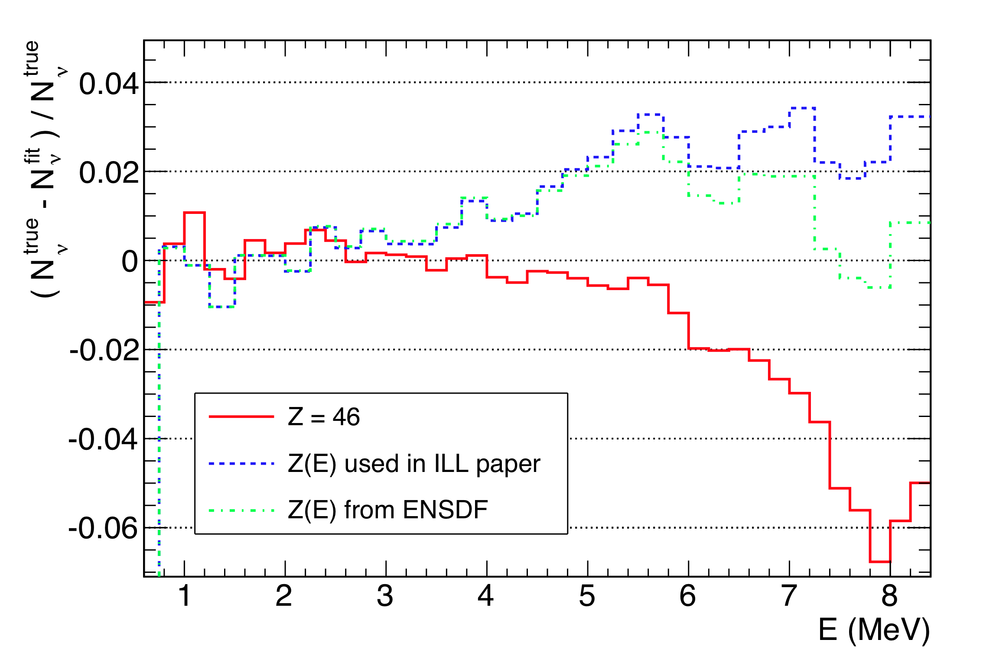
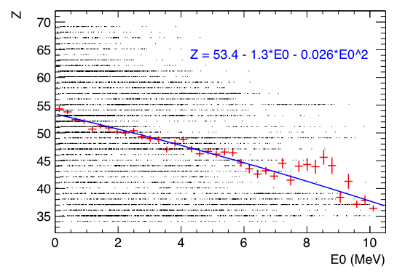
Origin of the 3% shift
E >4 MeV: mean fit of Z(E₀) doesn’t take into account the very large dispersion of Z around the mean curve

Slide 16


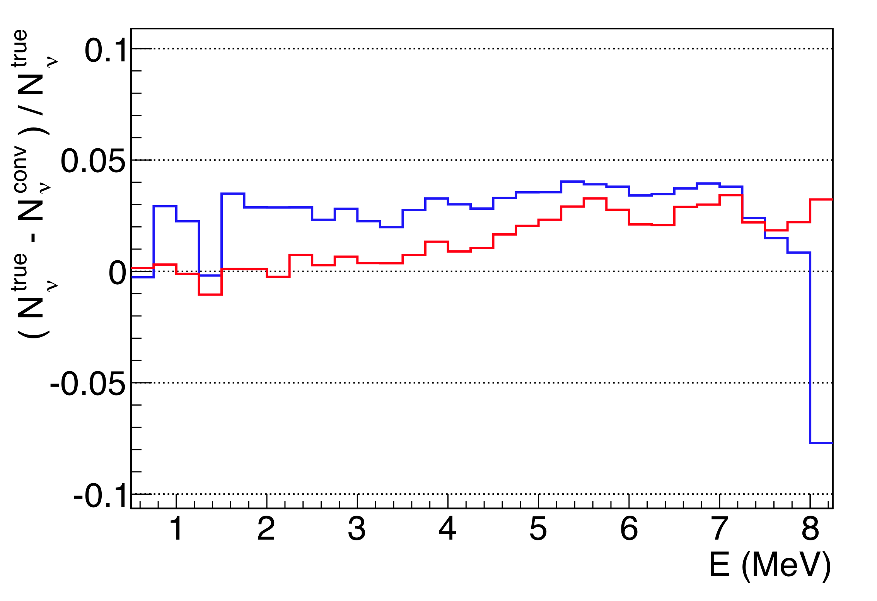
Origin of the 3% shift
E <4 MeV: deviation from effective linear A_{C,W} correction of ILL data
Effective global correction
β-branch level correction
+
with “true” Z distrib.
No new theoretical inputs
But…
Implementation at the level of all “true” β-branches is equivalent (to 1st order) to a change the slope factor and the intercept of the global correction.
Correct a bias, assume 100% error on final correction.
New conversion, A_{C,W} at branch level
Effective A_{C,W} “à la ILL”

Slide 17
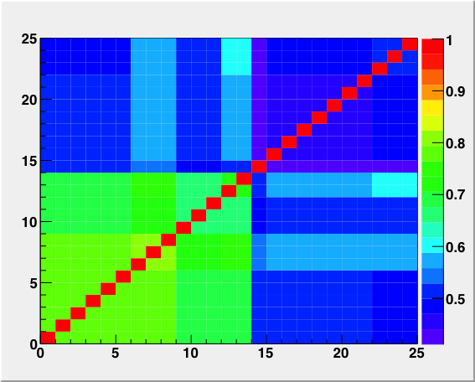
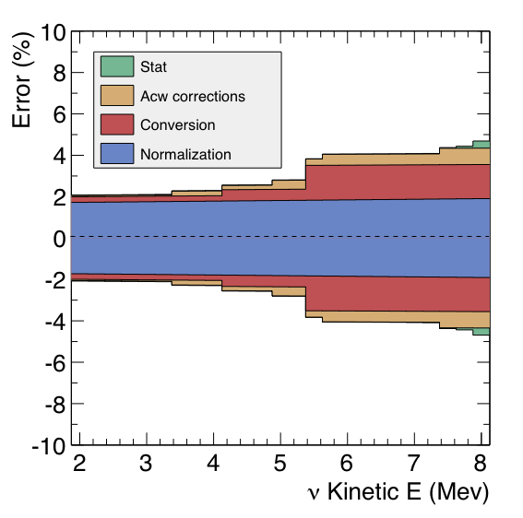
Error Budget
²³⁵U bin-to-bin correlation matrix
(25x25 bins, 2-8 MeV)
Stack of quadratic sum of ²³⁵U errors
(100% bin to bin correl from norm and A_{CW})

Slide 18
The Reactor Antineutrino Anomaly
G. Mention, M. Fechner, T. Lasserre*,
M. Cribier, Th. Mueller D. Lhuillier, A. Letourneau,
CEA / Irfu
arXiv:1101.2755 [hep-ex], accepted for publication in Phys Rev D
* corresponding author
Notes:
18

Slide 19
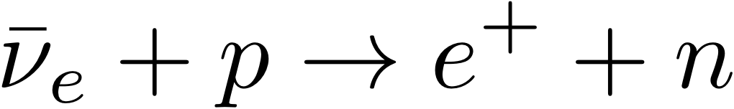
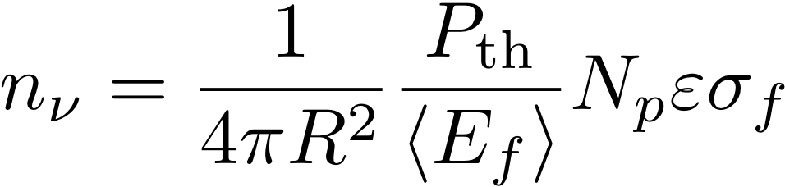
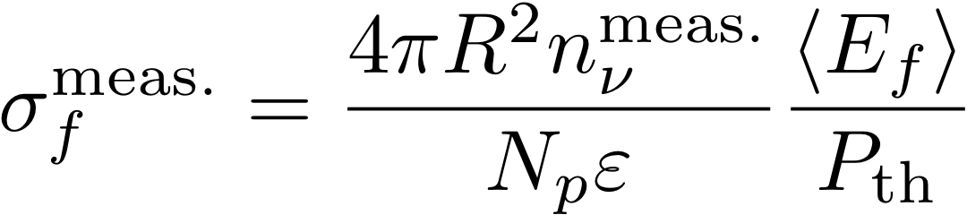
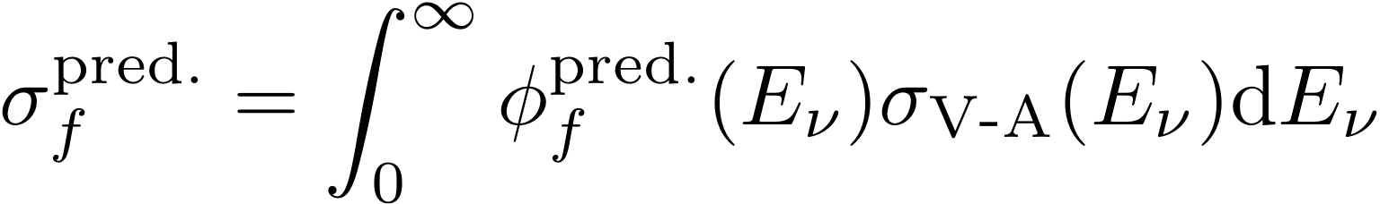
Reactor Electron Antineutrino Detection
  Inverse Beta Decay:
    Threshold: 1.806 MeV
  Anti-ν_{e} interaction rate
  Experimental cross section per fission: σ_{f}
  Predicted cross section per fission: σ_{pred}
Thermal power
Target free protons
E released / fission
efficiency

Slide 20
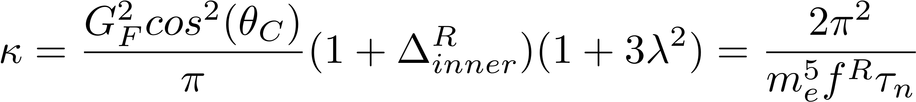
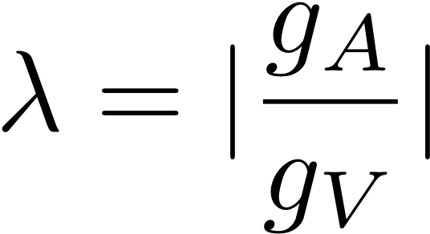
V-A Inverse β decay Cross Section
  Inverse Beta Decay:
  Theoretical predictions: our results agree with
    Vogel 1984 (Phys Rev D29 p1918). Fayans 1985 (Sov J Nucl Phys 42)
    Vogel-Beacom 1999: “supersedes” Vogel 84 (Phys Prev D60 053003)
    Strumia-Vissani Phys. Lett. B564 (2003) 42-54
  The pre-factor κ (two pseudo-independent approaches)
  κ decreased over the history, from 0.914 10⁻⁴² cm² in 1981
    Vogel-Beacom 1999 : κ = 0.952 10⁻⁴² cm²
    Our work is based on 2010 PDG τ_{n} : κ = 0.956 10⁻⁴² cm²
    <τ_{n}> revision 2011: κ=0.961 10⁻⁴² cm² (+0.5%)

Slide 21
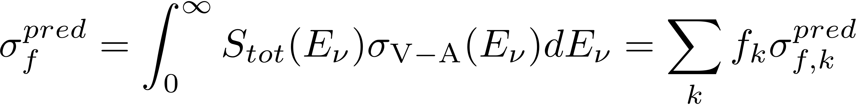
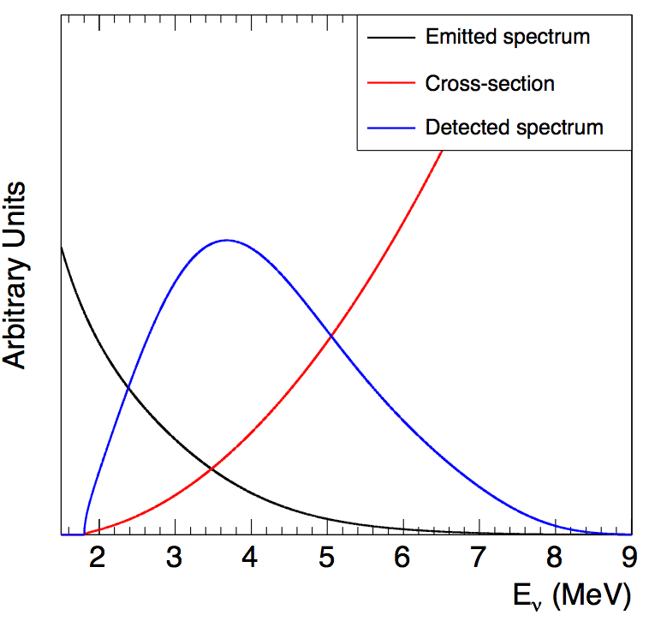
Computing the expected rate/spectrum
  Bugey-4 Benchmark
    Phys Lett B 338(1994) 383
    τ_{n} = 887.4 s
    “old” spectra (30 effective branches)
    no off-equilibrium corrections
    Validate our calculations
    Final agreement to better than 0.1%
on best known ²³⁵U
10⁻⁴³ cm²/fission | ²³⁵U | ²³⁹Pu | ²⁴¹Pu
BUGEY-4 | 6.39±1.9% | 4.18±2.4% | 5.76±2.1%
This work | 6.39±1.8% | 4.19±2.3% | 5.73±1.9%

Slide 22
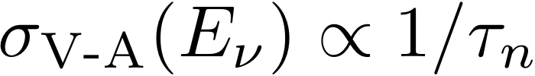
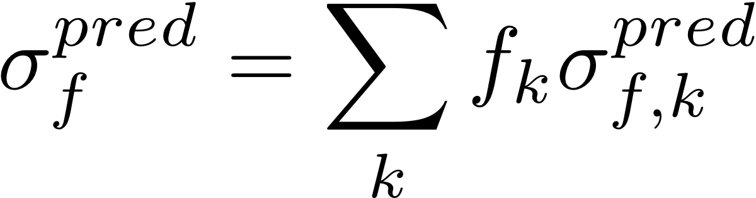
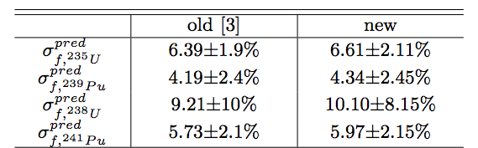
The New Cross Section Per Fission
ν-flux: ²³⁵U +2.5%, ²³⁹Pu +3.1%, ²⁴¹Pu +3.7%, ²³⁸U +9.8% (σ_{f}^{pred} )
Off-equilibrium corrections now included (σ_{f}^{pred} )
  Neutron lifetime decrease by a ~1.5% (σ_{f}^{pred} )
Slight evolution of the phase space factor (σ_{f}^{pred} ➔)
Slight evolution of the energy per fission per isotope (σ_{f}^{pred} ➔)
Burnup dependence: (σ_{f}^{pred} ➔)
New
Results:
new/old
+3.4%
+3.6%
+9.6%
+4.2%
22

Slide 23
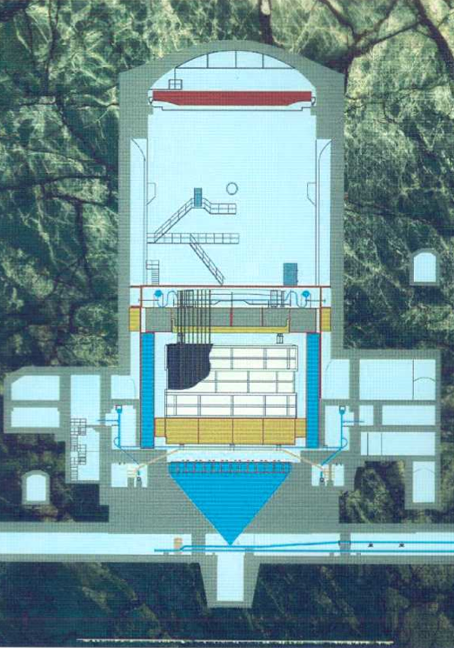
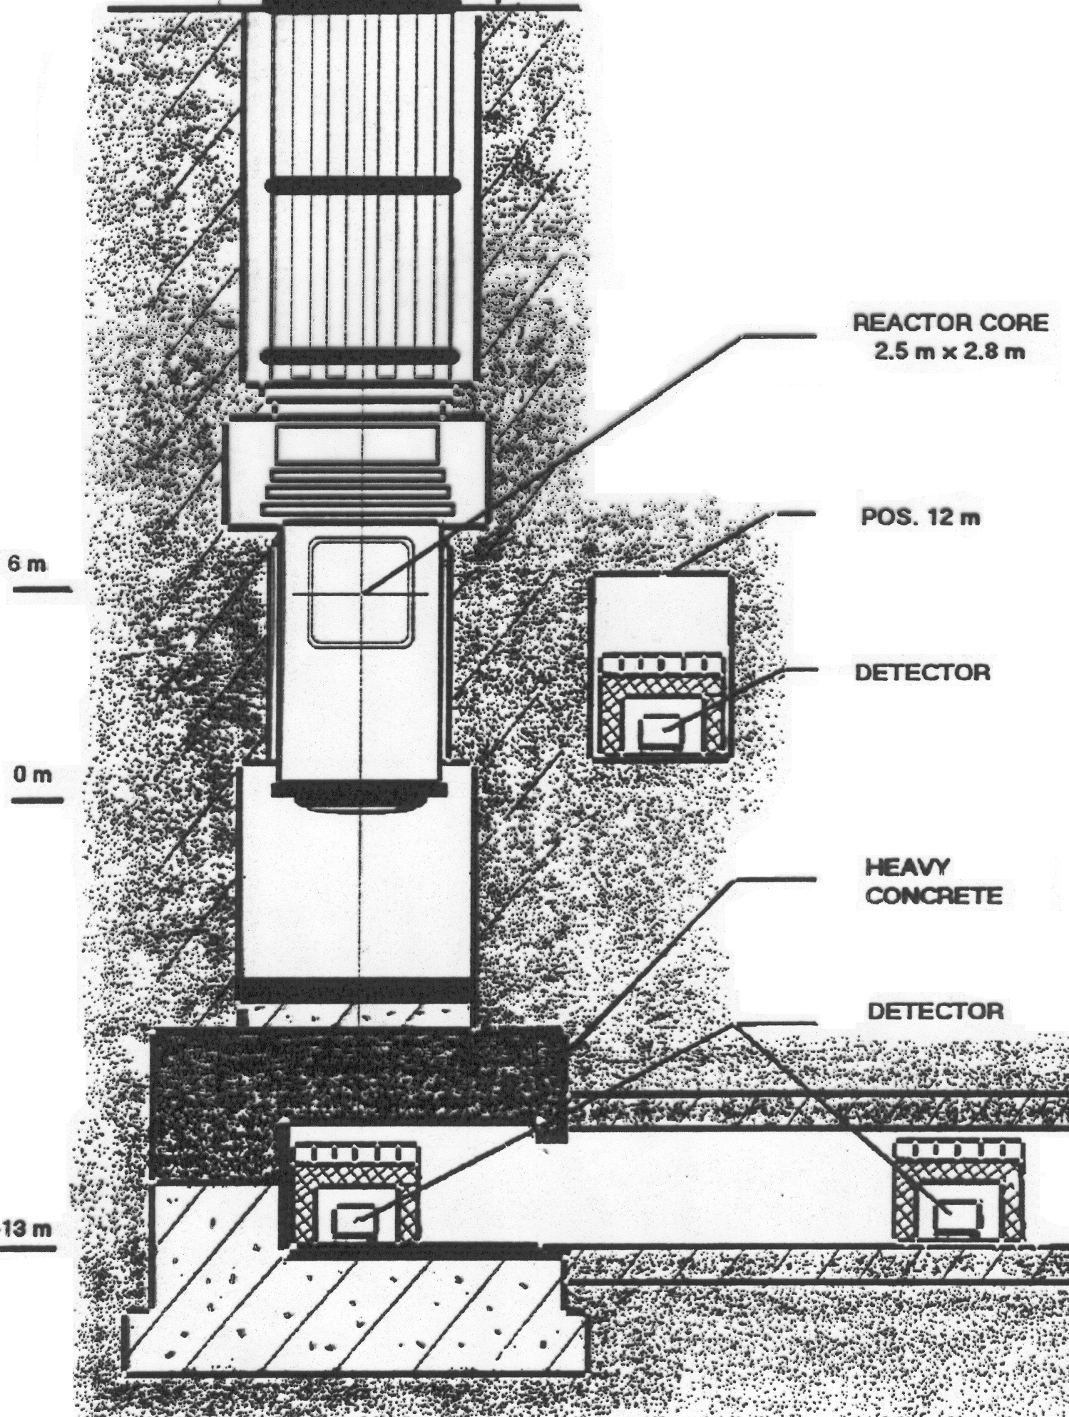
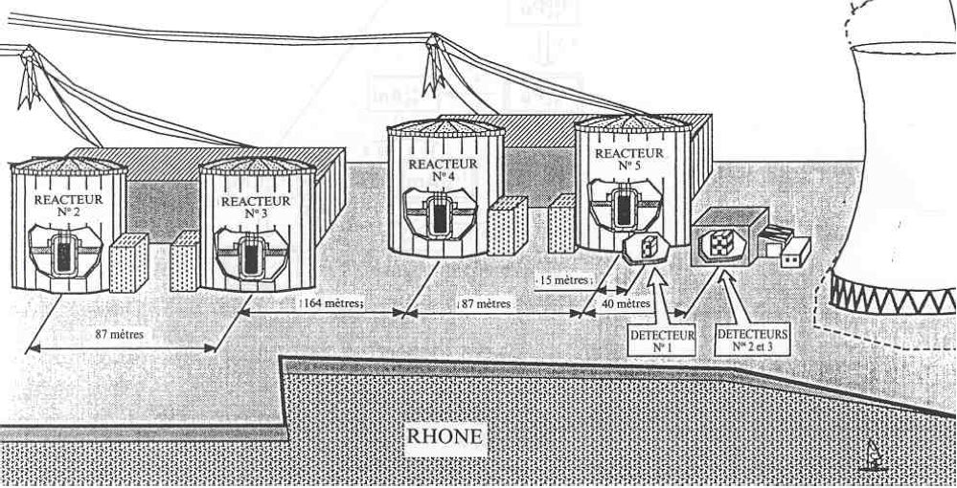
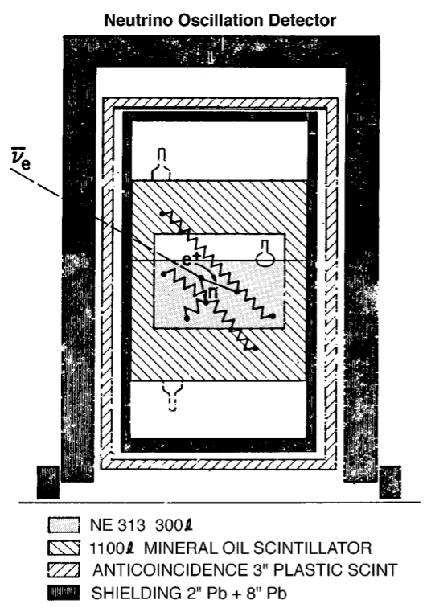
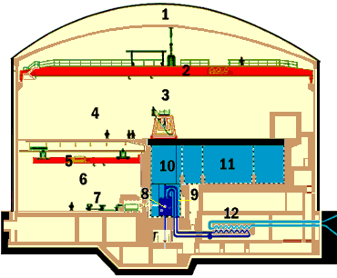
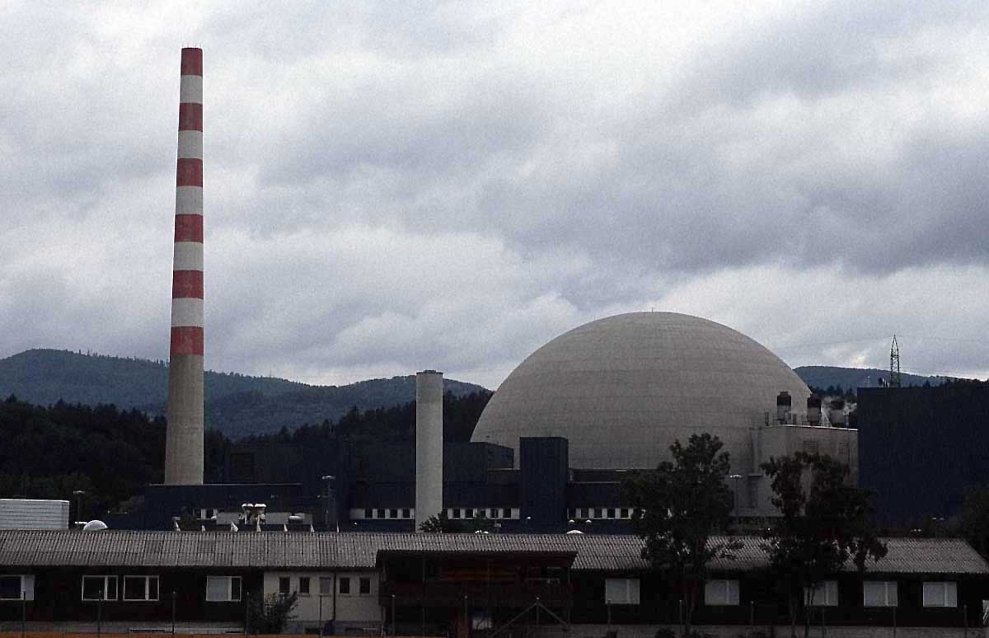
19 Experimental Results L<100m
Krasnoyarsk
Bugey
Savannah River
Rovno
ILL
Goesgen
Measured cross sections are taken at their face values
23

Slide 24

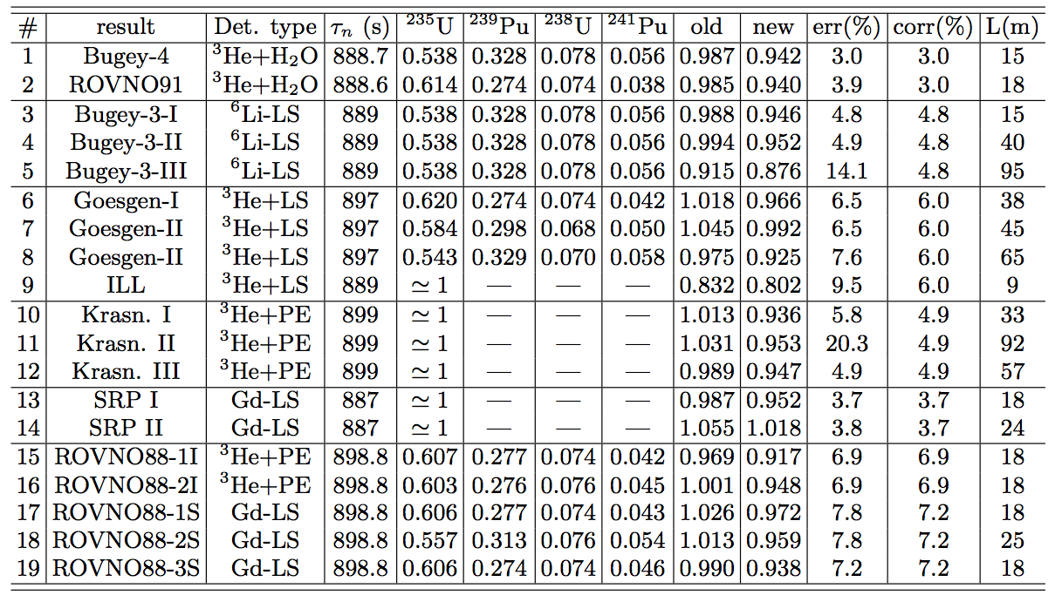
19 Experimental Results Revisited (L<100m)
Technology Baseline
24

Slide 25
19 Experimental Results Revisited (L<100m)
Neutron lifetime, τ_{n}(2010) = 885.7 s
25

Slide 26
19 Experimental Results Revisited (L<100m)
Averaged Fuel Composition
26

Slide 27
19 Experimental Results Revisited (L<100m)
OBSERVED/PREDICTED ratios: OLD & NEW (this work)
27

Slide 28
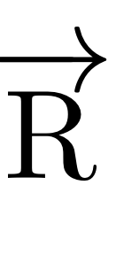



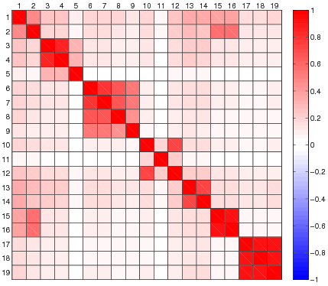
Experiments correlation matrix
(correlation matrix on Ratios)
(in %)
Bugey-4 15m
Rovno91 18m
Bugey-3 15m
Bugey-3 40m
Bugey-3 92m
Goesgen 38m
Goesgen 45m
Goesgen 65m
ILL 9m
Krasno 33m
Krasno 92m
Krasno 57m
SRP I 18m
SRP II 25m
Rovno88 1I 18m
Rovno88 2I 18 m
Rovno88 1S 18m
Rovno88 2S 25m
Rovno88 3S 18m
3.0 | 3.0
3.9 | 3.0
5.0 | 5.0
5.1 | 5.0
14.1 | 5.0
6.5 | 6.0
7.6 | 6.0
9.5 | 6.0
5.1 | 4.1
5.1 | 4.1
20.3 | 4.1
4.1 | 4.1
3.7 | 3.7
3.8 | 3.7
6.9 | 6.9
6.9 | 6.9
7.8 | 7.2
7.8 | 7.2
7.2 | 7.2
Main pink color comes from the 2% correlated norm error of ILL β-spectra
The experiment block correlations come from identical detector, technology or ν source
28
Notes:
28

Slide 29
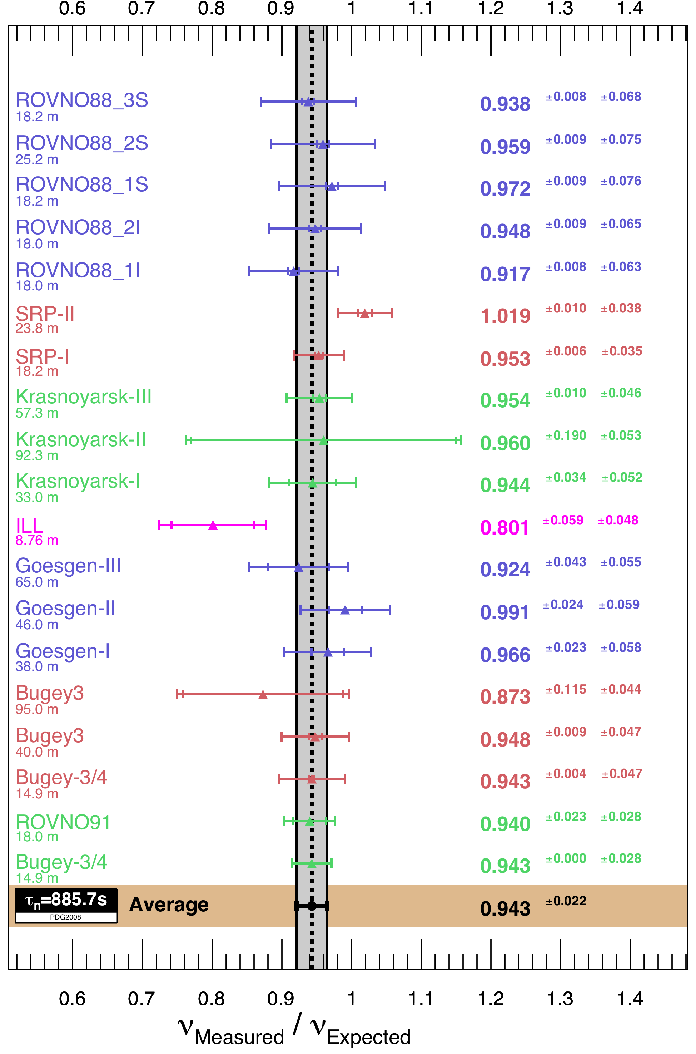
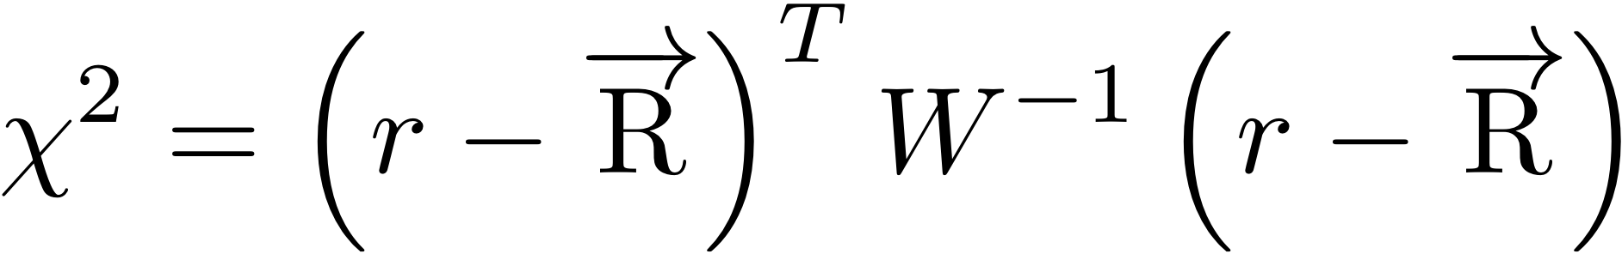
The reactor antineutrino anomaly
Best fit : μ = 0.943
Uncertainty : 0.023
χ² = 19.6/19
Deviation from unity
  Naïve Gaussian : 99.3% C.L.
  Toy MC: 98.6% C.L. (10⁶ trials)
No hidden covariance
  18% of Toy MC have χ²_{min}<19.6
~3.5% new spectra
~1.5% τ_{n}
~1% Off-eq effects

Slide 30
The reactor rate anomaly
19 short baseline experiments <100m from a reactor observed a deficit of anti-ν_{e} compared to the new prediction
The effect is statistically significant at 98.6% CL
Effect partly due to re-evaluation of cross-section parameters, especially updated neutron lifetime & accounting for off-eq. effect
At least three alternatives:
  Our conversion calculations are wrong. (We use the same ILL electron data as in the old prediction).
  Bias in all short-baseline experiments near reactors : unlikely…
  New physics at short baselines, explaining a deficit of anti-ν_{e} :
    Oscillation towards a 4th, sterile ν ?
    a 4th oscillation mode with θ_{new} and Δm²_{new}
30

Slide 31
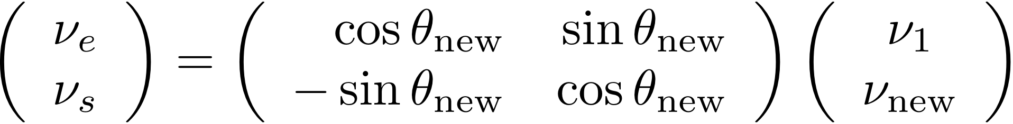
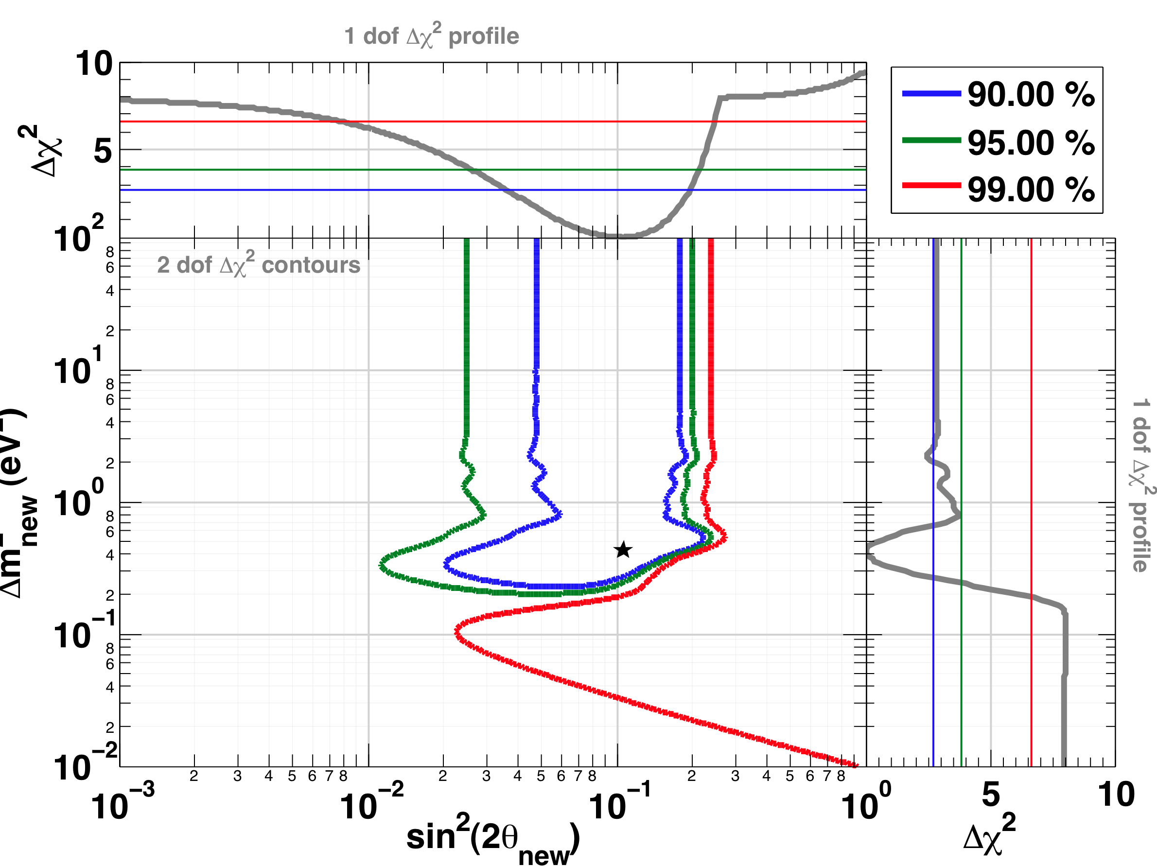
The 4th neutrino hypothesis
Combine all rate measurements, no spectral-shape information
Fit to anti-ν_{e} disappearance hypothesis
allowed
excluded
area
Absence of oscillations disfavored at 98.6% C.L.
31
Notes:
31

Slide 32
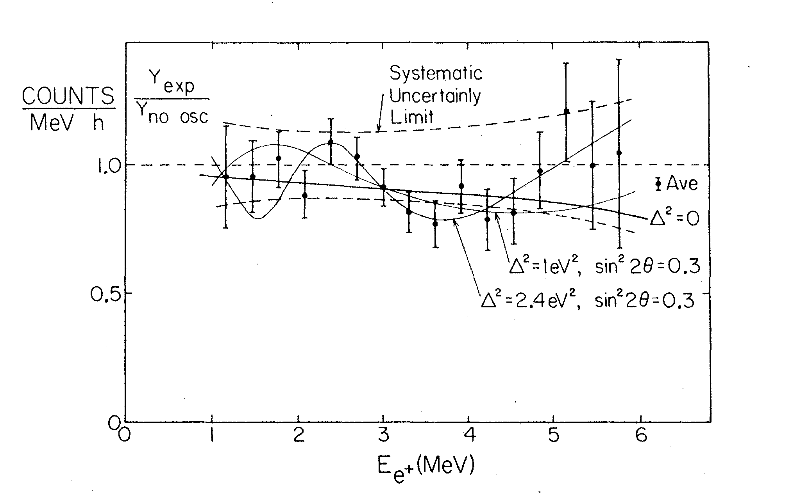
The 1981 ILL measurement
Reactor at ILL with almost pure ²³⁵U, with compact core
Detector 8.76(?) m from core. Any bias?
Reanalysis in 1995 by part of the collaboration to account for
overestimation of flux at ILL reactor by 10%... Affects the rate only
Large errors, but a striking pattern is seen by eye ?
1981
Notes:
32

Slide 33
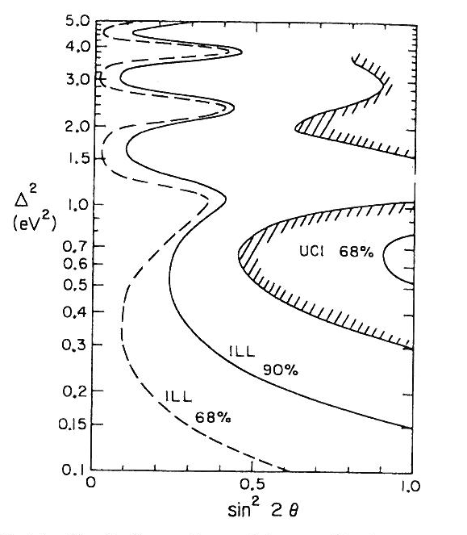
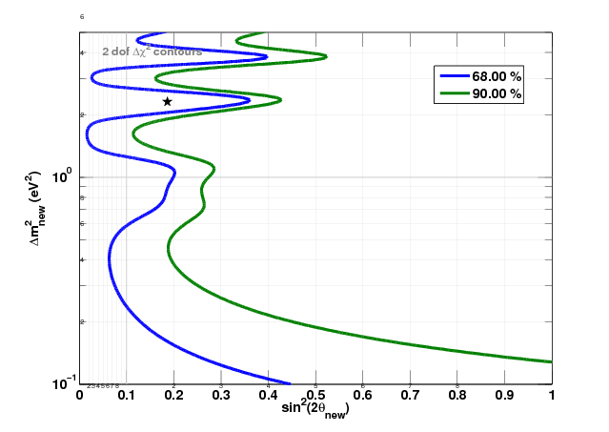
Our ILL re-analysis (reproduce no-oscillation claim)
1981: Try to reproduce published contour
1995: Reproduce claim that global fit disfavors no-oscillation at 2σ
How ? We add uncorrelated systematic in each bin until it's large enough
  Needed error : 11%, uncorrelated, in each bin.
1981 result
our reproduction of ILLresults

Slide 34
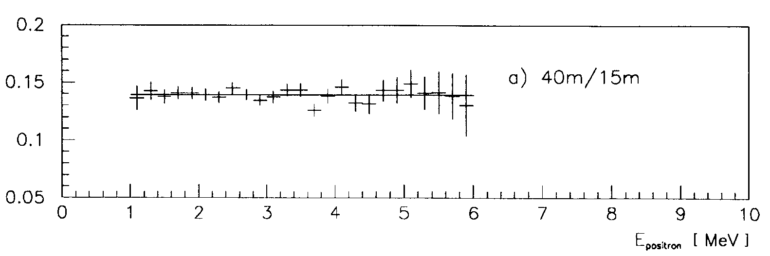


Spectral shape analysis of Bugey-3
Bugey-3 spectral measurements at 15 m, 40 m, 90 m
    Best constraint from high statistics R=15m/40m ratio
    Very robust since it does not rely on reactor spectra
  Reproduction of the collaboration’s
  raster-scan analysis
  Use of a global-scan in combined
  analysis
Notes:
34

Slide 35

Combined Reactor Rate+Shape contours
allowed
excluded
area
Best fit: sin²2θ~0.1
Δm²~1.5 eV²
No oscillation disfavored at 96.51%
Notes:
35

Slide 36
The Gallium Neutrino Anomaly
Based on PRD82 053005 (2010)
C. Giunti & M. Laveder

Slide 37

Radiochemical experiments Gallex (left) & Sage (right)
GALLEX (GaCl₃) and SAGE (liquid Ga) were radiochemical experiments, counting the conversion rate of Ga to ⁷¹Ge by (solar) neutrino capture [cannot detect anti-ν_{e}]
30.3 tons of Gallium
in an aqueous solution : GaCl₃ + HCl
30 to 57 tons of gallium
(metal) in 10 tanks

Slide 38


The Gallium anomaly
4 calibration runs with intense MCi neutrino sources:
    2 runs at Gallex with a ⁵¹Cr source (750 keV ν_{e} emitter)
    1 run at SAGE with a ⁵¹Cr source
    1 run at SAGE with a ³⁷Ar source ( 810 keV ν_{e} emitter)
    All observed a deficit of neutrino interactions compared
    to the expected activity. Hint of oscillation ?
Our analysis for Gallex & Sage:
    Monte Carlo computation of mean path lengths of neutrinos in Ga tanks
    NEW : Correlate the 2 Gallex runs together & the 2 SAGE runs together
data
Gallex-I
Gallex-II
Sage-Cr
Sage-Ar
Measured / predicted
Best fit
correlation matrix
Notes:
38

Slide 39

The Gallium anomaly
allowed
Excluded area
Effect reported in C. Giunti & M. Laveder in PRD82 053005 (2010)
Significance reduced by additional correlations in our analysis
No-oscillation hypothesis disfavored at 97.7% C.L.
Notes:
39

Slide 40


Putting it all together: reactor rates + shape + Gallium + (MB)
allowed
excluded
area
*
The no-oscillation hypothesis is disfavored at 99.8% CL
* Miniboone re-analysis of : C. Giunti, M. Laveder, Phys. Rev. D82 (2010) 053005
Notes:
40

Slide 41
Implication for θ₁₃

Slide 42
Implication for θ₁₃ at 1-2 km baselines
The choice of normalization is crucial for reactor experiments looking for θ₁₃ without near detector
σ_{f}^{pred,new} : new prediction of the antineutrino fluxes
σ_{f}^{ano} : experimental cross section (average of all meas. incl. correlations)
NEAR detector
blind analysis ?
FAR det.
θ₁₃-zone
Daya Bay, Double Chooz, Reno

Slide 43
The Normalization Dilemma
Experiments with baselines > 500 m
How do you normalize the expected flux, knowing the fuel composition?
If near + far detector, not an issue anymore
Use σ_{f}^{pred,new} =6.102 10⁻⁴³ cm²/fission ± 2.7%
σ_{f}^{pred}
Use σ_{f}^{pred,old}=5.850 10⁻⁴³ cm²/fission ± 2.7%
Choices
Use σ_{f}^{exp} Bugey-4=5.750 10⁻⁴³ cm²/fission ± 1.4%
Chooz’s choice: use lower error (total 2.7% instead of 3.3%)
Bugey-4 is a kind of “near detector” for Chooz
σ_{f}^{exp}
Use <σ_{f}^{exp}>=σ_{f}^{ano}=5.750 10⁻⁴³ cm²/fission ± 1% + ?% (syst.)
Average over short-baseline expts.
in this slide assume Bugey-4 fuel comp.

Slide 44

CHOOZ reanalysis
The choice of σ_{f} changes the limit on θ₁₃
Chooz original choice was σ_{f}^{exp} from Bugey-4 with low error
If σ_{f}^{pred,new} is used, limit is worse by factor of 2
If σ_{f}^{ano} is used with 2.7%, we obtain the original limit
→ But which error should we associate to σ_{f}^{ano} (burnup up error?)
σ_{f}^{pred,new}
σ_{f}^{ano} 1% error
Chooz
reproduction
CHOOZ (2003)
σ_{f}^{ano} 2.7% error

Slide 45

CHOOZ and KamLAND combined limit on θ₁₃
Normalization with σ_{f}^{pred,new}
Normalization using σ_{f}^{ano}
3-v framework & 2.7% uncertainty
3-v framework & 2.7% uncertainty
Our interpretation
  No hint on θ₁₃>0 from reactor experiments : sin²(2θ₁₃)<0.11 (90%C.L., 1dof)
  CHOOZ 90 % CL limit stays identical to Eur. Phys. J. C27, 331-374 (2003)
  Multi-detector experiments are not affected

Slide 46

Need for new experimental inputs !

Slide 47
ν Sources
Preliminary studies:
T. Lasserre, M. Cribier, M. Fechner, G. Mention

Slide 48

Concept
Preliminary studies
A strong, MCi scale, source in the middle of a large LS detector
A compact source to preserve the short baseline oscillation pattern (10 cm)
A good resolution in position (15 cm)
Elastic scattering on electrons

Slide 49
Signal
No distortion
Direct proof
Time and space signatures distinct from
backgrounds
Limited by spatial resolution σ_{r} (L_{osc} ≈ σ_{r})
Oscillation versus Radius
Activity: several 1000 ν evts within 1 year
E >250 keV (¹⁴C background)
Half-life ≥1 month
Compact
Limited heat
Efficient shielding
Low impurities level
Specifications

Slide 50
ν Sources Candidates
Isotope | E_{ν} (MeV) | MeanLife (days) | Heat/Mci (W) | Cooking
⁵¹Cr | 0.75 ; 90% 0.43 ; 10% | 40 | 180 (excited state) | 40 kg of enriched Cr (at Saclay) in thermal n flux
³⁷Ar | 0.811 | 50 | 18 (int. brem.) | 330 kg of nat. CaO in fast n flux
⁶⁵Zn | 1.34 ; 48% 0.23 ; 52% | 350 | 3460 (excited state) | Few 100 kg of nat. Zn in thermal n flux
Looking for single scattered e⁻ → high sensitivity to background

Slide 51
Backgrounds (preliminary)
Borexino setup:
  R_{min}= 1.0 m & R_{max} = 6.0 m
  15 cm vertex resolution
  Resolution: 50 keV * √E_{kinetic} (MeV)
Sheilding:
  15 cm W + 10 cm pure Cu
  1 ton 10 mBq/Kg
  Flat γ spectrum till 1.5 MeV, 1Bq
 | ⁵¹Cr | ³⁷Ar
Preparation + Exp time | 5 + 120 days | 14 + 150 days
Signal 1 MCi source | 42.4 kevt | 51.6 kevt
γ (IB + shielding 1Bq) | 70.6 kevt + impurities… | 89.4 kevt (pure?)
⁷Be | 46.6 kevt | 59.0 kevt
⁸⁵Kr | 23.8 kevt | 30.2 kevt
²¹⁰Bi+CNO | 21.7 kevt | 27.4 kevt
Borexino Solar Neutrino: Physical Review Letters Vol.101, No.9 (August 2008).

Slide 52

⁵¹Cr Signal & Backgrounds
sin2(2θ)=0.14
Δm2 = 2.0 eV2
Preliminary
52

Slide 53

³⁷Ar Signal & Backgrounds
sin2(2θ)=0.14
Δm2 = 2.0 eV2
Preliminary
53

Slide 54

³⁷Ar Expected Sensitivity (1 Mci)
Preliminary
2% bin-to-bin uncorrelated syst.
5% noramlization syst.
54

Slide 55

³⁷Ar Expected result for RAA
Preliminary
55

Slide 56
Anti-ν Sources
Preliminary studies:
T. Lasserre, M. Cribier, M. Fechner, G. Mention,
D. Lhuillier, A. Letourneau.

Slide 57
Candidates
Select β−decay chain with long-lived isotope as activity reservoir + E_{max}>1.8 MeV in one downstream decay.
Use prompt-delay IBD coincidence for powerful background rejection.
Potential L/E pattern.
Double n_{capt} very penalizing
→ Extract (⁹⁰Sr), ¹⁰⁶Ru and ¹⁴⁴Ce from irradiated fuel.

Slide 58

Signal VS Expected Backgrounds (preliminary)
External Bremsstrahlung:
Signal envelop
3.10⁷ attenuation through 15 cm W + 10 cm Cu shielding →5 Bq for 0.1 Mci ⁹⁰Sr
1ms coinc. window
Bremsstrahlung and shielding background
Geo & reactor anti-ν at ~% level.
Det and shielding bckgds negligible
Geo and reactor neutrinos
Long lifetime and low background allow smaller sources activity
58

Slide 59

Figure of Merit
Number of anti-ν interaction per decay grows like ~ (EndPoint-1.8 MeV)²

Slide 60

Figure of Merit
10 kCi scale source would make it !

Slide 61


R & E pattern of ¹⁰⁶Ru
sin²(2θ₁₃) = 0.6 for better visualization
25.0 kCi ¹⁰⁶Ru source in SNO+:
Activ. mass : 7.6 g
Total mass : 795 g
Heat : 284 W
Radius : 2.48 cm
sin²(2θ₁₃) = 0.16
Δm² = 2.5 eV²
50000 anti-ν detected

Slide 62

¹⁴⁴Ce - ¹⁴⁴Pr
Test of RAA solution
5 kCi.year
7 W/kCi
R = [1,6] m
2.5year x 2kCi
2260 anti-ν
10 brem.
56 react+geo
Preliminary

Slide 63

¹⁴⁴Ce - ¹⁴⁴Pr
Sensitivity – 5 kCi.year
Preliminary

Slide 64

¹⁰⁶Ru - ¹⁰⁶Rh
Test of RAA solution
5 kCi.year
9 W/kCi
R = [1,6] m
2.5year x 2kCi
6900 anti-ν
10 brem.
56 react+geo
Preliminary

Slide 65

¹⁰⁶Ru - ¹⁰⁶Rh
Sensitivity – 5 kCi.year
Preliminary

Slide 66
Conclusions
Deployment of a MCi-scale source in a large (6 m) liquid scintillator detector Borexino-like - KamLAND-like - SNO+-like
⁵¹Cr (electron scattering)
  Impurities radiating gammas makes the deployment at the center of a large LS very unlikely
  Deployment in the Borexino WT to be investigated (10 MCi scale)
³⁷Ar (electron scattering)
  Hope to reduce the impurities, Need a VERY clean shielding
  Need Borexino-class detector to fight bck with a 1 Mci source
  Difficult production: irradiation of 330 kg of natural Ca0 in a fast n flux.
Antineutrino Sources (IBD)
  STRONG background reduction
  R-oscillation pattern & E-oscillation pattern → STRONG signal
  ⁹⁰Sr could be done with a 0.1 Mci (700g, 700W)
  ¹⁴⁴Ce, ¹⁰⁶Ru → Could be powerful at the few kCi level !!! Investigating possible treatment of fission products (41g of ¹⁰⁶Ru & 82g of ¹⁴⁴Ce per assembly after 3 years in standard PWR)

Slide 67
Experiment
@
compact reactor

Slide 68





Nucifer
distance: 7 metres
First goal: Non Proliferation
Thermal Power Measurement
Fuel Composition Measurement U/Pu
70 MW
4π plastic scintillator Muon Veto (30 PMTs)
N2 blanket
overburden: 10 m.w.e
Osiris research reactor
CEA-Saclay (600 ν/d)
CEA – IN2P3 coll.
16 x 8’ PMTs low background
25 cm acrylics buffer
Calibration pipe
Target: 0.85 m³ Gd-LS (0.5%)
Stainless steel double containment vessel coated with white Teflon coating inside
2,8 m
Light injection system (7 diodes)
10 cm lead
2,8 m
15 cm polyethylene

Slide 69


NUCIFER in Saclay
Osiris-Saclay: Core Size: 57x57x60 cm
Nucifer Detector Size : 1.2x0.7m (850l)
Baseline distribution
  <L>=7.0 m, σ=0.3 m → eV² oscillations are not washed out
Folding Nucifer Geant4 Monte Carlo detector response
Δm² = 2.4 eV² & sin²(2θ)=0.15
No backgrounds. Thus to be taken with a grain of salt …
Such pattern could not be seen at Bugey-3 (extended core & 14 m baseline)
Reactor core
1year @ Osiris
7 m
stat. error only
65000 ν evts after bkg subtraction
Electronic bay

Slide 70
Conclusion and perspectives
New Reactor Antineutrino Anomaly Discovered
  Experimental bias to be deeply investigated
  New physics hypothesis tested: 4th neutrino
    no-oscillation hypothesis disfavored at 99.8%
Clear experimental confirmation / refutation is needed:
  L/E ≈ few m/MeV or km/GeV
  MCi neutrino source a large liquid scintillator detector like SNO+, Borexino, KamLAND:
    ³⁷Ar: fast n capture, to be placed inside detector
    ⁵¹Cr: thermal n capture, to be placed close to detector
  Few kCi anti-n sources: ¹⁰⁶Ru, ¹⁴⁴Ce extracted from spent fuel.
  New Experiment at compact Reactor. Short Baseline – Shape + Rate Analysis
  New neutrino beam experiment probing for electron GeV neutrino disappearance at1 km (C. Rubbias’s proposal at CERN-PS).

Slide 71
Backup slides

Slide 72
Reactor anti-neutrinos: introduction
Electron antineutrinos emitted through β decays of Fission Products
  Fissions of: ²³⁵U, ²³⁸U, ²³⁹Pu, ²⁴¹Pu
  Each fission product may have
  many β decay modes or branches
  About 6 ν / fission
Nuclear reactors

Slide 73

From e⁻ to anti-ν_{e} spectra
A single beta decay branch:
- depends on: nucleus (Z), branching ratio (BR), end point (Q),
spin-parity
- Energy conservation: E_{e} + E_{ν} = Q
antineutrino spectra are computed from electron spectra by “inverting” each branch separately
Cannot go from e- to ν from a global e spectrum, need each individual
β branch from each contributing nucleus
Conversion method
(Schreckenbach)
energy
M. Fechner

Slide 74
Pandemonium
Bias of β-decay scheme deduced from (e⁻,γ) coincidence:
Ε
γ
0
^{A}
_{Z} N
ε^{det} drops
fast with E_{γ}
+
difficult analysis
of continuum
β⁻
0
^{A}
_{Z-1}N’
  - Underestimation of the low E part of the spectrum
  Overestimation of the high E part
  - Missed γ are attributed to GS transition.
  Solution is Total Absorption Gamma Spectrometers (detect total E of γ chain)

Slide 75


Error budget
²³⁵U
²³⁹Pu
²⁴¹Pu

Slide 76


Slide 77


Neutron Lifetime

Slide 78

ROVNO-88 (5 measurements, Sov Phys JETP67, 1988)
Rovno, Russia, VVER, 1983-1986
Technology
  Integral detector with PE target containing ³He counters, only neutrons are detected
  Liquid Scintillator detector (ν spectrum measurement available)
Baselines
  18 m & 25 m
Typical fuel composition:
60.7% ²³⁵U, 27.7% ²³⁹Pu, 7.4% ²³⁸U, 4.2% ²⁴¹Pu,
Uncertainties:
  statistics: < 0.9%
  systematics: 7- 8%
Correlated with:
  Bugey-4
  Rovno91 (integral measurement only),
  with each other
top view
side view
78

Slide 79
ROVNO-91 (JETP Lett., 54, 1991, 253)
top view
Rovno, Russia, VVER, late 80’s
Technology:
  Upgraded integral detector : water target containing ³He counters, only neutrons are detected
Baselines
  18 m
Fuel composition:
61.4% ²³⁵U, 27.4% ²³⁹Pu, 7.4% ²³⁸U, 3.8% ²⁴¹Pu
Uncertainties:
  statistics: <1%
  systematics: 3.8%
Correlated with:
  Bugey-4 (same detector)
³He proportional counters
16X16
Distilled water
79
Notes:
79

Slide 80
Bugey-4 (Phys. Lett. B338, 383, 1994)
Bugey, France, PWR, early 1990s
Technology:
  Integral detector : water target containing ³He counters, only neutrons are detected
Baseline
  15 m
Fuel composition:
53.8% ²³⁵U, 32.8% ²³⁹Pu, 7.8% ²³⁸U, 5.6% ²⁴¹Pu
Uncertainties:
  statistics: 0.04%
  systematics: 3% (most precise exp.)
Correlated with:
  ROVNO-91 (same detector)
  ROVNO-88 (50% arb.)
Experimental cross section used to normalize the CHOOZ experiment result
³He proportional counters
16X16
Distilled water
80

Slide 81

Bugey-3 (3 measurements, Nucl Phys B434, 504, 1995)
Bugey, France, PWR, 80’s
Technology
  Liquid scintillator segmented detectors doped with ⁶Li
Fuel composition typical of PWR
53.8% ²³⁵U, 32.8% ²³⁹Pu, 7.8% ²³⁸U 5.6% ²⁴¹Pu
Baselines
  14m, 42m and 95m:
Uncertainties:
  statistics: 0.4%, 1.0%, 13.2%
  systematics: 5.0%
Correlated with
  each other
Stringent shape distortion analysis disfavoring sub-eV² oscillations
81
Notes:
81

Slide 82

Goesgen (3 measurements, Phys Rev D34, 2621, 1986)
Gösgen PWR, Switzerland, 1981-1984
Technology:
  liquid scintillator segmented detector + ³He counters for neutron capture
Baselines:
  37.9m, 45.9m, 64.7m
3 fuel compositions. Typical:
61.9% ²³⁵U, 27.2% ²³⁹Pu, 6.7% ²³⁸U, 4.2% ²⁴¹Pu
Uncertainties:
  statistics: 2.4%, 2.4%, 4.7%
  systematics: 6.0%
Correlated with
  ILL (same detector)
  each other
82
Notes:
82

Slide 83

ILL-ν (Phys Rev D24, 1981, 1097)
ILL, Research Reactor, Grenoble, 80-81
Technology:
  Liquid scintillator segmented detector + ³He counters for neutron capture
Baselines
  8.76 (15) m
Fuel composition:
  almost pure ²³⁵U
Uncertainties:
  statistics: 3.5%
  systematics: 8.9%
Correlated with:
  Goesgen
Data reanalyzed in 1995 by sub-group of
collaboration to correct 10% error in reactor power (underestimated for 10 years)
83
Notes:
83

Slide 84

Krasnoyarsk (3 measurements, G.S. Vidyakin et al., JETP. 93, 1987)
Krasnoyarsk research reactor, Russia
Technology:
  Integral detector filled with PE+ ³He counters
Baselines:
  33m, 92m from 2 reactors (1987)
  57.3m from 2 reactors (1994)
Fuel composition:
  mainly ²³⁵U
Uncertainties (33m, 57m, 92m):
  statistics: 3.6%, 1%, 19.9%
  systematics: 4.8% to 5.5% (corr)
Correlated with:
  each other
84
Notes:
84

Slide 85
Savannah River Plant (2 measurements, PRD53, 6054, 1996)
Savannah River, USA, long standing program initiated by F. Reines. Only the last two results are included in our work.
Technology:
  Liquid scintillator doped with 0.5% Gd
Baseline
  18.2m and 23.8 m
Fuel composition:
  Difference with pure ²³⁵U below 1.5%
Uncertainties:
  statistics: 0.6% and 1.0%
  systematics: 3.7%
Correlated with:
  each other,
  but the two results are in slight tension
85
Notes:
85

Slide 86
Error Budget & Correlations
Our guiding principles: Be conservative - Be stable numerically (SRP case)
Reactor Antineutrino Sources
  2% systematic on ν-flux 100% correlated over ALL ratios
    1.8% corresponds to the normalization error on the ILL e- data
Detector: Non-flux systematic error correlations across measurements:
  Same experiment with same technology: 100% correlated
  ILL shares 6% correlated error with Goesgen although detector slightly
  different. Rest of ILL error is uncorrelated.
  Rovno88 integral measurements 100% corr. with Rovno 91 despite
  detector upgrade, but not with Rovno88 LS data
  Rovno91 integral meas. 100% correlated with Bugey-4
  Rovno88 integral meas. 50% correlated with Bugey-4

Slide 87



Are the ratios normally distributed?
Our data points are ratios of Gaussians:
  Numerator: measurement, Gaussian
  with stat & syst error, partially correlated
  Denominator: common prediction,
  assumed to have Gaussian fluctuation of 2%
Toy MC with correlated denominator with 2% fluctuation → 10⁶ events
  Estimate weighted average R of 19 random
  points with correlations around 0.943.
  P-value for ( R >= 1) : 1.4% (2.2σ)
  compared to naive Gaussian 2.4σ.
  Our contours are reweighted by (2.2/2.4)²
  to take this slight non-normality into account
Hidden Covariance
  χ²_{min} of data to straight line in the 18% quantile → Data not incompatible with fluctuations
R
naive
Toy MC
χ²_{min}
to straight line
data

Slide 88




CHOOZ
Chooz (France) Power Station, late 90s ,
near French/Belgian border
liquid scintillator doped with 1g/l Gd
5 tons, 8.4 GW, 300 mwe
Detector placed at 1050m for the 2 cores
Look for an oscillation at atm. frequency
θ₁₃ mixing angle sensitivity, or more…
Fuel composition typical of starting PWR – 57.1% ²³⁵U, 29.5% ²³⁹Pu, 7.8% ²³⁸U, 5.6% ²⁴¹Pu
Neutron lifetime used in original paper: 886.7 s
Uncertainties:
  Stat: 2.8%
  Syst : 2.7% (3.3% in our work)

Slide 89


KamLAND experiment
Reactor anti-neutrino experiment with average
baseline around 180 km.
80% of total flux comes from
reactors 140 to 210km away.
Sensitive to « solar » oscillation
(θ₁₂,Δm²₁₂)
~1kt liquid scintillator
Japan
arXiv:1009.4771v2 [hep-ex]
KamLAND has some sensitivity to θ₁₃ as well
through the overall normalization of the spectrum

Slide 90




Reanalysis of KamLAND’s 2010 results
arXiv:1009.4771v2 [hep-ex]
Spectra from
Japanese reactors
(with ν_{e} oscillation)
Systematics
Reproduced KamLAND spectra
within 1% in [1-6] MeV range
With new spectra predictions
No change on
tan²θ₁₂ & Δm²₂₁
shift of θ₁₃

Slide 91

³⁷Ar - Expected Potential
2% bin-to-bin uncorrelated syst.
5% normalization syst.
91

