Slide 1
WG4 – Direct WISP Searches
WG 4 REPORT
Claudio GATTI, MARIN KARUZA Gatti - M Karuza

Slide 2
Tasks
T4.1: Review of present and future WISPs experiments (including DM ones) in order to assess their discovery potential.
Subtask 4.1.1: Perform an update of summary plots of present limits for various WISPs models (axion, hidden photons, chameleons etc.). For the axion constraints on the coupling with photons, electrons, nucleons. For HP, bounds on the kinetic mixing angle. Reinterpretation of existing experimental limits with new WISPs models.
Subtask 4.1.2: Combination of experimental results with astrophysical and cosmological limits to extract summary plots.
Subtask 4.1.3: Highlight regions of the parameter space not yet covered by experiments and discuss feasibility of the experimental searches in these regions. Discuss the feasibility of testing all the couplings (to leptons, photons, baryons etc.) in all the parameter space.
T4.2: Identify progress need in the key technologies and techniques (data analysis, signal filtering) for present and future experiments needed to cover the theoretically motivated region in the parameter space.
Subtask 4.2.1: perform a survey of technology (materials, detection, sources, cryogenics, magnets, high resolution detectors) needed in WISP experiments.
Subtask 4.2.2: perform a survey of solutions available (in SME or academic research) and of the competences available.

Slide 3
Activities [WG1-4]:
Organization of workshops on specific topics of the WGs.
Organization of Short Term Scientific Missions (STSM).
Organization of Technology Forums (WG4).
Publication of report on the scientific results in the webpage (in cooperation with WG5). Participation in outreach activities (in cooperation with WG5).
Preparation of the final White Paper and of the Training School Lecture Notes.
Milestones [WG1-4]:
WG meetings to track the progress of each WG and to take corrective measures in case of problems.
Deliverables:
D4.1 Draft Report on direct detection (month 12)
D4.2 Interim Report on direct detection (month 24)
D4.3 Final Report on direct detection
D4.4 Report on Technologies Forums

Slide 4
WG4 - General organization
WG4 meetings one per month
Report on direct detection and Tech. Forums: Overleaf LATEX
WG4 documents on Drive/Dropbox
Mailing List cosmicwisperwg4@lists.infn.it
INDICO meetings https://agenda.infn.it/category/1831/

Slide 5
Contact Persons
WG contact persons:
WG1 Mario Reig
WG2 Jose Cembranos
WG3 Maurizio Giannotti, Federico Urban
WG5 Loredana Gastaldo, Serkant Ali Cetin
Contact person with CERN-PBC Technology working group: Giovanni Cantatore, Pierre Pugnat
Contact person with ECFA Quantum Sensing WG (tbd)

Slide 6
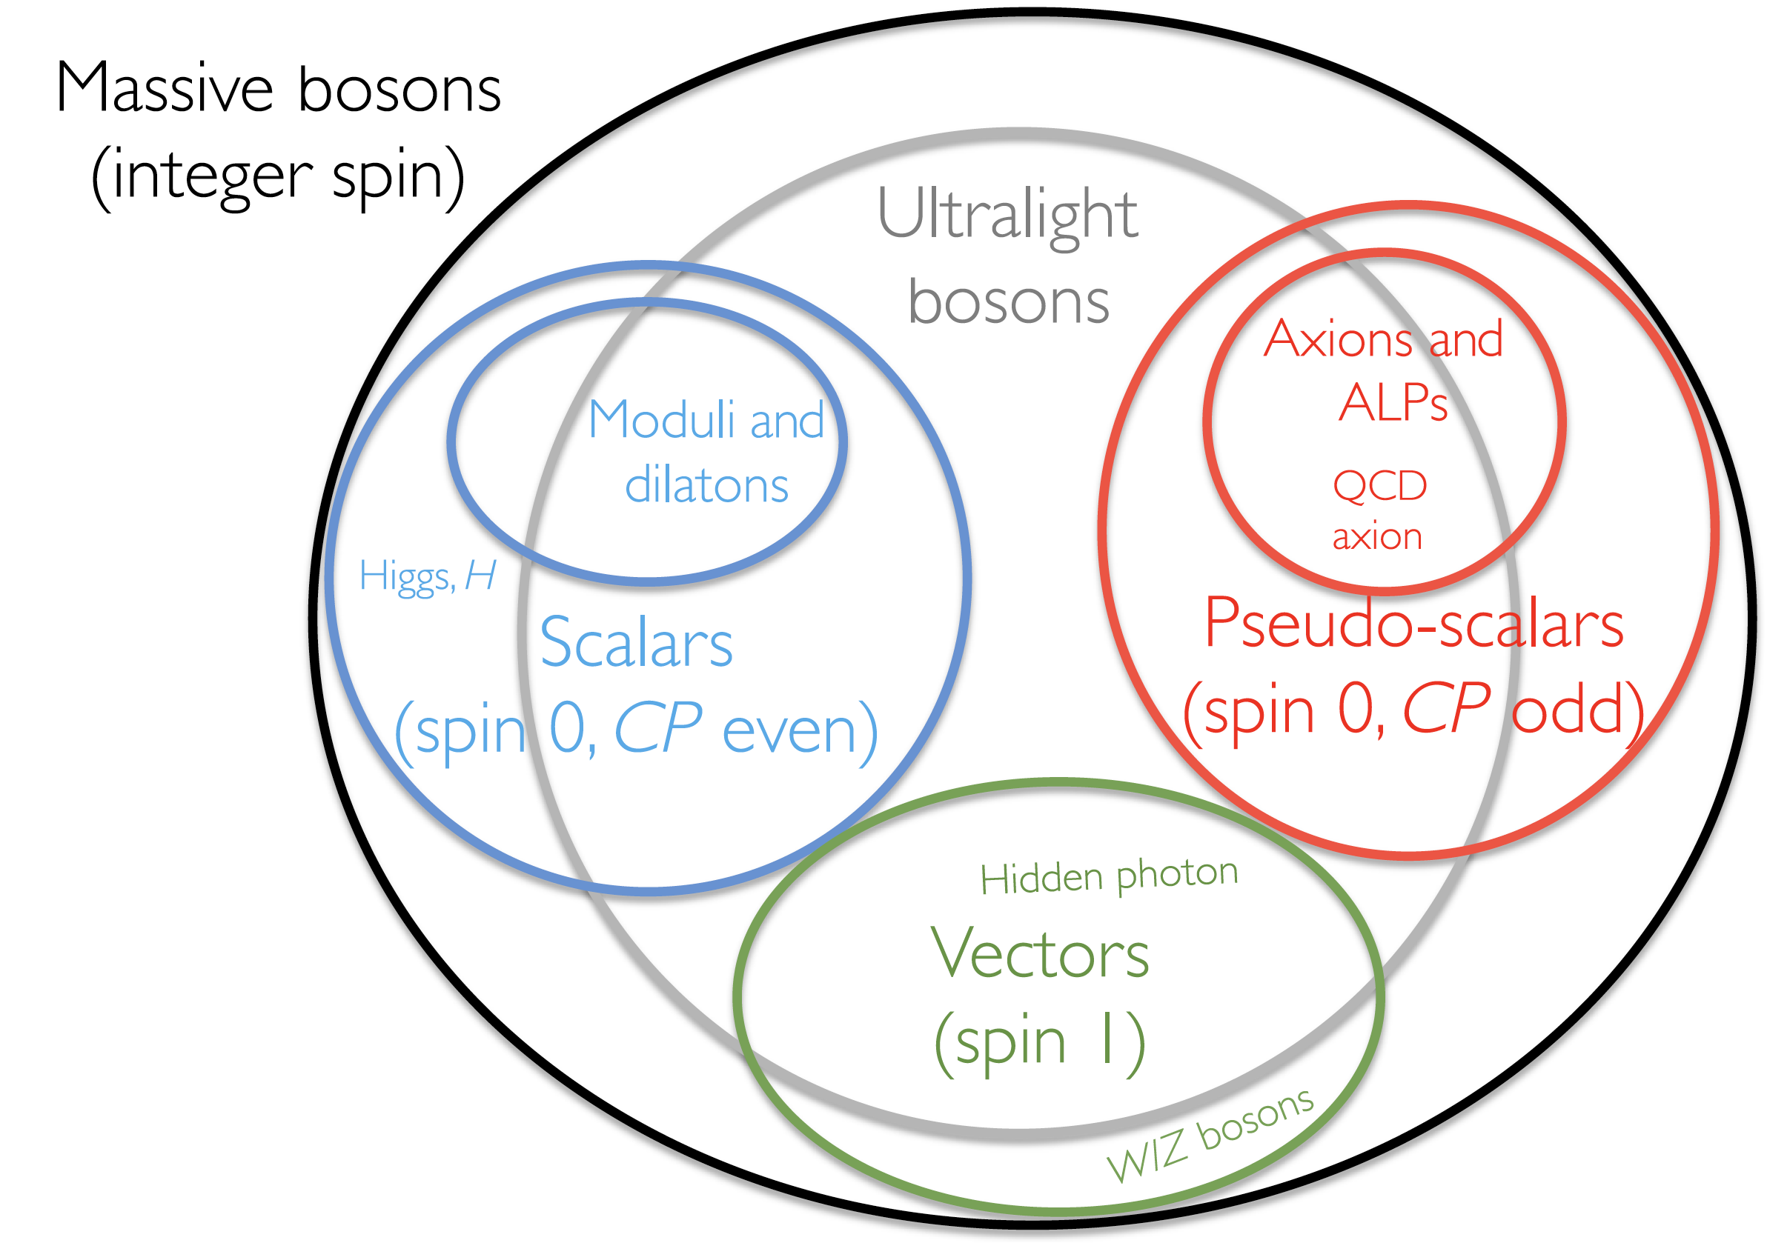
Inputs from WG1
Models

Slide 7
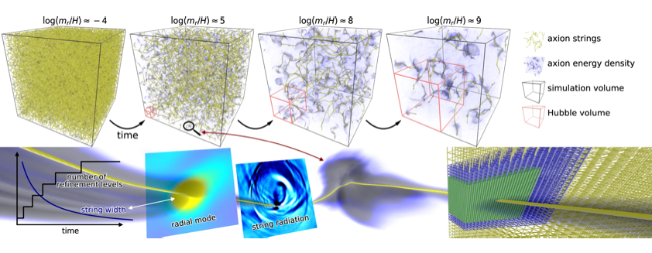
Inputs from WG2
Preferred parameter space for WISP dark matter candidates

Slide 8
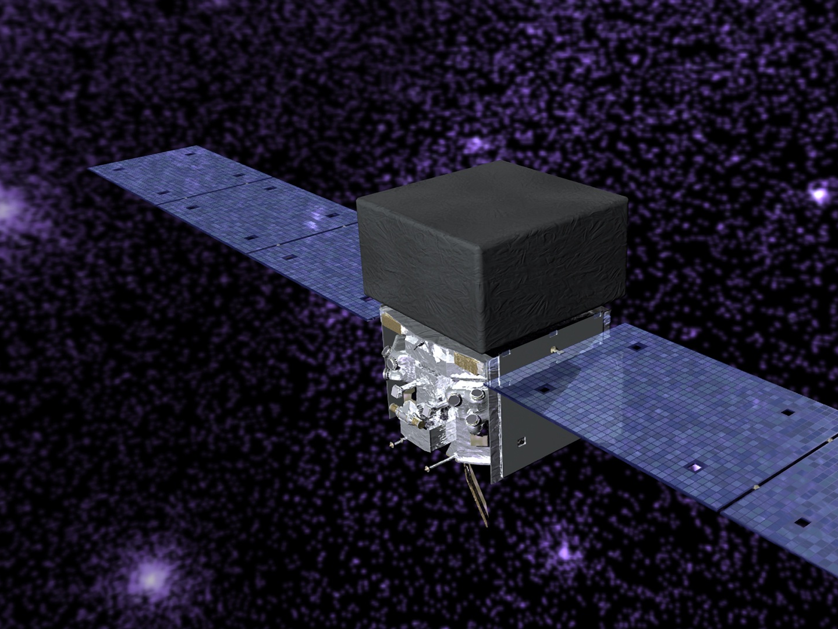
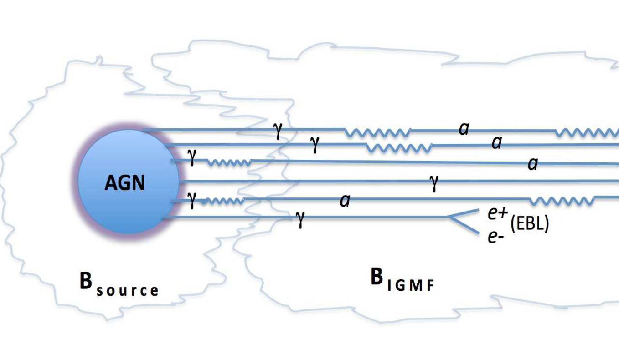
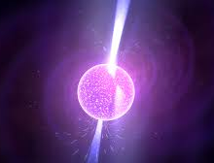
Inputs from WG3
Astrophysical experimental results (hints or limits)

Slide 9
Experiments and Techniques
Helioscopes
Haloscopes
LSW
polarization
AMO
Magnetometers
5th Force exp.
Casimir
Torsion balance
Atomic tests
Levitated microspheres
Micro resonators
GW Interferometer
Atom Interferometer
Neutron interferometry
Cold neutrons
Variation of fundamental constants
Colliders
Beam dump/on target
Underground
…

Slide 10
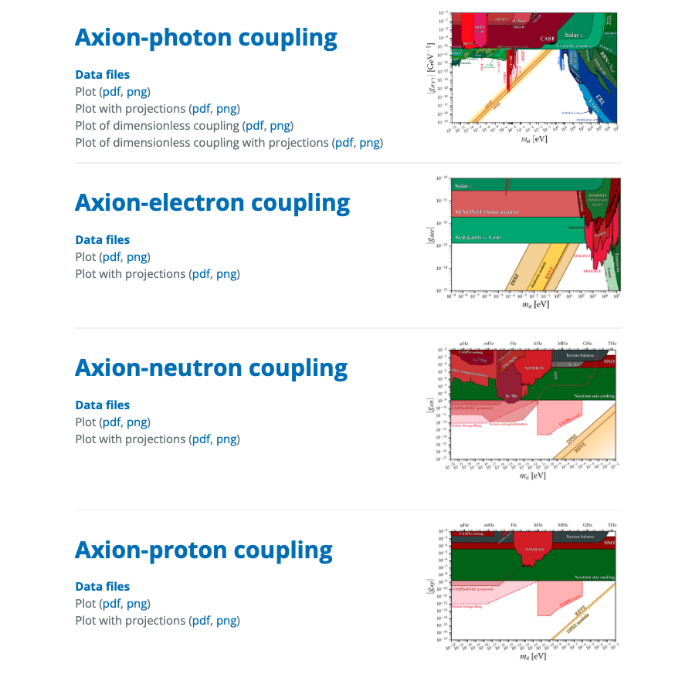
Plots for Exclusion Limits
We will use the software from Ciaran O'Hare (COST member)
https://cajohare.github.io/AxionLimits/
Ciaran’s project already rich of data on limits for several couplings of WISPS. We can help to extend the physics case, collect data and create new summary plots. Will organize a subworking group on this.

Slide 11
First year plan
Make a list of WISPs models
Make a list of WISPs experiments
Preliminary Summary Plots
Contact experts in specific experiments and techniques within and outside the COST. Invite them to join the COST.
Make a list of technology needed by WISP experiments
Draft of Direct Search Report

Slide 12
D4.1 Draft Report on direct detection (month 12)
Tentative agenda
February: List of editors; Latex/Word template
March-June: Meeting to define Report index/sections. Identify Editors for each section. Collect bibliography. Collect list of particles/models/experiments. Updated results for plots/limits. Combine experiment results. Inputs from other WGs.
September-October: First draft; Identify missing models/experiments. Invite experts to join COST.
December: Draft Report on direct detection (State of Art)

Slide 13
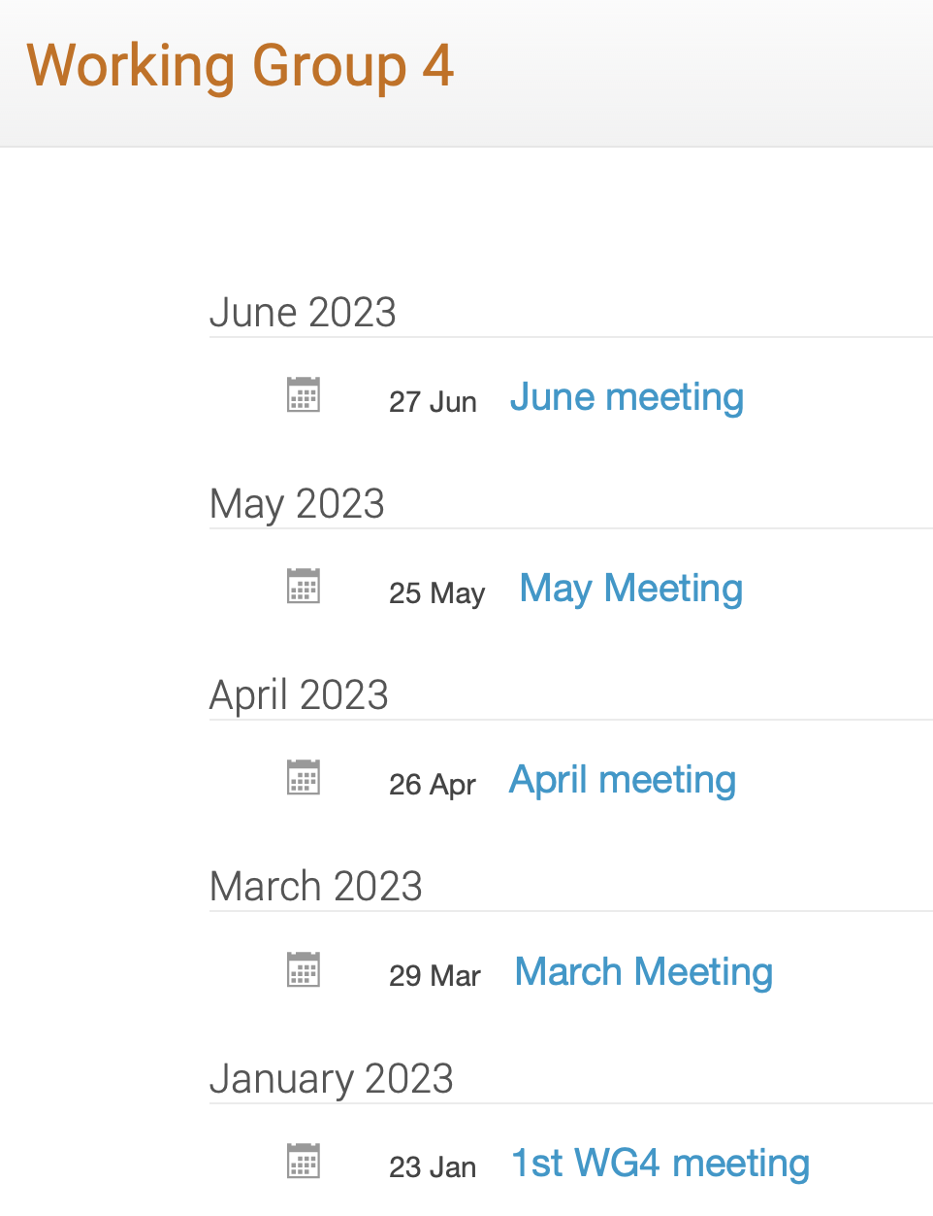
Monthly Meetings
Link to agenda: https://agenda.infn.it/category/1835/
Experiments
Axion limits package and data combination - C Ohare
BRASS Experiment - LH Nguyen
WISPFI Experiment - M Maroudas
Haloscopes - A Rettaroli
Helioscopes - J Vogel
Gnome - G Zoran
Experimental techniques
Microcalorimeters at Heidelberg - L Gastaldo
Theory Models
Spin 2 ULDM - F Urban
Experimental Schemes
Axions in plasma - H Tercas
Directly Deflecting Particle Dark Matter - S Ellis

Slide 14
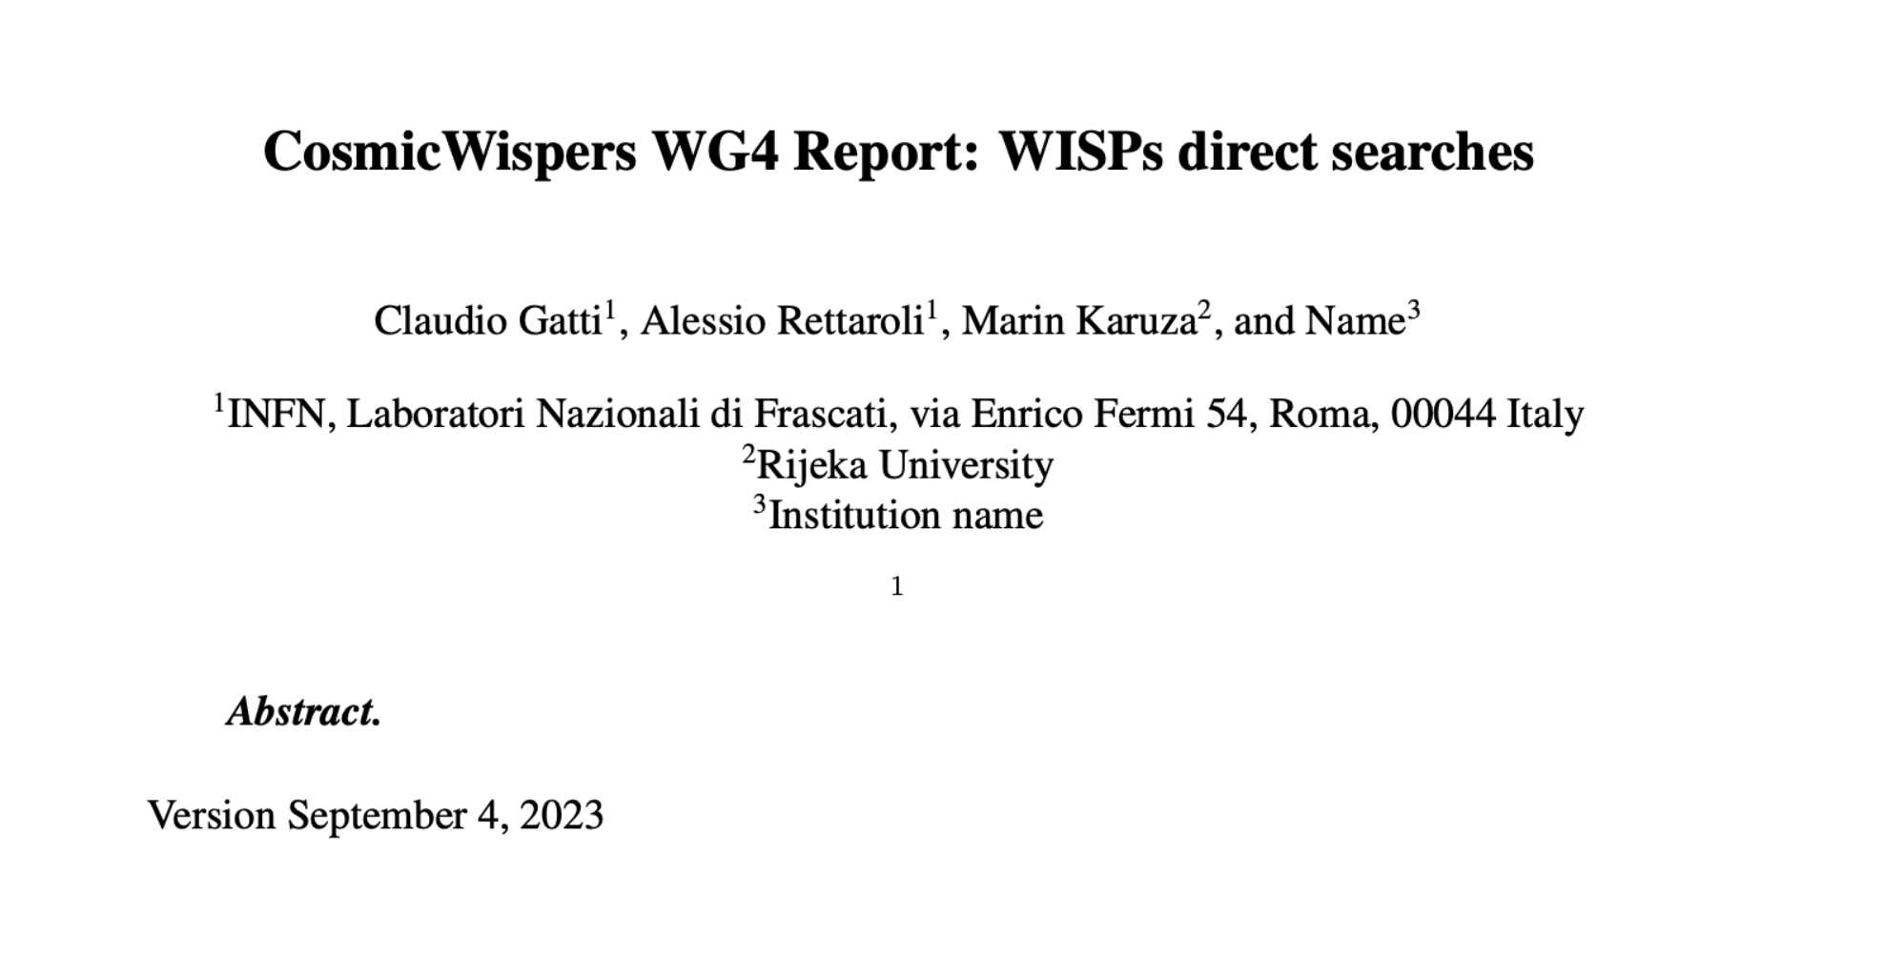
WG4 report draft
Link to Report: https://www.overleaf.com/4678842289cfhfndnmvtyr

Slide 15
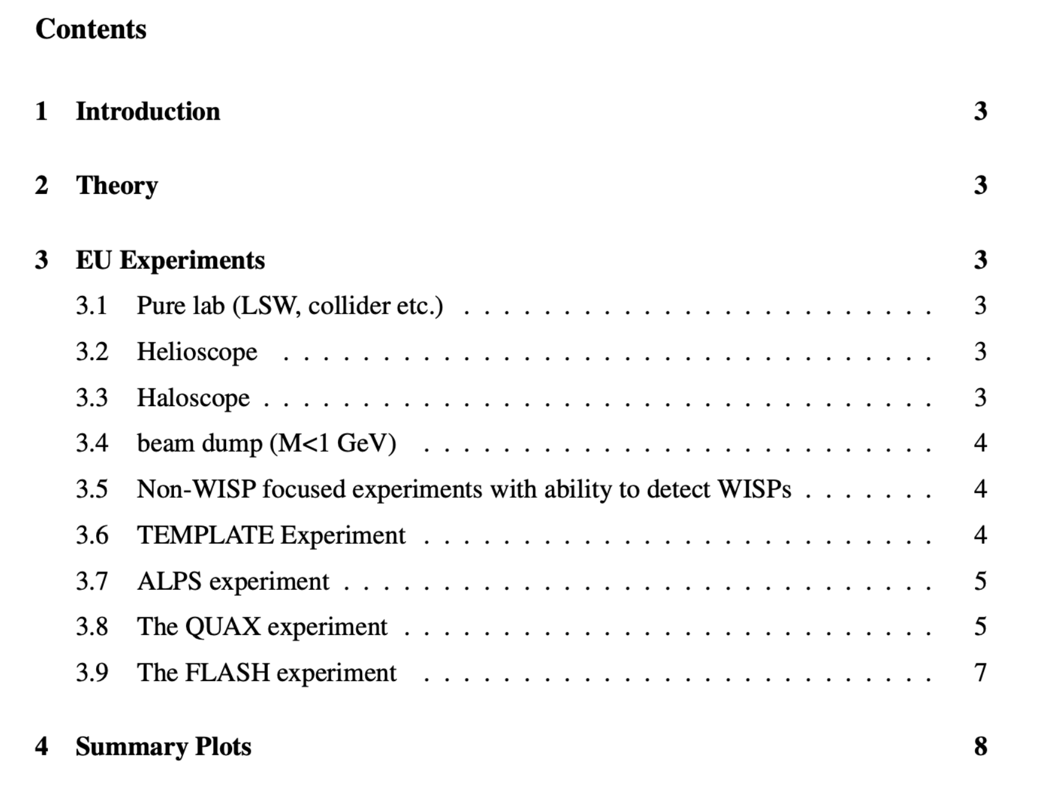
Report Content

Slide 16
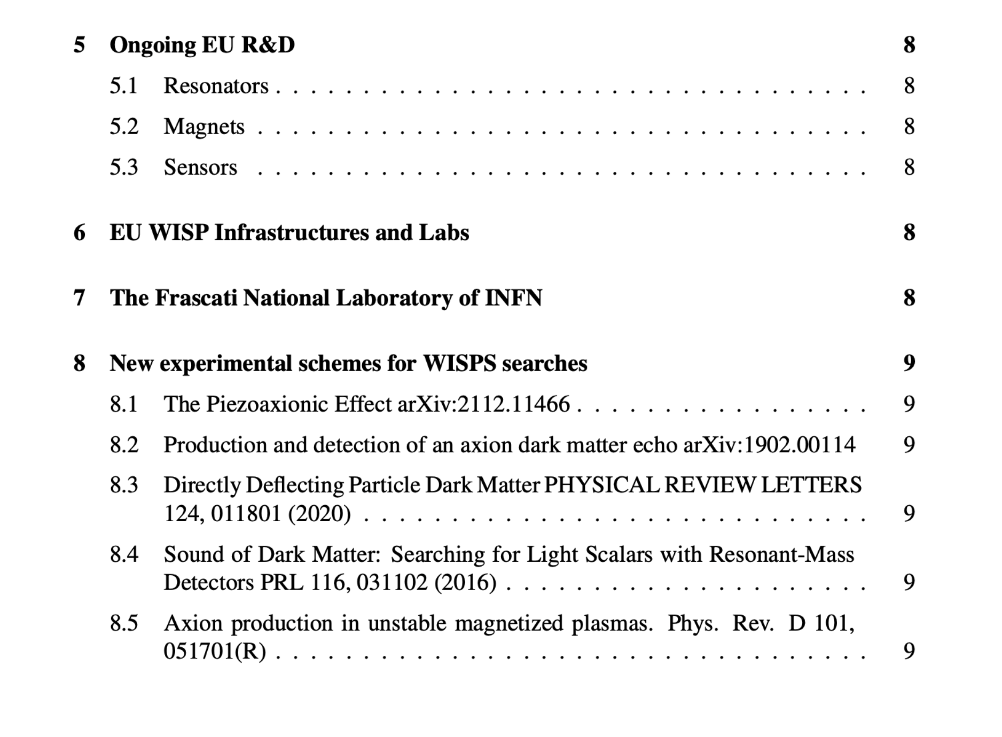
Report content

Slide 17
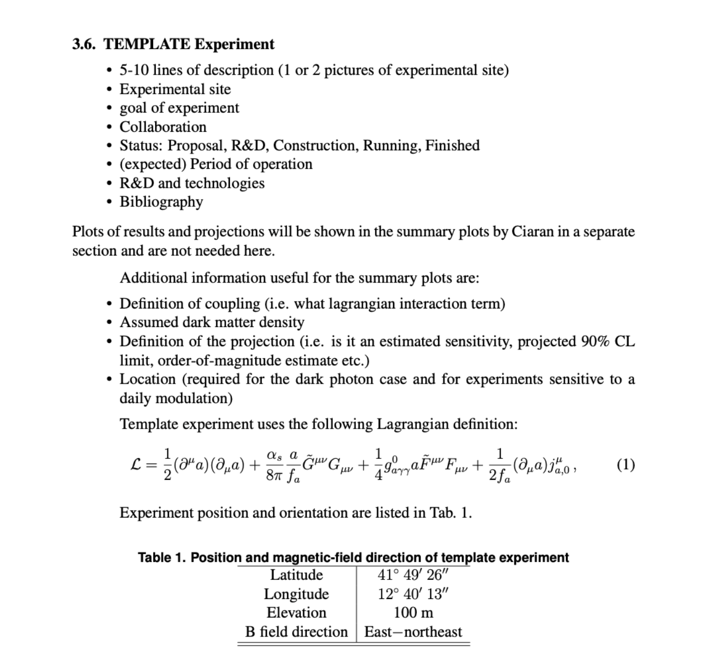
Latex template for experiments

Slide 18
WG4 Program
Distribute Latex template for experiment and complete the overview on experiments by end of November
Started working on R&D, facility and experimental schemes sections will be completed in 2024
Keep inviting speakers to monthly meeting and involve them in report preparation
Organization of second Technology Forum on (quantum) sensors.

