Slide 1
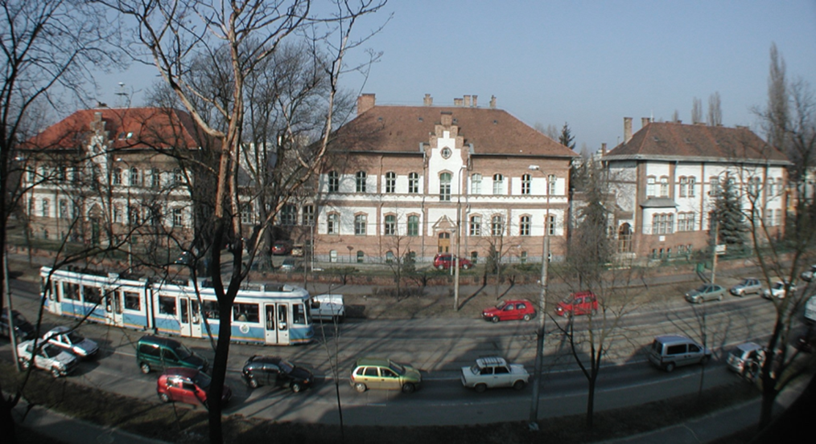



Observation of anomalies supporting the existence of the new particle X17
1st General Meeting
Attila J. Krasznahorkay
Institute for Nuclear Research (ATOMKI) Debrecen
Hungary

Slide 2
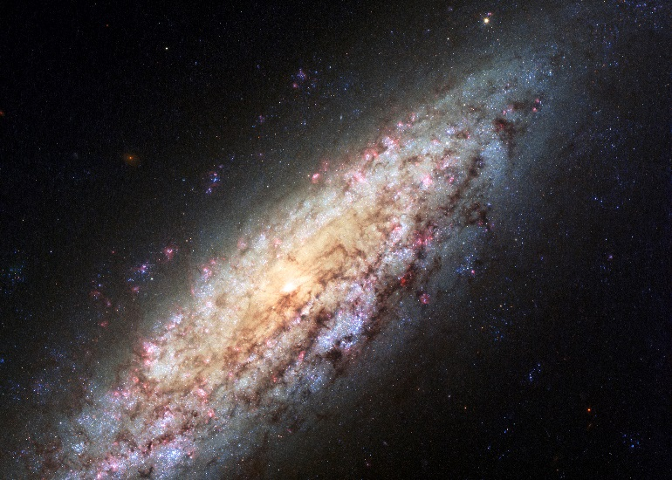
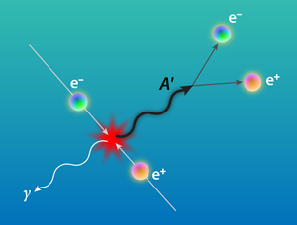
Should not have to defend this too much…
Searching for new physics and Dark Matter
Searching from the basement to the attic already for 30 years, every corner with tremendous strength, but didn’t find anything significant so far …
Fertile ground:
Light, Weakly Interacting DM, the dark photon concept (γ-like vector particles)
Pseudoscalar, Axion Like Particles (ALP) (axion search in nuclear transitions 1978 →)
M. Pospelov and A. Ritz, “Astrophysical Signatures of Secluded Dark Matter,” Phys. Lett. B 671, 391 (2009)

Slide 3
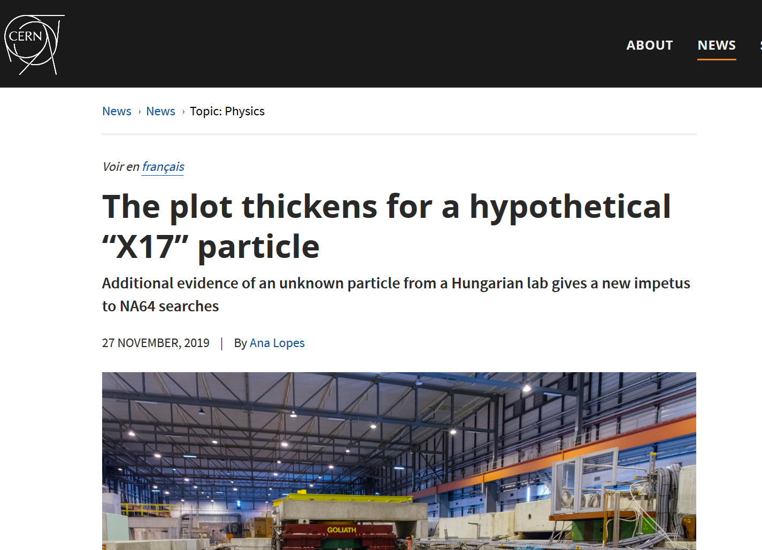
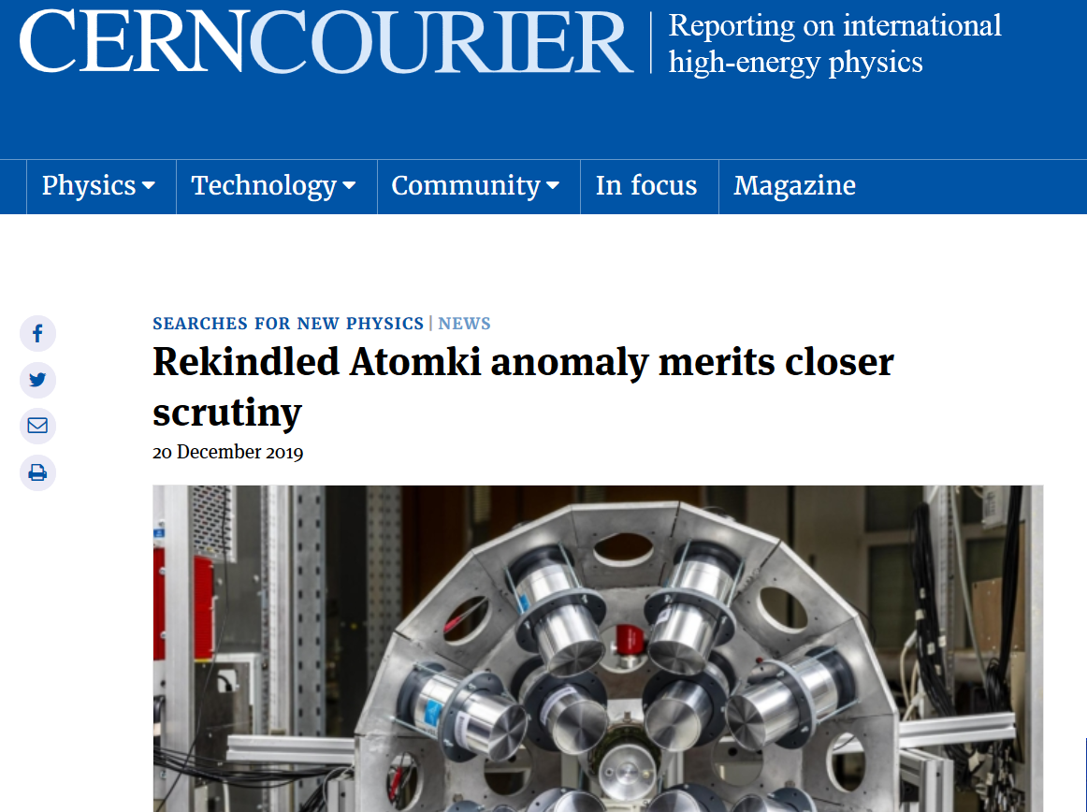
Protophobic Fifth-Force Interpretation of the Observed Anomaly in Be8 Nuclear Transitions, Jonathan L. Feng, et al., Phys. Rev. Lett. 117, 071803 (2016).
The ATOMKI anomaly → signals for a new 17 MeV boson → gauge boson of a new fundamental force of nature

Slide 4
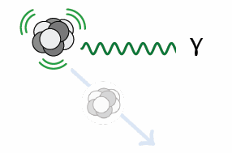
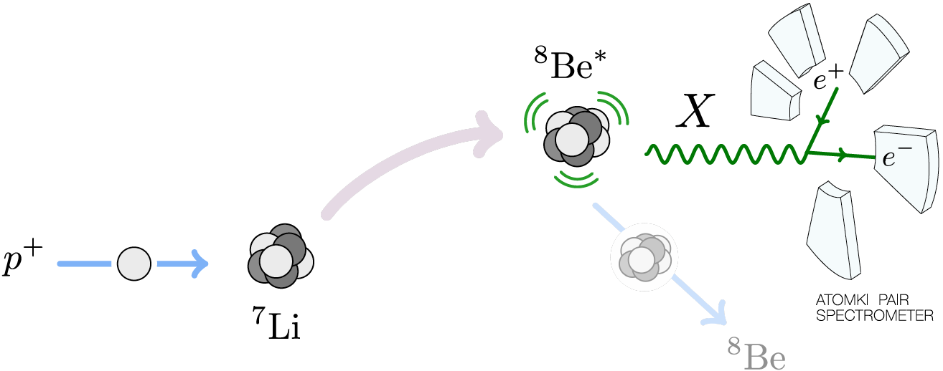
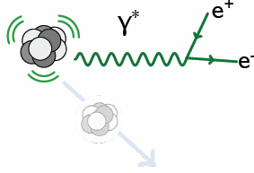
The creation and decay of ⁸Be*
18.2
1⁺
Ep= 1030 keV
17.6
1⁺
Proton decay: B(p + ⁷Li) ≈ 100%
γ-decay: B(⁸Be + γ) ≈ 1.5 x 10⁻⁵
Internal pair creation: B(⁸Be + e⁺ e⁻) ≈ 5.5 x 10⁻⁸
Ejection of a new particle: B(⁸Be + X) ≈ 5.5 x 10⁻¹⁰
3.0
2⁺
0
0⁺
⁸Be

Slide 5
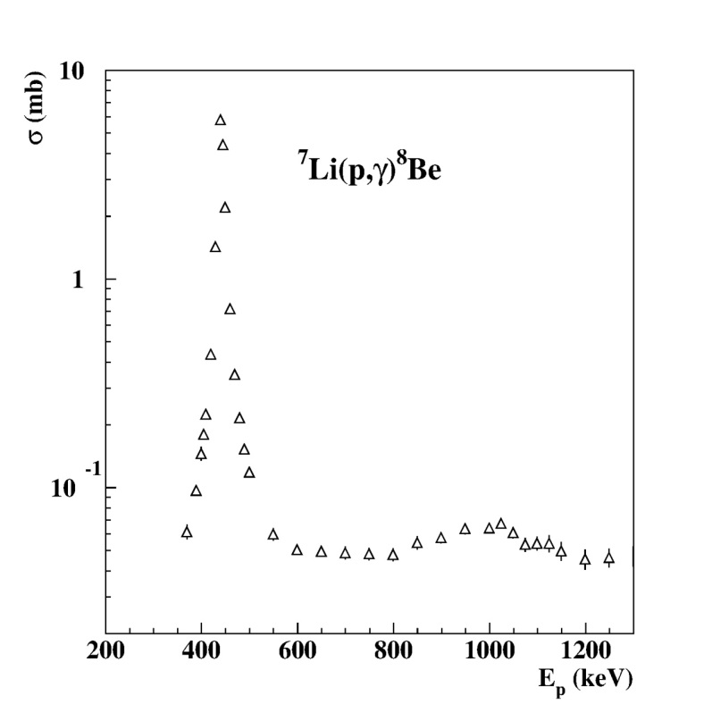
Study of the ⁸Be M1 transitions
Excitation with the
⁷Li(p,γ)⁸Be reaction
18.2
1⁺
Ep= 1030 keV
17.6
1⁺
Ep= 441 keV
⁸Be
3.0
2⁺
0
0⁺
⁸Be

Slide 6
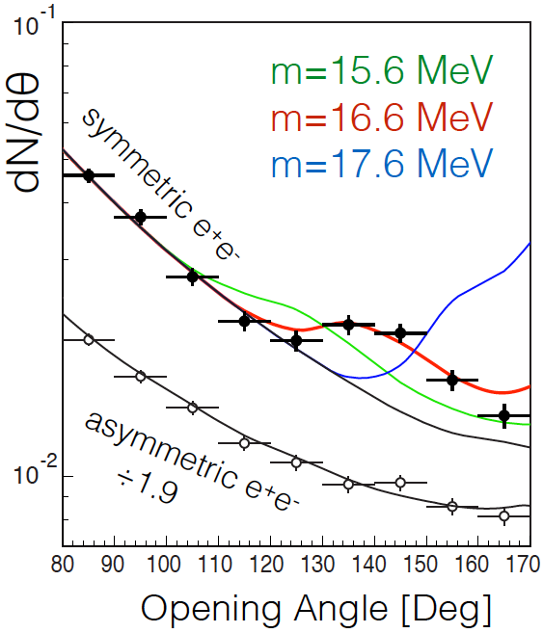
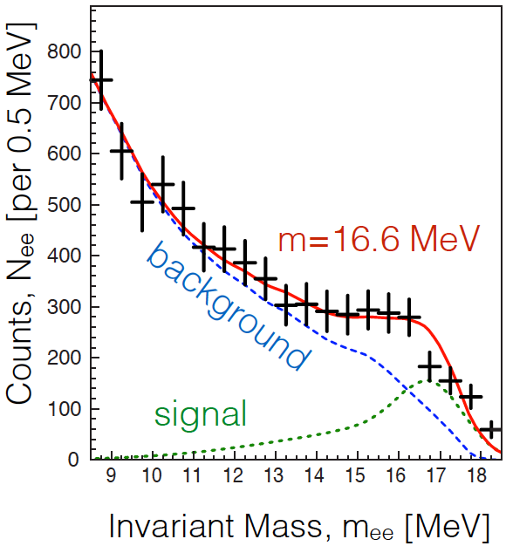
THE ATOMKI ANOMALY
The θ (and m_{ee}) distributions can be explained by postulating a new particle and the decay ⁸Be* → ⁸Be X, followed by X → e⁺e⁻
Best fit parameters: m = 16.7 ± 0.35 (stat) ± 0.5 (sys) MeV
B(⁸Be* → ⁸Be X) / B(⁸Be* → ⁸Be γ) = 5.6 x 10⁻⁶
χ²/dof = 1.07
Krasznahorkay et al. (2015)

Slide 7
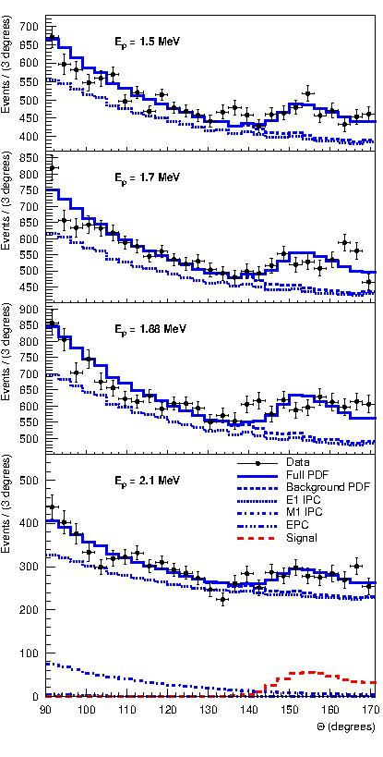
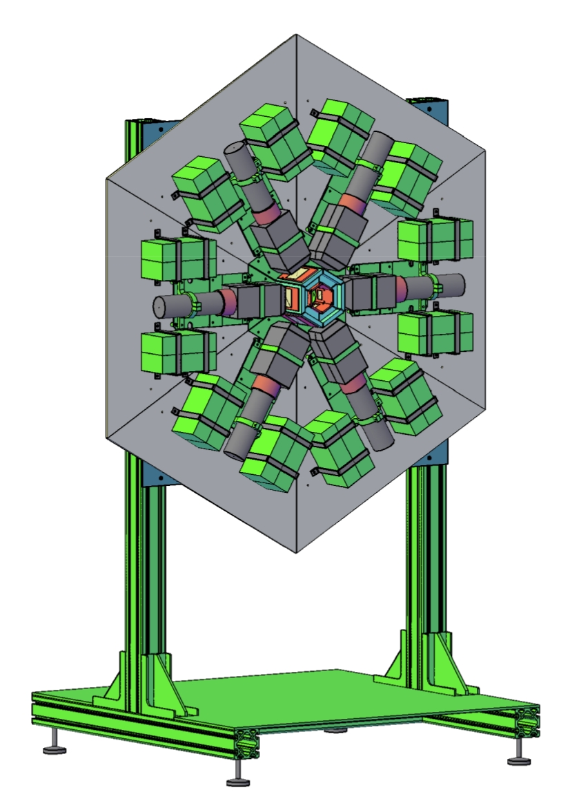
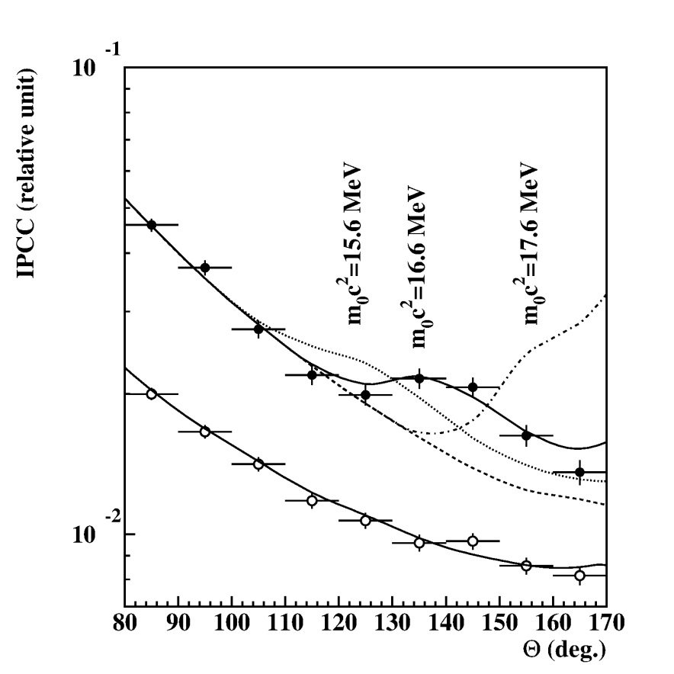
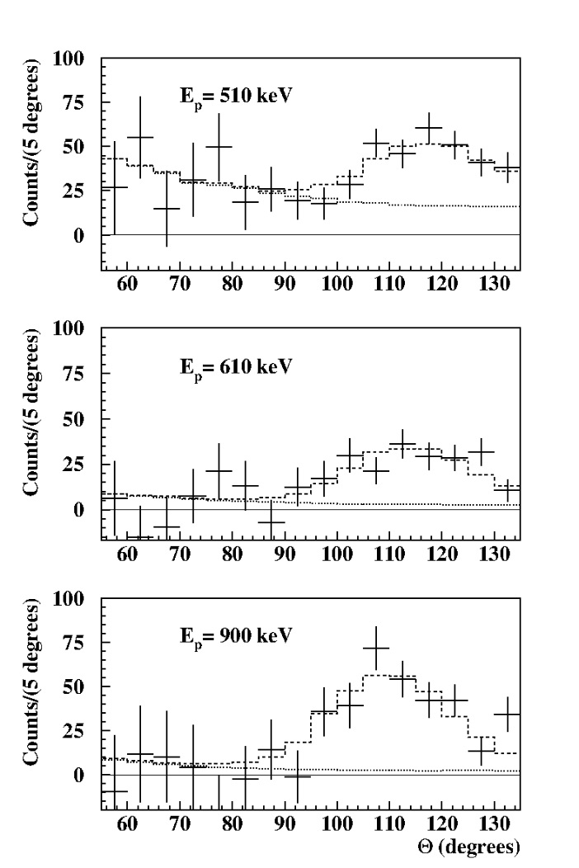
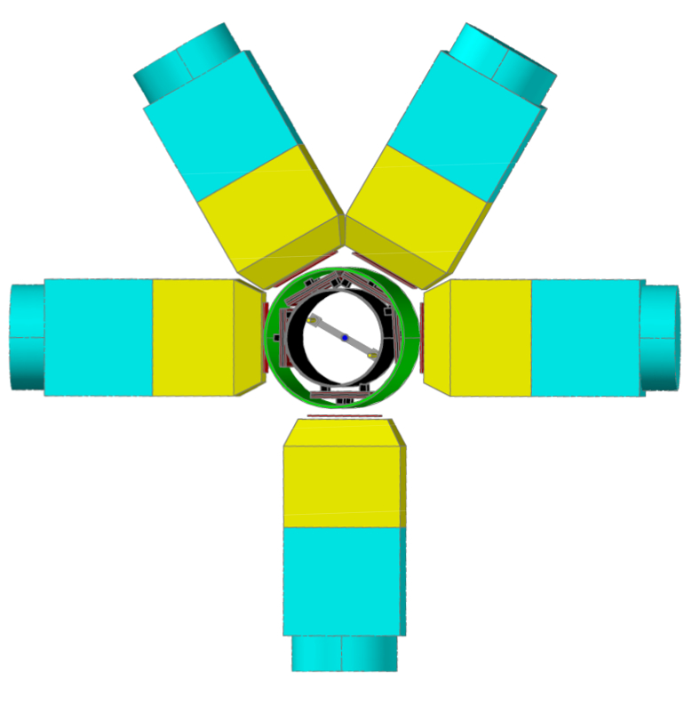
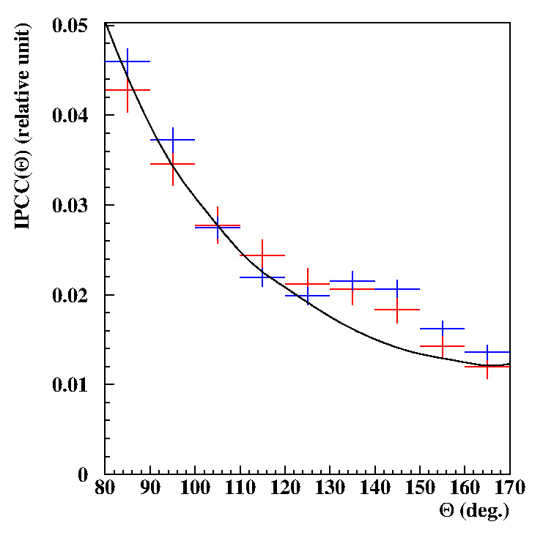
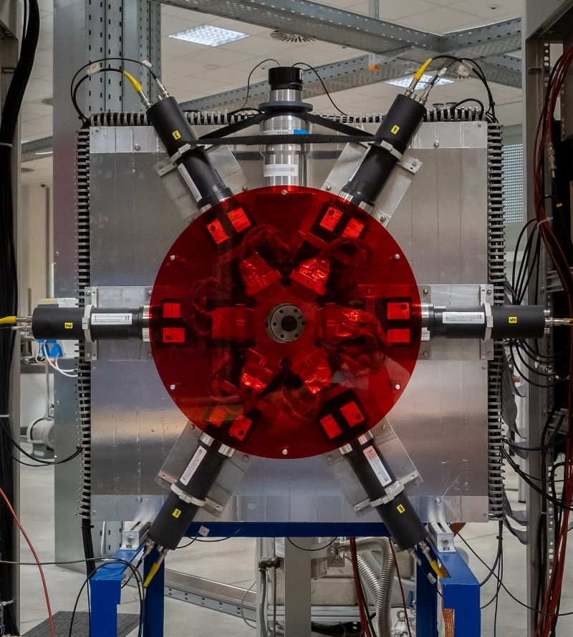
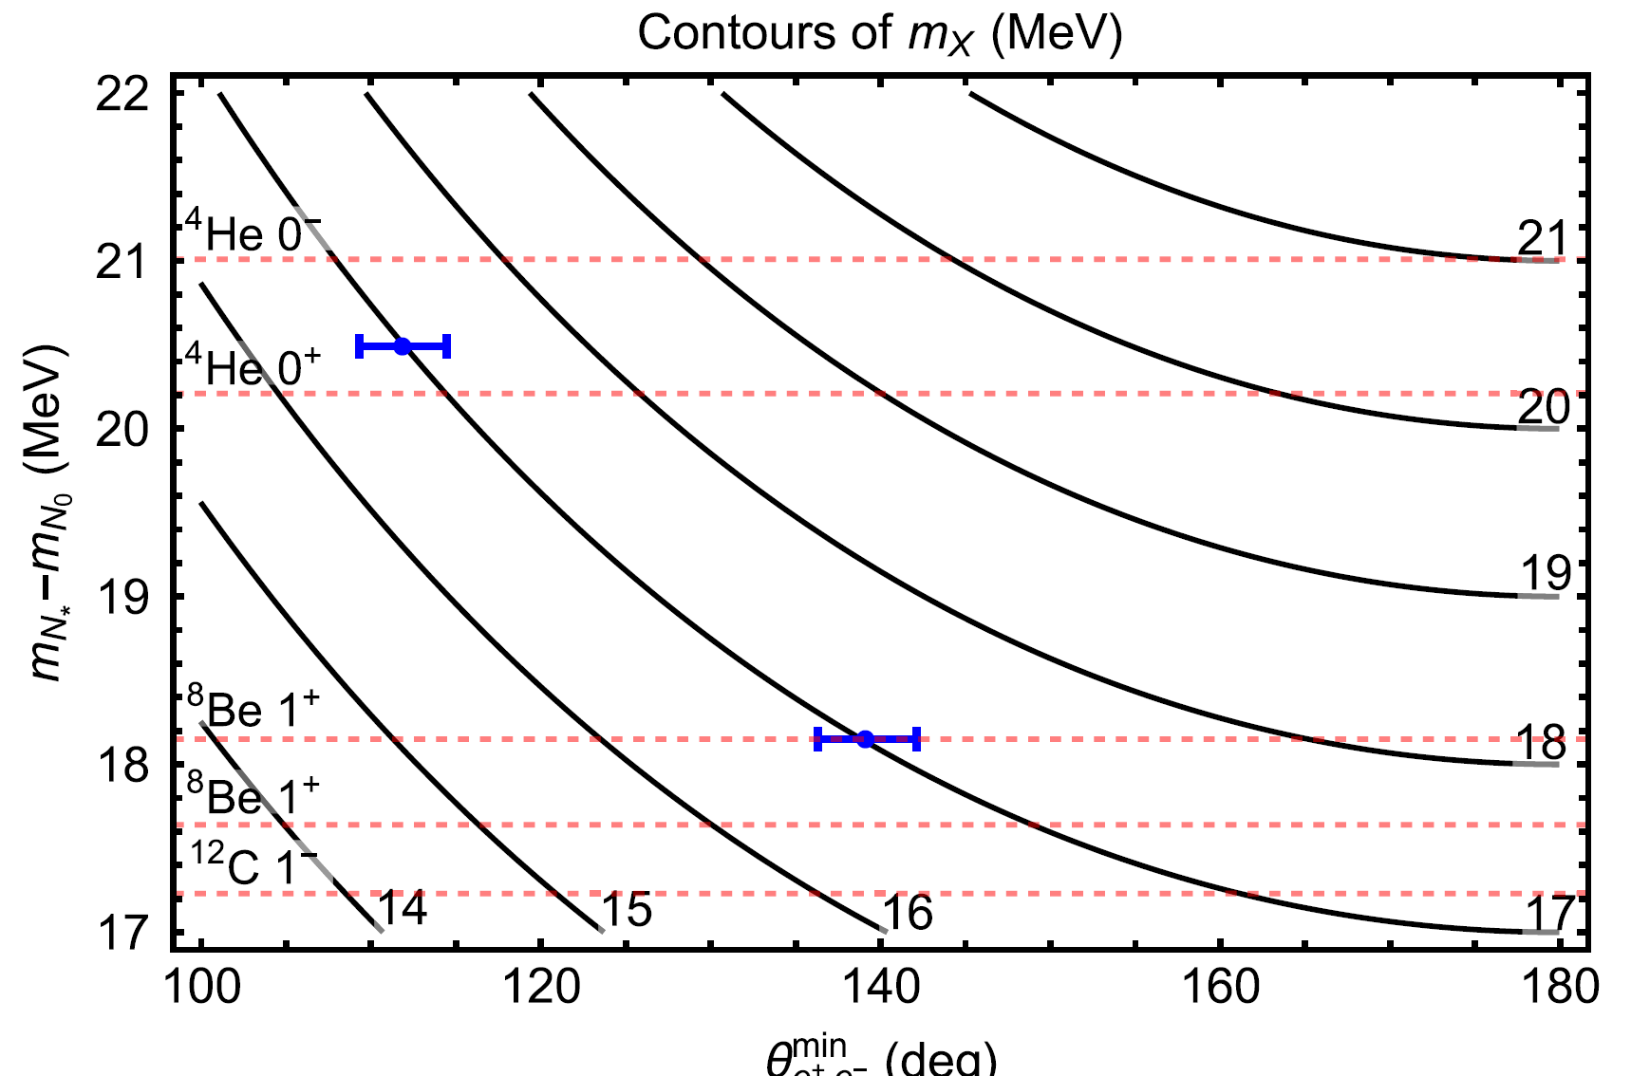
Previous experimental results
¹²C
⁴He
⁸Be
2016
PRL
2022
⁸Be
2021
2017
The newest version of the spectrometer
Kinematical evidence for the X17 particle
Vector character of X17 is supported
Ejected with L=1 in ⁸Be
Consistent result with
a new spectrometer

Slide 8
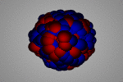
Observation of the X17 anomaly in the decay of the Giant Dipole Resonance
GDR
TRK sum rule
=

Slide 9
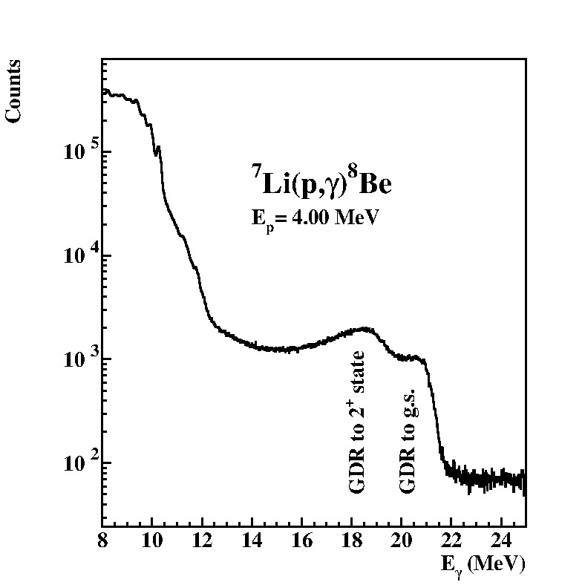
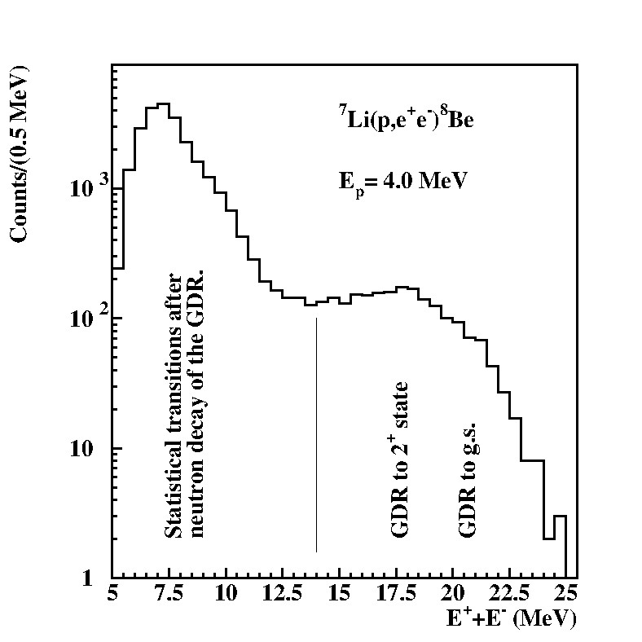
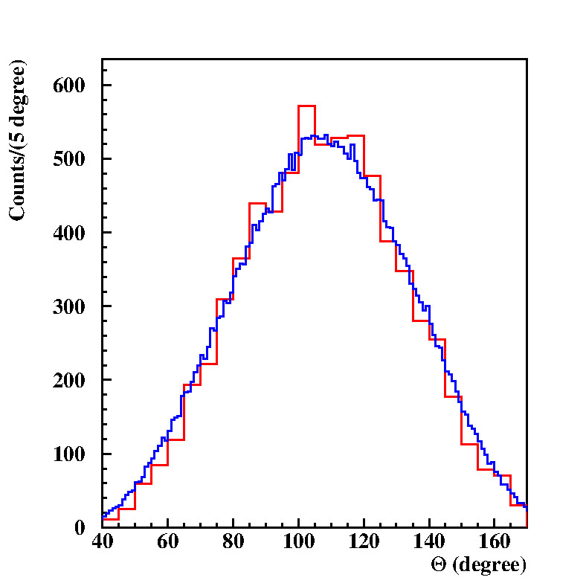
A new e⁺e⁻ spectrometer, their acceptance, γ-ray and energy-sum specta
Target
DSSD detectors
Plastic scintillator
Plastic scintillator
110 deg.
GDR
LaBr₃ γ-ray
monitor
Energy-sum spectrum

Slide 10
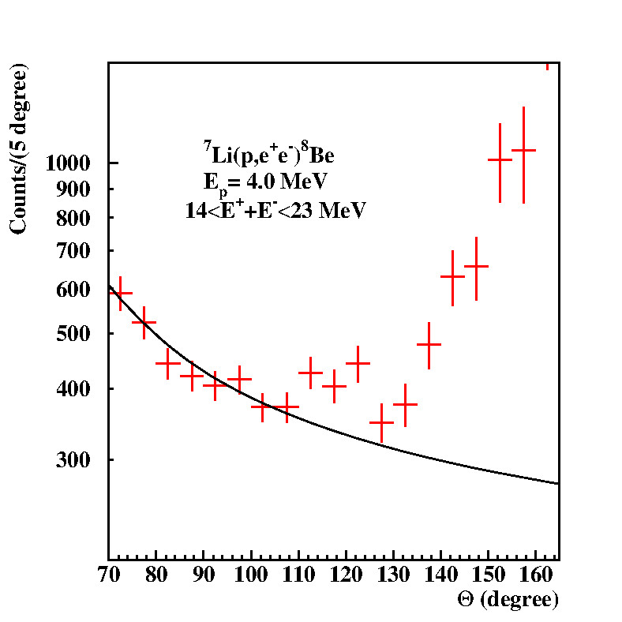
e⁺e⁻ angular correlations for the low-enegy region, and for the GDR one
GDR

Slide 11
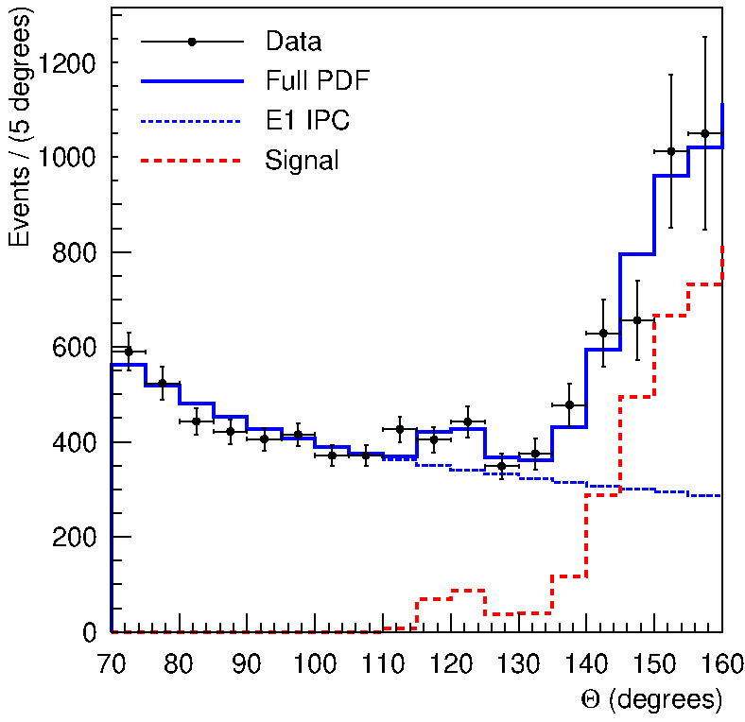
Fitting the e⁺e⁻ angular correlation for the GDR region
GDR
1⁺
3.0
2⁺
0
0⁺
⁸Be
m₀c²=17 MeV

Slide 12
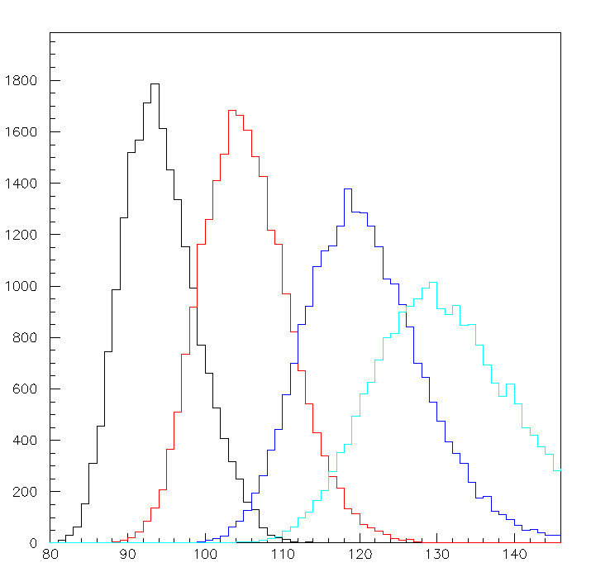
Simulation for the X17 decay created in the ⁷Li(p,γ)⁸Be reaction at different proton bombarding energies (γ₁ transition)
10 MeV
8 MeV
6 MeV
5 MeV

Slide 13
Conclusions
Anomalous internal pairing was first observed from the excitation of an M1 multipolarity transition of ⁸Be at 18.15 MeV. A peak-like deviation was found in the e⁺e⁻ angular correlation at large angles (140 degrees). The anomaly was later confirmed in an experiment with our upgraded spectrometer at a new accelerator and also very recently by a Vietnamise group.
For ⁴He, at an excitation energy of 20 MeV, the anomaly appeared at smaller angles (115 degrees), but could be explained by the formation and decomposition of a particle of the same mass (17 MeV). This provided kinematic evidence for the formation of the X17 particle. It was also found that the anomaly may have occurred in the direct capture of the proton and was not related to the excited states of 0⁺ or ​​0⁻ in ⁴He.
An anomaly was also observed in the ¹²C 17.2 MeV E1 transition. It is a broad resonance and we investigated it at 4 different bombarding proton bombarding energies, and the angle of the anomaly was slightly changed according to the decay kinematics of the X17 particle.
Very recently, the X17 anomaly was also observed in the decay of the Giant Dipole Resonance of ⁸Be. The spectra measured show a peak like anomaly at 120 degree and a broader anomaly also above 150 degree. Both anomalies could consistently be described by assuming that the same hypothetical X17 particle was created both in the ground-state transition and in the transition going to the broad (Γ=1.5 MeV), first excited state in ⁸Be. The invariant mass of the particle, which was derived to be m_{X}c² = 16.95±0.48(stat.) MeV, agrees well with our previously published values.
We are planning to study the decay of the very broad GDR (Γ~7 MeV) with different proton bombarding energies in order to stretch the kinematic evidence for the decay of the X17 particle.
I would like to ask you, theorists, to help us understanding the nature of X17 and my be its role connected to the dark matter.

Slide 14
Thank you very much for your kind attention
To ⁸Be continued…

