Slide 1
Future Collider
Pierluigi Paolucci

Slide 2
Storia dei collider e della sezione di Napoli

Slide 3
Da dove partiamo ? Energia, luminosità e Higgs Factory

Slide 4
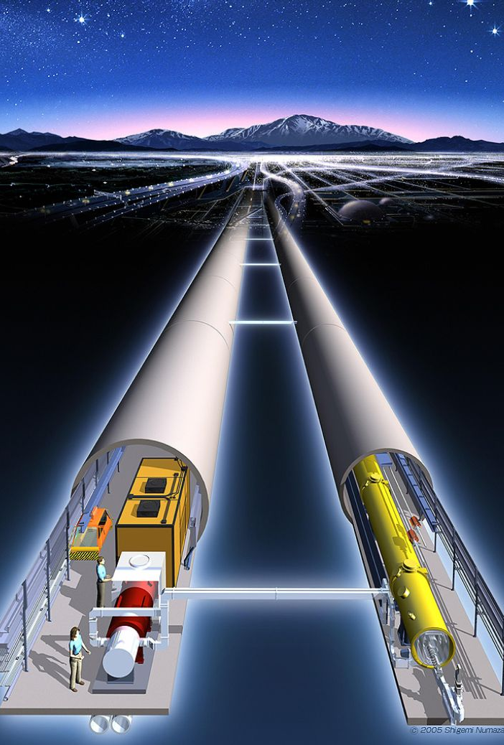
Come e dove fare tutto ciò?
e⁺e⁻ collider → linear or circulare
p-p collider
Muon collider
CERN
USA
China
Japan

Slide 5
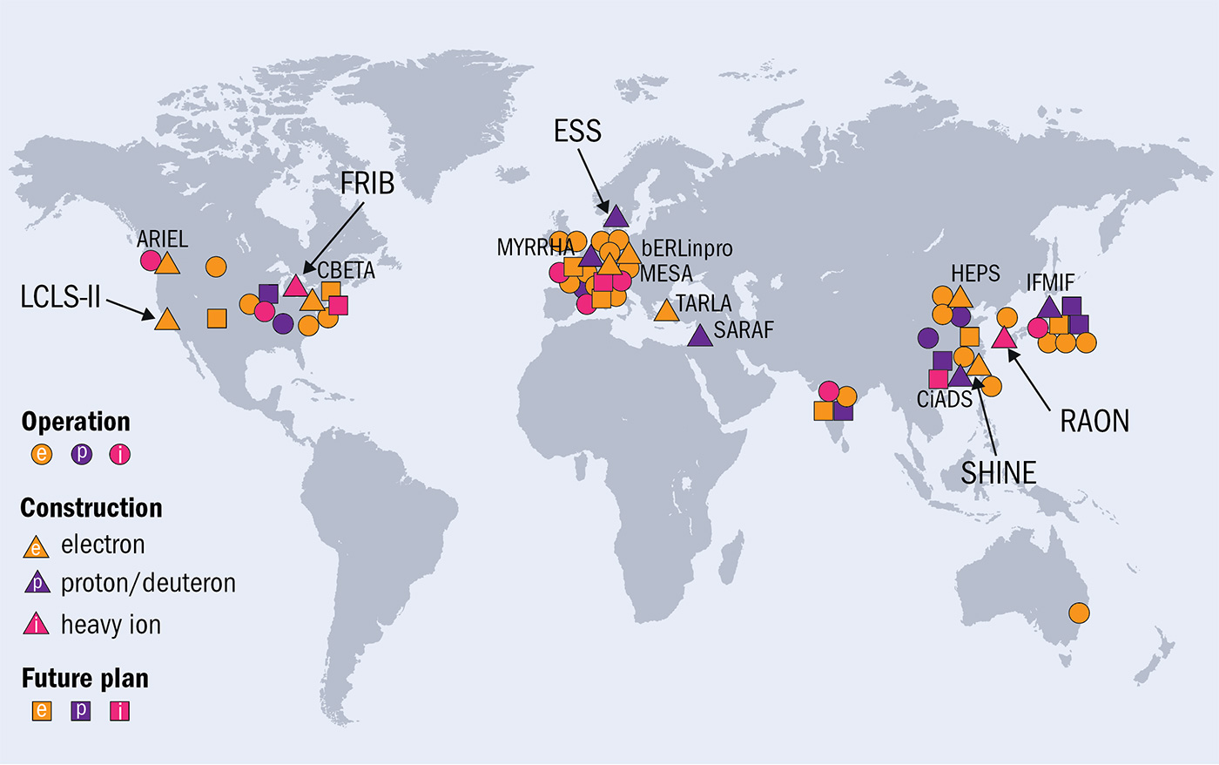
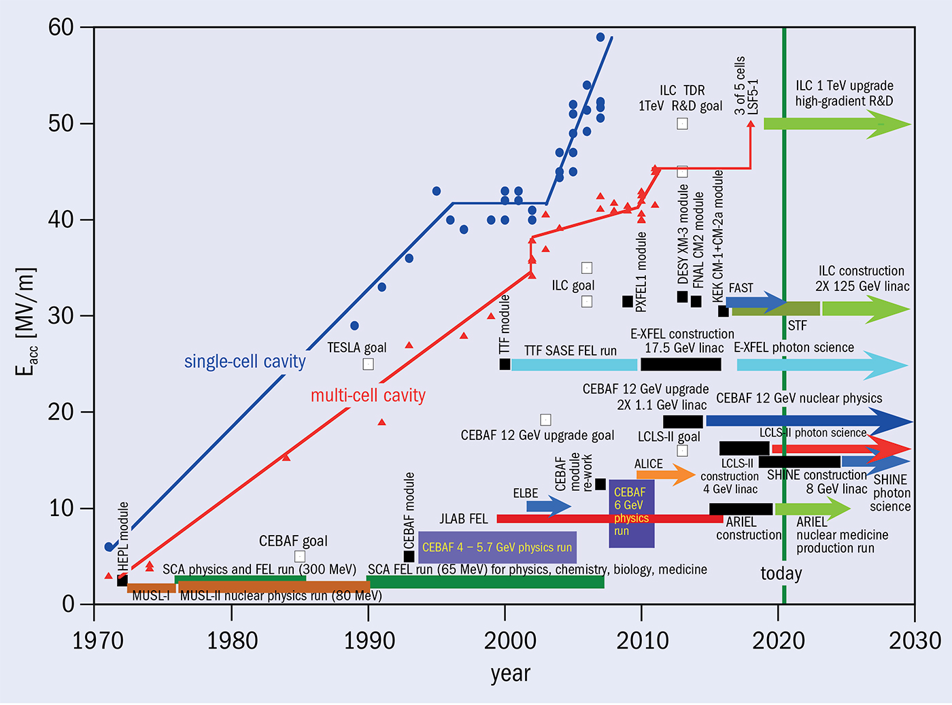
Cosa sappiamo fare oggi e dove

Slide 6
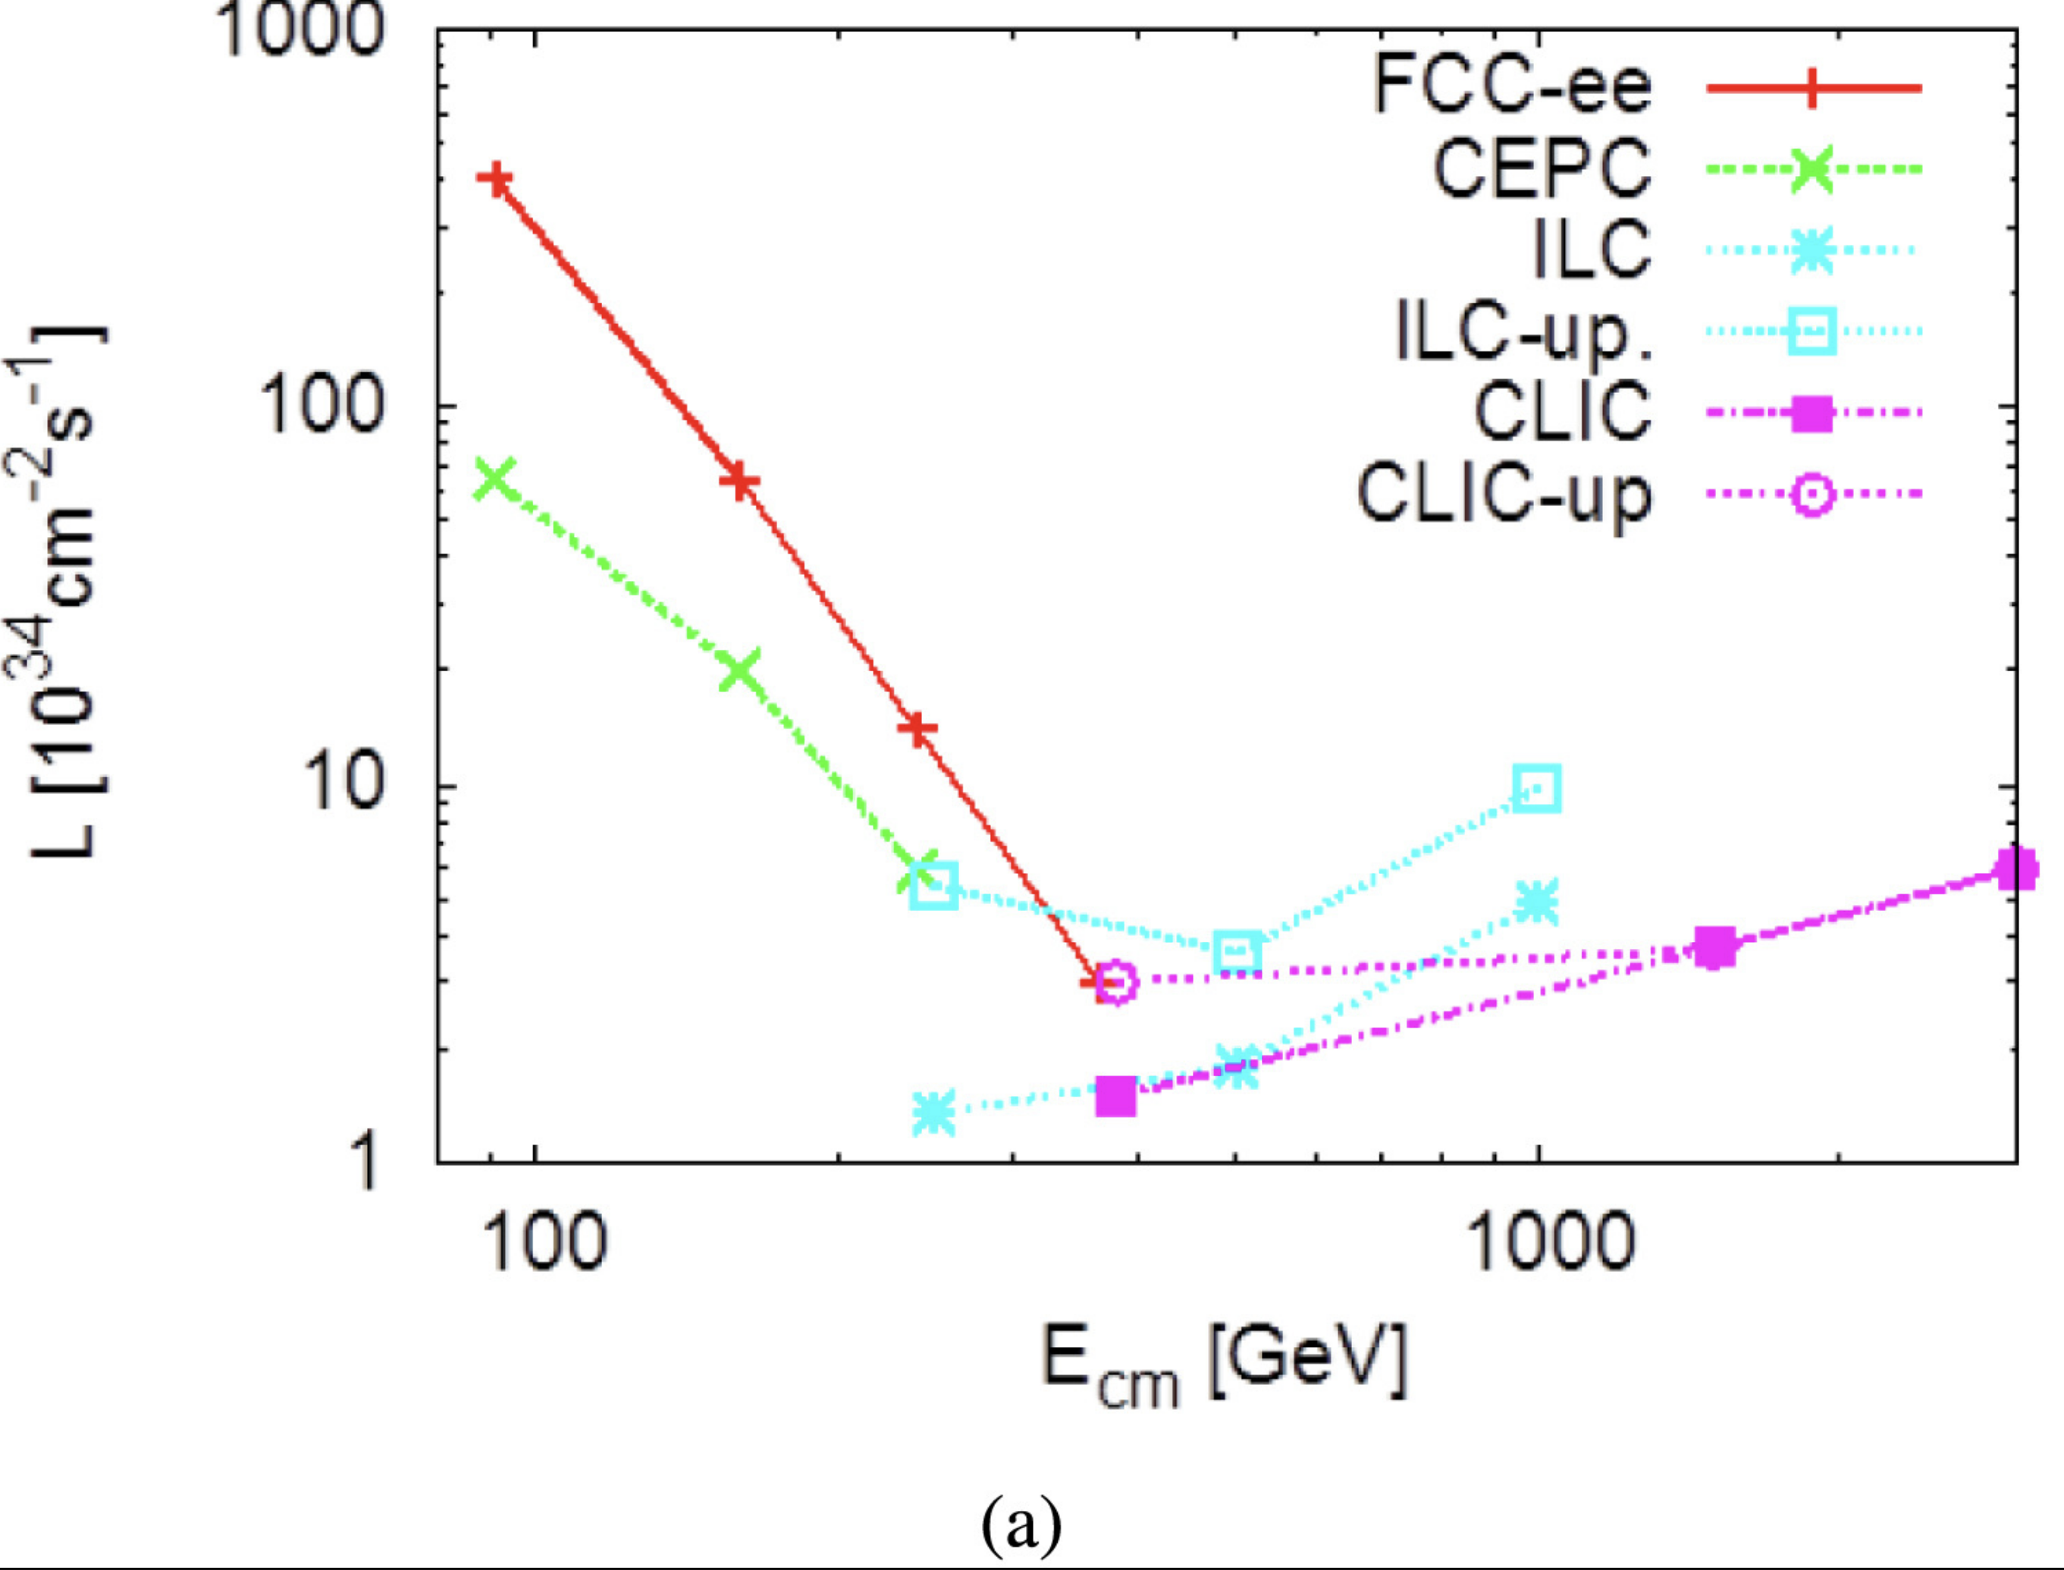
Future Electron Positron collider
The European Strategy process concluded that an e⁺e⁻ Higgs factory is the highest priority next collider.
The 2 linear colliders are the International Linear Collider (ILC), which would be located in Kitakami, Japan, and the Compact Linear Collider (CLIC), which would be located at CERN.
The 2 circular colliders are the Circular Electron–Positron Collider (CEPC), which would be located in China, and the Future Circular Collider (FCC)-ee, which would be located at CERN.
The FCC-ee and CEPC plan to deliver collisions at different center-of-mass energies:
at and around the Z pole (√s=91 GeV)
at the WW threshold (√s=161 GeV)
at the cross-section maximum for Higgs boson production in association with a Z boson (√s=240 GeV).
The FCC-ee also plans to deliver collisions at and above the top pair threshold (up to √s=365 GeV).
The current FCC-ee design has higher instantaneous luminosity than the CEPC at each center-of-mass energy.
Ultimately, the FCC-ee would reach 2×10³⁶ cm⁻²s⁻¹ and the CEPC would reach 32×10³⁴ cm⁻²s⁻¹ for √s=91 GeV.
The FCC-ee plans to run for four years at √s=91 GeV to produce five trillion Z bosons and one million Higgs boson while the CEPC plans to run for two years to produce almost one trillion Z bosons.

Slide 7
Future Hadron Collider
The HL-LHC is approved and under construction at CERN and is currently planned to begin delivering collisions in 2027.
It will reuse the existing LHC tunnel, with the key improvement being the increase in luminosity by a factor of five to seven.
The FCC-hh would be built at CERN, reuse the 100 km tunnel of the FCC-ee, and use the current LHC as an injector.
With a 100 km tunnel, reaching √s=100 TeV → dipole magnets of 16 T, which require a significant R&D program to be realized.
The same center-of-mass energy can also be achieved with a smaller tunnel with a circumference of 80 km, but with dipole magnets with a field strength of 20 T.
The FCC-hh would obtain an instantaneous luminosity of 30×10³⁴ cm⁻²s⁻¹ per interaction point and to deliver a total luminosity of 20–30 ab⁻¹.
The Super Proton–Proton Collider (SppC) would be built in China reusing the CEPC tunnel
In total, the FCC-hh would record physics data for approximately 25 years.
The SppC would initially have magnets with a field strength of 12 T, which could be later upgraded to a strength of 20 T, providing a center-of-mass energy ranging from 75 to 150 TeV.
The total luminosity of the SppC would be 30 ab⁻¹.

Slide 8
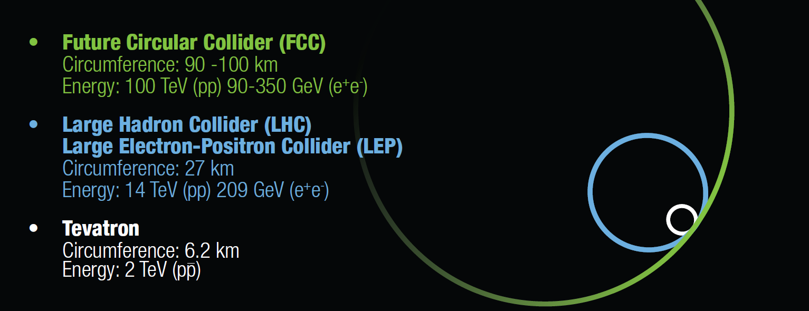

Slide 9
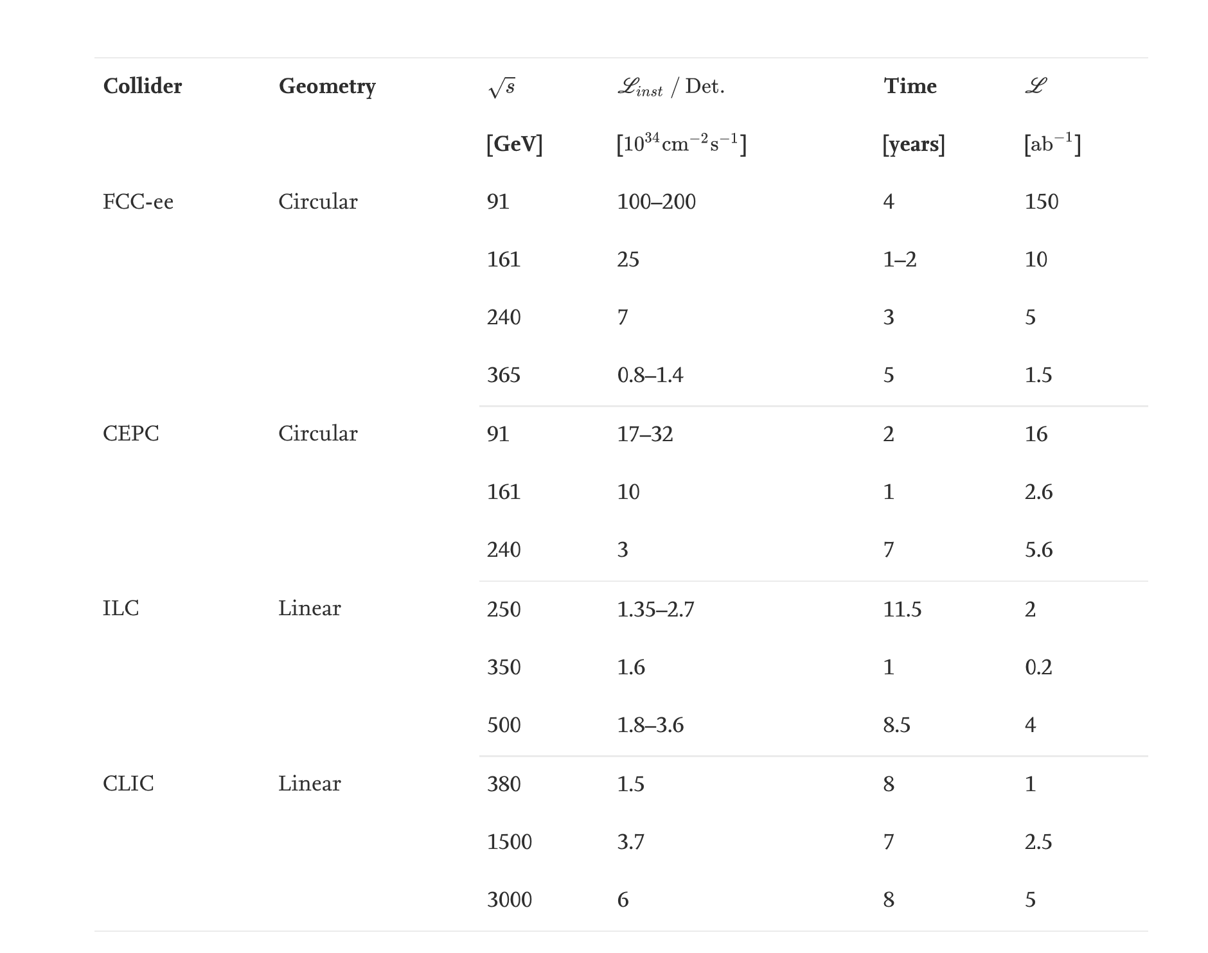
Summary

Slide 10
Intermediate energy accelerators
Potential intermediate energy accelerators include the High-Energy LHC (HE-LHC) and the Low-Energy FCC (LE-FCC).
The HE-LHC would reuse the existing LHC tunnel, but the dipole magnets would be upgraded to magnets with a field strength of 16 T, the same field strength as the magnets needed for the FCC-hh, to reach √s=27 TeV.
The LE-FCC would use the new 100 km tunnel but use dipoles with a magnetic field strength of 6 T, significantly lower than the field strength of 8.7 T in the current LHC, to reach √s=37.5 TeV. Both accelerators would obtain an integrated luminosity of 10 ab⁻¹.
A key challenge in building future pp colliders is the production of superconducting dipole magnets capable of providing a sufficiently strong magnetic field to bend the beam of high-energy protons around the tunnel.
Building such magnets requires solving fundamental challenges in superconductivity to obtain the required current density and to deal with the magnetic pressure and stress within the superconductors. It is currently estimated that to reach a field strength of 16 T would require 10–15 years of R&D followed by 10–15 years for prototyping such that construction could only begin in 20–30 years.

Slide 11
Muon colliders offer the promise to combine the benefits of pp and e⁺e⁻ machines.
They have a factor of 7 greater energy reach than a pp collider at the same center-of-mass energy, because muons are elementary particles in contrast to protons.
The energy loss due to synchrotron radiation is reduced by a factor of 100 million compared to an e⁺e⁻ collider because the muon mass is ∼200 larger than the electron mass.
Smaller colliders could be used to achieve comparable energy reach or higher energies could be obtained with the same size collider.
However, muon colliders face significant technical challenges because the muon’s lifetime is only 2.2μs at rest.

Slide 12
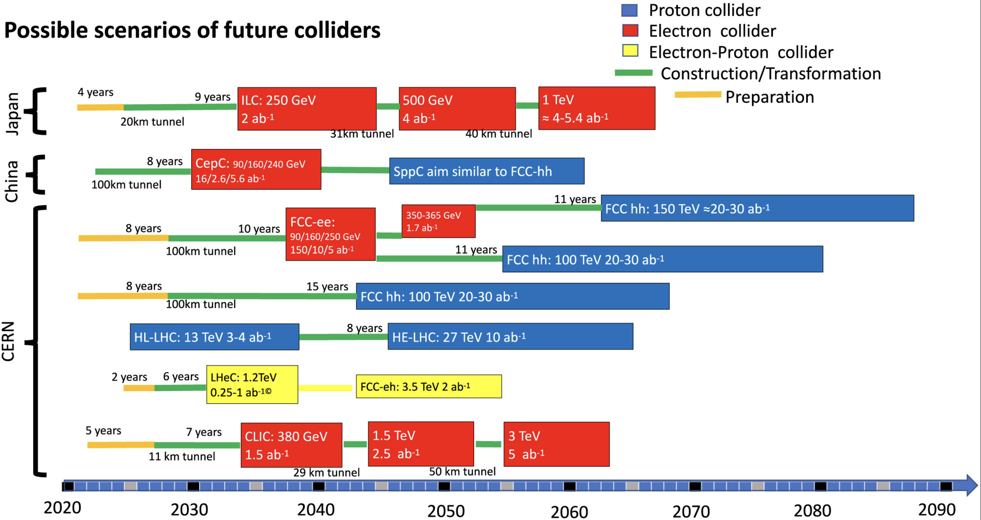

Slide 13
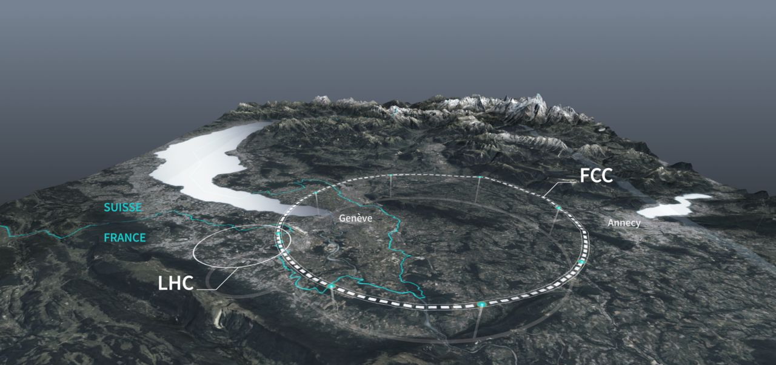
FCC – a research infrastructure for the 21st century
A new 91 km tunnel to host multiple colliders
100 – 300 m under ground, 8 surface sites
FCC-ee: electron-positron @ 91, 160, 240, 365 GeV
FCC-hh: proton-proton @ 100 TeV, and heavy-ions (Pb) @39 TeV
FCC-eh: electron-positron@ 3.5 TeV

Slide 14
Status of Global FCC Collaboration
Increasing international collaboration as a prerequisite for success: links with science, research & development and high-tech industry will be essential to further advance and prepare the implementation of FCC
147
Institutes
30
Companies
34
Countries
EC
H2020
FCC Feasibility Study: 58 fully-signed previous members, 17 new members, MoU renewal of remaining CDR participants in progress

Slide 15
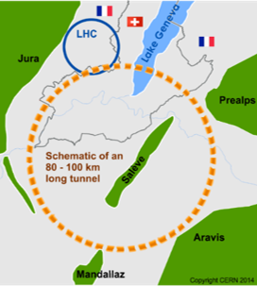
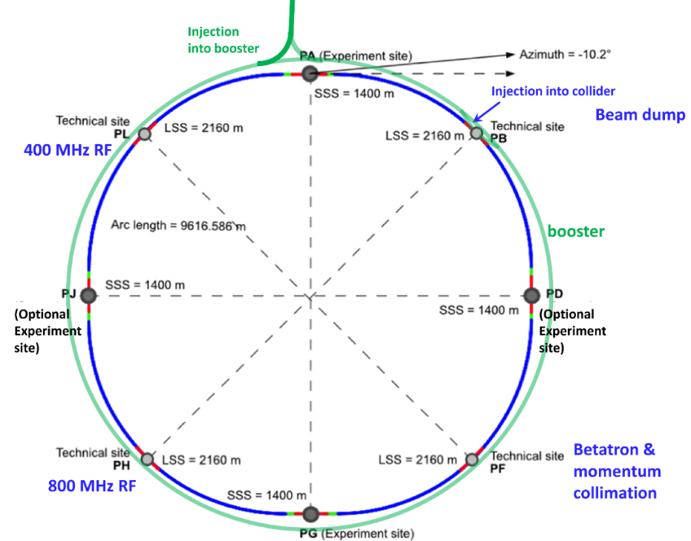
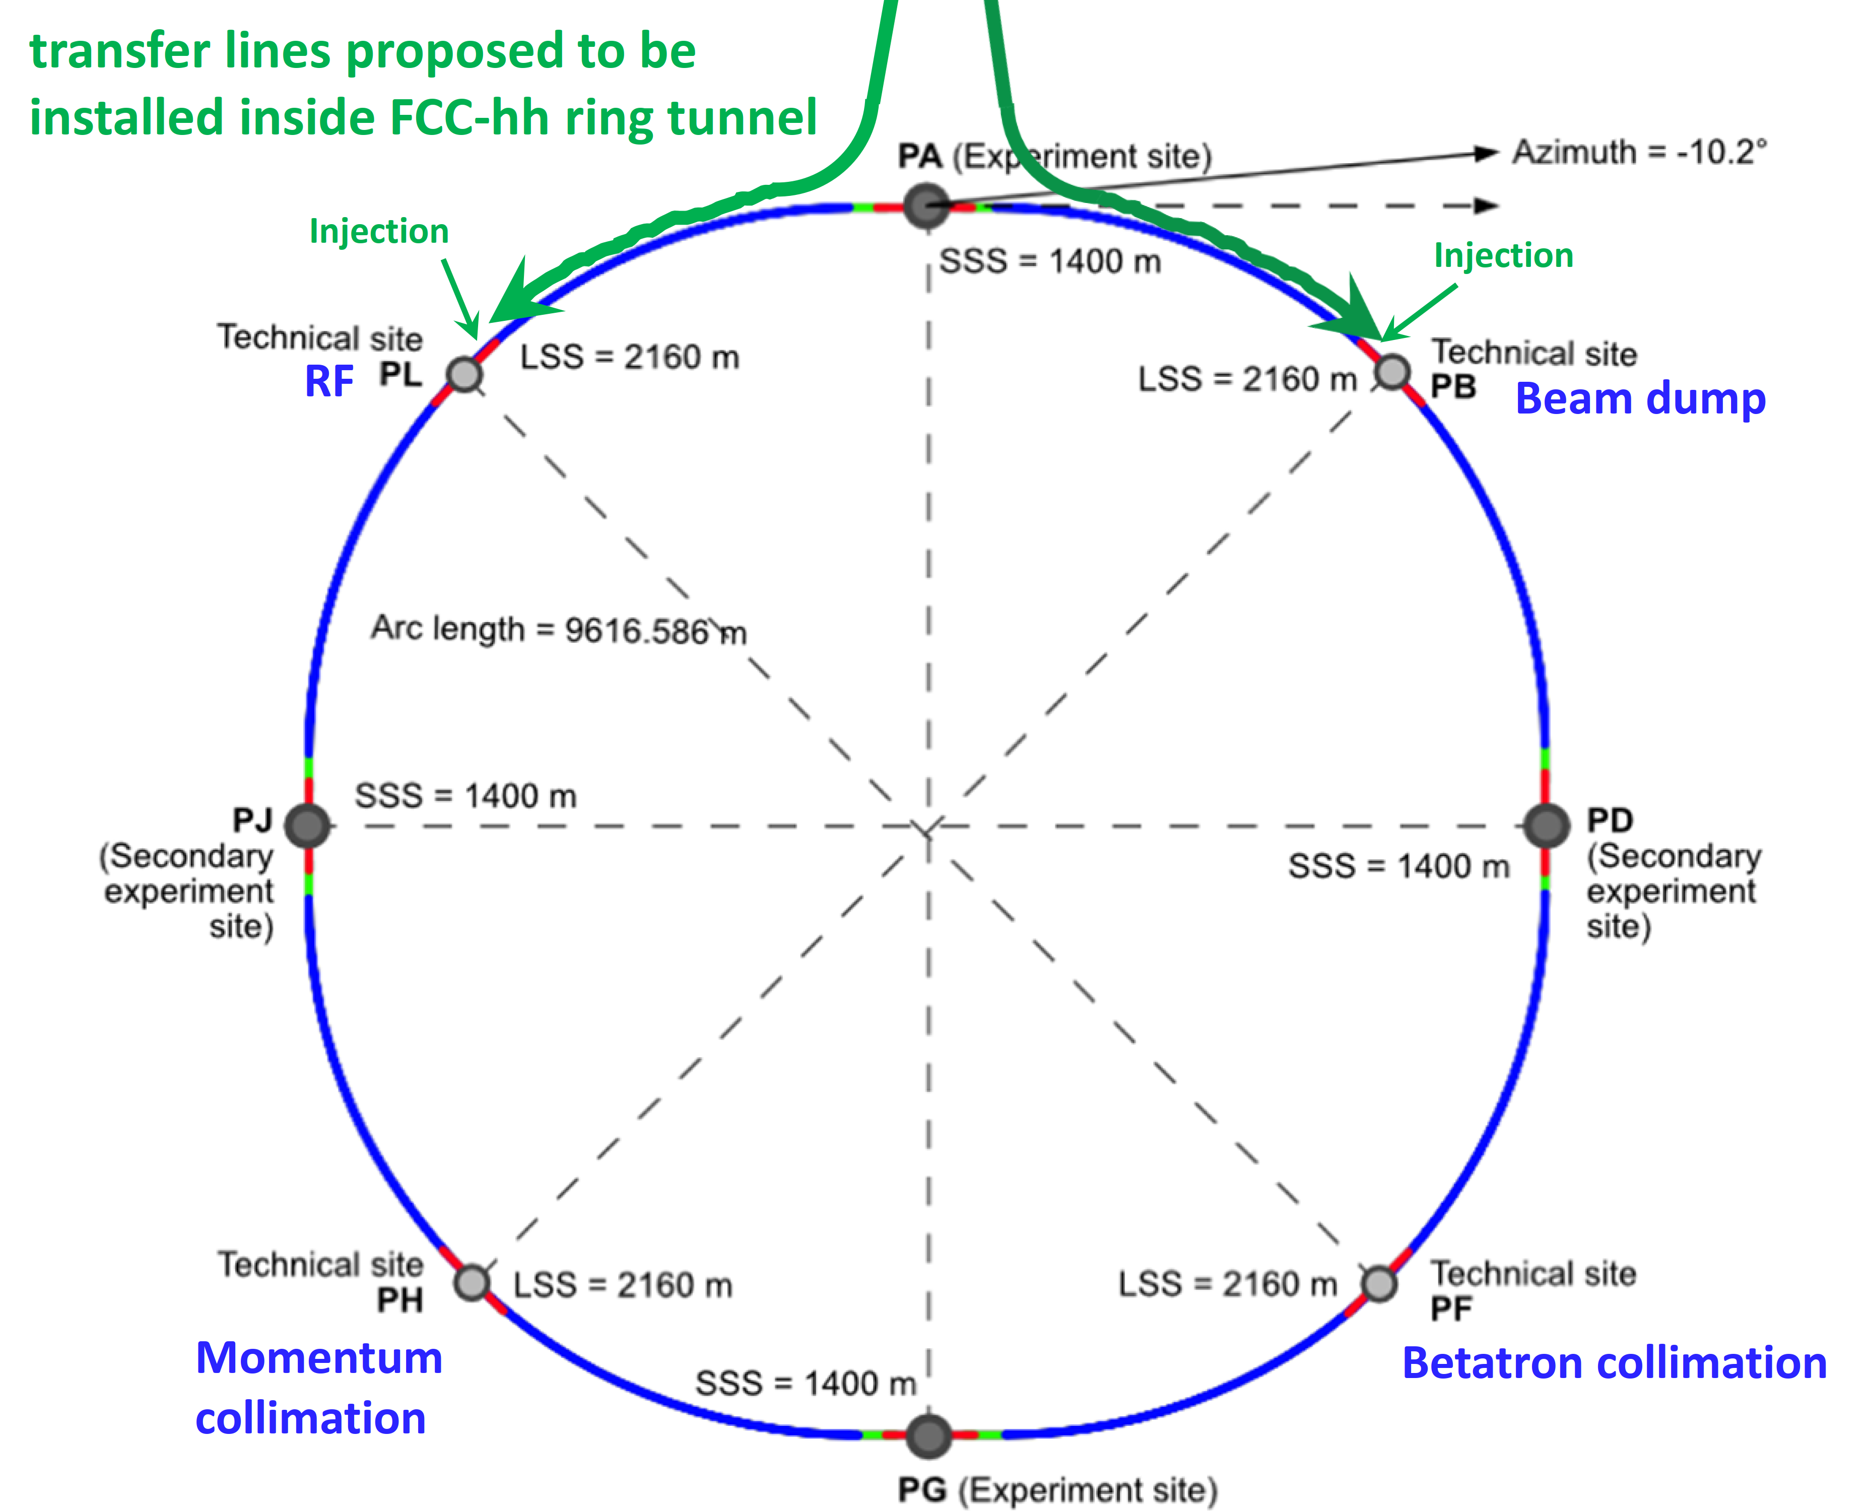
The FCC integrated program
inspired by successful LEP – LHC programs at CERN
comprehensive long-term program maximizing physics opportunities
stage 1: FCC-ee (Z, W, H, $\text{t}\overline{\text{t}}$) as Higgs factory, electroweak & top factory at highest luminosities
stage 2: FCC-hh (~100 TeV) as natural continuation at energy frontier, with ion and eh options
complementary physics
common civil engineering and technical infrastructures, building on and reusing CERN’s existing infrastructure
FCC integrated project allows seamless continuation of HEP after completion of the HL-LHC program
FCC-ee
FCC-hh
2020 - 2040
2045 - 2060
2070 - 2090++

Slide 18
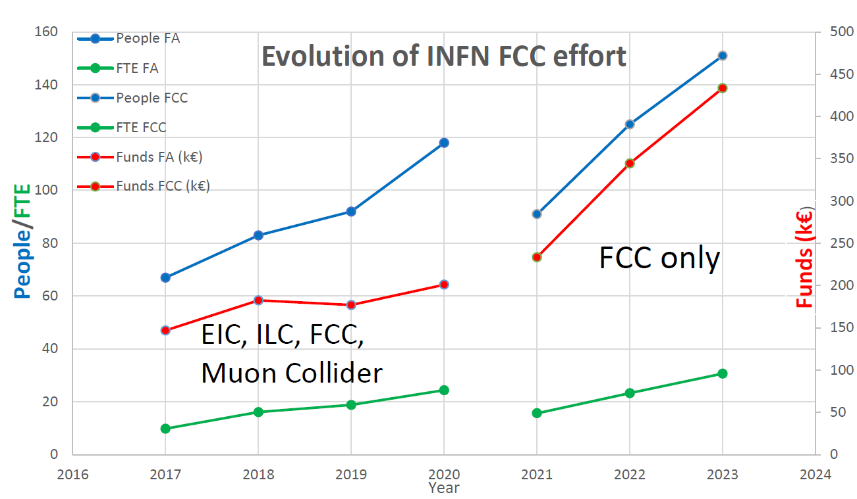

Slide 19
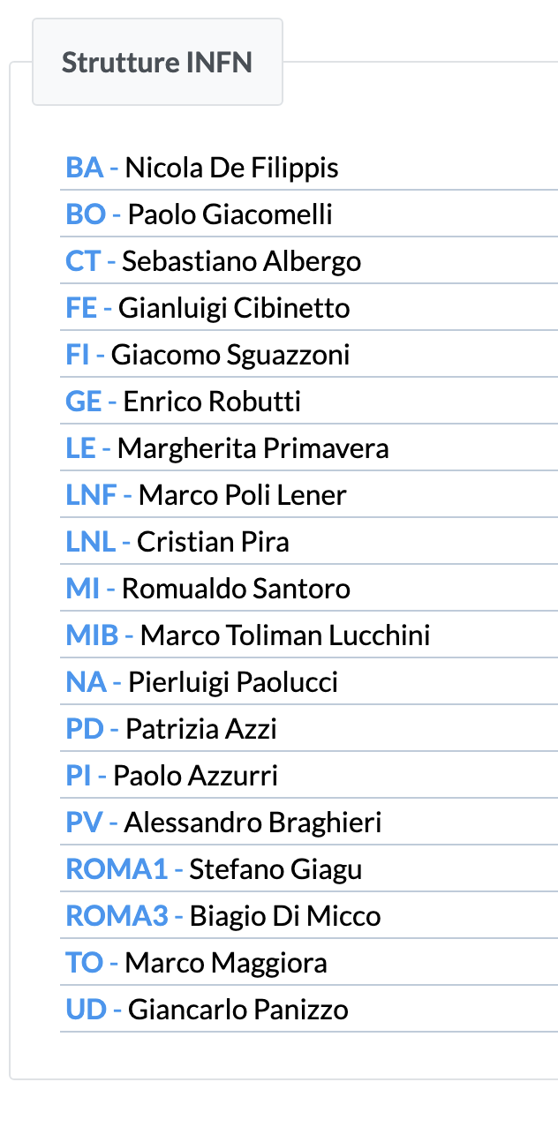
Gruppo di Napoli 2023
Partecipano senza una percentuale
Vincenzo Izzo
Mario Merola
Mariagrazia Alviggi
Gianpaolo Carlino

