Slide 1
ATLAS Report 2022
MDP a nome del gruppo ATLAS Napoli

Slide 2
Chi siamo
Acampora Giovanni
Aloisio Alberto
Alviggi Mariagrazia
Auricchio Silvia <-- fine PhD
Camerlingo Maria Teresa
Canale Vincenzo
Carlino Gianpaolo
Cirotto Francesco
Conventi Francesco
D'Avanzo Antonio <-- Borsista neolaureato
de Asmundis Riccardo
Della Pietra Massimo
Di Donato Camilla
Doria Alessandra
Iengo Paolo
Izzo Vincenzo
Massarotti Paolo
Merola Leonardo
Rossi Elvira
Russo Guido
Schiattarella Roberto
Spisso Bernardino
Sekhniaidze Givi
Vitiello Autilia
Grazie a tutti quelli che hanno contribuito a mettere su questo report!

Slide 3
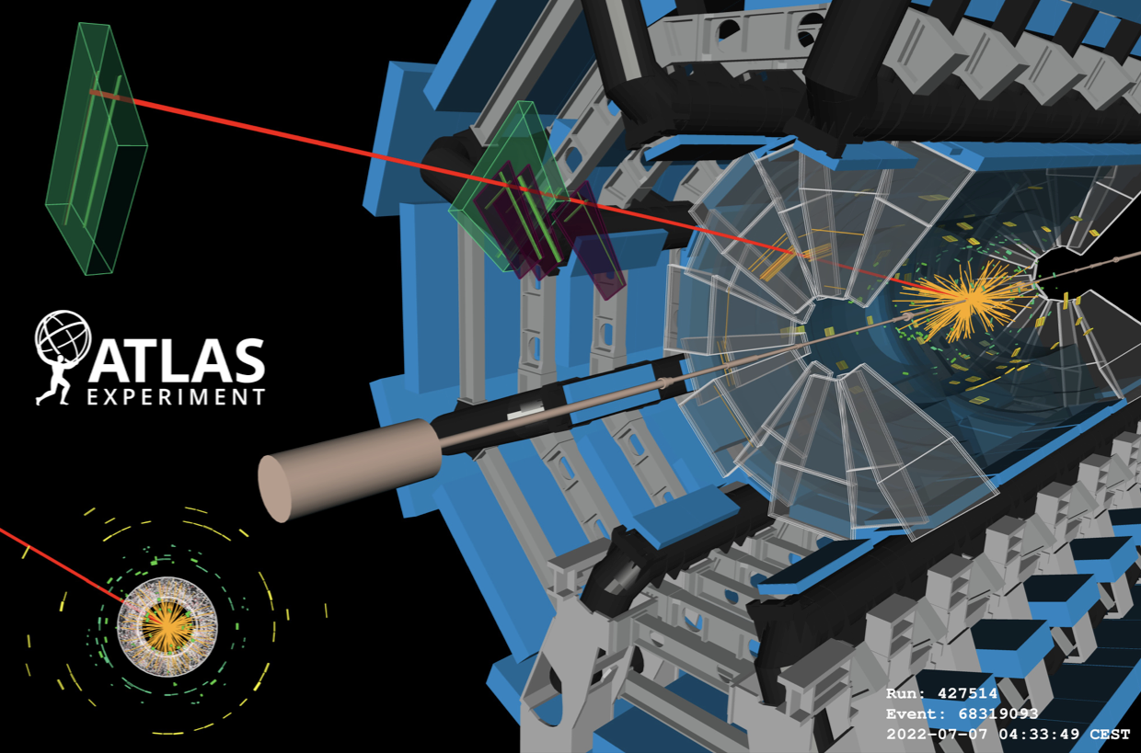
ATLAS RUN 3
LHC:
  Nuova energia: 13.6 TeV
  Massimizzazione della luminosità integrata (𝛽* leveling)
ATLAS
  Nuovi detector + elettronica installati (NSW, L1Muon, LAr + L1Calo, L1Topo, CTP)
  Upgrade del TDAQ
  Programma di fisica vasto su RUN3 e completamento delle analisi per il RUN2
Event display con NSW!

Slide 4
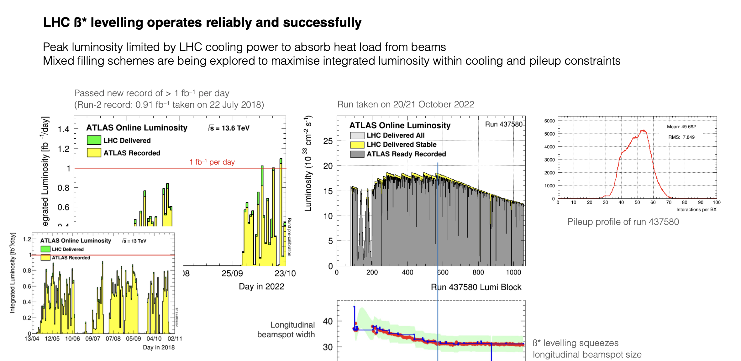
LHC luminosity production

Slide 5
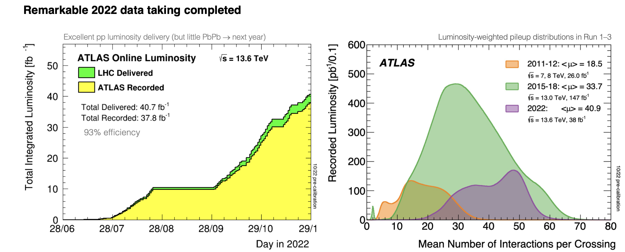
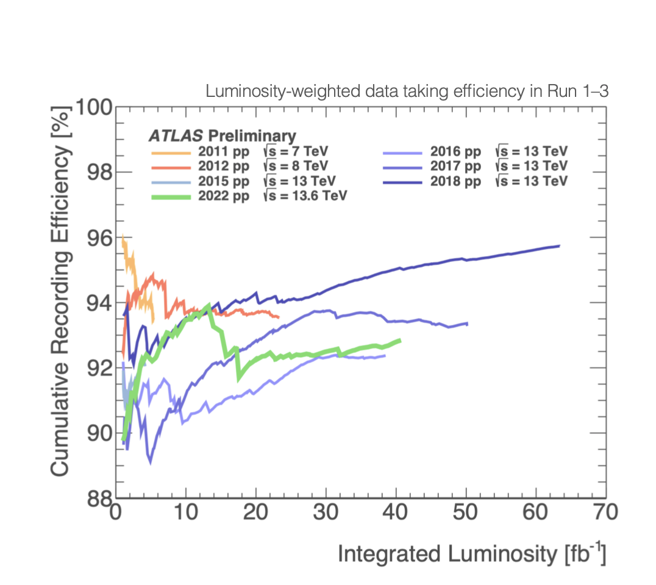
ATLAS Data taking
Livello finale di efficienza DAQ dell'ordine del 93%
Buon livello di performance raggiunto nonostante l'elevato pile-up
Alcuni degli upgrade di Fase I ancora non al meglio del funzionamento, ma buon funzionamento generale
Limiti strutturali al DAQ/Dataflow che saranno risolti durante YETS

Slide 6
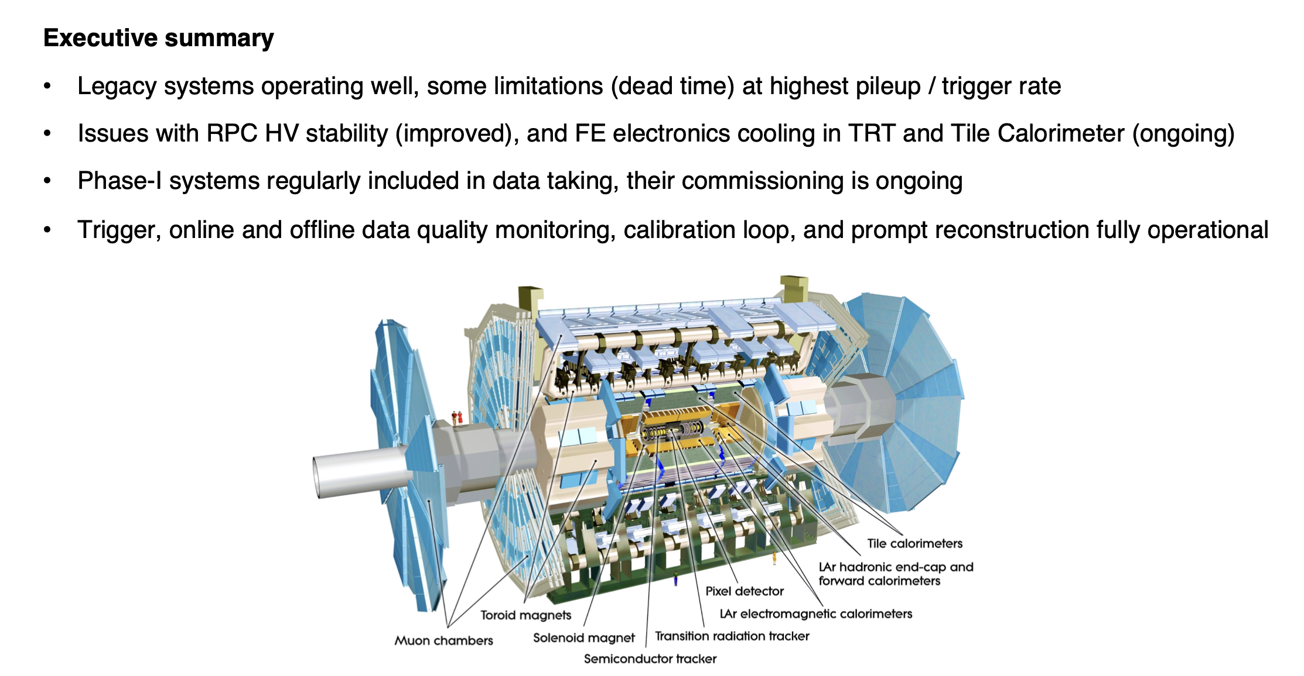
Detector Status

Slide 7
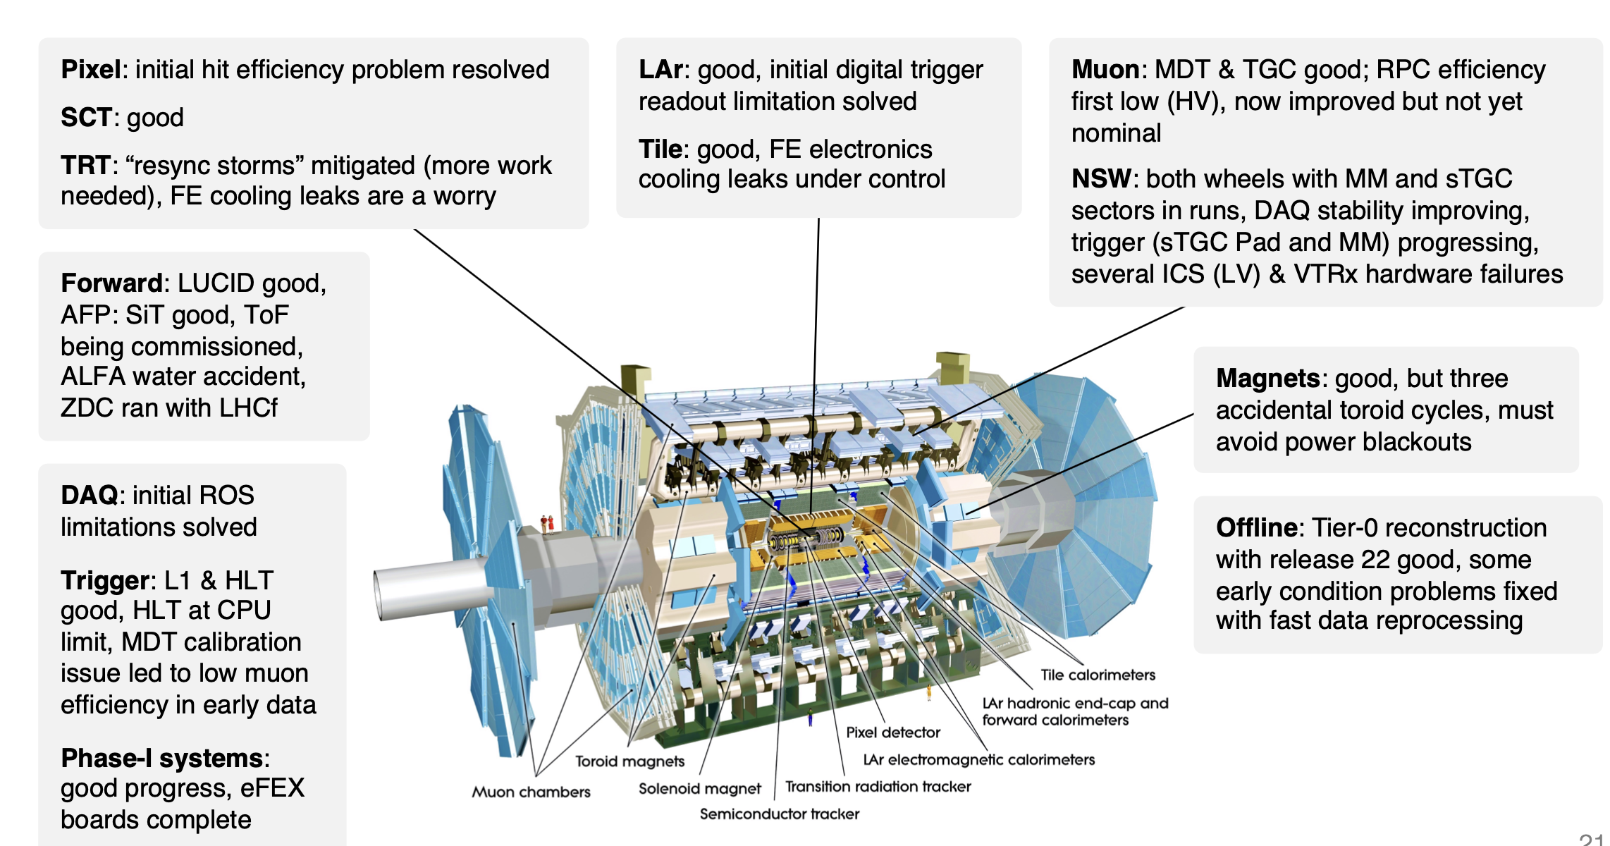
Detector Status

Slide 8
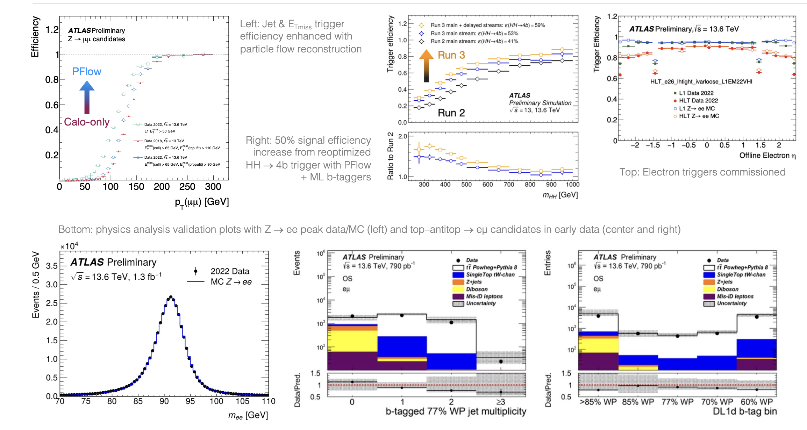
Trigger and reconstruction status

Slide 9
ATLAS NA Contribution to L1 Trigger and operation
Della Pietra M, Izzo V, Rossi E., Conventi F, D'Avanzo A

Slide 10
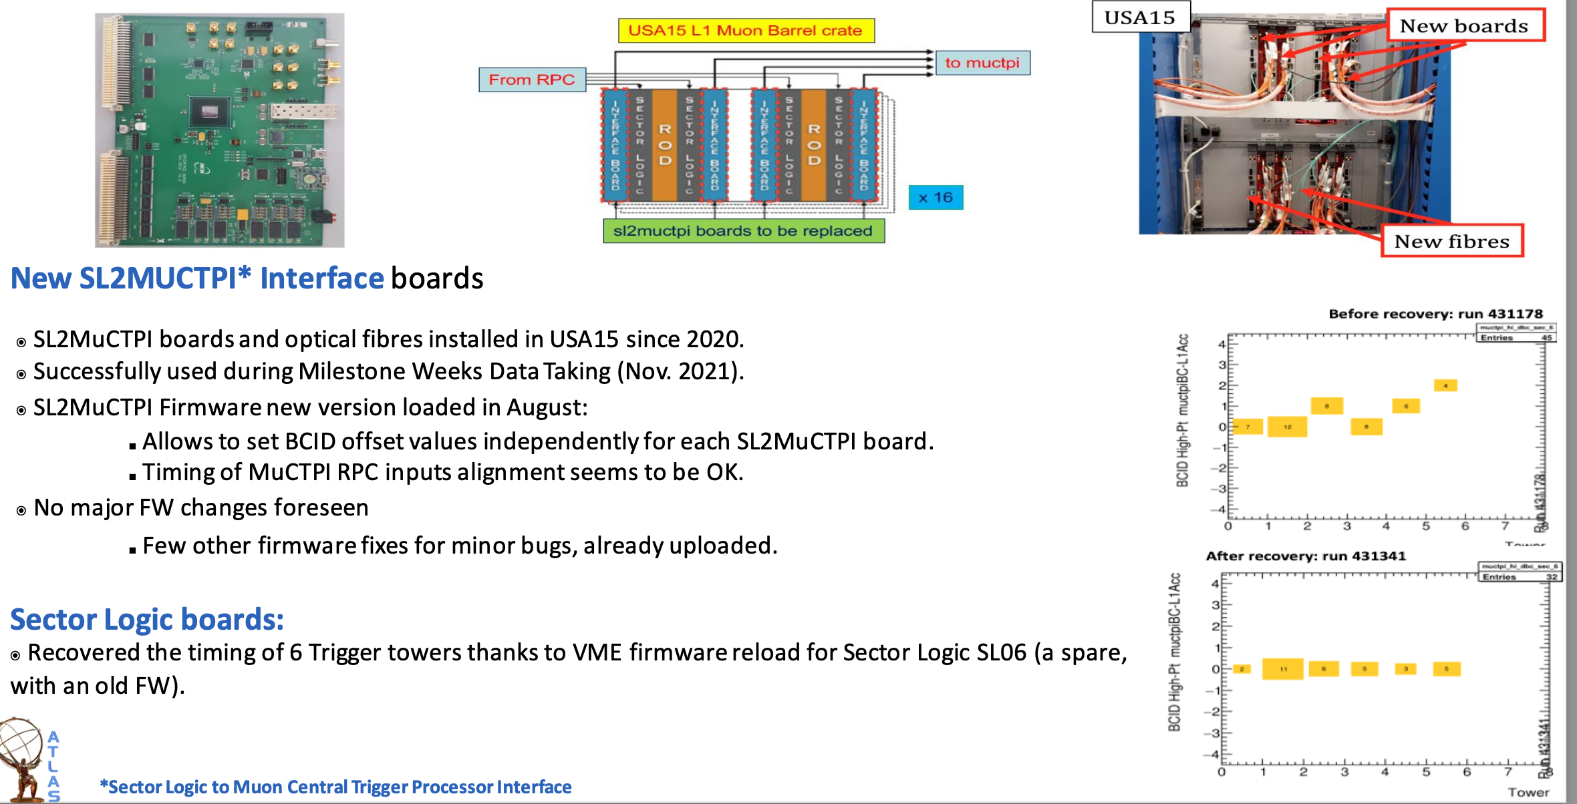
Hardware Phase I upgrade in L1MuonBarrel

Slide 11
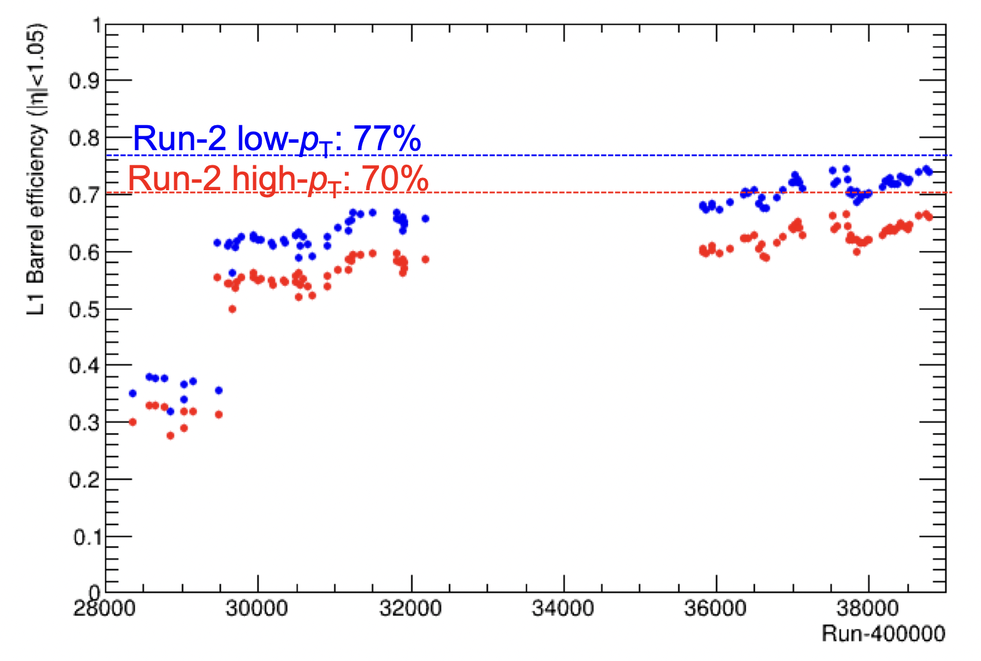
L1 Trigger efficiency recovery
At the beginning of RUN3 the L1MUB efficiency was very poor due to RPC problems with gas volumes
Orthogonal Trigger in physics_Main Stream
Big effort of whole community
RPC gas recovery campaign
Relaxed majority
Problem with resynchronization of problematic RPC towers:
  The whole sector started to trigger at wrong BC after resynch.
  This was eventually solved with the help of MuCTPi software.
In best runs, efficiency for high-PT was close to 67%
Comparable results using T&P method
After technical stop efficiency still increasing thanks to relaxed majority keeping rate under control
+ 22 towers relaxed maj.
2/4 on phi view
Fine time calibration
HV recovery
Sector s06 timed in
+ 8 towers relaxed maj.
Main HV recovery
8 towers relaxed maj.

Slide 12
ATLAS NA Contribution to NSW
Alviggi MG, Camerlingo MT, Canale V, Della Pietra M, Di Donato C, Iengo P, Izzo V, Massarotti P, Sekhniaidze G
C. Cassese, B. De Fazio, L. Panico, D. Trotta
Current responsibilities (P. Iengo): NSW Deputy PL, Micromegas project coordinator, Micromegas operation coordinator

Slide 13
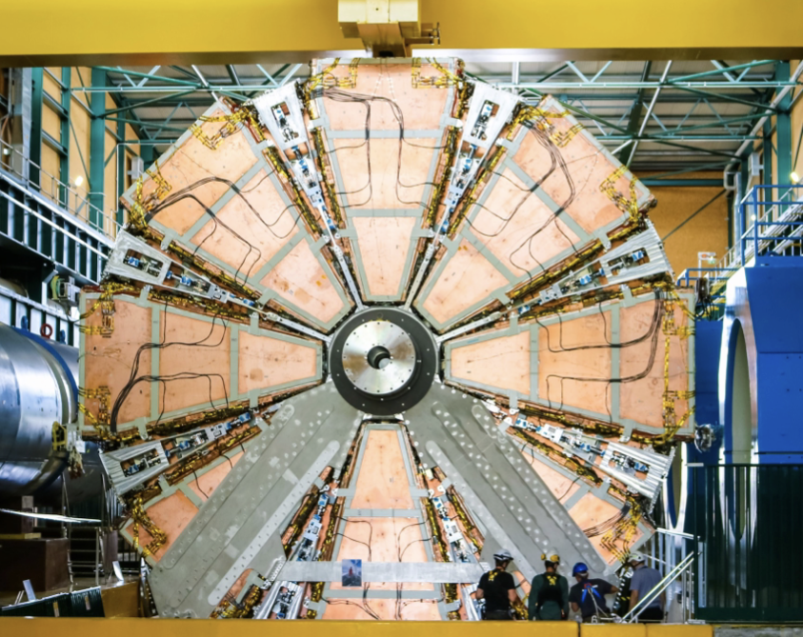
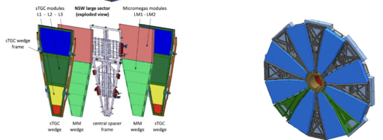
ATLAS NSW
New Small Wheel: largest ATLAS Phase-1 project
2 end cap muon stations.
16 detector sectors per station (8 large, 8 small).
16 detector planes per sector:
8 small-strip Thin Gap Chambers wedges (sTGC)
8 micromegas (MM) wedges

Slide 14
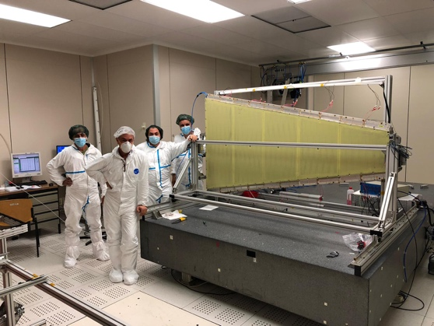
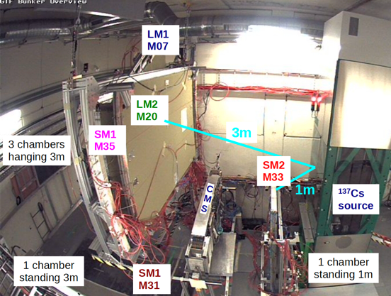
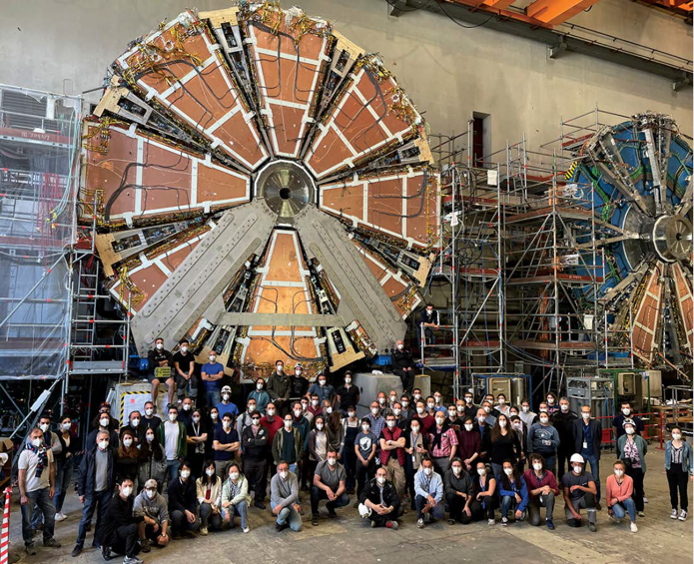
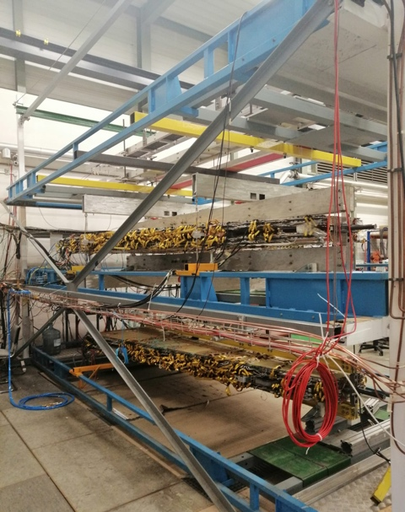
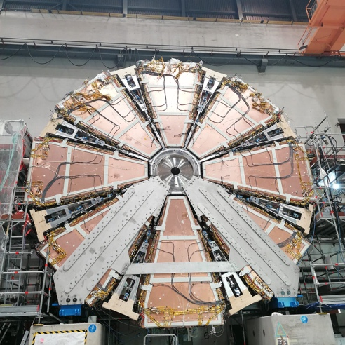
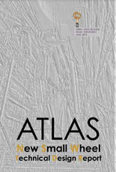
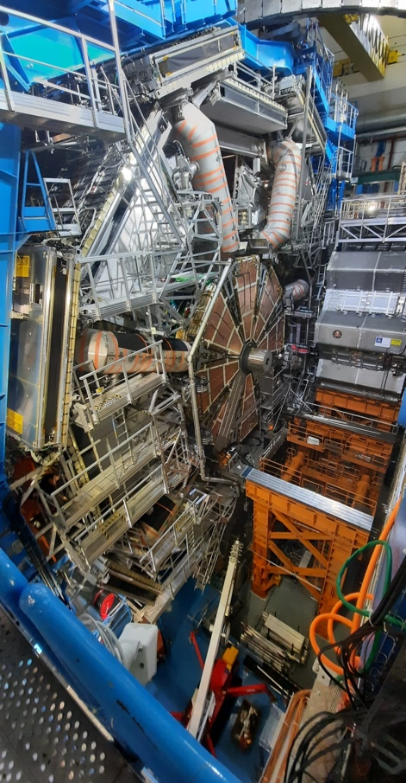
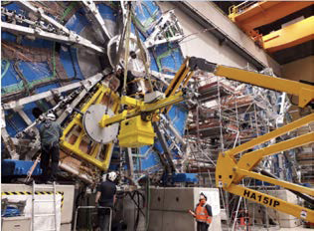
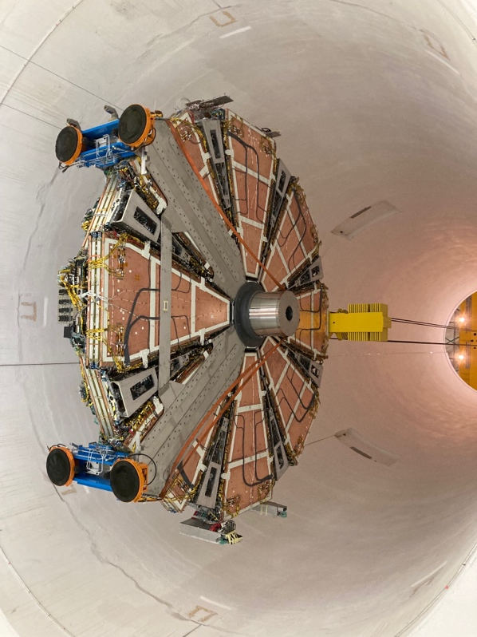
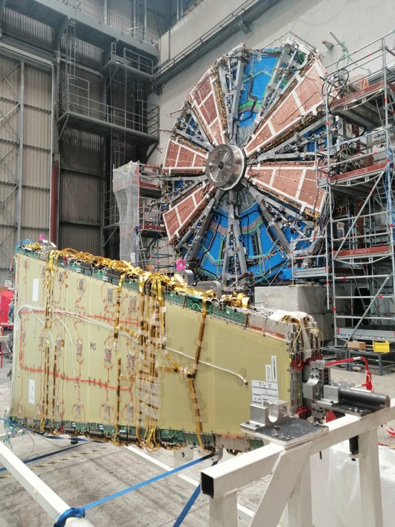
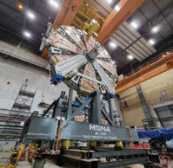
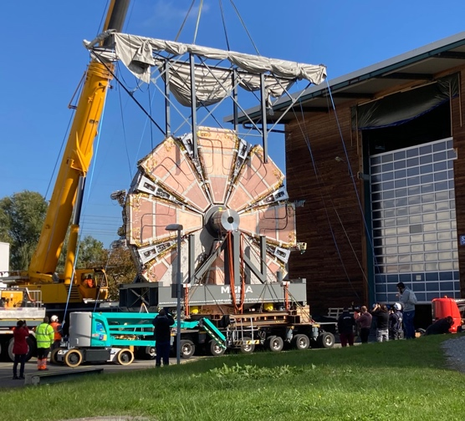
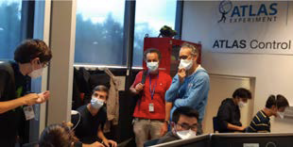
Roadmap from TDR to Operation!
NSW A End Surface Commissioning
18/06/21
MM validation of the ternary gas mixture 2018-2022
Integration at
CERN
2019-2021
ATLAS TDR
NSWs Underground
Commissioning
10/21-04/22
Module production
2018-2020
9 anni di impegno del gruppo di Napoli
NSW C End Surface Commissioning
08/10/21
2013
2019
2020
2021
2022
NSW A to the cavern
12/07/21
NSWs Running in ATLAS
since 05/22
1° sector on the Wheel
12/2019
NSW C to the cavern
Surface Commissioning
2019-2021

Slide 15
NSW HV/LV Status
NSW HV and LV status:
A: ^{HV pcb by pcb}
HV
A
C
2 Drifts not working:
A2 SM1 IP Layer 3, C15 LM1 IP Layer 2
C: ^{HV pcb by pcb}
LV
A
C
Hardware failure as from Low Voltage known issues that cannot be solved during standard interventions.
Wheel A:
- A4 affecting 8 MMFE8
- A6 affecting 16 MMFE8
- A14 affecting 8 MMFE8

Slide 16
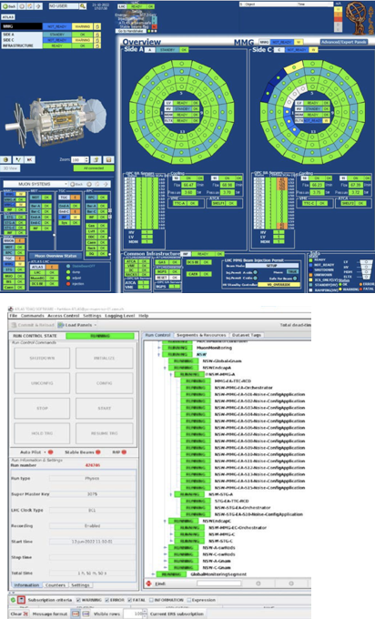
DAQ Status
NSWs successfully integrated into the ATLAS Muon Central DCS and in the ATLAS TDAQ
DCS fully working and stable
Some instabilities observed in the DAQ
  NSW employs new generation DAQ developed for the ATLAS Run-3:
  FELIX (Front End LInk eXchange) system + software ROD (swROD)
  —> Extremely tight schedule for DAQ commissioning
  Many calibrations required for the detector and DAQ operation:
  optimization of Front-end analog circuits, correct timing of
  detectors, data communication stabilities…
  Experienced DAQ instabilities with Felix buffer filling and data link
  de-synchronization while including more sectors or at higher
  (>10kHz) trigger rate —> expert work continuing to improve stability
Integration in the ATLAS TDAQ partition since May:
from a few sectors to entire wheel.
5/Jul-Nov22 -> Early Run3 started! NSW have been joining
the ATLAS data taking with nice results!

Slide 17
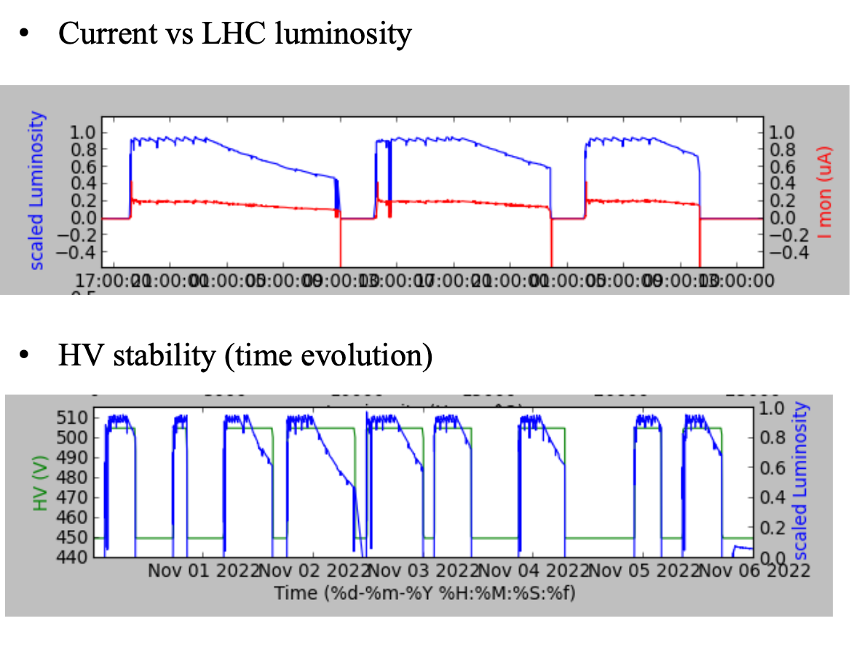
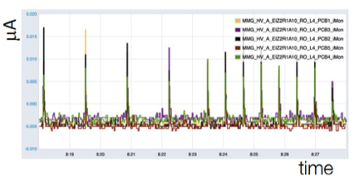
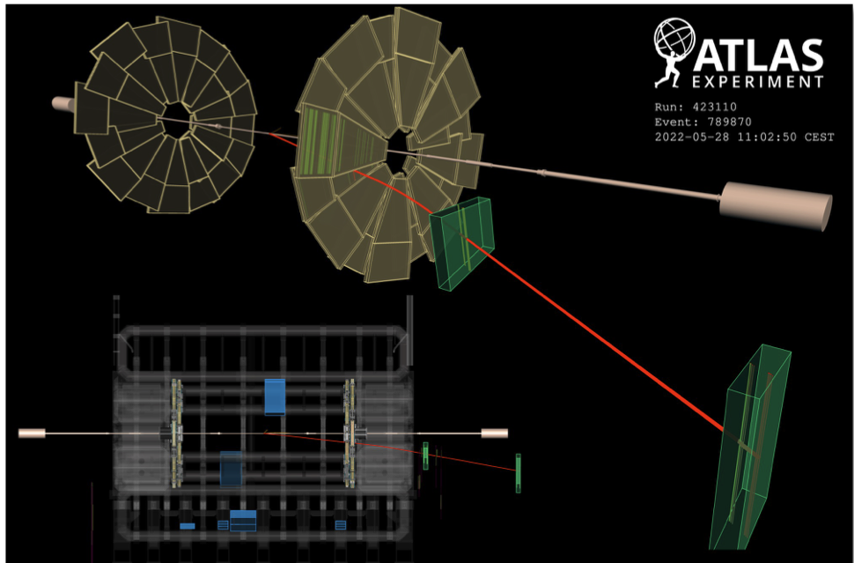
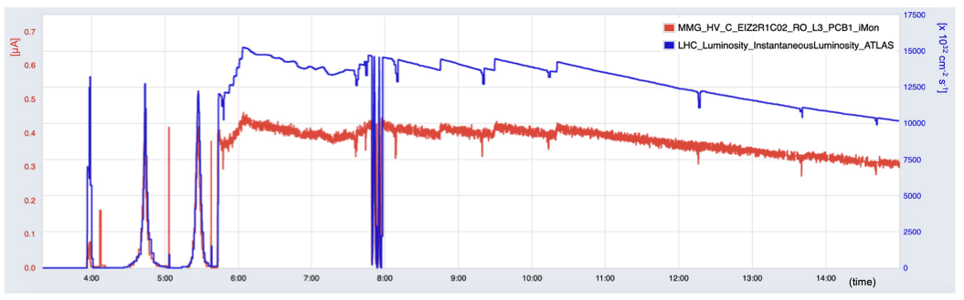
Detector response
Napoli è impegnata nel
monitoraggio della stabilità del detector
Splash events (7 May 2022) seen by the Micromegas: current peaks at each event
Time correlation between MM current and LHC luminosity (November 2022)
Muon reconstructed in the NSW Micromegas from pp collisions (28 May 2022)

Slide 18
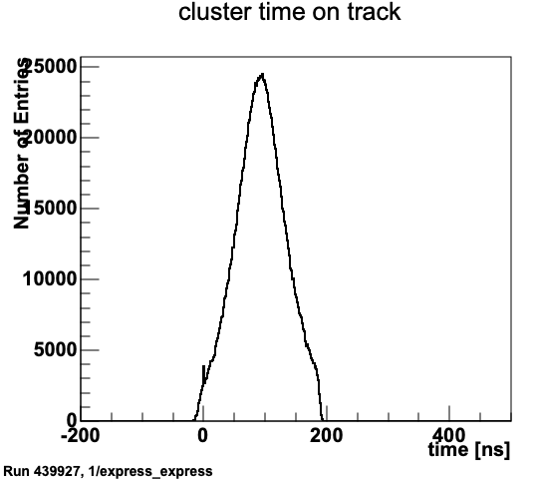
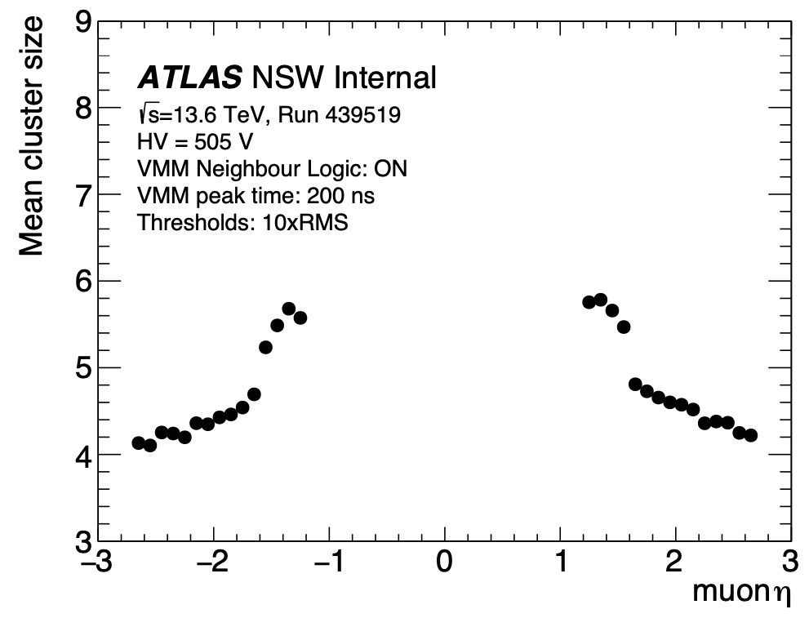
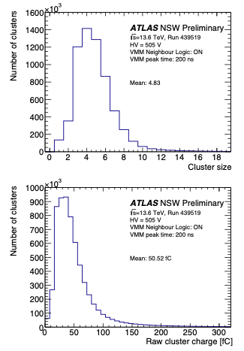
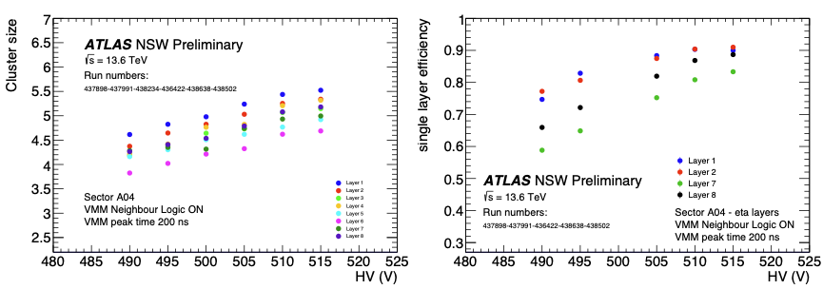
Preliminary performance studies
Cluster size vs Eta
Performance studies are affected by DAQ instabilities
Software and reconstruction under optimisation
Results are very preliminary
—> Full system still undergoing tuning and optimisation
Time alignment adjusted at sector level
Need tuning at MMFE8 /VMM level
Cluster size
Cluster size vs HV
Single layer efficiency vs HV
(DAQ inefficiency not removed)
Cluster charge

Slide 19
ATLAS NA Contribution to PHYSICS
F. Conventi – E. Rossi – F. Cirotto – A. D'Avanzo – S. Auricchio - R. Schiattarella – G. Acampora – A. Vitiello

Slide 20
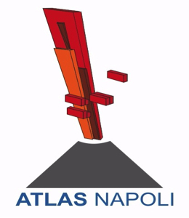
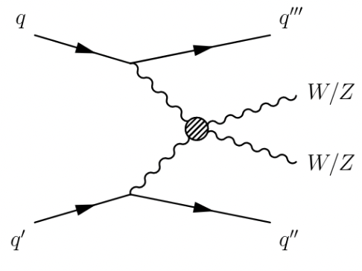
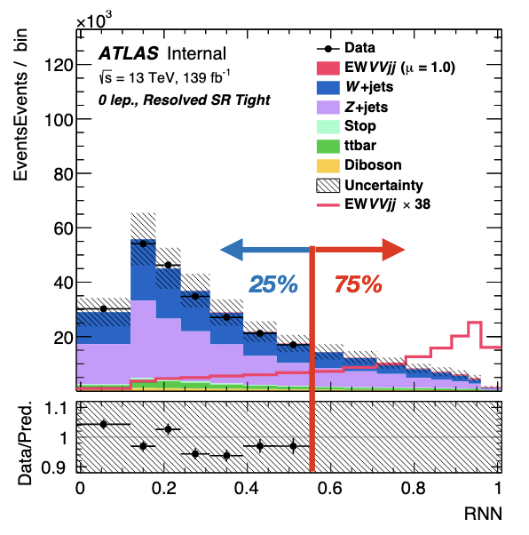
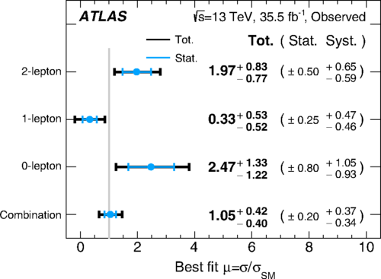
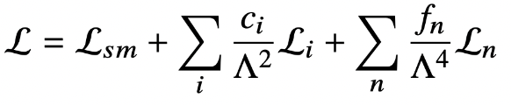
VBS VV semi-leptonic
13 TeV, L=139 fb⁻¹
STDM-2018-23
Study EW WW/WZ/ZZ production in semi-leptonic final states
Limits on anomalous-QGC (Quartic Gauge Coupling) in EFT
Focus on SM Vector Boson Scattering (VBS)
Previous analysis on 36 fb⁻¹ dataset with observed 2.7𝜎 (PhysRevD.100.032007)
ML approach to build the final discriminant with RNN
Background:V+jets; ttbar
➡ Aim for observation!
Limits on anomalous QGC:
VBS is a key diagram for probing QGC of EWK sector
New physics introduced by anomalous-QGC can be described via EFT:
Limit on Wilson coefficients for different operators
soon updated public results ➔ Elvira paper’s editor, analysis in final stages of approval

Slide 21
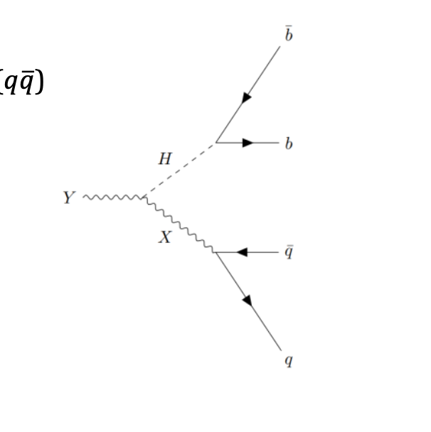
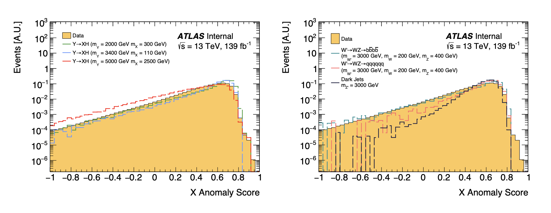
Fully-hadronic Y->Xh: First application of Anomaly detection in ATLAS
Model-independent discovery region introduced with novel data-driven anomaly score (AS)
AS determined from fully unsupervised variational recurrent neural network (VRNN) trained over jets modeled as sequence of constituent four-vectors.
  Tested on YXH signal samples
  Tested for NON-2 prong signal jets
High (~1-6TeV) Y mass resulting in X and H boosted
Y Reconstructed with two large-R jets
Object Reconstruction:
H Candidate: XbbTagger @60% WP + mass window (75GeV < mH < 145GeV)

Slide 22
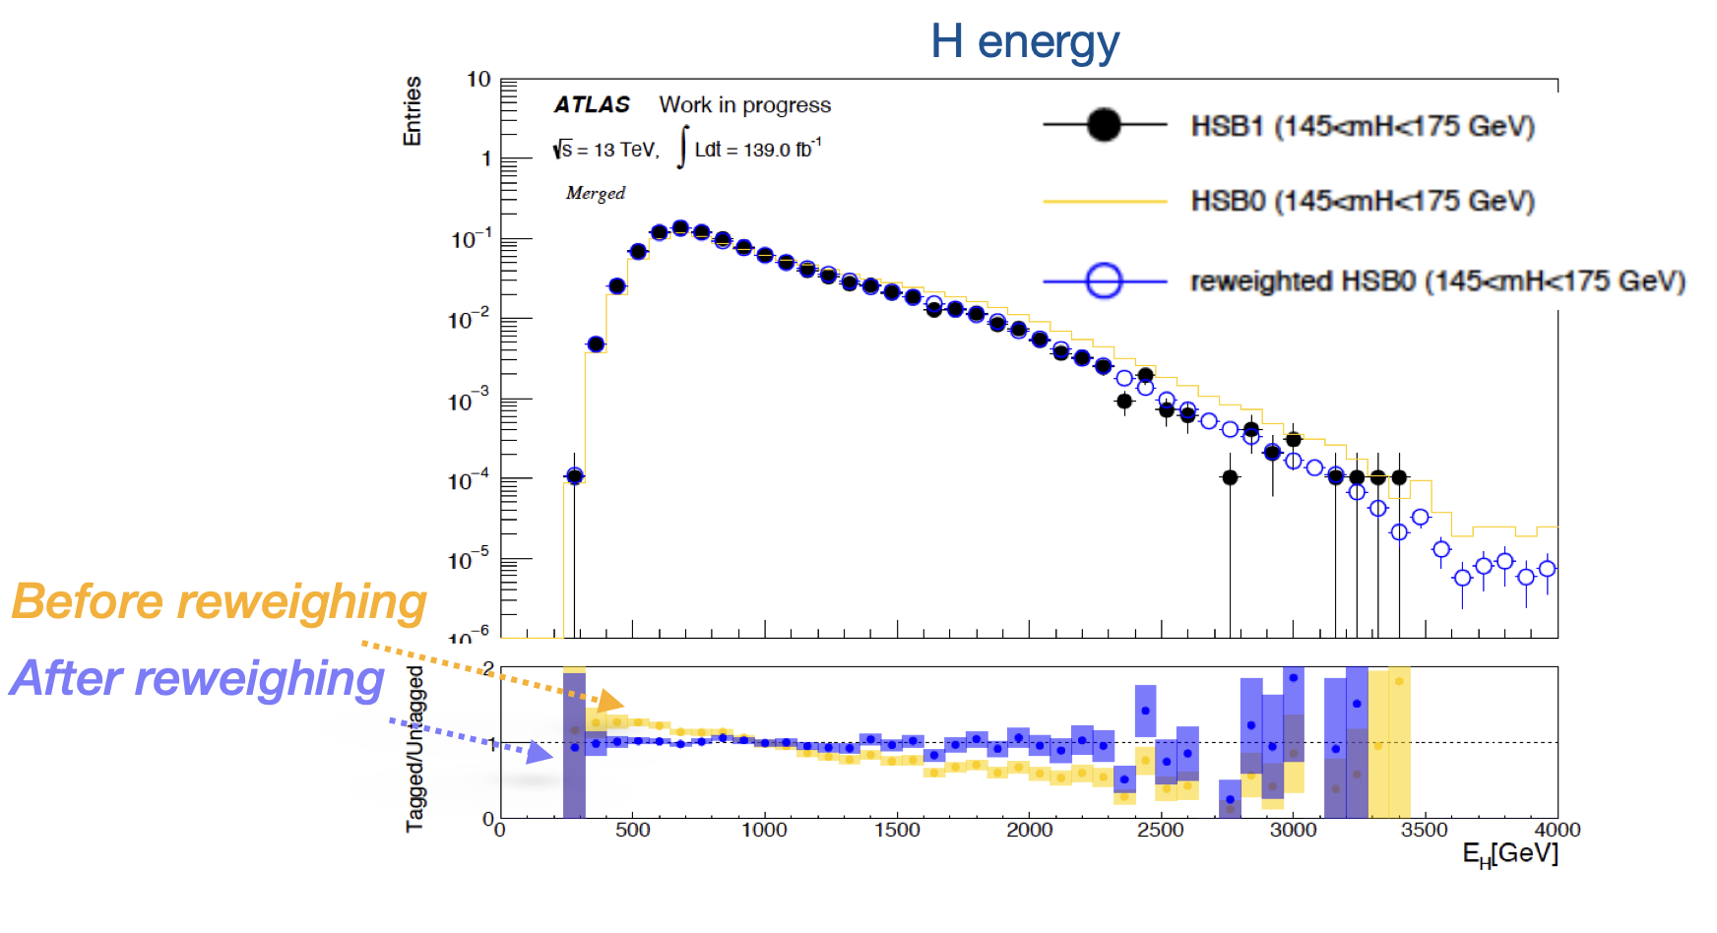
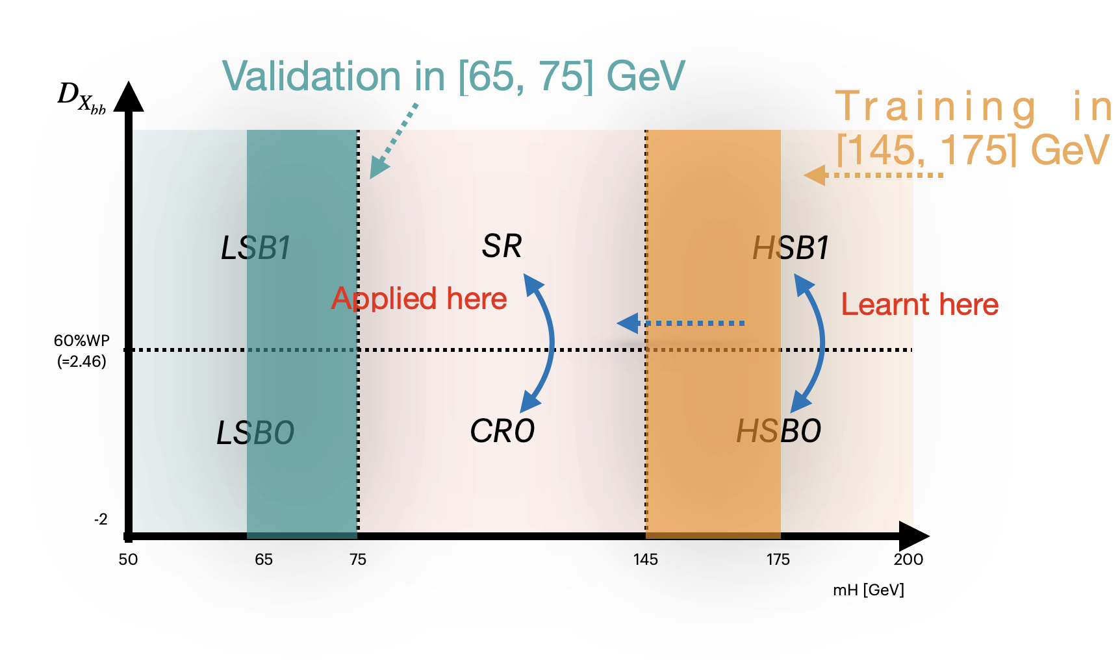
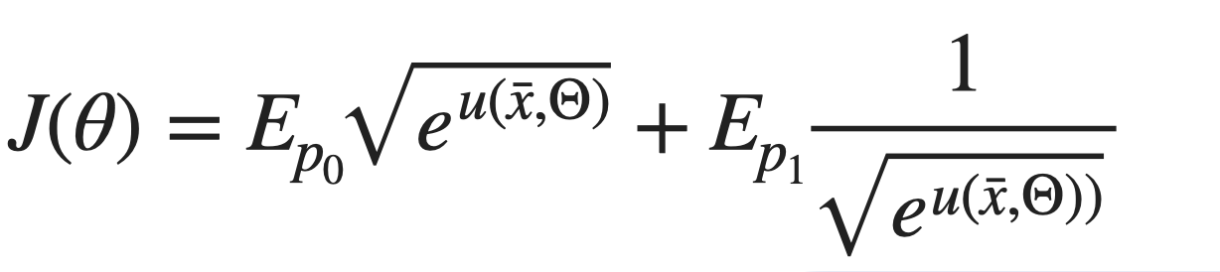
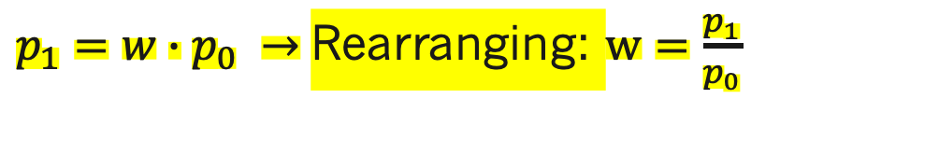
A Deep Neural Network for background reweighting
(Ref: [1] [2])
Direct importance estimation
In the YXH analyses a DNN has been applied for estimating the likelihood ratio between two kinematic regions and obtaining reweighting factor for the background estimation in the signal region
$p_{1}=w∙p_{0} →$Rearranging: $w=\frac{p_{1}}{p_{0}}$
DNN trained on Data inputs:
  H four-momentum
  Ntracks associated to H
  Leading and subleading track jets associated to H:
Minimized loss function
Silvia's PhD Thesis

Slide 23
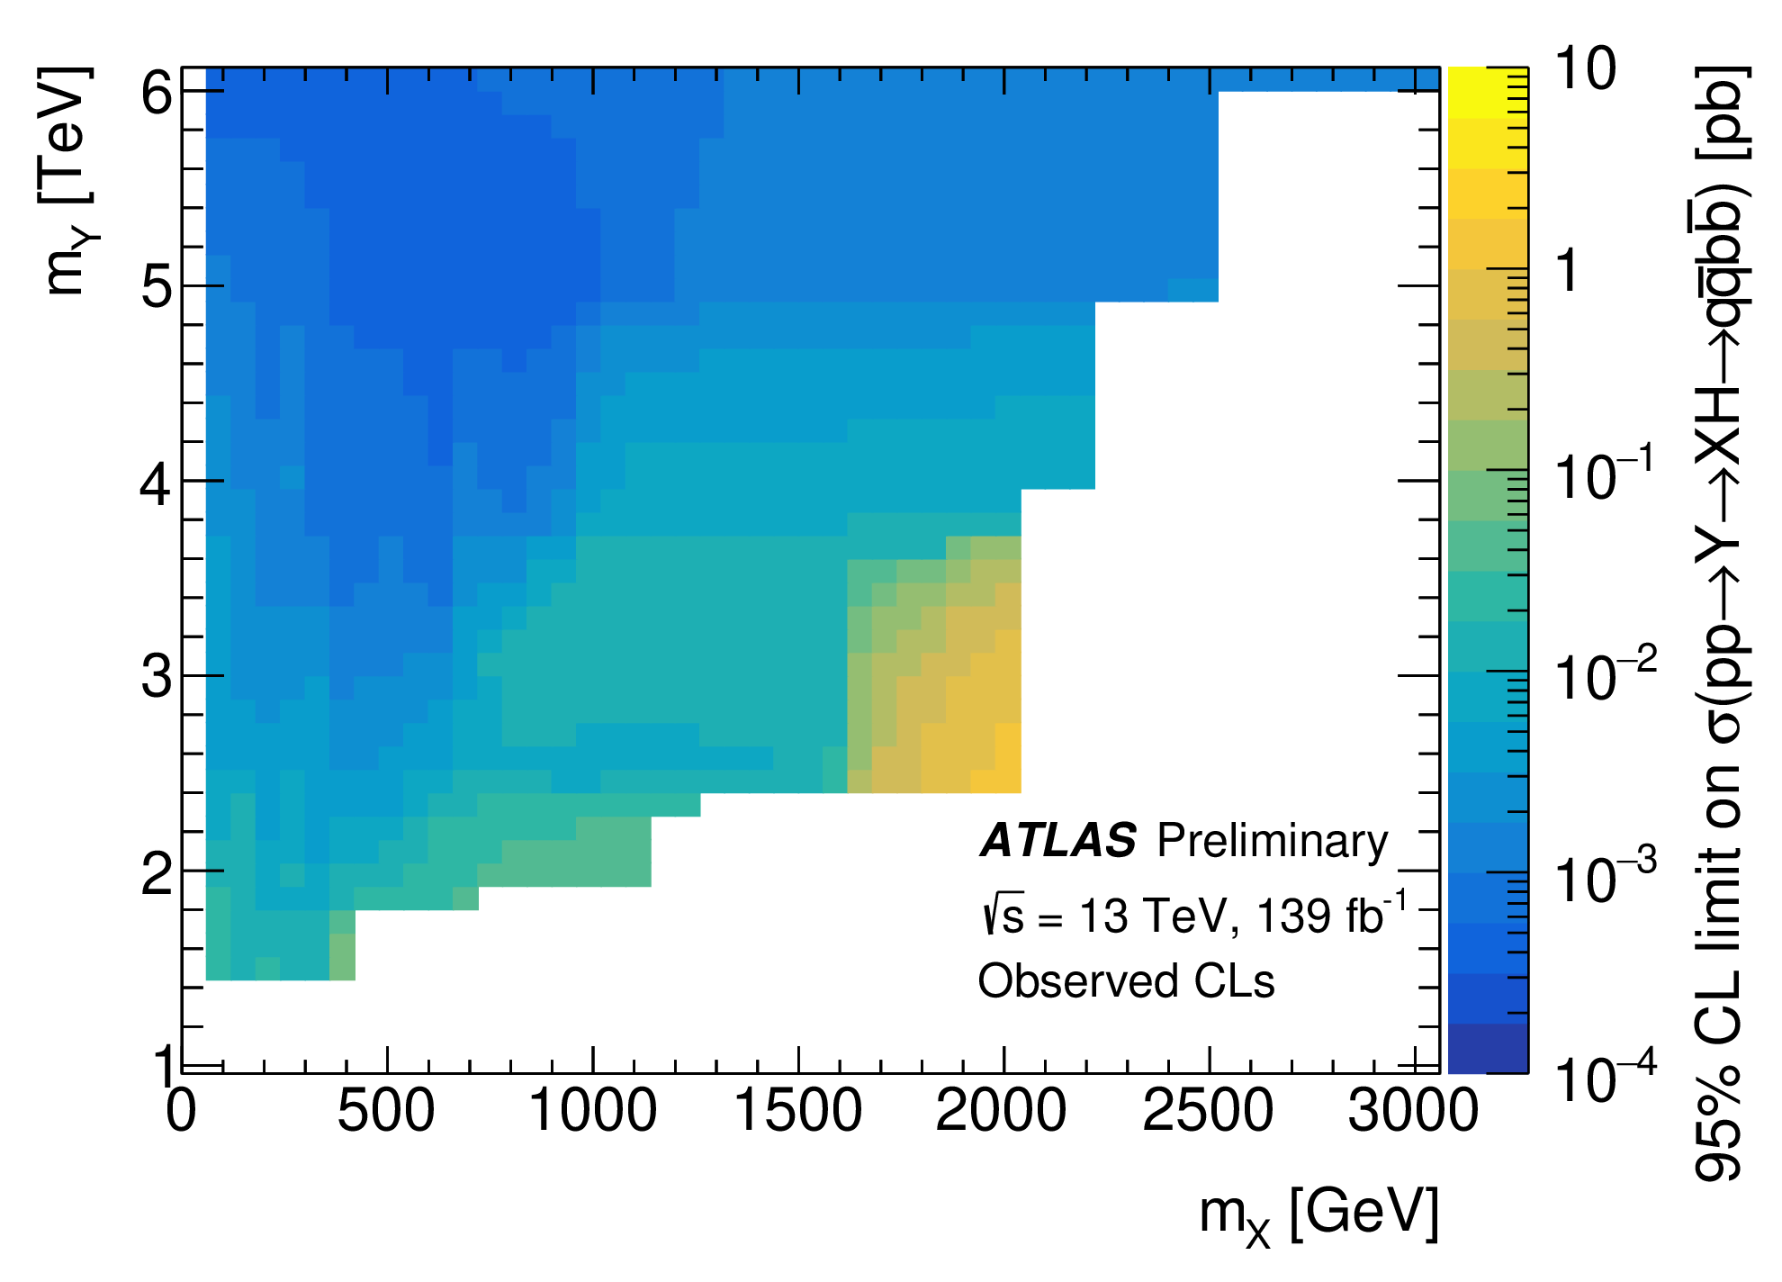
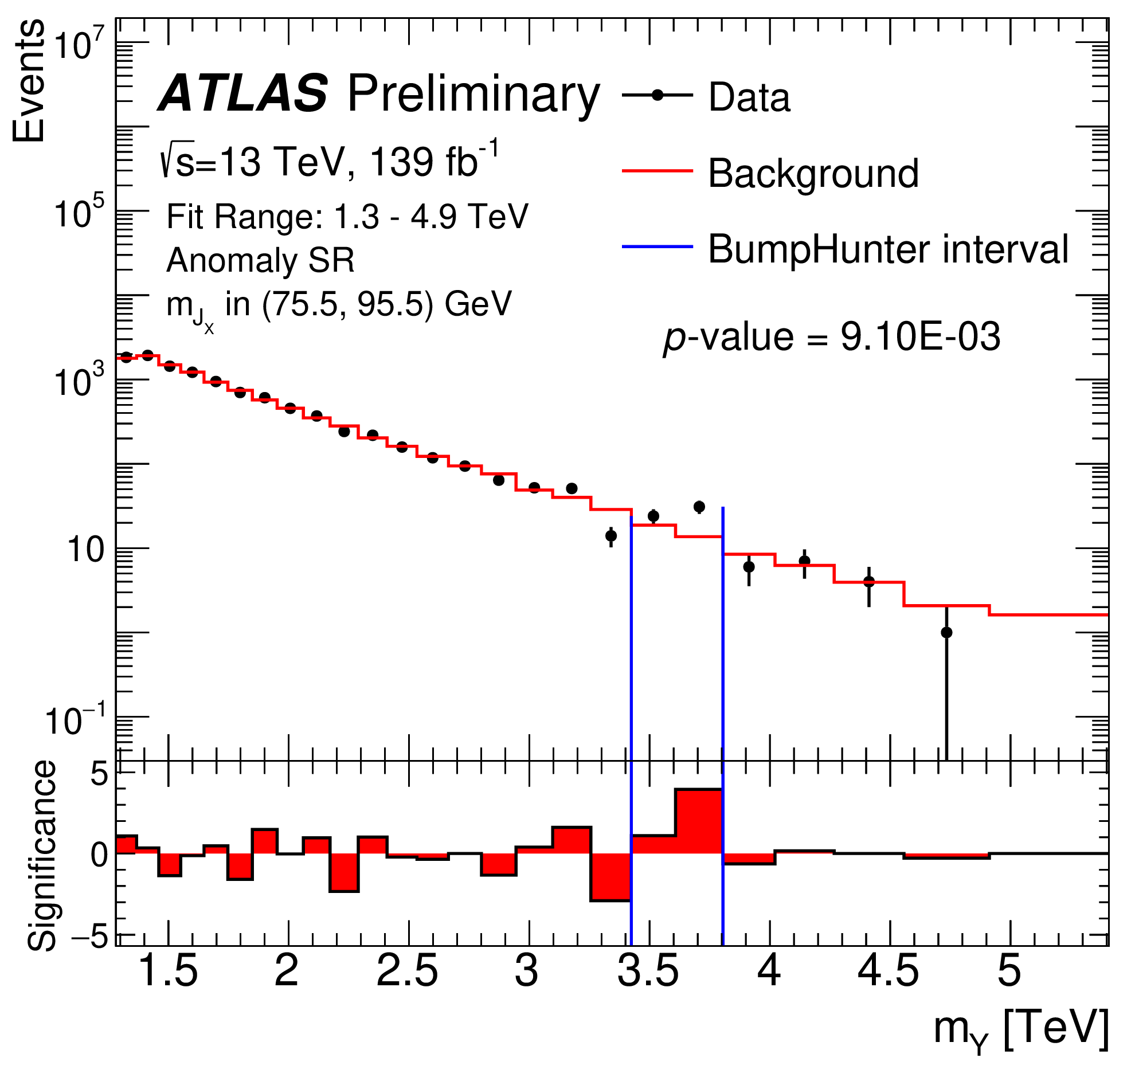
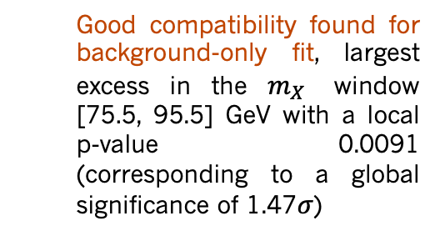
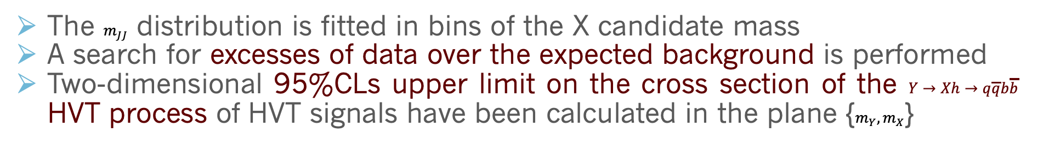

Fully-hadronic Y->Xh results
  ATLAS-CONF-2022-045
The $m_{JJ}$ distribution is fitted in bins of the X candidate mass
A search for excesses of data over the expected background is performed
Two-dimensional 95%CLs upper limit on the cross section of the $Y→Xh→q\overline{q}b\overline{b}$ HVT process of HVT signals have been calculated in the plane {$m_{Y},m_{X}$}
  Good compatibility found for background-only fit, largest excess in the $m_{X}$ window [75.5, 95.5] GeV with a local p-value 0.0091 (corresponding to a global significance of 1.47$σ$)
Global significance
$$1.47σ$$
Francesco Conventi paper’s editor, Francesco Cirotto internal note’s editor,
paper almost ready (2nd circulation)

Slide 24
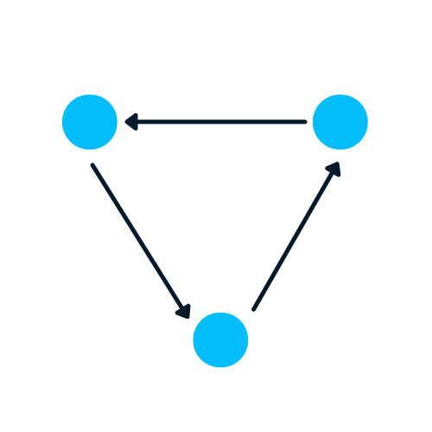
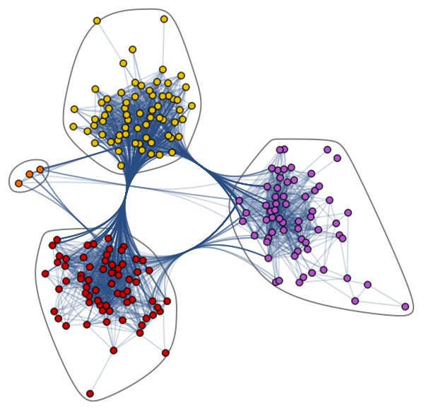






Graph anomaly detection in Diboson searches
Applying Graph Neural Network for performing anomaly detection
A Graph is the type of data structure that contains nodes and edges. A node can be a person, place, or thing, and the edges define the relationship between nodes. The edges can be directed and undirected based on directional dependencies.
node
edges
node
Graphs
Anomaly detection
edges
edges
node
Graph Neural Network (GNN) is a deep learning model that handles a graph as input data. Graph-structured data are ubiquitous across science and they are used to describe and analyse relations and interactions and they can encapsulate object or event information
Our strategy: to represent jets as graphs and then apply machine learning to build an anomaly detection algorithm
  Provide easier extension to variable multiplicity (many jets in the event)
  Targeting heavy resonance searches with hadronic final states ($A→BC→hadronic$)
Implementing a Graph Neural Network and testing on hadronic final states
  Two approaches under study for signal/background discrimination: supervised and unsupervised
  First GNN event level application in ATLAS!
Anomaly detection: Identification of rare items, events or observations which deviate significantly from the majority of the data and do not conform to a well defined notion of normal behaviour
➔ In HEP language: identify features of the data that are inconsistent with a background-only model or deviation from known SM processes
More information in Antonio’s lightning talk!

Slide 25

Quantum Fuzzy Logic
Classical Fuzzy Logic is a theory introduced by Lofti Zadeh with the idea to give computers the capability of dealing with uncertainty.
Fuzzy Logic is used to develop Control Systems based on linguistic rules, which are therefore highly interpretable.
In [1] a Quantum Fuzzy Control System is proposed. The main goal achieved by this approach is the exponential advantage in computing fuzzy rules on quantum computers over their classical counterpart.
[1] Acampora, Giovanni, Roberto Schiattarella, and Autilia Vitiello. "On the Implementation of Fuzzy Inference Engines on Quantum Computers." IEEE Transactions on Fuzzy Systems (2022).

Slide 26


Quantum Fuzzy Control Systems For Particle Accelerators
The Quantum Fuzzy Control System proposed in [1] has been tested for controlling the trajectory of particle beams in two real particle accelerator facilities at CERN:
  T4 target station at the CERN SPS fixed target physics beam line
  Advanced Proton Driven Plasma Wakefield Acceleration Experiment (AWAKE)
Experimental results carried out on the real accelerators show the suitability of this approach in controlling these systems.

Slide 27
ATLAS NA Computing Activity
A. Doria – B. Spisso – G- Carlino – G. Russo

Slide 28



Cluster HPC INFN Napoli
Sistema in fase di pre-produzione – risorse del progetto IBiSCo
6 nodi di calcolo PowerEdge R7525
  2 CPU AMD EPYC 7742 128 core
  2 GPU NVIDIA V100 32GB
  Memoria 1200 GB
Interconnessione Infiniband 100 GB
Sistema di Storage per il breve e medio termine circa 500 TB raw, diviso tra partizione all flash e partizione meccanica
Scelte architetturali
9 come sistema operativo (Red Hat 9 based)
NFS installato per la condivisione di spazio utente, scratch e software applicativo.
SLURM per la gestione dell’accesso alle risorse e lo scheduling dei job.
Bernardino Spisso

Slide 29




Accesso utenti (User interface)
Autorizzazione utenti locali
Prevista autenticazione AAI (utenti INFN)
Accesso tramite Command Line
Accesso tramite JupyterLab
Attualmente il cluster è in pre-produzione.
Utenti «beta tester» benvenuti per provare i workflow dei diversi esperimenti.
Bernardino Spisso

Slide 30
ATLAS NA Outreach Activity
C. Di Donato – P. Massarotti – et. al.

Slide 31


Outreach
Grande attenzione della collaborazione per l'Outreach e la presenza sui Social Media:
  2022 pieno di eventi: Higgs10, Run-3 start, ATLAS 30th anniversary!
  Grande presenza della collaborazione e di ATLAS IT sui principali social media (FB – IG – Twitter) e discreto successo in termini di followers.
Gruppo di lavoro "Outreach" Atlas Italia (Coordinatore G. Gaudio – PV):
Il gruppo di ATLAS – NA è stato sempre molto attivo nelle Masterclass.
  Ripresa nel 2023 degli appuntamenti Masterclass in sede

Slide 32
ATLAS NA Phase II
Uno sguardo al futuro

Slide 33



Attività di Upgrade per L0 Muon Barrel
L1 Muon Barrel Trigger schema
Elettronica per il trigger di Livello1 degli RPC
Schede DCT (1570) ricevono i segnali dal front-end degli RPC e inviano i dati digitalizzati alle schede Sector Logic (32) off-detector
La scheda Sector Logic riceve i dati dai DCT ed esegue l’algoritmo di trigger di Livello-0 nel barrel e la logica di readout degli RPC.
■ Test del prototipo DCT mostrano una corretta funzionalità della scheda
■ Test di qualificazione dei componenti per radiazioni completati nel 2022.
■ Test delle prestazioni della logica (TDC e readout) con un rivelatore RPC previsti nel 2023
■ Elevato tempo di consegna (~ 1 anno per gli FPGA) di componenti elettronici (FPGA, regolatori di tensione, trasduttori ottici, ...)
■ Alto rischio di ritardi nella produzione dei prototipi

Slide 34



Avvio attività ITK
Alla fine del 2022 alcuni membri del gruppo hanno preso contatti con la comunità italiana di ITK per capire se e come entrare in ITK
  Interesse nel seguire i test di integrazione a Frascati del detector di responsabilità italiana con l'ausilio dei servizi tecnici
  Interesse allo sviluppo del sistema di DAQ ed integrazione nel TDAQ di ATLAS (ancora allo stato embrionale)
    Attività in sede con messa a punto di un testbench
    per lo sviluppo del sistema di DAQ
Outer pixel endcap di responsabilità italiana

Slide 35
Backup

Slide 36

New 13 TeV elastic cross-section measurement

Slide 37

SM picture

Slide 38

Higgs Status Run2

Slide 39

Top Pair production

Slide 40

Joint WZ polarization studies

Slide 41

L1 Muon Barrel High-PT Efficiency

Slide 42

L1 Muon Barrel Efficiency: very last update
435946
2/4 on phi
436377
~58 - 59%
~60 - 61%
High Pt
Thr 6
High Pt
Thr 6
92 Towers with 2/4 majority in both eta and phi views over more than 400
Few days ago 2/4 added only on phi view on almost all towers: waiting for physics_Main processing:
  expecting 2 % more without increasing too much the rate.

Slide 43



L1Muon Barrel rates
Before 2/4 on phi view
After 2/4 on phi view
Rates under control even in the worst case (Tower 1 for Large sectors)

Slide 44

L1 Muon trigger timing

Slide 45




Fully-hadronic Y->Xh
  ATLAS-CONF-2022-045
Search for a narrow-width heavy resonance (Y) decaying into a SM Higgs h($b\overline{b}$) and a new particle X in a fully hadronic final state
Mass ranges investigated: $m_{Y}$ in (1500-6000) GeV, $m_{X}$ in (65-3000) GeV
Model-independent search, HVT model used as a benchmark for $Y→Xh→q\overline{q}b\overline{b}$ decay
large-R jet or 2 small-R jets
h
large-R jet
Single large-R jet trigger (large-R jet collection TCC R=1)
Higgs candidate tagged with the new Xbb tagger
For X candidate two tagging approaches are carried out:
  Discovery Region based on a jet-level anomaly score (from a variational Recurrent-Neural-Network trained on jets collection in data at preselection level)
    sensitive to an X with any hadronic decay, model-independence assessed
  Exclusion Regions for two-prong jets $X→q\overline{q}$
1st ATLAS analysis with a model independent (unsupervised) autoencoder!

Slide 46


Fully-hadronic Y->Xh results
  ATLAS-CONF-2022-045
Model independent search
HVT upper limits
Global significance =
$$1.47σ$$
Deep Neural Network (DNN)-based data-driven background reweighting
The $m_{JJ}$ distribution is fitted in overlapping bins of the X candidate mass
A BumpHunter search for excesses of data over the expected background is performed
  Good compatibility found for background-only fit, largest excess in the $m_{X}$ window [75.5, 95.5] GeV with a local p-value 0.0091 (corresponding to a global significance of 1.47$σ$)
Two-dimensional 95%CLs upper limit on the cross section of the $Y→Xh→q\overline{q}b\overline{b}$ HVT process of HVT signals have been calculated in the plane {$m_{Y},m_{X}$}
Francesco Conventi paper’s editor, Francesco Cirotto internal note’s editor,
paper almost ready (2nd circulation)

Slide 47

Anomaly Detection
Identification of rare items, events or observations which deviate significantly from the majority of the data and do not conform to a well defined notion of normal behaviour
🡺 In HEP language: identify features of the data that are inconsistent with a background-only model
Anomaly Detection (AD)
Supervised learning (labeled training datasets) has a long & effective history in HEP:
High statistics, complex dataset with many correlated features
Examples: neural net to classify boosted Higgs bosons from QCD/top backgrounds (ATLAS)
Supervised AD
H→bb
Semi-supervised AD
Unsupervised AD
Identification of Boosted Higgs Bosons Decaying Into bb With Neural Networks and Variable Radius Subjets in ATLAS
Notes:
Nell'analisi dei dati, il rilevamento delle anomalie è l'identificazione di osservazioni, elementi, eventi rari che differiscono in modo significativo dalla maggior parte dei dati.

Slide 48



Anomaly Detection
Identification of rare items, events or observations which deviate significantly from the majority of the data and do not conform to a well defined notion of normal behaviour
🡺 In HEP language: identify features of the data that are inconsistent with a background-only model
But, what if we don’t know the characteristics of our signal?
A broad search for “new physics” means we want to be sensitive to anything not predicted by the Standard Model (and perhaps, not even predicted by us)
Semi-supervised approach: labels for some events
Weakly supervised approach: noisy labels (“signal-enriched” instead of pure)
Unsupervised approach: train over unlabeled events
Unsupervised
approach
Weakly supervised approach
Anomalies in Open Data
Notes:
Nell'analisi dei dati, il rilevamento delle anomalie è l'identificazione di osservazioni, elementi, eventi rari che differiscono in modo significativo dalla maggior parte dei dati.

Slide 49



Anomaly Detection
Identification of rare items, events or observations which deviate significantly from the majority of the data and do not conform to a well defined notion of normal behaviour
🡺 In HEP language: identify features of the data that are inconsistent with a background-only model
ML for anomaly detection: a physics cases
Search for heavy resonance Y decaying into SM Higgs and new particle X in a fully hadronic final state
Targeting high Y mass regime
Boosted H and X with collimated decay products
Variational recurrent neural network (VRNN) trained on jets in data
Selection of X based on incompatibility of jet sub-structure with background jets
First application of ML technique fully usupervised for anomaly detection to ATLAS analysis
ATLAS-CONF-2022-45
Notes:
Nell'analisi dei dati, il rilevamento delle anomalie è l'identificazione di osservazioni, elementi, eventi rari che differiscono in modo significativo dalla maggior parte dei dati.

Slide 50

Graph Neural Network
Graph Neural Network (GNN) is a deep learning model that handles a graph as input data.
A Graph is the type of data structure that contains nodes and edges. A node can be a person, place, or thing, and the edges define the relationship between nodes. The edges can be directed and undirected based on directional dependencies.
node
edges
node
Data structure in HEP
edges
edges
2007.13681
2203.12852
node
Community Graph Plot by dataset Jazz Musicians Network
198 nodes and 2742 edges: different colors of nodes represent various communities of Jazz musicians and the edges connecting them
Task Definition: the first step is to decide what function one wants to learn with the GNN. In some applications this is trivial - for example jet, event or particle classification. In those cases a GNN is used to learn some representation of the node or the entire graph/set and a standard classifier is trained on that representation. For tasks such as segmentation or clustering this definition is less trivial.
Graphs are excellent in dealing with complex problems with relationships and interactions.
They are used in pattern recognition, social networks analysis, recommendation systems, and semantic analysis. Creating graph-based solutions is a whole new field that offers rich insights into complex and interlinked datasets.
Notes:
https://arxiv.org/pdf/2203.12852.pdf

Slide 51



Anomaly detection e Graph Neural Network
Roma/Napoli/INFN
Contatti: Valerio Ippolito (INFN Roma 1), Elvira Rossi (Federico II),
Descrizione: Sviluppo di algoritmi basati su graph neural networks, con applicazioni per anomaly detection a livello di oggetto ricostruito e di classificazione dell’evento. Implementazione a livello di trigger e di analisi, e possibile implementazione su acceleratori tipo FPGA.
Stato: Fase prototipale iniziata basata su OpenData (LHC Olimpics)
Esperimento: ATLAS
Tecnologie: GPU, FPGA, DataLake
Anomaly Detection to be more sensitive to New Physics:
Online algorithms to select (and for not discarding) interesting event @ trigger level
Low level trigger: Ready to implement the method on FPGA with more flexibility than traditional algorithms (like pathfinder) → Ultra-small CNN models (700 parameters) trained and performance loss is recovered thanks to compression techniques; Synthesis on XCV13P FPGA performed through HLS4ML library but only with a serial input (for now)
HLT-Physics motivations: What if we are not sensitive to select beyond SM events @ trigger level and, instead, we discard these events?
New Physics could have unconventional anomalous signature
High level trigger: Test with Long Living Particles (LLP) decay tracks in the MS using CNN; work on a full chain from ML model to FPGA implementation is ongoing (Implementation on Xilinx Alveo U50 FPGA with Vitis AI)
Notes:
https://indico.fnal.gov/event/49194/contributions/215700/attachments/143256/181157/0519_jgonski_lhco_clariphy.pdf

Slide 52
Anomaly detection e Graph Neural Network
Roma/Napoli/INFN
Contatti: Valerio Ippolito (INFN Roma 1), Elvira Rossi (Federico II),
Descrizione: Sviluppo di algoritmi basati su graph neural networks, con applicazioni per anomaly detection a livello di oggetto ricostruito e di classificazione dell’evento. Implementazione a livello di trigger e di analisi, e possibile implementazione su acceleratori tipo FPGA.
Stato: Fase prototipale iniziata basata su OpenData (LHC Olimpics)
Esperimento: ATLAS
Tecnologie: GPU, FPGA, DataLake
Anomaly Detection to be more sensitive to New Physics:
Offline algorithms to perform analysis, e.g. heavy diboson resonances
Graph NN code - Up to now:
Input data: Diboson Resonance and QCD multijet events for an anomaly detection task (LHC Olympics dataset)
Net: GIN (graph isomorphism network) and we are evaluating the performance approaches against more conventional (DNN without graph): a graph neural network is implemented for the classification of large-radius jets. The network starts from the topological clustering in the calorimeters (topoclusters) used to build each jet and uses the spatial information to connect N neighbors (nodes) with weights on their distance in ∆R (edge); the code run on Rome server with 2 GPU RTX 3090 24GB RAM
Computing time:
bottleneck: building the graph itself as it starts from energy deposit clusters ~50 events a second
training ~hours/ 1day but it strongly depends on the size of the dataset
The idea for analysis with AD:
Create graphs from energy deposits and track hits
Build unsupervised graph-based autoencoder and Anomaly Score
Train only on background (Standard Model events)
Test on anomalous events
Compare Standard Model distribution in Anomaly Score
Notes:
https://indico.fnal.gov/event/49194/contributions/215700/attachments/143256/181157/0519_jgonski_lhco_clariphy.pdf

