Slide 1


Shedding light on «dark energy» and Universe expansion with GRBs
Lorenzo Amati
(INAF – OAS Bologna)
(Sexten, Jan. 9th 2023)

Slide 2
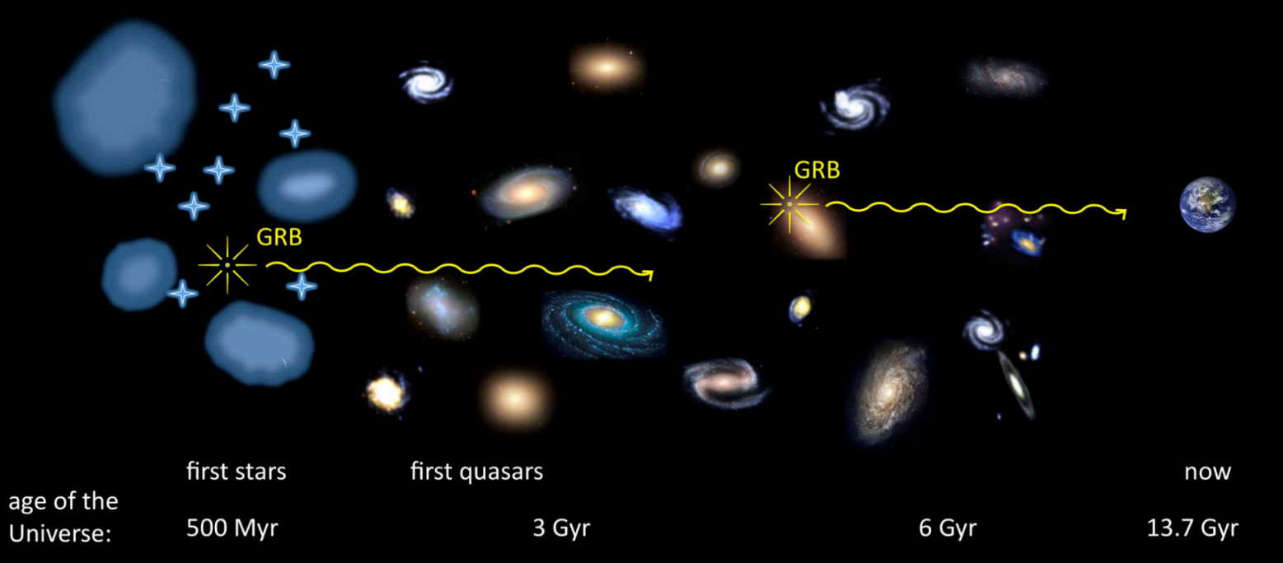
The power of long GRBs for cosmology
Most luminous and remote phenomena in the Universe, with isotropic-equivalent radiated energies in X-gamma rays up to more than 10⁵⁴ erg released in a few tens of seconds and a redshift distribution extending to at least z = 9-10.
GRBs as tools for exploring the early Universe at the end of the "dark ages" (reionization, first stars, star formation rate and metallicity evolution in the first billion of years)

Slide 3
The power of long GRBs for cosmology
Most luminous and remote phenomena in the Universe, with isotropic-equivalent radiated energies in X-gamma rays up to more than 10⁵⁴ erg released in a few tens of seconds and a redshift distribution extending to at least z = 9-10.
GRBs as tools for exploring the early Universe at the end of the "dark ages" (reionization, first stars, star formation rate and metallicity evolution in the first billion of years)
b) Using GRBs to investigate the expansion rate and geometry of the Universe, thus getting clues to "dark energy" properties and evolution

Slide 4
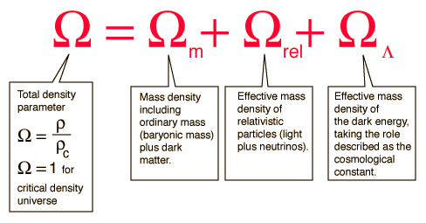
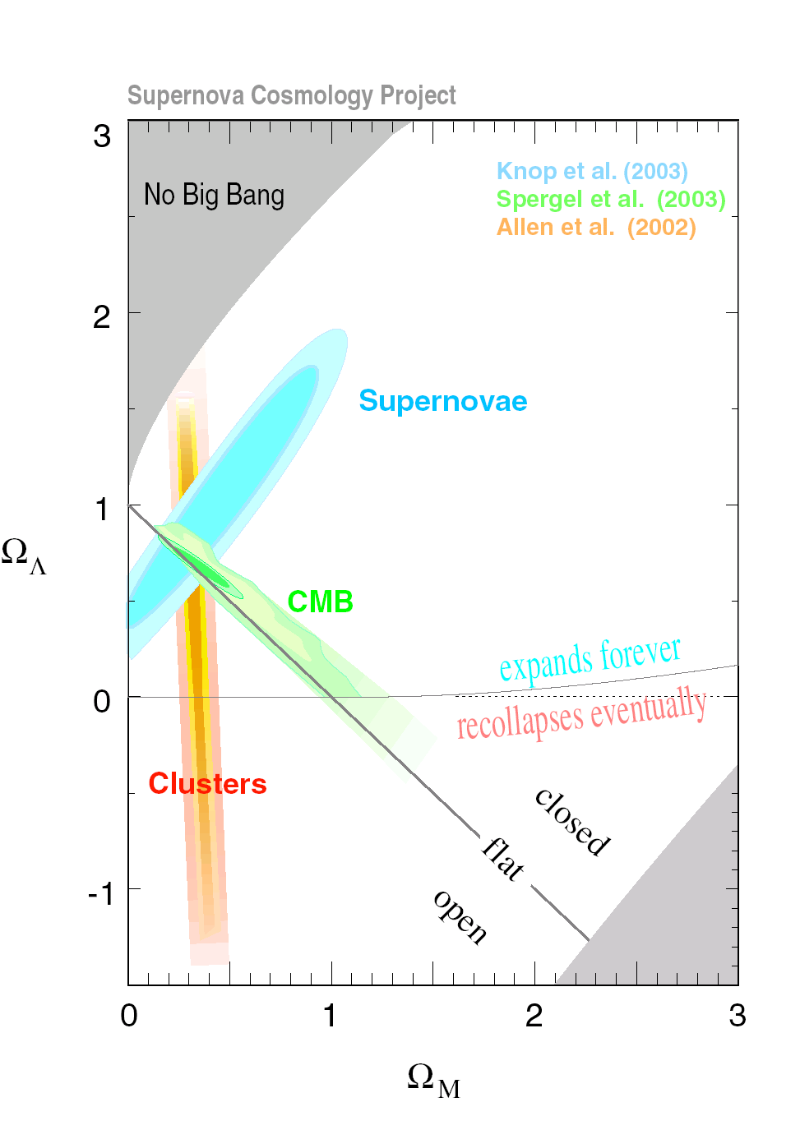
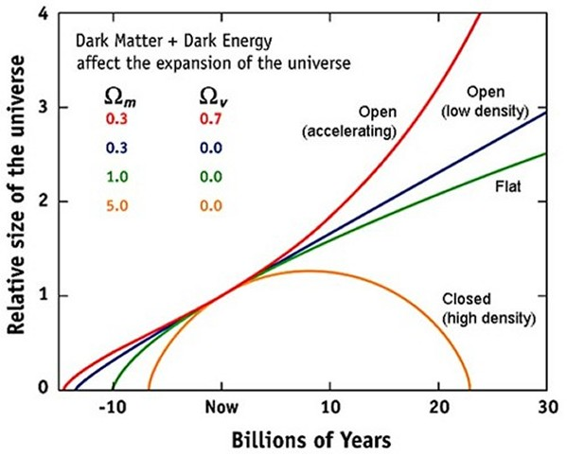
Why looking for more cosmological probes ?
different distribution in redshift and methods-> different sensitivity to different cosmological parameters

Slide 5
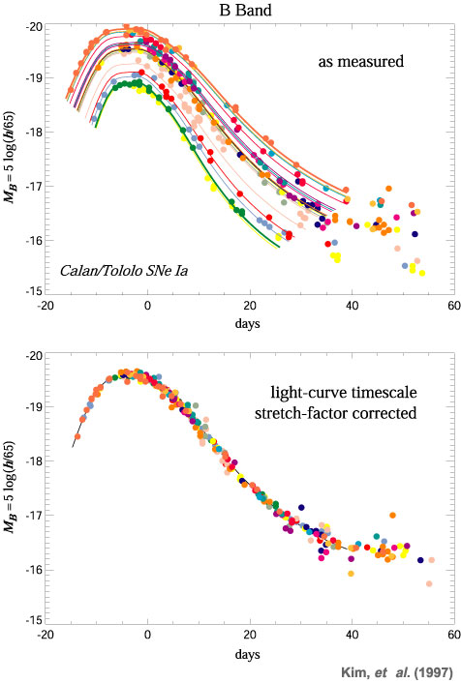
Each cosmological probe is characterized by possible systematics
e.g SN Ia:
different explosion mechanism and progenitor systems ? May depend on z ?
light curve shape correction for the luminosity normalisation may depend on z
signatures of evolution in the colours
correction for dust extinction
anomalous luminosity-color relation
contaminations of the Hubble Diagram by no-standard SNe-Ia and/or bright SNe-Ibc (e.g. HNe)

Slide 6
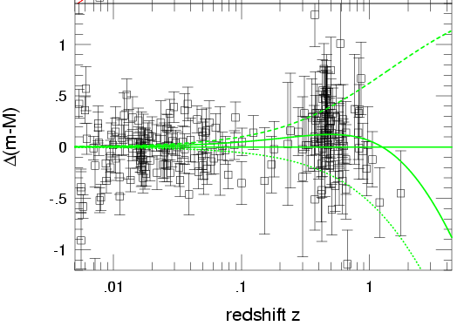
If the “offset from the truth” is just 0.1 mag….
(simulation by M. della Valle)

Slide 7
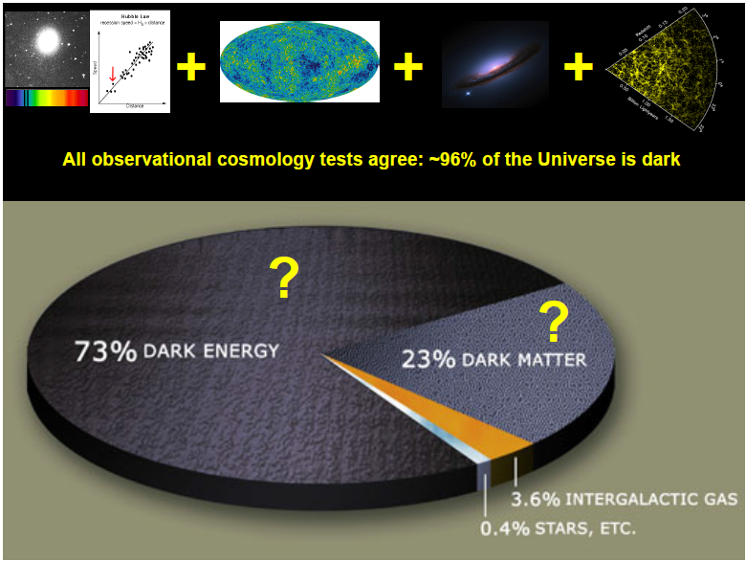
What we are aiming at ?

Slide 8
What we are aiming at ?

Slide 9
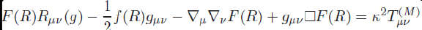
What we are aiming at ?

Slide 10
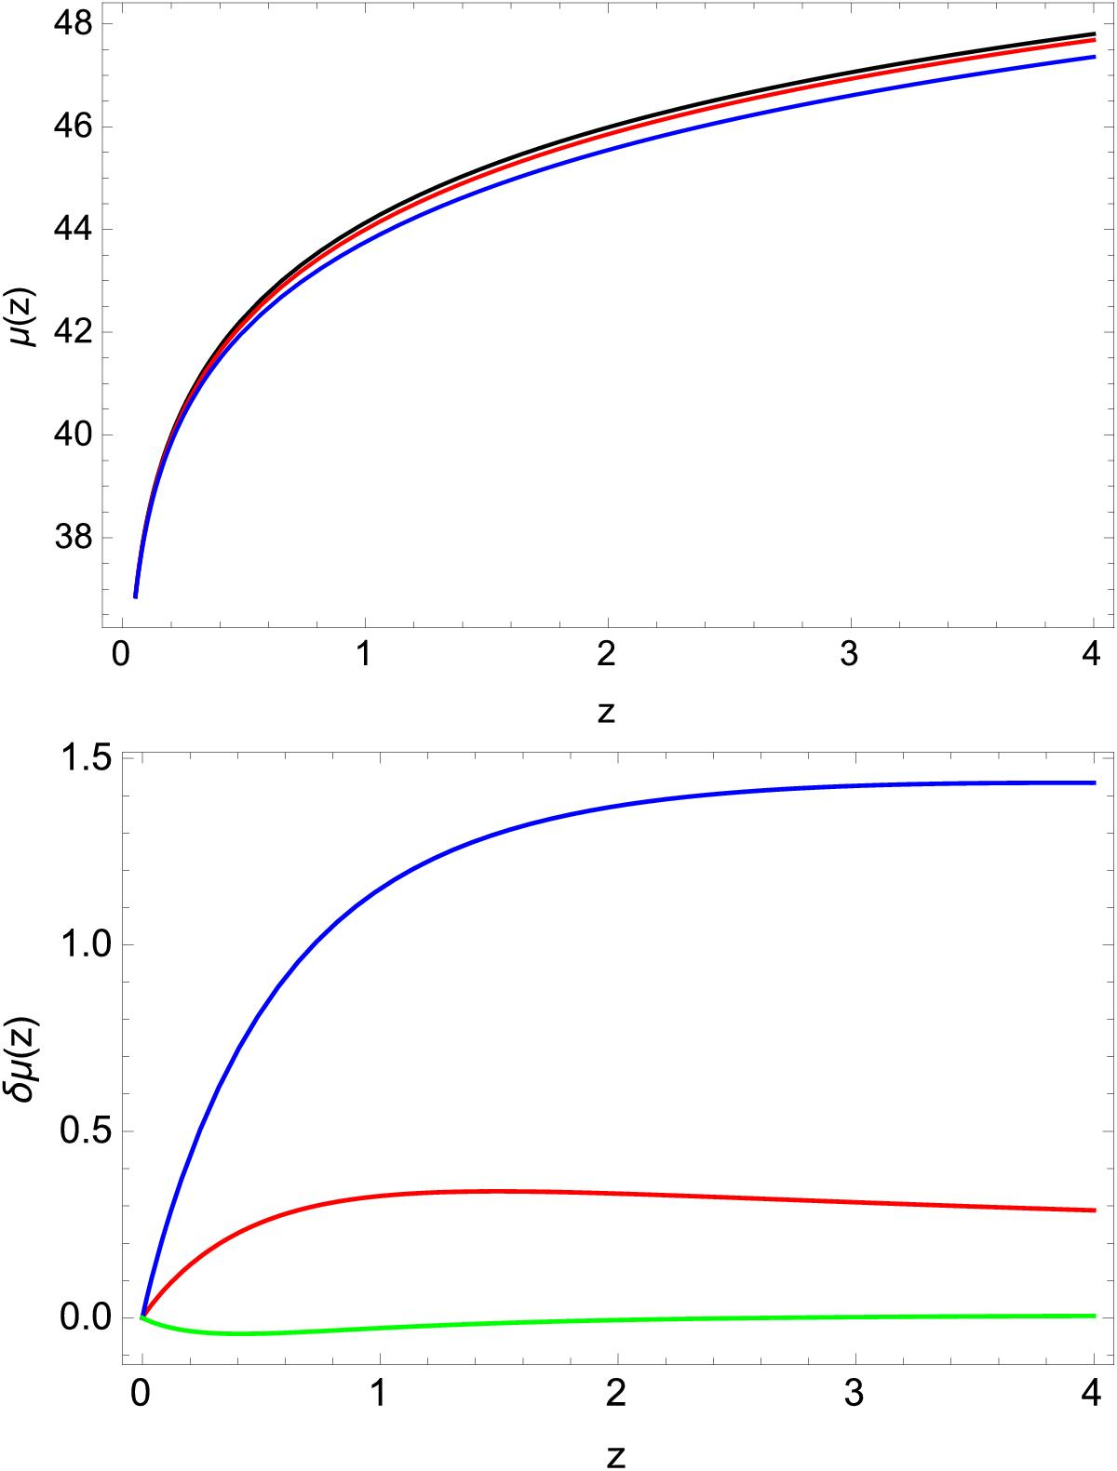
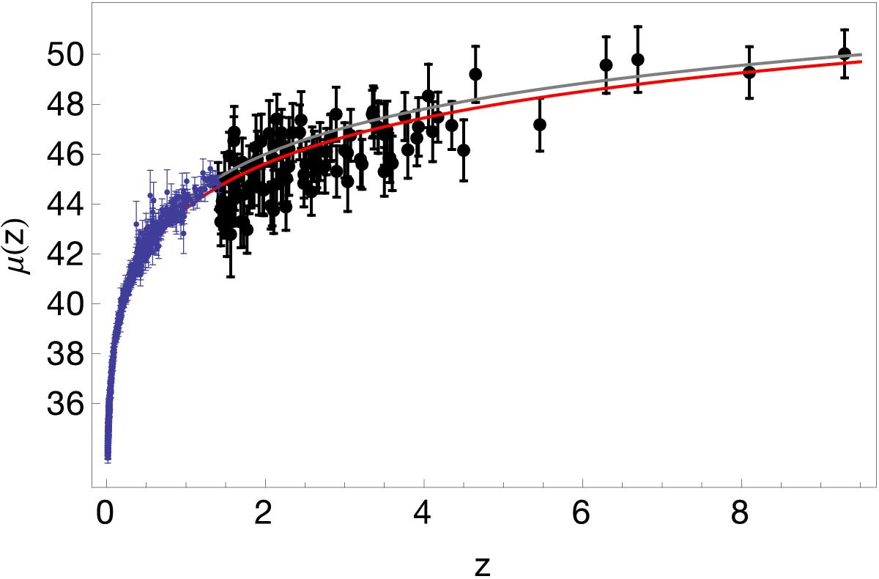
Why Gamma-Ray Bursts ?
Most luminous and remote phenomena in the Universe, with isotropic-equivalent radiated energies in X-gamma rays up to more than 10⁵⁴ erg released in a few tens of seconds and a redshift distribution extending to at least z = 9-10.
Provide improved sensitivity to deviations from ΛCDM (e.g., dark energy evolution) and to tests of alternative cosmological models
Demianski et al. 2017

Slide 11
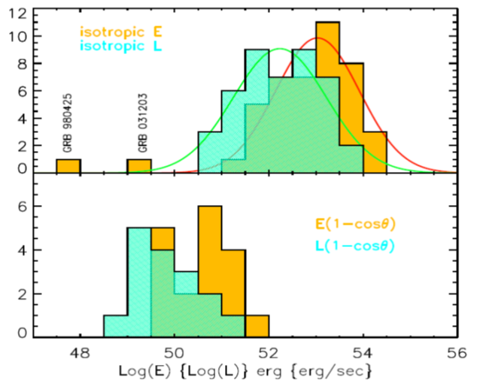
Gamma-Ray Bursts are not standard candles
Isotropic-equivalent peak luminosities and radiated energy span several order of magnitudes
Collimation-corrected quantities: still not standard, plus substantially smaller sample and larger uncertainties (additional observables needed, jet and CBM models needed, etc.)
e.g., Ghirlanda et al. 2007

Slide 12


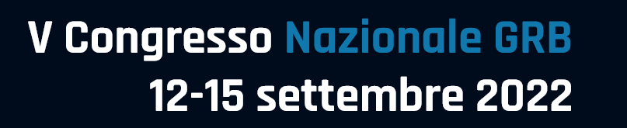
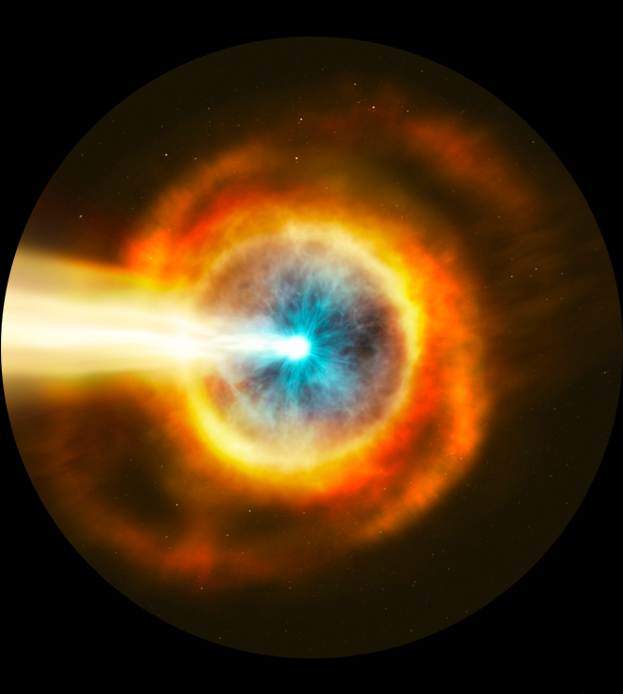
The E_{p,i} – E_{iso} correlation («Amati relation»)
Lorenzo Amati

Slide 13
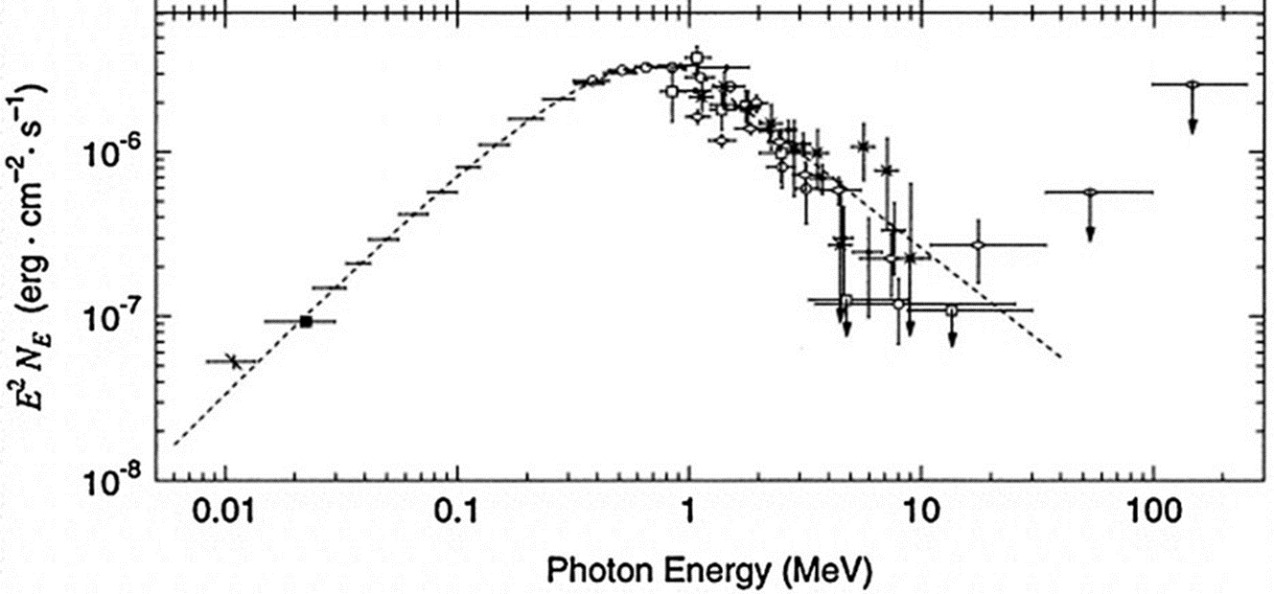
Ep,i and Eiso
GRB νFν spectra typically show a peak at a characteristic photon energy E_{p}
Ep

Slide 14
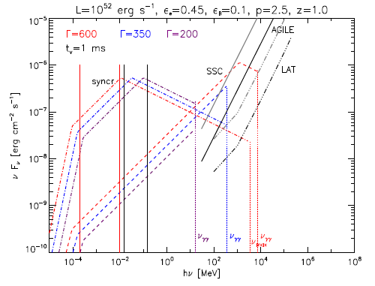
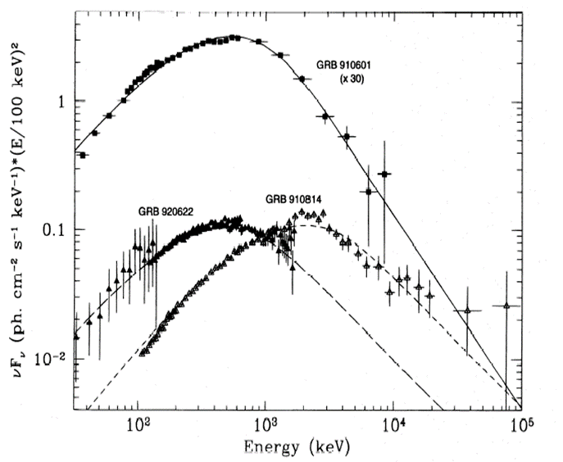
Ep,i and Eiso
e.g., in synchrotron shock models (SSM) Ep corresponds to a characteristic frequency (possibly νm in fast cooling regime) or to the temperature of the Maxwellian distribution of the emitting electrons
Galli & Guetta 2007
Tavani, ApJ, 1995

Slide 15
Ep,i and Eiso
e.g. in photospheric-dominated emission models Ep is linked to the temperature of BB photons (direct) or of scattering electrons (Comptonized)
Giannios 2012
Titarchuk et al., ApJ, 2012

Slide 16


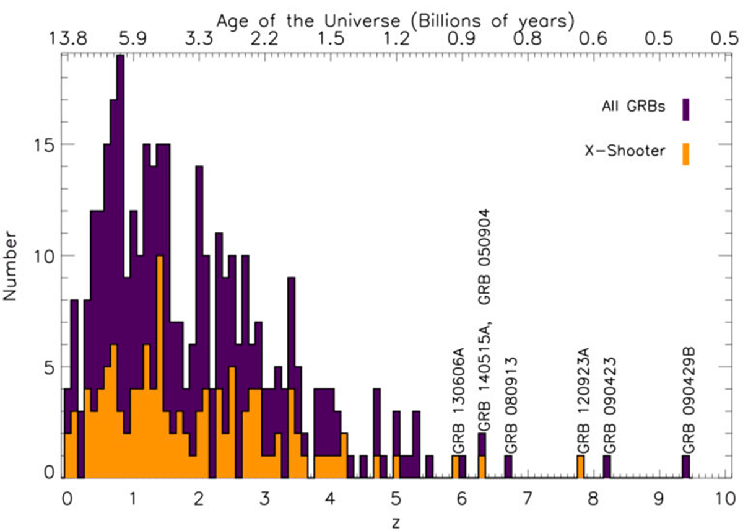
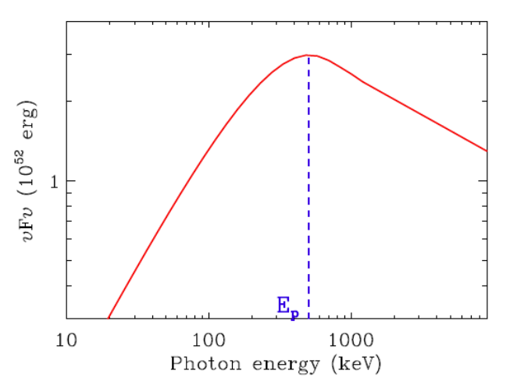
Ep,i and Eiso
measured time-integrated spectrum + measured redshift -> intrinsic peak energy E_{p,i} and radiated energy E_{iso}

Slide 17
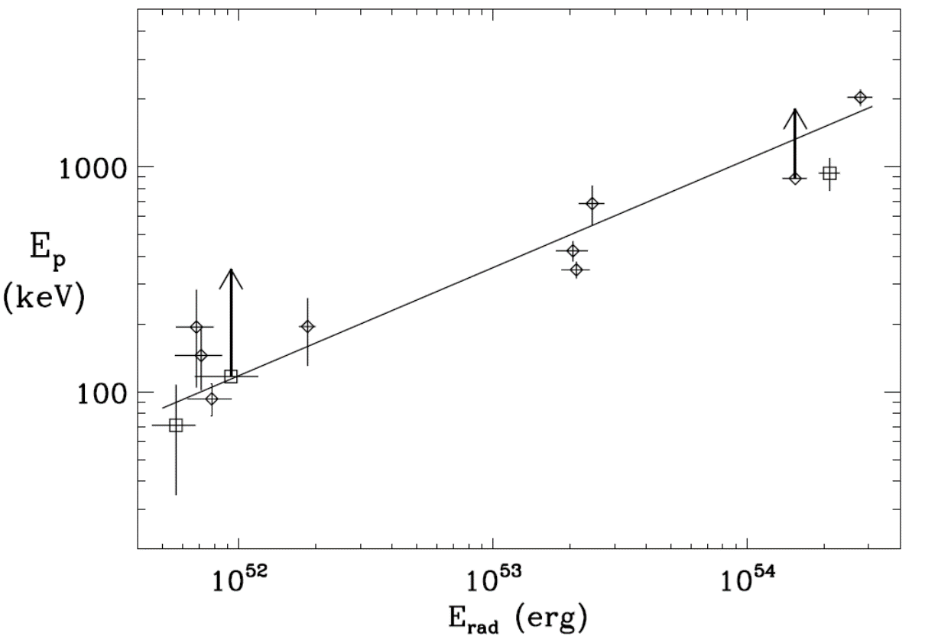
Discovery: Amati et al., A&A, 2002
Significant correlation between Ep,i and Eiso found based on first small sample of BeppoSAX GRBs with known redshift

Slide 18
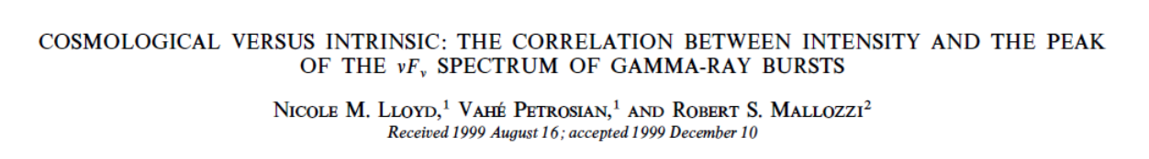
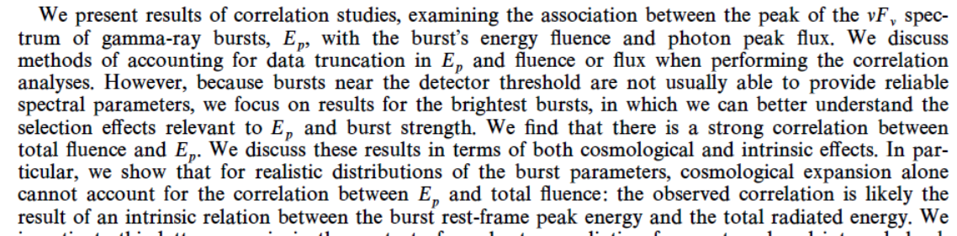
The prediction: Lloyd et al., ApJ, 2000
The possibility of a power-law correlation between Ep,i and Eiso was put forward based on large sample of BATSE spectra of GRBs without measured redshift

Slide 19
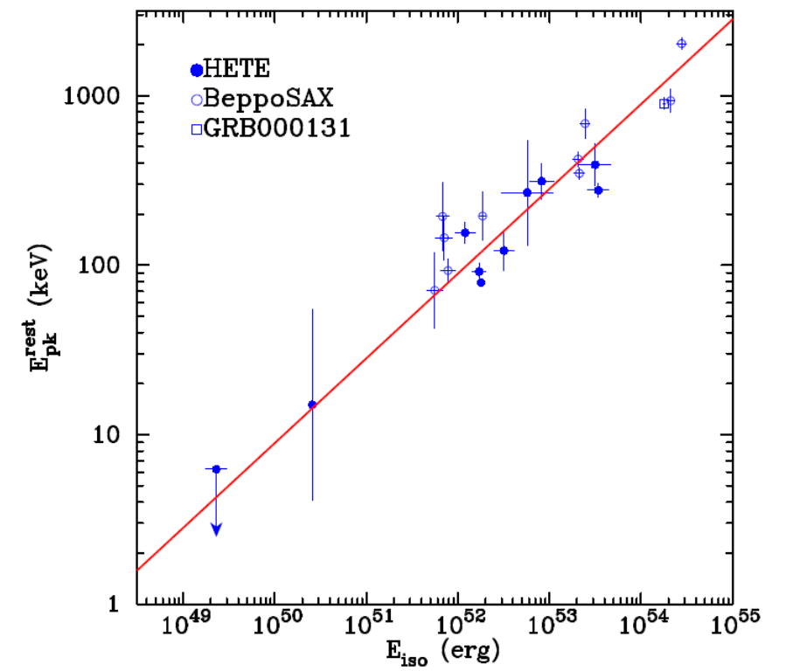
First confirmation: Lamb et al. 2003
Ep,i - Eiso correlation confirmed and exteded to XRFs by HETE-2: first emphasis given to the discovery, first time called «Amati relation» at BeppoSAX Workshop, Amsterdam, 2003

Slide 20
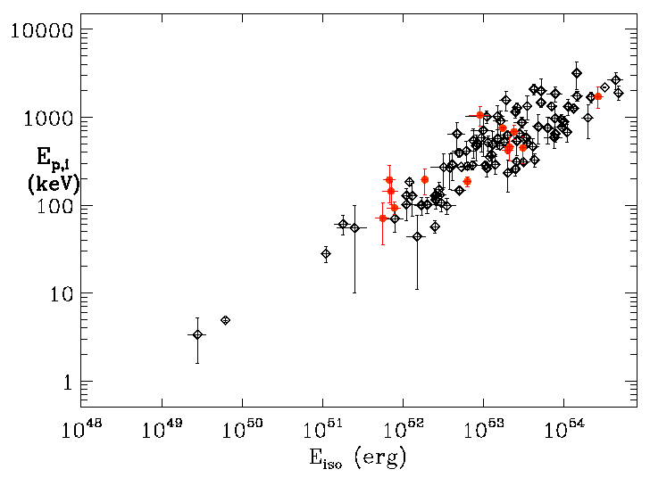
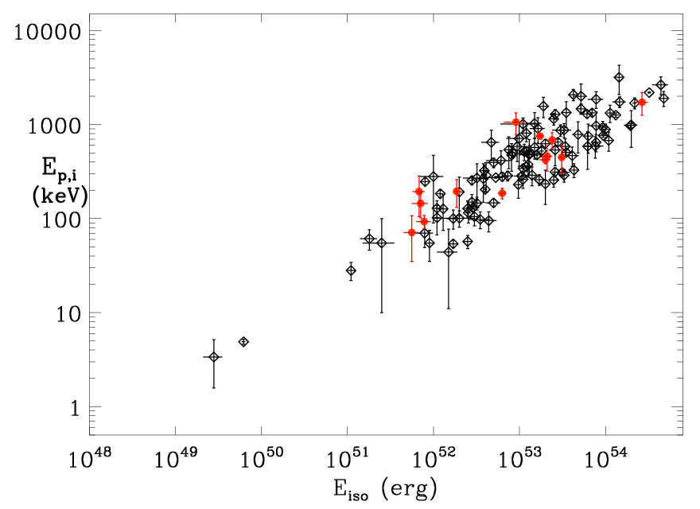
Further confirmation and extension
Ep,i – Eiso correlation for classical long GRBs with known redshift confirmed and extended by measurements of ALL other GRB detectors with spectral capabilities
130 long GRBs as of Sept. 2011
BeppoSAX GRBs

Slide 21
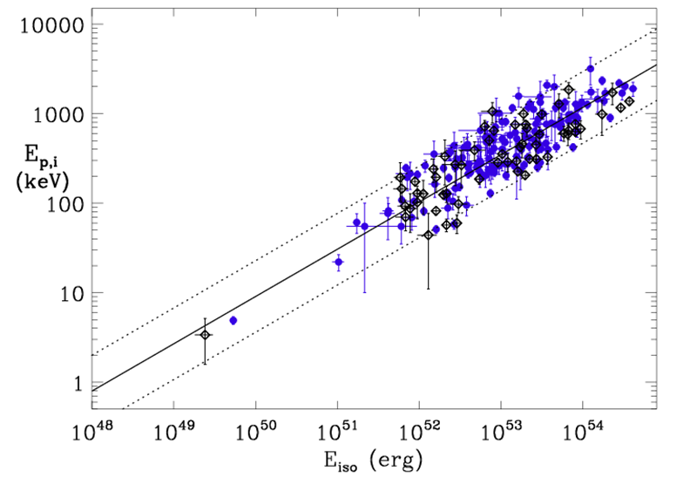
Further confirmation and extension
Ep,i – Eiso correlation for classical long GRBs with known redshift confirmed and extended by measurements of ALL other GRB detectors with spectral capabilities
212 classical long GRBs as of end 2020
Swift GRBs

Slide 22

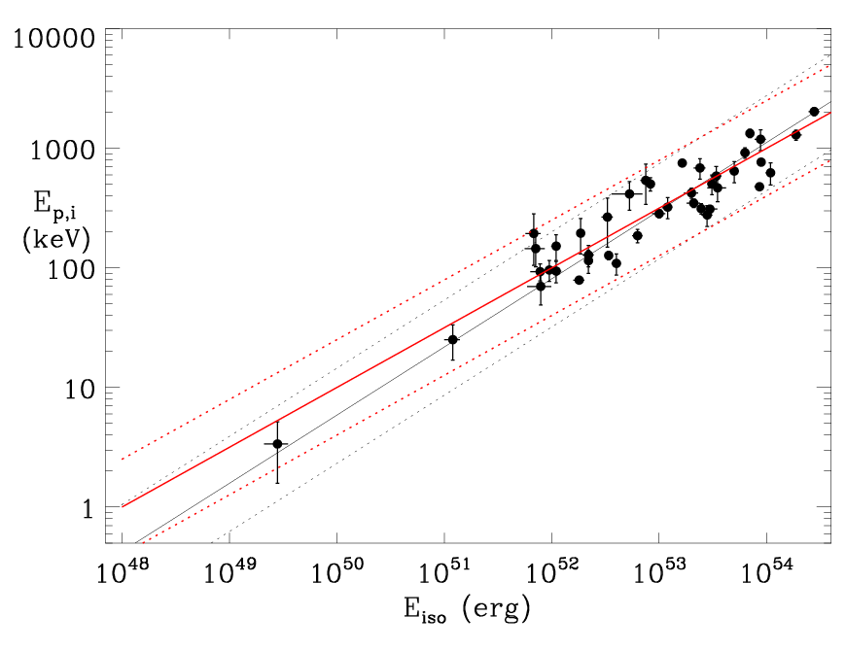
Main properties
strong correlation but significant dispersion of the data around the best-fit power-law; the “extra-statistical scatter” of the data can be quantified by performing a fit whith a max likelihood method which accounts for sample variance and the uncertainties on both X and Y quantities
with this method Amati et al. (2008, 2009) found an extrinsic scatter σ_{int}(logEp,i) ~ 0.2 and index and normalization t ~0.5 and ~100, respectively

Slide 23
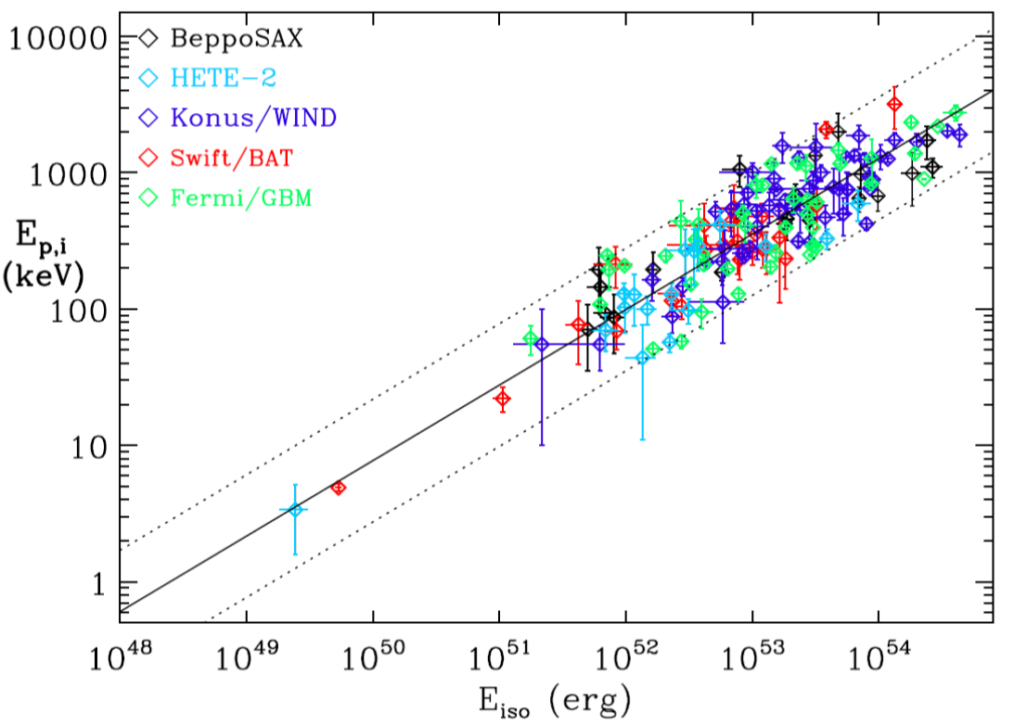
Amati, Frontera & Guidorzi (2009), Amati & Della Valle (2013: the normalization of the correlation varies only marginally using GRBs with known redshift measured by individual instruments with different sensitivities and energy bands
Amati & Della Valle 2013

Slide 24
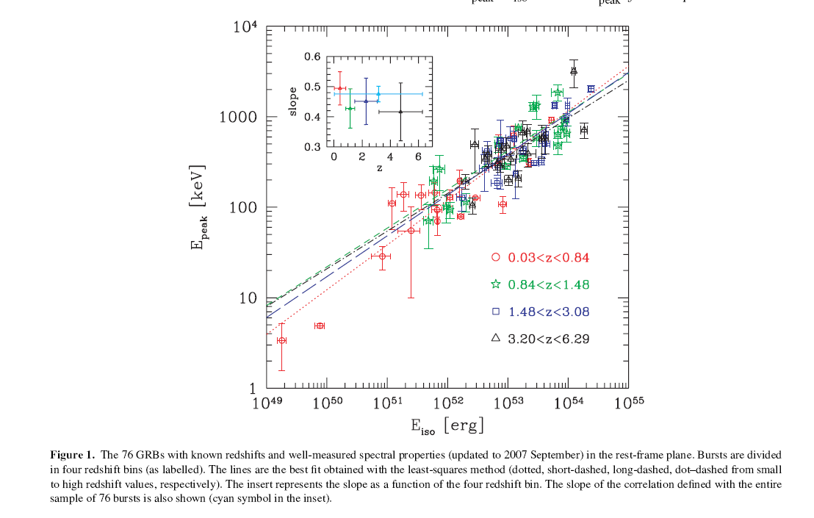
No evidence of evolution of index, normalization and dispersion of the Ep,i – Eiso correlation with redshift
e.g., Ghirlanda et al. 2008

Slide 25
Impact on GRB science
Physics of GRB prompt emission
Jet structure and viewing angles
Identification and understanding of GRB sub-classes
GRB cosmology
Other (e.g., redshift discrimination, GRB population models, SFR evolution)

Slide 26

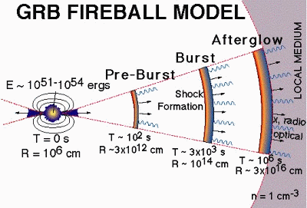
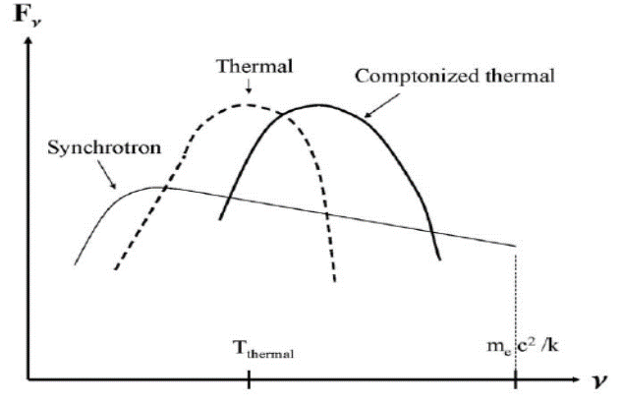
Amati relation: GRB physics
physics of prompt emission still not settled, various scenarios: SSM internal shocks, IC-dominated internal shocks, external shocks, photospheric emission dominated models, kinetic energy vs. Poynting flux dominated jet, …
e.g., Ep,i ∝ G⁻² L^{1/2} tn⁻¹ for syncrotron emission from a power-law distribution of electrons generated in an internal shock (Zhang & Meszaros 2002, Ryde 2005)
e.g., Ep,i ∝ G Tpk ∝ G² L^{-1/4} in scenarios in whch for comptonized thermal emission from the photosphere dominates (e.g. Rees & Meszaros 2005, Thomson et al. 2006)

Slide 27
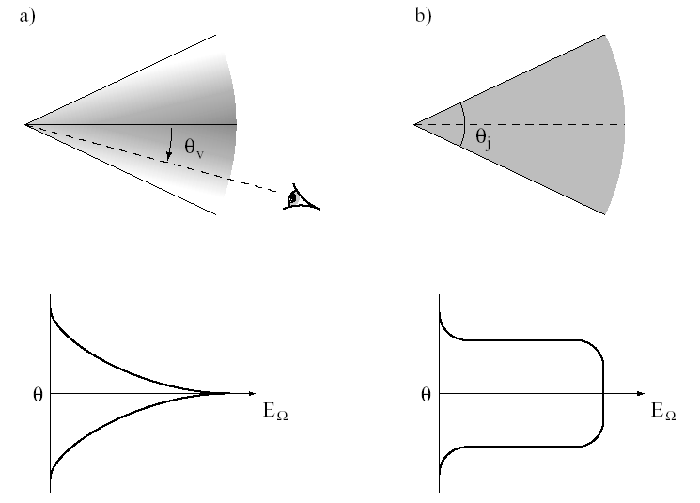
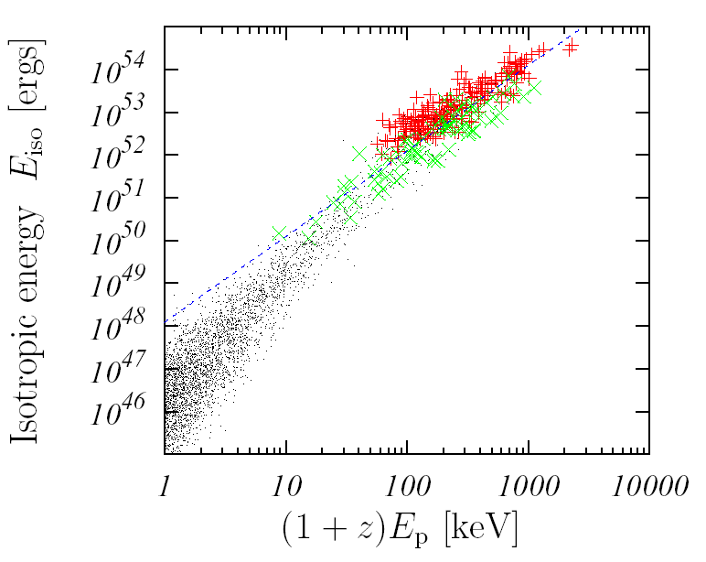
Amati relation: jet structure and viewing angle
jet geometry and structure and XRF-GRB unification models (e.g., Lamb et al. 2004)
viewing angle effects: δ=[γ(1 - βcos(θv - Δθ))]⁻¹ , ΔEp ∝ δ , ΔEiso ∝ δ^{(1+α)} (e.g, Yamazaki et al. 2003)
Uniform/variable jet
PL-structured /universal jet
Uniform/variable jet
PL-structured /universal jet
Uniform/iniversal jet + off-axis viewing
Lamb et al. 2005
Yamazaki et al. 2004

Slide 28
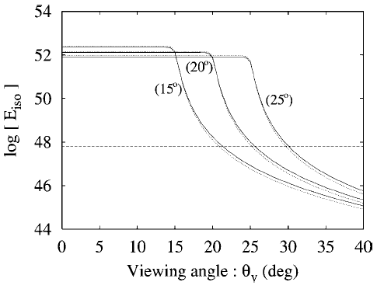
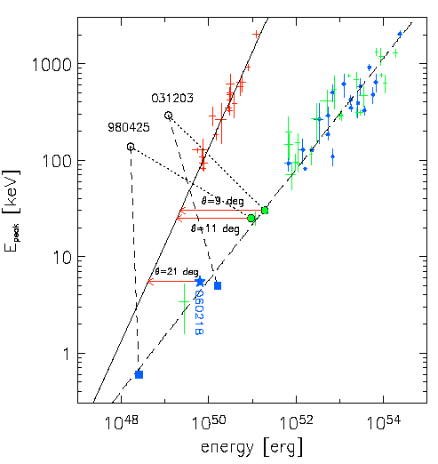
Amati relation: jet structure and viewing angle
the most common explanations for the (apparent ?) sub-energetic nature of GRB980425 and GRB031203 and their violation of the Ep,i – Eiso correlation assume that they are NORMAL events seen very off-axis (e.g. Yamazaki et al. 2003, Ramirez-Ruiz et al. 2005)
Yamazaki et al., ApJ, 2003

Slide 29
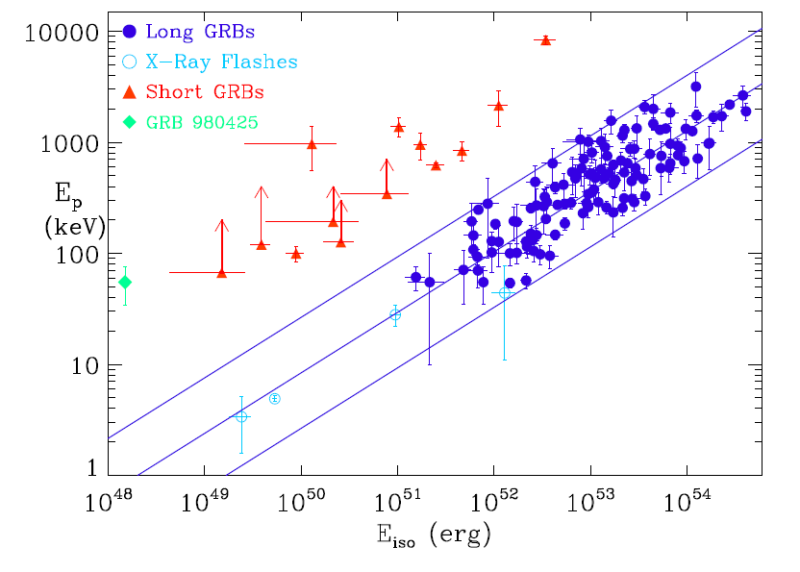
Amati relation: GRB classes
The Ep,i – Eiso plane and correlation is fundamental for identifying and understanding the origin and physics of different GRB classes
e.g., Amati & Della Valle 2013

Slide 30
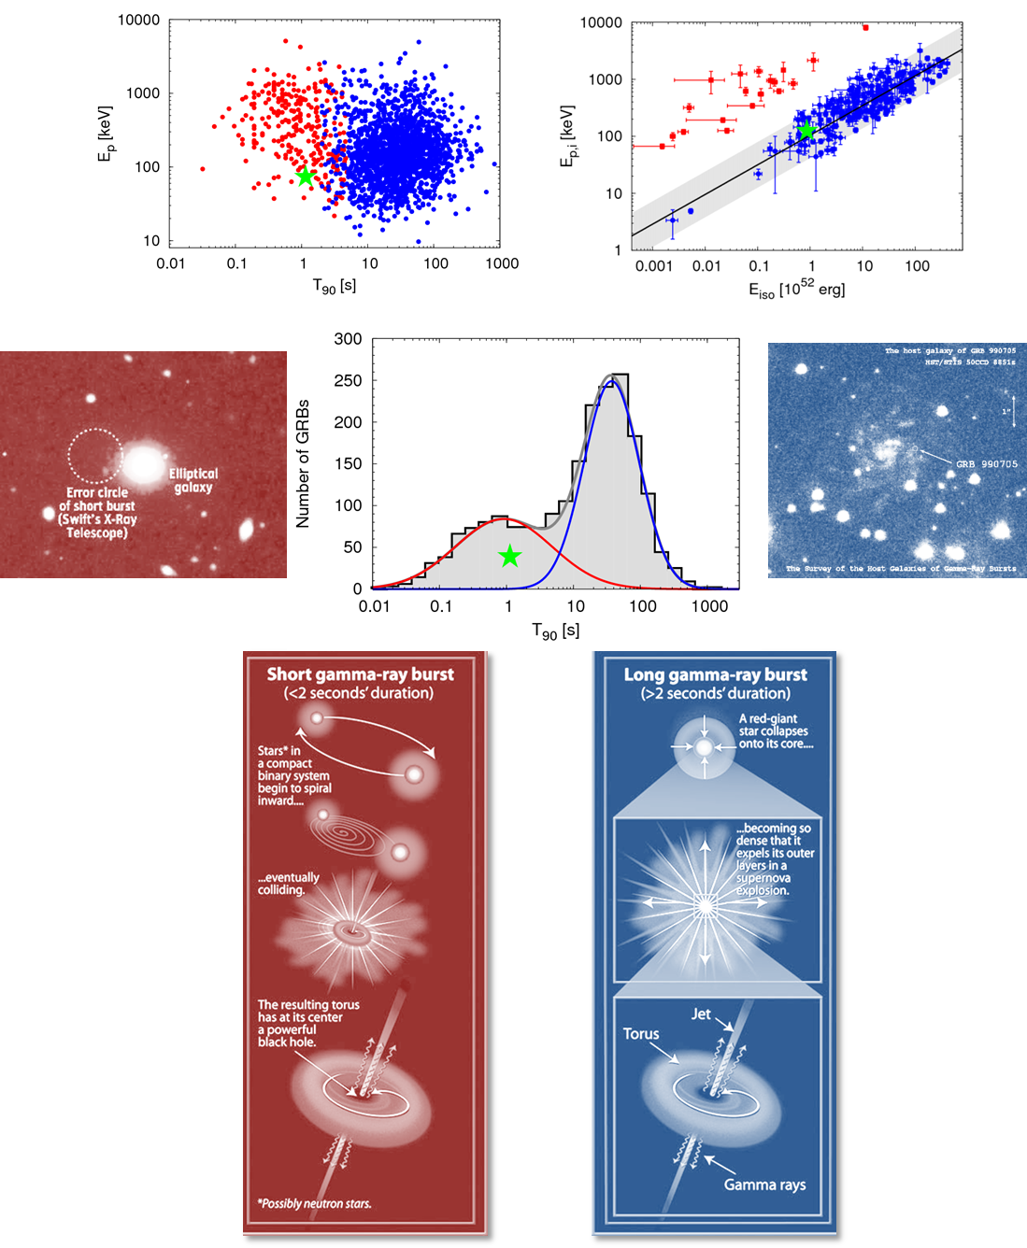
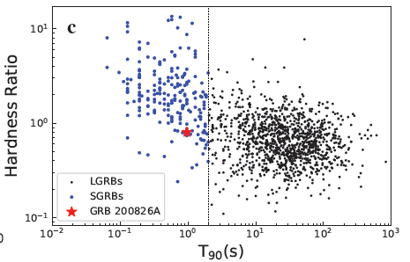
Short / long classification: the case of GRB 200817A, a short duration GRB with evidence of association with a SN
Ahumata et al., Zhang et al., Amati et al., Rossi et al. 2021

Slide 31
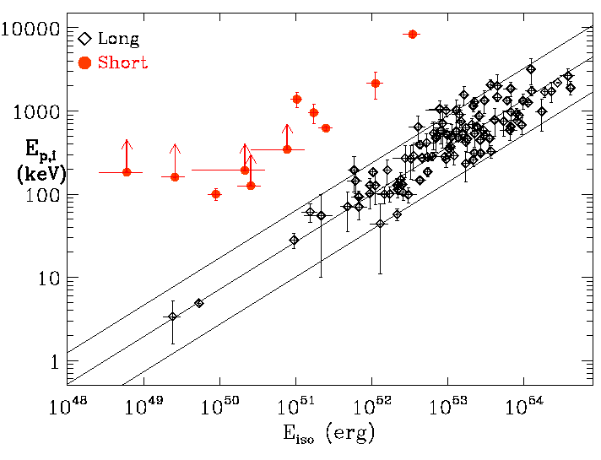
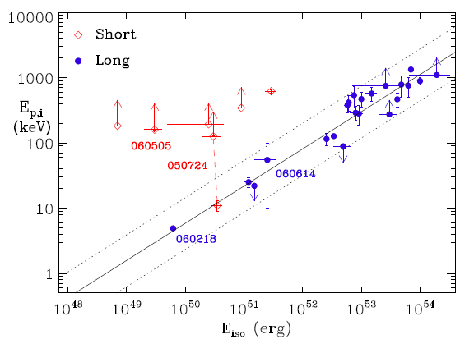
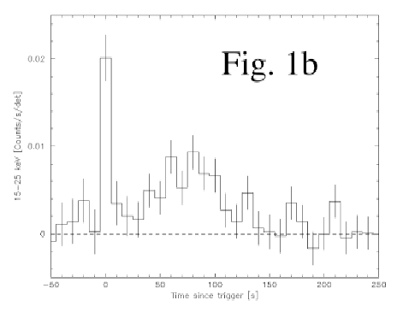
Short / long classification and physics
estimates and limits on Ep,i and Eiso are inconsistent with Ep,i-Eiso correlation holding for long GRBs
low Eiso values and high lower limits to Ep,i indicate inconsistency also for the other short GRBs
long weak soft emission in some cases, consistent with the Ep,i – Eiso correlations
GRB0050724

Slide 32
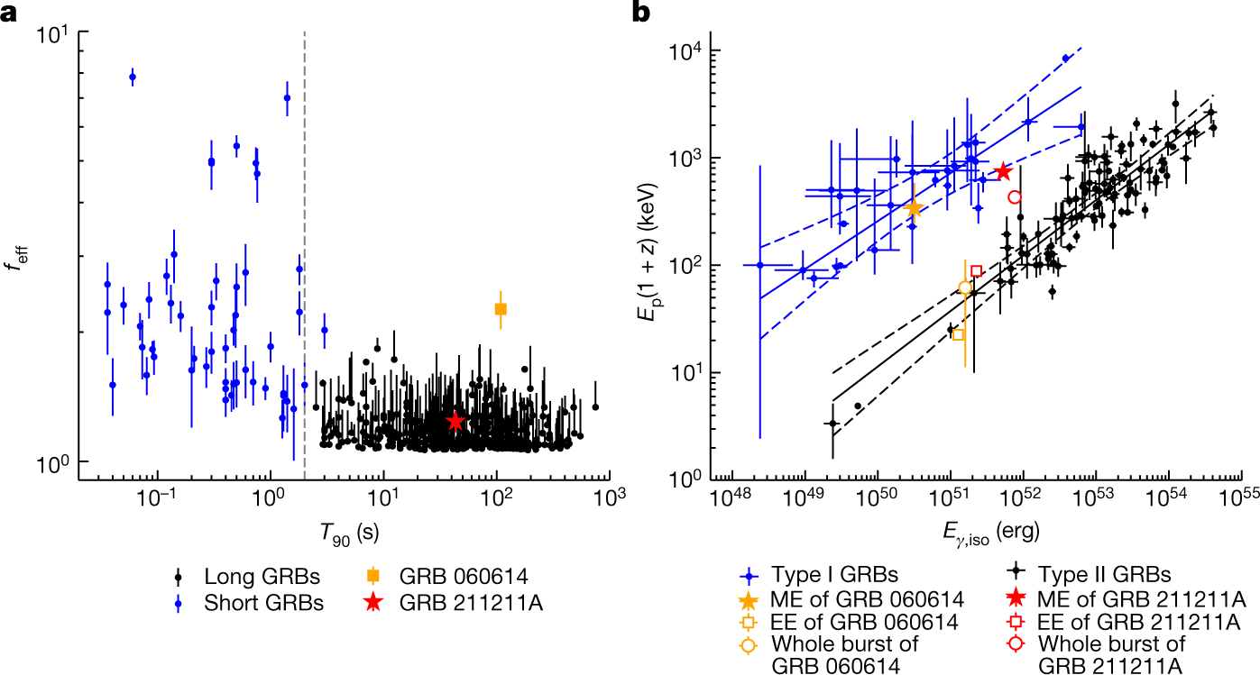
Short / long classification: the case of GRB 211211A, a long GRB with evidence of association KN (NS-NS merger origin)
Yang et al., Nature, 2022

Slide 33
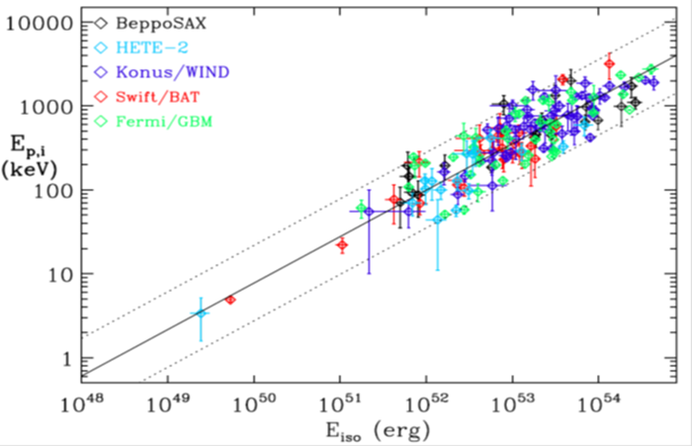
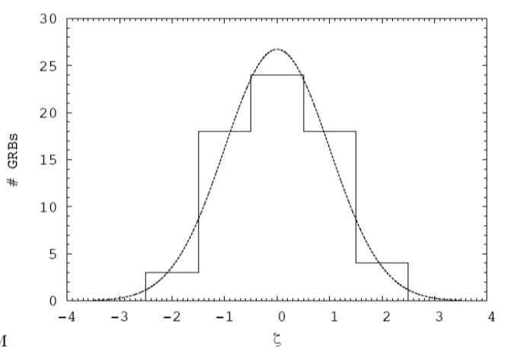
Amati relation: GRB cosmology
E_{p,i} = E_{p,obs} x (1 + z)
D_{l} = D_{l} (z , H₀ , Ω_{M} , Ω_{Λ} ,…)
not enough low-z GRBs for cosmology-independent calibration -> circularity is avoided by fitting simultaneously the parameters of the correlation and cosmological parameters
does the extrinsic scatter and goodness of fit of the Ep,i-Eiso correlation vary with the cosmological parameters used to compute Eiso ?

Slide 34
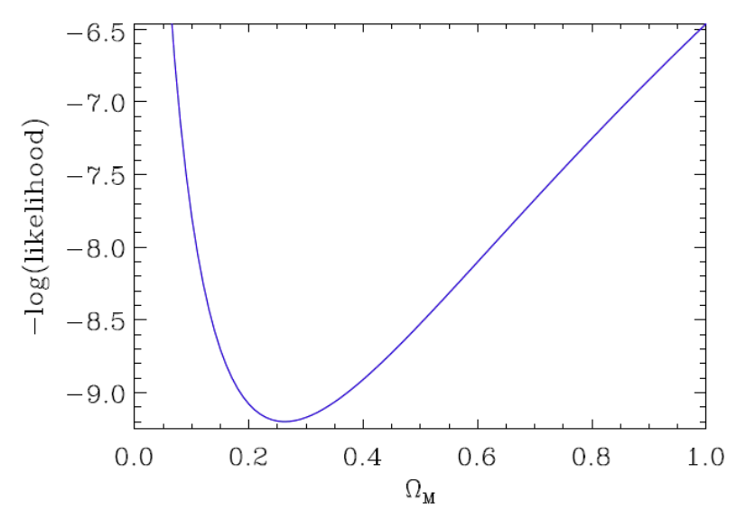
a fraction of the extrinsic scatter of the E_{p,i}-E_{iso} correlation is indeed due to the cosmological parameters used to compute E_{iso}
Evidence, independent on other cosmological probes, that, if we are in a flat Universe , Ω_{M} is lower than 1 and around 0.3
Amati et al. 2008, Amati & Della Valle 2013, Moresco, Amati et al. 2022

Slide 35
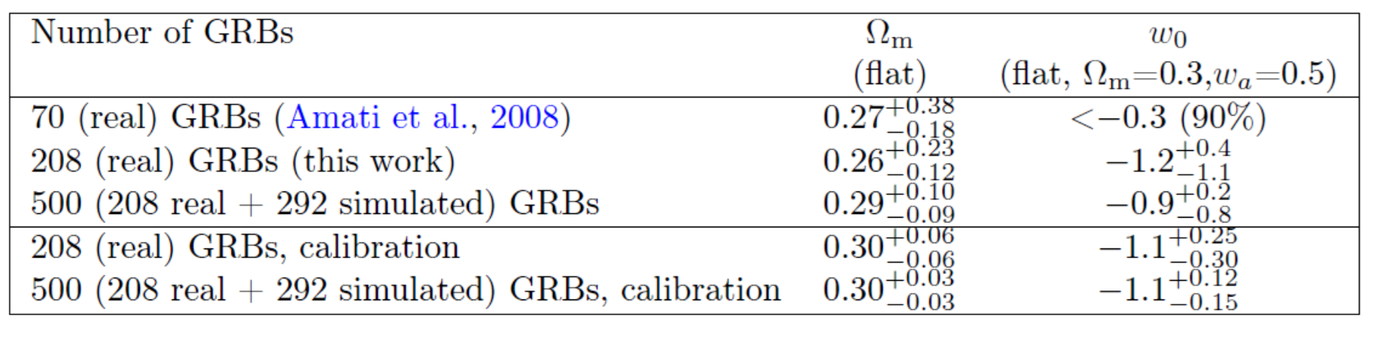
a fraction of the extrinsic scatter of the E_{p,i}-E_{iso} correlation is indeed due to the cosmological parameters used to compute E_{iso}
Evidence, independent on other cosmological probes, that, if we are in a flat Universe , Ω_{M} is lower than 1 and around 0.3
Amati et al. 2008, Amati & Della Valle 2013, Moresco, Amati et al. 2022

Slide 36
GRB

Slide 37
What we are aiming at ?

Slide 38
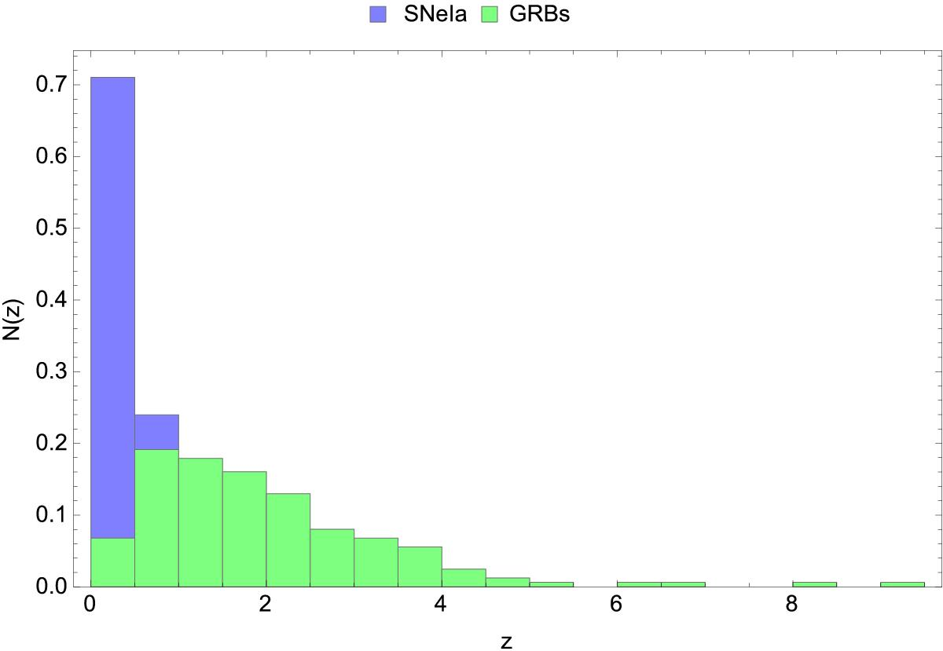
The power of GRBs
Demianski et al. 2017

Slide 39
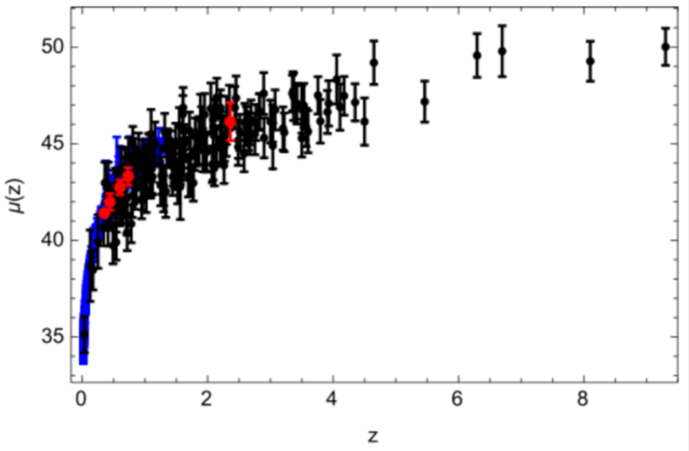
Calibration with SNe-Ia
SNe-Ia
The GRB Hubble diagram extends to much higher z w/r to SNe Ia
The GRB Hubble diagram is consistent with SNe Ia Hubble diagram and BAO points at low redshifts: reliability
e.g., Capozziello et al., Kodama et al., Tsutsui et al., Demianski et al.):
GRB

Slide 40
Other approaches investigated
using Lp instead of Eiso in the correlation with Ep,i (Yonetoku et al., and many): evidence of a general Ep,i – “Intensity” correlation (also time-resolved)
“self-calibration” of the correlation with a large enough number of GRBs lying within a narrow (Δz = 0.1-0.2) range of z): promising, requires sample enlargement
Extending the Ep-Intensity correlation by involving other prompt or afterglow properties: e.g., “Combo relation” (Izzo et al., Muccino et al.) , Lx-Ta and Lx-Ta-Lp relations (Dainotti et al.)

Slide 41
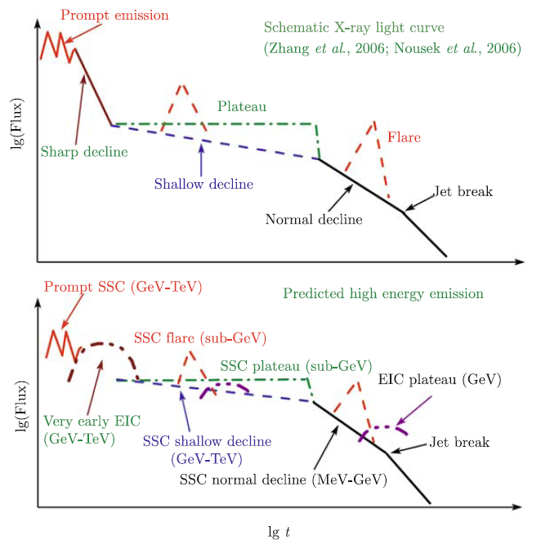
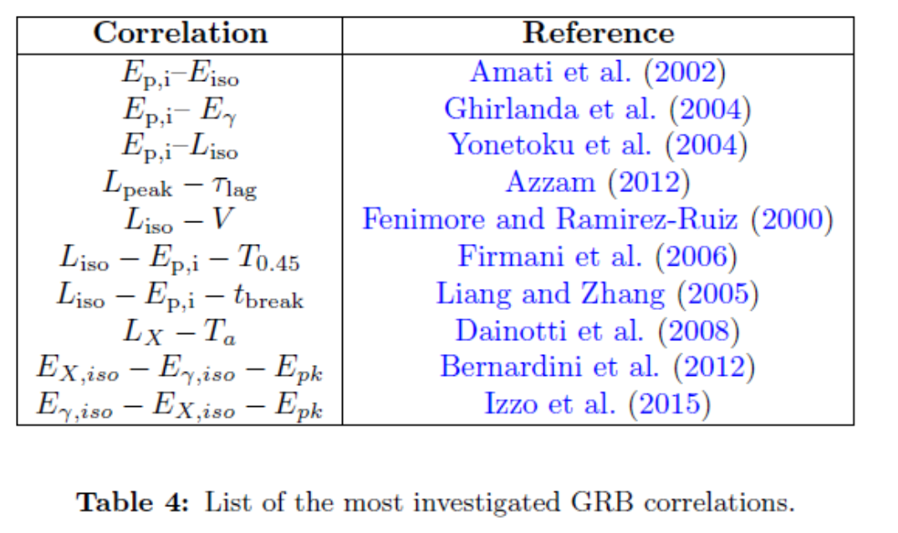
Involving other GRB observables
Extending or replacing the Ep-Intensity correlation by involving other prompt or afterglow properties: e.g., “Combo relation” (Izzo et al., Muccino et al.) , Lx-Ta and Lx-Ta-Lp relations (Dainotti et al.)
Moresco et al. 2022

Slide 42
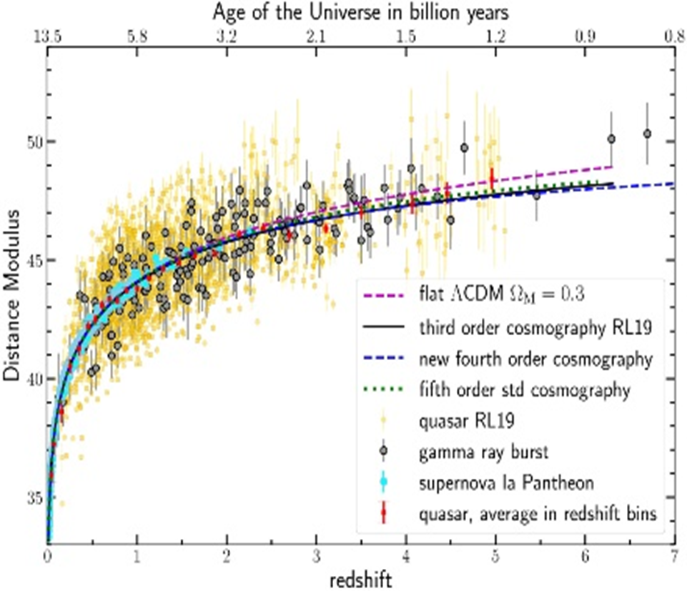

Joining GRBs with other probes: e.g., high-z GNs
Lusso et al. 2019

Slide 43




Accounting for collimation
2004: evidence that by substituting Eiso with the collimation corrected energy Eγ the logarithmic dispersion of the correlation decreases significantly and is low enough to allow its use to standardize GRB (Ghirlanda et al., Dai et al.)

Slide 44
Accounting for collimation: drawbacks
the Ep-Eγ correlation is model dependent: slope depends on the assumptions on the circum-burst environment density profile (ISM or wind)
addition of a third observable introduces further uncertainties (difficulties in measuring t_break, chromatic breaks, model assumptions) and substantially reduces the number of GRB that can be used (e.g., #Ep,i – Eγ ~ ¼ #Ep,i – Eiso )
ISM
WIND
Nava et al.. , A&A, 2005: ISM (left) and WIND (right)

Slide 45

Future GRB experiments (e.g., SVOM, HERMES, THESEUS, …) and more investigations (e.g., reliable estimates of jet angles and self-calibration) will improve the significance and reliability of the results and allow to go beyond SN Ia cosmology (e.g. investigation of dark energy)

Slide 46


Multi-messenger cosmology with GRBs
MEASURING THE EXPANSION RATE AND GEOMETRY OF SPACE-TIME
~20 joint GRB + GW events
ET collaboration
Notes:
Presenter’s note:

Slide 47
Summary
GRBs are a key phenomenon for cosmology (early Universe, cosmological parameters) and fundamental physics
The Ep,i – Eiso correlation (“Amati relation”) and related correlations provide a unique tool for investigating the physics and geometry of prompt emission, identifying and understanding GRB sub-classes, and exploiting GRBs for measuring cosmological parameters, shedding light on “dark energy”, testing alternative cosmological models.
Additional capabilities of GRBs for cosmology will be provided in the next years by joint detections with GW signals
Next generation GRB missions, like THESEUS, developed by a large European collaboration and already studied by ESA (M5 Phase A) will allow us to fully consolidate and exploit these potentialities

Slide 48
Back-up slides

Slide 49


Multi-messenger cosmology through GRBs
GW170817 + SHORT GRB 170817A + KN AT2017GFO (~40 Mpc): the birth of multi-messenger astrophysics
Notes:
Presenter’s note:

Slide 50

Multi-messenger cosmology through GRBs
GW170817 + SHORT GRB 170817A + KN AT2017GFO (~40 Mpc): the birth of multi-messenger astrophysics
Notes:
Presenter’s note:

Slide 51

Multi-messenger cosmology through GRBs
MEASURING THE EXPANSION RATE AND GEOMETRY OF SPACE-TIME
Notes:
Presenter’s note:

Slide 52
Multi-messenger cosmology through GRBs
MEASURING THE EXPANSION RATE AND GEOMETRY OF SPACE-TIME
~20 joint GRB + GW events
Notes:
Presenter’s note:

Slide 53

Correlation of Ep,i with other “intensity” indicators
the correlation holds also when substituting Eiso with Liso (e.g., Lamb et al. 2004) or Lpeak,iso (Yonetoku et al. 2004, Ghirlanda et al., 2005)
this is expected because Liso and Lpeak,iso are strongly correlated with Eiso
w/r to Eiso, Lp,iso is subject to more uncertainties (e.g., light curves peak at different times in different energy bands; spectral parameters at peak difficult to estimate; which peak time scale ?)
Nava et al. 2009

Slide 54

Correlation of Ep,i with other “intensity” indicators
the correlation holds also when substituting Eiso with Liso (e.g., Lamb et al. 2004) or Lpeak,iso (Yonetoku et al. 2004, Ghirlanda et al., 2005)
this is expected because Liso and Lpeak,iso are strongly correlated with Eiso
w/r to Eiso, Lp,iso is subject to more uncertainties (e.g., light curves peak at different times in different energy bands; spectral parameters at peak difficult to estimate; which peak time scale ?)
Nava et al. 2009

Slide 55


Time-resolved correlation
the Ep,i– Liso and Ep,i – Eiso correlation holds also within a good fraction of GRBs (Liang et al.2004, Firmani et al. 2008, Ghirlanda et al. 2009, Li et al. 2012, Frontera et al. 2012, Basak et al. 2013): robust evidence for a physical origin and clues to explanation
BATSE (Liang et al., ApJ, 2004)
Fermi (e.g., Li et al. , ApJ, 2012)

Slide 56
Time-resolved correlation
the Ep,i– Liso and Ep,i – Eiso correlation holds also within a good fraction of GRBs (Liang et al.2004, Firmani et al. 2008, Ghirlanda et al. 2009, Li et al. 2012, Frontera et al. 2012, Basak et al. 2013): robust evidence for a physical origin and clues to explanation
BATSE (Liang et al., ApJ, 2004)
Fermi (e.g., Li et al. , ApJ, 2012)

Slide 57
Time-resolved correlation
the Ep,i– Liso and Ep,i – Eiso correlation holds also within a good fraction of GRBs (Liang et al.2004, Firmani et al. 2008, Ghirlanda et al. 2009, Li et al. 2012, Frontera et al. 2012, Basak et al. 2013): robust evidence for a physical origin and clues to explanation
BATSE (Liang et al., ApJ, 2004)
Fermi (e.g., Li et al. , ApJ, 2012)

Slide 58

Impact on GRB science
Amati+02 most cited article on BeppoSAX mission, instruments and data analysis

Slide 59

Impact on GRB science
Amati+02 most cited article on BeppoSAX mission, instruments and data analysis

Slide 60

Impact on GRB science
«Amati relation» included in the title and/or abstract of >170 articles on international refereed journals (>300 total)

Slide 61



THESEUS: giant leap in GRB redshifts

Slide 62
THESEUS will have the ideal combination of instrumentation and mission profile for detecting all types of GRBs (long, short/hard, weak/soft, high-redshift), providing accurate location and redshift for a large fraction of them
Fermi/GBM
GRB170817A/GW170817
High-redshift

Slide 63



THESEUS: unprecedented spectroscopy of GRB
Notes:
Presenter’s note:
LOFT is being designed to address one of the key science themes of Cosmic Vision: matter under extreme conditions.
Two are the objectives at the core of the LOFT mission:
- First, to probe the state of matter at supra nuclear densities, the ones only reached in the interiors of Neutron Stars.
- Second, to probe the theory of gravity, general relativity, in the very strong environment of Black holes.
LOFT is therefore an observatory designed to probe two key questions of nature, through astrophysics.
But of course LOFT is an observatory and will explore, in addition to its core science, the physics of hundred of
galactic and extragalactic sources.

Slide 64
Future missions (early / mid ‘20s)
SVOM (2022-): prompt emission down to 5 keV and up to MeVs, prompt follow-up with small X-ray and O/UV telescopes, dedicated on-ground telescopes
Einstein Probe (2022-): very good sensitivity, arcmin location accuracy, operating only in the very soft X-ray energy band (0.3 - 5 keV), 1.4 sr FOV, follow-up in X-rays
GECAM (2020): all-sky FOV, 6 keV – few MeVs, source location a few degrees; POLAR-2 (2024?): improved polarimetry of prompt emission;
HERMES and other nano-satellite programs (2022-): small detectors, energy band > 10 keV, potentially very good location accuracy for mid-bright GRBs, very good timing, depends on follow-up from ground
eXTP (2025?) China-Europe, monitoring in 2-50 keV on 4-5 sr, X-ray followp-up with deep spectroscopy and polarimetric sensitivity

Slide 65








Future missions: the case of THESEUS
Soft X-ray Imager (SXI): a set of two sensitive lobster-eye telescopes observing in 0.3 - 5 keV band, total FOV of ~0.5sr with source location accuracy <2’
X-Gamma rays Imaging Spectrometer (XGIS): 2 coded-mask X-gamma ray cameras using Silicon drift detectors coupled with CsI crystal scintillator bars observing in 2 keV – 10 MeV band, a FOV of >2 sr, overlapping the SXI, with <15’ GRB location accuracy
InfraRed Telescope (IRT): a 0.7m class IR telescope observing in the 0.7 – 1.8 μm band, providing a 15’x15’ FOV, with both imaging and moderate resolution spectroscopy capabilities
Y_{IRTOR}
Z_{IRTOR}
Notes:
Presenter’s note:

Slide 66

Future missions: the case of THESEUS
Soft X-ray Imager (SXI): a set of two sensitive lobster-eye telescopes observing in 0.3 - 5 keV band, total FOV of ~0.5sr with source location accuracy <2’
X-Gamma rays Imaging Spectrometer (XGIS): 2 coded-mask X-gamma ray cameras using Silicon drift detectors coupled with CsI crystal scintillator bars observing in 2 keV – 10 MeV band, a FOV of >2 sr, overlapping the SXI, with <15’ GRB location accuracy
InfraRed Telescope (IRT): a 0.7m class IR telescope observing in the 0.7 – 1.8 μm band, providing a 15’x15’ FOV, with both imaging and moderate resolution spectroscopy capabilities
Low Earth Orbit (< 5°, ~600 km)
Autonomously rapid slewing bus
4-years nominal
Amati+ 2021
Notes:
Presenter’s note:

Slide 67
Accounting for collimation
2004: evidence that by substituting Eiso with the collimation corrected energy Eγ the logarithmic dispersion of the correlation decreases significantly and is low enough to allow its use to standardize GRB (Ghirlanda et al., Dai et al.)

Slide 68
Accounting for collimation: drawbacks
the Ep-Eγ correlation is model dependent: slope depends on the assumptions on the circum-burst environment density profile (ISM or wind)
addition of a third observable introduces further uncertainties (difficulties in measuring t_break, chromatic breaks, model assumptions) and substantially reduces the number of GRB that can be used (e.g., #Ep,i – Eγ ~ ¼ #Ep,i – Eiso )
ISM
WIND
Nava et al.. , A&A, 2005: ISM (left) and WIND (right)

Slide 69


lack of jet breaks in several Swift X-ray afterglow light curves, in some cases, evidence of achromatic break
challenging evidences for Jet interpretation of break in afterglow light curves or due to present inadequate sampling of optical light curves w/r to X-ray ones and to lack of satisfactory modeling of jets ?

Slide 70

But… is the Ep,i – intensity correlation real ?
different GRB detectors are characterized by different detection and spectroscopy sensitivity as a function of GRB intensity and spectrum
this may introduce relevant selection effects / biases in the observed Ep,i – Eiso and other correlations
Adapted from Sakamoto et al. 2011
Band 2008

Slide 71

selection effects are likely to play a relevant role in the process leading to the redshift estimate (e.g., Coward 2008, Jakobbson et al. 2010)
Swift: reduction of selection effects in redshift -> Swift GRBs expected to provide a robust test of the Ep,i – Eiso correlation

Slide 72

?
OK

Slide 73

GRBs WITH measured redshift
Swift era: substantial increase of the number of GRBs with known redshift: ~45 in the pre-Swift era (1997-2003), ~230 in the Swift era (2004-2012)
thanks also to combination with other GRB experiments with broad energy band (e.g., Konus/WIND, Fermi/GBM), substantial increase of GRBs in the Ep,i – Eiso plane
Pre-Swift: 37 GRBs

Slide 74
selection effects are likely to play a relevant role in the process leading to the redshift estimate (e.g., Coward 2008, Jakobbson et al. 2010)
Swift: reduction of selection effects in redshift -> Swift GRBs expected to provide a robust test of the Ep,i – Eiso correlation

Slide 75

Butler et al. based on analisys Swift/BAT spectra with a Bayesian method assuming BATSE Ep distribution: 50% of Swift GRB are inconsistent with the pre-Swift Ep,i - Eiso correlation
BUT: comparison of Ep derived by them from BAT spectra using a Bayesian method and those MEASURED by Konus/Wind show that BAT cannot measure Ep > 200 keV (as expected, given its 15-150 keV passband)
MOREOVER: Ep values by Butler et al. NOT confirmed by official analysis by BAT team (Sakamoto et al. 2008) and joint analysis of BAT + KW (Sakamoto et al. 2009) of BAT + Suzaku/WAM (Krimm et al. 2009) spectra.

Slide 76

Ep,i of Swift GRBs measured by Konus-WIND, Suzaku/WAM, Fermi/GBM and BAT (only when Ep inside or close to 15-150 keV and values provided by the Swift/BAT team (GCNs or Sakamoto et al. 2008, 2011): Swift GRBs are consistent with the Ep,i – Eiso correlation
Red points = Swift GRBs
Slope ~ 0.5
σ (logEp,i) ~ 0.2
Gaussian distribution of data scatter

Slide 77

Sakamoto et al. 2011

Slide 78

Nava et al. 2012: Ep,i – Eiso and Ep – Lp,iso correlations confirmed by the analysis of the complete sample by Salvaterra et al. 2011 -> further evidence of low impact of selection effects in redshift
GRB 061021 possible outlier, but Ep based on Konus-WIND analysis of only the first hard pulse -> need time-averaged spectral analysis including long soft tail for reliable Ep estimate
Nava et al. 2012, “complete sample of Salvaterra et al. 2011”

Slide 79
No evidence of evolution of index and normalization of the correlation with redshift
Ghirlanda et al. 2008

Slide 80

Detection, arcmin localization and study of GRBs in the GeV energy range through the Fermi/LAT instrument, with dramatic improvement w/r CGRO/EGRET
Detection, rough localization (a few degrees) and accurate determination of the shape of the spectral continuum of the prompt emission of GRBs from 8 keV up to 30 MeV through the Fermi/GBM instrument

Slide 81

Gruber et al (2011, official Fermi team): all Fermi/GBM long GRBs with known z are consistent with Ep,i – Eiso correlation, short GRBs are not
slight overestimate of normalization and dispersion possibly due to the use, for some GRBs, of the CPL model instead of the Band model (-> overestimate of Ep, underestimate of Eiso)
Gruber et al. 2011

Slide 82


When computing Ep,i and Eiso based on the fit with Band function (unless CPL significantly better) all Fermi/GBM long GRBs with known z are fully consistent with Ep,i – Eiso correlation as determined with previous / other experiments, both when considering preliminary fits (GCNs) or refined analysis (e.g., Nava et al. 2011)
Amati 2012
Zhang et al. 2012

Slide 83

Amati, Frontera & Guidorzi (2009): the normalization of the correlation varies only marginally using measures by individual instruments with different sensitivities and energy bands: -> no relevant selection effects
Amati , Frontera & Guidorzi 2009

Slide 84
Basak et al. 2013: time-resolved Ep,i – Eiso correlation

Slide 85
GRB060218 was a very long event (~3000 s) and without XRT mesurement (0.3-10 keV) Ep,i would have been over-estimated and found to be inconsistent with the Ep,i-Eiso correlation
Ghisellini et al. (2006) found that a spectral evolution model based on GRB060218 can be applied to GRB980425 and GRB031203, showing that these two events may be also consistent with the Ep,i-Eiso correlation
sub-energetic GRB consistent with the correlation; apparent outliers(s) GRB 980425 (GRB 031203) could be due to viewing angle or instrumental effect

Slide 86

Different behaviour of short GRBs in the Ep,i – Eiso and Ep,i – Lp,iso planes (e.g., Ghirlanda et al. 2011, Zhang et al. 2012, Tsutsui et al. 2012)

Slide 87
GRBs WITHOUT measured redshift
claims that a high fraction of BATSE events (without z) are inconsistent with the correlation (e.g. Nakar & Piran 2005, Band & Preece 2005, Kaneko et al. 2006, Goldstein et al. 2010)
but… is it plausible that we are measuring the redshift only for the very small fraction (10-15%) of GRBs that follow the Ep,i – Eiso correlation ? This would imply unreliably huge selection effects in the sample of GRBs with known redshift
in addition: Ghirlanda et al. (2005), Bosnjak et al. (2005), Nava et al. (2008), Ghirlanda et al. (2009) showed that most BATSE GRBs with unknown redshift are potentially consistent with the correlation
moreover: the existence of an Ep,i – Eiso correlation was supposed by Lloyd, Petrosian & Mallozzi in 2001 based on BATSE data

Slide 88


using GRBs with unknown redshift -> convert the Ep,i – Eiso correlation into an Ep,obs – Fluence correlation
Intrinsic (cosm. Rest-frame) plane
Observer’s plane
3 σ
2 σ
2 σ
GRBs WITH redshift (130)
GRBs WITHOUT redshift (thousands)

Slide 89

method: unknown redshift -> convert the Ep,i – Eiso correlation into an Ep,obs – Fluence correlation
the fit of the updated Ep,i – Eiso GRB sample with the maximum –likelihood method accounting for extrinsic variance provides a=0.53, k= 102, σ = 0.19
for these values f(z) maximizes for z between 3 and 5

Slide 90


Amati, Dichiara et al. (2013, in prep.): consider fluences and spectra from the Goldstein et al. (2010) BATSE complete spectral catalog (on line data)
considered long (777) and short (89) GRBs with fit with the Band-law and uncertainties on Ep and fluence < 40%
^{LONG}
^{SHORT}
^{LONG}
most long GRBs are potentially consistent with the Ep.i – Eiso correlation, most short GRBs are not

Slide 91

ALL long GRBs with 20% uncertainty on Ep and fluence (525) are potentially consistent with the correlation
^{LONG, 40% unc.}
^{LONG, 20% unc.}

Slide 92

measure only the harder portion of the event: overestimate of Ep and underestimate of the fluence

Slide 93


Amati, Dichiara et al. (2011, in prep.): MC simulations assuming the existence and the measured parameters of the Ep,i – Eiso correlation and accounting for the observed distributions (Eiso, z, Eiso vs. z) and BATSE instrumental sensitivity as a function of Ep (Band 2003-2009)
When accounting for spectral evolution, i.e. Ep = f(Flux), the small fraction of “outliers” in the Ep,obs – Fluence plane is reproduced

Slide 94
The Ep.i – intensity correlation within single GRBs
Liang et al.2004: evidence for an Ep – Flux correlation within most BATSE GRBs and, based on pseudo-redshifts, possible existence of a univoque Ep,i(t) – Liso(t) correlation
Liang et al., ApJ, 2004

Slide 95

Accounting for collimation: perspectives
the simulatenous operation of Swift, Fermi/GBM, Konus-WIND is allowing an increase of the useful sample (z + Ep) at a rate of 20 GRB/year, providing an increasing accuracy in the estimate of cosmological parameters
future GRB experiments (e.g., SVOM) and more investigations (physics, methods, calibration) will improve the significance and reliability of the results and allow to go beyond SN Ia cosmology (e.g. investigation of dark energy)
Adapted from Ghirlanda+ 2007

Slide 96

Calibrating the Ep,i – Eiso correlation with SN Ia
Several authors (e.g., Kodama et al., 2008; Liang et al., 2008, Li et al. 2008, Demianski et al. 2010-2011, Capozziello et al. 2010, Wang et al. 2012) are investigating the calibration of the Ep,i - Eiso correlation at z < 1.7 by using the luminosity distance – redshift relation derived for SN Ia
The aim is to extend the SN Ia Hubble diagram up to redshifts at which the luminosity distance is more sensitive to dark energy properties and evolution
Drawback: with this method GRB are no more an indipendent cosmological probe
Kodama et al. 2008
Amati & Della Valle 13, Amati+ 13

Slide 97

Calibrating the Ep,i – Eiso correlation with SN Ia
Several authors (e.g., Kodama et al., 2008; Liang et al., 2008, Li et al. 2008, Demianski et al. 2010-2011, Capozziello et al. 2010, Wang et al. 2012) are investigating the calibration of the Ep,i - Eiso correlation at z < 1.7 by using the luminosity distance – redshift relation derived for SN Ia
The aim is to extend the SN Ia Hubble diagram up to redshifts at which the luminosity distance is more sensitive to dark energy properties and evolution
Drawback: with this method GRB are no more an indipendent cosmological probe
Kodama et al. 2008
Amati & Della Valle 2013, Amati+ 2013

Slide 98

Discovered in 2002 by Amati et al., the Ep,i - Eiso correlation in Gamma-Ray Bursts is the BeppoSAX result with the highest impact in scientific literature, outshining even the discovery of X-ray afterglow
After 20 years, the Ep,i – Eiso correlation (“Amati” relation”) is still one of the most investigated and used properties of GRBs, with fundamental implications for prompt emission physics, jest structure and viewing angle, GRB sub-classes, GRB cosmology and more
Next generation space missions dedicated to GRBs, first of all SVOM, then HERMES and, hopefully, a THESEUS-like mission, and improved technicques and methods (self-calibration, jet opening angles, spectral components, physical grounds, combination with other observables, … ) will allow to further test, extend and fully exploit the correlation

