Slide 1
From ML prototype to a production tool The many additional effect you have to consider to deploy your ML model in the SW of an experiment to produce MC samples
Michele Faucci Giannelli

Slide 2
Outline
Developing a good model is not enough, you need to know your input samples and your detector
Many (not so) small effects need to be considered to produce objects that match G4
Energy corrections
Geometry corrections
Assign energy from voxels to cells
Other parameters and effects that are relevant in a production tool that you can neglect in a ML project
Scale up issues
Time and memory requirements
Integration with other models

Slide 3
Energy response

Slide 4
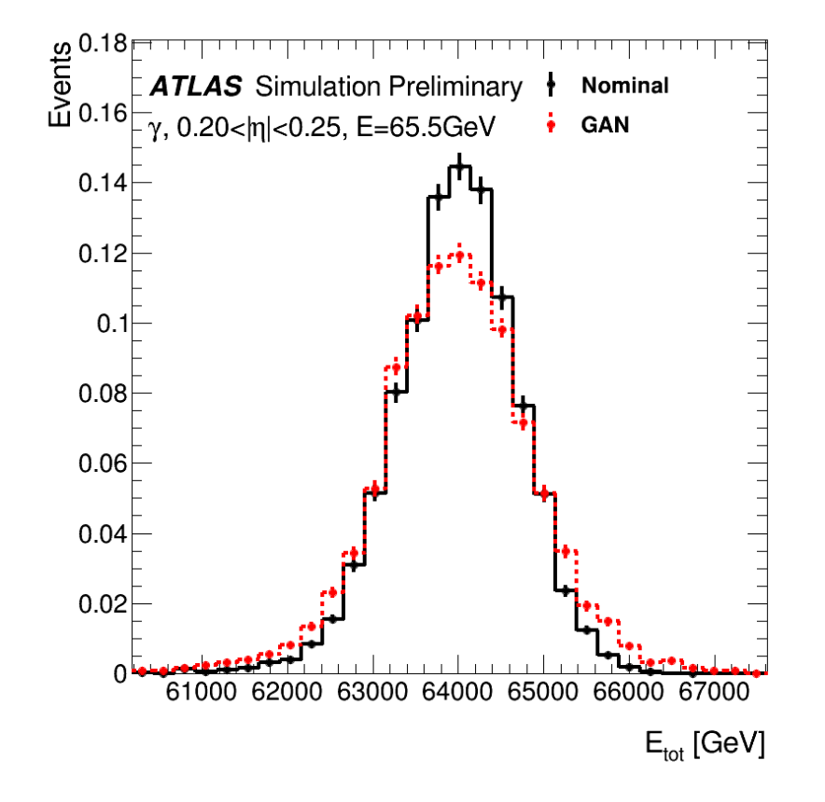
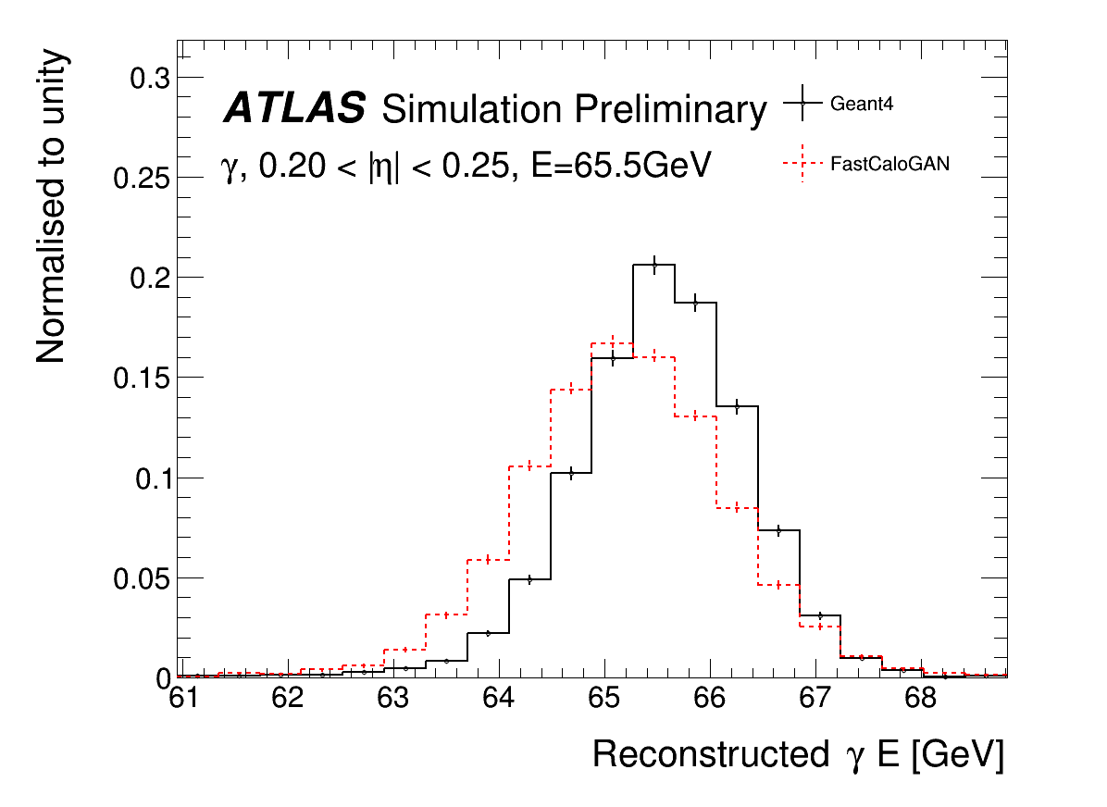
Photons total energy
Simulation and Reconstruction
Energy of sum of voxels
Energy of cluster
The discrepancy is due to a difference in the energy deposited between the “standard” Geant4 hits used in ATLAS and the detailed hits used in FCS

Slide 5
Detail of hits
ATLAS does not store the position of nominal G4 hits, the energy is assigned to the cell and therefore the granularity of rather course
In order to better parametrise the shower lateral shape, the decision was made to create a new type of hits called FCSHits with a smaller step size and store these positions
This unfortunately result in a different energy deposited in the cells, more hits integrate to a different total. The sample you used in Dataset 1 use FCS Hits
The cell energy information could also be used to renormalise the energy but it has some quality cuts on timing of hits resulting in a third total energy value
G4 Hits
FCS Hits

Slide 6
The solution
In principle rescaling the total energy from FCSHits to the cells should be the most accurate solution but we observed that for photons a better performance is achieved rescaling to G4Hits
For pions, FCSHits and G4Hits are very similar, so there is no effect in this rescaling
However, we just discovered that rescaling to the cell energy is a better solution for hadrons in the barrel

Slide 7
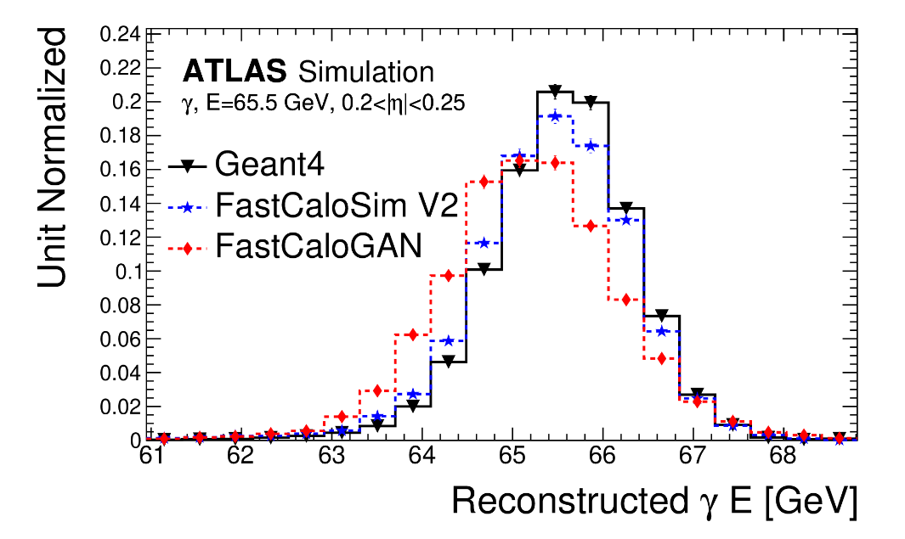
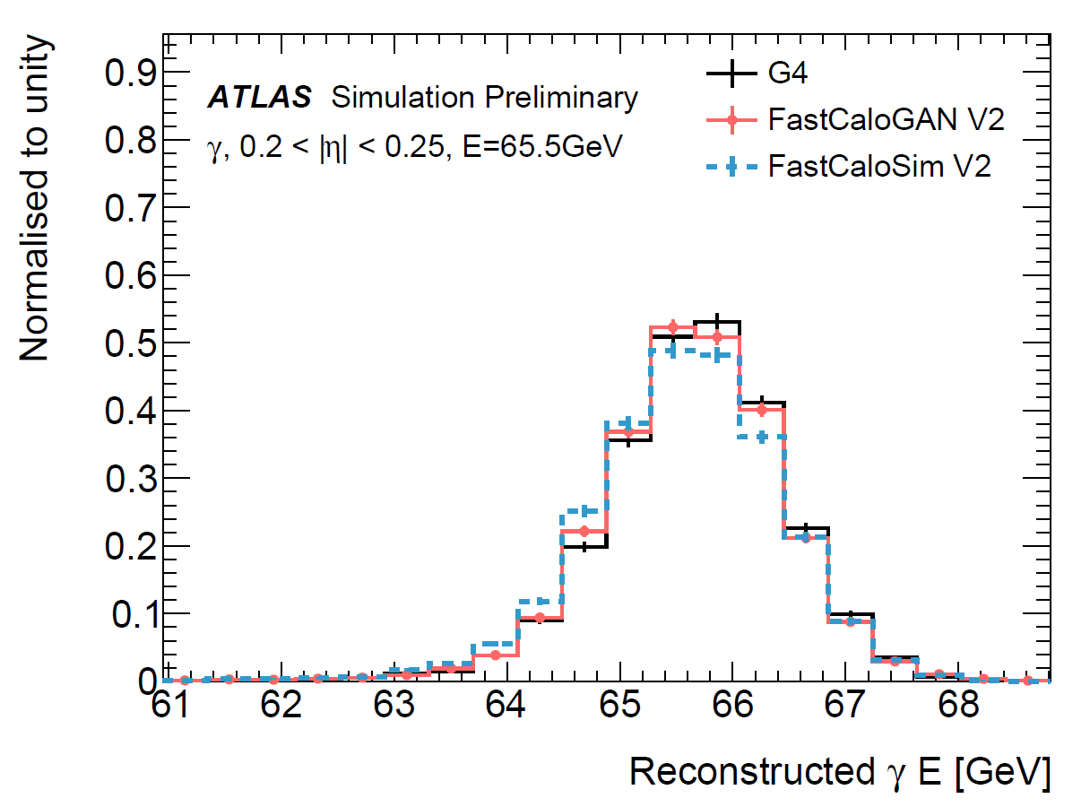
Rescaling from FCSHits to G4Hits total energy

Slide 8
Geometry corrections

Slide 9
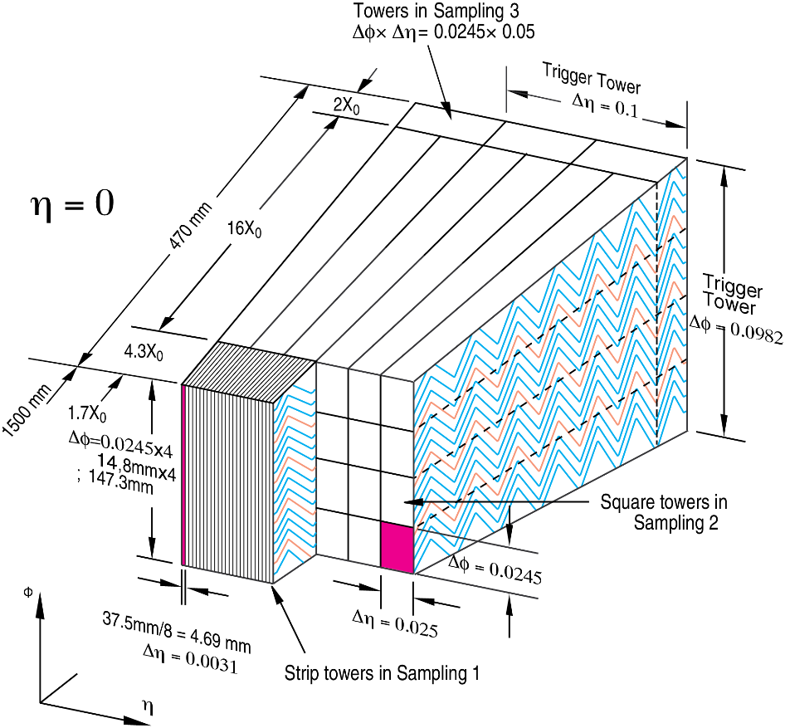
The effects of the real geometry of a detector
The geometry affects both energy response and the position of the hits
The energy changes depending on the position of impact as the shower develops in a region with more or less active material (Argon)
The position of the generated hits is assigned to the cells using a simplified geometry that is used to reduce memory consumption. This requires a shift of some of the energy from a cell to another to restore the correct shower shape

Slide 10
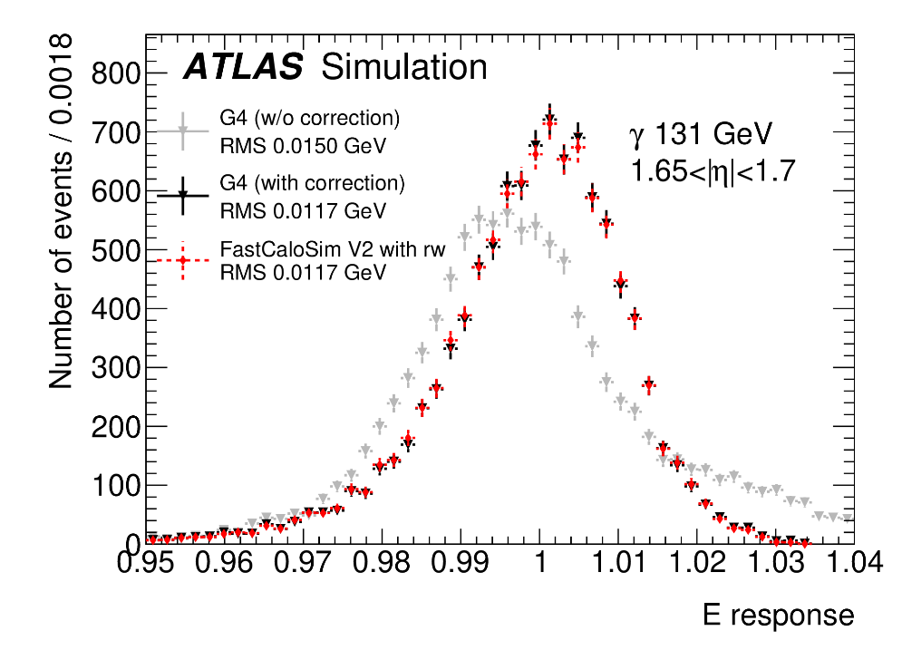
Energy correction due to accordion
There is a small dependence on the impact position in the accordion structure of the LAr
This cannot be emulated as it would require the detailed geometry.
Neglecting this correction makes the shower total energy wider;
the input you used does not have this correction, so the actual distribution you would need to train on is narrower (more difficult)
The dependence is considered in the Full simulation (Geant4) reconstruction.
AF3 deposit directly the corrected energy, hence, requires a dedicated calibration

Slide 11
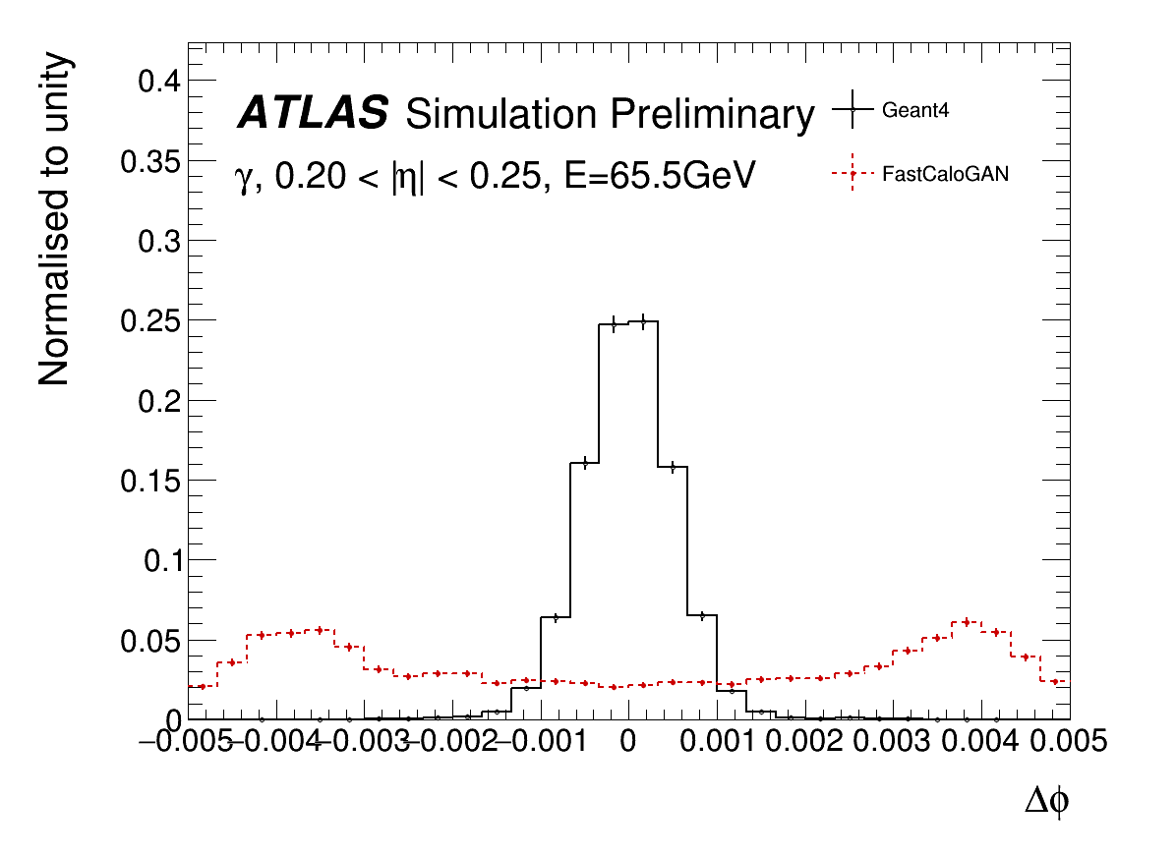
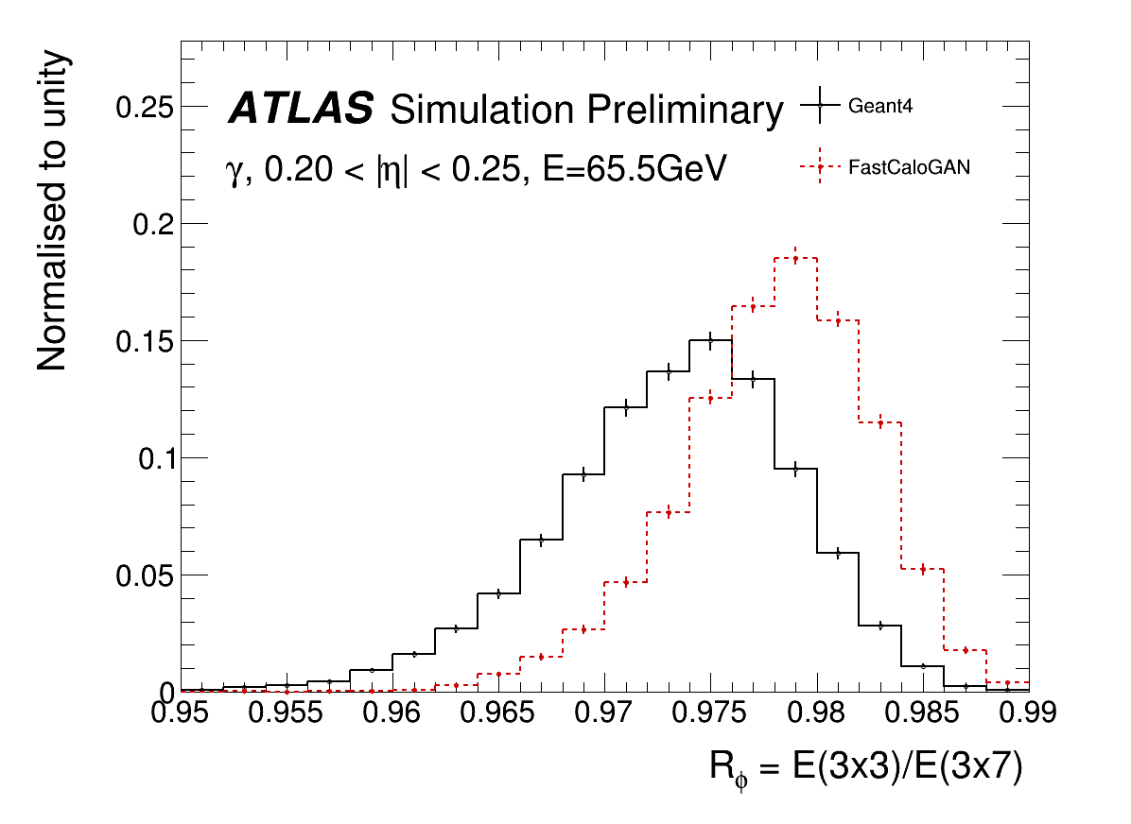
Position resolution in FastCaloGAN v1
FastCaloGAN has a poor agreement along φ due to the missing correction for the accordion structure of the LAr calorimeter

Slide 12
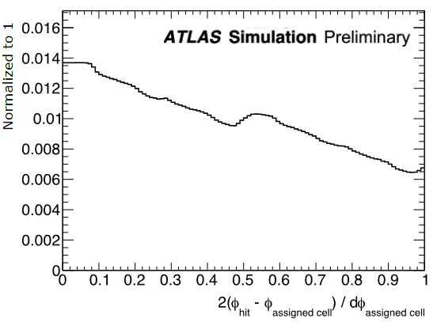
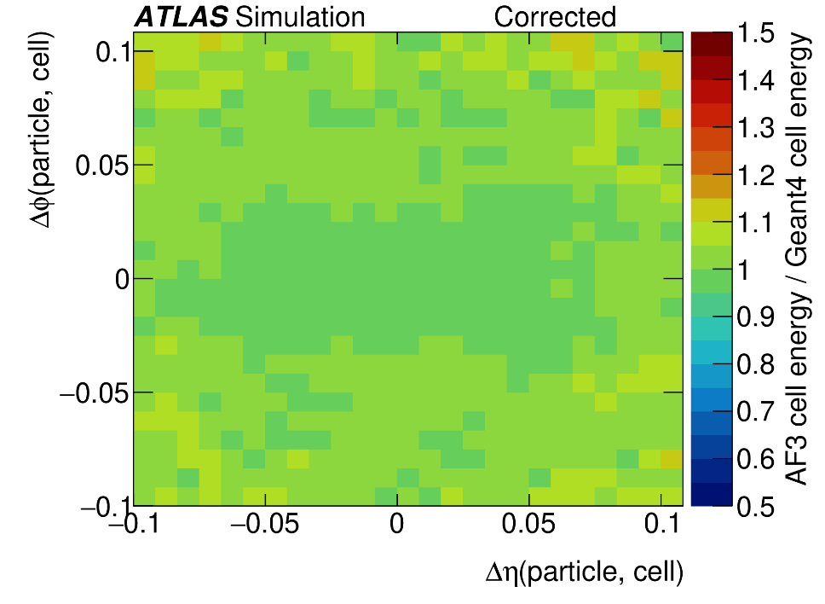
Simplified geometry correction
The simulated hits are assigned to cells using a simplified geometry that does not match the detector geometry
The probability for a cell mis-assignment is used to displace a hit before assigning to a cell
Hit shift

Slide 13
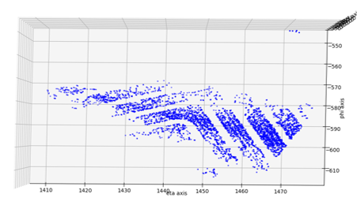
Point cloud input and geometry

Slide 14
Assign energy from voxels to cells

Slide 15
Voxel to hit
The voxelisation must be inverted in the Athena service by producing hits
Hits are generated by sampling the area of each voxel
Depending on the layer, the areas is divided in step of 1 or 5mm along both r,α coordinates
A maximum of 100 hits are produced to reduce the simulation time
The energy in the voxel is divided uniformly among the different hits

Slide 16
Voxelisation inversion
The total energy in a voxel is divided in grid so that it is better mapped to the cells of the calorimeter
ATLAS Calorimeter cells

Slide 17
FastCaloGAN v2 development
Improved voxel-to-cell energy assignment exploiting physics knowledge. Specifically, the fact that the lateral shower profile does not depend on the particle energy
There is actually a dependency when we look at individual layers as there is a correlation between impact energy and longitudinal position of maximum width, this is small enough that a single exp function can be used for all energies
In V2 hits are no longer generated in a grid, instead:
the alpha direction is randomised
Along the lateral direction, hits are generated according to the pdf evaluated on the GEANT4 input samples.
Technically we fit an exp in each bin along r and store the fitted value that is used in the pdf

Slide 18
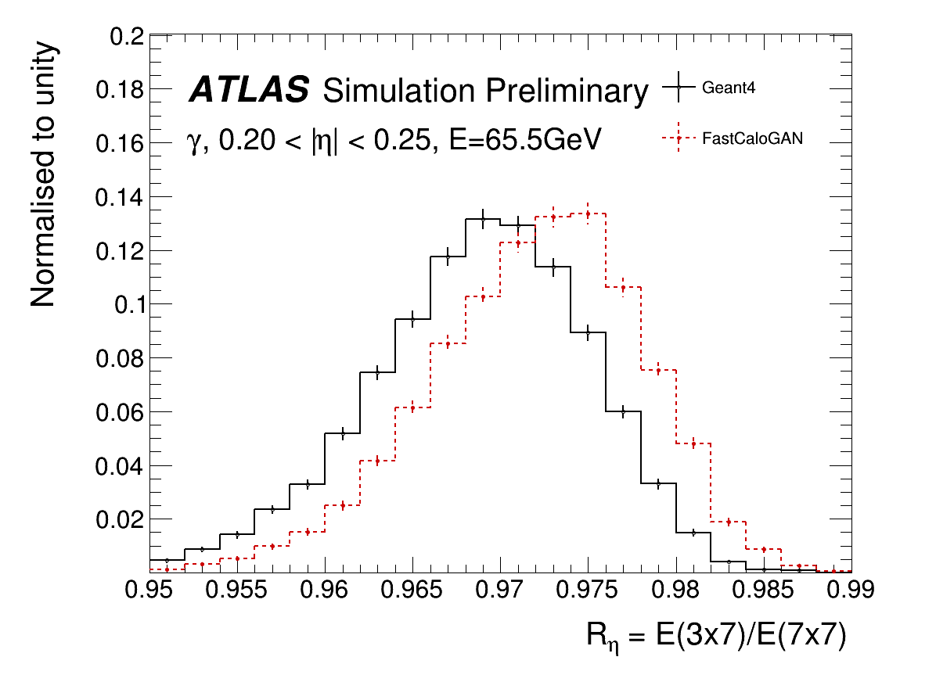
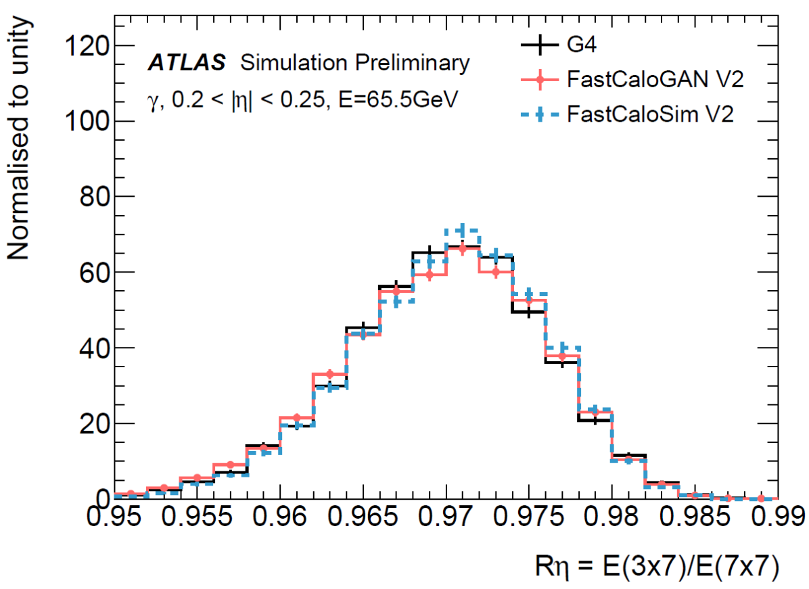
Effect of better hit assignment

Slide 19
Scale up the model to the full detector

Slide 20
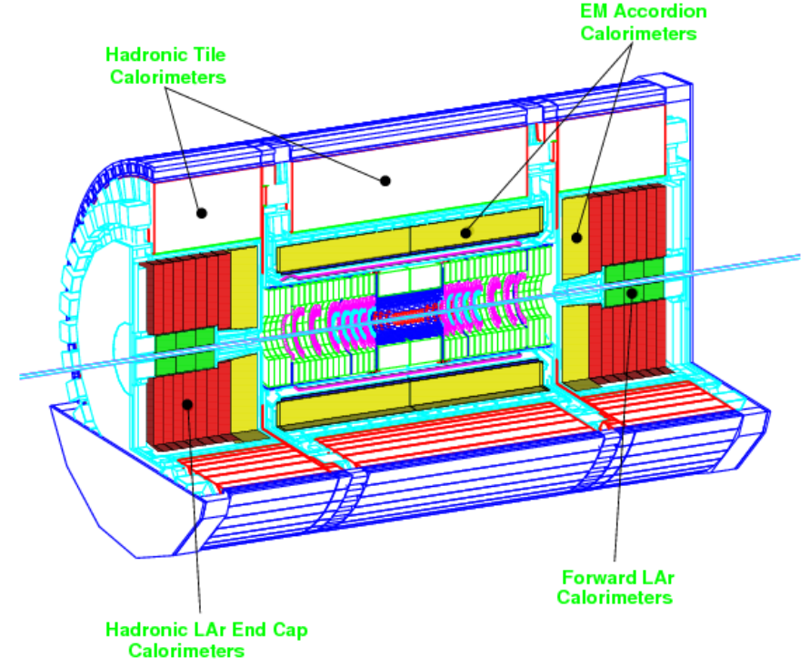
The ATLAS calorimeters
From ATLAS Calo TDR
Complex geometry

Slide 21
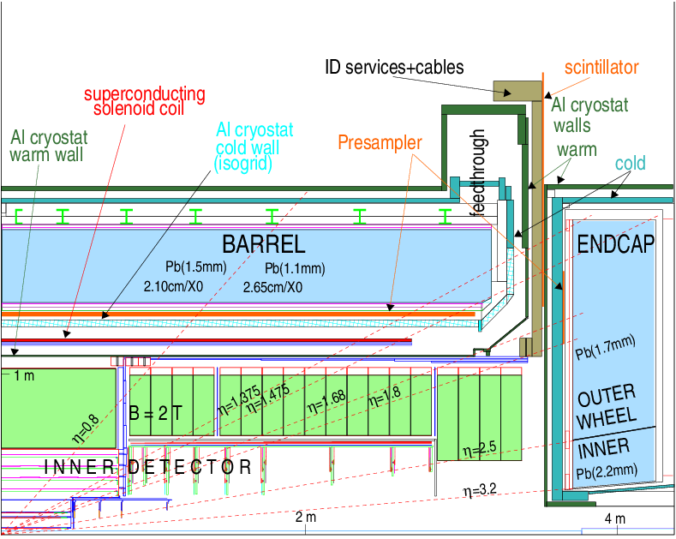
The ATLAS EM calorimeters
From ATLAS Calo TDR
Each line represent a discontinuity

Slide 22
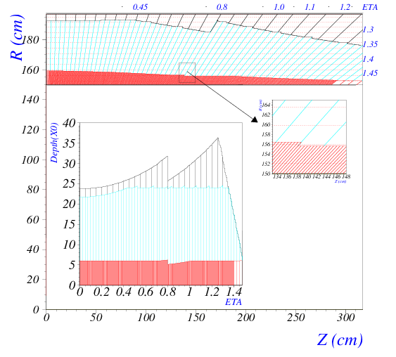
The barrel
4 layers:
Pre-sampler
EMB1
EMB2
EMB3
Sampling fraction depends on eta
From ATLAS Calo TDR

Slide 23
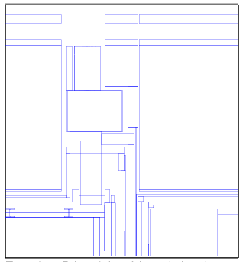
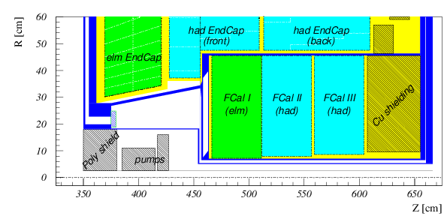
The hadronic calorimeter system
Complex transition region between barrel and endcap
Forward region
From ATLAS Calo TDR

Slide 24
Going full detector
Current ATLAS strategy is to slice the detector in 100 η slices and train a GAN in each slice
Conditioning on η will only help up to a certain point
At least 10 different regions are needed given the transition regions having very different responses even in very close η values
Hence, the total resource needed will be ~10x those listed by the model presented in the challenge
Very different detectors such as ATLAS FCAL or CMS HGCAL will benefit/require a special voxelisation and very different HP optimisation. This may add significant burden on the total resources and require a significant additional work

Slide 25
Time and memory requirements

Slide 26
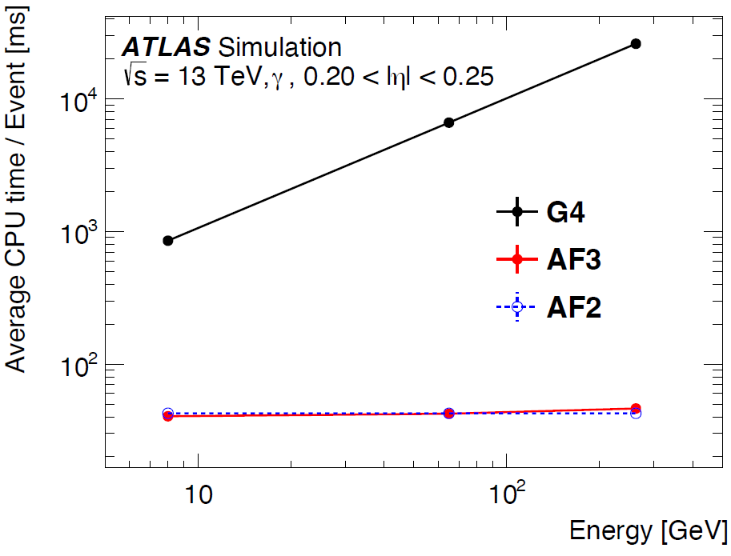
Time
Current fast sim is completely dominated by G4 simulation of the inner detector
No need to be super fast, 10-100 speed improvement is enough
~35 ms for simulating a single particle is good enough
This time should depend on number of hits generated, so it should scal ~SQRT(E) but is instead flat, this mean we are dominated by other effects (likely direction extrapolator use to get centre in each layer)

Slide 27
Memory
Some numbers:
Athena (the ATLAS SW) requires ~2GB
The latest param file requires ~7GB
The parametrisation with all models is run a separate service, so it can be shared between different Athena threads when running MT.
With 8 cores, we are well below 2GB/core, but some grid nodes have only 1GB/core, so reducing this requirement will allow running on more sites

Slide 28
Other models and integration

Slide 29
Your model will not live in vacuum
The experiment SW will put constraints on what you can and cannot do, prepare in advance
ONNX for a while was not really supported
You will need to deploy using existing formats
AF3 parametrisation is stored as a single root file, not really friendly to the format used to store nets by LWTNN or ONNX
The preparation for a FastSim campaign takes a long time, the strategy is defined well in advance and your training samples will not be what is best for your model
In ATLAS we have discrete energy points, ML usually prefer continuous
The η slicing of samples may also not work well for you
Changing strategy is a major decision for an experiment, you need to be very convincing to obtain what you prefer

Slide 30
What about other models?
ML is not the solution to everything
Parametric models like FCSV2 are very competitive and an experiment will want to pick the best of all available models
Or you may need to integrate with other ML
Could be easy if per particle or per eta region, much less if the difference is in energy regions
AF3 use a spline to define the energy response and use FCSV2 or GANs for the shape
Transition between the two is done like in physics lists in GEANT; the two models overlap in a range of energies and are randomly chosen to create a continuous distribution

Slide 31
What I don’t worry about
Incident angle, as studied by ILD people
The calorimeter is far from the IP and the beam spot is small, so the actual difference in entry angle is small
This distance is large
The beam spot is small
So the angle is very small

Slide 32
More topics of discussion
Voxelisation

