Slide 1
Introduction
Michele Faucci Giannelli, Gregor Kasieczka, Claudius Krause,
Ben Nachman, Dalila Salamani, David Shih and Anna Zaborowska

Slide 2
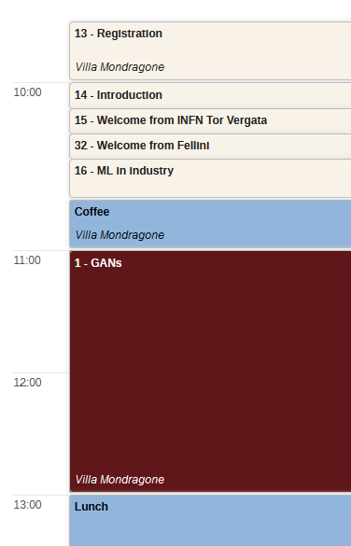
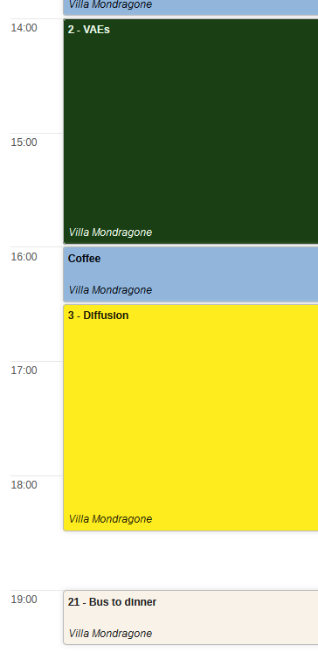
Timetable day 1
Introductions
Dedicated sessions
Breaks
Dinner by bus

Slide 3
Timetable day 2
Bus will collect you at the same place and time
Coffee break during the session
Challenge result and discussion
Lunch
Bus back to Frascati

Slide 4
Useful info
For any problem, please grab me or Umberto
If you need a taxi, we can call you one
Code of conduct: please be respectful and report any inappropriate behaviour
Enjoy the time here in Frascati!

