Slide 1



BEAM DYNAMICS STUDIES FOR HIGH BRIGHTNESS ELECTRON LINEAR ACCELERATORS
XXXVth PhD School in Accelerator Physics – Final Exam Jan 18th 2023
PhD Candidate: F. Bosco^{1,2,3*}
Supervisors: M. Migliorati^{1,2}, L. Palumbo^{1,2}
Referees: V. Dolgashev (SLAC), P. Musumeci (UCLA)
¹La Sapienza University of Rome, 00161 Rome, Italy
²INFN-Sez. Roma1, 00161 Rome, Italy
³UCLA, Los Angeles, 90095 CA, USA
⁴INFN-LNF, 00044 Frascati, Italy
* fabio.bosco@uniroma1.it
Notes:
Good afternoon everyone, my name is Fabio Bosco and during the years of my PhD I have joined one of the research groups from La Sapienza’s department of basic and applied science for engineering
Today I will present the results of the thesis I produced with their support and entitled “beam dynamics studies for high brightness electron linear accelerators”
I want to thank my supervisors prof. MM and LP but also I want to acknowledge all the people with whom I had positive scientific discussions during daily work, meetings and workshops
--------
Good afternoon everyone, my name is Fabio Bosco and during my PhD I have joined a group from the department of basic and applied science for engineering at La Sapienza
With their support, I have been working on a thesis entitled “beam dynamics studies for high brightness electron linear accelerators”

Slide 2


Acknowledgements
La Sapienza
M. Carillo
E. Chiadroni
D. De Arcangelis
L. Faillace
L. Ficcadenti
D. Francescone
G. Franciosini
L. Giuliano
M. Migliorati
A. Mostacci
L. Palumbo
V. Patera
M. Petrarca
S. Pisa
A. Sarti
G. J. Silvi
INFN-LNF
D. Alesini
M. Behtouei
A. Cianchi
M. Ferrario
A. Gallo
A. Giribono
B. Spataro
C. Vaccarezza
UCLA
G. Andonian
O. Camacho
S. Crisp
A. Fisher
A. Fukasawa
G. Lawler
M. Lenz
W. Lynn
N. Majernik
P. Manwani
P. Musumeci
A. Ody
J. Parson
J. B. Rosenzweig
Y. Sakai
A. Suraj
O. Williams
M. Yadav
Radiabeam
P. Carriere
M. Kravchenko
A. Murokh
M. Ruleas
Others
E. Aucone
F. Battisti
A. Culla
B. A. Esuain
L. Sabetta
B. Vitali
DESY
M. Diomede
M. Marongiu
LANL
D. Kim
E. Symakov
SLAC
C. Emma
Z. Li
E. Nanni
R. Robles
S. Tantawi
CERN
A. Ciarma
R. Costa
L. Intelisano
S. Joly
D. Quartullo
ENEA
F. Nguyen
M. Scisciò
Notes:
I want to thank my supervisors prof. MM and LP but also I want to acknowledge all the people with whom I had positive scientific discussions during daily work, meetings and workshops

Slide 3
Contents
Framework and Motivation
  The initiatives of our scientific collaboration
  Technological aspects and innovative concepts for high gradient RF linacs
Design of the C-band Hybrid Photoinjector Driving the DARPA-GRIT ICS Source
  Beam brightness and RF photo-injectors
  Electromagnetic design and beam dynamics optimization
  Commissioning at Radiabeam
MILES: Alternative Models for Collective Effects in Linacs
  Space charge forces and wakefield interaction with validation tests
  Applications: tolerances for misaligned linac structures and mitigation techniques for SRWF and LRWF interaction
Experimental Activities at UCLA
  Commissioning of the hybrid gun at Radiabeam
  Measurements of cryogenic RF structures
  Magnets development and test
Notes:
Here is an overview of the contents of this presentation
I will start by introducing the initiatives of the scientific collaboration behind my work as well as the innovative technological aspects that characterize such activities
Then, I will present the hybrid photoinjector designed and realized to provide the electron beam driving the DARPA ICS source
Next, I will discuss the modeling of self-induced fields in linacs with particular emphasis on the tracking code we developed to investigate such effects and applications in the context of alignment tolerances and mitigation schemes in presence of either the SR and LRWF effects
Last, I will report about my participation to some of the experimental activities during my visit at UCLA
----
I want to focus on the challenging beam physics characteristics of the machines we aim to descrìbe

Slide 4

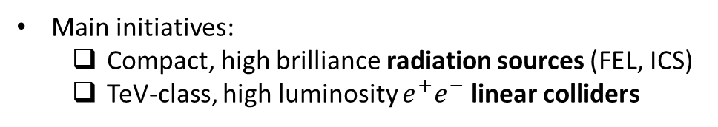
The Initiatives of the Collaboration
Scientific collaboration joining universities, laboratories and research institutes in the fields of accelerators and beam physics
Realization of high brightness electron linac-based facilities exploiting advanced accelerator concepts
Main initiatives:
  Compact, high brilliance radiation sources (FEL, ICS)
  TeV-class, high luminosity $e^{+}e^{−}$ linear colliders
Our group, from department SBAI*, mainly contributes to beam dynamics studies with special dedication to collective effects
  Space charge forces: Interaction of the beam with itself
  Wakefield effects: Interaction of the beam with the surrounding environment
(*SBAI = Department of basic and applied science for engineering)
Notes:
This work takes place in the framework of an international collaboration
The partners involved share the interest in exploiting advanced accelerator and beam physics concepts in order to realize state-of-the-art facilities based on high brightness electron linear accelerators
The main initiatives of the collaboration are addressed to compact, particle-driven radiation sources such as FEL and ICS machines but there is, in addition, a strong interest for high luminosity lepton colliders
In this context, our research group contributes to the beam dynamics studies with a special dedication for the collective effects attributed to space charge forces and wakefileds. The former describe the field produced and experienced by the charged beam itself whereas the latter is responsible for the interaction of the beam with the surrounding environment

Slide 5
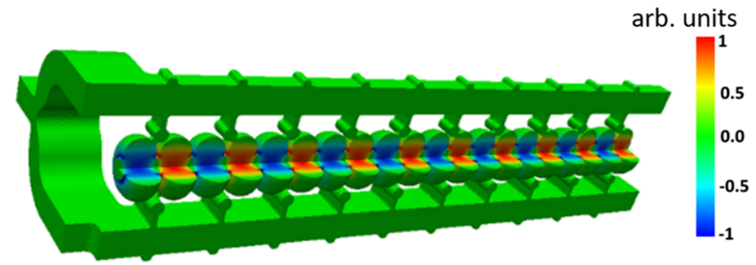
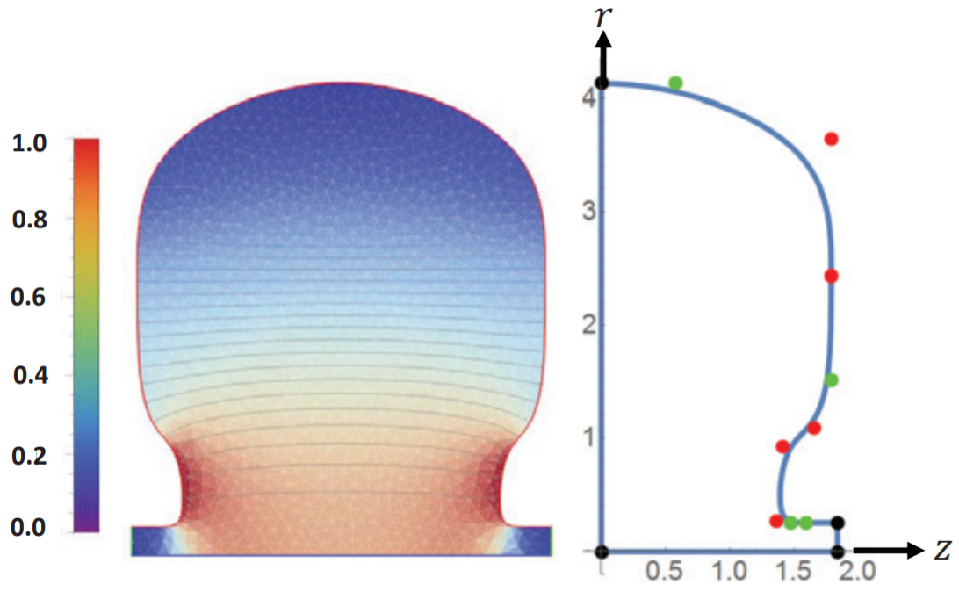
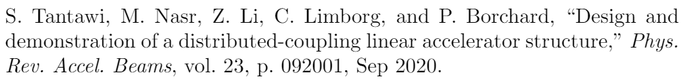
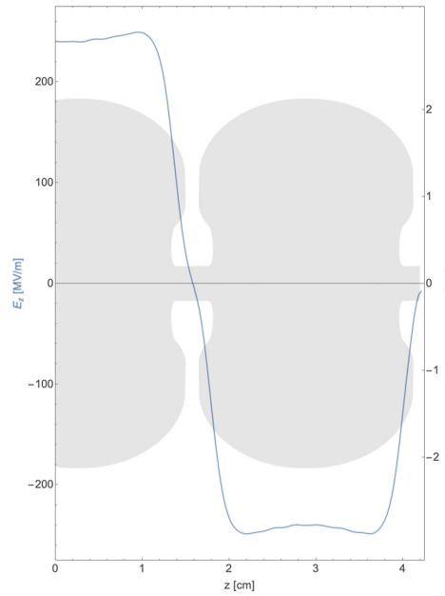
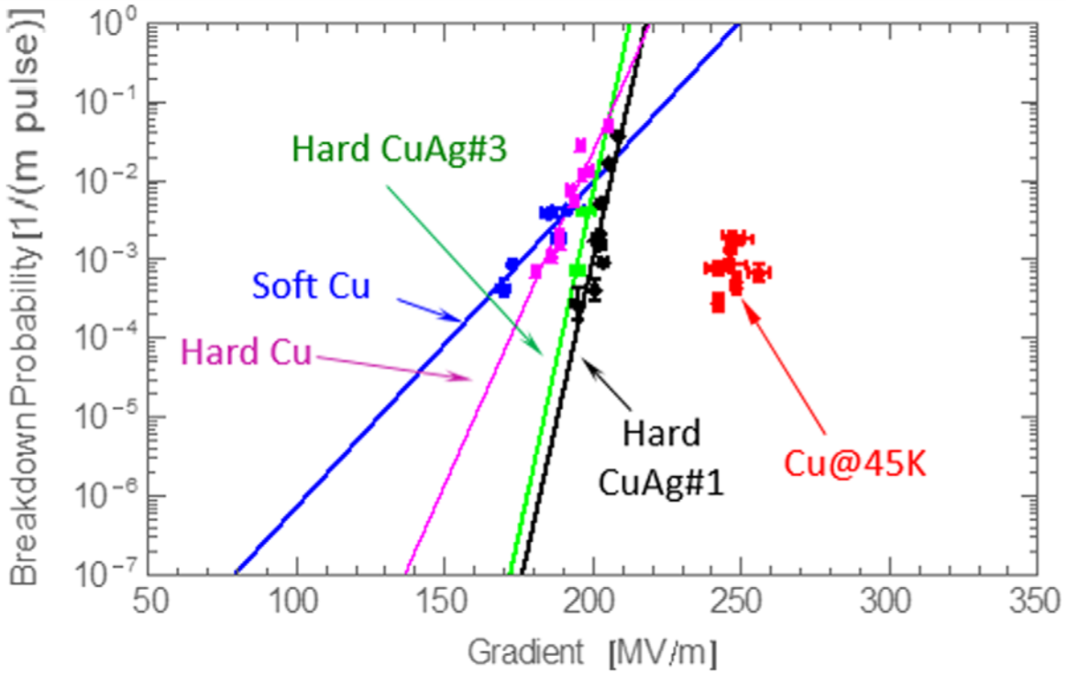
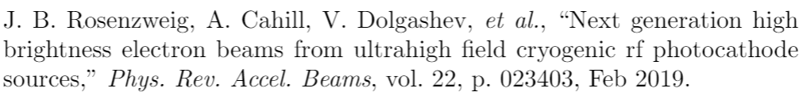
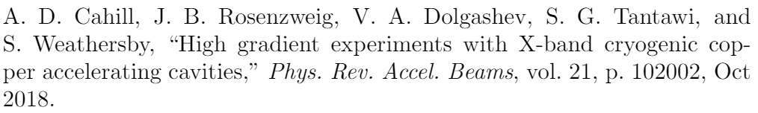

The Initiatives of the Collaboration (2)
Innovative RF-concepts for high gradient acceleration:
(a)
(b)
Distributed coupling scheme: cells receive the RF power individually from a guiding manifold structure (a)
Optimized cavity topology (b) enhances the efficiency in acceleration of charged particles (cell irises not subjected to coupling constraints)
Cryogenic operation: copper structures in the 45-77 K range support higher electromagnetic fields for a given breakdown rate (c)
Combination of such techniques enables also next-generation, very high field RF photoinjectors (d)
(c)
(d)
Notes:
Before moving on, I want to show some of the unique concepts for the high gradient acceleration that characterize the activities of the collaboration
This structure is a distributed coupling linac which uses a manifold waveguide to individually distribute the rf power in each cell of the periodic accelerating structure
As a consequence, the irises dimensions are no longer constrained to coupling requirements meaning that the entire unit-cell cavity shape can be optimized to improve the acceleration process
In addition, it has been observed that operation of copper cavities at cryogenic temperatures, below 77 K, mitigates the breakdown limit meaning that for a given BDR probability it is possible to operate at higher gradients
Also, the combination of optimized cavity design at cryogenic temperatures, enables ultra high field photoinjectors which improves the beam brightness at the source
------
Here I am showing some of the unique concepts for the high gradient acceleration that characterize the activities of the collaboration

Slide 6
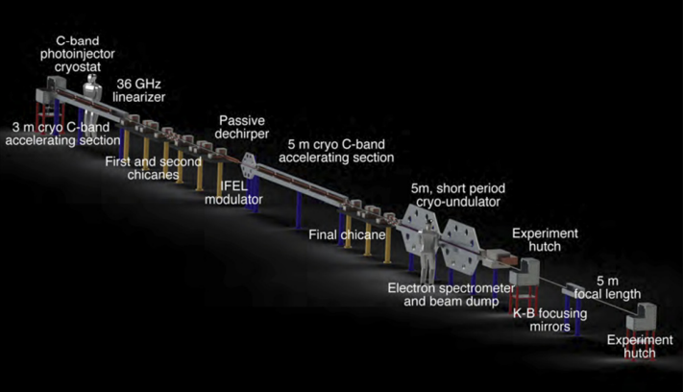
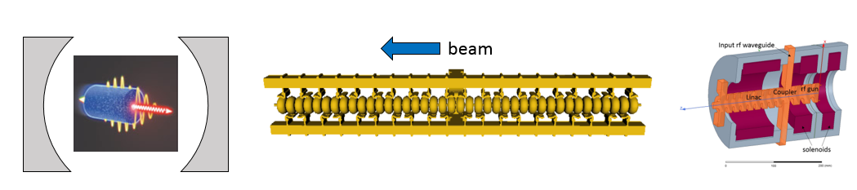
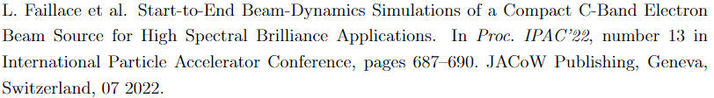
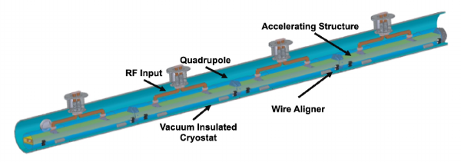
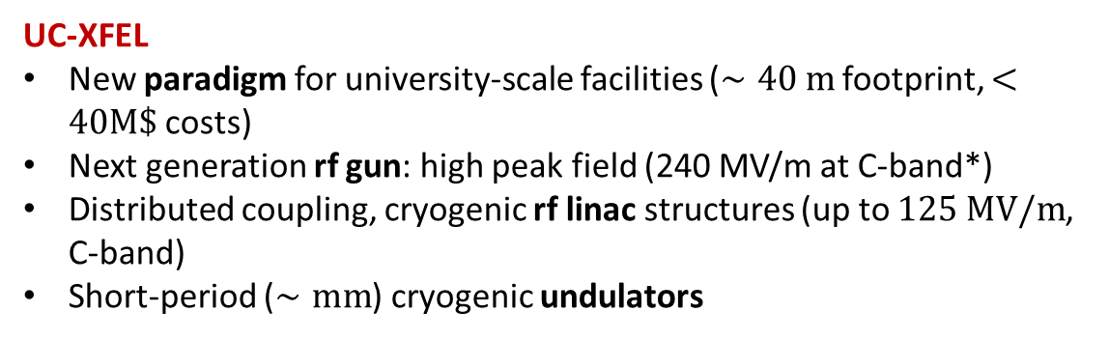
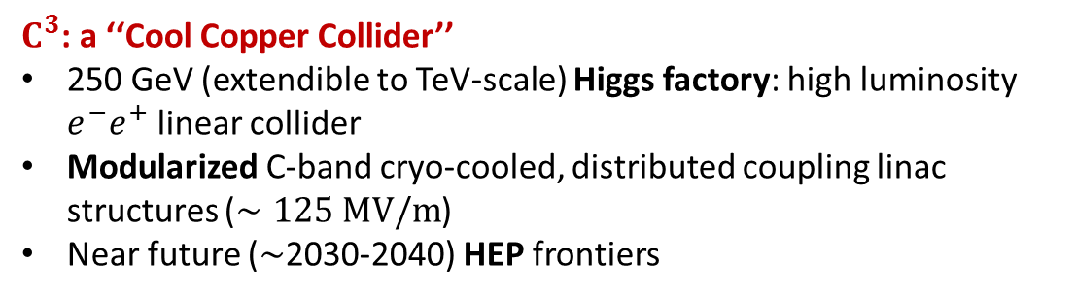
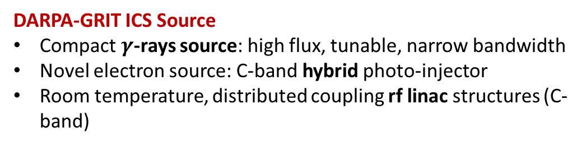
The Initiatives of the Collaboration (3)
UC-XFEL
New paradigm for university-scale facilities ($∼40 m$ footprint, $<40M\$$ costs)
Next generation rf gun: high peak field (240 MV/m at C-band*)
Distributed coupling, cryogenic rf linac structures (up to $125 MV/m$, C-band)
Short-period ($∼mm$) cryogenic undulators
DARPA-GRIT ICS Source
Compact $γ$-rays source: high flux, tunable, narrow bandwidth
Novel electron source: C-band hybrid photo-injector
Room temperature, distributed coupling rf linac structures (C-band)
$C^{3}$: a ‘‘Cool Copper Collider’’
250 GeV (extendible to TeV-scale) Higgs factory: high luminosity $e^{−}e^{+}$ linear collider
Modularized C-band cryo-cooled, distributed coupling linac structures ($∼125 MV/m$)
Near future ($∼$2030-2040) HEP frontiers
(*C-band = $5.712 GHz$)
Notes:
All such concepts are widely present in the main projects proposed by the collaboration and summarized here
The UC-XFEL is an ambitious design for the realization of university-scale facilities: despite the reduced footprint and cost, the expected photon flux per pulse is equal to several percent of the existing full-scale XFELs
The DARPA-GRIT machine is an ICS gamma ray source for which the driving electron beam is produced by a novel hybrid photoinjector. I will talk about this device later
The cool copper collider is a proposal for a high luminosity Higgs factory that is conceived as a modular facility made by the repetition of this 9 m long cryomodule unit. It represents a promising candidate for the near term future of HEP

Slide 7
Contents
Framework and Motivation
  The initiatives of our scientific collaboration
  Technological aspects and innovative concepts for high gradient RF linacs
Design of the C-band Hybrid Photoinjector Driving the DARPA-GRIT ICS Source
  Beam brightness and RF photo-injectors
  Electromagnetic design and beam dynamics optimization
  Commissioning at Radiabeam
MILES: Alternative Models for Collective Effects in Linacs
  Space charge forces and wakefield interaction with validation tests
  Applications: tolerances for misaligned linac structures and mitigation techniques for SRWF and LRWF interaction
Experimental Activities at UCLA
  Commissioning of the hybrid gun at Radiabeam
  Measurements of cryogenic RF structures
  Magnets development and test
Notes:
Let us move to the design of the high brightness hybrid photoinjector starting from the concept of brightness

Slide 8
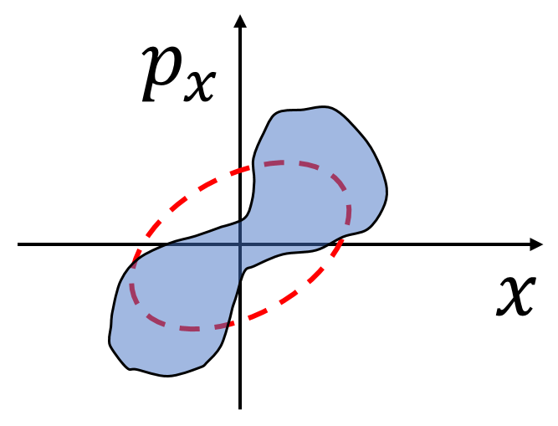
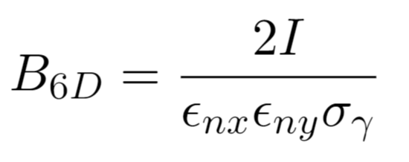
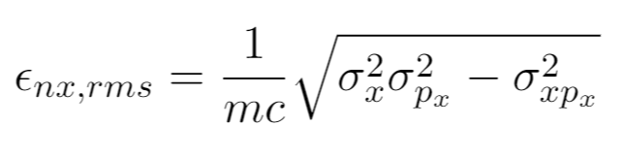
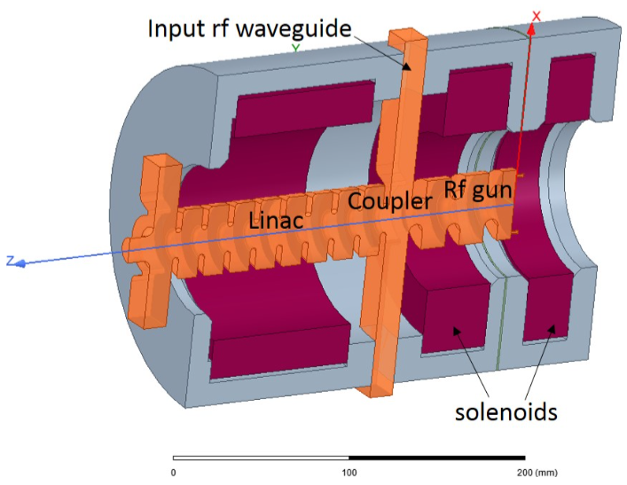
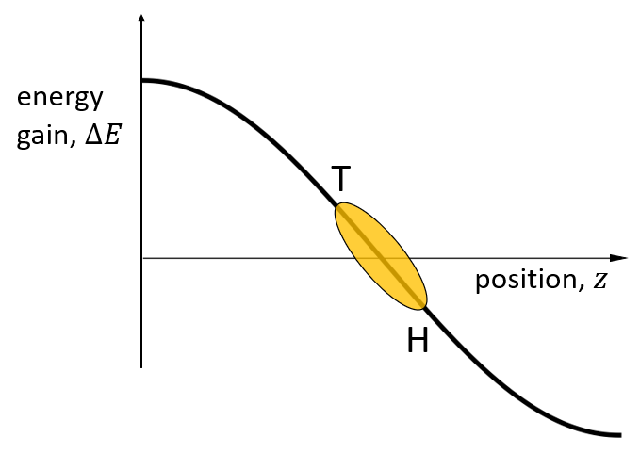
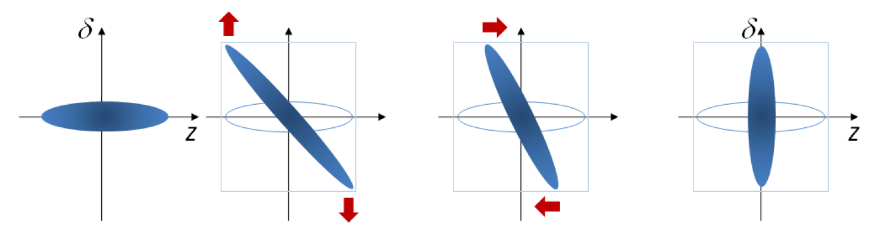
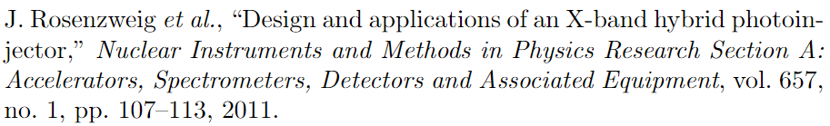
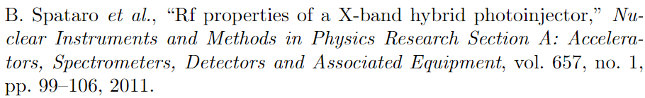
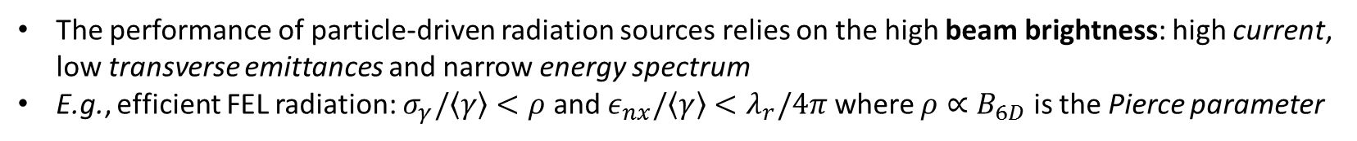
Hybrid RF Photo-injector
The performance of particle-driven radiation sources relies on the high beam brightness: high current, low transverse emittances and narrow energy spectrum
E.g., efficient FEL radiation: $σ_{γ}/\left\langle γ\right\rangle <ρ$ and $ε_{nx}/\left\langle γ\right\rangle <λ_{r}/4π$ where $ρ∝B_{6D}$ is the Pierce parameter
M. Reiser, Theory and Design of Charged Particle Beams,
John Wiley & Sons, New York, 1994
A “recipe” for high brightness electron beams
RF photoinjectors, or RF guns: UV, sub-ps laser pulse illuminating a metallic photo-cathode embedded in a high field multi-cell standing wave cavity
RF hybrid photo-injectors combine a SW and a TW section joint by a coupling cell
  The SW section provides energy gain (typically up to 3-5 MeV)
  Emittance compensation solenoid provides transverse focusing and emittance control
  The TW chirps the longitudinal phase-space and allows for velocity bunching
TW
SW
T
H
Notes:
The 6D brightness is a quantity that provides information on the beam intensity, spectrum and solid angle as it depends on the peak current, the energy spread and the rms emittances.
The brightness is thus a measure of the 6D phase space density and crucially impacts the quality of the radiation in electron-driven light sources
In addition, the rms emittances account for the transverse phase space area as well as its distortion which allows to describe the confinement of the beam nearby the reference trajectory
High brightness electron beams are typically produced by rf photoinjectors where the photo-emission occurs inside a SW multi-cell cavity which rapidly accelerates the particles acting against the intense repulsive intra-beam forces
Photoinjectors also exist in the hybrid configuration which combines a SW and a TW section through a coupling cell
The SW section still provides for the energy gain, a solenoid magnet introduces transverse focusing and emittance control as in the case of conventional rf guns whereas the TW can provide longitudinal focusing
In fact, the peculiarity of this device is that the field in the two sections is 90 degrees out of phase which introduces an energy-time correlation so that, as the beam propagates in a drift space, it experiences a ballistic compresses which enhances the peak current with a positive impact on the brightness
----
What is beam brightness? The 6D BB is a quantity defined through the peak current, the transverse emittances and the energy spread and is thus a measure of the charge per unit of 6D phase space volume
combines for the beam intensity, through the peak current, as well as its confinement nearby the reference the transverse emittances and the energy spread and is thus a measure of the charge per unit of 6D phase space volume
The quality of the radiation produced by electron-driven light sources strongly relies on the 6D brightness of the primary electron beam
As this quantity is defined through the peak current, the transverse emittances and the energy spread, it is a measure of the number of charges per unit of 6D phase space volume
High brightness electron beams are typically produced by rf photoinjectors where electrons are photoemitted with sub ps temporal structure and rapidly accelerated by the high field in the surrounding SW cavity

Slide 9

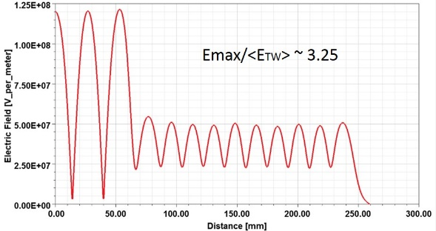
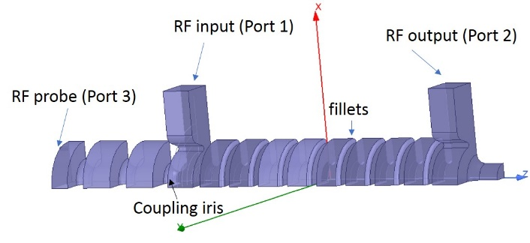
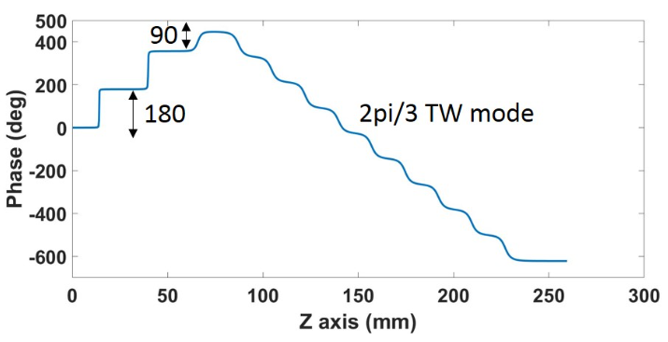
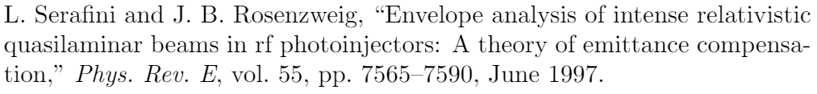
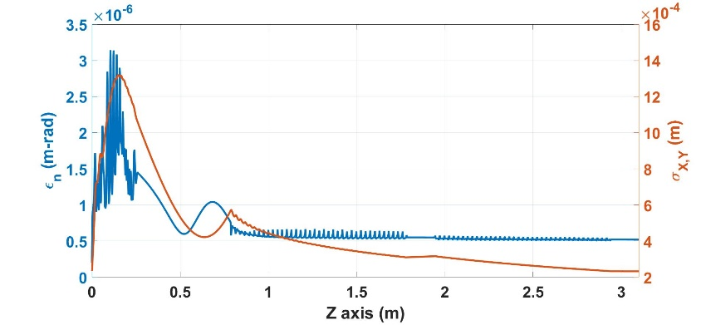
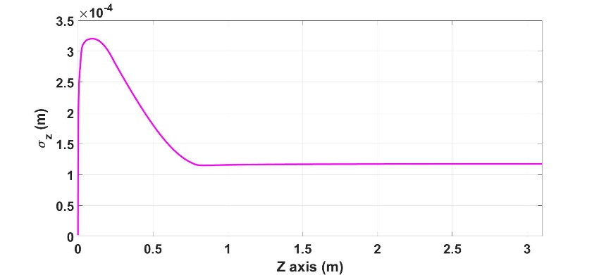
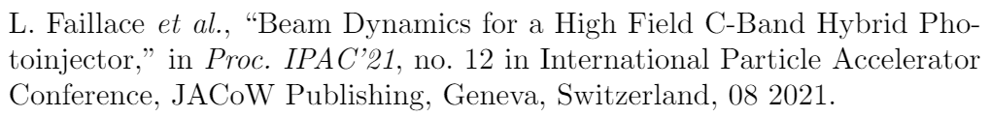

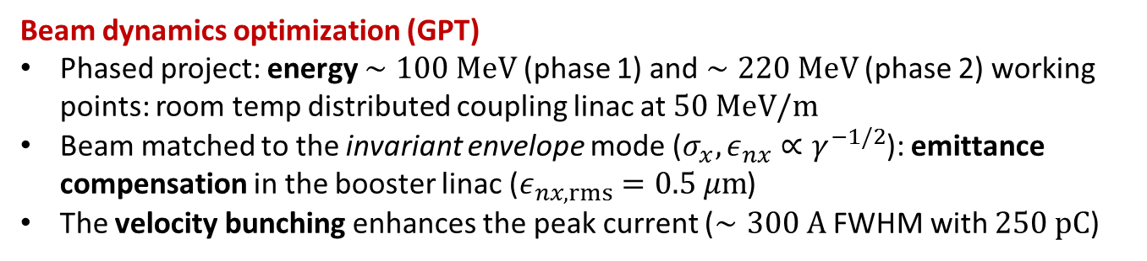
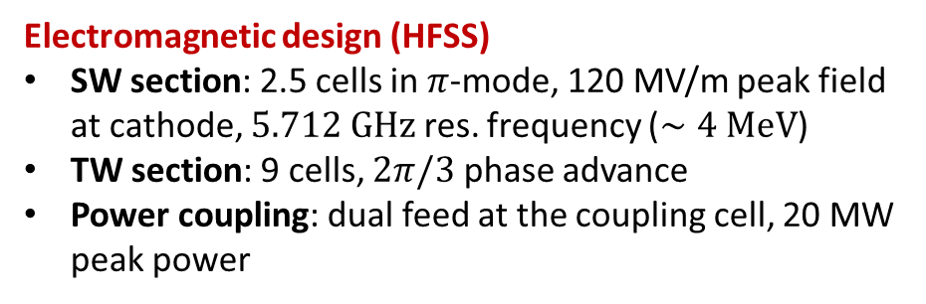
Hybrid RF Photo-injector (2)
High brightness $e^{−}$ source for the DARPA-GRIT ICS machine
Electromagnetic design (HFSS)
SW section: 2.5 cells in $π$-mode, 120 MV/m peak field at cathode, $5.712 GHz$ res. frequency ($∼4 MeV$)
TW section: 9 cells, $2π/3$ phase advance
Power coupling: dual feed at the coupling cell, 20 MW peak power
$$∼25 cm$$
Beam dynamics optimization (GPT)
Phased project: energy $∼100 MeV$ (phase 1) and $∼220 MeV$ (phase 2) working points: room temp distributed coupling linac at $50 MeV/m$
Beam matched to the invariant envelope mode ($σ_{x},ε_{nx}∝γ^{−1/2}$): emittance compensation in the booster linac ($ε_{nx,rms}=0.5 μm$)
The velocity bunching enhances the peak current ($∼300 A$ FWHM with $250 pC$)
Injection in the booster
Injection in the booster
L. Faillace et al., Phys. Rev. Accel. Beams 25, 063401, 2022
Notes:
Here I summarize the main features of the C-band hybrid photo-injector designed in collaboration with Radiabeam and driving the ICS machine
The device is made by 2.5 SW cells working in pi mode with a peak field at cathode of 120 MV/m for which I initiated the EM design. The SW section is followed by 9 cells of TWAS working in the 2pi/3 phase advance mode
This design requires a peak rf power of 20 MW which is provided at the coupling cell with a dual feed scheme
Here I show the results of the beam dynamics optimization for the intermediate energy case of 100 MeV where we notice that
The beam is matched to an equilibrium-like mode known as invariant envelope and receives both transverse focusing and compensation of the rms emittance down to a final value of .5 microns as it propagates in the linac
In addition, the velocity bunching process focuses the beam longitudinally and a peak current of 300 A with 250 pC charge is achieved
------
The beam propagates in the booster linac according to the invariant envelope mode receiving both transverse focusing and compensation of the rms emittance whose final value reaches .5 microns

Slide 10
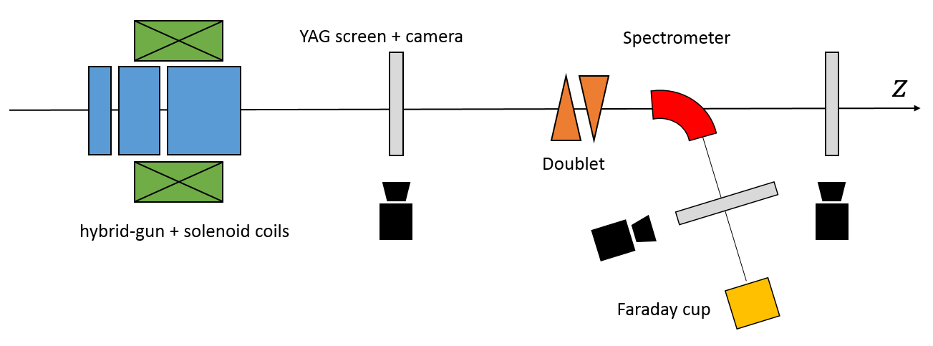
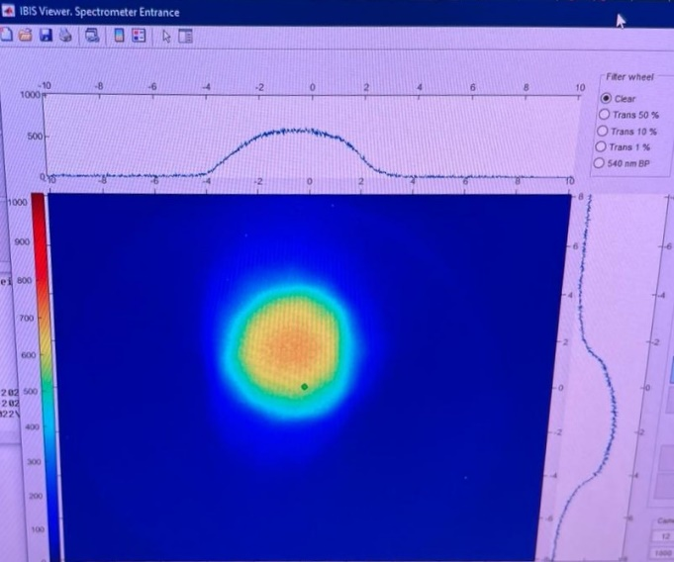
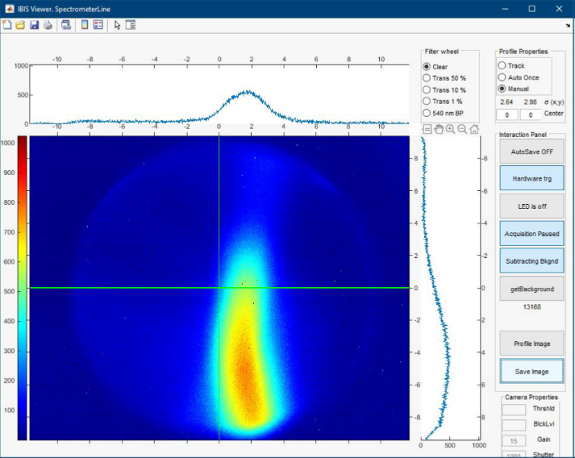
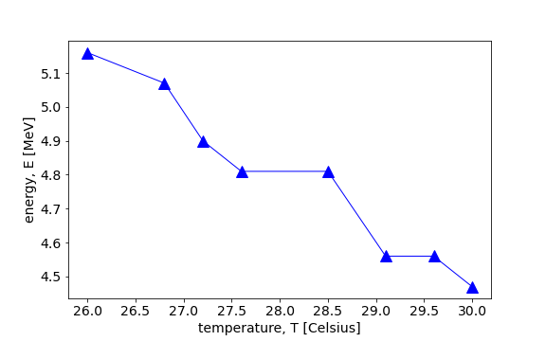
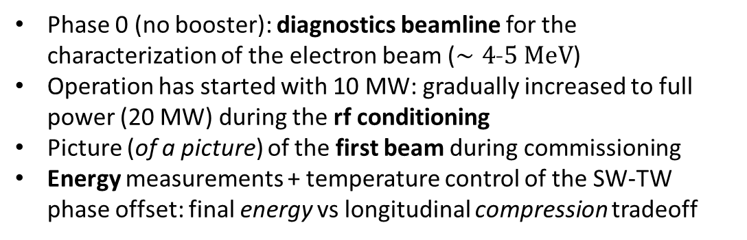
Hybrid Photoinjector - Commissioning
Phase 0 (no booster): diagnostics beamline for the characterization of the electron beam ($∼4$-$5 MeV$)
Operation has started with 10 MW: gradually increased to full power (20 MW) during the rf conditioning
Picture (of a picture) of the first beam during commissioning
Energy measurements + temperature control of the SW-TW phase offset: final energy vs longitudinal compression tradeoff
Courtesy of Radiabeam Technologies
“First beam” transverse profile measured at the YAG screen
Transverse beam profile in the spectrometer line (4.8 MeV energy)
Final energy vs temperature of the hybrid-gun (phase-offset tuning)
Notes:
The electron source was engineered and realized at Radiabeam technologies in Los Angeles, CA and I was able to participate at the commissioning
The first commissioning was aimed at the characterization of the beam produced by the hybrid gun in absence of boosters
Operation has started with half of the rf power which was gradually increased to the nominal value of 20 MW during the RF conditioning of the structure
Here I’m showing the transverse beam profile measured with YAG screens: despite thr bad quality of the first picture, it is very meaningful since it is the first one taken during the first day of commissioning; the second one is taken from the spectrometer line during energy measurements
The additional graph represents attempts of fine tuning of the resonant frequency with the temperature which modifies the phase shift between the SW and TW section with a tradeoff between the longitudinal compression and the final energy
---
The additional graph represents the fine tuning of the resonant frequency which changes the phase shift between the SW and TW section with a tradeoff between the longitudinal compression and the final energy

Slide 11
Contents
Framework and Motivation
  The initiatives of our scientific collaboration
  Technological aspects and innovative concepts for high gradient RF linacs
Design of the C-band Hybrid Photoinjector Driving the DARPA-GRIT ICS Source
  Beam brightness and RF photo-injectors
  Electromagnetic design and beam dynamics optimization
  Commissioning at Radiabeam
MILES: Alternative Models for Collective Effects in Linacs
  Space charge forces and wakefield interaction with validation tests
  Applications: tolerances for misaligned linac structures and mitigation techniques for SRWF and LRWF interaction
Experimental Activities at UCLA
  Commissioning of the hybrid gun at Radiabeam
  Measurements of cryogenic RF structures
  Magnets development and test
Notes:
Let us now discuss the study of alternative models for collective effects

Slide 12
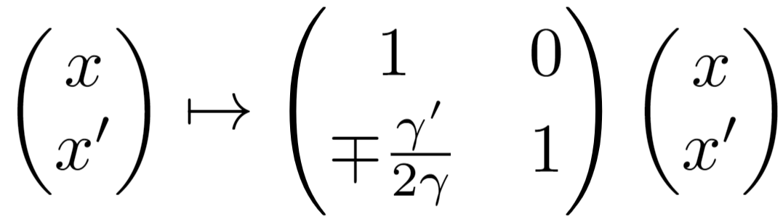
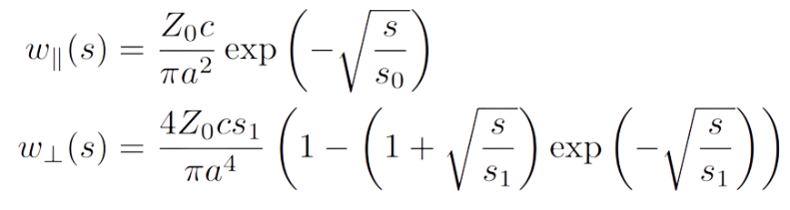
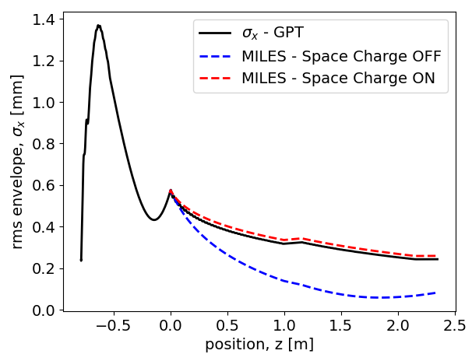
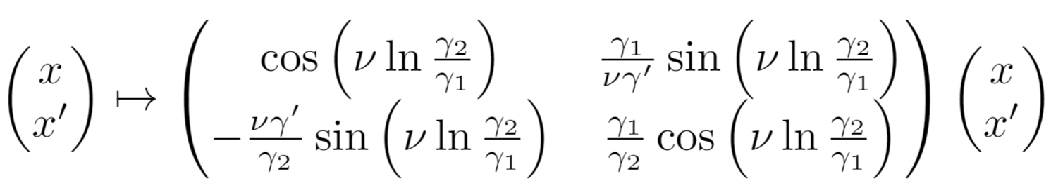
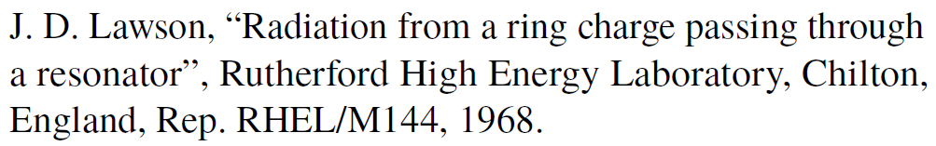
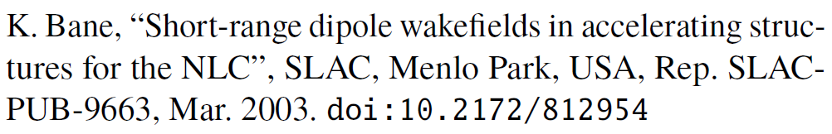
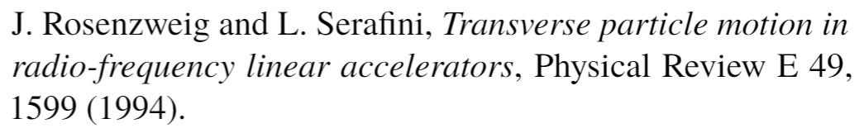
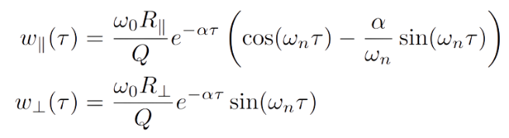
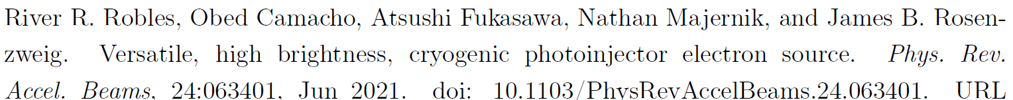
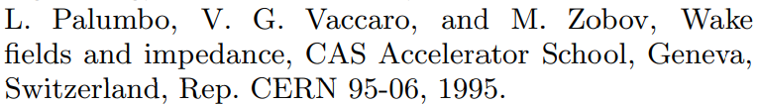
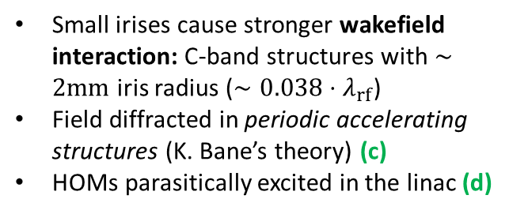
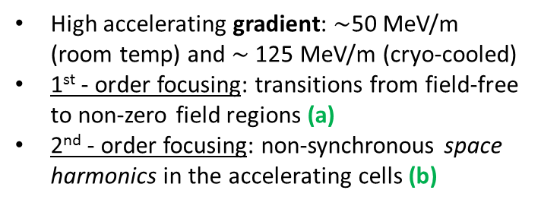
Motivation: Unique Beam Physics
Enhanced radial focusing in rf linacs
Strong wakefield interaction
Space-charge sensitivity
High accelerating gradient: $∼$50 MeV/m (room temp) and $∼$125 MeV/m (cryo-cooled)
1st - order focusing: transitions from field-free to non-zero field regions (a)
2nd - order focusing: non-synchronous space harmonics in the accelerating cells (b)
Small irises cause stronger wakefield interaction: C-band structures with $∼2mm$ iris radius ($∼0.038⋅λ_{rf}$)
Field diffracted in periodic accelerating structures (K. Bane’s theory) (c)
HOMs parasitically excited in the linac (d)
Beams produced by rf photoinjectors are in the 3-5 MeV energy range
Highly space charge-dominated nearby the injection in linac boosters
Nominal focusing anomalously strong in absence of SC forces (overfocusing)
(a)
SRWF
(c)
(b)
Injection in the booster
Note: $ν=η/8\cos\left(Δφ\right)$ with $η=1.12−0.5\cos\left(2Δφ\right)$
(d)
LRWF
Notes:
The motivation for such studies arises from the combination of photoinjectors and linac boosters with the properties described earlier which defines a unique and challenging scenario from the beam physics perspective
The optimized cell geometry of distributed coupling linacs enhances the accelerating gradient as well as the presence of non-synchronous space harmonics which are responsible for inherent radial focusing mechanisms introduced by the linac itself
Conversely, the small irises increase the impedance of the structures causing strong wakefields acting both within the same bunch or among different bunches
In addition to that, nearby the injection region our beams are highly space charge dominated so we need to take such effects into account. Such forces act against the external focusing which, as shown by this simple example with photoinjector + booster, results anomalously strong in absence of SC causing overfocusing and loss of laminarity
------
I want to focus on the challenging beam physics characteristics of the machines we aim to describe

Slide 13




The Code MILES
Dedicated tracking code
Motivation to investigate wakefields effects in linacs in presence of non-negligible space charge endangering the nominal beam quality
Use of simple semi-analytical models: flexible and time-efficient tool (factors $∼$1/30-1/10) with acceptable reduction of the accuracy
Main applications: investigation of misalignment effects and design of possible correction schemes
Miles Davis (May 26, 1926 – September 28, 1991)
MILES = Modeling Instabilities in Linacs with Ellipsoidal Space charge
Comparison with other codes utilized in accelerator physics
SPACE CHARGE: Particle in cell, PIC, approach (GPT, ASTRA, PARMELA,TSTEP…)
WAKEFIELDS: Convolution integral with the beam slices, often solved with FFT algorithms (ASTRA, ELEGANT, LUCRETIA…)
SC + WF: Complexity and CPU times increase and, thus, it is not a trivial feature (ASTRA, IMPACT-Z, OCELOT, HOMDYN)
Notes:
This challenging framework was for me a motivation to develop MILES: a dedicated tracking code investigating wakefield effects in linacs while also including simple models for space charge forces
The code uses semi-analytical approaches that yield a flexible and time-efficient tool at the expenses of an acceptable reduction of the accuracy
The primary goal conceived for MILES is the investigation of misalignment tolerances and the design of mitigation schemes for such imperfections
In addition, MILES gave us the opportunity to compare different approaches identifying possible advantages and limits also in comparison with standard approaches.
Indeed, as the action of self-induced fields depends on the beam distribution, most codes utilize particle in cell methods for space charge and an integral convolution with the beam slices for wakefields
Such methods can be time consuming for large particle sets and thus the combination of space charge and wakefield is not trivial

Slide 14













Modeling Space Charge Forces
Equivalent ellipsoid method
Multi-slice superposition method
Ellipsoidal beams arise from the blowout process
An equivalent uniform ellipsoid is associated to the actual beam distribution
Self-induced forces are known analytically
Forces are linear: self consistent model
Divide the beam in cylindrical slices with individual size, energy and aspect ratio
Field produced by each (uniform) slice is known analytically ($∂/∂θ=0$, $∂E_{z}/∂r=0$)
Force on each particle: superposition of the fields produced by all the slices (generalization of “HOMDYN”)
Field form factors
Advantages
Very fast ($∼30$ times than 3D PIC )
Successfully reproduces rms size ($σ_{x},σ_{y},σ_{z}$) and energy spread ($σ_{E}$)
Limitations
Absence of correlation prevents the observation of emittance dynamics
Loss of axial symmetry in presence of strong transverse wakefield
Advantages/Limitations
Correlation between the planes describes the emittance dynamics
Allows description of more arbitrary geometries
More time-consuming but still faster than PIC
Notes:
Let me review briefly two semi-analytical methods we proposed for space charge effects
The first one associates the actual beam distribution to an equivalent uniform ellipsoid which produces well-known self induced forces
In addition, this approach is attractive because ellipsoidal beams appear frequently in modern beamlines as they are naturally produced by the so-called blowout process
The second method can be considered a generalization of the code HOMDYN and divides the beam in cylindrical slices with individual size and energy which produce a field in this form in the surrounding space
The force acting on each particle is then given by the superposition of the EM field produced by all the slices
The ellipsoid method is very fast and in many practical cases reproduces the rms beam dimension and energy spread correctly
However, since the forces are not slice-dependent, the model forbids to observe well-known emittance dynamics that are induced by the independent evolution of the beam slices
In addition, in presence of wakefields, the deflection introduced by the transverse wake will displace the centroid of each slice breaking the symmetry that is implied in the ellipsoidal model meaning that the model is not valid in strong-BBU regime unless correction schemes for the trajectories are introduced
The multi-slice approach overcomes both these limitations: it exhibits a correlation between the planes and allows description of more arbitrary shapes. The drawback is that this method become more time consuming but remains faster than a PIC
---
For what concerns SC forces, the strength of such effects depends on the shape and the size of the distribution, and therefore their description utilizes PIC methods
Here I am showing two alternative semi-analytical methods:

Slide 15









Modeling Space Charge Forces (2)
Equivalent ellipsoid method
Multi-slice superposition method
$250 pC$ $e^{−}$ beam from the C-band hybrid gun
Evolution in a field-free (drift) region with GPT (solid lines) and with the ellipsoidal model in MILES (dashed lines)
$250 pC$ $e^{−}$ beam produced by the hybrid gun and matched to its invariant envelope in a booster linac
Emittance dynamics: oscillations in the drift and compensation in the linac
Transverse plane: $σ_{x}$, $ε_{nx }$
Injection in the booster
Longitudinal plane: $σ_{z}$, $σ_{E}$
Relative error within 3% with $∼$1/6 execution time
Relative error within 4% (except emittance) with $∼$1/40 execution time
M. Ferrario et al., Direct measurement of the double emittance minimum in the beam dynamics of the Sparc high-brightness photoinjector, Phys. Rev. Lett. 99, 234801 (2007).
Notes:
Here we can see some examples where our approach is compared to codes like GPT and ASTRA, both using PIC
In both cases we consider the beam produced by the hybrid photoinjector that, on the left, propagates in a long drift space and on the right is injected in a booster linac receiving emittance compensation
On the LHS MILES is using the Ellipsoidal model which, as anticipated, describes the transverse and the longitudinal dimensions as well as the energy spread correctly but it fails to reproduce the emittance oscillation
On the RHS the ellipsoidal model still fails in describing the evolution of the rms emittance however the multi-slice approach reproduces successfully both the oscillation in the drift and the compensation process

Slide 16











Modeling Wakefield Effects
Interaction of a particle with a cavity resonant mode
The change in momentum (energy/deflection) is described by the equivalent shunt circuit voltage
Evolution of the voltage state
Recursive formula
State after the $n$ charges have passed
$N$ particles $⇒$ $N−1$ operations
Perturbation:
Kick induced by the passing charges
Free-evolution:
Homogenous 2nd order differential equation
Notes:
Here I want to introduce the algebraic formalism that I developed in order to describe the effects of both longitudinal and transverse wakefields
The fundamental idea upon which the formalism relies is the interaction of a charged particle with a resonant cavity mode
Such modes can wither be the actual higher order modes excited in the accelerating structures or can be used to represent arbitrary wakefunctions
It can be shown that the energy variation as well as the deflection of a particle interacting with a resonant mode can be described in terms of the voltage across the equivalent RLC circuit representing the mode. Therefore, all is needed is to keep track of the evolution of the voltage continuously excited by the passing charges
The evolution of the voltage state, consisting of the voltage and its derivative, is described by this operator where the matrix M accounts for the free-evolution according to the usual homogeneous differential equation whereas the perturbation vector p modifies the state after the passage of a new charge
The voltage state after the transit of n charges is obtained by the composition of operators of such kind and provides a recursive formula which significantly reduces the number of operations with respect to the convolution integral approach

Slide 17









Modeling Wakefield Effects (2)
Short-range wakefield (SRWF) effects in a distributed coupling linac
Longitudinal monopole and transverse dipole wake-functions from diffraction theory
Longitudinal interaction
Transverse interaction
$50 MeV$ rectangular beam propagating on-axis in a $∼1 m$ long linac section: long. phase-space
$5 MeV$ rectangular beam propagating in two linac sections with transverse offset $Δx_{1}=100 μm$ and $Δx_{2}=0$
Head
Injection
Extraction
Tail
Energy spread induced by the longitudinal SRWF in a linac section (longitudinal phase space)
Misaligned linac section: the beam propagates off axis exciting dipole wakes which cause emittance growth
Notes:
Here we consider an example where the SRWF excited in a distributed coupling linac cause mutual interaction among particles in the same bunch
The longitudinal and transverse binary interaction in a periodic accelerating structure is described by use of diffraction theory by means of well known wake-functions
In the first example the longitudinal wakefield excited in the linac affects the energy spread of an originally monochromatic beam modifying its projection on the LPS
In the second example a misaligned linac section causes the beam centroid to travel off-axis where dipole wakefields are excited causing a growth of the rms emittance
In both cases our model reproduces the expected behavior

Slide 18





Trajectory Steering
Steering magnets: dipole fields of moderate strength providing correction of the trajectories
Transverse kick from a corrector of integrated field $K$
Beam position monitors (BPMs) measure the transverse position of the beam
Beam based alignment (BBA): adjust the strength of the kickers as a function of the BPM readings
Courtesy of A. Mostacci
Notes:
As shown by the previous example, dipole wakes excited in misaligned linacs are a cause of emittance dilution
Therefore it is useful to exploit our code to design correction schemes for the beam trajectories based on the combination of BPMs steering dipole magnets
BPMs measure the transverse displacement of the beam at various locations and such information can be exploited to adjust accordingly the strength of the dipole kickers upstream modifying the center-of-mass trajectory
This correction technique is known as beam based alignment

Slide 19















Beam Based Alignment (BBA)
Reference case from the UC-XFEL
Two section linac ($∼2 m$)
Section 1 is 100 $μm$ off-axis
Alignment errors cause off-axis motion: excitation of dipole wakes leads to emittance growth
Design of correction schemes: BPM readings are used to adjust the strength in the steering dipole correctors
One-to-one steering: one corrector upstream each linac section
“Wake-free” steering: two correctors upstream each linac section
$〈x〉$ vs $z$
$ε_{nx,rms}$ vs $z$
$〈x〉$ vs $z$
$ε_{nx,rms}$ vs $z$
Moderate corrector strength ($∼10÷100 μT⋅m$)
Notes:
Here we show two possible correction schemes applied to a common reference case where the first section of the UCXFEL linac is 100 um off-axis
On the LHS we use one steering magnet per linac section forcing the trajectory to intersect the linac axis at the BPM locations which reduces but does not prevent the emittance growth since the algorithm aims for a local control of the trajectory instead of a global optimization
On the RHS instead, we use two steering magnets per linac section so that we can force the beam to propagate always on the axis of each section regardless of the misalignments. In this case the excitation of dipole wakes is minimized and the emittance is preserved
----
As shown by the previous example, dipole wakes excited in misaligned linacs are a cause of emittance dilution
Therefore it is useful to exploit our code to design correction schemes for the beam trajectories where measurements of the transverse offset are used to adjust the strength of the steering dipoles deflecting the beam

Slide 20






Misalignments in Multi-Bunch Mode
Off-axis bunches excite dipole HOMs: LRWFs may lead to beam break-up (BBU) instabilities
Center of mass oscillations: sequence of point-like, structureless macro-particles carrying the whole bunch charge
BBU studies for the $C^{3}$ linear collider at the TeV-scale (cryogenic distributed coupling C-band linac)
$C^{3}$ working point at TeV-scale
Injection error:
Linac sections are perfectly aligned (ideal)
Injection with a transverse offset $Δx$ for all bunches
Random alignment errors:
On-axis injection
Linac sections exhibit gaussian transverse offsets with std dev $σ_{Δx}$
+ knowledge of dipole HOMs parameters ($ω_{0}$, $Q$, $R_{⊥}$)
Amplitude of the transverse oscillation of the bunches at the interaction point
D. Kim et. al, Design Study of HOM Coupler for the C-band Accelerating Structure, doi:10.18429/JACoW-IPAC2022-TUPOMS057
Notes:
The examples shown previously focus on intra-beam effects where the mutual interaction among charges occurs on a short range time scale
The next two slides show an additional example where multi-bunch operation is considered and different bunches interact through the excitation of LRWFs
In particular, bunches traveling off-axis excite dipole HOMs that induce transverse oscillation of the trailing bunches which may lead to unstable motion
The example is based on the TeV-scale working point of the C3 linear collider for which the main parameters are reported here and we investigate injection and alignment errors in absence of mitigation techniques
The plot shows the amplitude of the transverse oscillation for each of the 75 bunches in the rf-macro pulse at the end of the linac. Clearly, mitigation techniques are necessary since, due to the HOMs, alignment errors in the order of a few tens of microns produce oscillations in the millimeter scale
----------
In the next two slides I will show some examples concerning the C3 linac
Injection and Alignment errors in absence of mitigation techniques
Amplitude of the transverse oscillation for each of the 75 bunches at the end of the linac: notice the scale in mm (interaction takes place in a very long machine)
Larger oscillations in case of alignment errors: dipole modes are continuously excited regardless of the adiabatic damping

Slide 21






Misalignments in Multi-Bunch Mode (2)
Detuning of the HOMs
Unstable motion if the ratio $f_{HOM}/f_{b}$ is close to an integer (see Mosnier)
Mitigation through frequency spread (or detuning)
Seven cavity-designs from small variations of the original geometry
HOMs exhibit different (random) frequencies through subsequent linac sections
Worst case scenario from previous plot:
Random misalignments with $σ_{Δx}=100 μm$
Courtesy of D. Kim
Amplitude of the transverse oscillation for each bunch in the rf-pulse at the interaction point normalized to the first bunch’s amplitude
Notes:
Here I investigated a possible mitigation scheme, known as frequency spread
It is possible to demonstrate that the motion becomes highly unstable when the ratio of the HOM frequency and the bunch repetition rate is close to an integer
Frequency spread allows to avoid such a resonant condition by applying small changes to the nominal geometry of the cavity so that the modes will appear with different frequencies in subsequent linac sections
Such fluctuations break the coherent interplay of the pulsed beam with the mode
Now we focus on the worst case from the previous simulation but we introduce a frequency spread of the HOMs in our tracking code. The transverse oscillations of the bunches are now normalized with respect to the first bunch that does not experience dipole wakes. We can observe that, since all the amplitudes are close to 1, breaking the interaction pattern cancels the BBU-effects completely

Slide 22
Contents
Framework and Motivation
  The initiatives of our scientific collaboration
  Technological aspects and innovative concepts for high gradient RF linacs
Design of the C-band Hybrid Photoinjector Driving the DARPA-GRIT ICS Source
  Beam brightness and RF photo-injectors
  Electromagnetic design and beam dynamics optimization
  Commissioning at Radiabeam
MILES: Alternative Models for Collective Effects in Linacs
  Space charge forces and wakefield interaction with validation tests
  Applications: tolerances for misaligned linac structures and mitigation techniques for SRWF and LRWF interaction
Experimental Activities at UCLA
  Commissioning of the hybrid gun at Radiabeam
  Measurements of cryogenic RF structures
  Magnets development and test

Slide 23









C-band Cryo-RF Activities at MOTHRA
MOTHRA (Multi-Objective Testing for High gradient Radio-frequency Accelerators) is an on-campus lab at UCLA
Beamline under development to investigate the half-cell gun (40 K,120 MV/m, 5.712 GHz): quantify the attainable brightness at source (QE vs MTE)
Stepping stone for the UCXFEL cryogenic 1.6 cell rf gun
Preliminary test of the cryogenic infrastructure
Characterization of a C-band cryo-cooled pillbox cavity
Cryostat unit
  Stainless steel vacuum chamber
  Helium compressor + Coldhead
  Thermal braided straps
Automatic measurement setup: GPIB interface with VNA and temperature sensors
The use of thermal braids allows the cavity to achieve lower temperatures
The quality factor of the ${TM}_{010}$-mode increases at low temperatures (smaller surface resistivity)
without/with thermal braids
Courtesy of G. Lawler and J. Parson
Notes:
Let us move now to the last section of this presentation and concerning some of the experimental activities I focused on during my visit at UCLA starting from the characterization of cryogenic C-band structures at MOTHRA Lab
MOTHRA is an on-campus lab at UCLA that performs studies for the development of high gradient rf accelerators. In particular the beamline sketched here is under development and it aims to investigate the attainable beam brightness of cryogenic photocathodes by use of a half cell gun
The latter will establish a proof-of-principle for the operation of cryogenic rf guns and a stepping stone for the actual 1.6 cell photoinjector foreseen by the UCXFEL
In view of such activities we need to investigate the performance of the cryogenic infrastructures in the lab starting from the cryostat unit
To do so we performed measurements on a test C-band pillbox cavity within the vacuum chamber where the heat is removed by a Helium compressor. The cavity is in thermal connection with the cryostat cold head by means of copper thermal straps which reduce the temperature gradient between the cavity and the col head
In addition we measured the enhancement of the unloaded quality factor for the fundamental mode due to the smaller surface resistivity at low temperatures

Slide 24






Magnets Development and Test
Beamlines: MOTHRA and SAMURAI Lab at UCLA
Dipole magnets (spectrometer, beamline selector)
Quadrupole magnets (matching optics, emittance measurement)
Operation with magnets:
  Assemble (reassemble) new (old) magnets
  Wiring and connection to power supply
  Induction magnetic field measurements (Gauss-meter)
External control provided by a DAC unit
A script forces the control voltage (0-10 V) on the DAC unit
The DAC unit drives the power supply which provides analog currents (0-10 A) in the coils
The induction magnetic field is measured by the Gauss meter
Notes:
Changing subject, here I’d like to report about the work with magnetic devices
Indeed, in the context of the development of university-scale facilities, design, maintenance and test operations of such devices are necessary.
In particular such operations concerned dipole magnets, to be used as spectrometer or beamline selector as well as quadrupole magnets, employed for matching or, possibly, emittance measurements
Once assembled and powered, simple test on such magnets can be performed by measuring the field with a Gauss-meter
In addition to the manual operation, I investigated the possibility of automatic operation by which the current in the coils is controlled externally by means of a DAC unit driven by a computer script as illustrated in this simple measurement setup

Slide 25






Conclusions and Future Perspectives
XXXVth PhD School in Accelerator Physics –Final Exam Jan 18th 2023
Review of the initiatives endorsed by our collaboration: high brightness electrons combined with high gradient linacs
Contribution to the RF design and beam dynamics optimization for the C-band hybrid photoinjector driving the DARPA-GRIT ICS source
Development, benchmark and applications for the code MILES
Experimental activities at UCLA: RF measurements of cryogenic cavities, operation with magnets and commissioning of the hybrid RF photoinjector
NEXT STEPS
MILES upgrades and specific applications
  Simultaneous investigation of SRWF and LRWF effects
  Energy spread induced by the resistive wall wakes in a planar undulator
  SRWF studies for “COMB" configuration (driver + witness beams)
  BNS damping in rectangular DWA slabs with alternating orientation
Postdoc research at UCLA
  Experimental work in Cryo-RF structures for production and acceleration of high brightness electron beams
  Extension of beam dynamics studies investigating the stability in such structures
fabio.bosco@uniroma1.it
Notes:
In conclusion, allow me to summarize the main achievements of the past three years in the context of the advanced projects endorsed by the collaboration we are a part of
The first item is the contribution to the rf design and beam dynamics optimization for the Cband hybrid photoinjector realized at Radiabeam and driving the DARPA-GRIT photon source
Development and benchmark of the code MILES describing self-induced fields in electron linacs
Last, during my visit at UCLA I had the chance to focus on new interesting topics with an experimental flavor. In particular such topics concern the characterization of cryogenic rf structures, magnetic devices and I had the chance to participate at the commissioning of the hybrid photoinjector designed by Sapienza and Radiabeam
Concerning the future direction of my work:
We are currently investigating the possibility to extend the simple models adopted by MILES for the description of specific and diverse applications that can benefit from the fast simulation framework
Here I listed some examples that we are discussing with potential users: simultaneous investigation of SR and LRWF in a single simulation framework, wakefield effects in planar undulators, studies on comb charge configuration where driver and witness beams propagate with a short time-separation as well as the slice-dependent focusing responsible for BNS damping in rectangular DWA slabs
In addition, I will have the opportunity to extend the experimental work at UCLA where I was offered a postdoc position in order to continue the study of cryogenic rf structures for the production and acceleration of high brightness electron beams

Slide 26
Scientific Production
List of the scientific publications
M. Behtouei et al. “Studies of a Ka-Band High Power Klystron Amplifier at INFN-LNF”, 13th Int. Particle Accelerator Conf. (IPAC’22), Bangkok, Thailand, June 2022
L. Faillace et al. “Start-to-End Beam-Dynamics Simulations of a Compact C-Band Electron Beam Source for High Spectral Brilliance Applications”, 13th Int. Particle Accelerator Conf. (IPAC’22), Bangkok, Thailand, June
2022
M. Carillo et al. “Space Charge Analysis for Low Energy Photoinjector”, 13th Int. Particle Accelerator Conf. (IPAC’22), Bangkok, Thailand, June 2022
F. Bosco et al. “Modeling and Mitigation of Long-Range Wakefields for Advanced Linear Colliders”, 13th Int. Particle Accelerator Conf. (IPAC’22), Bangkok, Thailand, June 2022, paper WEPOMS045
L. Giuliano et al. “Proposal of a VHEE Linac for FLASH Radiotherapy”, 13th Int. Particle Accelerator Conf. (IPAC’22), Bangkok, Thailand, June 2022
L. Faillace et al. “High field hybrid photoinjector electron source for advanced light source applications”, Phys. Rev. Accel. Beams Vol. 25 06, June 2022
F. Bosco et al., “Modeling Short Range Wakefield Effects in a High Gradient Linac”, 12th Int. Particle Accelerator Conf. (IPAC’21), Campinas, Brazil, May 2021
M. Carillo et al., “Three-dimensional space charge oscillations in a hybrid photoinjector”, 12th Int. Particle Accelerator Conf. (IPAC’21), Campinas, Brazil, May 2021
L. Faillace et al., “Beam dynamics for a high field C-band hybrid photoinjector”, 12th Int. Particle Accelerator Conf. (IPAC’21), Campinas, Brazil, May 2021
L. Giuliano et al., “Preliminary Studies of a Compact VHEE Linear Accelerator System for FLASH Radiotherapy”, 12th Int. Particle Accelerator Conf. (IPAC’21), Campinas, Brazil, May 2021
List of the attended workshops
“High gradient accelerating structures”, SLAC, Stanford, CA, USA, April 2021 (remote)
“IPAC 2021”, Campinas, Brazil, May 2021 (remote)
“Toward an UC-XFEL”, UCLA, Los Angeles, CA, USA, July 2021 (remote)
“IPAC 2022”, Bangkok, Thailand, June 2022
“125th national SIF congress”, Milan, Italy, September 2022
“EuroNNAC special topics”, Isola d’Elba, Italy, September 2022
“Cool copper collider workshop”, SLAC, Stanford, CA, USA, October 2022 (remote)
“A fast tracking code for evaluating collective effects in linacs”, INFN-LNF, Frascati, Italy, November 2022
Nothing in life has to be feared. It only has to be understood. Now is the time that we
understand more so that we may fear less.
M.S. Skłodowska

Slide 27
Conclusions and Future Perspectives
XXXVth PhD School in Accelerator Physics –Final Exam Jan 18th 2023
Review of the initiatives endorsed by our collaboration: high brightness electrons combined with high gradient linacs
Contribution to the RF design and beam dynamics optimization for the C-band hybrid photoinjector driving the DARPA-GRIT ICS source
Development, benchmark and applications for the code MILES
Experimental activities at UCLA: RF measurements of cryogenic cavities, operation with magnets and commissioning of the hybrid RF photoinjector
NEXT STEPS
MILES upgrades and specific applications
  Simultaneous investigation of SRWF and LRWF effects
  Energy spread induced by the resistive wall wakes in a planar undulator
  SRWF studies for “COMB" configuration (driver + witness beams)
  BNS damping in rectangular DWA slabs with alternating orientation
Postdoc research at UCLA
  Experimental work in Cryo-RF structures for production and acceleration of high brightness electron beams
  Extension of beam dynamics studies investigating the stability in such structures
Thank you for your attention
(Questions are welcome)
fabio.bosco@uniroma1.it
Notes:
In conclusion, allow me to summarize the main achievements of the past three years in the context of the advanced projects endorsed by the collaboration we are a part of
The first item is the contribution to the rf design and beam dynamics optimization for the Cband hybrid photoinjector realized at Radiabeam and driving the DARPA-GRIT photon source
Development and benchmark of the code MILES describing self-induced fields in electron linacs
Last, during my visit at UCLA I had the chance to focus on new interesting topics with an experimental flavor. In particular such topics concern the characterization of cryogenic rf structures, magnetic devices and I had the chance to participate at the commissioning of the hybrid photoinjector designed by Sapienza and Radiabeam
Concerning the future direction of my work:
We are currently investigating the possibility to extend the simple models adopted by MILES for the description of specific and diverse applications that can benefit from the fast simulation framework
Here I listed some examples that we are discussing with potential users: simultaneous investigation of SR and LRWF in a single simulation framework, wakefield effects in planar undulators, studies on comb charge configuration where driver and witness beams propagate with a short time-separation as well as the slice-dependent focusing responsible for BNS damping in rectangular DWA slabs
In addition, I will have the opportunity to extend the experimental work at UCLA where I was offered a postdoc position in order to continue the study of cryogenic rf structures for the production and acceleration of high brightness electron beams

Slide 28
Additional References
Los Alamos Accelerator Code Group. A compendium of computer codes used in particle accelerator design and analysis. AIP Conference Proceedings, 184(2):1137–1326, 1989. doi: 10.1063/1.38056
M. Borland. Elegant: A Flexible SDDS-Compliant Code for Accelerator Simulation. In 6th International Computational Accelerator Physics Conference (ICAP 2000), 2000. doi:10.2172/761286
P. Tenenbaum. Lucretia: A matlab-based toolbox for the modelling and simulation of single-pass electron beam transport systems. In Proceedings of the 2005 Particle Accelerator Conference, pages 4197–4199, 2005. doi: 10.1109/PAC.2005.1591763
General particle tracer. http://www.pulsar.nl/gpt/index.html
L. Young and J. Billen. Tech. rep., LA-UR-96-1835. Los Alamos National Laboratory, 1996
Klaus Floettmann. A space charge tracking code. https://www.desy.de/~mpyflo/
Ji Qiang, Robert D. Ryne, Salman Habib, and Viktor Decyk. An object-oriented parallel particle-in-cell code for beam dynamics simulation in linear accelerators. Journal of Computational Physics, 163(2):434–451, 2000. ISSN 0021-9991. doi: https://doi.org/
10.1006/jcph.2000.6570
Ji Qiang, Steve Lidia, Robert D. Ryne, and Cecile Limborg-Deprey. Three-dimensional quasistatic model for high brightness beam dynamics simulation. Phys. Rev. ST Accel. Beams, 9:044204, Apr 2006. doi: 10.1103/PhysRevSTAB.9.044204
I. Agapov, G. Geloni, S. Tomin, and I. Zagorodnov. Ocelot: A software framework for synchrotron light source and FEL studies. Nuclear Instruments and Methods in Physics Research Section A: Accelerators, Spectrometers, Detectors and Associated Equipment, 768:151–156, 2014. ISSN 0168-9002. doi: https://doi.org/10.1016/j.nima.2014.09.057
H. Motz. Applications of the radiation from fast electron beams. Journal of Applied Physics, 22(5):527–535, 1951. doi: 10.1063/1.1700002. URL https://doi.org/10.1063/1.1700002.
John M. J. Madey. Stimulated emission of bremsstrahlung in a periodic magnetic field. Journal of Applied Physics, 42(5):1906–1913, 1971. doi:10.1063/1.1660466. URL https://doi.org/10.1063/1.1660466.

Slide 29
Personal Contributions
Design, development and benchmark of MILES, a custom tracking code describing wakefield interaction in linacs including space charge effects
Generalization of the multi-slice approach introduced by HOMDYN (see Proc. Particle Accelerators Conference 93. pp. 3279) for the description of space charge forces. The new method accounts for the superposition of the fields produced by all the slices and acting on each macro-particle
Development and proof of the algebraic formalism capable to describe the longitudinal and transverse wakefield interaction with a resonant mode initially introduced in MuSiC (see Phys.Rev.ST Accel.Beams 18 3, 031001)
Initial electromagnetic design for the 2.5 cells standing wave section of the C-band hybrid photoinjector (see Phys. Rev. Accel. Beams 25, 063401). Beyond, I actively took part in the final rf and beam dynamics optimization of such a device
Investigation of the velocity bunching performance with reduced peak power in the context of the commissioning of the hybrid photoinjector at Radiabeam
Development of an automatic setup with a GPIB interface for quality factor and temperature measurements of a resonant cavity inside a cryostat
Operation on electro-magnets such as assembling, wiring and testing in addition to the development of a DAC-based automatic setup controlling the corresponding power supplies

Slide 30
Additional Slides
Back-up material

Slide 31

The Initiatives of the Collaboration
Scientific collaboration joining universities, laboratories and research institutes in the fields of accelerators and beam physics
Realization of high brightness electron linac-based facilities exploiting advanced accelerator concepts
Main initiatives:
  Compact high brilliance radiation sources (FEL, ICS)
  TeV-class high luminosity $e^{+}e^{−}$ linear colliders
Our group, from department SBAI*, mainly contributes to beam dynamics studies with special dedication to collective effects
(*SBAI = Department of basic and applied science for engineering)
Notes:
This work takes place in the framework of an international collaboration
The partners involved share the interest in exploiting advanced accelerator and beam physics concepts in order to realize state-of-the-art facilities based on high brightness electron linear accelerators
The main initiatives of the collaboration are addressed to compact, particle-driven radiation sources such as FEL and ICS machines but there is, in addition, a strong interest for high luminosity lepton colliders
In this context, our research group contributes to the beam dynamics studies with a special dedication for the collective effects

Slide 32








Floquet periodic field in $π$-mode cavities
Floquet expansion of the longitudinal field on axis
The fundamental harmonic ($a_{1}$) is resonant with the beam and provides acceleration
The non-synchronous harmonics ($a_{n}, n>1$) provide transverse focusing
Averaged radial force and focusing strength parameter
The averaged force in the transverse plane depends on the squared field: second order focusing effects
Typically $η≈1$ for SW structures and $η≈0$ for TW structures (no backward propagating wave)

Slide 33










Single Particle Dynamics
Linac layout
Sequence of accelerating structures separated by field-free regions
Smoothed energy gradient $γ^{′}=\left\langle eE_{z}\right\rangle /mc^{2}$
$$x$$
$$L_{d}$$
$e^{−}$ beam
$$z$$
Single particle transverse optics
First-order focusing: radial kick from field-free to non-zero field regions and vice versa (a)
Second-order focusing: transfer map for an accelerating cell, i.e. $γ_{1}↦γ_{2}$ (b)
$N$ linac sections
(a)
(b)
(*)
(*)

Slide 34




Single Particle Dynamics (2)
Single particle longitudinal optics
Deviation from the rf-crest $Δφ$ affects the energy gain
Energy spread is responsible for a slippage $Δζ$ relative to the centroid
$$x$$
$$L_{d}$$
$e^{−}$ beam
$$z$$
$N$ linac sections
Main consequences
Correlation with the transverse plane
Chromatic effects (energy dependent optics)
Synchrotron oscillations

Slide 35





Single Particle Dynamics - Tracking
RF accelerating cell
Entering/leaving an accelerating section
Evolution of second order moments

Slide 36





High Brightness $e^{−}$ Beams
The performance of particle-driven radiation sources relies on the high beam brightness: high current, low transverse emittances and narrow energy spectrum
E.g., efficient FEL radiation: $σ_{γ}/\left\langle γ\right\rangle <ρ$ and $ε_{nx}/\left\langle γ\right\rangle <λ_{r}/4π$ where $ρ∝B_{6D}$ is the Pierce parameter
M. Reiser, Theory and Design of Charged Particle Beams,
John Wiley & Sons, New York, 1994
The “recipe” for high brightness electron beams
RF gun: UV, sub-ps laser pulse illuminating a metallic photo-cathode embedded in a high field multi-cell standing wave cavity
Emittance compensation solenoid: provides transverse focusing and reverses the emittance growth
Booster linac: beam matched to an equilibrium-like propagation mode known as the invariant envelope mode ($σ_{x},ε_{nx}∝γ^{−1/2}$)
Courtesy of O. Camacho
Transverse dynamics in a split photoinjector
Notes:
The quality of the radiation from electron-driven photon sources relies on some key parameters of the particle beam
In particular, the peak current accounts for the intensity of the beam while
The transverse rms emittance is a measure of the phase space area and its distortion
The two quantities, combined with the energy spread, define the six-dimensional brightness that is proportional to the number of charges per unit of 6D PS volume
Electron beam of high brightness are typically produced by rf photoinjectors which consist of metallic photocathode embedded in a high field standing wave cavity
compared to other electron sources, the photoemission process ensures a small intrinsic emittance and ultra-short temporal length
Typically such sources are properly combined with a focusing lens and a booster linac downstream, so that the beam propagates according to an equilibrium solution of the envelope equation and experiences emittance compensation

Slide 37
Hybrid RF Photo-injector
RF hybrid photo-injectors combine a SW and a TW section joint by a coupling cell
  The SW section provides energy gain (typically up to 3-5 MeV)
  Solenoid coil around the cells provides focusing and emittance control
  The TW chirps the longitudinal phase-space and allows velocity bunching
Main advantages over the conventional SW device
  The TW section cancels power reflections obviating the use of a circulator
  Possible scaling at higher frequency and field strength increasing the brightness
  Avoid beam lengthening in the drift space
TW
SW
T
H
Notes:
The quality of the radiation produced by electron-driven light sources strongly relies on the 6D brightness of the primary electron beam
As this quantity is defined through the peak current, the transverse emittances and the energy spread, it is a measure of the number of charges per unit of 6D phase space volume
High brightness electron beams are typically produced by rf photoinjectors where electrons are photoemitted with sub ps temporal structure and rapidly accelerated by the high field in the surrounding SW cavity
Photoinjectors also exist in the hybrid configuration which combines a SW and a TW section through a coupling cell
The peculiarity of this device is that the field in the two sections is 90 degrees out of phase which introduces an energy-time correlation
The propagation in a drift space compresses the chirped beam longitudinally enhancing the peak current with a positive impact on the brightness

Slide 38


High Brightness $e^{−}$ Beams
The performance of particle-driven radiation sources relies on the high beam brightness: high current, low transverse emittances and narrow energy spectrum
M. Reiser, Theory and Design of Charged Particle Beams,
John Wiley & Sons, New York, 1994
High brightness electrons are generated by rf-photoinjectors: small intrinsic emittance ($≲1 μm⋅rad$) and short temporal-profile ($∼ps$) at source
The beam spotsize evolves according to the rms envelope equation
Courtesy of O. Camacho
Matching to an equilibrium-like solution ($σ_{x}∝γ^{−1/2}$) in the booster linac: the “invariant envelope” and the emittance compensation process
Notes:
The quality of the radiation from electron-driven photon sources relies on some key parameters of the particle beam
In particular, the peak current accounts for the intensity of the beam while
The transverse rms emittance is a measure of the phase space area and its distortion
The two quantities, combined with the energy spread, define the six-dimensional brightness that is proportional to the number of charges per unit of 6D PS volume
Electron beam of high brightness are typically produced by rf photoinjectors which consist of metallic photocathode embedded in a high field standing wave cavity
compared to other electron sources, the photoemission process ensures a small intrinsic emittance and ultra-short temporal length
Typically such sources are properly combined with a focusing lens and a booster linac downstream, so that the beam propagates according to an equilibrium solution of the envelope equation and experiences emittance compensation

Slide 39


Hybrid RF Photo-injector
The performance of particle-driven radiation sources relies on the high beam brightness: high current, low transverse emittances and narrow energy spectrum
High brightness electron beams are generated by rf-photoinjectors: small intrinsic emittance ($≲1 μm⋅rad$) and short temporal-profile ($∼sub−ps$) at source
M. Reiser, Theory and Design of Charged Particle Beams,
John Wiley & Sons, New York, 1994
Rf hybrid photo-injectors combine a SW and a TW section joint by a coupling cell
  The SW section provides energy gain (typically up to 3-5 MeV)
  Solenoid coil around the cells provide transverse focusing
  The TW chirps the longitudinal phase-space and allows for velocity bunching
TW
SW
T
H
Notes:
The quality of the radiation produced by electron-driven light sources strongly relies on the 6D brightness of the primary electron beam
As this quantity is defined through the peak current, the transverse emittances and the energy spread, it is a measure of the number of charges per unit of 6D phase space volume
High brightness electron beams are typically produced by rf photoinjectors where electrons are photoemitted with sub ps temporal structure and rapidly accelerated by the high field in the surrounding SW cavity
Photoinjectors also exist in the hybrid configuration which combines a SW and a TW section through a coupling cell
The peculiarity of this device is that the field in the two sections is 90 degrees out of phase which introduces an energy-time correlation
The propagation in a drift space compresses the chirped beam longitudinally enhancing the peak current with a positive impact on the brightness

Slide 40





RF Conditioning
Peak power = 10 MW (nominal = 20 MW)
Solenoid peak field = 0.21 T (nominal = 0.27 T)
Launch phase: deviation from zero-crossing with negative slope (nominal = 51 deg)

Slide 41






Blow-out Process
Short laser pulses with a suitable transverse shaping produce “half-circle” beams that undergo the process of longitudinal and transverse blowout under the action of the space charge forces
The beam naturally forms a uniform ellipsoidal distribution
The effect was known for astronomical objects contracting under the gravitational forces
Notes:
The quality of the radiation produced by electron-driven light sources strongly relies on the 6D brightness of the primary electron beam
As this quantity is defined through the peak current, the transverse emittances and the energy spread, it is a measure of the number of charges per unit of 6D phase space volume
High brightness electron beams are typically produced by rf photoinjectors where electrons are photoemitted with sub ps temporal structure and rapidly accelerated by the high field in the surrounding SW cavity
Photoinjectors also exist in the hybrid configuration which combines a SW and a TW section through a coupling cell
The peculiarity of this device is that the field in the two sections is 90 degrees out of phase which introduces an energy-time correlation
The propagation in a drift space compresses the chirped beam longitudinally enhancing the peak current with a positive impact on the brightness

Slide 42










FEL Radiation
Emission at the resonant wavelength as a function of $γ,$ $B_{0}$ and $λ_{u}$ ($P_{SE}∝Q_{b}/e$)
Work of the EM field and the beam: energy modulation in the beam
Energy modulation induces density modulation: micro bunching
Coherent emission of FEL radiation ($P_{FEL}∝{\left(Q_{b}/e\right)}^{2}$)
L. Faillace et al., Phys. Rev. Accel. Beams 25, 063401, 2022

Slide 43








ICS Sources
Compton scattering: recoil of a photon and an electron (initially at rest)
Energy-momentum conservation implies that the photon is red-shifted
In the ICS process the photon energy is enhanced by an ultra-relativistic electron: $X,γ$-rays from visible light
$θ$ is the lab-frame recoil angle of the electron with respect to the initial direction of propagation

Slide 44




Linear Colliders
High energy, high luminosity colliders led to major discoveries concerning elementary particles and their interaction: formulation of the Standard Model (SM)
$e^{−}e^{+}$ collisions are characterized by a clean environment: tool for precision measurements
Among the leading interests of the HEP community: coupling of particles with the Higgs boson ($125 GeV/c^{2}$) and its self-coupling
Luminosity
$$\sqrt{s}≈2γmc^{2}$$
Center of mass energy

Slide 45


Double emittance minimum: SPARC
Courtesy of M. Carillo
Effect of a beating between head and tail plasma frequencies caused by chromatic effects in the solenoid
Different focusing due to space charge correlated energy spread
Under laminar conditions: the space charge dominated waist is rached at different position by the head and the tail slices of the bunch
**emittance minimum decreases with shorter rise time:
Reduced non linear transeverse space charge effect in cylindrical like bunch charge distributions
In Gaussian pulse case, weaker effect:
Slice current at the bunch ends is vanishing
[*]Ferrario, M.; et al. Direct measurement of the double emittance minimum in the beam dynamics of the sparc high-brightness photoinjector. Phys. Rev. Lett. 2007, 99, 234801.
Notes:
Quindi il comportamento che abbiamo volute sudiare è cercare di capire come funzionano queste oscillazioni di emittanza e da cosa dipende questo doppio minimo.
Su questo argomento ci sono state diverse definiamole intrepretazioni, la rima tra tutti è quella di sparc. A sparc infatti è stato il primo posto in cui il doppio minimo di emittanza è stato speimentalmente misurato. E l’interpretazione che è stata data è che.
L’effetto di battimento della frequenza diplasma tra la coda e la testa del fascio causa effetti cromatici nelsolenoide. Questo quindi porta ad un focusing diverso correlato all’energy spread. E quindi un waist a diverse posizioni
Questa analisi viene confermata dal fatto che se si cambia il rise time, il minimo di emittanza decresce. Questo perche nel caso di fascio con distribuzione cilindrica, gli effetti non lineari della forza di carica spaziale sono minori. Mentre invece, nel caso di distribuzione gaussiana questo effetto è minore, infatti la corrente slice alla coda e alla testa del fascio è praticamente nulla. (c’è un gradiente piu forte!!)

Slide 46





Double emittance minimum: Floettmann
Courtesy of M. Carillo
We know that the emittance of the beam is formed by a superposition of the slices with their respective orientation and form in phase space
L
H
$$z$$
We need to understand the emittance growth
$$m= \frac{\left\langle \left.xx′\right\rangle \right.}{\left\langle \left.x^{2}\right\rangle \right.}=\frac{σ^{′}}{σ}$$
When $Δm$ is small $→$ the fanlike structure in the phase space is close: the slices are aligned in the phase space
The condition for the emittance minimum is $Δm=0$
In the case of two slice, this condition become a quadratic equation in z, so we have two solution and so two position for minimum emittance
[*] K. Floettmann, Emittance compensation in split photoinjectors, Phys. Rev. Accel. Beams 20, 013401 (2017).
martina.carillo@uniroma1.it
Notes:
Per studiare il disallineamento delle slice nello spazio fasi ci sono diversi modelli. Qui prendiamo in esame quello previsto da Floettmann. Abbiamo definite l’emittanza come l’area occupata dal fasico nello spazio fasi, quindi immaginiamo di divider il fascio in fettine. Ovviamente l’area occupata sarà Maggiore se ognuna di queste slice ha un orientamento diverso. Nel modello Floettmann si prendono in esame solo due di queste slice, quelle ad alto valore di perveance e quelle a basso valore. Floettmann riesce a trovare una condizione analitica di minimo di emittanza nel modello a due slice, ovvenro delta m =0

Slide 47










Multi slice model
Courtesy of M. Carillo
$$ε_{rms}^{2}=σ_{x}^{2}σ_{p_{x}}^{2}−σ_{x,p_{x}}^{2}= …=\sum_{i=j}{{\left(\frac{M_{i}}{N}\right)}^{2}{ε_{rms}}_{i}^{2}+\sum_{i≠j}{\frac{M_{i}M_{j}}{N^{2}}({σ_{x,}}_{i}^{2}σ_{p_{xj}}^{2}−σ_{x{p_{x},}_{i}}σ_{x{p_{x},}_{j}})}}$$
$M_{i}:number of particles in i−th$ slice
N: number of particles in the bunch
$S$: number of slices
Correlated emittance
$$ε_{corr }^{2}=\frac{1}{2S^{2}}\sum_{i≠j}{{\left(σ_{i}σ_{j}^{′}−σ_{j}σ_{i}^{′}\right)}^{2}}$$
We want to connect $ε_{corr}$ with $m$
$$σ_{i}^{′}=m_{i}σ_{i}$$
$$ε_{corr}^{2}=\frac{1}{2S^{2}}\sum_{i≠j}{{\left(σ_{i}m_{j}σ_{j}−σ_{j}m_{i}σ_{i}\right)}^{2}}=\frac{1}{2S^{2}}\sum_{i≠j}{σ_{i}^{2}σ_{j}^{2}{\left(m_{i}−m_{j}\right)}^{2}}$$
[*] M. Carillo et al., “Space Charge Analysis for Low Energy Photoinjector”, presented at the 13th Int.Particle Accelerator Conf. (IPAC’21), Bangkok, Thailand, June2022
Notes:
Quello che noi abbiamo cercato di fare è stato di estndere questo modello al caso multi slice. Infatti difficilmente si riesce a schemattizare un intero fascio con due sole slice. Tuttavia sviluppando calcoli analitici si trova le oscillazioni di emittanza correlata delle slice non può avere una dipendenzadiretta delle slice, ma è pesata dalle dimensioni delle slice stesse.

Slide 48




Phase Space Evolution
Courtesy of M. Carillo
Emittance minimum:
$s=0.52 m$
$s= 0.85 m$
Without space charge the slides would all rotate in the same way (with the same speed), this means that the total emittance of the beam remains constant at the output value from the hybrid.
If the space charge is present, the slices rotate differently, that is with different speeds because they are subjected to different forces.
So the double minimum arises from the fact that the alignment of the slices occurs in the two slopes: both in the beam focusing trend $(σ_{x}$focusing) and in the beam expansion trend ($σ_{x}$ defocusing).
[*] M. Carillo et al., “Space Charge Analysis for Low Energy Photoinjector”, presented at the 13th Int.Particle Accelerator Conf. (IPAC’21), Bangkok, Thailand, June2022

Slide 49






Equilibrium Solutions – Brillouin Flow
Non-accelerated, laminar beam moving along a focusing channel of uniform strength (e.g. solenoid magnet)
A particular equilibrium solution is given by a beam whose envelope experiences no changes during the propagation.
A beam with such characteristic is said to be matched to the channel and it propagates in the so-called Brillouin-flow
Due to the correlation, pure matching is only possible for some beam’s slices. Different slices posses different equilibrium solutions
Non-equilibrium (linearized) solutions for mismatched slices can be found by assuming small deviations from matched envelopes
Slices perform a coherent collective oscillation around their equilibria
The amplitude is an individual slice property: it depends on the deviation from the equilibrium solution at the input (it is assumed $σ_{x}\left(0,ζ\right)=σ_{B}$ and $σ^{′}\left(0,ζ\right)=0$
The beam perform plasma oscillation resulting in a single component plasma for which the restoring force is provided by the external focusing
Notes:
Fascio laminare, non accelerato, in un canale focheggiante uniforme come quello di un solenoid: eq di inviluppo
Ammette soluzione particolare detta di equilibrio in cui l’inviluppo resta inalterato durante la propagazione all’interno del canale
Per supportare tale soluzione il fascio deve possedere un inviluppo opportune e, in tal caso, si dirà accoppiato al canale e si propagherà seguendo il Brillouin flow
A causa della dipendenza dalla posizione interna (longitudinale) slice diverse possiedono diverse soluzioni di equilibrio e non tutte saranno accoppiate al canale
Le slice disaccoppiate compiono oscillazioni intorno ai rispettivi valori di equilibrio: l’ampiezza delle oscillazioni dipende dalla deviazione di ciascuna slice dall’equilibrio (caratteristica individuale della sliceo) mentre la frequenza, detta anche frequenza di plasma, per deviazioni sufficientemente piccole è legata solamente alle proprietà del canale (caratteristica collettiva del moto)

Slide 50






Equilibrium Solutions – Brillouin Flow (2)
Correlation is a cause of emittance growth
Oscillation of mismatched slices induce correlated emittance oscillations in turn: evaluated by means of a two-slice model
Oscillations periodically return to zero: emittance growth is reversible if due to space charge induced coupling
Minima of emittance correspond to maxima of beam size $(σ^{′}=0)$
with $σ_{B}\left(ζ\right)≈σ_{rB}\left(1+\frac{g\left(ζ\right)−g(ζ_{r})}{2g(ζ_{r})}\right)$ since $σ_{B}\left(ζ\right)∝\sqrt{g(ζ)}$ and $ζ_{r}$ is the reference slice
Notes:
L’oscillazione delle slice disaccoppiate dal canale induce oscillazioni dell’emittanza che possono essere stimate tramite un modello con due slices
Le oscillazioni tuttavia ritornano periodicamente al valore minimo mostrando la reversibilità del processo di crescita dell’emittanza quando questa sia dovuta alla correlazione indotta dagli effetti di carica spaziale
Nella figura si mostrano le oscillazioni delle slice intorno ai rispettivi valori di equilibrio. Le oscillazioni dell’emittanza hanno frequenza doppia e i minimi si trovano in corrispondenza degli estremi dell’inviluppo delle slice

Slide 51







Rms Envelope Dynamics in Linacs
Rms envelope evolution for an ultra-relativistic, space charge-dominated $(ρ≫1)$ cylindrically symmetric electron beam in a multicell linac structure where $σ_{x}=σ_{x}(s,ζ)$ is slice dependent due to space-charge induced correlation
RF focusing provided by non-synchronous space harmonics of the accelerating field. The parameter $η$ allows to account for solenoid coils as well
Energy increase is smoothed throughout the linac so that $γ\left(s\right)=γ_{i}+γ^{′}s$ where $γ^{′}=q\left\langle E_{z}\right\rangle /mc^{2}$ and $γ_{i}=γ(0)$ is the input energy
Equilibrium-like Solution
The equation simplifies in the so-called dimensionless Cauchy space $\left(τ,y\right)$
$y=\ln\left(γ/γ_{i}\right)$, $γ∈\left(γ_{i},+∞\right)↦y∈(0,+∞)$
$τ(y)=σ(y,ζ)/\sqrt{S(ζ)}$, with $S\left(ζ\right)=κ_{SC}(ζ)/γ_{i}{γ^{′}}^{2}$
$\dot{τ}≡dτ/dy$
$Ω^{2}=η/8\cos{Δφ}$
An equilibrium (particular) solution can be searched in the form $τ(y)=τ_{0}e^{ny}, n∈ℝ$ which is valid for $n=−1/2$
Equilibrium Brillouin-like Flow
$$τ_{0}=\frac{1}{\sqrt{Ω^{2}+1/4}}$$
$$τ=τ_{0}e^{−y/2}$$
with
Notes:
Quella di equilibrio è una soluzione particolare dell’equazione di inviluppo all’interno di una struttura accelerante
L’equazione d’inviluppo in un linac per un fascio di elettroni ultra-relativistico dominato dagli effetti di carica spaziale assume questa forma dove
1-beta=1,
2-il focusing è dovuto alle armoniche spaziali non-sincrone ed eventualmente a un campo solenoidale che è possible sovrapporre e dove
3-il contributo di carica spaziale domina su quello termico introducendo tuttavia una correlazione con la posizione della slice.
In aggiunta l’incremento di energia viene linearizzato assumendo un gradiente costante legato al campo accelerante medio della macchina
L’equazione assume una forma più semplice nello spazio di Cauchy adimensionale dove
la nuova variabile indipendente è legata al logaritmo dell’energia
l’inviluppo viene scalato dalla perveanza
il parametro costante omega tiene conto delle proprietà focheggianti del canale
E’ possible cercare una soluzione di equilibrio per questa equazione ipotizzando una soluzione particolare in forma esponenziale che risulta valida se l’esponente è -1/2 e il coefficient di ampiezza ha un legame opportuno con il parametro Omega
Soluzione di quasi-equilibrio: definisce un’orbita di riferimento che non resta costante come nel caso di Brillouin flow ma viene seguita qualora siano soddisfatte condizioni iniziali di accoppiamento definite dal canale

Slide 52








Rms Envelope Dynamics in Linacs (2)
Off-equilibrium solution can be found in the hypothesis that the motion exhibits small deviation from the equilibrium solution
$ω^{2}>0$ means the motion is stable: beams slightly mismatched from the equilibrium solution follow oscillatory trajectories around it
Harmonic oscillation in Cauchy space about equilibrium solutions: areas are conserved in the $(δτ,δp_{τ})$ offset space, $δp_{τ}=\dot{δτ}$
The Hamiltonian $H_{δ}=\frac{{δp}_{τ}^{2}}{2}+ω^{2}\frac{δτ^{2}}{2}$ describing the perturbation at first order is a constant of motion
$$τ\left(y\right)=τ_{eq}\left(y\right)+δτ(y)$$
with $τ_{eq}\left(y\right)=\frac{\exp\left(−y/2\right)}{\sqrt{Ω^{2}+1/4}}$
$$\ddot{δτ}+\left(2Ω^{2}+1/4\right)δτ=0$$
$$δτ=δτ_{0}\cos\left(ωy\right)+\frac{\dot{δτ_{0}}}{ω}\sin{(ωy)},$$
with $ω=\sqrt{2Ω^{2}+1/4}$
Back to Configuration Space
Inverse substitution provides the solution in the original space $(σ_{x},s)$
The near-equilibrium slice dependent envelope is given by $σ_{x}\left(s,ζ\right)=σ_{eq}\left(s,ζ\right)+δσ_{x}(s,ζ)$
Equilibrium Brillouin-like Flow
Non-equilibrium deviation for slightly mismatched slices
$$σ_{0}(ζ)=\frac{2}{γ^{′}}\sqrt{\frac{κ_{SC}\left(ζ\right)/γ_{i}}{η/2+1}}$$
$$δσ_{x}\left(s,ζ\right)=δσ_{0}(ζ)\cos\left[\frac{\sqrt{η+1}}{2}\ln\left(\frac{γ}{γ_{i}}\right)\right]+\frac{δσ_{0}^{′}(ζ)}{\sqrt{η+1}/2}\sin\left[\frac{\sqrt{η+1}}{2}\ln\left(\frac{γ}{γ_{i}}\right)\right]$$
$$σ_{eq}=σ_{0}{\left(γ_{i}/γ\right)}^{1/2}$$
with
Collective anharmonic plasma oscillation in the proximity of the equilibrium (damping) solution
Plasma frequency diminishes with acceleration
Plasma wavenumber: $k_{p}=\frac{d}{ds}\left[\frac{\sqrt{η+1}}{2}\ln\left(\frac{γ}{γ_{i}}\right)\right]=\frac{\sqrt{η+1}}{2}\frac{γ^{′}}{γ}$
Notes:
Soluzioni diverse da quella di equilibrio possono essere studiate come deviazioni rispetto ad essa
Per deviazioni piccole, l’inviluppo segue una traiettoria oscillante in prossimità del valore di equilibrio. Nello spazio di Cauchy le oscillazioni sono armoniche e l’area dell’offset rispetto alla traiettoria di equilibrio nello spazio fasi tau,tau_dot rimane costante
Nello spazio originale la soluzione di equilibrio mostra che l’inviluppo rms, a causa dell’accelerazione, scala con la radice dell’energia.
Tuttavia l’inviluppo di ingresso che assicura un accoppiamento con il linac dipende dalla posizione interna: slice con piccole deviazioni rispetto alla soluzione di equilibrio compiono oscillazioni di plasma anarmoniche intorno alla traiettoria di equilibrio con una frequenza di plasma che si reduce con l’energia rallentando le oscillazioni

Slide 53







Invariant Envelope
For both spaces, the equilibrium solution exhibits a constant phase space angle
Such angle does not depend on initial condition nor slice current: the solution is referred to as invariant envelope
Negative sign means the beam is converging
Simultaneous damping of spotsize $σ_{x}$ and momentum $p_{x}=γσ_{x}^{′}$ as $γ^{−1/2}$
Beam matched to its invariant envelope
Conditions that allow beam propagation with the equilibrium Brillouin-like mode
  It is injected with a proper (matched) spotsize
  The derivative matches the invariant angle
$σ_{0}=\frac{2}{γ^{′}}\sqrt{\frac{κ_{SC}\left(ζ\right)/γ_{i}}{η/2+1}}⇒γ^{′}=\frac{e\left\langle E_{z}\right\rangle }{mc^{2}}=\frac{2}{σ_{0}}\sqrt{\frac{κ_{SC}\left(ζ\right)/γ_{i}}{η/2+1}}$
$σ_{x}^{′}\left(0^{+}\right)=−\frac{γ^{′}}{2γ_{i}}σ_{x}(0)$
Transverse momentum kicks at linac’s entrance and exit
Beams entering/leaving a field region experience a focusing/defocusing kick due to the radial field
The kick is implied by conservation of canonical momentum: exchange of mechanical and vector potential momentum occurs
$$Δx_{i,f}^{′}=∓\frac{γ^{′}}{2γ_{i,f}}x_{i,f}$$
$$Δ{σ_{x}^{′}}_{i,f}=∓\frac{γ^{′}}{2γ_{i,f}}{σ_{x}}_{i,f}$$
$$Δ{\dot{τ}}_{i,f}=∓\frac{τ_{i,f}}{2}$$
in Cauchy space
which corresponds to
or
Notes:
Peculiarità della soluzione di equilibrio mostrata: possiede, in entrambi gli spazi, un angolo costante nello spazio delle fasi.
Tale angolo risulta indipendente dalle condizioni iniziali e dalla corrente locale: di conseguenza questa soluzione di equilibrio è nota come inviluppo invariante
Il segno negative dell’angolo indica che la corrispondente traiettoria nello spazio fasi è convergente: si può constatare che sia l’inviluppo che il momento trasverso \gs’ scalano come la radice dell’energia
Nello spazio delle fasi \s,\gs’ l’inviluppo di equilibrio si muova su una retta con pendenza data dall’angolo invariante avvicinandosi all’origine
Per piccolo deviazioni, slice fuori equilibrio descrivono traiettorie di offset chiuse, adiacenti alla retta corrispondente alla traiettoria di equilibrio e la cui area è costante
Condizioni che l’inviluppo del fascio deve soddisfare all’iniezione affinché il moto si svolga con le caratteristiche dell’inviluppo invariante
1-Da una parte è stato già anticipato che il fascio debba entrare nel linac con un inviluppo rms opportune accoppiato al canale, o viceversa condizione fornisce il gradiente del linac per un dato spotsize di ingresso
2-La derivate in ingresso, invece, deve corrispondere a quella specificata dall’angolo invariante
Tale condizione viene soddisfatta in modo naturale grazie al kick focheggiante introdotto dal campo radiale all’ingress del linac: esso introduce una discontinuità locale nella derivate dell’inviluppo di intensità tale per cui un fascio che si trova in ingress al linac con derivate nulla, entra automaticamente con l’angolo invariante

Slide 54








Injection and Extraction from Linacs
The focusing kick causes a parallel beam to propagate with the phase space invariant angle inside the linac
The defocusing kick causes extraction as a parallel beam removing the angle
Injection
$σ_{x}\left(0^{−}\right)=σ_{x}\left(0^{+}\right)=σ_{0}$
$σ_{x}^{′}\left(0^{−}\right)=0$
$σ_{x}^{′}\left(0^{+}\right)=−\frac{γ^{′}}{2γ_{i}}σ_{x}(0)$
Extraction
$γ=γ_{t}$
$σ_{x}\left(L^{∓}\right)=σ_{0}{\left(γ_{i}/γ_{t}\right)}^{1/2}$
$σ_{x}^{′}\left(L^{−}\right)=−\frac{γ^{′}}{2γ_{t}}σ_{x}(L)$
$σ_{x}^{′}\left(L^{+}\right)=0$
A two slice model shows $ε_{n,rms}∝σ_{eq}∝γ^{−1/2}$ which allows emittance compensation
Thermal regime equilibrium solution
Acceleration and focusing cause the emittance pressure mechanism to become as effective as space charge forces
Transition between laminar and thermal regime is expected at the so-called transition energy, $γ_{t}$ so that $ρ=1$
For $γ>γ_{t}$ the beam is no more sensitive to space charge and becomes emittance dominated: an equilibrium solution for thermal beams in a linac exists
$$γ_{t}=\frac{I/I_{A}}{γ^{′}ε_{nx,rms}}\frac{1}{\sqrt{1+η/2}}$$
Notes:
Mentre l’inviluppo risulta continuo in ingresso e in uscita dal linac, la sua derivate subisce una discontinuità a causa del kick trasverso. In particolare
Nell’iniezione, un fascio con inviluppo parallel all’asse della macchina riceve un kick focheggiante che assicura la propagazione con l’angolo invariante dello spazio fasi
In estrazione un kick defocheggiante dovuto al campo radiale rimuove l’angolo e il fascio esce dal linac con inviluppo parallel all’asse della macchina
All’interno del linac l’inviluppo viene focheggiato delicatamente e lo stesso accade all’emittanza che risulta proporzionale all’inviluppo invariante, come è possible mostrare adottando un modello a due slice vicine all’equilibrio
Il processo di compensazione si arresta quando il fascio non è più dominato dagli effetti di carica spaziale. L’accelerazione e il focusing acquisiti nella struttura accelerante rendono progressivamente gli effetti della pressione di emittanza confrontabili con quelli di carica spaziale. Eventualmente ci sarà un cambio di regime all’energia di transizione che, per l’inviluppo invariante, assume questa espressione
Per sfruttare al Massimo il processo di compensazione la lunghezza del linac si sceglie in modo tale da raggiungere all’estrazione l’energia di transizione
L’emittanza, per energie maggiori di quella di transizione, risulta praticamente insensibile agli effetti di carica spaziale. Nell’ipotesi di volerne aumentare l’energia, il fascio può essere iniettato in un secondo linac dove il moto si svolge in regime termico ed è ammessa una soluzione di equilibrio per la quale l’inviluppo resta inalterato

Slide 55







Sources of Wakefields in Linacs
Field generated by the beam, diffracted by the surrounding environment and acting back on the beam itself
Causality: for $β→1$ the self-field acts behind the source
Responsible for energy spread and transverse deflection
Modes in resonant cavities
Periodic accelerating structures
Longitudinal monopole and transverse dipole higher order modes (HOMs) in the accelerating cavities
Responsible for the long-range wakefield (LRWF) interaction ($ω_{n}=ω_{0}\sqrt{1−{\left(2Q\right)}^{−2}}$ and $α=ω_{0}/2Q$)
Longitudinal monopole and transverse dipole impedance from diffraction theory
Responsible for the short-range wakefield (SRWF) interaction in periodic accelerating structures
$ω_{0}$, $Q$, $R$

Slide 56


Modeling Space Charge Forces
Beams consist of large ensembles of charged particles exerting mutual repulsive forces
For arbitrary distributions, the strength of the force depends on both its shape and size
Exact solution typically utilizes particle in cell (PIC) approaches
Equivalent ellipsoid method
Multi-slice superposition method
An equivalent uniform ellipsoid is associated to the actual beam distribution
Self-induced forces are known analytically
Forces are linear: self consistent model
Divide the beam in cylindrical slices with individual size, energy and aspect ratio
Field produced by each (uniform) slice is known analytically ($∂/∂θ=0$, $∂E_{z}/∂r=0$)
Force on each particle: superposition of the fields produced by all the slices (generalization of “HOMDYN”)
Advantages
Very fast ($∼30$ times than 3D PIC )
Successfully reproduces rms size ($σ_{x},σ_{y},σ_{z}$) and energy spread ($σ_{E}$)
Limitations
Absence of correlation prevents the observation of emittance dynamics
Loss of axial symmetry in presence of strong transverse wakefield
Advantages/Limitations
Correlation between the planes describes the emittance dynamics
Allows description of more arbitrary geometries
More time-consuming but still faster than PIC
Notes:
For what concerns SC forces, the strength of such effects depends on the shape and the size of the distribution, and therefore their description utilizes PIC methods
Here I am showing two alternative semi-analytical methods:
The first one associates the actual beam to an equivalent uniform ellipsoid which produces well-known self induced forces
whereas the second one divides the beam in cylindrical slices with individual size and energy and producing a field in this form in the surrounding space
The force acting on each particle is then given by the superposition of the EM field produced by all the slices
The ellipsoid method is very fast and in many practical cases reproduces the rms beam dimension and energy spread correctly
However, since the forces are not slice-dependent, the model forbids to observe well-known emittance dynamics that are induced by the independent evolution of the beam slices
In addition, in presence of wakefields, the deflection introduced by the transverse wake will displace the centroid of each slice breaking the symmetry that is implied in the ellipsoidal model meaning that the model is not valid in strong-BBU regime unless correction schemes for the trajectories are introduced
The multi-slice approach overcomes both this limitations: it exhibits correlation between the planes and allows description of more arbitrary shapes. The drawback is that this method become more time consuming but remains faster than a PIC

Slide 57






High Gradient Linac Sections
Power coupling through manifolds allows to reduce the cell iris dimension: optimization of the energy transfer process
C-band structures with $∼2mm$ iris radius ($∼0.038⋅λ_{rf}$)
Advantages
Disadvantages
(Tantawi’s structure)
High accelerating gradient $\left\langle eE_{z}\right\rangle =γ^{′}mc^{2}$: 50 MeV/m (NC) and 125 MeV/m (cryo-cooling)
Enhanced transverse focusing strength:
  1st - order focusing: radial kick due to transitions from field-free to non-zero field (a)
  2nd - order focusing: contribution of non-synchronous space harmonics in accelerating cells (b)
Smaller iris causes a stronger collective interaction
Wakefields: parasitic fields excited by moving charges, diffracted by the surrounding environment and acting back on the beam itself
Main effects are due to the transverse dipole interaction arising from off-axis particles
  Dipole wake-function per unit-length in periodic accelerating structures: diffraction theory and K. Bane’s formula
  The strength scales as $a^{−3}$ ($a$ being the iris radius)
(a)
(b)
Notes:
Booster linac sections with small irises present advantages and difficulties: on one hand
They allow to achieve high accelerating gradients, which promotes the compactness of the overall machine,
And they enhance the transverse focusing due to radial fields related mechanisms
Conversely, acceleration in small iris structures is accompanied by stronger collective effects
In particular, parasitic fields, or wakefields, excited by moving charges, act back on the tail of the beam perturbing its motion
In linacs, the major effect arises from the transverse dipole component which is excited by particles traveling off axis
The corresponding binary interaction in periodic accelerating structures is described by the well-known K. Bane’s wake-function whose strength scales approximately as the inverse third power of the iris radius

Slide 58




Collective Effects in Linacs
Space Charge Forces
Wakefield Effects
Beams consist of large ensembles of charged particles exerting mutual repulsive forces
For two particles at distance $r$ traveling with velocity $βc$ one has the radial force ($γ=1/\sqrt{1−β^{2}}$)
Field generated by the beam, diffracted by the surrounding environment and acting back on the beam itself
Causality: for $β→1$ the self-field acts behind the source
Responsible for energy spread and transverse deflection
For an arbitrary distribution, the strength of the force depends on both its shape and size
Space charge forces – PIC Methods
Solve Poisson equation in the beam frame
Lorentz field transformation in the laboratory frame
Integration of the equations of motion
Wakefield interaction – Convolution integral
Knowledge of the wake-function
Calculate the wake-potential (convolution integral with the current)

Slide 59

Fit of Arbitrary Wakefunctions
Superposition of equivalent HOMs fitting arbitrary wakefunctions
Example:
SRWF wake-functions from diffraction theory

Slide 60




Ellipsoidal Space Charge
Hybrid gun exit
An equivalent uniform ellipsoid (beam-frame semi-axes $a,b,c$) can be associated to the actual distribution (lab-frame rms dimensions $σ_{x},σ_{y},σ_{z}$)
Courtesy of M. Carillo
The electrostatic field (beam-frame $K^{′}$) produced by an uniform ellipsoid of charge is known analytically: for a point inside the ellipsoid
A Lorentz transformation provides the forces in the laboratory-frame $K$ and thus the corresponding change in momentum (it only requires the evaluation of the field coefficients $A_{0}$-$C_{0}$)
Linearity preserves the uniform ellipsoidal distribution: self-consistent model
Notes:
Writing a new tracking code requires a careful validation process and, accordingly, MILES has been continuously submitted to benchmark tests in comparison with pre-existent codes and models from theory
As a demonstration, here I want to show the benchmark test for the space charge forces
As I mentioned, we apply the model for uniform ellipsoidal charge distributions for which the electrostatic field is known in the literature
Specifically, this equations hold for the beam reference frame, where particles are almost at rest, but can be extended to the laboratory frame by applying a Lorentz transformation

Slide 61
Ellipsoidal Space Charge (2)
$250 pC$ $e^{−}$ beam from the C-band hybrid photoinjector
Evolution in a field-free (drift) region with GPT (solid lines) and with the ellipsoidal model in MILES (dashed lines)
Limitations of the ellipsoidal model
!
Absence of correlation
The field coefficients $A_{0}$, $B_{0}$, $C_{0}$ are not slice dependent
Emittance dynamics induced by slices with different equilibrium-like solutions or plasma frequencies cannot be described thoroughly (e.g. double minimum, oscillations in Brillouin flow, compensation process)
Transverse plane: $σ_{x}$
M. Ferrario et al., Direct measurement of the double emittance minimum in the beam dynamics of the Sparc high-brightness photoinjector, Phys. Rev. Lett. 99, 234801 (2007).
L. Serafini and J. B. Rosenzweig, Envelope analysis of intense relativistic quasilaminar beams in rf photoinjectors: A theory of emittance compensation, Physical Review E 55, 7565 (1997).
Loss of axial symmetry
Transverse wakefields displace the slice centroids breaking the axial symmetry implied by the ellipsoid
Not valid in case of strong-BBU regime but still useful in presence of correction schemes mitigating the BBU
Longitudinal plane: $σ_{z}$, $σ_{E}$
Notes:
Let us look at an example: we consider the beam produced by the hybrid photo-injector and let it propagate in a long drift where it is exclusively subjected to space charge forces
The rms beam moments calculated using the software GPT are shown with solid lines for both the transverse and longitudinal plane. The corresponding quantities calculated with our ellipsoidal model are represented by dashed lines showing a very good agreement
A similar analysis is shown for the transverse beam envelope in a 2m long linac
The analysis shows that for the low energy regime nearby the injection it is crucial to include the effects of space charge forces: if they are not included the focusing is too strong and there is a significant deviation from the expected behavior

Slide 62






Suggestions from HOMDYN
HOMDYN (Higer Order Modes DYNamics) (*) assumes uniform cylindrical beams whose length and radius evolves in time
Slice envelopes and centroids evolve according to the system of equation below
Successfully describes the dynamics for beams using an LCLS-like working point: $∼$10 ps uniform cross-section and flat-top longitudinal: slight deviations from the original uniform cylinder are expected
A generalization is required for modern beams produced by short (tens of fs) laser pulses forming approximately ellipsoidal via the process of blowout
Slice radius evolution
($G(ζ_{s},A_{s})$ describes the slice-dependent space charge field)
Centroid evolution
(*)

Slide 63


From HOMDYN to MILES
HOMDYN
Forces acting on the s-th slice generated by an equivalent cylinder with properties
  Charge $Q$ and length $L$ of the overall beam
  Radius $R_{s}$, energy $γ_{s}mc^{2}$ and aspect ratio $A_{s}=R_{s}/γ_{s}L$ of the slice
MILES
Force acting on the i-th macro-particle given by the superposition of the field generated by all the slices with individual charge $Q_{s}$, length $L_{s},$ radius $R_{s}$, energy $γ_{s}mc^{2}$ and aspect ratio $A_{s}=R_{s}/γ_{s}L_{s}$

Slide 64

Emittance Dynamics - Comparison
250 pC electron beam produced by a hybrid gun and matched to its invariant envelope in a booster linac
Emittance dynamics: oscillations and compensation

Slide 65
Set of Cylindrical Slices
Divide the beam in cylindrical slices with individual size ($R,L$), energy ($γmc^{2}$) and aspect ratio ($A=R/γL$)
Each slice produces a field in the surrounding space (assumptions: axisymmetric slice, $∂/∂θ=0$, and near-axis motion, $∂E_{z}/∂r=0$)
Each particle experiences a force given by the superposition of the fields produced by all the slices
250 pC electron beam produced by a hybrid gun and matched to its invariant envelope in a booster linac
Emittance dynamics: oscillations and compensation

Slide 66

Modeling Space Charge Forces (2)
Equivalent ellipsoid method
Multi-slice superposition method
$250 pC$ $e^{−}$ beam from the C-band hybrid gun
Evolution in a field-free (drift) region with GPT (solid lines) and with the ellipsoidal model in MILES (dashed lines)
$250 pC$ $e^{−}$ beam produced by the hybrid gun and matched to its invariant envelope in a booster linac
Emittance dynamics: oscillations in the drift and compensation process in the linac
Transverse plane: $σ_{x}$, $ε_{nx }$
Injection in the booster
Longitudinal plane: $σ_{z}$, $σ_{E}$
M. Ferrario et al., Direct measurement of the double emittance minimum in the beam dynamics of the Sparc high-brightness photoinjector, Phys. Rev. Lett. 99, 234801 (2007).
Notes:
Here we can see some examples where our approach is compared to codes like GPT and ASTRA, both using PIC
In both cases we consider the beam produced by the hybrid photoinjector that, on the left, propagates in a long drift space and on the right is injected in a booster linac receiving emittance compensation
On the LHS MILES is using the Ellipsoidal model which, as anticipated, describes the transverse and the longitudinal dimensions as well as the energy spread correctly but it fails to reproduce the emittance oscillation
On the RHS the ellipsoidal model still fails in describing the evolution of the rms emittance however the multi-slice approach reproduces successfully both the oscillation in the drift and the compensation process

Slide 67






Next Steps
Additional applications can benefit from the fast simulation framework developed in the code
Extend the simple models to describe specific and diverse applications currently under investigation with potential users
  Investigation of short-range and long-range wakefield effects simultaneously (e.g. 220 MeV, multi-bunch configuration of DARPA-GRIT linac)
  Energy spread induced by the longitudinal resistive wall wakefields in a flat undulator (e.g. EuPRAXIA@SPARC_LAB FEL)
  SRWF studies for the “COMB" charge configuration at EuPRAXIA: rf linacs (S-band injector + X-band main rf linac) and plasma capillary
  BNS damping introduced by the slice-dependent transverse focusing in rectangular DWA slabs with alternating orientation (to be discussed with UCLA/SLAC)
Flat room-temp undulator
Courtesy of G. Silvi

Slide 68





Wakefield Matrix Formalism - LRWF
Benchmark with Mosnier’s theory
Analytic perturbative approach describing the transverse oscillations in presence of a single LR dipole HOM
Approximation of moderate BBU in a single betatron wavelength
Asymptotic solution for strong BBU
Transverse bunch oscillations induced by a dipole HOM responsible for LRWF interaction: injection 100 $μm$ off-axis
Notes:
Here I reported an example to prove the validity of our approach
Comparison with Mosnier’s analytic model: a perturbative approach providing the transverse oscillation of the bunches in presence of a single HOM

Slide 69






Beam Breakup
Two particles model for short range BBU
$x^{′′}\left(z,τ\right)+K_{x}x\left(z,τ\right)=\frac{F_{x}^{wake}}{γmc^{2}}∝x_{0}\left(z\right)w_{⊥}(τ)$
$x_{0}\left(z\right)=A\cos{(\sqrt{K_{x}}z)}$(leading particle performs betatron oscillations)
The trailing particle behaves like an oscillator driven at the resonant frequency: $x\left(z,τ\right)∝w_{⊥}\left(τ\right)⋅z$
Long range BBU (Mosnier)
The contour of integration on the complex plane can be deformed and turned into the union of smaller contours including the major contributions to the integral
$$x\left(s;nT\right)=\frac{1}{2πi}\oint_{C}{\tilde{x}\left(s;z\right)z^{n−1}dz}=x_{0}\sqrt{\frac{β_{x}\left(s\right)γ\left(0\right)}{β_{x}\left(0\right)γ\left(s\right)}}e^{iφ_{x}\left(s\right)}\frac{1}{2πi}\oint_{C}{\frac{z^{n}}{z−1}e^{−ia\left(s\right){\tilde{w}}_{t}(z)}dz}$$
Pole in $z=1$ accounting for the steady-state contribution
For large BBU strength, steepest descent method from the saddle-point of $a\left(s\right){\tilde{w}}_{t}(z)$
Asymptotic envelope of the oscillations
$$\left|x\left(s;kT\right)−x\left(s;∞\right)\right|=x_{0}\sqrt{\frac{β_{x}\left(s\right)γ\left(0\right)}{β_{x}\left(0\right)γ\left(s\right)}}\frac{1}{\sqrt{2π}}\frac{e^{−k\frac{ω_{0}T}{2Q}}{\left(2a\left(s\right)k\right)}^{1/4}e^{\sqrt{2a\left(s\right)k}}}{2k\sqrt{2e^{\frac{ω_{0}T}{2Q}}}\sqrt{\cosh{\frac{ω_{0}T}{2Q}}−\cos{ω_{0}T}}}$$
$a\left(s\right)=\frac{qQ_{b}}{2mc^{2}}\frac{ω_{0}R_{t}}{Q}\int_{0}^{s}{ds^{′}β_{x}(s^{′})/γ\left(s^{′}\right)}$ is the “BBU strength”

Slide 70


Trajectory Steering
Steering magnets: dipole fields of moderate strength providing correction of the trajectories
Transverse kick from a corrector of integrated field $K$
Beam position monitors (BPMs) measure the transverse position of the beam
Beam based alignment (BBA): adjust the strength of the kickers as a function of the BPM readings
Courtesy of A. Mostacci
Notes:
A possible solution to correct off-axis trajectories is the introduction of steering dipole magnets combined with a set of beam position monitors
BPMs measure the transverse displacement of the beam at various locations and such information can be exploited to adjust the strength of the dipole kickers upstream which modify the centero-of-mass trajectory
This process of steering the trajectories from bpm readings is known as beam based alignments

Slide 71

One-to-one Steering Algorithm
Find the corrector strengths which ensure zero bpm readings:
$$K_{i} so that x_{i}=0, i=1,2$$
Reference case
Two section linac ($∼2 m$)
Section 1 is 100 $μm$ off-axis
Correctors $K_{1}$ and $K_{2}$ aim to compensate errors
Bpm readings
Corrector strength
Reminder term
$〈x〉$ vs $z$
$ε_{nx,rms}$ vs $z$
$$\left({x_{1} \atop x_{2}}\right)=\left(\begin{matrix}R_{12}^{1→1} & 0 \\ R_{12}^{1→2} & R_{12}^{2→2}\end{matrix}\right)\left({K_{1} \atop K_{2}}\right)+\left({m_{1} \atop m_{2}}\right)$$
$$\left({K_{1} \atop K_{2}}\right)=−{\left(\begin{matrix}R_{12}^{1→1} & 0 \\ R_{12}^{1→2} & R_{12}^{2→2}\end{matrix}\right)}^{−1}\left({m_{1} \atop m_{2}}\right)$$
(forcing $x_{i}=0$)
Integrated field $\left[μT⋅m\right]$:
$K_{1}=15.5$
$K_{2}=−6.3$
Note: Example from “UC-XFEL” linac
Notes:
The first kind of correction scheme investigated is the one-to-one steering algorithm which I have applied to a reference case with a two section linac where the first one is 100 micron off-axis
One-to-one algorithms aim to find the corrector strengths that ensure zero-offset at bpms’ locations.
The algorithm consists in writing an explicit relation connecting the bpm readings and the kicker strengths which can be solved forcing zero offset
If we do not apply the corrections the center of mass trajectory has a significant deviation from the nominal axis and the emittance grows up to 50% as shown by the red triangles
Conversely, if we apply the corrections calculated by the algorithm the new trajectory crosses the axis at bpm’s locations and the emittance growth is reduced even if it is not negligible.
Notice, in fact, that the algorithm fixes the trajectory imperfections with moderate integrated field strength however it is not optimized for emittance minimization

Slide 72





“Wake-free” Trajectories
Find trajectories with minimum wakefield excitation: force the beam to travel on-axis in each section
Two correctors (i.e. two degrees of freedom) per module adjust both the offset and the angle at injection
$〈x〉$ vs $z$
$ε_{nx,rms}$ vs $z$
Moderate corrector strength (order of $∼10÷100 μT⋅m$)
Note: Example from “UC-XFEL” linac
Notes:
An alternative approach I have recently investigated is to find a trajectory for which the excitation of dipole wakefield is minimized so that we can expect minimum emittance growth
If two dipole correctors per linac module are employed instead of a single one, we have two degrees of freedom which allow to adjust the offset and the angle independently at each section’s input
This procedure forces the beam to travel always on the axis of a given linac section so that dipole wakes are not excited and the emittance growth is limited
The solution is very simple and it works with moderate strength of the dipole correctors

Slide 73








The “Cool Copper Collider” or $C^{3}$ in Numbers
Working point
A total charge of 75 nC is delivered within a 250 ns long macro-pulse (1428 rf-bucket in C-band, i.e. 5.712 GHz)
75 electron bunches (1 nC each) with a separation of 19 rf periods (3.3 ns)
The electrons are injected at 10 GeV and accelerated up 1 TeV with an average gradient of 117 MeV/m -exploiting distributed coupling and cryo-cooling - (i.e., overall length $≳$12 km)
Alternate gradient FODO lattice with $⟨β_{x}⟩=4$ m provides focusing in the transverse plane
$TM_{110}$-like Mode
Higher order modes
CST Studio Suite: 20 HOMs (excluding degeneracy) in the range 5<$f$<20 GHz
9 of them are dipole modes responsible for BBU effects
Mitigation through frequency spread for each dipole mode (unstable motion if the ratio $f_{HOM}/f_{b}$ is close to an integer)
Courtesy of D. Kim
Notes:
Recap of the main machine parameters from the reference paper
LRWF exist in the form of HOMs: EM study of the unit-cell -> 9 main dipole modes excited by bunch traveling off-axis and causing the parasitic interaction
Variations of the original geometry introduce detuning of the res freq of the HOM (example TM110-like): frequ-spread technique
Unstable motion if the ratio fHOM/fb is close to an integer

Slide 74




Misalignments in Multi-Bunch Mode
Off-axis bunches excite dipole HOMs: further deflections potentially leading to beam break-up (BBU) instabilities
Center of mass oscillations: sequence of point-like, structureless macro-particles carrying the whole bunch charge
The “Cool Copper Collider”, or $C^{3}$, is a high-luminosity $e^{−}e^{+}$ linear collider exploiting cryogenic distributed coupling C-band linac modules
$C^{3}$ working point at TeV-scale
Dipole HOMs
Injection error:
Linac sections are perfectly aligned
Injection of all bunches occurs with a transverse shift $Δx$
Random alignment errors:
Injection occurs on-axis
Linac sections are shifted transversely with gaussian offsets with std dev $σ_{Δx}$
Amplitude of the transverse oscillation for each bunch in the rf-pulse at the interaction point
D. Kim et. al, Design Study of HOM Coupler for the C-band Accelerating Structure, doi:10.18429/JACoW-IPAC2022-TUPOMS057
Notes:
In the next two slides I will show some examples concerning the C3 linac
Injection and Alignment errors in absence of mitigation techniques
Amplitude of the transverse oscillation for each of the 75 bunches at the end of the linac: notice the scale in mm (interaction takes place in a very long machine)
Larger oscillations in case of alignment errors: dipole modes are continuously excited regardless of the adiabatic damping

Slide 75

Misalignments in Multi-Bunch Mode (2)
Detuning of the HOMs
Unstable motion if the ratio $f_{HOM}/f_{b}$ is close to an integer (see Mosnier)
Mitigation through frequency spread (or detuning)
Seven cavity-designs from small variations of the original geometry
HOMs exhibit different (random) frequencies through subsequent linac sections
Worst case scenario from previous plot:
Random misalignments with $σ_{Δx}=100 μm$
Courtesy of D. Kim
Amplitude of the transverse oscillation for each bunch in the rf-pulse at the interaction point normalized to the first bunch’s amplitude
Notes:
Now we focus on the worst case from the previous simulation, random errors with std 100, but we introduce a frequency spread
The variations of the geometry that change the resonant frequencies are applied section by section rather than cell by cell

Slide 76






More Cryo-RF Topics
Finite residual resistivity ratio (RRR): $ρ(T=0)/ρ(T=270 K)$
The half-cell gun
Pillbox ${TM}_{010}$ mode: $Q_{0}∝ρ^{−1/2}$
Courtesy of G. Lawler
The resistivity decreases at low temperatures and, thus, the Q-factor increases

